Slide 1
Toric IOL (IntraOcular Lens) Implant Digital Alignment
Presenter: 陳孝寧
Email: r12922162@ntu.edu.tw
Tel: 0972064212

Slide 2
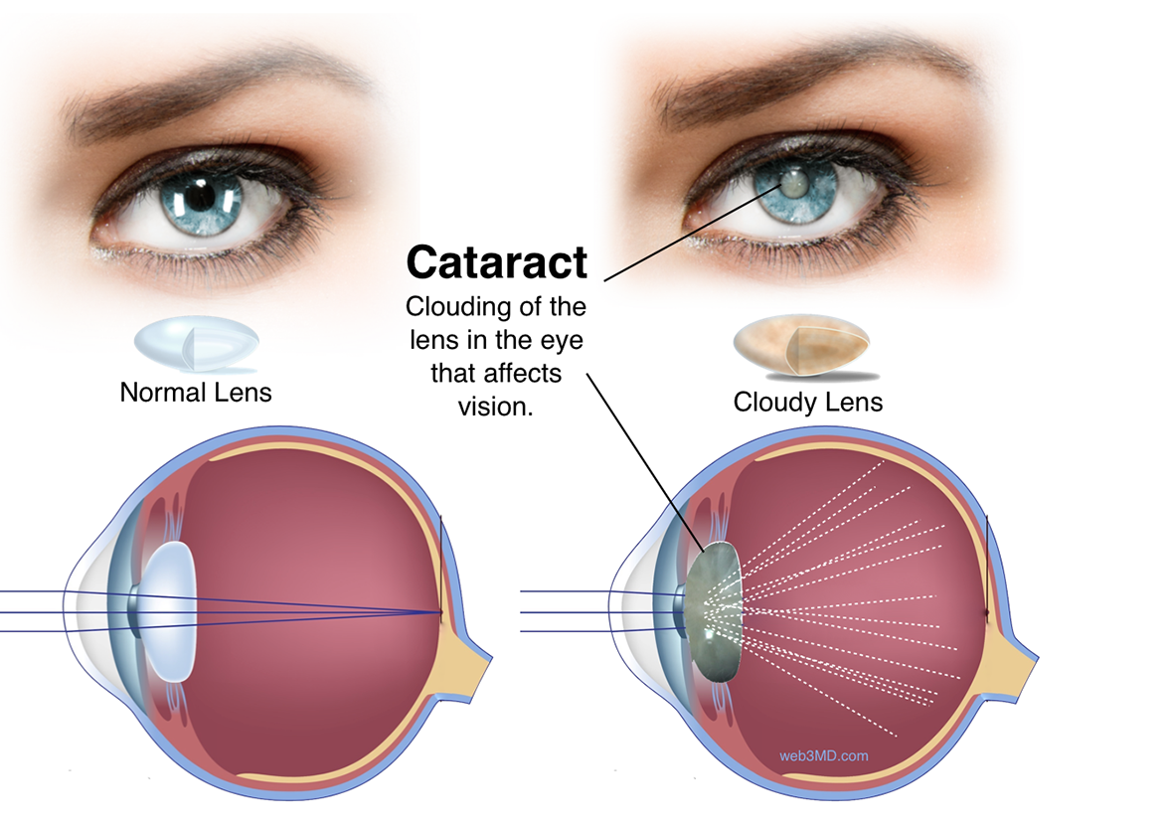
Introduction | Cataract Surgery

Slide 3
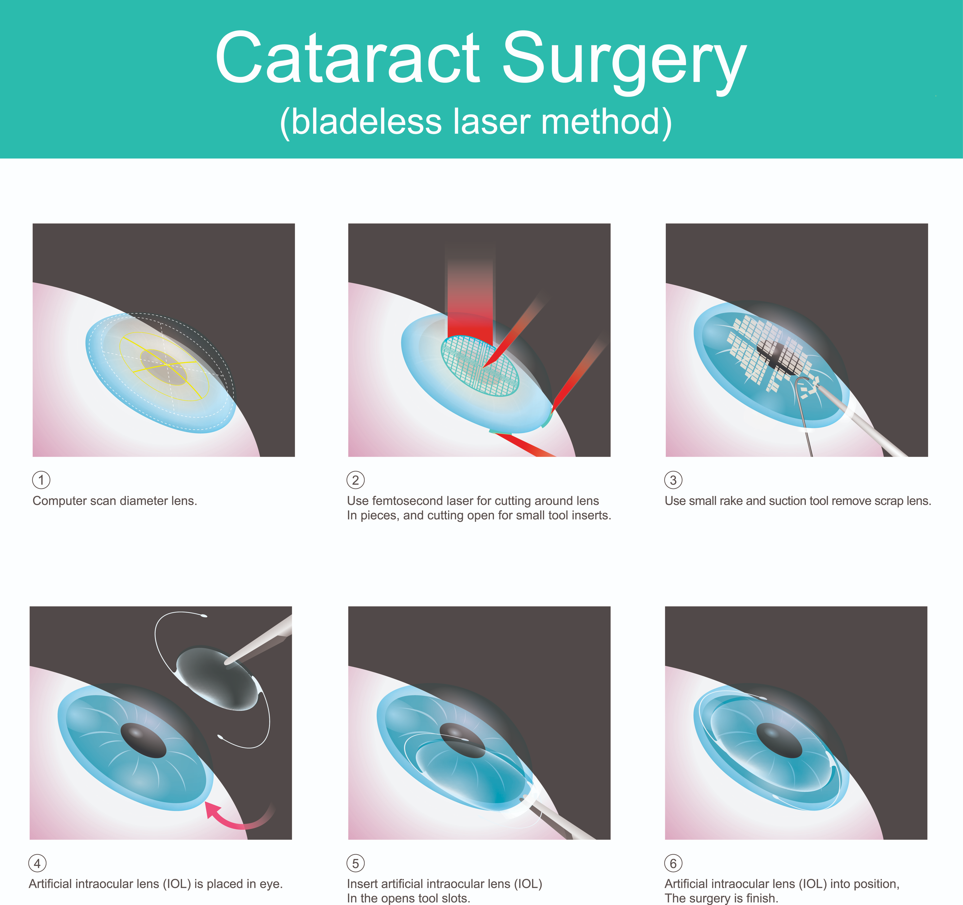
Introduction | Cataract Surgery
Surgery:
Femtosecond Laser-Assisted Cataract Surgery (FLACS): Higher operating cost, more limitations.

Slide 4
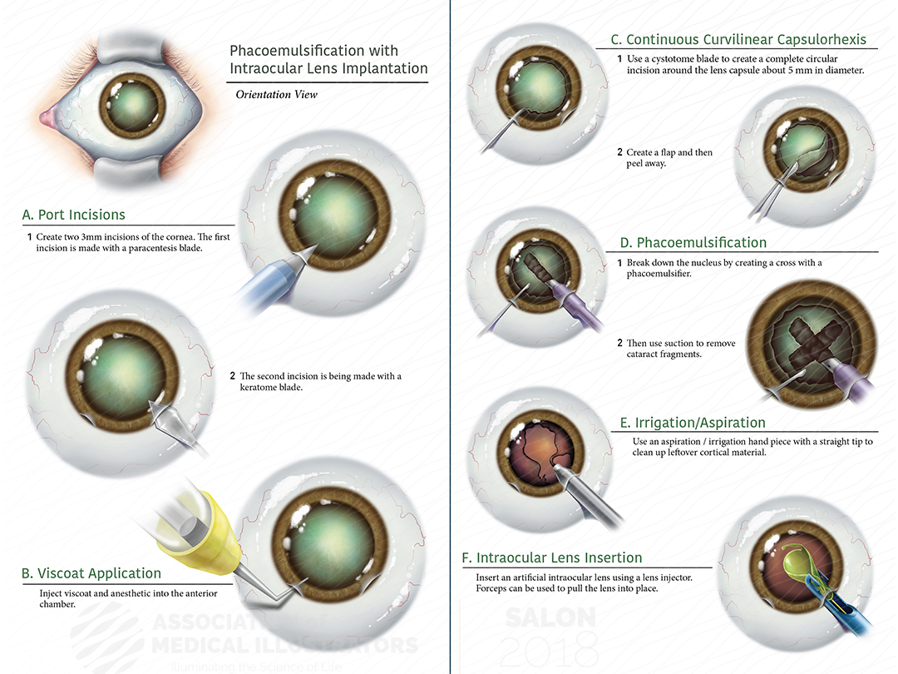
Introduction | Cataract Surgery
Surgery:
By phacoemulsification (超音波乳化晶體摘除手術): Traditional method, lower cost and fewer limitations.

Slide 5
Introduction | Cataract Surgery
Important factor:
During the operation, the size and position of the capsulorhexis (撕囊術) is important for the performance of IOL.
Small capsulorhexis can lead to anterior capsule fibrosis(水晶體前纖維化) and hyperopia shift (遠視偏移).
Large or asymmetric capsulorhexis can cause decentration, as well as subluxation (脫位) and posterior capsule opacification (水晶體後混濁) of IOL.
Accurate toric IOL alignment along the desired corneal meridian is a prerequisite for achieving optimal visual outcome. Approximately, one degree of misalignment reduces the astigmatism correction by 3.3%.

Slide 6
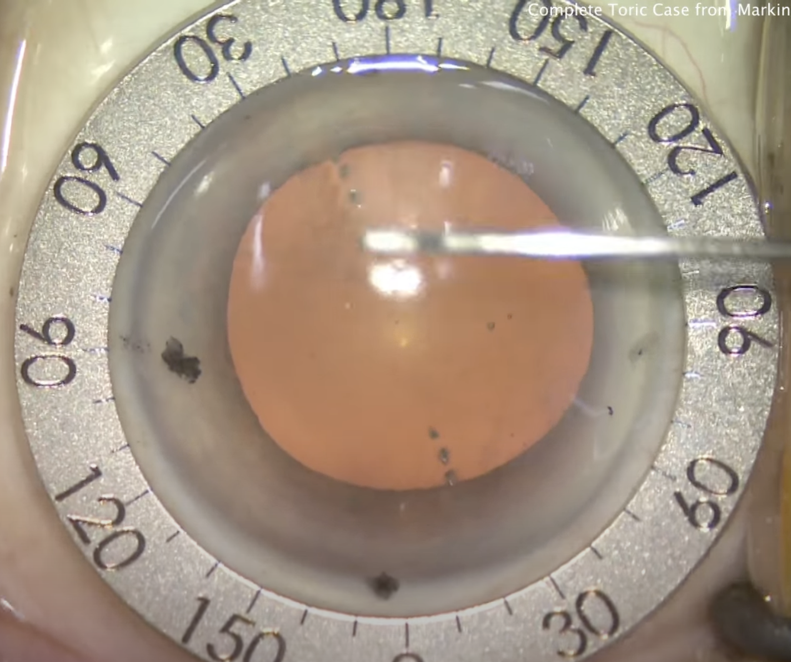
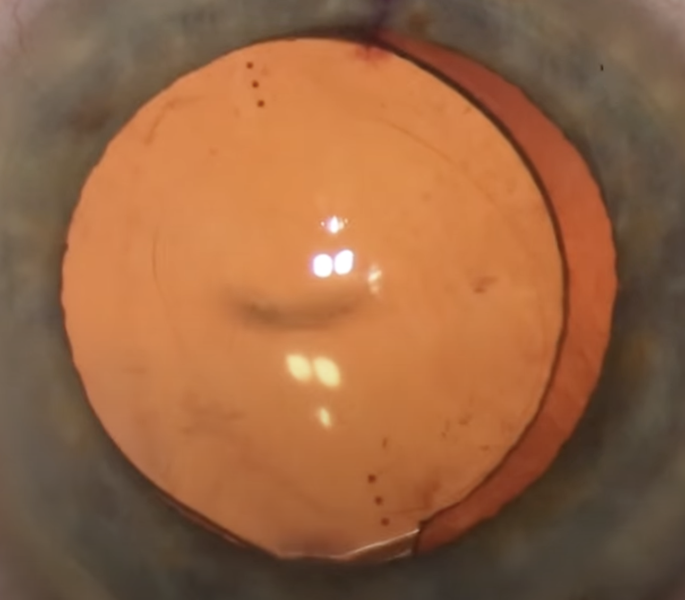
Introduction | Cataract Surgery
Traditional manual marking:
https://www.youtube.com/watch?v=dAzb-wU7mgU
Mark
Mark
Marking Tool
Mark
Mark

Slide 7
Introduction | Cataract Surgery
Drawbacks:
Color of mark may fade or disappear.
Contact marking may cause discomfort and risk of infection.
Accuracy of manual marking highly depends on surgeons.
Therefore computer-assisted IOL alignment is needed.

Slide 8
Method
Step1: Eye center detection: Piecewise Contour Sampling Method.
Current frame.
Binarize the image by the threshold obtained by Otsu’s algorithm according to the principle of maximum variance between foreground and background.
Acquire contours from binarized image.
Determine the set of connected outline points belonging to limbus using morphological criteria based on region size and roundness.
d

Slide 9
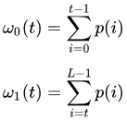
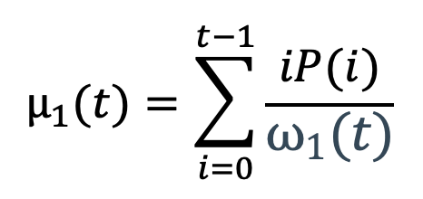
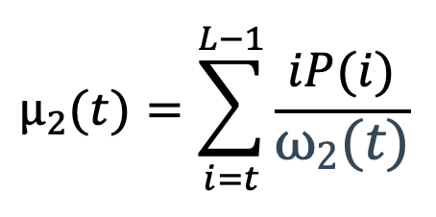
Method
Otsu’s Algorithm:
intra-class variance:
: probability for the group with values ≦ t
: probability for the group with values > t
: variance for the group with values ≦ t
: variance for the group with values > t
Find t that minimizes

Slide 10
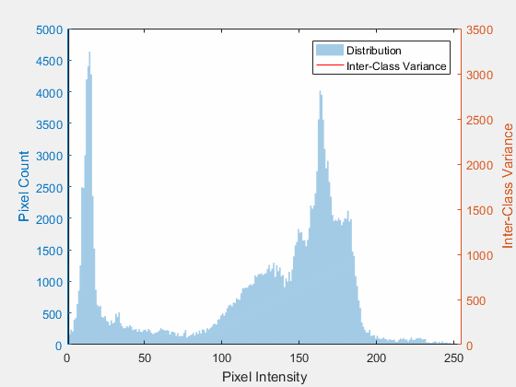
Method
Otsu’s Algorithm:
Algorithm:

Slide 11
Method
Step1: Eye center detection: Piecewise Contour Sampling Method.
Divide the contour into S uniform segments.
For each segment, a subset of D points are randomly sampled and used as the representation of this segment.
Then, N non-repetitive segments are selected from the S segments, generating M combinations of point sets.
D points
Segment

Slide 12
Method
Step 1: Eye center detection: Piecewise Contour Sampling Method.

Slide 13
Method
Step 2: Eye rotation tracking
ROI selection/re-selection
The current frame with the eye center and limbus determined.
The scleral region near the limbus under polar coordinates.
Vessel enhanced image by matched filtering.
Vascular skeleton image by morphological thinning.
Vascular density image based on the vascular skeleton points.
Assume that all ROIs were failed in tracking in the previous frame, the blue boxes are the re-selected ROIs in the current frame according to (e).

Slide 14
Method
Step 2: Eye rotation tracking
Inter-frame rotation tracking
Typical inter-frame ROI tracking results. The yellow boxes are the ROIs successfully tracked in the current frame.
Real-time tracking results overlaid on the original image. Black: the horizontal line; Yellow: tracked corneal meridian; Red: limbus circle.

Slide 15
Method
Step 2: Eye rotation tracking
Long-term cumulative error correction
Using the same tracking algorithm as in the first tracking module, with the previous frame replaced by the reference frame.
When to use:
1. Every 10 frames.
2. When the number of successful ROIs in inter-frame rotation tracking is too low (≤ 25% of the total ROIs in this study).
Tracking result of the initial ROIs in the current frame. The white boxes indicate ROIs that succeed in tracking, and the red boxes are the ROIs that are failed.
The reference frame in Cartesian and polar coordinates. The white boxes show the initial ROIs distributed evenly in the reference frame.

Slide 16
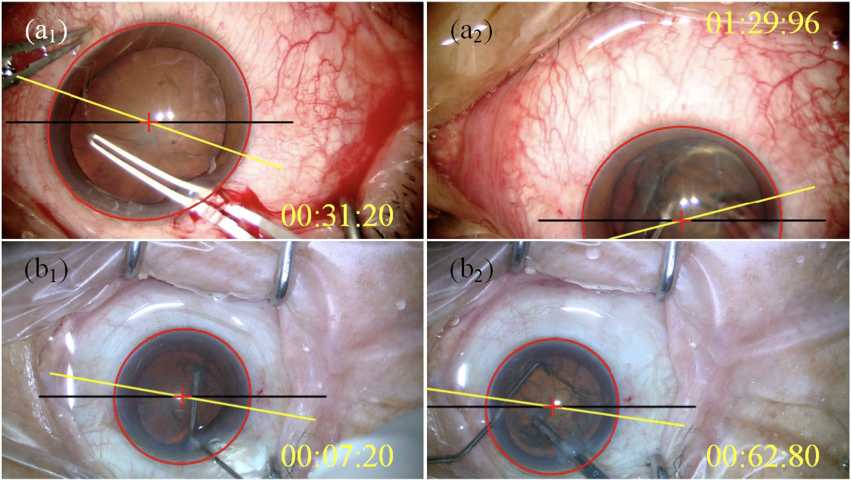
Target Result
Limbus
Alignment axis
Horizontal line
Eye center

Slide 17
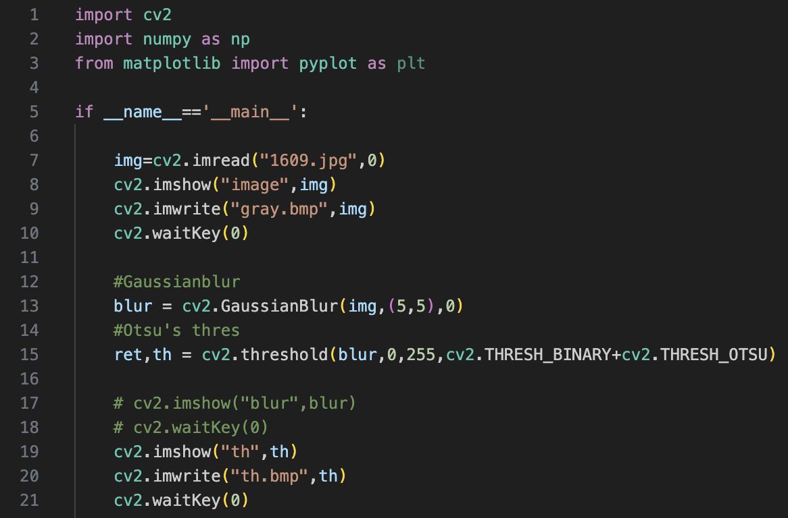
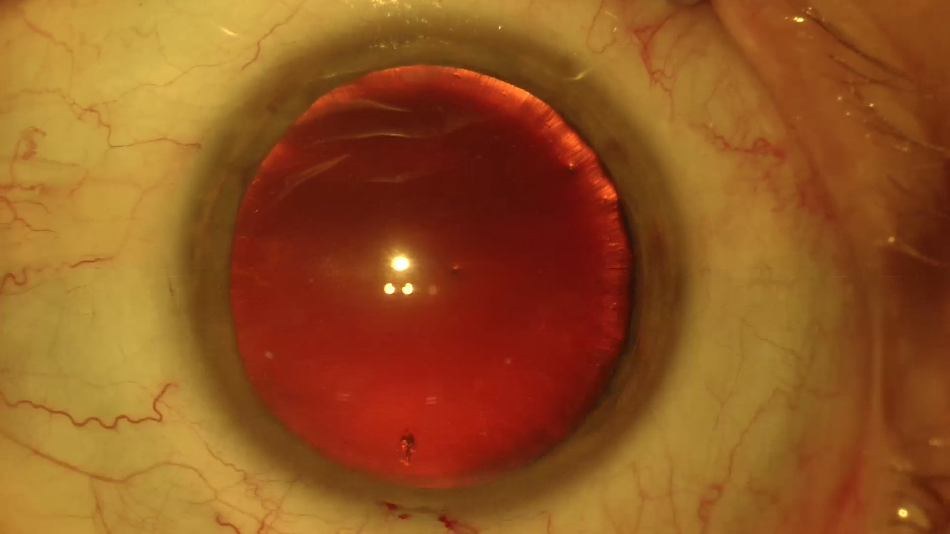
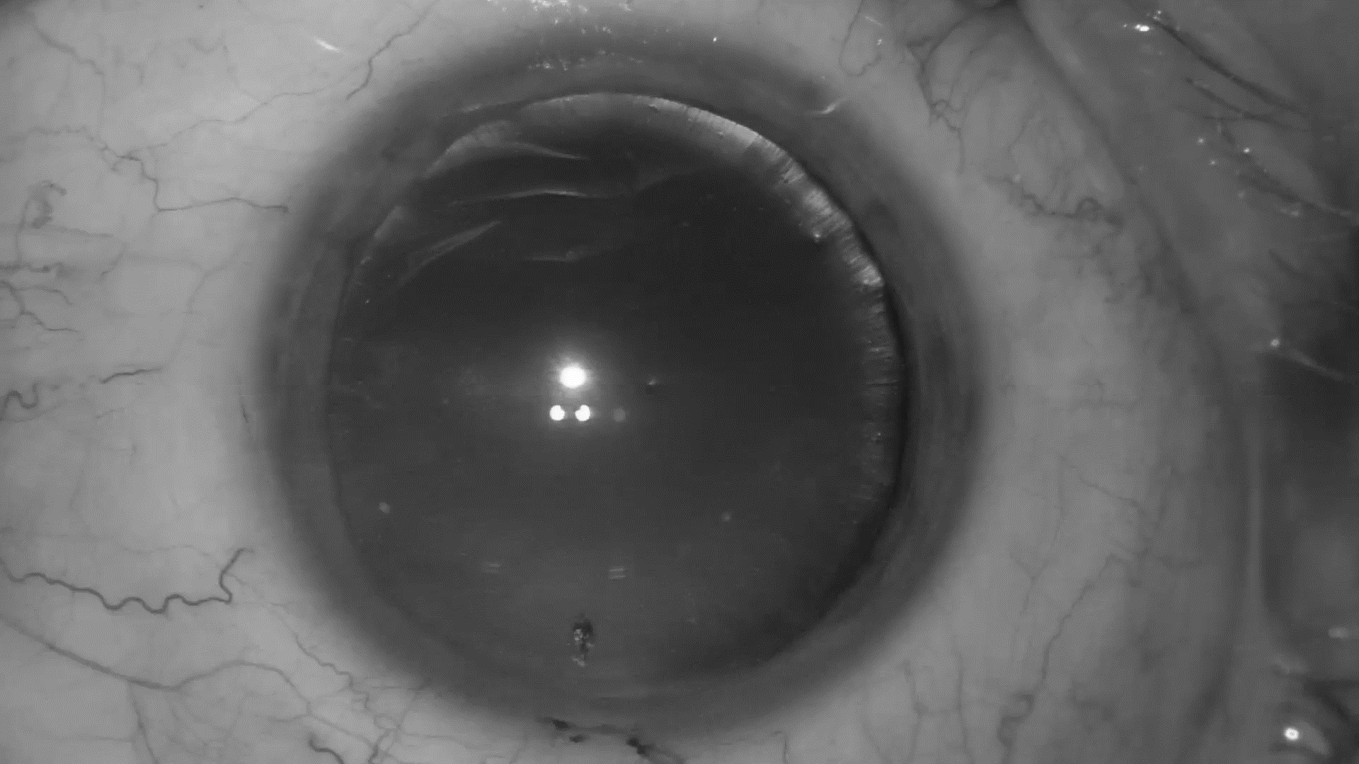
Implementation
Code
Input image
Grayscale image
Binarized image

Slide 18
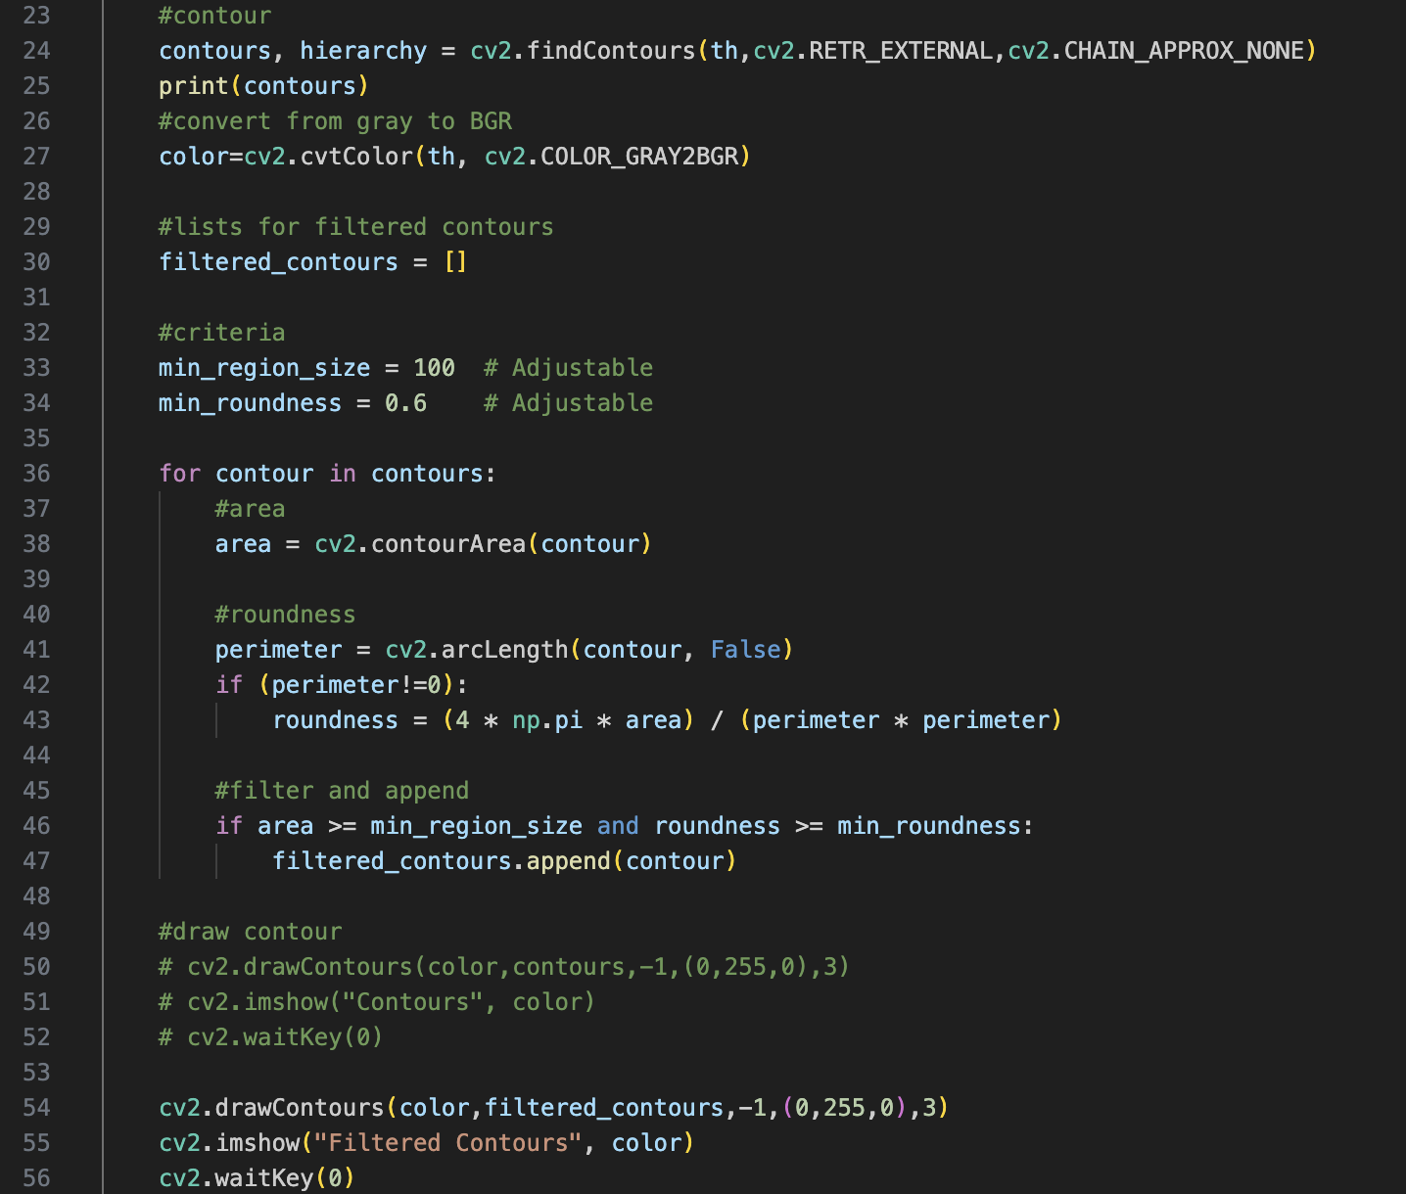
Implementation
Contour
Code
Contour filtered by area and roundness

Slide 19
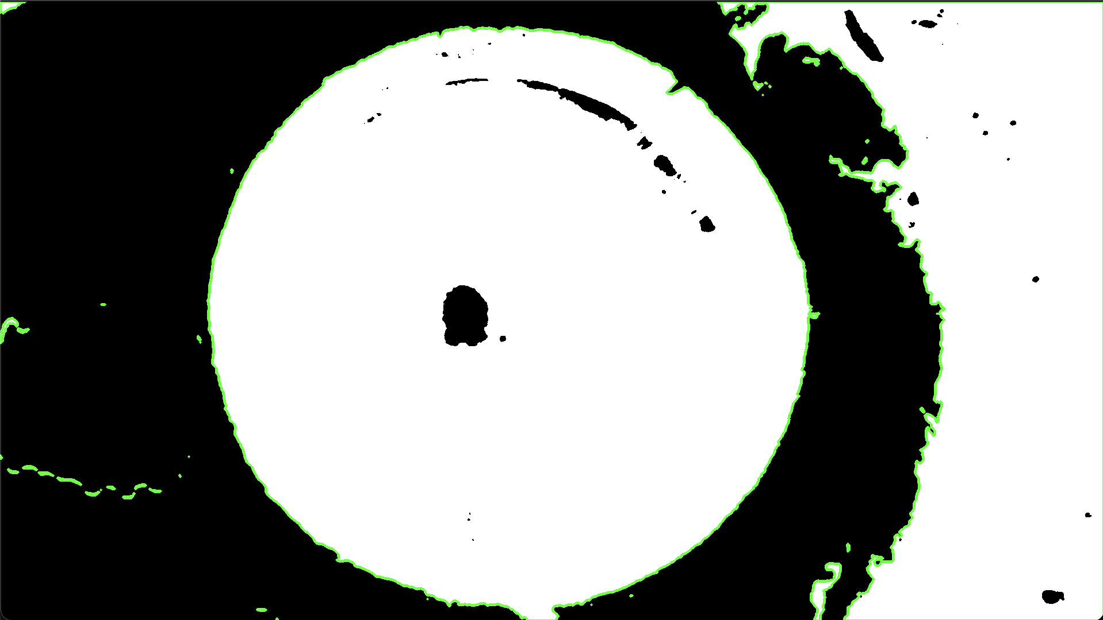
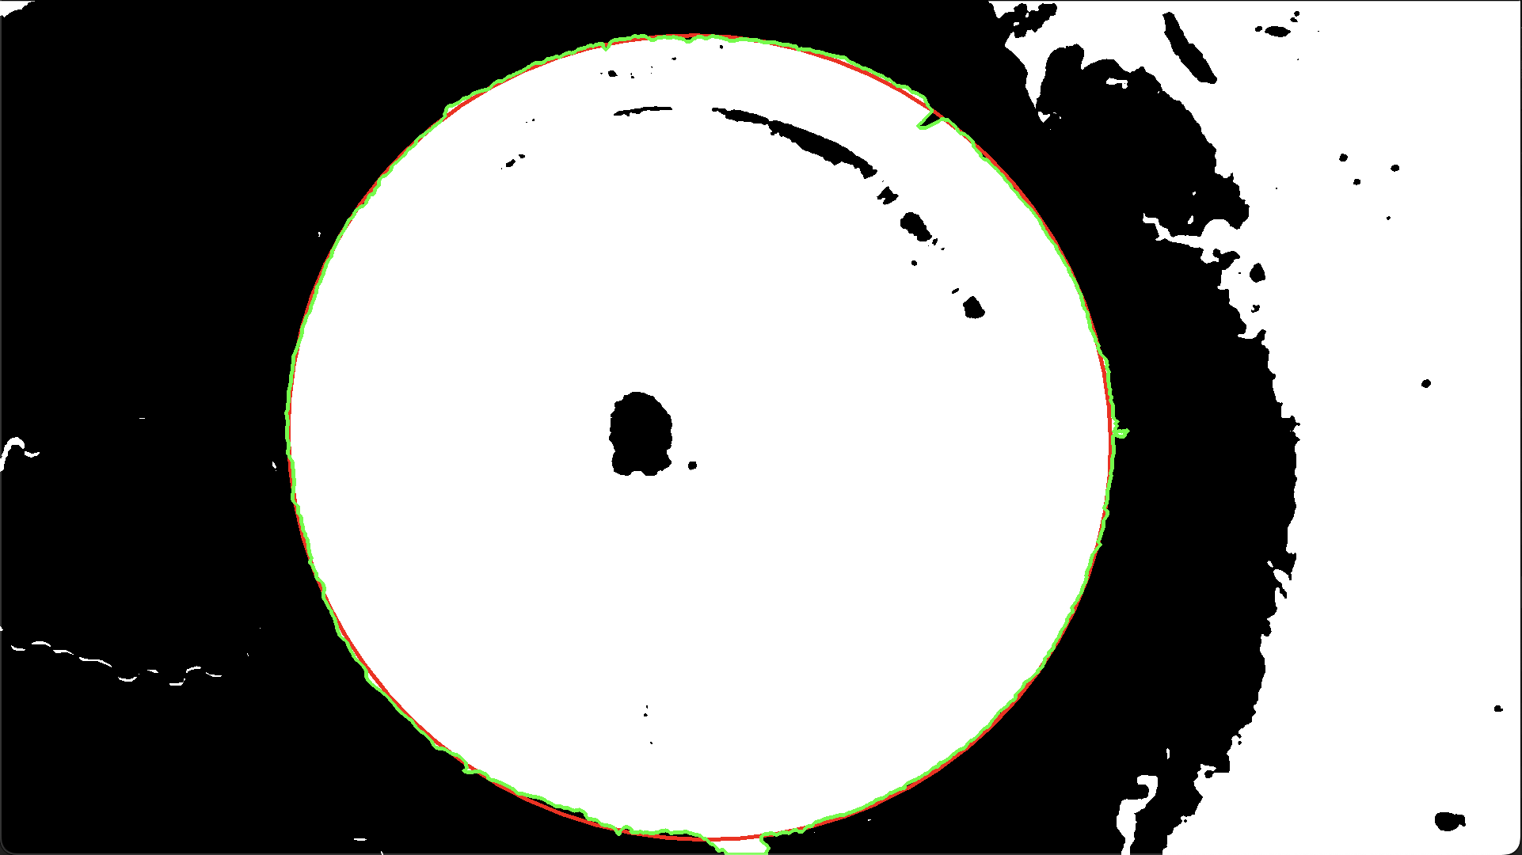
Implement
Contour
Code
Contour filtered by area and roundness

Slide 20
Summary
(6 points)
Purpose: To enhance the accuracy and stability of IOL alignment during cataract surgery.
Method:
Eye center detection
Eye rotation tracking: ROI selection -> Inter-frame rotation tracking -> long-term error correction.
Result: Show eye center, limbus and alignment axis in every frame, target average position error <0.3mm, axis alignment error <1°.

Slide 21
Thanks for listening!

Slide 22
Reference
Y. Zhai et al., "Computer-Aided Intraoperative Toric Intraocular Lens Positioning and Alignment During Cataract Surgery," in IEEE Journal of Biomedical and Health Informatics, vol. 25, no. 10, pp. 3921-3932, Oct. 2021.
https://ieee-dataport.org/open-access/cataracts
https://ieee-dataport.org/documents/cataract-surgery-dataset-eye-positioning-and-alignment#files
https://en.wikipedia.org/wiki/Otsu%27s_method

