Slide 1
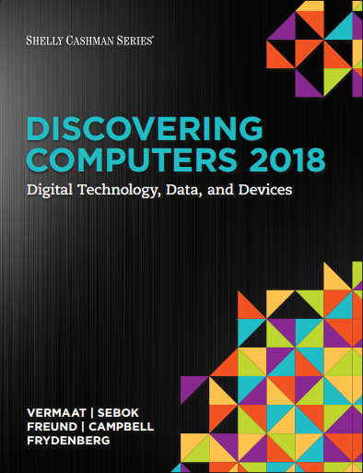
DISCOVERING COMPUTERS 2018 Digital Technology, Data, and Devices
Module 6
Computing Components: Processors, Memory, the Cloud, and More
© 2018 Cengage版權所有，為課本著作之延伸教材，亦受著作權法之規範保護，僅作為授課教學使用，禁止列印、影印、未經授權重製和公開散佈

Slide 2
李亦宸

Slide 3
Objectives Overview (1 of 2)
Describe the various computer and mobile device cases and the contents they protect.
Describe multi-core processors, the components of a processor, and the four steps in a machine cycle.
Identify characteristics of various personal computer processors on the market today, and describe the ways processors are cooled.
Describe what is meant by the Internet of Things.
Explain the advantages and services of cloud computing.

Slide 4
Objectives Overview (2 of 2)
Define a bit, and describe how a series of bits represents data.
Explain how program and application instructions transfer in and out of memory.
Differentiate among the various types of memory.
Describe the purpose of adapter cards and Universal Serial Bus (USB) adapters.
Explain the function of a bus.
Explain the purpose of a power supply and batteries.
Describe how to care for computers and mobile devices.
Notes:
通用序列匯流排 (Universal Serial Bus)
”Bus" 通常是指計算機硬碟的接口或總線。這個詞用來描述計算機系統中連接硬碟的物理或邏輯通道。在硬碟的上下文中，有幾種常見的總線類型，包括以下幾種：
1. **SATA（Serial ATA）**：SATA總線是連接許多內部和外部硬碟驅動器的常見接口。它是一種串行接口，通常用於連接機械硬碟、固態硬碟（SSD）和光碟驅動器等存儲設備。
2. **IDE（Integrated Drive Electronics）**：IDE總線曾經是連接早期計算機硬碟的標準接口。它通常是一種平行接口，現在已經不太常見，被SATA所取代。
3. **SCSI（Small Computer System Interface）**：SCSI總線是一種高級接口，通常用於連接高性能伺服器硬碟和其他外部設備。SCSI接口支援多個設備的鏈路，並具有較高的帶寬和功能。
4. **NVMe（Non-Volatile Memory Express）**：NVMe是一種用於連接固態硬碟（SSD）的高速接口。它比SATA更快，旨在充分發揮SSD的性能潛力。
總線的類型會影響硬碟的連接方式以及數據傳輸速度。當你購買硬碟時，需要確保硬碟的接口與你的計算機主板或擴展卡上的總線兼容。否則，你可能需要使用適配器或更換硬碟以確保正常連接和數據傳輸。總線的選擇也會影響計算機系統的性能，因為較快的總線通常能夠提供更高的數據傳輸速度。

Slide 5
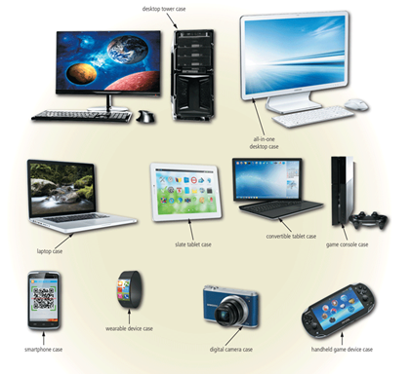
The case contains and protects the electronics of the computer or mobile device from damage
Figure 6-1 Cases for computers and mobile devices are available in a variety of shapes and sizes

Slide 6
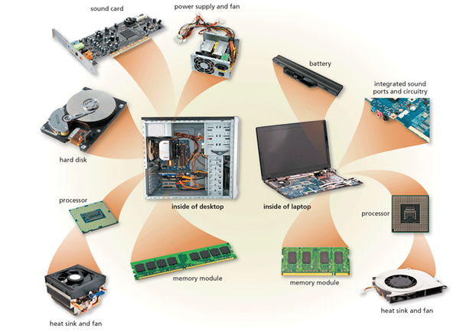
Figure 6-2 This figure shows typical components in a higher-end desktop and laptop. Many basic desktops have integrated video and sound capability, similar to the laptop image shown here.
Notes:
音效卡

Slide 7
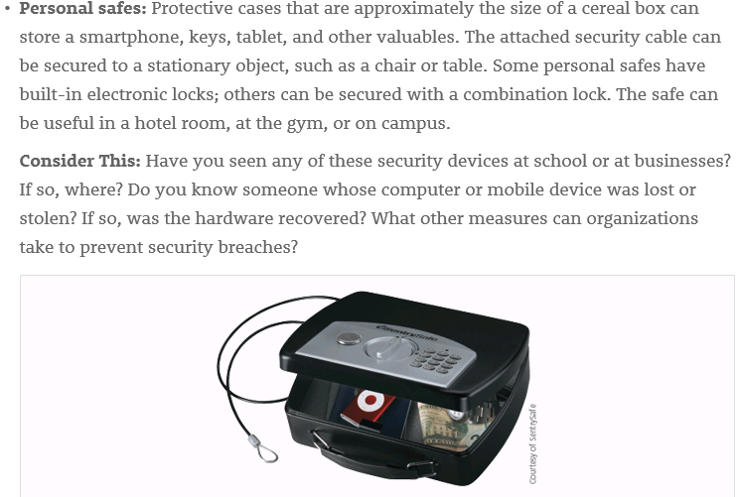

Slide 8
Inside the Case (3 of 4)
The motherboard is the main circuit board of the computer.
A computer chip is a small piece of semiconducting material, usually silicon, on which integrated circuits are etched.
Notes:
主機板MB（Motherboard），如果CPU是電腦的大腦，那主機板就像是人體脊椎一樣，負責串聯個人電腦全部的零件，向個人電腦的每個部分發出指令。根據尺寸，目前市面上常見的是Standard-ATX(簡稱ATX)與Micro-ATX(簡稱MATX)等類型。 由於CPU插槽和CPU有標準規格，因此需要注意，在選擇主機版時要跟CPU一起考慮。

Slide 9
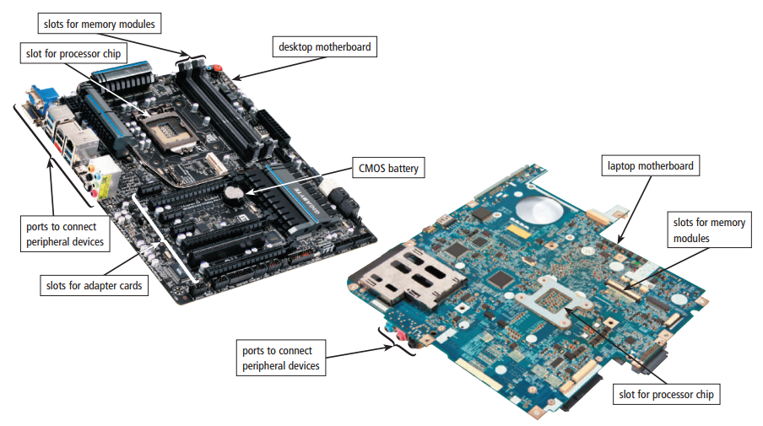
Figure 6-3 A desktop motherboard and a laptop motherboard.
Notes:
基本上，每台電腦的主機板上面，都會有個「CMOS電池」來維持主機板正常運作。CMOS電池的最主要功能，就是「為主機板上的揮發性記憶體晶片供電，以保存使用者的BIOS設定」；若是沒有CMOS電池，電腦每次斷電重開之後，BIOS設定都會恢復預設，就像阿湯哥的《明日邊界》一樣，無論你更改多少次，BIOS設定都不會被儲存，只會重複重複再重複的被打回出廠設定。
CMOS電池的另一個功能，就是讓BIOS上的「實時時鐘」（Real-time clock，RTC）可以正常運作，並確保電腦的時鐘功能保持準確。請注意，雖然BIOS上的時間設定並不等於作業系統（如Windows）中的時間設定，但有時BIOS上的時間設定錯誤，卻會影響到作業系統運行。換個簡單的方式說，如果主機板上沒有CMOS電池的存在，BIOS上時間會一直被重置，當然作業系統的時間也會變得不準確。
第三個CMOS電池的功能，就是讓使用者可以「重置BIOS」。前面說過，電腦一旦沒有CMOS電池為儲存晶片進行供電，BIOS就會被重置到出廠時的原始設定；而使用者此時也可以反過來利用這個特性，在BIOS遭到破壞，或是自己不小心調整BIOS中的參數，導致電腦無法開機時，將電腦總電源關閉後，再把主機板上的CMOS電池拔起來，等待數秒鐘再將CMOS電池裝回去，用這樣的方式來重置BIOS進行電腦救援。
在計算中，BIOS（Basic Input/Output System，也稱為System BIOS、ROM BIOS、BIOS ROM或電腦 BIOS）是用於為作業系統和程式提供運行時服務並在啟動過程中進行硬體安裝的韌體（開機啟動）

Slide 10
Reel

Slide 11
Processors (1 of 9)
The processor, also called the Central Processing Unit (CPU), interprets and carries out the basic instructions that operate a computer.
A multi-core processor is a single chip with two or more separate processor cores.
Processors contain a control unit and an Arithmetic Logic Unit (ALU).
Notes:
在電腦中，CPU負責各部門的運作以及處理各種算術運算與邏輯運算。 因為CPU具有多樣重要的功能，所以它也是電腦系統中最複雜的一部分。
CPU主要是由兩個主要的部分所構成：
控制單元(control unit, CU)
算術邏輯單元(arithmatic and logical unit, ALU)。

Slide 12
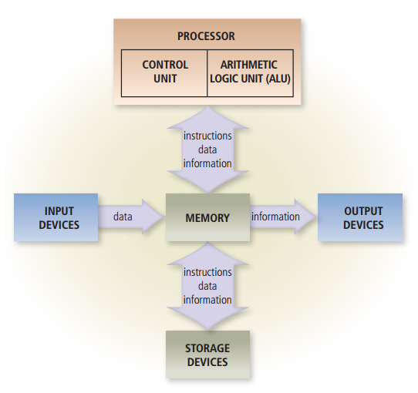
Figure 6-4 Most devices connected to the computer communicate with the processor to carry out a task.

Slide 13
Funny Accidents

Slide 14
Processors (3 of 9)
The control unit is the component of the processor that directs and coordinates most of the operations in the computer.
The Arithmetic Logic Unit (ALU), another component of the processor, performs arithmetic, comparison, and other operations.
Notes:
控制單元（Control Unit），有時為CPU一部分，有時安裝於CPU外部，負責指揮CPU工作。通過該裝置的運行來控制其他裝置的活動，也被視作有限狀態自動機 (finite-state machine) 的一種。
算術邏輯單元（英語：Arithmetic logic unit，縮寫：ALU）是一種可對二進位整數執行算術運算或位元運算的組合邏輯數位電路。^{[1][2][3][4]}ALU 與浮點數運算單元（FPU）不同，後者僅對浮點數進行操作。ALU 是許多類型的計算電路的基本部件，這些計算電路包括電腦的中央處理單元（CPU）、浮點處理單元（FPU）和圖形處理單元（GPU）。單個CPU、FPU 或 GPU 可能包含多個 ALU。
ALU 的輸入包括需要運算的資料（也稱為運算數）和表明了運算操作類型的指令碼。ALU 的輸出是其執行運算的結果。在許多的設計中，ALU 還帶有狀態輸入或輸出，可將其之前操作或當前操作的資訊在 ALU 和外部狀態暫存器間傳遞。

Slide 15
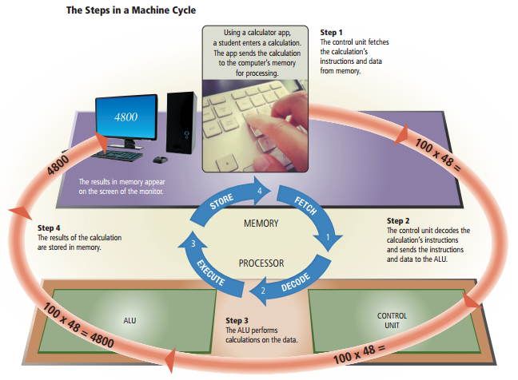
For every instruction, a processor repeats a set of four basic operations, which comprise a machine cycle
Figure 6-5 This figure shows the steps in a machine cycle.

Slide 16
Processors (5 of 9)
The processor contains registers, that temporarily hold data and instructions.
The system clock controls the timing of all computer operations.
The pace of the system clock is called the clock speed, and is usually measured in GigaHertz (GHz).
Notes:
寄存器：Register 處理器包含寄存器，這是CPU（中央處理單元）內的小型、高速存儲位置。寄存器用於暫時保存CPU需要執行操作的數據和指令。它們的訪問速度比主記憶體快得多，這使它們對於高效處理至關重要。
系統時鐘： 系統時鐘是計算機的重要組件之一，它控制各種計算機操作的時序。它以恆定的速率生成一系列電子脈衝，這些脈衝同步計算機的不同部件的活動，包括CPU、內存和輸入/輸出設備。
時鐘速度： 系統時鐘生成這些脈衝的速率稱為時鐘速度或時鐘頻率。通常以赫茲（Hz）或其倍數來衡量，如吉赫茲（GHz），適用於現代處理器。時鐘速度決定了CPU每秒可以執行多少週期或指令。通常情況下，更高的時鐘速度意味著CPU可以更快地處理指令。
值得注意的是，儘管時鐘速度是處理器性能的重要因素之一，但它並不是唯一的因素。現代CPU可能具有多個核心、先進的微架構和其他功能，這些也會影響其整體性能。此外，技術的改進使得即使在較低的時鐘速度下，也能實現更高效的處理。因此，時鐘速度只是評估CPU性能時需要考慮的多個因素之一。

Slide 17
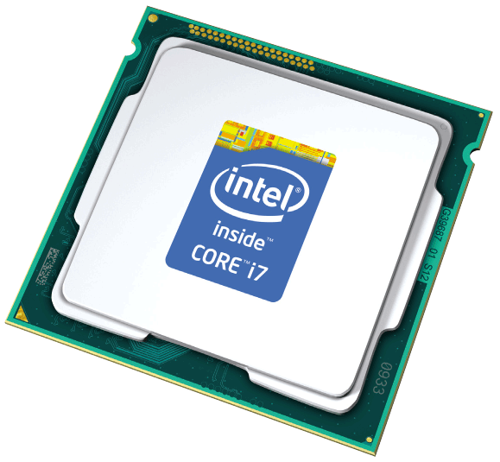
The leading manufacturers of personal computer processor chips are Intel and Advanced Micro Devices (AMD).

Slide 18
Processors (7 of 9)
A processor chip generates heat that could cause the chip to malfunction or fail.
Require additional cooling
Heat sinks
Liquid cooling technology
Cooling pads

Slide 19
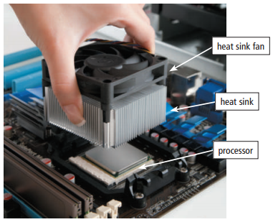
Figure 6-6 This photo shows a heat sink being attached to the top of a processor to prevent the chip from overheating.

Slide 20
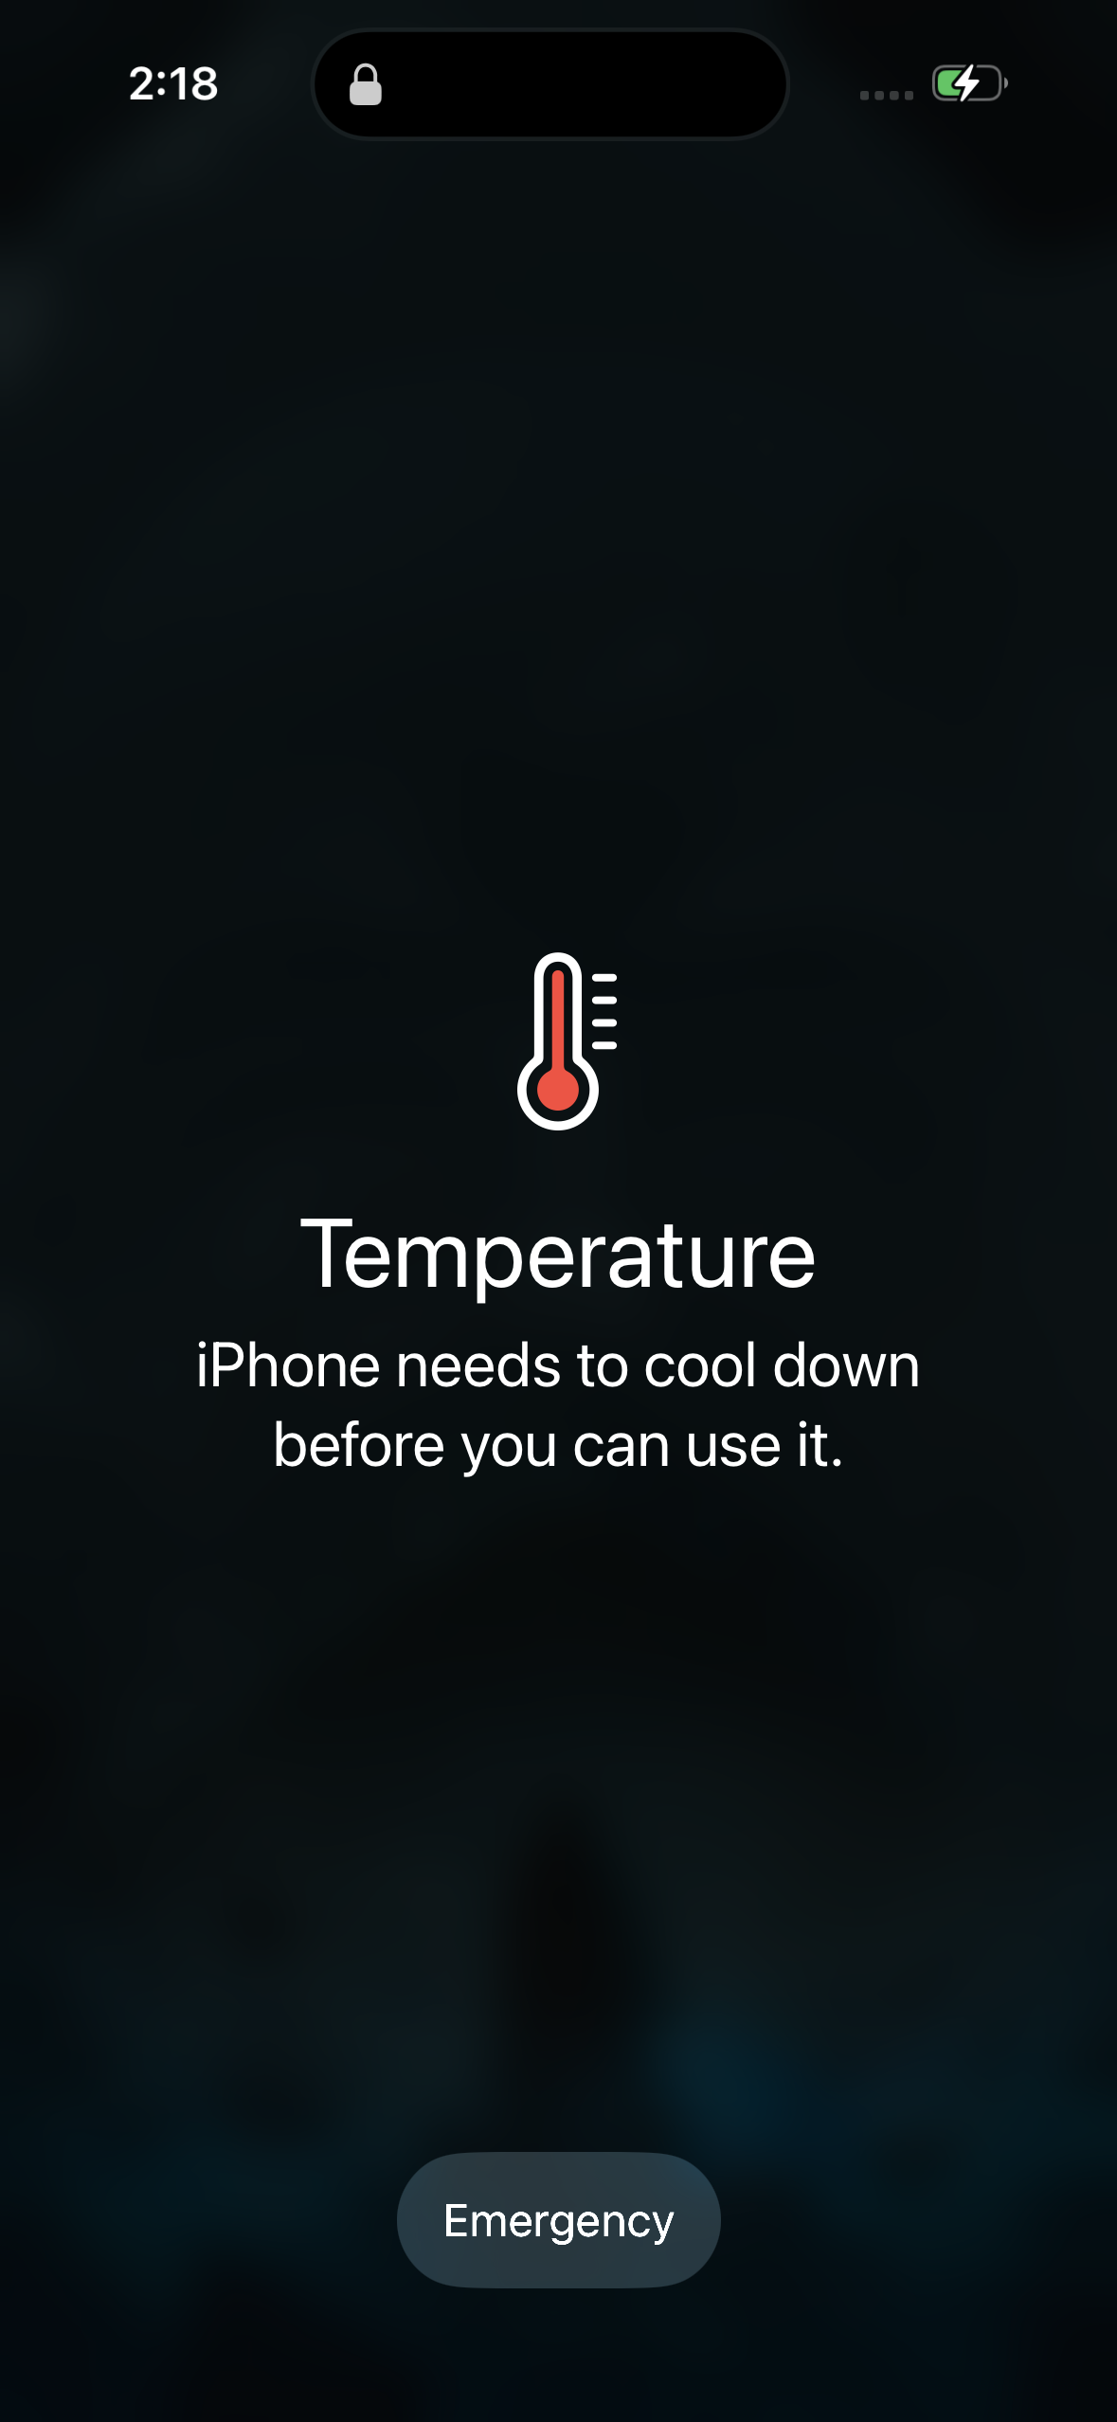

Slide 21
Reel

Slide 22
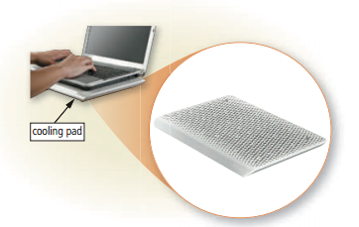
Figure 6-7 A laptop cooling pad helps reduce heat generated by a laptop.

Slide 23
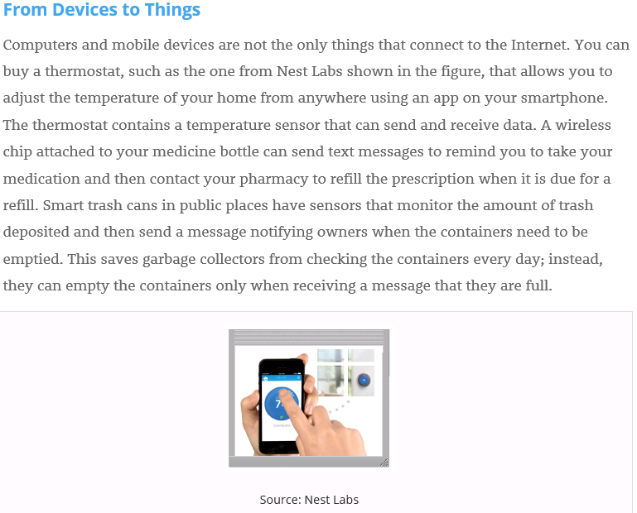
Notes:
短距離無線
藍牙網狀網路（Bluetooth mesh networking）– 規範採用藍牙技術的網狀網路，可增加節點數，並提供標準化的應用層^{[28]}。
光照上網技術（Li-Fi）– 與Wi-Fi標準相似的無線通信技術，但使用可見光通訊以增加頻寬^{[29]}。
近場通訊（Near-field communication，NFC）– 使兩個電子裝置能夠在4公分範圍內進行通訊的通訊協定^{[30]}。
無線射頻辨識（Radio-frequency identification，RFID）– 使用電磁場存取無線射頻辨識（RFID）標籤中數據的技術^{[31]}。
Wi-Fi – 基於IEEE 802.11標準的無線區域網路技術^{[32]}。
ZigBee – 基於IEEE 802.15.4標準的個人區域網路通訊協定，具有低功耗，低數據速率，低成本的特性^{[33]}。
Z-Wave – 主要應用於智慧型家庭和安全應用的無線通訊協定^{[34]}。
中距離無線
進階長期演進技術（LTE-Advanced）– 高速蜂巢式網路的通信規範。通過擴展的覆蓋範圍，提供更高的數據傳輸量和更低的延遲^{[35]}。
5G - 新一代行動通訊技術，提供高資料速率、減少延遲、節省能源、提高系統容量和大規模裝置連接^{[36]}。
長距離無線
低功率廣域網路（Low-Power Wide-Area Network，LPWAN）– 提供低資料速率與遠程通訊，降低功耗和傳輸成本。可用的LPWAN技術和協定分為使用授權頻段的NB-IoT，以及使用非授權頻段的LoRa、Sigfox、Weightless、Random Phase Multiple Access（RPMA）、IEEE 802.11ah等^{[37]}。
甚小孔徑終端（Very Small Aperture Terminal, VSAT）– 使用小型碟型天線，透過人造衛星傳輸之通訊技術^{[38]}。

Slide 24
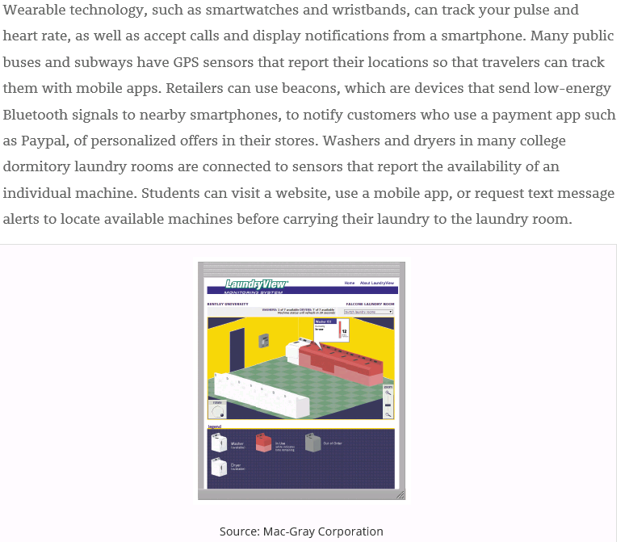
GPS: Global Positioning System
Notes:
全球定位系統（英語：Global Positioning System，通常簡稱GPS），又稱全球衛星定位系統，是美國國防部研製，美國太空軍運營與維護的中地球軌域衛星導航系統。它可以為地球表面絕大部分地區（98%）提供準確的定位、測速和高精度的標準時間。全球定位系統可滿足位於全球地面任何一處或近地空間的軍事使用者連續且精確地確定三維位置、三維運動和時間的需求。

Slide 25
Family Guy!

Slide 26
Cloud Computing
Home and business users choose cloud computing for a variety of reasons:
Accessibility
Cost savings
Space savings
Scalability

Slide 27
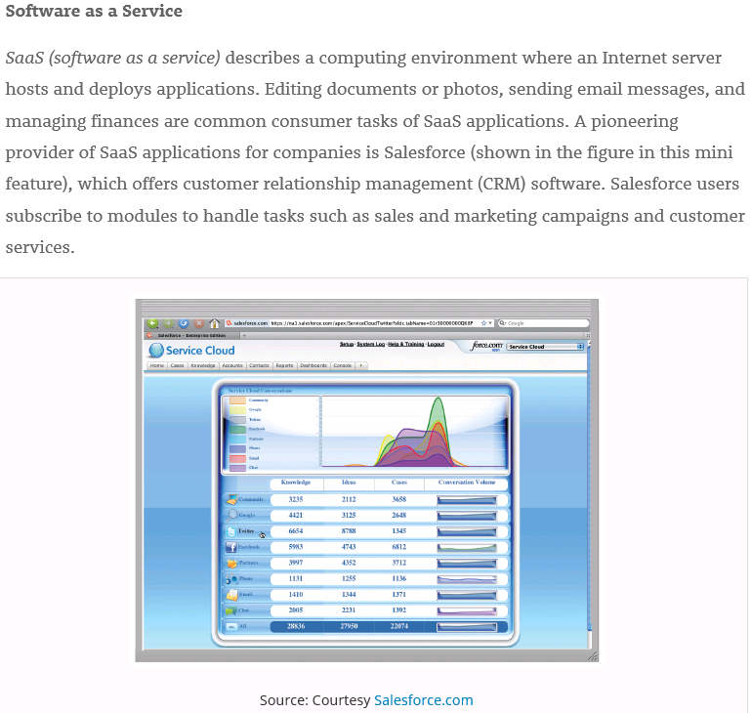
Notes:
軟體即服務（英語：Software as a Service，縮寫：SaaS，發音：/sæs/或/sɑs/^{[1]}），亦可稱為「按需即用軟體」（即「一經要求，即可使用」）^{[2]}，它是一種軟體交付模式^{[3]}。在這種交付模式中，軟體僅需通過網路，不須經過傳統的安裝步驟即可使用，軟體及其相關的資料集中代管於雲端服務。

Slide 28
Data Representation (1 of 4)
Analog signals are continuous and vary in strength and quality.
Digital signals are in one of two states: on or off
Most computers are digital.
The binary system uses two unique digits (0 and 1).
Bits and bytes

Slide 29
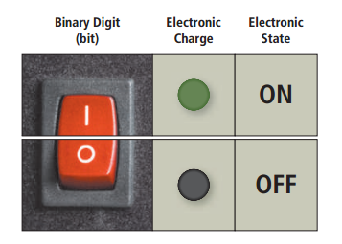
Figure 6-8 The circuitry in a computer or mobile device represents the on or the off states electronically by the presence or absence of an electronic charge.

Slide 30
Reel

Slide 31
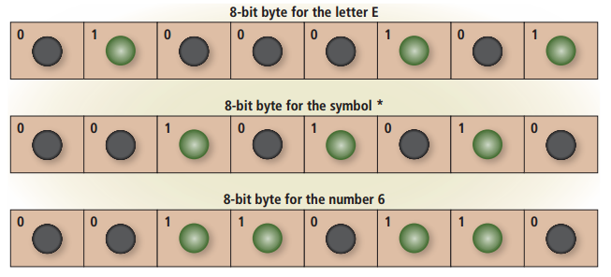
Figure 6-9 Eight bits grouped together as a unit are called a byte. A byte represents a single character in the computer or mobile device.

Slide 32
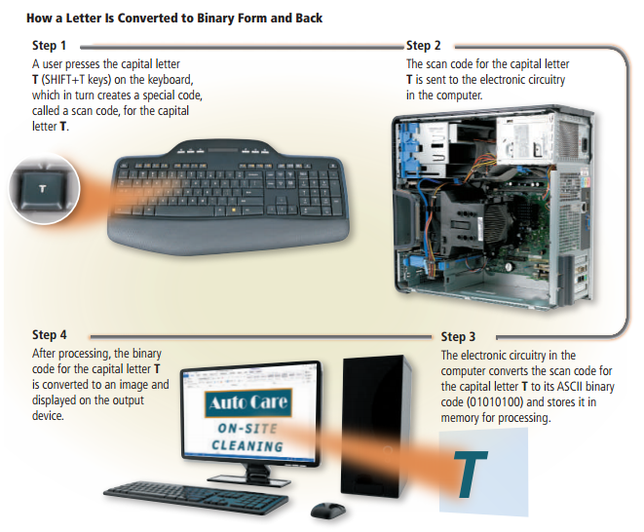
Figure 6-10 This figure shows how a letter is converted to binary form and back.

Slide 33
Memory (1 of 12)
Memory consists of electronic components that store instructions waiting to be executed by the processor, data needed by those instructions, and the results of processing the data.
Stores three basic categories of items:
The operating system and other programs
Applications
Data being processed and the resulting information

Slide 34
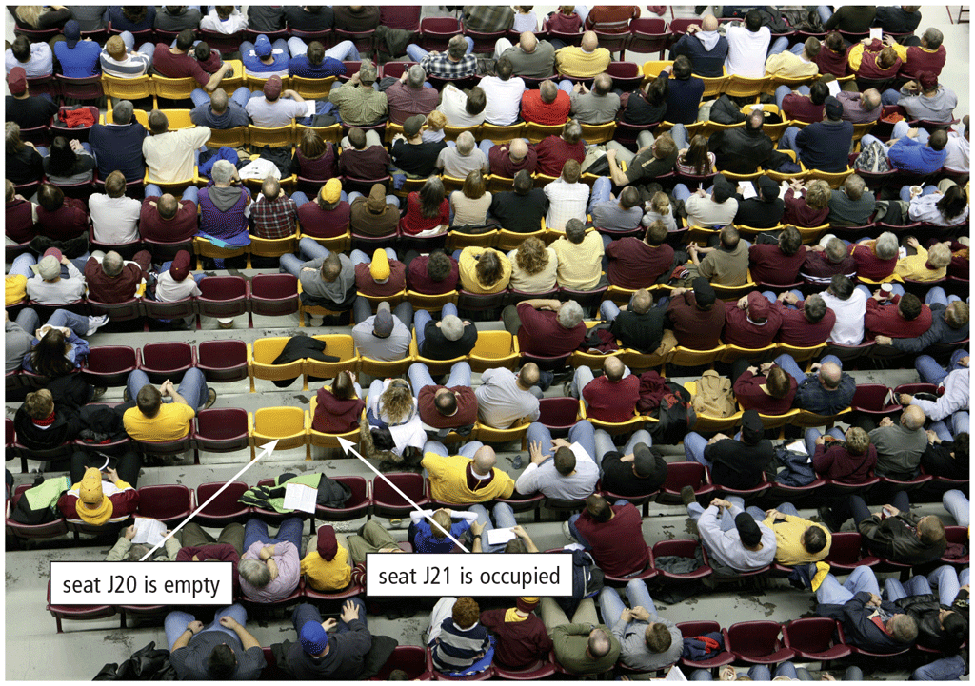
Memory (2 of 12)
Each byte resides temporarily in a location in memory that has an address
Memory size commonly is measured in GigaBytes (GB)

Slide 35
Memory (3 of 12)
Computers and mobile devices contain two types of memory:
Volatile memory
Loses its contents when power is turned off
Example includes RAM
Nonvolatile memory
Does not lose contents when power is removed
Examples include ROM, flash memory, and CMOS
RAM: Random Access Memory
ROM: Read-Only Memory
CMOS: Complementary Metal Oxide Semiconductor
Notes:
揮發性記憶體
非揮發性記憶體
揮發性記憶體（英語：Volatile memory）是指當電流中斷後，所儲存的資料便會消失的電腦記憶體。與之相對的是非揮發性記憶體 ，後者的電源供應中斷後，記憶體所儲存的資料也不會消失，只要重新供電後，就能夠讀取記憶體資料。

Slide 36
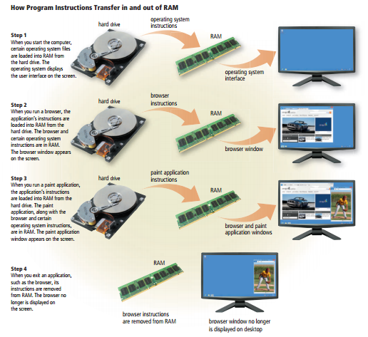
Figure 6-12 This figure shows how program and application instructions transfer in and out of RAM.

Slide 37
Memory (5 of 12)
Two common types of RAM exist:
Dynamic RAM (DRAM)
Static RAM (SRAM)
Notes:
揮發性記憶體主要有以下類型：
RAM（Random Access Memory，隨機存取記憶體）
DRAM（Dynamic Random Access Memory，動態隨機存取記憶體）
SRAM（Static Random Access Memory，靜態隨機存取記憶體）

Slide 38
Reel

Slide 39
Notes:
SRAM和DRAM的差異在於，DRAM得隨時充電，而SRAM儲存記憶不必作自動充電的動作，會出現充電動作的唯一時刻是有寫入動作時。 如果沒有寫入的指令，在SRAM裏不會有任何東西被更動，這也是它為什麼被稱為靜態的原因。 SRAM的優點是它比DRAM快得多，和BFDO的50ns相較，它甚至可以達到12ns。
ns是奈米秒

Slide 40
Memory (6 of 12)
Table 6-1 common DRAM Variations
Name | Comments
SDRAM (Synchronous DRAM) | Synchronized to the system clock Much faster than DRAM
DDR SDRAM (Double Data Rate SDRAM) | Transfers data twice, instead of once, for each clock cycle Faster than SDRAM
DDR2 | Second generation of DDR Faster than DDR
DDR3 | Third generation of DDR Designed for computers with multi-core processors Faster than DDR2
DDR4 | Fourth generation of DDR Faster than DDR3
RDRAM (Rambus DRAM) | Much faster than SDRAM
Notes:
SDRAM (同步動態隨機存取記憶體) - 同步於系統時鐘
DDR SDRAM (雙倍資料速度同步動態隨機存取記憶體) - 每個時鐘週期傳輸兩次資料，而非一次
DDR2 - DDR的第二代，比DDR更快
DDR3 - DDR的第三代，設計用於多核心處理器的電腦，比DDR2更快
DDR4 - DDR的第四代，比DDR3更快
RDRAM (Rambus動態隨機存取記憶體) - 比SDRAM快得多

Slide 41
Memory (7 of 12)
RAM chips usually reside on a memory module and are inserted into memory slots.
Figure 6-13 Memory modules contain memory chips.

Slide 42
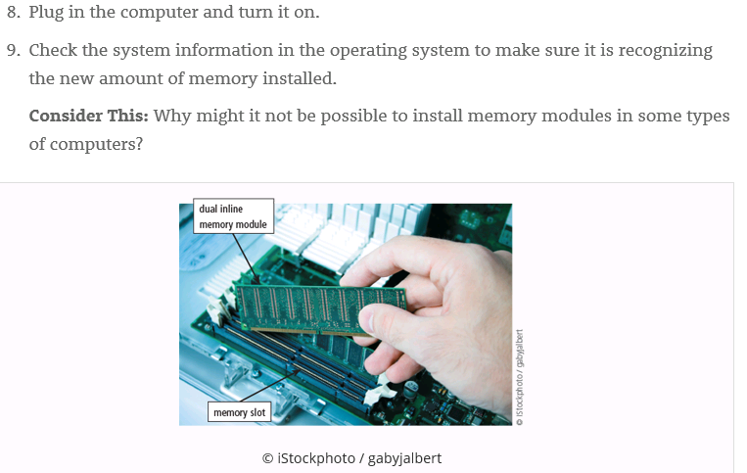

Slide 43
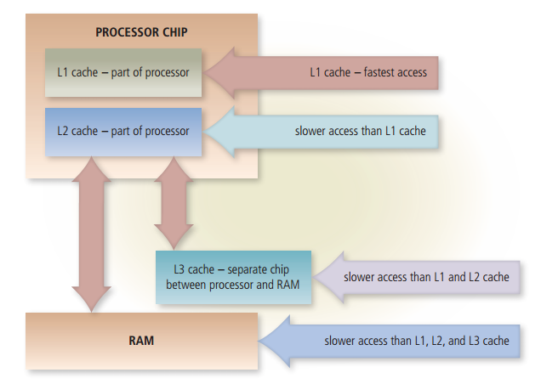
Memory cache speeds the processes of the computer because it stores frequently used instructions and data
Figure 6-14 Memory cache helps speed processing times when the processor requests data, instructions, or information.

Slide 44
Memory (9 of 12)
Read-Only Memory (ROM) refers to memory chips storing permanent data and instructions.
Firmware
Notes:
"Firmware" 為 "固件"。這是一種嵌入式軟體，通常儲存在硬體設備中，用於控制和管理設備的運作。固件可在許多不同的電子設備中找到，包括電腦、手機、路由器、數位相機和其他許多裝置中。

Slide 45
Memory (10 of 12)
Flash memory can be erased electronically and rewritten.
Complementary Metal Oxide Semiconductor (CMOS) technology uses battery power to retain information when the power to the computer is off.

Slide 46
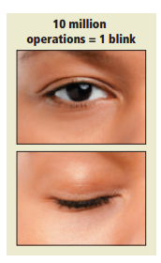
Access time is the amount of time it takes the processor to read from memory
Measured in nanoseconds
Figure 6-15 It takes about one-tenth of a second to blink your eye, in which time a computer can perform some operations 10 million times.

Slide 47
Memory (12 of 12)
Table 6-2 access Time Terminology
Term | Abbreviation | Speed
Millisecond | ms | One-thousandth of a second
Microsecond | µs | One-millionth of a second
Nanosecond | ns | One-billionth of a second
Picosecond | ps | One-trillionth of a second

Slide 48
Reel

Slide 49
Adapters (1 of 4)
An adapter card enhances functions of a component of a desktop or server system unit and/or provides connections to peripheral devices:
Sound card and video card
An expansion slot is a socket on a desktop or server motherboard that can hold an adapter card.
Notes:
一個介面卡可以增強桌面或伺服器系統單元的組件功能，並/或提供連接外設設備的功能： 聲音卡和顯示卡
擴充插槽是桌面或伺服器主機板上可以容納適配卡的插座。

Slide 50
Adapters (2 of 4)
MIDI: Musical Instrument Digital Interface
TV: TeleVision
USB: Universal Serial Bus
Table 6-3 adapter cards
Type | Purpose
Bluetooth | Enables Bluetooth connectivity
MIDI | Connects to musical instruments
Modem | Connects to transmission media, such as cable television lines or phone lines
Network | Provides network connections, such as to an Ethernet port
Sound | Connects to speakers or a microphone
TV tuner | Allows viewing of digital television broadcasts on a monitor
USB | Connects to high-speed USB ports
Video | Provides enhanced graphics capabilities, such as accelerated processing or the ability to connect a second monitor
Video capture | Connects to a digital video camera

Slide 51
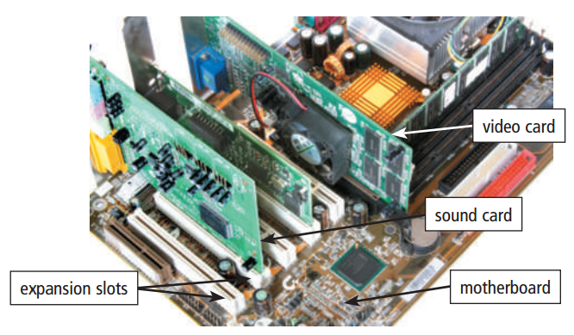
With Plug and Play technology, the computer automatically can recognize peripheral devices as you install them
Figure 6-16 Cards inserted in expansion slots on a desktop motherboard.

Slide 52
Shot on iPhone

Slide 53
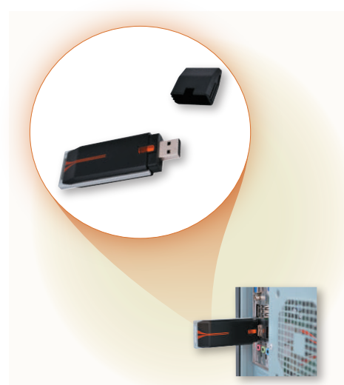
A USB adapter enhances functions of a mobile computer and/or provides connections to peripheral devices.
Figure 6-17 A USB adapter inserts into a USB port on a computer or mobile device.

Slide 54
VGA: Video Graphics Array
DVI: Digital Video Interface
HDMI: High-Definition Media Interface

Slide 55
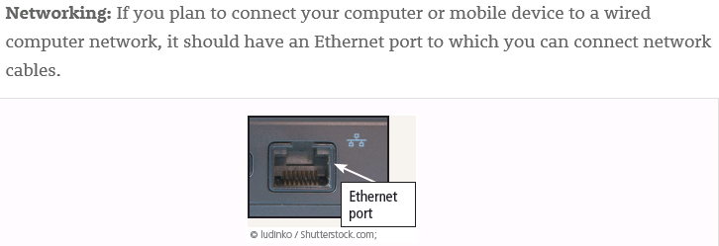

Slide 56
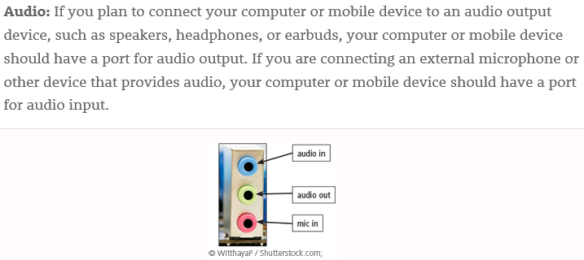

Slide 57
Reel

Slide 58
USB: Universal Serial Bus

Slide 59
Buses (1 of 3)
A bus allows the various devices both inside and attached to the system unit to communicate with one another.
Data bus
Address bus
Word size is the number of bits the processor can interpret and execute at a given time.

Slide 60
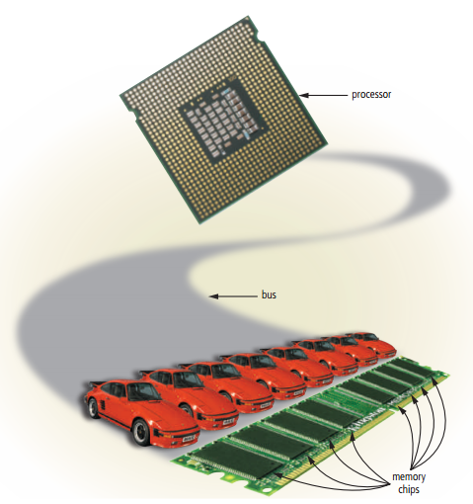
Figure 6-18 Just as vehicles travel on a highway, bits travel on a bus. Buses are used to transfer bits from input devices to memory, from memory to the processor, from the processor to memory, and from memory to output or storage devices.

Slide 61
Buses (3 of 3)
A computer might have these three types of buses:
System bus
Backside bus
Expansion bus
Notes:
一台電腦可能擁有以下三種類型的匯流排：
系統匯流排
背面匯流排
擴充匯流排

Slide 62
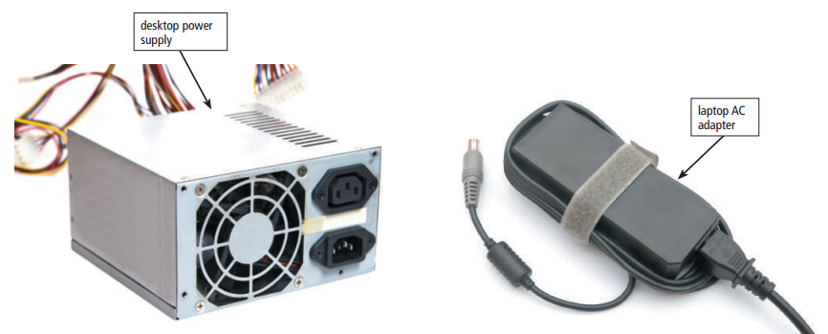
The power supply or laptop AC adapter converts the wall outlet AC power into DC power.
AC: Alternating Current
DC: Direct Current
Figure 6-19 Examples of desktop power supply and laptop AC adapter.

Slide 63
Reel

Slide 64
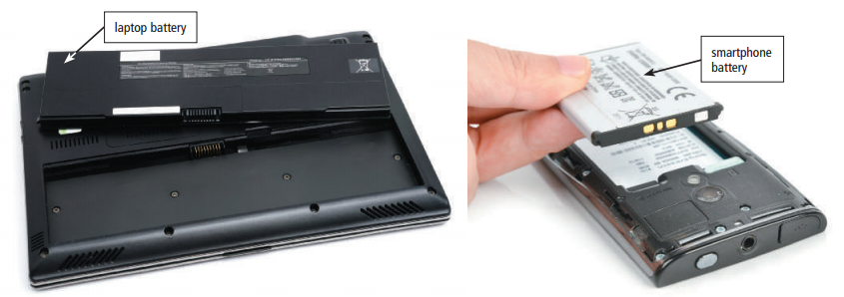
Mobile computers and devices can run using either a power supply or batteries
Batteries typically are rechargeable lithium-ion batteries
Figure 6-20 Rechargeable batteries for mobile computers and devices.

Slide 65
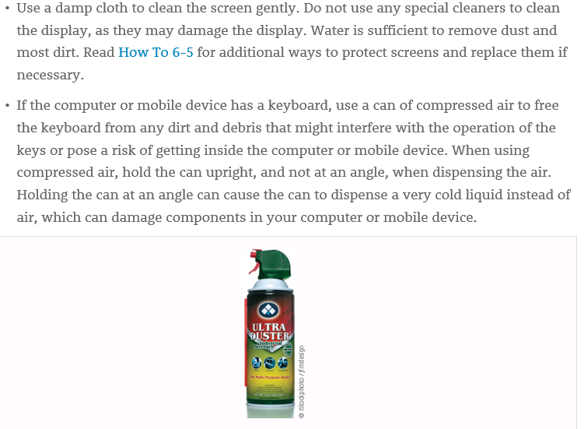

Slide 66
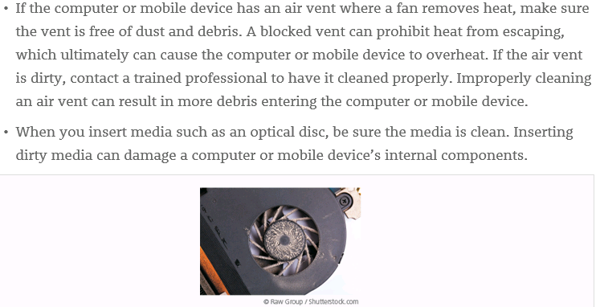

Slide 67
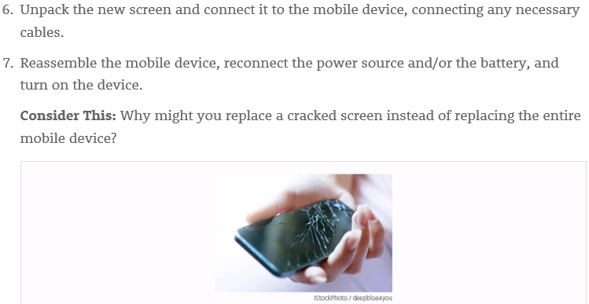

Slide 68
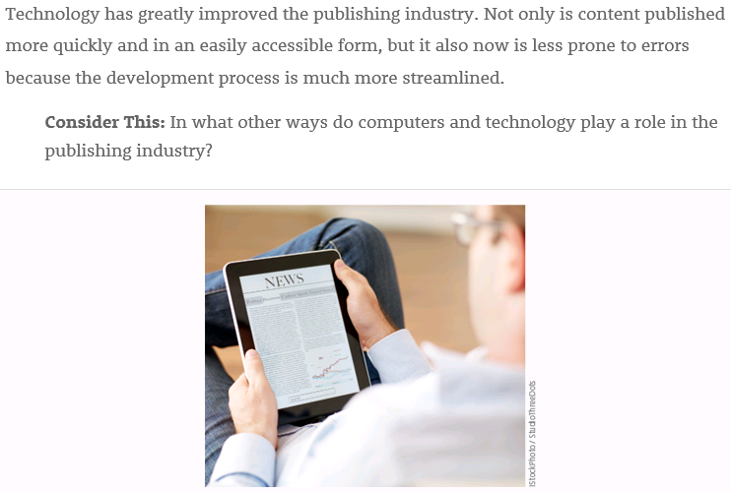

Slide 69
Summary
Various components inside computers and mobile devices
Types of processors, steps in a machine cycle, and processor cooling methods
Advantages and services of cloud computing
How memory stores data and various types of memory
Adapters, buses, power supplies and batteries
Ways to care for computers and mobile devices

Slide 70
Reel

Slide 71
What does the term USB stand for? Explain its usage and functions.
What does the term ROM stand for? Explain its usage and functions.

Slide 72
What does the term USB stand for? Explane its usage and functions.
"USB" stands for "Universal Serial Bus. Its functions include data transfer, charging, peripheral connection, device configuration, audio and video, and fast data transfer.
What does the term ROM stand for? Explane its usage and functions.
"ROM" stands for "Read-Only Memory.” Its functions include permanent data storage, firmware, operating system, game consoles, car navigation systems, and security.
Notes:
USB
Data Transfer: USB allows for the transfer of data between devices, such as copying files from a computer to a USB flash drive or connecting a digital camera to transfer photos.
Charging: USB ports can also provide power to recharge devices like smartphones, tablets, and other portable gadgets. This function is especially useful for keeping our devices powered while on the go.
Peripheral Connection: USB is used to connect various peripherals like keyboards, mice, printers, and external hard drives to a computer. This versatility makes it a universal interface for connecting hardware.
Device Configuration: Many devices can be configured and updated via USB connections. For example, firmware updates for smartphones or programming microcontrollers can be done through USB.
Audio and Video: USB can transmit audio and video signals, making it common for connecting webcams, microphones, and external speakers to computers.
Fast Data Transfer: USB has evolved over the years, with newer versions offering faster data transfer speeds. USB 3.0 and USB 3.1, for instance, provide much higher data transfer rates than older USB 2.0.
ROM
Permanent Data Storage: ROM is used to store data that needs to be retained even when the computer is turned off. It contains essential firmware and software instructions that are required for the computer's basic functions, such as booting up.
Firmware: Many electronic devices, including computers and mobile devices, have ROM chips that contain firmware. Firmware is software that is permanently programmed into the ROM and is responsible for initializing hardware components during startup. For example, your blue lightsaber's programming and configuration may be stored in ROM.
Operating System: A portion of the ROM is often reserved for the basic code needed to start the computer's operating system. This code, known as the BIOS (Basic Input/Output System) or UEFI (Unified Extensible Firmware Interface), is essential for the computer to begin the booting process.
Game Consoles: In our galaxy, ROM is also used in gaming consoles to store video game software. These ROMs are read-only to prevent modification of the game code, ensuring fair play.
Car Navigation Systems: Some car navigation systems use ROM to store maps and essential software. This allows the system to function without relying on an internet connection.
Security: In certain applications, ROM is used to store cryptographic keys and security-related information. Since ROM cannot be easily modified, it enhances the security of sensitive data.

