Slide 1
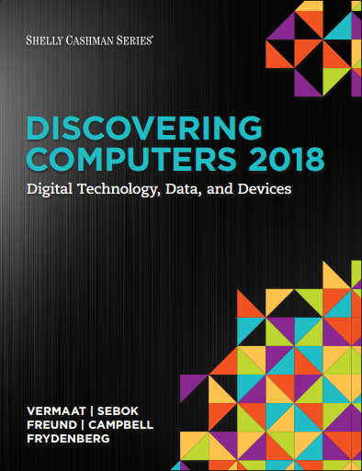
CS
Module 4
Programs and Apps: Productivity, Graphics, Security, and Other Tools
© 2018 Cengage版權所有，為課本著作之延伸教材，亦受著作權法之規範保護，僅作為授課教學使用，禁止列印、影印、未經授權重製和公開散佈

Slide 2
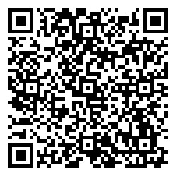
My Note
https://reurl.cc/kaEpLx

Slide 3
A Funny Video
https://www.youtube.com/watch?v=5bId3N7QZec
https://www.youtube.com/watch?v=rR4n-0KYeKQ
https://www.youtube.com/watch?v=Rgx8dpiPwpA
https://www.youtube.com/watch?v=jYuZwx2CR1Y

Slide 4
Objectives Overview (1 of 2)
Identify the general categories of programs and apps.
Describe how an operating system interacts with applications and hardware.
Differentiate among the ways you can acquire programs and apps.
Identify the key features of productivity applications.
Identify the key features of graphics and media applications.

Slide 5
Objectives Overview (2 of 2)
Identify the uses of personal interest applications.
Identify the purpose of software used in communications.
Identify the key features of security tools.
Identify the key features of file, disk, and system management tools.

Slide 6
Programs and Apps (1 of 5)
A program, or software, consists of a series of related instructions, organized for a common purpose, that tells the computer what tasks to perform and how to perform them.
An application, or app, sometimes called application software, consists of programs designed to make users more productive and/or assist them with personal tasks.
An operating system is a set of programs that coordinates all the activities among computer or mobile device hardware:
Tools and utilities
System software

Slide 7
Figure 4-1 Users work with a variety of programs and apps, some of which are shown in this figure.

Slide 8
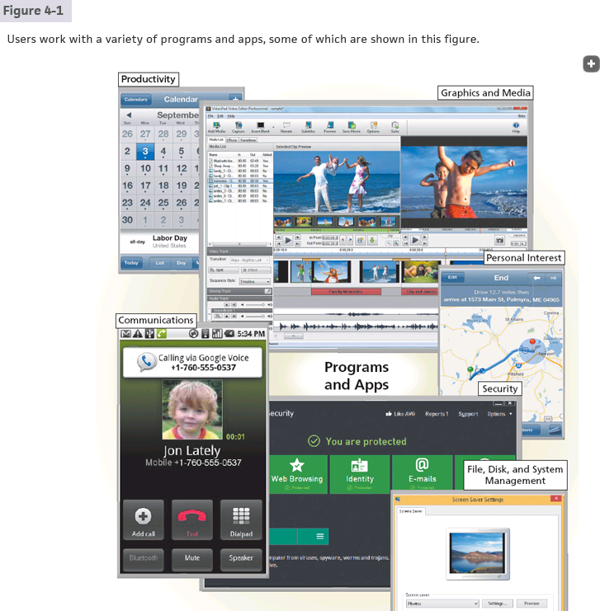
© 2016 Cengage Learning®. May not be scanned, copied or duplicated, or posted to a publicly accessible website, in whole or in part.
6

Slide 9
Figure 4-2 This figure shows how the operating system is the interface between the user, the application(s) and other programs, and the hardware.

Slide 10
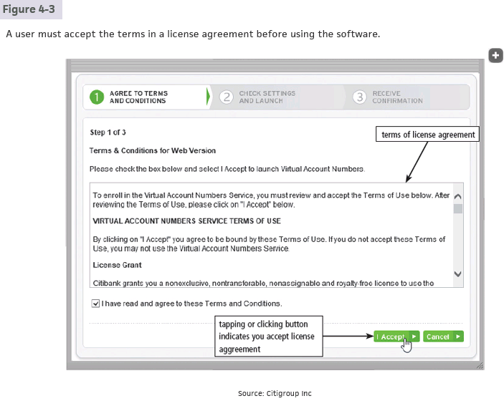
© 2016 Cengage Learning®. May not be scanned, copied or duplicated, or posted to a publicly accessible website, in whole or in part.
8

Slide 11
Programs and Apps (4 of 5)
The technologies that developers use to create apps often depends whether they will be installed on a user’s device or accessed via a network
Native app
Cloud app
Web app
Mobile web app

Slide 12
Programs and Apps (5 of 5)
Programs and apps are distributed in a variety of forms
Retail software
Custom software
Shareware
Freeware
Open source software
Public domain software

Slide 13
Productivity Applications (1 of 18)
Productivity applications can assist you in becoming more effective and efficient while performing daily activities at work, school, and home
Word processing
Presentation
Spreadsheet
Database
Note taking
Calendar and contact management
Project management
Accounting

Slide 14
Productivity Applications (2 of 18)
Personal finance
Legal
Tax preparation
Document management
Support services
Enterprise computing

Slide 15
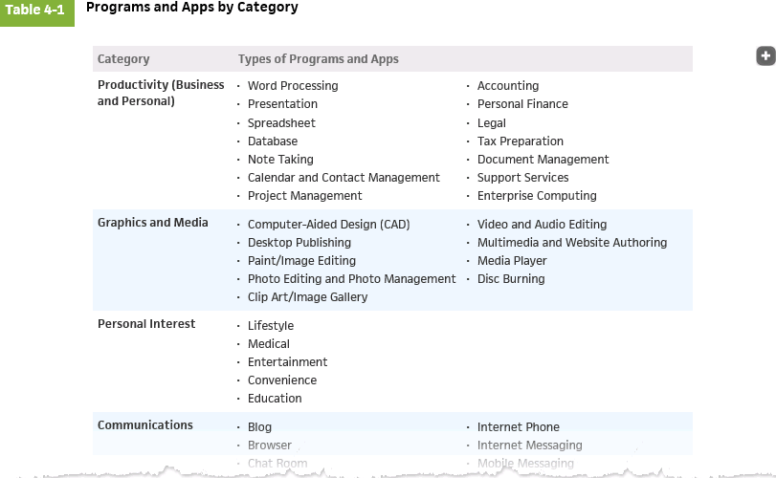
© 2016 Cengage Learning®. May not be scanned, copied or duplicated, or posted to a publicly accessible website, in whole or in part.
13

Slide 16
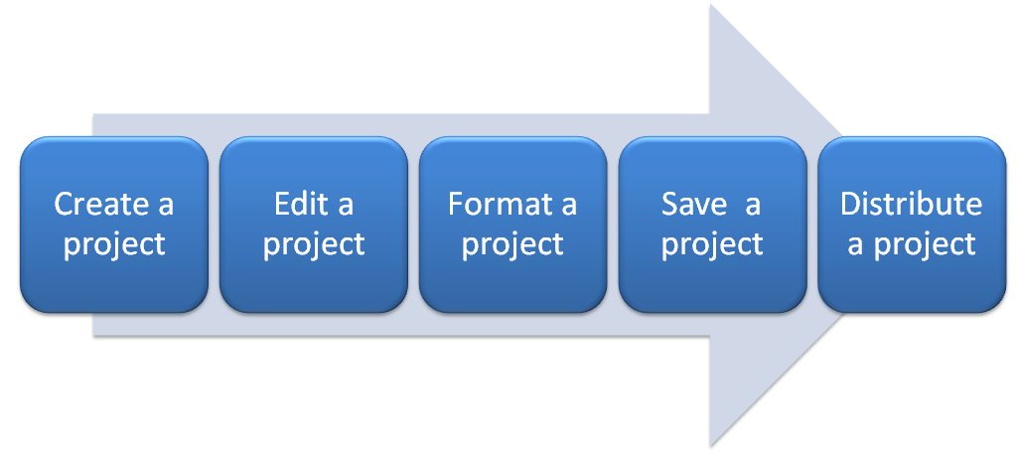
Productivity Applications (3 of 18)
With productivity applications, users often:

Slide 17
Productivity Applications (4 of 18)
Word processing software allows users to create and manipulate documents
People use word processing software to develop documents such as letters, memos, reports, mailing labels, and newsletters

Slide 18
© 2016 Cengage Learning®. May not be scanned, copied or duplicated, or posted to a publicly accessible website, in whole or in part.
16

Slide 19
Figure 4-5 Word processing software enables users to create professional and visually appealing documents.

Slide 20
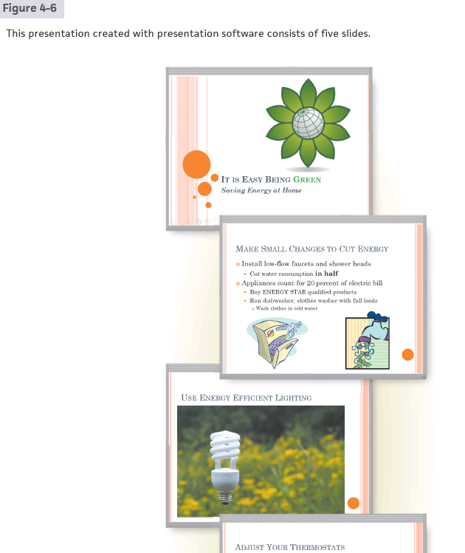
© 2016 Cengage Learning®. May not be scanned, copied or duplicated, or posted to a publicly accessible website, in whole or in part.
18

Slide 21
Presentation software allows users to create visual aids for presentations to communicate ideas, messages, and other information to a group
Figure 4-6 Presentation software provides tools for creating slides with content arranged in a variety of formats.

Slide 22
Spreadsheet software allows users to organize data in columns and rows and perform calculations on the data
Figure 4-7 With spreadsheet software, you create worksheets that contain data arranged in columns and rows, and you can perform calculations on the data in worksheets.

Slide 23
A database is a collection of data organized in a manner that allows access, retrieval, and use of that data
Database software allows users to create, access, and manage a database.
Figure 4-8 This database contains two tables: one for customers and one for book reps. The Customer table has 15 records and 10 fields; the Book Rep table has 4 records and 10 fields.

Slide 24
Note taking software is an application that enables users to enter typed text, handwritten comments, drawings, sketches, photos, and links anywhere on a page
Figure 4-9 With note taking software, mobile users can handwrite notes, draw sketches, insert photos and links, and type text.

Slide 25
Calendar and contact management software helps you organize your calendar, keep track of contacts, and share this information with other users
Figure 4-10 Users access their calendars on computers and mobile devices.

Slide 26
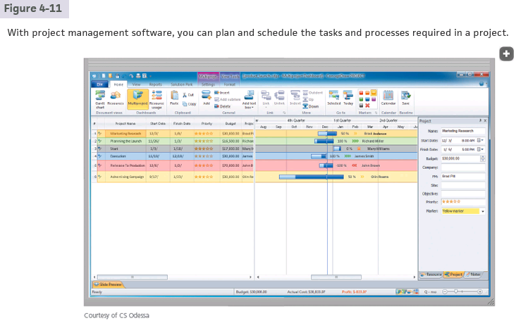
© 2016 Cengage Learning®. May not be scanned, copied or duplicated, or posted to a publicly accessible website, in whole or in part.
24

Slide 27
Productivity Applications (11 of 18)
A software suite is a collection of individual related applications available together as a unit.
Project management software is an application that allows a user to plan, schedule, track, and analyze the events, resources, and costs of a project.

Slide 28
Figure 4-11 With project management software, you can plan and schedule the tasks and resources required in a project.

Slide 29
Accounting software is an application that helps businesses of all sizes record and report their financial transactions
Figure 4-12 Accounting software helps businesses record and report their financial transactions.

Slide 30
Personal finance software is a simplified accounting application that helps home users and small/home office users balance their checkbooks, pay bills, track personal income and expenses, verify account balances, transfer funds, track investments, and evaluate financial plans
Figure 4-13 Personal finance software assists home users with tracking personal accounts.

Slide 31
Legal software is an application that assists in the preparation of legal documents and provides legal information to individuals, families, and small businesses
Figure 4-14 Legal software assists individuals, families, and small businesses in the preparation of legal documents.

Slide 32
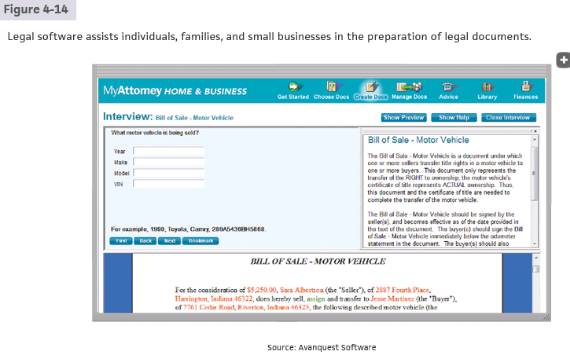
© 2016 Cengage Learning®. May not be scanned, copied or duplicated, or posted to a publicly accessible website, in whole or in part.
30

Slide 33
Tax preparation software is an application that can guide individuals, families, or small businesses through the process of filing federal and state taxes
Figure 4-15 Tax preparation software guides individuals, families, or small businesses through the process of filing federal taxes.

Slide 34
Document conversion software saves documents created in any application into a common format that has the same appearance as the original document
PDF: Portable Document Format
Figure 4-16 Users can edit content and add comments to a PDF document.

Slide 35
© 2016 Cengage Learning®. May not be scanned, copied or duplicated, or posted to a publicly accessible website, in whole or in part.
33

Slide 36
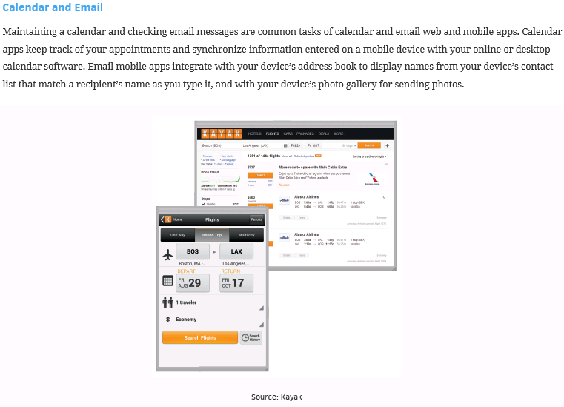
© 2016 Cengage Learning®. May not be scanned, copied or duplicated, or posted to a publicly accessible website, in whole or in part.
34

Slide 37
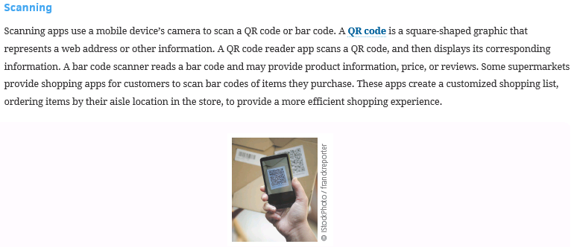
QR: Quick Response
© 2016 Cengage Learning®. May not be scanned, copied or duplicated, or posted to a publicly accessible website, in whole or in part.
35

Slide 38
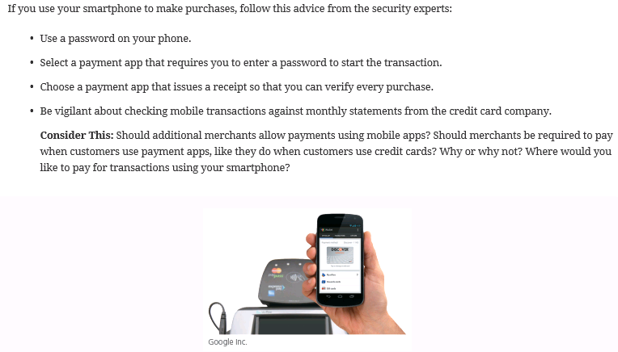
© 2016 Cengage Learning®. May not be scanned, copied or duplicated, or posted to a publicly accessible website, in whole or in part.
36

Slide 39
Productivity Applications (18 of 18)
A large organization, commonly referred to as an enterprise, requires special computing solutions because of its size and geographic distribution
Human resources software
Accounting and finance software
Engineering or product development software
Manufacturing software
Marketing software
Sales software
Distribution software
Customer service software
Information technology software

Slide 40
Graphics and Media Software (1 of 5)
Computer-Aided Design (CAD) software
Desktop publishing software
Paint/Image editing software
Photo editing and photo management software
Video and audio editing software

Slide 41
CAD: Computer-Aided Design
© 2016 Cengage Learning®. May not be scanned, copied or duplicated, or posted to a publicly accessible website, in whole or in part.
39

Slide 42
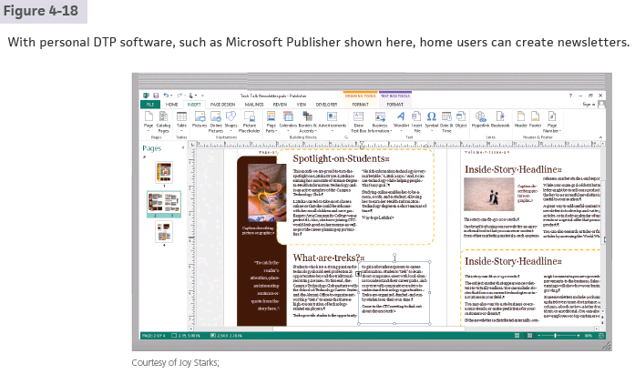
DTP: Desk-Top Publishing
© 2016 Cengage Learning®. May not be scanned, copied or duplicated, or posted to a publicly accessible website, in whole or in part.
40

Slide 43
Graphics and Media Software (2 of 5)
Multimedia authoring software allows users to combine text, graphics, audio, video, and animation in an interactive application
Website authoring software helps users create business websites for a variety of purposes

Slide 44
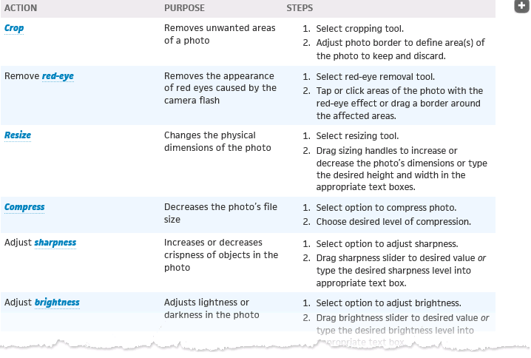
42

Slide 45
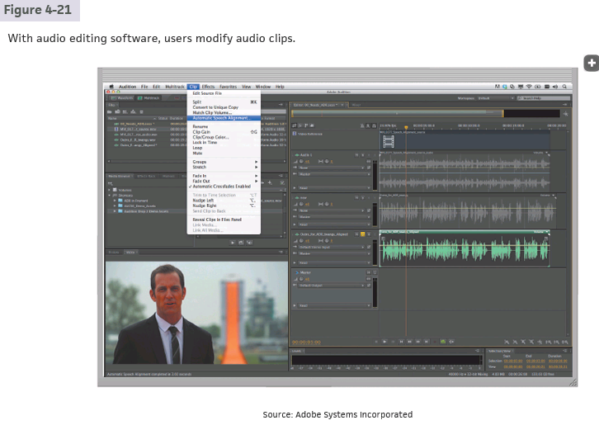
© 2016 Cengage Learning®. May not be scanned, copied or duplicated, or posted to a publicly accessible website, in whole or in part.
43

Slide 46
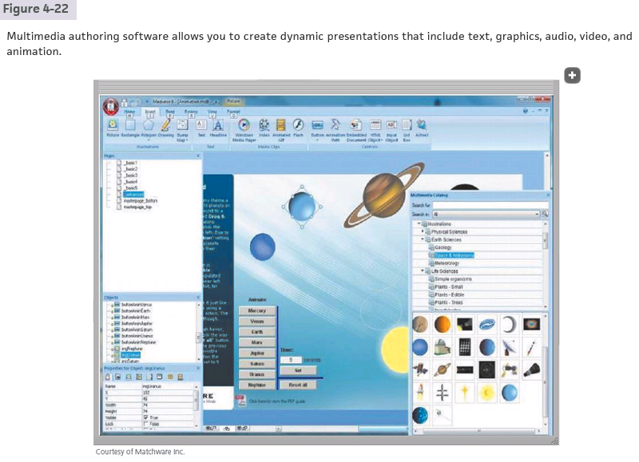
© 2016 Cengage Learning®. May not be scanned, copied or duplicated, or posted to a publicly accessible website, in whole or in part.
44

Slide 47
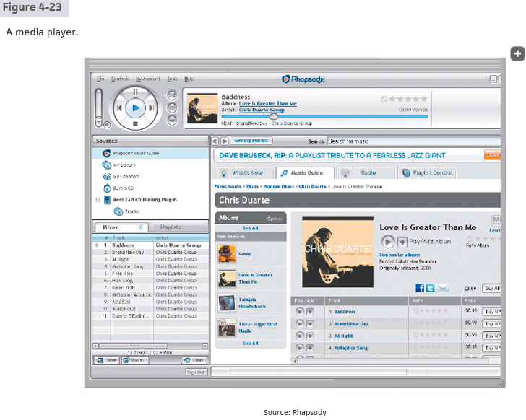
© 2016 Cengage Learning®. May not be scanned, copied or duplicated, or posted to a publicly accessible website, in whole or in part.
45

Slide 48
Graphics and Media Software (3 of 5)
Figure 4-22 Website authoring software allows you to create engaging personal and business websites by adding your text, images, and videos to existing website templates.

Slide 49
Graphics and Media Software (4 of 5)
A media player is a program that allows you to view images and animations, listen to audio, and watch video files on your computer or mobile device
An augmented reality app overlays information and digital content on top of physical objects or locations
A virtual reality app provides an immersive user experience

Slide 50
Graphics and Media Software (5 of 5)
Figure 4-23 Scanning a target image with a tablet or smartphone displays an
interactive model of the human body in this augmented reality app used for medical education.

Slide 51
Media Software
© 2016 Cengage Learning®. May not be scanned, copied or duplicated, or posted to a publicly accessible website, in whole or in part.
49

Slide 52
Communications Applications
Blog
Browser
Chat
Online Discussion
Email
File Transfer
Internet Phone
Internet Messaging
Mobile (Text) Messaging
Videoconference視訊通話

Slide 53
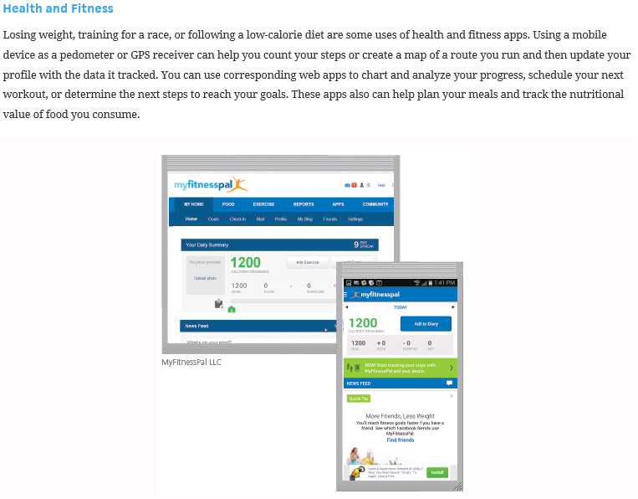
© 2016 Cengage Learning®. May not be scanned, copied or duplicated, or posted to a publicly accessible website, in whole or in part.
50

Slide 54
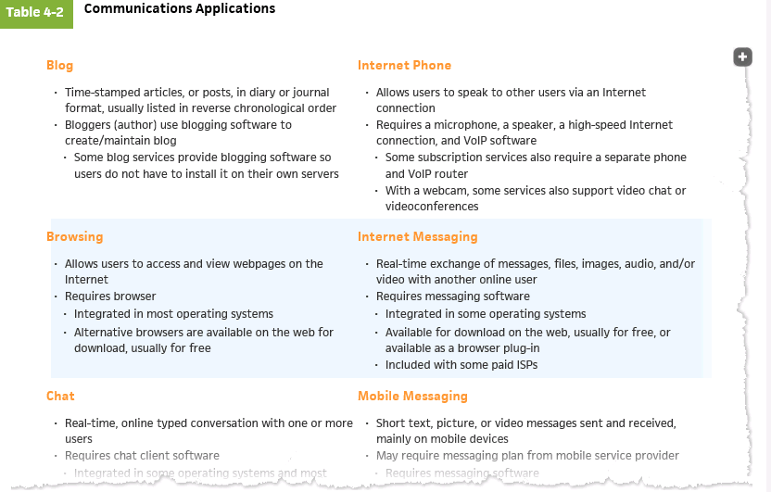
© 2016 Cengage Learning®. May not be scanned, copied or duplicated, or posted to a publicly accessible website, in whole or in part.
51

Slide 55
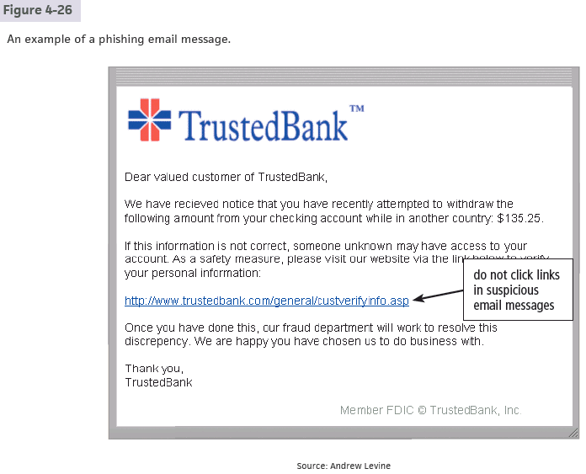
網路釣魚
© 2016 Cengage Learning®. May not be scanned, copied or duplicated, or posted to a publicly accessible website, in whole or in part.
52

Slide 56
Personal Interest Applications
Lifestyle applications
Medical applications
Entertainment applications
Convenience applications
Education applications

Slide 57
Security Applications
Firewall
antivirus program
…

Slide 58
A personal firewall is a security tool that detects and protects a personal computer and its data from unauthorized intrusions
Figure 4-24 This personal firewall detected a threat to the computer and
provided a means to remove the threat.

Slide 59
An antivirus program protects a computer against viruses by identifying and removing any computer viruses found in memory, on storage media, or on incoming files
Figure 4-25 An antivirus program scans memory, media, and incoming email messages and attachments for viruses and attempts to remove any viruses it finds.

Slide 60
Security Tools (slide 3 of 5)
Spyware is a type of program placed on a computer or mobile device without the user’s knowledge that secretly collects information about the user and then communicates the information it collects to some outside source while the user is online
Adware is a type of program that displays an online advertisement in a banner or pop-up or pop-under window on webpages, email messages, or other Internet services

Slide 61
Security Tools (slide 4 of 5)
A spyware remover is a type of program that detects and deletes spyware and similar programs
An adware remover is a program that detects and deletes adware

Slide 62
Security Tools (slide 5 of 5)
Anti-spam programs
Web filtering software
Phishing filters
Pop-up and pop-under blockers

Slide 63
A file manager is a tool that performs functions related to file management
Figure 4-27 With a file manager, you can view folders and different types of files containing documents, photos, and music. In this case, thumbnails of photos are displayed.

Slide 64
A search tool is a program, usually included with an operating system, that attempts to locate a file, contact, calendar event, app, or any other item stored on your computer or mobile device based on criteria you specify
Figure 4-28 Search tools locate apps, folders, files, settings, and other items on your device or the web that match a search criteria

Slide 65
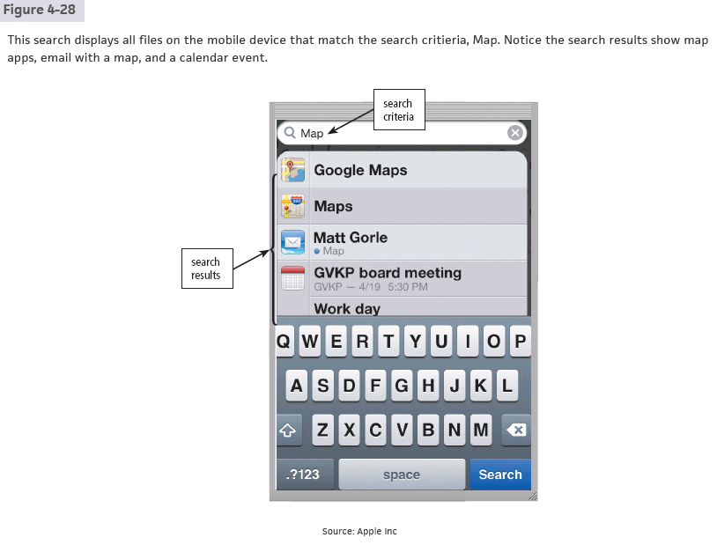
© 2016 Cengage Learning®. May not be scanned, copied or duplicated, or posted to a publicly accessible website, in whole or in part.
62

Slide 66
An image viewer is a tool that allows users to display, copy, and print the contents of a graphics file, such as a photo.
An uninstaller is a tool that removes a program, as well as any associated entries in the system files.
Figure 4-29 An image viewer allows users to see the contents of a photo file.

Slide 67
A disk cleanup tool searches for and removes unnecessary files
Figure 4-30 A disk cleanup tool searches for and removes unnecessary files on a computer or mobile device.

Slide 68
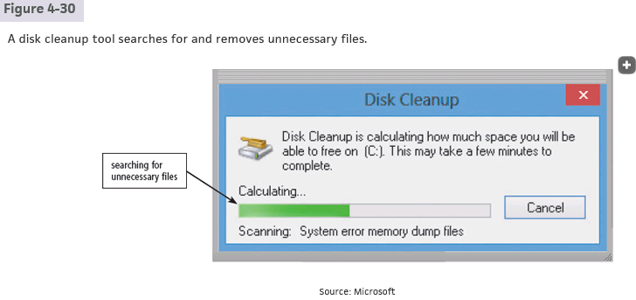
© 2016 Cengage Learning®. May not be scanned, copied or duplicated, or posted to a publicly accessible website, in whole or in part.
65

Slide 69
A disk defragmenter is a tool that reorganizes the files and unused space on a computer’s hard disk so that the operating system accesses data more quickly and programs run faster.
Defragmenting
Figure 4-31 A fragmented hard disk has many files stored in noncontiguous sectors. Defragmenting reorganizes the files so that they are located in contiguous sectors, which speeds access time.

Slide 70
File, Disk, and System Management Tools (6 of 7)
A screen saver is a tool that causes a display device’s screen to show a moving image or blank screen if no keyboard or mouse activity occurs for a specified time
A file compression tool shrinks the size of a file(s)
A PC maintenance tool is a program that identifies and fixes operating system problems, detects and repairs drive problems, and includes the capability of improving a computer’s performance

Slide 71
File, Disk, and System Management Tools (7 of 7)
A backup tool allows users to copy, or back up, selected files or the contents of an entire storage medium to another storage location
A restore tool reverses the process and returns backed up files to their original form
A power management tool monitors a laptop or mobile device’s battery usage, showing apps that consume the most battery power, displaying battery usage since the device was last charged, and estimating usage time remaining

Slide 72
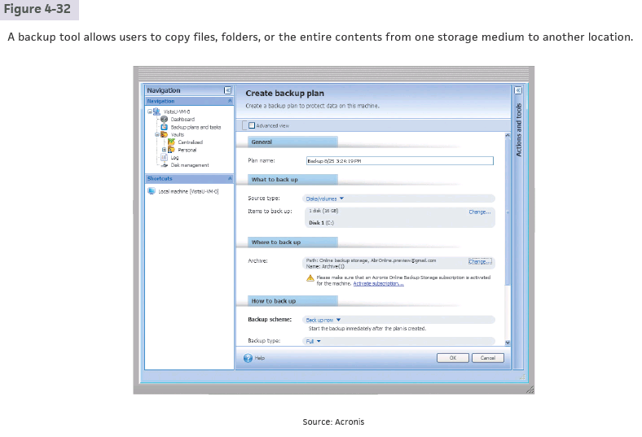
© 2016 Cengage Learning®. May not be scanned, copied or duplicated, or posted to a publicly accessible website, in whole or in part.
69

Slide 73
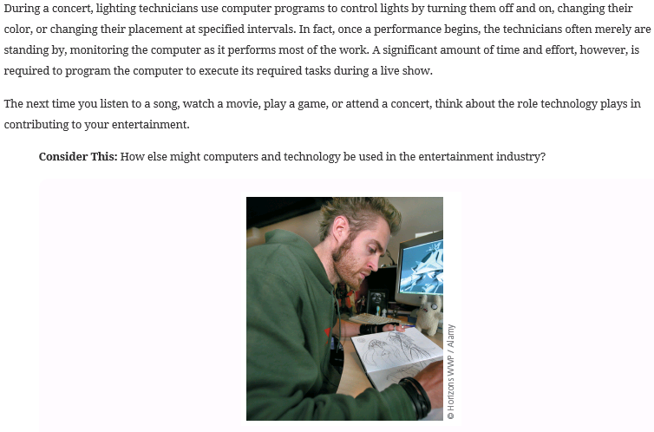
© 2016 Cengage Learning®. May not be scanned, copied or duplicated, or posted to a publicly accessible website, in whole or in part.
70

Slide 74
Summary
Programs and apps available for computers and mobile devices
Role of the operating system and the various ways software is distributed
Features of a variety of applications
Communications applications
Security tools and file, disk, and system management tools

Slide 75
Project due Oct. 9, 2023
Use Microsoft Word to type our textbook page.
The page number is 100 + the last two digits of your ID number.
Try to type the page as similar to textbook as possible.
Scan images if necessary, but try to use as much text as possible.
Type another page with Microsoft Word to show off your capability.
Include as much graphics, sounds, HTML, mail merge, style, font, type, ... as possible.
8A-72

