Slide 1
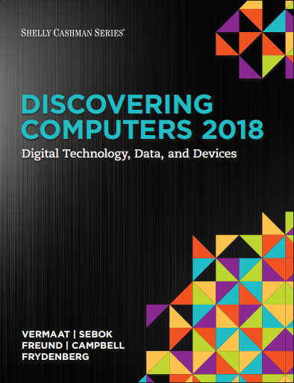
DISCOVERING COMPUTERS 2018 Digital Technology, Data, and Devices
Module 2
Connecting and Communicating Online:
The Internet, Website, and Media
© 2018 Cengage版權所有，為課本著作之延伸教材，亦受著作權法之規範保護，僅作為授課教學使用，禁止列印、影印、未經授權重製和公開散佈

Slide 2
Objectives Overview (1 of 2)
Discuss the evolution of the Internet.
Briefly describe various broadband Internet(寬頻) connections.
Describe the purpose of an IP address and its relationship to a domain name(網域名).
Describe features of browsers and identify the components of a web address.
Describe ways to compose effective search text.

Slide 3
Objectives Overview (2 of 2)
Explain benefits and risks of using online social networks.
Describe uses of various types of websites.
Explain how the web uses graphics, animation, audio, video, and virtual reality.
Explain how email, email lists, Internet messaging, chat rooms, online discussions, VoIP, and FTP work. (VoIP:Voice over Internet Protocol)
(FTP:File Transfer Protocol)
Identify the rules of netiquette(網絡禮儀).
Notes:
Figure 2.1 Exercise/exercise dropout cycle

Slide 4
The Internet is a worldwide collection of networks that connects millions of businesses, government agencies, educational institutions, and individuals.
Figure 2-1 People around the world use the internet in daily activities, such as accessing information, exchanging messages, and conversing with others from their computers and mobile devices.

Slide 5
The Internet (2 of 3)
The Internet originated as ARPANet in September 1969 and had two main goals:
Allow scientists at different physical locations to share information and work together
Function even if part of the network were disabled or destroyed by a disaster
ARPANet(Advanced Research Projects Agency Network)

Slide 6
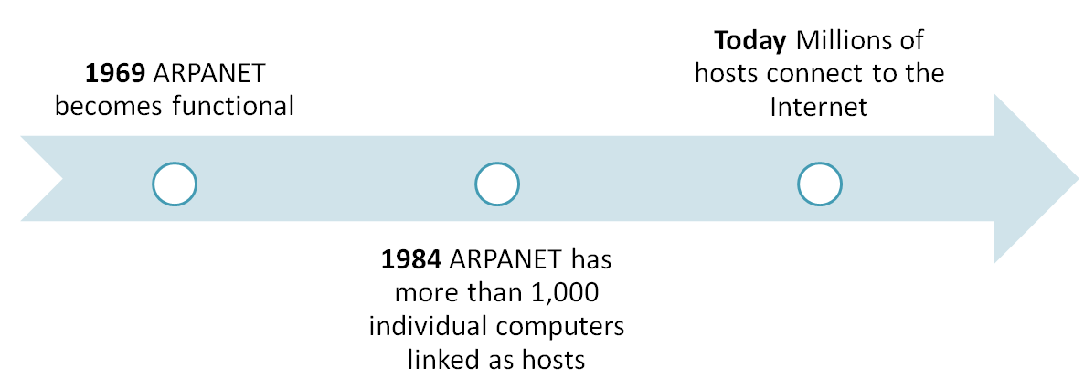
The Internet (3 of 3)
Notes:
Our environment is not conducive to a healthy, physically active lifestyle.

Slide 7
Connecting to the Internet (1 of 10)
With wired connections, a computer or device physically attaches via a cable or wire to a communications device
Computers without a communications device can use a wireless modem(數據機) or other communications device that enables wireless connectivity

Slide 8
Figure 2-2 Using a modem is one way to connect computers and mobile devices to the Internet.
USB: Universal Serial Bus

Slide 9
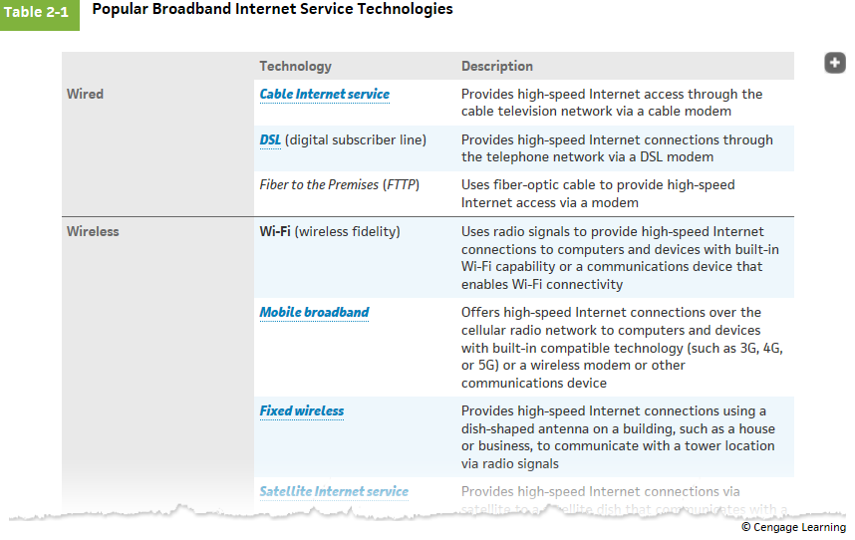
© 2016 Cengage Learning®. May not be scanned, copied or duplicated, or posted to a publicly accessible website, in whole or in part.
9

Slide 10
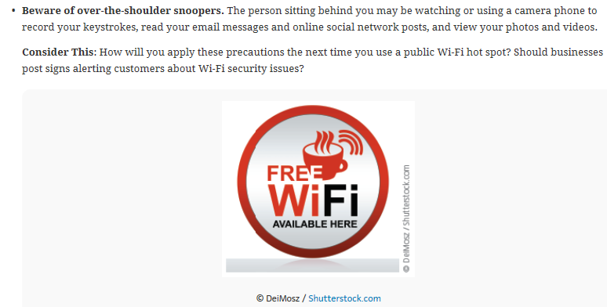
© 2016 Cengage Learning®. May not be scanned, copied or duplicated, or posted to a publicly accessible website, in whole or in part.
10

Slide 11
Connecting to the Internet (3 of 10)
Wired
Cable Internet service
DSL (Digital Subscriber Line)
Fiber to the Premises (FTTP)
Wireless
Wi-Fi (Wireless Fidelity)
Mobile broadband
Fixed wireless
Satellite Internet Service

Slide 12
Connecting to the Internet (4 of 10)
A hot spot is a wireless network that provides Internet connections to mobile computers and devices
Figure 2-3 You can create a mobile hot spot using a communications device or by tethering a smartphone.

Slide 13
Connecting to the Internet (5 of 10)
An Internet Service Provider (ISP) is a business that provides individuals and organizations access to the Internet free or for a fee.
Bandwidth is a measure of the capability of a network to send and receive data.
Megabyte (MB)
Gigabyte (GB)

Slide 14
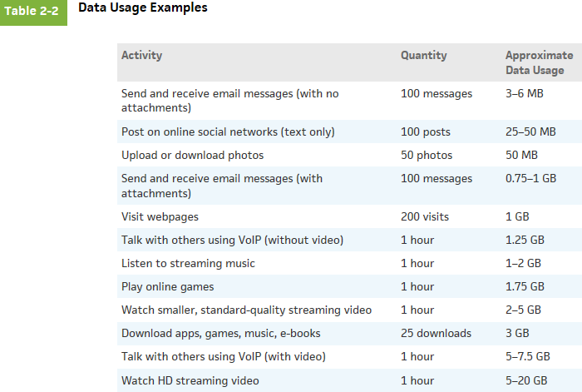
HD: High Definition
VoIP: Voice over Internet Protocol
© 2016 Cengage Learning®. May not be scanned, copied or duplicated, or posted to a publicly accessible website, in whole or in part.
14

Slide 15
Figure 2-4 This figure shows how a home user’s request for eBay’s webpage might travel the internet using cable Internet service.

Slide 16
Connecting to the Internet (7 of 10)
An IP address is a sequence of numbers that uniquely identifies the location of each computer or device connected to the Internet or any other network
A domain name is a text-based name that corresponds to the IP address of a server
A DNS server translates the domain name into its associated IP address

Slide 17
Connecting to the Internet (8 of 10)
Figure 2-5 The IPv4 and IPv6 addresses, along with the domain name for Google's website.

Slide 18
Table 2-3 Popular TLDs
TLD | Intended Purpose
.biz | Businesses
.com | Commercial organizations, businesses, and companies
.edu | Educational institutions
.gov | Government agencies
.mil | Military organizations
.museum | Museums and individual museum professionals
.name | Individuals
.net | Network providers or commercial companies
.org | Nonprofit organizations
.pro | Licensed professionals
.technology | Technology information
.travel | Entities whose primary area of activity is in the travel industry

Slide 19
DNS: Doman Name Server
Figure 2-6 This figure show how a user’s entered domain name (google.com) uses a DNS server to display a webpage (Google, in this case).

Slide 20
The World Wide Web (1 of 5)
The World Wide Web (WWW), or web, consists of a worldwide collection of electronic documents (webpages)
A website is a collection of related webpages and associated items
A web server is a computer that delivers requested webpages to your computer or mobile device
HTML (Hypertext Markup Language) is a set of symbols that developers use to specify the headings, paragraphs, images, links, and other content elements that a webpage contains

Slide 21
The World Wide Web (2 of 5)
A browser is an application that enables users with an Internet connection to access and view webpages on a computer or mobile device
Internet-capable mobile devices such as smartphones use a special type of browser, called a mobile browser
A home page is the first page that a website displays
Current browsers typically support tabbed browsing(分頁)

Slide 22
Figure 2-7 Many websites, such as the Centers for Disease Control and Prevention shown here, provide a mobile version that is designed specifically for display on a mobile browser.

Slide 23
A webpage has a unique address, called a web address or URL (Uniform Resource Locator)
Figure 2-8 After entering http://www.nps.gov/history/preserve-places.htm in the address bar and then pressing the ENTER key or clicking the Search, Go, or similar button in a browser, the U.S. Department of the Interior National Park Service (NPS) home page shown here is displayed.

Slide 24
A web app is an application stored on a web server that you access through a browser
Web apps usually store users’ data and information on their hosts’ servers
Figure 2-9 Web and mobile apps often work together, enabling you to access your content from a variety of computers and devices.

Slide 25
Types of Websites (1 of 8)
A web search engine is software that finds websites, webpages, images, videos, news, maps, and other information related to a specific topic
A subject directory classifies webpages in an organized set of categories, such as sports or shopping, and related subcategories

Slide 26
Types of Websites (2 of 8)
Operator | Description | Examples | Explanation
Space or + | Display search results that include specific words. | art + music art music | Results have both words, art and music, in any order
OR | Display search results that include only one word from a list. | dog OR puppy dog OR puppy OR canine | Results have either the word, dog, or the word, Puppy. Results have the word, dog, or the word, puppy, or the word, canine.
() | Combine search results that include specific words with those that include only one word from a list. | Kalamazoo Michigan (pizza OR subs) | Results include both words, Kalamazoo Michigan, and either the word, pizza, or the word, subs.
Notes:
Figure 2.3 Stages of change model

Slide 27
Types of Websites (3 of 8)
Operator | Description | Examples | Explanation
_ | Exclude a word from search results. | automobile-convertible | Results include the word, automobile, but do not include the word, convertible.
“ ” | Search for an exact phrase in a certain order. | "19th century literature" | Results include the exact phrase, 19th century literature.
* | Substitute characters in place of the asterisk. | writer* | Results include any word that begins with the text, writer (e.g., writer, writers, writer's)

Slide 28
Types of Websites (4 of 8)
There are several types of websites
Search engine
Online social network
Informational and research
Media sharing
Bookmarking
News, weather, sports, and other mass media

Slide 29
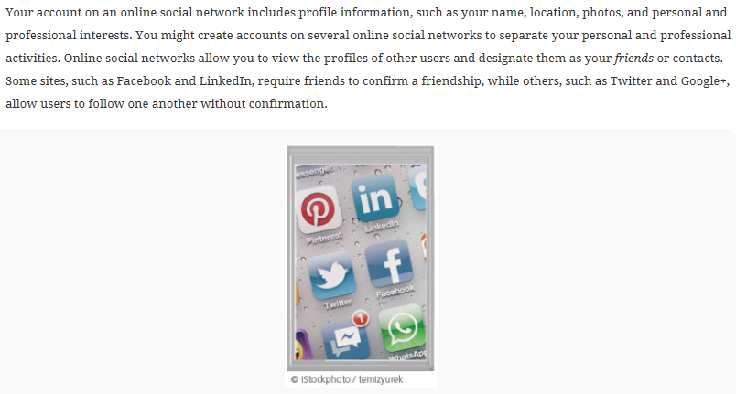
© 2016 Cengage Learning®. May not be scanned, copied or duplicated, or posted to a publicly accessible website, in whole or in part.
29

Slide 30
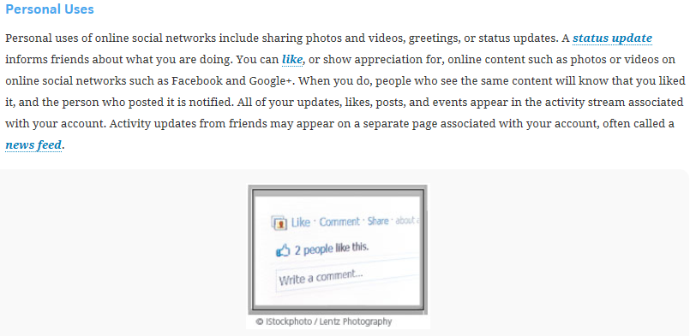
© 2016 Cengage Learning®. May not be scanned, copied or duplicated, or posted to a publicly accessible website, in whole or in part.
30

Slide 31
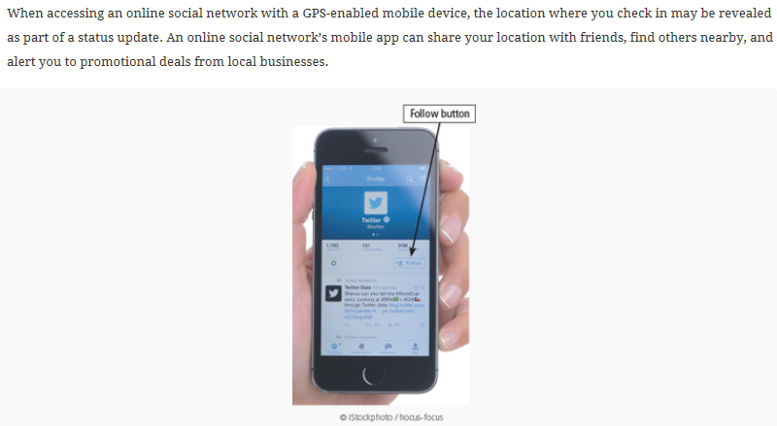
GPS: Global Positioning System
© 2016 Cengage Learning®. May not be scanned, copied or duplicated, or posted to a publicly accessible website, in whole or in part.
31

Slide 32
Types of Websites (5 of 8)
Educational
Business, governmental, and organizational
Blogs
Wiki and collaboration
Health and fitness
Science
Notes:
Figure 2.4 Goal setting and supportive behaviors

Slide 33
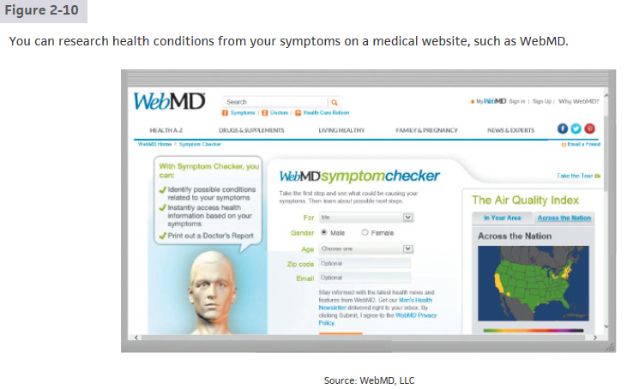
MD: Medical Doctor
LLC: Limited Liability Company
© 2016 Cengage Learning®. May not be scanned, copied or duplicated, or posted to a publicly accessible website, in whole or in part.
33

Slide 34
Inc.: Incorporated
© 2016 Cengage Learning®. May not be scanned, copied or duplicated, or posted to a publicly accessible website, in whole or in part.
34

Slide 35
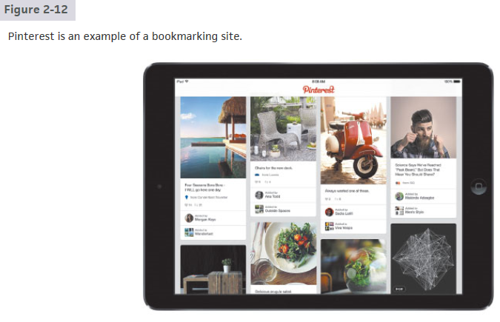
© 2016 Cengage Learning®. May not be scanned, copied or duplicated, or posted to a publicly accessible website, in whole or in part.
35

Slide 36
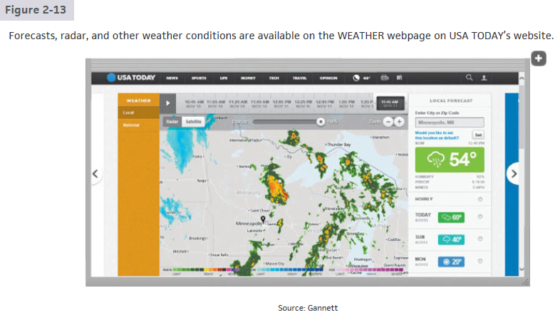
© 2016 Cengage Learning®. May not be scanned, copied or duplicated, or posted to a publicly accessible website, in whole or in part.
36

Slide 37
Types of Websites
Business, governmental, and organizational
Educational
Blogs
Wiki and collaboration
Science
Health and fitness
© 2016 Cengage Learning®. May not be scanned, copied or duplicated, or posted to a publicly accessible website, in whole or in part.
Pages 77 – 79
37

Slide 38
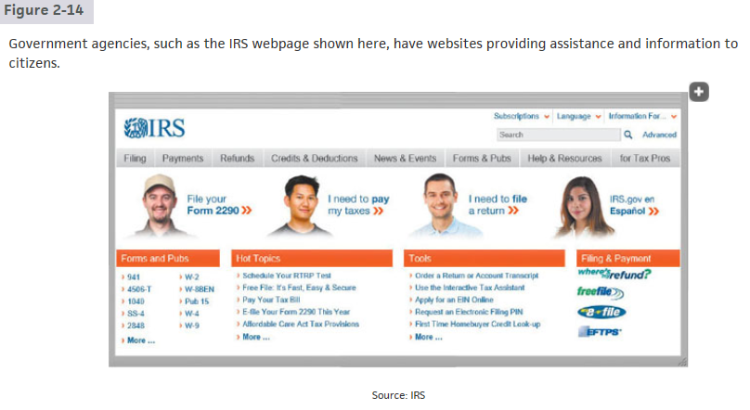
IRS: Internal Revenue Service
© 2016 Cengage Learning®. May not be scanned, copied or duplicated, or posted to a publicly accessible website, in whole or in part.
38

Slide 39
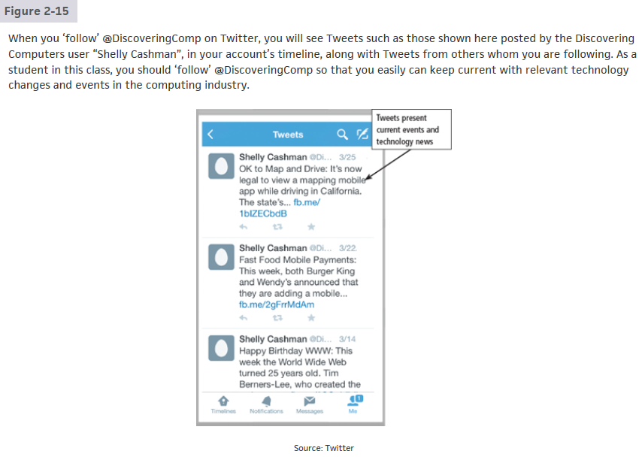
© 2016 Cengage Learning®. May not be scanned, copied or duplicated, or posted to a publicly accessible website, in whole or in part.
39

Slide 40
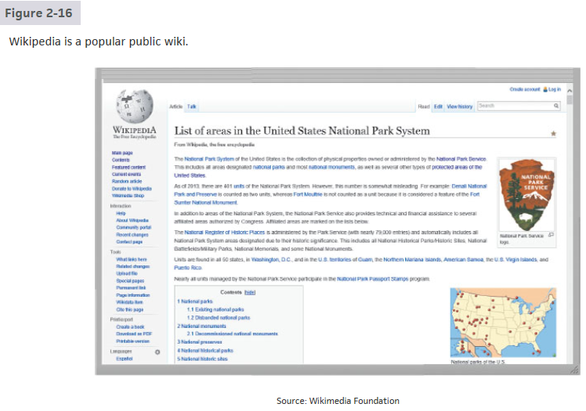
© 2016 Cengage Learning®. May not be scanned, copied or duplicated, or posted to a publicly accessible website, in whole or in part.
40

Slide 41
Types of Websites
Banking and finance
Travel and tourism
Entertainment
Retail and auctions
Mapping
© 2016 Cengage Learning®. May not be scanned, copied or duplicated, or posted to a publicly accessible website, in whole or in part.
Pages 79 – 82
41

Slide 42
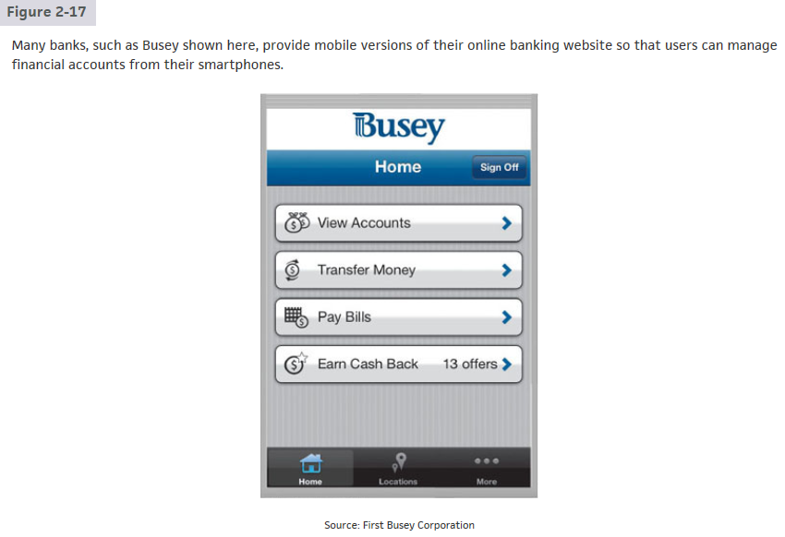
© 2016 Cengage Learning®. May not be scanned, copied or duplicated, or posted to a publicly accessible website, in whole or in part.
42

Slide 43
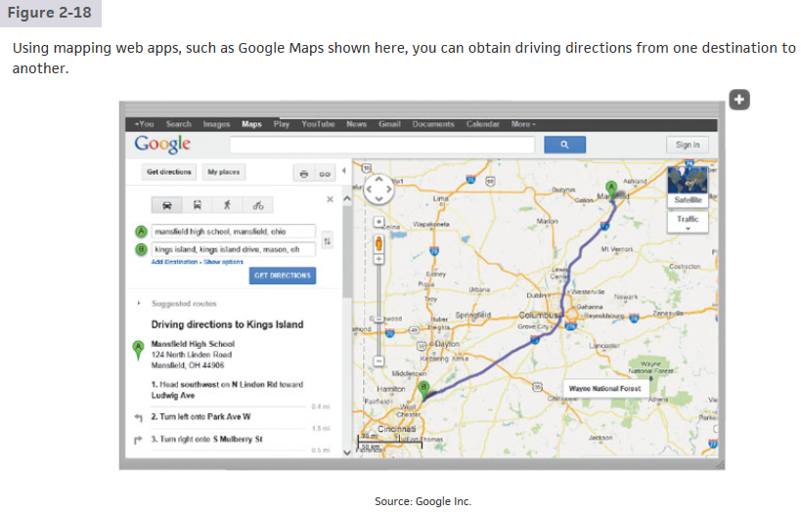
© 2016 Cengage Learning®. May not be scanned, copied or duplicated, or posted to a publicly accessible website, in whole or in part.
43

Slide 44
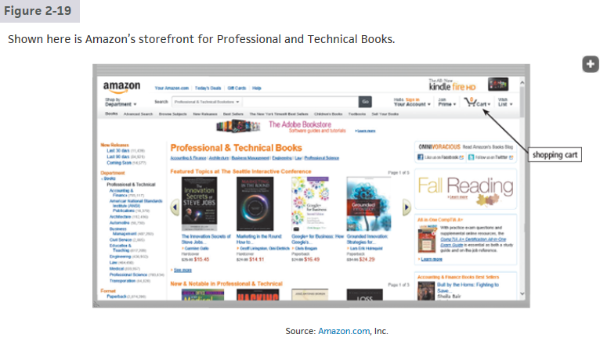
© 2016 Cengage Learning®. May not be scanned, copied or duplicated, or posted to a publicly accessible website, in whole or in part.
44

Slide 45
Types of Websites
Careers and employment
E-commerce
Portals
Website creation and management
Content aggregation
© 2016 Cengage Learning®. May not be scanned, copied or duplicated, or posted to a publicly accessible website, in whole or in part.
Pages 82 – 84
45

Slide 46
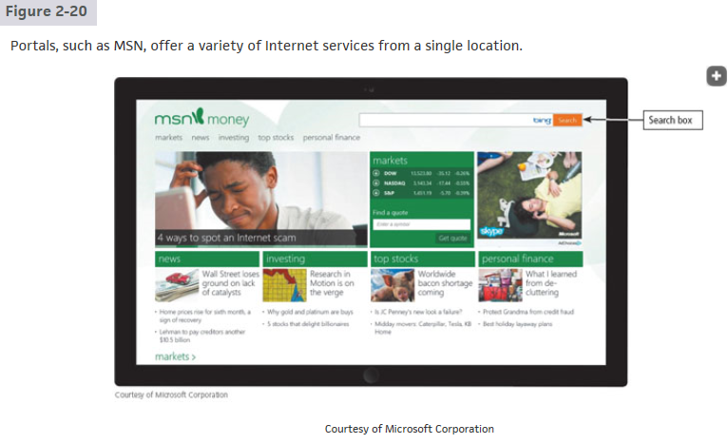
MSN: MicroSoft Network
© 2016 Cengage Learning®. May not be scanned, copied or duplicated, or posted to a publicly accessible website, in whole or in part.
46

Slide 47
© 2016 Cengage Learning®. May not be scanned, copied or duplicated, or posted to a publicly accessible website, in whole or in part.
47

Slide 48
Types of Websites (6 of 8)
Entertainment
Banking and finance
Travel and tourism
Mapping
Retail and auctions

Slide 49
Types of Websites (7 of 8)
Careers and employment
E-commerce
Portals
Content aggregation
Website creation and management
Notes:
Figure 2.5 Model of progression and relapse

Slide 50
Types of Websites (8 of 8)
Web publishing is the creation and maintenance of websites

Slide 51
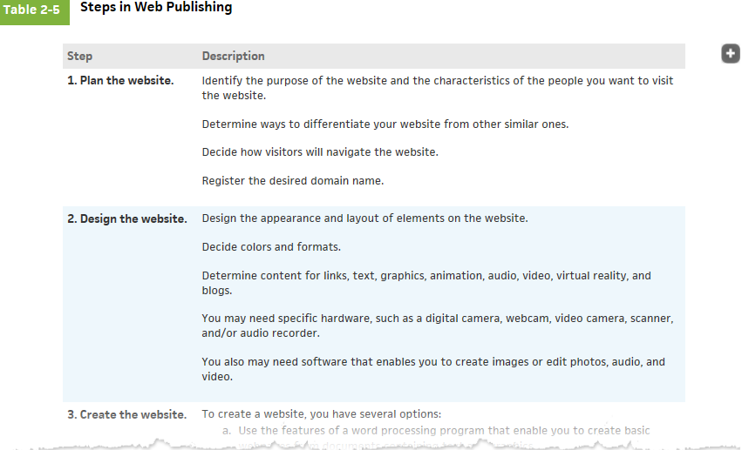
© 2016 Cengage Learning®. May not be scanned, copied or duplicated, or posted to a publicly accessible website, in whole or in part.
51

Slide 52
Digital Media on the Web (1 of 7)
Multimedia refers to any application that combines text with media
Graphics
Animation
Audio
Video
Virtual Reality

Slide 53
Digital Media on the Web (2 of 8)
A graphic is a visual representation of nontext information
Graphic formats include BMP, GIF, JPEG, PNG, and TIFF

Slide 54
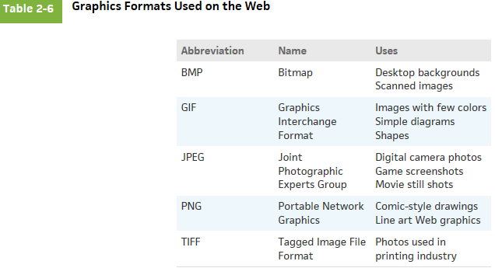
© 2016 Cengage Learning®. May not be scanned, copied or duplicated, or posted to a publicly accessible website, in whole or in part.
54

Slide 55
Digital Media on the Web (3 of 8)
Figure 2-22 Many webpages use colorful graphics to convey messages. For example, the variety of colors, images, shapes, and thumbnails on the San Diego Zoo webpage visually separate and draw attention to areas of the webpage, making the webpage more dynamic and enticing.

Slide 56
An infographic(資訊圖表) is a visual representation of data and information, designed to communicate quickly, simplify complex concepts, or present patterns or trends.
Figure 2-23 An infographic presents complex concepts at a glance.

Slide 57
Digital Media on the Web (6 of 11)
Animation is the appearance of motion created by displaying a series of still images in sequence

Slide 58
Digital Media on the Web (7 of 11)
Audio includes music, speech, or any other sound
Compressed to reduce file size
You listen to audio on your computer using a media player
Notes:
Figure 2.7 SMART goals

Slide 59
Figure 2-24 Windows Media Player is a popular media player, through which you can listen to music and watch video.

Slide 60
Digital Media on the Web (9 of 11)
Video consists of images displayed in motion
Virtual Reality (VR) is the use of computers to simulate a real or imagined environment that appears as a three-dimensional (3-D) space.

Slide 61
Figure 2-25 Users can explore a VR world using a touch screen or their input device. For example, users can explore the inside of the Gemini 7 space capsule, located at the Smithsonian Air and Space Museum in Washington, D.C., from their computer or mobile device. D.C.: District of Columbia

Slide 62
Digital Media on the Web (11 of 11)
A plug-in, or add-on, is a program that extends the capability of a browser

Slide 63
Other Internet Services (1 of 11)
Email is the transmission of messages and files via a computer network
An email program allows you to create, send, receive, forward, store, print, and delete email messages

Slide 64
Figure 2-26 This figure shows how an email message may travel from a sender to a receiver.

Slide 65
An email list is a group of email addresses used for mass distribution of a message
Figure 2-27 When you subscribe to a mailing list, you and all others in the list receive messages from the website. Shown here is a user who receives newsletters and alerts from FoxNews .com.

Slide 66
Other Internet Services (4 of 11)
Internet messaging services, which often occur in real-time, are communications services that notify you when one or more of your established contacts are online and then allows you to exchange messages or files or join a private chat room with them

Slide 67
Figure 2-28 With Internet messaging services, you and the person(s) with whom you are conversing are online at the same time. The conversation appears on all parties' screens at the same time. Shown here is Facebook messenger.

Slide 68
Other Internet Services (6 of 11)
A chat is a real-time typed conversation that takes place on a computer or mobile device with many other online users
A chat room is a website or application that permits users to chat with others who are online at the same time

Slide 69
Figure 2-29 As you type, others in the same chat room see what you have typed.

Slide 70
Other Internet Services (8 of 11)
An online discussion is an online area in which users have written discussions about a particular subject

Slide 71
Figure 2-30 Users in an line discussion read and reply to other user’s messages.

Slide 72
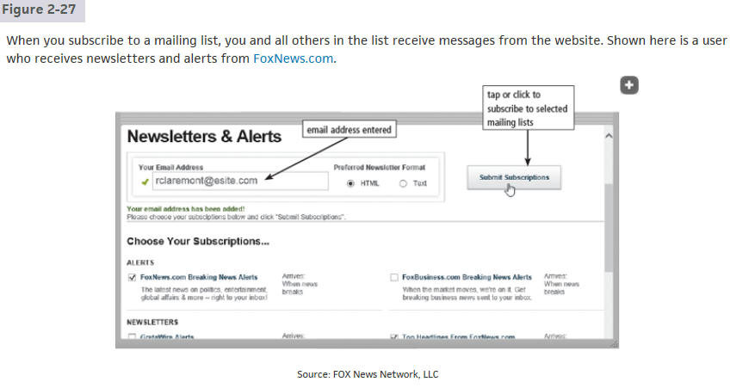
HTML: Hyper-Text Markup Language
© 2016 Cengage Learning®. May not be scanned, copied or duplicated, or posted to a publicly accessible website, in whole or in part.
72

Slide 73
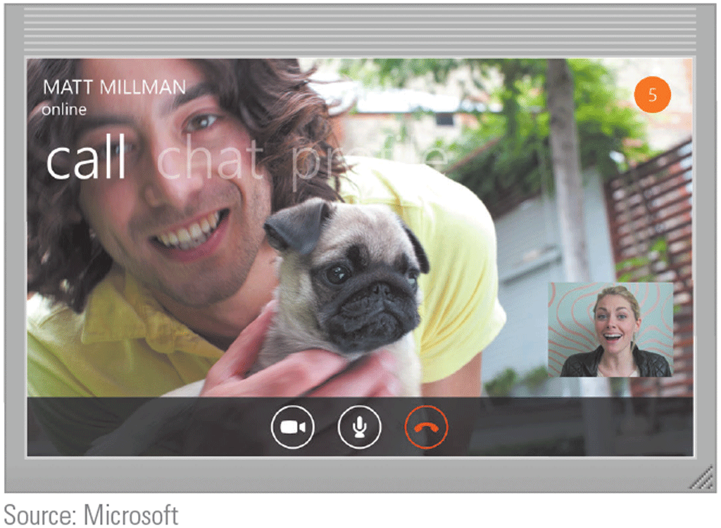
Other Internet Services (10 of 11)
VoIP (Voice over Internet Protocol) enables users to speak to other users via their Internet connection.
Source: Microsoft

Slide 74
© 2016 Cengage Learning®. May not be scanned, copied or duplicated, or posted to a publicly accessible website, in whole or in part.
74

Slide 75
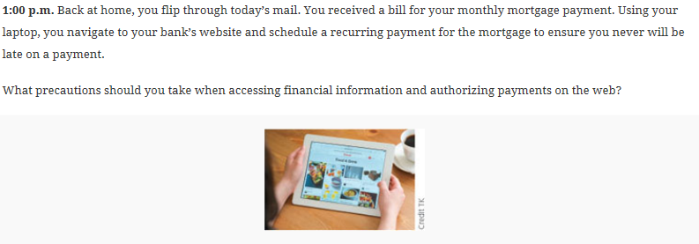
© 2016 Cengage Learning®. May not be scanned, copied or duplicated, or posted to a publicly accessible website, in whole or in part.
75

Slide 76
© 2016 Cengage Learning®. May not be scanned, copied or duplicated, or posted to a publicly accessible website, in whole or in part.
76

Slide 77
Other Internet Services (11 of 11)
FTP (File Transfer Protocol) is an Internet standard that permits file uploading and downloading to and from other computers on the Internet
Many operating systems include FTP capabilities
An FTP server is a computer that allows users to upload and/or download files using FTP

Slide 78
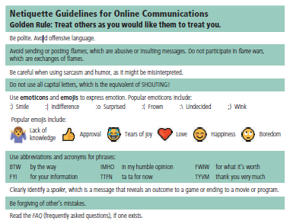
Netiquette
Netiquette is the code of acceptable Internet behavior users should follow while on the Internet
Figure 2-31 Some of the rules of netiquette, with respect to online communications.
Source: Microsoft

Slide 79
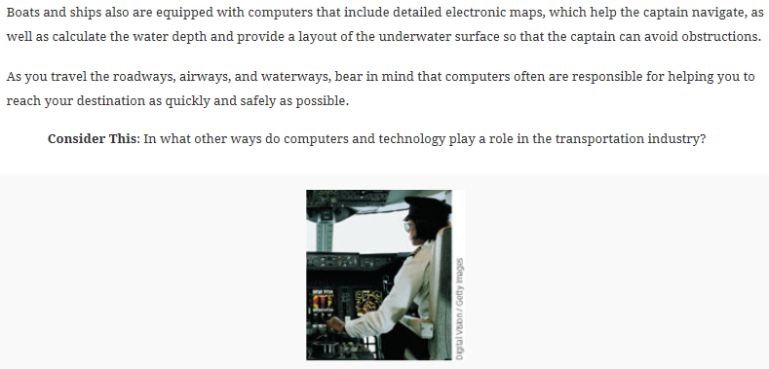
© 2016 Cengage Learning®. May not be scanned, copied or duplicated, or posted to a publicly accessible website, in whole or in part.
79

Slide 80
Summary
Evolution of the Internet
The web
Various types of websites and media
Other services available on the Internet
Netiquette

Slide 81
Project due Sep. 25, 2023
Use WWW to find ten best home pages about the following ten topics and sort
them by content quality, completeness, and relevance:
Trinidad Tobago, San Francisco, Taipei Satellite Images,
Systemic Lupus Erythematosus, Harvard University, Science Citation Index,
Airbus A380, HTC, Bioinformatics, National Parks in United States.
Each of the ten best home pages must have different domain name.

