Slide 1
Advanced Computer Vision
Chapter 2
Image Formation
Presented by: 傅楸善 & 張乃婷
0919508863
r99922068@ntu.edu.tw

Slide 2
Image Formation
2.1 Geometric primitives and transformations
2.2 Photometric image formation
2.3 The digital camera

Slide 3
2.1.1 Geometric Primitives (1/4)
2D points (pixel coordinates in an image)

Slide 4
2.1.1 Geometric Primitives (2/4)
2D lines
normalize the line equation vector

Slide 5
2.1.1 Geometric Primitives (3/4)
2D conics: circle, ellipse, parabola, hyperbola
There are other algebraic curves that can be expressed with simple polynomial homogeneous equations.

Slide 6
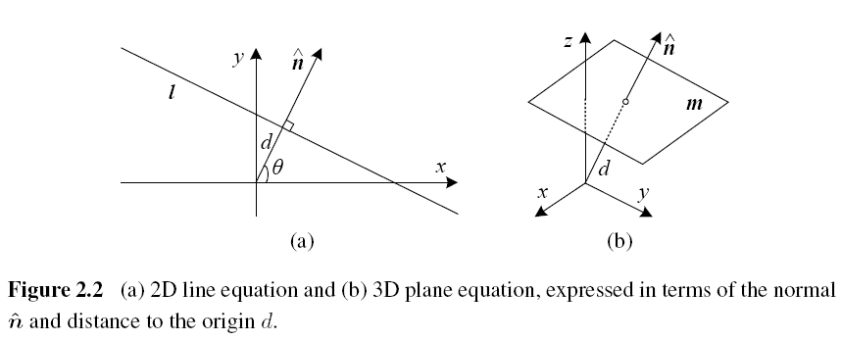
2.1.1 Geometric Primitives (4/4)

Slide 7
3D (1/3)
3D points
3D planes
normalize the plane equation vector

Slide 8
3D (2/3)
3D lines
two points on the line, (p, q)
Any other point on the line can be expressed as a linear combination of these two points.
3D quadrics

Slide 9
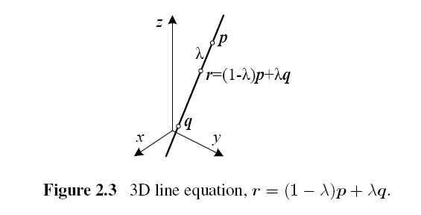
3D (3/3)

Slide 10
2.1.2 2D Transformations

Slide 11
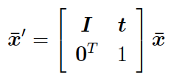
Translation
x’
y’
x
y
tx
ty
x’
y’
1 | 0 | tx
0 | 1 | ty
x
y
1
x’
y’
1
=
+
=
.
1 | 0 | tx
0 | 1 | ty
0 | 0 | 1
.
x
y
1
=

Slide 12
Rotation + Translation
2D Euclidean transformation
R: orthonormal rotation matrix

Slide 13
Scaled Rotation
Similarity transform

Slide 14
Affine
Parallel lines remain parallel under affine transformations.

Slide 15
Projective
Perspective transform
Perspective transformations preserve straight lines.

Slide 16
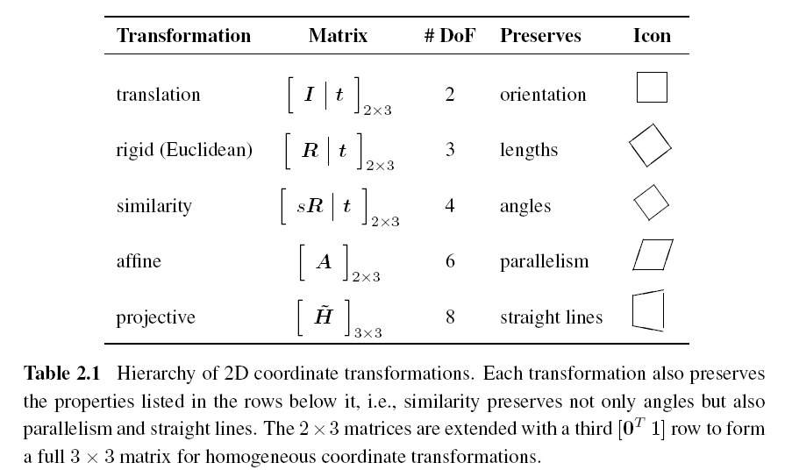

Slide 17
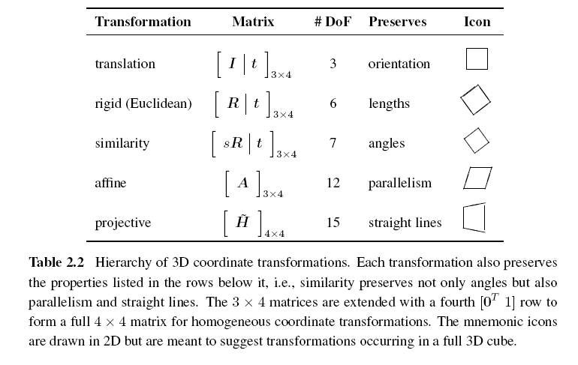
2.1.3 3D Transformations

Slide 18
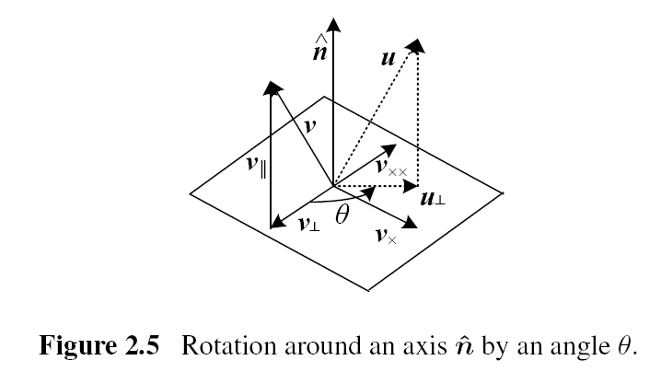
2.1.4 3D Rotations (1/2)
Axis/angle

Slide 19
2.1.4 3D Rotations (2/2)
Project the vector v onto the axis
Compute the perpendicular residual of v from

Slide 20
2.1.5 3D to 2D Projections
Drops the z component of the three-dimensional coordinate p to obtain the 2D point x.
Orthography and para-perspective
Scaled orthography

Slide 21
Perspective
Points are projected onto the image plane by dividing them by their z component.

Slide 22
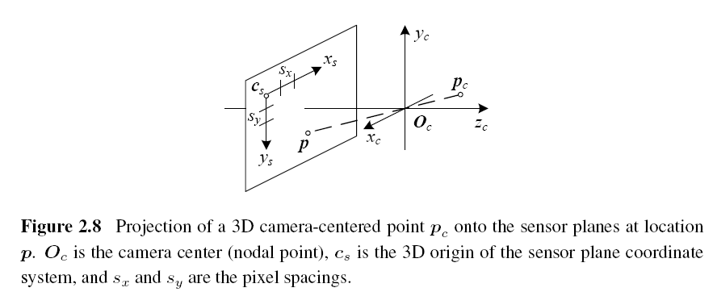
Camera Intrinsics (1/4)

Slide 23
Camera Intrinsics (2/4)
The combined 2D to 3D projection can then be written as
(x_{s}, y_{s}): pixel coordinates
(s_{x}, s_{y}): pixel spacings
c_{s}: 3D origin coordinate
R_{s}: 3D rotation matrix
M_{s}: sensor homography matrix

Slide 24
Camera Intrinsics (3/4)
K: calibration matrix
p_{w}: 3D world coordinates
P: camera matrix

Slide 25
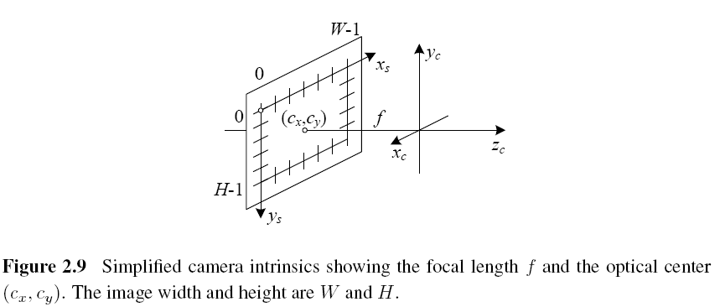
Camera Intrinsics (4/4)

Slide 26
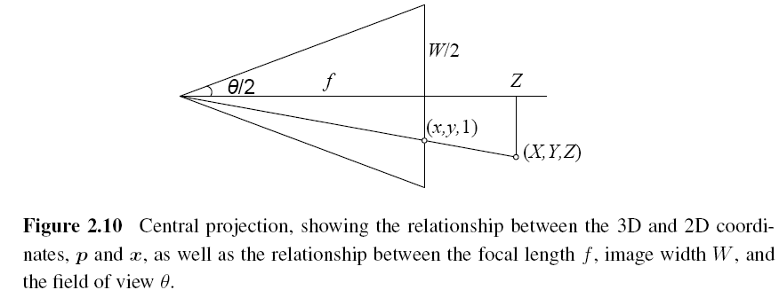
A Note on Focal Lengths

Slide 27
Camera Matrix
3×4 camera matrix

Slide 28
2.1.6 Lens Distortions (1/2)
Imaging models all assume that cameras obey a linear projection model where straight lines in the world result in straight lines in the image.
Many wide-angle lenses have noticeable radial distortion, which manifests itself as a visible curvature in the projection of straight lines.

Slide 29
2.1.6 Lens Distortions (2/2)

Slide 30
2.2 Photometric Image Formation
2.2.1 Lighting
To produce an image, the scene must be illuminated with one or more light sources.
A point light source originates at a single location in space (e.g., a small light bulb), potentially at infinity (e.g., the sun).
A point light source has an intensity and a color spectrum, i.e., a distribution over wavelengths L(λ).

Slide 31
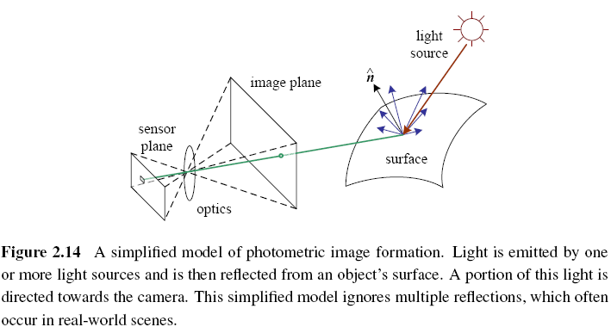

Slide 32
2.2.2 Reflectance and Shading
Bidirectional Reflectance Distribution Function (BRDF)
the angles of the incident and reflected directions relative to the surface frame

Slide 33
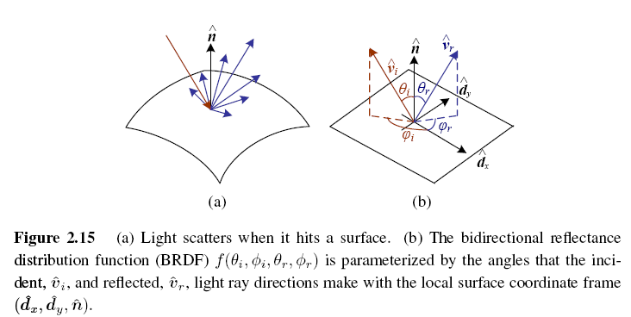

Slide 34
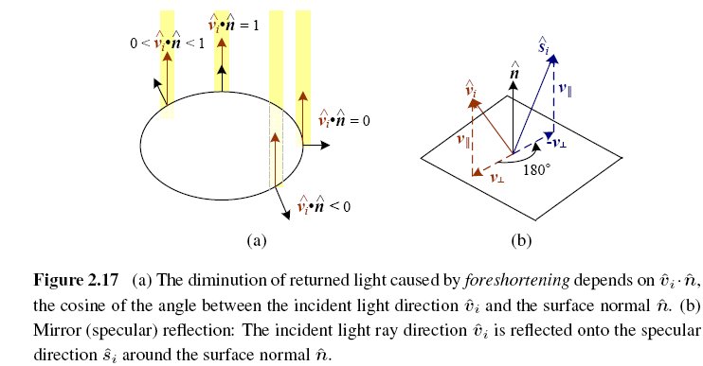
Diffuse Reflection vs. Specular Reflection (1/2)

Slide 35
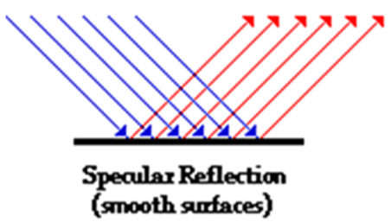
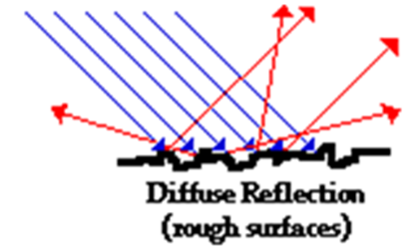
Diffuse Reflection vs. Specular Reflection (2/2)

Slide 36
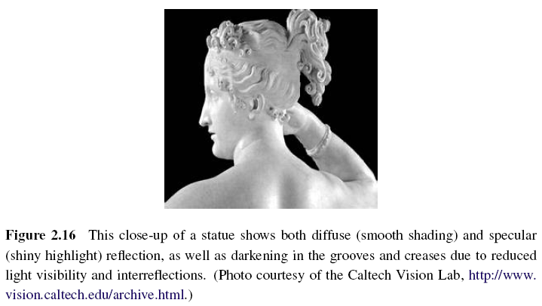

Slide 37
Phong Shading
Phong reflection is an empirical model of local illumination.
Combined the diffuse and specular components of reflection.
Objects are generally illuminated not only by point light sources but also by a diffuse illumination corresponding to inter-reflection (e.g., the walls in a room) or distant sources, such as the blue sky.

Slide 38
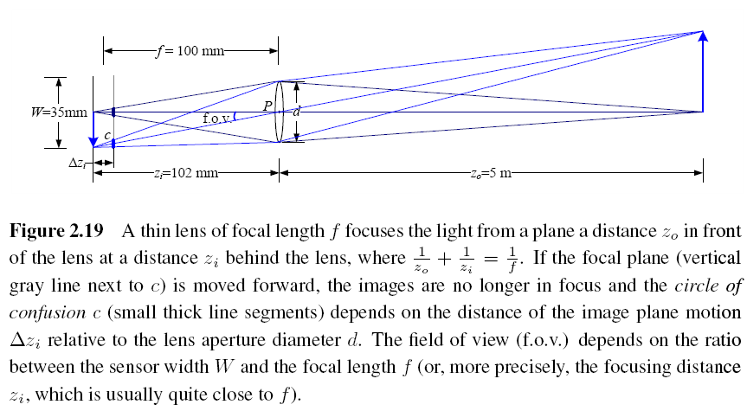
2.2.3 Optics

Slide 39
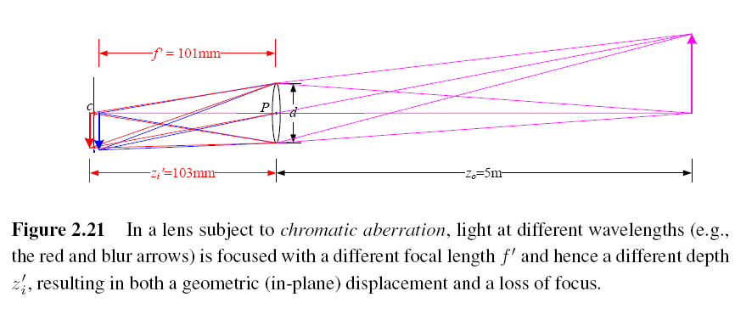
Chromatic Aberration
The tendency for light of different colors to focus at slightly different distances.

Slide 40
Vignetting
The tendency for the brightness of the image to fall off towards the edge of the image.

Slide 41
2.3 The Digital Camera
CCD: Charge-Coupled Device
CMOS: Complementary Metal-Oxide-Semiconductor
A/D: Analog-to-Digital Converter
DSP: Digital Signal Processor
JPEG: Joint Photographic Experts Group

Slide 42
Image Sensor (1/6)
CCD: Charge-Coupled Device
Photons are accumulated in each active well during the exposure time.
In a transfer phase, the charges are transferred from well to well in a kind of “bucket brigade” until they are deposited at the sense amplifiers, which amplify the signal and pass it to an Analog-to-Digital Converter (ADC).

Slide 43
Image Sensor (2/6)
CMOS: Complementary Metal-Oxide-Semiconductor
The photons hitting the sensor directly affect the conductivity of a photodetector, which can be selectively gated to control exposure duration, and locally amplified before being read out using a multiplexing scheme.

Slide 44
Image Sensor (3/6)
Shutter speed
The shutter speed (exposure time) directly controls the amount of light reaching the sensor and, hence, determines if images are under- or over-exposed.
Sampling pitch
The sampling pitch is the physical spacing between adjacent sensor cells on the imaging chip.

Slide 45
Image Sensor (4/6)
Fill factor
The fill factor is the active sensing area size as a fraction of the theoretically available sensing area (the product of the horizontal and vertical sampling pitches).
Chip size
Video and point-and-shoot cameras have traditionally used small chip areas(1/4-inch to 1/2-inch sensors).

Slide 46
Image Sensor (5/6)
Analog gain
Before analog-to-digital conversion, the sensed signal is usually boosted by a sense amplifier.
Sensor noise
Throughout the whole sensing process, noise is added from various sources, which may include fixed pattern noise, dark current noise, shot noise, amplifier noise and quantization noise.

Slide 47
Image Sensor (6/6)
ADC resolution
Resolution: how many bits it yields
noise level: how many of these bits are useful in practice
Digital post-processing
To enhance the image before compressing and storing the pixel values.

Slide 48
2.3.1 Sampling and Aliasing

Slide 49
Nyquist Frequency
The maximum frequency in a signal is known as the Nyquist frequency and the inverse of the minimum sampling frequency known as the Nyquist rate.

Slide 50
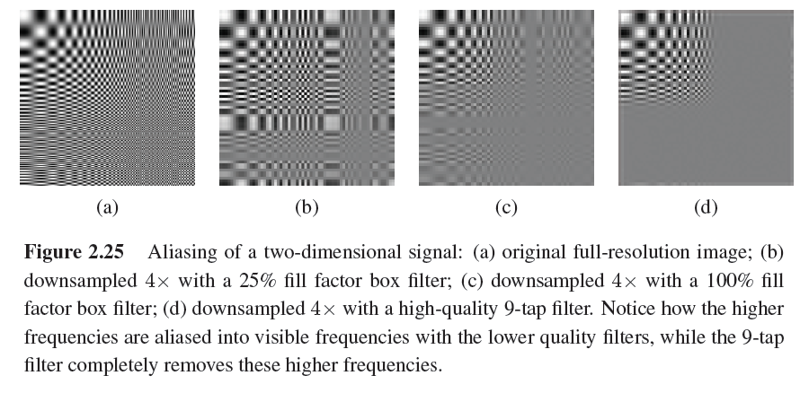

Slide 51
2.3.2 Color

Slide 52
CIE RGB
In the 1930s, the Commission Internationale d’Eclairage (CIE) standardized the RGB representation by performing such color matching experiments using the primary colors of red (700.0nm wavelength), green (546.1nm), and blue (435.8nm).
For certain pure spectra in the blue–green range, a negative amount of red light has to be added.

Slide 53
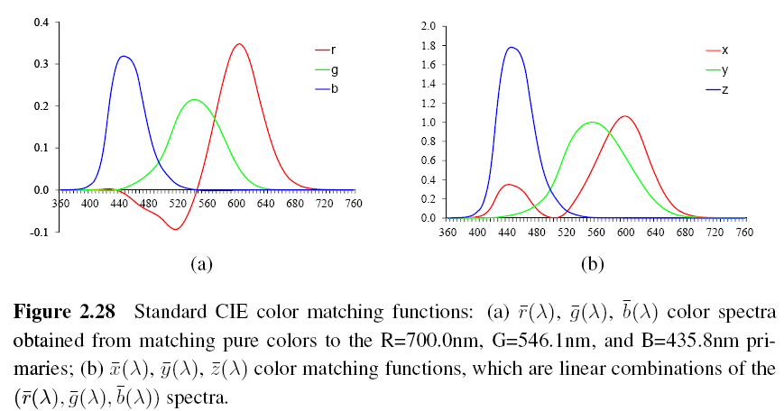

Slide 54
XYZ
The transformation from RGB to XYZ is given by
Chromaticity coordinates

Slide 55
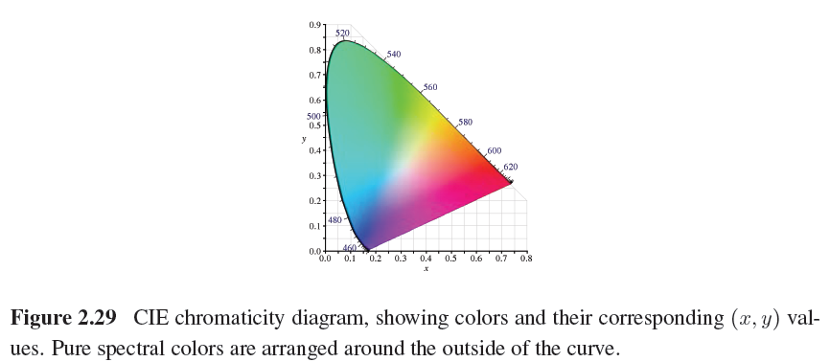

Slide 56
L*a*b* Color Space
CIE defined a non-linear re-mapping of the XYZ space called L*a*b* (also sometimes called CIELAB)
L*: lightness

Slide 57
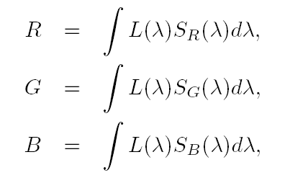
Color Cameras
Each color camera integrates light according to the spectral response function of its red, green, and blue sensors
L(λ): incoming spectrum of light at a given pixel
S_{R}(λ), S_{B} (λ), S_{G} (λ): the red, green, and blue spectral sensitivities of the corresponding sensors

Slide 58
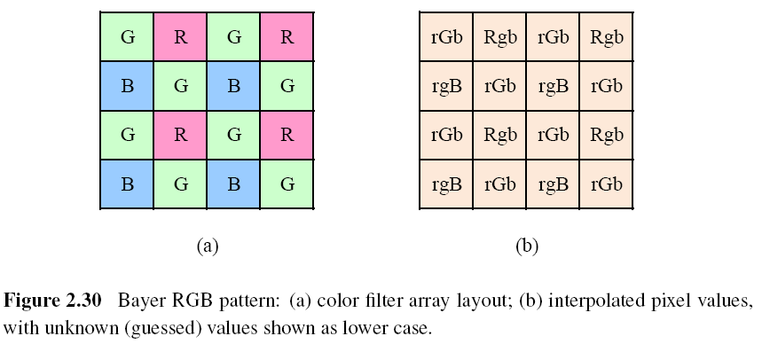
Color Filter Arrays

Slide 59
Bayer Pattern
Green filters over half of the sensors (in a checkerboard pattern), and red and blue filters over the remaining ones.
The reason that there are twice as many green filters as red and blue is because the luminance signal is mostly determined by green values and the visual system is much more sensitive to high frequency detail in luminance than in chrominance.
The process of interpolating the missing color values so that we have valid RGB values for all the pixels.

Slide 60
Color Balance (Auto White Balance)
Move the white point of a given image closer to pure white.
If the illuminant is strongly colored, such as incandescent indoor lighting (which generally results in a yellow or orange hue), the compensation can be quite significant.

Slide 61
Gamma (1/2)
The relationship between the voltage and the resulting brightness was characterized by a number called gamma (γ), since the formula was roughly
γ: 2.2

Slide 62
Gamma (2/2)
To compensate for this effect, the electronics in the TV camera would pre-map the sensed luminance Y through an inverse gamma
: 0.45

Slide 63
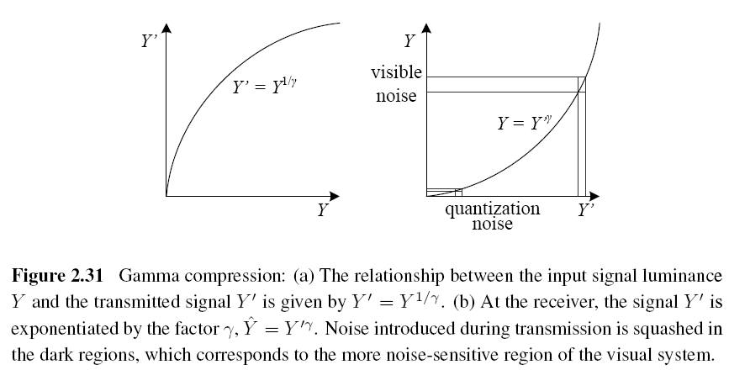

Slide 64
Other Color Spaces (1/3)
YCbCr
The Cb and Cr signals carry the blue and red color difference signals and have more useful mnemonics than UV.
: the triplet of gamma-compressed color components

Slide 65
Other Color Spaces (2/3)
JPEG standard uses the full eight-bit range with no reserved values
: the eight-bit gamma-compressed color components

Slide 66
Other Color Spaces (3/3)
HSV: hue, saturation, value
A projection of the RGB color cube onto a non-linear chroma angle, a radial saturation percentage, and a luminance-inspired value.

Slide 67
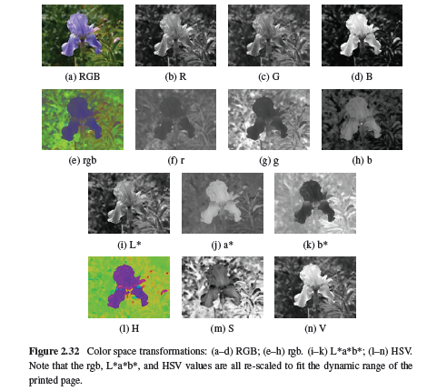

Slide 68
2.3.3 Compression (1/4)
All color video and image compression algorithms start by converting the signal into YCbCr (or some closely related variant), so that they can compress the luminance signal with higher fidelity than the chrominance signal.
In video, it is common to subsample Cb and Cr by a factor of two horizontally; with still images (JPEG), the subsampling (averaging) occurs both horizontally and vertically.

Slide 69
2.3.3 Compression (2/4)
Once the luminance and chrominance images have been appropriately subsampled and separated into individual images, they are then passed to a block transform stage.
The most common technique used here is the Discrete Cosine Transform (DCT), which is a real-valued variant of the Discrete Fourier Transform (DFT).

Slide 70
2.3.3 Compression (3/4)
After transform coding, the coefficient values are quantized into a set of small integer values that can be coded using a variable bit length scheme such as a Huffman code or an arithmetic code.

Slide 71
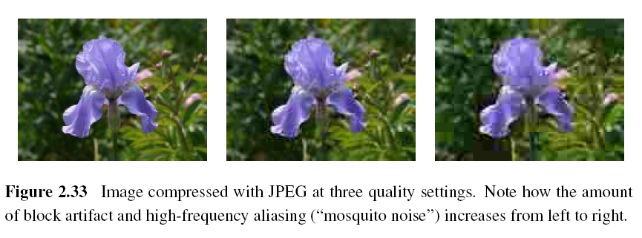
2.3.3 Compression (4/4)
JPEG (Joint Photographic Experts Group)

Slide 72
PSNR (Peak Signal-to-Noise Ratio)
The quality of a compression algorithm

Slide 73
Project due March 29
Camera calibration i.e. compute #pixels/mm object displacement
Use lens of focal length: 16mm, 25mm, 55mm
Object displacement of: 1mm, 5mm, 10mm, 20mm
Object distance of: 0.5m, 1m, 2m
Camera parameters: 8.8mm * 6.6mm ==> 512*485 pixels
Are pixels square or rectangular?

Slide 74
Calculate theoretical values and compare with measured values.
Calculate field of view in degrees of angle.

