Slide 1
Advanced Computer Vision
Chapter 3
Image Processing
Presented by: 傅楸善 & 李祐賢
0983868080
ab122858280@gmail.com

Slide 2
Image Processing
3.1 Point Operators
3.2 Linear Filtering
3.3 More Neighborhood Operators
3.4 Fourier Transforms
3.5 Pyramids and Wavelets
3.6 Geometric Transformations
3.7 Global Optimization
Notes:
點運算子

Slide 3
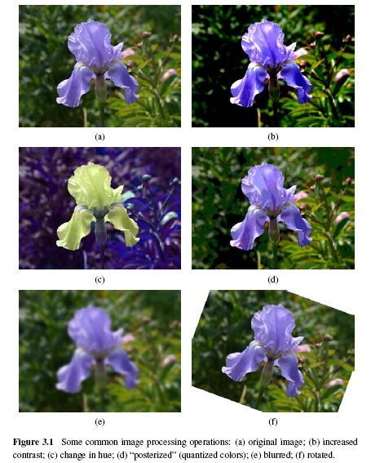

Slide 4
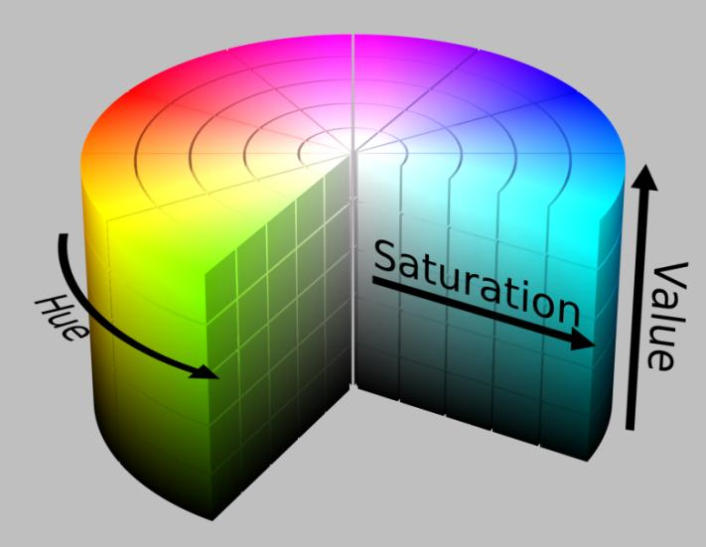

Slide 5
3.1.1 Pixel Transforms (1/3)
x is in the D-dimensional domain of the functions (usually D = 2 for images) and the functions f and g operate over some range, which can either be scalar or vector-valued, e.g., for color images or 2D motion.
For discrete images, the domain consists of a finite number of pixel locations, x = (i, j), and we can write

Slide 6
3.1.1 Pixel Transforms (2/3)
Multiplication and addition with a constant
The parameters a > 0 and b are often called the gain and bias parameters.
The bias and gain parameters can also be spatially varying.

Slide 7
3.1.1 Pixel Transforms (3/3)
Multiplicative gain is a linear operation
Dyadic (two-input) operator is the linear blend operator
Non-linear transform: gamma correction

Slide 8
3.1.2 Color Transforms
In fact, adding the same value to each color channel not only increases the apparent intensity of each pixel, it can also affect the pixel’s hue and saturation.

Slide 9
3.1.3 Compositing and Matting (1/4)
In many photo editing and visual effects applications, it is often desirable to cut a foreground object out of one scene and put it on top of a different background.
The process of extracting the object from the original image is often called matting, while the process of inserting it into another image (without visible artifacts) is called compositing.

Slide 10
3.1.3 Compositing and Matting (2/4)
Alpha-matted color image
In addition to the three color RGB channels, an alpha-matted image contains a fourth alpha channel α (or A) that describes the relative amount of opacity or fractional coverage at each pixel.
Pixels within the object are fully opaque (α= 1), while pixels fully outside the object are transparent (α= 0).

Slide 11
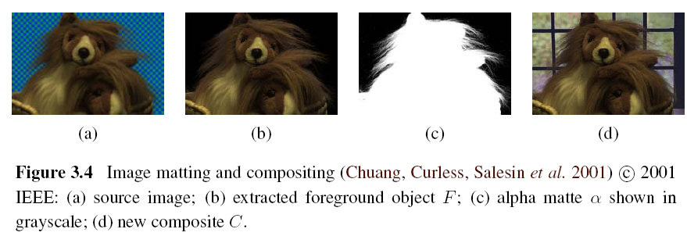
3.1.3 Compositing and Matting (3/4)

Slide 12
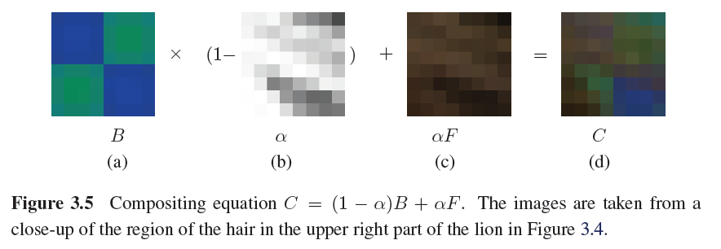
3.1.3 Compositing and Matting (4/4)

Slide 13
3.1.4 Histogram Equalization
To find an intensity mapping function f(I) such that the resulting histogram is flat
h(I): original histogram
c(I): cumulative distribution
N: the number of pixels in the image
A linear blend between the cumulative distribution function and the identity transform

Slide 14
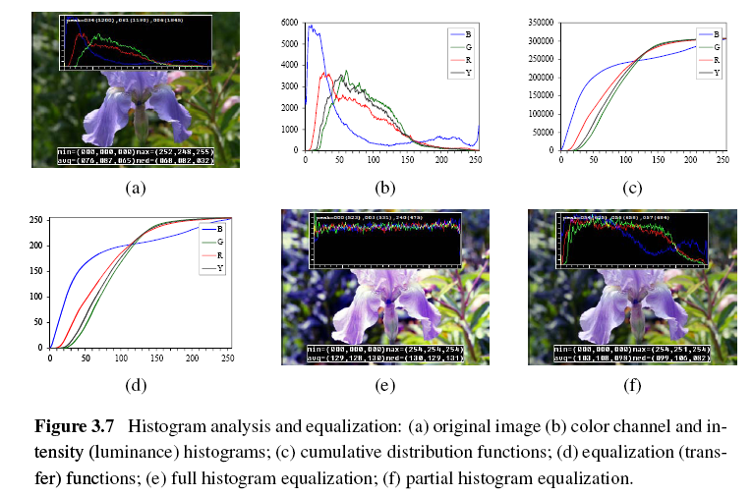

Slide 15
Locally Adaptive Histogram Equalization (1/4)
Subdivide the image into M×M pixel blocks and perform separate histogram equalization in each sub-block.
But the resulting image exhibits a lot of blocking artifacts, i.e., intensity discontinuities at block boundaries.

Slide 16
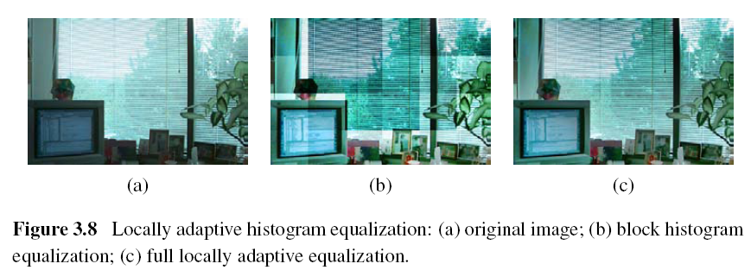

Slide 17
Locally Adaptive Histogram Equalization (2/4)
One way to eliminate blocking artifacts is to use a moving window, i.e., to recompute the histogram for every M×M block centered at each pixel.
A more efficient approach is to compute non-overlapped block-based equalization functions as before, but to then smoothly interpolate the transfer functions as we move between blocks. This technique is known as adaptive histogram equalization (AHE).

Slide 18
Locally Adaptive Histogram Equalization (3/4)
Adaptive Histogram Equalization (AHE)
The weighting function for a given pixel (i, j) can be computed as a function of its horizontal and vertical position (s, t) within a block.
To blend the four lookup {f₀₀,…,f₁₁}, a bilinear blending function

Slide 19
Locally Adaptive Histogram Equalization (4/4)
A variant on this algorithm is to place the lookup tables at the corners of each M×M block.
In addition to blending four lookups to compute the final value, we can also distribute each input pixel into four adjacent lookup tables during the histogram accumulation phase.

Slide 20
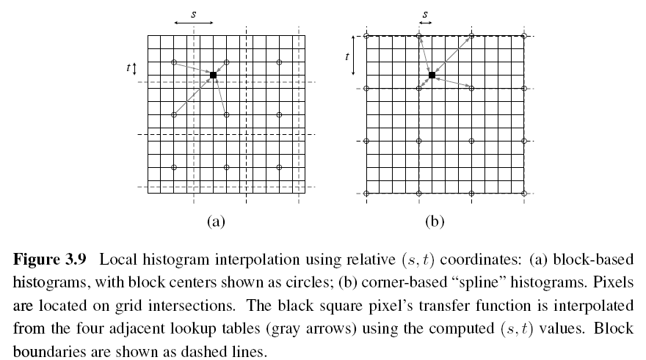

Slide 21
Image Processing
3.1 Point Operators
3.2 Linear Filtering
3.3 More Neighborhood Operators
3.4 Fourier Transforms
3.5 Pyramids and Wavelets
3.6 Geometric Transformations
3.7 Global Optimization

Slide 22
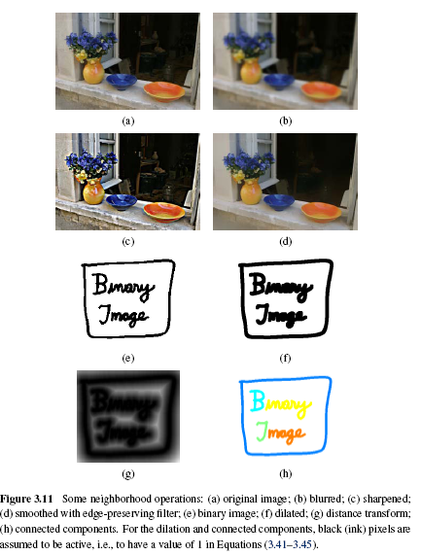

Slide 23
3.2 Linear Filtering
An output pixel’s value is determined as a weighted sum of input pixel values.

Slide 24
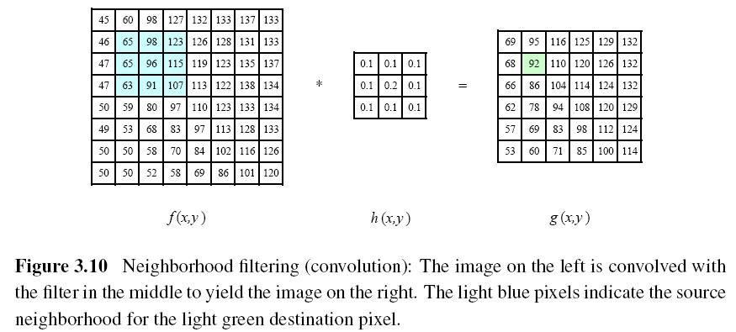
Notes:
92 = 65*0.1 + 98*0.1 + 123*0.1 + 65*0.1 + 96*0.2 + 115*0.1 + 63*0.1 + 91*0.1 + 107*0.1

Slide 25
A one-dimensional convolution can be represented in matrix-vector form.

Slide 26
Padding (Border Effects)
zero: set all pixels outside the source image to 0.
constant (border color): set all pixels outside the source image to a specified border value.
clamp (replicate or clamp to edge): repeat edge pixels indefinitely
(cyclic) wrap (repeat or tile): loop “around” the image in a toroidal configuration
mirror: reflect pixels across the image edge
extend: extend the signal by subtracting the mirrored version of the signal from the edge pixel value

Slide 27
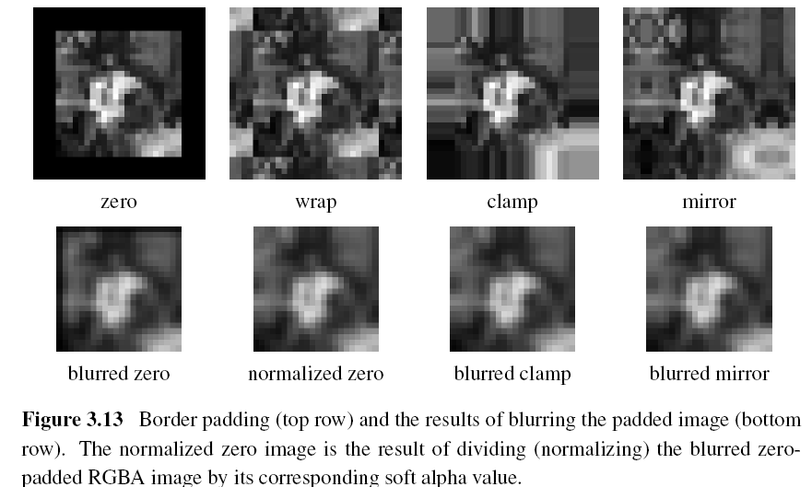

Slide 28
3.2.1 Separable Filtering (1/2)
The process of performing a convolution requires K² operations per pixel, where K is the size (width or height) of the convolution kernel.
This operation can be significantly sped up by first performing a one-dimensional horizontal convolution followed by a one-dimensional vertical convolution (which requires a total of 2K operations per pixel).

Slide 29
3.2.1 Separable Filtering (2/2)
It is easy to show that the two-dimensional kernel K corresponding to successive convolution with a horizontal kernel h and a vertical kernel v is the outer product of the two kernels,

Slide 30
3.2.2 Examples of Linear Filtering
The simplest filter to implement is the moving average or box filter, which simply averages the pixel values in a K×K window.

Slide 31
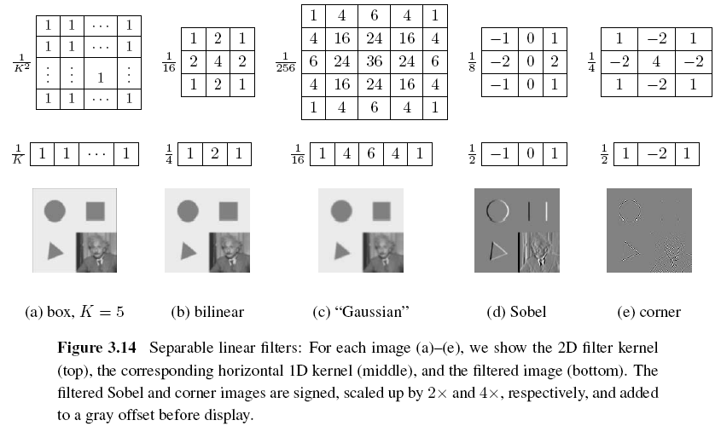

Slide 32
3.2.3 Band-Pass and Steerable Filters (1/4)
The Sobel and corner operators are simple examples of band-pass and oriented filters.
More sophisticated kernels can be created by first smoothing the image with a Gaussian filter, and then taking the first or second derivatives.
Such filters are known collectively as band-pass filters, since they filter out both low and high frequencies.

Slide 33
3.2.3 Band-Pass and Steerable Filters (2/4)
The (undirected) second derivative of a two-dimensional image is known as the Laplacian operator.
Blurring an image with a Gaussian and then taking its Laplacian is equivalent to convolving directly with the Laplacian of Gaussian (LoG) filter.

Slide 34
3.2.3 Band-Pass and Steerable Filters (3/4)
The Sobel operator is a simple approximation to a directional or oriented filter, which can be obtained by smoothing with a Gaussian (or some other filter) and then taking a directional derivative , which is obtained by taking the dot product between the gradient field and a unit direction

Slide 35
3.2.3 Band-Pass and Steerable Filters (4/4)
The smoothed directional derivative filter,
is an example of a steerable filter, since the value of an image convolved with can be computed by first convolving with the pair of filters (G_{x}, G_{y}) and then steering the filter by multiplying this gradient field with a unit vector

Slide 36
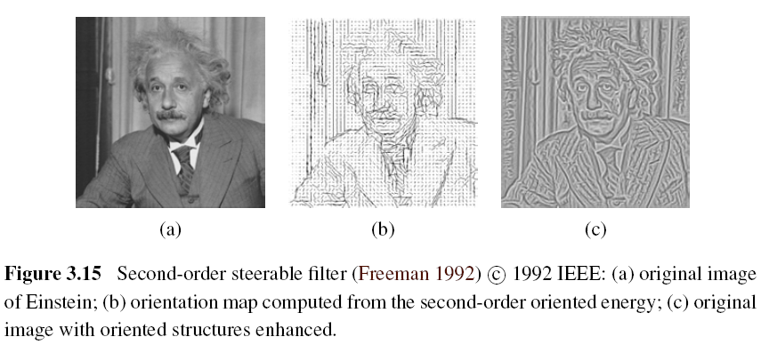

Slide 37
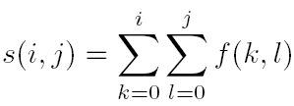
Summed Area Table (Integral Image)
To find the summed area (integral) inside a rectangle[i₀, i₁] ×[j₀, j₁], we simply combine four samples from the summed area table,

Slide 38
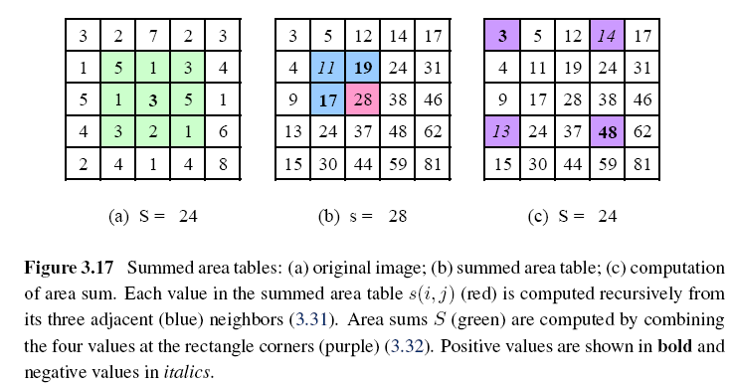

Slide 39
Image Processing
3.1 Point Operators
3.2 Linear Filtering
3.3 More Neighborhood Operators
3.4 Fourier Transforms
3.5 Pyramids and Wavelets
3.6 Geometric Transformations
3.7 Global Optimization

Slide 40
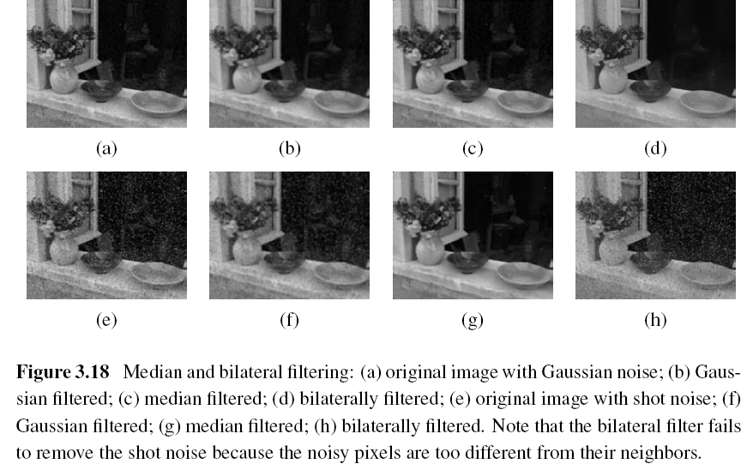
3.3 More Neighborhood Operators

Slide 41
3.3.1 Non-Linear Filtering
Median filtering: selects the median value from each pixel’s neighborhood.
α-trimmed mean: averages together all of the pixels except for the α fraction that are the smallest and the largest.
Weighted median: each pixel is used a number of times depending on its distance from the center.

Slide 42
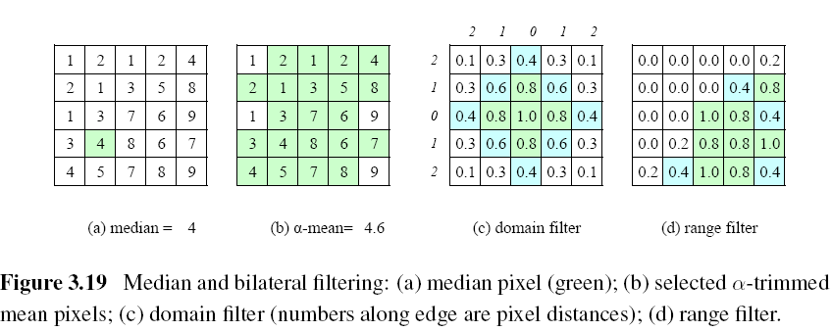

Slide 43
Bilateral Filtering
The output pixel value depends on a weighted combination of neighboring pixel values
w(i, j, k, l): bilateral weight function, which is depends on the product of a domain kernel and a data-dependent range kernel.

Slide 44
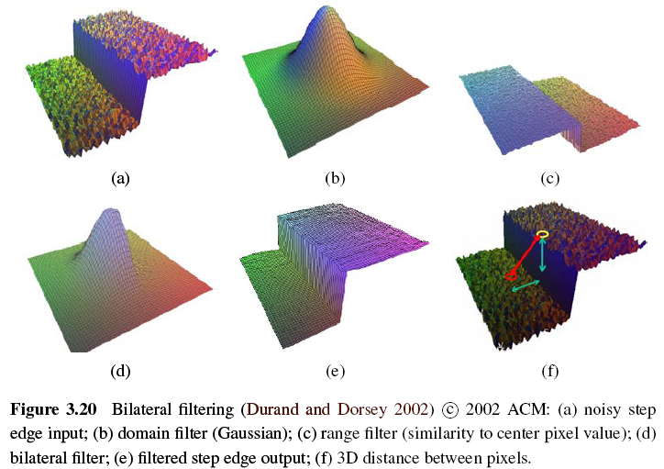

Slide 45
3.3.2 Morphology (1/3)
Such images often occur after a thresholding operation,
We first convolve the binary image with a binary structuring element and then select a binary output value depending on the thresholded result of the convolution.

Slide 46
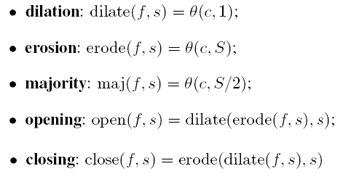
3.3.2 Morphology (2/3)
c: count of the number of 1s inside each structuring element as it is scanned over the image
s: structuring element
S: the size of the structuring element

Slide 47
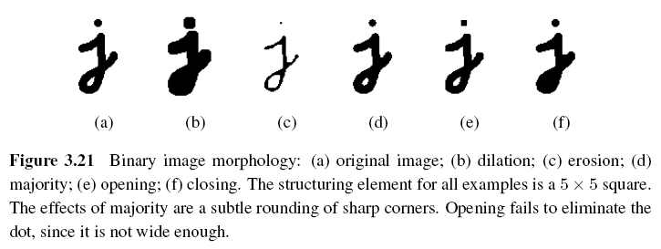
3.3.2 Morphology (3/3)

Slide 48
3.3.3 Distance Transforms
City block or Manhattan distance
Euclidean distance
The distance transform is then defined as

Slide 49
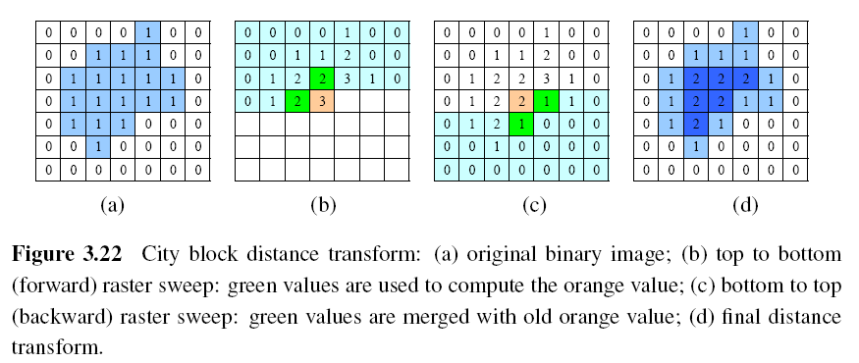
During the forward pass, each non-zero pixel is replaced by the minimum of 1 + the distance of its north or west neighbor.
During the backward pass, the same occurs.

Slide 50
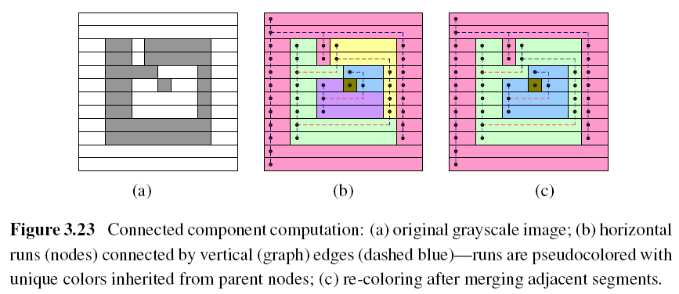
3.3.4 Connected Components (1/2)

Slide 51
3.3.4 Connected Components (2/2)
The area (number of pixels)
The perimeter (number of boundary pixels)
The centroid (average x and y values)

Slide 52
Image Processing
3.1 Point Operators
3.2 Linear Filtering
3.3 More Neighborhood Operators
3.4 Fourier Transforms
3.5 Pyramids and Wavelets
3.6 Geometric Transformations
3.7 Global Optimization

Slide 53
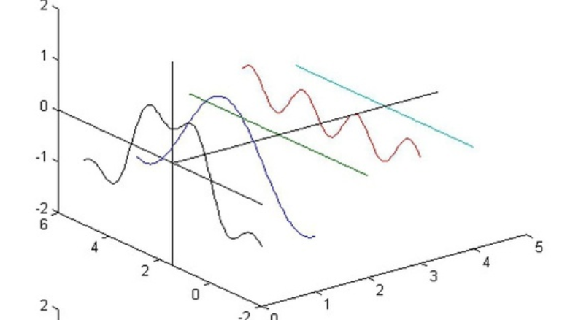
3.4 Fourier Transforms
相關連結

Slide 54
3.4 Fourier Transforms

Slide 55
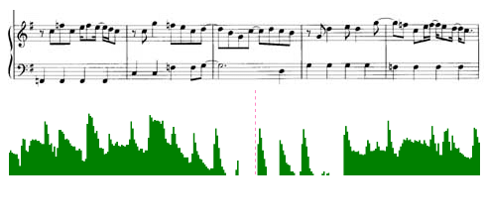
3.4 Fourier Transforms

Slide 56
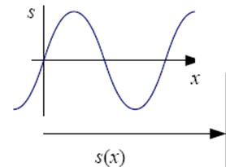
3.4 Fourier Transforms (1/5)
f: frequency
: angular frequency
: phase
A: the gain or magnitude of the filter

Slide 57
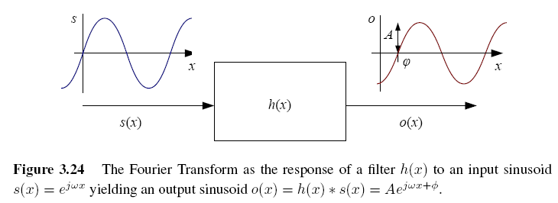
3.4 Fourier Transforms (2/5)

Slide 58
3.4 Fourier Transforms (3/5)
The Fourier transform is simply a tabulation of the magnitude and phase response at each frequency
Fourier transform pair:
Continuous domain:
Discrete domain:

Slide 59
3.4 Fourier Transforms (4/5)
Discrete Fourier Transform: O(N²)
Fast Fourier Transform: O(N logN)

Slide 60
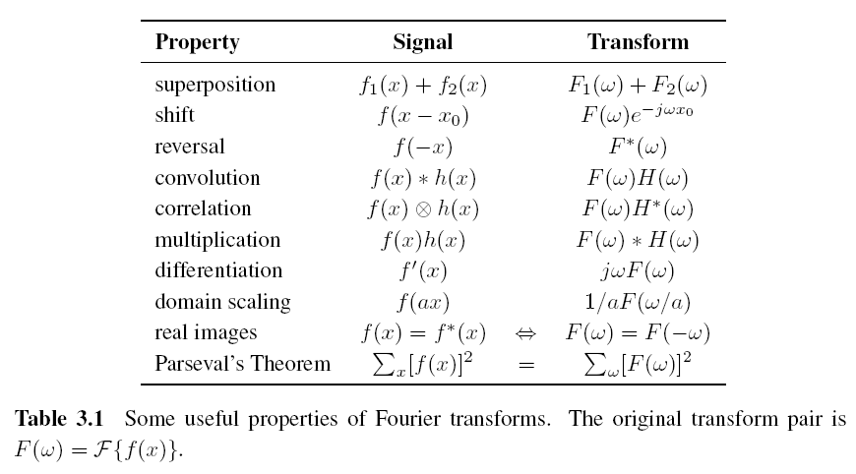
3.4 Fourier Transforms (5/5)

Slide 61
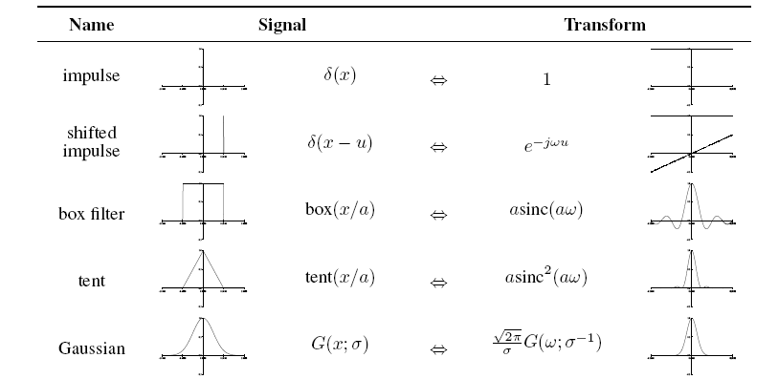
3.4.1 Fourier Transform Pairs

Slide 62
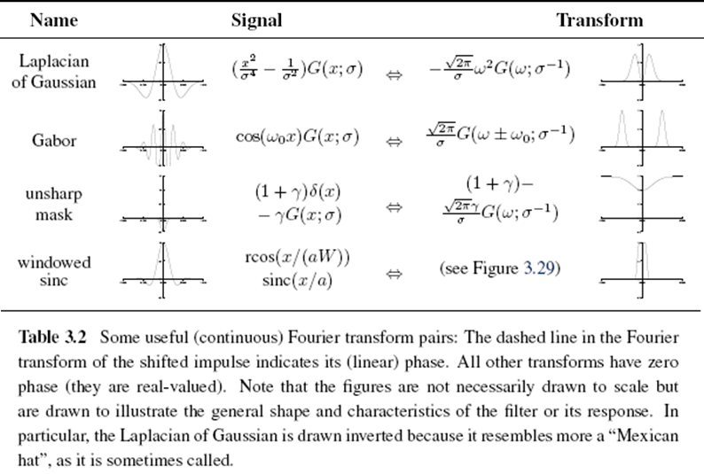

Slide 63
3.4 Fourier Transforms
We use Fourier Transforms to analyze what a given filter does to high, medium, and low frequencies.

Slide 64
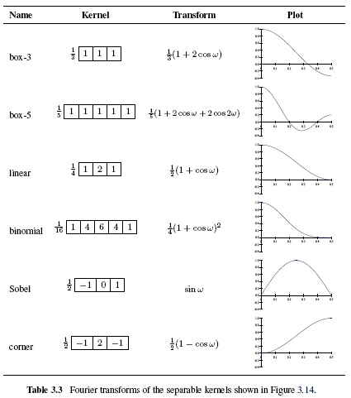

Slide 65
3.4.2 Two-Dimensional Fourier Transforms
Continuous domain:
Discrete domain:

Slide 66
Discrete Cosine Transform
The one-dimensional DCT is computed by taking the dot product of each N-wide block of pixels with a set of cosines of different frequencies,
The two-dimensional version of the DCT is
Like the FFT, each of the DCTs can also be computed in O(N logN) time.

Slide 67
Discrete Cosine Transform

Slide 68
Discrete Cosine Transform

Slide 69
Discrete Cosine Transform

Slide 70
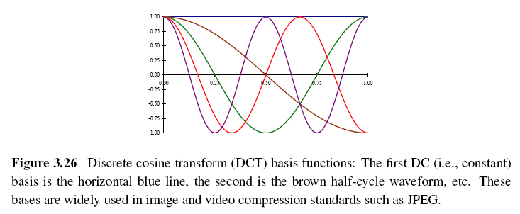
The first basis function (the straight blue line) encodes the average DC value in the block of pixels, while the second encodes a slightly curvy version of the slope.
https://www.youtube.com/watch?v=Q2aEzeMDHMA&t=695s

Slide 71
Image Processing
3.1 Point Operators
3.2 Linear Filtering
3.3 More Neighborhood Operators
3.4 Fourier Transforms
3.5 Pyramids and Wavelets
3.6 Geometric Transformations
3.7 Global Optimization

Slide 72
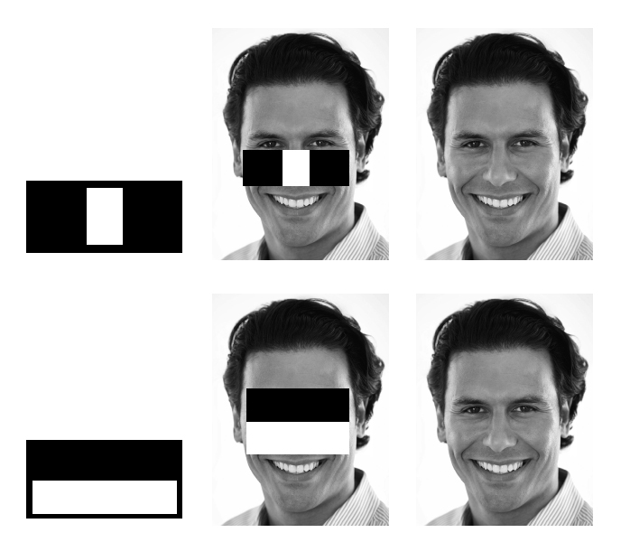
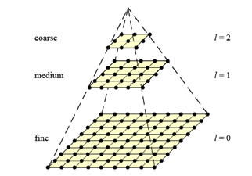
3.5 Pyramids and Wavelets
We may want to reduce the size of an image to speed up the execution of an algorithm .

Slide 73
3.5 Pyramids and Wavelets
A pyramid can also be very helpful in accelerating the search for an object by first finding a smaller instance of that object at a coarser level of the pyramid and then looking for the full resolution object only in the vicinity of coarse-level detections
Image pyramids are extremely useful for performing multi-scale editing operations such as blending images while maintaining details.

Slide 74
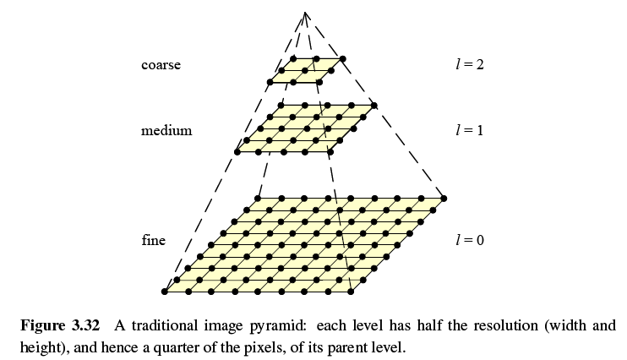

Slide 75
3.5.1 Interpolation (Upsampling)
Interpolation can be used to increase the resolution of an image.
r: upsampling rate.

Slide 76
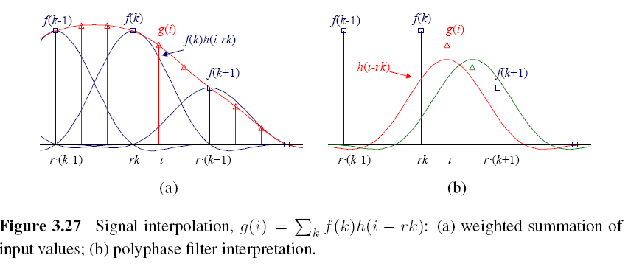

Slide 77
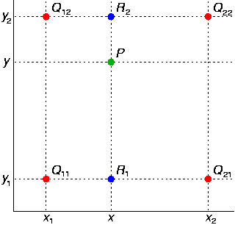
Bilinear Interpolation

Slide 78
Cubic Interpolation
Bicubic interpolation
Is an extension of cubic interpolation for interpolating data points on a two dimensional regular grid.
The interpolated surface is smoother than corresponding surfaces obtained by bilinear interpolation.

Slide 79
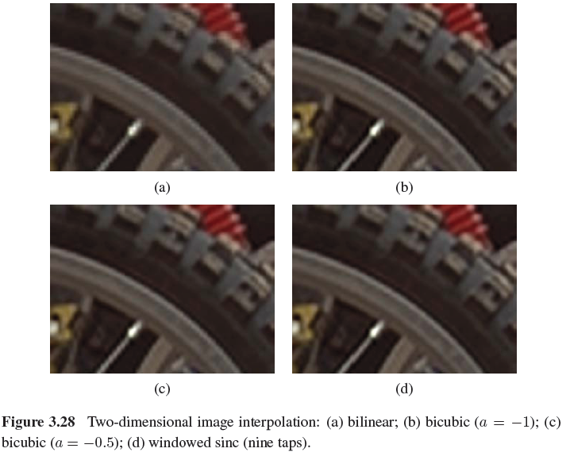

Slide 80
3.5.2 Decimation (Downsampling)
Decimation is required to reduce the resolution.
To perform decimation, we first convolve the image with a low-pass filter (to avoid aliasing) and then keep every rth sample.
h(k,l): smoothing kernel

Slide 81
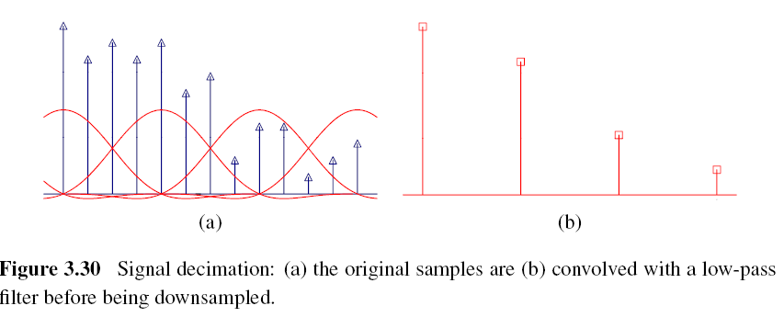

Slide 82
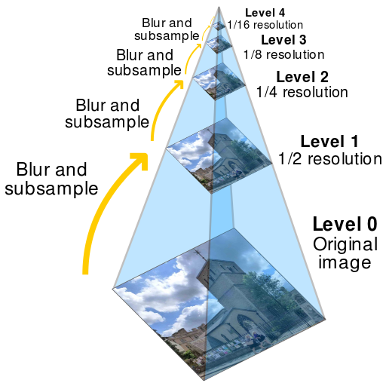
3.5.3 Multi-Resolution Representations
To construct the pyramid, we first blur and subsample the original image by a factor of two and store this in the next level of the pyramid.

Slide 83
Gaussian Pyramid
The technique involves creating a series of images which are weighted down using a Gaussian average and scaled down.
Five-tap kernel:
, a: 0.3~0.6

Slide 84
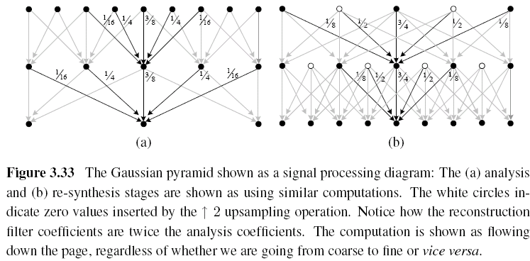

Slide 85
3.5.4 Wavelets
Two-dimensional wavelets
The high-pass filter followed by decimation keeps 3/4 of the original pixels, while 1/4 of the low-frequency coefficients are passed on to the next stage for further analysis.
The resulting three wavelet images are called the high–high (HH), high–low (HL), and low–high (LH) images.
The HL and LH images accentuate the horizontal and vertical edges and gradients, while the HH image contains the less frequently occurring mixed derivatives.

Slide 86
3.5.4 Wavelets

Slide 87
3.5.4 Wavelets
https://www.youtube.com/watch?v=f1AzPyGl7kI

Slide 88
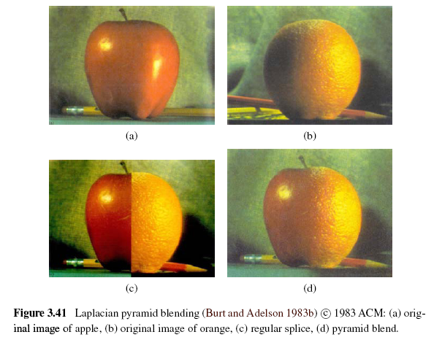
Image Blending

Slide 89
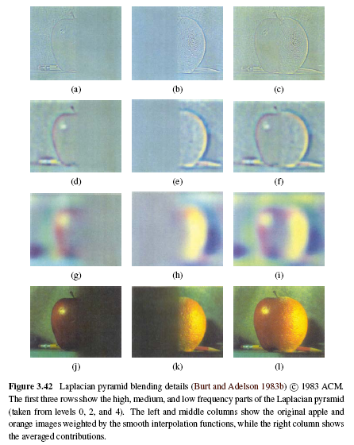
The key point is low-frequency color variations between the red apple and the orange are smoothly blended, while the higher-frequency textures on each fruit are blended more quickly to avoid “ghoasting” effects when two text are overlaid.

Slide 90
Image Processing
3.1 Point Operators
3.2 Linear Filtering
3.3 More Neighborhood Operators
3.4 Fourier Transforms
3.5 Pyramids and Wavelets
3.6 Geometric Transformations
3.7 Global Optimization

Slide 91
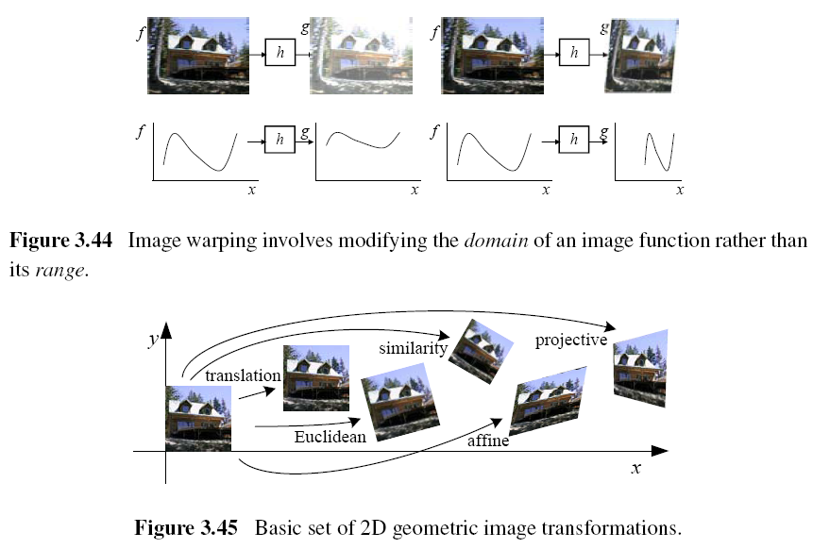
3.6 Geometric Transformations

Slide 92
3.6.1 Parametric Transformations
Parametric transformations apply a global deformation to an image, where the behavior of the transformation is controlled by a small number of parameters.

Slide 93
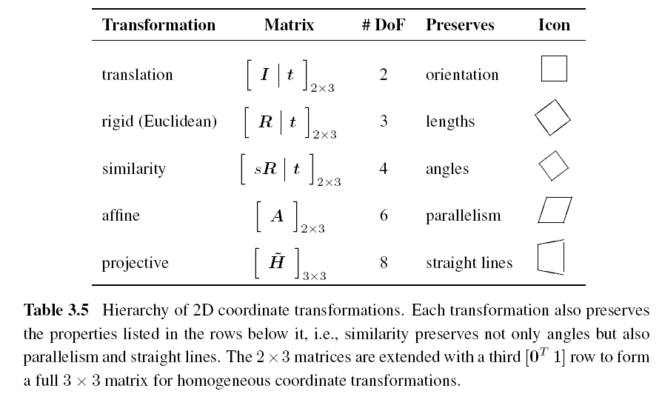
3.6.1 Parametric Transformations

Slide 94
Forward Warping
The process of copying a pixel f(x) to a location in g is not well defined when has a non-integer value.
You can round the value of to the nearest integer coordinate and copy the pixel there, but the resulting image has severe aliasing and pixels that jump around a lot when animating the transformation.
The second major problem with forward warping is the appearance of cracks and holes, especially when magnifying an image.

Slide 95
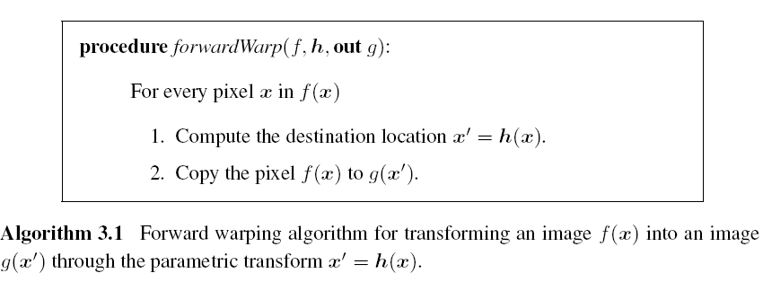
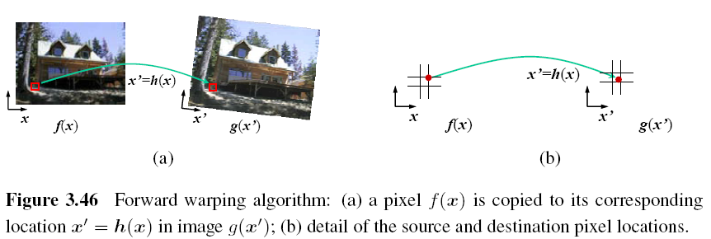

Slide 96
Inverse Warping
is (presumably) defined for all pixels in , we no longer have holes.
can simply be computed as the inverse of
In fact, all of the parametric transforms listed in Table 3.5 have closed form solutions for the inverse transform: simply take the inverse of the 3×3 matrix specifying the transform.

Slide 97
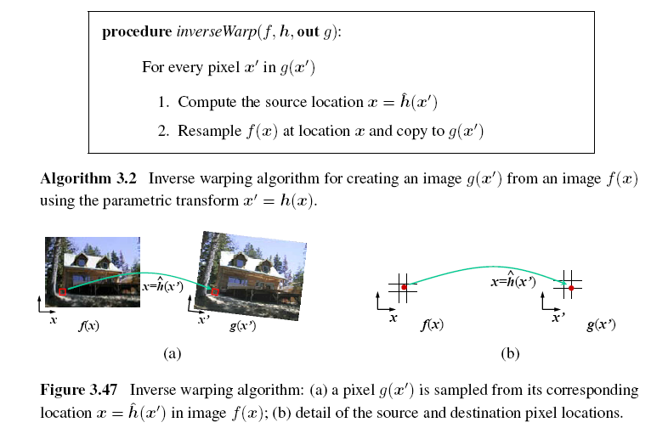

Slide 98
MIP-Mapping (1/3)
MIP-mapping was first proposed by Williams (1983) as a means to rapidly pre-filter images being used for texture mapping in computer graphics.
A MIP-map is a standard image pyramid, where each level is pre-filtered with a high-quality filter rather than a poorer quality approximation, such as five-tap binomial.

Slide 99
MIP-Mapping (2/3)
To resample an image from a MIP-map, a scalar estimate of the resampling rate r is first computed.
For example, r can be the maximum of the absolute values in A (which suppresses aliasing) or it can be the minimum (which reduces blurring).
Once a resampling rate has been specified, a fractional pyramid level is computed using the base 2 logarithm,

Slide 100
MIP-Mapping (3/3)
One simple solution is to resample the texture from the next higher or lower pyramid level, depending on whether it is preferable to reduce aliasing or blur.
A better solution is to resample both images and blend them linearly using the fractional component of l.
Since most MIP-map implementations use bilinear resampling within each level, this approach is usually called trilinear MIP-mapping.

Slide 101
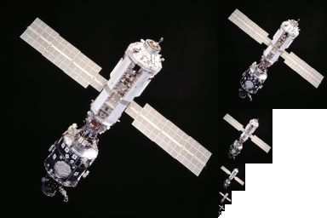
An example of MIP-mapping image storage: the principal image on the left is accompanied by filtered copies of reduced size.
https://zh.wikipedia.org/wiki/Mipmap

Slide 102
3.6.2 Mesh-Based Warping (1/3)
While parametric transforms specified by a small number of global parameters have many uses, local deformations with more degrees of freedom are often required.
Different amounts of motion are required in different parts of the image.

Slide 103
3.6.2 Mesh-Based Warping (2/3)
The first approach, is to specify a sparse set of corresponding points. The displacement of these points can then be interpolated to a dense displacement field.
A second approach to specifying displacements for local deformations is to use corresponding oriented line segments.

Slide 104
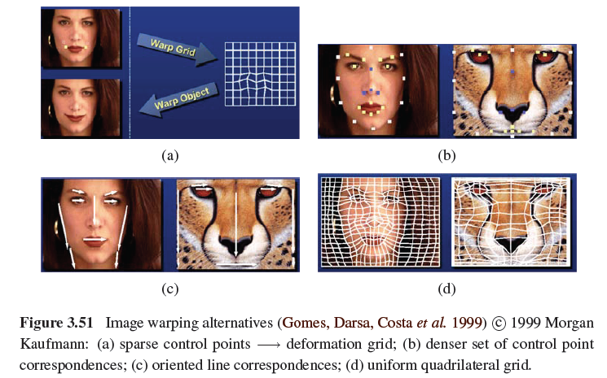
3.6.2 Mesh-Based Warping (3/3)

Slide 105
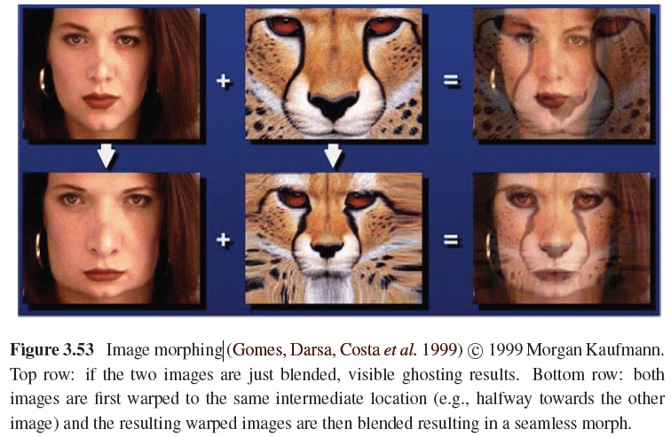

Slide 106
Image Processing
3.1 Point Operators
3.2 Linear Filtering
3.3 More Neighborhood Operators
3.4 Fourier Transforms
3.5 Pyramids and Wavelets
3.6 Geometric Transformations
3.7 Global Optimization

Slide 107
3.7 Global Optimization
Regularization (variational methods)
Constructs a continuous global energy function that describes the desired characteristics of the solution and then finds a minimum energy solution using sparse linear systems or related iterative techniques.
Markov random field
Using Bayesian statistics, modeling both the noisy measurement process that produced the input images as well as prior assumptions about the solution space.

Slide 108
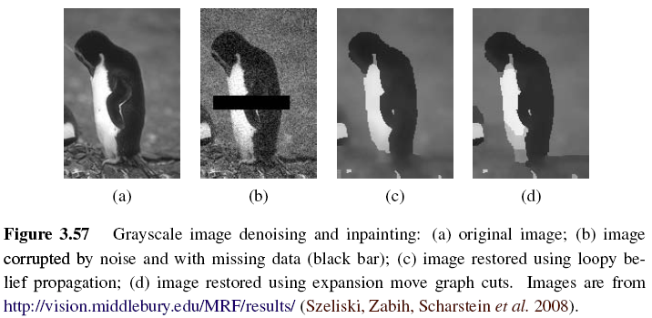

Slide 109
3.7.1 Regularization (1/6)

Slide 110
3.7.1 Regularization (2/6)
Finding a smooth surface that passes through (or near) a set of measured data points.
Such a problem is described as ill-posed because many possible surfaces can fit this data.
Since small changes in the input can sometimes lead to large changes in the fit, such problems are also often ill-conditioned.

Slide 111
3.7.1 Regularization (3/6)
Since we are trying to recover the unknown function f(x, y) from which the data point
d(x_{i}, y_{i}) were sampled, such problems are also often called inverse problems.
Many computer vision tasks can be viewed as inverse problems, since we are trying to recover a full description of the 3D world from a limited set of images.

Slide 112
3.7.1 Regularization (4/6)
In order to quantify what it means to find a smooth solution, we can define a norm on the solution space.
For one-dimensional functions f(x), we can integrate the squared first derivative of the function,
or perhaps integrate the squared second derivative,

Slide 113
3.7.1 Regularization (5/6)
In two dimensions, the corresponding smoothness functionals are
The first derivative norm is often called the membrane, since interpolating a set of data points using this measure results in a tent-like structure.
The second-order norm is called the thin-plate spline, since it approximates the behavior of thin plates (e.g., flexible steel) under small deformations.

Slide 114
3.7.1 Regularization (6/6)
For scattered data interpolation, the data term measures the distance between the function f(x, y) and a set of data points d_{i} =d(x_{i} , y_{i})
To obtain a global energy that can be minimized, the two energy terms are usually added together,

Slide 115
3.7.2 Markov Random Fields (1/3)
The posterior distribution for a given set of measurements y, combined with a prior p(x) over the unknowns x, is given by
Negative posterior log likelihood.

Slide 116
3.7.2 Markov Random Fields (2/3)
To find the most likely (maximum a posteriori or MAP) solution x given some measurements y, we simply minimize this negative log likelihood, which can also be thought of as an energy,
E_{d}(x, y) is the data energy or data penalty
E_{p}(x) is the prior energy

Slide 117
3.7.2 Markov Random Fields (3/3)
For image processing applications, the unknowns x are the set of output pixels
The data are (in the simplest case) the input pixels

Slide 118
Binary MRFs
The simplest possible example of a Markov random field is a binary field.
Examples of such fields include 1-bit (black and white) scanned document images as well as images segmented into foreground and background regions.

Slide 120
Ordinal-Valued MRFs
In addition to binary images, Markov random fields can be applied to ordinal-valued labels such as grayscale images or depth maps.
The term “ordinal” indicates that the labels have an implied ordering, e.g., that higher values are lighter pixels.

Slide 121
Unordered Labels

Slide 122
Term Project
Tentative term project problems: Exercises in textbook, (30%) total grade:
Submit one page in English explaining method, steps, expected results
Submit report in a month: April 12
Report progress every other week
All right to be the same problem with Master’s thesis

Slide 123
Objective: a working prototype with new, original, novel ideas
Objective: not just literature survey
Objective: not just straightforward implementation of existing algorithms
Objective: all right to modify existing algorithms

