Slide 1
Advanced Computer Vision
Chapter 7
STRUCTURE FROM MOTION
Presented by
Prof. Chiou-Shann Fuh & Po-Kai Yang(楊博凱)
Y05214@ms1.ylh.gov.tw

Slide 2
Introduction
Chapter 6:
2D and 3D point sets → estimate camera pose and internal calibration parameters
Chapter 7:
Converse: estimating location of 3D points from multiple images given only sparse set of correspondence between image features

Slide 3
What Is Structure from Motion?
Simultaneously estimate both 3D geometry (structure) and camera pose (motion)
Method for creating 3D models from 2D pictures of an object
Biological equivalence: human recovery of 3D structure from projected 2D (retinal) motion field of a moving object or scene

Slide 4
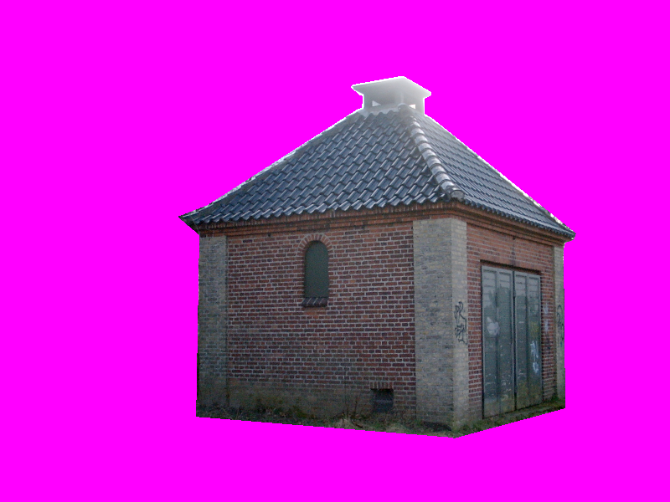
Example
Picture 1
Picture 2

Slide 5
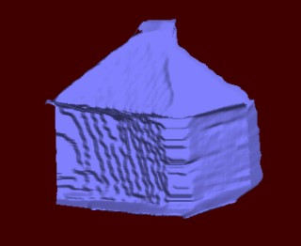
Example (cont).
3D model created from the two images

Slide 6
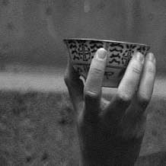
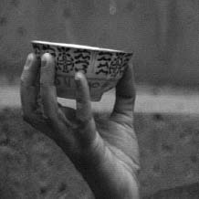
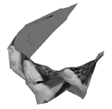
Example
Figure7.1:3D teacup model reconstructed from a 240-frame video sequence

Slide 7
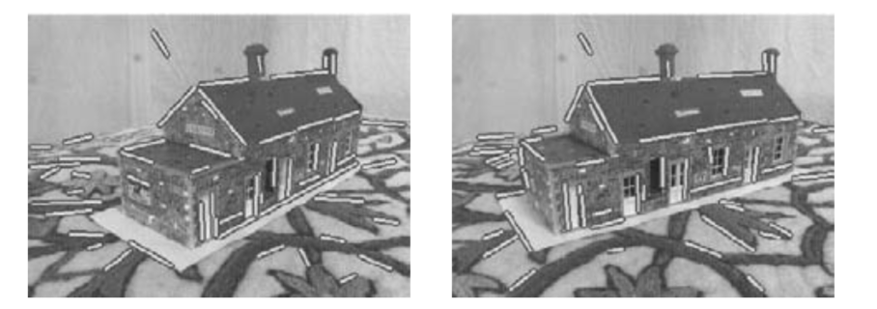
Example
Figure 7.2: Two images of a toy house along with their matched 3D line segments

Slide 8
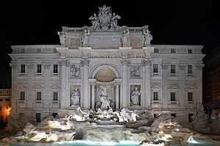
Example
Figure 7.3: (a-e) incremental structure from motion of Trevi Fountain, Rome (特雷維噴泉)

Slide 9
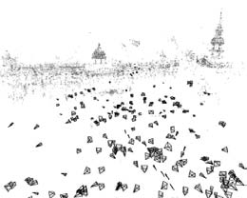
Example
Figure 7.4: 3D reconstruction of Trafalgar Square, London (特拉法加廣場)

Slide 10
Introduction
The topics of projective geometry and structure from motion are extremely rich (such as trifocal tensor, algebraic techniques for full self-calibration)
This chapter focus on the basics that are useful in large-scale, image-based reconstruction problems

Slide 11
7.1 Triangulation
Estimating a point’s 3D location when it is seen from multiple cameras is known as triangulation
It is a converse of pose estimation problem
Given projection matrices, 3D points can be computed from their measured image positions in two or more views

Slide 12
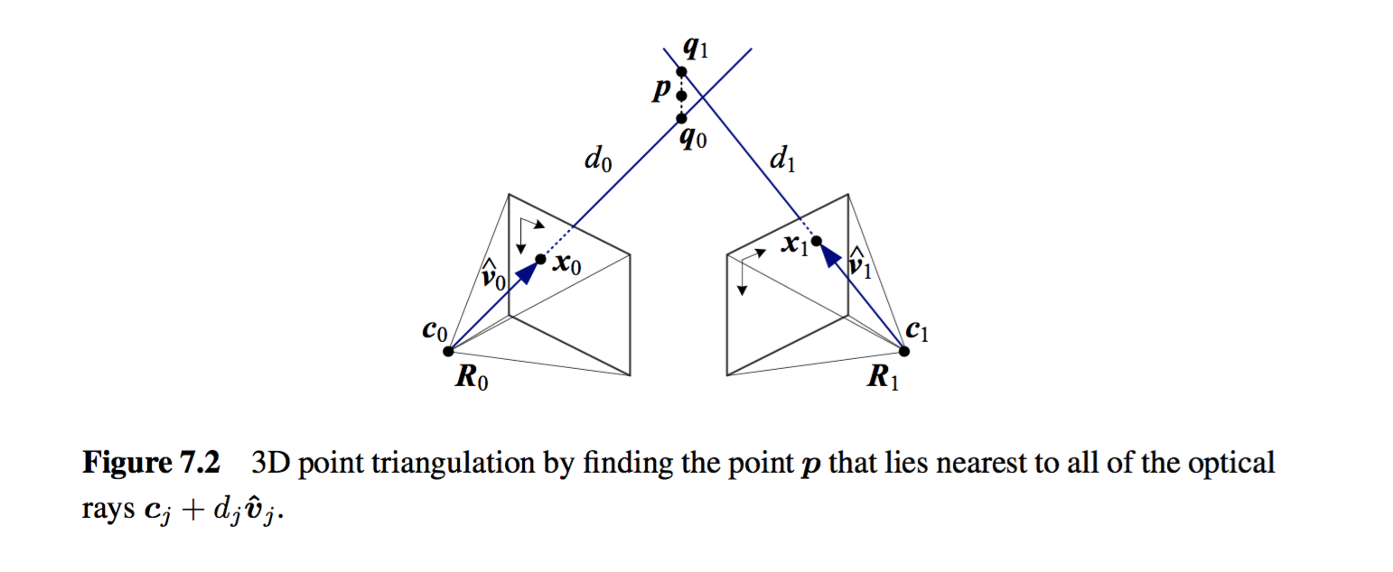
Triangulation (cont).

Slide 13
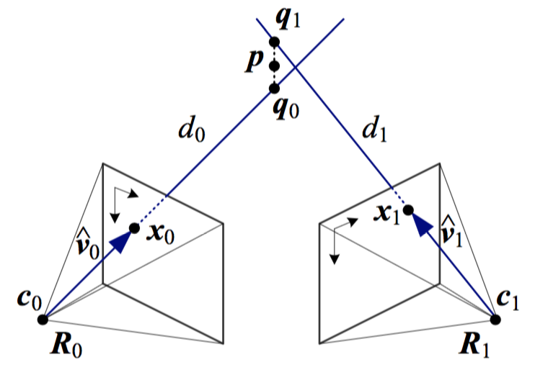
Triangulation (cont).
Find the 3D point p that lies closest to all of the 3D rays corresponding to the 2D matching feature locations {x_{j}} observed by cameras {P_{j =} K_{j} [R_{j} | t_{j}] }
t_{j} = -R_{j}c_{j}
c_{j} is the jth camera center.

Slide 14
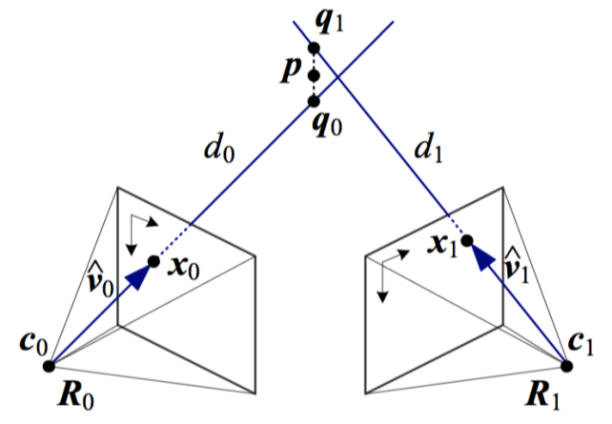
Triangulation (cont).
The rays originate at c_{j} in a direction
Minimize the distance between the rays and p.
which has a minimum at

Slide 15
Triangulation (cont).
Hence, The nearest point to p on this ray, which is denoted as q_{j},
The squared distance between p and q_{j} is

Slide 16
Triangulation (cont).
The optimal value for p, which lies closest to all of the rays, can be computed as a regular least square problem by summing over all the r_{j}² and finding the optimal value of p,

Slide 17
Triangulation (cont).
Alternative formulation which is statistically optimal and can produce better estimates if some of the cameras are closer to the 3D points than the other, it minimizes the residual in the measurement equations.

Slide 18
Triangulation (cont).
This set of non-linear equations can be converted into a linear least squares problem by multiplying both sides of the denominator.
If we use homogeneous coordinates p=(X,Y,Z,W), the resulting set of equation is homogeneous and is solved as singular value decomposition (SVD).

Slide 19
7.2 Two-Frame Structure from Motion
So far in study of 3D reconstruction, we have always assumed that either 3D points position or the 3D camera poses are known in advance
In this section, we take our first look at structure from motion, which is the simultaneous recovery of 3D structure and pose from image correspondences

Slide 20
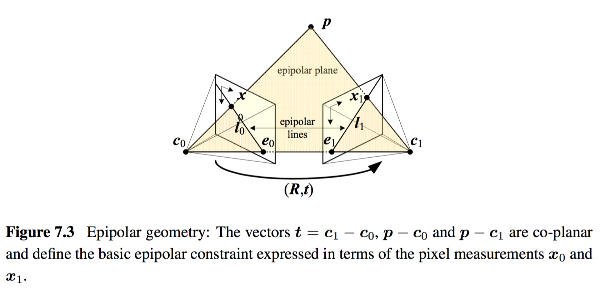
Two-Frame Structure from Motion (cont).
Figure shows a 3D point p being viewed from two cameras whose relative position can be encoded by a rotation R and a translation t

Slide 21
Two-Frame Structure from Motion (cont).
We do not know anything about the camera positions
Without loss of generality, we can set the first camera at the origin c₀=0, orientation R₀=I

Slide 22
Two-Frame Structure from Motion (cont).
The observed location of point p in the first image, is mapped into the second image by the transformation
the ray direction vectors

Slide 23
Two-Frame Structure from Motion (cont).
Taking the cross product of both the sides with t in order to annihilate it on the right hand side yields

Slide 24
Two-Frame Structure from Motion (cont).
Taking the dot product of both the sides with

Slide 25
Two-Frame Structure from Motion (cont).
The cross product matrix [t]_{x} is skew symmetric and returns 0 when pre- and post-multiplied by the same vector

Slide 26
Two-Frame Structure from Motion (cont).
The cross product matrix [t]_{x} is skew symmetric and returns 0 when pre- and post-multiplied by the same vector

Slide 27
Two-Frame Structure from Motion (cont).
We therefore arrive at the basic epipolar constraint

Slide 28
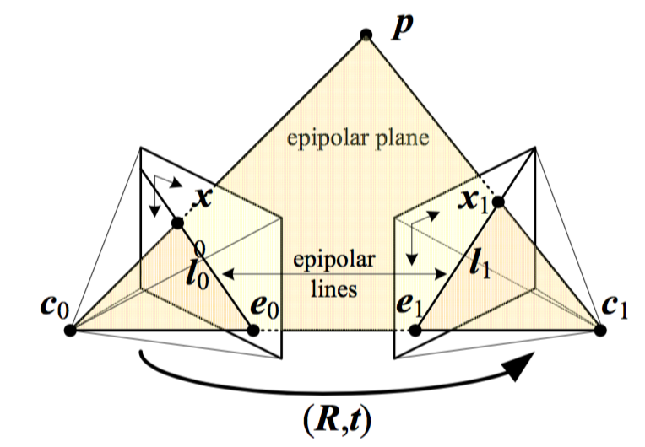
Two-Frame Structure from Motion (cont).
The basic epipolar constraint:
E : essential matrix

Slide 29
Two-Frame Structure from Motion (cont).
An alternative way to derive the epipolar constraint is to use the coplanarity

Slide 30
Two-Frame Structure from Motion (cont).
An alternative way to derive the epipolar constraint is to use the coplanarity

Slide 31
Two-Frame Structure from Motion (cont).
An alternative way to derive the epipolar constraint is to use the coplanarity
Rays corresponding to x₀ and x₁

Slide 32
Two-Frame Structure from Motion (cont).
An alternative way to derive the epipolar constraint is to use the coplanarity
c₁-c₀

Slide 33
Two-Frame Structure from Motion (cont).
An alternative way to derive the epipolar constraint is to use the coplanarity

Slide 34
Two-Frame Structure from Motion (cont).
The essential matrix E maps a point
in image 0 into a line in image 1
since

Slide 35
Two-Frame Structure from Motion (cont).
All such lines must pass through the second epipole e₁, which is therefore defined as the left singular vector of E with 0 singular value, or, equivalently the projection of the vector t into image 1.

Slide 36
Two-Frame Structure from Motion (cont).
The transpose of these relationships gives us the epipolar line in the first image as
and e₀ as the zero value right singular vector of E.

Slide 37
Two-Frame Structure from Motion (cont).
Given the relationship ,
How can we use it to recover the camera motion encoded in the essential matrix E?
If we have N corresponding measurements
{(x_{i0},x_{i1})}, we can form N homogeneous equations in the elements of E= {e₀₀…..e₂₂}

Slide 38
Two-Frame Structure from Motion (cont).
If we have N corresponding measurements
{(x_{i0},x_{i1})}, we can form N homogeneous equations in the elements of E= {e₀₀…..e₂₂}
1

Slide 39
Two-Frame Structure from Motion (cont).
: element-wise multiplication and summation of matrix elements
z_{i} and f: the vector forms of the and E matrices
Given N ≥ 8 such equations, we can compute an estimate for the entire E using a Singular Value Decomposition (SVD)

Slide 40
Two-Frame Structure from Motion (cont).
In the presence of noisy measurement, how close is this estimate to being statistically optimal?
In the matrix, some entries are products of image measurements while others are direct image measurements
1

Slide 41
Two-Frame Structure from Motion (cont).
If the measurements have noise, the terms that are product of measurement have their noise amplified by the other element in the product, which can lead to poor scaling
In order to deal with this, a suggestion is that the point coordinate should be translated and scaled so that their centroid lies at the origin and their variance is unity

Slide 42
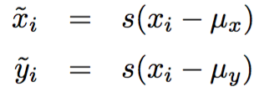
Two-Frame Structure from Motion (cont).
such that
and
Once the essential matrix has been computed from the transformed coordinates, where
the original essential matrix E can be recovered as

Slide 43
Two-Frame Structure from Motion (cont).
Once an estimate for the essential matrix E has been recovered, the direction of the translation vector t can be estimated
But the absolute distance between two cameras can never be recovered from pure image measurement alone without ground control points

Slide 44
Two-Frame Structure from Motion (cont).
To estimate direction , observe that under the ideal noise-free conditions, the essential matrix E is singular, i.e.,
This singularity shows up as a singular value of 0 when an SVD of E is performed,
When E is computed from noisy measurements, the singular vector associated with the smallest singular value gives us t

Slide 45
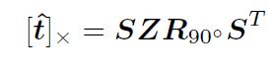
Two-Frame Structure from Motion (cont).
Once t has been recovered, we can we estimate the corresponding rotation matrix R:

Slide 46
Two-Frame Structure from Motion (cont).
Once t has been recovered, we can we estimate the corresponding rotation matrix R:

Slide 47
Two-Frame Structure from Motion (cont).
Once t has been recovered, we can we estimate the corresponding rotation matrix R:

Slide 48
Two-Frame Structure from Motion (cont).
Once t has been recovered, we can we estimate the corresponding rotation matrix R:

Slide 49
Two-Frame Structure from Motion (cont).
Unfortunately, we only know both E and t up to a sign.
Furthermore, the matrices U and V are not guaranteed to be rotations (you can flip both their signs and still get a valid SVD).
For this reason, we have to generate all four possible rotation matrices
and keep the two whose determinant |R| = 1.

Slide 50
Two-Frame Structure from Motion (cont).
To disambiguate between the remaining pair of potential rotations, we need to pair them with both possible signs of the translation direction ± t and select the combination for which the largest number of points is seen in front of both cameras
The property that points must lie in front of the camera, i.e., at a positive distance along the viewing rays emanating from the camera, is known as chirality

Slide 51
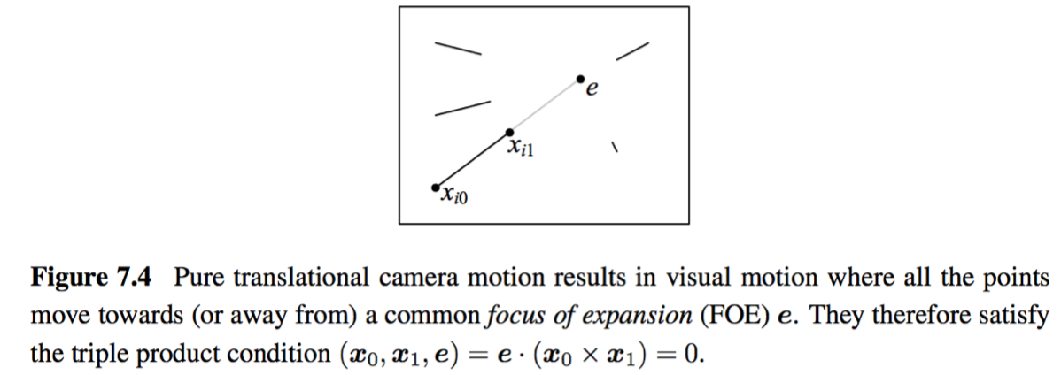
Pure Translation (Known rotation)
In the case where we know the rotation, we can pre-rotate the points in the second image to match the viewing direction of the first

Slide 52
Pure Translation (cont).
The resulting essential matrix E is (in the noise-free case) skew symmetric and so can be estimated more directly by setting e_{ij} = -e_{ji} and e_{ii} = 0
Two points with non-zero parallax now suffice to estimate the FOE.

Slide 53
Pure Translation (cont).
A more direct derivation of FOE estimates can be obtained by minimizing the triple product
which is equivalent to finding null space for the set of equations:

Slide 54
Pure Translation (cont).
A more direct derivation of FOE estimates can be obtained by minimizing the triple product
which is equivalent to finding null space for the set of equations:
1

Slide 55
Pure Translation (cont).
A more direct derivation of FOE estimates can be obtained by minimizing the triple product
which is equivalent to finding null space for the set of equations:
X
1
X
X

Slide 56
Pure Translation (cont).
A more direct derivation of FOE estimates can be obtained by minimizing the triple product
which is equivalent to finding null space for the set of equations:
X
-
-
1
X
-
X

Slide 57
Pure Translation (cont).
A more direct derivation of FOE estimates can be obtained by minimizing the triple product
which is equivalent to finding null space for the set of equations:

Slide 58
7.2.1 Projective Reconstruction
When we try to build 3D model from the photos taken by unknown cameras without any EXIF tags, we do not know ahead of time the intrinsic calibration parameters associated with input images
Still, we can estimate a two-frame reconstruction, although the true metric structure may not be available

Slide 59
Projective Reconstruction (cont.)
In the unreliable case, we do not know the calibration matrices K_{j} in , so we cannot use the normalized ray directions
We have access to the image coordinate x_{j}, so essential matrix becomes:
fundamental matrix:
0

Slide 60
Projective Reconstruction (cont.)
Its smallest left singular vector indicates the epipole e₁ in the image 1.
Its smallest right singular vector is e_{0.}

Slide 61
Projective Reconstruction (cont.)
To create a projective reconstruction of a scene, we pick up any valid homography that satisfies
and hence
: singular value matrix with the smallest value
replaced by the middle value.

Slide 62
Projective Reconstruction (cont.)
We can then form a pair of camera matrices from which a projective reconstruction of the scene can be computed using triangulation
1

Slide 63
7.2.2 Self-calibration
Auto-calibration is developed for converting a projective reconstruction into a metric one
i.e. parallel lines are parallel, orthogonal walls are at right angles, and model is scaled version of reality
Equivalent to recovering the unknown calibration matrix K_{j} associated with each image

Slide 64
Self-calibration (cont.)
In situations where certain additional information is known about the scene, different methods may be employed:
If there are parallel lines, > 3 vanishing points can be used to establish the homography for the plane at infinity; focal length and rotations can be recovered
If > 2 orthogonal vanishing points have been observed, the single-image calibration method based on vanishing points can be used

Slide 65
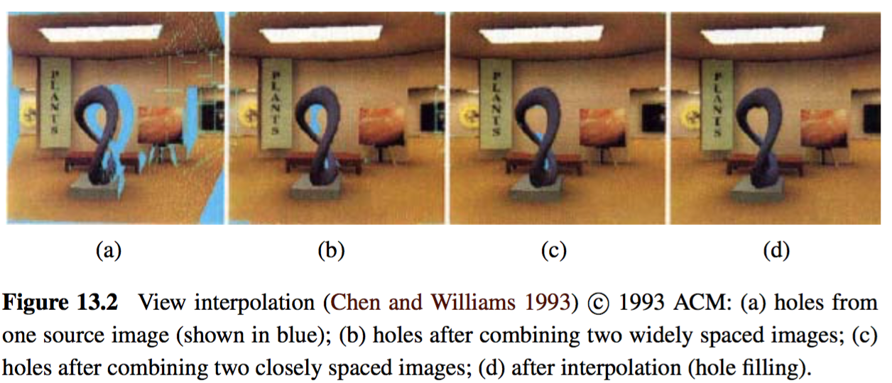
Application: View Morphing
An interesting application of basic two-frame structure from motion is view morphing, also known as view interpolation, which can be used to generate a smooth 3D animation from one view of a 3D scene to another

Slide 66
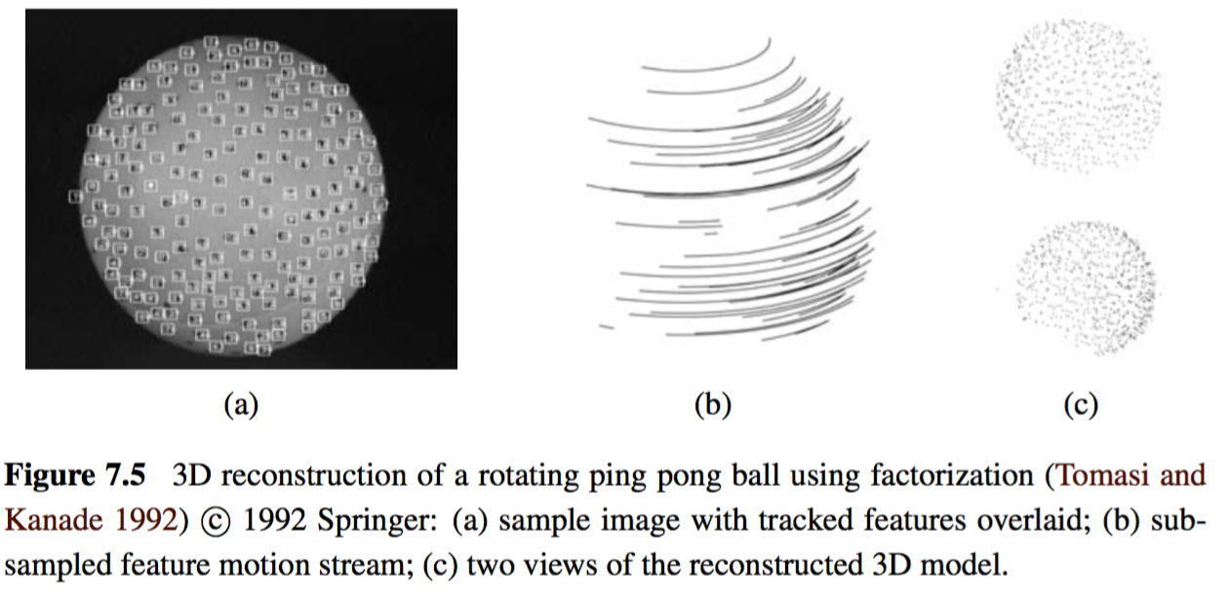
7.3 Factorization
When processing video sequences, we often get extended feature track from which it is possible to recover the structure and motion using a process called factorization.

Slide 67
Factorization (cont.)
Consider orthographic and weak perspective projection models
Since the last row is always [0 0 0 1], there is no perspective division
x_{ji}: location of i ^{th} point in j ^{th} frame
: upper 2 x 4 portion of projection matrix P_{j}
: augmented 3D point position

Slide 68
Factorization (cont.)
Assume that every point i is visible in every frame j
We can take the centroid (average) of the projected point locations x_{ij} in frame j.
: augmented 3D centroid of the point cloud.
we can place the origin of the world at the centroid of the points, i.e, so that
Centroid of 2D points in each frame directly gives us last element of

Slide 69
Factorization (cont.)
Let be the 2D point locations after their image centroid has been subtracted. We can write:
M_{j}: upper 2 by 3 portion of the projection matrix P_{j}
p_{i}=(X_{i},Y_{i},Z_{i})
We can concatenate all of these measurements into one large matrix.

Slide 70
Factorization (cont.)
: measurement matrix
: motion matrices
: structure matrices

Slide 71
Factorization (cont.)
If SVD of directly returns the matrices ; But it does not. Instead we can write the relationship
where
and
To recover values of the 3 x 3 matrix Q depends on motion model being used.

Slide 72
Factorization (cont.)
In the case of orthographic projection, the entries in M_{j} are the first two rows of rotation matrices R_{j}.
So we have
u_{k}: 3 x 1 rows of matrix U.
This gives us a large set of equations for the entries in matrix QQ^{T} from which matrix Q can be recovered using matrix square root.

Slide 73
Factorization (cont.)
Limitations:
They require a complete set of tracks, i.e., each point must be visible in each frame, in order for the factorization approach to work.
It cannot deal with perspective cameras.
(One way to get around this problem is to perform an initial affine (e.g., orthographic) reconstruction and to then correct for the perspective effects in an iterative manner)

Slide 74
Application: Sparse 3D Model Extraction
Once a multi-view 3D reconstruction of the scene has been estimated, it then becomes possible to create a texture-mapped 3D model of the object and to look at it from new directions.
The first step is to create a denser 3D model than the sparse point cloud that structure from motion produces. A simple technique such as 3D triangulation can be used.
In order to create a more realistic model, a texture map can be extracted for each triangle face.

Slide 75
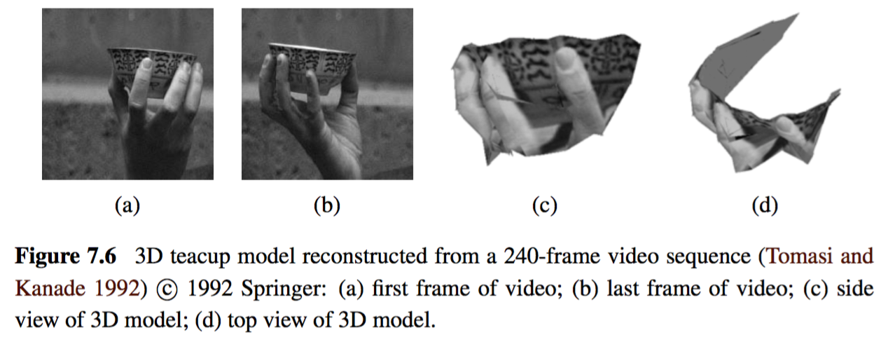
Application: Sparse 3D Model Extraction

Slide 76
7.4 Bundle Adjustment
The most accurate way to recover structure and motion is to perform robust non-linear minimization of the measurement (re-projection) errors, which is commonly known as bundle adjustment.
The term bundle refers to the bundles of rays connecting camera centers to 3D points and the term adjustment refers to the iterative minimization of re-projection error.

Slide 77
7.4 Bundle Adjustment
Given a set of images depicting a number of 3D points from different viewpoints
Bundle adjustment can be defined as the problem of simultaneously refining…
the 3D coordinates describing the scene geometry
the parameters of the relative motion
the optical characteristics of the camera(s) employed to acquire the images
…according to an optimality criterion involving the corresponding image projections of all points

Slide 78
Bundle Adjustment
The feature location measurements x_{ij} depends on the following parameters
x_{ij} = f(P_{i},R_{j},c_{j},K_{j}) P: 3D position R: Rotation c: Camera center(Translation) K: Camera intrinsic
All these parameters will be updated during the iterative process.

Slide 79
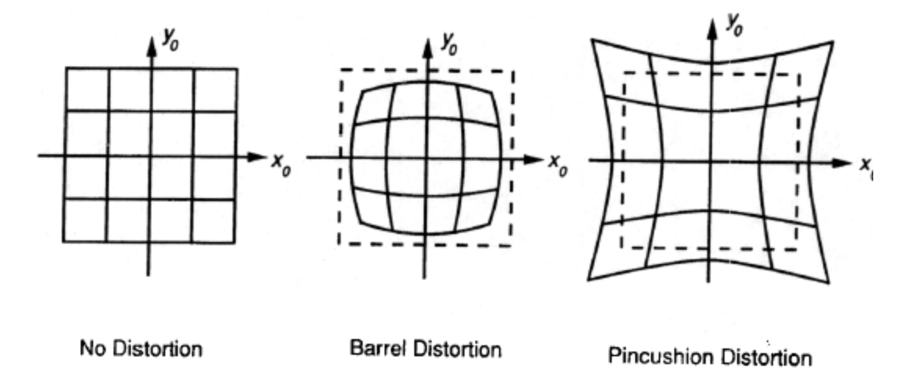
Bundle Adjustment
In addition, it is common to add a stage for radial distortion parameter estimation.
Radial distortion:

Slide 80
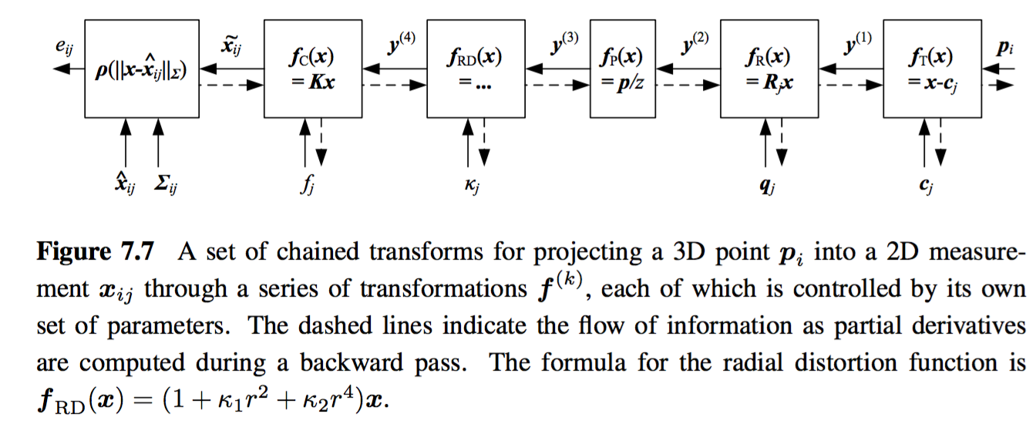
Bundle Adjustment
Σ_{ij}: measured noise covariance

Slide 81
Bundle Adjustment
Iteration: Minimize the sum of re-projection error between the observed and predicted image points.
The re-projection error functions are nonlinear. Thus, the minimization is achieved using iterative least squares algorithms. (Newton, LM, etc.)

Slide 82
Application: Reconstruction from Internet Photos
Widely used application of structure from motion: the reconstruction of 3D objects and scenes from video sequences and collection of images.
Before structure from motion comparison can begin, it is first necessary to establish sparse correspondences between different pairs of images and to then link such correspondences into feature track, which associates individual 2D image feature with global 3D points.

Slide 83
Application: Reconstruction from Internet Photos
Once an initial pair has been reconstructed, the pose of cameras that see a sufficient number of the resulting 3D points can be estimated and the complete set of cameras and feature correspondences can be used to perform another round of bundle adjustment.

Slide 84
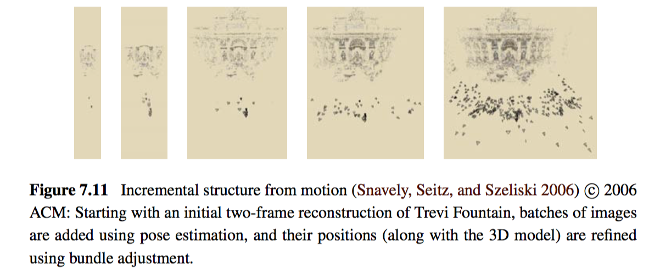
Reconstruction from Internet Photos (cont).

Slide 85
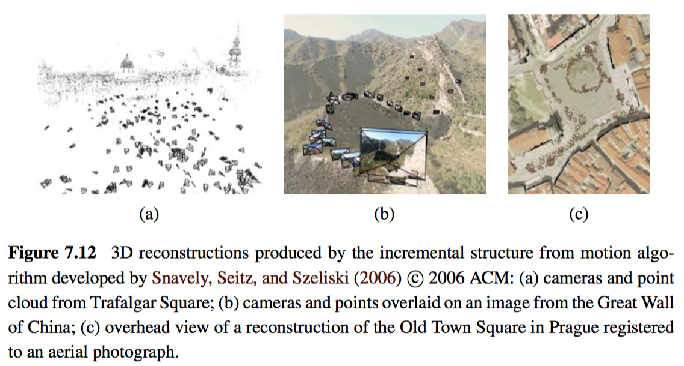
Reconstruction from Internet Photos (cont).

Slide 86
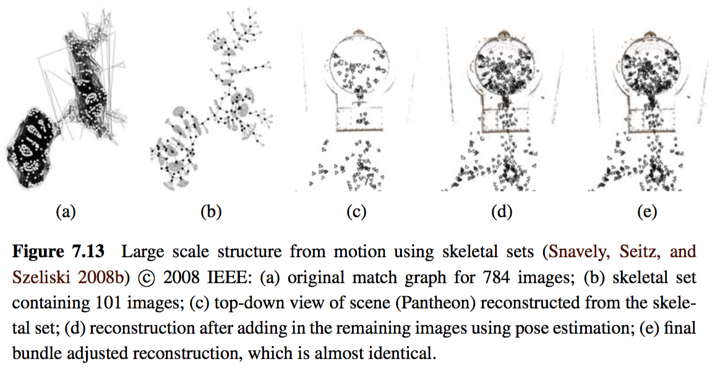
Reconstruction from Internet Photos (cont).

Slide 87
7.5 Constrained Structure and Motion
The most general algorithms for structure from motion make no prior assumptions about the objects or scenes that they are reconstructing.
In many cases, however, the scene contains higher-level geometric primitives, such as lines and planes.
Furthermore, these primitives are often arranged in particular relationships, i.e., many lines and planes are either parallel or orthogonal to each other.

Slide 88
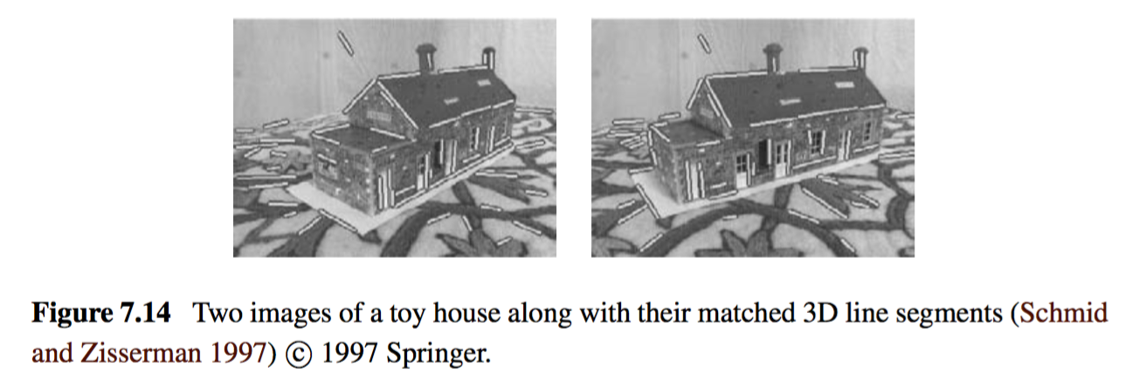
Constrained Structure and Motion (cont).
Line-based technique:
When lines are visible in three or more views, the trifocal tensor can be used to transfer lines from one pair of images to another.

Slide 89
Constrained Structure and Motion (cont).
Plane-based technique:
In scenes that are rich in planar structures, e.g., in architecture and certain kinds of manufactured objects such as furniture, it is possible to directly estimate homographies between different planes, using either feature-based or intensity-based methods.

Slide 90
End of Chapter 7
Thank you for listening!

