Slide 1
Chapter 6
Feature-based alignment Advanced Computer Vision
Presented by 林炳彰、傅楸善
Phone: 0979258928
E-mail: r07921114@ntu.edu.tw
http://media.ee.ntu.edu.tw/courses/cv/18F/

Slide 2
Feature-based Alignment
Match extracted features across different images.
Verify the geometrical consistency of matching features.
Applications:
Image stitching
Augmented reality
……

Slide 3
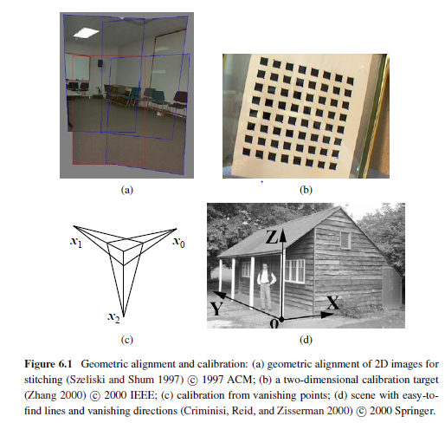
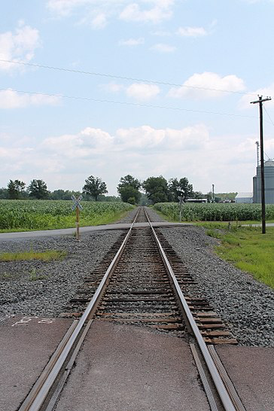
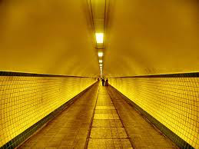
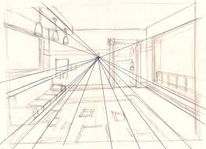
Vanishing point:

Slide 4
Feature-based Alignment
Outline
2D and 3D feature-based alignment
Pose estimation
Geometric intrinsic calibration

Slide 5
2D and 3D feature-based alignment
Estimate the motion between two or more sets of matched 2D or 3D points.
In this section:
Restrict to global parametric transformations
Curved surfaces with higher order transformation
Non-rigid or elastic deformations will not be discussed here

Slide 6
Non-rigid or elastic deformations
Rigid-transform
Elastic deformation

Slide 7
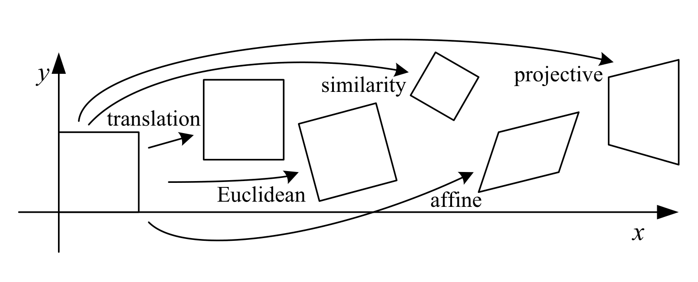
2D and 3D feature-based alignment
Basic set of 2D planar transformations

Slide 8
Homogeneous Coordinates
Homogeneous representation of lines:
$ax+by+c=0$
$\left(x, y, 1\right)∙{\left(a,b,c\right)}^{T}$
Homogeneous representation of points:
$p=\left(x,y\right)$ on $l={\left(a,b,c\right)}^{T}$ if and only if $ax+by+c=0$
$\left(x, y, 1\right)⋅{\left(a,b,c\right)}^{T}=\left(x,y,1\right)⋅l=0$

Slide 9
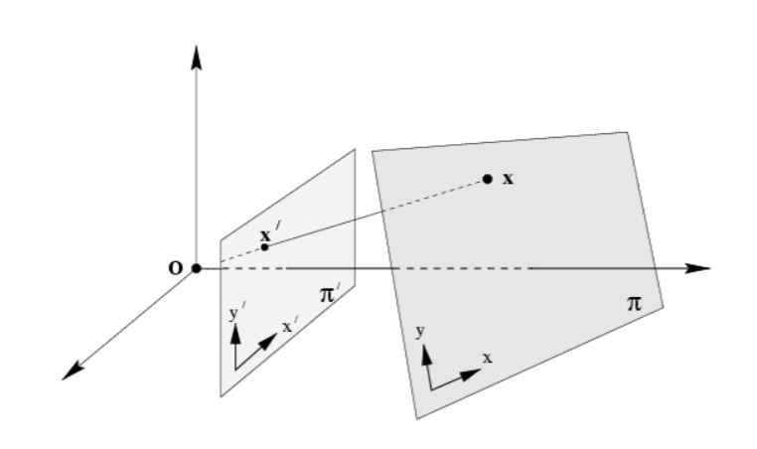
Homogeneous Coordinates
The points $p$ lies on the line $l$ if and only if $p⋅l=0$
Homogeneous coordinates : $\left(x,y,z\right)$
Inhomogeneous coordinates : $(x,y)$
The point $p=(x,y,z)$ represents the $p^{′}=(\frac{x}{z},\frac{y}{z})$ in $ℝ^{2}$

Slide 10
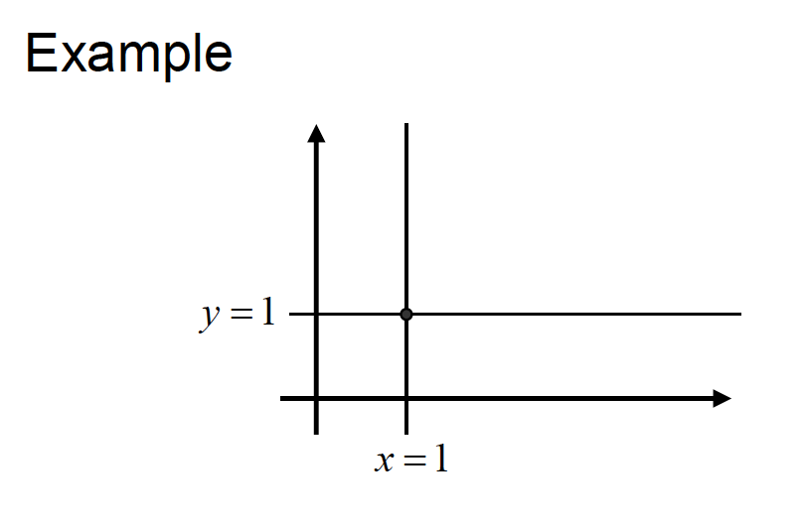
Homogeneous Coordinates
Intersections of lines
The intersection of two lines $x=l×l^{′}$
Line joining two points
The line through two points $l=x×x^{′}$
$$x−1=0→ l={\left(1,0,−1\right)}^{T}$$
$$y−1=0→l^{′}={\left(0,1,−1\right)}^{T}$$
$$p=l×l^{′}={\left(1,1,1\right)}^{T}$$

Slide 11
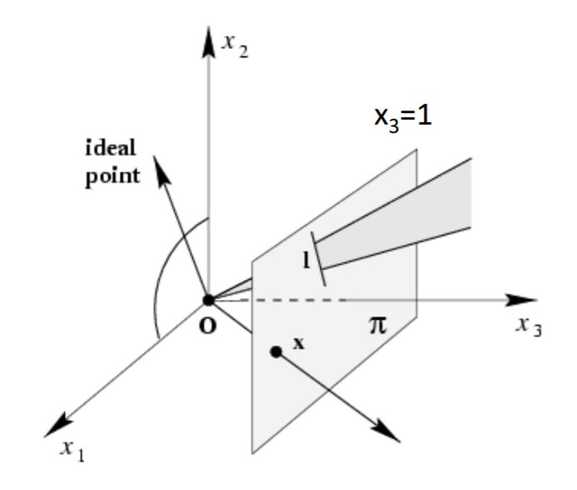
Homogeneous Coordinates
Intersections of parallel lines
$l={\left(a,b,c\right)}^{T}, l^{′}={\left(a,b,c^{′}\right)}^{T}$
Ideal point: $p=l×l^{′}={\left(b,−a,0 \right)}^{T}$
Line at infinity: $l_{∞}={\left(0,0,1\right)}^{T}$
Some relationships
$x⟷l$
$x^{T}l=0⟷l^{T}x=0$
$x=l×l^{′}⟷l=x×x^{′}$

Slide 12
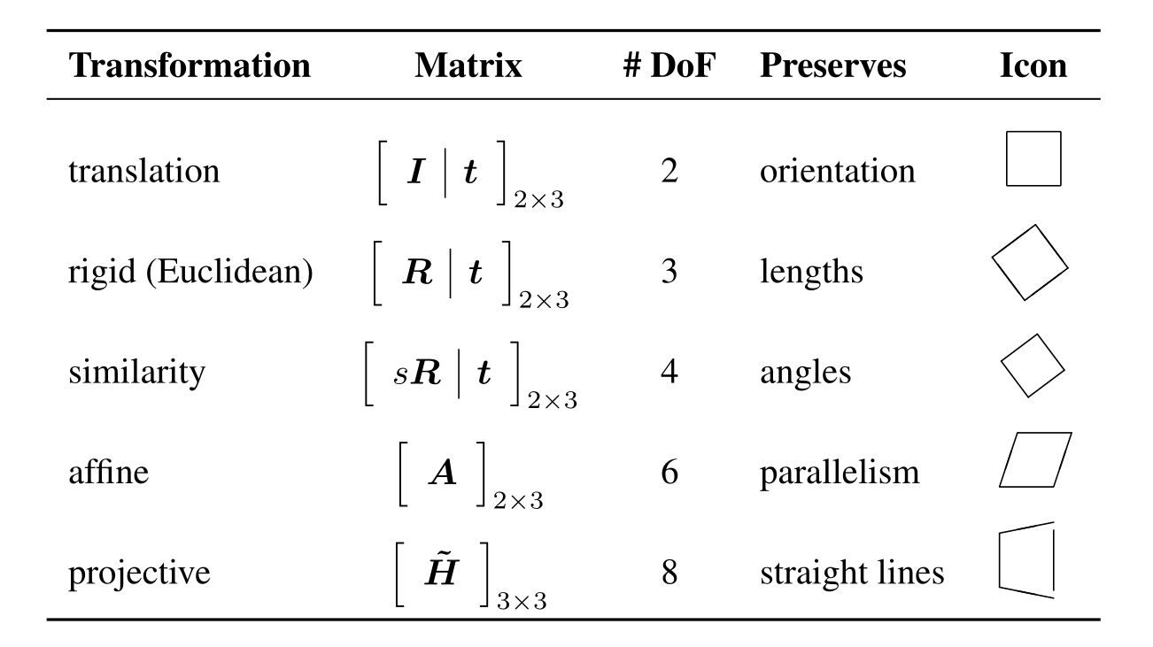
2D and 3D feature-based alignment

Slide 13
2D and 3D feature-based alignment
Translation: $p={\left(x,y,1\right)}^{T}$
$H=\left[\begin{matrix}1 & 0 & dx \\ 0 & 1 & dy \\ 0 & 0 & 1\end{matrix}\right]$
$H∙p=\left[\begin{matrix}1 & 0 & dx \\ 0 & 1 & dy \\ 0 & 0 & 1\end{matrix}\right]\left[\begin{matrix}x \\ y \\ 1\end{matrix}\right]=\left[\begin{matrix}x+dx \\ y+dy \\ 1\end{matrix}\right]$

Slide 14
2D and 3D feature-based alignment
Euclidean: $p={\left(x,y,1\right)}^{T}$
$H=\left[\begin{matrix}\cos{θ} & \sin{θ} & dx \\ −sin{θ} & \cos{θ} & dy \\ 0 & 0 & 1\end{matrix}\right]$
$H∙p=\left[\begin{matrix}\cos{θ} & \sin{θ} & dx \\ −sin{θ} & \cos{θ} & dy \\ 0 & 0 & 1\end{matrix}\right]\left[\begin{matrix}x \\ y \\ 1\end{matrix}\right]=\left[\begin{matrix}x\cos{θ}+y\sin{θ}+dx \\ −x\sin{θ}+y\cos{θ}+dy \\ 1\end{matrix}\right]$

Slide 15
2D and 3D feature-based alignment
Similarity: $p={\left(x,y,1\right)}^{T}$
$H=\left[\begin{matrix}s\cos{θ} & \sin{θ} & dx \\ −sin{θ} & s\cos{θ} & dy \\ 0 & 0 & 1\end{matrix}\right]$
$H∙p=\left[\begin{matrix}\operatorname{scos}{θ} & \sin{θ} & dx \\ −sin{θ} & s\cos{θ} & dy \\ 0 & 0 & 1\end{matrix}\right]\left[\begin{matrix}x \\ y \\ 1\end{matrix}\right]=\left[\begin{matrix}sx\cos{θ}+y\sin{θ}+dx \\ −x\sin{θ}+sy\cos{θ}+dy \\ 1\end{matrix}\right]$

Slide 16
2D and 3D feature-based alignment
Affine: $p={\left(x,y,1\right)}^{T}$
$H=\left[\begin{matrix}s\cos{θ} & a\sin{θ} & dx \\ −bsin{θ} & s\cos{θ} & dy \\ 0 & 0 & 1\end{matrix}\right]$
$H∙p=\left[\begin{matrix}\operatorname{scos}{θ} & \operatorname{asin}{θ} & dx \\ −bsin{θ} & s\cos{θ} & dy \\ 0 & 0 & 1\end{matrix}\right]\left[\begin{matrix}x \\ y \\ 1\end{matrix}\right]=\left[\begin{matrix}sx\cos{θ}+ay\sin{θ}+dx \\ −bx\sin{θ}+sy\cos{θ}+dy \\ 1\end{matrix}\right]$

Slide 17
2D and 3D feature-based alignment
Projective: $p={\left(x,y,1\right)}^{T}$
$H=\left[\begin{matrix}a & b & c \\ d & e & f \\ g & h & i\end{matrix}\right]$
$H∙p=\left[\begin{matrix}a & b & c \\ d & e & f \\ g & h & 1\end{matrix}\right]\left[\begin{matrix}x \\ y \\ 1\end{matrix}\right]=\left[\begin{matrix}ax+by+c \\ dx+ey+f \\ gx+hy+1\end{matrix}\right]$

Slide 18
Projective Transformations
Definition: Projective transformation
$$\left[\begin{matrix}x^{′} \\ y^{′} \\ z^{′}\end{matrix}\right]=\left[\begin{matrix}h_{11} & h_{12} & h_{13} \\ h_{21} & h_{22} & h_{23} \\ h_{31} & h_{32} & h_{33}\end{matrix}\right]\left[\begin{matrix}x \\ y \\ z\end{matrix}\right] or x^{′}=Hx$$

Slide 19
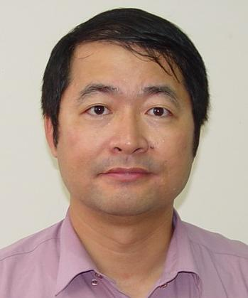
Projective Transformations

Slide 20
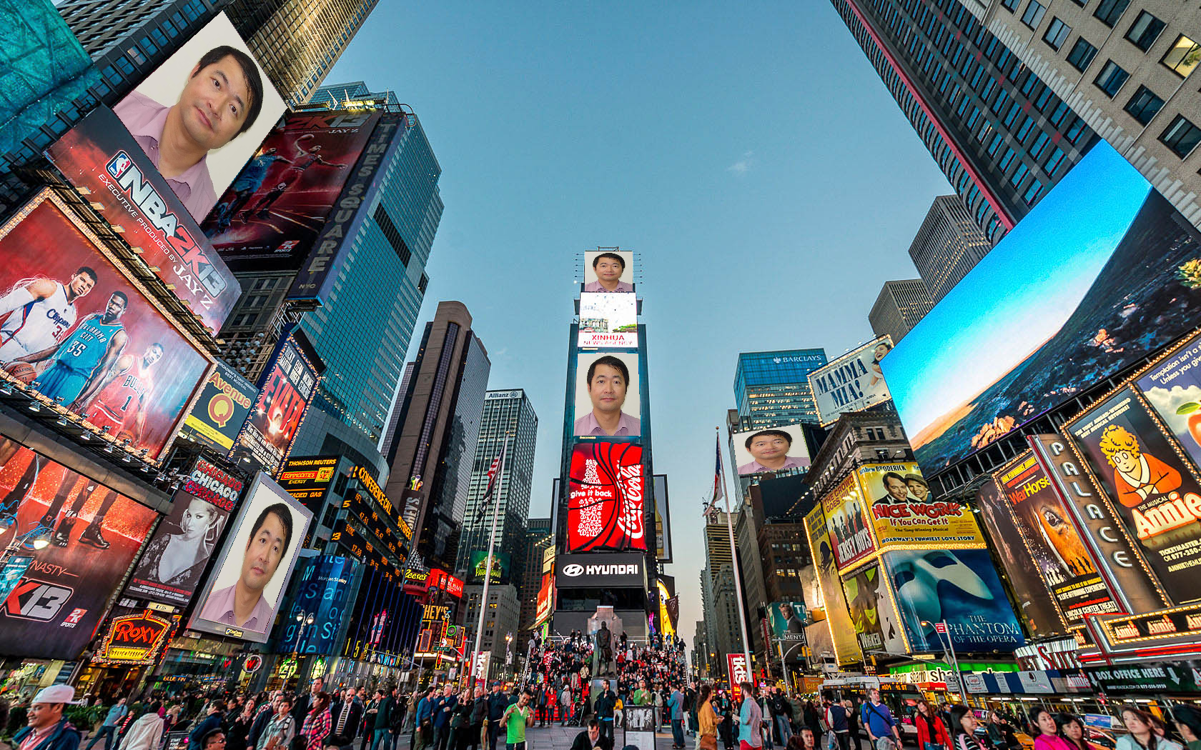
Projective Transformations

Slide 21
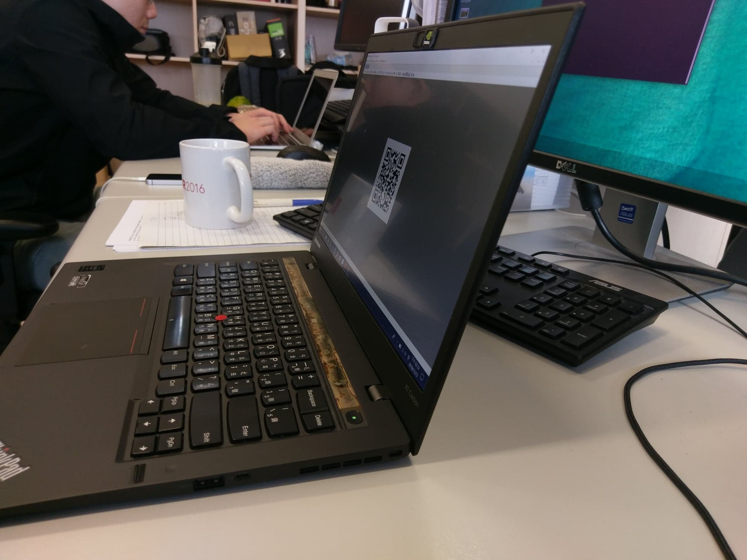
Projective Transformations

Slide 22
Projective Transformations

Slide 23
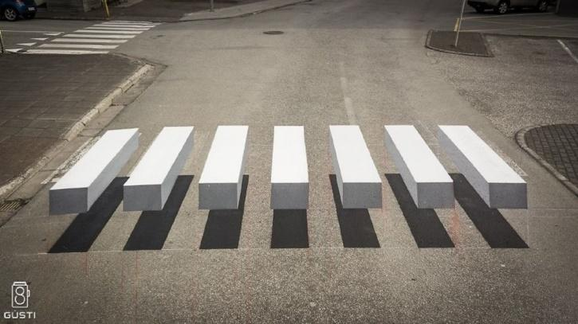
Projective Transformations

Slide 24
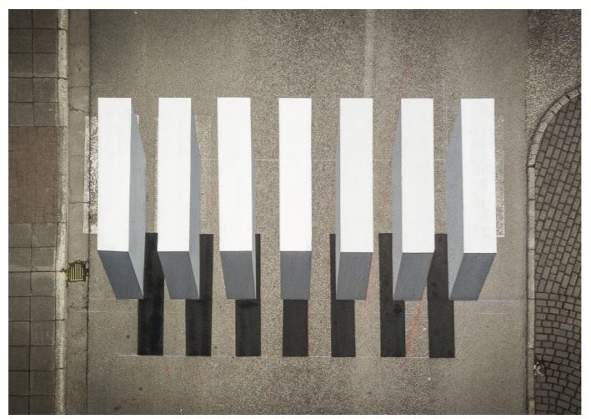
Projective Transformations
Is it possible to generate the ground-truth like below?

Slide 25
Projective Transformations

Slide 26
2D Alignment Using Least Squares
Given a set of matched feature points $\{\left(x_{i},x_{i}^{′}\right)\}$
A planar parametric transformation:
$$x^{′}=f\left(x;p\right)$$
$p$ are the parameters of the function $f$
How to estimate the motion parameters $p$?

Slide 27
Projective 2D Motion
How to solve the H ($p$)?
$Hp=p^{′}=λ\left[\begin{matrix}x^{′} \\ y^{′} \\ 1\end{matrix}\right]$=$\left[\begin{matrix}h_{11} & h_{12} & h_{13} \\ h_{21} & h_{22} & h_{23} \\ h_{31} & h_{32} & h_{33}\end{matrix}\right]\left[\begin{matrix}x \\ y \\ 1\end{matrix}\right]$
$x^{′}=\frac{xh_{11}+yh_{12}+h_{13}}{{xh}_{31}+yh_{32}+h_{33}},y^{′}=\frac{xh_{21}+yh_{22}+h_{23}}{{xh}_{31}+yh_{32}+h_{33}}$
Degree of freedom: 8
Given 4 matched points or more.

Slide 28
Projective 2D Motion
$Hp=p^{′}=λ\left[\begin{matrix}x^{′} \\ y^{′} \\ 1\end{matrix}\right]$=$\left[\begin{matrix}h_{11} & h_{12} & h_{13} \\ h_{21} & h_{22} & h_{23} \\ h_{31} & h_{32} & h_{33}\end{matrix}\right]\left[\begin{matrix}x \\ y \\ 1\end{matrix}\right]$
$$x^{′}=\frac{xh_{11}+yh_{12}+h_{13}}{{xh}_{31}+yh_{32}+h_{33}},y^{′}=\frac{xh_{21}+yh_{22}+h_{23}}{{xh}_{31}+yh_{32}+h_{33}}$$
$$x^{′}\left({xh}_{31}+yh_{32}+h_{33}\right)=xh_{11}+yh_{12}+h_{13}$$
$$y^{′}\left({xh}_{31}+yh_{32}+h_{33}\right)=xh_{21}+yh_{22}+h_{23}$$

Slide 29
Projective 2D Motion
$$x^{′}\left({xh}_{31}+yh_{32}+h_{33}\right)=xh_{11}+yh_{12}+h_{13}$$
$$y^{′}\left({xh}_{31}+yh_{32}+h_{33}\right)=xh_{21}+yh_{22}+h_{23}$$
$$xh_{11}+yh_{12}+h_{13}−x^{′}{xh}_{31}−x^{′}{yh}_{32}−x^{′}h_{33}=0$$
$$xh_{21}+yh_{22}+h_{23}−y^{′}{xh}_{31}−y^{′}{yh}_{32}−y^{′}h_{33}=0$$
$$A_{i}H=\left[\begin{matrix}x y 1 0 0 0 −x^{′}x −x^{′}y −x^{′} \\ 0 0 0 x y 1 −y^{′}x −y^{′}y −y^{′}\end{matrix}\right]\left[\begin{matrix}h_{11} \\ ⋮ \\ h_{33}\end{matrix}\right]=\left[\begin{matrix}0 \\ 0\end{matrix}\right]$$
2×9
9×1

Slide 30
Projective 2D Motion
Solving for H
$$\left[\begin{matrix}A_{1} \\ ⋮ \\ A_{4}\end{matrix}\right]H=0$$
Find approximate solution
$AH=0$ not possible, so minimize $\left\|AH\right\|$

Slide 31
Projective 2D Motion
Solution 1: set $h_{33}=1$
$x^{′}=\frac{xh_{11}+yh_{12}+h_{13}}{{xh}_{31}+yh_{32}+1},y^{′}=\frac{xh_{21}+yh_{22}+h_{23}}{{xh}_{31}+yh_{32}+1}$
Solution 2: impose unit vector constraint
$x^{′}=\frac{xh_{11}+yh_{12}+h_{13}}{{xh}_{31}+yh_{32}+h_{33}},y^{′}=\frac{xh_{21}+yh_{22}+h_{23}}{{xh}_{31}+yh_{32}+h_{33}}$
Subject to: $h_{11}^{2}+h_{12}^{2}$+$h_{13}^{2}$…+$h_{33}^{2}$=1

Slide 32
Projective 2D Motion
Solution 1: set $h_{33}=1$
$x^{′}=\frac{xh_{11}+yh_{12}+h_{13}}{{xh}_{31}+yh_{32}+1},y^{′}=\frac{xh_{21}+yh_{22}+h_{23}}{{xh}_{31}+yh_{32}+1}$
$A_{i}H=\left[\begin{matrix}x y 1 0 0 0 −x^{′}x −x^{′}y \\ 0 0 0 x y 1 −y^{′}x −y^{′}y\end{matrix}\right]\left[\begin{matrix}h_{11} \\ ⋮ \\ h_{32}\end{matrix}\right]=\left[\begin{matrix}x^{′} \\ y^{′}\end{matrix}\right]$
$AH=P^{′}$
$$8×8$$
$$8×1$$

Slide 33
Projective 2D Motion
Solution 1: set $h_{33}=1$
$AH=P^{′}$
$AH=P^{′}→H=A^{−1}AH=A^{−1}P^{′}$
Using the Gauss-Newton approximation
Converge to a local minimum with proper checking for downhill steps

Slide 34
Projective 2D Motion
Solution 2: impose unit vector constraint
$x^{′}=\frac{xh_{11}+yh_{12}+h_{13}}{{xh}_{31}+yh_{32}+h_{33}},y^{′}=\frac{xh_{21}+yh_{22}+h_{23}}{{xh}_{31}+yh_{32}+h_{33}}$
Subject to: $h_{11}^{2}+h_{12}^{2}$+$h_{13}^{2}$…+$h_{33}^{2}$=1
$A_{i}H\left[\begin{matrix}x y 1 0 0 0 −x^{′}x −x^{′}y −x^{′} \\ 0 0 0 x y 1 −y^{′}x −y^{′}y −y^{′}\end{matrix}\right]\left[\begin{matrix}h_{11} \\ ⋮ \\ h_{33}\end{matrix}\right]=\left[\begin{matrix}0 \\ 0\end{matrix}\right]$
$AH=0$

Slide 35
Projective 2D Motion
Solution 2: impose unit vector constraint
For each correspondence $p_{i}→p_{i}^{′}$ compute $A_{i}$.
Assemble $n 2×9$ matrices $A_{i}$ into a single $2n×9$ matrix A
Obtain Singular Value Decomposition of A.
Solution for h is last column of V

Slide 36
2D Alignment Using Least Squares
Residual:
$$r_{i}=x_{i}^{′}−f\left(x_{i};p\right)=\hat{x_{i}}−\tilde{x_{i}}$$
$\hat{x_{i}}$: the measured location
$\tilde{x_{i}}$: the predicted location
Least squares:
Minimize the sum of squared residuals
$$E_{LS}=\sum_{i}{{\left\|r_{i}\right\|}^{2}}=\sum_{i}{{\left\|f\left(x_{i};p\right)−x_{i}^{′}\right\|}^{2}}$$

Slide 37
2D Alignment Using Least Squares
Many of the motion models have a linear relationship:
$$Δx=x^{′}−x=J\left(x\right)p$$
$J=∂f/∂p$: The Jacobian of the transformation $f$

Slide 38
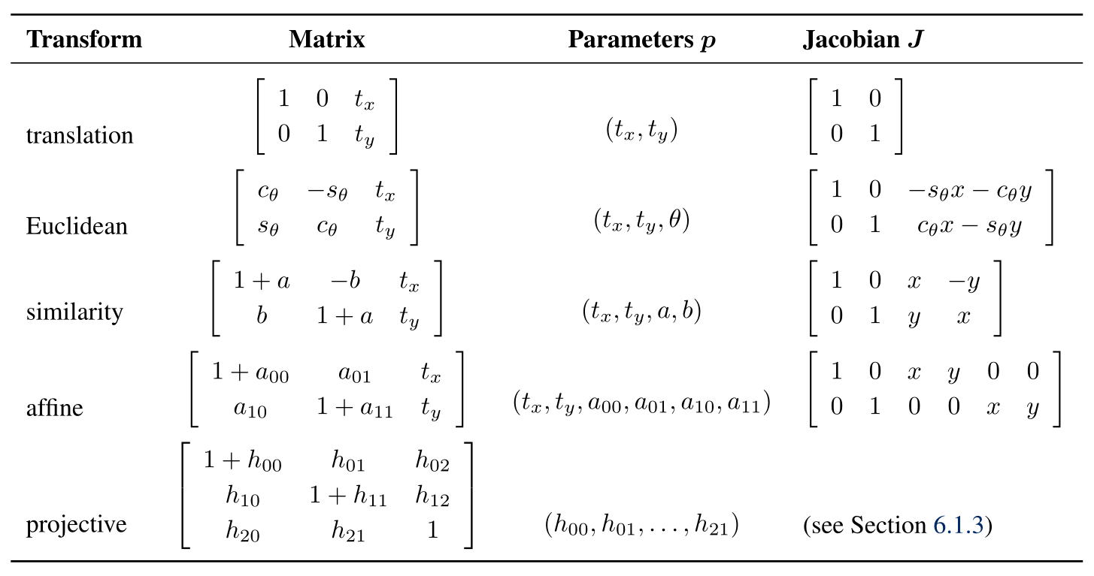
2D Alignment Using Least Squares

Slide 39
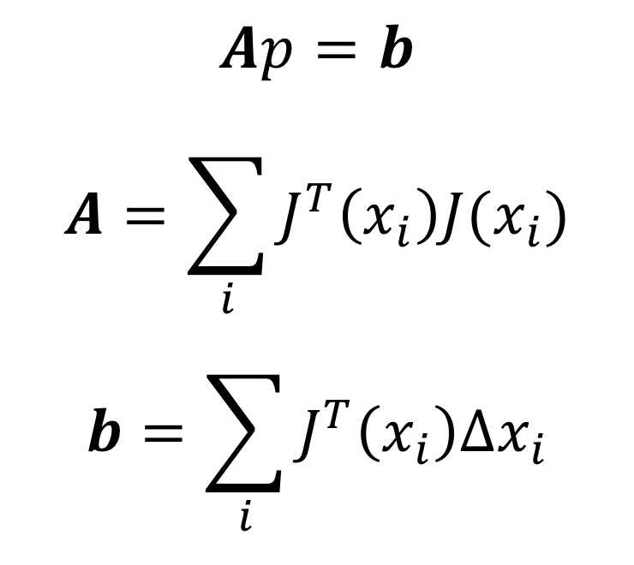
2D Alignment Using Least Squares
Linear least squares:
Find the minimum by solving:

Slide 40
Robust least squares
More robust versions of least squares are required when there are outliers among the correspondences.
M−estimator: apply a robust penalty function $ρ(r)$ to the residuals.
RLS: Reweighted Least Squares
$$E_{RLS}\left(Δp\right)=\sum_{i}{ρ(\left\|r_{i}\right\|)}$$

Slide 41
Iterative algorithms
Most problems do not have a simple linear relationship
Non-linear least squares
Non-linear regression

Slide 42
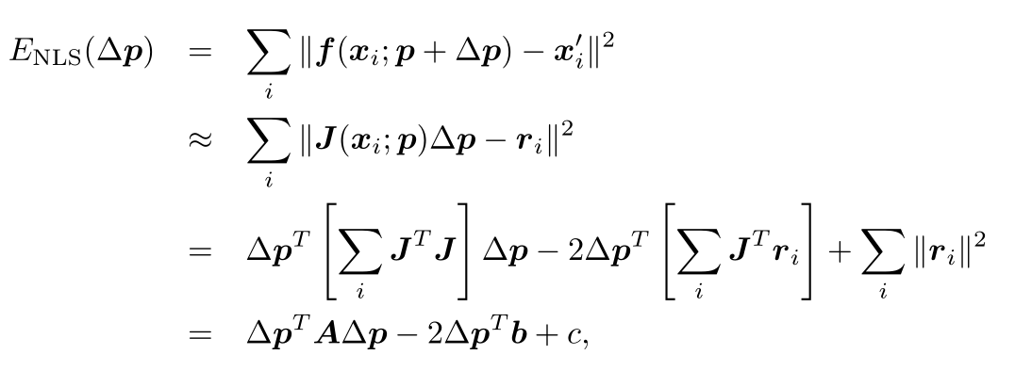
Iterative algorithms
Iteratively find an update Δ𝑝 to the current parameter estimate 𝑝 by minimizing:

Slide 43
Iterative algorithms
Solve the $Δp$ with:
$$\left(A+λdiag\left(A\right)\right)Δp=b$$
$$A=\sum_{i}{J^{T}\left(x_{i}\right)J(x_{i})}$$
$$b=\sum_{i}{J^{T}\left(x_{i}\right)r_{i}}$$
$λ$: an additional damping parameter
ensure that the system takes a “downhill” step in energy
can be set to 0 in many applications
Iteratively update the parameter: $p←p+Δp$

Slide 44
RANSAC and Least Median of Squares
Sometimes, too many outliers will prevent IRLS (or other gradient descent algorithms) from converging to the global optimum.
A better approach is to find a starting set of inlier correspondences
RANSAC (RANdom SAmple Consensus)
Least Median of Squares

Slide 45
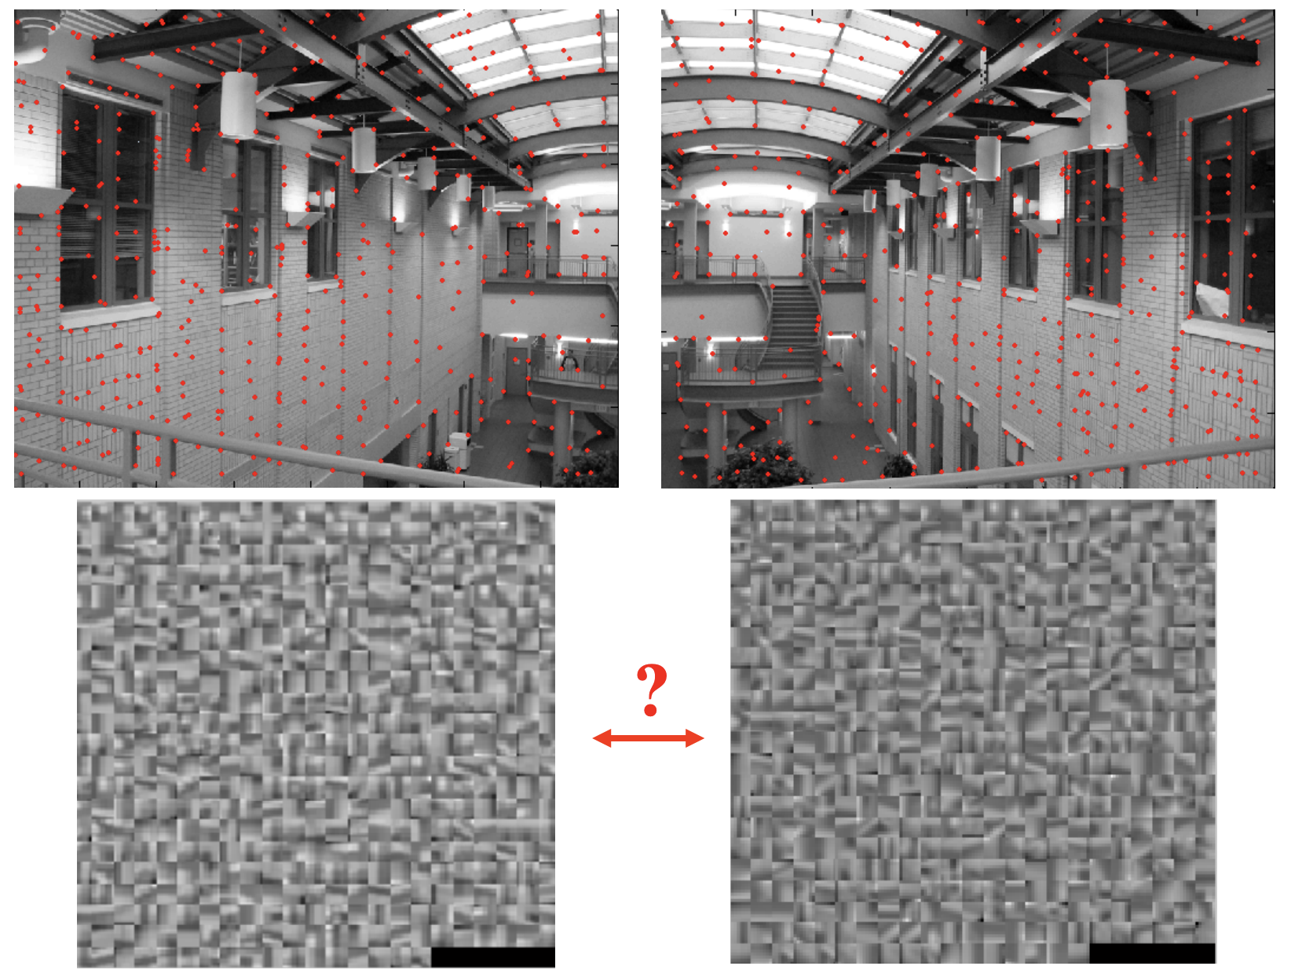
https://people.cs.umass.edu/~elm/Teaching/ppt/370/370_10_RANSAC.pptx.pdf

Slide 46
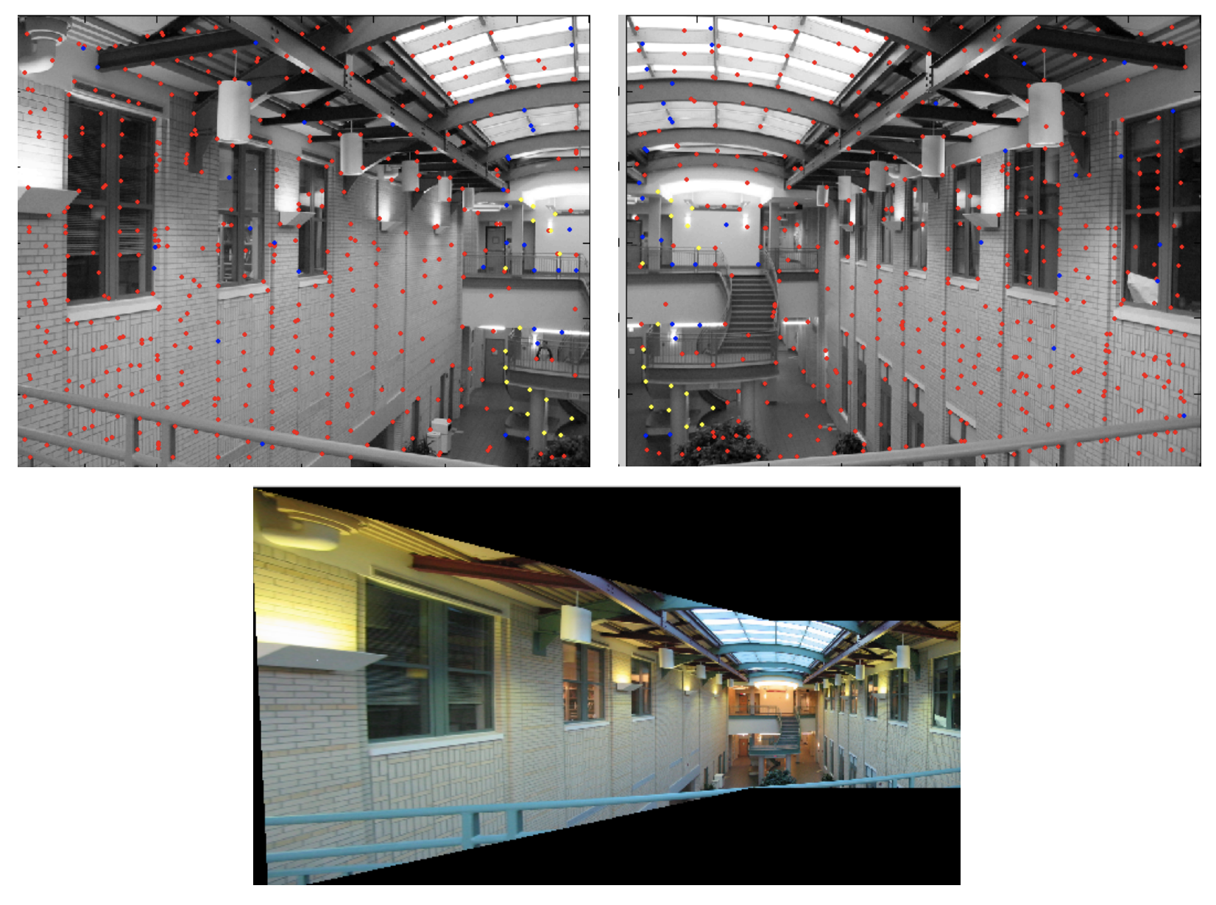
https://people.cs.umass.edu/~elm/Teaching/ppt/370/370_10_RANSAC.pptx.pdf

Slide 47
Outlier rejection
Remove some outlier and preserve those “similar enough” matches.
Sum of Squared Differences (SSD)
SSD(patch1, patch2) < threshold
Compute the initial estimate of H, and count the number of the inliers, whose $\left\|r_{i}\right\|≤ε$

Slide 48
RANSAC and Least Median of Squares
Random select 4 or more feature pairs
Compute the initial estimate of H
Compute the inlier which SSD($p^{′}, Hp$) $≤ε$
Keep largest set of inliers
Re-compute least-squares H estimate on all of the inliers

Slide 49
RANSAC and Least Median of Squares
The random selection process is repeated 𝑆 times
The sample set with the largest number of inliers (or with the smallest median residual) is kept as the final solution

Slide 50
Preemptive RANSAC
Only score a subset of the measurements in an initial round
Select the most plausible hypotheses for additional scoring and selection
Significantly speed up its performance

Slide 51
PROSAC
PROgressive ample Consensus
Random samples are initially added from the most “confident” matches
Speeding up the process of finding a likely good set of inliers

Slide 52
RANSAC
S must be large enough to ensure that random sampling has a good chance of finding a true set of inliers:
$$S=\frac{log⁡(1−P)}{log⁡(1−p^{k})}$$
P: probability of success
$p$: probability of inlier
$k$: number of sample points

Slide 53
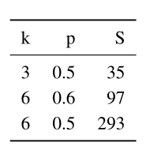
RANSAC
Number of trials $S$ to attain a 99% probability of success:

Slide 54
RANSAC
The number of trials S grows quickly with the number of sample points k used
Use the minimum number of sample points to reduce the number of trials
Which is also normally used in practice

Slide 55
3D Alignment
Many computer vision applications require the alignment of 3D points
Linear 3D transformations can use regular least squares to estimate parameters

Slide 56
3D Alignment
Rigid (Euclidean) motion:
$$E_{R3D}=\sum_{i}{{\left\|x_{i}^{′}−Rx_{i}−t\right\|}^{2}}$$
$t=c^{′}−Rc$
We can center the point clouds:
$$\left\{{\hat{x}}_{i}=x_{i}−c\right\}$$
$$\{{\hat{x}}_{i}^{′}=x_{i}^{′}−c′\}$$
Estimate the rotation between ${\hat{x}}_{i}$ and ${\hat{x}}_{i}^{′}$

Slide 57
3D Alignment
Orthogonal Procrustes algorithm
Computing the Singular Value Decomposition (SVD) of $3×3$ correlation matrix:
$$C=\sum_{i}{{\hat{x}}_{i}^{′}{\hat{x}}_{i}^{T}}=UΣV^{T}$$
$$R=UV^{T}$$

Slide 58
3D Alignment
Absolute orientation algorithm
Estimate the unit quaternion corresponding to the rotation matrix $R$
Form a 4×4 matrix from the entries in $C$
Find the eigenvector associated with its largest positive eigenvalue

Slide 59
3D Alignment
The difference of these two techniques’ accuracy is negligible (below the effects of measurement noise)
Sometimes these closed-form algorithms are not applicable

Slide 60
http://old.cescg.org/CESCG-2007/papers/Bonn-Koertgen-Marcel/

Slide 61
Pose Estimation
Estimate an object’s 3D pose from a set of 2D point projections
Linear algorithms
Iterative algorithms

Slide 62
Pose Estimation - Linear Algorithms
Simplest way to recover the pose of the camera
Form a set of linear equations analogous to those used for 2D motion estimation from the camera matrix form of perspective projection

Slide 63
Pose Estimation - Linear Algorithms
$p=Cp^{′}=K[R|t]p^{′}$

Slide 64
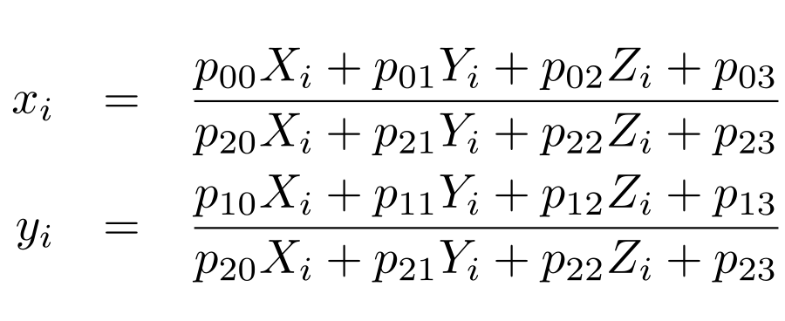
Pose Estimation - Linear Algorithms
$\left(x_{i},y_{i}\right)$: measured 2D feature locations
$(X_{i},Y_{i},Z_{i})$: known 3D feature locations

Slide 65
Pose Estimation - Linear Algorithms

Slide 66
Pose Estimation - Linear Algorithms
Solve the camera matrix $P$ in a linear fashion
multiply the denominator on both sides of the equation
Denominator($D$):
$$p_{20}X_{i}+p_{21}Y_{i}+p_{22}Z_{i}+p_{23}$$

Slide 67
Pose Estimation - Linear Algorithms
Direct Linear Transform (DLT)
At least six correspondences are needed to compute the 12 (or 11) unknowns in $P$
More accurate estimation of $P$ can be obtained by non-linear least squares with a small number of iterations.

Slide 68
Pose Estimation - Linear Algorithms
$$P=K[R|t]$$
Recover both the intrinsic calibration matrix $K$ and the rigid transformation $(R,t)$
$K$ and $R$ can be obtained from the front 3 × 3 sub-matrix of $P$ using $RQ$ factorization

Slide 69
Pose Estimation - Linear Algorithms
In most applications, we have some prior knowledge about the intrinsic calibration matrix $K$
Constraints can be incorporated into a non-linear minimization of the parameters in $K$ and $(R,t)$

Slide 70
Pose Estimation - Linear Algorithms
In the case where the camera is already calibrated: the matrix $K$ is known
we can perform pose estimation using as few as three points

Slide 71
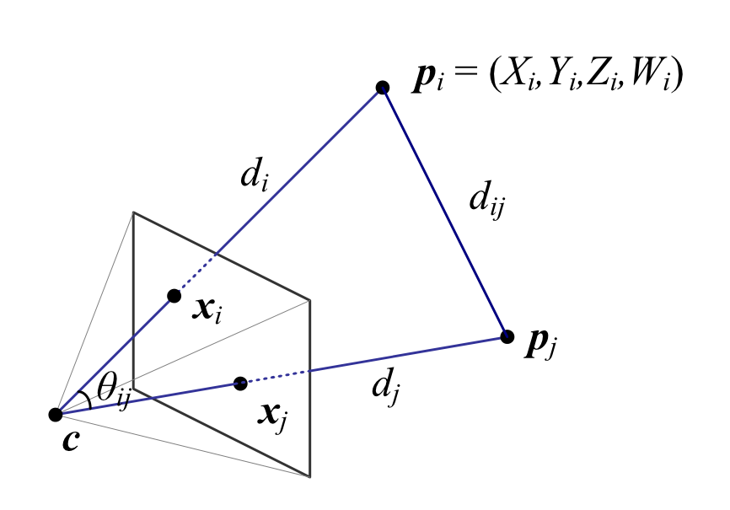
Pose Estimation - Linear Algorithms
${\hat{x}}_{i}$: unit directions of $x_{i}$
The visual angle $θ_{ij}$ between any pair of 2D points ${\hat{x}}_{i}$ and ${\hat{x}}_{j}$ must be the same as the angle between their corresponding 3D points $p_{i}$ and $p_{j}$

Slide 72
Pose Estimation - Linear Algorithms
$${\hat{x}}_{i}=𝒩\left(K^{−1}x_{i}\right)=\frac{K^{−1}x_{i}}{\left\|K^{−1}x_{i}\right\|}$$
$$p_{i}=d_{i}{\hat{x}}_{i}+c$$

Slide 73
Pose Estimation - Linear Algorithms
The cosine law gives:
$$d_{ij}^{2}=d_{i}^{2}+d_{j}^{2}−2d_{i}d_{j}cos{θ_{ij}} \\ =d_{i}^{2}+d_{j}^{2}−2d_{i}d_{j}{\hat{x}}_{i}{\hat{x}}_{j} \\ ={\left\|p_{i}−p_{j}\right\|}^{2}$$

Slide 74
Pose Estimation - Linear Algorithms
We can take any triplet of constraints and using Sylvester resultants to obtain a quartic equation in $d_{i}^{2}$:
$$g_{ijk}\left(d_{i}^{2}\right)=a_{4}d_{i}^{8}+a_{3}d_{i}^{6}+a_{2}d_{i}^{4}+a_{1}d_{i}^{2}+a_{0}=0$$

Slide 75
Pose Estimation - Linear Algorithms
Given five or more correspondences, we can obtain a linear estimate (using SVD) for the values of $(d_{i}^{8},d_{i}^{6},d_{i}^{4},d_{i}^{2})$
Computed $d_{i}^{2n+2}/d_{i}^{2n}$ to estimate $d_{i}^{2}$ and $d_{i}$

Slide 76
Pose Estimation - Linear Algorithms
We can generate a 3D structure consisting of the scaled point directions $d_{i}{\hat{x}}_{i}$
Use 3D Alignment to obtain the desired pose estimation

Slide 77
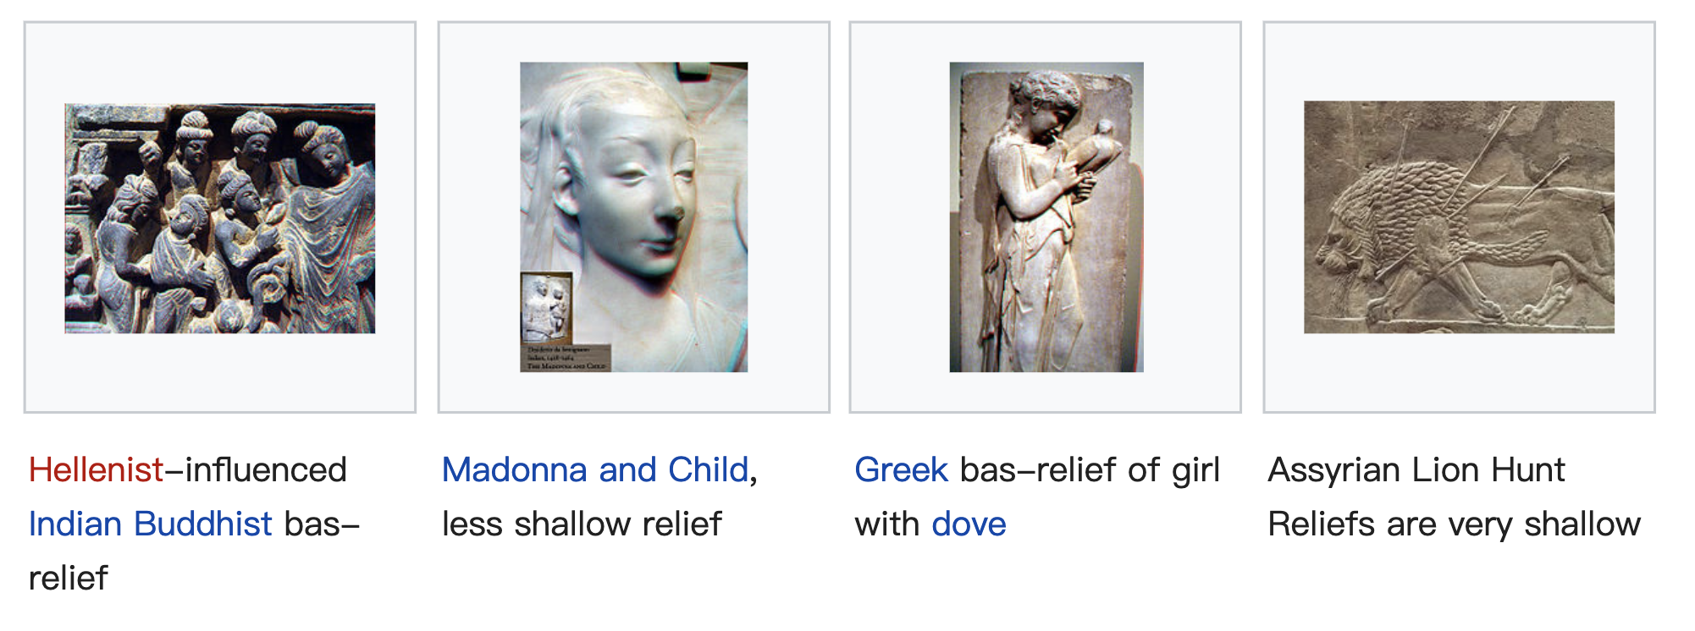
Pose Estimation - Linear Algorithms
Minimal PnP solutions can be quite noise sensitive
Also suffer from bas-relief ambiguities
Use the linear algorithm to obtain an initial pose estimation
Optimize this estimation using the iterative algorithm

Slide 78
Pose Estimation - Iterative Algorithms
The most accurate (and flexible) way to estimate pose is using non-linear least squares
Projection equations:
$$x_{i}=f(p_{i};R,t,K)$$

Slide 79
Pose Estimation - Iterative Algorithms
Iteratively minimize the robustified linearized reprojection errors:

Slide 80
Pose Estimation - Iterative Algorithms
An easier to understand (and implement) version of the above non-linear regression problem can be constructed by re-writing the projection equations as a concatenation of simpler steps

Slide 81
Pose Estimation - Iterative Algorithms

Slide 82
Geometric Intrinsic Calibration
Intrinsic and extrinsic calibration can be computed at the same time
Intrinsic calibration: Internal camera calibration parameters
Extrinsic calibration: Pose of the camera
The classic approach to camera calibration

Slide 83
Calibration patterns
One of the more reliable ways to estimate a camera’s intrinsic parameters
In photogrammetry, it is common to set up a camera in a large field looking at distant calibration targets whose exact location has been pre-computed using surveying equipment

Slide 84
Calibration patterns

Slide 85
Calibration patterns
Span the calibration object as much of the workspace as possible if a smaller calibration rig needs to be used
Estimate the covariance in the parameters to determine the quality of calibration

Slide 86
Vanishing points
A man-made scene with a lot of rectangular objects such as boxes or room walls
Intersect the 2D lines corresponding to 3D parallel lines to compute their vanishing points
Use these to determine the intrinsic and extrinsic calibration parameters

Slide 88
Vanishing points

Slide 89
Vanishing points
Assume a simplified form for the calibration matrix $K$ where only the focal length is unknown
$${\hat{x}}_{i}=\left[\begin{matrix}x_{i}−c_{x} \\ y_{i}−c_{y} \\ f\end{matrix}\right]∼Rp_{i}=r_{i}$$
$p_{i}$: $\left(1,0,0\right)$, $(0,1,0)$, or $(0,0,1)$
$r_{i}$: $i$th column of the rotation matrix $R$

Slide 90
Vanishing points
Columns of the rotation matrix are orthogonal
$$\left(x_{i}−c_{x}\right)\left(x_{j}−c_{x}\right)+\left(y_{i}−c_{y}\right)\left(y_{j}−c_{y}\right)+f^{2}=0$$
We can obtain an estimate for $f^{2}$

Slide 91
Vanishing points
It is also possible to estimate the optical center as the orthocenter of the triangle formed by the three vanishing points
It is more accurate to re-estimate using non-linear least squares

Slide 92
Rotational motion
When no calibration targets are available but you can rotate the camera around its front nodal point
We can calibrate the camera from a set of overlapping images by assuming that it is undergoing pure rotational motion

Slide 93
Rotational motion

Slide 94
Radial distortion
When images are taken with wide-angle lenses, it is often necessary to model lens distortions such as radial distortion
barrel distortion
pincushion distortion

Slide 95
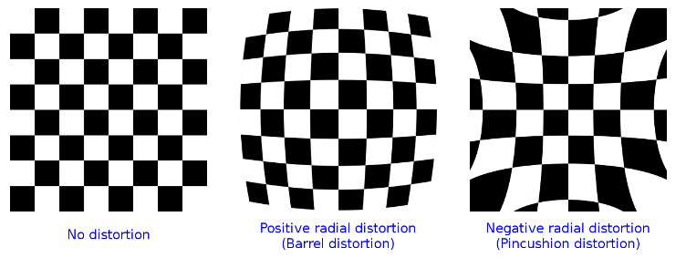
Radial distortion

Slide 96
Radial distortion
$$\hat{x}=x\left(1+k_{1}r^{2}+k_{2}r^{4}\right)$$
$$\hat{y}=y(1+k_{1}r^{2}+k_{2}r^{4})$$
$r^{2}=x^{2}+y^{2}$
$k_{1},k_{2}$: radial distortion parameters

Slide 98
Radial distortion
A lot of different ways to estimate the radial distortion parameters
One of the simplest and most useful way:
Take an image of a scene with a lot of straight lines
Adjust the parameters until all of the lines are straight
Plumb-line method

Slide 99
Radial distortion
Another approach is to use several overlapping images and to combine the estimation of the radial distortion parameters with the image alignment process

Slide 100
Radial distortion
We can add another stage to the general non-linear minimization pipeline between $f_{C} and f_{P}$when a known calibration target is used

Slide 101
Radial distortion
Sometimes we need more general models of lens distortion
The general approach of either using calibration rigs with known 3D positions or self-calibration through the use of multiple overlapping images of a scene can both be used

