Slide 1
Chapter 6 Feature-based alignment
Advanced Computer Vision
高咸培
Hsien-Pei Kao
jack805201@hotmail.com
0928082150

Slide 2
Feature-based Alignment
Match extracted features across different images
Verify the geometrical consistency of matching features
Applications:
Image stitching
Augmented reality
…

Slide 4
Feature-based Alignment
Outline:
2D and 3D feature-based alignment
Pose estimation
Geometric intrinsic calibration

Slide 5
2D and 3D Feature-based Alignment
Estimate the motion between two or more sets of matched 2D or 3D points
In this section:
Restrict to global parametric transformations
Curved surfaces with higher order transformation
Non-rigid or elastic deformations will not be discussed here.

Slide 6
2D and 3D Feature-based Alignment
Basic set of 2D planar transformations

Slide 7
2D and 3D Feature-based Alignment

Slide 8
2D Alignment Using Least Squares
Given a set of matched feature points $\left\{\left(x_{i},x_{i}^{′}\right)\right\}$
A planar parametric transformation:
$$x^{′}=f\left(x;p\right)$$
$p$ are the parameters of the function $f$
How to estimate the motion parameters $p$?

Slide 9
2D Alignment Using Least Squares
Residual:
$$r_{i}=x_{i}^{′}−f\left(x_{i};p\right)=\hat{x_{i}}−\tilde{x_{i}}$$
$\hat{x_{i}}$: the measured location
$\tilde{x_{i}}$: the predicted location

Slide 10
2D Alignment Using Least Squares
Least squares:
Minimize the sum of squared residuals
$$E_{LS}=\sum_{i}{{\left\|r_{i}\right\|}^{2}}=\sum_{i}{{\left\|f\left(x_{i};p\right)−x_{i}^{′}\right\|}^{2}}$$

Slide 11
2D Alignment Using Least Squares
Many of the motion models have a linear relationship:
$$Δx=x^{′}−x=J\left(x\right)p$$
$J=∂f/∂p$: The Jacobian of the transformation $f$

Slide 12
2D Alignment Using Least Squares

Slide 13
2D Alignment Using Least Squares
Linear least squares:

Slide 14
2D Alignment Using Least Squares
Find the minimum by solving:
$$Ap=b$$
$$A=\sum_{i}{J^{T}\left(x_{i}\right)J(x_{i})}$$
$$b=\sum_{i}{J^{T}\left(x_{i}\right)Δx_{i}}$$

Slide 15
Iterative algorithms
Most problems do not have a simple linear relationship
non-linear least squares
non-linear regression

Slide 16
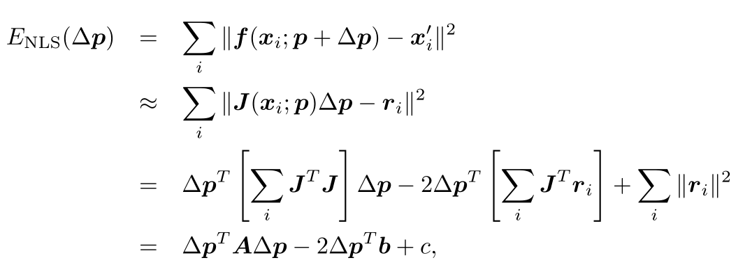
Iterative algorithms
Iteratively find an update $Δp$ to the current parameter estimate $p$ by minimizing:

Slide 17
Iterative algorithms
Solve the $Δp$ with:
$$\left(A+λdiag\left(A\right)\right)Δp=b$$
$$A=\sum_{i}{J^{T}\left(x_{i}\right)J(x_{i})}$$
$$b=\sum_{i}{J^{T}\left(x_{i}\right)r_{i}}$$

Slide 18
Iterative algorithms
$λ$: an additional damping parameter
ensure that the system takes a “downhill” step in energy
can be set to 0 in many applications
Iteratively update the parameter
$$p←p+Δp$$

Slide 19
Projective 2D Motion
$$x^{′}=\frac{\left(1+h_{00}\right)x+h_{01}y+h_{02}}{h_{20}x+h_{21}y+1}$$
$$y^{′}=\frac{h_{10}x+\left(1+h_{11}\right)y+h_{12}}{h_{20}x+h_{21}y+1}$$

Slide 20
Projective 2D Motion
Jacobian:
$$D=h_{20}x+h_{21}y+1$$

Slide 21
Projective 2D Motion
Multiply both sides by the denominator($D$) to obtain an initial guess for $\{h_{00},h_{01},…,h_{21}\}$
Not an optimal form

Slide 22
Projective 2D Motion
One way is to reweight each equation by $\frac{1}{D}$:
Performs better in practice

Slide 23
Projective 2D Motion
The most principled way to do the estimation is using the Gauss–Newton approximation
Converge to a local minimum with proper checking for downhill steps

Slide 24
Projective 2D Motion
An alternative compositional algorithm with simplified formula:

Slide 25
Robust least squares
More robust versions of least squares are required when there are outliers among the correspondences

Slide 26
Robust least squares
M−estimator: apply a robust penalty function $ρ(r)$ to the residuals
$$E_{RLS}\left(Δp\right)=\sum_{i}{ρ(\left\|r_{i}\right\|)}$$

Slide 27
Robust least squares
Weight function $w\left(r\right)$
Finding the stationary point is equivalent to minimizing the iteratively reweighted least squares:
$$E_{IRLS}=\sum_{i}{w\left(\left\|r_{i}\right\|\right){\left\|r_{i}\right\|}^{2}}$$

Slide 28
RANSAC and Least Median of Squares
Sometimes, too many outliers will prevent IRLS (or other gradient descent algorithms) from converging to the global optimum.
A better approach is find a starting set of inlier correspondences

Slide 29
RANSAC and Least Median of Squares
RANSAC (RANdom SAmple Consensus)
Least Median of Squares

Slide 30
RANSAC and Least Median of Squares
Start by selecting a random subset of $k$ correspondences
Compute an initial estimate of $p$
RANSAC counts the number of the inliers, whose $\left\|r_{i}\right\|≤ε$
Least median of Squares finds the median of ${\left\|r_{i}\right\|}^{2}$

Slide 31
RANSAC and Least Median of Squares
The random selection process is repeated $S$ times
The sample set with the largest number of inliers (or with the smallest median residual) is kept as the final solution
Notes:
https://www.youtube.com/watch?v=UV9DeftTqNk

Slide 32
Preemptive RANSAC
Only score a subset of the measurements in an initial round
Select the most plausible hypotheses for additional scoring and selection
Significantly speed up its performance

Slide 33
PROSAC
PROgressive SAmple Consensus
Random samples are initially added from the most “confident” matches
Speeding up the process of finding a likely good set of inliers

Slide 34
RANSAC
$S$must be large enough to ensure that the random sampling has a good chance of finding a true set of inliers:
$S=\frac{log⁡(1−P)}{log⁡(1−p^{k})}$
$P$: $\text{probability} \text{of} \text{success}$
$p$: $\text{probability} \text{of} \text{inlier}$
k: number of sample points
Notes:
$$P=1−{\left(1 −p^{k}\right)}^{s}$$

Slide 35
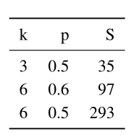
RANSAC
Number of trials $S$ to attain a 99% probability of success:

Slide 36
RANSAC
The number of trials S grows quickly with the number of sample points k used
Use the minimum number of sample points to reduce the number of trials
Which is also normally used in practice

Slide 37
3D Alignment
Many computer vision applications require the alignment of 3D points
Linear 3D transformations can use regular least squares to estimate parameters

Slide 38
3D Alignment
Rigid (Euclidean) motion:
$$E_{R3D}=\sum_{i}{{\left\|x_{i}^{′}−Rx_{i}−t\right\|}^{2}}$$
$t=c^{′}−Rc$
We can center the point clouds:
$$\left\{{\hat{x}}_{i}=x_{i}−c\right\}$$
$$\{{\hat{x}}_{i}^{′}=x_{i}^{′}−c′\}$$
Estimate the rotation between ${\hat{x}}_{i}$ and ${\hat{x}}_{i}^{′}$

Slide 39
3D Alignment
Orthogonal Procrustes algorithm
computing the singular value decomposition (SVD) of the 3 × 3 correlation matrix:
$$C=\sum_{i}{{\hat{x}}_{i}^{′}{\hat{x}}_{i}^{T}}=UΣV^{T}$$
$$R=UV^{T}$$

Slide 40
3D Alignment
Absolute orientation algorithm
Estimate the unit quaternion corresponding to the rotation matrix $R$
Form a 4×4 matrix from the entries in $C$
Find the eigenvector associated with its largest positive eigenvalue

Slide 41
3D Alignment
The difference of these two techniques’ accuracy is negligible (below the effects of measurement noise)
Sometimes these closed-form algorithms are not applicable

Slide 42
Pose Estimation
Estimate an object’s 3D pose from a set of 2D point projections
Linear algorithms
Iterative algorithms

Slide 43
Pose Estimation - Linear Algorithms
Simplest way to recover the pose of the camera
Form a set of linear equations analogous to those used for 2D motion estimation from the camera matrix form of perspective projection

Slide 44
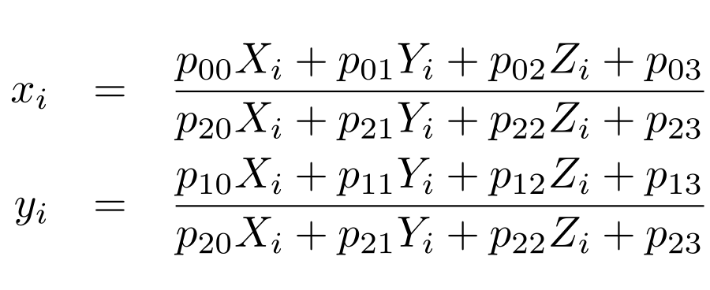
Pose Estimation - Linear Algorithms
$\left(x_{i},y_{i}\right)$: measured 2D feature locations
$(X_{i},Y_{i},Z_{i})$: known 3D feature locations

Slide 45
Pose Estimation - Linear Algorithms

Slide 46
Pose Estimation - Linear Algorithms
Solve the camera matrix $P$ in a linear fashion
multiply the denominator on both sides of the equation
Denominator($D$):
$$p_{20}X_{i}+p_{21}Y_{i}+p_{22}Z_{i}+p_{23}$$

Slide 47
Pose Estimation - Linear Algorithms
Direct Linear Transform (DLT)
At least six correspondences are needed to compute the 12 (or 11) unknowns in $P$
More accurate estimation of $P$ can be obtained by non-linear least squares with a small number of iterations.

Slide 48
Pose Estimation - Linear Algorithms
$$P=K[R|t]$$
Recover both the intrinsic calibration matrix $K$ and the rigid transformation $(R,t)$
$K$ and $R$ can be obtained from the front 3 × 3 sub-matrix of $P$ using $RQ$ factorization

Slide 49
Pose Estimation - Linear Algorithms
In most applications, we have some prior knowledge about the intrinsic calibration matrix $K$
Constraints can be incorporated into a non-linear minimization of the parameters in $K$ and $(R,t)$

Slide 50
Pose Estimation - Linear Algorithms
In the case where the camera is already calibrated: the matrix $K$ is known
we can perform pose estimation using as few as three points

Slide 51
Pose Estimation - Linear Algorithms
${\hat{x}}_{i}$: unit directions of $x_{i}$
The visual angle $θ_{ij}$ between any pair of 2D points ${\hat{x}}_{i}$ and ${\hat{x}}_{j}$ must be the same as the angle between their corresponding 3D points $p_{i}$ and $p_{j}$

Slide 52
Pose Estimation - Linear Algorithms
$${\hat{x}}_{i}=𝒩\left(K^{−1}x_{i}\right)=\frac{K^{−1}x_{i}}{\left\|K^{−1}x_{i}\right\|}$$
$$p_{i}=d_{i}{\hat{x}}_{i}+c$$

Slide 53
Pose Estimation - Linear Algorithms
The cosine law gives:
$$d_{ij}^{2}=d_{i}^{2}+d_{j}^{2}−2d_{i}d_{j}cos{θ_{ij}} \\ =d_{i}^{2}+d_{j}^{2}−2d_{i}d_{j}{\hat{x}}_{i}{\hat{x}}_{j} \\ ={\left\|p_{i}−p_{j}\right\|}^{2}$$

Slide 54
Pose Estimation - Linear Algorithms
We can take any triplet of constraints and using Sylvester resultants to obtain a quartic equation in $d_{i}^{2}$:
$$g_{ijk}\left(d_{i}^{2}\right)=a_{4}d_{i}^{8}+a_{3}d_{i}^{6}+a_{2}d_{i}^{4}+a_{1}d_{i}^{2}+a_{0}=0$$

Slide 55
Pose Estimation - Linear Algorithms
Given five or more correspondences, we can obtain a linear estimate (using SVD) for the values of $(d_{i}^{8},d_{i}^{6},d_{i}^{4},d_{i}^{2})$
Computed $d_{i}^{2n+2}/d_{i}^{2n}$ to estimate $d_{i}^{2}$ and $d_{i}^{}$

Slide 56
Pose Estimation - Linear Algorithms
We can generate a 3D structure consisting of the scaled point directions $d_{i}{\hat{x}}_{i}$
Use 3D Alignment to obtain the desired pose estimation

Slide 57
Pose Estimation - Linear Algorithms
Minimal PnP solutions can be quite noise sensitive
Also suffer from bas-relief ambiguities
Use the linear algorithm to obtain an initial pose estimation
Optimize this estimation using the iterative algorithm

Slide 58
Pose Estimation - Iterative Algorithms
The most accurate (and flexible) way to estimate pose is using non-linear least squares
Projection equations:
$$x_{i}=f(p_{i};R,t,K)$$

Slide 59
Pose Estimation - Iterative Algorithms
Iteratively minimize the robustified linearized reprojection errors:

Slide 60
Pose Estimation - Iterative Algorithms
An easier to understand (and implement) version of the above non-linear regression problem can be constructed by re-writing the projection equations as a concatenation of simpler steps

Slide 61
Pose Estimation - Iterative Algorithms

Slide 62
Geometric Intrinsic Calibration
Intrinsic and extrinsic calibration can be computed at the same time
Intrinsic calibration: Internal camera calibration parameters
Extrinsic calibration: Pose of the camera
The classic approach to camera calibration

Slide 63
Calibration patterns
One of the more reliable ways to estimate a camera’s intrinsic parameters
In photogrammetry, it is common to set up a camera in a large field looking at distant calibration targets whose exact location has been pre-computed using surveying equipment

Slide 64
Calibration patterns

Slide 65
Calibration patterns
Span the calibration object as much of the workspace as possible if a smaller calibration rig needs to be used
Estimate the covariance in the parameters to determine the quality of calibration

Slide 66
Vanishing points
A man-made scene with a lot of rectangular objects such as boxes or room walls
Intersect the 2D lines corresponding to 3D parallel lines to compute their vanishing points
Use these to determine the intrinsic and extrinsic calibration parameters

Slide 67
Vanishing points

Slide 68
Vanishing points
Assume a simplified form for the calibration matrix $K$ where only the focal length is unknown
$${\hat{x}}_{i}=\left[\begin{matrix}x_{i}−c_{x} \\ y_{i}−c_{y} \\ f\end{matrix}\right]∼Rp_{i}=r_{i}$$
$p_{i}$: $\left(1,0,0\right)$, $(0,1,0)$, or $(0,0,1)$
$r_{i}$: $i$th column of the rotation matrix $R$

Slide 69
Vanishing points
Columns of the rotation matrix are orthogonal
$$\left(x_{i}−c_{x}\right)\left(x_{j}−c_{x}\right)+\left(y_{i}−c_{y}\right)\left(y_{j}−c_{y}\right)+f^{2}=0$$
We can obtain an estimate for $f^{2}$
Notes:
Use dot

Slide 70
Vanishing points
It is also possible to estimate the optical center as the orthocenter of the triangle formed by the three vanishing points
It is more accurate to re-estimate using non-linear least squares

Slide 71
Rotational motion
When no calibration targets are available but you can rotate the camera around its front nodal point
We can calibrate the camera from a set of overlapping images by assuming that it is undergoing pure rotational motion

Slide 72
Rotational motion

Slide 73
Radial distortion
When images are taken with wide-angle lenses, it is often necessary to model lens distortions such as radial distortion
barrel distortion
pincushion distortion

Slide 74
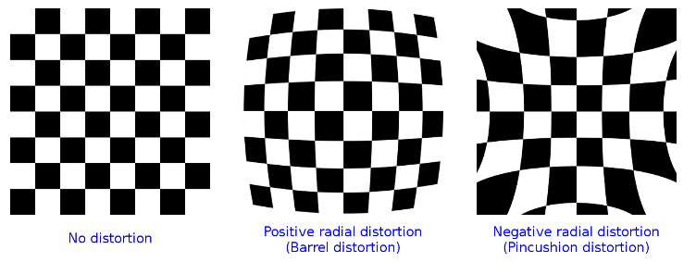
Radial distortion

Slide 75
Radial distortion
$$\hat{x}=x\left(1+k_{1}r^{2}+k_{2}r^{4}\right)$$
$$\hat{y}=y(1+k_{1}r^{2}+k_{2}r^{4})$$
$r^{2}=x^{2}+y^{2}$
$k_{1},k_{2}$: radial distortion parameters

Slide 76
Radial distortion
A lot of different ways to estimate the radial distortion parameters
One of the simplest and most useful way:
Take an image of a scene with a lot of straight lines
Adjust the parameters until all of the lines are straight
Plumb-line method

Slide 77
Radial distortion
Another approach is to use several overlapping images and to combine the estimation of the radial distortion parameters with the image alignment process

Slide 78
Radial distortion
We can add another stage to the general non-linear minimization pipeline between $f_{C} and f_{P}$when a known calibration target is used

Slide 79
Radial distortion
Sometimes we need more general models of lens distortion
The general approach of either using calibration rigs with known 3D positions or self-calibration through the use of multiple overlapping images of a scene can both be used

