Slide 1
Chapter 6 Feature-based alignment
Advanced Computer Vision

Slide 2
Feature-based Alignment
Match extracted features across different images
Verify the geometrically consistent of matching features
Applications:
Image stitching
Augmented reality
…

Slide 3
Feature-based Alignment

Slide 4
Feature-based Alignment
Outline:
2D and 3D feature-based alignment
Pose estimation
Geometric intrinsic calibration
Notes:
3D pose estimation is the problem of determining the transformation of an object in a 2D image which gives the 3D object.

Slide 5
2D and 3D Feature-based Alignment
Estimate the motion between two or more sets of matched 2D or 3D points
In this section:
Restrict to global parametric transformations
Curved surfaces with higher order transformation
Non-rigid or elastic deformations will not be discussed here.

Slide 6
2D and 3D Feature-based Alignment
Basic set of 2D planar transformations

Slide 7
2D and 3D Feature-based Alignment

Slide 8
2D Alignment Using Least Squares
Given a set of matched feature points $\left\{\left(x_{i},x_{i}^{′}\right)\right\}$
A planar parametric transformation:
$$x^{′}=f\left(x;p\right)$$
$p$ are the parameters of the function $f$
How to estimate the motion parameters $p$?

Slide 9
2D Alignment Using Least Squares
Residual:
$$r_{i}=x_{i}^{′}−f\left(x_{i};p\right)=\hat{x_{i}}−\tilde{x_{i}}$$
$\hat{x_{i}}$: the measured location
$\tilde{x_{i}}$: the predicted location

Slide 10
2D Alignment Using Least Squares
Least squares:
Minimize the sum of squared residuals
$$E_{LS}=\sum_{i}{{\left\|r_{i}\right\|}^{2}}=\sum_{i}{{\left\|f\left(x_{i};p\right)−x_{i}^{′}\right\|}^{2}}$$

Slide 11
2D Alignment Using Least Squares
Many of the motion models have a linear relationship:
$$Δx=x^{′}−x=J\left(x\right)p$$
$J=∂f/∂p$: The Jacobian of the transformation $f$

Slide 12
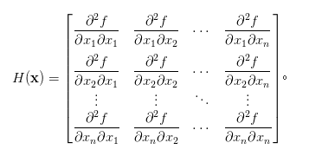
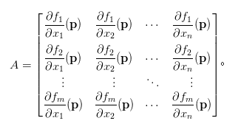
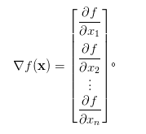
Three Brothers
gradient f的 Jacobian 即為 f 的 Hessian 矩陣。

Slide 13
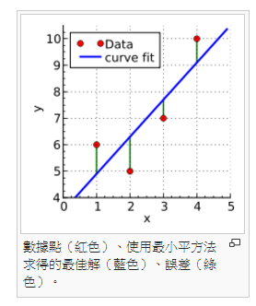
Least squares
某次實驗得到了四個數據點 (x, y)：(1, 6)、(2, 5)、(3, 7)、(4, 10)（右圖中紅色的點）。我們希望找出一條和這四個點最匹配的直線 y=b+ax

Slide 14
The general problem

Slide 15
The general problem
Beta ?
Notes:
The minimum of the sum of squares is found by setting the gradient to zero. Since the model contains m parameters, there are m gradient equations:

Slide 16
2D Alignment Using Least Squares

Slide 17
2D Alignment Using Least Squares
Linear least squares:

Slide 18
2D Alignment Using Least Squares
Find the minimum by solving:
$$Ap=b$$
$$A=\sum_{i}{J^{T}\left(x_{i}\right)J(x_{i})}$$
$$b=\sum_{i}{J^{T}\left(x_{i}\right)Δx_{i}}$$

Slide 19
Iterative algorithms
Most problems do not have a simple linear relationship
non-linear least squares
non-linear regression

Slide 20
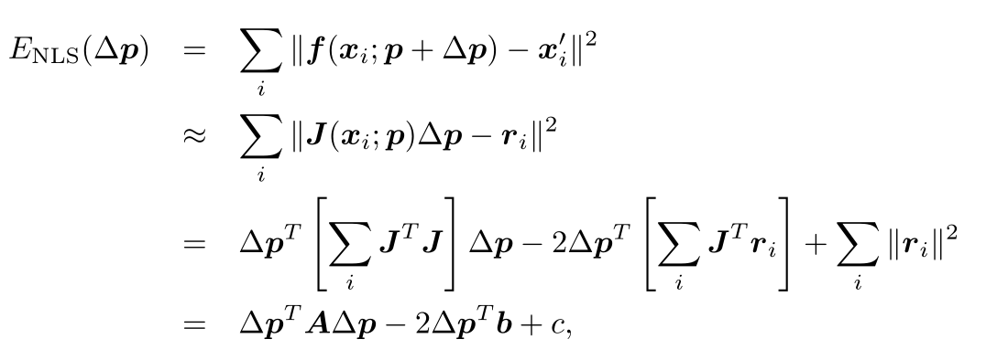
Iterative algorithms
Iteratively find an update $Δp$ to the current parameter estimate $p$ by minimizing:

Slide 21
Iterative algorithms
Solve the $Δp$ with:
$$\left(A+λdiag\left(A\right)\right)Δp=b$$
$$A=\sum_{i}{J^{T}\left(x_{i}\right)J(x_{i})}$$
$$b=\sum_{i}{J^{T}\left(x_{i}\right)r_{i}}$$

Slide 22
Iterative algorithms
$λ$: an additional damping parameter
ensure that the system takes a “downhill” step in energy
can be set to 0 in many applications
Iterative update the parameter
$$p←p+Δp$$

Slide 23
Projective 2D Motion
$$x^{′}=\frac{\left(1+h_{00}\right)x+h_{01}y+h_{02}}{h_{20}x+h_{21}y+1}$$
$$y^{′}=\frac{h_{10}x+\left(1+h_{11}\right)y+h_{12}}{h_{20}x+h_{21}y+1}$$

Slide 24
Projective 2D Motion
Jacobian:
$$D=h_{20}x+h_{21}y+1$$

Slide 25
Projective 2D Motion
Multiply both sides by the denominator($D$) to obtain an initial guess for $\{h_{00},h_{01},…,h_{21}\}$
Not an optimal form

Slide 26
Projective 2D Motion
One way is to reweight each equation by $\frac{1}{D}$:
Performs better in practice

Slide 27
Projective 2D Motion
The most principled way to do the estimation is using the Gauss–Newton approximation
Converge to a local minimum with proper checking for downhill steps

Slide 28
Projective 2D Motion
An alternative compositional algorithm with simplified formula:

Slide 29
Robust least squares
More robust versions of least squares are required when there are outliers among the correspondences

Slide 30
Least squares
某次實驗得到了四個數據點 (x, y)：(1, 6)、(2, 5)、(3, 7)、(4, 10)（右圖中紅色的點）。我們希望找出一條和這四個點最匹配的直線 y=b+ax

Slide 31
Robust least squares
M−estimator: apply a robust penalty function $ρ(r)$ to the residuals
$$E_{RLS}\left(Δp\right)=\sum_{i}{ρ(\left\|r_{i}\right\|)}$$
Least squares:
Minimize the sum of squared residuals
$$E_{LS}=\sum_{i}{{\left\|r_{i}\right\|}^{2}}=\sum_{i}{{\left\|f\left(x_{i};p\right)−x_{i}^{′}\right\|}^{2}}$$

Slide 32
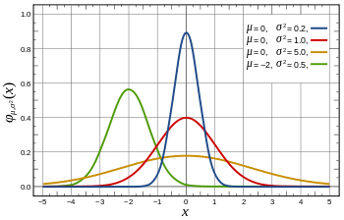
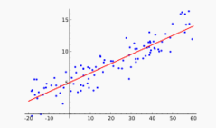
Robust least squares
Weight function $w\left(r\right)$
Finding the stationary point is equivalent to minimizing the iteratively reweighted least squares:
$$E_{IRLS}=\sum_{i}{w\left(\left\|r_{i}\right\|\right){\left\|r_{i}\right\|}^{2}}$$

Slide 33
RANSAC and Least Median of Squares
Sometimes, too many outliers will prevent IRLS (or other gradient descent algorithms) from converging to the global optimum.
A better approach is to find a starting set of inlier correspondences
Notes:
RANdom SAmple Consensus

Slide 34
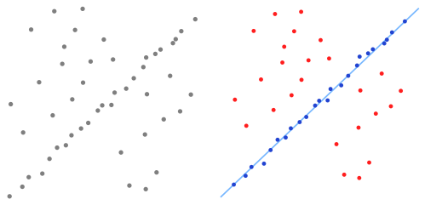
RANSAC and Least Median of Squares
RANSAC (RANdom SAmple Consensus)
Least Median of Squares

Slide 35
RANSAC and Least Median of Squares
Start by selecting a random subset of $k$ correspondences
Compute an initial estimate of $p$
RANSAC counts the number of the inliers, whose $\left\|r_{i}\right\|≤ε$
Least median of Squares finds the median of ${\left\|r_{i}\right\|}^{2}$
Notes:
最小化誤差平方的中位數

Slide 36
RANSAC and Least Median of Squares
The random selection process is repeated $S$ times
The sample set with the largest number of inliers (or with the smallest median residual) is kept as the final solution

Slide 37
PROSAC
PROgressive SAmple Consensus
Random samples are initially added from the most “confident” matches
Speeding up the process of finding a likely good set of inliers

Slide 38
RANSAC
$S$must be large enough to ensure that the random sampling has a good chance of finding a true set of inliers:
$$S=\frac{log⁡(1−P)}{log⁡(1−p^{k})}$$
$P$: $\text{probability} \text{of} \text{success}$
$p$: $\text{probability} \text{of} \text{inlier}$
k: the points we select in one trail

Slide 39
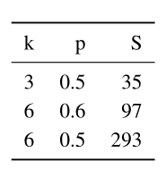
RANSAC
Number of trials $S$ to attain a 99% probability of success:

Slide 40
RANSAC
The number of trials grows quickly with the number of sample points used
Use the minimum number of sample points to reduce the number of trials
Which is also normally used in practice

Slide 41
3D Alignment
Many computer vision applications require the alignment of 3D points
Linear 3D transformations can use regular least squares to estimate parameters

Slide 42
3D Alignment
Rigid (Euclidean) motion:
$$E_{R3D}=\sum_{i}{{\left\|x_{i}^{′}−Rx_{i}−t\right\|}^{2}}$$
We can center the point clouds:
$$\left\{{\hat{x}}_{i}=x_{i}−c\right\}$$
$$\{{\hat{x}}_{i}^{′}=x_{i}^{′}−c′\}$$
Estimate the rotation between ${\hat{x}}_{i}$ and ${\hat{x}}_{i}^{′}$

Slide 43
3D Alignment
Orthogonal Procrustes algorithm
computing the singular value decomposition (SVD) of the 3 × 3 correlation matrix:
$$C=\sum_{i}{{\hat{x}}_{i}^{′}{{\hat{x}}_{i}^{}}^{T}}=UΣV^{T}$$
$$R=UV^{T}$$

Slide 44
3D Alignment
Absolute orientation algorithm
Estimate the unit quaternion corresponding to the rotation matrix $R$
Form a 4×4 matrix from the entries in $C$
Find the eigenvector associated with its largest positive eigenvalue

Slide 45
3D Alignment
The difference of these two techniques is negligible
Below the effects of measurement noise
Sometimes these closed-form algorithms are not applicable
Use incremental rotation update

Slide 46
Pose Estimation
Estimate an object’s 3D pose from a set of 2D point projections
Linear algorithms
Iterative algorithms

Slide 47
Pose Estimation - Linear Algorithms
Simplest way to recover the pose of the camera
Form a set of linear equations analogous to those used for 2D motion estimation from the camera matrix form of perspective projection

Slide 48
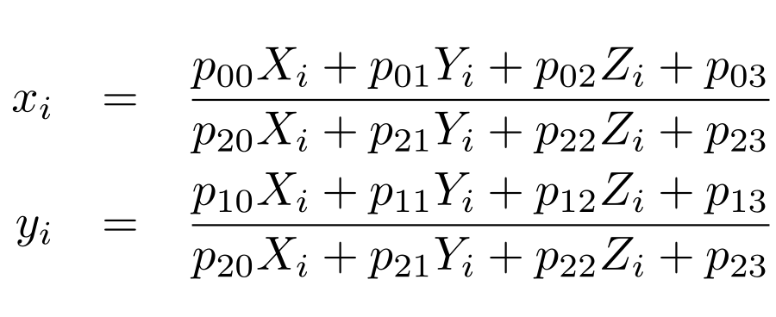
Pose Estimation - Linear Algorithms
$\left(x_{i},y_{i}\right)$: measured 2D feature locations
$(X_{i},Y_{i},Z_{i})$: known 3D feature locations

Slide 49
Pose Estimation - Linear Algorithms
Solve the camera matrix $P$ in a linear fashion
multiply the denominator on both sides of the equation
Denominator($D$):
$$p_{20}X_{i}+p_{21}Y_{i}+p_{22}Z_{i}+p_{23}$$

Slide 50
Pose Estimation - Linear Algorithms
Direct Linear Transform (DLT)
At least six correspondences are needed to compute the 12 (or 11) unknowns in $P$
More accurate estimation of $P$ can be obtained by non-linear least squares with a small number of iterations.

Slide 51
Pose Estimation - Linear Algorithms
$$P=K[R|t]$$
Recover both the intrinsic calibration matrix $K$ and the rigid transformation $(R,t)$
$K$ and $R$ can be obtained from the front 3 × 3 sub-matrix of $P$ using $RQ$ factorization

Slide 52
Pose Estimation - Linear Algorithms
In most applications, we have some prior knowledge about the intrinsic calibration matrix $K$
Constraints can be incorporated into a non-linear minimization of the parameters in $K$ and $(R,t)$

Slide 53
Pose Estimation - Linear Algorithms
In the case where the camera is already calibrated: the matrix $K$ is known
we can perform pose estimation using as few as three points

