Slide 1
Advanced Computer Vision
Chapter 9 Image Stitching
https://goo.gl/dFnLEH
Presented by: 陳毅
b03202042@ntu.edu.tw
指導教授: 傅楸善 博士
Notes:
第9章 影像縫合

Slide 2
Outline
9.0 Introduction
9.1 Motion Models
9.2 Global Alignment
9.3 Compositing
9.4 Additional Reading
9.5 Exercises

Slide 3
9.0 Introduction
What is image stitching?
Goal
Stitch together several images into a seamless composite.

Slide 4
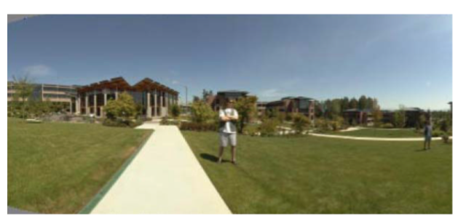
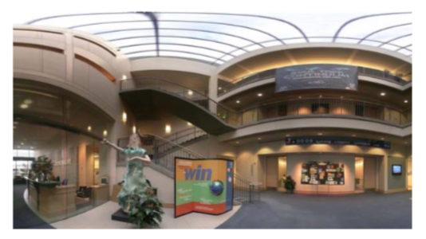
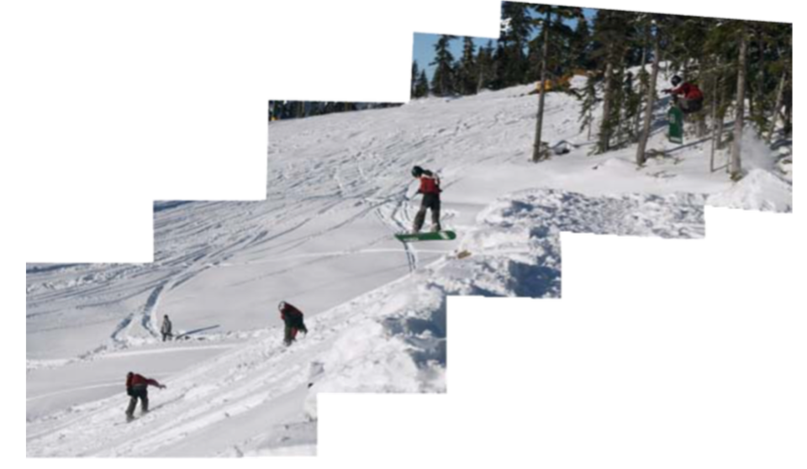
9.0 Introduction
Example: Panorama
Cylindrical panorama
Spherical panorama
https://www.ptgui.com/
Multi-image panorama

Slide 5
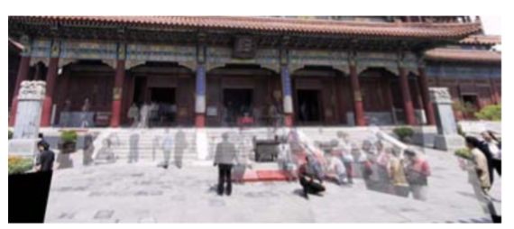
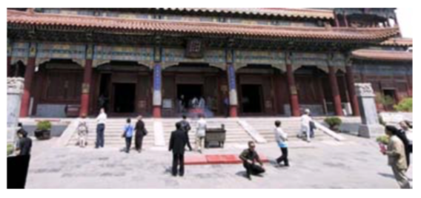
9.0 Introduction
Example: Multi-image
Without moving object removal
With moving object removal

Slide 6
9.0 Introduction
9.1 Motion Models
Review the basic models
Some new motion models related to panoramic image stitching
How to correctly align two images
9.2 Global Alignment
How to correctly align all images
9.3 Compositing
How to blend images

Slide 7
Break time

Slide 8
9.1 Motion Models
9.1.1 Planar Perspective Motion
9.1.2 Application: Whiteboard and Document Scanning
9.1.3 Rotational Panoramas
9.1.4 Gap Closing
9.1.5 Application: Video Summarization and Compression
9.1.6 Cylindrical and Spherical Coordinates
Notes:
實際執行處理觀察的數位影像
需要相鄰的像素點來描述一個模型表面的一般式

Slide 9
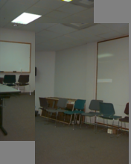
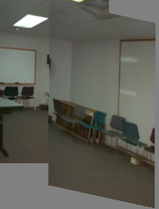
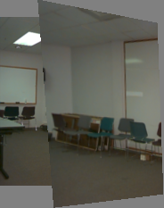
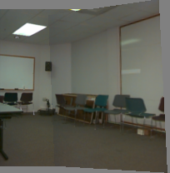
9.1.1 Planar Perspective Motion
Translation
Affine
Perspective
3D rotation
Notes:
Translation(平移)
Affine(仿射)
Perspective(透視)
3D rotation(3D旋轉)

Slide 10
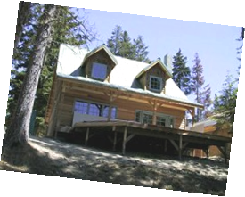
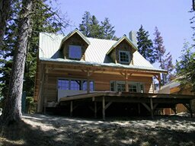
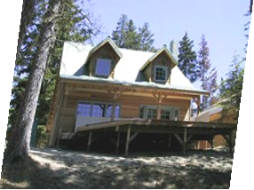
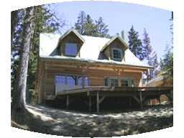
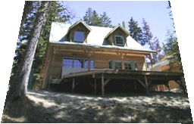
9.1.1 Planar Perspective Motion
Examples of parametric warps
translation
rotation
aspect
affine
perspective
cylindrical
Notes:
warp(變形)
線性投影：translation, rotation, aspect(x與y的伸縮比例可以不一樣), affine, perspective
非線性投影：cylindrical

Slide 11
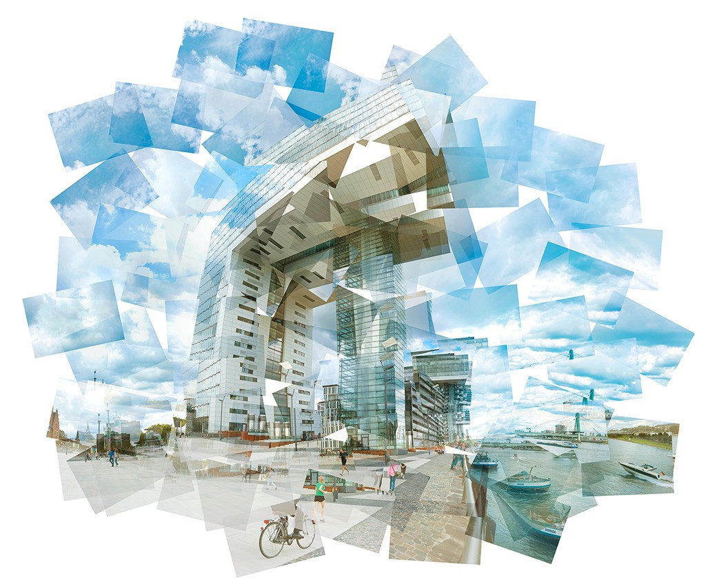
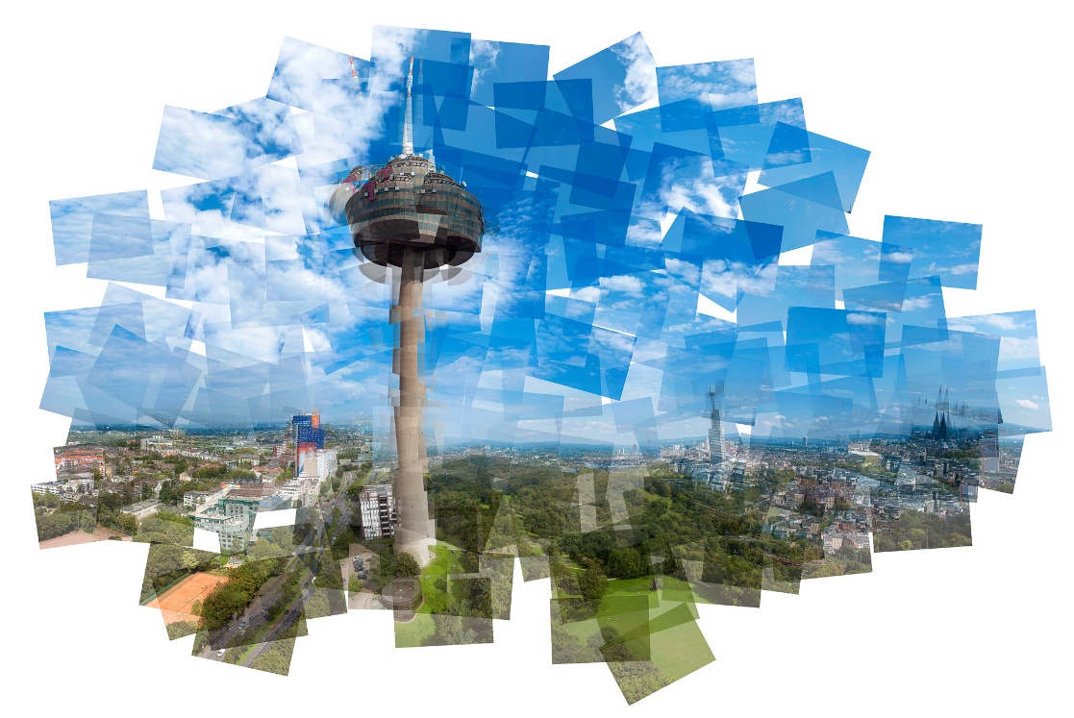
9.1.1 Planar Perspective Motion
Panography
MAREENFISCHINGER
http://mareenfischinger.com/places/panography/

Slide 12
9.1.1 Planar Perspective Motion
In Section 6.1.3, we saw how the mapping between two cameras viewing a common plane can be described using a homography.
$${\tilde{x}}_{1}\sim {\tilde{P}}_{1}{\tilde{P}}_{0}^{−1}{\tilde{x}}_{0}=M_{10}{\tilde{x}}_{0}$$
The resulting homography matrix ${\tilde{H}}_{10}$(the upper left 3*3 sub-matrix of $M_{10}$) describes the mapping between pixels in the two images,
$${\tilde{x}}_{1}\sim ={\tilde{H}}_{10}{\tilde{x}}_{0}$$

Slide 13
9.1.1 Planar Perspective Motion
More recent stitching algorithms first extract features and then match them up, often using robust techniques such as RANSAC (Section 6.1.4) to compute a good set of inliers.
RANSAC: RANdom SAmple Consensus
The final computation of the homography, i.e., the solution of the least squares fitting problem given pairs of corresponding features (see Section 2),
$$x_{1}=\frac{\left(1+h_{00}\right)x_{0}+h_{01}y_{0}+h_{02}}{h_{20}x_{0}+h_{21}y_{0}+1},y_{1}=\frac{h_{10}x_{0}+\left(1+h_{11}\right)y_{0}+h_{12}}{h_{20}x_{0}+h_{21}y_{0}+1}$$
Notes:
RANSAC: RANdom SAmple Consensus

Slide 14
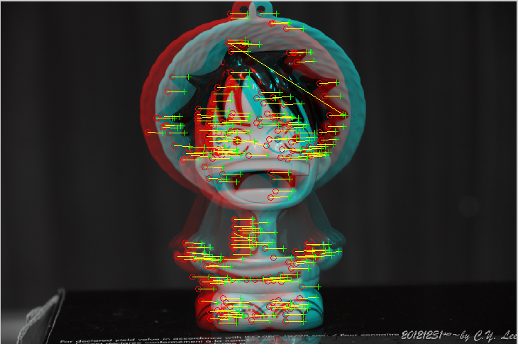
9.1.1 Planar Perspective Motion
Example: RANSAC
outlier
inlier

Slide 15
9.1.2 Application: Whiteboard and Document Scanning
The simplest image-stitching application is to stitch together a number of image scans taken on a flatbed scanner.
Example (the size is too large to fit on your scanner)
A large map
A piece of child’s artwork
Method
2D rigid transform: $x_{k+1}=R_{k}x_{k}+t_{k}$
Sound good! But is there any potential problem?

Slide 16
9.1.2 Application: Whiteboard and Document Scanning
Problem
2D rigid transformation is non-linear in the rotation angle. $x_{k+2}=R_{k+1}\left(R_{k}x_{k}+t_{k}\right)+t_{k+1}$
A bigger problem lies in the pairwise alignment process. As you align more and more pairs, the solution may drift so that it is no longer globally consistent.

Slide 17
9.1.2 Application: Whiteboard and Document Scanning
Solution to Drift Problem
Add another of the first image at the end
Give a constraint: $y_{n}=y_{1}$
Add displacement of ${\left(y_{1}−y_{n}\right)}/{\left(n−1\right)}$ to each image after the first
Compute a global warp $y^{′}=y+ax$
Run a big optimization problem, incorporating this constraint
copy of first image

Slide 18
9.1.2 Application: Whiteboard and Document Scanning

Slide 19
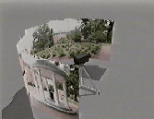
9.1.3 Rotational Panoramas
The most typical case for panoramic image stitching is when the camera undergoes a pure rotation.

Slide 20
9.1.4 Gap Closing

Slide 21
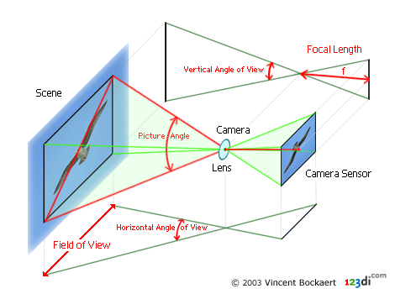
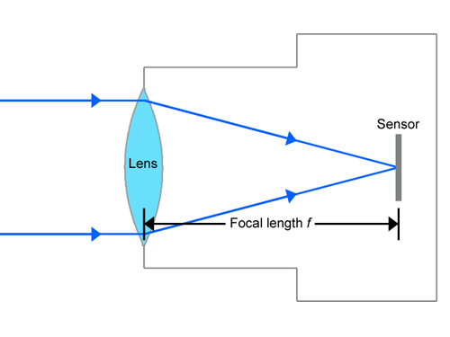
9.1.4 Gap Closing
Focal length
The focal length of a lens is the distance from the image plane to the lens.

Slide 22
Break time

Slide 23
9.1.5 Application: Video Summarization and Compression

Slide 24
9.1.5 Application: Video Summarization and Compression
=
+
Input
Segmentation result
前後景分離
Result by: L.Zelnik-Manor, M.Irani
“Multi-frame estimation of planar motion”, PAMI 2000

Slide 25
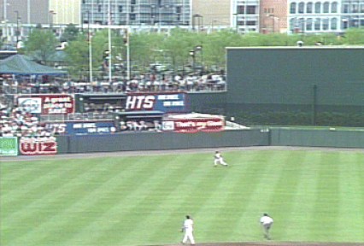
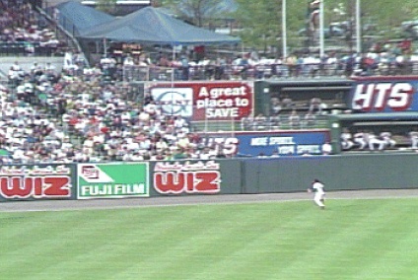
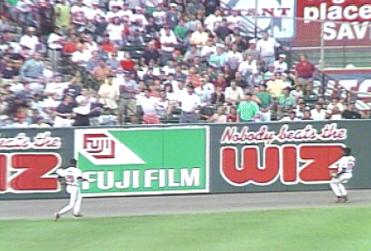
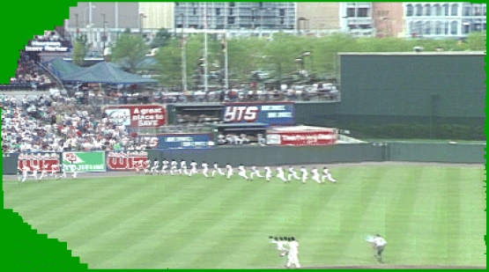
9.1.5 Application: Video Summarization and Compression

Slide 26
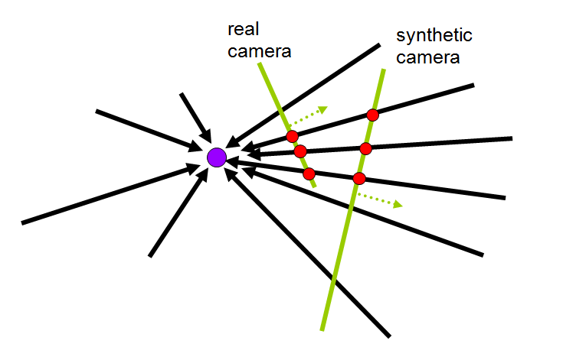
9.1.6 Cylindrical and Spherical Coordinates
An alternative to using homographies or 3D motions to align images is to first warp the images into cylindrical coordinates and then use a pure translational model to align them.
Main Advantage: Reduce distortion due to stitching.
Notes:
在攝影機只進行旋轉的情況下，我們能夠將影像投影到圓柱上，從直角坐標轉換成圓柱座標。
由於二維影像沒有影像深度的資訊，只有角度以及高度的資訊。因此我們可以很輕鬆的將角度及高度相同的pixels對應在一起。 這樣的話，能夠很單純轉動角度來對齊影像。

Slide 27
9.1.6 Cylindrical and Spherical Coordinates

Slide 28
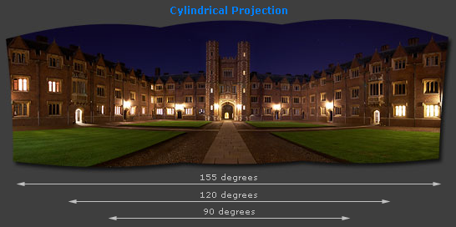
9.1.6 Cylindrical and Spherical Coordinates

Slide 29
9.1.6 Cylindrical and Spherical Coordinates
Purpose
We wish to project the image onto cylindrical surface of unit radius

Slide 30
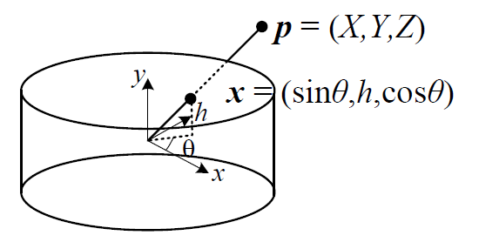
9.1.6 Cylindrical and Spherical Coordinates
Points on this surface are parameterized by an angle and a height $h$, with the 3D cylindrical coordinates corresponding to $\left(θ,h\right)$ given by:
$$\left(\sin{θ},h,\cos{θ}\right)∝\left(x,y,f\right)$$
$$x^{′}=sθ=s\tan^{−1}{\frac{x}{f}} y^{′}=sh=s\frac{y}{\sqrt{x^{2}+f^{2}}}$$
$s$ is an arbitrary scaling factor (sometimes called the radius of the cylinder)
We can set $s=f$ to minimize the distortion (scaling) near the center of the image.
Notes:
請注意，課本所附的這張圖有畫錯。

Slide 31
9.1.6 Cylindrical and Spherical Coordinates
Images can also be projected onto a spherical surface, which is useful if the final panorama includes a full sphere or hemisphere of views, instead of just a cylindrical strip.

Slide 32
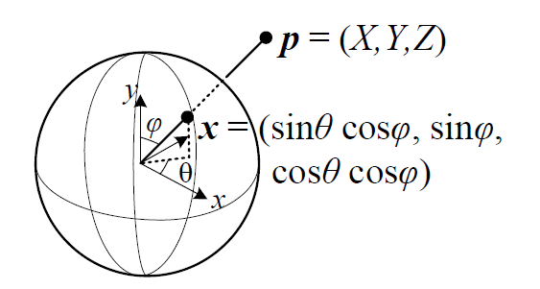
9.1.6 Cylindrical and Spherical Coordinates
In this case, the sphere is parameterized by two angles $\left(θ,φ\right)$, with 3D spherical coordinates given by:
$$\left(\sin{θ}\cos{φ},\sin{φ},\cos{θ}\cos{φ}\right)∝\left(x,y,f\right)$$
The correspondence between coordinates is now given by:
$$x^{′}=sθ=s\tan^{−1}{\frac{x}{f}}$$
$$y^{′}=sφ=s\tan^{−1}{\frac{y}{\sqrt{x^{2}+f^{2}}}}$$

Slide 33
9.1.6 Cylindrical and Spherical Coordinates

Slide 34
Break time

Slide 35
9.2 Global Alignment
9.2.1 Bundle adjustment
9.2.2 Parallax removal
9.2.3 Recognizing panoramas
9.2.4 Direct vs. feature-based alignment
Notes:
Bundle adjustment(束调整)
Parallax removal(視差消除)

Slide 36
9.2 Global Alignment
In this section, we extend the pair-wise matching criteria to a global energy function that involves all of the per-image pose parameters.
Once we have computed the global alignment, we often need to perform local adjustments, such as parallax removal, to reduce double images and blurring due to local mis-registrations.

Slide 37
9.2.1 Bundle Adjustment
The process of simultaneously adjusting pose parameters for a large collection of overlapping images is called bundle adjustment in the photogrammetry community.
In this section, we formulate the problem of global alignment using a feature-based approach, since this results in a simpler system.

Slide 38
9.2.2 Parallax Removal

Slide 39
9.2.2 Parallax Removal
The resulting stitched image sometimes looks blurry or ghosted in some places.
This can be caused by:
A unmodeled radial distortion
3D parallax (failure to rotate the camera around its optical center)
Small scene motions such as waving tree branches
Large-scale scene motions such as people moving in and out of pictures
Notes:
Unmodeled radial distortion(沒有建模的徑向形變)

Slide 40
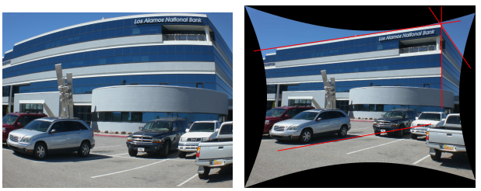
9.2.2 Parallax Removal
Radial distortion
Barrel distortion
Pincushion distortion
Notes:
Barrel distortion：酒桶形失真
Pincushion distortion：針墊形失真

Slide 41
9.2.2 Parallax Removal
Solution
Radial distortion
Plumb-line method
3D parallax
A full 3D bundle adjustment
Small scene motions
optical flow can be used to perform an appropriate correction before blending using a process called local alignment
Large-scale scene motions
simply select pixels from only one image at a time
Notes:
Plumb-line method: Duane, C. B. (1971). Close-range camera calibration.Photogrammetric engineering, 37(8), 855-866.
http://www.rose-hulman.edu/Users/faculty/young/CS-Classes/csse461/handouts/Day21/Brown71.pdf

Slide 42
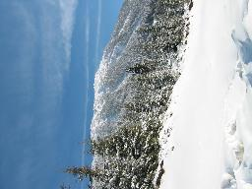
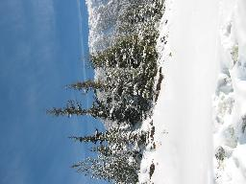
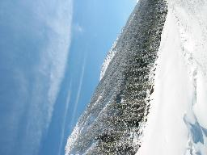
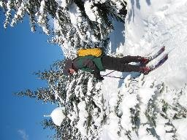
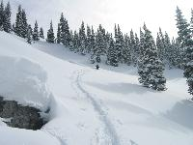
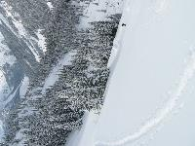
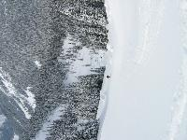
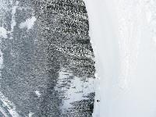
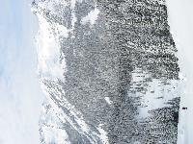
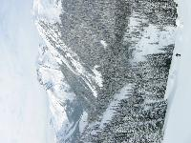
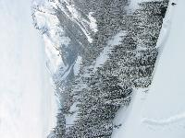
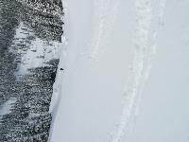
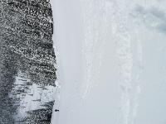
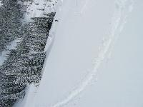
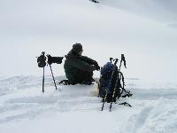
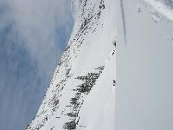
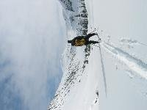
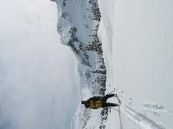
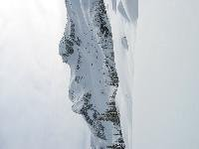
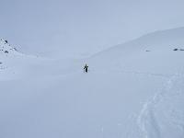
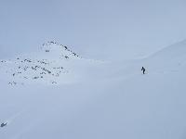
9.2.3 Recognizing panoramas
Notes:
全景圖辨識 目標: 從散亂影像中取出可以做為全景圖的部分

Slide 43
9.2.3 Recognizing panoramas
Feature detection and description (SIFT)
Fast matching (hash table)
RANSAC filtering of matches
Intensity-based verification
Incremental bundle adjustment
[M. Brown, R. Szeliski, and S. Winder. Multi-image matching using multi-scale oriented patches, CVPR'2005]
[Note] SIFT: scale invariant feature transform
Notes:
1. 先用SIFT挑點 2. Match這些點 3. RANSAC去掉outlier 4. 說明一下，Intensity-based，指的就是不是依靠SIFT，而是用影像強度/顏色/亮度…這些最基本的東西，去驗證重疊部分的相似度
SIFT雖然穩定，但可能有出錯的時候，如果SIFT把影像對齊正確，重疊部分的強度也應該要相近

Slide 44
9.2.3 Recognizing panoramas
Notes:
從一堆影像去偵測特徵點、去matching、判斷哪些影像是有對應部分的

Slide 45
9.2.3 Recognizing panoramas
Notes:
把有對應的影像拼接起來，做一些RANSAC、bundle adjustment

Slide 46
9.2.3 Recognizing panoramas
Notes:
拼接完之後，確定是怎麼擺的了

Slide 47
9.2.3 Recognizing panoramas
Notes:
合成出最終結果

Slide 48
Interesting panorama
近日，Reddit用戶MalletsDark上傳了一張由該技術處理過的照片，但沒走尋常路，從全景圖中看，他的一個朋友居然被疊加在了一叢樹林和雪山的中間，看上去就像一個躲在峽谷中的「潛伏者」。
原文網址：https://read01.com/5Me80QB.html

Slide 49
Interesting panorama

Slide 50
Interesting panorama

Slide 51
Break time

Slide 52
9.2.4 Direct vs. feature-based alignment
Early feature-based methods
The features get confused in regions that were either too textured or not textured enough
The features be distributed unevenly over the images, thereby failing to match image pairs that should have been aligned.
The features did not work well when the images were rotated or had foreshortening due to homographies.
Notes:
舊的特徵點有時不太可靠(像是Harris corner detector)

Slide 53
9.2.4 Direct vs. feature-based alignment
Notes:
features get confused… 脖子和腳那邊，取出來的feature都差不多
features be distributed unevenly…. feature有一堆集中在脖子跟腳的位置，很容易有配對錯誤的情況
features did not work …. 影像縮小跟旋轉後，有些feature就不可靠了

Slide 54
9.2.4 Direct vs. feature-based alignment
Today, feature detection and matching schemes are remarkably robust and can even be used for known object recognition from widely separated views.
Furthermore, because they operate in scale-space and use a dominant orientation (or orientation invariant descriptors), they can match images that differ in scale, orientation, and even foreshortening.

Slide 55
9.2.4 Direct vs. feature-based alignment
Notes:
SIFT(尺度不便特徵變化) 重點在於他能取出在平移、旋轉、跟縮放三種情況下都不變的feature
平移: 取局部，所以平移不變
旋轉: 取了角度的histogram後找出最主要的方向()，以該方向為基準，所以旋轉不變
縮放: 因為在不同解析度取共同的feature，所以縮放不變

Slide 56
Break time

Slide 57
9.3 Compositing
9.3.1 Choosing a compositing surface
9.3.2 Pixel selection and weighting (de-ghosting)
9.3.3 Application: Photomontage
9.3.4 Blending

Slide 58
9.3 Compositing
Goal
Compositing surface parameterization
Pixel and seam selection
Blending
Exposure compensation

Slide 59
9.3.1 Choosing a compositing surface
Flat panorama
If only a few images are stitched together, a natural approach is to select one of the images as the reference and to then warp all of the other images into its reference coordinate system.

Slide 60
9.3.1 Choosing a compositing surface
For larger fields of view, however, we cannot maintain a flat representation without excessively stretching pixels near the border of the image.
The usual choice for compositing larger panoramas is to use a cylindrical or spherical projection

Slide 61
9.3.1 Choosing a compositing surface
View selection
As mentioned above, for a flat composite, we can choose one of the images as a reference.
A reasonable choice is the one that is geometrically most central.

Slide 62
9.3.1 Choosing a compositing surface
Coordinate transformations
The final compositing surface is flat.
The final composite surface has some other analytic form (e.g., cylindrical or spherical).
lookup tables by the partial trigonometric functions
computing exact pixel mappings on a coarser grid and then interpolating these values

Slide 63
9.3.1 Choosing a compositing surface
Sampling issues
If the final panorama has a lower resolution than the input images, pre-filtering the input images is necessary to avoid aliasing.
Under certain conditions, it may also be possible to produce images with a higher resolution than the input images using the process of super-resolution.

Slide 64
9.3.1 Choosing a compositing surface
Super resolution
Notes:
超解析: 用許多低解析度影像生成高解析度影像

Slide 65
9.3.2 Pixel selection and weighting (de-ghosting)
Once the source pixels have been mapped onto the final composite surface, we must still decide how to blend them in order to create an attractive-looking panorama.
visible seams (due to exposure differences)
blurring (due to mis-registration)
ghosting (due to moving objects)

Slide 66
9.3.2 Pixel selection and weighting (de-ghosting)
The simplest way to create a final composite is to simply take an average value at each pixel.
Visible drawback by:
exposure differences
misregistrations
scene movement

Slide 67
9.3.2 Pixel selection and weighting (de-ghosting)
Final composites computed by a variety of algorithms (Szeliski 2006a):
(a)average, (b)median, (c)feathered average, (d)p-norm p = 10
Notes:
Median filter: 快速移動用，pixel selection P-norm: feather improving，挑距離時增加距離近者的權重

Slide 68
9.3.2 Pixel selection and weighting (de-ghosting)
(e)Voronoi, (f)weighted ROD vertex cover with feathering
(g)graph cut seams with Poisson blending, (h)with pyramid blending
Notes:
Voroni: p-norm p->infinite weighted ROD: 多圖疊合，建graph，重疊不一樣的部分有weight，然後避免走到這些weight poisson blending: gradient domain smoothing

Slide 69
9.3.3 Application: Photomontage
While image stitching is normally used to composite partially overlapping photographs, it can also be used to composite repeated shots of a scene taken with the aim of obtaining the best possible composition and appearance of each element.
Notes:
Photomontage(照片集錦)

Slide 70
9.3.3 Application: Photomontage

Slide 71
9.3.3 Application: Photomontage

Slide 74
Break time

Slide 75
9.3.4 Blending

Slide 76
9.3.4 Blending
+
1
1
0
0
=

Slide 77
9.3.4 Blending
Weight each image proportional to its distance from the edge (distance map [Danielsson, CVGIP 1980]
Generate weight map for each image
Sum up all of the weights and divide by sum: weights sum up to 1: $w_{i}^{′}={w_{i}}/{\sum_{i}{w_{i}}}$

Slide 78
9.3.4 Blending
Image Feathering

Slide 79
9.3.4 Blending
1
left
1
right
0
0

Slide 80
9.3.4 Blending
1
1
0
0

Slide 81
9.3.4 Blending
Burt, P. J. and Adelson, E. H., A multiresolution spline with applications to image mosaics, ACM Transactions on Graphics, 42(4), October 1983, 217-236.

Slide 82
End

