Slide 1
Advanced Computer Vision
Chapter 9
Image Stitching
Presented by 陳威宇 and 傅楸善教授
Cell phone: 0937106763
E-mail: r04921038@ntu.edu.tw

Slide 2
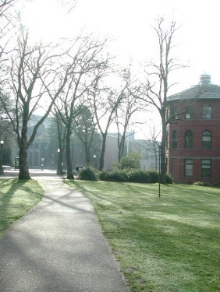
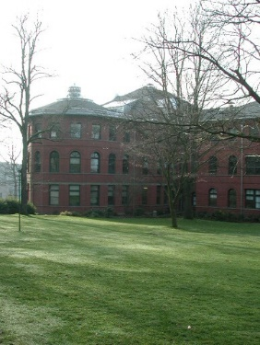
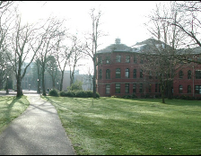
What is image stitching?
Notes:
甚麼是影像拼接呢? 把分開的影像拼接在一起

Slide 3
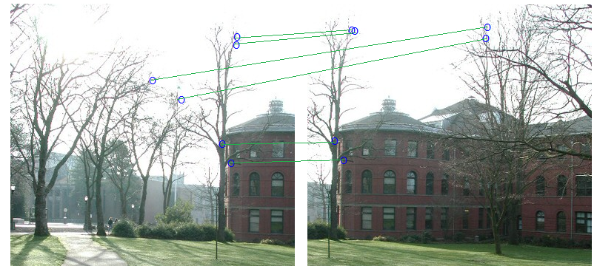
Steps for image stitching
1. Find parts in common
( Feature detection & matching )
Notes:
第一步: 你要先找出 這兩張影像，有哪些是相同的部分

Slide 4

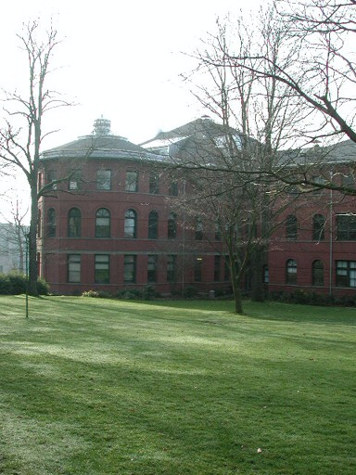
Steps for image stitching
2. Align common parts
( Image alignment )
Notes:
第二步: 將這兩張影像相同的部分對齊在一起

Slide 5
Steps for image stitching
3. Generate final image
( Image blending )

Slide 6
Key problems for image stitching
1. What feature to extract?
SIFT feature is a robust feature extractor which is invariant to shift, rotation and scale transformation.

Slide 7
Key problems for image stitching
2. How to correctly align two images?
To correctly align two images, we need to find out how these images are projected from real scene
Notes:
就算把相同的部分對齊了，可能實際上的情況並不是那樣的
要正確的對齊兩張影像，就必須去計算，他們實際上是怎麼從環境投影到相機平面上的

Slide 8
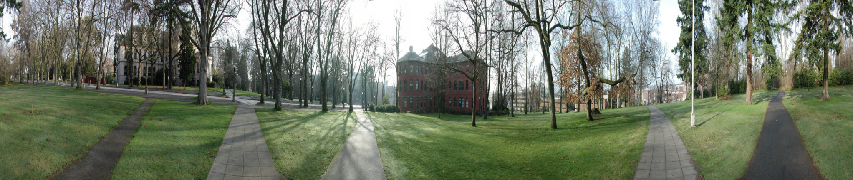

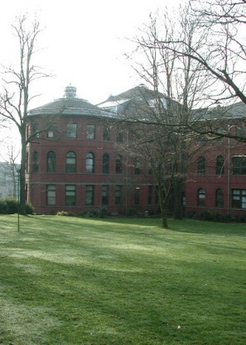
Focal length?
Camera movements?
Notes:
相機從這個角度拍出了這個影像，是經過了甚麼樣的移動，焦距有甚麼樣的調整 ，才拍出下一張影像的
知道這點就能夠反推該如何對齊這兩張影像

Slide 9
Problems for image stitching
3. How to correctly align all images?
Pairwise optimization may ruin overall performance. Need to do global alignment.

Slide 10
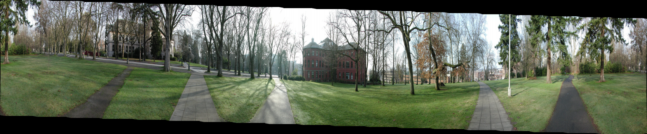

Slide 11
Problems for image stitching
4. How to blend images?
Make two images smoothly blended together.

Slide 12
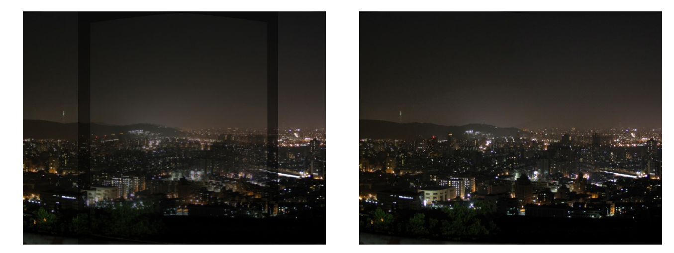
Notes:
就算兩張圖錯開的很嚴重，如果有適當的混成方法，也能夠有看起來還不錯的效果

Slide 13
Outline
9.1 Motion Models (What feature to extract & How to correctly align two images)
9.2 Global Alignment (How to correctly align all images)
9.3 Compositing (How to blend images)
9.4 Additional Reading
9.5 Exercises

Slide 14
Image Mosaics
+ + … + =
Goal: Stitch together several images into a seamless composite
Notes:
影像拼接: 將同一個場景內部分的影像拼接成一張完整的大影像，像是用iphone可以拍的全景圖(panorama)那種感覺

Slide 15
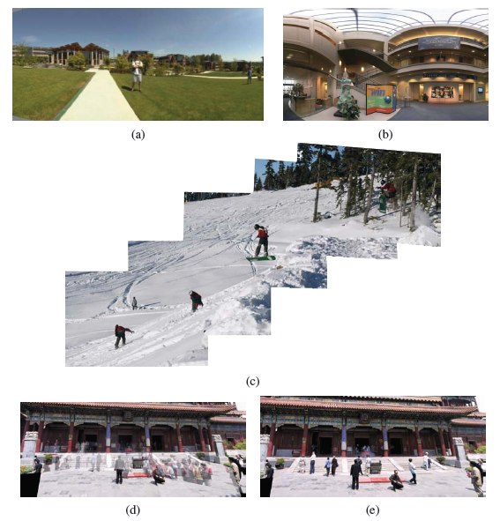
Figure 9.1 Image stitching: (a) portion of a cylindrical panorama and (b) a spherical panorama constructed from 54 photographs (Szeliski and Shum 1997) c 1997 ACM; (c) a multi-image panorama automatically assembled from an unordered photo collection; a multi-image stitch (d) without and (e) with moving object removal (Uyttendaele, Eden, and Szeliski 2001) c 2001 IEEE.
Notes:
影像拼接的幾個變化
(a)(b)是兩種影像拼接出來的全景圖(panorama)，(a)目標拼出一個圓柱，(b)目標拼出一個球面
(c) 有時候拿來拼全景圖那些影像不會照順序，會叫你從一堆影像中挑出可以拼在一起的部分(見後面Recognizing panoramas)
(d)(e)是鬼影問題，有時候拍的時候有人在動，所以(d)拼起來有殘像，(e)把它拿掉了

Slide 16
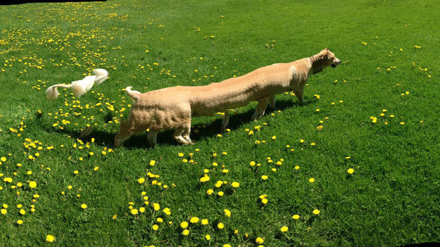
Moving object

Slide 17
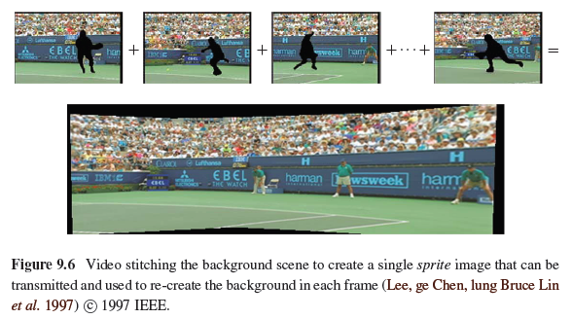
9.1.5 Application: Video Compression
Notes:
一個比較有趣的應用，如果你的影片在拍攝時，是把攝影機繞一圈去拍攝整個場景
那其實這段影片，就可以用全景圖來表示
可以先把影片的前後景分離後，把背景拼出一張完整的影像，這樣就可以用一張影像去取代整個影片

Slide 18
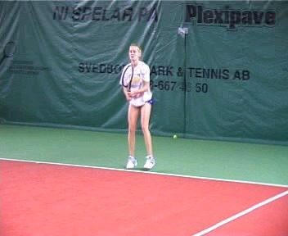
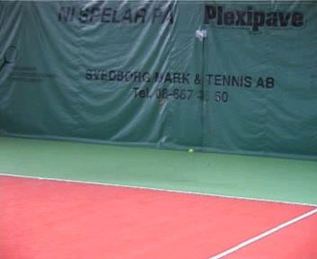
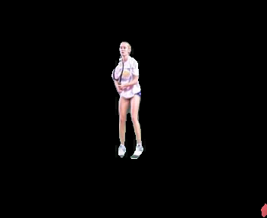
9.1.5 Application: Video Compression
=
+
Input
Segmentation result
Result by: L.Zelnik-Manor, M.Irani
“Multi-frame estimation of planar motion”, PAMI 2000
Notes:
總之要做到這件事，要先能分離前後景

Slide 19
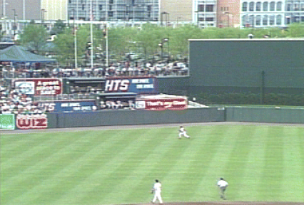
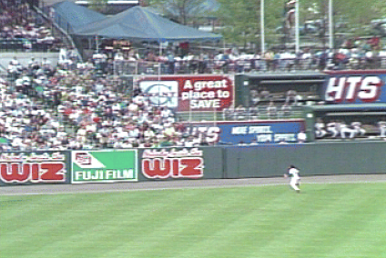
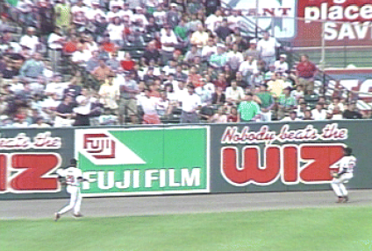
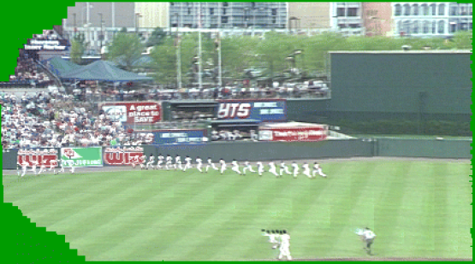
Video summarization
9.1.5 Application: Video Summarization
Notes:
拼的好，就可以弄出這種動感的圖片

Slide 20
360 video
https://www.youtube.com/watch?v=m9pbCzUPmY8

Slide 21
Key problems for image stitching
1. What feature to extract?
SIFT feature is a robust feature extractor which is invariant to shift, rotation and scale transformation.

Slide 22
9.2.4 Direct vs. feature-based alignment
Early feature-based methods
  The features get confused in regions that were either too textured or not textured enough
  The features be distributed unevenly over the images, thereby failing to match image pairs that should have been aligned.
  The features did not work well when the images were rotated or had foreshortening due to homographies.
Notes:
舊的特徵點有時不太可靠(像是Harris corner detector)

Slide 23
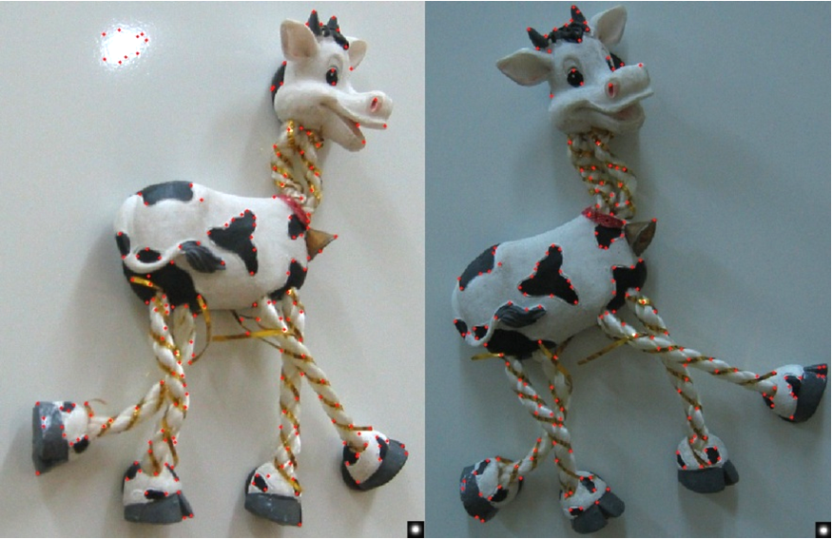
Harris corner detector
Notes:
features get confused… 脖子和腳那邊，取出來的feature都差不多
features be distributed unevenly…. feature有一堆集中在脖子跟腳的位置，很容易有配對錯誤的情況
features did not work …. 影像縮小跟旋轉後，有些feature就不可靠了

Slide 24
9.2.4 Direct vs. feature-based alignment
Today, feature detection and matching schemes are remarkably robust and can even be used for known object recognition from widely separated views.
Furthermore, because they operate in scale-space and use a dominant orientation (or orientation invariant descriptors), they can match images that differ in scale, orientation, and even foreshortening.
Notes:
只是告訴大家，因為SIFT特徵點的出現，所以效果變好了~

Slide 25
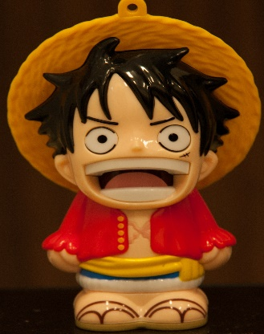
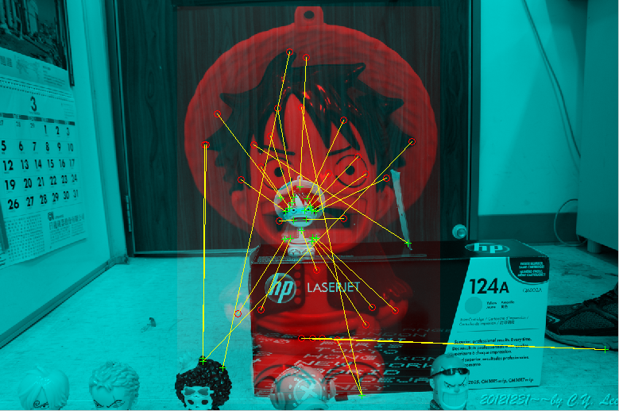
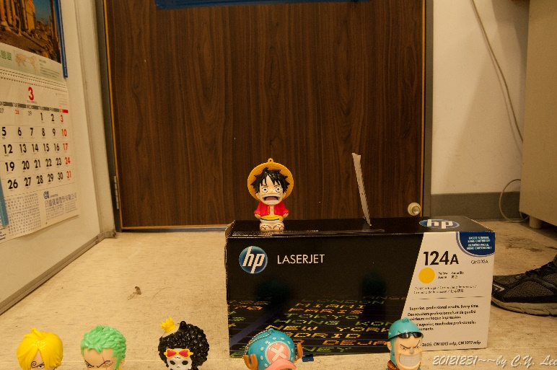
Object recognition

Slide 26
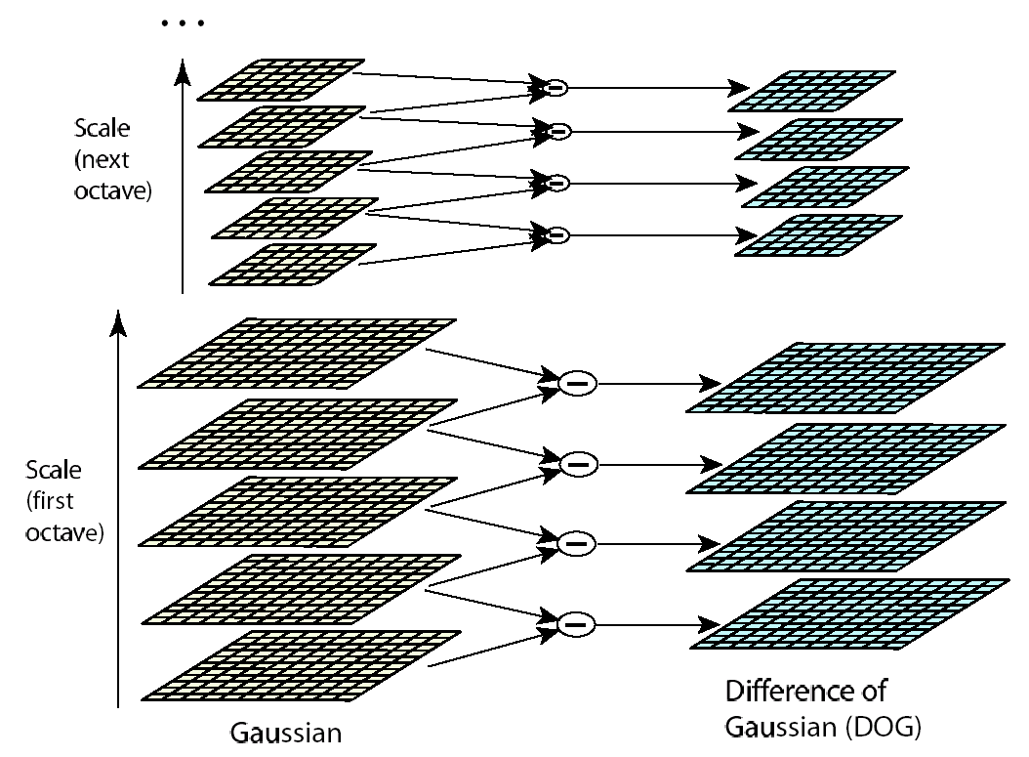


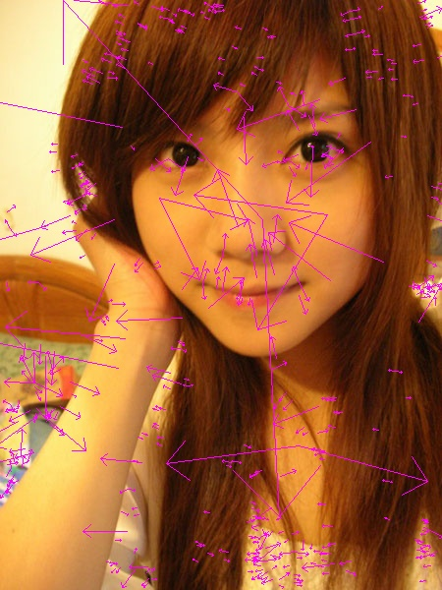

SIFT
Notes:
SIFT(尺度不便特徵變化)
重點在於他能取出在平移、旋轉、跟縮放三種情況下都不變的feature
平移: 取局部，所以平移不變
旋轉: 取了角度的histogram後找出最主要的方向()，以該方向為基準，所以旋轉不變
縮放: 因為在不同解析度取共同的feature，所以縮放不變

Slide 27
Key problems for image stitching
2. How to correctly align two images?
To correctly align two images, we need to find out how these images are projected from real scene
Notes:
就算把相同的部分對齊了，可能實際上的情況並不是那樣的
要正確的對齊兩張影像，就必須去計算，他們實際上是怎麼從環境投影到相機平面上的

Slide 28
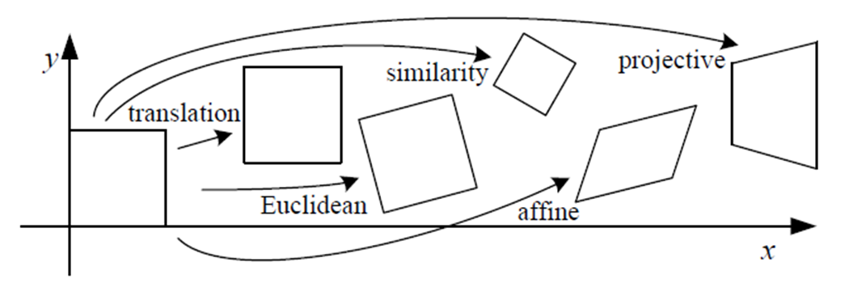



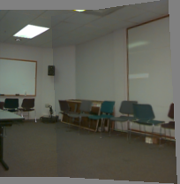
9.1.1 Planar Perspective Motion
Translation
Affine
Perspective
3D rotation
Notes:
首先，先來複習，相機移動、旋轉等等之後，會讓影像產生甚麼樣的變換
也許是Translation(平移)、Affine(仿射)、Perspective(透視)或3D旋轉

Slide 29



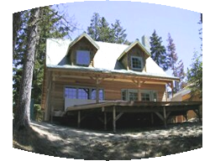

Parametric (Global) Warping
Examples of parametric warps:
translation
rotation
aspect
perspective
affine
cylindrical
Notes:
要將兩張影像對齊在一起，就要將其中一張影像做變形(warp)
大部分跟上頁相同，但是要注意cylindrical(圓柱投影)，這是第一次出現非線性變換，後面會提

Slide 30

9.1.1 Planar Perspective Motion
In Section 6.1.3, we saw how the mapping between two cameras viewing a common plane can be described using a 3*3 homography.
The resulting homography matrix (the upper left 3*3 sub-matrix of ) describes the mapping between pixels in the two images,
Notes:
前面提過，兩個相機看同一個地點拍出的兩張照片，他們之間的關係可以用一個單應性矩陣來表示
要解這個單應性矩陣，可以兩張影像間配對好的特稱點的位置來求得

Slide 31

9.1.1 Planar Perspective Motion
More recent stitching algorithms first extract features and then match them up, often using robust techniques such as RANSAC (Section 6.1.4) to compute a good set of inliers.
The final computation of the homography (9.2), i.e., the solution of the least squares fitting problem given pairs of corresponding features (see Section 2),
RANSAC: RANdom SAmple Consensus

Slide 32
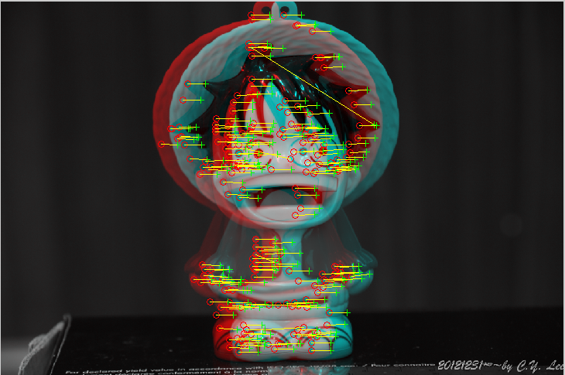
RANSAC to remove outlier
outlier
correct
pair
Notes:
複習:
RANSAC的目標，在於從一堆配對點中，挑出哪些是正確的配對，哪些是錯誤的配對
理論上，所有配對點，他的位移關係都應該是一樣的
隨機挑一堆當正確，如果沒挑outlier，就會發現outlier跟其他人都不一樣
如果挑到outlier，就會發現位移好像往右下偏，結果會不太對，就重挑

Slide 33
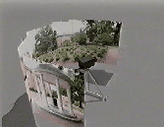
9.1.3 Rotational Panoramas
The most typical case for panoramic image stitching is when the camera undergoes a pure rotation.
http://crchaffee.com/panorama3.html
Notes:
相機的移動越複雜，全景圖效果就越差
拍全景圖一個常見的情況，一個相機在原地轉360度拍出一個全景圖

Slide 34
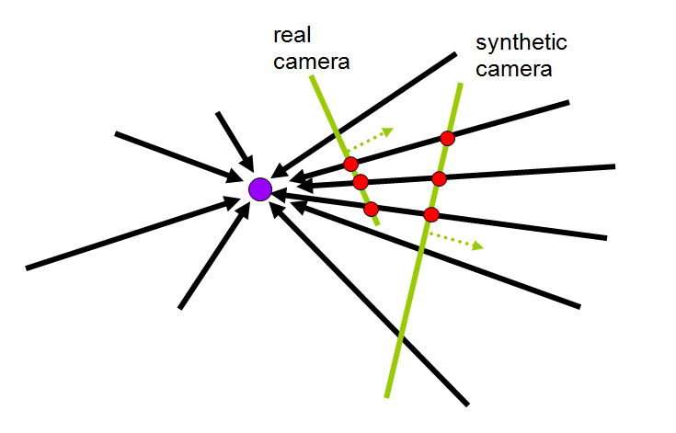
9.1.6 Cylindrical and Spherical Coordinates
An alternative to using homographies or 3D motions to align images is to first warp the images into cylindrical coordinates and then use a pure translational model to align them.
Notes:
在純粹只是旋轉的情況下，我們能夠先將影像投影到一個圓柱上，座標變成角度跟高度
這樣的話，就能夠很單純的只是用角度的平移來對齊影像

Slide 35
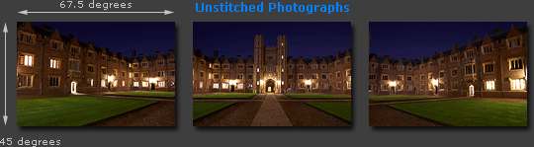
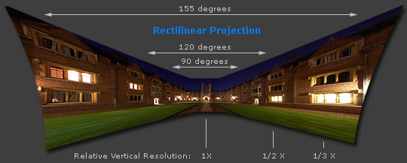
Cylindrical projection
Adopted from http://www.cambridgeincolour.com/tutorials/image-projections.htm
Notes:
http://www.cambridgeincolour.com/tutorials/image-projections.htm
為什麼要這樣做呢?大家可以看到，因為各張照片視角不同，如果沒有做這種圓柱投影的話，有時候為了讓連接正確，會反而扭曲掉外圍的部分
可以看到，圖上角度變的一點都不線性了

Slide 36
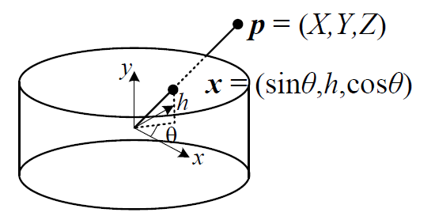

9.1.6 Cylindrical and Spherical Coordinates
We wish to project this image onto a cylindrical surface of unit radius.
Points on this surface are parameterized by an angle and a height h, with the 3D cylindrical coordinates corresponding to (θ,h) given by:
f: focal length
Notes:
所以，我們改將影像投影到一個圓柱上
投影的方法相當的單純，把x,y投到h,theta平面上

Slide 37
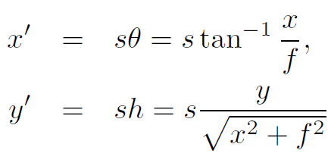
9.1.6 Cylindrical and Spherical Coordinates
s is an arbitrary scaling factor (sometimes called the radius of the cylinder)
We can set s = f to minimize the distortion (scaling) near the center of the image.

Slide 38
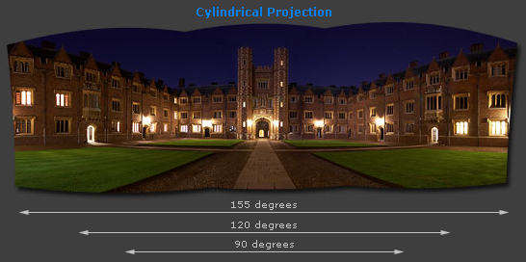
Cylindrical projection
Adopted from http://www.cambridgeincolour.com/tutorials/image-projections.htm
Notes:
http://www.cambridgeincolour.com/tutorials/image-projections.htm
可以看到，改成圓柱投影後，現在角度變的線性多了

Slide 39

9.1.6 Cylindrical and Spherical Coordinates
Images can also be projected onto a spherical surface, which is useful if the final panorama includes a full sphere or hemisphere of views, instead of just a cylindrical strip.
In this case, the sphere is parameterized by two angles (θ,ϕ), with 3D spherical coordinates given by:
Notes:
同樣的 ，也能夠投到圓球上

Slide 40
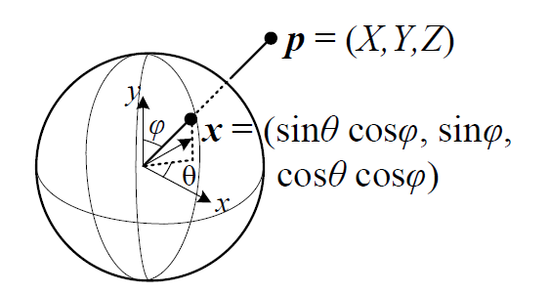
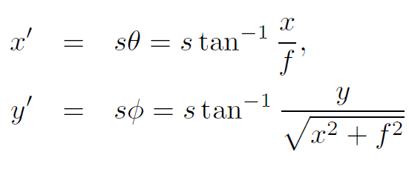
9.1.6 Cylindrical and Spherical Coordinates
The correspondence between coordinates is now given by:

Slide 41
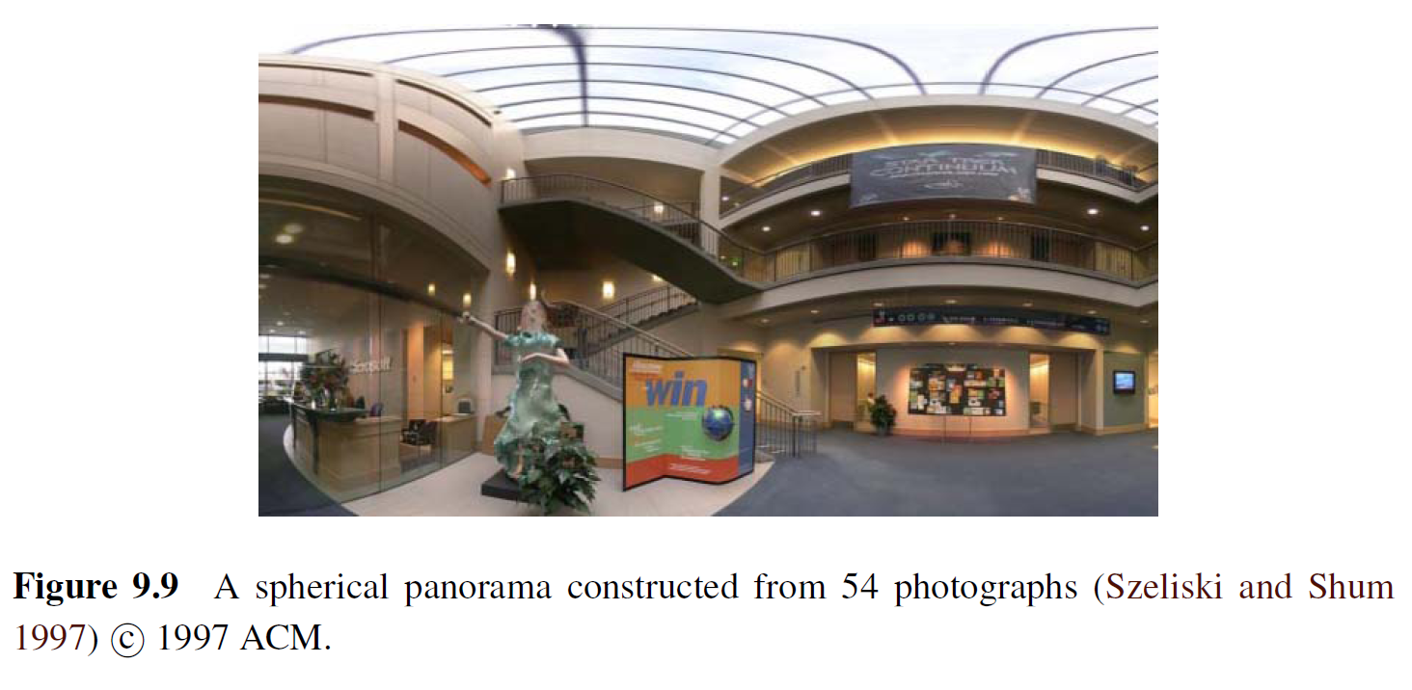
9.1.6 Cylindrical and Spherical Coordinates

Slide 42
Problems for image stitching
3. How to correctly align all images?
Pairwise optimization may ruin overall performance. Need to do global alignment.

Slide 43
9.2 Global Alignment
In this section, we extend the pair wise matching criteria to a global energy function that involves all of the per-image pose parameters.
Once we have computed the global alignment, we often need to perform local adjustments, such as parallax removal, to reduce double images and blurring due to local mis-registrations.
Notes:
parallax removal: 消除視差

Slide 44
9.2.1 Bundle Adjustment
The process of simultaneously adjusting pose parameters for a large collection of overlapping images is called bundle adjustment in the photogrammetry community.
In this section, we formulate the problem of global alignment using a feature-based approach, since this results in a simpler system.
Notes:
Bundle adjustment(束调整)

Slide 45
9.1.2 Application: Whiteboard and Document Scanning
The simplest image-stitching application is to stitch together a number of image scans taken on a flatbed scanner.
One complication is that a 2D rigid transformation is non-linear in the rotation angle.
A bigger problem lies in the pairwise alignment process. As you align more and more pairs, the solution may drift so that it is no longer globally consistent.
Problem: drift
Notes:
先來看一個簡單的例子，要拼出一個完整的影像，不能只是把連續兩張兩張拼好就算了，因為很可能最後頭尾歪掉拼不在一起(稱為drift，飄移)

Slide 46
Problem: Drift
copy of first image
Solution
  add another copy of first image at the end
  this gives a constraint: y_{n} = y₁
  there are a bunch of ways to solve this problem
    add displacement of (y₁ – y_{n})/(n -1) to each image after the first
    compute a global warp: y’ = y + ax
    run a big optimization problem, incorporating this constraint
Notes:
解決Drift的一些方法，但注意這邊有個假設，就是兩張影像之間只差一個二維平移關係

Slide 47
Notes:
Drift的經典例子，把很多影像拼接成一個完整的全景圖，不能只看兩兩關係
上面那張，兩兩全部都拼的很好，可是其實拚到最後會歪掉
下面那張才是有把頭尾接在一起

Slide 48
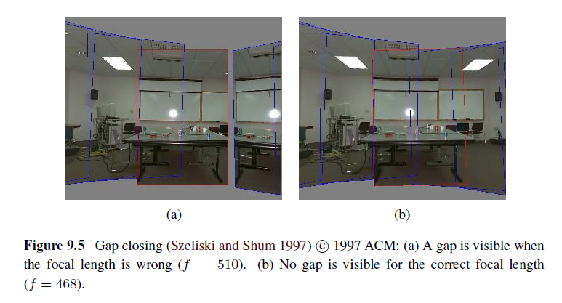
9.1.4 Gap Closing
Notes:
Szeliski et al. "Creating full view panoramic image mosaics and environment maps." Proceedings of the 24th annual conference on Computer graphics and interactive techniques. ACM Press/Addison-Wesley Publishing Co., 1997.
http://faculty.cse.tamu.edu/jchai/csce641/szeliskiShum97.pdf
另外一個情況，如果焦距弄錯，可能會發生panorama一圈拼不起來的情況

Slide 49
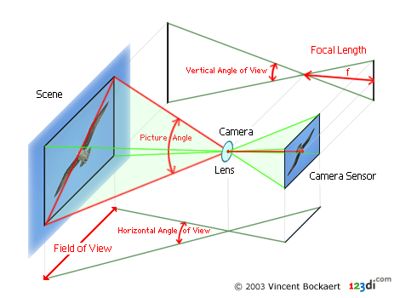
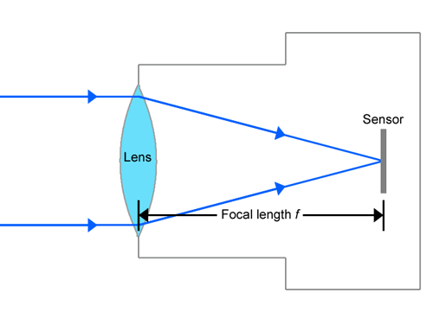
Focal Length
The focal length of a lens is the distance from the image plane to the lens.
Notes:
只是在講焦距

Slide 50
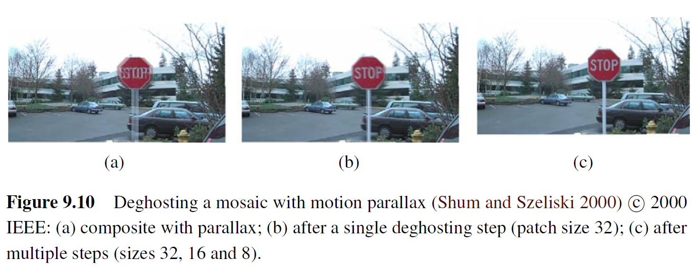
9.2.2 Parallax Removal
Notes:
消除視差:

Slide 51
9.2.2 Parallax Removal
The resulting stitched image sometimes looks blurry or ghosted in some places.
This can be caused by:
  A unmodeled radial distortion
  3D parallax (failure to rotate the camera around its optical center)
  Small scene motions such as waving tree branches
  Large-scale scene motions such as people moving in and out of pictures
Notes:
Unmodeled radial distortion: 沒有建模的徑向形變
Parallax: 視差

Slide 52
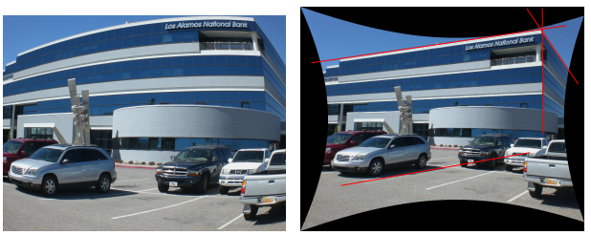
radial distortion

Slide 53
9.2.2 Parallax Removal
Radial distortion
  Plumb-line method
3D parallax
  A full 3D bundle adjustment
Small scene motions
  optical flow can be used to perform an appropriate correction before blending using a process called local alignment
Large-scale scene motions
  simply select pixels from only one image at a time
Notes:
Plumb-line method: Duane, C. B. (1971). Close-range camera calibration.Photogrammetric engineering, 37(8), 855-866.
http://www.rose-hulman.edu/Users/faculty/young/CS-Classes/csse461/handouts/Day21/Brown71.pdf

Slide 54
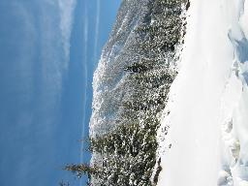
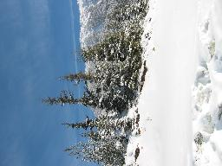
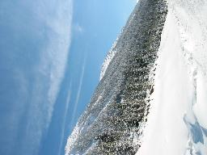
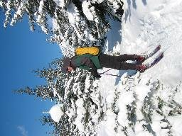
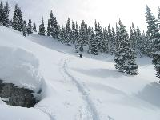
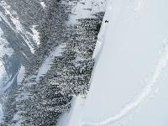






















9.2.3 Recognizing panoramas
Notes:
全景圖辨識
目標: 從散亂影像中取出可以做為全景圖的部分

Slide 55
9.2.3 Recognizing panoramas
Feature detection and description (SIFT)
Fast matching (hash table)
RANSAC filtering of matches
Intensity-based verification
Incremental bundle adjustment
[M. Brown, R. Szeliski, and S. Winder. Multi-image matching using multi-scale oriented patches, CVPR'2005]
SIFT: scale invariant feature transform
Notes:
1. 先用SIFT挑點
2. Match這些點
3. RANSAC去掉outlier
4. 說明一下，Intensity-based，指的就是不是依靠SIFT，而是用影像強度/顏色/亮度…這些最基本的東西，去驗證重疊部分的相似度
SIFT雖然穩定，但可能有出錯的時候，如果SIFT把影像對齊正確，重疊部分的強度也應該要相近

Slide 56
9.2.3 Recognizing panoramas
Notes:
1. 從一堆影像去偵測特徵點、去matching、判斷哪些影像是有對應部分的

Slide 57
9.2.3 Recognizing panoramas
Notes:
把有對應的影像拼接起來，作一些RANSAC、bundle adjustment

Slide 58
9.2.3 Recognizing panoramas
Notes:
拼接完之後，確定是怎麼擺的了

Slide 59
9.2.3 Recognizing panoramas
Notes:
最後合成出最終結果

Slide 60
9.3 Compositing
namely compositing surface parameterization
pixel and seam selection
Blending
exposure compensation
Notes:
好了，重點3，怎麼樣把兩張影像拼的很好
要有新的座標、新的位置
兩張影像拼接在一起時，重疊部分你要挑哪張影像的
找接縫?或著混成?如果有曝光時間差異還要補正

Slide 61
9.3.1 Choosing a compositing surface
Flat panorama
  If only a few images are stitched together, a natural approach is to select one of the images as the reference and to then warp all of the other images into its reference coordinate system.

Slide 62

9.3.1 Choosing a compositing surface
For larger fields of view, however, we cannot maintain a flat representation without excessively stretching pixels near the border of the image.
  The usual choice for compositing larger panoramas is to use a cylindrical or spherical projection

Slide 63
9.3.1 Choosing a compositing surface
View selection
  As mentioned above, for a flat composite, we can choose one of the images as a reference.
  A reasonable choice is the one that is geometrically most central.

Slide 64
9.3.1 Choosing a compositing surface
Coordinate transformations
  The final compositing surface is flat.
  The final composite surface has some other analytic form (e.g., cylindrical or spherical).
    lookup tables by the partial trigonometric functions
    computing exact pixel mappings on a coarser grid and then interpolating these values

Slide 65
9.3.1 Choosing a compositing surface
Sampling issues
  If the final panorama has a lower resolution than the input images, pre-filtering the input images is necessary to avoid aliasing.
  Under certain conditions, it may also be possible to produce images with a higher resolution than the input images using the process of super-resolution.

Slide 66


aliasing
Notes:
混疊: 因為取樣頻率不足導致的失真

Slide 67

Super resolution
Notes:
超解析: 用許多低解析度影像生成高解析度影像

Slide 68
9.3.2 Pixel selection and weighting
(de-ghosting)
Once the source pixels have been mapped onto the final composite surface, we must still decide how to blend them in order to create an attractive-looking panorama.
  visible seams (due to exposure differences)
  blurring (due to mis-registration)
  ghosting (due to moving objects)

Slide 69

9.3.2 Pixel selection and weighting
(de-ghosting)
The simplest way to create a final composite is to simply take an average value at each pixel:
Visible drawback by:
  exposure differences
  misregistrations
  scene movement

Slide 70

Final composites computed by a variety of algorithms (Szeliski 2006a):
(a)average, (b) median, (c) feathered average, (d) p-norm p = 10,
Notes:
Median filter: 快速移動用，pixel selection
P-norm: feather improving，挑距離時增加距離近者的權重

Slide 71

(e) Voronoi, (f) weighted ROD vertex cover with feathering, (g) graph cut seams with Poisson blending and (h) with pyramid blending.
Notes:
Voroni: p-norm p->infinite
weighted ROD: 多圖疊合，建graph，重疊不一樣的部分有weight，然後避免走到這些weight
poisson blending: gradient domain smoothing

Slide 72
9.3.3 Application: Photomontage
While image stitching is normally used to composite partially overlapping photographs, it can also be used to composite repeated shots of a scene taken with the aim of obtaining the best possible composition and appearance of each element.
Notes:
Photomontage: 照片集錦

Slide 73



Slide 74


Slide 75

9.3.4 Blending

Slide 76



9.3.4 Blending
+
1
=
1
0
0

Slide 77
Image Feathering
Weight each image proportional to its distance from the edge (distance map [Danielsson, CVGIP 1980]
  Generate weight map for each image
  Sum up all of the weights and divide by sum: weights sum up to 1:
    w_{i}’ = w_{i} / ( ∑_{i} w_{i})

Slide 78
Image feathering
Weight each image proportional to its distance from the edge (distance map [Danielsson, CVGIP 1980]
1. Generate weight map for each image
2. Sum up all of the weights and divide by sum:
weights sum up to 1: w_{i}’ = w_{i} / ( ∑_{i} w_{i})

Slide 79



Image Feathering
Notes:
直接拼在一起

Slide 80


Effect of window size
1
left
1
right
0
0
Notes:
Window size: 哪個範圍內做image feathering

Slide 81


Effect of window size
1
1
0
0

Slide 82

Good window size
1
0
“Optimal” window: smooth but not ghosted
  Doesn’t always work...

Slide 83



Pyramid Blending
Burt, P. J. and Adelson, E. H., A multiresolution spline with applications to image mosaics, ACM Transactions on Graphics, 42(4), October 1983, 217-236.

Slide 84

Notes:
http://graphics.cs.cmu.edu/courses/15-463/2005_fall/www/Lectures/Pyramids.pdf

Slide 85
9.4 Additional reading

