Slide 1
Advanced Computer Vision Chapter 8
Dense Motion Estimation
Presented by 王嘉会 and 傅楸善教授
E-mail:r07945045@ntu.edu.tw Digital Camera and Computer Vision Laboratory
Department of Computer Science and Information Engineering
National Taiwan University, Taipei, Taiwan, R.O.C.

Slide 2
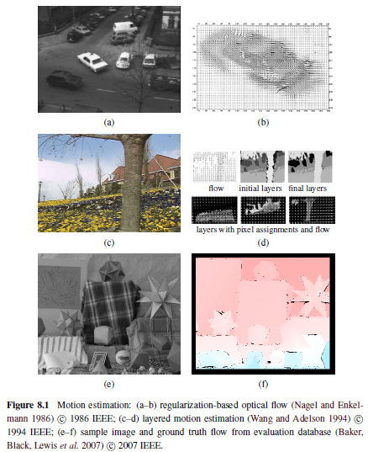
What contained in this lecture
Translational alignment
Parametric motion
Spline-based motion
Optical flow
Layered motion

Slide 3
A brief review
What happened three weeks ago?
Definition of error matrix
sum of squared differences (SSD)
sum of robust differences (SRD)
Sum of absolute differences (SAD)
Weighted (or windowed) SSD function(WSSD)
Root mean square intensity error(RMS)
Bias and gain (BG)
Cross correlation(CC)
Normalized cross correlation(NCC)
Normalized SSD score (NSSD)

Slide 4
8.1 Translational alignment
The simplest way: shift one image relative to the other
Find the minimum of the sum of squared differences (SSD) function:
u = (u, v) : displacement
e_{i} = I₁(x_{i} + u) I₀(x_{i}) : residual error or displacement frame difference
In practice, a bilinear interpolation is often used but
bicubic interpolation can yield slightly better results
The assumption that corresponding pixel values remain the same in the two images is often called the brightness constancy constraint.²

Slide 5
8.1 Translational alignment
Robust error metrics.(robust to outlier)
The robust norm ⇢(e) is a function that grows less quickly than the quadratic penalty associated with least squares.
One such function
:sum of absolute differences (SAD)
it is not well suited to gradient- descent approaches such as the ones presented in Section 8.1.3.

Slide 6
8.1 Translational alignment
BUT
The error metrics above ignore that fact that for a given alignment, some of the pixels being compared may lie outside the original image boundaries.
Spatially varying weights
we may want to down-weight the middle part of the image, which often contains independently moving objects being tracked by the camera.
weighted (or windowed) SSD function
where the weighting functions w₀ and w₁ are zero outside the image boundaries.

Slide 7
8.1 Translational alignment
BUT
If a large range of potential motions is allowed, the above metric can have a bias towards smaller overlap solutions.
the windowed SSD score can be divided by the overlap area
root mean square intensity error

Slide 8
8.1 Translational alignment
Bias and gain (exposure differences).
BUT
the two images being aligned were not taken with the same exposure
bias and gain model,
where is the alpha bias and beta is the gain
linear regression is needed to find the parameter

Slide 9
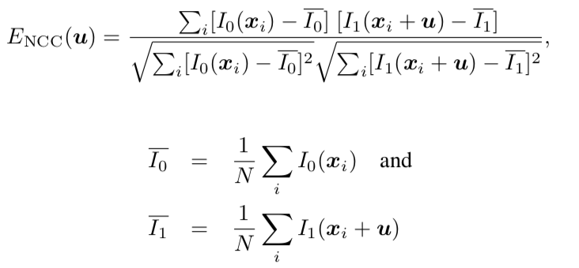
8.1 Translational alignment
Correlation.
cross-correlation
If a very bright patch exists in I₁(x), the maximum product may actually lie in that area.
normalized cross-correlation
Normalized correlation works well when matching images taken with different exposures

Slide 10
8.1 Translational alignment（1/）
normalized SSD score

Slide 11
Joke

Slide 12
8.1.1 Hierarchical motion estimation (1/1)
Now that we have a well-defined alignment cost function to optimize, how can we find its minimum?
The simplest solution is to do a full search over some range of shifts, This is often the approach used for block matching in motion compensated video compression
To accelerate this search process, hierarchical motion estimation is often used
The motion estimate from one level of the pyramid is then used to initialize a smaller local search at the next finer level.

Slide 13
8.1.2 Fourier-based alignment
When the search range corresponds to a significant fraction of the larger image, the hierarchical approach may not work that well
Fourier transform of the cross-correlation function E_{CC} can be written as
convolution in the spatial domain corresponds to multiplication in the Fourier domain
O(N M log N M )
we take the Fourier transforms of both images I₀(x) and I₁(x), multiply both transforms together (after conjugating the second one), and take the inverse transform of the result.

Slide 14
8.1.2 Fourier-based alignment
Consider the SSD formula given in (8.1).
Its Fourier transform can be written as
Thus, the SSD function can be computed by taking twice the correlation function and subtracting it from the sum of the energies in the two images.

Slide 15
Windowed correlation.
The Fourier convolution theorem only applies when the summation over x_{i} is performed over all the pixels in both images
It makes no sense when the images overlap by a small amount or one image is a small subset of the other.
w₀ and w₁ are zero outside the valid ranges of the images
circular shifts return 0 values outside the original image boundaries.

Slide 16
phase correlation
The spectrum of the two signals being matched is whitened by dividing each per-frequency product by the magnitudes of the Fourier transforms,
In the case of noiseless signals ,we have I₁(x + u) = I₀(x)
The output of phase correlation is a single spike located at the correct value of u.

Slide 17
rotations and scale
Consider two images that are related purely by rotation

Slide 18
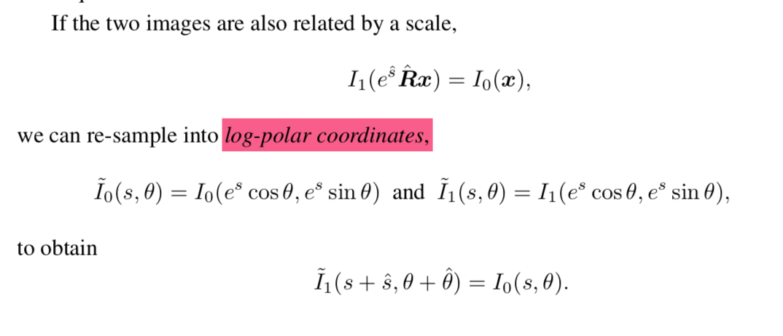
rotations and scale

Slide 19
rotations and scale
the two images are aligned in rotation and scale using the polar or log-polar representations.
Once rotation and scale are estimated, one of the images can be de-rotated and scaled and a regular translational algorithm can be applied to estimate the translational shift.
Unfortunately, this trick only applies when the images have large overlap (small translational motion).

Slide 20
Joke

Slide 21
Incremental refinement
In general, image stabilization and stitching applications require much higher accuracies to obtain acceptable results.
A more commonly used approach is to perform gradient descent on the SSD energy function (8.1), using a Taylor series expansion
Lucas and Kanade
image gradient or Jacobian at (x_{i} + u)：

Slide 22
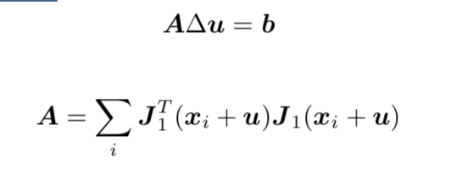
Incremental refinement
optical flow constraint or brightness constancy constraint equation
I_{x} and I_{y} denote is spatial derivatives, and I_{t} is called the temporal derivative.
When squared and summed or integrated over a region, it can be used to compute optic flow
associated normal equations
Hessian

Slide 23
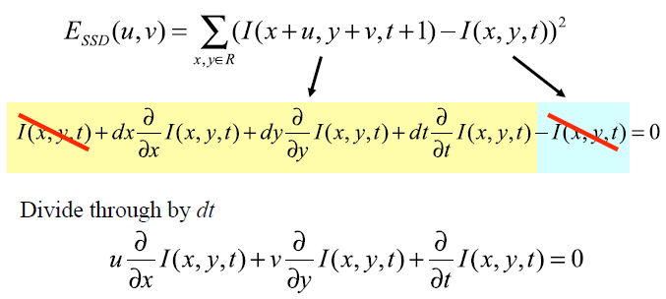
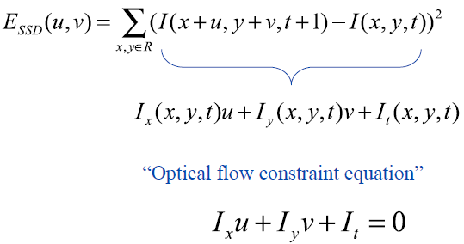
Incremental refinement

Slide 24
Incremental refinement
optical flow constraint or brightness constancy constraint equation
I_{x} and I_{y} denote is spatial derivatives, and I_{t} is called the temporal derivative.
When squared and summed or integrated over a region, it can be used to compute optic flow
associated normal equations
Hessian

Slide 25
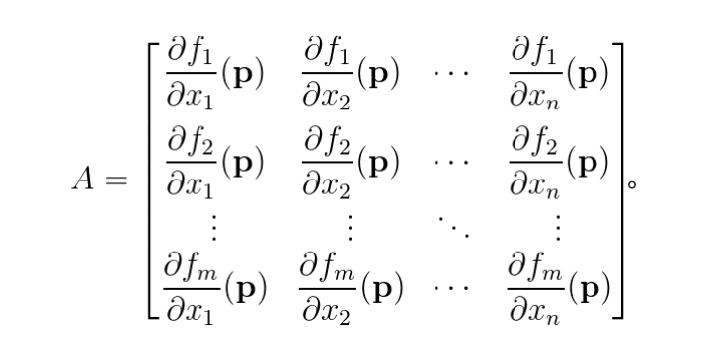
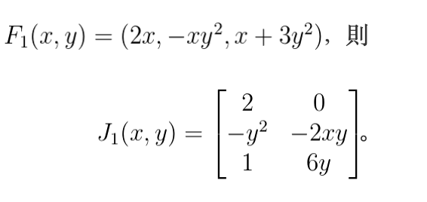
Jacobian
Jacobian matrix or derivative matrix

Slide 26
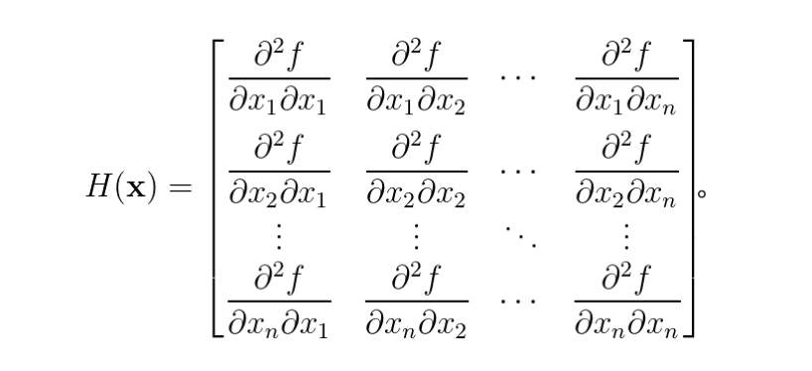
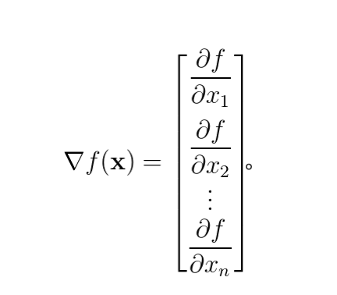
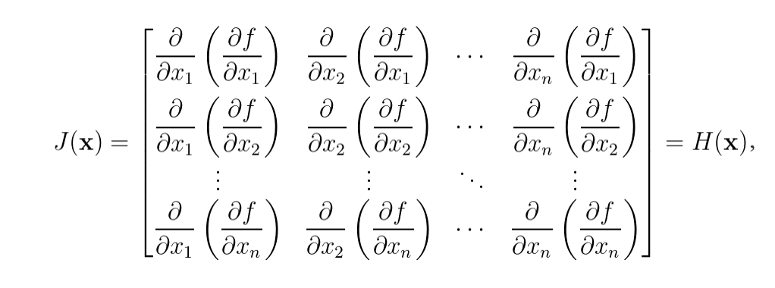
Hessian
Jacobian of ▽f =Hessian matrix of f

Slide 27
Incremental refinement
hessian
gradient-weighted residual vector,
I_{x} and I_{y} denote spatial derivatives, and I_{t} is called the temporal derivative,

Slide 28
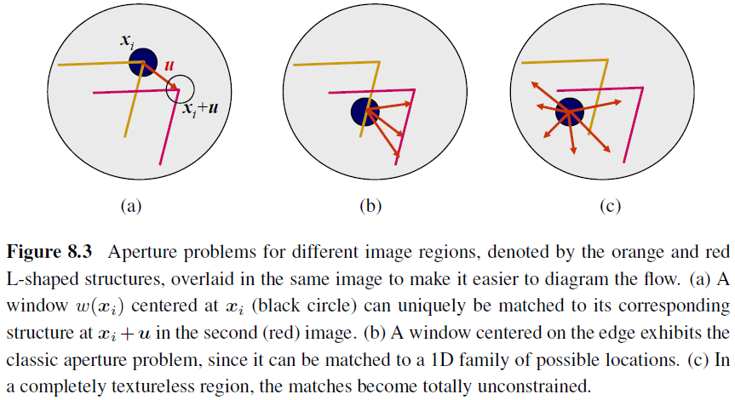
Conditioning and Aperture Problems

Slide 29
Conditioning and Aperture Problems
The component of the displacement along the edge is very poorly conditioned and can result in wild guesses under small noise perturbations.
One way to mitigate this problem is to add a prior (soft constraint) on the expected range of motions

Slide 30
Uncertainty Modeling
The reliability of a particular patch-based motion estimate can be captured more formally with an uncertainty model
The simplest model: a covariance matrix
Under small amounts of additive Gaussian noise, the covariance matrix is proportional to the inverse of the Hessian
: the variance of the additive Gaussian noise
where _{n}² is the variance of the additive Gaussian noise

Slide 31
Bias and Gain, Weighting, and Robust Error Metrics
Apply Lucas–Kanade update rule to the following metrics
Bias and gain model
Weighted version of the Lucas–Kanade algorithm
Robust error metric
DC & CV Lab.
CSIE NTU

Slide 32
JOKE

Slide 33
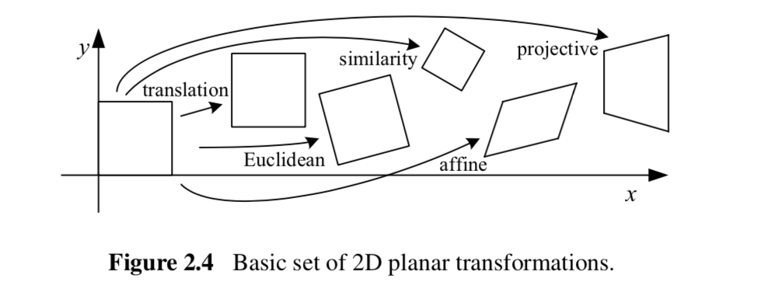
Parametric motion
For parametric motion, instead of using a single constant translation vector u, we use a spatially varying motion field or correspondence map, x⁰(x;p),

Slide 34
Parametric motion
Instead of using a single constant translation vector u, we use a spatially varying motion field or correspondence map, x⁰(x;p), parameterized by a low- dimensional vector p, where x⁰ can be any of the motion models presented in Section 2.1.2.
The modified parametric incremental motion update rule

Slide 35
Parametric motion
The modified parametric incremental motion update rule
The (Gauss–Newton) Hessian and gradient-weighted residual vector for parametric motion:

Slide 36
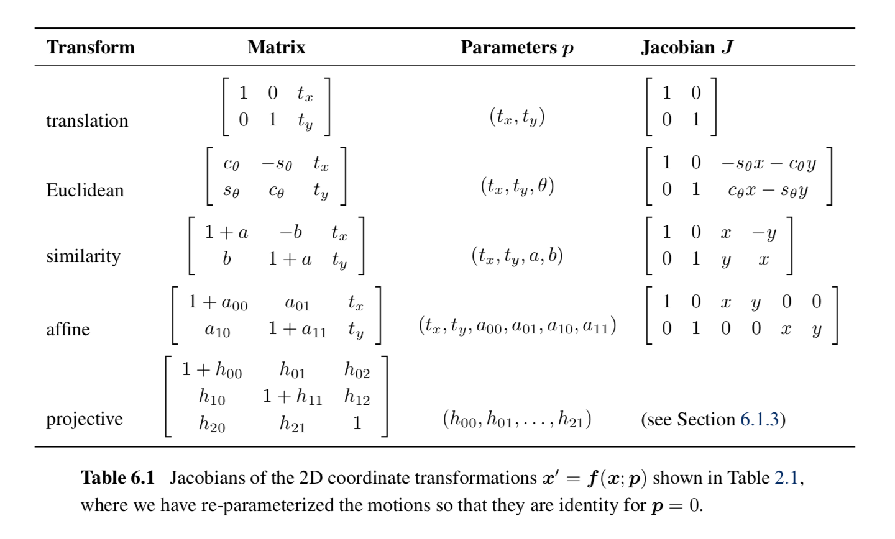
Parametric motion
motion models presented in Section 2.1.2.

Slide 37
Patch-based Approximation (1/2)
The computation of the Hessian and residual vectors for parametric motion can be significantly more expensive than for the translational case
Divide the image up into smaller sub-blocks (patches) and to only accumulate the simpler 2x2 quantities inside the square brackets at the pixel level
DC & CV Lab.
CSIE NTU

Slide 38
Patch-based Approximation (2/2)
The full Hessian and residual can then be approximated as:
where xˆ_{j} is the center of each patch P_{j}
DC & CV Lab.
CSIE NTU

Slide 39
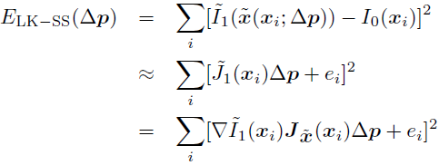
Compositional Approach (1/3)
For a complex parametric motion such as a homography, the computation of the motion Jacobian becomes complicated and may involve a per-pixel division.
Simplification:
first warp the target image according to the current motion estimate
compare this warped image against the template
DC & CV Lab.
CSIE NTU

Slide 40
Compositional Approach (2/3)
Inverse compositional algorithm:
warp the template image and minimize
Has the potential of pre-computing the inverse Hessian and the steepest descent image
Because the inverse compositional algorithm has the potential of pre-computing the inverse Hessian and the steepest de- scent images, this makes it the preferred approach

Slide 41
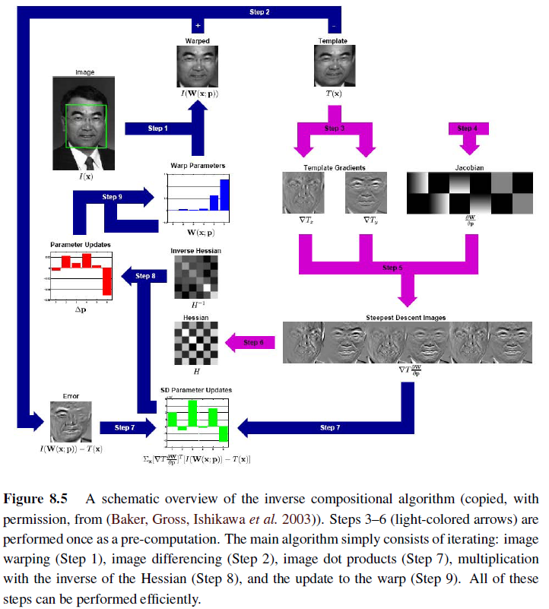
Compositional Approach (3/3)

Slide 42
8.2.1 Application: Video stabilization
Algorithms for stabilization run inside both hardware devices,
Three major stages of stabilization, namely motion estimation, motion smoothing, and image warping
Motion estimation algorithms lock onto the background motion, which is a result of the camera movement, without getting distracted by independent moving foreground objects.
Motion smoothing algorithms recover the low-frequency (slowly varying) part of the motion and then estimate the high-frequency shake component that needs to be removed.
Finally, image warping algorithms apply the high-frequency correction to render the original frames as if the camera had undergone only the smooth motion.

Slide 43
JOKe

Slide 44
8.2.2 Learned Motion Models
First, a set of dense motion fields (Section 8.4) is computed from a set of training videos.
Next, singular value decomposition (SVD) is applied to the stack of motion fields u_{t}(x) to compute the first few singular vectors v_{k}(x).
Finally, for a new test sequence, a novel flow field is computed using a coarse-to-fine algorithm that estimates the unknown coefficient a_{k} in the parameterized flow field

Slide 45
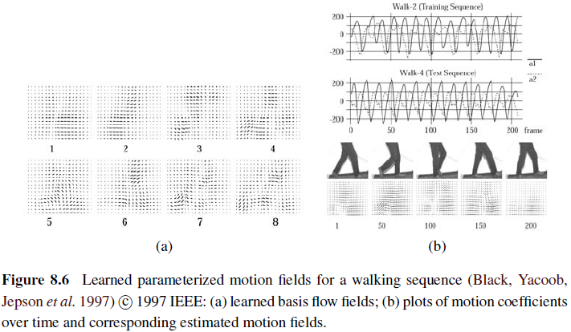
8.2.2 Learned Motion Models

Slide 46
8.3 Spline-based Motion (1/4)
Traditionally, optical flow algorithms compute an independent motion estimate for each pixel.
The general optical flow analog can thus be written as
Represent the motion field as a two-dimensional spline controlled by a smaller number of control vertices
the basis functions; only non-zero over a small finite support interval

Slide 47
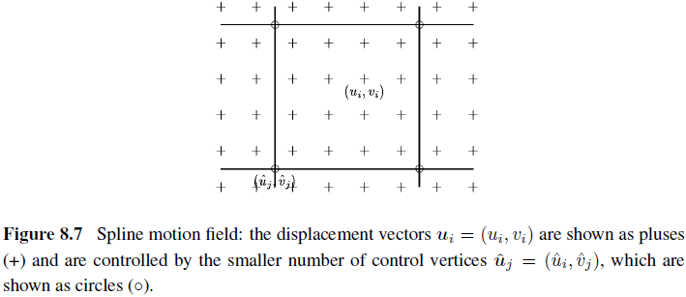
8.3 Spline-based Motion (2/4)

Slide 48
8.3 Spline-based Motion (1/4)
Traditionally, optical flow algorithms compute an independent motion estimate for each pixel.
The general optical flow analog can thus be written as
Represent the motion field as a two-dimensional spline controlled by a smaller number of control vertices
the basis functions; only non-zero over a small finite support interval

Slide 49
8.3 Spline-based Motion (1/4)
where the B_{j}(x_{i}) are called the basis functions and are only non-zero over a small finite sup- port interval .
We call the w_{ij} = B_{j}(x_{i}) weights to emphasize that the {u_{i}} are known linear combinations of the {uˆ_{j}}.
Some commonly used spline basis functions are shown below

Slide 50
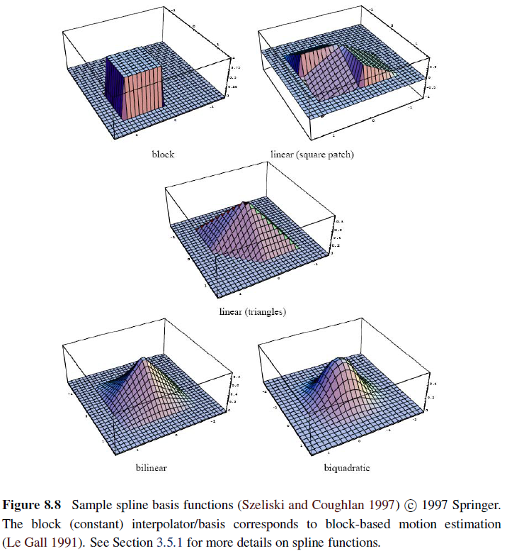
8.3 Spline-based Motion (2/4)

Slide 51
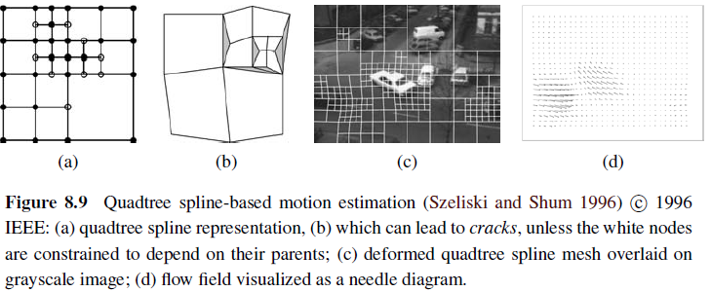
8.3 Spline-based Motion (2/4)
One disadvantage of the basic technique, however, is that the model does a poor job near motion discontinuities, unless an excessive number of nodes is used.
Large cells are used to present regions of smooth motion, while smaller cells are added in regions of motion discontinuities

Slide 52
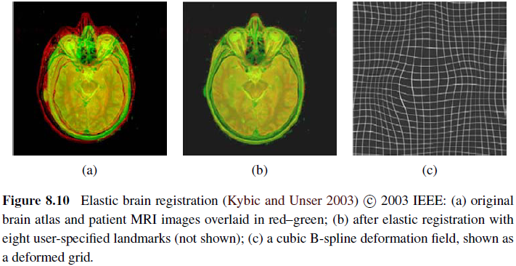
8.3.1 Application: Medical Image Registration (1/2)

Slide 53
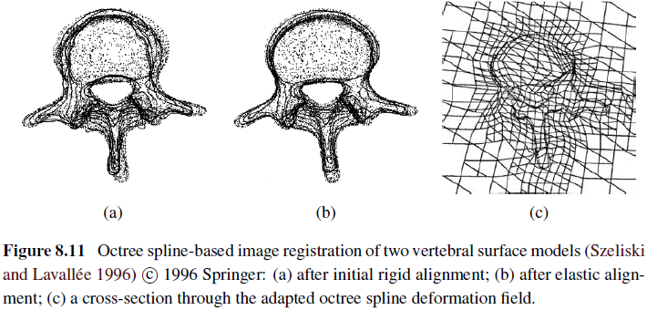
8.3.1 Application: Medical Image Registration (1/2)

Slide 54
JOKE

Slide 55
8.4 Optical Flow
The most general version of motion estimation is to compute an independent estimate of motion at each pixel, which is generally known as optical (or optic) flow

Slide 56
8.4 Optical Flow
Bergen, Anandan, Hanna et al.
After each iteration of optic flow estimation in a coarse-to-fine pyramid, they re-warp one of the images so that only incremental flow estimates are computed
When overlapping patches are used, an efficient implementation is to first compute the outer products of the gradients and intensity errors at every pixel
and then perform the overlapping window sums using a moving average filter.¹¹

Slide 57
8.4 Optical Flow
Horn and Schunck
HW assign

Slide 58
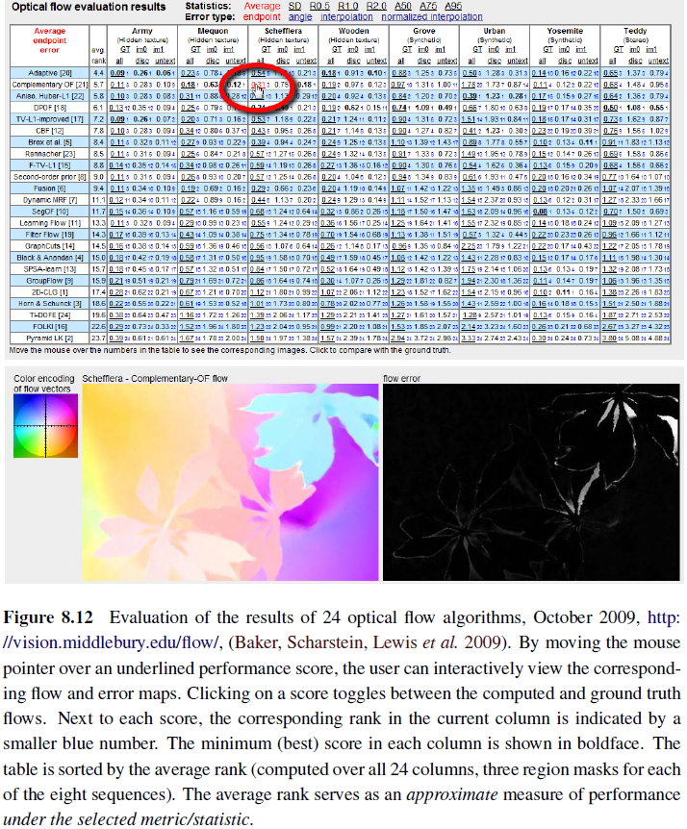
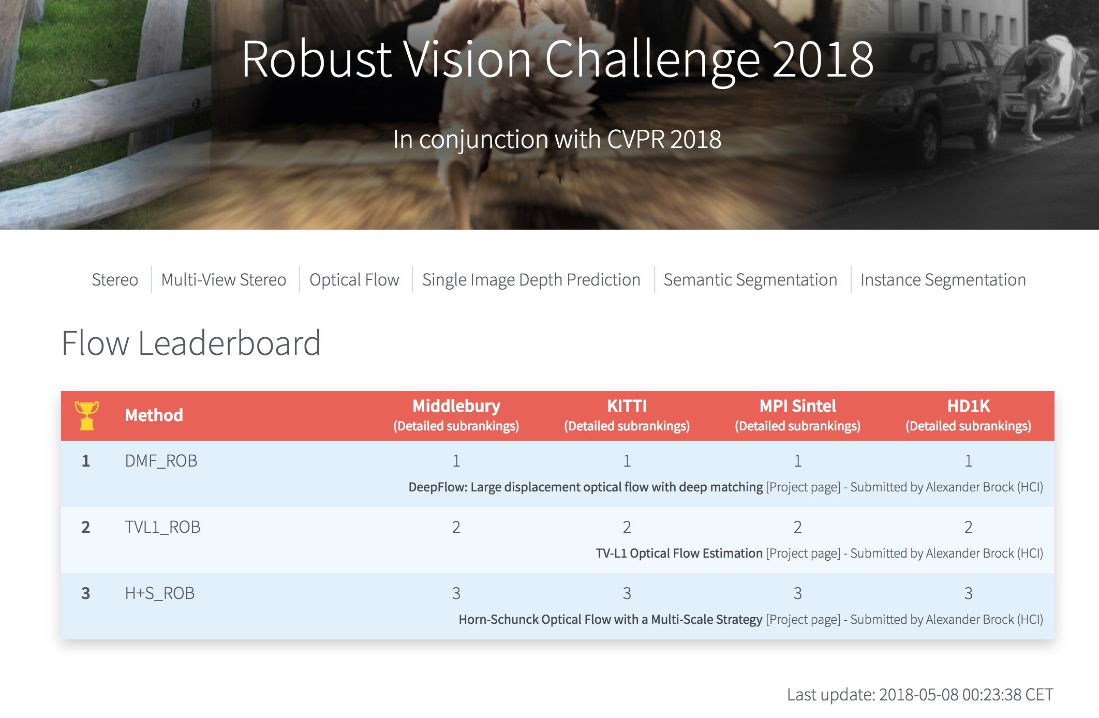
8.4 Optical Flow
Robust Vision Challenge

Slide 59
8.4.1 Multi-frame Motion Estimation
So far, we have looked at motion estimation as a two-frame problem, where the goal is to compute a motion field that aligns pixels from one image with those in another.
In practice, motion estimation is usually applied to video, where a whole sequence of frames is available to perform this task.
One classic approach to multi-frame motion is to filter the spatiotemporal volume using oriented or steerable filters

Slide 60
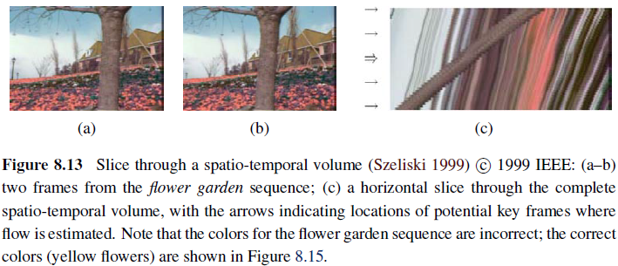
8.4.1 Multi-frame Motion Estimation
Because the pixel motion is mostly horizontal, the slopes of individual (textured) pixel tracks, which correspond to their horizontal velocities, can clearly be seen.
Spatiotemporal filtering uses a 3D volume around each pixel to determine the best orientation in space–time, which corresponds directly to a pixel’s velocity.

Slide 61
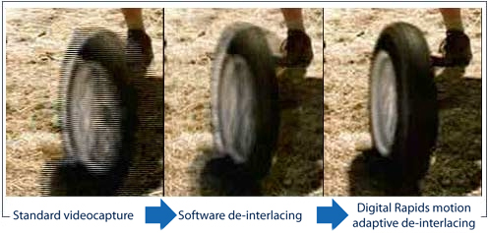
8.4.2~8.4.3 Application
Video denoising
Unlike single image denoising, where the only information available is in the current picture, video denoisers can average or borrow information from adjacent frames.
De-interlacing
video de-interlacing, which is the process of converting a video taken with alternating fields of even and odd lines to a non-interlaced signal that contains both fields in each frame

Slide 62
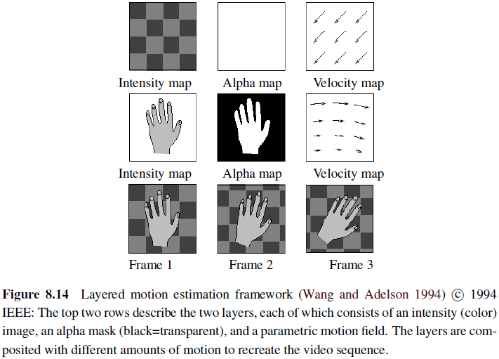
8.5 Layered Motion
In many situation, visual motion is caused by the movement of a small number of objects at different depths in the scene.
In such situations, the pixel motions can be described more succinctly (and estimated more reliably) if pixels are grouped into appropriate objects or layers

Slide 63
8.5 Layered Motion
Layered motion representations not only lead to compact representations but they also exploit the information available in multiple video frames, as well as accurately modeling the appearance of pixels near motion discontinuities.

Slide 64
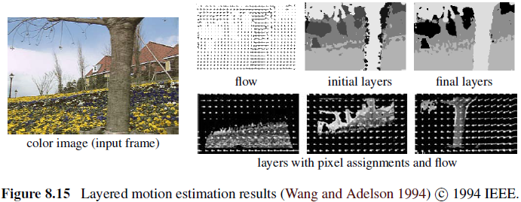
8.5 Layered Motion
first estimate affine motion models over a collection of non-overlapping patches
then cluster these estimates using k-means.
then alternate between assigning pixels to layers and recomputing motion estimates for each layer using the assigned pixels
layers are constructed by warping and merging the various layer pieces from all of the frames together.

Slide 65
8.5 Layered Motion
the motion of each layer is described using a 3D plane equation plus per-pixel residual depth offsets
that rigid planar motions (homographies) are used instead of affine motion models.
The final model refinement re-optimizes the layer pixel by minimizing the discrepancy between the re-synthesized and observed motion sequences
required a rough initial assignment of pixels to layers

Slide 66
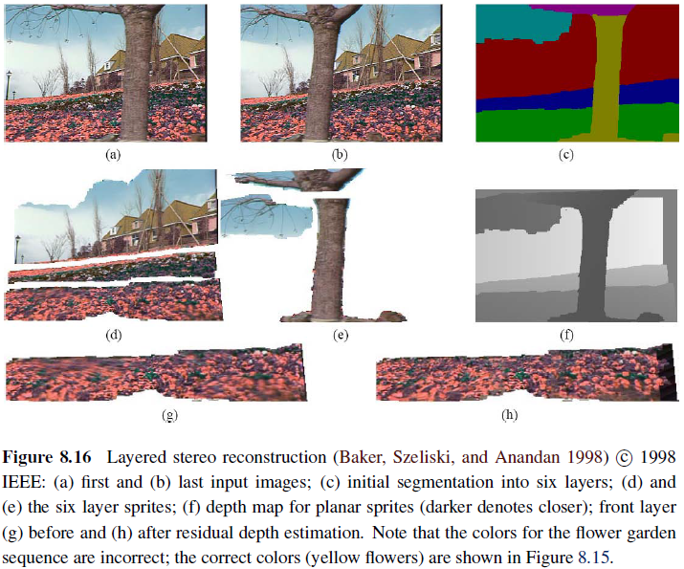
8.5 Layered Motion

Slide 67
8.5.1 Application: Frame Interpolation (1/2)
If the same motion estimate is obtained at location in image as is obtained at location in image , the flow vectors are said to be consistent.
This motion estimate can be transferred to location in the image being generated, where is the time of interpolation.
The final color value at pixel can be computed as a linear blend

Slide 68
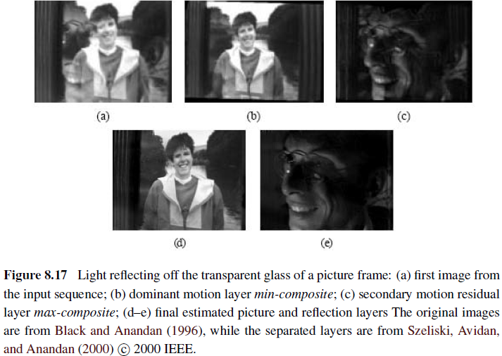
8.5.2 Transparent Layers and Reflections (1/2)
A special case of layered motion that occurs quite often is transparent motion, which is usually caused by reflections seen in windows and picture frames

Slide 69
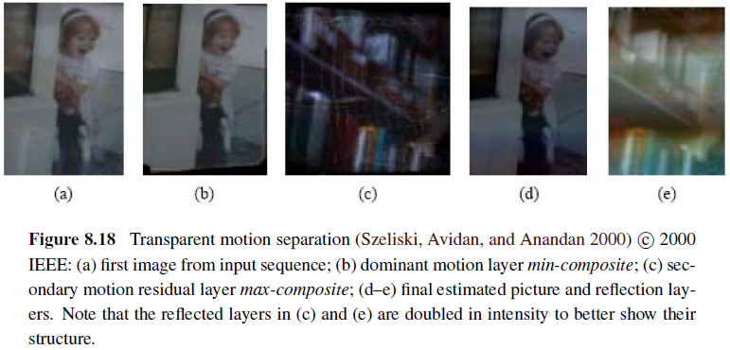
8.5.2 Transparent Layers and Reflections (1/2)
A special case of layered motion that occurs quite often is transparent motion, which is usually caused by reflections seen in windows and picture frames

Slide 70
JOKE

Slide 71
gradient descent

