Slide 1
Advanced Computer Vision Chapter 8
Dense Motion Estimation
Presented by 謝尊安 and 傅楸善教授
Cell phone: 0975329907
E-mail: r05944036@ntu.edu.tw

Slide 2
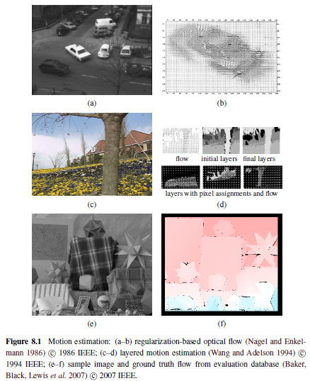

Slide 3
8.1 Translational Alignment
The simplest way: shift one image relative to the other
Find the minimum of the sum of squared differences (SSD) function:
$u=\left(u,v\right)$: displacement
$e_{i}=I_{1}\left(x_{i}+u\right)−I_{0}\left(x_{i}\right)$: residual error or displacement frame difference
Brightness constancy constraint

Slide 4
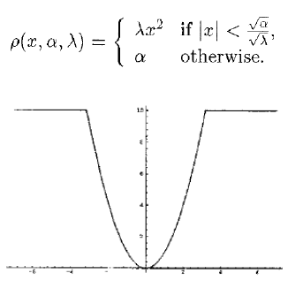
Robust Error Metrics (1/2)
Replace the squared error terms with a robust function $ρ\left(e_{i}\right)$
$ρ\left(e_{i}\right)$grows less quickly than the quadratic penalty associated with least squares

Slide 5
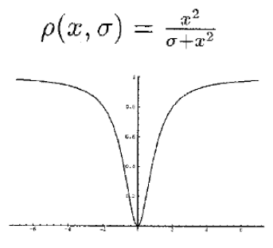
Robust Error Metrics (2/2)
Sum of absolute differences (SAD) metric or L₁ norm
Geman–McClure function
$a$: outlier threshold
Notes:
The outlier threshold can be derived using robust statistics, e.g., by computing the median absolute deviation, MAD = med|ei|, and multiplying it by 1.4 to obtain a robust estimate of the standard deviation of the inlier noise process

Slide 6
Spatially Varying Weights (1/2)
Weighted (or windowed) SSD function:
The weighting functions $ω_{0}$ and $ω_{1}$ are zero outside the image boundaries
The above metric can have a bias towards smaller overlap solutions if a large range of potential motions is allowed

Slide 7
Spatially Varying Weights (2/2)
Use per-pixel (or mean) squared pixel error instead of the original weighted SSD score
The use of the square root of this quantity (the root mean square intensity error) is reported in some studies

Slide 8
Bias and Gain (Exposure Differences)
A simple model with the following relationship:
$α$: gain
$β$: bias
The least squares formulation becomes:
Use linear regression to estimate both gain and bias

Slide 9
Correlation (1/2)
Maximize the product (or cross-correlation) of the two aligned images
Normalized Cross-Correlation (NCC)
NCC score is always guaranteed to be in the range $\left[−1,1\right]$

Slide 10
Correlation (2/2)
Normalized SSD:

Slide 11
8.1.1 Hierarchical Motion Estimation (1/2)
An image pyramid is constructed
Level $l$ is obtained by subsampling a smoothed version of the image at level $l−1$
Solving from coarse to fine
$S$: the search range at the finest resolution level

Slide 12
8.1.1 Hierarchical Motion Estimation (2/2)
The motion estimate from one level of the pyramid is then used to initialize a smaller local search at the next finer level

Slide 13
8.1.2 Fourier-based Alignment
$ω$: the vector-valued angular frequency of the Fourier transform
Accelerate the computation of image correlations and the sum of squared differences function

Slide 14
Windowed Correlation
The weighting functions $ω_{0}$ and $ω_{1}$ are zero outside the image boundaries

Slide 15
Phase Correlation (1/2)
The spectrum of the two signals being matched is whitened by dividing each per-frequency product by the magnitudes of the Fourier transforms

Slide 16
Phase Correlation (2/2)
In the case of noiseless signals with perfect (cyclic) shift, we have
The output of phase correlation (under ideal conditions) is therefore a single impulse located at the correct value of $u$, which makes it easier to find the correct estimate

Slide 17
Rotations and Scale (1/2)
Pure rotation
Re-sample the images into polar coordinates
The desired rotation can then be estimated using a Fast Fourier Transform (FFT) shift-based technique

Slide 18
Rotations and Scale (2/2)
Rotation and Scale
Re-sample the images into log-polar coordinates
Must take care to choose a suitable range of $s$ values that reasonably samples the original image

Slide 19
8.1.3 Incremental Refinement (1/3)
A commonly used approach proposed by Lucas and Kanade is to perform gradient descent on the SSD energy function by a Taylor series expansion

Slide 20
8.1.3 Incremental Refinement (2/3)
The image gradient or Jacobian at
The current intensity error
The linearized form of the incremental update to the SSD error is called the optical flow constraint or brightness constancy constraint equation

Slide 21
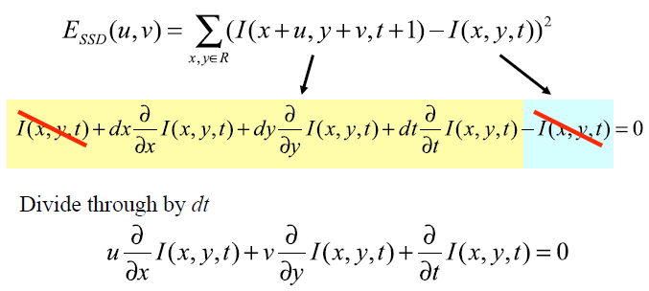
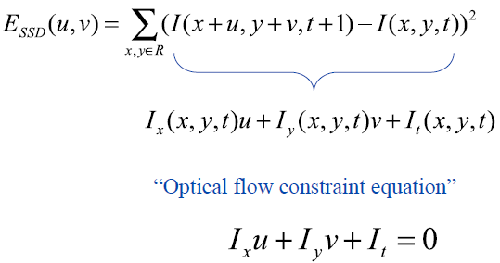

Slide 22
8.1.3 Incremental Refinement (3/3)
The least squares problem can be minimized by solving the associated normal equations
$A$: Hessian matrix
$b$: gradient-weighted residual vector

Slide 23
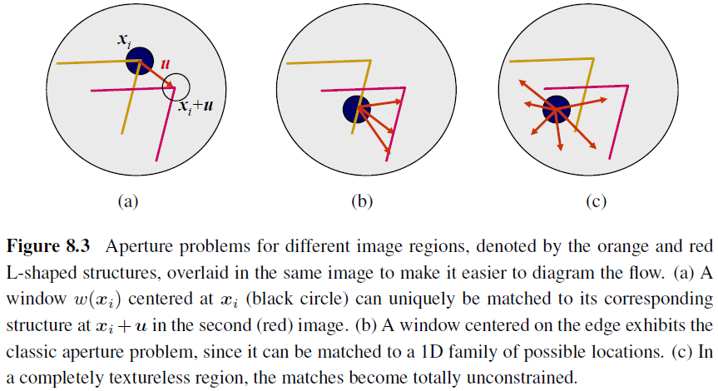
Conditioning and Aperture Problems

Slide 24
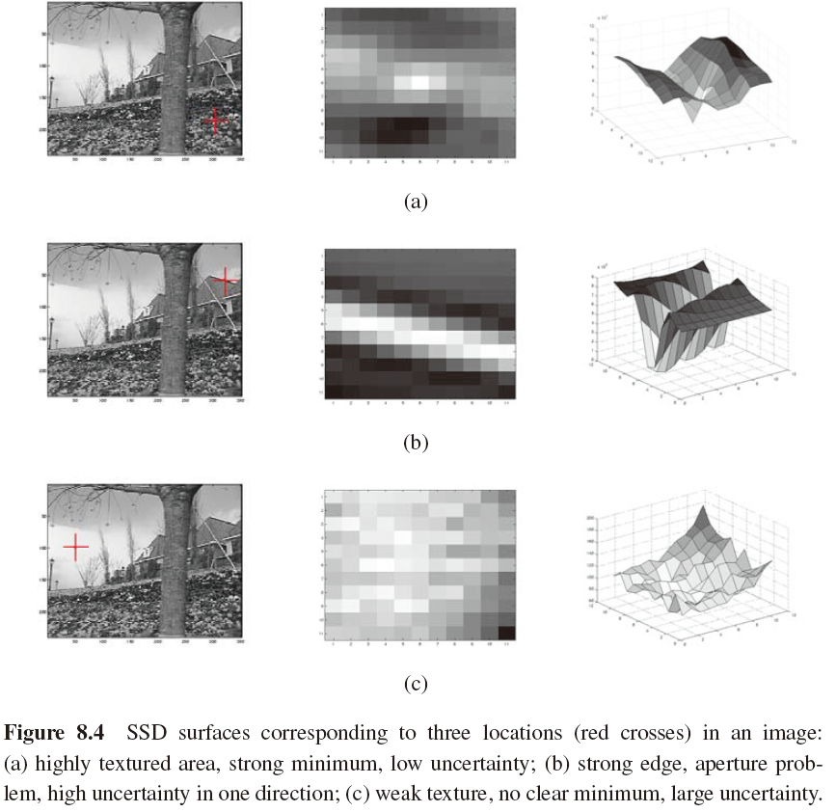

Slide 25
Uncertainty Modeling
The reliability of a particular patch-based motion estimate can be captured more formally with an uncertainty model
The simplest model: a covariance matrix
Under small amounts of additive Gaussian noise, the covariance matrix $Σ_{u}$ is proportional to the inverse of the Hessian $A$
: the variance of the additive Gaussian noise

Slide 26
Bias and Gain, Weighting, and Robust Error Metrics
Apply Lucas–Kanade update rule to the following metrics
Bias and gain model
Weighted version of the Lucas–Kanade algorithm
Robust error metric

Slide 27
8.2 Parametric Motion (1/2)
$x′\left(x;p\right)$: a spatially varying motion field or correspondence map, parameterized by a low-dimensional vector $p$
The modified parametric incremental motion update rule:

Slide 28
8.2 Parametric Motion (2/2)
The (Gauss–Newton) Hessian and gradient-weighted residual vector for parametric motion:

Slide 29
Patch-based Approximation (1/2)
The computation of the Hessian and residual vectors for parametric motion can be significantly more expensive than for the translational case
Divide the image up into smaller sub-blocks (patches) $P_{j}$ and to only accumulate the simpler 2x2 quantities inside the square brackets at the pixel level

Slide 30
Patch-based Approximation (2/2)
The full Hessian and residual can then be approximated as:

Slide 31
Compositional Approach (1/3)
For a complex parametric motion such as a homography, the computation of the motion Jacobian becomes complicated and may involve a per-pixel division.
Simplification:
first warp the target image $I_{1}$ according to the current motion estimate $x′\left(x;p\right)$
compare this warped image against the template $I_{0}\left(x\right)$

Slide 32
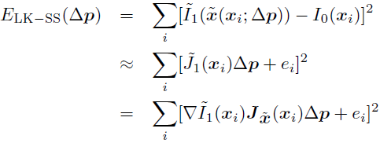
Compositional Approach (2/3)
Simplification:
first warp the target image $I_{1}$ according to the current motion estimate $x′\left(x;p\right)$
compare this warped image against the template $I_{0}\left(x\right)$

Slide 33
Compositional Approach (3/3)
Inverse compositional algorithm:
warp the template image $I_{0}\left(x\right)$and minimize
Has the potential of pre-computing the inverse Hessian and the steepest descent images

Slide 34
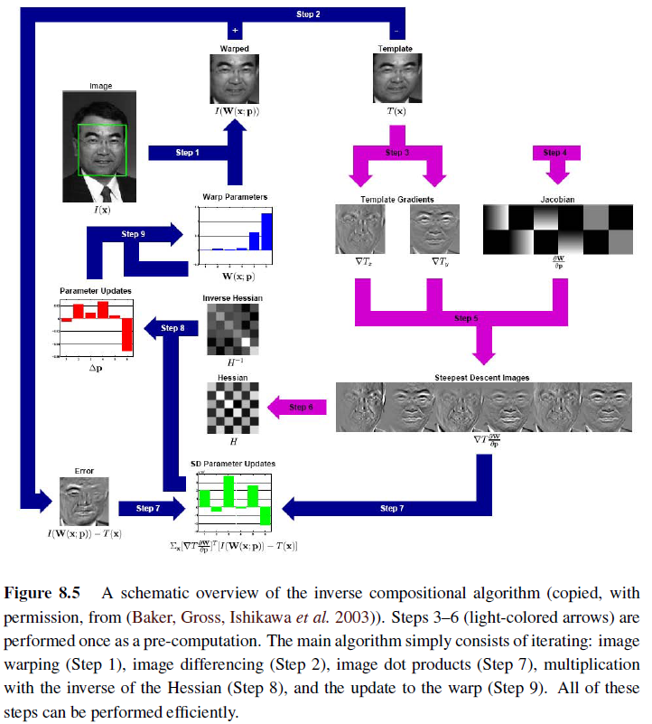

Slide 35
8.2.1~8.2.2 Applications
Video stabilization
Learned motion models:
First, a set of dense motion fields is computed from a set of training videos.
Next, singular value decomposition (SVD) is applied to the stack of motion fields $u_{t}\left(x\right)$ to compute the first few singular vectors $v_{k}\left(x\right)$.
Finally, for a new test sequence, a novel flow field is computed using a coarse-to-fine algorithm that estimates the unknown coefficient $a_{k}$ in the parameterized flow field.

Slide 36
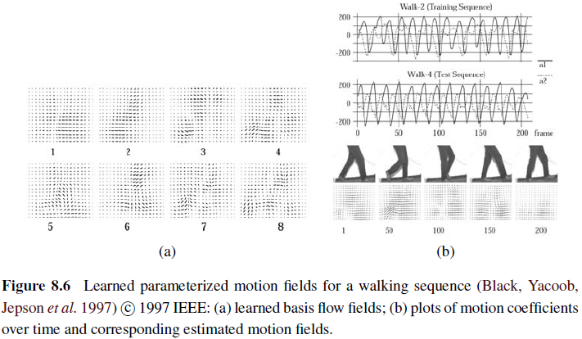
8.2.2 Learned Motion Models

Slide 37
8.3 Spline-based Motion (1/4)
Traditionally, optical flow algorithms compute an independent motion estimate for each pixel.
The general optical flow analog can thus be written as

Slide 38
8.3 Spline-based Motion (2/4)
Represent the motion field as a two-dimensional spline controlled by a smaller number of control vertices $\left\{\hat{u_{j}}\right\}$
$B_{j}\left(x_{i}\right)$: the basis functions; only non-zero over a small finite support interval
${w_{i,j}=B}_{j}\left(x_{i}\right)$: weights; the $\left\{u_{i}\right\}$ are known linear combinations of the $\left\{\hat{u_{j}}\right\}$

Slide 39
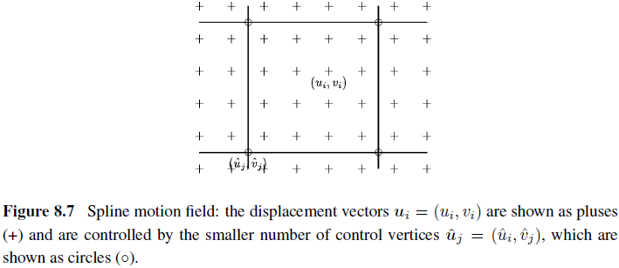
8.3 Spline-based Motion (3/4)

Slide 40
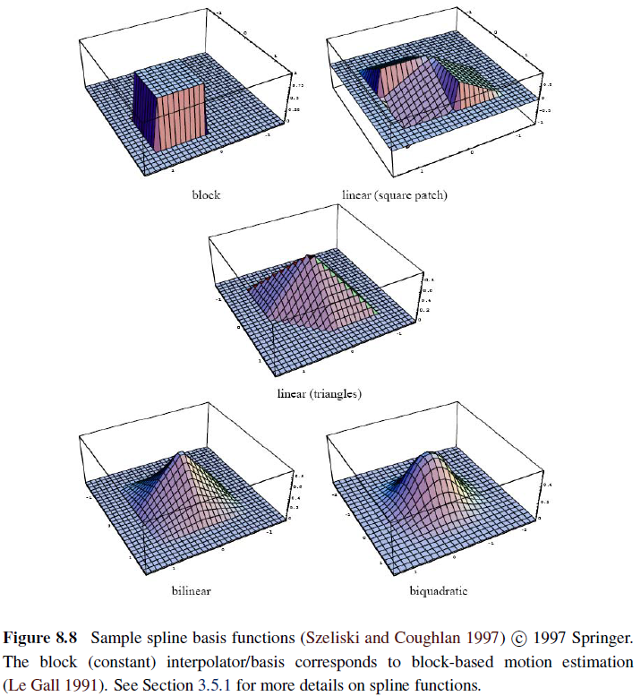

Slide 41
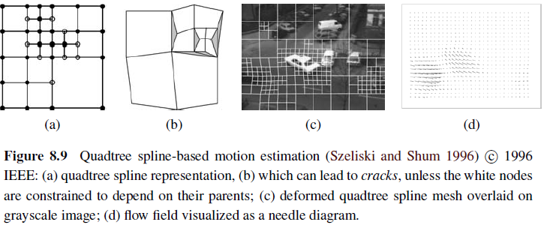
8.3 Spline-based Motion (4/4)

Slide 42
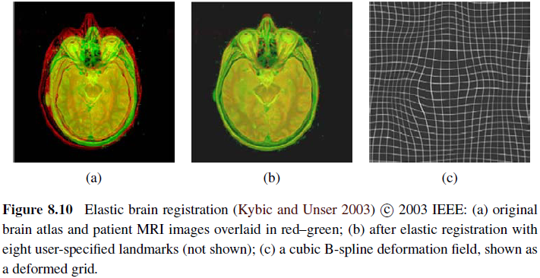
8.3.1 Application: Medical Image Registration (1/2)

Slide 43
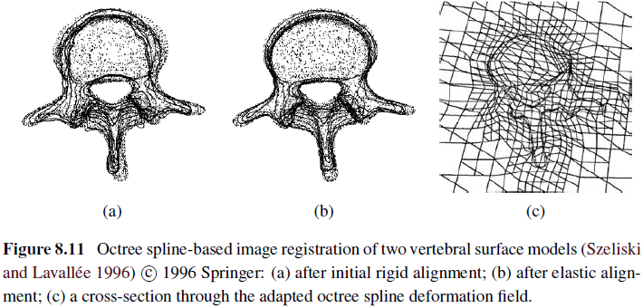
8.3.1 Application: Medical Image Registration (2/2)

Slide 44
8.4 Optical Flow (1/2)
The most general version of motion estimation is to compute an independent estimate of motion at each pixel, which is generally known as optical (or optic) flow

Slide 45
8.4 Optical Flow (2/2)
Brightness constancy constraint
: temporal derivative
discrete analog to the analytic global energy:

Slide 46
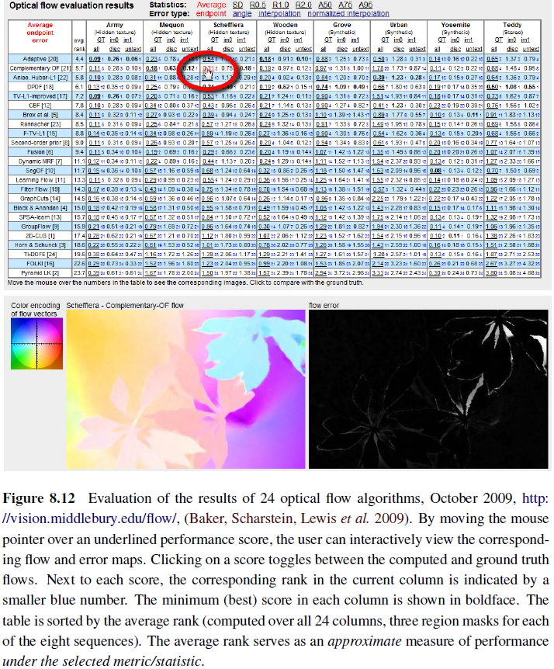

Slide 47
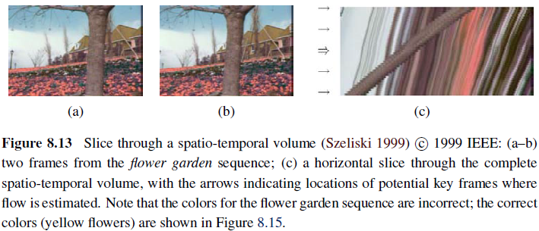
8.4.1 Multi-frame Motion Estimation

Slide 48
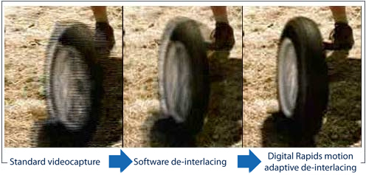
8.4.2~8.4.3 Application
Video denoising
De-interlacing

Slide 49
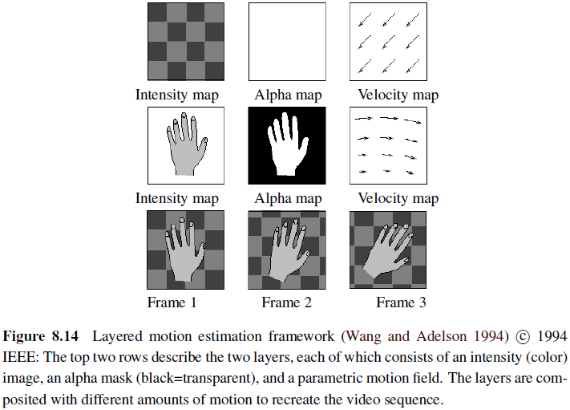
8.5 Layered Motion (1/2)

Slide 50
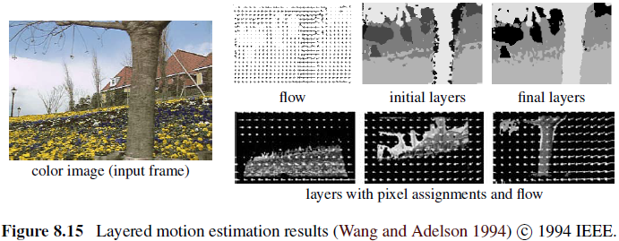
8.5 Layered Motion (2/2)

Slide 51
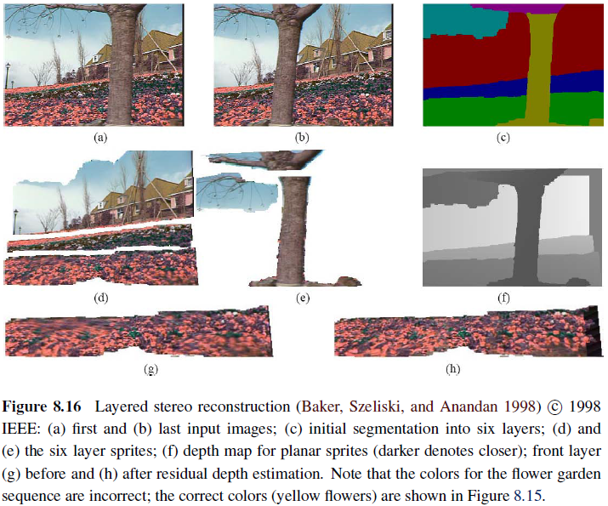

Slide 52
8.5.1 Application: Frame Interpolation (1/2)
If the same motion estimate $u_{0}$ is obtained at location $x_{0}$ in image $I_{0}$ as is obtained at location ${x_{0}+u}_{0}$in image $I_{1}$, the flow vectors are said to be consistent.
This motion estimate can be transferred to location ${x_{0}+tu}_{0}$in the image $I_{t}$ being generated, where $t∈\left(0,1\right)$ is the time of interpolation.

Slide 53
8.5.1 Application: Frame Interpolation (2/2)
The final color value at pixel ${x_{0}+tu}_{0}$can be computed as a linear blend

Slide 54
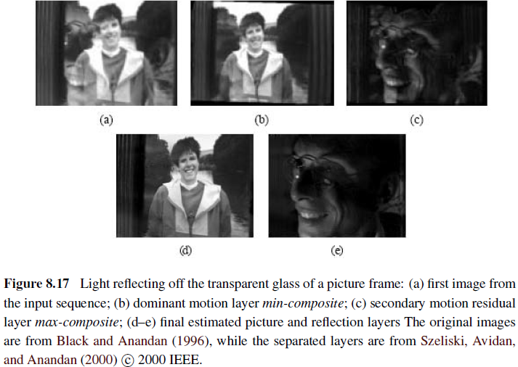
8.5.2 Transparent Layers and Reflections (1/2)

Slide 55
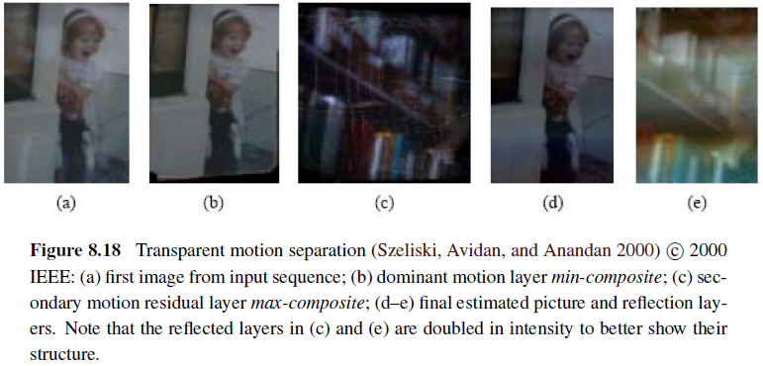
8.5.2 Transparent Layers and Reflections (2/2)

Slide 56
B.K.P, Horn, Robot Vision, The MIT Press, Cambridge, MA, 1986
Chapter 12 Motion Field & Optical Flow
optic flow: apparent motion of brightness patterns during relative motion

Slide 57
12.1 Motion Field
motion field: assigns velocity vector to each point in the image
P_{o}: some point on the surface of an object
P_{i}: corresponding point in the image
v_{o}: object point velocity relative to camera
v_{i}: motion in corresponding image point

Slide 58
12.1 Motion Field (cont’)
r_{i}: distance between perspectivity center and image point
r_{o}: distance between perspectivity center and object point
f’: camera constant
z: depth axis, optic axis
object point displacement causes corresponding image point displacement

Slide 59
12.1 Motion Field (cont’)

Slide 60
12.1 Motion Field (cont’)
Velocities:
where r_{o} and r_{i} are related by

Slide 61
12.1 Motion Field (cont’)
differentiation of this perspective projection equation yields

Slide 62
12.2 Optical Flow
optical flow need not always correspond to the motion field
(a) perfectly uniform sphere rotating under constant illumination:
no optical flow, yet nonzero motion field
(b) fixed sphere illuminated by moving light source:
nonzero optical flow, yet zero motion field

Slide 64
12.2 Optical Flow (cont’)
not easy to decide which P’ on contour C’ corresponds to P on C

Slide 66
12.2 Optical Flow (cont’)
optical flow: not uniquely determined by local information in changing
irradiance at time t at image point (x, y)
components of optical flow vector

Slide 67
12.2 Optical Flow (cont’)
assumption: irradiance the same at time
fact: motion field continuous almost everywhere

Slide 68
12.2 Optical Flow (cont’)
expand above equation in Taylor series
e: second- and higher-order terms in
cancelling E(x, y, t), dividing through by

Slide 69
12.2 Optical Flow (cont’)
which is actually just the expansion of the equation
abbreviations:

Slide 70
12.2 Optical Flow (cont’)
we obtain optical flow constraint equation:
flow velocity (u, v): lies along straight line perpendicular to intensity gradient

Slide 72
12.2 Optical Flow (cont’)
rewrite constraint equation:
aperture problem: cannot determine optical flow along isobrightness contour

Slide 73
12.3 Smoothness of the Optical Flow
motion field: usually varies smoothly in most parts of image
try to minimize a measure of departure from smoothness

Slide 74
12.3 Smoothness of the Optical Flow (cont’)
error in optical flow constraint equation should be small
overall, to minimize

Slide 75
12.3 Smoothness of the Optical Flow (cont’)
large if brightness measurements are accurate
small if brightness measurements are noisy

Slide 76
12.4 Filling in Optical Flow Information
regions of uniform brightness: optical flow velocity cannot be found locally
brightness corners: reliable information is available

Slide 77
12.5 Boundary Conditions
Well-posed problem: solution exists and is unique
partial differential equation: infinite number of solution unless with boundary

Slide 78
12.6 The Discrete Case
first partial derivatives of u, v: can be estimated using difference

Slide 80
12.6 The Discrete Case (cont’)
measure of departure from smoothness:
error in optical flow constraint equation:
to seek set of values that minimize

Slide 81
12.6 The Discrete Case (cont’)
dieffrentiating e with respect to

Slide 82
12.6 The Discrete Case (cont’)
where are local average of u, v (9 neighbors? )
extremum occurs where the above derivatives of e are zero:

Slide 83
12.6 The Discrete Case (cont’)
determinant of 2x2 coefficient matrix:
so that

Slide 84
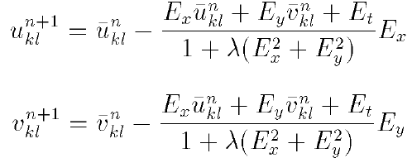
12.6 The Discrete Case (cont’)
suggests iterative scheme such as
new value of (u, v): average of surrounding values minus adjustment

Slide 86
12.6 The Discrete Case (cont’)
first derivatives estimated using first differences in 2x2x2 cube

Slide 88
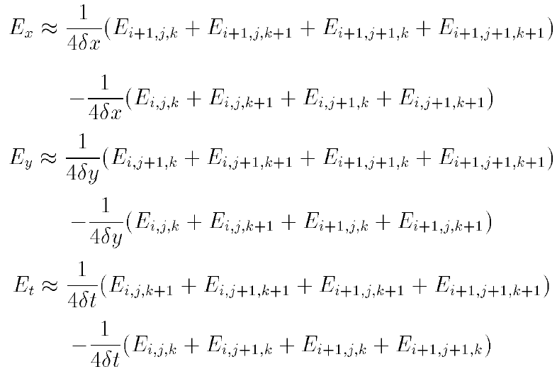
12.6 The Discrete Case (cont’)
consistent estimates of three first partial derivatives:

Slide 89
12.6 The Discrete Case (cont’)
four successive synthetic images of rotating sphere

Slide 91
12.6 The Discrete Case (cont’)
estimated optical flow after 1, 4, 16, and 64 iterations

Slide 93
12.6 The Discrete Case (cont’)
(a) estimated optical flow after several more iterations
(b) computed motion field

Slide 95
12.7 Discontinuities in Optical Flow
discontinuities in optical flow: on silhouettes where occlusion occurs

Slide 96
Project due June 6
implementing Horn & Schunck optical flow estimation as above
synthetically translate lena.im one pixel to the right and downward
Try

