Slide 1
Dense Motion Estimation
Presented by 张易冰 and 傅楸善教授

Slide 2
Introduction
Algorithms for aligning images and estimating motion

Slide 3
Keywords
alignment
motion estimation
error metric
hierarchical coarse-to-fine
parametric motion

Slide 4
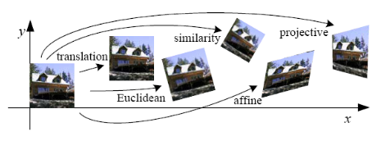

Slide 5
8.1 Translational Alignment
Shift one image relative to the other.
Find the minimum of the sum of squared differences (SSD) function.

Slide 6
8.1 Translational Alignment
: displacement
: residual error

Slide 7


Robust error metrics
make the above error metric more robust to outliers by replacing
the squared error terms with a robust function
is a function that grows less quickly than the quadratic penalty associated with least squares.

Slide 8
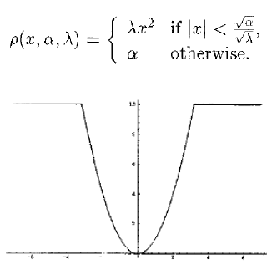
Robust error metrics

Slide 9

Robust error metrics
sum of absolute differences (SAD)
High speed.
Often used in motion estimation in video.

Slide 10
Robust error metrics
However, since this function is not differentiable at the origin, it is not well suited to gradient descent approaches
Instead, a smoothly varying function that is quadratic for small values but grows more slowly away from the origin is often used

Slide 11
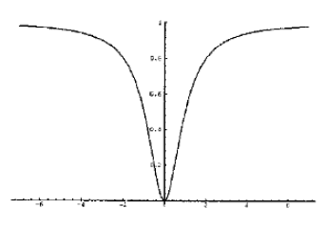

the Geman–McClure function
a： outlier threshold

Slide 12
Spatially Varying Weights
some of the pixels being compared may lie outside the original image boundaries.
we may want to partially or completely downweight the contributions of certain pixels.

Slide 13

Spatially Varying Weights
The error metric then becomes the weighted (or windowed) SSD function
where the weighting functions w₀ and w₁ are zero outside the image boundaries.

Slide 14
Spatially Varying Weights
If a large range of potential motions is allowed, the above metric can have a bias towards smaller overlap solutions.
v

Slide 15


Spatially Varying Weights
To counteract this bias, the windowed SSD score can be divided by the overlap area
to compute a per-pixel (or mean) squared pixel error
root mean square intensity error

Slide 16
Bias and gain (exposure differences)
A simple model of linear (affine) intensity variation between the two
images is the bias and gain model
α : gain β : bias
The least squares formulation then becomes
It becomes necessary to perform a linear regression

Slide 17

Correlation
To maximize the product (or cross-correlation) of the two aligned images
At first glance, this may appear to make bias and gain modeling unnecessary.
However, this is actually not true.If a very bright patch exists in , the maximum product may actually lie in that area.

Slide 18



Correlation
For this reason, normalized cross-correlation is more commonly used
mean images of the corresponding patches and N is the number of pixels in the patch.

Slide 19

Correlation
normalized SSD

Slide 20
8.1.1 Hierarchical Motion Estimation
The simplest solution to find the minimum of alignment cost function between two images is to do a full search over some range of shifts.
To accelerate this search process, hierarchical motion estimation is often used

Slide 21

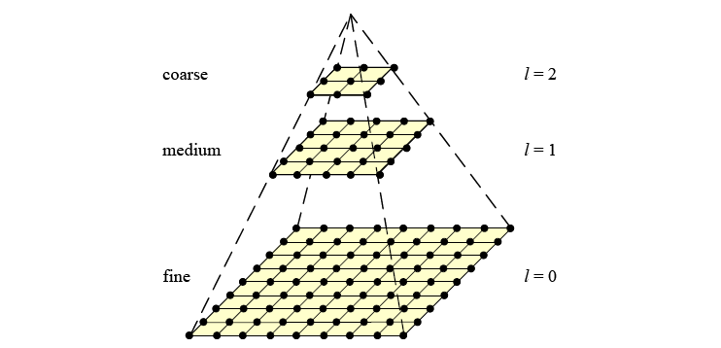
Hierarchical Motion Estimation

Slide 22
Hierarchical Motion Estimation
At the coarsest level, we search for the best displacement
that minimizes the difference between images and
This is usually done by using a full search over some range of displacements

Slide 23

Hierarchical Motion Estimation
Once a suitable motion vector has been estimated, it is used to predict a likely displacement for the next finer level.
The search over displacements is then repeated at the finer level over
a much narrower range of displacements

Slide 24
8.1.2 Fourier-based Alignment
When the search range corresponds to a significant fraction of the
larger image , the hierarchical approach may not work that well, since
it is often not possible to coarsen the representation too much before significant features are blurred away.
In this case, a Fourier-based approach may be preferable.

Slide 25
Fourier-based Alignment
Fourier-based alignment relies on the fact that the Fourier transform of a shifted signal has the same magnitude as the original signal but a linearly varying phase

Slide 26

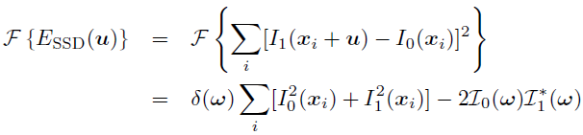
Fourier-based Alignment
While Fourier-based convolution is often used to accelerate the computation of image correlations, it can also be used to accelerate the sum of squared differences function.

Slide 27


Windowed Correlation
the weighting functions and are zero outside the valid ranges of the images

Slide 28

Phase Correlation

Slide 29

Phase Correlation
we have and hence,

Slide 30
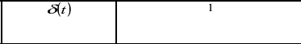
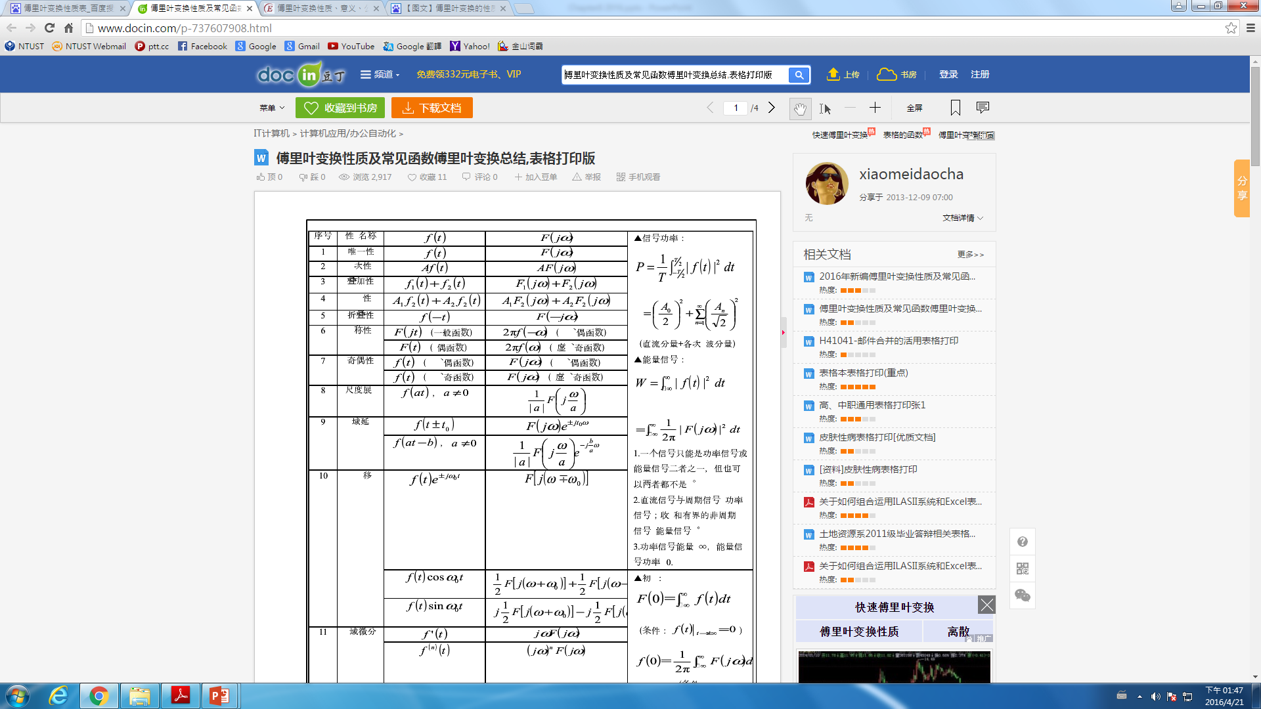
Phase Correlation
The output of phase correlation (under ideal conditions) is therefore a single spike (impulse) located at the correct value of u, which (in principle) makes it easier to find the correct estimate.

Slide 31

Rotations and Scale
While Fourier-based alignment is mostly used to estimate translational shifts between images, it can, under certain limited conditions, also be used to estimate in-plane rotations and scales.

Slide 32



Rotations and Scale
re-sample the images into polar coordinates
The desired rotation can then be estimated using a Fast Fourier Transform (FFT) shift-based technique.

Slide 33



Rotations and Scale
If the two images are also related by a scale,
we can re-sample into log-polar coordinates,

Slide 34

Rotations and Scale
I believe we can use two dimensional FFT to solve the alignment.

Slide 35
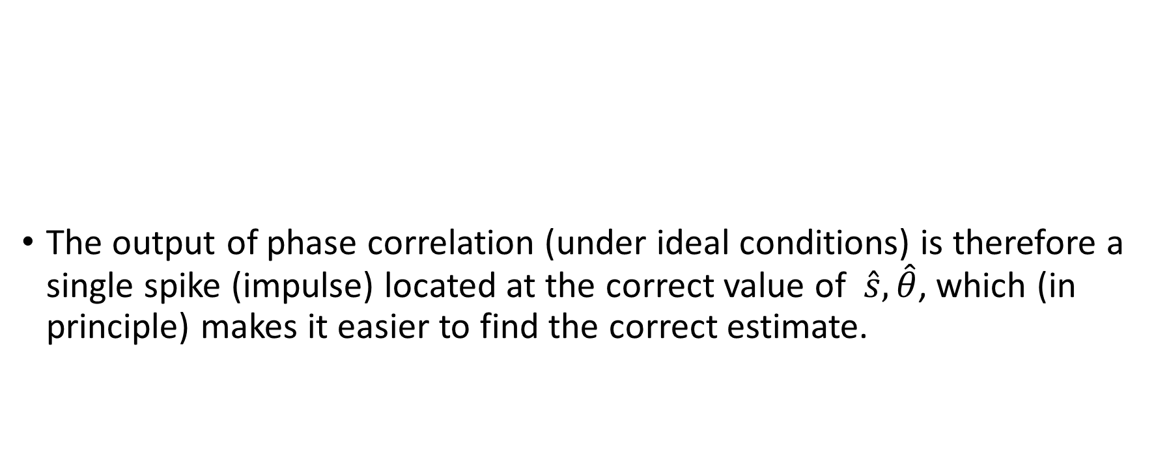
Rotations and Scale
The output of phase correlation (under ideal conditions) is therefore a single spike (impulse) located at the correct value of $\hat{s},\hat{θ}$, which (in principle) makes it easier to find the correct estimate.

Slide 36
8.1.3 Incremental Refinement
The techniques described up till now can estimate alignment to the nearest pixel .
In general, image stabilization and stitching applications require much higher accuracies to obtain acceptable results.

Slide 37
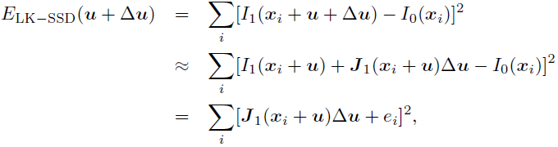
Incremental Refinement
To obtain better sub-pixel estimates
A commonly used approach is to perform gradient descent on the SSD energy function ,using a Taylor series expansion of the image function.

Slide 38




Incremental Refinement
is the image gradient or Jacobian at
the simplest way of computing the gradient is to simply take the horizontal and vertical differences between pixels

Slide 39

Incremental Refinement
The linearized form of the incremental update to the SSD error (8.35) is often called the optical flow constraint or brightness constancy constraint equation

Slide 40
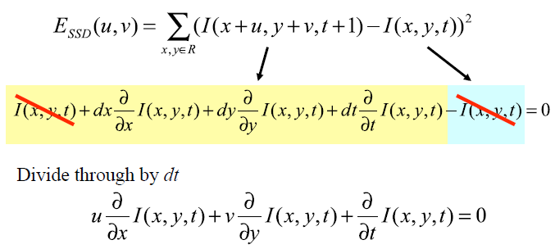
Incremental Refinement

Slide 41
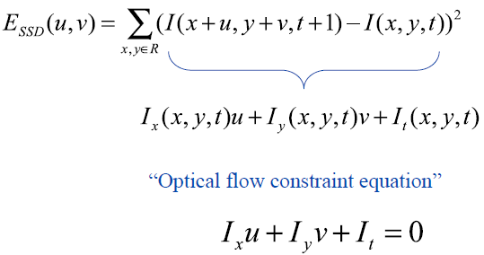
Incremental Refinement

Slide 42


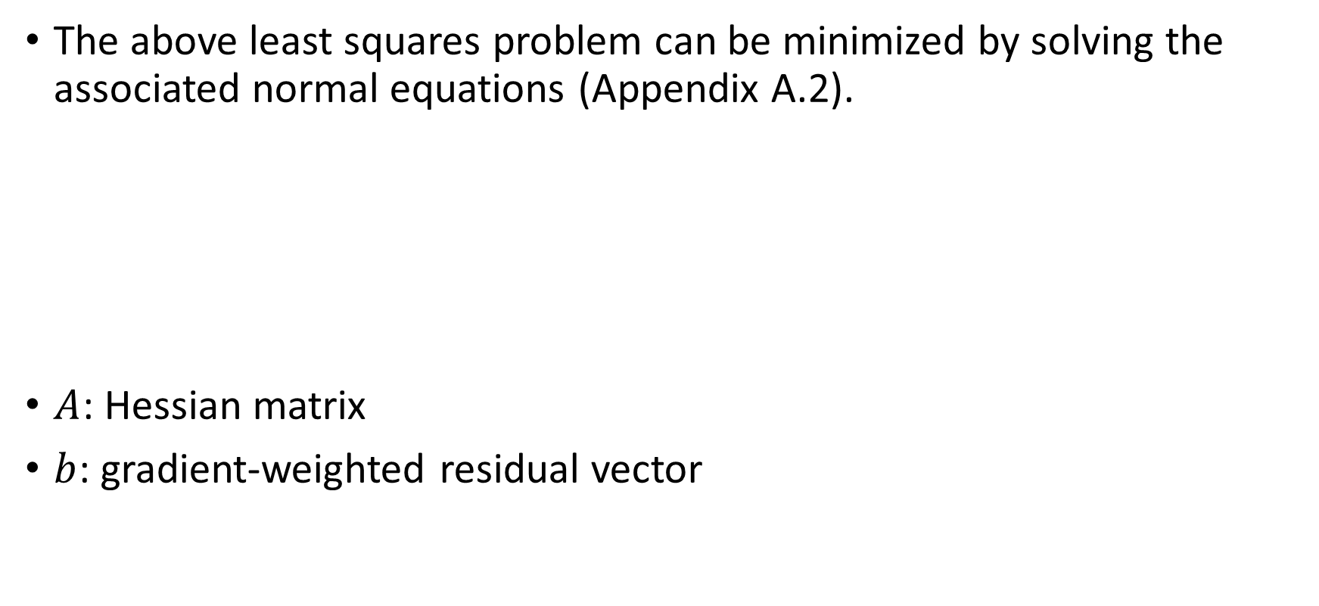
Incremental Refinement
The above least squares problem can be minimized by solving the associated normal equations (Appendix A.2).
$A$: Hessian matrix
$b$: gradient-weighted residual vector

Slide 43


Incremental Refinement

Slide 44
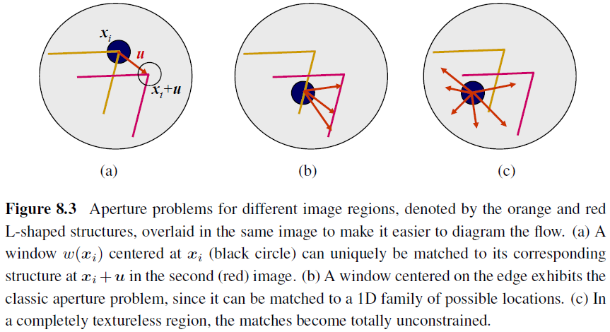
Conditioning and Aperture Problems

Slide 45
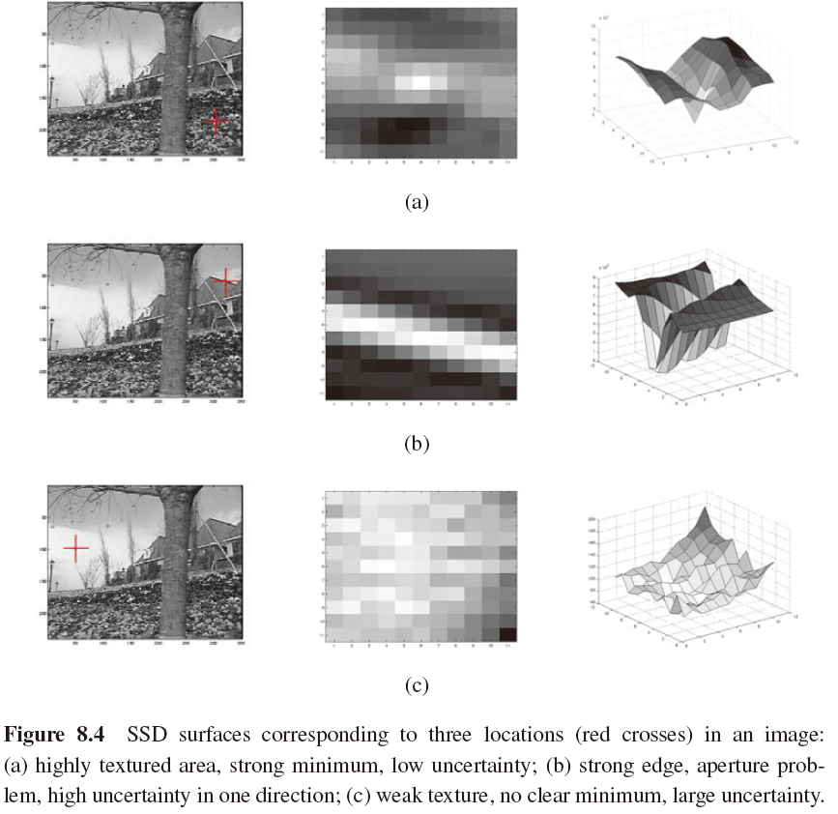

Slide 46


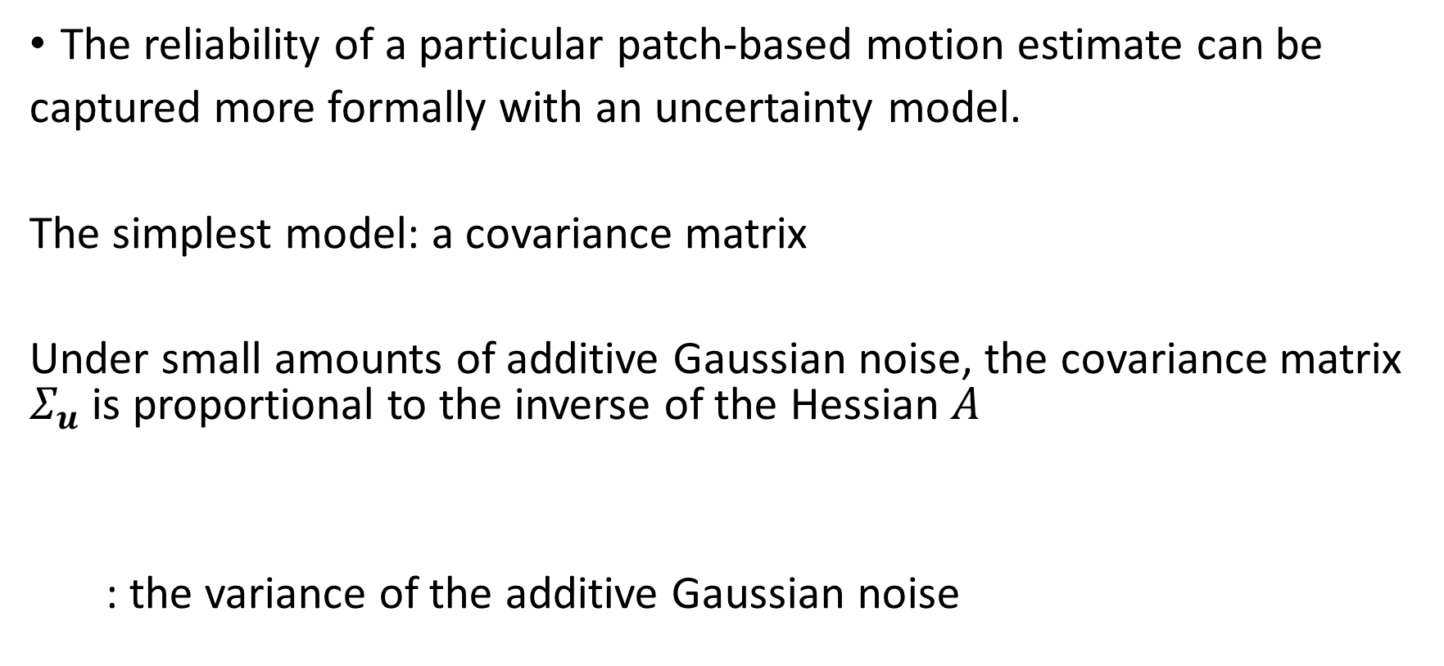
Uncertainty Modeling
The reliability of a particular patch-based motion estimate can be
captured more formally with an uncertainty model.
The simplest model: a covariance matrix
  Under small amounts of additive Gaussian noise, the covariance matrix $Σ_{u}$ is proportional to the inverse of the Hessian $A$
: the variance of the additive Gaussian noise

Slide 47

Bias and Gain, Weighting, and Robust Error Metrics
Apply Lucas–Kanade update rule to the following metrics
  Bias and gain model
  Weighted version of the Lucas–Kanade algorithm
  Robust error metric

Slide 48
8.2 Parametric Motion
Many image alignment tasks, for example image stitching with handheld cameras, require the use of more sophisticated motion models.
e.g., affine deformations, typically have more parameters than pure translation.
A full search over the possible range of values is impractical. Instead, the incremental Lucas–Kanade algorithm can be generalized to parametric motion models and used in conjunction with a hierarchical search algorithm.

Slide 49
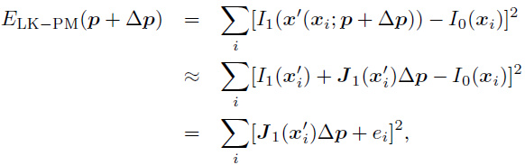


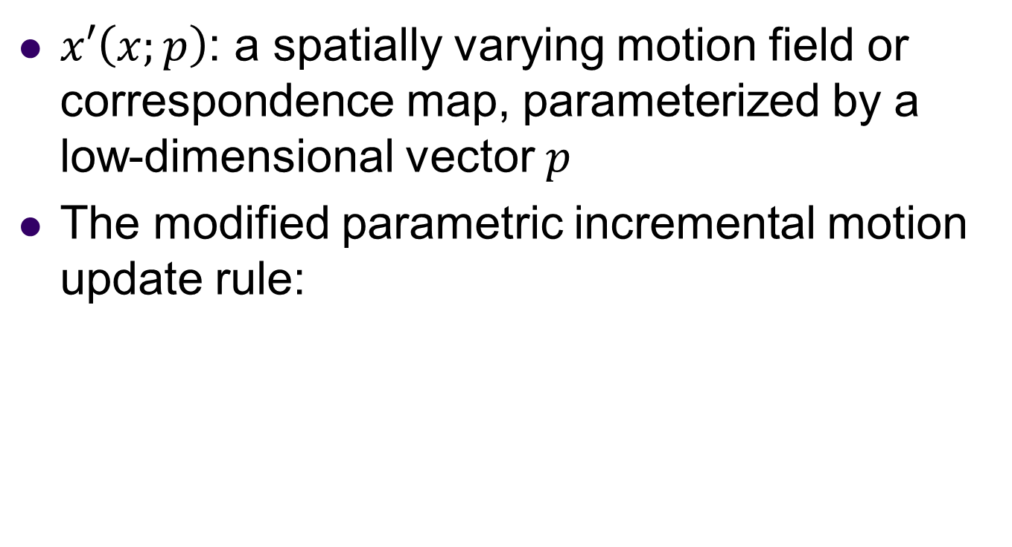
8.2 Parametric Motion
$x′\left(x;p\right)$: a spatially varying motion field or correspondence map, parameterized by a low-dimensional vector $p$
The modified parametric incremental motion update rule:

Slide 50


8.2 Parametric Motion
The (Gauss–Newton) Hessian and gradient-weighted residual vector for parametric motion:

Slide 51
Patch-based approximation
The computation of the Hessian and residual vectors for parametric motion can be significantly more expensive than for the translational case.
One way to reduce this by a significant amount is to divide the image up into smaller sub-blocks (patches) and to only accumulate the simpler
quantities inside the square brackets at the pixel level.

Slide 52


Patch-based Approximation (2/2)
The full Hessian and residual can then be approximated as:

Slide 53

Parametric Motion
where is the center of each patch . This is equivalent to replacing the true motion Jacobian with a piecewise-constant approximation. In practice, this works quite well.

Slide 54
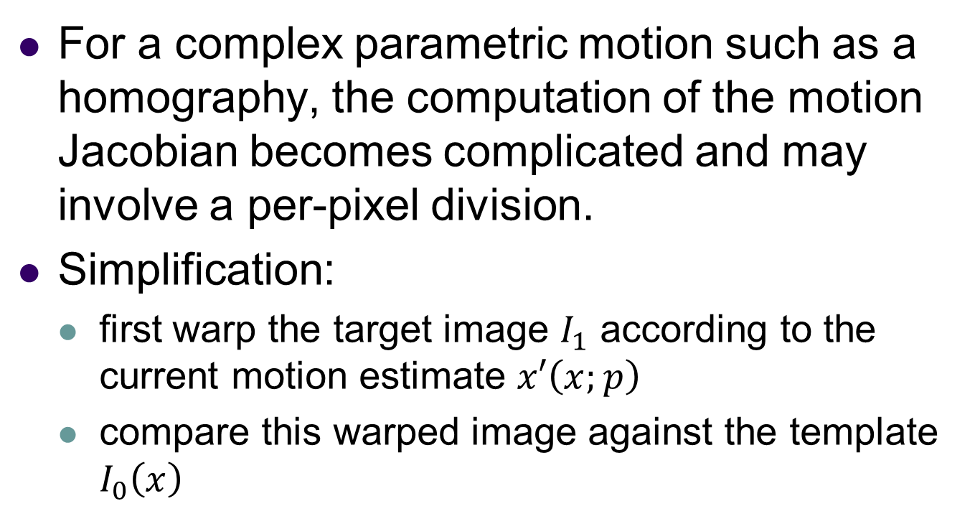
Compositional Approach
For a complex parametric motion such as a homography, the computation of the motion Jacobian becomes complicated and may involve a per-pixel division.
Simplification:
  first warp the target image $I_{1}$ according to the current motion estimate $x′\left(x;p\right)$
  compare this warped image against the template $I_{0}\left(x\right)$

Slide 55

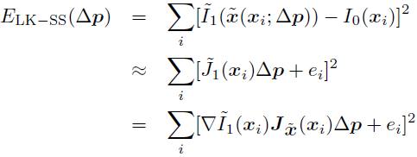
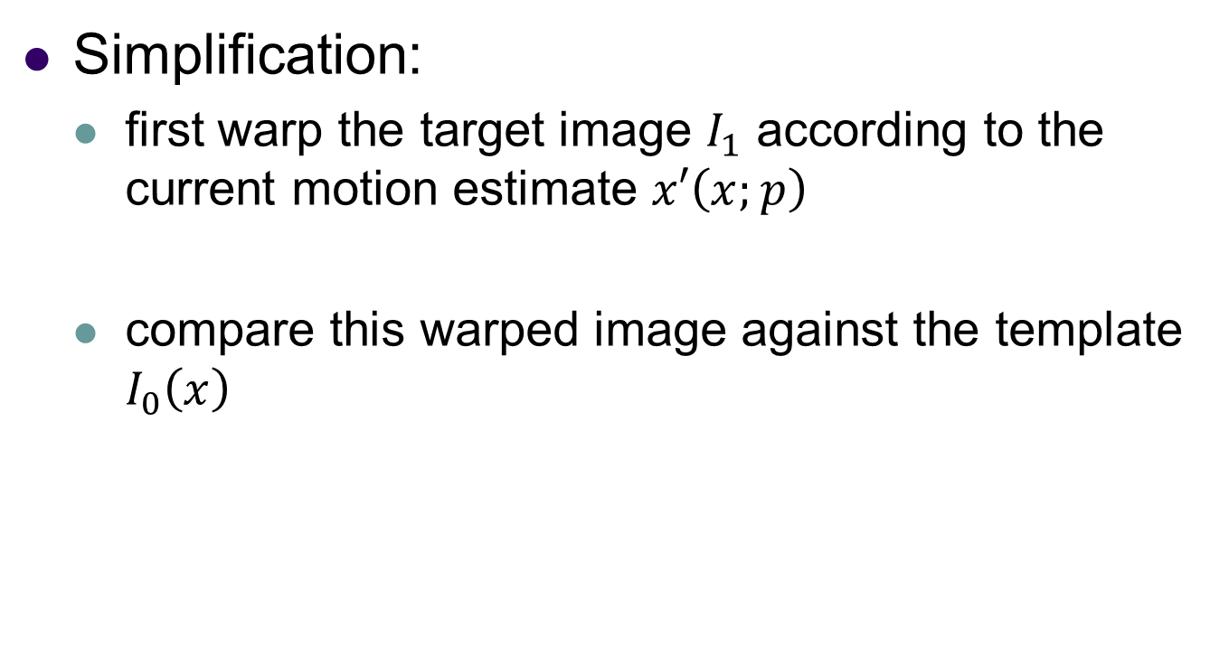
Compositional Approach
Simplification:
  first warp the target image $I_{1}$ according to the current motion estimate $x′\left(x;p\right)$
  compare this warped image against the template $I_{0}\left(x\right)$

Slide 56
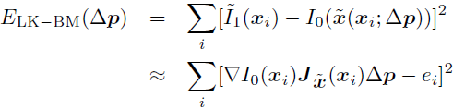
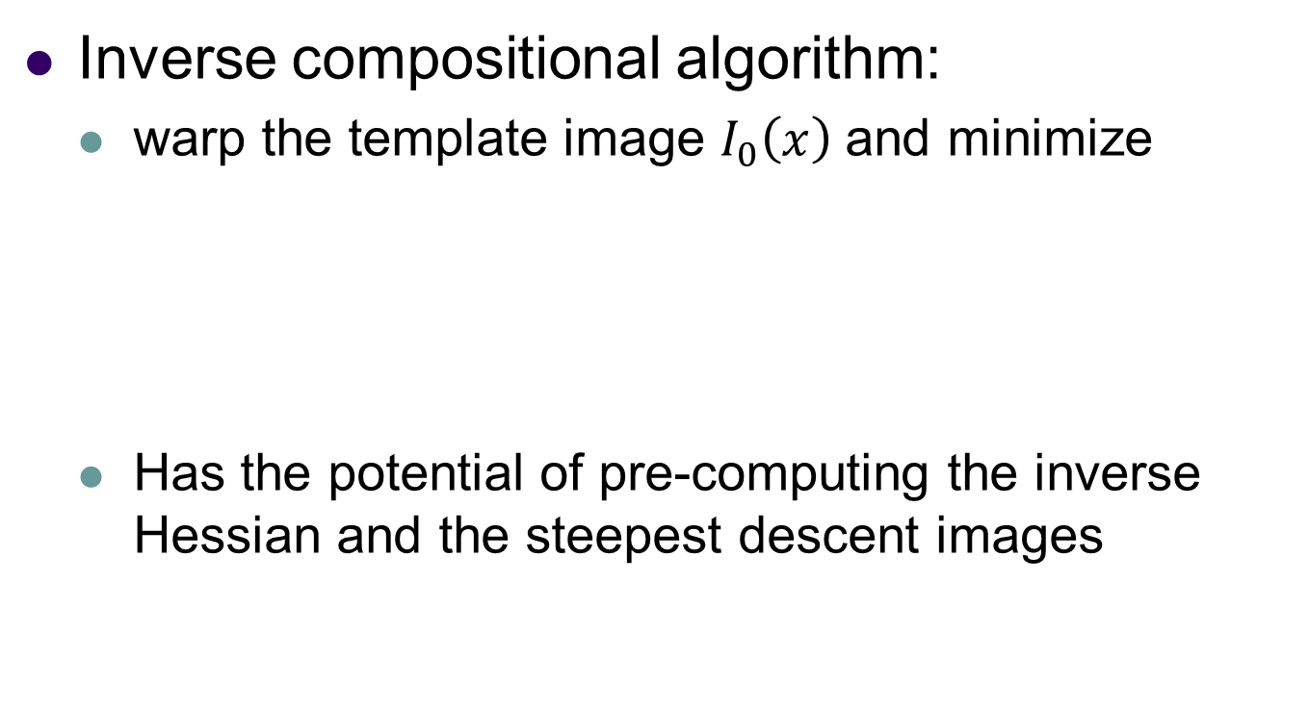
Compositional Approach
Inverse compositional algorithm:
  warp the template image $I_{0}\left(x\right)$and minimize
  Has the potential of pre-computing the inverse Hessian and the steepest descent images

Slide 57
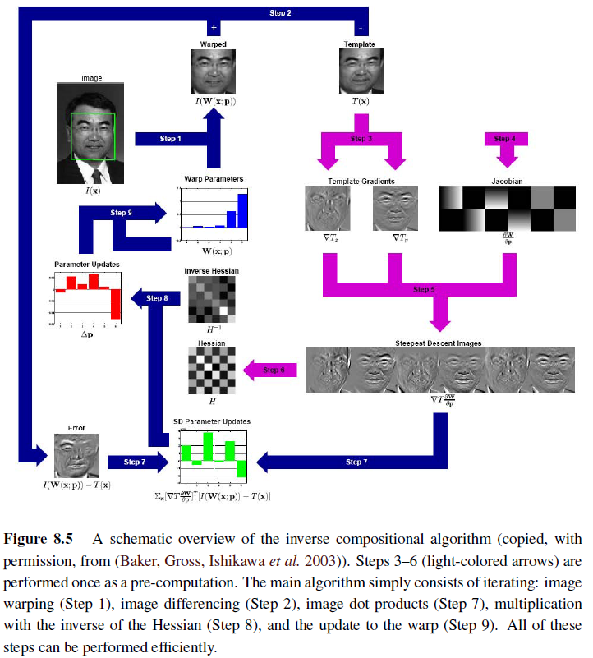

Slide 58
8.2.1 Application: Video stabilization
Video stabilization is one of the most widely used applications of parametric motion estimation
Matsushita, Ofek, Ge et al. (2006) give a nice overview of the three major stages of stabilization, namely motion estimation, motion smoothing, and image warping. Motion estimation algorithms often use a similarity transform to handle camera translations, rotations, and zooming.

Slide 59
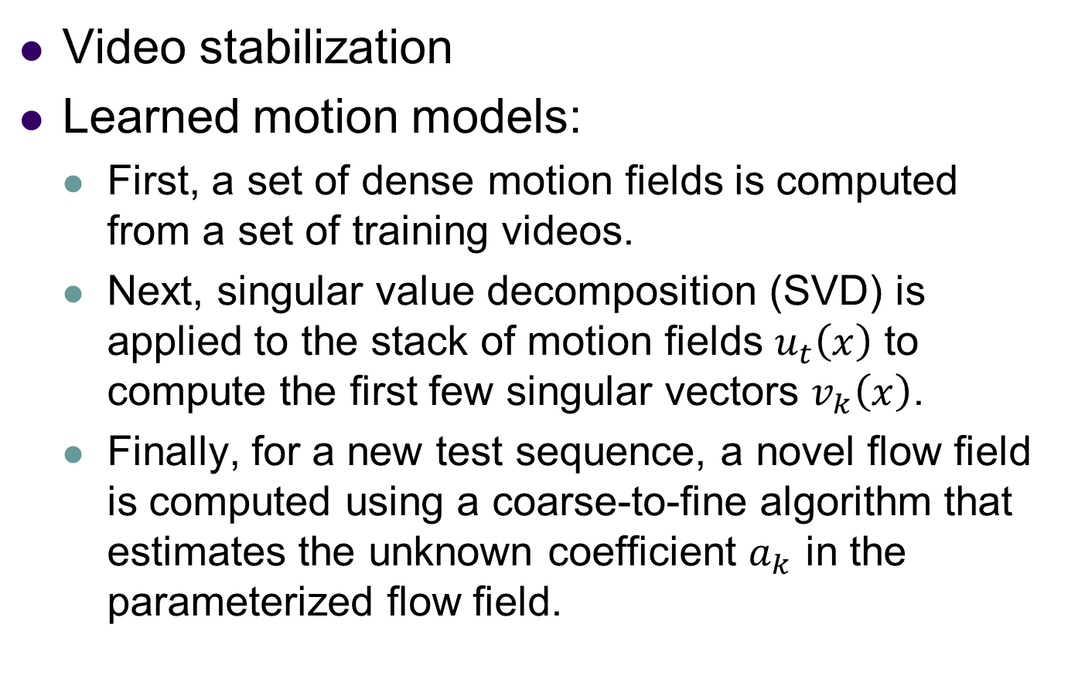
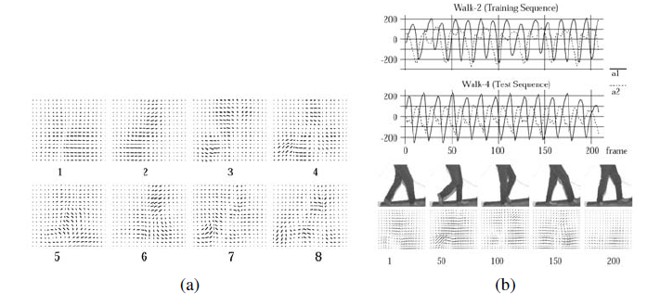
8.2.2 Learned motion models
An alternative to parameterizing the motion field with a geometric deformation such as an affine transform is to learn a set of basis functions tailored to a particular application.

Slide 60

8.3 Spline-based Motion
Traditionally, optical flow algorithms compute an independent motion estimate for each pixel.
The general optical flow analog can thus be written as

Slide 61
Spline-based Motion
However,in the above equation, the number of variables is twice the number of measurements, so the problem is underconstrained.

Slide 62
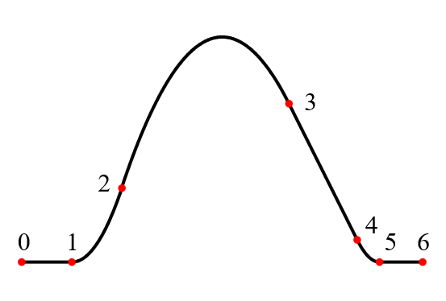
Spline-based Motion
Spline
A spline is a numeric function that is piecewise-defined by polynomial functions, and which possesses a high degree of smoothness at the places where the polynomial pieces connect (which are known as knots).

Slide 63
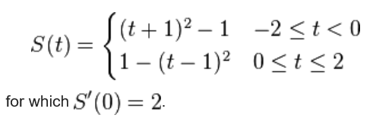
Spline-based Motion
A simple example of a quadratic spline (a spline of degree 2) is

Slide 64

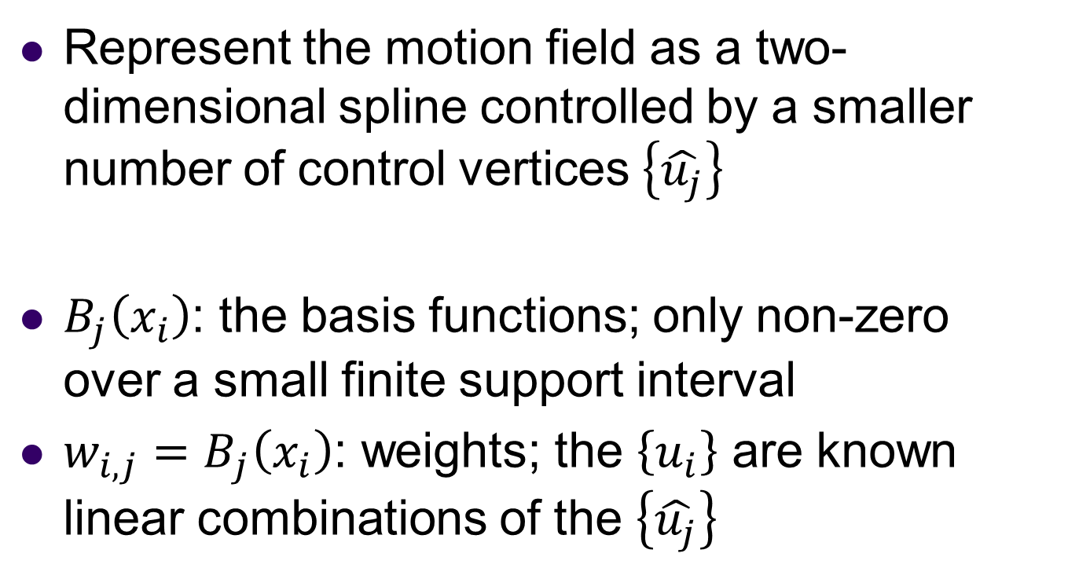
Spline-based Motion
Represent the motion field as a two-dimensional spline controlled by a smaller number of control vertices $\left\{\hat{u_{j}}\right\}$
$B_{j}\left(x_{i}\right)$: the basis functions; only non-zero over a small finite support interval
${w_{i,j}=B}_{j}\left(x_{i}\right)$: weights; the $\left\{u_{i}\right\}$ are known linear combinations of the $\left\{\hat{u_{j}}\right\}$

Slide 65
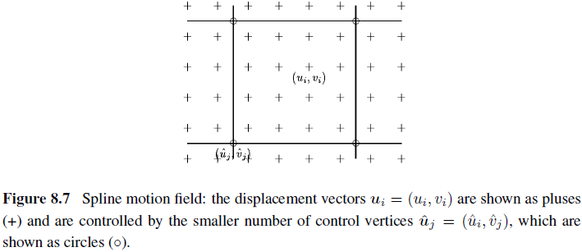
Spline-based Motion

Slide 66
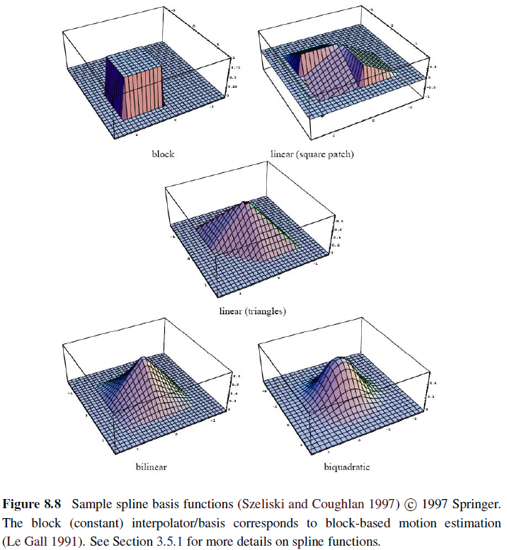

Slide 67
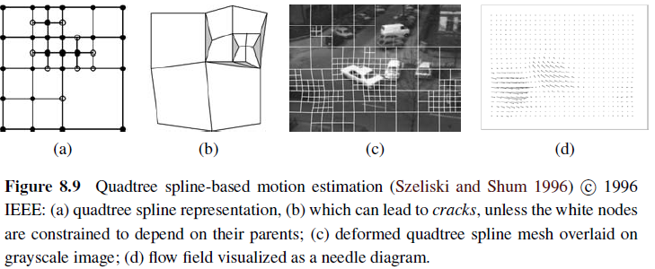
Spline-based Motion

Slide 68
Spline-based Motion
To estimate the motion, a coarse-to-fine strategy is used.
Starting with a regular spline imposed over a lower-resolution image, an initial motion estimate is obtained.
Spline patches where the motion is inconsistent, i.e., the squared residual (8.67) is above a threshold, are subdivided into smaller patches.

Slide 69
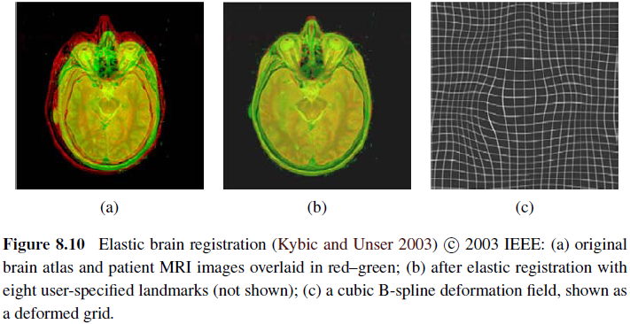
8.3.1 Application: Medical Image Registration

Slide 70

8.4 Optical Flow
The most general version of motion estimation is to compute an independent estimate of motion at each pixel, which is generally known as optical (or optic) flow

Slide 71
Optical Flow
However,in the above equation, the number of variables is twice the number of measurements, so the problem is underconstrained.

Slide 72


Optical Flow
Brightness constancy constraint
  temporal derivative
  discrete analog to the analytic global energy:

Slide 73
8.4.1 Multi-frame Motion Estimation
A horizontal slice through the spatio-temporal volume, i.e., the 3D volume created by stacking all of the video frames together,can indicate the horizontal motion of objects.

Slide 74
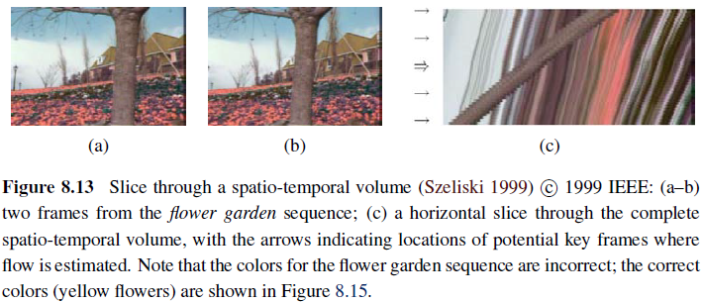
Multi-frame Motion Estimation

Slide 75
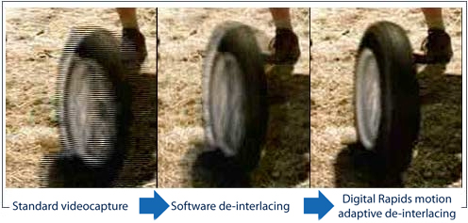
8.4.2~8.4.3 Application
Video denoising
De-interlacing

Slide 76
8.5 Layered Motion
In many situation, visual motion is caused by the movement of a small number of objects at different depths in the scene.
In such situations, the pixel motions can be described more succinctly (and estimated more reliably) if pixels are grouped into appropriate objects or layers

Slide 77
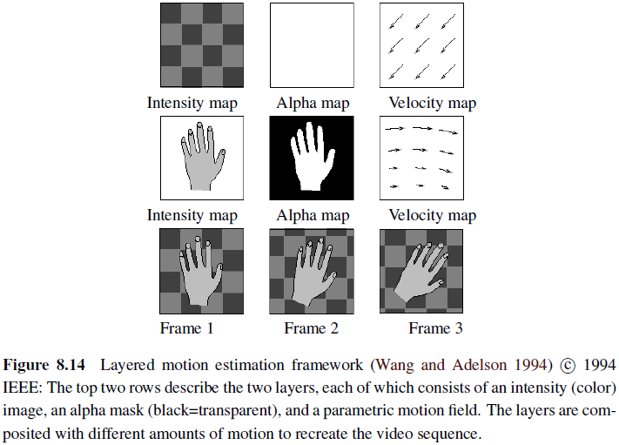
8.5 Layered Motion

Slide 78
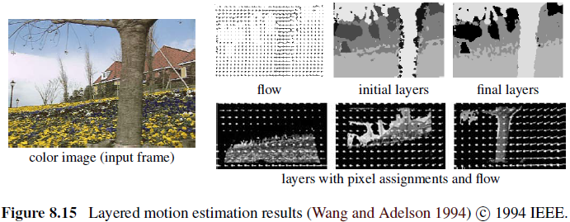
Layered Motion
Median filtering is used to produce sharp composite layers that are robust to small intensity variations.

Slide 79
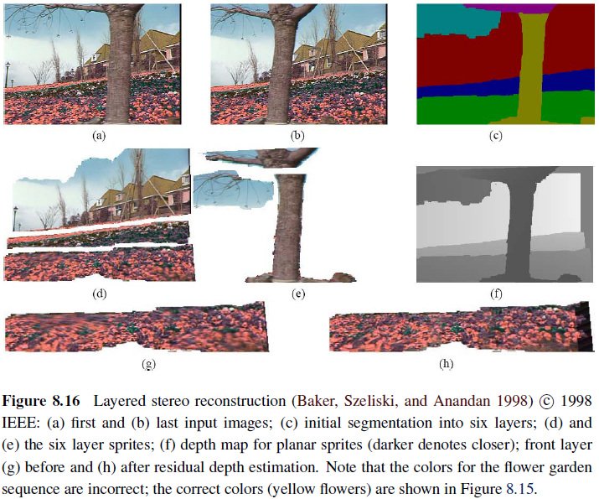

Slide 80
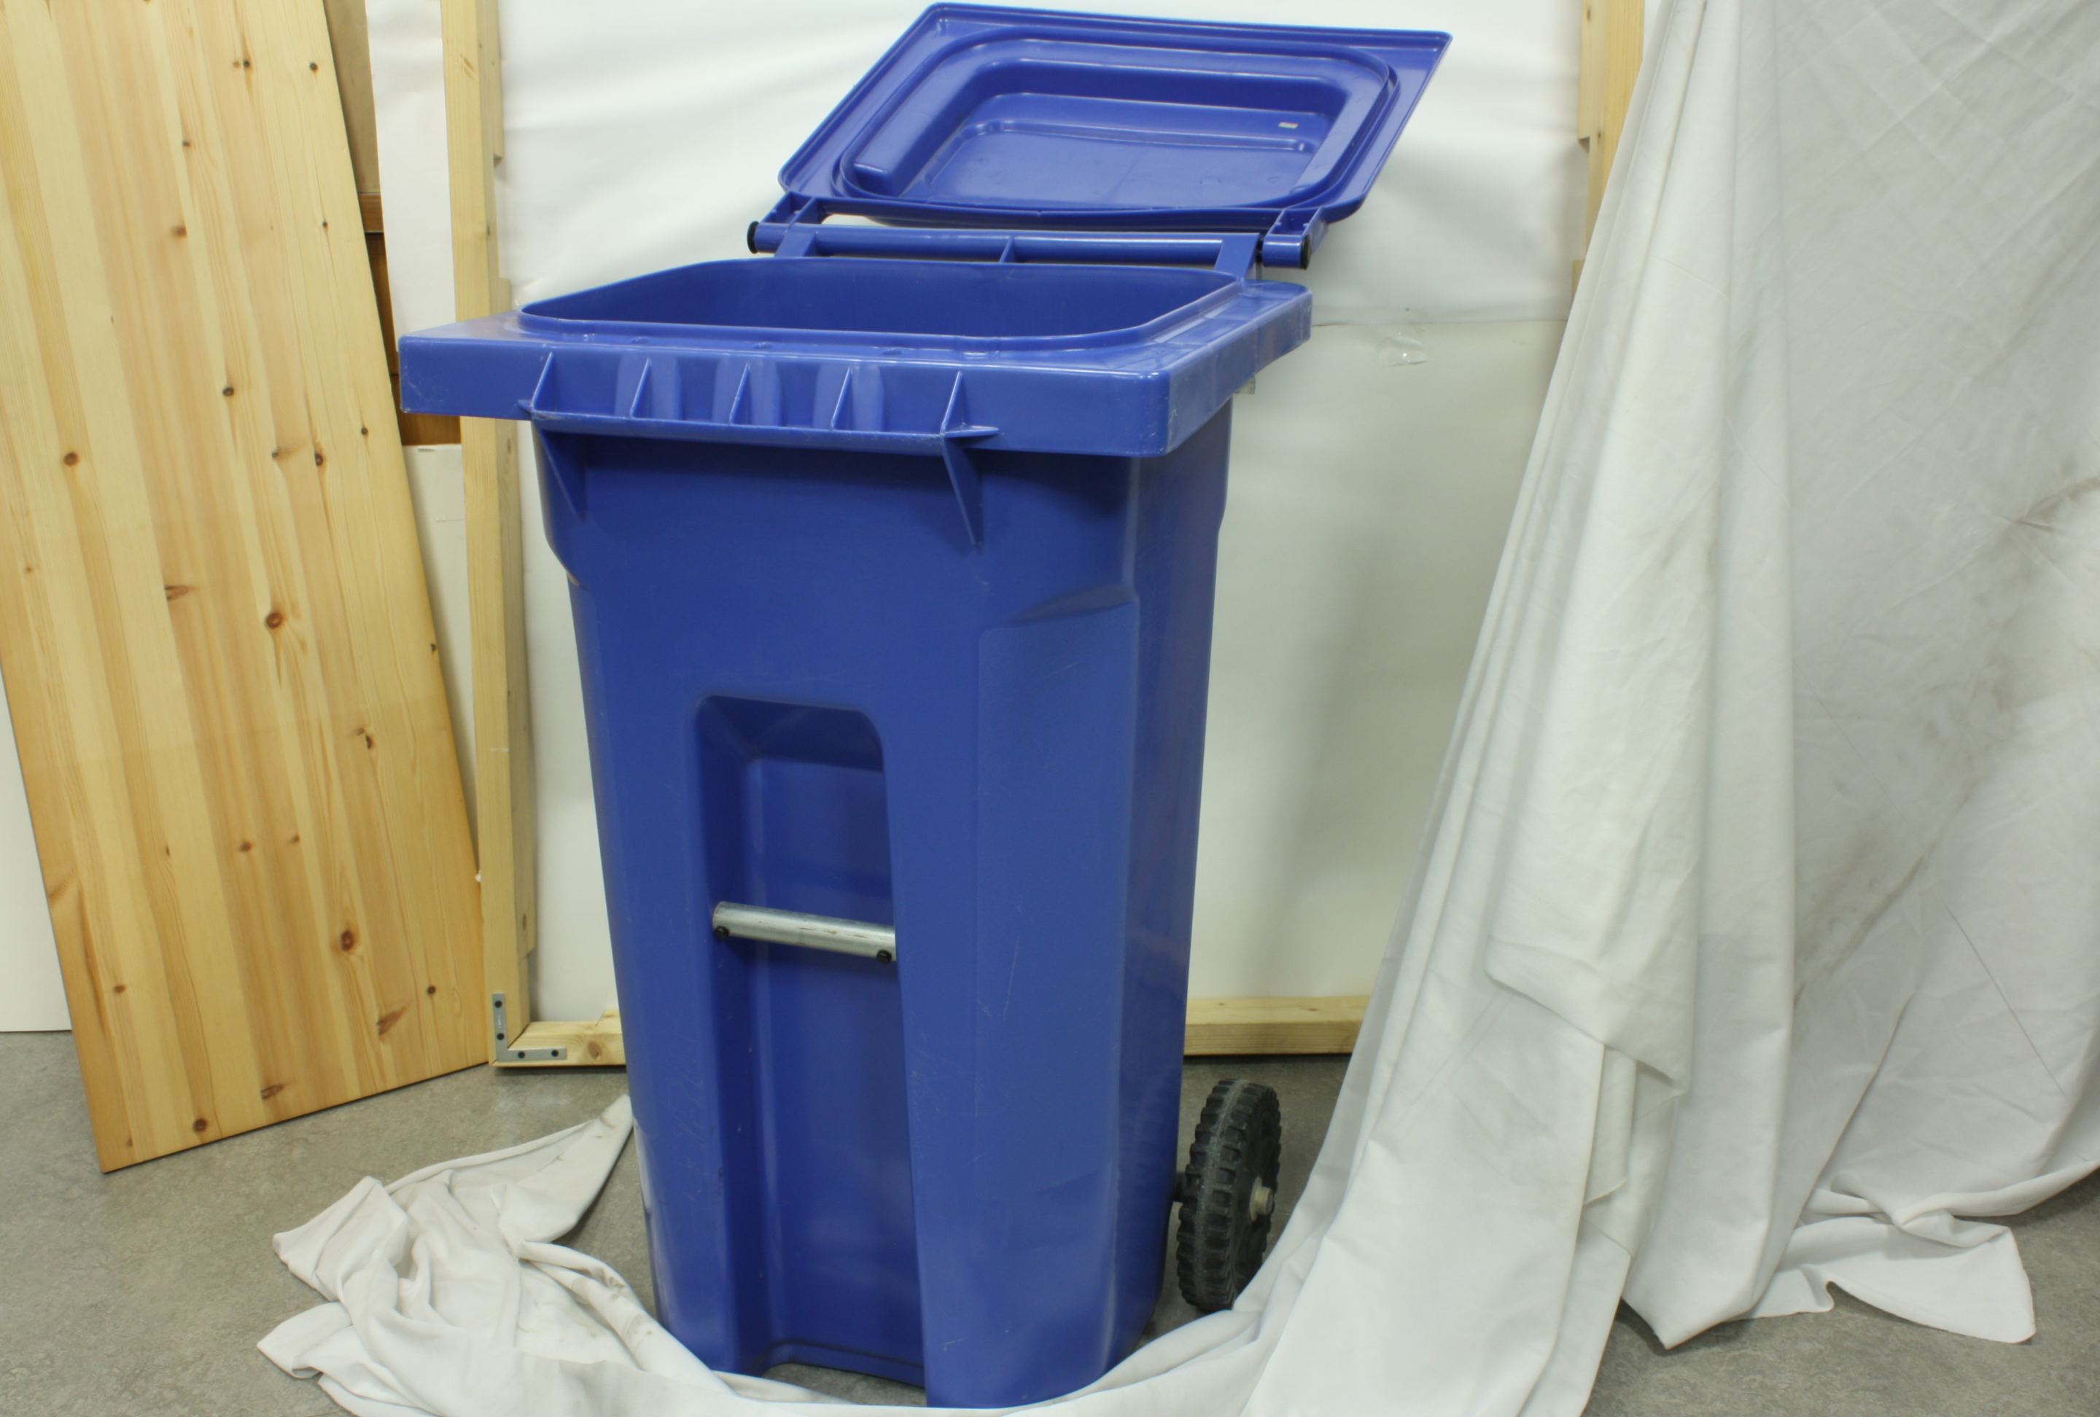
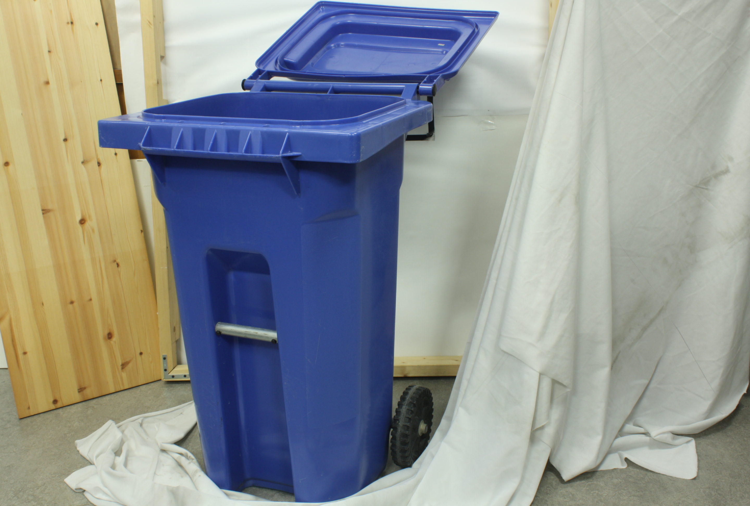
Layered Motion
The first step is to know the depth of different objects.And then segment objects of the same depth into one layer.
Following are two images containing same objects.

Slide 81
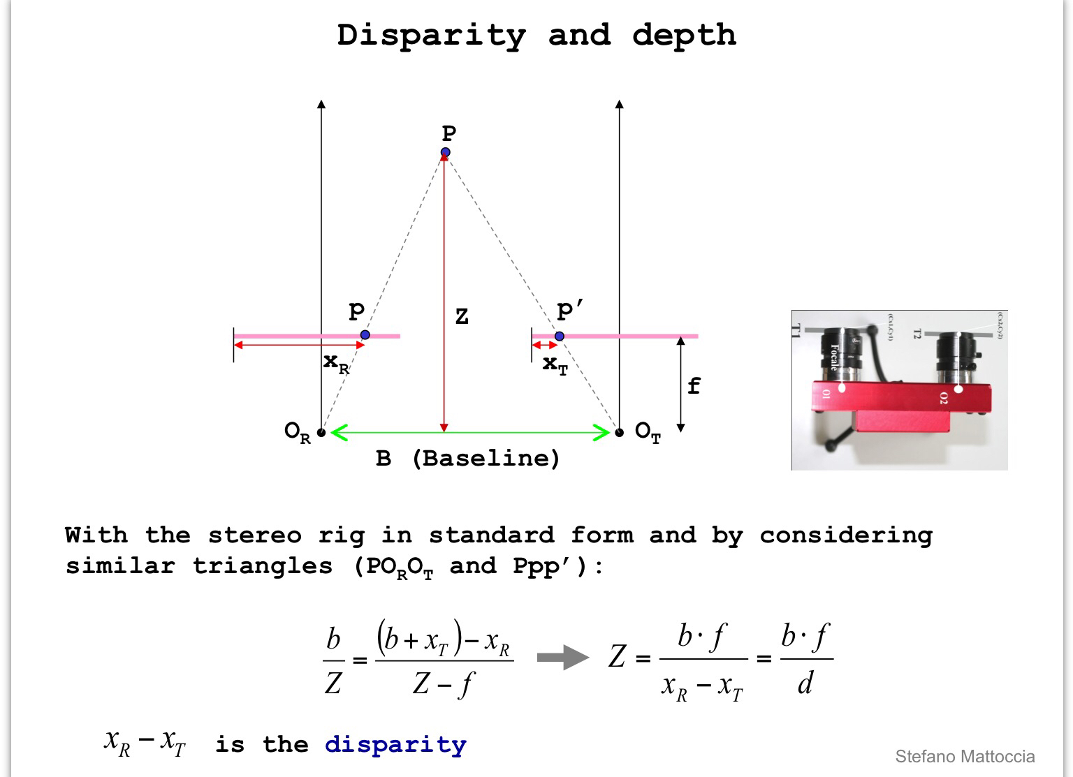
Layered Motion

Slide 82
Layered Motion
disparitymap.m
T=-68;
I1 = rgb2gray(imread('F:\document\education\CV\disparity\im0.png'));
I2 = rgb2gray(imread('F:\document\education\CV\disparity\im1.png'));
I1=imresize(I1,0.1);
I2=imresize(I2,0.1);
s=3;
[m,n]=size(I1);
I3=double(I1);
for j=2+(s-1)/2:1:m-(s+1)/2
for i=2+(s-1)/2:1:n-(s+1)/2
x=0;mini=9999999999;
for c=i+T-40:1:i+T+40
if (c>=2+(s-1)/2)&&(c<=n-(s+1)/2)
ssd1=0;
for co=(1-s)/2:1:(s-1)/2
for ro=(1-s)/2:1:(s-1)/2
p=s*s;
ssd1=ssd1+(I1(j+ro,i+co)-I2(j+ro,c+co))^2/p;
end
end
if ssd1<mini
mini=ssd1;x=c-1;y=j-1;
end
end
end
I3(j,i)=i-(x+1);
end
end
O=max(max(I3));
I3=I3/O;
figure;imshow(I3);

Slide 83
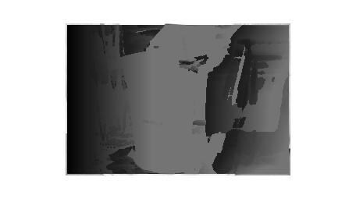
Layered Motion

Slide 84
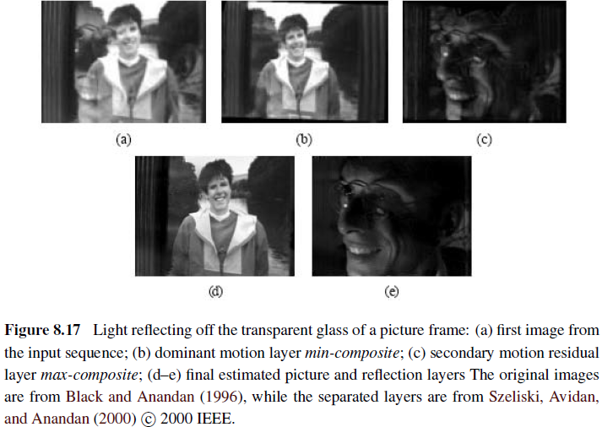
Transparent Layers and Reflections

Slide 85
Thank you

