Slide 1
Chapter 8
Image Alignment and Stitching
Presented by: Ryandhimas Zezario
Edited by: Chi Chia Wu
Ryandhimas@citi.sinica.edu.tw
kevinwu777k#@gmail.com
授課教授：傅楸善 博士
DC&CV LAB CSIE NTU 2020
Notes:
In this

Slide 2
Outlines
8.1 Pairwise alignment
8.2 Image stitching
8.3 Global alignment
8.4 Compositing
DC&CV LAB CSIE NTU 2021

Slide 3
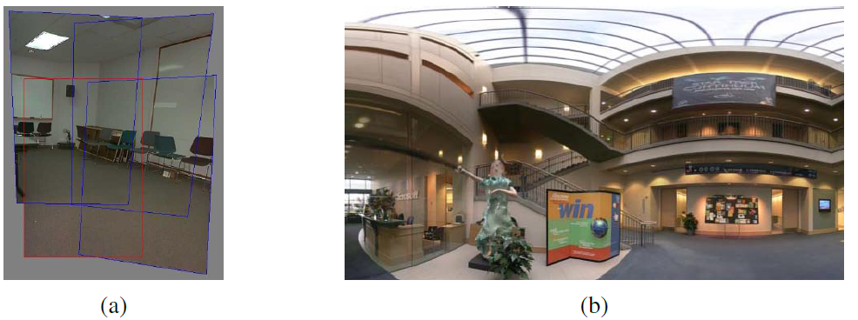
ACM: Association for Computing Machinery
Geometric alignment of 2D images for stitching
(Szeliski and Shum 1997) ©
A spherical panorama constructed from 54 photographs
(Szeliski and Shum 1997) © 1997 ACM
DC&CV LAB CSIE NTU 2021

Slide 4
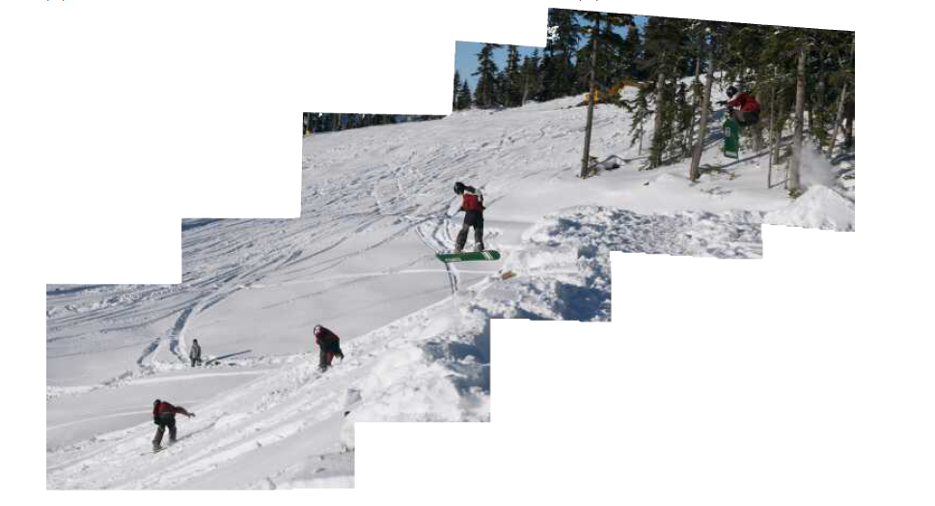
A multi-image panorama automatically assembled from an unordered photo collection
DC&CV LAB CSIE NTU 2021
Notes:
In this chapter, we look at the topic of geometric image registration, i.e., the computation of 2D and 3D transformations that map features in one image to another

Slide 5
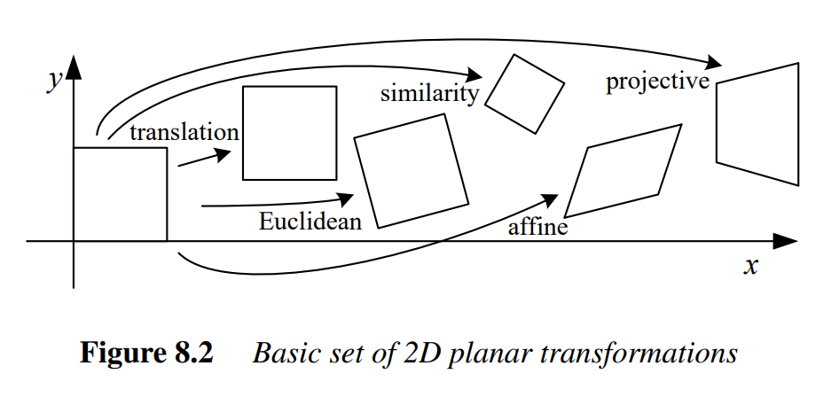
8.1 Pairwise Alignment
Feature-based alignment is the problem of estimating the motion between two or more sets of matched 2D or 3D points.
In this section, we restrict ourselves to global parametric transformations, such as basic 2D planar transformations, or higher order transformation for curved surfaces.
DC&CV LAB CSIE NTU 2021

Slide 6
8.1 Pairwise Alignment
8.1.1 2D alignment using least squares
Given a set of matched feature points $\{(x_{i}, x_{i}^{′})\}$ and a planar parametric transformation of the form:
The usual way to estimate motion parameters p is to use least squares, i.e., to minimize the sum of squared residuals
where
DC&CV LAB CSIE NTU 2021
Notes:
1transformation, For examples of non-planar parametric models, such as quadrics, see the work of Shashua and Toelg (1997); Shashua and Wexler (2001).
Ri is the residual between the measured location ^x0i and its corresponding current predicted location ~x0i = f (xi; p).

Slide 7
8.1 Pairwise Alignment
8.1.1 2D alignment using least squares
Many of the motion models presented, i.e., translation, similarity, and affine, have a linear relationship between the amount of motion and the unknown parameters p.
where is the Jacobian of the transformation f with respect to the motion parameters p. In this case, a simple linear regression (linear least squares problem) can be formulated as:
DC&CV LAB CSIE NTU 2021

Slide 8
8.1 Pairwise Alignment
8.1.1 2D alignment using least squares
The minimum can be found by solving the Symmetric Positive Definite (SPD) system of normal equations
where
is called the Hessian and
DC&CV LAB CSIE NTU 2021
Notes:
For the case of pure translation, the resulting equations have a particularly simple form, i.e., the translation is the average translation
between corresponding points or, equivalently, the translation of the point centroids.

Slide 9
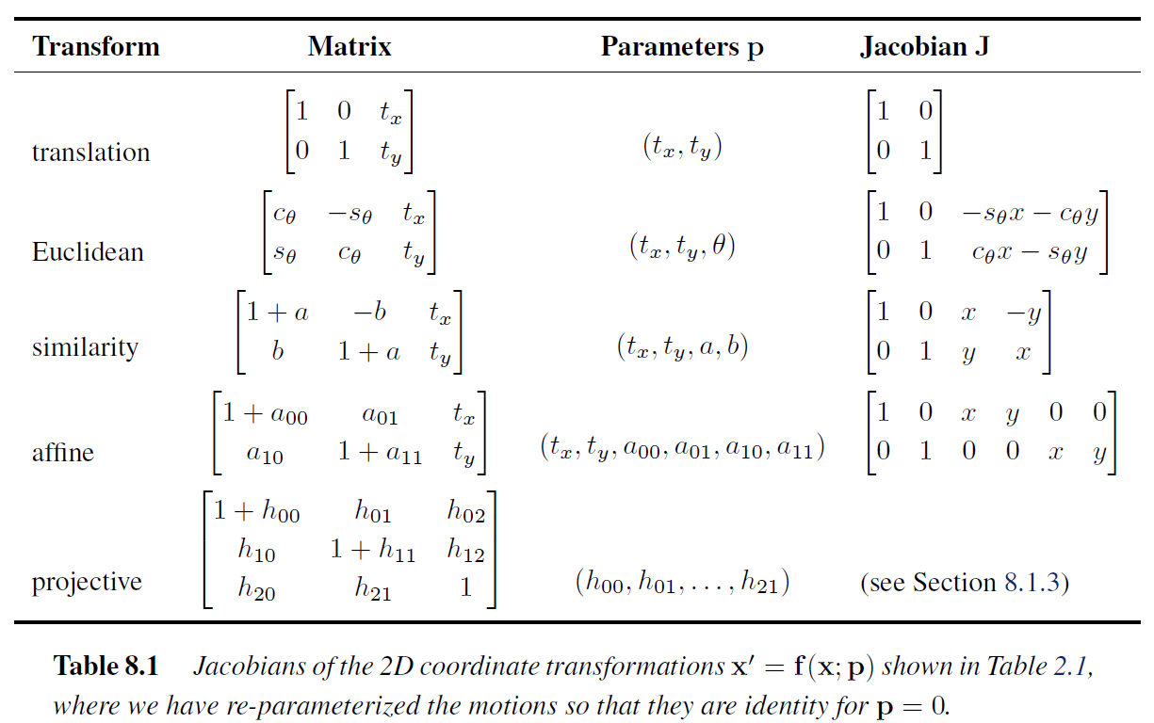
8.1 Pairwise Alignment
DC&CV LAB CSIE NTU 2021

Slide 10
8.1 Pairwise Alignment
8.1.1 2D alignment using least squares
Uncertainty weighting
The above least squares formulation assumes that all feature points are matched with the same accuracy.
This is often not the case, since certain points may fall into more textured regions than others. If we associate a scalar variance estimate with each correspondence, we can minimize the weighted least squares problem instead.
DC&CV LAB CSIE NTU 2021

Slide 11
8.1 Pairwise Alignment
8.1.1 2D alignment using least squares
Uncertainty weighting
Weighting each squared residual by its inverse covariance (which is called the information matrix), we obtain
This will be discussed in section 9.1.3.
DC&CV LAB CSIE NTU 2021

Slide 12
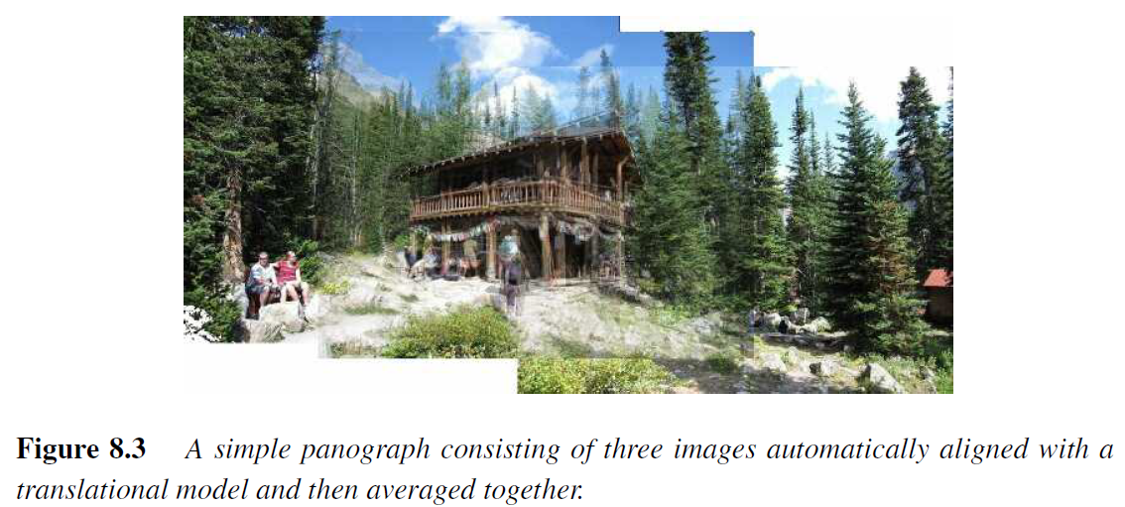
8.1 Pairwise Alignment
8.1.2 Application: Panography
In a panograph, images are translated and optionally rotated and scaled before being blended with simple averaging
DC&CV LAB CSIE NTU 2021

Slide 13
8.1 Pairwise Alignment
8.1.2 Application: Panography
Consider a simple translational model. We want all the corresponding features in different images to line up as best as possible.
Let $t_{i}$ be the location of the $j$th image coordinate frame in the global composite frame and $x_{ij}$ be the location of the $i$th matched feature in the $j$th image.
In order to align the images, we wish to minimize the least squares error
DC&CV LAB CSIE NTU 2021

Slide 14
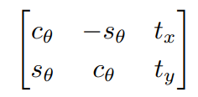
8.1 Pairwise Alignment
8.1.3 Iterative algorithms
We cannot use linear least squares to solve a non-linear least squares or non-linear regression problem.
For example, the problem of estimating a rigid Euclidean 2D transformation (translation plus rotation) between two sets of points.
DC&CV LAB CSIE NTU 2021

Slide 15
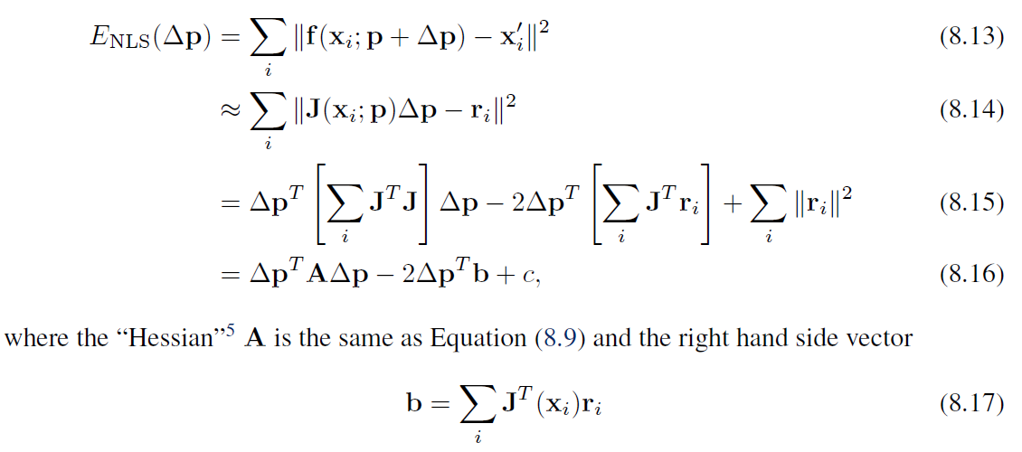
8.1 Pairwise Alignment
8.1.3 Iterative algorithms: Gauss–Newton approximation
We iteratively find an update to the current parameter estimate p by minimizing
DC&CV LAB CSIE NTU 2021

Slide 16
8.1 Pairwise Alignment
8.1.3 Iterative algorithms
Once A and b have been computed, we solve for using
Levenberg–Marquardt algorithm (damped least-squares) is more robust than Gauss-Newton algorithm.
In many applications, $λ$ can be set to 0 if the system is successfully converging.
DC&CV LAB CSIE NTU 2021
Notes:
and update the parameter vector p <-p + delta p accordingly
The parameter lamda is an additional damping parameter used to ensure that the system takes a “downhill” step in energy
(squared error) and is an essential component of the Levenberg–Marquardt algorithm.
In many applications, it can be set to 0 if the system is successfully converging.

Slide 17
8.1 Pairwise Alignment
8.1.3 Iterative algorithms
In the projective 2D motion (homography), the equations can be written in parametric form as
DC&CV LAB CSIE NTU 2021

Slide 18
8.1 Pairwise Alignment
8.1.3 Iterative algorithms
The eight unknowns can be obtained by multiplying both sides of the equations in (8.19) by the denominator
However, this is not optimal, since the denominator D, can vary quite a bit from point to point.
One way to compensate for this is to reweight each equation by the inverse of the current estimate of the denominator, D,
DC&CV LAB CSIE NTU 2021
Notes:
However, this is not optimal from a statistical point of view, since the denominator D, which
was used to multiply each equation, can vary quite a bit from point to point.

Slide 19
8.1 Pairwise Alignment
8.1.3 Iterative algorithms
The most principled way to do the estimation, however, is to directly minimize the squared residual equations using the Gauss–Newton approximation, which yields the set of equations,
The left-hand side consists of unweighted prediction errors.
the quantities inside J involve predicted feature locations (x˜, y˜) instead of sensed feature locations (xˆ, yˆ).
DC&CV LAB CSIE NTU 2021
Notes:
While these look similar to (8.22), they differ in two important respects. First, the left hand
side consists of unweighted prediction errors rather than point displacements and the solution
vector is a perturbation to the parameter vector p. Second, the quantities inside J involve
predicted feature locations (~x0; ~y0) instead of sensed feature locations (^x0; ^y0).

Slide 20
8.1 Pairwise Alignment
RANSAC: RANdom Sample Consensus
8.1.4 Robust least squares and RANSAC
It is preferable to use an M-estimator when there are outliers among the correspondences. M-estimators are a broad class of extremum estimators for which the objective function is a sample average.
Apply a robust penalty function $ρ(|\left|r_{i}\right||)$ to the residuals instead of squaring them
We can take the derivative of this function with respect to p and set it to 0,
DC&CV LAB CSIE NTU 2021

Slide 21
8.1 Pairwise Alignment
RANSAC: RANdom Sample Consensus
8.1.4 Robust least squares and RANSAC
If we introduce a weight function, , we observe that finding the stationary point of (8.25) using (8.26) is equivalent to minimizing the Iteratively Reweighted Least Squares (IRLS) problem
DC&CV LAB CSIE NTU 2021

Slide 22
8.1 Pairwise Alignment
8.1.4 Robust least squares and RANSAC
The IRLS algorithm alternates between computing the influence functions and solving the resulting weighted least squares problem (with fixed w values)
While M-estimators can help reduce the influence of outliers. Starting with too many outliers will prevent IRLS (or other gradient descent algorithms) from converging to the global optimum.
A better approach is often to find a starting set of inlier correspondences, i.e., points that are consistent with a dominant motion estimate
DC&CV LAB CSIE NTU 2021

Slide 23
8.1 Pairwise Alignment
8.1.4 Robust least squares and RANSAC
Two widely used approaches to this problem are called RANdom SAmple Consensus, or RANSAC for short (Fischler and Bolles 1981), and Least Median of Squares (LMS) (Rousseeuw 1984).
Both techniques start by selecting (at random) a subset of k correspondences, which is then used to compute an initial estimate for p. The residuals of the full set of correspondences are then computed as
DC&CV LAB CSIE NTU 2021

Slide 24
8.1 Pairwise Alignment
8.1.4 Robust least squares and RANSAC
The RANSAC technique then counts the number of inliers that are within $ε$ of their predicted location, i.e., whose
(The epsilon value is application-dependent but is often around 1–3 pixels.)
Least median of squares finds the median value of the values.
The random selection process is repeated S times and the sample set with the largest number of inliers (or with the smallest median residual) is kept as the final solution.
DC&CV LAB CSIE NTU 2021

Slide 25
8.1 Pairwise Alignment
8.1.4 Robust least squares and RANSAC
When the number of measurements is quite large, it may be preferable to only score a subset of the measurements in an initial round that selects the most plausible hypotheses for additional scoring and selection.
This modification of RANSAC, which can significantly speed up its performance, is called Preemptive RANSAC (Nist´er 2003).
In another variant on RANSAC called PROSAC (PROgressive SAmple Consensus), random samples are initially added from the most “confident” matches, thereby speeding up the process of finding a (statistically) likely good set of inliers (Chum and Matas 2005).
DC&CV LAB CSIE NTU 2021

Slide 26
8.1 Pairwise Alignment
8.1.5 3D Alignment
Instead of aligning 2D sets of image features, many computer vision applications require the alignment of 3D points.
In the case where the 3D transformations are linear in the motion parameters, e.g., for translation, similarity, and affine, regular least squares (8.5) can be used
which arises more frequently and is often called the absolute orientation problem (Horn
1987), requires slightly different techniques.
DC&CV LAB CSIE NTU 2021

Slide 27
8.1 Pairwise Alignment
8.1.5 3D Alignment
If only scalar weightings are being used (as opposed to full 3D per-point anisotropic covariance estimates), the weighted centroids of the two point clouds c and c’ can be used to estimate the translation
We are then left with the problem of estimating the rotation between two sets of points and that are both centered at the origin.
One commonly used technique is called the orthogonal Procrustes algorithm (Golub and Van Loan 1996, p. 601) and involves computing the singular value decomposition (SVD) of the 3 x 3 correlation matrix
DC&CV LAB CSIE NTU 2021

Slide 28
8.2 Image Stitching
Image stitching algorithms create the high-resolution photo-mosaics used to produce today’s digital maps and satellite photos. They are also now a standard mode in smartphone cameras and can be used to create beautiful ultra wide-angle panoramas.
Image stitching originated in the photogrammetry(攝影測量法) community, where more manually intensive methods based on surveyed ground control points or manually registered tie points have long been used to register aerial photos into large-scale photo-mosaics (Slama 1980).
While early techniques worked by directly minimizing pixel-to-pixel dissimilarities, today’s algorithms extract a sparse set of features and match them to each other, as described in Chapter 7.
DC&CV LAB CSIE NTU 2021

Slide 29
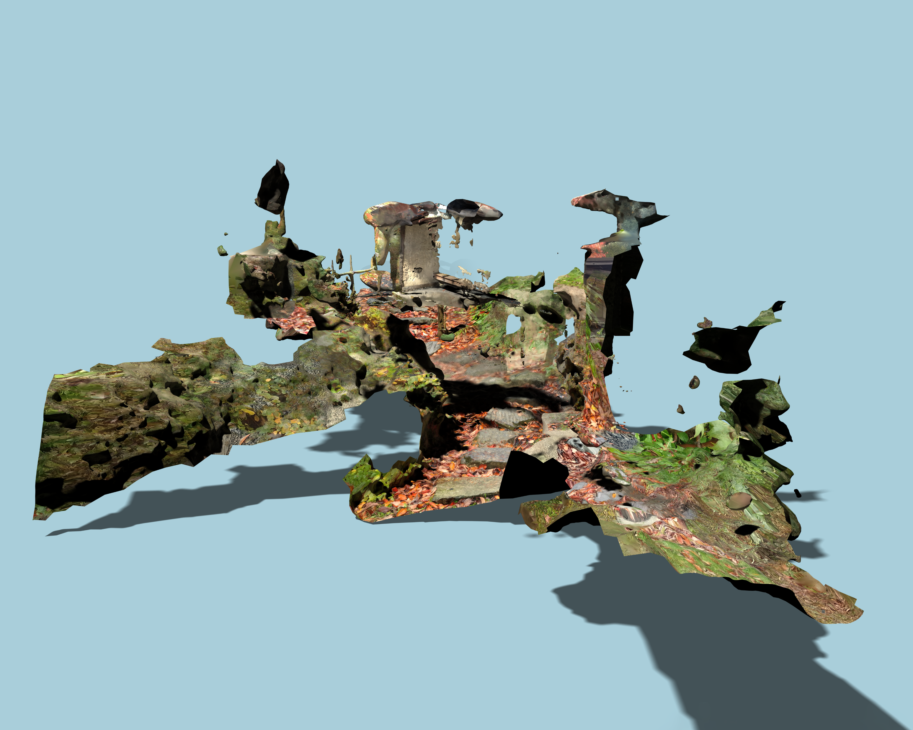
Tuure Leppänen, Reconstruction I: 2D image from a 3D model built with photogrammetry methods from hundreds of ground-level photos of a japanese garden.

Slide 30
8.2 Image Stitching
As with image alignment, we must first determine the appropriate mathematical model relating pixel coordinates in one image to pixel coordinates in another.
Next, estimate the correct alignments relating various pairs (or collections) of images
Once we have aligned the images, we must choose a final compositing surface for warping the aligned images (Section 8.4.1).
Finally, we need to seamlessly cut and blend overlapping images, even in the presence of parallax, lens distortion, scene motion, and exposure differences (Section 8.4.2–8.4.4).
DC&CV LAB CSIE NTU 2021
Notes:
Section 8.2.1 reviews the basic models we have studied and presents some new motion models related specifically to panoramic image stitching
Section 8.3, we look at how each of these previously developed techniques can be modified to take advantage of the imaging setups commonly used to create panoramas
Once we have aligned the images, we must choose a final compositing surface for warping the aligned images (Section 8.4.1). We also need algorithms to seamlessly cut and blend overlapping
images, even in the presence of parallax, lens distortion, scene motion, and exposure differences (Section 8.4.2–8.4.4).

Slide 31
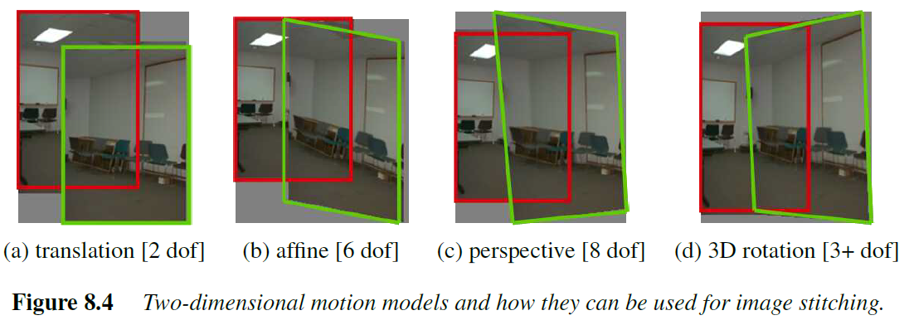
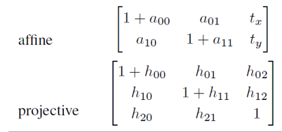
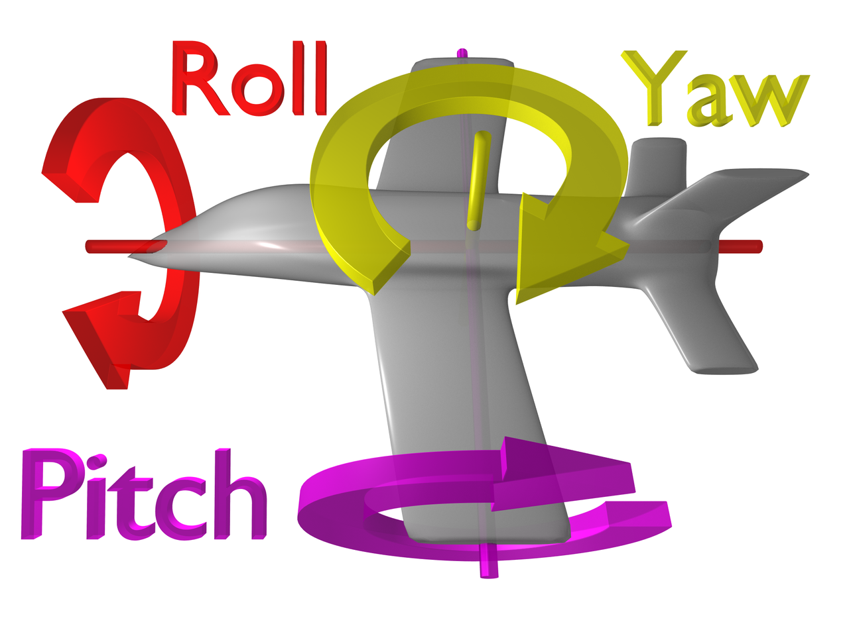
8.2 Image Stitching
dof : degree of freedom
8.2.1 Parametric motion models
DC&CV LAB CSIE NTU 2021
Notes:
The simplest possible motion model to use when aligning images is to simply translate and
rotate them in 2D (Figure 8.4a). This is exactly the same kind of motion that you would
use if you had overlapping photographic prints
Translation and rotation are also usually adequate motion models to compensate for small camera motions in applications
such as photo and video stabilization and merging

Slide 32
8.2 Image Stitching
8.2.2 Application: Whiteboard and document scanning
The simplest image-stitching application is to stitch together a number of image scans taken on a flatbed scanner.
Say you have a large map, or a piece of child’s artwork, that is too large to fit on your scanner.
Simply take multiple scans of the document, making sure to overlap the scans by a large enough amount to ensure that there are enough common features.
Next, take successive pairs of images that you know overlap, extract features, match them up, and estimate the 2D rigid transform.
DC&CV LAB CSIE NTU 2021

Slide 33
8.2 Image Stitching
8.2.2 Application: Whiteboard and document scanning
Then, if necessary, use Two-point RANSAC to find a good set of inliers.
Finally, on a final compositing surface (aligned with the first scan, for example), resample your images (Section 3.6.1) and average them together.
Can you see any potential problems with this scheme?
DC&CV LAB CSIE NTU 2021

Slide 34
8.2 Image Stitching
8.2.2 Application: Whiteboard and document scanning
One complication is that a 2D rigid transformation is non-linear in the rotation angle $θ$ so you will have to either use non-linear least squares or constrain R to be orthonormal, as described in Section 8.1.3.
A bigger problem lies in the pairwise alignment process. As you align more and more pairs, the solution may drift so that it is no longer globally consistent.
- A global optimization procedure, as described in Section 8.3, may be required.
DC&CV LAB CSIE NTU 2021
Notes:
Such global optimization often requires a large system of non-linear equations to be solved, although in some cases,
such as linearized homographies (Section 8.2.3) or similarity transforms (Section 8.1.2), regular
least squares may be an option
A slightly more complex scenario is when you take multiple overlapping handheld pictures
of a whiteboard or other large planar object (He and Zhang 2005; Zhang and He 2007).
Here, the natural motion model to use is a homography, although a more complex model that
estimates the 3D rigid motion relative to the plane (plus the focal length, if unknown), could
in principle be used.

Slide 35
8.2 Image Stitching
8.2.3 Rotational panoramas
The most typical case for panoramic image stitching is when the camera undergoes a pure rotation.
Think of standing at the rim of the Grand Canyon. Relative to the distant geometry in the scene, as you snap away, the camera is undergoing a pure rotation, which is equivalent to assuming that all points are very far from the camera, i.e., on the plane at infinity.
DC&CV LAB CSIE NTU 2021

Slide 36
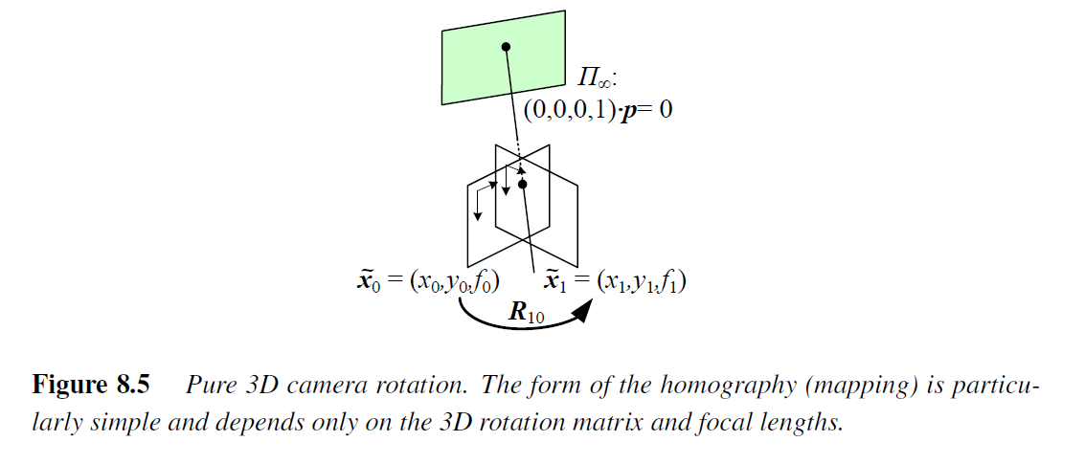
8.2 Image Stitching
8.2.3 Rotational panoramas
DC&CV LAB CSIE NTU 2021

Slide 37
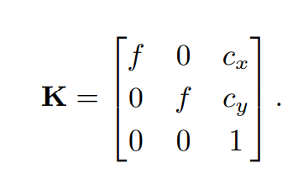
8.2 Image Stitching
8.2.3 Rotational panoramas
Setting t₀ = t₁ = 0, we get the simplified 3x3 homography.
DC&CV LAB CSIE NTU 2021

Slide 38
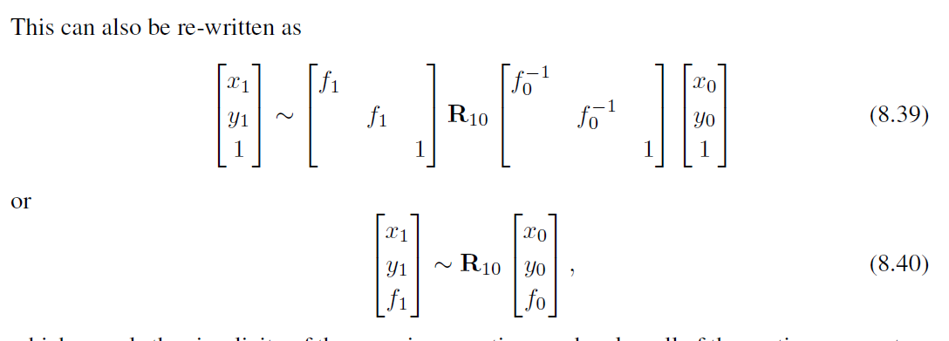
8.2 Image Stitching
8.2.3 Rotational panoramas
Setting t₀ = t₁ = 0, we get the simplified 3x3 homography.
DC&CV LAB CSIE NTU 2021
Notes:
which reveals the simplicity of the mapping equations and makes all of the motion parameters
explicit
Thus, instead of the general eight-parameter homography relating a pair of images,
we get the three-, four-, or five-parameter 3D rotation motion models corresponding to the
cases where the focal length f is known, fixed, or variable

Slide 39
8.2 Image Stitching
8.2.3 Rotational panoramas
Given a current estimate for the homography in (8.38), the best way to update is to prepend an incremental rotation matrix to the current estimate (Szeliski and Shum 1997; Shum and Szeliski 2000),
DC&CV LAB CSIE NTU 2021
Notes:
Using the small-angle approximation to R(w) given in (2.35), we can write the incremental update matrix as 8.42

Slide 40
8.2 Image Stitching
8.2.3 Rotational panoramas
Notice how there is now a nice one-to-one correspondence between the entries in the D matrix and the e parameters used in Table 8.1 and Equation (8.19), i.e.,
DC&CV LAB CSIE NTU 2021
Notes:
which give us the linearized update equations needed to estimate w

Slide 41
8.2 Image Stitching
8.2.4 Gap Closing
The techniques presented in this section can be used to estimate a series of rotation matrices and focal lengths, which can be chained together to create large panoramas.
Unfortunately, because of accumulated errors, this approach will rarely produce a closed 360 panorama. Instead, there will invariably be either a gap or an overlap.
We can solve this problem by matching the first image in the sequence with the last one.
The difference between the two rotation matrix estimates associated with the repeated first indicates the amount of misregistration.
DC&CV LAB CSIE NTU 2021

Slide 42
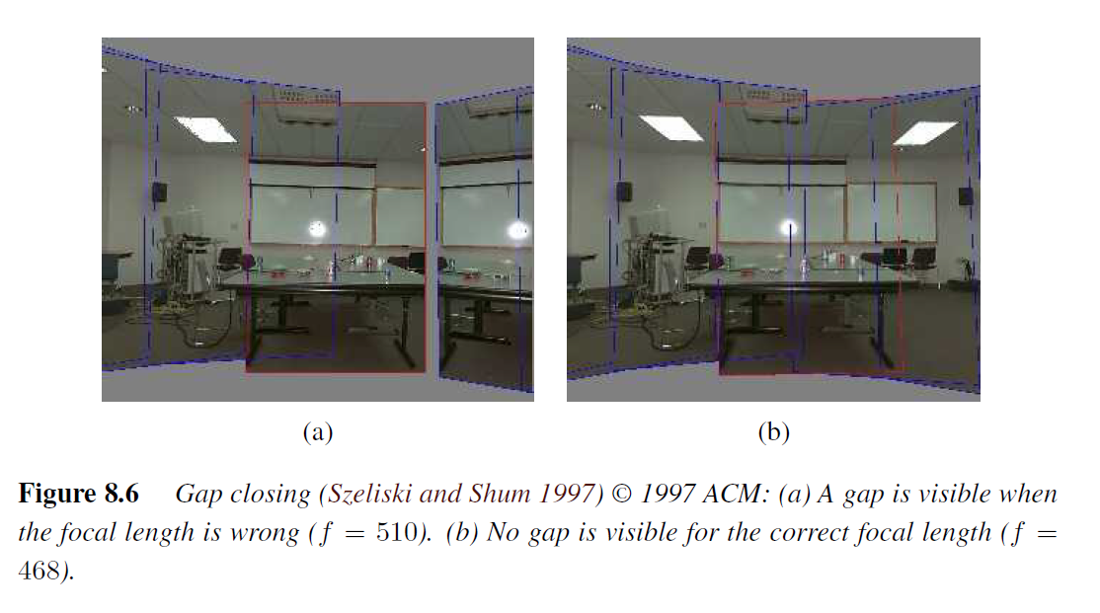
8.2 Image Stitching
8.2.4 Gap Closing
Notice that both mosaics show very little visual misregistration (except at the gap).
DC&CV LAB CSIE NTU 2021
Notes:
Figure 8.6a shows the end of registered image sequence and the first image. There is a
big gap between the last image and the first which are in fact the same image. The gap is
32 degree because the wrong estimate of focal length (f = 510) was used.
Figure 8.6b shows the registration after closing the gap with the correct focal length (f = 468).

Slide 43
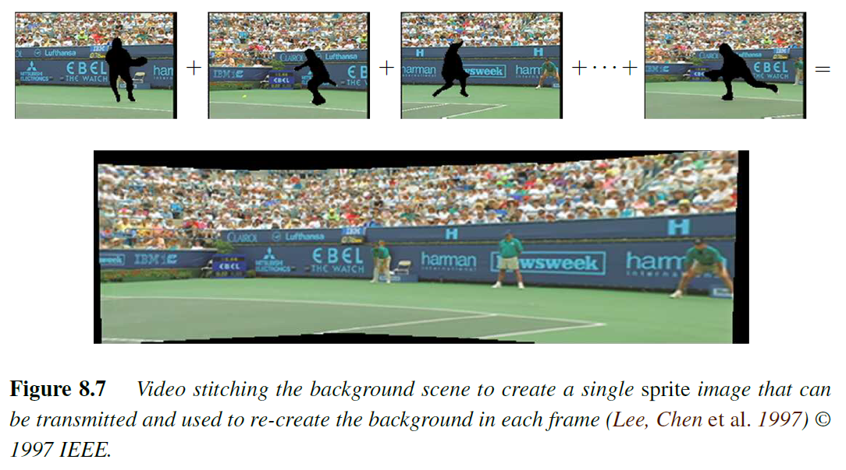
8.2 Image Stitching
IEEE: Institute of Electrical and Electronics Engineers
8.2.5 Application: Video summarization and compression
DC&CV LAB CSIE NTU 2021

Slide 44
8.2 Image Stitching
8.2.6 Cylindrical and spherical coordinates
An alternative to using homographies or 3D motions to align images is to first warp the images into cylindrical coordinates and then use a pure translational model to align them (Chen 1995; Szeliski 1996).
Unfortunately, this only works if the images are all taken with a level camera or with a known tilt angle.
Assume for now that the camera is in its canonical position, i.e., its rotation matrix is the identity, R = I, so that the optical axis is aligned with the z axis and the y axis is aligned vertically. The 3D ray corresponding to an (x; y) pixel is therefore (x; y; f).
DC&CV LAB CSIE NTU 2021

Slide 45
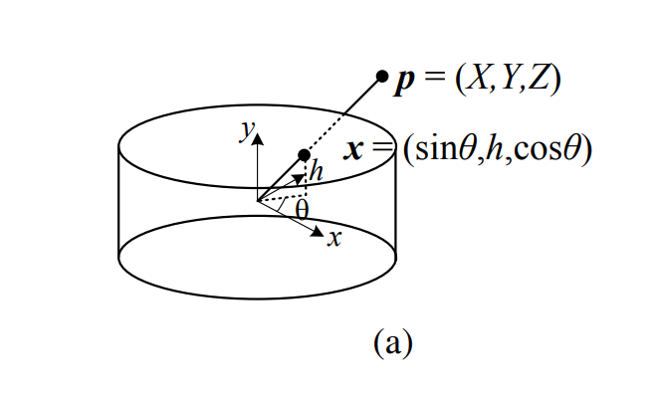
8.2 Image Stitching
8.2.6 Cylindrical and spherical coordinates
DC&CV LAB CSIE NTU 2021

Slide 46
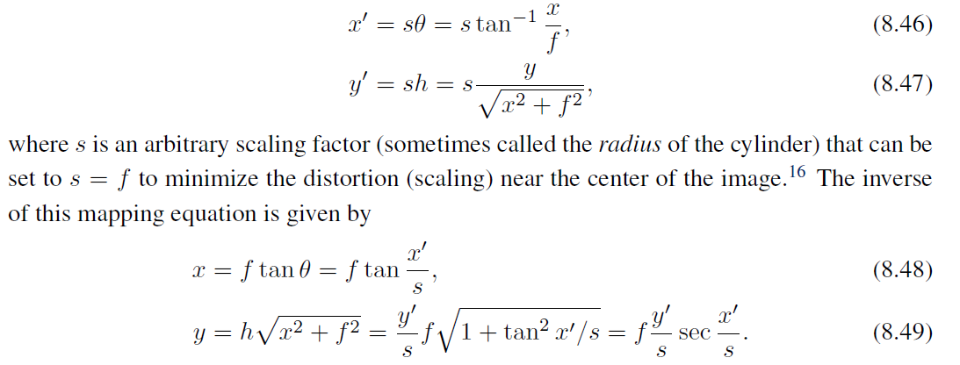
8.2 Image Stitching
8.2.6 Cylindrical and spherical coordinates
DC&CV LAB CSIE NTU 2021

Slide 47
8.2 Image Stitching
8.2.6 Cylindrical and spherical coordinates
Images can also be projected onto a spherical surface (Szeliski and Shum 1997), which is useful if the final panorama includes a full sphere or hemisphere of views.
In this case, the sphere is parameterized by two angles spherical coordinates given by
DC&CV LAB CSIE NTU 2021

Slide 48
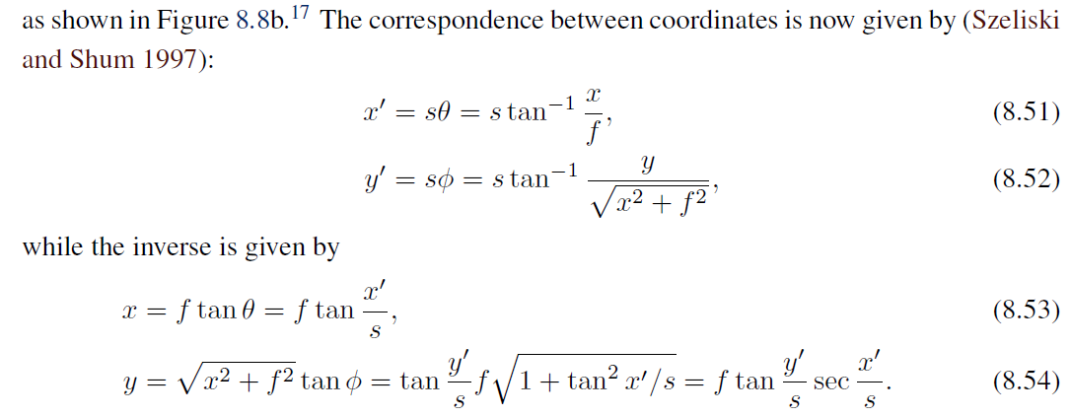
8.2 Image Stitching
8.2.6 Cylindrical and spherical coordinates
DC&CV LAB CSIE NTU 2021

Slide 49
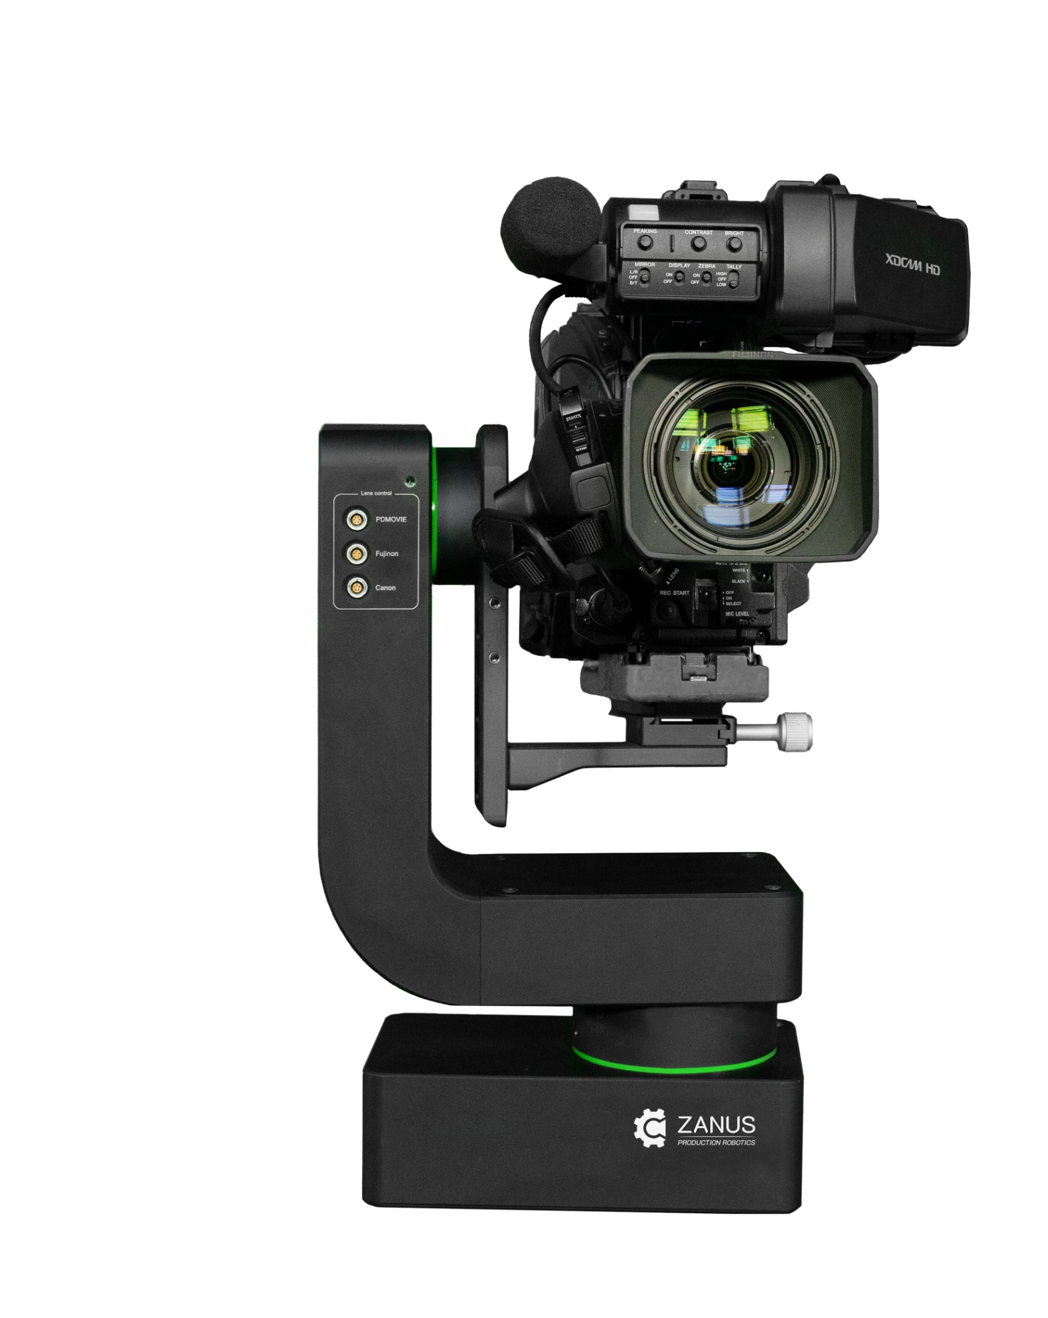
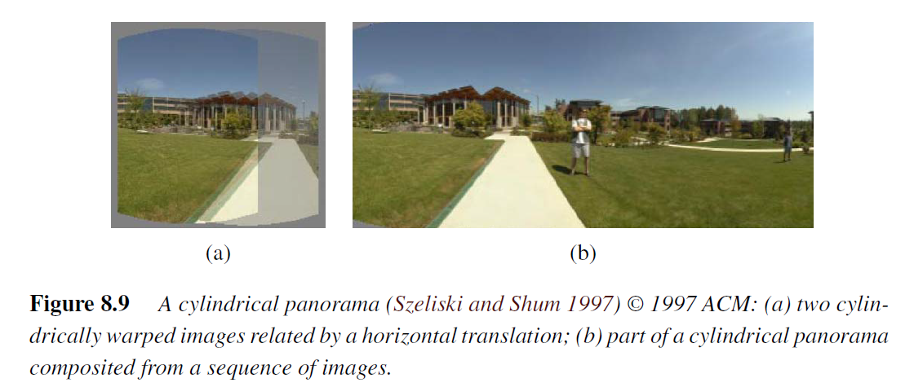
8.2 Image Stitching
8.2.6 Cylindrical and spherical coordinates
DC&CV LAB CSIE NTU 2021
Notes:
Cylindrical image stitching algorithms are most commonly used when the camera is
known to be level and only rotating around its vertical axis (Chen 1995). Under these conditions,
images at different rotations are related by a pure horizontal translation

Slide 50
8.3 Global Alignment
The goal is to find a globally consistent set of alignment parameters that minimize the misregistration between all pairs of images.
8.3.1: Extend the pairwise matching criteria (8.2, 9.1, and 9.43) to a global energy function that involves all of the per-image pose parameters.
8.3.2: Perform local adjustments, such as parallax removal, to reduce double images and blurring due to local mis-registrations.
8.3.3 panorama recognition: Given an unordered set of images to register, we need to discover which images go together to form one or more panoramas.
DC&CV LAB CSIE NTU 2021

Slide 51
8.3 Global Alignment
8.3.1 Bundle adjustment
Instead of a single collection of pairwise feature correspondences, we have
A collection of n features,
The location of the ith feature point in jth image: $x_{ij}$
Its scalar confidence (i.e. inverse variance) $c_{ij}$
Each image’s pose parameters.
DC&CV LAB CSIE NTU 2021

Slide 52
8.3 Global Alignment
8.3.1 Bundle adjustment
In this section, we assume that the pose consists of a rotation matrix and a focal length although formulations in terms of homographies are also possible.
The equation mapping a 3D point into a point in frame j can be re-written from Equations (2.68) and (8.38) as
DC&CV LAB CSIE NTU 2021
Notes:
For multi-image alignment, instead of having a single collection of pairwise feature correspondences, (xi; x hat prime i),
we have a collection of n features, with the location of the ith feature point in the jth image denoted by xij and its scalar confidence (i.e., inverse variance) denoted
by cij
Each image also has some associated pose parameters.

Slide 53
8.3 Global Alignment
8.3.1 Bundle adjustment
DC&CV LAB CSIE NTU 2021
53

Slide 54
Note that since x˜ depends on the xˆ observed value, we actually have an errors-in-variable problem, which in principle requires more sophisticated techniques than least squares to solve.
However, in practice, if we have enough features, we can directly minimize the above quantity using regular non-linear least squares and obtain an accurate multi-frame alignment.
Features that are observed many times are overweighted in the final solution.
counted $(m, 2)$ times

Slide 55
8.3 Global Alignment
8.3.1 Bundle adjustment
Another way to formulate the optimization is to use true bundle adjustment, i.e., to solve not only for the pose parameters but also for the 3D point positions
An alternative formulation is to minimize the error in 3D projected ray directions (Shum and Szeliski 2000), i.e.,
DC&CV LAB CSIE NTU 2021

Slide 56
8.3 Global Alignment
8.3.1 Bundle adjustment
However, if we eliminate the 3D rays $x_{i}$, we can derive a pairwise energy formulated in 3D ray space (Shum and Szeliski 2000)
This results in the simplest set of update equations.
DC&CV LAB CSIE NTU 2021

Slide 57
8.3 Global Alignment
8.3.2 Parallax Removal
Once we have optimized the global orientations and focal lengths of our cameras, we may find that the images are still not perfectly aligned, i.e., the resulting stitched image looks blurry or ghosted in some places.
This can be caused by a variety of factors, including unmodeled radial distortion, 3D parallax (failure to rotate the camera around its front nodal point), small scene motions such as waving tree branches, and large-scale scene motions such as people moving in and out of pictures
DC&CV LAB CSIE NTU 2021

Slide 58
8.3 Global Alignment
8.3.2 Parallax Removal
3D parallax can be handled by doing a full 3D bundle adjustment, i.e., by replacing the projection, which models camera translations.
The 3D positions of the matched feature points and cameras can then be simultaneously recovered, although this can be significantly more expensive than parallax-free image registration.
Once the 3D structure has been recovered, the scene could (in theory) be projected to a single (central) viewpoint that contains no parallax.
DC&CV LAB CSIE NTU 2021

Slide 59
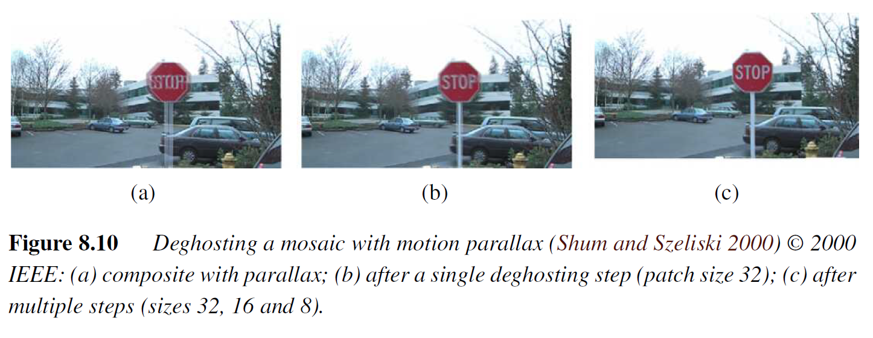
8.3 Global Alignment
8.3.2 Parallax Removal
DC&CV LAB CSIE NTU 2021

Slide 60
8.3 Global Alignment
8.3.3 Parallax Removal
The final piece needed to perform fully automated image stitching is a technique to recognize which images actually go together, which Brown and Lowe (2007) call recognizing panoramas.
To recognize panoramas, Brown and Lowe (2007) first find all pairwise image overlaps using a feature-based method and then find connected components in the overlap graph to “recognize” individual panoramas (Figure 8.11)
DC&CV LAB CSIE NTU 2021

Slide 61
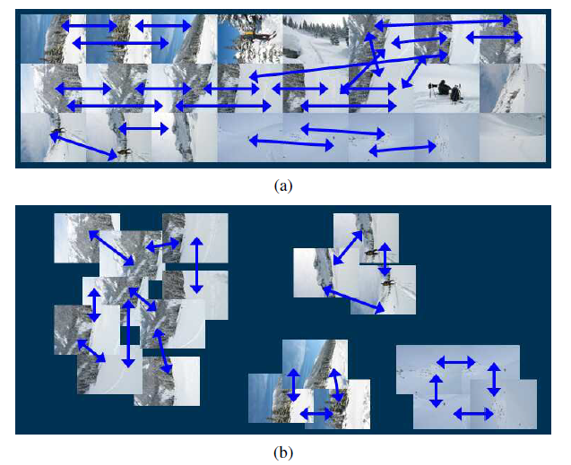
8.3 Global Alignment
8.3.3 Parallax Removal
DC&CV LAB CSIE NTU 2021

Slide 62
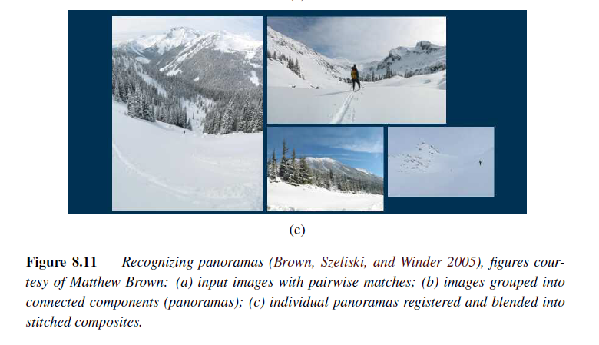
8.3 Global Alignment
8.3.3 Parallax Removal
DC&CV LAB CSIE NTU 2021

Slide 63
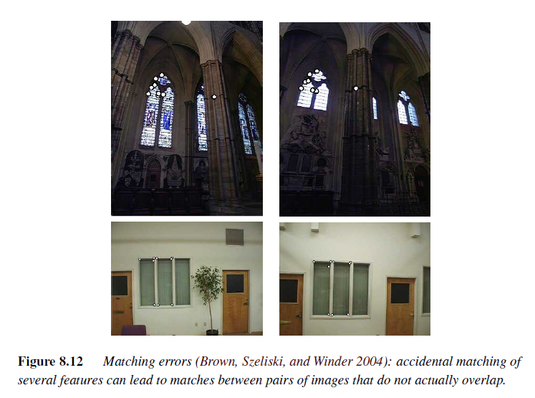
8.3 Global Alignment
8.3.3 Parallax Removal
DC&CV LAB CSIE NTU 2021

Slide 64
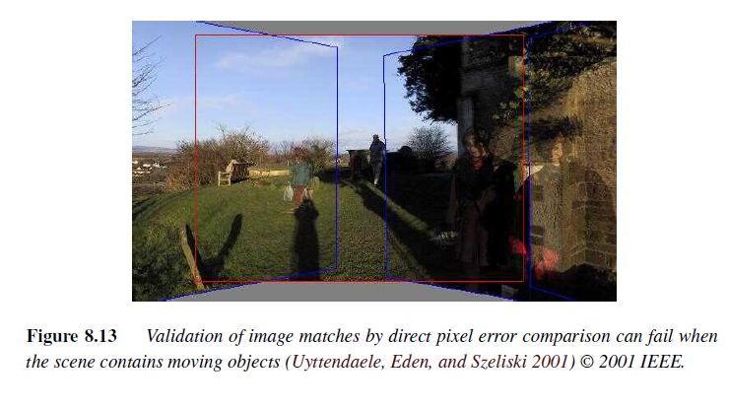
8.3 Global Alignment
8.3.3 Parallax Removal
DC&CV LAB CSIE NTU 2021

Slide 65
8.4 Compositing
Once we have registered all of the input images with respect to each other, we need to decide how to produce the final stitched mosaic image.
This involves selecting a final compositing surface (flat, cylindrical, spherical, etc.) and view (reference image).
It also involves selecting which pixels contribute to the final composite and how to optimally blend these pixels to minimize visible seams, blur, and ghosting.
DC&CV LAB CSIE NTU 2021
Notes:
In this section, we review techniques that address these problems, namely compositing
surface parameterization, pixel and seam selection, blending, and exposure compensation.
Our emphasis is on fully automated approaches to the problem.

Slide 66
8.4 Compositing
8.4.1 Choosing a compositing surface
The first choice to be made is how to represent the final image.
If only a few images are stitched together, a natural approach is to select one of the images as the reference and to then warp all of the other images into its reference coordinate system.
The resulting composite is sometimes called a flat panorama, since the projection onto the final surface is still a perspective projection, and hence straight lines remain straight (which is often a desirable attribute)
For larger fields of view, however, we cannot maintain a flat representation without excessively stretching pixels near the border of the image.
DC&CV LAB CSIE NTU 2021

Slide 67
8.4 Compositing
8.4.1 Choosing a compositing surface
The first choice to be made is how to represent the final image.
If only a few images are stitched together, a natural approach is to select one of the images as the reference and to then warp all of the other images into its reference coordinate system.
The resulting composite is sometimes called a flat panorama, since the projection onto the final surface is still a perspective projection, and hence straight lines remain straight (which is often a desirable attribute)
DC&CV LAB CSIE NTU 2021

Slide 68
8.4 Compositing
8.4.1 Choosing a compositing surface
The usual choice for compositing larger panoramas is to use a cylindrical or spherical projection.
In fact, any surface used for environment mapping in computer graphics can be used, including a cube map, which represents the full viewing sphere with the six square faces of a cube.
DC&CV LAB CSIE NTU 2021

Slide 69
8.4 Compositing
8.4.1 Choosing a compositing surface
View selection
Coordinate transformations
Sampling issues
DC&CV LAB CSIE NTU 2021

Slide 70
8.4 Compositing
8.4.1 Choosing a compositing surface
View selection
Once we have chosen the output parameterization, we still need to determine which part of the scene will be centered in the final view. As mentioned above, for a flat composite, we can choose one of the images as a reference.
For example, for rotational panoramas represented as a collection of 3D rotation matrices, we can choose the image whose z-axis is closest to the average z-axis (assuming a reasonable field of view).
DC&CV LAB CSIE NTU 2021

Slide 71
8.4 Compositing
8.4.1 Choosing a compositing surface
Coordinate transformations
After selecting the parameterization and reference view, we still need to compute the mappings between the input and output pixels coordinates.
If the final compositing surface is flat (e.g., a single plane or the face of a cube map) and the input images have no radial distortion, the coordinate transformation is the simple homography described by (8.38).
If the final composite surface has some other analytic form (e.g., cylindrical or spherical), we need to convert every pixel in the final panorama into a viewing ray (3D point) and then map it back into each image according to the projection (and optionally radial distortion) equations.
DC&CV LAB CSIE NTU 2021

Slide 72
8.4 Compositing
8.4.1 Choosing a compositing surface
Sampling issues
While the above computations can yield the correct (fractional) pixel addresses in each input image, we still need to pay attention to sampling issues.
For example, if the final panorama has a lower resolution than the input images, pre-filtering the input images is necessary to avoid aliasing
The basic problem is to compute the appropriate pre-filter, which depends on the distance (and arrangement) between neighboring samples in a source image.
As discussed in Sections 3.5.2 and 3.6.1, various approximate solutions, such as MIP mapping (Williams 1983) or elliptically weighted Gaussian averaging (Greene and Heckbert 1986) have been developed in the graphics community
DC&CV LAB CSIE NTU 2021

Slide 73
8.4 Compositing
8.4.2 Pixel selection and weighting (de-ghosting)
Once the source pixels have been mapped onto the final composite surface, we must still decide how to blend them in order to create an attractive-looking panorama.
If all of the images are in perfect registration and identically exposed, this is an easy problem, i.e., any pixel or combination will do.
However, for real images, visible seams (due to exposure differences), blurring (due to mis-registration), or ghosting (due to moving objects) can occur.
DC&CV LAB CSIE NTU 2021

Slide 74
8.4 Compositing
8.4.2 Pixel selection and weighting (de-ghosting)
Feathering and center-weighting
When an image has some cutout regions, down-weighting pixels near the edges of both cutouts and the image is preferable.
This can be done by computing a distance map or grassfire transform.
DC&CV LAB CSIE NTU 2021

Slide 75
8.4 Compositing
8.4.2 Pixel selection and weighting (de-ghosting)
Feathering and center-weighting
The simplest way to create a final composite is to simply take an average value at each pixel,
DC&CV LAB CSIE NTU 2021

Slide 76
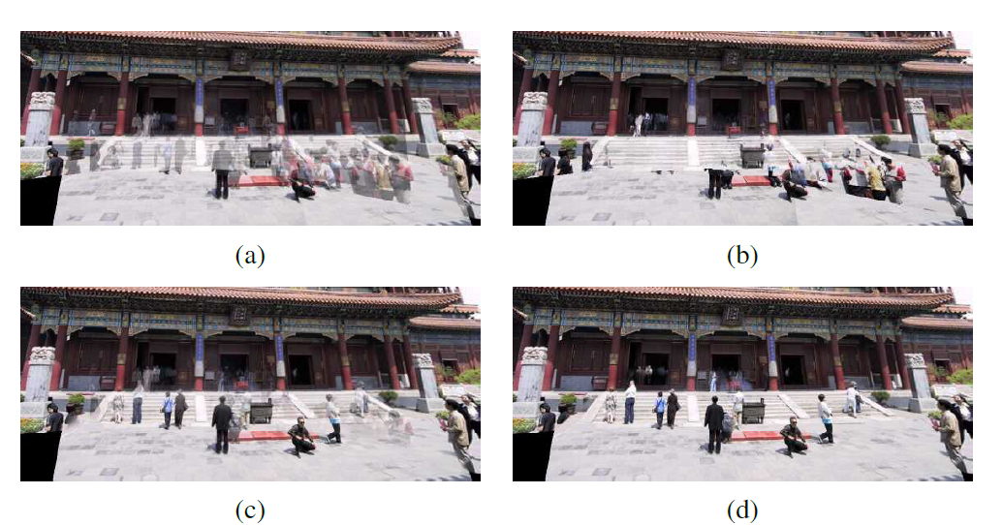
8.4 Compositing
8.4.2 Pixel selection and weighting (de-ghosting)
DC&CV LAB CSIE NTU 2021

Slide 77
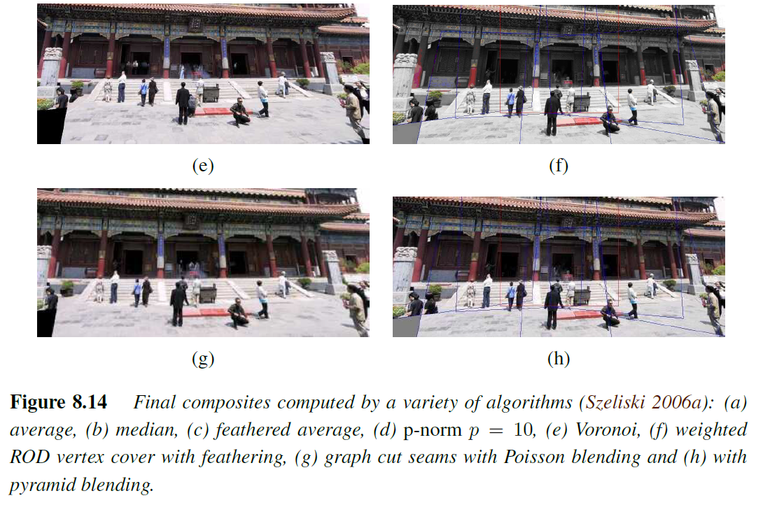
8.4 Compositing
8.4.2 Pixel selection and weighting (de-ghosting)
DC&CV LAB CSIE NTU 2021

Slide 78
8.4 Compositing
8.4.2 Pixel selection and weighting (de-ghosting)
Optimal seam selection
Computing the Voronoi diagram is one way to select the seams between regions where different images contribute to the final composite.
However, Voronoi images totally ignore the local image structure underlying the seam.
A better approach is to place the seams in regions where the images agree, so that transitions from one source to another are not visible. In this way, the algorithm avoids “cutting through” moving objects where a seam would look unnatural (Davis 1998).
For a pair of images, this process can be formulated as a simple dynamic program starting from one edge of the overlap region and ending at the other
DC&CV LAB CSIE NTU 2021

Slide 79
8.4 Compositing
8.4.3 Photomontage
While image stitching is normally used to composite partially overlapping photographs, it can also be used to composite repeated shots of a scene taken with the aim of obtaining the best possible composition and appearance of each element.
DC&CV LAB CSIE NTU 2021

Slide 80
8.4 Compositing
8.4.3 Photomontage
DC&CV LAB CSIE NTU 2021

Slide 81
8.4 Compositing
8.4.4 Blending
Once the seams between images have been determined and unwanted objects removed, we still need to blend the images to compensate for exposure differences and other misalignments.
The spatially varying weighting (feathering) previously discussed can often be used to accomplish this.
DC&CV LAB CSIE NTU 2021

Slide 82
8.4 Compositing
8.4.4 Blending
Laplacian pyramid blending
Instead of using a single transition width, a frequency-adaptive width is used by creating a band-pass (Laplacian) pyramid and making the transition widths within each level a function of the level, i.e., the same width in pixels
DC&CV LAB CSIE NTU 2021

Slide 83
8.4 Compositing
8.4.4 Blending
Gradient domain blending
An alternative approach to multi-band image blending is to perform the operations in the gradient domain.
Perez, Gangnet, and Blake (2003) show how gradient domain reconstruction can be used to do seamless object insertion in image editing applications
DC&CV LAB CSIE NTU 2021

Slide 84
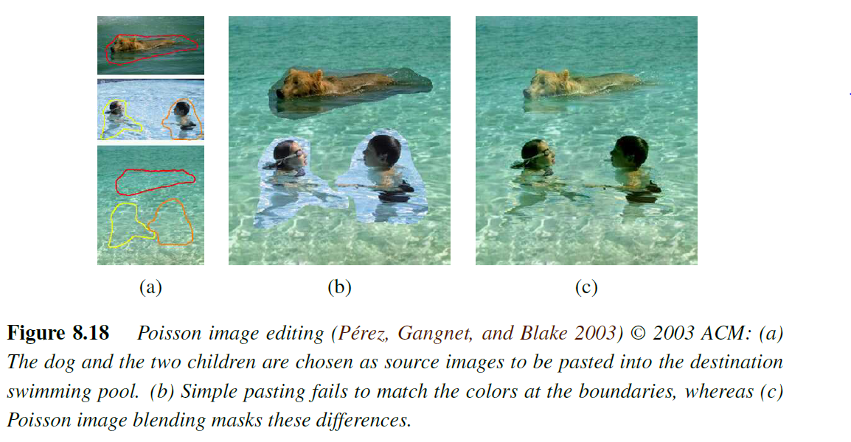
8.4 Compositing
8.4.4 Blending
Gradient domain blending
DC&CV LAB CSIE NTU 2021

Slide 85
8.4 Compositing
8.4.4 Blending
Exposure compensation
Pyramid and gradient domain blending can do a good job of compensating for moderate amounts of exposure differences between images.
However, when the exposure differences become large, alternative approaches may be necessary
DC&CV LAB CSIE NTU 2021

Slide 86
8.4 Compositing
8.4.4 Blending
Exposure compensation
Uyttendaele, Eden, and Szeliski (2001) iteratively estimate a local correction between
each source image and a blended composite.
First, a block-based quadratic transfer function is fit between each source image and an initial feathered composite.
Next, transfer functions are averaged with their neighbors to get a smoother mapping and per-pixel transfer functions are computed by splining (interpolating) between neighboring block values.
Once each source image has been smoothly adjusted, a new feathered composite is computed and the process is repeated (typically three times).
DC&CV LAB CSIE NTU 2021
Notes:
The results shown by Uyttendaele, Eden, and Szeliski (2001) demonstrate that this does a better job of exposure compensation than simple feathering and can handle local variations in exposure due to effects such as lens vignetting.

Slide 87
Thank You

