Slide 1
Advanced Computer Vision
Chapter 7
STRUCTURE FROM MOTION
Presented by
Prof. Chiou-Shann Fuh & Po-Kai Yang(楊博凱)
vitronectin@ntuh.gov.tw
Notes:
https://www.youtube.com/watch?v=O3HW67QzTpU
https://www.youtube.com/watch?v=vzaXw2ztCqU
https://www.youtube.com/watch?v=lOr2NOomssA
https://www.youtube.com/watch?v=vXgAShZ8vv0
https://www.youtube.com/watch?v=YlaWGd1cUms

Slide 2
Introduction
Chapter 6:
3D point + 2D point sets → estimate camera pose and internal calibration parameters

Slide 3
Introduction
Chapter 7: Converse problem
2D point sets from multiple images (with sparse correspondence) → estimating 3D point locations

Slide 4
Introduction
Chapter 7: Converse problem
2D point sets from multiple images (with sparse correspondence) → estimating 3D point locations
(+ camera pose)

Slide 5
What Is Structure from Motion?
Simultaneously estimate both 3D geometry (structure) and camera pose (motion)
Method for creating 3D models from 2D pictures of an object
Biological equivalence: human recovery of 3D structure from projected 2D (retinal) motion field of a moving object or scene

Slide 6
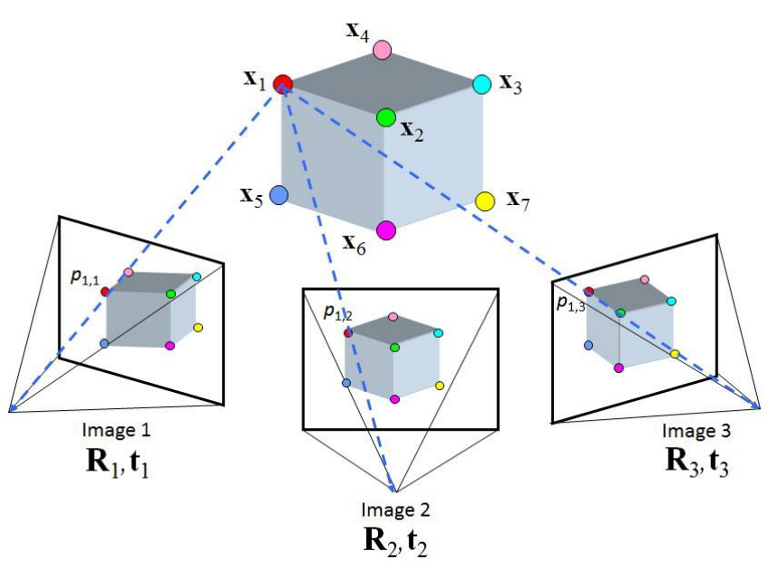
What Is Structure from Motion?
Concept: Motion (observer, object or scene) → changing relations between 3D structure(s) on 2D projections → infer 3D structure
https://www.researchgate.net/figure/Structure-from-Motion-SfM-process-is-illustrated-The-structure-in-the_fig2_269327935

Slide 7
Example 1
View A

Slide 8
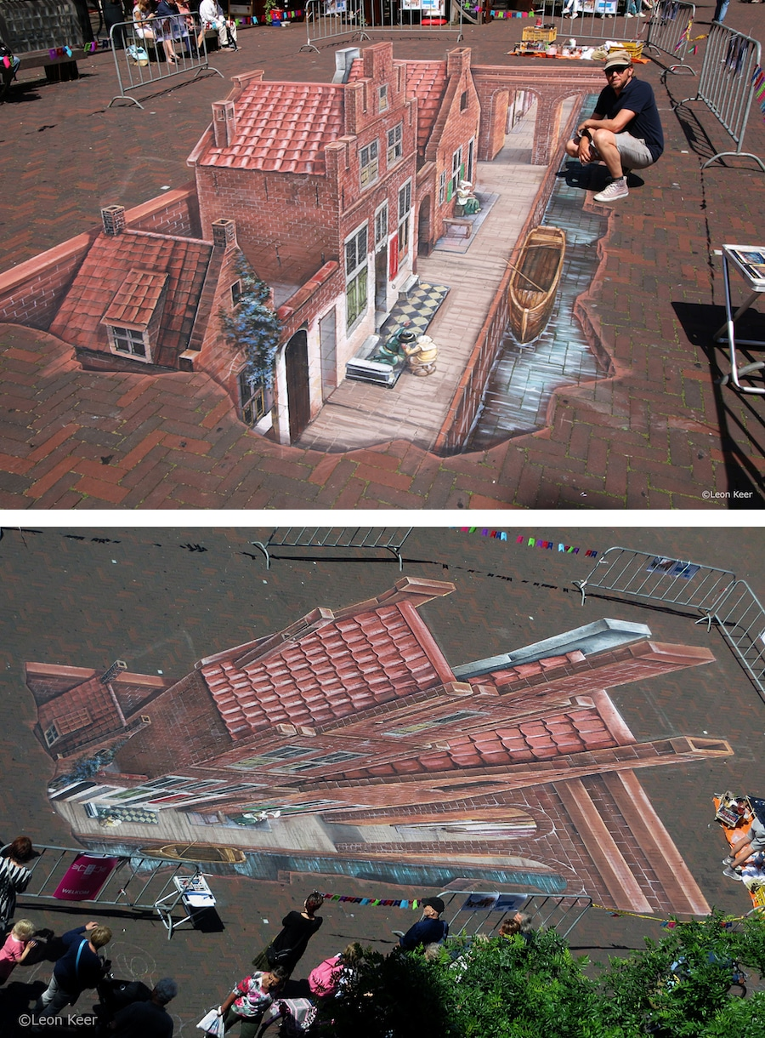
Example 1
?
View A

Slide 9
Example 1
A
B
View A

Slide 10
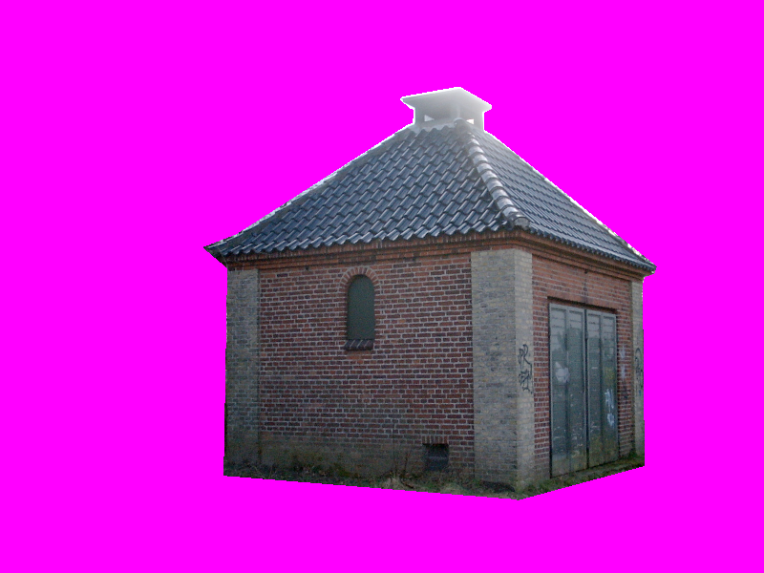
Example 1
View A
View B

Slide 11
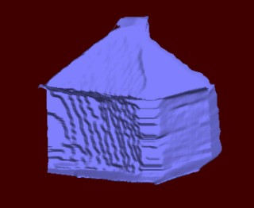
Example 1
3D model created from the two images

Slide 12
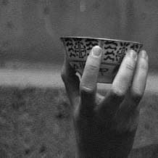
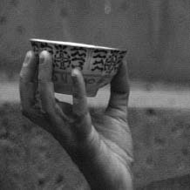
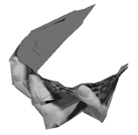
Example 2
Figure7.1:3D teacup model reconstructed from a 240-frame video sequence

Slide 13
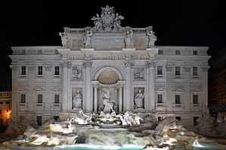
Example 3
Figure 7.3: (a-e) incremental structure from motion of Trevi Fountain, Rome (特雷維噴泉)

Slide 14
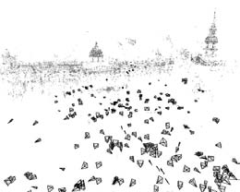
Example 4
Figure 7.4: 3D reconstruction of Trafalgar Square, London (特拉法加廣場)

Slide 15
Introduction
The topics of projective geometry and structure from motion are extremely rich:
(include trifocal tensor, algebraic techniques for full self-calibration)
We will focuses on the basics that are useful in large-scale, image-based reconstruction problems

Slide 16
Today’s Lecture Outline
7.1 Triangulation
7.2 Two-frame structure from motion
7.2.1 Projective (uncalibrated) Reconstruction
7.2.2 Self-calibration
7.3 Factorization
7.4 Bundle adjustment
7.5 Constrained structure and motion

Slide 17
7.0 Mini Review
http://www.cs.cmu.edu/~16385/s17/Slides/

Slide 18
7.0 Mini Review
http://www.cs.cmu.edu/~16385/s17/Slides/

Slide 19
7.0 Mini Review
http://www.cs.cmu.edu/~16385/s17/Slides/

Slide 20
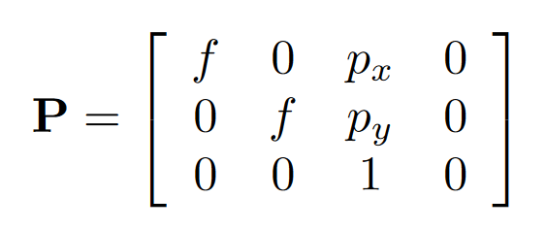
7.0 Mini Review
http://www.cs.cmu.edu/~16385/s17/Slides/

Slide 21
7.0 Mini Review
http://www.cs.cmu.edu/~16385/s17/Slides/

Slide 22
7.0 Mini Review
camera and world share
the same coordinate system
http://www.cs.cmu.edu/~16385/s17/Slides/

Slide 23
7.0 Mini Review
http://www.cs.cmu.edu/~16385/s17/Slides/

Slide 24
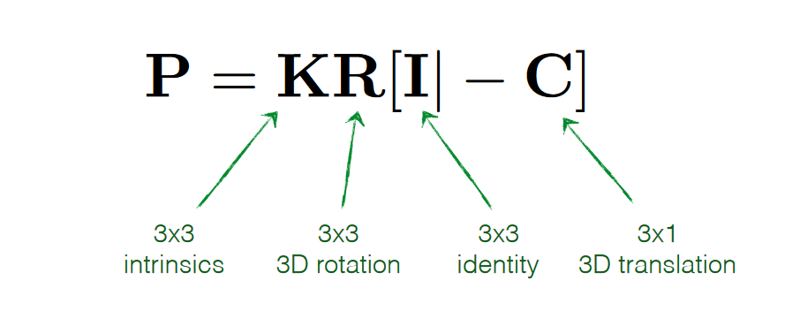
7.0 Mini Review
http://www.cs.cmu.edu/~16385/s17/Slides/

Slide 25
7.0 Mini Review
http://www.cs.cmu.edu/~16385/s17/Slides/

Slide 26
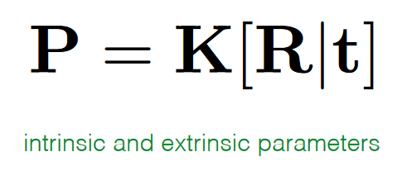
7.0 Mini Review
http://www.cs.cmu.edu/~16385/s17/Slides/

Slide 27
7.0 Mini Review
http://www.cs.cmu.edu/~16385/s17/Slides/

Slide 28
7.1 Triangulation
Definition: Estimating a point’s 3D location when it is seen from multiple cameras
Given: Measured image point in two or more views (ex. x₀, x₁) and camera matrix P
Compute: Location of 3D point (ex. p)

Slide 29
7.1 Triangulation
Generalized: Find 3D point p, given 2D matched feature locations { x_{j} } observed by cameras { P_{j} = K_{j} [ R_{j} | t_{j} ] }, where t_{j} = -R_{j}c_{j}

Slide 30
7.1 Triangulation
Generalized: Find 3D point p, given 2D matched feature locations { x_{j} } observed by cameras { P_{j} = K_{j} [ R_{j} | t_{j} ] }, where t_{j} = -R_{j}c_{j}
P_{j}
Camera matrices
c_{j}
Camera center
p
3D point that lies closest to all of the 3D rays

Slide 31
7.1 Triangulation
From the camera matrices
Calculate the rays from c_{j} to x_{j}
Find nearest point (q_{j}) to p on the rays

Slide 32
7.1 Triangulation
From the camera matrices
Calculate the rays from c_{j} to x_{j}
Find nearest point (q_{j}) to p on the rays

Slide 33
7.1 Triangulation
From the camera matrices
Calculate the rays from c_{j} to x_{j}
Find nearest point (q_{j}) to p on the rays

Slide 34
7.1 Triangulation
From the camera matrices
Calculate the rays from c_{j} to x_{j}
Find nearest point (q_{j}) to p on the rays

Slide 35
7.1 Triangulation
From the camera matrices
Calculate the rays from c_{j} to x_{j}
Find nearest point (q_{j}) to p on the rays

Slide 36
7.1 Triangulation
From the camera matrices
Calculate the rays from c_{j} to x_{j}
Find nearest point (q_{j}) to p on the rays

Slide 37
7.1 Triangulation
From the camera matrices
Calculate the rays from c_{j} to x_{j}
Find nearest point (q_{j}) to p on the rays

Slide 38
7.1 Triangulation
From the camera matrices
Calculate the rays from c_{j} to x_{j}
Find nearest point (q_{j}) to p on the rays

Slide 39
7.1 Triangulation
From the camera matrices
Calculate the rays from c_{j} to x_{j}
Find nearest point (q_{j}) to p on the rays

Slide 40
7.1 Triangulation
Optimal value for p, which lies closest to all of the rays, can be computed as a regular least square problem by summing over all the r_{j}² and finding the optimal value of p

Slide 41
7.1 Triangulation
Optimal value for p, which lies closest to all of the rays, can be computed as a regular least square problem by summing over all the r_{j}² and finding the optimal value of p.

Slide 42
7.1 Triangulation
Alternatively: statistically optimal and better estimates if some of the cameras are closer to the 3D points than others
p^{j}₀₀ p^{j}₀₁ p^{j}₀₂ p^{j}₀₃
p^{j}₁₀ p^{j}₁₁ p^{j}₁₂ p^{j}₁₃
p^{j}₂₀ p^{j}₂₁ p^{j}₂₂ p^{j}₂₃
X
Y
Z
W
x_{j}
y_{j}
1
x'/z'
y'/z'
1
=
=

Slide 43
7.1 Triangulation
Linear least squares problem by multiplying both sides of the denominator
If homogeneous coordinates p=(X,Y,Z,W), solved as singular value decomposition (SVD)

Slide 44
7.2 Two-Frame Structure from Motion
Previously: Assumed that either 3D points position or the 3D camera poses are known in advance

Slide 45
7.2 Two-Frame Structure from Motion
First look at structure from motion, which is the simultaneous recovery of 3D structure and pose from image correspondences

Slide 46
7.2 Two-Frame Structure from Motion
First look at structure from motion, which is the simultaneous recovery of 3D structure and pose from image correspondences
i.e. given 2D correspondences, intrinsics
estimate 3D points, pose

Slide 47
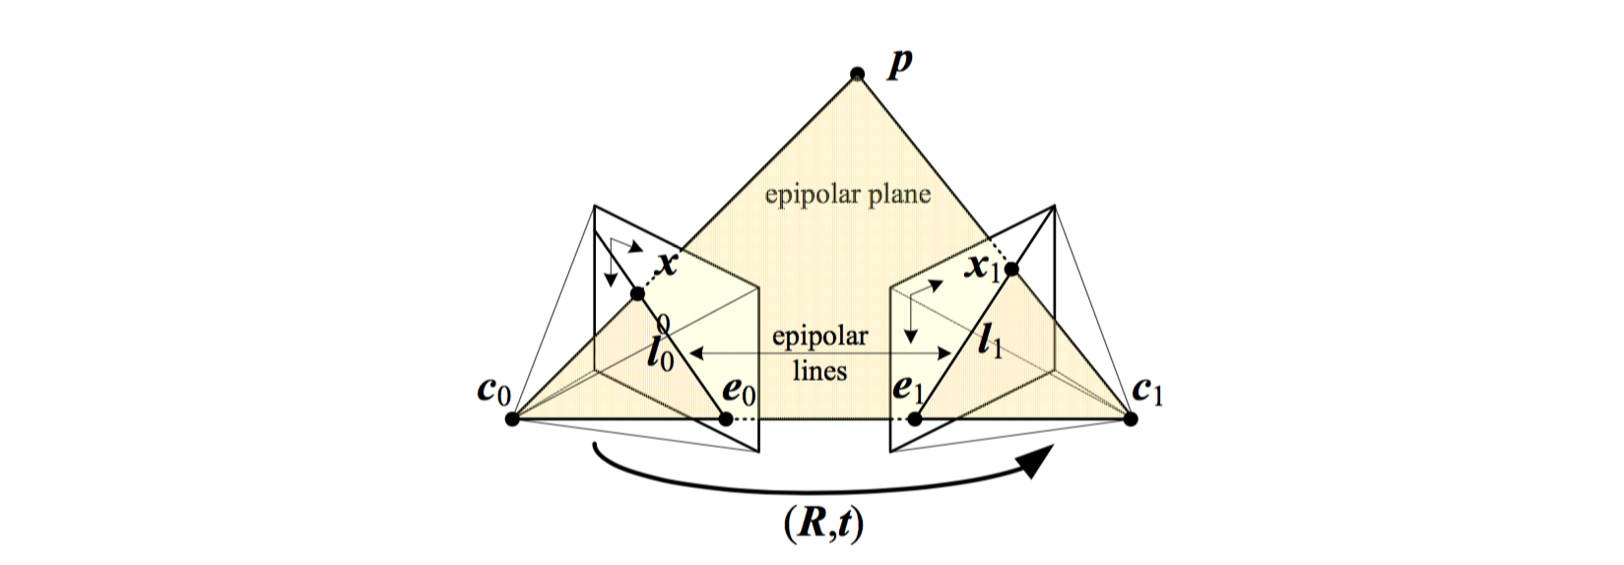
7.2 Two-Frame Structure from Motion

Slide 48
7.2 Two-Frame Structure from Motion

Slide 49
7.2 Two-Frame Structure from Motion

Slide 50
7.2 Two-Frame Structure from Motion

Slide 51
7.2 Two-Frame Structure from Motion
How do you describe the relationship between p₀ (point p seen from c₀) and
p₁ (point p seen from c₁) ?

Slide 52
7.2 Two-Frame Structure from Motion
c₀ = 0
R₀ = I
Notes:
Without loss of generality, we can set the first camera at the origin c₀=0, orientation R₀=I

Slide 53
7.2 Two-Frame Structure from Motion
c₀ = 0
R₀ = I
Notes:
The observed location of point p in the first image, is mapped into the second image by the transformation

Slide 54
7.2 Two-Frame Structure from Motion
c₀ = 0
R₀ = I
Notes:
The observed location of point p in the first image, is mapped into the second image by the transformation

Slide 55
7.2 Two-Frame Structure from Motion
c₀ = 0
R₀ = I
Notes:
The observed location of point p in the first image, is mapped into the second image by the transformation

Slide 56
7.2 Two-Frame Structure from Motion
c₀ = 0
R₀ = I
Notes:
The observed location of point p in the first image, is mapped into the second image by the transformation

Slide 57
7.2 Two-Frame Structure from Motion
c₀ = 0
R₀ = I
Notes:
The observed location of point p in the first image, is mapped into the second image by the transformation

Slide 58
7.2 Two-Frame Structure from Motion
c₀ = 0
R₀ = I
Notes:
The observed location of point p in the first image, is mapped into the second image by the transformation

Slide 59
7.2 Two-Frame Structure from Motion
Notes:
The observed location of point p in the first image, is mapped into the second image by the transformation

Slide 60
7.2 Two-Frame Structure from Motion
Structure from Motion
Notes:
Taking the cross product of both sides with t in order to annihilate it on the right hand side yields1

Slide 61
7.2 Two-Frame Structure from Motion
Structure from Motion
Notes:
Taking the dot product of both sides with ^x1 yields

Slide 62
7.2 Two-Frame Structure from Motion
Structure from Motion
Notes:
a triple product with two identical entries
The cross product matrix [t]_{x} is skew symmetric and returns 0 when pre- and post-multiplied by the same vector

Slide 63
7.2 Two-Frame Structure from Motion
Structure from Motion
Notes:
The cross product matrix [t]_{x} is skew symmetric and returns 0 when pre- and post-multiplied by the same vector

Slide 64
7.2 Two-Frame Structure from Motion
Structure from Motion
Notes:
The cross product matrix [t]_{x} is skew symmetric and returns 0 when pre- and post-multiplied by the same vector

Slide 65
7.2 Two-Frame Structure from Motion
E : essential matrix
Structure from Motion
Notes:
The cross product matrix [t]_{x} is skew symmetric and returns 0 when pre- and post-multiplied by the same vector

Slide 66
7.2 Two-Frame Structure from Motion
E : essential matrix
Structure from Motion
Notes:
The cross product matrix [t]_{x} is skew symmetric and returns 0 when pre- and post-multiplied by the same vector

Slide 67
7.2 Two-Frame Structure from Motion
E : essential matrix
basic epipolar constraint
Structure from Motion
Notes:
The cross product matrix [t]_{x} is skew symmetric and returns 0 when pre- and post-multiplied by the same vector

Slide 68
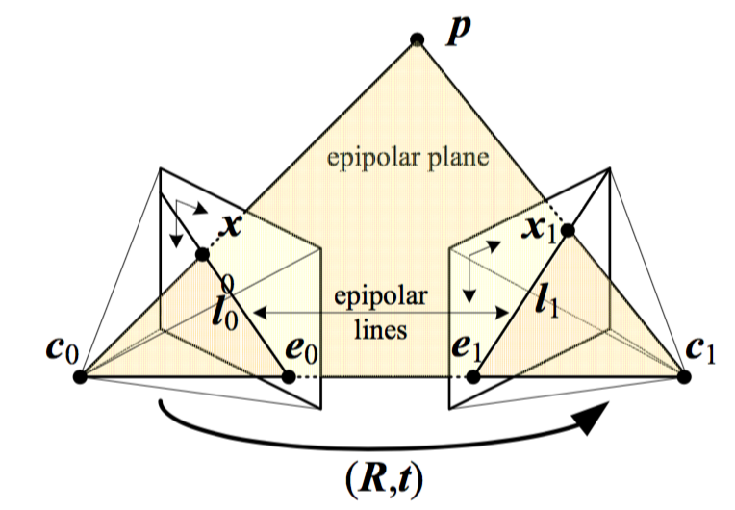
7.2 Two-Frame Structure from Motion
Alternatively: derive from co-planarity

Slide 69
7.2 Two-Frame Structure from Motion
Alternatively: derive from co-planarity

Slide 70
7.2 Two-Frame Structure from Motion
Alternatively: derive from co-planarity
Rays corresponding to x₀ and x₁

Slide 71
7.2 Two-Frame Structure from Motion
Alternatively: derive from co-planarity
c₁-c₀

Slide 72
7.2 Two-Frame Structure from Motion
Alternatively: derive from co-planarity

Slide 73
7.2 Two-Frame Structure from Motion
The essential matrix E maps a point
in image 0 into a line in image 1
since

Slide 74
7.2 Two-Frame Structure from Motion
The essential matrix E maps a point
in image 0 into a line in image 1
since
distance?

Slide 75
7.2 Two-Frame Structure from Motion
All such lines must pass through epipole e₁, equivalent to projection of t into image 1.
Defined as the left singular vector of E with 0 singular value

Slide 76
7.2 Two-Frame Structure from Motion
The transpose maps a point in image 1 onto a line in image 0
e₀ as the zero value right singular vector of E

Slide 77
7.2 Two-Frame Structure from Motion
Given: the fundamental relationship:
Compute: the camera motion encoded in the essential matrix E

Slide 78
7.2 Two-Frame Structure from Motion
Given: the fundamental relationship:
Compute: the camera motion encoded in the essential matrix E
e₀₀ e₀₁ e₀₂
e₁₀ e₁₁ e₁₂
e₂₀ e₂₁ e₂₂
E =

Slide 79
7.2 Two-Frame Structure from Motion
Given: the fundamental relationship:
Compute: the camera motion encoded in the essential matrix E
N corresponding measurements {(x_{i0}, x_{i1})}, can form N homogeneous equations for elements in E

Slide 80
7.2 Two-Frame Structure from Motion
Given: the fundamental relationship:
Compute: the camera motion encoded in the essential matrix E
x N
1

Slide 81
7.2 Two-Frame Structure from Motion
Given: the fundamental relationship:
Compute: the camera motion encoded in the essential matrix E
x N
1
1
** N ≥ 8, can compute E using a SVD
SVD: Singular Value Decomposition

Slide 82
7.2 Two-Frame Structure from Motion
Question: In the presence of noisy measurement, how close is this estimate to being statistically optimal?
Observation: In the matrix, some entries are products of image measurements while others are direct image measurements
1

Slide 83
7.2 Two-Frame Structure from Motion
Question: In the presence of noisy measurement, how close is this estimate to being statistically optimal?
Answer: Noise amplified by the other element in the product, lead to poor scaling (i.e. inordinately large influence of points far from image center)

Slide 84
7.2 Two-Frame Structure from Motion
Question: In the presence of noisy measurement, how close is this estimate to being statistically optimal?
Answer: Noise amplified by the other element in the product, lead to poor scaling (i.e. inordinately large influence of points far from image center)
1

Slide 85
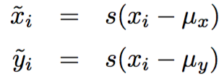
7.2 Two-Frame Structure from Motion
Possible solution (Hartley, 1997):
Point coordinates should be translated and scaled so that their centroid lies at the origin and their variance is unity

Slide 86
7.2 Two-Frame Structure from Motion
Possible solution (Hartley, 1997):
Once the essential matrix has been computed from the transformed coordinates, where the original essential matrix E can be recovered as:
Other solutions: Zhang, 1998; Torr and Fitzgibbon, 2004; please refer to p. 350 in the text

Slide 87
7.2 Two-Frame Structure from Motion
Estimating translation vector:
Once an estimate for the essential matrix E has been recovered, the direction of the translation vector t can be estimated
But the absolute distance between two cameras can never be recovered from pure image measurement alone without ground control points

Slide 88
7.2 Two-Frame Structure from Motion
Estimating translation vector:
To estimate direction , observe that under the ideal noise-free conditions, the essential matrix E is singular, i.e.,
This singularity shows up as a singular value of 0 when an SVD of E is performed

Slide 89
7.2 Two-Frame Structure from Motion
Estimating translation vector:
When E is computed from noisy measurements, the singular vector associated with the smallest singular value gives us t
The other two singular values should be similar but are not equal to 1

Slide 90
7.2 Two-Frame Structure from Motion
Estimating rotation matrix:
Once t has been recovered, we can estimate the corresponding rotation matrix R
Since projects a vector onto a set of orthogonal basis vectors that include t, zeros out the t component, and rotates the other two by 90°

Slide 91
7.2 Two-Frame Structure from Motion
Estimating rotation matrix:
Once t has been recovered, we can estimate the corresponding rotation matrix R
Since projects a vector onto a set of orthogonal basis vectors that include t, zeros out the t component, and rotates the other two by 90°

Slide 92
7.2 Two-Frame Structure from Motion
Estimating rotation matrix:
Once t has been recovered, we can estimate the corresponding rotation matrix R
Since projects a vector onto a set of orthogonal basis vectors that include t, zeros out the t component, and rotates the other two by 90°

Slide 93
7.2 Two-Frame Structure from Motion
Estimating rotation matrix:
Once t has been recovered, we can estimate the corresponding rotation matrix R
Since projects a vector onto a set of orthogonal basis vectors that include t, zeros out the t component, and rotates the other two by 90°

Slide 94
7.2 Two-Frame Structure from Motion
Estimating rotation matrix:
Once t has been recovered, we can estimate the corresponding rotation matrix R
Since projects a vector onto a set of orthogonal basis vectors that include t, zeros out the t component, and rotates the other two by 90°

Slide 95
7.2 Two-Frame Structure from Motion
Estimating rotation matrix:
We only know both E and t up to a sign.
Furthermore, the matrices U and V are not guaranteed to be rotations (you can flip both their signs and still get a valid SVD) → loss of chirality

Slide 96
7.2 Two-Frame Structure from Motion
Estimating rotation matrix:
For this reason, we have to generate all four possible rotation matrices and keep the two whose determinant |R| = 1
To disambiguate between the remaining pair of potential rotations, pair with both possible signs of the translation direction ± t
Notes:
and select the combination for which the largest number of points is seen in front of both cameras

Slide 97
7.2 Two-Frame Structure from Motion
Pure Translation (Known rotation)
In the case where we know the rotation, we can pre-rotate the points in the second image to match the viewing direction of the first
epipole

Slide 98
7.2 Two-Frame Structure from Motion
Pure Translation (Known rotation)
In the case where we know the rotation, we can pre-rotate the points in the second image to match the viewing direction of the first
epipole

Slide 99
7.2 Two-Frame Structure from Motion
Pure Translation (Known rotation)
In the case where we know the rotation, we can pre-rotate the points in the second image to match the viewing direction of the first
epipole

Slide 100
7.2 Two-Frame Structure from Motion
Pure Translation (Known rotation)
In the case where we know the rotation, we can pre-rotate the points in the second image to match the viewing direction of the first
epipole
FOE

Slide 101
7.2 Two-Frame Structure from Motion
Pure Translation (Known rotation)
In the case where we know the rotation, we can pre-rotate the points in the second image to match the viewing direction of the first
epipole

Slide 102
7.2 Two-Frame Structure from Motion
Pure Translation (Known rotation)
In the case where we know the rotation, we can pre-rotate the points in the second image to match the viewing direction of the first
epipole

Slide 103
7.2 Two-Frame Structure from Motion
Pure Translation (Known rotation)
In the case where we know the rotation, we can pre-rotate the points in the second image to match the viewing direction of the first
epipole
FOC

Slide 104
7.2 Two-Frame Structure from Motion
Pure Translation (Known rotation)
The resulting essential matrix E is (in the noise-free case) skew symmetric and so can be estimated more directly by setting e_{ij} = -e_{ji} and e_{ii} = 0
1

Slide 105
7.2 Two-Frame Structure from Motion
Pure Translation (Known rotation)
The resulting essential matrix E is (in the noise-free case) skew symmetric and so can be estimated more directly by setting e_{ij} = -e_{ji} and e_{ii} = 0
X
1
X
X

Slide 106
7.2 Two-Frame Structure from Motion
Pure Translation (Known rotation)
The resulting essential matrix E is (in the noise-free case) skew symmetric and so can be estimated more directly by setting e_{ij} = -e_{ji} and e_{ii} = 0
X
-
-
1
X
-
X

Slide 107
7.2 Two-Frame Structure from Motion
Pure Translation (Known rotation)
The resulting essential matrix E is (in the noise-free case) skew symmetric and so can be estimated more directly by setting e_{ij} = -e_{ji} and e_{ii} = 0

Slide 108
7.2 Two-Frame Structure from Motion
Alternatively:
A more direct derivation of FOE estimates can be obtained by minimizing the triple product

Slide 109
7.2 Two-Frame Structure from Motion
Pure Translation (Known rotation)
Two points with non-zero parallax now suffice to estimate the FOE → epipole
Notes:
非視差

Slide 110
7.2 Two-Frame Structure from Motion
Pure Translation (Known rotation)
In situations where a large number of points at infinity are available (e.g. outdoor scenes)
Pick a pair of points to estimate a rotation, hoping that both of the points lie at infinity

Slide 111
7.2 Two-Frame Structure from Motion
Pure Translation (Known rotation)
In situations where a large number of points at infinity are available (e.g. outdoor scenes)
Pick a pair of points to estimate a rotation, hoping that both of the points lie at infinity

Slide 112
7.2 Two-Frame Structure from Motion
Pure Translation (Known rotation)
In situations where a large number of points at infinity are available (e.g. outdoor scenes)
Pick a pair of points to estimate a rotation, hoping that both of the points lie at infinity

Slide 113
7.2 Two-Frame Structure from Motion
Pure Translation (Known rotation)
In situations where a large number of points at infinity are available (e.g. outdoor scenes)
Pick a pair of points to estimate a rotation, hoping that both of the points lie at infinity

Slide 114
7.2 Two-Frame Structure from Motion
Pure Translation (Known rotation)
In situations where a large number of points at infinity are available (e.g. outdoor scenes)
Pick a pair of points to estimate a rotation, hoping that both of the points lie at infinity

Slide 115
7.2 Two-Frame Structure from Motion
Pure Translation (Known rotation)
In situations where a large number of points at infinity are available (e.g. outdoor scenes)
Pick a pair of points to estimate a rotation, hoping that both of the points lie at infinity
Pre-rotate → Compute the epipole and check residual, consistency of FOE or FOC ➔ confirm pure translation

Slide 116
7.2 Two-Frame Structure from Motion
Pure Rotation
The case of pure rotation results in a degenerate estimate of the essential matrix E and of the t
Consider first the case of the rotation matrix being known, the estimates for the FOE will be degenerate since x_{i0} ≈ x_{i1}

Slide 117
7.2 Two-Frame Structure from Motion
Pure Rotation
Prudent to compute a rotation estimate R, with just a small number of points
Compute the residuals after rotating the points
Proceed with a full E computation

Slide 118
7.2.1 Projective (uncalibrated) Reconstruction
Here: First look at structure from motion, which is the simultaneous recovery of 3D structure and pose from image correspondences
i.e. given 2D correspondences, intrinsics
estimate 3D points, pose

Slide 119
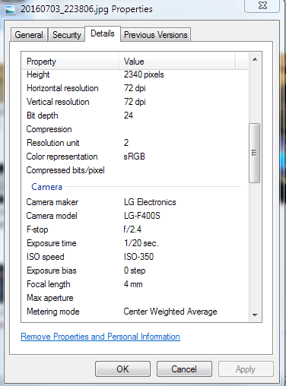
7.2.1 Projective (uncalibrated) Reconstruction
Intrinsics Unknown:
When we try to build 3D model from the photos taken by unknown cameras without any EXIF tags

Slide 120
7.2.1 Projective (uncalibrated) Reconstruction
Intrinsics Unknown:
Do not know ahead of time the intrinsic calibration parameters associated with input images.

Slide 121
7.2.1 Projective (uncalibrated) Reconstruction
Intrinsics Unknown:
We can still estimate a two-frame reconstruction, although the true metric structure may not be available
*True metric structure: parallel lines are parallel, orthogonal walls are at right angles, and model is scaled version of reality

Slide 122
7.2.1 Projective (uncalibrated) Reconstruction
Intrinsics Unknown:
In the unreliable case, we do not know the calibration matrices K_{j} in , so we cannot use the normalized ray directions
We have access to the image coordinate x_{j}, so essential matrix becomes:

Slide 123
7.2.1 Projective (uncalibrated) Reconstruction
Intrinsics Unknown:
In the unreliable case, we do not know the calibration matrices K_{j} in , so we cannot use the normalized ray directions
We have access to the image coordinate x_{j}, so essential matrix becomes:

Slide 124
7.2.1 Projective (uncalibrated) Reconstruction
Intrinsics Unknown:
In the unreliable case, we do not know the calibration matrices K_{j} in , so we cannot use the normalized ray directions
We have access to the image coordinate x_{j}, so essential matrix becomes:

Slide 125
7.2.1 Projective (uncalibrated) Reconstruction
Intrinsics Unknown:
In the unreliable case, we do not know the calibration matrices K_{j} in , so we cannot use the normalized ray directions
We have access to the image coordinate x_{j}, so essential matrix becomes:
fundamental matrix

Slide 126
7.2.1 Projective (uncalibrated) Reconstruction
Intrinsics Unknown:
In the unreliable case, we do not know the calibration matrices K_{j} in , so we cannot use the normalized ray directions
We have access to the image coordinate x_{j}, so essential matrix becomes:
fundamental matrix

Slide 127
7.2.1 Projective (uncalibrated) Reconstruction
Similar to guessing R in E, the homography H cannot be uniquely recovered from F
Any valid homographies H maps some plane in the scene from one image to the other
Not possible to know which one before tests
Selecting ≥ 4 co-planar correspondences to compute H as part of the F estimation process

Slide 128
7.2.1 Projective (uncalibrated) Reconstruction
To create a projective reconstruction of a scene, we pick up any valid homography that satisfies
and hence
: singular value matrix with the smallest value
replaced by the middle value.

Slide 129
7.2.1 Projective (uncalibrated) Reconstruction
Form a pair of camera matrices from which a projective reconstruction of the scene can be computed using triangulation
While may not be useful in practice (not metric!), it can often be upgraded to a metric reconstruction (self-calibration)
Useful in finding additional correspondences
1

Slide 130
7.2.2 Self-calibration
Auto-calibration is developed for converting a projective reconstruction into a metric one
* True metric structure: parallel lines are parallel, orthogonal walls are at right angles, and model is scaled version of reality
Equivalent to recovering the unknown calibration matrix K_{j} associated with each image

Slide 131
7.2.2 Self-calibration
Certain information about the scene can be exploited:
Parallel lines, > 3 vanishing points: establish the homography for the plane at infinity → recover focal length and rotations
> 2 vanishing points, orthogonal: single-image calibration method can be done

Slide 132
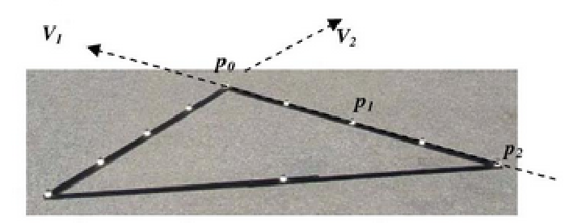
7.2.2 Self-calibration
From this relationship, it is possible to compute the camera focal length
Can be interpreted as the equation of the line orthogonal to a vanishing point

Slide 133
Summary
Conditions |  |  |  | Method | Goal
2D sets | K | R, t | 3D points
a | a | a | r | 7.1 Triangulation | 3D geometry
a | a | r | r | 7.2 2-Frame structure from Motion (Essential matrix) | Pose (loss of chirality) → 3D geometry
a | r | r | r | 7.2.1 Projective reconstruction (Fundamental matrix) | Homography (loss of chirality) → 3D geometry (loss of metric structure

Slide 134
Summary
Conditions |  |  |  | Method | Goal
2D sets | K | R, t | 3D points
a | a | a | r | 7.1 Triangulation | 3D geometry
a | a | r | r | 7.2 2-Frame structure from Motion (Essential matrix) | Pose (loss of chirality) → 3D geometry
a | r | r | r | 7.2.1 Projective reconstruction (Fundamental matrix) | Homography (loss of chirality) → 3D geometry (loss of metric structure

Slide 135
Summary
Conditions |  |  |  | Method | Goal
2D sets | K | R, t | 3D points
a | a | a | r | 7.1 Triangulation | 3D geometry
a | a | r | r | 7.2 2-Frame structure from Motion (Essential matrix) | Pose (loss of chirality) → 3D geometry
a | r | r | r | 7.2.1 Projective reconstruction (Fundamental matrix) | Homography (loss of chirality) → 3D geometry (loss of metric structure

Slide 136
Summary
Conditions |  |  |  | Method | Goal
2D sets | K | R, t | 3D points
a | a | a | r | 7.1 Triangulation | 3D geometry
a | a | r | r | 7.2 2-Frame structure from Motion (Essential matrix) | Pose (loss of chirality) → 3D geometry
a | r | r | r | 7.2.1 Projective reconstruction (Fundamental matrix) | Homography (loss of chirality) → 3D geometry (loss of metric structure

Slide 137
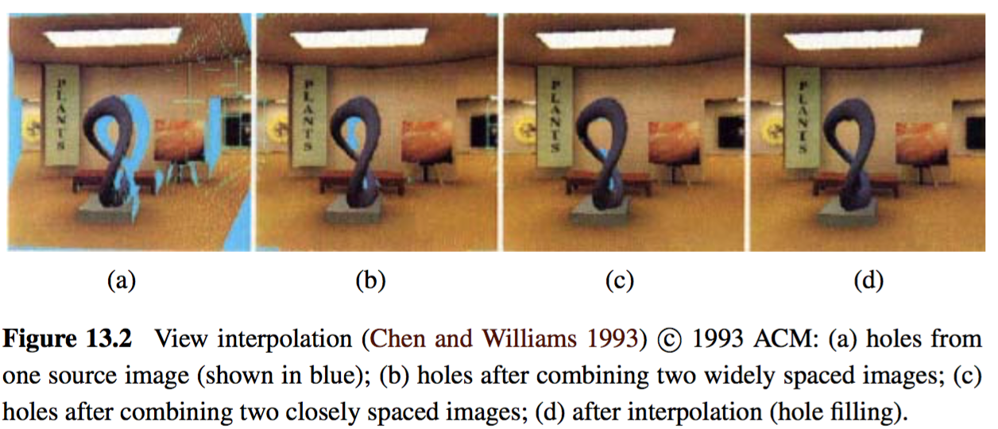
Application: View Morphing
An application of basic two-frame structure: view morphing (a.k.a. view interpolation)
Generate a smooth 3D animation from one view of a 3D scene to another

Slide 138
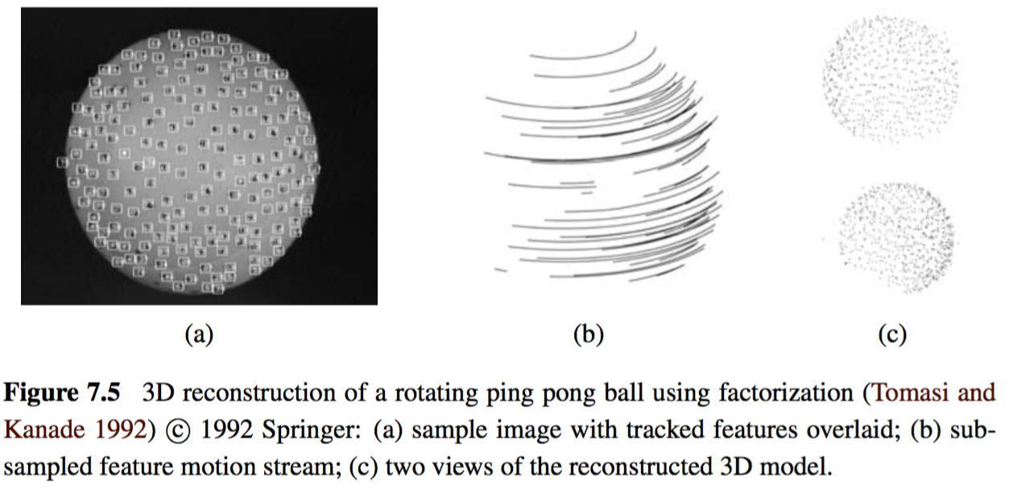
7.3 Factorization
When processing video sequences, we often get extended feature track from which it is possible to recover the structure and motion using a process called factorization.

Slide 139
7.3 Factorization
Consider orthographic and weak perspective projection models
Since the last row is always [0 0 0 1], there is no perspective division
x_{ji}: location of i ^{th} point in j ^{th} frame
: upper 2 x 4 portion of projection matrix P_{j}
: augmented 3D point position

Slide 140
7.3 Factorization
Assume that every point i is visible in every frame j
We can take the centroid (average) of the projected point locations x_{ij} in frame j.
: augmented 3D centroid of the point cloud.
We can place the origin of the world at the centroid of the points, i.e, so that
Centroid of 2D points in each frame directly gives us last element of

Slide 141
7.3 Factorization
Let be the 2D point locations after their image centroid has been subtracted. We can write:
M_{j}: upper 2 by 3 portion of the projection matrix P_{j}
p_{i}=(X_{i},Y_{i},Z_{i})
We can concatenate all of these measurements into one large matrix.

Slide 142
7.3 Factorization
: measurement matrix
: motion matrices
: structure matrices

Slide 143
7.3 Factorization
between points
: measurement matrix
: motion matrices
: structure matrices
structure
between frames
motion

Slide 144
7.3 Factorization
Since is 2M x 3 and the structure matrix is 3 x N, an SVD applied to has only three non-zero singular values
If SVD of directly returns the matrices ; But it does not. Instead we can write the relationship
where
and
To recover values of the 3 x 3 matrix Q depends on motion model being used

Slide 145
7.3 Factorization
In the case of orthographic projection, the entries in M_{j} are the first two rows of rotation matrices R_{j}
i.e. they are orthogonal with size unity
So we have:
u_{k}: 3 x 1 rows of matrix U
Notes:
This gives us a large set of equations for the entries in matrix QQ^{T} from which matrix Q can be recovered using matrix square root

Slide 146
7.3 Factorization
So we have:
u_{k}: 3 x 1 rows of matrix U
This gives us a large set of equations for the entries in matrix QQ^{T} from which matrix Q can be recovered using matrix square root
Notes:
This gives us a large set of equations for the entries in matrix QQ^{T} from which matrix Q can be recovered using matrix square root

Slide 147
7.3 Factorization
So we have:
u_{k}: 3 x 1 rows of matrix U
and can be estimated
Notes:
This gives us a large set of equations for the entries in matrix QQ^{T} from which matrix Q can be recovered using matrix square root

Slide 148
7.3 Factorization
In the case of scaled orthography, i.e. M_{j} = s_{j}R_{j}, the first and third equation = s_{j} and can be set equal to each other
u_{k}: 3 x 1 rows of matrix U
s_{j}
s_{j}

Slide 149
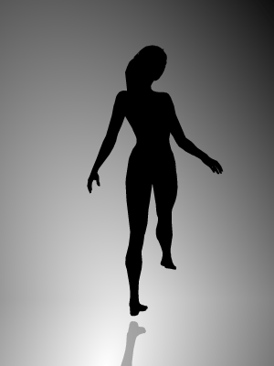
7.3 Factorization
Limitations:
Bas-relief ambiguity
Cannot determine if the object is rotating left to right or if its depth reversed version is moving the other way
Wikipedia.com

Slide 150
7.3 Factorization
Limitations:
Require a complete set of tracks:
Each point must be visible in each frame
May apply to smaller denser subsets → using known motion and structure, hallucinate missing values
Treat missing data as special cases of outliers

Slide 151
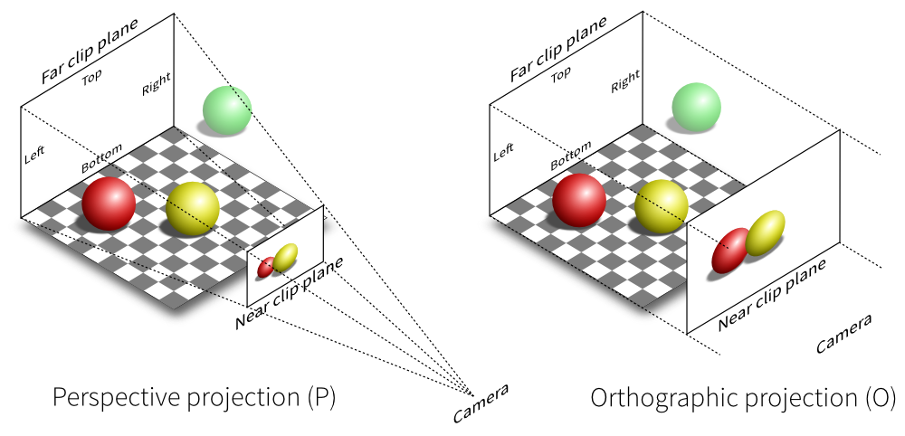
7.3 Factorization
Limitations:
Cannot deal with perspective cameras
Perform an initial affine (e.g., orthographic) reconstruction and to then correct for the perspective effects in an iterative manner
https://www.quora.com/What-is-the-difference-between-orthographic-and-perspective-projections-in-engineering-drawing

Slide 152
Application: Sparse 3D Model Extraction
A multi-view 3D reconstruction of the scene has been estimated, create a texture-mapped 3D model of the object and to look at it from new directions
Create a denser 3D model than the sparse point cloud that structure from motion produces
A simple technique such as 3D triangulation can be used
A more realistic model, a texture map can be extracted for each triangle face

Slide 153
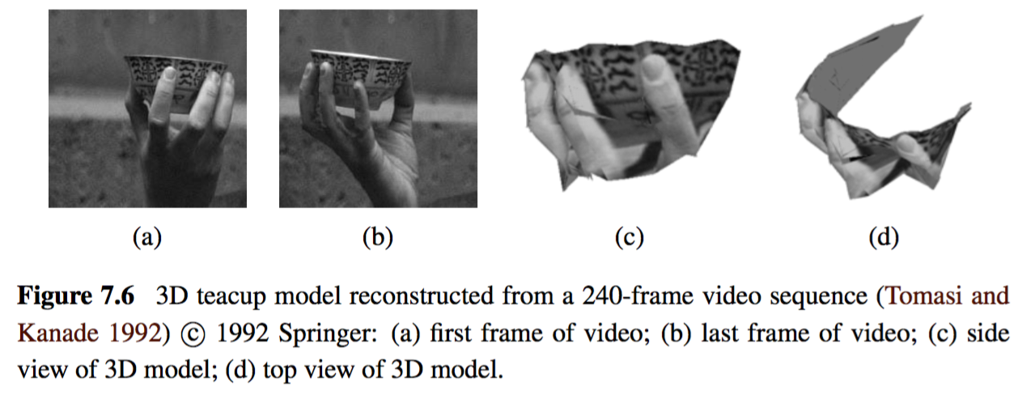
Application: Sparse 3D Model Extraction

Slide 154
7.4 Bundle Adjustment
The most accurate way to recover structure and motion is to perform robust non-linear minimization of the measurement (re-projection) errors, which is commonly known as bundle adjustment
The term bundle refers to the bundles of rays connecting camera centers to 3D points and the term adjustment refers to the iterative minimization of re-projection error

Slide 155
7.4 Bundle Adjustment
The iterative adjustment of estimating equations given each new point (bundle of ray)
Adjustments are based on some pre-defined criteria

Slide 156
7.4 Bundle Adjustment
The iterative adjustment of estimating equations given each new point (bundle of ray)
Adjustments are based on some pre-defined criteria
*non-linear minimization of the measurement (re-projection) errors

Slide 157
7.4 Bundle Adjustment
Σ_{ij}: measured noise covariance

Slide 158
7.4 Bundle Adjustment
Translation
Σ_{ij}: measured noise covariance

Slide 159
7.4 Bundle Adjustment
Rotation
Σ_{ij}: measured noise covariance

Slide 160
7.4 Bundle Adjustment
Projection
Σ_{ij}: measured noise covariance

Slide 161
7.4 Bundle Adjustment
Radial Dist.
Σ_{ij}: measured noise covariance

Slide 162
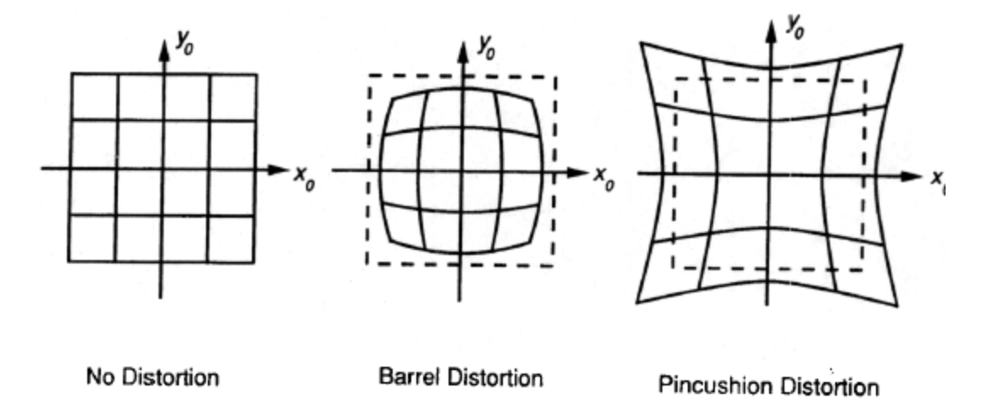
7.4 Bundle Adjustment
Radial Dist.
Σ_{ij}: measured noise covariance

Slide 163
7.4 Bundle Adjustment
Radial Dist.
Σ_{ij}: measured noise covariance

Slide 164
7.4 Bundle Adjustment
Instrinsics
Σ_{ij}: measured noise covariance

Slide 165
7.4 Bundle Adjustment
Correction metric
Σ_{ij}: measured noise covariance

Slide 166
Application: Reconstruction from Internet Photos
Widely used application of structure from motion: the reconstruction of 3D objects and scenes from video sequences and collection of images
Before structure from motion comparison can begin, it is first necessary to establish sparse correspondences between different pairs of images and to then link such correspondences into feature track, which associates individual 2D image feature with global 3D points

Slide 167
Application: Reconstruction from Internet Photos
Once an initial pair has been reconstructed, the pose of cameras that see a sufficient number of the resulting 3D points can be estimated and the complete set of cameras and feature correspondences can be used to perform another round of bundle adjustment

Slide 168
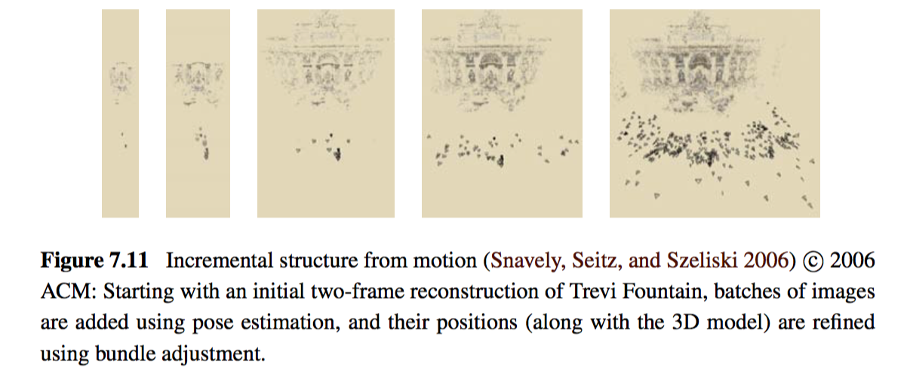
Application: Reconstruction from Internet Photos

Slide 169
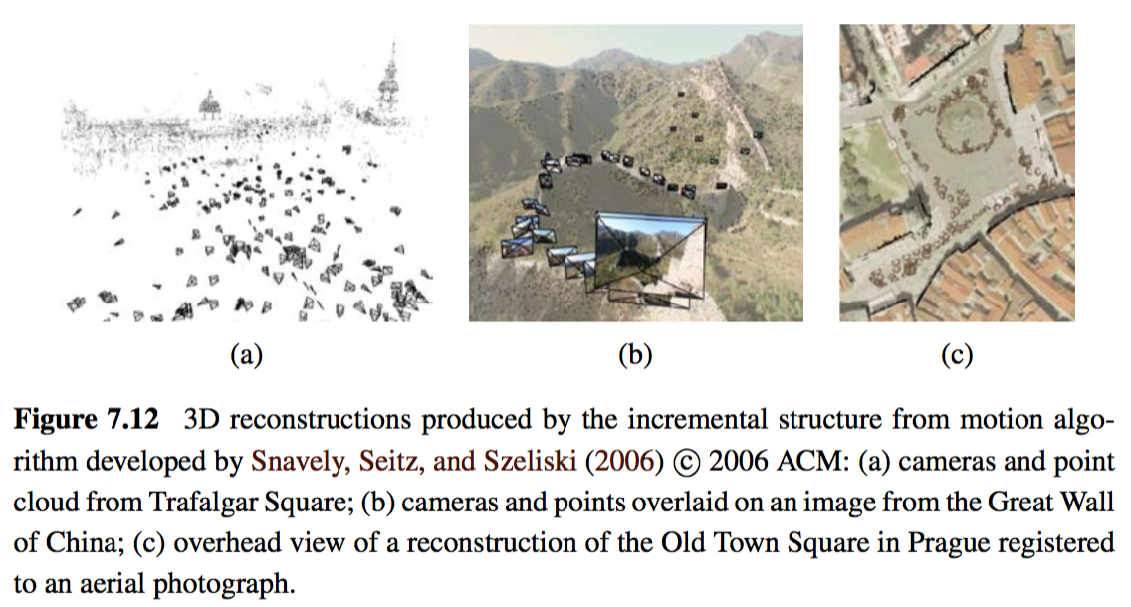
Application: Reconstruction from Internet Photos

Slide 170
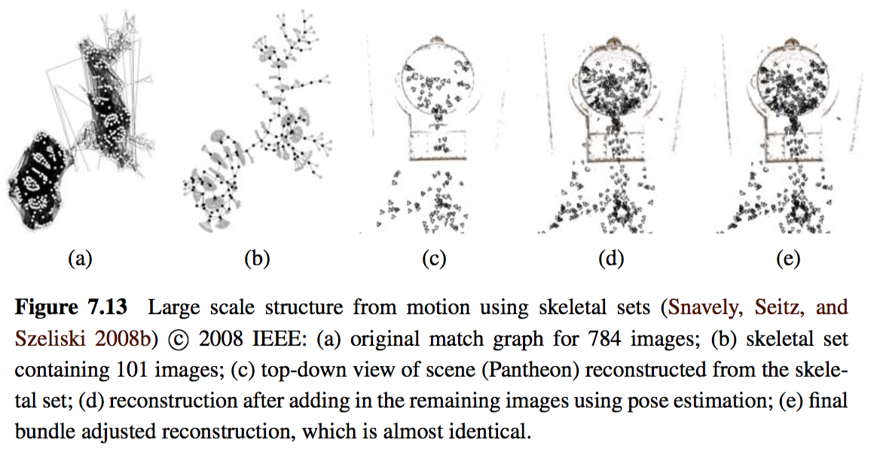
Application: Reconstruction from Internet Photos

Slide 171
7.5 Constrained Structure and Motion
The general algorithms for structure from motion make no prior assumptions about the objects or scenes that they are reconstructing
In many cases, however, the scene contains higher-level geometric primitives, such as lines and planes
Furthermore, these primitives are often arranged in particular relationships, i.e., many lines and planes are either parallel or orthogonal to each other

Slide 172
7.5 Constrained Structure and Motion
Line-based technique:
Pairwise epipolar geometry cannot be recovered from line matches alone, even if the cameras are calibrated
When lines are visible in three or more views, the trifocal tensor can be used to transfer lines from one pair of images to another
Others group by coplanar sets, parallelism

Slide 173
7.5 Constrained Structure and Motion
Plane-based technique:
In scenes that are rich in planar structures, e.g., in architecture and certain kinds of manufactured objects such as furniture, it is possible to directly estimate homographies between different planes, using either feature-based or intensity-based methods
Directly compute for F, but performance poor due to algebraic errors

Slide 174
7.5 Constrained Structure and Motion
Plane-based technique:
Hallucinate virtual points from the homographic planes areas
Use full bundle adjustment with explicit plane equations, as well as additional constraints to force reconstructed co-planar features to lie exactly on their corresponding planes

Slide 175
End of Chapter 7
Thank you for listening!

