Slide 1
Chapter 5
Segmentation
Presented by: 傅楸善教授、曾民君
r08922167@ntu.edu.tw
Notes:
Segmentation :分割
通常用來定義圖像的邊界(直線 曲線 等)，來區分前景跟背景
把同類型的pixel貼上同一個標籤

Slide 2
Segmentation (1/3)
5.1 Active Contours
5.2 Split and Merge
5.3 Mean Shift and Mode Finding
5.4 Normalized Cuts
5.5 Graph Cuts and Energy-based Methods
Notes:
In statistics, this problem is known as cluster analysis
Early method : region split or merging
這章會分成5小節來講
1. Active Contours: 主動輪廓模型
2. Split and Merge: 拆分並合併法
3. Mean Shift and Mode Finding: 均值漂移算法
4. Normalized Cuts: 正規化分割
5. Graph Cuts and Energy-based Methods: 基於能量的方法的影像切割

Slide 3
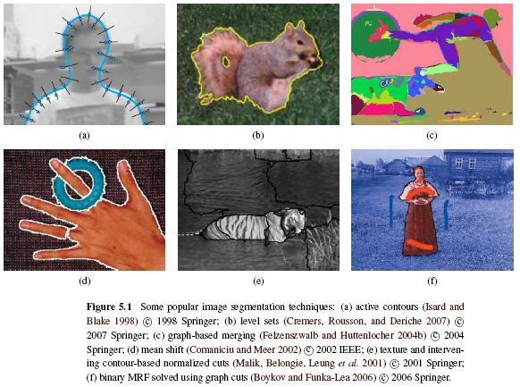
Segmentation (2/3)
MRF: Markov Random Field
Particle filter + snake
Level set
Graph based merging
Mean shift
Normalize cut
Graph cut
Notes:
Particle filter + snake 5.1
Level set: 水平集 5.1
Graph based merging 5.2.4
Mean shift 5.3
Normalize cut 5.4
Graph cut 5.5

Slide 4
Segmentation (3/3)
Notes:
這張大概念架構為如圖，基本上這章提到的方法會一直出求能量最小化/最大化，或是用能量大小區分，
能量定義就只是某個算法的作者自訂一個函釋後，將需要的資訊丟進去所產生的值而已，
所以說接下來的課程主要會是介紹方法這塊，至於自訂義的函數是可以任意變換，
之後課程中會提到幾個 函數 常搭配哪個方法，但並不是一定要如此，抱著這樣觀點聽接下來課程應該會比較好理解內容

Slide 5
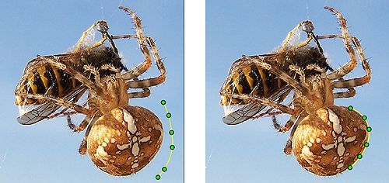
5.1 Active Contours
Active Contours: these boundary detectors iteratively move towards their final solution under the combination of image and optional user-guidance forces
Snakes
Scissors
Level Sets
Notes:
主動式輪廓的概念是說，任何物體都能被一個封閉式的輪廓給包起來，所以只要能找到輪廓，等價於做完 Segmentation
主動輪廓模型的大概念就是結合圖像和用戶自定義的要求透過多次迭代慢慢逼近最終結果
Snake:二維的閉合能量曲線，曲線在計算過程中，會慢慢朝輪廓靠近，當能量最小時就是segment完成
Scissor:半自動的segment，他需要user給定一些在輪廓上的點，然後過計算將點跟點之間的強邊給連結起來，有點像是photoshop功能的套索工具
Level set:把圖片想像成3D的，從最低的地方水平線慢慢上升的切面圖就是segment的結果
Snakes (Kass, Witkin, and Terzopoulos 1988)
Scissors (Mortensen and Barrett 1995)
Level Sets (Malladi, Sethian, and Vemuri 1995)

Slide 6
5.1.1 Snakes(1/7)
Snakes are a two-dimensional generalization of the 1D energy-minimizing splines.
One may visualize the snake as a rubber band of arbitrary shape that is deforming with time trying to get as close as possible to the object contour.
Ex: https://www.youtube.com/watch?v=RJEMDkhVgqQ (3:34)
Notes:
在第3章有提到1維最小化能量平滑曲線，而 snake 就是從一維推廣到2維的應用
把目標邊緣想像是一個閉合的連續曲線
主動輪廓模型:可變形的閉合曲線+能量函數，以最小化能量目標函數為目標控制變形，在最小能量時就是目標輪廓
人們可以將蛇形象化為任意形狀的橡皮筋，該橡皮筋會隨著時間而變形，以盡可能接近物體輪廓。

Slide 7
Snakes(2/7)
s ∈ [0,1] : arc parameter
contour represented as v(s) = (x(s), y(s))
x(s) and y(s) are the coordinates along the contour
Notes:
Snakes 的能量來源可分為兩種，內部能量及外部能量
其中內部能量控制曲線形狀，而外部能量則控制曲線靠近物理輪廓邊緣
實際效果上來說，最小化內部能量的曲線不斷向內部緊縮且保持平滑，而外能量則是保證曲線緊縮到目標物體邊緣時停止；
那整體能量部分通常我們就直接區分為內部能量以及外部能量
內部能量: 輪廓或是曲線的能量=>讓曲線越光華
外部能量: (圖像能量:梯度等,約束力:人人給的)讓蛇朝輪廓特徵移動
圖像能量:梯度等
約束力:人給的

Slide 8
Snakes(3/7)
Internal spline energy:
$E_{cont}$: continuity of the contour
$E_{curv}$: smoothness of the contour
$f_{s}$, $f_{ss}$: first-order and second-order derivatives of curve
$α, β$: first-order and second-order weighting functions
Notes:
內部能量部分:
cont:continuity 輪廓表示的能量:彈性能量
curv:curvature 曲率表示的能量
彈性能量迅速把輪廓線壓縮成一個光滑的圓，
彎曲能量驅使輪廓線成為光滑曲線或直線，
一次微分:表輪廓的連續性
二次微分:表輪廓的曲率
Alpha越大蛇就會收縮得越快，beta越大,曲線就會越平滑
方程式決定曲線是否可以再這一點伸展or彎曲
如果noise越大,alpha跟beta就要越大
合理的選擇alpha跟beta可以讓輪廓收縮到合理的位置
h is the step size, which can be neglected if we resample the curve along its arc-length after each iteration.

Slide 9
Snakes(4/7)
Discretized form of internal spline energy
$∵f_{s}\left(a\right)≈\frac{f\left(a+h\right)−f\left(a\right)}{h} ≈\frac{f\left(a\right)−f\left(a−h\right)}{h}$
$∴f_{ss}^{ }\left(a\right)≈\frac{f_{s}(a+h)−f_{s}\left(a\right)}{h}$
$≈\frac{f\left(a+h\right)−f\left(a\right)−f\left(a\right)+f\left(a−h\right)}{h^{2}}$
$≈\frac{f\left(a+h\right)−2f\left(a\right)+f\left(a−h\right)}{h^{2}}$
$h:$ step size
Notes:
這邊是剛剛連續的能量函式轉換成離散化函式的推導
使用方法就是用差分近似微分方是可以推導出離散化後的公式
原本連續的式子中含有一階跟二階的元素
首先很 trivial 從微分的定義可以得出低一行的式子
那二階微分可以從一階推導過去，此時一階微分已知，將其代換後可以得到下方推導~
h is the step size, which can be neglected if we resample the curve along its arc-length after each iteration.

Slide 10
Snakes(5/7)
External spline energy:
$line$ term: attracting to dark ridges
$edge$ term: attracting to strong gradients
$term$ term: attracting to line terminations
In practice, most systems only use the edge term, which can be directly estimated by gradient.
Notes:
外部能量=圖像力+約束力
圖像力的組成:
線: 將曲線引往深色邊緣上
邊緣: 將曲線引往強烈漸變的邊緣上
終端:將曲線引往到線的末端上
在不少的現實系統中，只使用邊緣的這項去找

Slide 11
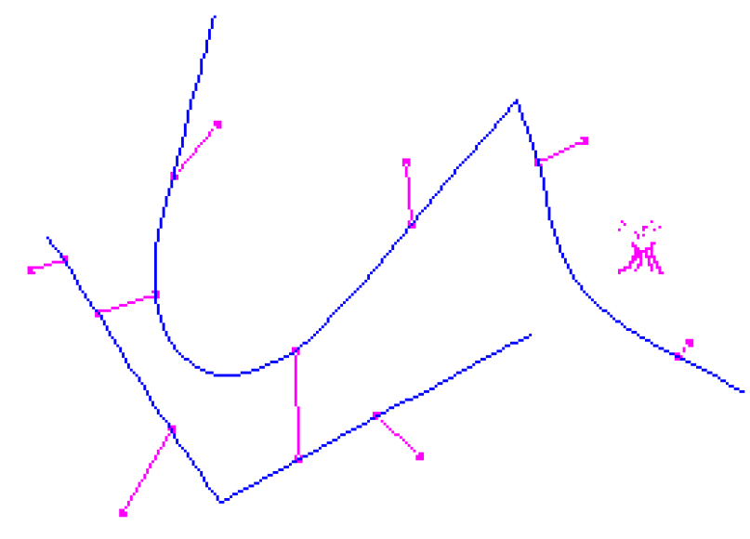
Snakes(6/7)
User-placed constraints can also be added.
Spring: attractive forces towards anchor points
f: the snake points
d: anchor points
The “snake pit” for interactively
controlling shape
Notes:
Wiggle:擺動
Slither:滑行
故得名

Slide 12
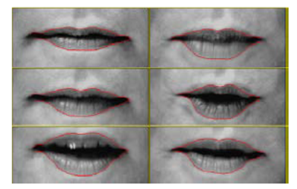
Snakes(7/7)
Because regular snakes have a tendency to shrink, it is usually better to initialize them by drawing the snake outside the object of interest to be tracked.

Slide 13
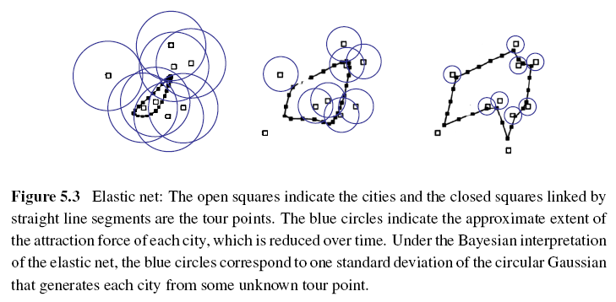
Elastic Nets and Slippery Springs
Applying to TSP (Traveling Salesman Problem):
Notes:
這邊來講一個 Snakes 的變形，彈性網絡
我們先假設說事先得知物體輪廓上的點，那理想上來說，snakes 的結果必定會通過這些點，
那如此一來這個問題就能轉換成 Traveling Salesman Problem (TSP) 的問題，
那剛剛要解的問題太困難，所以放鬆一點限制條件，就是說我們不要求一定要通過那些點，只需要不要離太遠
為了得到最佳解，elastic net可以以pass一些點不用travel
藍色的圈圈:城市的吸引力(機率)
白色:要travel的點
黑色:snake:初始位置是travel點的mean

Slide 14
Elastic Nets and Slippery Springs
Probabilistic interpretation:
i: each snake node
j: each city
σ: standard deviation of the Gaussian
d_{ij}: Euclidean distance between a tour point f(i) and a city location d(j)
Notes:
概率解釋
i: each snake node
j: each city
d_{ij}: Euclidean distance between a tour point f(i) and a city location d(j)
f(i) : tour point
d(j): city location

Slide 15
Elastic Nets and Slippery Springs
The tour f(s) is initialized as a small circle around the mean of the city points and σ is progressively lowered.
Slippery spring: this allows the association between constraints (cities) and curve (tour) points to evolve over time.
Notes:
第一步:
在重心位置附近隨機生成一組路徑
第二步:
縮小容忍區間並更新路徑
第三步:
重複第二步直到有線次數或誤差夠小

Slide 16
B-spline Approximations
Snakes sometimes exhibit too many degrees of freedom, making it more likely that they can get trapped in local minima during their evolution.
Use B-spline approximations to control the snake with fewer degrees of freedom.
https://en.wikipedia.org/wiki/B-spline
Notes:
Snakev給太多自由，可能會陷入局部極小
Sol:B 曲線的近似

Slide 17
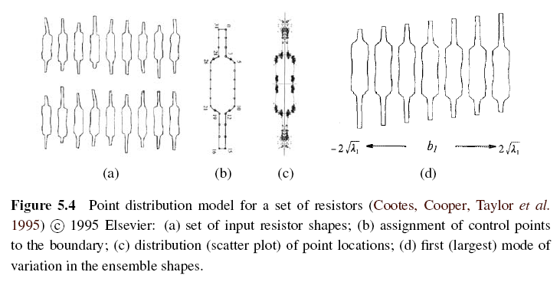
Shape Prior
Notes:
事先知道目標物形狀:
若已知物體大致形狀，我們就能推測一些物體的可能變形，比如說圖中 b 所示，是給定的形狀
其周圍這些點都是有可能會變形的部分，
已經得知目標形狀，給主動輪廓曲線給一個形狀模板

Slide 18
5.1.2 Dynamic snakes and CONDENSATION
CONDENSATION: CONditional DENSity propagATION
In many applications of active contours, the object of interest is being tracked from frame to frame as it deforms and evolves.
In this case, it make sense to use estimates from the previous frame to predict and constrain the new estimates.
Notes:
Conditional Density Propagation 機率: 條件密度傳播
在主動輪廓的許多應用中，隨著物體的變形和演化，逐 frame 跟踪目標物體。
在這種情況下，使用前一幀的估計值來預測和約束新的估計值是有意義的。

Slide 19
Kalman Filtering and Kalman Snakes (1/3)
Kalman filter uses estimates from the previous frame to predict and constrain the new estimates.
x_{t}: current state variable
x_{t-1}: previous state variable
A: linear transition matrix
w: noise vector, which is often modeled as a Gaussian
https://www.youtube.com/watch?v=4OerJmPpkRg&list=PLn8PRpmsu08pzi6EMiYnR-076Mh-q3tWr&index=2 (0:50)
Notes:
第一個方式是 Kalman filter
如果你從初始時間開始,就紀錄了某一系統狀態的值. 而這個值受到隨機雜訊的干擾, 所以你不能直接拿來用.
所以Kalman filter只是在做上述的filtering動作, 但它是經過最佳化的演算法, 其可在隨機環境中 進行最小平方計算
Kalman Filter: 將預測的位置跟當下測量到的位置做一個整合找出機率較好的

Slide 20
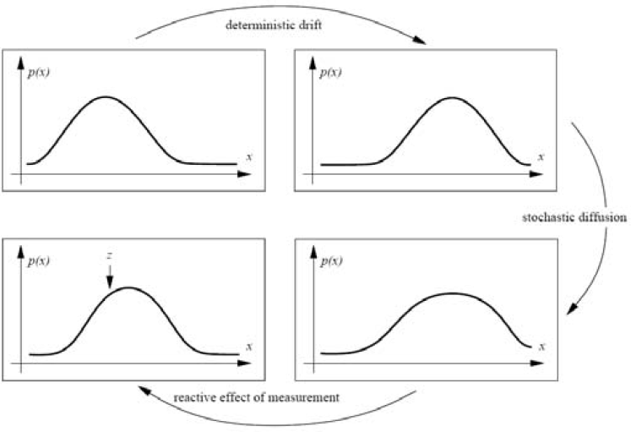
Kalman Filtering and Kalman Snakes (2/3)
Notes:
線性動態模型在先前的估計中導致確定性變化（漂移），而過程噪聲導致隨機擴散，從而增加系統熵。
從當前幀開始的新測量值可恢復更新估算值中的某些確定性。

Slide 21
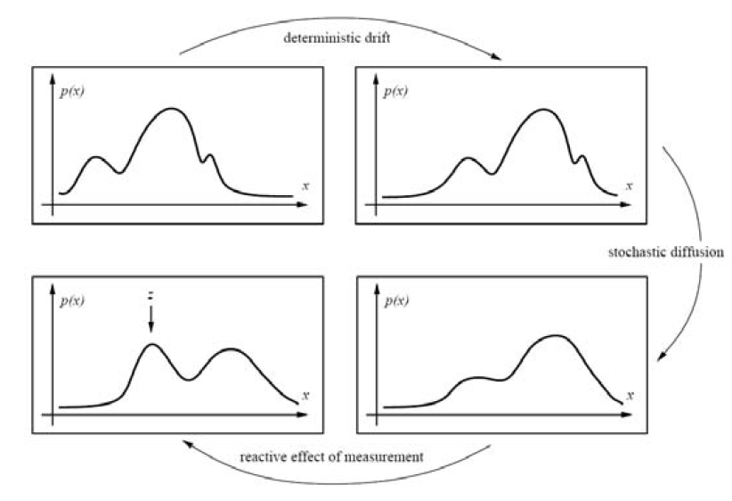
Kalman Filtering and Kalman Snakes (3/3)
Notes:
但是，在許多情況下，例如在混亂中進行跟踪時，某些應用程序需要更通用的多峰分佈。

Slide 22
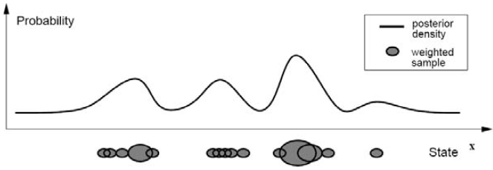
Particle Filter
Particle filtering techniques represent a probability distribution using a collection of weighted point samples.
Then use CONDENSATION to estimate.
(Conditional Density Propagation )
Notes:
Particle Filter: 依照之前機率分布關係去取樣觀察點，再依照各點各自運動關係去做飄移
然後再加入隨機擾動，得到新的樣本分布，再依此去預測當下的分布
Conditional Density Propagation 機率: 條件密度傳播
每個密度分佈使用加權粒子的疊加表示。

Slide 23
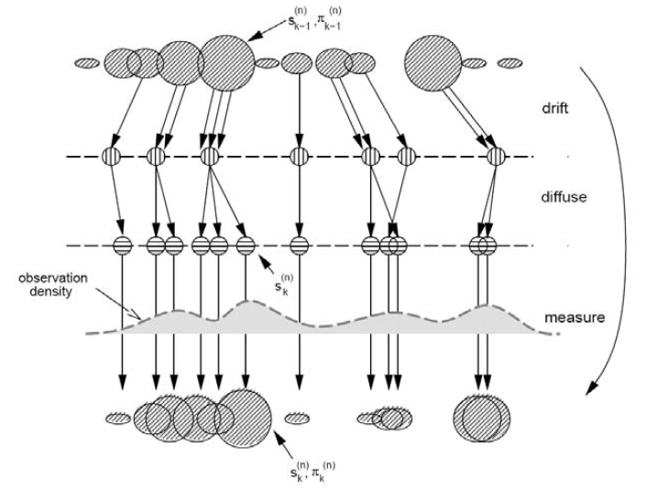
CONditional DENSity propagATION (1/2)
Notes:
使用隨機採樣，擾動和重新加權階段實現的漂移擴散測量週期。

Slide 24
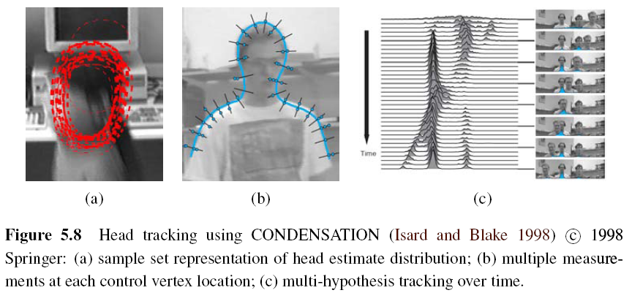
CONditional DENSity propagATION (2/2)
Notes:
圖5.8a: 顯示了頭部跟踪器的分解樣本的外觀，為每個被跟踪的粒子（子集）繪製了紅色的B樣條曲線。
圖5.8b: 顯示了為什麼測量密度本身通常是多峰的：由於背景雜亂，垂直於樣條曲線的邊緣位置可能具有多個局部最大值。
最後，圖5.8c: 顯示了隨著時間的推移，條件密度（頭和肩膀跟踪器質心的x坐標）隨時間變化的時間演變。

Slide 25
5.1.3 Scissors (1/2)
Scissors can draw a better curve (optimal curve path) that clings to high-contrast edges as the user draws a rough outline.
Semi-automatic segmentation
Algorithm:
Step 1: Associate edges that are likely to be boundary elements.
Step 2: Continuously recompute the lowest cost path between the starting point and the current mouse location using Dijkstra’s algorithm.
Notes:
Semi-automatic segmation
1.User先大致畫好輪廓，然後計算過程中會慢慢地往高對比的邊靠近
2.把邊跟 low cost 的 boundary element 連起來 (Zero crossing, gradient )
Dijkstra:單個源點到其他頂點的最短路徑問題

Slide 26
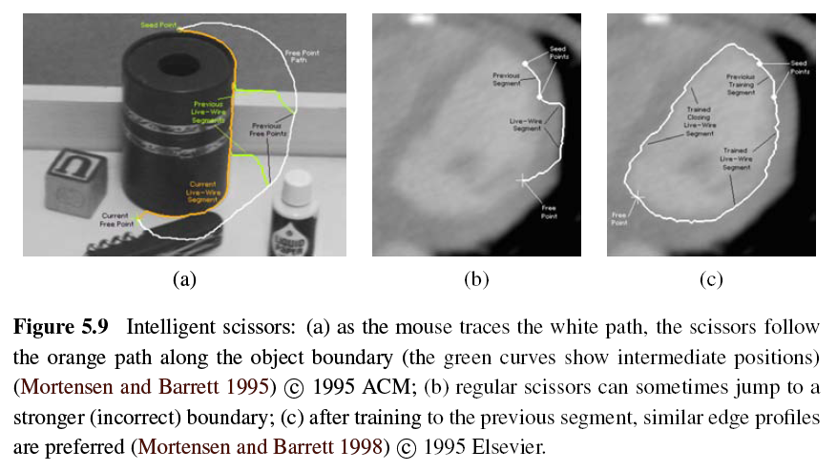
Scissors (2/2)
ACM: Association for Computing Machinery
https://www.youtube.com/watch?v=_PrfWr63feQ (1:05)
Notes:
白色:人的滑鼠
橘色:剪刀自己切出來的
As the user draws a rough outline, the system computes and draws a better curve that clings to high-contrast edges.

Slide 27
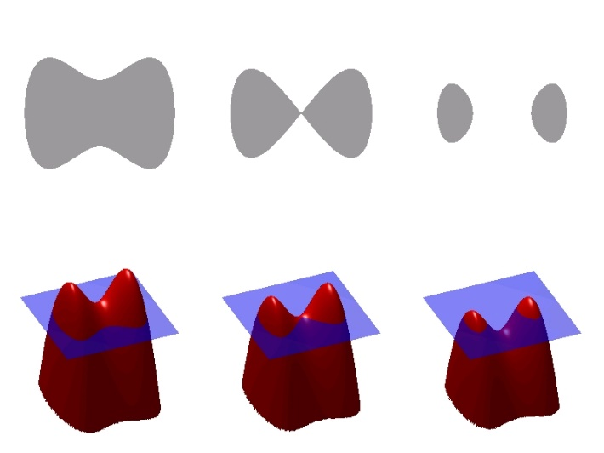
5.1.4 Level Sets (1/5)
If the active contours based on parametric curves of the form f(s), as the shape changes dramatically, curve reparameterization may also be required.
Level sets use 2D embedding function $φ$(x, y) instead of the curve f(s).
https://www.youtube.com/watch?v=YhqhuhfEPWQ
Notes:
Level Set方法把低维的一些计算上升到更高一维，把N维的描述看成是N＋1维的一个水平
第一，低维时的拓扑变化在高维中不再是一个难题；第二，低维需要不时的重新参数化，高维中不需要；第三，高维的计算更精确，更鲁棒；第四，Level Set方法可以非常容易的向更高维推广

Slide 28
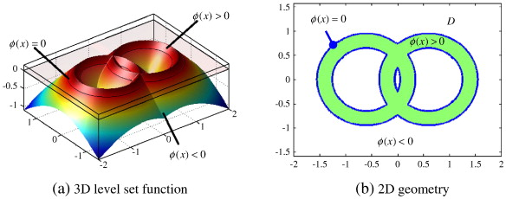
Level Sets (5/5)

Slide 29
Level Sets (3/5)
An example is the geodesic active contour:
$g(I)$: snake edge potential (gradient)
$φ$: signed distance function away from the curve
Notes:
geodesic :大地測量學，測地線
第一項:拉長曲線 第二項:把曲線導向低一點的方

Slide 30
Level Sets (4/5)
According to g(I), the first term can straighten the curve and the second term encourages the curve to migrate towards minima of g(I).
Level-set is still susceptible to local minima.
An alternative approach is to use the energy measurement inside and outside the segmented regions.
Notes:
1.第一項:拉長曲線 第二項:把曲線導向低一點的方
2.雖然很容易去改變它的拓樸形狀，但是容易受到局部極小
3.另所以另外一個方法 測量能量的差別(如顏色 紋路…等)

Slide 31
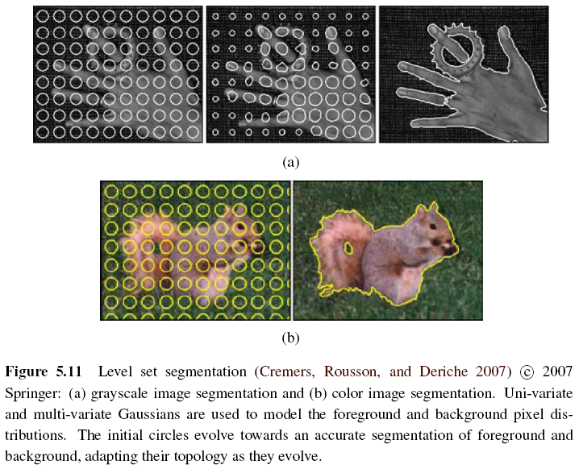
Level Sets (5/5)
Notes:
圓圈會慢慢演化成精確的segmentation的結果

Slide 32
5.2 Split and Merge
Watershed
Region splitting and merging
Graph-based Segmentation
k-means clustering
Mean Shift
Notes:
分裂合併法
最簡單的方法->直接使用threshold，但是往往資訊都不會夠

Slide 33
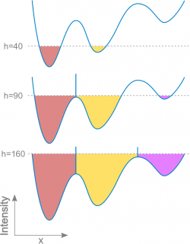
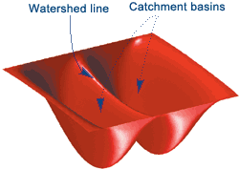
5.2.1 Watershed (1/2)
An efficient way to compute such regions is to start flooding the landscape at all of the local minima and to label ridges wherever differently evolving components meet.
Watershed segmentation is often used with the user manual marks corresponding to the centers of different desired components.
Notes:
Threshold(因為她是對一個grayscale的圖做運算)
把圖想像成3D的，比較低的地方就是盆地
想像開始下雨，從盆地開始滿上來，然後兩個不同的component相遇的時候把他標記成山脊
Watershed segmentation:通常是user會去mark出感興趣的元件的中心

Slide 34
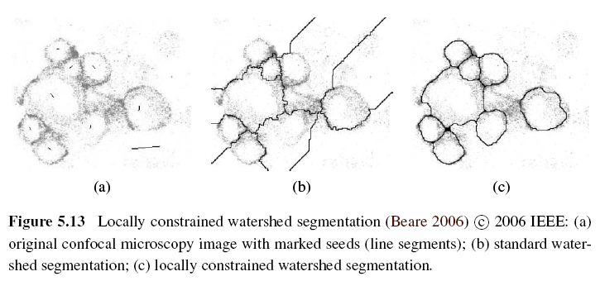
Watershed (2/2)
https://www.youtube.com/watch?v=Ya0jcjEylqQ
Notes:
聚焦顯微鏡
可能會造成over segmentation

Slide 35
5.2.2 Region Splitting (Divisive Clustering)
Step 1: Computes a histogram for the whole image.
Step 2: Finds a threshold that best separates the large peaks in the histogram.
Step 3: Repeated until regions are either fairly uniform or below a certain size.
Notes:
利用一些圖像的特性去做簡單的分群
如灰階特徵，或是紋路特徵等等

Slide 36
5.2.3 Region Merging (Agglomerative Clustering)
The various criterions of merging regions:
Relative boundary lengths and the strength of the visible edges at these boundaries
Distance between closest points and farthest points
Average color difference or whose regions are too small
Notes:
1兩個region之間的相對邊界長度 或是 強度
2兩個region 最近點跟最遠2點
3相鄰顏色的區域平均 < threshold 太小

Slide 37
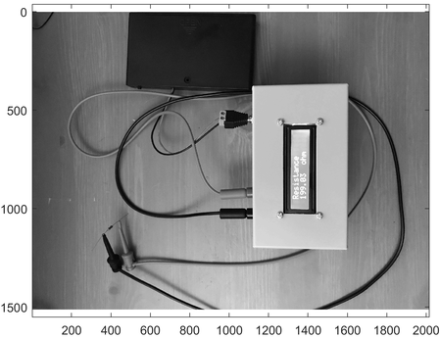
Region Splitting + Region Merging

Slide 38
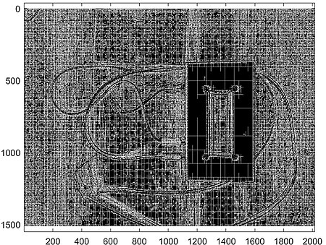
Region Splitting + Region Merging

Slide 39
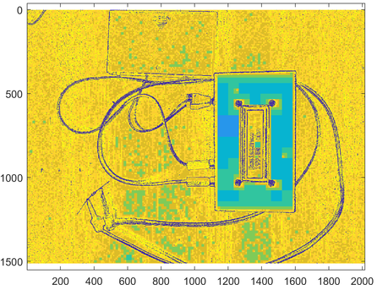
Region Splitting + Region Merging

Slide 40
5.2.4 Graph-based Segmentation (1/3)
This algorithm uses relative dissimilarities between regions to determine which ones should be merged.
Internal difference for any region R:
MST(R): Minimum Spanning Tree of R
$ω(e)$: Intensity differences of an edge in MST(R)
Notes:
Felzenszwalb and Huttenlocher (2004b)
w(e) that measures, for example, intensity differences between N8 neighbors.

Slide 41
Graph-based Segmentation (2/3)
Difference between two adjacent regions:
Minimum internal difference of these two regions:
τ(R): heuristic region penalty
Notes:
兩個相鄰區域之間的差異
兩個區域假設merge再一起之間的最小差異

Slide 42
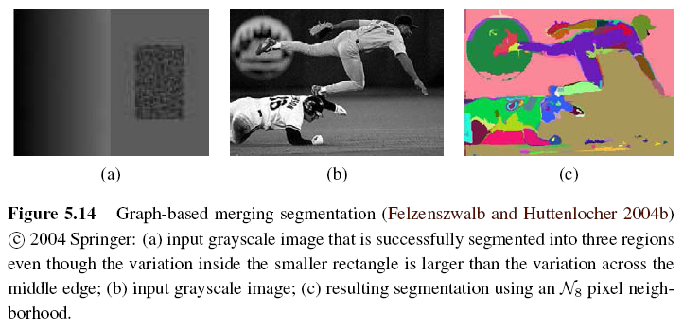
Graph-based Segmentation (3/3)
If Dif(R1, R2) < Mint(R1, R2) then merge these two adjacent regions.
https://www.youtube.com/watch?v=iistwGmX0vA
Notes:
正方形裡面的變化比 中間那條亮的線還來的大 ，但是我們還是可以自動segment成三塊區域
因為看同一個region的相異性的話 中間那條可以被切出來

Slide 43
5.2.5 Probabilistic Aggregation (1/3)
Gray level similarity:
Minimal external difference between R_{i} and R_{j}:
∆_{i}⁺ = min_{k}| ∆_{ik}| and ∆_{ik} is the difference in average intensities between regions R_{i} and R_{k}
Average intensity difference:
∆_{i}⁻ = Σ_{k}(τ_{ik} ∆_{ik}) / Σ_{k}(τ_{ik}) and τ_{ik} is the boundary length between regions R_{i} and R_{k}
Notes:
機率聚合
Gray level similarity
Texture similarity

Slide 44
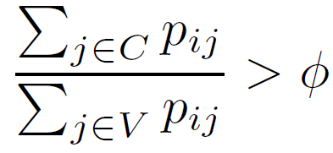
Probabilistic Aggregation (2/3)
Texture similarity:
The pairwise statistics σ_{local}⁺ and σ_{local}⁻ are used to compute the likelihoods p_{ij} that two regions should be merged.
Definition of strong coupling:
C: a subset of V
φ: usually set to 0.2

Slide 45
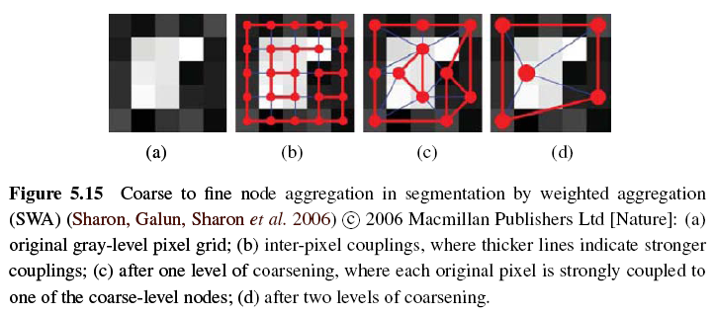
Probabilistic Aggregation (3/3)

Slide 46
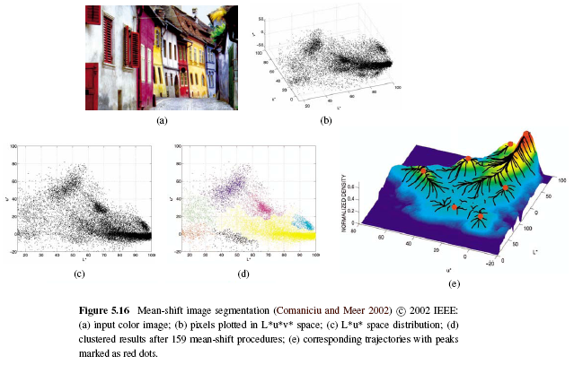
5.3 Mean Shift and Mode Finding
https://www.youtube.com/watch?v=DEtx_R1NzPY
Notes:
L:亮度
UV:色度

Slide 47
5.3.1 K-means and Mixtures of Gaussians (1/4)
K-means:
Def:
The k-means and mixtures of Gaussians techniques assume the density is the superposition of a small number of simpler distributions (e.g., Gaussians) whose locations (centers) and shape (covariance) can be estimated.
https://towardsdatascience.com/gaussian-mixture-models-d13a5e915c8e
https://medium.com/clustering-with-gaussian-mixture-model
Notes:
K-means: http://neural.cs.nthu.edu.tw/jang/books/dcpr/kMeans.asp?title=3-3+K-means+%E5%88%86%E7%BE%A4%E6%B3%95

Slide 48
K-means and Mixtures of Gaussians (2/4)
Steps:
Give the number of clusters k it is supposed to find.
Then choose k samples as the centers of clusters. We call the set of centers Y.
2. Use fixed Y to compute the square error for all pixels, then we can get the clusters U which has least square error E_{min}.
Use fixed Y and U to compute the square error E_{min}’.
If E_{min} = E_{min}’ then stop and we get the final clusters.
If E_{min} ≠ E_{min}’ then use U to find new cluster centers
Y’. Go to Step 2 and find new cluster U’, iteratively.
https://www.youtube.com/watch?v=_aWzGGNrcic 4:30
Notes:
把每個component想成一個gaussian，而一張圖上面有很多不同的gaussian去疊加而成
分群演算法，必須事前設定群集的數量 k，然後找尋下列公式的極大值，以達到分群的最佳化之目的。
1.隨機指派群集的中心(隨機找到K個point當作初始群集的中心)
2.產生初始群集(計算其他點離這k個point中誰比較近，然後就會assign到那個群集)
3.產生新的質量中心(重新計算此群體的新的質量中心，並取代剛剛的隨機point當作該群的中心)
4.變動群集邊界(指定完之後，再重新比較每個point跟群集之間的距離，然後再根據距離重新assign依次群集

Slide 49
K-means and Mixtures of Gaussians (3/4)
Find k clusters
Randomly choose k cluster flags
2. Classify each node via min distance to each flag

Slide 50
K-means and Mixtures of Gaussians (4/4)
Find k clusters
3. Reset each flag as the mean of cluster
4. Repeat 2~4 until it can’t move any more.

Slide 51
5.3.2 Mean Shift (1/8)
Mean shift segmentation is the inverse of the watershed algorithm => find the peaks (modes) and then expand the region.
https://www.youtube.com/watch?v=TMPEujQrY70 1:00
Notes:
找到peak之後，去identify那些region可以爬到這個peak，就是同一個component

Slide 52
Intuitive Description
Region of
interest
Center of
mass
Mean Shift
vector
Objective : Find the densest region
Distribution of identical billiard balls

Slide 53
Intuitive Description
Region of
interest
Center of
mass
Mean Shift
vector
Objective : Find the densest region
Distribution of identical billiard balls

Slide 54
Intuitive Description
Region of
interest
Center of
mass
Mean Shift
vector
Objective : Find the densest region
Distribution of identical billiard balls

Slide 55
Intuitive Description
Region of
interest
Center of
mass
Mean Shift
vector
Objective : Find the densest region
Distribution of identical billiard balls

Slide 56
Intuitive Description
Region of
interest
Center of
mass
Mean Shift
vector
Objective : Find the densest region
Distribution of identical billiard balls

Slide 57
Intuitive Description
Region of
interest
Center of
mass
Mean Shift
vector
Objective : Find the densest region
Distribution of identical billiard balls

Slide 58
Intuitive Description
Region of
interest
Center of
mass
Objective : Find the densest region
Distribution of identical billiard balls

Slide 59
Mean Shift (2/8)
Step 1: Use kernel density estimation to estimate the density function given a sparse set of samples.
f(x): density function
x_{i}: input samples
k(r): kernel function or Parzen window
h: width of kernel
Notes:
最簡單的方式就是假設kernel的大小是固定的下去尋找

Slide 60
Mean Shift (3/8)
Step 2: Starting at some guess for a local maximum y_{k}, mean shift computes the gradient of the density estimate f(x) at y_{k} and takes an uphill step in that direction.
Notes:
Delta fx: local maxima的高度
Mx:有點類似算梯度變化，然後得到mean shift向量
http://nccuir.lib.nccu.edu.tw/bitstream/140.119/32716/10/53002210.pdf

Slide 61
Mean Shift (4/8)
The location of y_{k} iteration can be expressed in the following formula:
Repeat Step 2 until completely converge or after finite steps.
Step 3: The remaining points can then be classified based on the nearest evolution path.
Notes:
找到梯度變化接近為零處

Slide 62
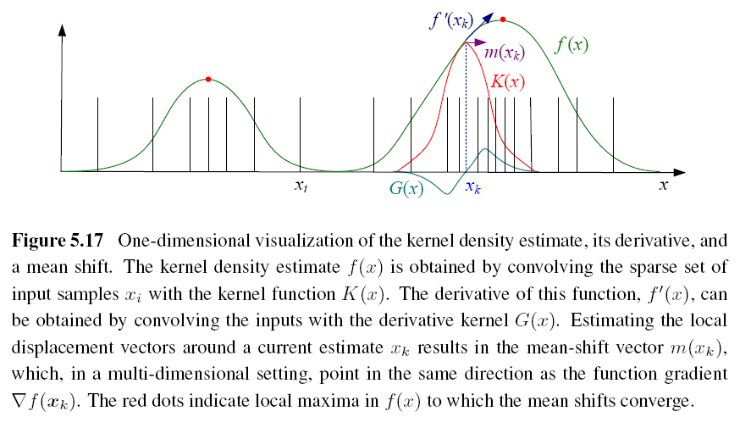
Mean Shift (5/8)

Slide 63
Mean Shift (6/8)
There are still some kernels to be used:
Epanechnikov kernel (converge in finite steps)
Gaussian (normal) kernel (slower but result better)
Notes:
這兩個是常用的 Kernel
1. 在有限的步數收斂

Slide 64
Mean Shift (7/8)
Joint domain: use spatial domain and range domain to segment color image.
Kernel of joint domain (five-dimensional):
x_{r}: (L*, u*, v*) in range domain
x_{s}: (x, y) in spatial domain
h_{r}, h_{s}: color and spatial widths of kernel
Notes:
前面討論到的是color based去設計的kernel，可能會有一些isolate的pixel會沒有對應到
Color and location
Hr hs去control空間跟顏色對kernel的影響力

Slide 65
Example

Slide 66
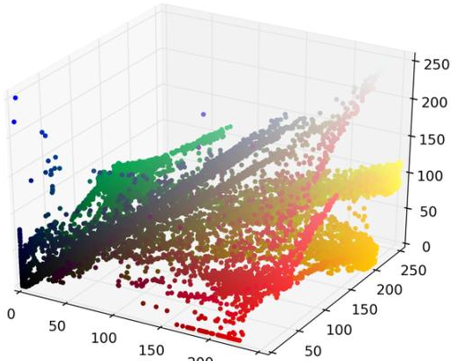
Example

Slide 67
Example

Slide 68
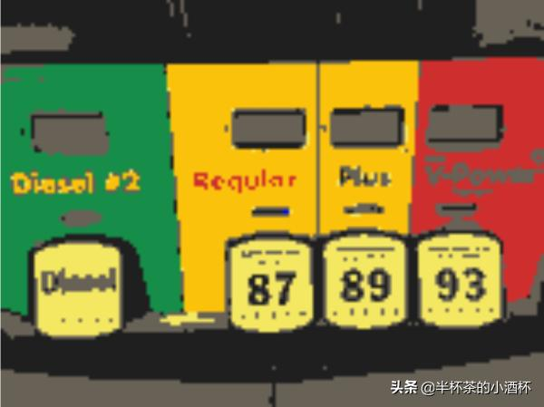
Example

Slide 69
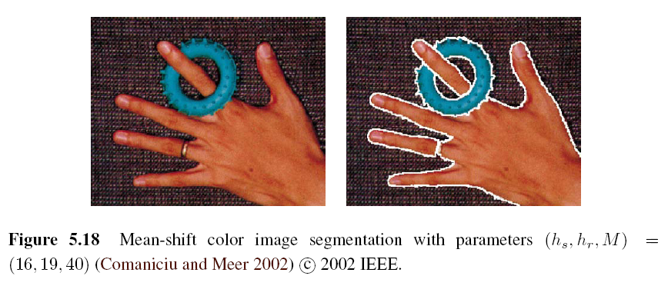
Mean Shift (8/8)
M: a region has pixels under the number threshold will be eliminated
Notes:
這張圖是課本的範例

Slide 70
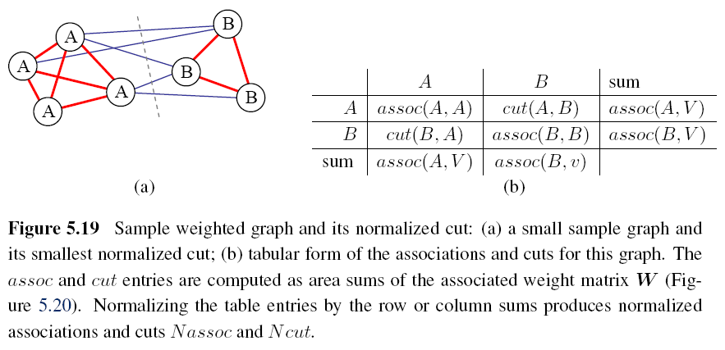
5.4 Normalized Cuts (1/9)
Normalized cuts examine the affinities between nearby pixels and try to separate groups that are connected by weak affinities.
Minimum Cuts: https://www.youtube.com/watch?v=YMME2Xaqnq8
Notes:
Normalized cut 的概念是給定每個 pixel 間互相相近的程度作為區分的依據，這個問題可以對應到 minimum cut的問題
如果不知minimum cuts 的同學可以回家自己看下方附的連結

Slide 71
5.4 Normalized Cuts (2/9)
Pixel-wise affinity weight for pixels within a radius ∥x_{i} - x_{j}∥ < r :
F_{i}, F_{j}: feature vectors that consist of intensities, colors, or oriented filter histograms
x_{i}, x_{j}: pixel locations

Slide 72
Normalized Cuts (3/9)
To find the minimum cut between two groups A and B:
A better measure of segmentation is to find minimum normalized cut:
assoc(X, Y): Σ_{i ∈ X, j ∈ Y} w_{ij}
Notes:
1.定義為 所有要被切斷的weight的sum ，但是不大好，因為這樣為了得到最小的cut，可能會有isolate的pixel
2.assoc:sum of all the weight=>等於先做過normalize

Slide 73
Normalized Cuts (4/9)

Slide 74
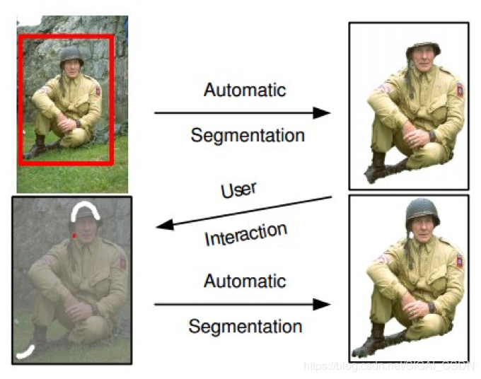

Slide 75
Normalized Cuts (5/9)
But computing the optimal normalized cut is NP-complete. The following is a faster method.
Minimize the Rayleigh quotient:
W: weight matrix [w_{ij}], which is an adjacency matrix
D: diagonal matrix, diagonal entries are the number of corresponding row sums in W
Notes:
可以把問題轉換成哀跟value problem

Slide 76
Normalized Cuts (6/9)
y = ((1 + x) - b(1 - x)) / 2 is a vector consisting of all 1s and -bs such that y‧d = 0.
x is the indicator vector where xi = +1 iff i ∈ A and xi = -1 iff i ∈ B.
It is equivalent to solving a regular eigenvalue problem:
N = D^{-1/2}WD^{-1/2} and N is called normalized affinity matrix.

Slide 77
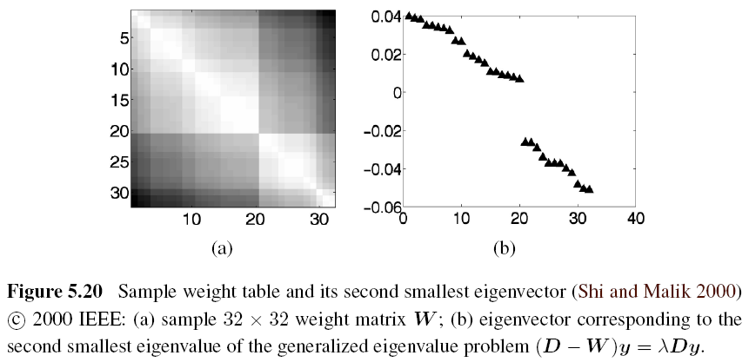
Normalized Cuts (7/9)

Slide 78
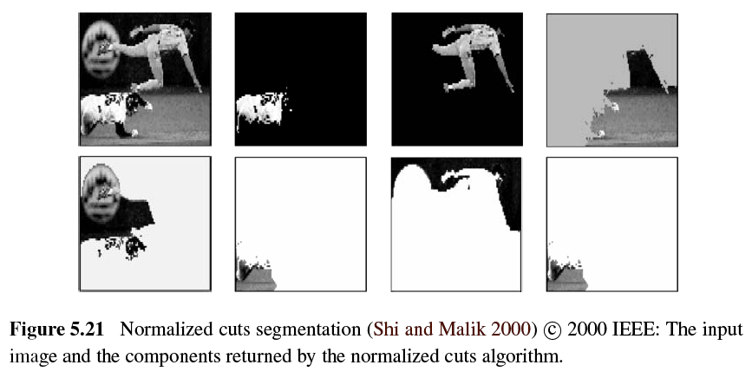
Normalized Cuts (8/9)

Slide 79
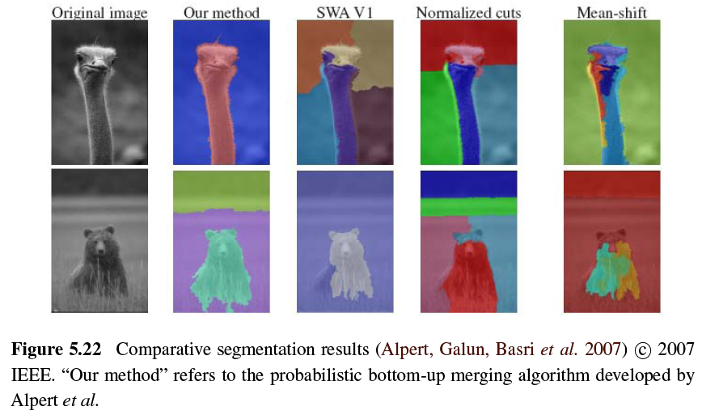
Normalized Cuts (9/9)

Slide 80
5.5 Graph Cuts and Energy-based Methods (1/5)
Energy corresponding to a segmentation problem:
Region term:
Region statistics can be mean gray level or color:
Boundary term:
https://www.youtube.com/watch?v=HMGX8HXskKk&t=282s 1:00
Notes:
圖上的每個pixel想成node，node跟其他相鄰的node之間有相鄰的邊
邊上面的weight就是energy
energy又分為兩項，region term跟 boundry term
region term:這個pixel分配為某個label的懲罰，label又分為前景跟背景，所以可以透過跟給定的目標以及前景的histogram來比較獲得，換句話說就是這個像素屬於某個特定label的機率，但是因為我們希望像素p如果被標記成機率最大的label的時候能量是最小，所以一般取機率的負對數值
boundary term:如果p跟q這兩個pixel是相鄰的像素，那energy就可以當成p跟q之間不連續的懲罰，一般來說p跟q如果越像的話(比如說他們的灰度)那麼這個energy term就會越大，越不向的話就會趨近於零

Slide 81
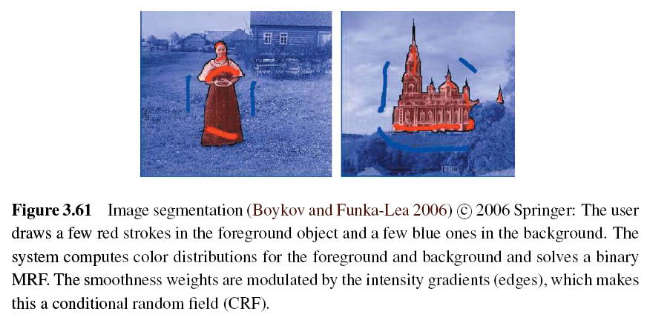
Graph Cuts and Energy-based Methods (2/5)
Use Binary Markov Random Field Optimization:
Notes:
紅色是前景
藍色是背景

Slide 82
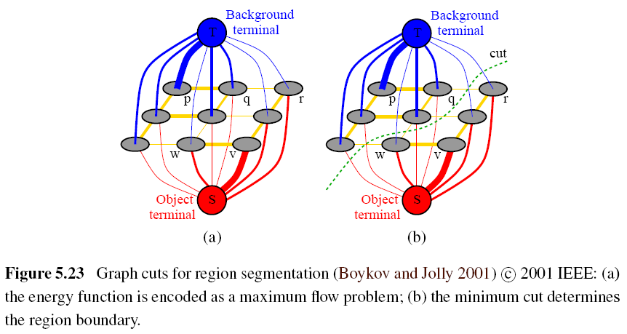
Graph Cuts and Energy-based Methods (3/5)
Notes:
也可以把此問題改成用圖來表示
node的組成就是原本圖上的pixel外，另外多兩個點，sink跟tie
s一般表示前景，t表示背景
每條邊上的weight，就是前面講的energy
普通node的是boundary term來決定，跟s跟t的是region term決定
找到一個cut可以把點分成兩個集合(不相交的集合S跟T)
minium cut就是此時這樣切時所有邊的weight總和，也等於maxium flow最大流
很明顯，發生在目標和背景邊界處的cut就是我們想要的
最大流/最小割
http://wenku.baidu.com/view/d9c9b9220722192e4536f6e1.html
http://rritw.com/a/bianchengyuyan/C__/20130123/296053.html
http://courses.engr.illinois.edu/cs543/sp2011/lectures/Lecture%2012%20-%20MRFs%20and%20Graph%20Cut%20Segmentation%20-%20Vision_Spring2011.pdf

Slide 83
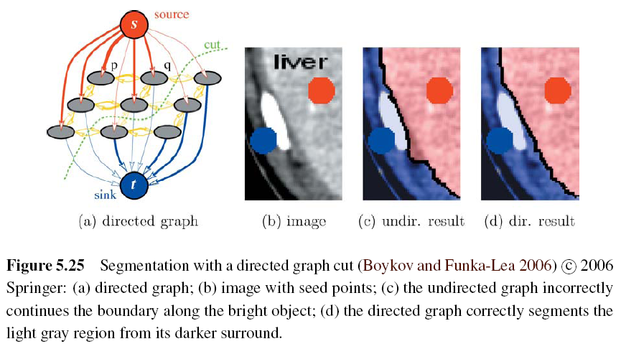
Graph Cuts and Energy-based Methods (4/5)
Notes:
原始二進制分割公式的另一個主要擴展是添加了有向邊。 此方法更喜歡從淺到暗的過渡，反之亦然。

Slide 84
Graph Cuts and Energy-based Methods (5/5)
GrabCut image segmentation:
Notes:
這允許他們的系統在給定的用戶輸入最少的情況下運行，例如單個邊界框-從框輪廓周圍的像素帶初始化背景顏色模型，並從內部像素初始化前景顏色模型。
此過程將反復進行以重新估計區域統計信息，直到獲得更好的區域統計信息為止。

