Slide 1
Advanced Computer Vision
Chapter 5
Segmentation
Presented by: 傅楸善 & 許承偉
r99922094@ntu.edu.tw
0928083710

Slide 2
Segmentation (1/2)
5.1 Active Contours
5.2 Split and Merge
5.3 Mean Shift and Mode Finding
5.4 Normalized Cuts
5.5 Graph Cuts and Energy-based Methods

Slide 3
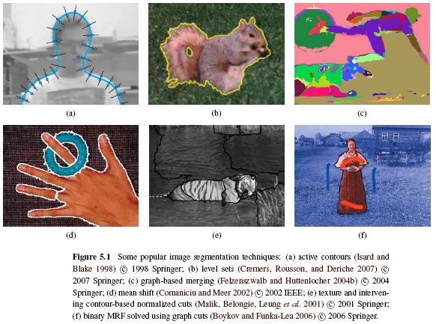
Segmentation (2/2)

Slide 4
5.1 Active Contours
Snakes
Scissors
Level Sets

Slide 5
5.1.1 Snakes (1/5)
Snakes are a two-dimensional generalization of the 1D energy-minimizing splines.
Internal spline energy:
s: arc length
f_{s}, f_{ss}: first-order and second-order derivatives of snake curve
α, β: first-order and second-order weighting functions

Slide 6
Snakes (2/5)
Discretized form of internal spline energy:
External spline energy:
Line term: attracting to dark ridges
Edge term: attracting to strong gradients
Term term: attracting to line terminations
Notes:
h is the step size, which can be neglected if we resample the curve along its arc-length after each iteration.

Slide 7
Snakes (3/5)
Energy can be estimated by gradient:
f: the curve function
i: the pixels on the curve
Notes:
the line term attracts the snake to dark ridges, the edge term attracts it to strong gradients (edges), and the term term attracts it to line terminations. In practice, most systems only use the edge term

Slide 8
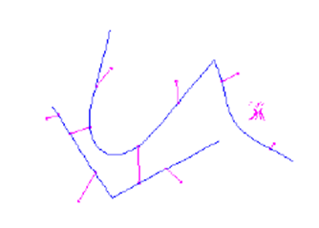
Snakes (4/5)
User-placed constraints can also be added.
f: the snake points
d: anchor points

Slide 9
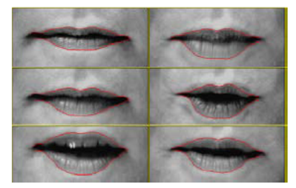
Snakes (5/5)
Because regular snakes have a tendency to shrink, it is usually better to initialize them by drawing the snake outside the object of interest to be tracked.

Slide 10
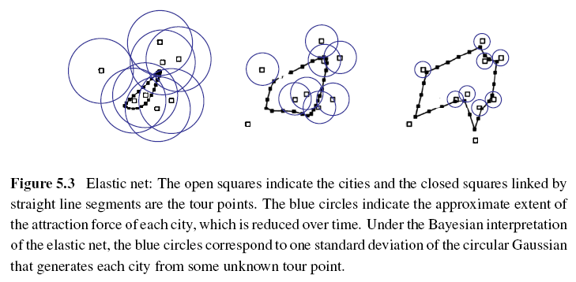
Elastic Nets and Slippery Springs (1/3)
Applying to TSP (Traveling Salesman Problem):
Notes:
Instead of having a fixed constraint between snake nodes and cities, a city is assumed to pass near some point along the tour.

Slide 11
Elastic Nets and Slippery Springs (2/3)
Probabilistic interpretation:
i: each snake node
j: each city
σ: standard deviation of the Gaussian
d_{ij}: Euclidean distance between a tour point f(i) and a city location d(j)

Slide 12
Elastic Nets and Slippery Springs (3/3)
The tour f(s) is initialized as a small circle around the mean of the city points and σ is progressively lowered.
Slippery spring: this allows the association between constraints (cities) and curve (tour) points to evolve over time.

Slide 13
B-spline Approximations
Snakes sometimes exhibit too many degrees of freedom, making it more likely that they can get trapped in local minima during their evolution.
Use B-spline approximations to control the snake with fewer degrees of freedom.

Slide 14
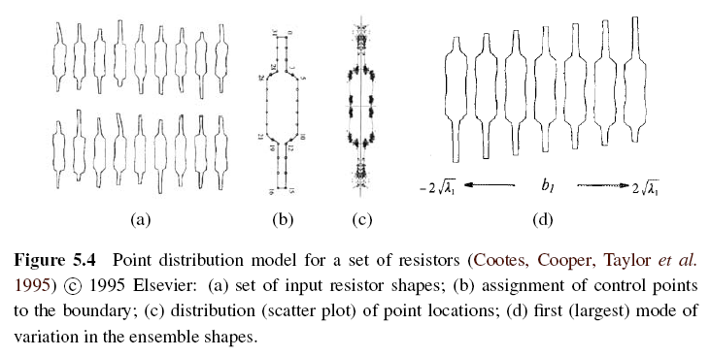
Shape Prior

Slide 15
5.1.2 Dynamic snakes and CONDENSATION
The object of interest is being tracked from frame to frame as it deforms and evolves.
Use estimates from the previous frame to predict and constrain the new estimates.

Slide 16
Kalman Filtering and Kalman Snakes (1/3)
Kalman filter uses estimates from the previous frame to predict and constrain the new estimates.
x_{t}: current state variable
x_{t-1}: previous state variable
A: linear transition matrix
w: noise vector, which is often modeled as a Gaussian
Notes:
One way to do this is to use Kalman filtering, which results in a formulation called Kalman snakes.

Slide 17
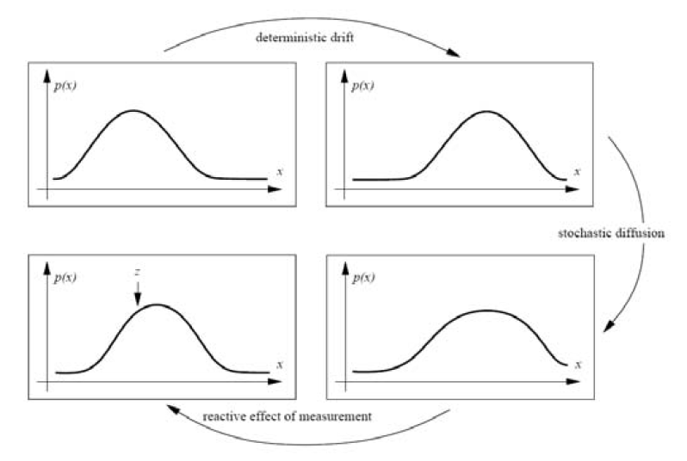
Kalman Filtering and Kalman Snakes (2/3)
Notes:
The linear dynamic model causes a deterministic change (drift) in the previous estimate, while the process noise causes a stochastic diffusion that increases the system entropy. New measurements from the current frame restore some of the certainty in the updated estimate.

Slide 18
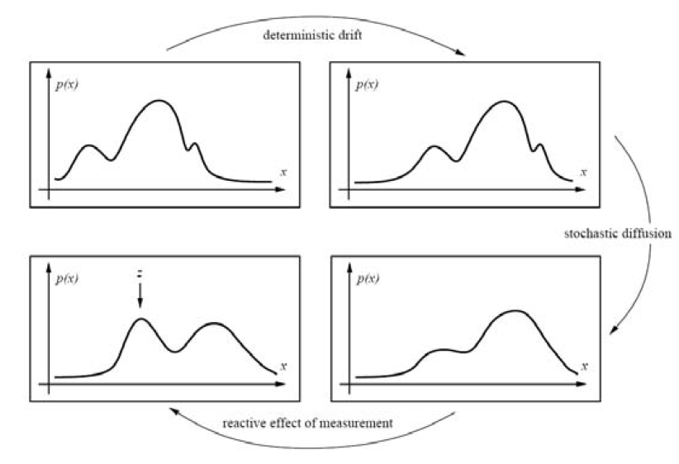
Kalman Filtering and Kalman Snakes (3/3)
Notes:
But in many situations, however, such as when tracking in clutter, some applications require more general multi-modal distributions.

Slide 19
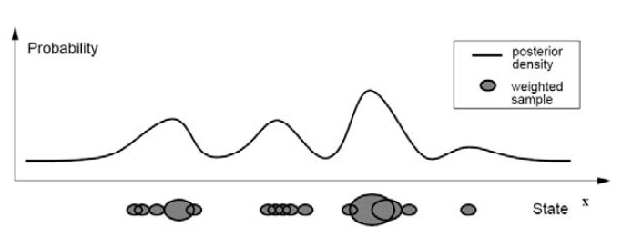
Particle Filter
Particle filtering techniques represent a probability distribution using a collection of weighted point samples.
Then use CONDENSATION to estimate.
Notes:
each density distribution is represented using a superposition of weighted particles.

Slide 20
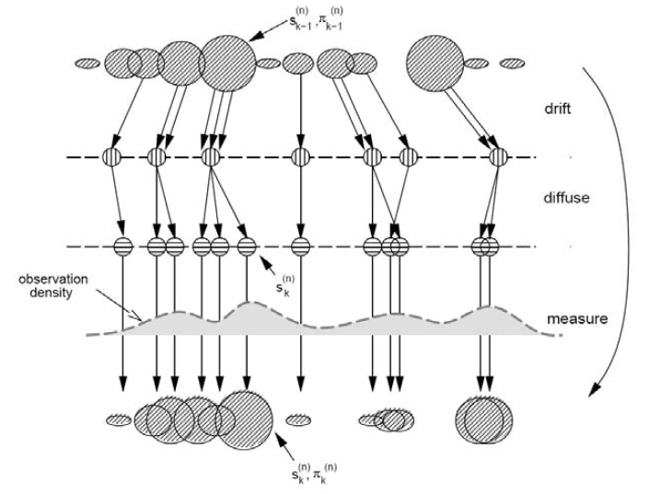
CONditional DENSity propagATION (1/2)
Notes:
the drift-diffusion-measurement cycle implemented using random sampling, perturbation, and re-weighting stages.

Slide 21
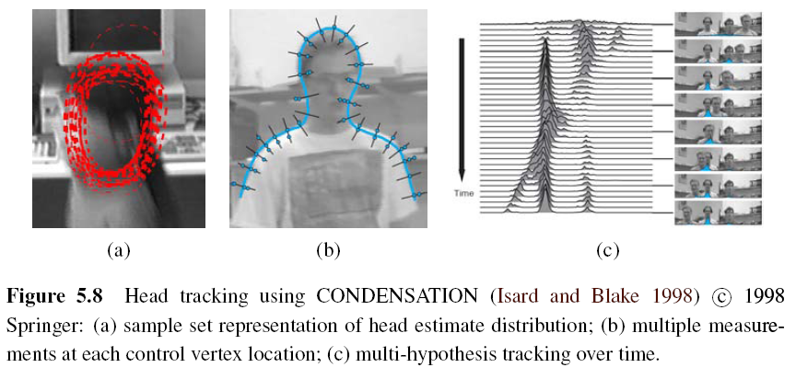
CONditional DENSity propagATION (2/2)
Notes:
Figure 5.8a shows what a factored sample of a head tracker might look like, drawing a red B-spline contour for each of (a subset of) the particles being tracked. Figure 5.8b shows why the measurement density itself is often multi-modal: the locations of the edges
perpendicular to the spline curve can have multiple local maxima due to background clutter. Finally, Figure 5.8c shows the temporal evolution of the conditional density (x coordinate of the head and shoulder tracker centroid) as it tracks several people over time.

Slide 22
5.1.3 Scissors (1/2)
Scissors can draw a better curve (optimal curve path) that clings to high-contrast edges as the user draws a rough outline.
Algorithm:
Step 1: Associate edges that are likely to be boundary elements.
Step 2: Continuously recompute the lowest cost path between the starting point and the current mouse location using Dijkstra’s algorithm.

Slide 23
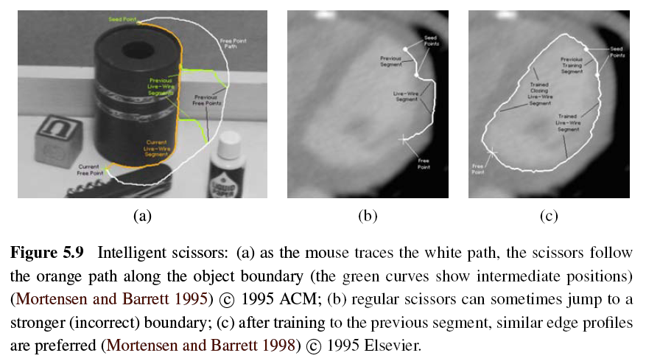
Scissors (2/2)
Notes:
As the user draws a rough outline, the system computes and draws a better curve that clings to high-contrast edges.

Slide 24
5.1.4 Level Sets (1/3)
If the active contours based on parametric curves of the form f(s), as the shape changes dramatically, curve reparameterization may also be required.
Level sets use 2D embedding function φ(x, y) instead of the curve f(s).

Slide 25
Level Sets (2/4)
An example is the geodesic active contour:
g(I): snake edge potential (gradient)
φ: signed distance function away from the curve

Slide 26
Level Sets (3/4)
According to g(I), the first term can straighten the curve and the second term encourages the curve to migrate towards minima of g(I).
Level-set is still susceptible to local minima.
An alternative approach is to use the energy measurement inside and outside the segmented regions.

Slide 27
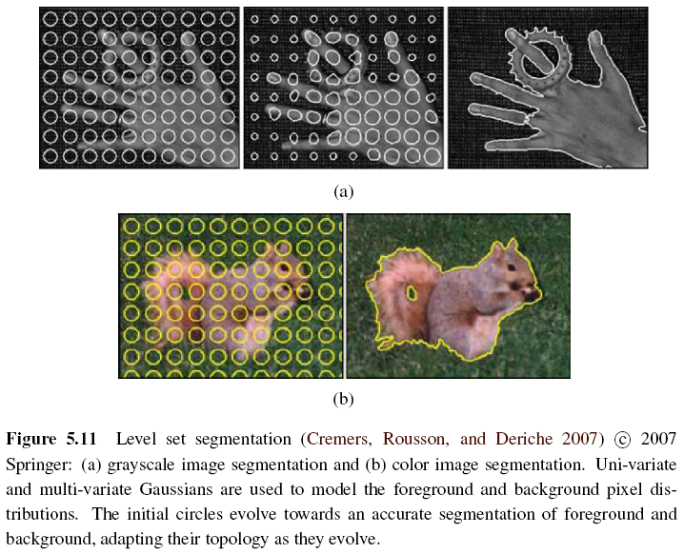
Level Sets (4/4)

Slide 28
5.2 Split and Merge
Recursively split the whole image into pieces based on region statistics.
Merge pixels and regions together in a hierarchical fashion.

Slide 29
5.2.1 Watershed (1/2)
An efficient way to compute such regions is to start flooding the landscape at all of the local minima and to label ridges wherever differently evolving components meet.
Watershed segmentation is often used with the user manual marks corresponding to the centers of different desired components.

Slide 30
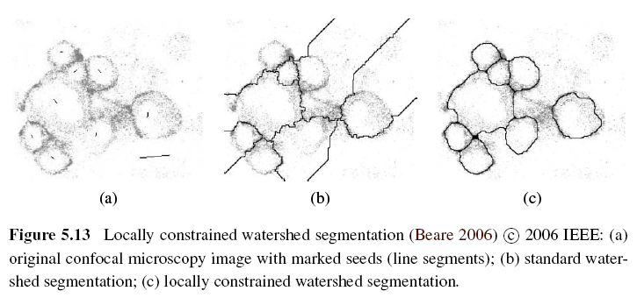
Watershed (2/2)

Slide 31
5.2.2 Region Splitting (Divisive Clustering)
Step 1: Computes a histogram for the whole image.
Step 2: Finds a threshold that best separates the large peaks in the histogram.
Step 3: Repeated until regions are either fairly uniform or below a certain size.

Slide 32
5.2.3 Region Merging (Agglomerative Clustering)
The various criterions of merging regions:
Relative boundary lengths and the strength of the visible edges at these boundaries
Distance between closest points and farthest points
Average color difference or whose regions are too small

Slide 33
5.2.4 Graph-based Segmentation (1/3)
This algorithm uses relative dissimilarities between regions to determine which ones should be merged.
Internal difference for any region R:
MST(R): minimum spanning tree of R
w(e): intensity differences of an edge in MST(R)

Slide 34
Graph-based Segmentation (2/3)
Difference between two adjacent regions:
Minimum internal difference of these two regions:
τ(R): heuristic region penalty

Slide 35
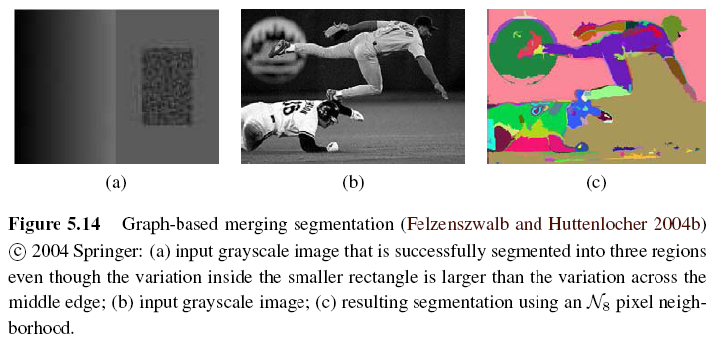
Graph-based Segmentation (3/3)
If Dif(R1, R2) < Mint(R1, R2) then merge these two adjacent regions.

Slide 36
5.2.5 Probabilistic Aggregation (1/3)
Minimal external difference between R_{i} and R_{j}:
∆_{i}⁺ = min_{k}| ∆_{ik}| and ∆_{ik} is the difference in average intensities between regions R_{i} and R_{k}
Average intensity difference:
∆_{i}⁻ = Σ_{k}(τ_{ik} ∆_{ik}) / Σ_{k}(τ_{ik}) and τ_{ik} is the boundary length between regions R_{i} and R_{k}

Slide 37
Probabilistic Aggregation (2/3)
The pairwise statistics σ_{local}⁺ and σ_{local}⁻ are used to compute the likelihoods p_{ij} that two regions should be merged.
Definition of strong coupling:
C: a subset of V
φ: usually set to 0.2

Slide 38
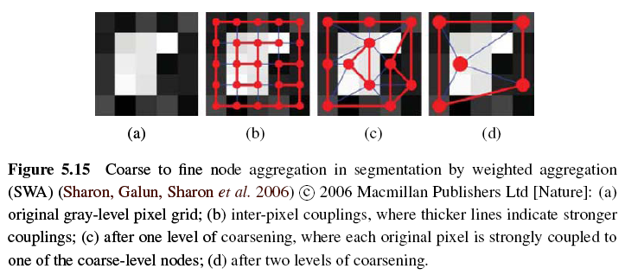
Probabilistic Aggregation (3/3)

Slide 39
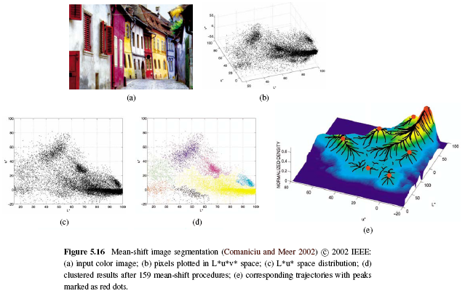
5.3 Mean Shift and Mode Finding

Slide 40
5.3.1 K-means and Mixtures of Gaussians (1/2)
K-means:
Step 1: Give the number of clusters k it is supposed to find. Then choose k samples as the centers of clusters. We call the set of centers Y.
Step 2: Use fixed Y to compute the square error for all pixels, then we can get the clusters U which has least square error E_{min}.
Notes:
K-means: http://neural.cs.nthu.edu.tw/jang/books/dcpr/kMeans.asp?title=3-3+K-means+%E5%88%86%E7%BE%A4%E6%B3%95

Slide 41
K-means and Mixtures of Gaussians (2/2)
Step 3: Use fixed Y and U to compute the square error E_{min}’. If E_{min} = E_{min}’ then stop and we get the final clusters.
Step 4: If E_{min} ≠ E_{min}’ then use U to find new cluster centers Y’. Go to Step 2 and find new cluster U’, iteratively.
Use mixtures of Gaussians to model the superposition of density distributions, and then adopt k-means to find clusters.
Notes:
K-means and Mixtures of Gaussians use a parametric model.

Slide 42
5.3.2 Mean Shift (1/8)
Mean shift segmentation is the inverse of the watershed algorithm => find the peaks (modes) and then expand the region.

Slide 43
Mean Shift (2/8)
Step 1: Use kernel density estimation to estimate the density function given a sparse set of samples.
f(x): density function
x_{i}: input samples
k(r): kernel function or Parzen window
h: width of kernel

Slide 44
Mean Shift (3/8)
Step 2: Starting at some guess for a local maximum y_{k}, mean shift computes the gradient of the density estimate f(x) at y_{k} and takes an uphill step in that direction.

Slide 45
Mean Shift (4/8)
The location of y_{k} in iteration can be express in following formula:
Repeat Step 2 until completely converge or after a finite steps.
Step 3: The remaining points can then be classified based on the nearest evolution path.

Slide 46
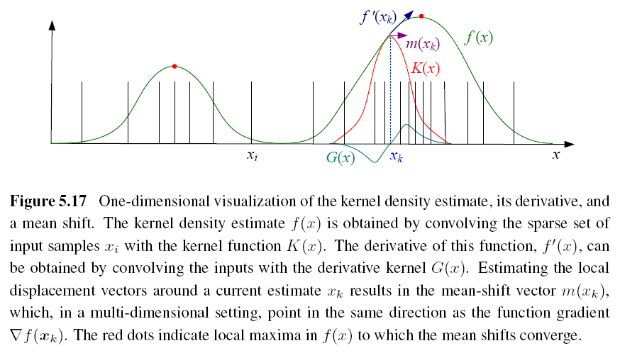
Mean Shift (5/8)

Slide 47
Mean Shift (6/8)
There are still some kernels to be used:
Epanechnikov kernel (converge in finite steps)
Gaussian (normal) kernel (slower but result better)

Slide 48
Mean Shift (7/8)
Joint domain: use spatial domain and range domain to segment color image.
Kernel of joint domain (five-dimensional):
x_{r}: (L*, u*, v*) in range domain
x_{s}: (x, y) in spatial domain
h_{r}, h_{s}: color and spatial widths of kernel

Slide 49
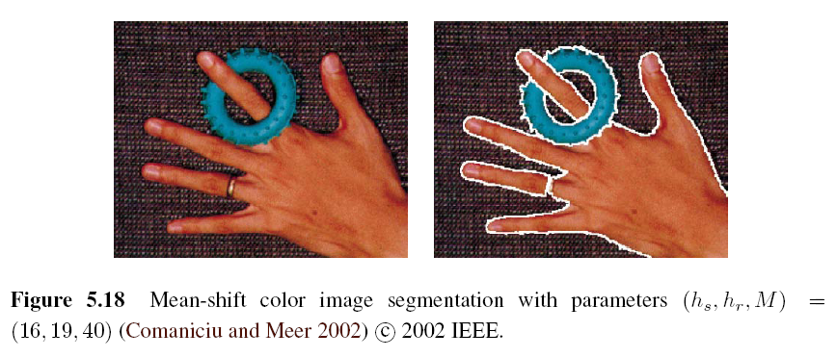
Mean Shift (8/8)
M: a region has pixels under the number threshold will be eliminated

Slide 50
Intuitive Description
Region of
interest
Center of
mass
Mean Shift
vector
Objective : Find the densest region
Distribution of identical billiard balls

Slide 51
Intuitive Description
Region of
interest
Center of
mass
Mean Shift
vector
Objective : Find the densest region
Distribution of identical billiard balls

Slide 52
Intuitive Description
Region of
interest
Center of
mass
Mean Shift
vector
Objective : Find the densest region
Distribution of identical billiard balls

Slide 53
Intuitive Description
Region of
interest
Center of
mass
Mean Shift
vector
Objective : Find the densest region
Distribution of identical billiard balls

Slide 54
Intuitive Description
Region of
interest
Center of
mass
Mean Shift
vector
Objective : Find the densest region
Distribution of identical billiard balls

Slide 55
Intuitive Description
Region of
interest
Center of
mass
Mean Shift
vector
Objective : Find the densest region
Distribution of identical billiard balls

Slide 56
Intuitive Description
Region of
interest
Center of
mass
Objective : Find the densest region
Distribution of identical billiard balls

Slide 57
5.4 Normalized Cuts (1/8)
Normalized cuts examine the affinities between nearby pixels and try to separate groups that are connected by weak affinities.
Pixel-wise affinity weight for pixels within a radius ∥x_{i} - x_{j}∥ < r :
F_{i}, F_{j}: feature vectors that consist of intensities, colors, or oriented filter histograms
x_{i}, x_{j}: pixel locations

Slide 58
Normalized Cuts (2/8)
To find the minimum cut between two groups A and B:
A better measure of segmentation is to find minimum normalized cut:
assoc(X, Y): Σ_{i ∈ X, j ∈ Y} w_{ij}

Slide 59
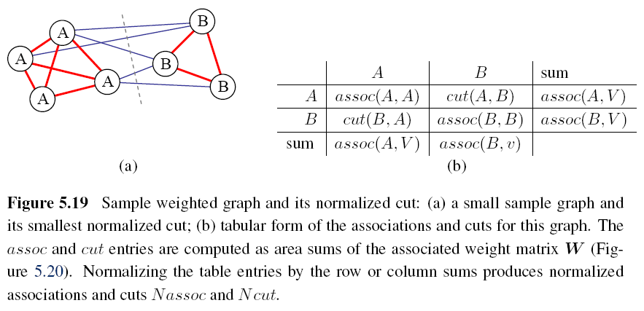
Normalized Cuts (3/8)

Slide 60
Normalized Cuts (4/8)
But computing the optimal normalized cut is NP-complete. The following is a faster method.
Minimize the Rayleigh quotient:
W: weight matrix [w_{ij}]
D: diagonal matrix, diagonal entries are the number of corresponding row sums in W

Slide 61
Normalized Cuts (5/8)
y = ((1 + x) - b(1 - x)) / 2 is a vector consisting of all 1s and -bs such that y‧d = 0.
x is the indicator vector where xi = +1 iff i ∈ A and xi = -1 iff i ∈ B.
It is equivalent to solving a regular eigenvalue problem:
N = D^{-1/2}WD^{-1/2} and N is called normalized affinity matrix.

Slide 62
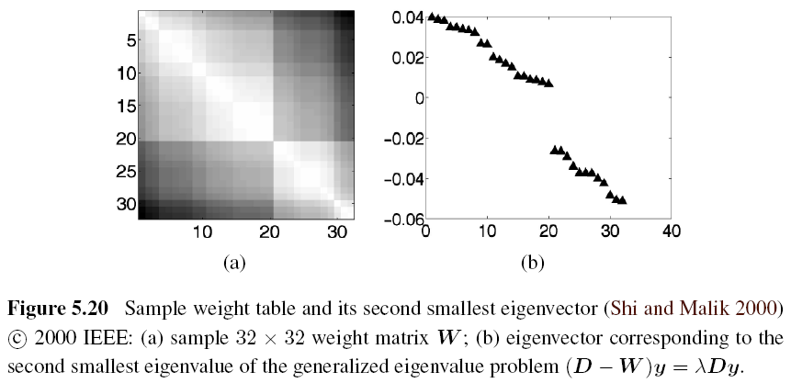
Normalized Cuts (6/8)

Slide 63
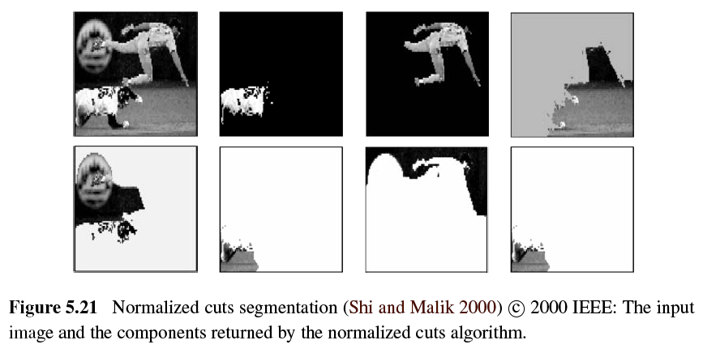
Normalized Cuts (7/8)

Slide 64
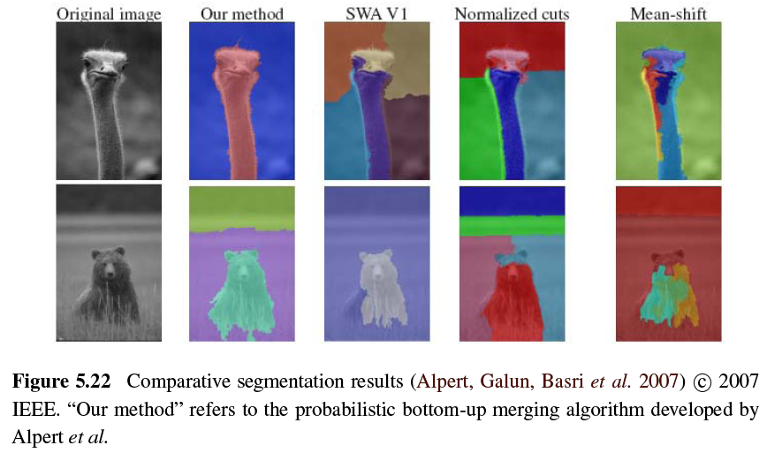
Normalized Cuts (8/8)

Slide 65
5.5 Graph Cuts and Energy-based Methods (1/5)
Energy corresponding to a segmentation problem:
Region term:
Region statistics can be mean gray level or color:
Boundary term:
Notes:
E(f): the total energy used in segmentation
E_{r}(): represent the consistency of images or regions
E_{s}(): used to measure the consistency of images or regions
E_{b}(): represent the N₄ boundary inconsistency and used to compute the inconsistency

Slide 66
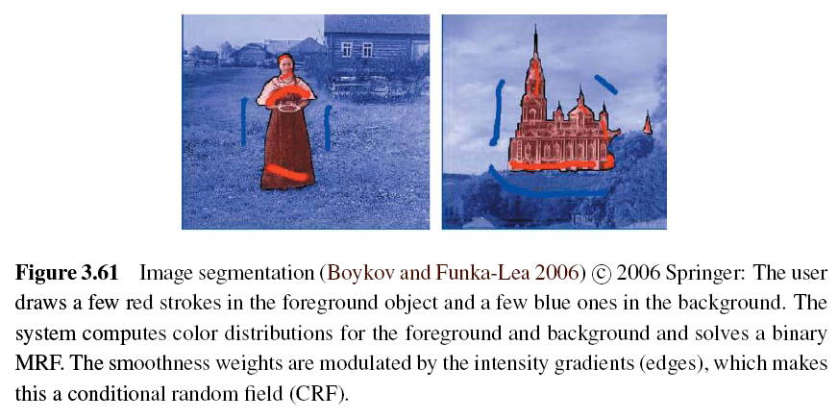
Graph Cuts and Energy-based Methods (2/5)
Use Binary Markov Random Field Optimization:
Notes:
The user first delineates pixels in the background and foreground regions using a few strokes of an image brush (seed pixels).
Seed pixels can also be used to estimate foreground and background region statistics

Slide 67
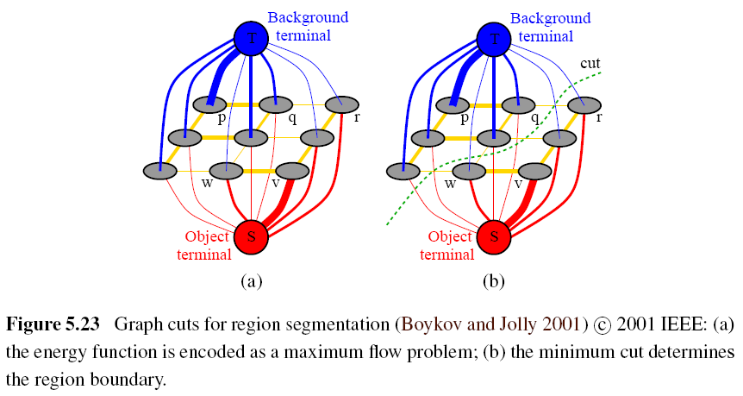
Graph Cuts and Energy-based Methods (3/5)
Notes:
pixels that are more compatible with the foreground or background region get stronger connections to the respective source or sink; adjacent pixels with greater smoothness also get stronger links.
It is turned into a minimum-cut/maximum-flow problem.

Slide 68
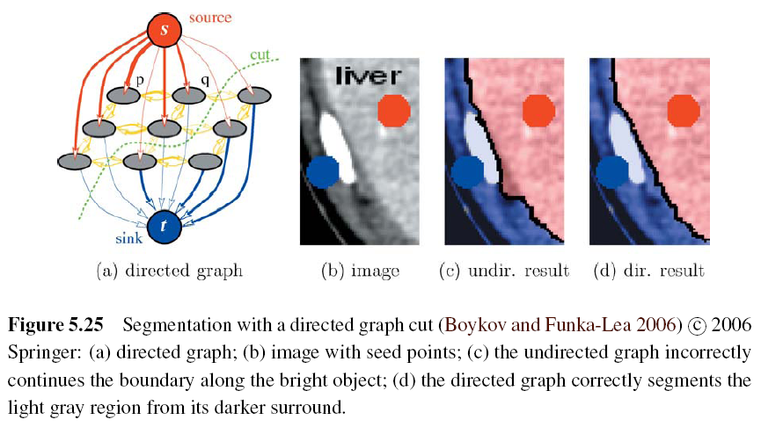
Graph Cuts and Energy-based Methods (4/5)
Notes:
Another major extension to the original binary segmentation formulation is the addition of directed edges.
This method prefers light to dark transitions or vice versa.

Slide 69
Graph Cuts and Energy-based Methods (5/5)
GrabCut image segmentation:
Notes:
This allows their system to operate given minimal user input, such as a single bounding box —the background color model is initialized from a strip of pixels around the box outline, and the foreground color model is initialized from the interior pixels.
This process runs iteratively to re-estimates the region statistics until resulting better region statistics.

