Slide 1
Advanced Computer Vision
Chapter 4
Feature Detection and Matching
Presented by: 傅楸善 & 董子嘉
D04944016@ntu.edu.tw
0925708818

Slide 2
Feature Detection and Matching (1/3)
4.1 Points and Patches
4.2 Edges
4.3 Lines

Slide 3
Feature Detection and Matching (2/3)

Slide 4
Feature Detection and Matching (3/3)

Slide 5
4.1 Points and Patches (1/2)
There are two main approaches:
Find features in one image that can be accurately tracked using a local search technique. (e.g., video sequences)
Independently detect features in all the images under consideration and then match features based on their local appearance. (e.g., stitching panoramas, establishing correspondences)

Slide 6
Points and Patches (2/2)
Three stages:
Feature detection (extraction) stage
Feature description stage
Feature matching stage or Feature Tracking stage

Slide 7
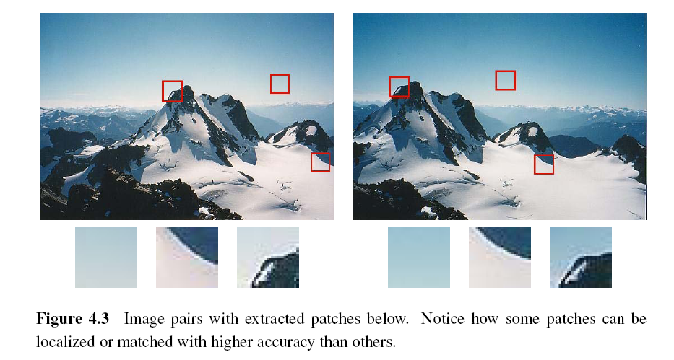
4.1.1 Feature Detectors

Slide 8
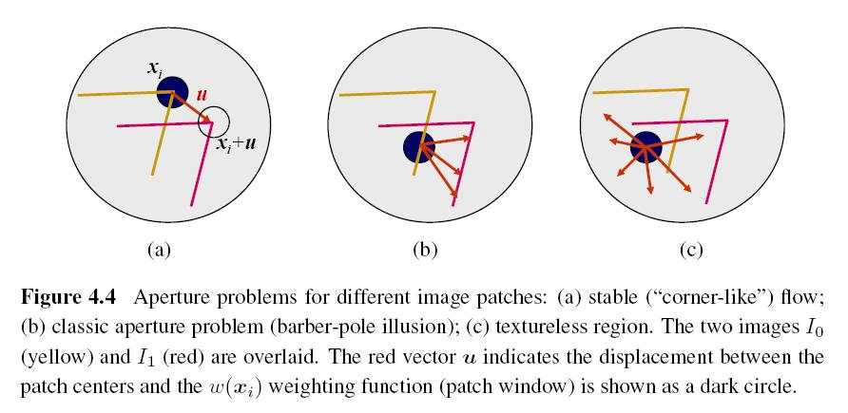
Aperture Problem

Slide 9
Weighted Summed Square Difference
I₀, I₁: the two images being compared
u: the displacement vector
w(x): spatially varying weighting function
summation i: over all the pixels in the patch

Slide 10
Auto-correlation Function or Surface
I₀: the image being compared
∆u: small variations in position
w(x): spatially varying weighting function
summation i: over all the pixels in the patch

Slide 12
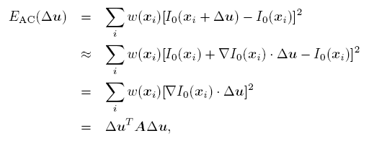
Approximation of Auto-correlation Function (1/3)
I₀(x_{i}+ ∆u) ≈ I₀(x_{i}) + ∇ I₀(x_{i})．∆u
∇ I₀(x_{i}): image gradient at x_{i}

Slide 13
Approximation of Auto-correlation Function (2/3)
Auto-correlation matrix A:
w: weighting kernel (from spatially varying weighting function)
I_{x}, I_{y}: horizontal and vertical derivatives of Gaussians
Schmid, C., Mohr, R., and Bauckhage, C. (2000). Evaluation of interest point detectors. International Journal of Computer Vision, 37(2):151–172.

Slide 14
Approximation of Auto-correlation Function (3/3)
Assume (λ₀, λ₁) are two eigenvalues of A and λ₀ <= λ₁.
Since the larger uncertainty depends on the smaller eigenvalue, it makes sense to find maxima in the smaller eigenvalue to locate good features to track.

Slide 15
Other Measurements (1/2)
Quantity proposed by Harris and Stephens:
α = 0.06
No square roots
It is still rotationally invariant and downweights edge-like features when λ₁ >> λ₀.

Slide 16
Other Measurements (2/2)
Quantity proposed by Brown, Szeliski, and Winder:
It can be used when λ₁ ≈ λ₀.

Slide 17
Basic Feature Detection Algorithm (1/2)
Step 1: Compute the horizontal and vertical derivatives of the image I_{x} and I_{y} by convolving the original image with derivatives of Gaussians.
Step 2: Compute the three images (I_{x}², I_{y} ², I_{x}I_{y}) corresponding to the outer products of these gradients.

Slide 18
Basic Feature Detection Algorithm (2/2)
Step 3: Convolve each of these images with a larger Gaussian (the weighting kernel).
Step 4: Compute a scalar interest measure using one of the formulas discussed above.
Step 5: Find local maxima above a certain threshold and report them as detected feature point locations.

Slide 19
Adaptive Non-maximal Suppression (ANMS) (1/2)
Simply finding local maxima -> uneven distribution of feature points
Detect features that are:
Local maxima
Response value is greater than all of its neighbors within a radius r

Slide 20
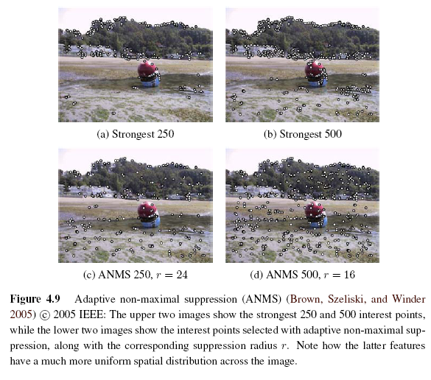
Adaptive Non-maximal Suppression (ANMS) (2/2)

Slide 21
Measuring Repeatability
Which feature points should we use among the large number of detected feature points?
Measure repeatability after applying rotations, scale changes, illumination changes, viewpoint changes, and adding noise.

Slide 22
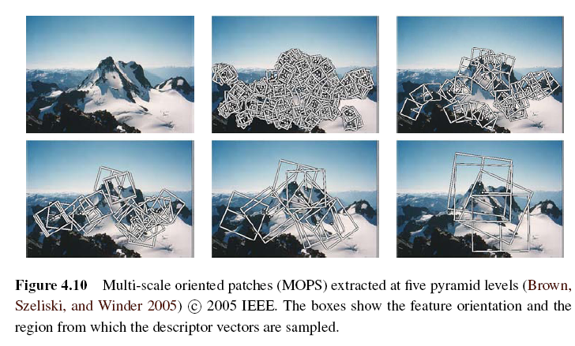
Scale Invariance (1/2)
Problem: if no good feature points in image?
Solution: multi-scale

Slide 23
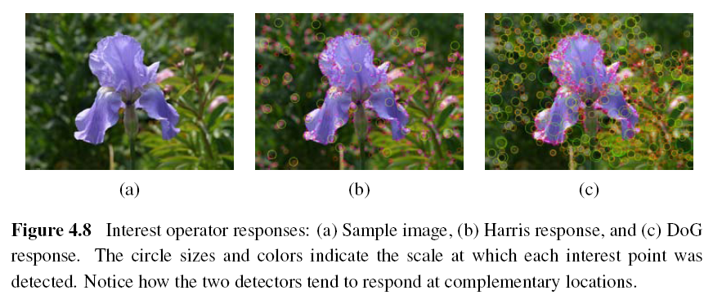
Scale Invariance (2/2)
DoG: Difference of Gaussian

Slide 24
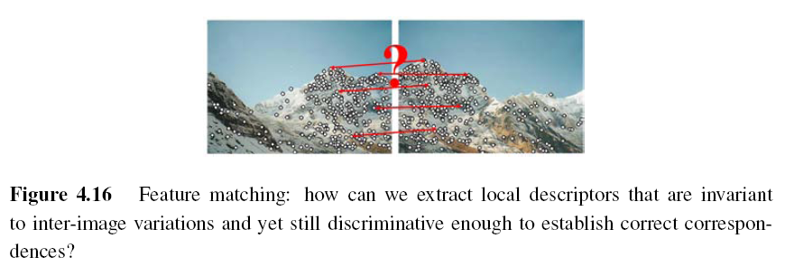
4.1.2 Feature Descriptors
Sum of squared difference
Normalized cross-correlation (Chapter 8)

Slide 25
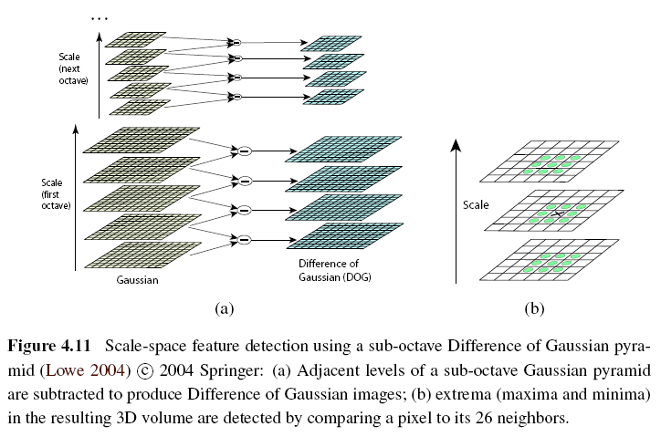
Scale Invariant Feature Transform (SIFT)

Slide 26
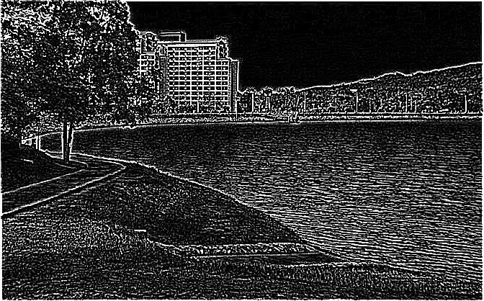
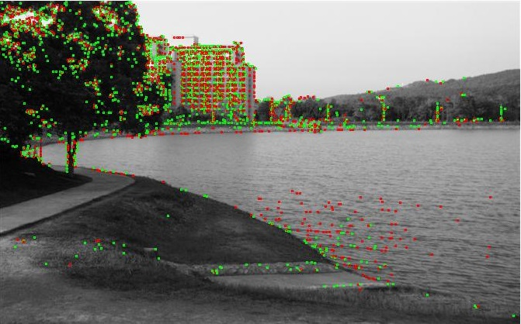
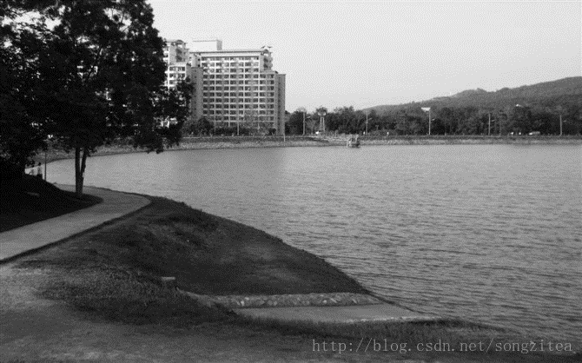

Slide 27
Multi-scale Oriented Patches (MSOP)
Simpler SIFT, without every scale DoGs
Used on image stitching, and so on
Detector: Harris corner detector
Multi-scale -> make program robust
DoG: Difference of Gaussian

Slide 28
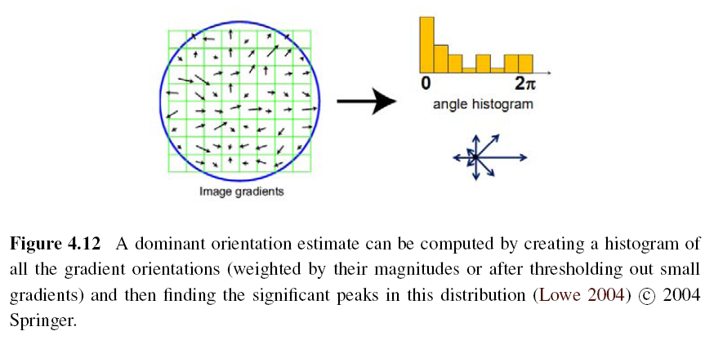
Orientation Estimation

Slide 29
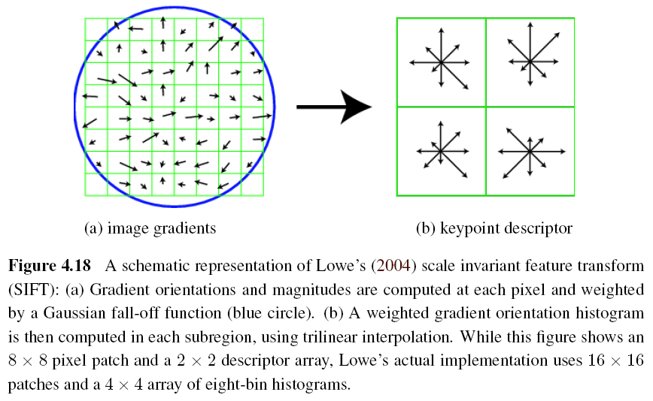
Gradient Location-orientation Histogram (GLOH)

Slide 30
Maximally Stable Extremal Region (MSER)
Only work for grayscale images
Incrementally add pixels as the threshold is changed.
Maximally stable: changing rate of area with respect to the threshold is minimal

Slide 31
4.1.3 Feature Matching
Two subjects:
select a matching strategy
devise efficient data structures and algorithms to perform this matching

Slide 32
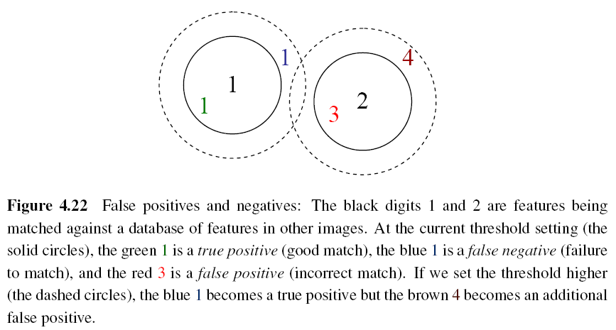
Matching Strategy (1/4)
Simplest method: set a distance threshold and match within this threshold.

Slide 33
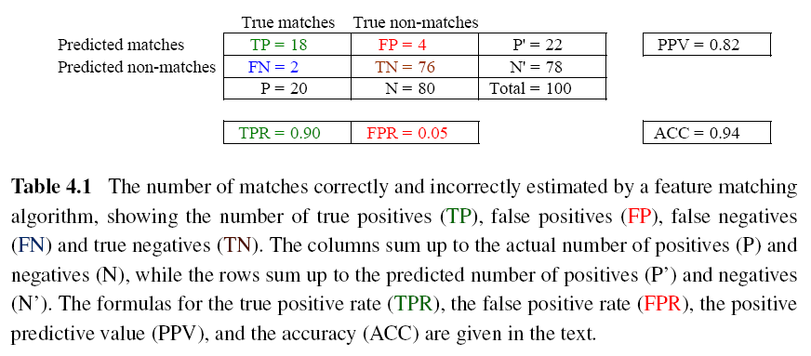
Matching Strategy (2/4)
Confusion matrix to estimate performance:

Slide 35
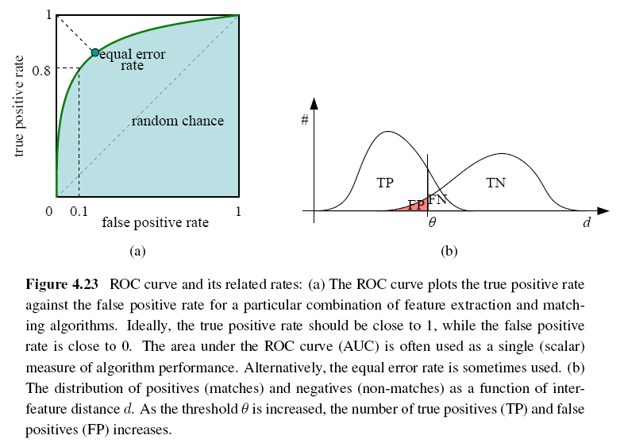
Matching Strategy (3/4)
ROC: Receiver Operating Characteristic

Slide 36
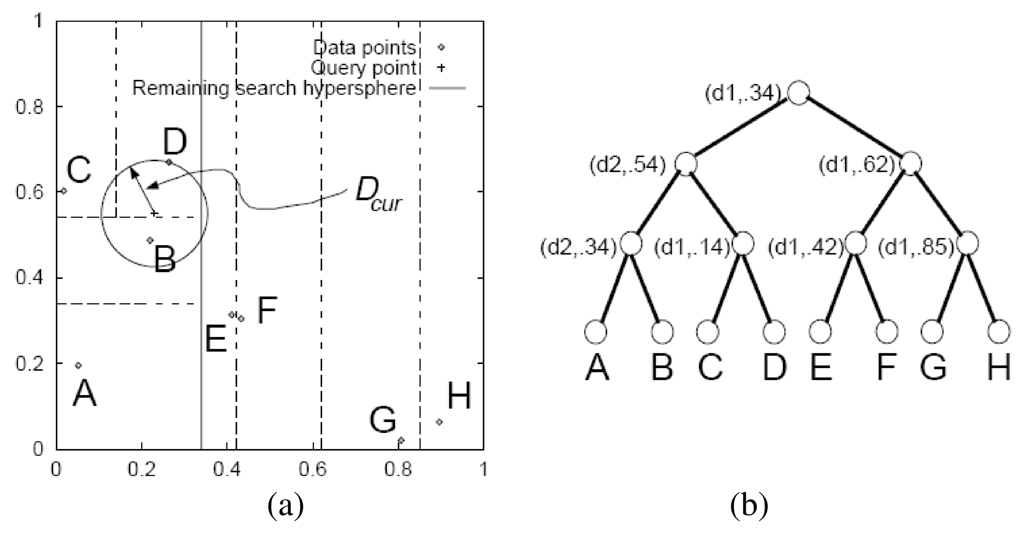
Matching Strategy (4/4)
Indexing structures:
Multi-dimensional search tree
Multi-dimensional hashing

Slide 37
4.1.4 Feature Tracking (1/3)
To find a set of likely feature locations in a first image and to then search for their corresponding locations in subsequent images.
Expected amount of motion and appearance deformation between adjacent frames is expected to be small.

Slide 38
Feature Tracking (2/3)
Selecting good features to track is closely related to selecting good features to match.
When searching corresponding patch, weighted summed square difference works well enough.

Slide 39
Feature Tracking (3/3)
If features are being tracked over longer image sequences, their appearance can undergo larger changes.
Continuously match against the originally detected feature
Re-sample each subsequent frame at the matching location
Use affine motion model to measure dissimilarity
(ex: Kanade–Lucas–Tomasi (KLT) tracker)

Slide 40
4.2 Edges (1/2)
What are edges in image:
The boundaries of objects
Occlusion events in 3D
Shadow boundaries or crease edges
Grouped into longer curves or contours

Slide 41
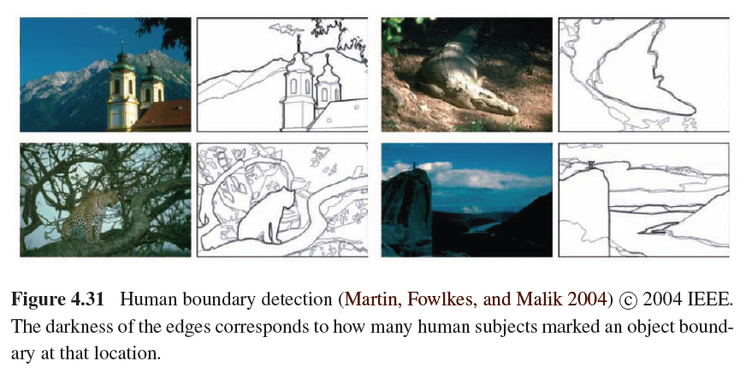
Edges (2/2)

Slide 42
4.2.1 Edge Detection (1/3)
Edge has rapid intensity variation.
J: local gradient vector
Its direction is perpendicular to the edge, and its magnitude is the intensity variation.
I: original image

Slide 43
Edge Detection (2/3)
Taking image derivatives makes noise larger.
Use Gaussian filter to remove noise:
G: Gaussian filter
σ: width of Gaussian filter

Slide 44
Edge Detection (3/3)
To thin such a continuous gradient image to only return isolated edges:
Use Laplacian of Gaussian:
S: second gradient operator
Then find the zero crossings to get the maximum of gradient.

Slide 45
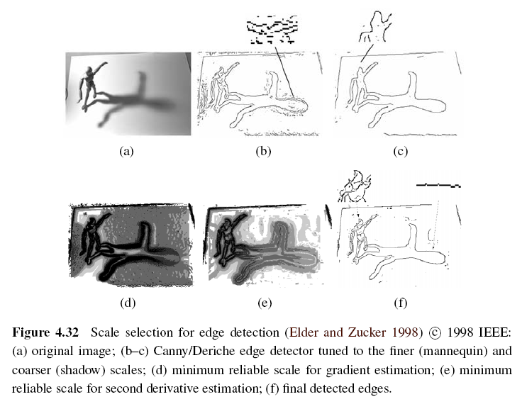
Scale Selection

Slide 46
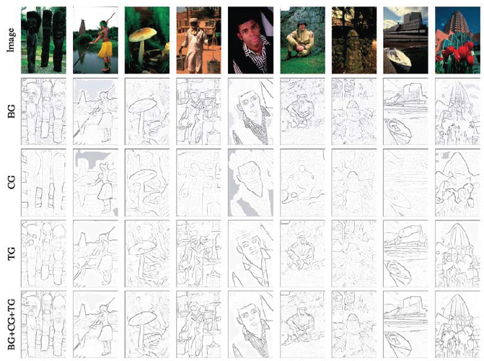
Color Edge Detection
Band separation and combination -> not good

Slide 47
4.3 Lines
Man-made world is full of straight lines, so detecting and matching these lines can be useful in a variety of applications.

Slide 48
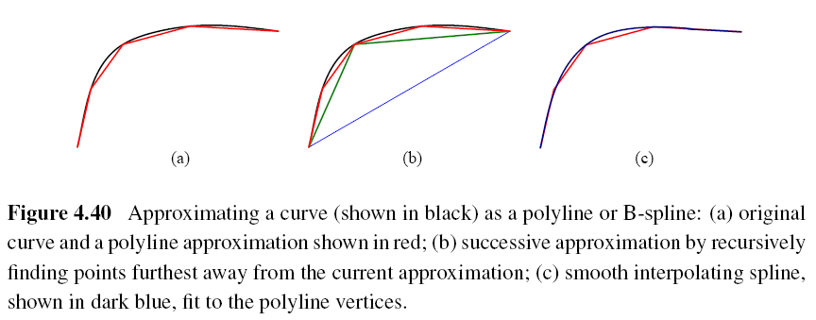
4.3.1 Successive Approximation
Line simplification:
Piecewise-linear polyline
B-spline curve

Slide 49
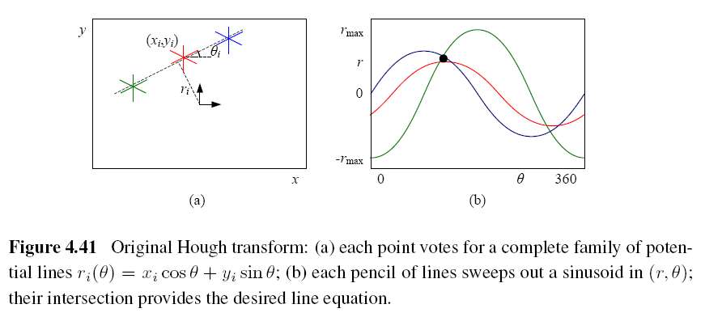
4.3.2 Hough Transforms (1/2)
Original Hough transforms:

Slide 50
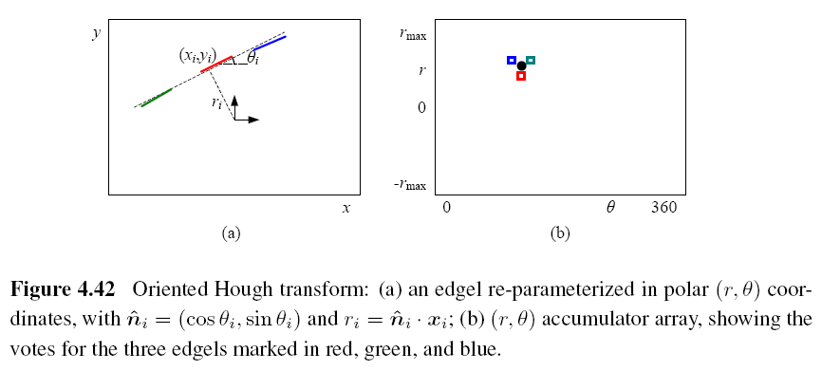
Hough Transforms (2/2)
Oriented Hough transform:

Slide 51
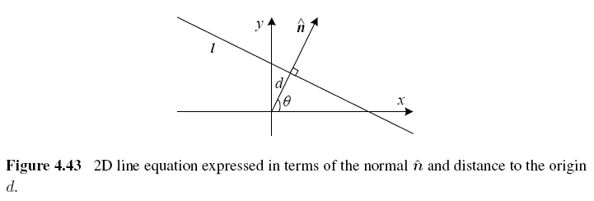
Hough Transforms Algorithm (1/2)
Step 1: Clear the accumulator array.
Step 2: For each detected edgel at location
(x, y) and orientation θ = tan⁻¹(n_{y}/n_{x}), compute the value of d = x*n_{x} + y*n_{y} and increment the accumulator corresponding to (θ, d).

Slide 52
Hough Transforms Algorithm (2/2)
Step 3: Find the peaks in the accumulator corresponding to lines.
Step 4: Optionally re-fit the lines to the constituent edgels.

Slide 53
RANSAC-based Line Detection
Another alternative to the Hough transform is the RANdom SAmple Consensus (RANSAC) algorithm.
RANSAC randomly chooses pairs of edgels to form a line hypothesis and then tests how many other edgels fall onto this line.
Lines with sufficiently large numbers of matching edgels are then selected as the desired line segments.

Slide 54
RANSAC

Slide 55
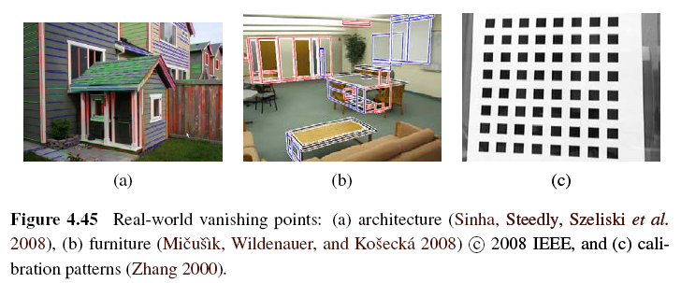
4.3.3 Vanishing Points (1/5)
Parallel lines in 3D have the same vanishing point.

Slide 56
Vanishing Points (2/5)
An alternative to the 2D polar (θ, d) representation for lines is to use the full 3D m = line equation, projected onto the unit sphere.
The location of vanishing point hypothesis:
m: line equations in 3D representation

Slide 57
Vanishing Points (3/5)
Corresponding weight:
l_{i}, l_{j}: corresponding line segment lengths
This has the desirable effect of downweighting (near-)collinear line segments and short line segments.

Slide 58
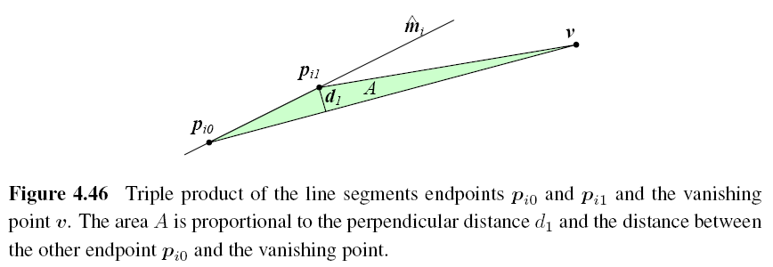
Vanishing Points (4/5)

Slide 59
Vanishing Points (5/5)
A robustified least squares estimate for the vanishing point:

