Slide 1
Advanced Computer Vision
Chapter 4
Feature Detection and Matching
Presented by: 傅楸善 & 荻本雅俊b01902115@ntu.edu.tw
0988860365

Slide 2
Feature Detection and Matching (1/3)
4.1 Points and Patches
4.2 Edges
4.3 Lines
Notes:
特徵 偵測
配對
點，小塊
邊
線

Slide 3
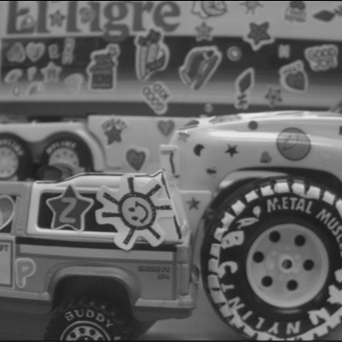

Slide 4
Feature Detection and Matching (2/3)
Notes:
各式各樣的 特徵偵測器 與 描述 可以 被用來 分析 描述與配對影像
A 像點的有興趣運算子
B 像區域的有興趣運算子
C 邊
D 直線

Slide 5
Feature Detection and Matching (3/3)
Notes:
兩張影像要被配對
用哪一些 特徵 建立影像間的對應

Slide 6
4.1 Points and Patches (1/2)
There are two main approaches:
Find features in one image that can be accurately tracked using a local search technique. (e.g., video sequences)
Independently detect features in all the images under consideration and then match features based on their local appearance. (e.g., stitching panoramas, establishing correspondences)
Notes:
點 與 小塊
有兩種主要的方法
從一張影像要找特徵可以準確追踪使用局域搜尋技術 例如 視訊 系列
獨立偵測特徵在所有影像內，然後配對特徵的基於它們的區域外貌 例如 縫合全景 ，建立對應

Slide 7
First Approach

Slide 8
First Approach

Slide 9
First Approach

Slide 10
First Approach

Slide 11
4.1 Points and Patches (1/2)
There are two main approaches:
Find features in one image that can be accurately tracked using a local search technique. (e.g., video sequences)
Independently detect features in all the images under consideration and then match features based on their local appearance. (e.g., stitching panoramas, establishing correspondences)
Notes:
Suitable when large amount of motion or appearance changes
Object recognition

Slide 12
Second Approach

Slide 13
Points and Patches (2/2)
Keypoint detection, matching
Three pipeline stages:
Feature detection (extraction) stage
Feature description stage
Feature matching stage or Feature Tracking stage
Notes:
關鍵點增廁，配對
三個步驟
特徵偵測 與 攫取步驟
特徵描述 步驟
特徵配對 步驟 或 特徵追踪步驟
feature description stage
(Section 4.1.2), each region around detected keypoint locations is converted into a more compact
and stable (invariant) descriptor that can be matched against other descriptors.
------
Detection – find locations that may be able to match with other image, find correspondences
Description – region around keypoint, give more stable descriptor to be matched
Matching – search matching candidates
Tracking – search small neighbors (for video)

Slide 14
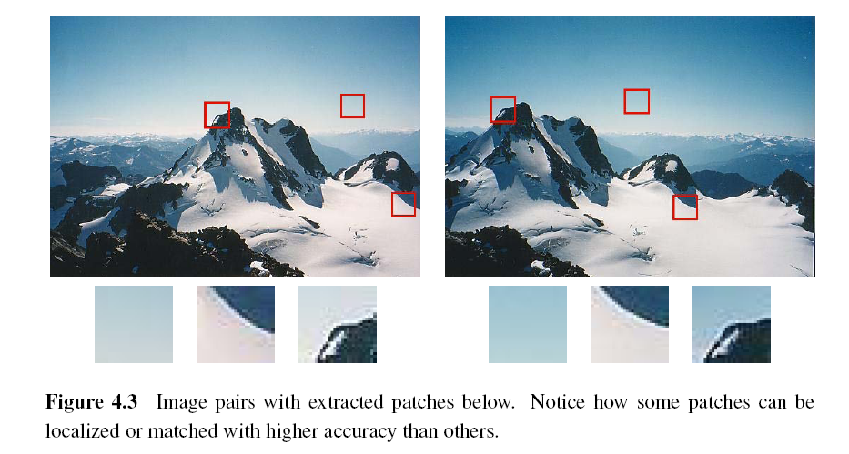
4.1.1 Feature Detectors
Notes:
特徵偵測器
影像對 下面有擷取的小塊
注意 有些小塊有區域化會 比其他小塊有較高準確度 配對
Square patches
Try to find location where we can find correspondences with other images
Textureless
Large contrast changes (gradients) easier to localize
Straight line segments – suffer from aperture problem

Slide 15
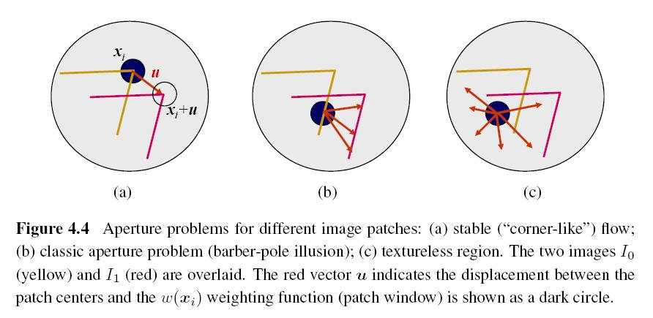
Aperture Problem
Notes:
不同小塊的孔徑問題
A 穩定的像角落的流動
b 經典的孔徑問題 (理髮師招牌幻覺)
c. 沒有紋理區域
兩張影像I0 黃色 與 I1 紅色 重疊
紅色的向量 u 指出 小塊中心的位移 權重函數w(xi) 黑色圓圈
Patches with gradients in at least two (significantly) different orientations are the easiest to localize

Slide 17
????

Slide 18
????

Slide 19
Barber Pole Illusion

Slide 20
Weighted Summed Square Difference
I₀, I₁: the two images being compared
u: the displacement vector
w(x): spatially varying weighting function
summation i: over all the pixels in the patch
Notes:
權重平方差的和
要比較的兩張影像
u 位移向量
W(x) 空間變化的權重函數
和 i: 所有的像素在小塊內
simplest possible matching criterion

Slide 21
Auto-correlation Function of Surface
I₀: the image being compared
∆u: small variations in position
w(x): spatially varying weighting function
summation i: over all the pixels in the patch
Notes:
表面的自我關聯函數
I0 正在被比較的影像
u 位置的小的變化
W(x) 空間變化的權重函數
和 I: 在小塊內的所有像素
When performing feature detection, we do not know which other image locations the
feature will end up being matched against. Therefore, we can only compute how stable this
metric is with respect to small variations in position u by comparing an image patch against
Itself.

Slide 22
Notes:
三個自我關聯表面顯示成為灰階影像與表面圖
A 原本的影像用三個十字標示計算的自我關聯表面
B 這個小塊是從花床 (好的唯一極小值)
C 這個小塊是從屋頂邊緣 (一維孔徑問題)
D 這個小塊是從雲來 （沒有好的頂點）
圖b至d的每個格點是 delta u 的一個值
(b) flower bed - exhibits a strong minimum
(c) Roof edge - strong ambiguity
(d) Cloud – no stable minimum

Slide 23
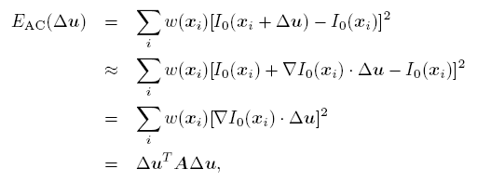
Approximation of Auto-correlation Function (1/3)
I₀(x_{i}+ ∆u) ≈ I₀(x_{i}) + ∇ I₀(x_{i})．∆u
∇ I₀(x_{i}): image gradient at x_{i}
Notes:
自我關聯函數的近似
Nabla I0(xi) 在xi影像的梯度
This gradient can be computed using a variety of techniques. The classic “Harris” detector uses a [-2 -1 0 1 2] filter, but more modern variants convolve the image with horizontal and vertical derivatives of a Gaussian.
---------
Use Taylor Series (above equation) to approximate auto-correlation surface

Slide 24
Approximation of Auto-correlation Function (2/3)
Auto-correlation matrix A:
w: weighting kernel (from spatially varying weighting function)
I_{x}, I_{y}: horizontal and vertical derivatives of Gaussians
Notes:
自我關聯函數的近似
自我關聯矩陣 A
W 權重核心 (從空間變化權重函數)
Ix Iy, 高斯函數的水平垂直微分

Slide 25
Approximation of Auto-correlation Function (3/3)
Assume (λ₀, λ₁) are two eigenvalues of A and λ₀ <= λ₁.
Since the larger uncertainty depends on the smaller eigenvalue, it makes sense to find maxima in the smaller eigenvalue to locate good features to track.
Notes:
Inverse of matrix A provides lower bound on uncertainty in location of matching patch
Useful indicator of which patches can be reliably matched
自我關聯函數的近似
假設 lambda0,1 是A的兩個特徵值，而且lambda0 小於等於lambda1
因為較小的特徵值決定較大的不確定性，應該要找較小特徵值的極大值找好的特徵來追踪

Slide 26
Other Measurements (1/2)
Quantity proposed by Harris and Stephens:
α = 0.06
No square roots
It is still rotationally invariant and downweights edge-like features when λ₁ >> λ₀.
Notes:
其他的測量值
Harris and Stephens 建議的數量
沒用平方根
他仍然是旋轉不變的而且減低類似邊緣特徵的權重 當 lambda1 絕對大於 lambda0
Finding local maximum

Slide 27
Harris Corner Detector
If $I_{x}^{2}$ and $I_{y}^{2}$ are large

Slide 29
Other Measurements (2/2)
Quantity proposed by Brown, Szeliski, and Winder:
It can be used when λ₁ ≈ λ₀.
Notes:
Finding interest points by computing “corner strength”
其他的測量值
Brown, Szeliski, and Winder 建議的數量
當lambda1 近似lambda0 時可用
Finding local maximum

Slide 30
Basic Feature Detection Algorithm (1/2)
Step 1: Compute the horizontal and vertical derivatives of the image I_{x} and I_{y} by convolving the original image with derivatives of Gaussians.
Step 2: Compute the three images (I_{x}², I_{y} ², I_{x}I_{y}) corresponding to the outer products of these gradients.
Notes:
基本的特徵偵測的演算法
第一步 計算影像的水平和垂直微分Ix and Iy 藉由卷積原始影像與高斯函數的微分
第二步 計算三張影像 (Ix2, Iy2, IxIy) 對應到這些梯度的外積

Slide 31
Basic Feature Detection Algorithm (2/2)
Step 3: Convolve each of these images with a larger Gaussian (the weighting kernel).
Step 4: Compute a scalar interest measure using one of the formulas discussed above.
Step 5: Find local maxima above a certain threshold and report them as detected feature point locations.
Notes:
第三步 卷積每張影像用較大的高斯權重核心
第四步 計算單量有興趣的量測值使用上面討論公式之一
第五步 找大於某一門檻值的區域最大值，而且報告他們的為偵測的特徵點位置

Slide 32
Adaptive Non-maximal Suppression (ANMS) (1/2)
Simply finding local maxima -> uneven distribution of feature points
Detect features that are:
Local maxima
Response value is greater than all of its neighbors within a radius r
Notes:
適應性的非最大的壓制
光找出區域最大值會導致特徵點的不均勻的分佈
偵測如下特徵
區域最大值
反應值大於所有半徑r之內的鄰居
Only looking for local maxima for interest function leads to uneven distribution of feature points
Denser where region with high contrast
ANMS – only detect features where it is:
- both local maxima
- response value greater than (10%) all of neighbor within radius r

Slide 33
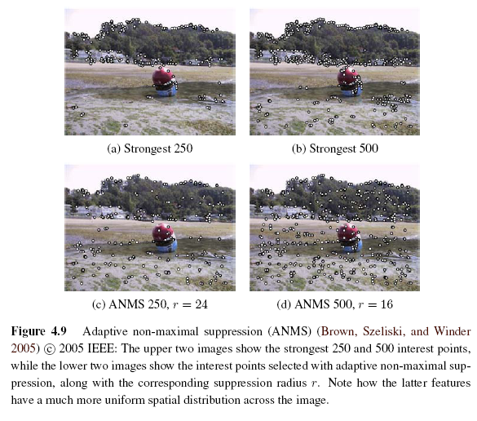
Adaptive Non-maximal Suppression (ANMS) (2/2)
Notes:
適應性的非最大值壓制
適應性的非最大值壓制
最上面兩張影像表示最強的250與500的有興趣的點而且最下面的兩張影像表示有興趣的點使用適應性的非最大值壓制，以及對應的壓制半徑 r
注意後者的特徵比較均勻空間分佈在影像上

Slide 34
(a) Strongest 250

Slide 35
(b) Strongest 500

Slide 36
(c) ANMS 250, r = 24

Slide 37
(d) ANMS 500, r = 16

Slide 38
Measuring Repeatability
Which feature points should we use among the large number of detected feature points?
Measure repeatability after applying rotations, scale changes, illumination changes, viewpoint changes, and adding noise.
Notes:
量測可重複性
用哪一些特徵點在大量的偵測特徵點中？
應用旋轉、放大縮小、照明改變、視角改變、而且加雜訊後量測可重複性
Repeatability
Frequency with which keypoints detected in one image are found within epsilon (1.5) pixels of corresponding location in transformed image

Slide 39
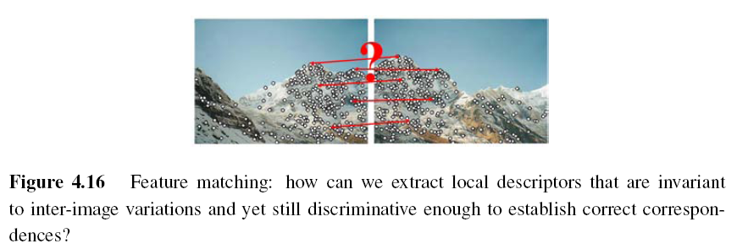
4.1.2 Feature Descriptors
Sum of squared difference
Normalized cross-correlation (Chapter 8)
Notes:
特徵描述
特徵配對: 怎麼攫取局域描述
影像內的變異不變
而且會辨析
正確的對應
Even after compensating for these changes, the local appearance of image patches will usually still vary from image to image. How can we make image descriptors more invariant to such changes, while still preserving discriminability between different (non-corresponding) patches?

Slide 40
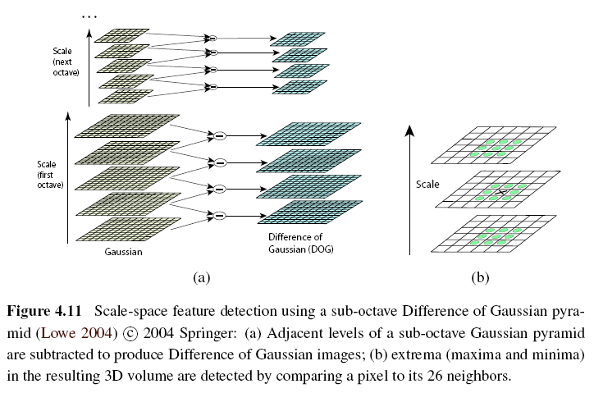
Scale Invariant Feature Transform (SIFT)
Notes:
Performing the same operations at multiple resolutions in a pyramid and then matching features at the
same level.
Needs Sub-pixel accuracy, Remove low contrast, and Remove edge
解析度不變特徵轉換
解析度空間特徵偵測用次八度
用高斯差的金字塔
A.鄰居階層的次八度高斯金字塔相減以產生高斯差的影像。
b. 極值（極大值和極小值）在結果的三維體積中被偵測出藉由比較一個像素和它的26個鄰居。

Slide 41
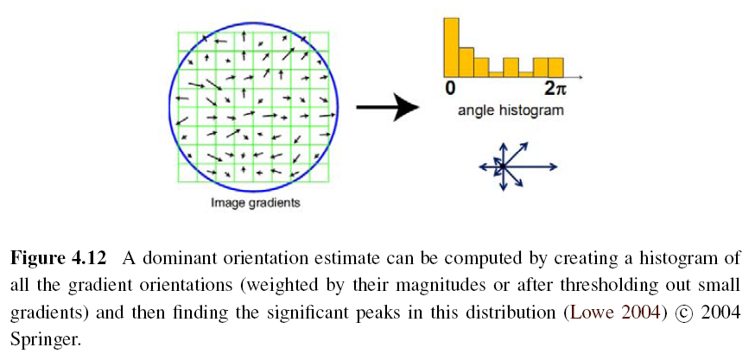
Orientation Estimation
Notes:
The simplest possible orientation estimate is the average gradient within a region around the keypoint.
Ex: Gaussian weighting function, histogram of orientations computed around the keypoint
方向估計
可以計算主要的方向估計藉由產生所有的梯度方向的直方圖（用大小做權重或移除小的梯度）然後找重要的頂點在分佈內。

Slide 42
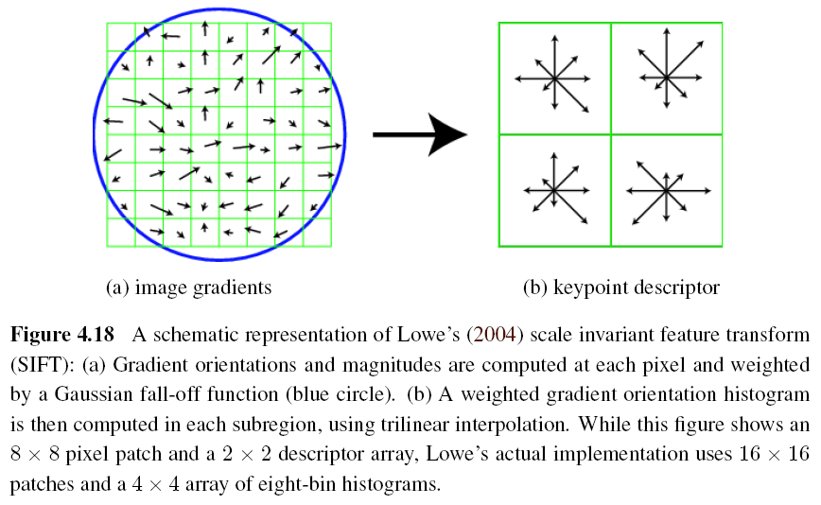
Gradient Location-orientation Histogram (GLOH)
Notes:
梯度位置方向直方圖
圖形顯示Lowe’s解析度不變特徵轉換。
在每個像素計算梯度方向與大小，然後權重高斯的衰減函數（藍色的圓圈）。
用三線性內插在每個子區域計算權重梯度方向直方圖。圖形表示8x8像素小塊與2x2描述矩陣，可是Lowe’s的真正建置用16x16小塊與4x4矩陣的八方向直方圖。

Slide 43
Multi-scale Oriented Patches (MOPS)
Simpler SIFT, without every scale DoGs
Used on image stitching, and so on
Detector: Harris corner detector
Multi-scale -> make program robust
DoG: Difference of Gaussian
Notes:
多解析度有方向性小塊
比解析度不變特徵轉換簡單，不用每個解析度的高斯差
用在縫合全景 等等
特徵偵測器: Harris角落偵測器
多解析度 → 使程式強壯
高斯差

Slide 44
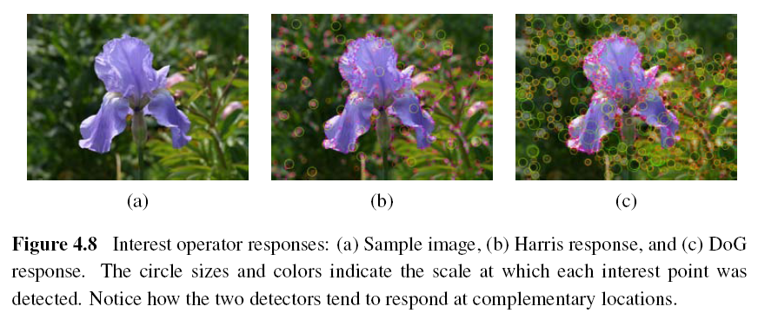
Scale Invariance (1/2)
Notes:
有興趣運算字反應
A 樣本的影像
B Harris 反應
C 高斯差的反應
圓圈大小與顏色表示每個有興趣點的解析度
注意兩個偵測器往往反應在互補的位置

Slide 45
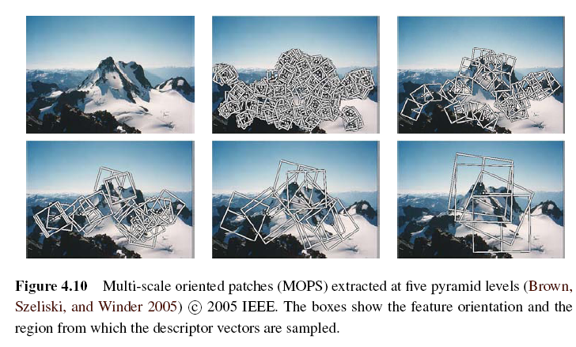
Scale Invariance (2/2)
Problem: if no good feature points in image?
Solution: multi-scale
Notes:
放大縮小不變性
問題：如果在影像內沒有好的特徵點
解答：多解析度
多解析度有方向性小塊金字塔階層擷取
方塊表示特徵方向性與描述向量取樣的區域
Detecting features at Finest stable scale possible may not be good (clouds)
extract features at a variety of scales,
then matching features
Good for when images do not undergo large scale changes (fixed-focal-length)

Slide 46
????

Slide 48
Maximally Stable Extremal Region (MSER)
Only work for grayscale images
Incrementally add pixels as the threshold is changed.
Maximally stable: changing rate of area with respect to the threshold is minimal
Notes:
最大穩定極值區域
只適合灰階影像
逐漸增加像素當門檻值改變時
最大穩定：區域的變化率相對於門檻值是最小時
最大穩定極值區域擷取與配對從一些影像
affine invariance region detector
Thresholding image at all possible gray levels
Sort pixels by gray value
Incrementally add pixels to each connected component as threshold changes
Monitor area of each component or region
Maximally stable – regions whose rate of change of area with respect to threshold is minimal

Slide 49
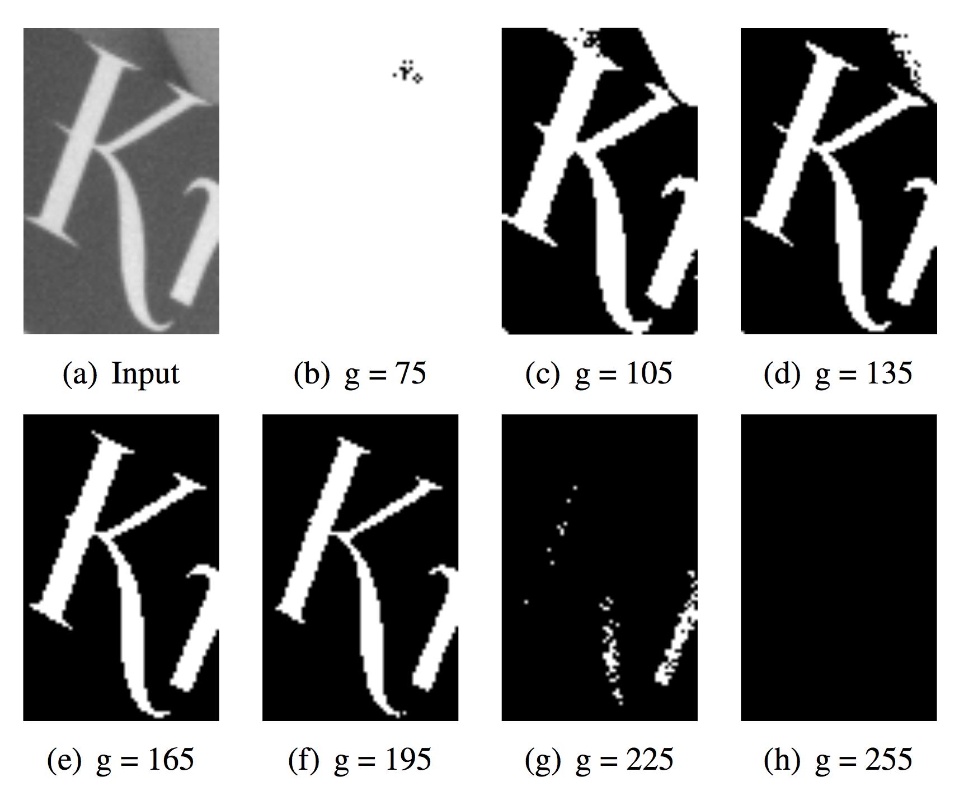

Slide 50
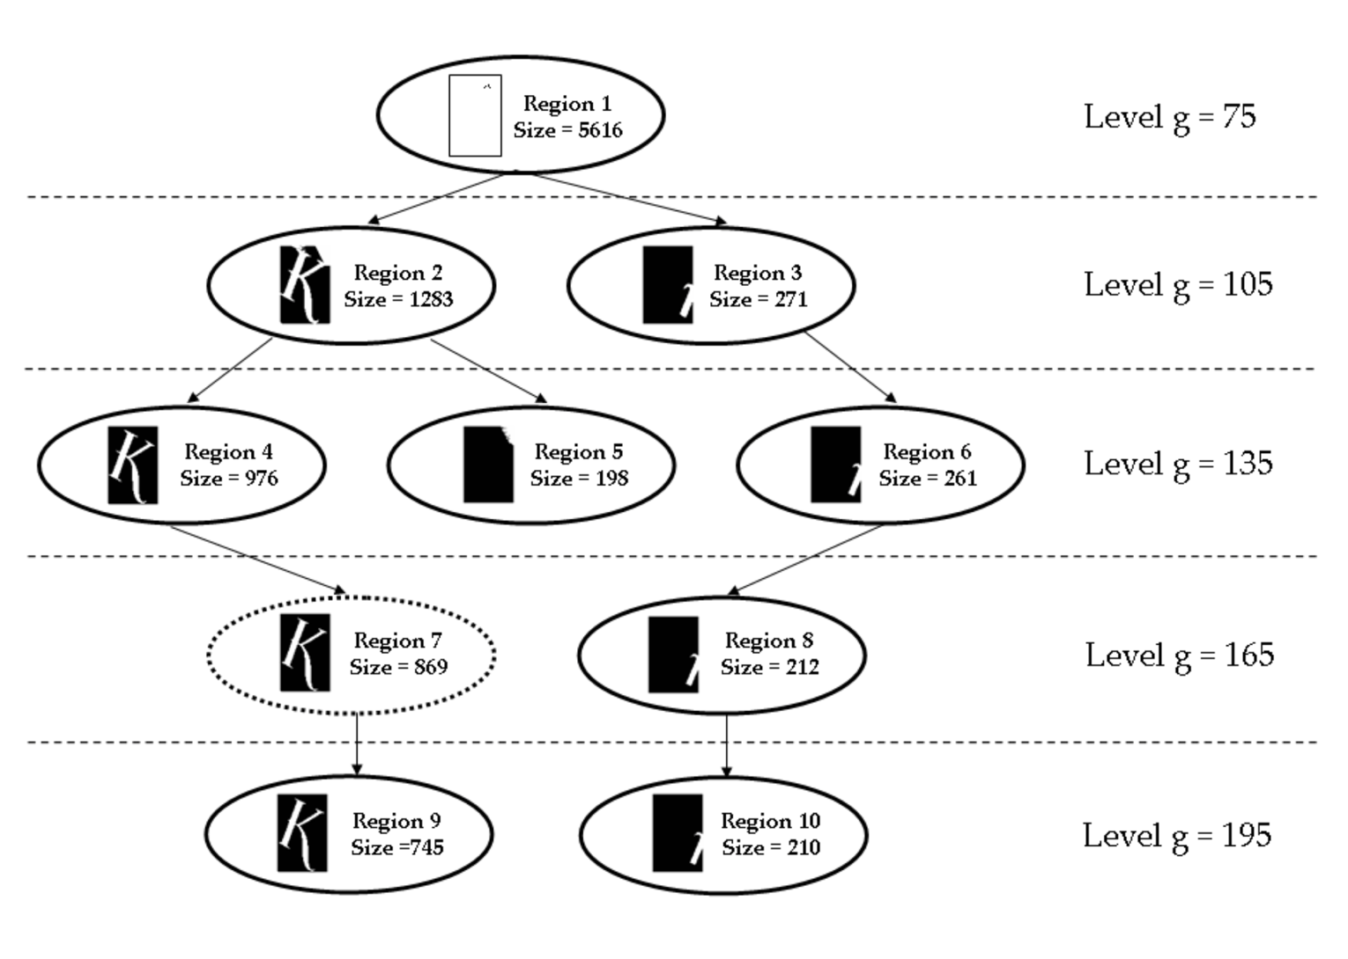

Slide 51
4.1.3 Feature Matching
Two subjects:
select a matching strategy
devise efficient data structures and algorithms to perform this matching
Notes:
特徵配對
兩個主題
選擇配對的策略
設計高效的資料結構與演算法
執行這種配對

Slide 52
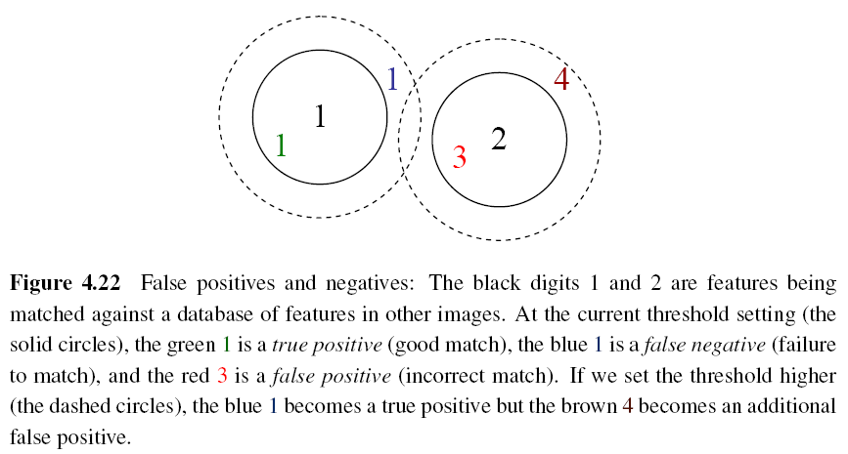
Matching Strategy (1/7)
Simplest method: set a distance threshold and match within this threshold.
Notes:
配對策略
最簡單的方法
設置距離門檻值而且在門檻值內配對
假陽性與假陰性:黑色的數字1與2是配對的特徵相對於其他的影像的特徵的資料庫。在本門檻值的設定（實線圓圈）綠色的1是真正陽性（好配對）藍色的1是假陰性（失敗的配對）與紅色的3是假陽性（錯誤的配對）。如果我們用比較高的門檻值（虛線圓圈），藍色的1變成真正陽性，可是棕色的4變成另一個假陽性。

Slide 53
True positive rate
$TPR=\frac{TP}{TP+FN}=\frac{TP}{P}$
False positive rate
$FPR=\frac{FP}{FP+TN}=\frac{FP}{N}$
Positive predictive value
$PPV=\frac{TP}{TP+FP}=\frac{TP}{P′}$
Accuracy
$ACC=\frac{TP+TN}{P+N}$
TP: true positives
number of correct matches
FN: false negatives
Matches that were not correctly detected
FP: false positives
Proposed matches that are incorrect
TN: true negatives
Non-matches that were correctly rejected
Notes:
TPR 真正陽性率
FPR 假陽性率
PPV 陽性預測值
ACC 準確率
TP 真正陽性
正確配對數
FN 假陰性
錯誤的配對數
FP 假陽性
建議的錯誤配對
TN 真正陰性
錯的配對被適當拒絕

Slide 54
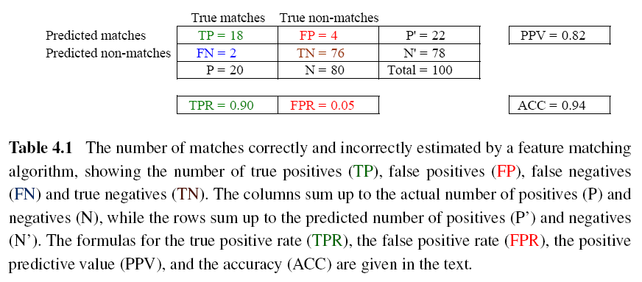
Matching Strategy (2/7)
Confusion matrix to estimate performance:
Notes:
配對策略
估計性能的迷惑矩陣
特徵配對的演算法估計的正確與錯誤配對的個數，表示真正陽性的個數(TP)，假陽性個數(FP)，假陰性個數(FN)與真正陰性（TN）。直行加起來是陽性的真正數目(P)與陰性的真正數目(N)，橫列加起來是陽性的預測數目(P’)與陰性的預測數目(N’)。真正陽性率(TPR),錯誤陽性率(FPR),陽性預測值(PPV),準確率(ACC)的公式，在文字中解釋
AB:
A = T or F, means whether the result is correct
B = P or N, means the result should be correct or not
TPR (true positive rate) = TP / (TP + FN) = TP / P
FPR (false positive rate) = FP / (FP + TN) = FP / N
PPV (positive predictive value) = TP / (TP + FP) = TP / P’
ACC (accuracy) = (TP + TN) / (P + N)

Slide 55
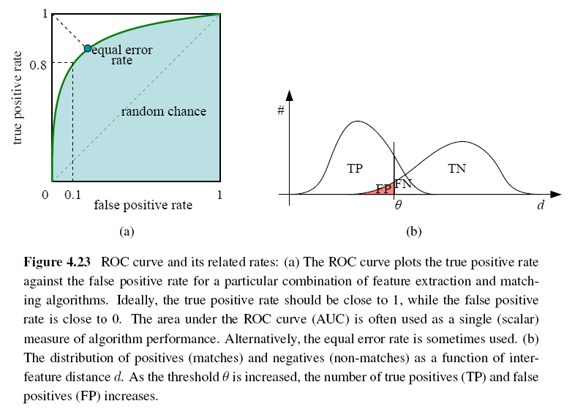
Matching Strategy (3/7)
ROC: Receiver Operating Characteristic
Notes:
Receiver operating characteristic
ideally: True positive rate -> 1 and False positive rate -> 0
配對策略
ROC接收者操作特徵曲線 和它的相關比率
接收者操作特徵曲線 畫出真正陽性率相對於假陽性率對特定特徵攫取與配對演算法的組合。理想上真正陽性率應該接近1，同時假陽性率應該接近0。接收者操作特徵曲線的下面的面積是常常用來當成演算法的性能的單量標準。其他時候有時用相同錯誤率。
陽性與陰性的分佈是特徵距離d的函數。當門檻值theta增加時，真正陽性(TP)與假陽性(FP)個數會增加。

Slide 56
Matching Strategy (4/7)
Other methods:
Nearest neighbor
Nearest neighbor distance ratio
Nearest neighbor distance ratio (NNDR):
d₁, d₂: nearest and second nearest distances
D_{A}: the target descriptor
D_{B} and D_{C}: closest two neighbors of D_{A}
Notes:
配對策略
其他的方法
最近的鄰居
最近的鄰居距離比率
D1,d2 最近與第二近的距離
DA 目標描述
DB DC: DA的兩個最近鄰居

Slide 57
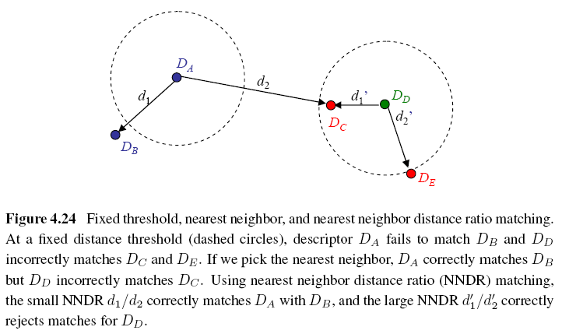
Matching Strategy (5/7)
Notes:
NNDR: used when dealing with a collection of images
If the distance of nearest feature not “MUCH” less than the second nearest feature, it means that this descriptor has no precise matching.
配對策略
固定門檻值，最近鄰居與最近鄰居距離比率配對。用固定的距離門檻值（虛線圓圈），描述Da失敗配對Db而且Dd錯誤配對DC與DE。如果我們選最近鄰居，Da正確配對DB，可是Dd錯誤配對DC。用最近鄰居距離比率配對(NNDR)，小的NNDR d1/d2 正確配對DA跟DB，大的NNDR d1’/d2` 正確拒絕配對DD。

Slide 58
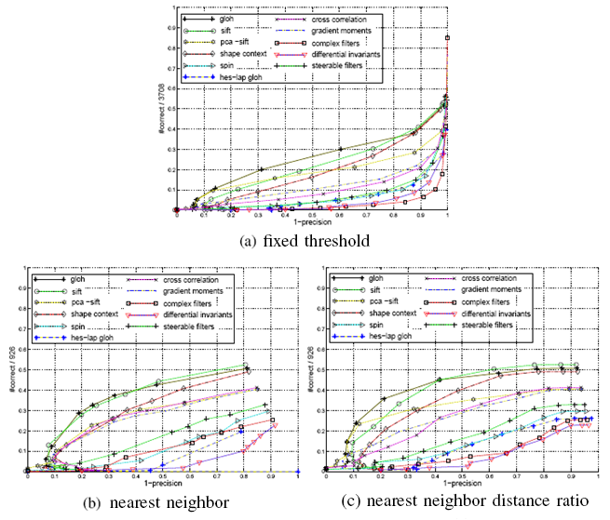
Matching Strategy (6/7)
Notes:
配對策略
a. 固定門檻值
b. 最近鄰居
C. 最近鄰居距離比率

Slide 59
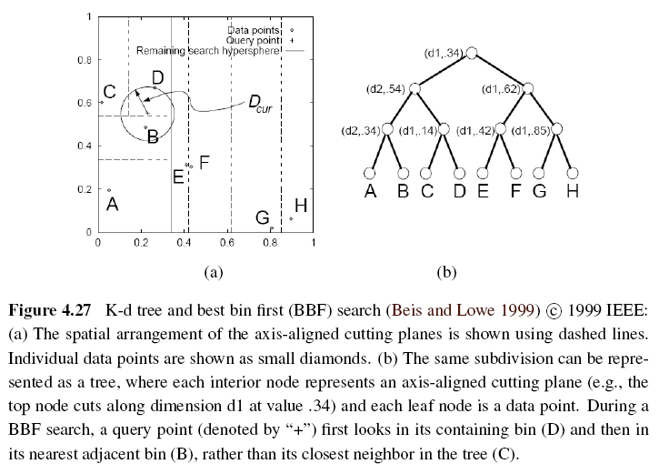
Matching Strategy (7/7)
Indexing structures:
Multi-dimensional search tree
Multi-dimensional hashing
Notes:
Split plane along axis-aligned (hor or vert) cutting planes
(dimension, split value)
Splits arranged so that it balance the tree (keep max depth small)
配對策略
索引結構
多維度搜尋樹
多維度散列
K-d維度樹與最好籃子先(BBF)搜尋
軸對準的切平面的空間安排 用虛線表示。獨立資料點表示成小鑽石
一樣的區分可以表示成為樹，每個內節點表示軸對準的切平面(例如最上面的節點切在維度d1在值.34）而且每個葉子節點是一個資料點。BBF搜尋時，詢問點（用加＋表示）先看它的包含籃子D然後最近鄰近籃子B，而不是在樹C裡的最近鄰居。

Slide 61
4.1.4 Feature Tracking (1/3)
To find a set of likely feature locations in a first image and to then search for their corresponding locations in subsequent images.
Expected amount of motion and appearance deformation between adjacent frames is expected to be small.
Notes:
特徵追蹤
先找第一張影像的可能特徵位置的集合，然後在隨後影像搜尋它們的對應位置
鄰近影像之間的運動與外表變形預期會小

Slide 62
Feature Tracking (2/3)
Selecting good features to track is closely related to selecting good features to match.
When searching corresponding patch, weighted summed square difference works well enough.
Notes:
特徵追蹤
選好的特徵追蹤是與選擇好特徵配對是密切相關的
當搜尋對應小塊時 權重平方差的和性能夠好了

Slide 63
Feature Tracking (3/3)
If features are being tracked over longer image sequences, their appearance can undergo larger changes.
Continuously match against the originally detected feature
Re-sample each subsequent frame at the matching location
Use affine motion model to measure dissimilarity
(ex: Kanade–Lucas–Tomasi (KLT) tracker)
Notes:
The first strategy is prone to failure as the original patch can undergo appearance changes such as foreshortening.
The second runs the risk of the feature drifting from its original location to some other location in the image.
measure dissimilarity: like weighted summed square difference (only translation and measure dissimilarity)
特徵追蹤
如果特徵被追蹤在比較長的影像序列，它們的外表會有大改變。
繼續配對最原始的偵測的特徵 (例如 Kanade－Lucas-Tomasi (KLT) 追蹤器)
在每個隨後影像在配對位置重新取樣
用仿射運動模型來量測差異

Slide 64
4.2 Edges (1/2)
What are edges in image:
The boundaries of objects
Occlusion events in 3D
Shadow boundaries or crease edges
Grouped into longer curves or contours
Notes:
邊
在影像中邊是什麼
物體的邊緣
三維中的阻擋的事件
影子邊緣或裂縫邊
組合成為較長的曲線或輪廓線

Slide 65
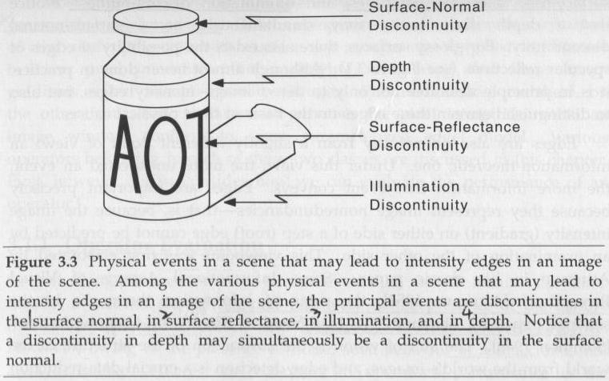
Notes:
表面法向量不連續
深度不連續
表面反射率不連續
照明不連續
場景中物理事件可能導致場景中的影像的亮度的邊。場景中物理事件可能會是表面法向量不連續，深度不連續，表面反射率不連續，照明不連續。注意深度不連續可能同時是表面法向量不連續。

Slide 66
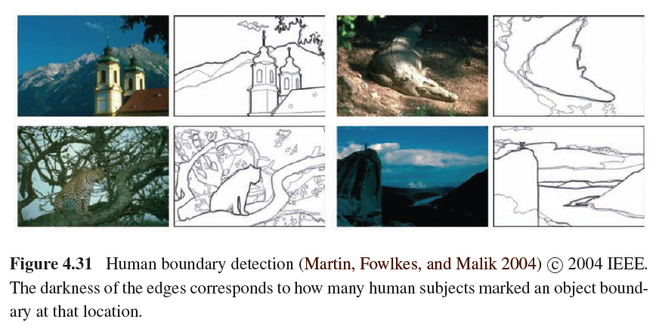
Edges (2/2)

Slide 67
4.2.1 Edge Detection (1/3)
Edge has rapid intensity variation.
J: local gradient vector
Its direction is perpendicular to the edge, and its magnitude is the intensity variation.
I: original image
Notes:
邊緣檢測

Slide 68
Edge Detection (2/3)
Taking image derivatives makes noise larger.
Use Gaussian filter to remove noise:
G: Gaussian filter
σ: width of Gaussian filter
Notes:
we would like the response of our edge detector to be independent of orientation, a circularly symmetric smoothing filter is desirable.
-> Gaussian filter

Slide 69
Edge Detection (3/3)
To thin such a continuous gradient image to only return isolated edges:
Use Laplacian of Gaussian:
S: second gradient operator
Then find the zero crossings to get the maximum of gradient.
Notes:
we wish to thin such a continuous gradient image to only return isolated edges, i.e., as single pixels at discrete locations along the edge contours. This can be achieved by looking for maxima in the edge strength (gradient magnitude) in a direction perpendicular to the edge orientation, i.e., along the gradient direction
Finding this maximum corresponds to taking a directional derivative of the strength field in the direction of the gradient and then looking for zero crossings. The desired directional derivative is equivalent to the dot product between a second gradient operator and the results of the first

Slide 70
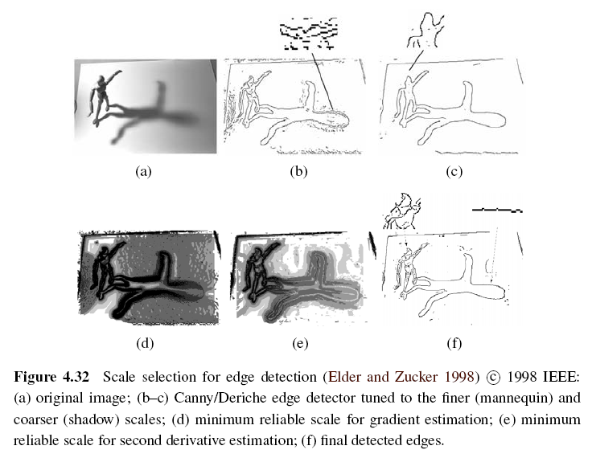
Scale Selection
Notes:
析度選擇
As we mentioned before, the derivative, Laplacian, and Difference of Gaussian filters (4.20– 4.23) all require the selection of a spatial scale parameter rho
Detect sharp edges
Width of filter can determine from image noise characteristics
Which scale to choose?
D. Given a known image noise level, their technique computes, for every pixel, the minimum scale at which an edge can be reliably detected
Their approach first computes gradients densely over an image by selecting among gradient estimates computed at different scales, based on their gradient magnitudes. It then performs a similar estimate of minimum scale for directed second derivatives and uses zero crossings of this latter quantity to robustly select edges (e-f)
Minimum reliable scale: an reliable scale so that an edge can be reliably detected

Slide 71
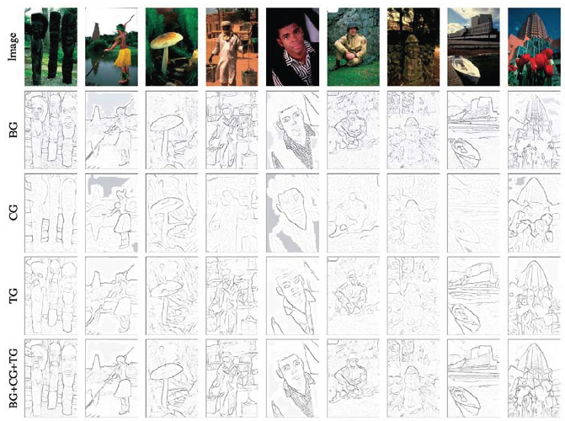
Color Edge Detection
Band separation and combination -> not good
Notes:
For example, noticeable edges between iso-luminant colors (colors that have the same luminance) are useful cues but fail to be detected by grayscale edge operators.
Successive rows show the outputs of the brightness gradient (BG), color gradient (CG), texture gradient (TG), and combined (BG+CG+TG) detectors

Slide 72
4.2.2 Edge Linking
To link isolated edge into continuous contours.
If we use zero crossing to find edge, then linking is just picking up two unlinked edgels in neighbors.
Otherwise, comparing the orientation of adjacent edgels can be used.
As the curve grouped by edges more smooth, the more robust object recognition will be.
Notes:
Edgel: the pixel of an edge

Slide 73
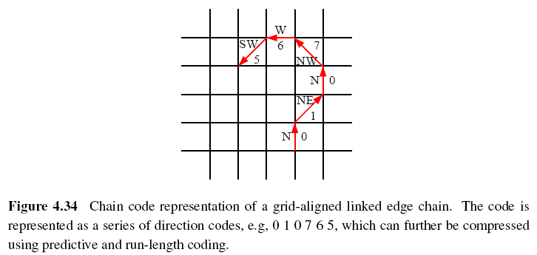
Chain Representation (1/2)
Chain code with eight direction:
Notes:
Linked edgel lists can be encoded more compactly using a variety of alternative representations

Slide 74
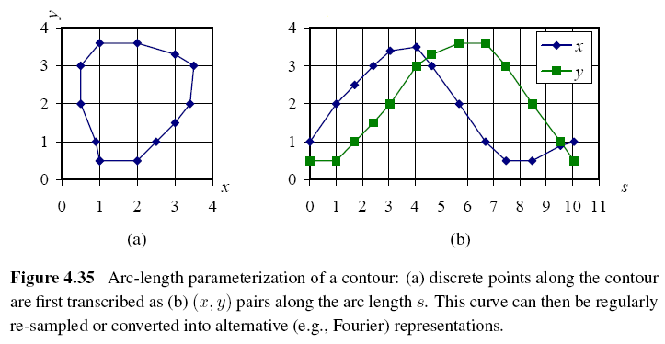
Chain Representation (2/2)
Arc length parameterization
Notes:
The advantage of the arc-length parameterization is that it makes matching and processing (e.g., smoothing) operations much easier

Slide 75
4.3 Lines
Man-made world is full of straight lines, so detecting and matching these lines can be useful in a variety of applications.
Notes:
The Grassfire Transform is a name given to the concept in image processing for computing the distance of a pixel to the border of a region.

Slide 76
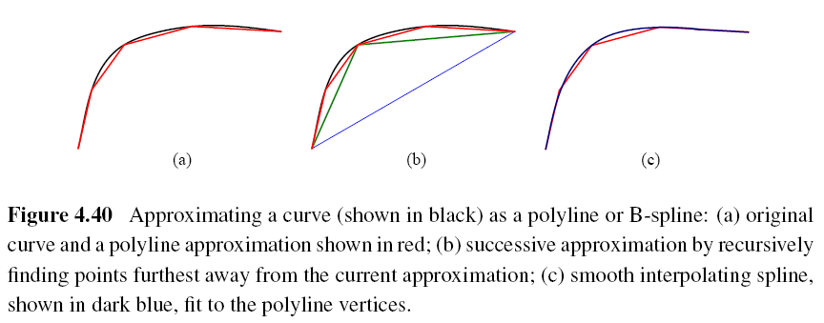
4.3.1 Successive Approximation
Line simplification:
Piecewise-linear polyline
B-spline curve
Notes:
Spline: a mathematical function used for interpolation or smoothing

Slide 77
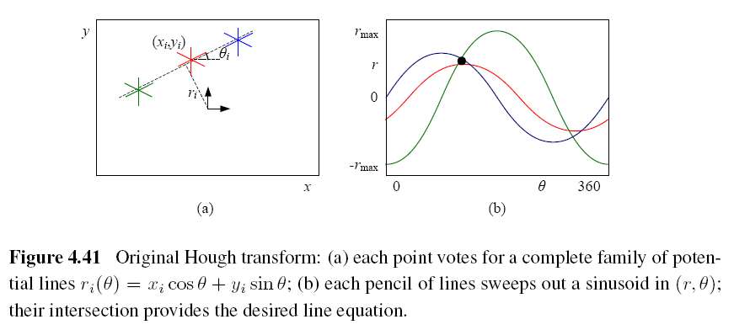
4.3.2 Hough Transforms (1/2)
Original Hough transforms:

Slide 78
Hough Transform
x
m
(x1,y1)
b = -x2m + y2
(x2,y2)
(m,b)
y
b = -x1m + y1
Y=mx + b
b

Slide 79
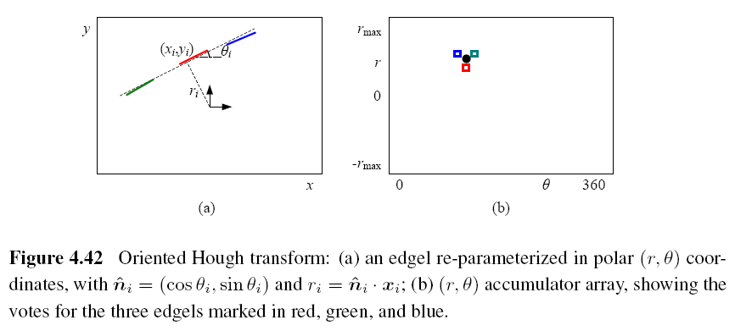
Hough Transforms (2/2)
Oriented Hough transform:

Slide 80
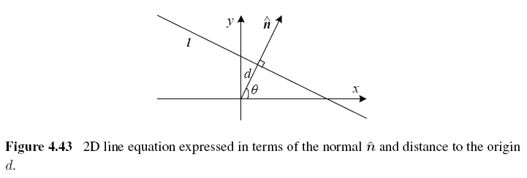
Hough Transforms Algorithm (1/2)
Step 1: Clear the accumulator array.
Step 2: For each detected edgel at location
(x, y) and orientation θ = tan⁻¹(n_{y}/n_{x}), compute the value of d = x*n_{x} + y*n_{y} and increment the accumulator corresponding to (θ, d).
Notes:
The range of (θ; d) values is [-180°; 180°] [-√2; √2], assuming that we are using normalized pixel coordinates that lie in [-1; 1].
vector n: gradient vector, θ can be estimated by local orientation.

Slide 81
Hough Transforms Algorithm (2/2)
Step 3: Find the peaks in the accumulator corresponding to lines.
Step 4: Optionally re-fit the lines to the constituent edgels.

Slide 82
RANSAC-based Line Detection
Another alternative to the Hough transform is the RANdom SAmple Consensus (RANSAC) algorithm.
RANSAC randomly chooses pairs of edgels to form a line hypothesis and then tests how many other edgels fall onto this line.
Lines with sufficiently large numbers of matching edgels are then selected as the desired line segments.
Notes:
Advantage: space efficient (no accumulator array)
Disadvantage: many more hypotheses may need
http://soe.rutgers.edu/~meer/TEACH/ADD/myransac.pdf

Slide 83
Notes:
http://soe.rutgers.edu/~meer/TEACH/ADD/myransac.pdf

Slide 93
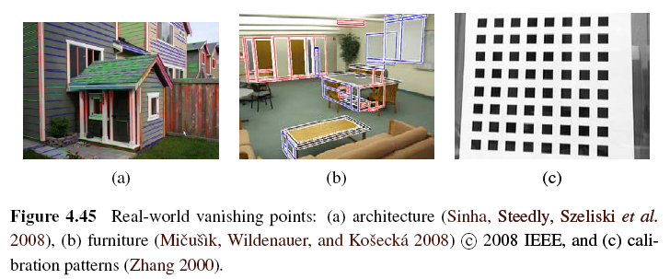
4.3.3 Vanishing Points (1/5)
Parallel lines in 3D have the same vanishing point.
Notes:
Can help refine their position in image
Help determine intrinsic and extrinsic orientation of camera

Slide 95
Vanishing Points (2/5)
An alternative to the 2D polar (θ, d) representation for lines is to use the full 3D m = line equation, projected onto the unit sphere.
The location of vanishing point hypothesis:
m: line equations in 3D representation
Notes:
First stage – use Hough transform to accumulate votes for likely vanishing point candidates
Have each line vote for all possible vanishing point directions
Author’s approach - use pairs of detected line segments to form candidate vanishing point locations
m_i m_j line equations for pair of line segments l_i l_j

Slide 96
Vanishing Points (3/5)
Corresponding weight:
l_{i}, l_{j}: corresponding line segment lengths
This has the desirable effect of downweighting (near-)collinear line segments and short line segments.

Slide 97
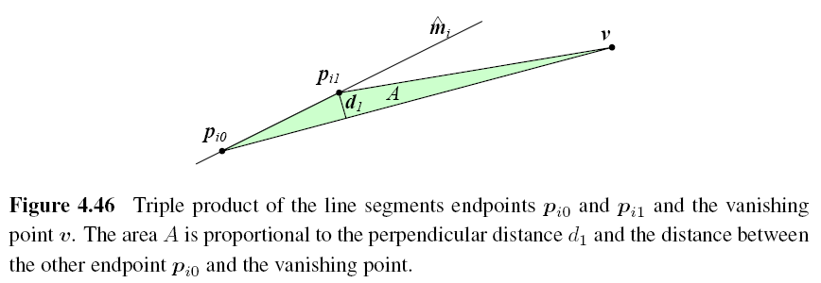
Vanishing Points (4/5)

Slide 98
Vanishing Points (5/5)
A robustified least squares estimate for the vanishing point:

