Slide 1
Advanced Computer Vision
Chapter 4
Feature Detection and Matching
Presented by: 傅楸善 & 許承偉
r99922094@ntu.edu.tw
0928083710

Slide 2
Feature Detection and Matching (1/3)
4.1 Points and Patches
4.2 Edges
4.3 Lines

Slide 3
Feature Detection and Matching (2/3)

Slide 4
Feature Detection and Matching (3/3)

Slide 5
4.1 Points and Patches (1/2)
There are two main approaches:
Find features in one image that can be accurately tracked using a local search technique. (e.g., video sequences)
Independently detect features in all the images under consideration and then match features based on their local appearance. (e.g., stitching panoramas, establishing correspondences)

Slide 6
Points and Patches (2/2)
Three stages:
Feature detection (extraction) stage
Feature description stage
Feature matching stage or Feature Tracking stage
Notes:
feature description stage
(Section 4.1.2), each region around detected keypoint locations is converted into a more compact
and stable (invariant) descriptor that can be matched against other descriptors.

Slide 7
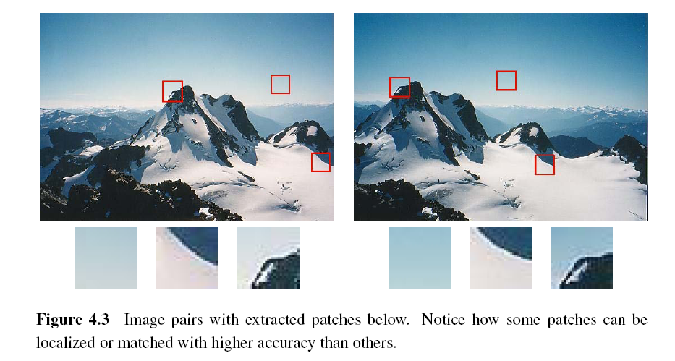
4.1.1 Feature Detectors

Slide 8
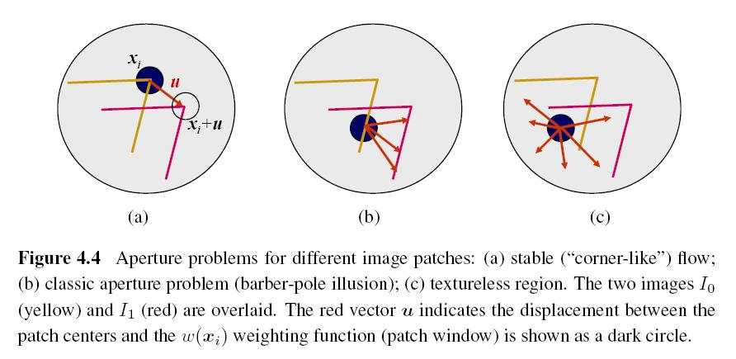
Aperture Problem

Slide 9
Weighted Summed Square Difference
I₀, I₁: the two images being compared
u: the displacement vector
w(x): spatially varying weighting function
summation i: over all the pixels in the patch

Slide 10
Auto-correlation Function or Surface
I₀: the image being compared
∆u: small variations in position
w(x): spatially varying weighting function
summation i: over all the pixels in the patch
Notes:
When performing feature detection, we do not know which other image locations the
feature will end up being matched against. Therefore, we can only compute how stable this
metric is with respect to small variations in position u by comparing an image patch against
Itself.

Slide 12
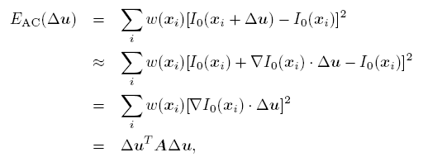
Approximation of Auto-correlation Function (1/3)
I₀(x_{i}+ ∆u) ≈ I₀(x_{i}) + ∇ I₀(x_{i})．∆u
∇ I₀(x_{i}): image gradient at x_{i}
Notes:
This gradient can be computed using a variety of techniques. The classic “Harris” detector uses a [-2 -1 0 1 2] filter, but more modern variants convolve the image with horizontal and vertical derivatives of a Gaussian.

Slide 13
Approximation of Auto-correlation Function (2/3)
Auto-correlation matrix A:
w: weighting kernel (from spatially varying weighting function)
I_{x}, I_{y}: horizontal and vertical derivatives of Gaussians

Slide 14
Approximation of Auto-correlation Function (3/3)
Assume (λ₀, λ₁) are two eigenvalues of A and λ₀ <= λ₁.
Since the larger uncertainty depends on the smaller eigenvalue, it makes sense to find maxima in the smaller eigenvalue to locate good features to track.

Slide 15
Other Measurements (1/2)
Quantity proposed by Harris and Stephens:
α = 0.06
No square roots
It is still rotationally invariant and downweights edge-like features when λ₁ >> λ₀.
Notes:
Finding local maximum

Slide 16
Other Measurements (2/2)
Quantity proposed by Brown, Szeliski, and Winder:
It can be used when λ₁ ≈ λ₀.
Notes:
Finding local maximum

Slide 17
Basic Feature Detection Algorithm (1/2)
Step 1: Compute the horizontal and vertical derivatives of the image I_{x} and I_{y} by convolving the original image with derivatives of Gaussians.
Step 2: Compute the three images (I_{x}², I_{y} ², I_{x}I_{y}) corresponding to the outer products of these gradients.

Slide 18
Basic Feature Detection Algorithm (2/2)
Step 3: Convolve each of these images with a larger Gaussian (the weighting kernel).
Step 4: Compute a scalar interest measure using one of the formulas discussed above.
Step 5: Find local maxima above a certain threshold and report them as detected feature point locations.

Slide 19
Adaptive Non-maximal Suppression (ANMS) (1/2)
Simply finding local maxima -> uneven distribution of feature points
Detect features that are:
Local maxima
Response value is greater than all of its neighbors within a radius r

Slide 20
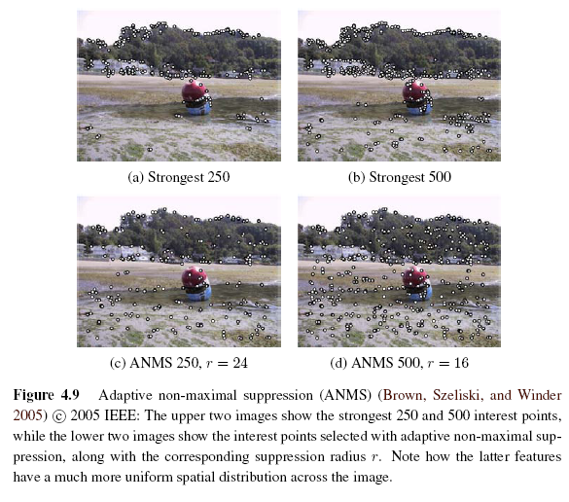
Adaptive Non-maximal Suppression (ANMS) (2/2)

Slide 21
Measuring Repeatability
Which feature points should we use among the large number of detected feature points?
Measure repeatability after applying rotations, scale changes, illumination changes, viewpoint changes, and adding noise.

Slide 22
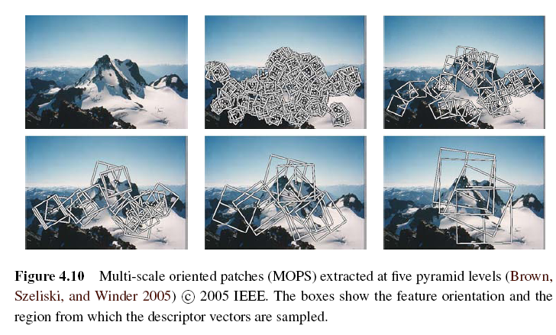
Scale Invariance (1/2)
Problem: if no good feature points in image?
Solution: multi-scale

Slide 23
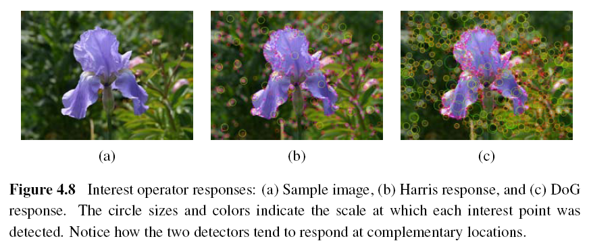
Scale Invariance (2/2)

Slide 24
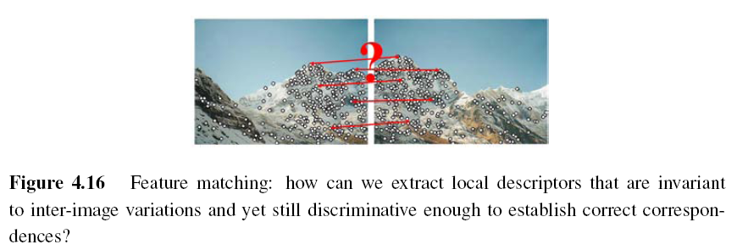
4.1.2 Feature Descriptors
Sum of squared difference
Normalized cross-correlation (Chapter 8)
Notes:
Even after compensating for these changes, the local appearance of image patches will usually still vary from image to image. How can we make image descriptors more invariant to such changes, while still preserving discriminability between different (non-corresponding) patches?

Slide 25
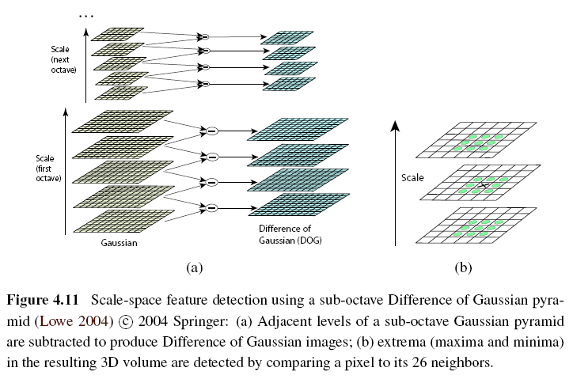
Scale Invariant Feature Transform (SIFT)
Notes:
Performing the same operations at multiple resolutions in a pyramid and then matching features at the
same level.
Needs Sub-pixel accuracy, Remove low contrast, and Remove edge

Slide 26
Multi-scale Oriented Patches (MSOP)
Simpler SIFT, without every scale DoGs
Used on image stitching, and so on
Detector: Harris corner detector
Multi-scale -> make program robust
DoG: Difference of Gaussian

Slide 27
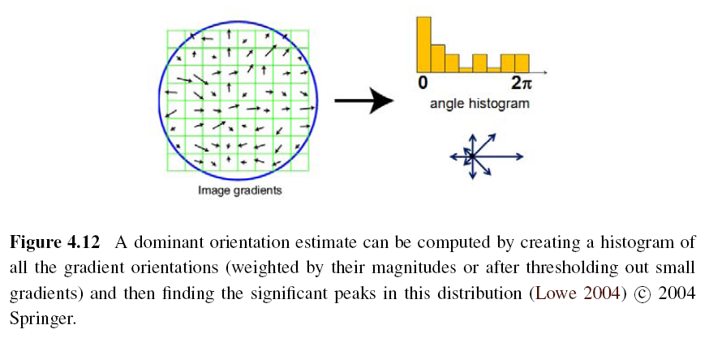
Orientation Estimation
Notes:
The simplest possible orientation estimate is the average gradient within a region around the keypoint.
Ex: Gaussian weighting function, histogram of orientations computed around the keypoint

Slide 28
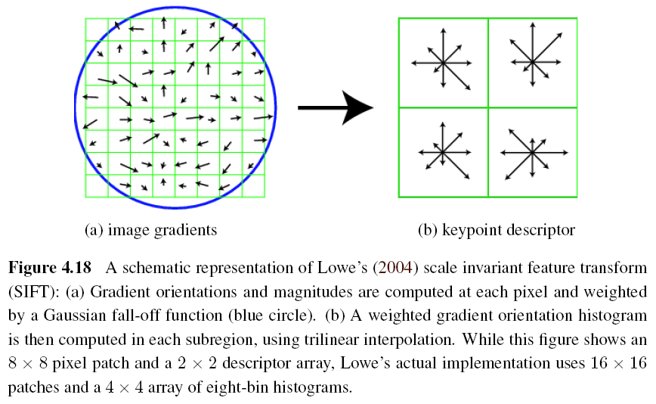
Gradient Location-orientation Histogram (GLOH)

Slide 29
Maximally Stable Extremal Region (MSER)
Only work for grayscale images
Incrementally add pixels as the threshold is changed.
Maximally stable: changing rate of area with respect to the threshold is minimal

Slide 30
4.1.3 Feature Matching
Two subjects:
select a matching strategy
devise efficient data structures and algorithms to perform this matching

Slide 31
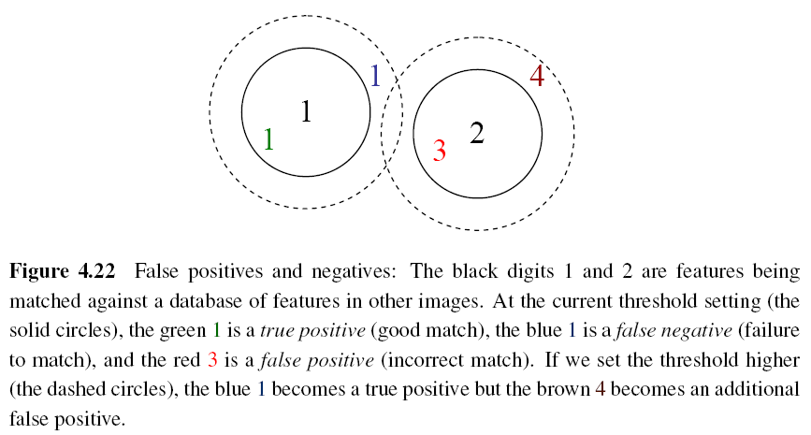
Matching Strategy (1/7)
Simplest method: set a distance threshold and match within this threshold.

Slide 32
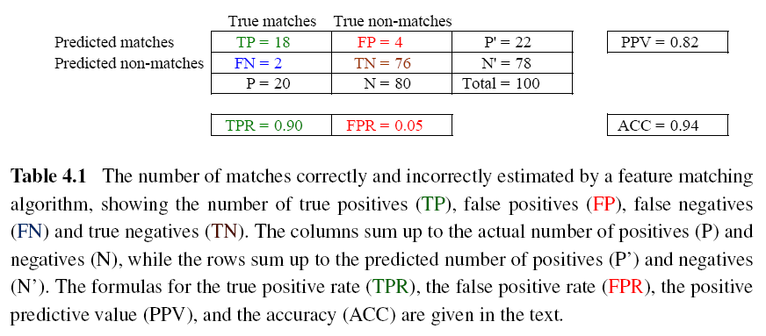
Matching Strategy (2/7)
Confusion matrix to estimate performance:
Notes:
AB:
A = T or F, means whether the result is correct
B = P or N, means the result should be correct or not
TPR (true positive rate) = TP / (TP + FN) = TP / P
FPR (false positive rate) = FP / (FP + TN) = FP / N
PPV (positive predictive value) = TP / (TP + FP) = TP / P’
ACC (accuracy) = (TP + TN) / (P + N)

Slide 33
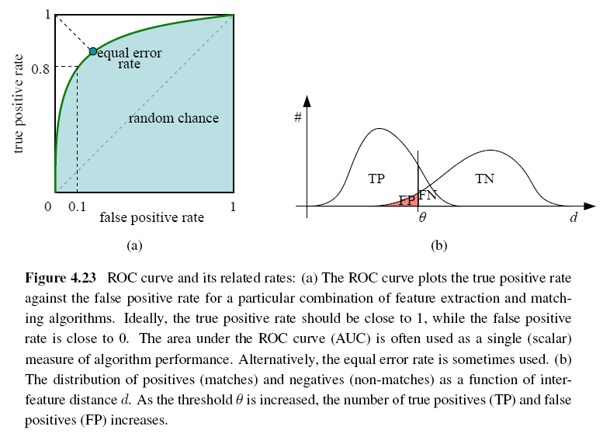
Matching Strategy (3/7)
ROC: Receiver Operating Characteristic
Notes:
Receiver operating characteristic
ideally: True positive rate -> 1 and False positive rate -> 0

Slide 34
Matching Strategy (4/7)
Other methods:
Nearest neighbor
Nearest neighbor distance ratio
Nearest neighbor distance ratio (NNDR):
d₁, d₂: nearest and second nearest distances
D_{A}: the target descriptor
D_{B} and D_{C}: closest two neighbors of D_{A}

Slide 35
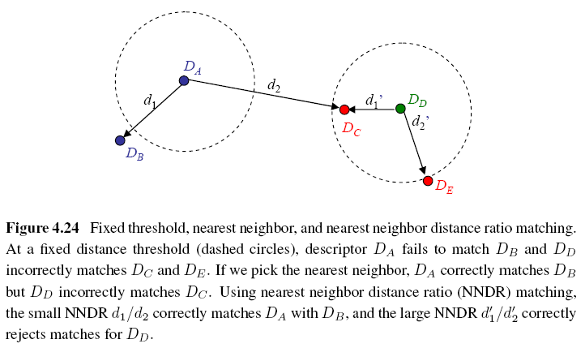
Matching Strategy (5/7)
Notes:
NNDR: used when dealing with a collection of images
If the distance of nearest feature not “MUCH” less than the second nearest feature, it means that this descriptor has no precise matching.

Slide 36
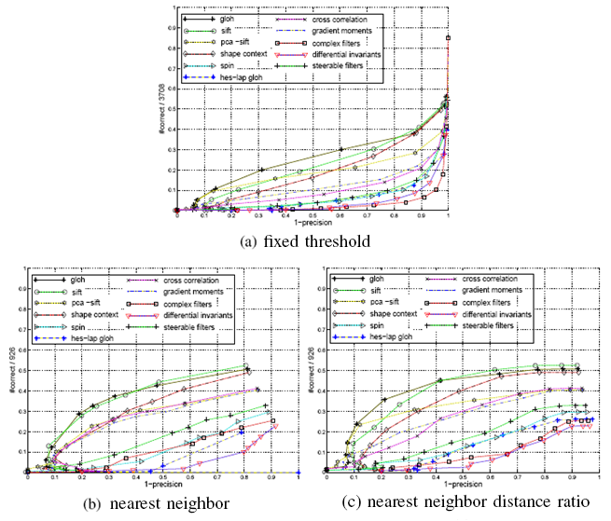
Matching Strategy (6/7)

Slide 37
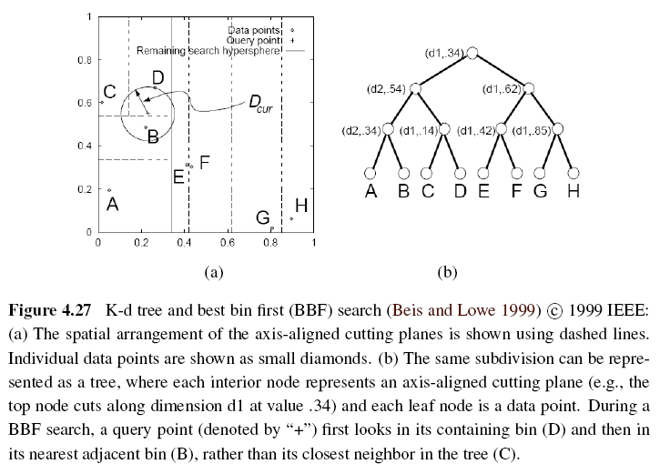
Matching Strategy (7/7)
Indexing structures:
Multi-dimensional search tree
Multi-dimensional hashing

Slide 38
4.1.4 Feature Tracking (1/3)
To find a set of likely feature locations in a first image and to then search for their corresponding locations in subsequent images.
Expected amount of motion and appearance deformation between adjacent frames is expected to be small.

Slide 39
Feature Tracking (2/3)
Selecting good features to track is closely related to selecting good features to match.
When searching corresponding patch, weighted summed square difference works well enough.

Slide 40
Feature Tracking (3/3)
If features are being tracked over longer image sequences, their appearance can undergo larger changes.
Continuously match against the originally detected feature
Re-sample each subsequent frame at the matching location
Use affine motion model to measure dissimilarity
(ex: Kanade–Lucas–Tomasi (KLT) tracker)
Notes:
The first strategy is prone to failure as the original patch can undergo appearance changes such as foreshortening.
The second runs the risk of the feature drifting from its original location to some other location in the image.
measure dissimilarity: like weighted summed square difference (only translation and measure dissimilarity)

Slide 41
4.2 Edges (1/2)
What are edges in image:
The boundaries of objects
Occlusion events in 3D
Shadow boundaries or crease edges
Grouped into longer curves or contours

Slide 42
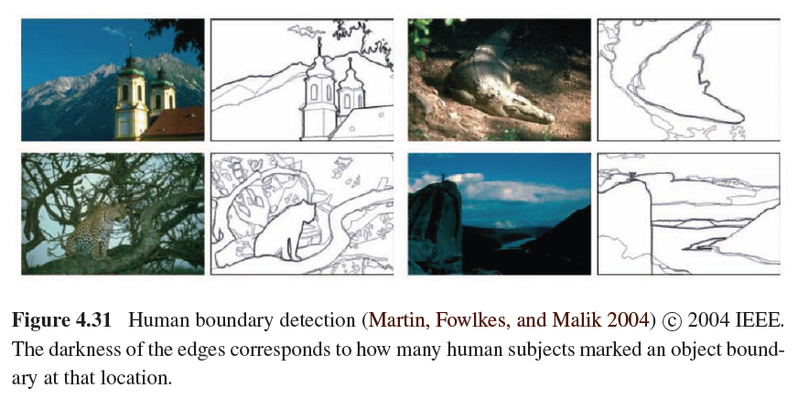
Edges (2/2)

Slide 43
4.2.1 Edge Detection (1/3)
Edge has rapid intensity variation.
J: local gradient vector
Its direction is perpendicular to the edge, and its magnitude is the intensity variation.
I: original image

Slide 44
Edge Detection (2/3)
Taking image derivatives makes noise larger.
Use Gaussian filter to remove noise:
G: Gaussian filter
σ: width of Gaussian filter
Notes:
we would like the response of our edge detector to be independent of orientation, a circularly symmetric smoothing filter is desirable.
-> Gaussian filter

Slide 45
Edge Detection (3/3)
To thin such a continuous gradient image to only return isolated edges:
Use Laplacian of Gaussian:
S: second gradient operator
Then find the zero crossings to get the maximum of gradient.

Slide 46
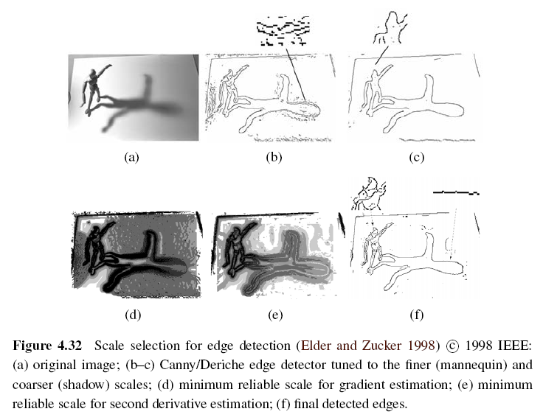
Scale Selection
Notes:
Minimum reliable scale: an reliable scale so that an edge can be reliably detected

Slide 47
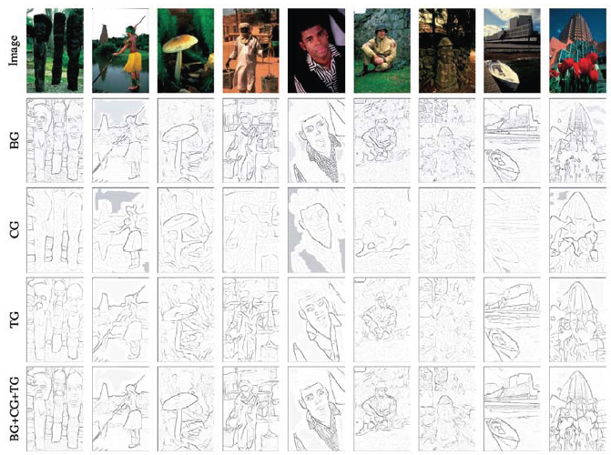
Color Edge Detection
Band separation and combination -> not good

Slide 48
4.2.2 Edge Linking
To link isolated edge into continuous contours.
If we use zero crossing to find edge, then linking is just picking up two unlinked edgels in neighbors.
Otherwise, comparing the orientation of adjacent edgels can be used.
As the curve grouped by edges more smooth, the more robust object recognition will be.
Notes:
Edgel: the pixel of an edge

Slide 49
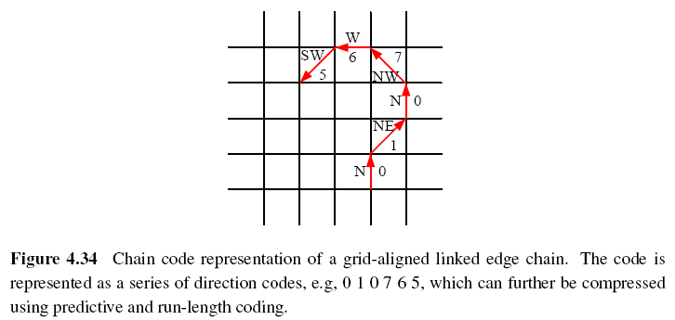
Chain Representation (1/2)
Chain code with eight direction:

Slide 50
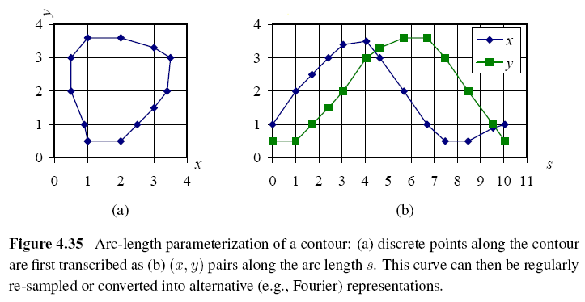
Chain Representation (2/2)
Arc length parameterization

Slide 51
4.3 Lines
Man-made world is full of straight lines, so detecting and matching these lines can be useful in a variety of applications.
Notes:
The Grassfire Transform is a name given to the concept in image processing for computing the distance of a pixel to the border of a region.

Slide 52
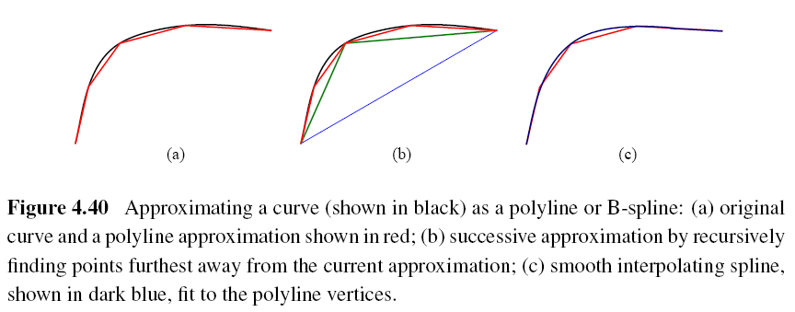
4.3.1 Successive Approximation
Line simplification:
Piecewise-linear polyline
B-spline curve
Notes:
Spline: a mathematical function used for interpolation or smoothing

Slide 53
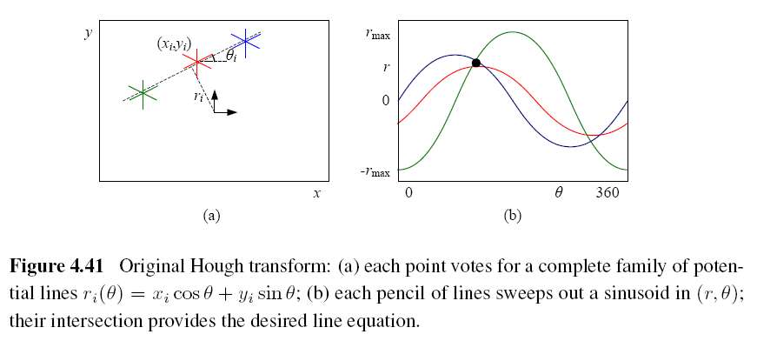
4.3.2 Hough Transforms (1/2)
Original Hough transforms:

Slide 54
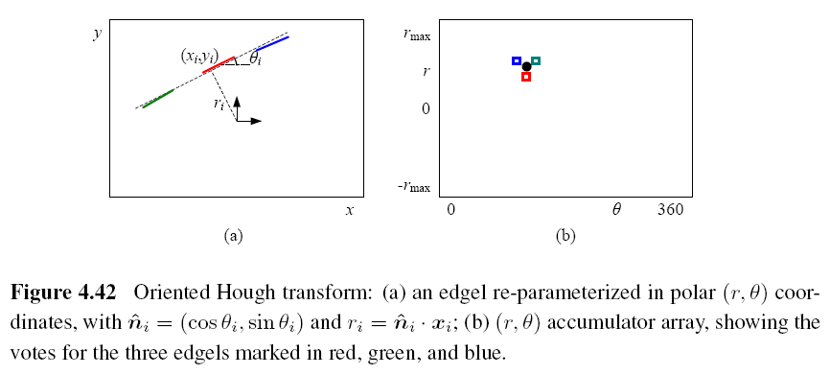
Hough Transforms (2/2)
Oriented Hough transform:

Slide 55
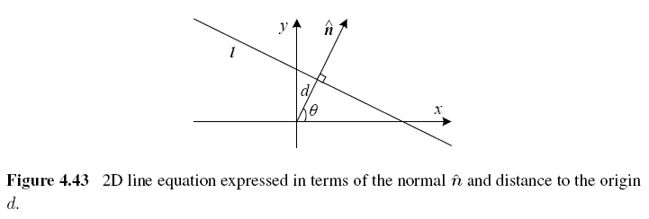
Hough Transforms Algorithm (1/2)
Step 1: Clear the accumulator array.
Step 2: For each detected edgel at location
(x, y) and orientation θ = tan⁻¹(n_{y}/n_{x}), compute the value of d = x*n_{x} + y*n_{y} and increment the accumulator corresponding to (θ, d).
Notes:
The range of (θ; d) values is [-180°; 180°] [-√2; √2], assuming that we are using normalized pixel coordinates that lie in [-1; 1].
vector n: gradient vector, θ can be estimated by local orientation.

Slide 56
Hough Transforms Algorithm (2/2)
Step 3: Find the peaks in the accumulator corresponding to lines.
Step 4: Optionally re-fit the lines to the constituent edgels.

Slide 57
RANSAC-based Line Detection
Another alternative to the Hough transform is the RANdom SAmple Consensus (RANSAC) algorithm.
RANSAC randomly chooses pairs of edgels to form a line hypothesis and then tests how many other edgels fall onto this line.
Lines with sufficiently large numbers of matching edgels are then selected as the desired line segments.
Notes:
Advantage: space efficient (no accumulator array)
Disadvantage: many more hypotheses may need

Slide 58
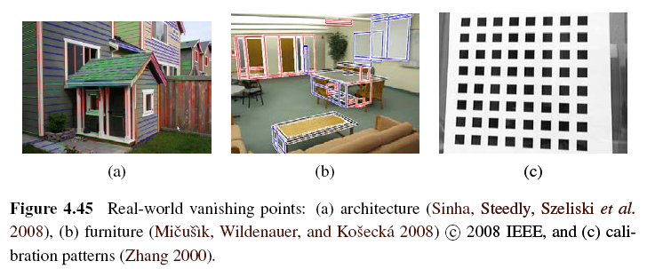
4.3.3 Vanishing Points (1/5)
Parallel lines in 3D have the same vanishing point.

Slide 59
Vanishing Points (2/5)
An alternative to the 2D polar (θ, d) representation for lines is to use the full 3D m = line equation, projected onto the unit sphere.
The location of vanishing point hypothesis:
m: line equations in 3D representation

Slide 60
Vanishing Points (3/5)
Corresponding weight:
l_{i}, l_{j}: corresponding line segment lengths
This has the desirable effect of downweighting (near-)collinear line segments and short line segments.

Slide 61
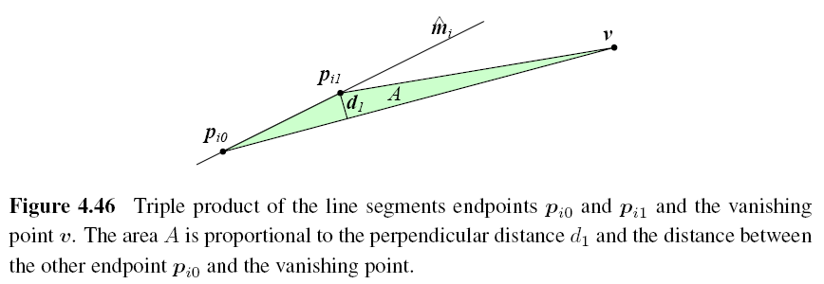
Vanishing Points (4/5)

Slide 62
Vanishing Points (5/5)
A robustified least squares estimate for the vanishing point:

