Slide 1
Advanced Computer Vision
Chapter 3
Image Processing
Presented by: 傅楸善 & 劉政倫
0989266789
a09911911@gmail.com

Slide 2
Image Processing
3.1 Point Operators
3.2 Linear Filtering
3.3 More Neighborhood Operators
3.4 Fourier Transforms
3.5 Pyramids and Wavelets
3.6 Geometric Transformations
3.7 Global Optimization
Notes:
點運算子

Slide 3
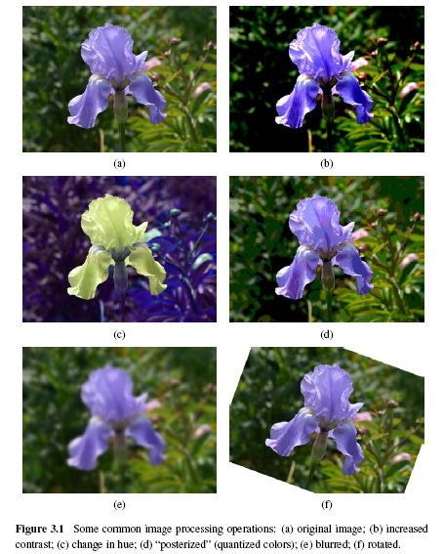

Slide 4
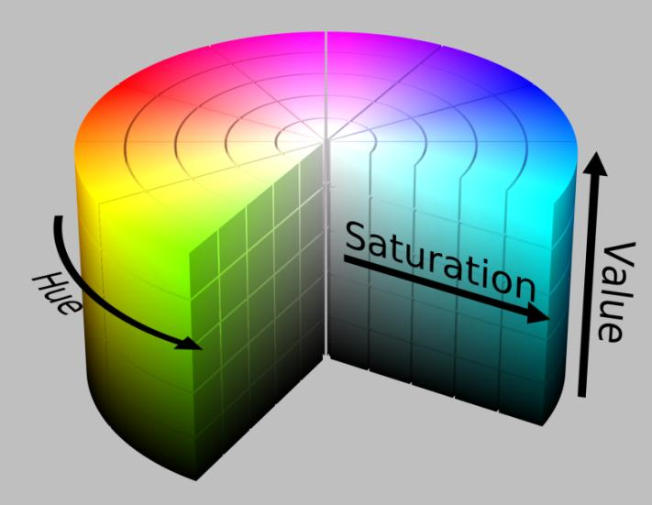

Slide 5
3.1.1 Pixel Transforms (1/5)
x is in the D-dimensional domain of the functions (usually D = 2 for images)
Functions f and g operate over some range, which can either be scalar or vector-valued, e.g., for color images or 2D motion.
For discrete images, the domain consists of a finite number of pixel locations, x = (i, j), and we can write

Slide 6
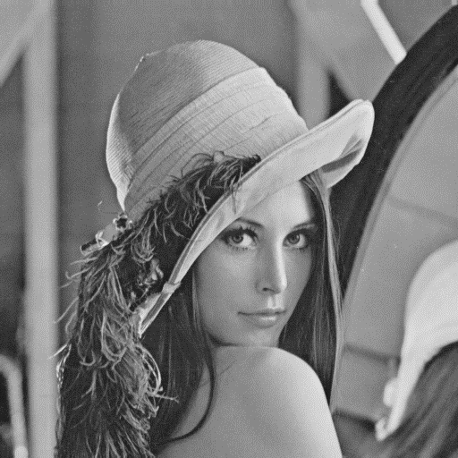
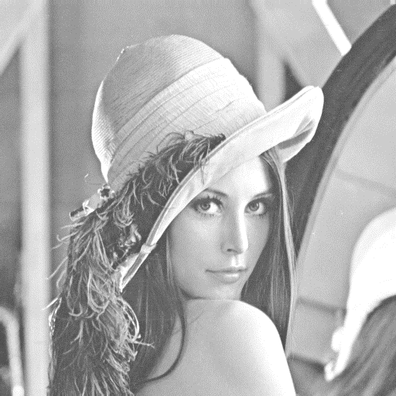
3.1.1 Pixel Transforms (2/5)
$h\left(f(x)\right)=f(x)+50$
before
after

Slide 7
3.1.1 Pixel Transforms (3/5)
Multiplication and addition with a constant
The parameters a > 0 and b are often called the gain and bias parameters.
The bias and gain parameters can also be spatially varying.

Slide 8
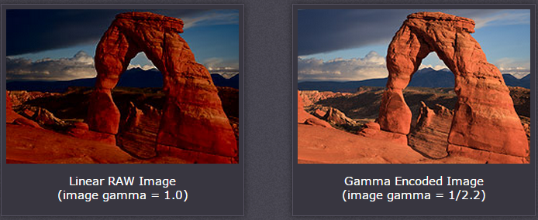
3.1.1 Pixel Transforms (4/5)
linear operation:
Non-linear transform: gamma correction
Notes:
伽瑪校正就是對影象的伽瑪曲線進行編輯，以對影象進行非線性色調編輯的方法，檢出影象訊號中的深色部分和淺色部分，並使兩者比例增大，從而提高影象對比度效果。
Gamma=2.2怎麼來的？ 將人眼感受到的灰階轉換成自然界真實的灰階 比如 (0.5)^2.2=0.2
gamma校正原理:https://www.itread01.com/content/1547003716.html
歸一化
預補償
反歸一化

Slide 9
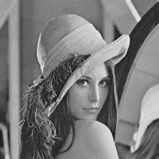
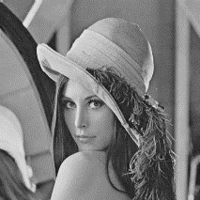
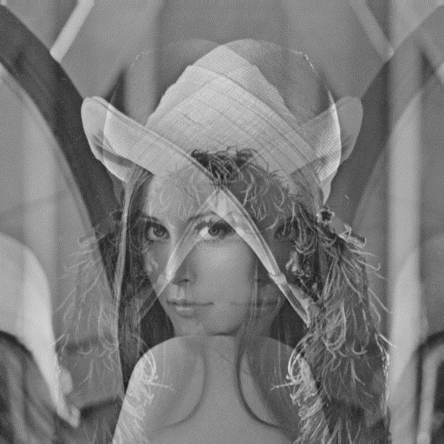
3.1.1 Pixel Transforms (5/5)
Dyadic (two-input) operator is the linear blend operator
$$f_{0}(x)$$
$$f_{1}(x)$$
$$α=0.7$$
$α=0.$2

Slide 10
3.1.2 Color Transforms
In fact, adding the same value to each color channel not only increases the apparent intensity of each pixel, it can also affect the pixel’s hue and saturation.

Slide 11
3.1.3 Compositing and Matting (1/4)
In many photo editing and visual effects applications, it is often desirable to cut a foreground object out of one scene and put it on top of a different background.
The process of extracting the object from the original image is often called matting, while the process of inserting it into another image (without visible artifacts) is called compositing.
Notes:
Matting: 抽圖
Compositing: 合成

Slide 12
3.1.3 Compositing and Matting (2/4)
Alpha-matted color image
In addition to the three color RGB channels, an alpha-matted image contains a fourth alpha channel α (or A) that describes the relative amount of opacity or fractional coverage at each pixel.
Notes:
阿法遮罩，是代表對於影像前景透明度的遮罩，大小和影像相同，遮罩中每個像素的值為相應的影像像素的阿法值（英語：Alpha）。阿法值為1代表該像素屬於前景，0則代表該像素屬於背景。阿法值也可能介於0,1之間，表示對應到的影像像素為半透明，例如煙霧、動態模糊。
有些圖片額外增加一個數值，代表透明程度；簡稱 A ， alpha 的首字母。
0 是完全透明、呈現背景底色； 255 是完全不透明、呈現圖片原色；其餘數值則按比例混合圖片顏色與背景底色。

Slide 13
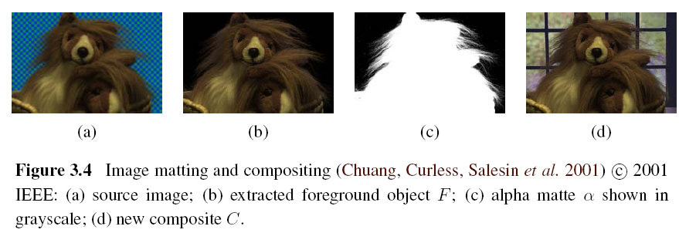
3.1.3 Compositing and Matting (3/4)
Alpha-matted color image
Pixels within the object are fully opaque (α= 1), while pixels fully outside the object (Background) are transparent (α= 0).
Notes:
已經有先分出Background與Foreground，所以a=1套入後就是前景不透明背景透明
(c)就是a頻道的值以灰階顯示

Slide 14
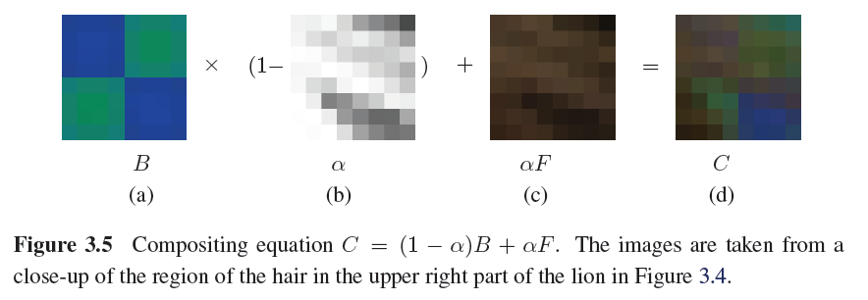
3.1.3 Compositing and Matting (4/4)
Notes:
注意背景與前景差別，背景已經用(1-a)希望他透明了
1為不透明，0為透明
這邊的a值以灰階圖表示，越白就是越接近1，前景就越不透明

Slide 15
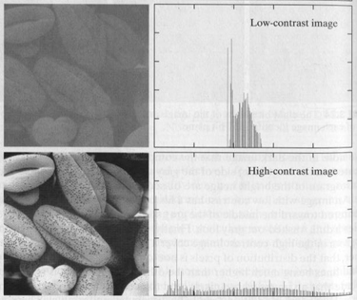
3.1.4 Histogram Equalization
Find intensity mapping function f(I)
Use Histogram Equalization
Flat histogram with high contrast

Slide 16
3.1.4 Histogram Equalization
Source Image -> Histogram
Use histogram to calculate PDF of each gray value.
PDF->CDF
Round value in CDF to make our table.
Look up table.

Slide 17
3.1.4 Histogram Equalization
Notes:
本圖的Source Image 是一張 64*64 Intensity 3-bit 的Digital Image。
Source Image -> Histogram
利用 Histogram 算出各個灰階值的 PDF
將PDF 做累加求出 CDF
將CDF 的結果 4捨5入後做出對照表
透過查詢剛剛建立的對照表，決定Transition 完各個灰階值的機率

Slide 18
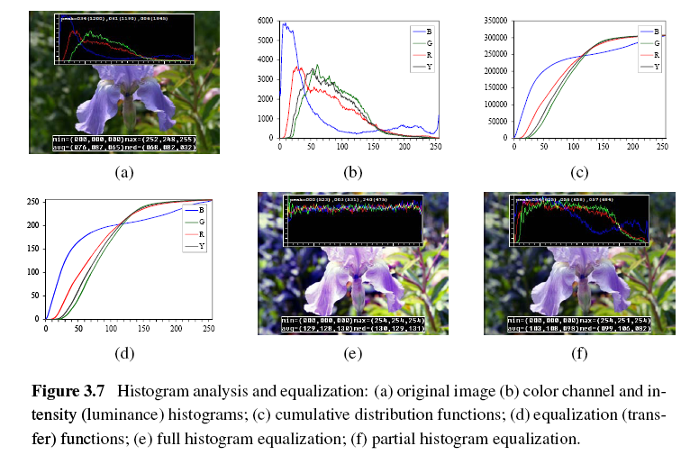

Slide 19
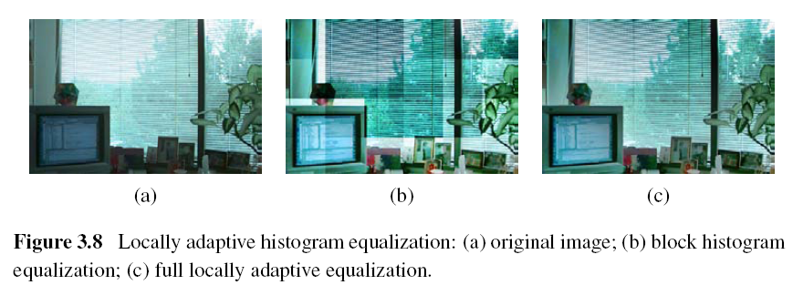
Locally Adaptive Histogram Equalization
Subdivide the image into M×M pixel blocks and perform separate histogram equalization in each sub-block.
But the resulting image exhibits a lot of blocking artifacts, i.e., intensity discontinuities at block boundaries.

Slide 20
Locally Adaptive Histogram Equalization
One way to eliminate blocking artifacts is to use a moving window, i.e., to recompute the histogram for every M×M block centered at each pixel.
A more efficient approach is to compute non-overlapped block-based equalization functions as before, but to then smoothly interpolate the transfer functions as we move between blocks. This technique is known as adaptive histogram equalization (AHE).
Notes:
先做好 block HE，本頁為改善方式

Slide 21
Locally Adaptive Histogram Equalization
Adaptive Histogram Equalization (AHE)
The weighting function for a given pixel (i, j) can be computed as a function of its horizontal and vertical position (s, t) within a block.
bilinear blending function
Notes:
就是在說用雙線姓內插解決邊界瑕疵

Slide 22
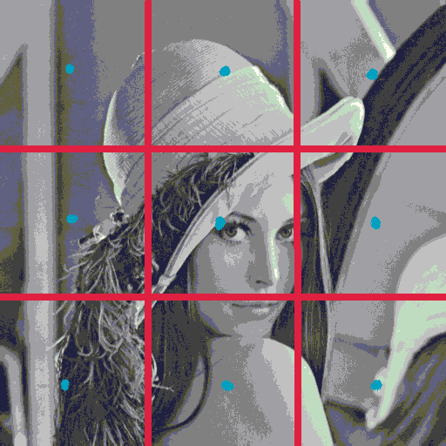

Slide 23
f₀₀
t
1-t
f₀₁
f₀₂
s
1-s
f₁₀
f₁₁
f₁₂
f₂₀
f₂₁
f₂₂
Notes:
bilinear blending function 就是運用各個block的中間pixel值，去跟附近的座內插如上

Slide 24
f₀₀
t
1-t
f₀₁
s
$$(1−s)f_{00}+(s)f_{10}$$
$$(1−s)f_{01}+(s)f_{11}$$
1-s
f₁₀
f₁₁
$$\left(1−t\right)(\left(1−s\right)f_{00}+\left(s\right)f_{10}) + (t)(\left(1−s\right)f_{01}+\left(s\right)f_{11})$$

Slide 25
Image Processing
3.1 Point Operators
3.2 Linear Filtering
3.3 More Neighborhood Operators
3.4 Fourier Transforms
3.5 Pyramids and Wavelets
3.6 Geometric Transformations
3.7 Global Optimization

Slide 26
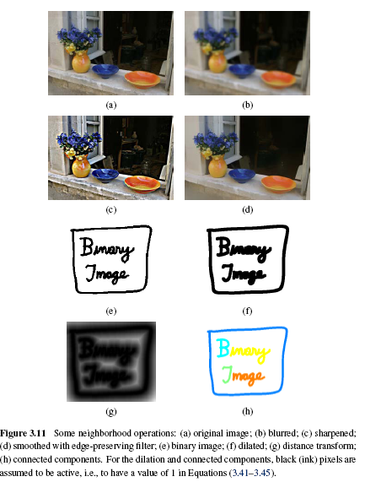
Notes:
(h)後面會提到用filter做smooth會無法照顧到整張圖的邊緣部分
(g)Distance Transforms 後面會提到，有City block or Manhattan distance與Euclidean distance等等

Slide 27
3.2 Linear Filtering
An output pixel’s value is determined as a weighted sum of input pixel values.
Notes:
3x3 block的話就是 k, l 由-1到+1

Slide 28
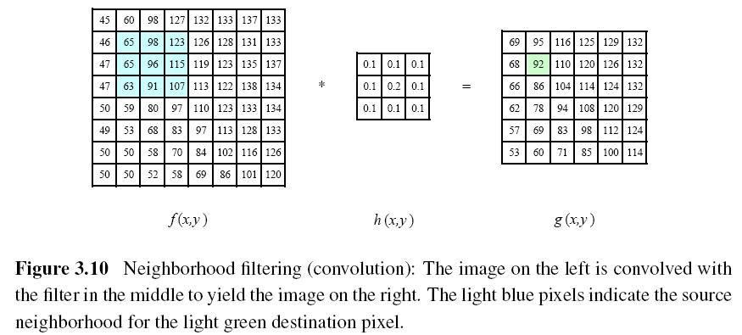
Notes:
92 = 65*0.1 + 98*0.1 + 123*0.1 + 65*0.1 + 96*0.2 + 115*0.1 + 63*0.1 + 91*0.1 + 107*0.1
此範例上下左右對稱，所以correlation與convolution結果相同

Slide 29
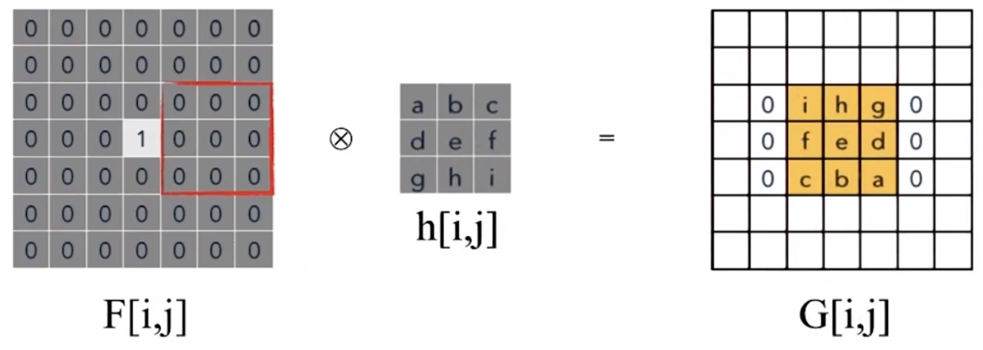
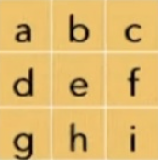
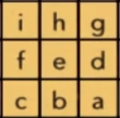

Slide 30
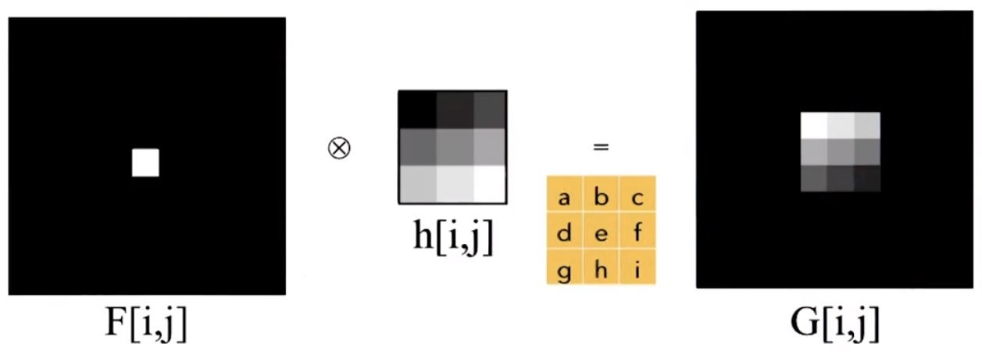

Slide 31
Matrix-Vector Form
A one-dimensional convolution can be represented in matrix-vector form.
Notes:
這邊也考慮了邊界，一般不會考慮，不考慮的話就把第一和最後一橫列去掉即可
此時會需要填補，也就是下一頁內容

Slide 32
Padding (Border Effects)
zero: set all pixels outside the source image to 0.
constant (border color): set all pixels outside the source image to a specified border value.
clamp (replicate or clamp to edge): repeat edge pixels indefinitely
Notes:
Kernel很大的話是有可能這麼多區域為黑色的，其他方式造成的邊界效應也是用這些

Slide 33
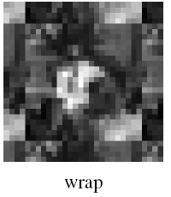
Padding (Border Effects)
mirror: reflect pixels across the image edge
(cyclic) wrap (repeat or tile): loop “around” the image in a toroidal configuration
Raw
Notes:
Wrap: 最上面的邊界效應用中間區域的下半部去填補，形成環形配置感

Slide 34
3.2.1 Separable Filtering (1/2)
The process of performing a convolution requires K² operations per pixel, where K is the size (width or height) of the convolution kernel.
The simplest filter to implement is the moving average or box filter, which simply averages the pixel values in a K×K window.

Slide 35
3.2.1 Separable Filtering (2/2)
This operation can be significantly sped up:
Perform a one-dimensional horizontal convolution.
Perform a one-dimensional vertical convolution.
The above method only requires 2K operations per pixel.
Notes:
這頁抄黑板，描述為何可分離

Slide 36
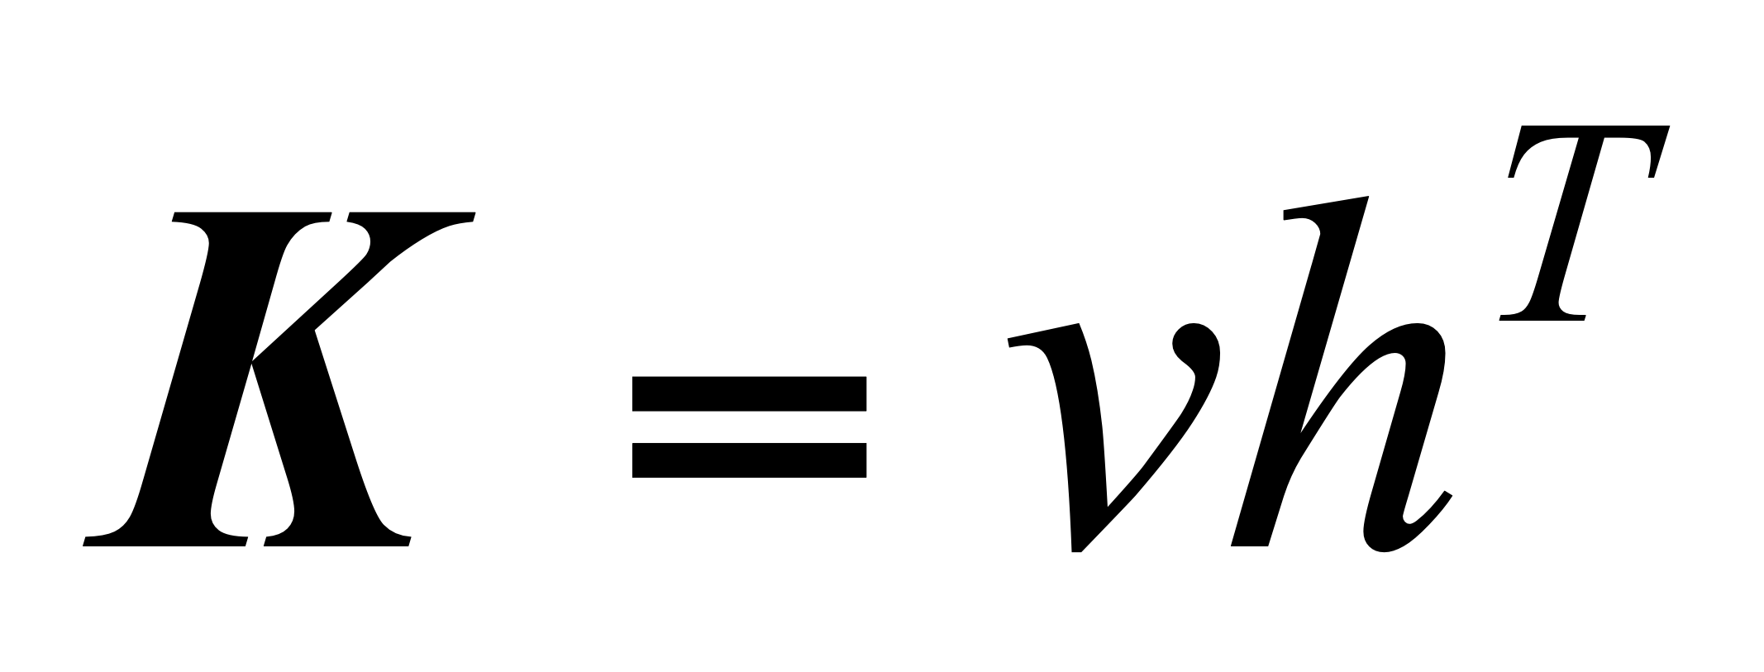
3.2.2 Examples of Linear Filtering
It is easy to show that the two-dimensional kernel K corresponding to successive convolution with a horizontal kernel h and a vertical kernel v is the outer product of the two kernels,

Slide 37
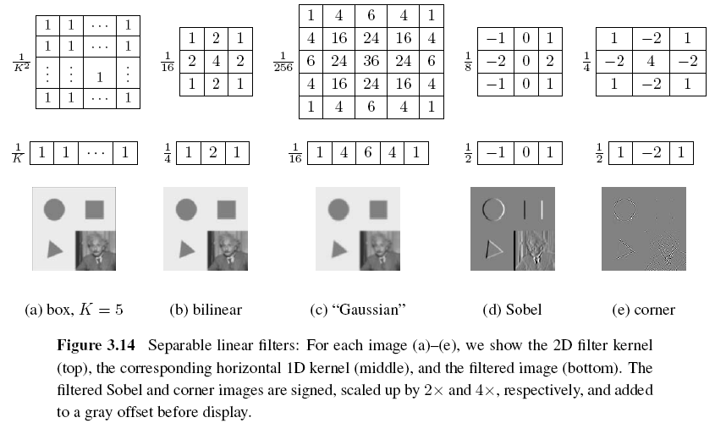
Notes:
Sobel邊緣檢測演算法 : https://www.itread01.com/content/1546447870.html
可知這邊的一維都符合剛剛說的可分離計算法則
索伯檢測邊緣，e是檢測角落

Slide 38
3.2.3 Band-Pass and Steerable Filters (1/4)
The Sobel and corner operators are simple examples of band-pass and oriented filters.
More sophisticated kernels can be created by first smoothing the image with a Gaussian filter, and then taking the first or second derivatives.
Such filters are known collectively as band-pass filters, since they filter out both low and high frequencies.
Notes:
帶通濾波器之用途是只使特定頻帶之訊號通過的電，像是Sobel讓邊緣的訊號通過，corner讓角落的訊號通過

Slide 39
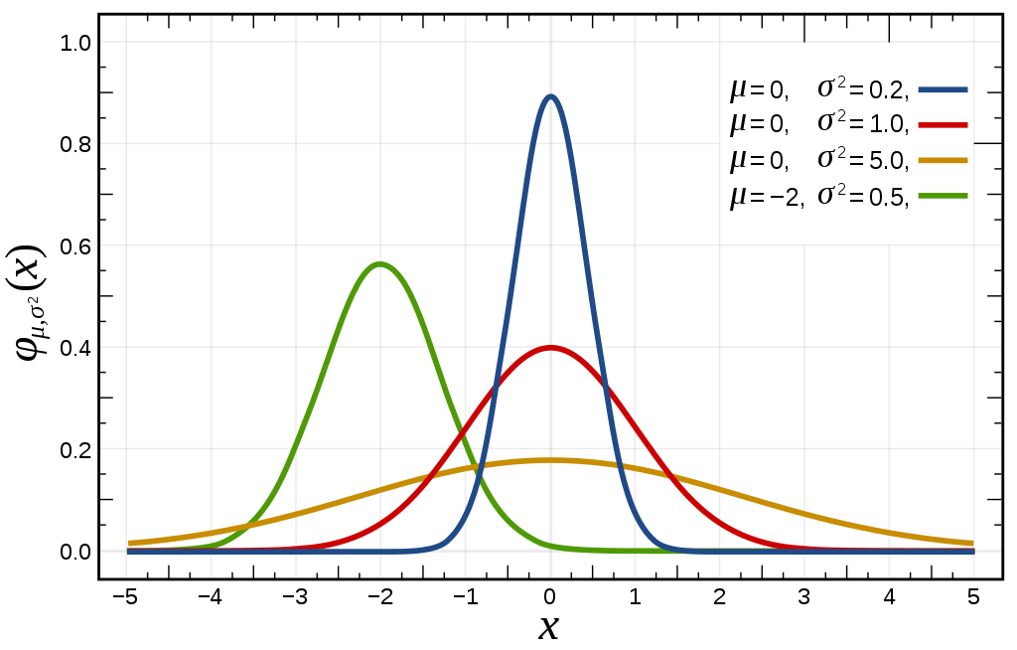
3.2.3 Band-Pass and Steerable Filters (1/3)
The (undirected) second derivative of a two-dimensional image is known as the Laplacian operator.
Normal (Gaussion) distribution is a type of continuous probability distribution of real-valued random variable
The general form of its probability density function is

Slide 40
3.2.3 Band-Pass and Steerable Filters (1/3)
The general form of its probability density function is
Blurring an image with a Gaussian and then taking its Laplacian is equivalent to convolving directly with the Laplacian of Gaussian (LoG) filter.
http://fourier.eng.hmc.edu/e161/lectures/gradient/node8.html
Notes:
https://codertw.com/%E7%A8%8B%E5%BC%8F%E8%AA%9E%E8%A8%80/560259/

Slide 41
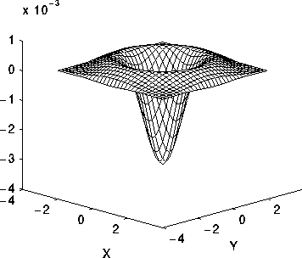
3.2.3 Band-Pass and Steerable Filters (1/3)
One-dimensional Gaussian function
Two-dimensional Gaussian function
Blurring an image with a Gaussian and then taking its Laplacian is equivalent to convolving directly with the Laplacian of Gaussian (LoG) filter.
Notes:
推導在下一頁

Slide 42
3.2.3 Band-Pass and Steerable Filters (1/3)

Slide 43
3.2.3 Band-Pass and Steerable Filters (2/3)
The Sobel operator is a simple approximation to a directional or oriented filter, which can be obtained by smoothing with a Gaussian (or some other filter) and then taking a directional derivative , which is obtained by taking the dot product between the gradient field and a unit direction
Notes:
高斯濾波: https://codertw.com/%E7%A8%8B%E5%BC%8F%E8%AA%9E%E8%A8%80/560259/
LoG代表做一次Laplacian
directional derivative: 方向導數: http://blog.ncue.edu.tw/sys/lib/read_attach.php?id=13237
梯度P內積n向量是否等於對P偏微n向量

Slide 44
3.2.3 Band-Pass and Steerable Filters (3/3)
The smoothed directional derivative filter,
is an example of a steerable filter, since the value of an image convolved with can be computed by first convolving with the pair of filters (G_{x}, G_{y}) and then steering the filter by multiplying this gradient field with a unit vector
Notes:
可導引濾波器(steerable filter)的特性為"任意方向的濾波器,可用有限個固定方 向的濾波器當基底(basis filter)來線性合成" (linear combination).

Slide 45
Example of Steerable Filters
a
b
c

Slide 46
Example of Steerable Filters

Slide 47
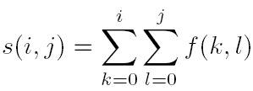
Summed Area Table (Integral Image)
To find the summed area (integral) inside a rectangle[i₀, i₁] ×[j₀, j₁], we simply combine four samples from the summed area table,
Notes:
積分影像 ( integral image ) 又可稱 summed area table (總合面積表)
Integral image: https://dotblogs.com.tw/dragon229/2013/01/18/87485
Integral image 示意圖在下一頁

Slide 48
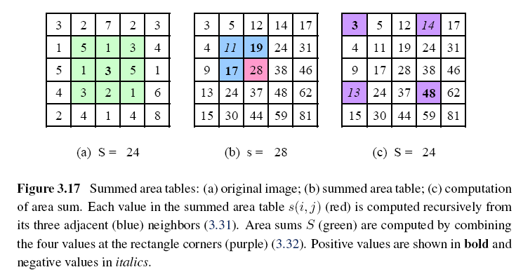
Notes:
(a)S=24是綠色區域的和
(b)s=28是粉色區域的值
(c)s=24公式在上一頁，意思是48-14-13+3
https://dotblogs.com.tw/dragon229/2013/01/18/87485 有說
(a)和(c)都得到24，也就是的好處
好處與使用時機裡面也有寫!
Bold = 粗體
Italics = 斜體

Slide 49
Image Processing
3.1 Point Operators
3.2 Linear Filtering
3.3 More Neighborhood Operators
3.4 Fourier Transforms
3.5 Pyramids and Wavelets
3.6 Geometric Transformations
3.7 Global Optimization

Slide 50
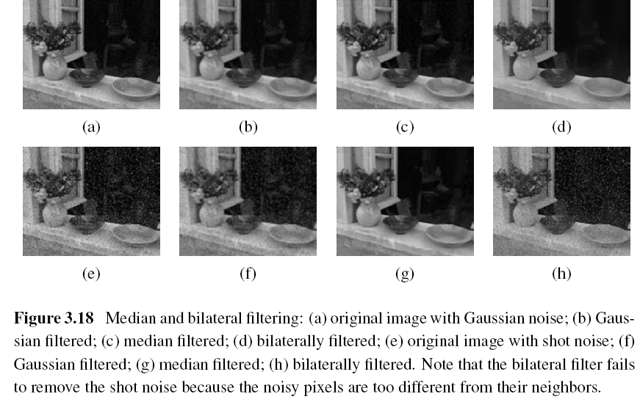
3.3 More Neighborhood Operators
Notes:
Bilateral filtering: https://www.itread01.com/content/1541801252.html (含高斯濾波)
Shot noise = 散粒雜訊

Slide 51
3.3.1 Non-Linear Filtering
Median filtering: selects the median value from each pixel’s neighborhood.
Notes:
Median filter: http://honglung.pixnet.net/blog/post/85115497-image-processing---%E4%B8%AD%E5%80%BC%E6%BF%BE%E6%B3%A2(median-filter)

Slide 52
3.3.1 Non-Linear Filtering
Median filtering:

Slide 53
3.3.1 Non-Linear Filtering
α-trimmed mean: averages together all of the pixels except for the α fraction that are the smallest and the largest.
Notes:
扣掉上下兩格後取平均

Slide 54
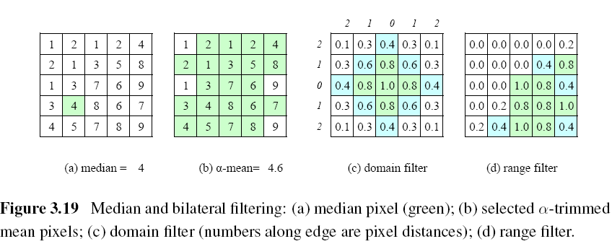
Notes:
傳統常使用的濾波器為距離濾波器(domain filter)，亦即高斯低通濾波器
相似度濾波器(range filter): 中心點7為基準1.0，相差1的pixel為0.8，相差2為0.4，相差3為0.2，再多都是0
雙邊濾波（bilateral filtering）的基本思路是同時考慮將要被濾波的畫素點的空域資訊（domain）和值域資訊（range）。因此他集合了距離濾波器濾除雜訊的特性以及相似度濾波器可以留住邊緣(此邊緣是索伯那種邊緣不是整張圖的邊緣)的特性
許多不同濾波器在第二節: http://rportal.lib.ntnu.edu.tw/bitstream/20.500.12235/95761/2/n069475002502.pdf

Slide 55
Bilateral Filtering
The output pixel value depends on a weighted combination of neighboring pixel values
w(i, j, k, l): bilateral weight function, which is depends on the product of a domain kernel and a data-dependent range kernel.
Notes:
雙邊濾波原理: https://codertw.com/%E7%A8%8B%E5%BC%8F%E8%AA%9E%E8%A8%80/574284/
W(i ,j ,k ,l )公式長那樣，可看出括弧內第一式代表空間(domain filter)，空間的決定關係靠的是高斯分布，第二式代表range filter

Slide 56
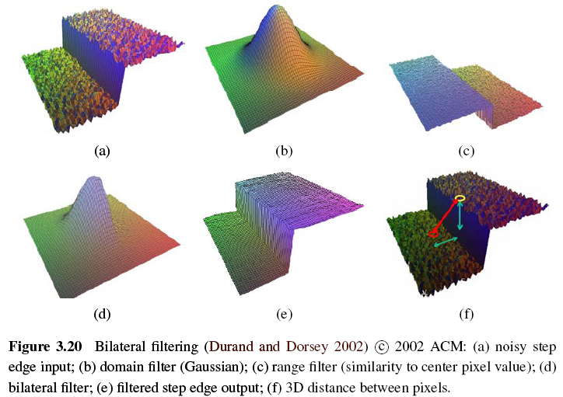

Slide 57
Bilateral Filtering
Notes:
除了平滑(Gaussion)還可保有物件邊緣特徵(range)

Slide 58
3.3.2 Morphology (1/4)
The most common binary image operations are called morphological operations, since they change the shape of the underlying binary objects.
Such images often occur after a thresholding operation,

Slide 59
3.3.2 Morphology (2/4)
We first convolve the binary image with a binary structuring element and then select a binary output value depending on the threshold result of the convolution.
Notes:
S 即 structure element 看你要甚麼

Slide 60
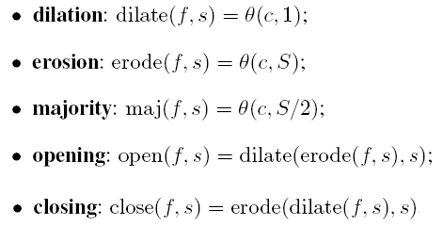
3.3.2 Morphology (3/4)
c: count of the number of 1s inside each structuring element as it is scanned over the image
s: structuring element
S: the size of the structuring element
Notes:
morphology這幾頁全部改掉自己做一份

Slide 61
0 | 0 | 1 | 1 | 0
0 | 2 | 3 | 3 | 0
1 | 3 | 5 | 4 | 1
1 | 3 | 5 | 3 | 1
0 | 2 | 2 | 2 | 0
$$=$$
0 | 0 | 1 | 1 | 0
0 | 2 | 3 | 3 | 0
1 | 3 | 5 | 4 | 1
1 | 3 | 5 | 3 | 1
0 | 2 | 2 | 2 | 0
0 | 0 | 1 | 1 | 0
0 | 2 | 3 | 3 | 0
1 | 3 | 5 | 4 | 1
1 | 3 | 5 | 3 | 1
0 | 2 | 2 | 2 | 0
Dilation
Erosion
Notes:
黑塊是0，白塊為1
Dilation: 大於1的才會有東西
Erosion: kernal都有值的5才會留下

Slide 62
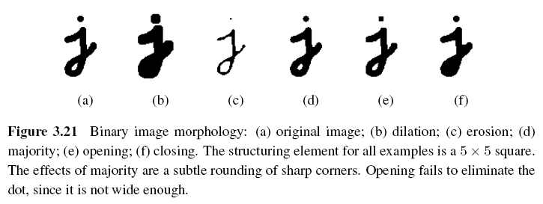
3.3.2 Morphology (4/4)

Slide 63
3.3.3 Distance Transforms
City block or Manhattan distance
Euclidean distance
The distance transform is then defined as
Notes:
叫做city block的意思應該是，城市你要從某地走到某地，中間的block你無法穿越，所以只能兩步到位
歐基里德距離就是一般常見的

Slide 64
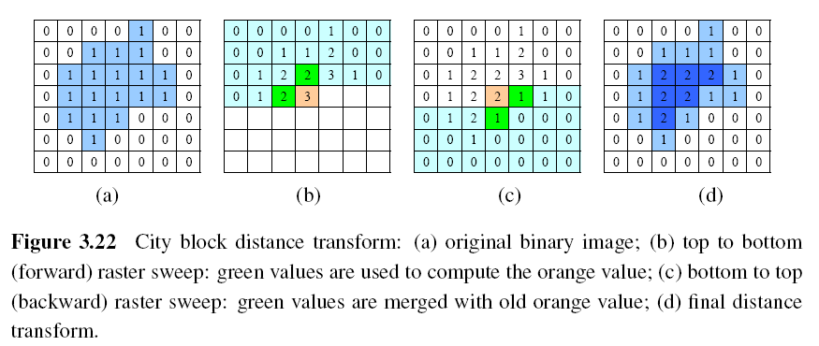
During the forward pass, each non-zero pixel is replaced by the minimum of 1 + the distance of its north or west neighbor.
During the backward pass, the same occurs.
Notes:
前向計算與後向計算可看: http://ccy.dd.ncu.edu.tw/~chen/course/vision/ch7/%E7%AC%AC%E4%B8%83%E5%96%AE%E5%85%83%20%E7%B4%B0%E7%B7%9A%E5%8C%96%E8%88%87%E9%AA%A8%E6%9E%B6%E6%8A%BD%E5%8F%96.pdf
網址內的8-distance即可了解，主要看取最小值+1那部分，而本頁Figure3.22的是4-ditance的，最終結果也差不多
可以自己設一個7x7矩陣，邊緣都設為0，內部都為1，算出city block distance transform 可得到最內部為3，即可得知這些值代表該像素跟0的最近距離為何

Slide 65
3.3.4 Connected Components (1/3)
To compute the connected components of an image, we first split the image into horizontal runs of adjacent pixels, and then color the runs with unique labels, re-using the labels of vertically adjacent runs whenever possible. In a second phase, adjacent runs of different colors are then merged.

Slide 66
Review
Notes:
1的部分被切掉了
這邊黑白各別分隔

Slide 67
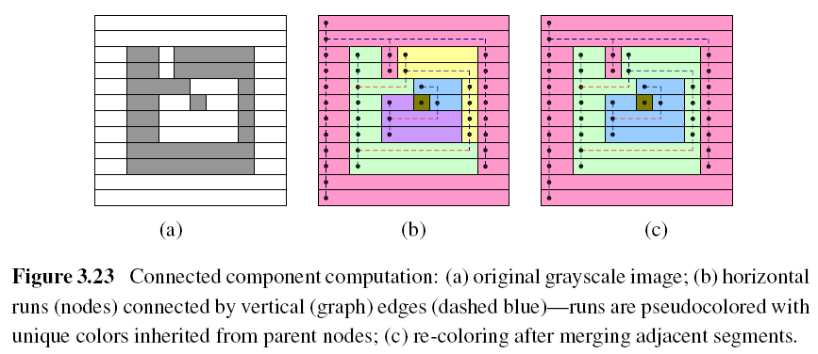
3.3.4 Connected Components (1/2)
Notes:
可以放上學期CH2的p.39投影片解釋
這邊黑白各別分隔

Slide 68
3.3.4 Connected Components (2/2)
The area (number of pixels)
The perimeter (number of boundary pixels)
The centroid (average x and y values)
Notes:
可放上學期CH3我教的那邊
Perimeter看你要用4 connective 或是 8 connective

Slide 69
Image Processing
3.1 Point Operators
3.2 Linear Filtering
3.3 More Neighborhood Operators
3.4 Fourier Transforms
3.5 Pyramids and Wavelets
3.6 Geometric Transformations
3.7 Global Optimization
Notes:
http://ip.csie.ncu.edu.tw/course/IP/IP1505cp.pdf
數位影像表示法: http://aries.dyu.edu.tw/~thhu/EN/chapter4.pdf

Slide 70
3.4 Fourier Series (1/2)
Notes:
以下圖形代表利用 sin(nx) 的波形去組合出函數 f(x) 的一個情況
根據這種方法、前面的項數加得越多，逼近的程度就越高、越精確。
可以講一下Gibbs 現象
一定要給他們看維基的動圖，最後得到的是振幅的離散圖
也才可以解釋為何通常挖掉中間就代表頻率低的

Slide 71
3.4 Fourier Series (2/2)
Complete Orthogonal function set: Fourier Series
Complex Fourier Series
Fourier Integral
Fourier Transform and Inverse
Notes:
頻域表示將原訊號看成是不同的正交序號組成，如向量空間中的基底
傅立葉轉換就是將原影像轉換成頻率部分
複數的傅立葉級數可推得傅立葉積分，傅立葉積分差不多就是傅立葉轉換了(喻p.825)，中間過程牽涉太多證明，這邊了解到這裡就很足夠
1.從複數的傅立葉級數到傅立葉積分，只要令頻率w=n拍/l 即可

Slide 72
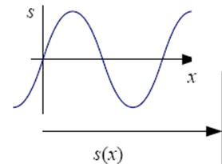
3.4 Fourier Transforms (1/5)
f : frequency
: angular frequency
: phase
A: the gain or magnitude of the filter

Slide 73
3.4 Fourier Transforms (2/5)

Slide 74
3.4 Fourier Transforms (3/5)
The Fourier transform is simply a tabulation of the magnitude and phase response at each frequency
Fourier transform pair:
Continuous domain:
Discrete domain:
Notes:
影像等等當然是應用在離散的傅立葉轉換
傅立葉有許多版本，反正課本教的版本如上

Slide 75
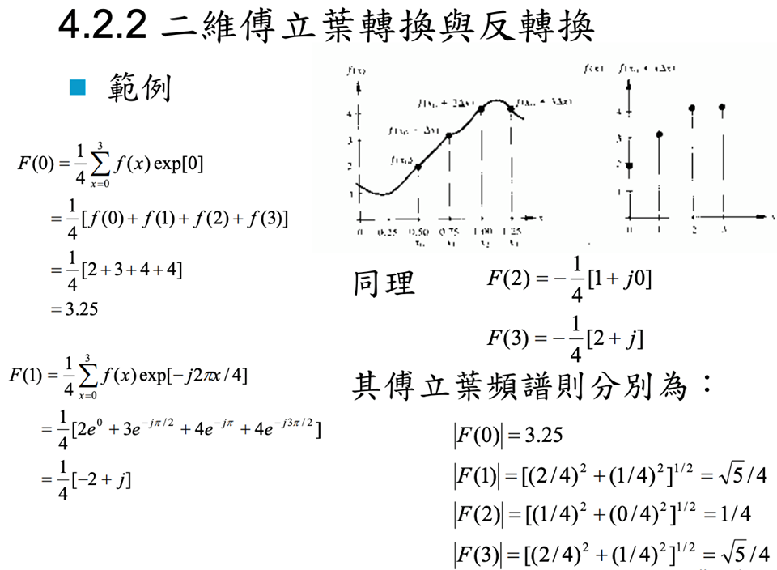
3.4 Fourier Transforms (4/5)
Notes:
因為影像是離散的所以取樣即可

Slide 76
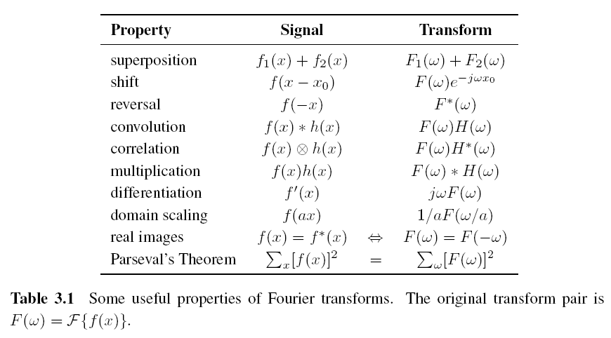
3.4 Fourier Transforms (5/5)
Notes:
可以自己出幾個基本範例，或是convolution證明，畢竟常常在講到convolution
而且兩個函數個別做完傅立葉轉換後，接著相乘，再做傅立葉反轉換即可得到原始兩函數做卷積的這個效果

Slide 77
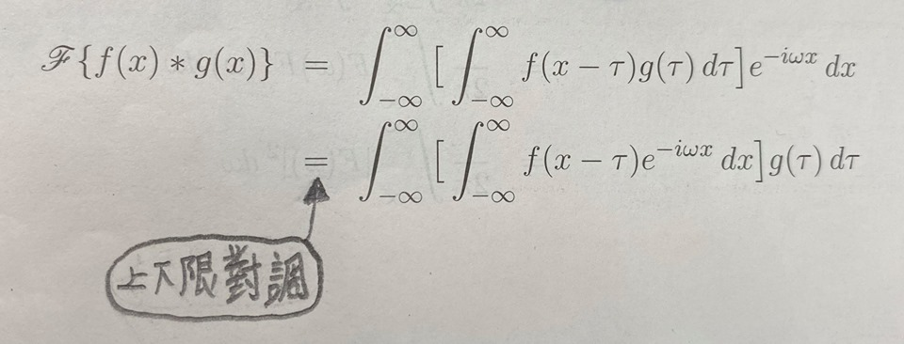
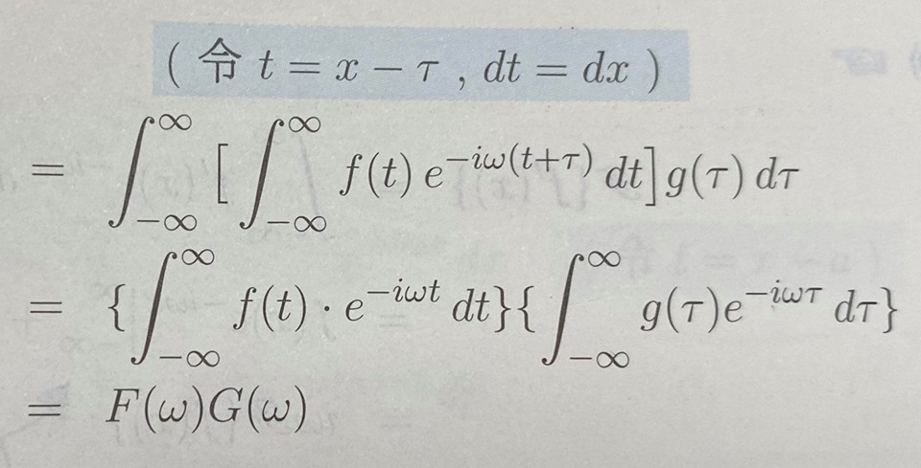
3.4 Fourier Transforms (convolution)
Notes:
可知算兩個convolution的另一個方法:
1.先各取傅立葉轉換
2.再相乘
3.相乘結果做反轉換可得
可以提到Laplace轉換，下底是0，上圖上下線轉換在Laplace轉換就有關係了，但不在討論範圍不用特別說

Slide 78
3.4 Fourier Transforms (convolution)
Notes:
看一下動圖
說明影像捲積步驟與訊號的差不多

Slide 79
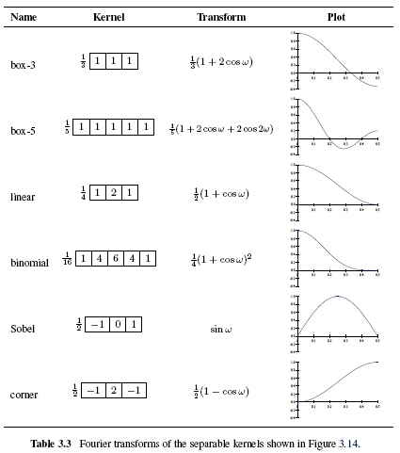

Slide 80
3.4 Fourier Transforms
We use Fourier Transforms to analyze what a given filter does to high, medium, and low frequencies.
Notes:
https://www.slideshare.net/YKLee3434/spatial-filtering-41713087 和桌面的ppt是FT的sources

Slide 81
3.4 Two-Dimensional Fourier Transforms
Continuous domain:
Discrete domain:

Slide 82
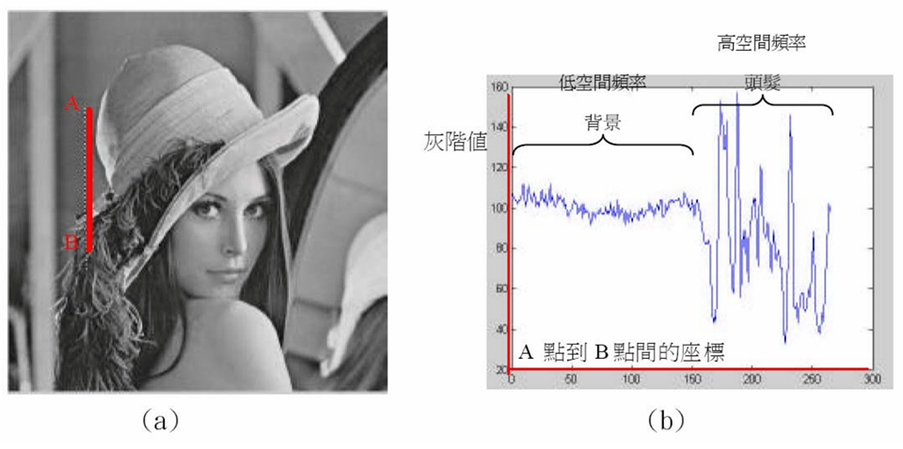
Image Frequency
Notes:
空間頻率: 影像的亮度從暗轉亮或是亮轉暗的變化頻率，解析度越大也越可能得到高頻圖片

Slide 83
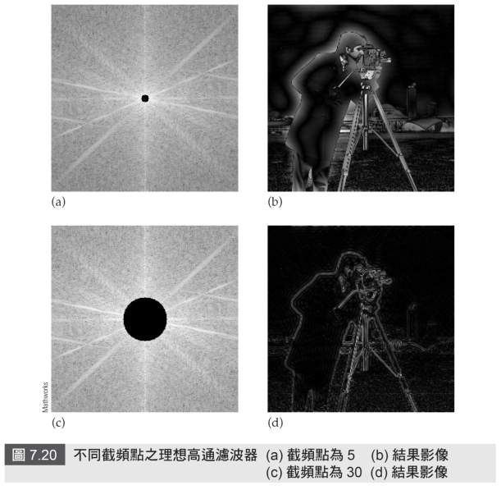
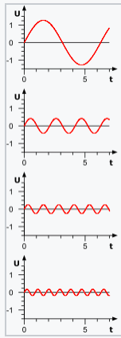
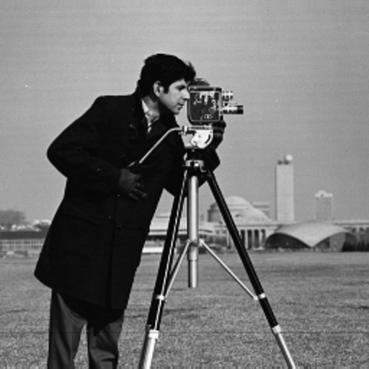
3.4 Two-Dimensional Fourier Transforms
Notes:
http://machinevision.iem.yzu.edu.tw/vision/thesis/105_Chihkai%20Huang/%E7%B6%B2%E9%A0%81%E7%89%882.htm
低頻的可以想像成只有一個波峰，由傅立葉級數那邊可知道，所以去掉中間黑圈圈就代表可去掉低頻，而成高通濾波器
這邊就是一個轉換與反轉換的例子

Slide 84
3.4 Two-Dimensional Fourier Transforms
Low Pass Filter:
High Pass Filter:
Notch Filter:
Notes:
http://machinevision.iem.yzu.edu.tw/vision/thesis/105_Chihkai%20Huang/%E7%B6%B2%E9%A0%81%E7%89%882.htm
低頻的可以想像成只有一個波峰，由傅立葉級數那邊可知道，所以去掉中間黑圈圈就代表可去掉低頻，而成高通濾波器
低通濾波器就像是個高斯曲線
這邊就是一個轉換與反轉換的例子

Slide 85
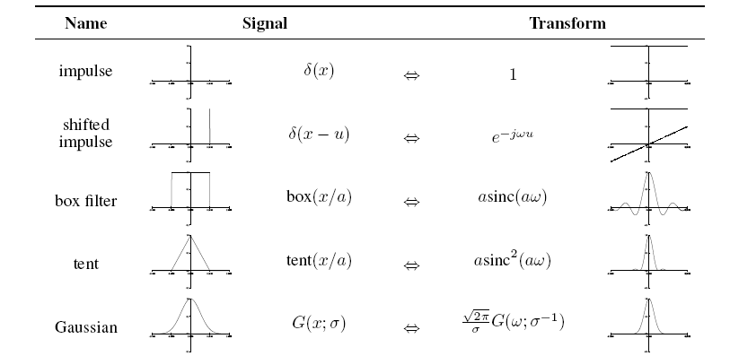
3.4 Fourier Transform Pairs
Notes:
可以給一個範例應用上述的轉換，說明這些只是look up table

Slide 86
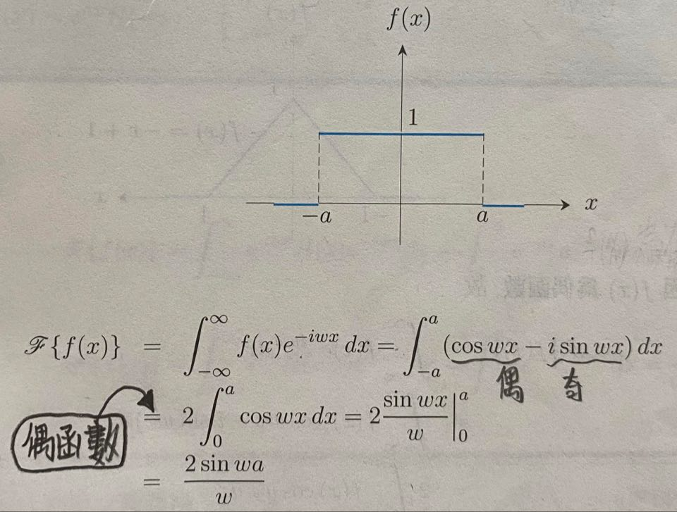
3.4 Fourier Transform Pairs
Notes:
此函式示意圖在下一頁

Slide 87
3.4 Fourier Transform Pairs
F . T
Notes:
由羅畢達可知: 中心一定是亮的
X軸與Y軸線上也會是相對亮的

Slide 88
3.4 Fourier Transform Pairs
a=1: Vertical axis
a=2: Horizontal axis

Slide 89
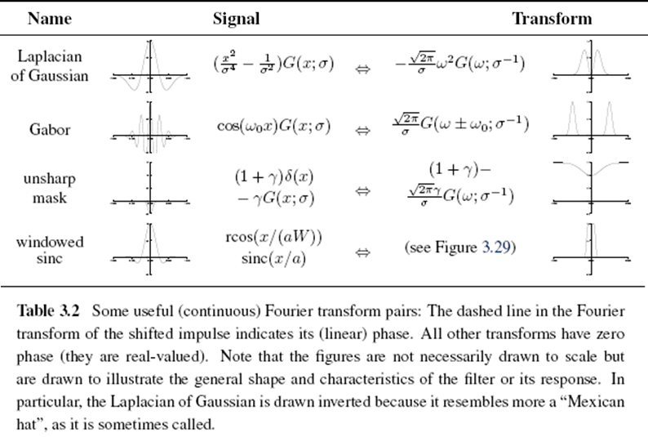

Slide 90
Image Processing
3.1 Point Operators
3.2 Linear Filtering
3.3 More Neighborhood Operators
3.4 Fourier Transforms
3.5 Pyramids and Wavelets
3.6 Geometric Transformations
3.7 Global Optimization

Slide 91
3.5 Pyramids and Wavelets
Image pyramids are extremely useful for performing multi-scale editing operations such as blending images while maintaining details.
For example, the task of finding a face in an image. Since we do not know the scale at which the face will appear, we need to generate a whole pyramid of differently sized images and scan each one for possible faces.

Slide 92
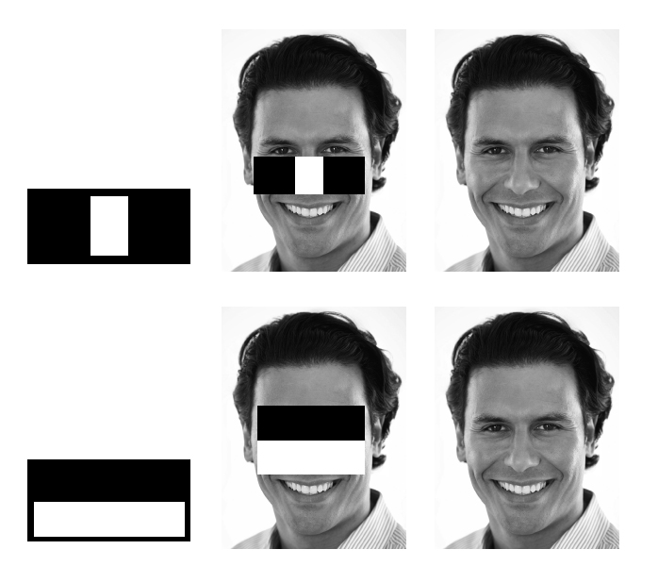
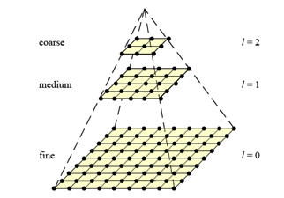
3.5 Pyramids and Wavelets
We may want to reduce the size of an image to speed up the execution of an algorithm .

Slide 93
3.5 Pyramids and Wavelets
A pyramid can also be very helpful in accelerating the search for an object by first finding a smaller instance of that object at a coarser level of the pyramid and then looking for the full resolution object only in the vicinity of coarse-level detections.

Slide 94
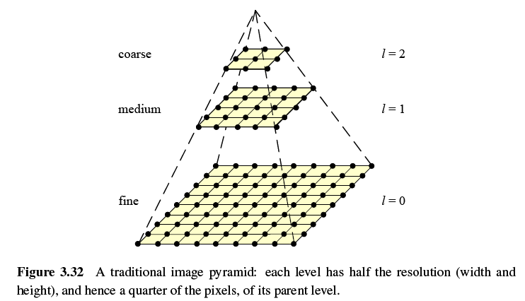

Slide 95
3.5.1 Interpolation (Upsampling)
Interpolation can be used to increase the resolution of an image.
r: upsampling rate.

Slide 96
Bilinear Interpolation
Notes:
p.22, 23有相關的

Slide 97
Cubic Interpolation
Bicubic interpolation
Is an extension of cubic interpolation for interpolating data points on a two dimensional regular grid.
The interpolated surface is smoother than corresponding surfaces obtained by bilinear interpolation.

Slide 98
Notes:
Bilinear有鋸齒狀，bicubic比較平滑

Slide 99
3.5.2 Decimation (Downsampling)
Decimation is required to reduce the resolution.
To perform decimation, we first convolve the image with a low-pass filter (to avoid aliasing) and then keep every rth sample.
h(k,l): smoothing kernel

Slide 101
3.5.3 Multi-Resolution Representations
To construct the pyramid, we first blur and subsample the original image by a factor of two and store this in the next level of the pyramid.

Slide 102
Gaussian Pyramid
The technique involves creating a series of images which are weighted down using a Gaussian average and scaled down.
Five-tap kernel:
, a: 0.3~0.6

Slide 104
3.5.4 Wavelets
Two-dimensional wavelets
The high-pass filter followed by decimation keeps 3/4 of the original pixels, while 1/4 of the low-frequency coefficients are passed on to the next stage for further analysis.
The resulting three wavelet images are called the high–high (HH), high–low (HL), and low–high (LH) images.
The HL and LH images accentuate the horizontal and vertical edges and gradients, while the HH image contains the less frequently occurring mixed derivatives.

Slide 105
3.5.4 Wavelets

Slide 106
3.5.4 Wavelets
https://www.youtube.com/watch?v=f1AzPyGl7kI
Notes:
越左上越重要，解壓縮才需要其他高頻訊號
解壓縮:
低頻有相加訊息，高頻為相減訊息
列出方程式可得解

Slide 107
3.5.4 Laplacian pyramid
Notes:
還原當然還是會有誤差的

Slide 108
The key point is low-frequency color variations between the red apple and the orange are smoothly blended, while the higher-frequency textures on each fruit are blended more quickly to avoid “ghoasting” effects when two textures are overlaid.
Notes:
Image Blending:
兩幅圖像的Laplacian Pyramid
求高斯金字塔
每一層拼接並重建圖像
從上到下插值放大

Slide 109
Image Blending

Slide 110
Image Processing
3.1 Point Operators
3.2 Linear Filtering
3.3 More Neighborhood Operators
3.4 Fourier Transforms
3.5 Pyramids and Wavelets
3.6 Geometric Transformations
3.7 Global Optimization

Slide 111
3.6 Geometric Transformations

Slide 112
2.1.2 2D Transformations
3.6 Geometric Transformations
Preserves | Translation | Euclidean | Similarity | Affine | Projective
Lengths | O | O | X | X | X
Angles | O | O | O | X | X
Parallelism | O | O | O | O | X
Notes:
轉換(位移)、歐基里德(旋轉+位移)、相似、仿射、投影

Slide 113
3.6.1 Parametric Transformations
Parametric transformations apply a global deformation to an image, where the behavior of the transformation is controlled by a small number of parameters.

Slide 114
3.6.1 Parametric Transformations
Notes:
第二章助教有說了，各個轉換的矩陣們在第二章也有舉例，故就不多加著墨了
主要就是在說運用這些轉換矩陣可達成一般的空間座標變換

Slide 115
Forward Warping
The process of copying a pixel f(x) to a location in g is not well defined when has a non-integer value.
You can round the value of to the nearest integer coordinate and copy the pixel there, but the resulting image has severe aliasing and pixels that jump around a lot when animating the transformation.
The second major problem with forward warping is the appearance of cracks and holes, especially when magnifying an image.
splatting
Notes:
https://www.csie.ntu.edu.tw/~b97074/vfx_html/hw1.html
https://www.csie.ntu.edu.tw/~cyy/courses/vfx/05spring/lectures/scribe/03scribe.pdf
以上筆記有解釋slatting的概念，還有很多下面的投影片，在以上筆記都有!!!!!!

Slide 117
Inverse Warping
is (presumably) defined for all pixels in , we no longer have holes.
can simply be computed as the inverse of
In fact, all of the parametric transforms listed in Table 3.5 have closed form solutions for the inverse transform: simply take the inverse of the 3×3 matrix specifying the transform.
interpolation

Slide 119
3.6.2 Mesh-Based Warping (1/3)
While parametric transforms specified by a small number of global parameters have many uses, local deformations with more degrees of freedom are often required.
Different amounts of motion are required in different parts of the image.

Slide 120
3.6.2 Mesh-Based Warping (2/3)
The first approach, is to specify a sparse set of corresponding points. The displacement of these points can then be interpolated to a dense displacement field.
A second approach to specifying displacements for local deformations is to use corresponding oriented line segments.

Slide 121
Notes:
上半部是原始圖片做Cross dissolve，最終那種詭異的照片就是產生的Ghosting Effect，這是因為 feature points 沒有對齊的關係。
下半部是原始圖片做完Warp後，對其各個feature point後，再做Cross dissolve

Slide 122
3.6.2 Mesh-Based Warping (3/3)

Slide 123
Notes:
(X-P) 和 (Q-P) 代表向量，做內積後，依照有COS的那個公式可得到單位向量，單位向量乘上同方向向量可得到長度，都由公式可推得
第一條公式u其實有多除一個||Q-P||，這樣最後一條X ’ 就不用除了
最後一條公式的 X’ 與 P’ 為新的點座標，P ’ 要到 X ’ 就是
第一項先知道P ’ 座標
前面 ||Q-P|| 就只是長度，所以||Q-P||等於||Q’-P’|| ，前面除了兩次所以這邊就不用除了
中間項的||Q-P|| 平方分一次給u用以後就是常見的u乘上單位長度了，u本身依內積定義根本只要除一次

Slide 124
Image Processing
3.1 Point Operators
3.2 Linear Filtering
3.3 More Neighborhood Operators
3.4 Fourier Transforms
3.5 Pyramids and Wavelets
3.6 Geometric Transformations
3.7 Global Optimization

Slide 125
3.7.1 Regularization (1/6)
Finding a smooth surface that passes through (or near) a set of measured data points.
Such a problem is described as ill-posed because many possible surfaces can fit this data.
Since small changes in the input can sometimes lead to large changes in the fit, such problems are also often ill-conditioned.

Slide 126
3.7.1 Regularization (2/6)
Notes:
像是機器學習在找最佳函數

Slide 127
3.7.1 Regularization (3/6)
Since we are trying to recover the unknown function f(x, y) from which the data point
d(x_{i}, y_{i}) were sampled, such problems are also often called inverse problems.
Many computer vision tasks can be viewed as inverse problems, since we are trying to recover a full description of the 3D world from a limited set of images.

Slide 128
3.7.1 Regularization (4/6)
In order to quantify what it means to find a smooth solution, we can define a norm on the solution space.
For one-dimensional functions f(x), we can integrate the squared first derivative of the function,
or perhaps integrate the squared second derivative,

Slide 129
3.7.1 Regularization (5/6)
In two dimensions, the corresponding smoothness functionals are
The first derivative norm is often called the membrane, since interpolating a set of data points using this measure results in a tent-like structure.
The second-order norm is called the thin-plate spline, since it approximates the behavior of thin plates (e.g., flexible steel) under small deformations.
Notes:
下標一個x就代表微一次
兩個就是微分兩次

Slide 130
3.7.1 Regularization (6/6)
For scattered data interpolation, the data term measures the distance between the function f(x, y) and a set of data points d_{i} =d(x_{i} , y_{i})
To obtain a global energy that can be minimized, the two energy terms are usually added together,
: smoothness penalty
: regularization parameter
Notes:
正規化的概念是，透過加入更大的偏誤（bias）來懲罰極端的參數權重

Slide 131
3.7.1 Regularization (6/6)
For scattered data interpolation, the data term measures the distance between the function f(x, y) and a set of data points d_{i} =d(x_{i} , y_{i})
To obtain a global energy that can be minimized, the two energy terms are usually added together,
: smoothness penalty
: regularization parameter
Notes:
正規化的概念是，透過加入更大的偏誤（bias）來懲罰極端的參數權重

Slide 132
Term Project
Tentative term project problems: Exercises in textbook, (30%) total grade:
Submit one page in English explaining method, steps, expected results
Submit report in a month: April 9
Report progress every other week
All right to be the same problem with Master’s thesis

Slide 133
Objective: a working prototype with new, original, novel ideas
Objective: not just literature survey
Objective: not just straightforward implementation of existing algorithms
Objective: all right to modify existing algorithms

