Slide 1
Advanced Computer Vision
Chapter 3
Image Processing
Presented by: 傅楸善 & 陳弘毅
0922489262
r04922099@ntu.edu.tw

Slide 2
Image Processing
3.1 Point Operators
3.2 Linear Filtering
3.3 More Neighborhood Operators
3.4 Fourier Transforms
3.5 Pyramids and Wavelets
3.6 Geometric Transformations
3.7 Global Optimization
Notes:
點運算子

Slide 3
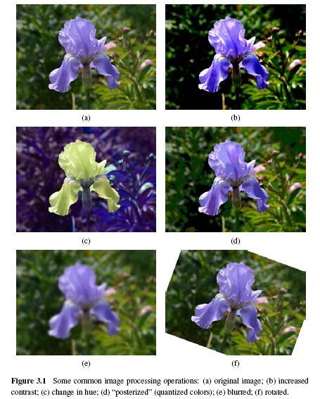
Notes:
Hue:色調
Posterized:海報化

Slide 4
3.1.1 Pixel Transforms (1/3)
x is in the D-dimensional domain of the functions (usually D = 2 for images) and the functions f and g operate over some range, which can either be scalar or vector-valued, e.g., for color images or 2D motion.
For discrete images, the domain consists of a finite number of pixel locations, x = (i, j), and we can write
Notes:
X是在function中d維的定義域內
可以經過f,g作用得出結果
對一個離散影像來說,定義域是由有限個像素位置所組成

Slide 5
3.1.1 Pixel Transforms (2/3)
Multiplication and addition with a constant
The parameters a > 0 and b are often called the gain and bias parameters.
The bias and gain parameters can also be spatially varying.
Notes:
可以乘或加一個常數
a : gain
b : bias
Gain & bias 可以被縮放

Slide 6
3.1.1 Pixel Transforms (3/3)
Multiplicative gain is a linear operation
Dyadic (two-input) operator is the linear blend operator
Non-linear transform: gamma correction
Notes:
Gain是一個線性運算
二進運算是一個混合線性運算
會有疊影的效果
非線性就是gamma

Slide 7
3.1.2 Color Transforms
In fact, adding the same value to each color channel not only increases the apparent intensity of each pixel, it can also affect the pixel’s hue and saturation.
Notes:
若對每一個channel加同一個值
不只會增加亮度也會影像色調與飽和度

Slide 8
3.1.3 Compositing and Matting (1/4)
In many photo editing and visual effects applications, it is often desirable to cut a foreground object out of one scene and put it on top of a different background.
The process of extracting the object from the original image is often called matting, while the process of inserting it into another image (without visible artifacts) is called compositing.
Notes:
做影像處理有時候會想把前景物件和背景分離
Matting: 提取圖片中的物件
Compositing: 再把物件放到另一張圖中

Slide 9
3.1.3 Compositing and Matting (2/4)
Alpha-matted color image
In addition to the three color RGB channels, an alpha-matted image contains a fourth alpha channel α (or A) that describes the relative amount of opacity or fractional coverage at each pixel.
Pixels within the object are fully opaque (α= 1), while pixels fully outside the object are transparent (α= 0).
Notes:
除了RGB外多新增一個alpha channel來描述每一個pixel的透明與重疊的相對關係
Alpha=1: 不透明
Alpha=0: 全透明

Slide 10
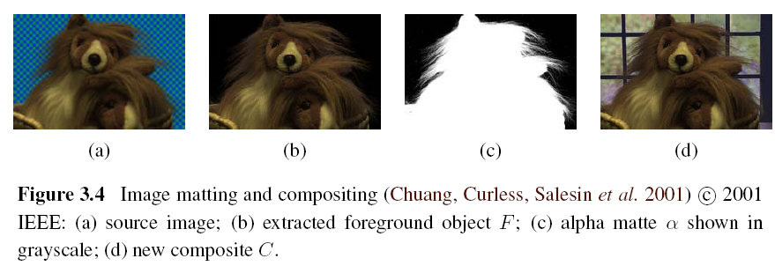
3.1.3 Compositing and Matting (3/4)

Slide 11
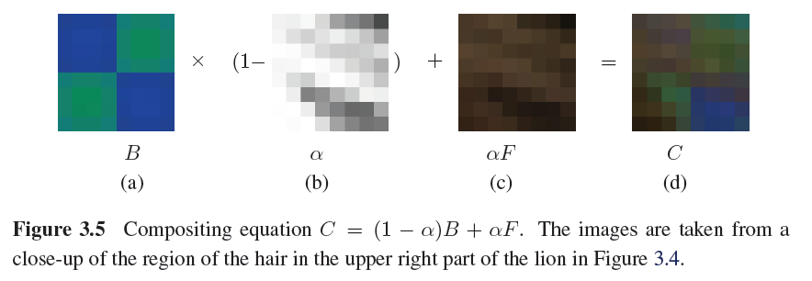
3.1.3 Compositing and Matting (4/4)

Slide 12
3.1.4 Histogram Equalization
To find an intensity mapping function f(I) such that the resulting histogram is flat
h(I): original histogram
c(I): cumulative distribution
N: the number of pixels in the image
A linear blend between the cumulative distribution function and the identity transform
Notes:
Linear blend用來對HE做一個補償,因為純HE對比較不強烈

Slide 13
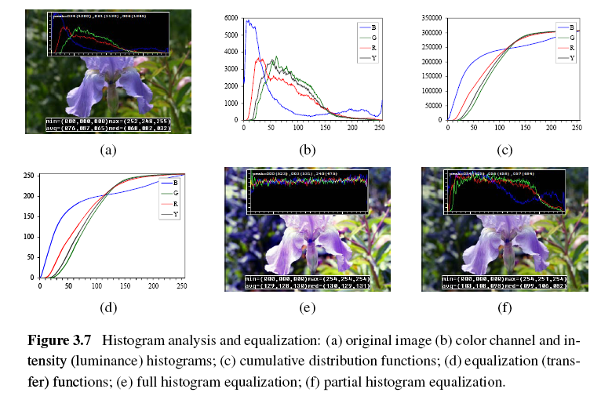

Slide 14
Locally Adaptive Histogram Equalization (1/4)
Subdivide the image into M×M pixel blocks and perform separate histogram equalization in each sub-block.
But the resulting image exhibits a lot of blocking artifacts, i.e., intensity discontinuities at block boundaries.
Notes:
若想要再對比更強烈,可以搭配LAHE
原理是將影像切成多的M*M的區塊個別做HE
但這樣會有blocking arifacts的瑕疵（每個區塊有間隙 不連續）

Slide 15
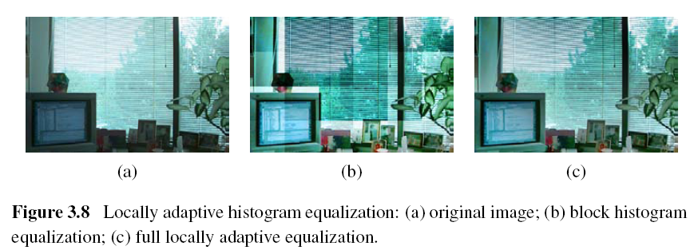

Slide 16
Locally Adaptive Histogram Equalization (2/4)
One way to eliminate blocking artifacts is to use a moving window, i.e., to recompute the histogram for every M×M block centered at each pixel.
A more efficient approach is to compute non-overlapped block-based equalization functions as before, but to then smoothly interpolate the transfer functions as we move between blocks. This technique is known as adaptive histogram equalization (AHE).
Notes:
一種改善的方法是moving window,以每個pixel為中心建一個block去重新計算Histogram(太慢)
更有效的方法是adaptive gistogram equalization
一樣去對每個block做equaliztion後,移到下block運算的時候做內差

Slide 17
Locally Adaptive Histogram Equalization (3/4)
Adaptive Histogram Equalization (AHE)
The weighting function for a given pixel (i, j) can be computed as a function of its horizontal and vertical position (s, t) within a block.
To blend the four lookup {f₀₀,…,f₁₁}, a bilinear blending function
Notes:
給定權重依據pixel的位置
再將四個象限的lookup table混合計算得到自己的lookup table

Slide 18
Locally Adaptive Histogram Equalization (4/4)
A variant on this algorithm is to place the lookup tables at the corners of each M×M block.
In addition to blending four lookups to compute the final value, we can also distribute each input pixel into four adjacent lookup tables during the histogram accumulation phase.
Notes:
另一種方式是去取代角落的lookup table
上述的方式做完之後,再將得到的lookup table逆推給corner的lookup table

Slide 19
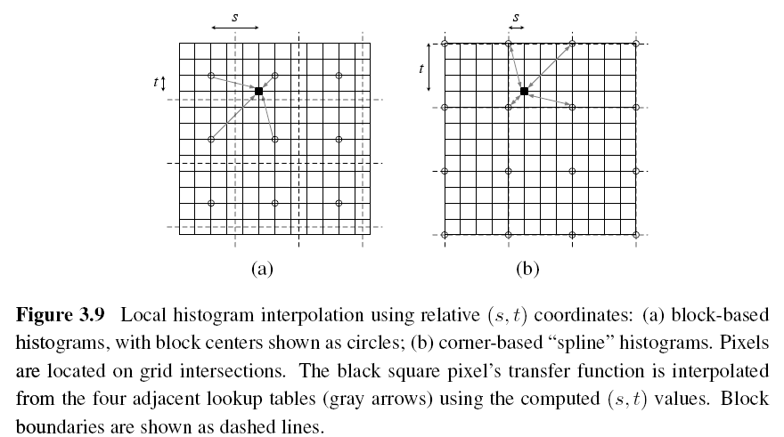

Slide 20
Image Processing
3.1 Point Operators
3.2 Linear Filtering
3.3 More Neighborhood Operators
3.4 Fourier Transforms
3.5 Pyramids and Wavelets
3.6 Geometric Transformations
3.7 Global Optimization

Slide 21
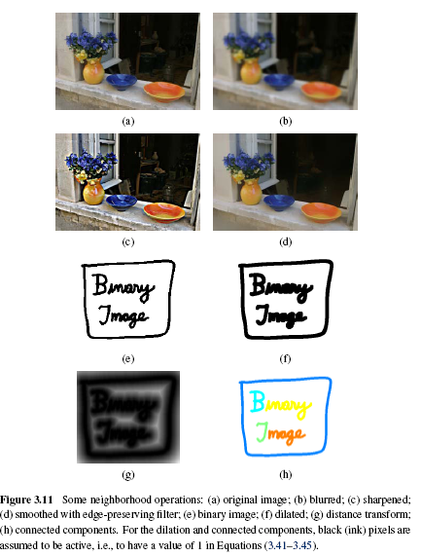
Notes:
Neighborhood Operation: 收集相鄰點的值來定義自己的值

Slide 22
3.2 Linear Filtering
An output pixel’s value is determined as a weighted sum of input pixel values.
Notes:
Output pixel的值是input pixel的權重和
常見的運算 correlation convolution
兩者只是正負號相反的差異

Slide 23
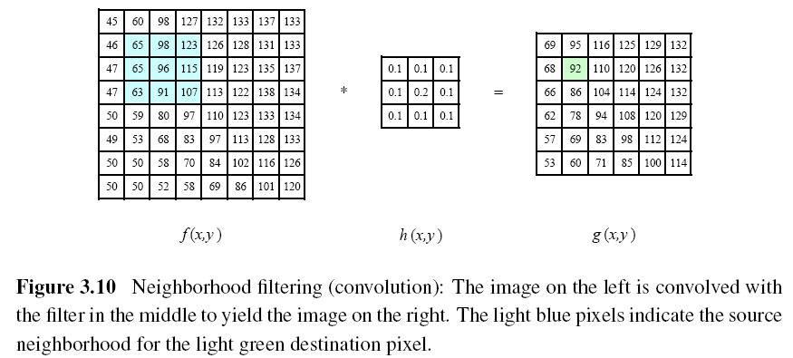
Notes:
92 = 65*0.1 + 98*0.1 + 123*0.1 + 65*0.1 + 96*0.2 + 115*0.1 + 63*0.1 + 91*0.1 + 107*0.1

Slide 24
A one-dimensional convolution can be represented in matrix-vector form.

Slide 25
Padding (Border Effects)
zero: set all pixels outside the source image to 0.
constant (border color): set all pixels outside the source image to a specified border value.
clamp (replicate or clamp to edge): repeat edge pixels indefinitely
(cyclic) wrap (repeat or tile): loop “around” the image in a toroidal configuration
mirror: reflect pixels across the image edge
extend: extend the signal by subtracting the mirrored version of the signal from the edge pixel value
Notes:
Padding：填充
Zero: 給0 填黑
Constant: 有顏色
Clamp: 邊緣pixel延伸出去
Wrap: 沿著邊環狀鋪影像
Mirror: 映射上去
Extend: 邊緣-mirror

Slide 26
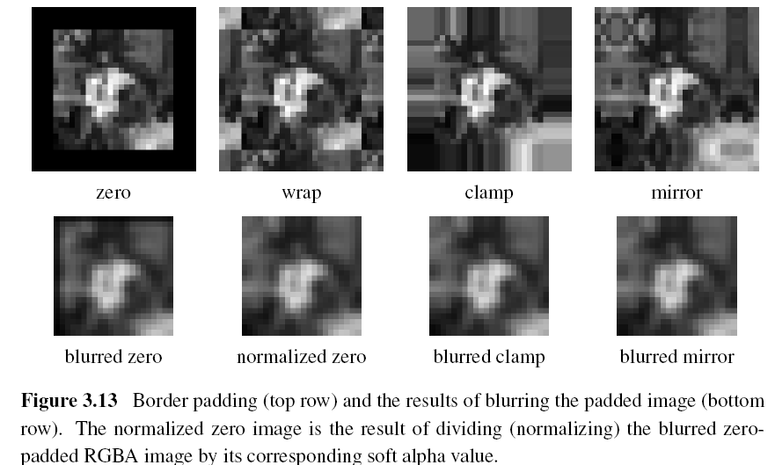

Slide 27
3.2.1 Separable Filtering (1/2)
The process of performing a convolution requires K² operations per pixel, where K is the size (width or height) of the convolution kernel.
This operation can be significantly sped up by first performing a one-dimensional horizontal convolution followed by a one-dimensional vertical convolution (which requires a total of 2K operations per pixel).
Notes:
若直接拿size為k的kernel去做convolution, 每個pixel需k^2次的運算
若將二維拆成兩個一維只需要2k次

Slide 28
3.2.1 Separable Filtering (2/2)
It is easy to show that the two-dimensional kernel K corresponding to successive convolution with a horizontal kernel h and a vertical kernel v is the outer product of the two kernels,
Notes:
一個2維的拆成水平和垂直的kernel 兩者作外積

Slide 29
3.2.2 Examples of Linear Filtering
The simplest filter to implement is the moving average or box filter, which simply averages the pixel values in a K×K window.
Bilinear kernel
Gaussian kernel
Notes:
Bilinear kernel: 像素所表示點周圍四個最近的點（紋素點）之間進行雙線性插值。For smooth

Slide 30
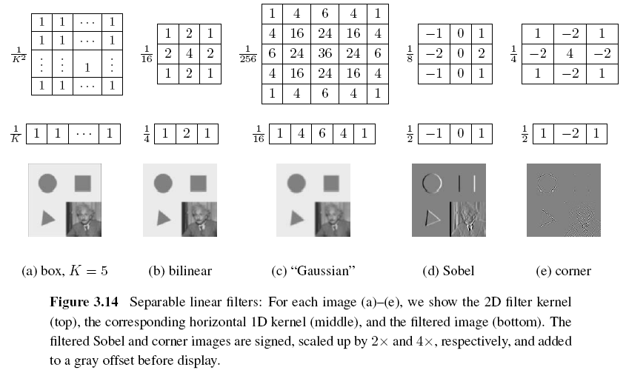

Slide 31
3.2.3 Band-Pass and Steerable Filters (1/4)
The Sobel and corner operators are simple examples of band-pass and oriented filters.
More sophisticated kernels can be created by first smoothing the image with a Gaussian filter, and then taking the first or second derivatives.
Such filters are known collectively as band-pass filters, since they filter out both low and high frequencies.
Notes:
sophisticated : 複雜的
collectively ：統稱

Slide 32
3.2.3 Band-Pass and Steerable Filters (2/4)
The (undirected) second derivative of a two-dimensional image is known as the Laplacian operator.
Blurring an image with a Gaussian and then taking its Laplacian is equivalent to convolving directly with the Laplacian of Gaussian (LoG) filter.

Slide 33
3.2.3 Band-Pass and Steerable Filters (3/4)
The Sobel operator is a simple approximation to a directional or oriented filter, which can be obtained by smoothing with a Gaussian (or some other filter) and then taking a directional derivative , which is obtained by taking the dot product between the gradient field and a unit direction
Notes:
is obtained by 由..得到

Slide 34
3.2.3 Band-Pass and Steerable Filters (4/4)
The smoothed directional derivative filter,
is an example of a steerable filter, since the value of an image convolved with can be computed by first convolving with the pair of filters (G_{x}, G_{y}) and then steering the filter by multiplying this gradient field with a unit vector

Slide 35
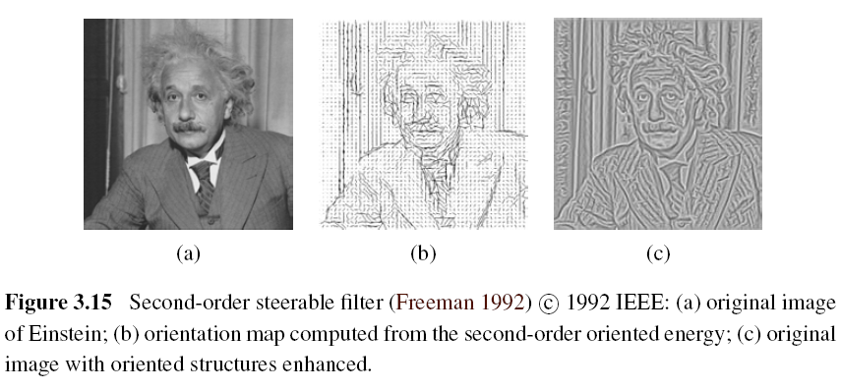

Slide 36
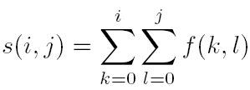
Summed Area Table (Integral Image)
To find the summed area (integral) inside a rectangle[i₀, i₁] ×[j₀, j₁], we simply combine four samples from the summed area table,

Slide 37
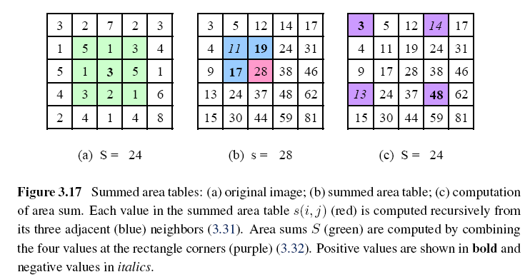

Slide 38
Image Processing
3.1 Point Operators
3.2 Linear Filtering
3.3 More Neighborhood Operators
3.4 Fourier Transforms
3.5 Pyramids and Wavelets
3.6 Geometric Transformations
3.7 Global Optimization

Slide 39
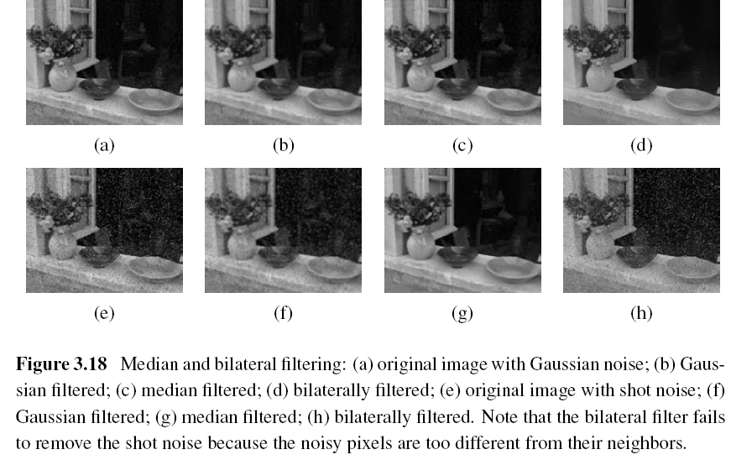
3.3 More Neighborhood Operators

Slide 40
3.3.1 Non-Linear Filtering
Median filtering: selects the median value from each pixel’s neighborhood.
α-trimmed mean: averages together all of the pixels except for the α fraction that are the smallest and the largest.
Weighted median: each pixel is used a number of times depending on its distance from the center.

Slide 41
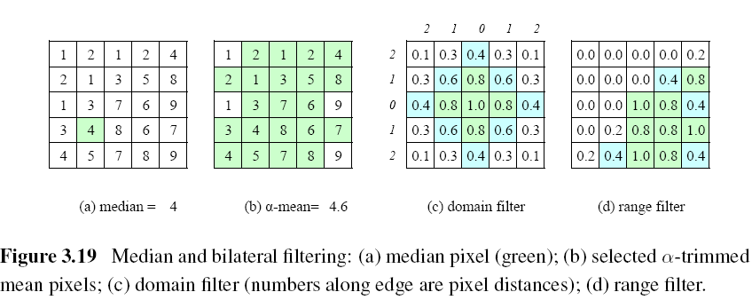

Slide 42
Bilateral Filtering
The output pixel value depends on a weighted combination of neighboring pixel values
w(i, j, k, l): bilateral weight function, which is depends on the product of a domain kernel and a data-dependent range kernel.

Slide 43
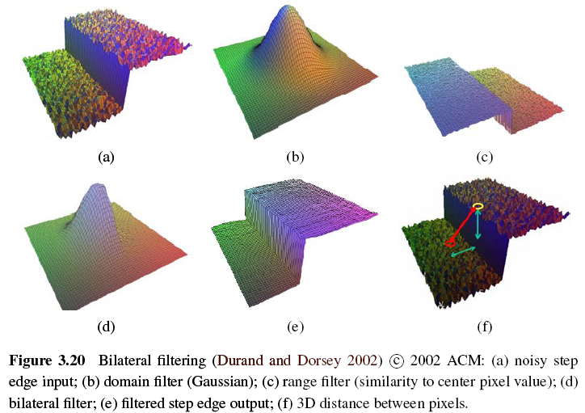

Slide 44
3.3.2 Morphology (1/3)
Such images often occur after a thresholding operation,
We first convolve the binary image with a binary structuring element and then select a binary output value depending on the thresholded result of the convolution.

Slide 45
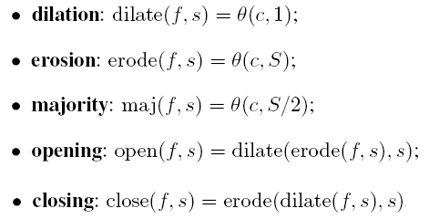
3.3.2 Morphology (2/3)
c: count of the number of 1s inside each structuring element as it is scanned over the image
s: structuring element
S: the size of the structuring element

Slide 46
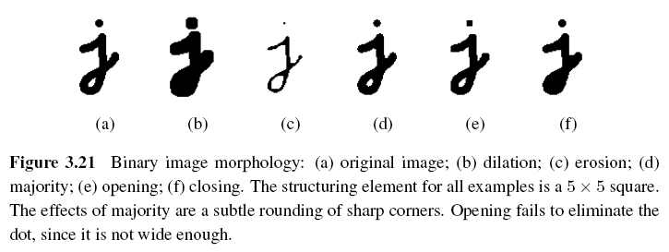
3.3.2 Morphology (3/3)

Slide 47
3.3.3 Distance Transforms
City block or Manhattan distance
Euclidean distance
The distance transform is then defined as

Slide 48
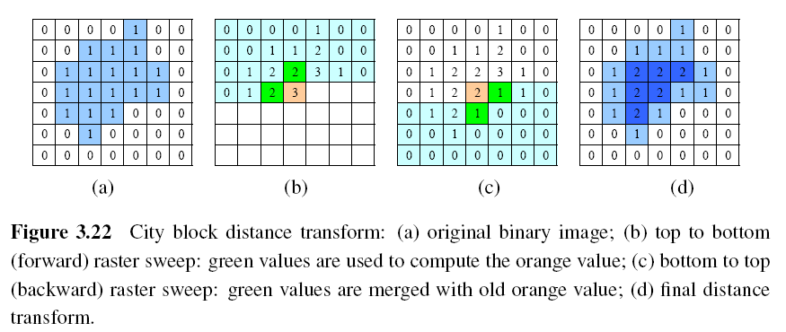
During the forward pass, each non-zero pixel is replaced by the minimum of 1 + the distance of its north or west neighbor.
During the backward pass, the same occurs.

Slide 49
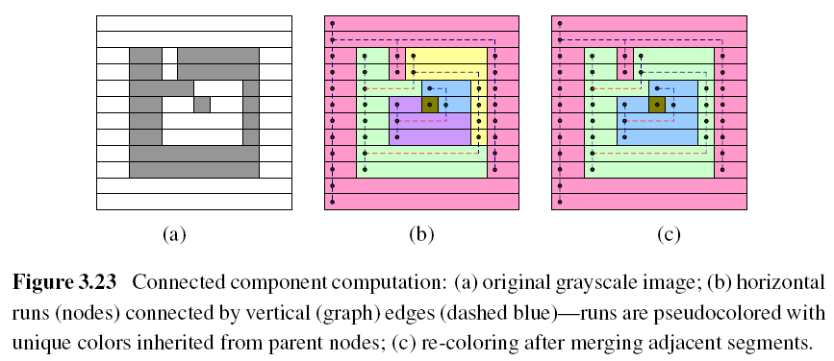
3.3.4 Connected Components (1/2)

Slide 50
3.3.4 Connected Components (2/2)
The area (number of pixels)
The perimeter (number of boundary pixels)
The centroid (average x and y values)

Slide 51
Image Processing
3.1 Point Operators
3.2 Linear Filtering
3.3 More Neighborhood Operators
3.4 Fourier Transforms
3.5 Pyramids and Wavelets
3.6 Geometric Transformations
3.7 Global Optimization

Slide 52
3.4 Fourier Transforms (1/5)
f: frequency
: angular frequency
: phase
A: the gain or magnitude of the filter

Slide 53
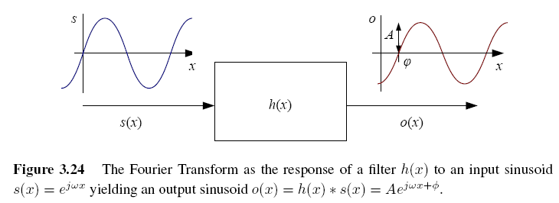
3.4 Fourier Transforms (2/5)

Slide 54
3.4 Fourier Transforms (3/5)
The Fourier transform is simply a tabulation of the magnitude and phase response at each frequency
Fourier transform pair:
Continuous domain:
Discrete domain:

Slide 55
3.4 Fourier Transforms (4/5)
Discrete Fourier Transform: O(N²)
Fast Fourier Transform: O(N logN)

Slide 56
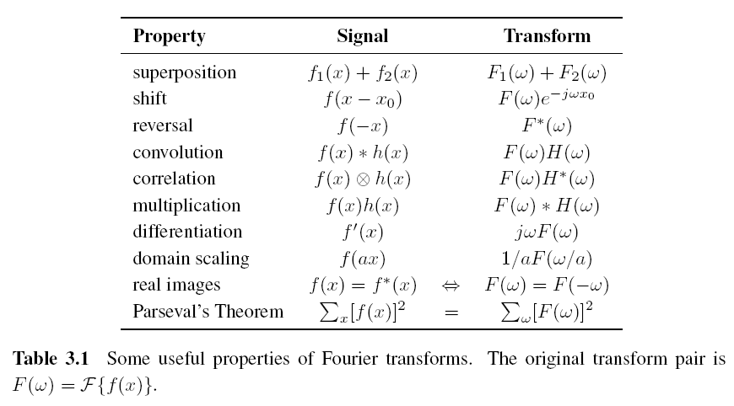
3.4 Fourier Transforms (5/5)

Slide 57
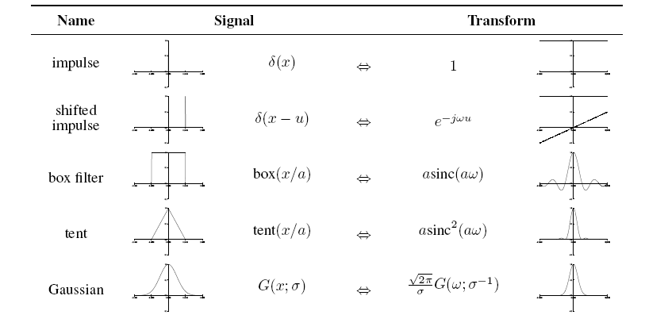
3.4.1 Fourier Transform Pairs

Slide 58
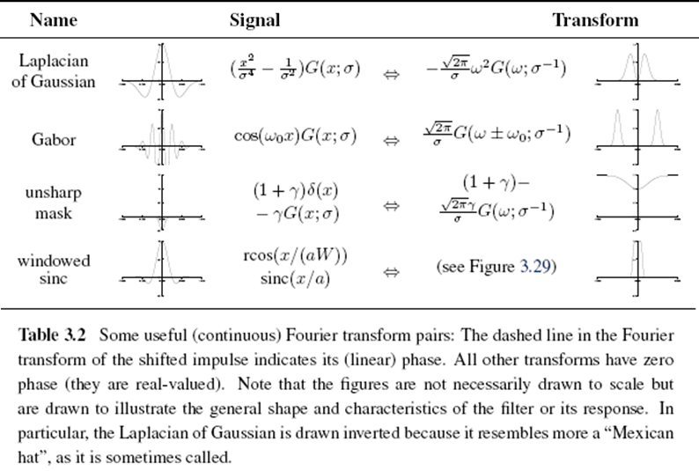

Slide 59
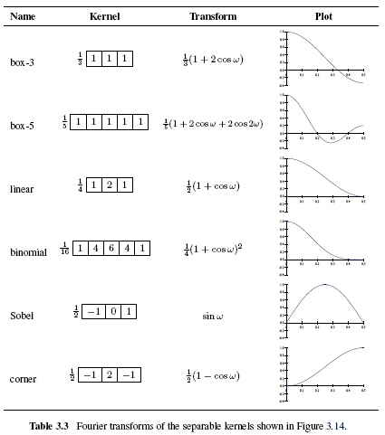

Slide 60
3.4.2 Two-Dimensional Fourier Transforms
Continuous domain:
Discrete domain:

Slide 61
Discrete Cosine Transform
The one-dimensional DCT is computed by taking the dot product of each N-wide block of pixels with a set of cosines of different frequencies,
The two-dimensional version of the DCT is
Like the FFT, each of the DCTs can also be computed in O(N logN) time.

Slide 62
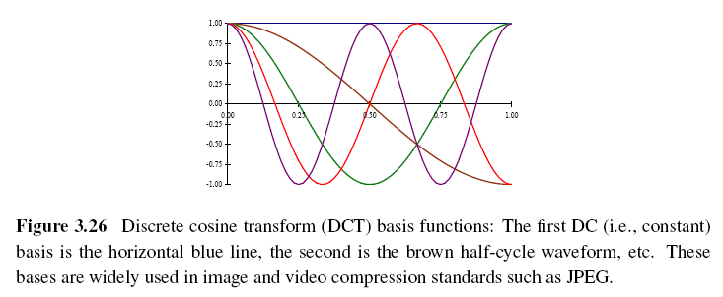
The first basis function (the straight blue line) encodes the average DC value in the block of pixels, while the second encodes a slightly curvy version of the slope.

Slide 63
Image Processing
3.1 Point Operators
3.2 Linear Filtering
3.3 More Neighborhood Operators
3.4 Fourier Transforms
3.5 Pyramids and Wavelets
3.6 Geometric Transformations
3.7 Global Optimization

Slide 64
3.5 Pyramids and Wavelets
We may want to reduce the size of an image to speed up the execution of an algorithm or to save on storage space or transmission time.
For example, the task of finding a face in an image. Since we do not know the scale at which the face will appear, we need to generate a whole pyramid of differently sized images and scan each one for possible faces.

Slide 65
3.5 Pyramids and Wavelets
A pyramid can also be very helpful in accelerating the search for an object by first finding a smaller instance of that object at a coarser level of the pyramid and then looking for the full resolution object only in the vicinity of coarse-level detections
Image pyramids are extremely useful for performing multi-scale editing operations such as blending images while maintaining details.

Slide 66
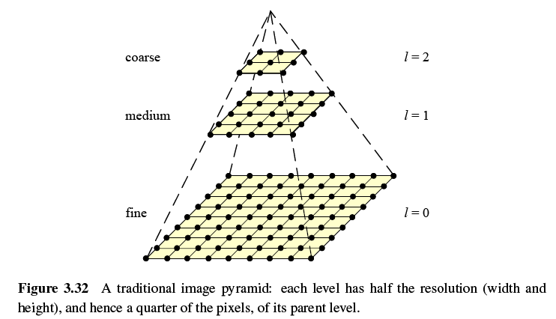

Slide 67
3.5.1 Interpolation (Upsampling)
Interpolation can be used to increase the resolution of an image.
r: upsampling rate.

Slide 68
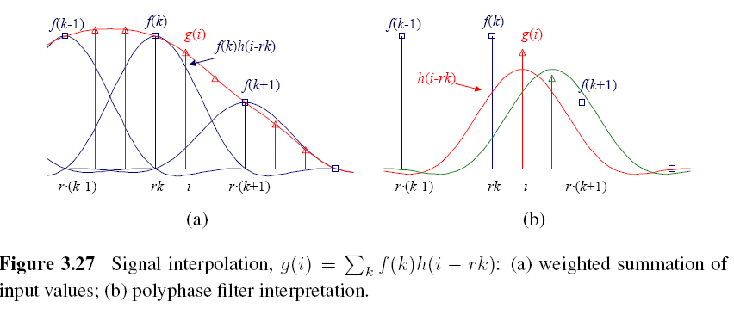

Slide 69
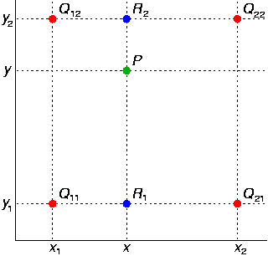
Bilinear Interpolation

Slide 70
Cubic Interpolation
Bicubic interpolation
Is an extension of cubic interpolation for interpolating data points on a two dimensional regular grid.
The interpolated surface is smoother than corresponding surfaces obtained by bilinear interpolation.

Slide 71
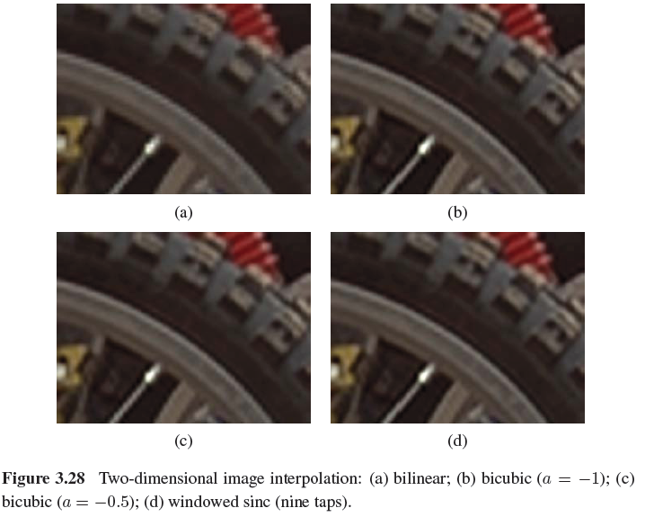

Slide 72
3.5.2 Decimation (Downsampling)
Decimation is required to reduce the resolution.
To perform decimation, we first convolve the image with a low-pass filter (to avoid aliasing) and then keep every rth sample.
h(k,l): smoothing kernel

Slide 73
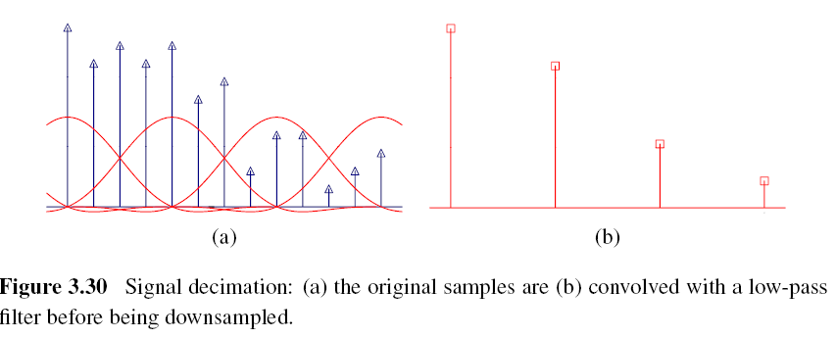

Slide 74
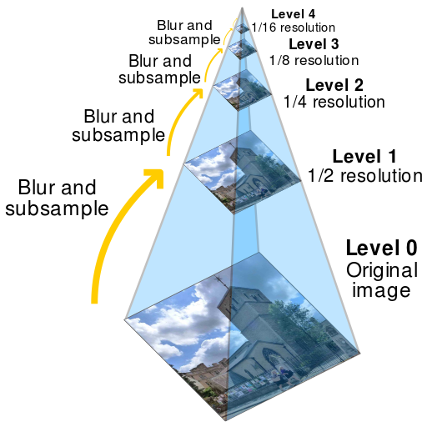
3.5.3 Multi-Resolution Representations
To construct the pyramid, we first blur and subsample the original image by a factor of two and store this in the next level of the pyramid.

Slide 75
Gaussian Pyramid
The technique involves creating a series of images which are weighted down using a Gaussian average and scaled down.
Five-tap kernel:
, a: 0.3~0.6

Slide 76
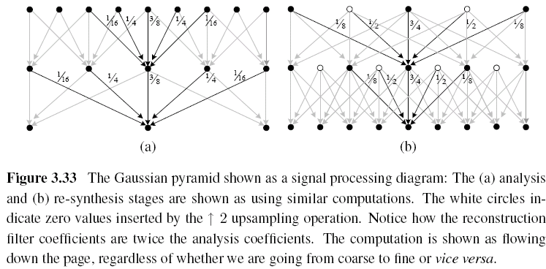

Slide 77
Laplacian Pyramid
First, interpolate a lower resolution image to obtain a reconstructed low-pass version of the original image.
They then subtract this low-pass version from the original to yield the band-pass “Laplacian” image, which can be stored away for further processing.

Slide 78
3.5.4 Wavelets
Two-dimensional wavelets
The high-pass filter followed by decimation keeps 3/4 of the original pixels, while 1/4 of the low-frequency coefficients are passed on to the next stage for further analysis.
The resulting three wavelet images are called the high–high (HH), high–low (HL), and low–high (LH) images.
The HL and LH images accentuate the horizontal and vertical edges and gradients, while the HH image contains the less frequently occurring mixed derivatives.

Slide 79
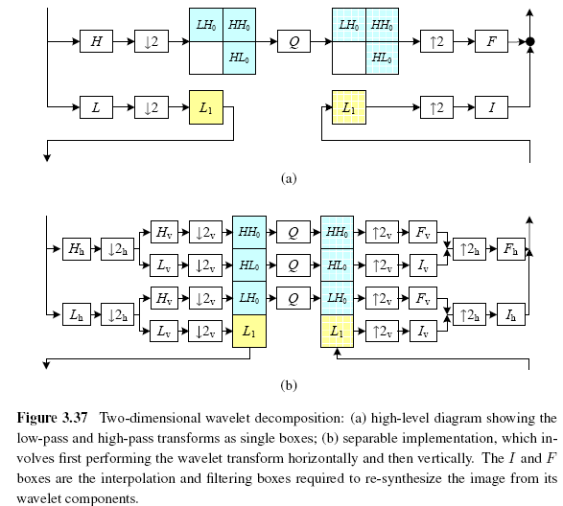

Slide 80
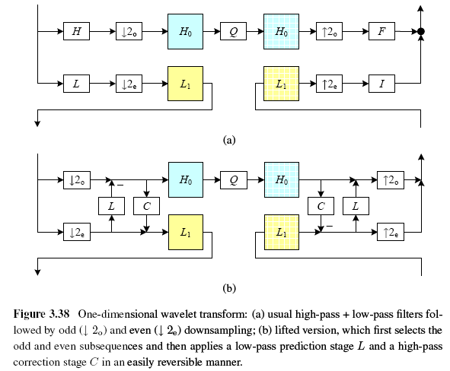
One-Dimensional Wavelets

Slide 81
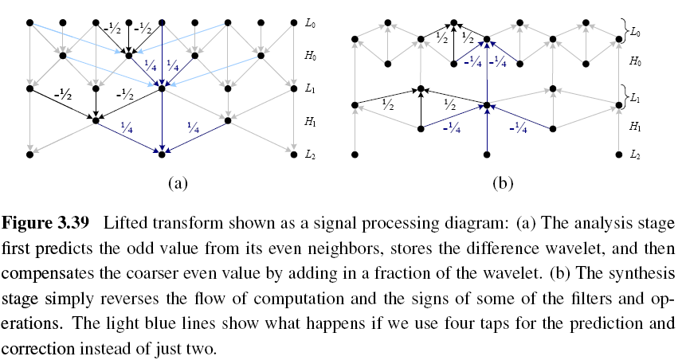
Lifted Transform

Slide 82
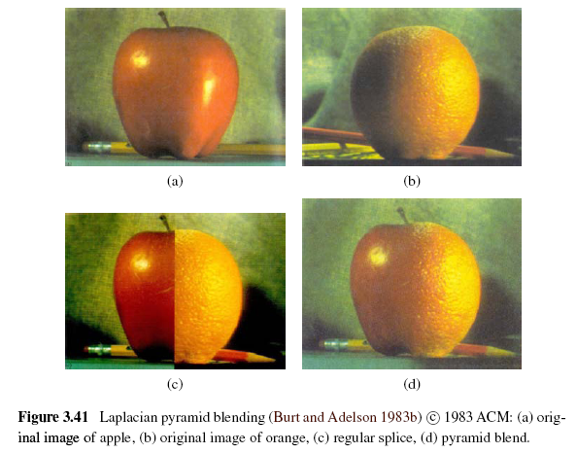
Image Blending

Slide 83
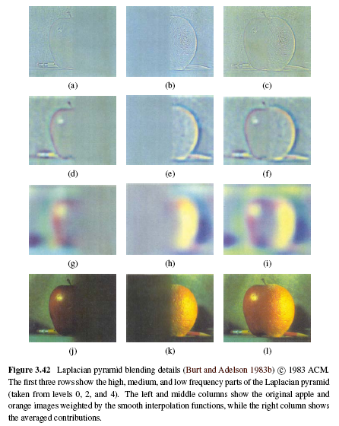

Slide 84
Image Processing
3.1 Point Operators
3.2 Linear Filtering
3.3 More Neighborhood Operators
3.4 Fourier Transforms
3.5 Pyramids and Wavelets
3.6 Geometric Transformations
3.7 Global Optimization

Slide 85
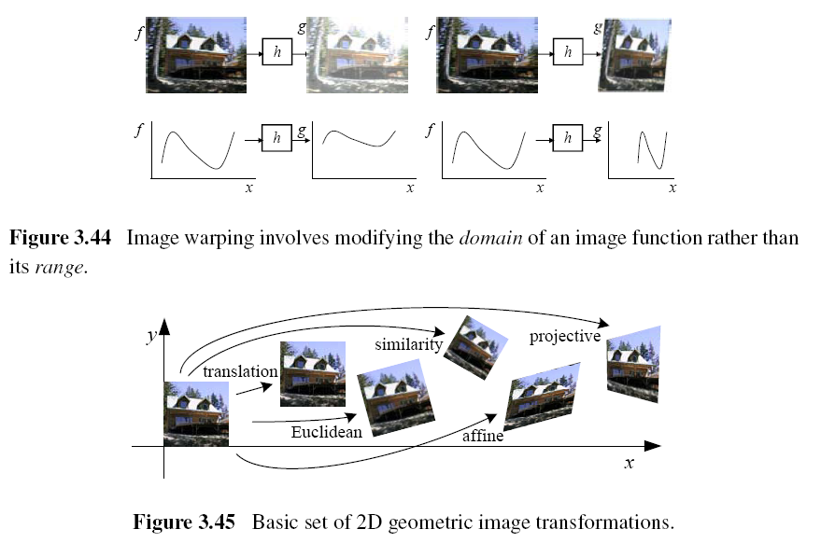
3.6 Geometric Transformations

Slide 86
3.6.1 Parametric Transformations
Parametric transformations apply a global deformation to an image, where the behavior of the transformation is controlled by a small number of parameters.

Slide 87
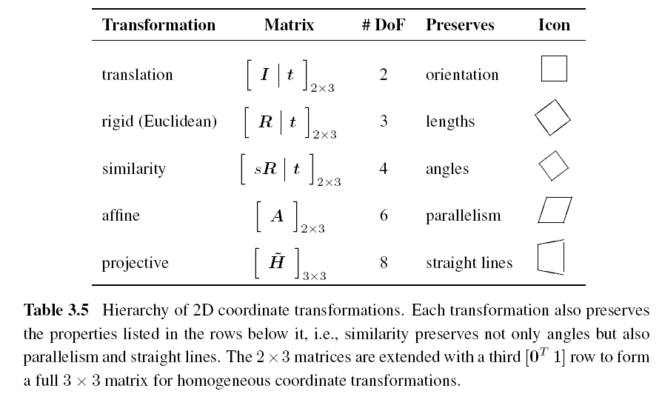
3.6.1 Parametric Transformations

Slide 88
Forward Warping
The process of copying a pixel f(x) to a location in g is not well defined when has a non-integer value.
You can round the value of to the nearest integer coordinate and copy the pixel there, but the resulting image has severe aliasing and pixels that jump around a lot when animating the transformation.
The second major problem with forward warping is the appearance of cracks and holes, especially when magnifying an image.

Slide 89
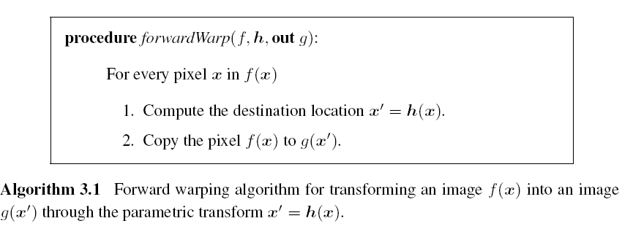
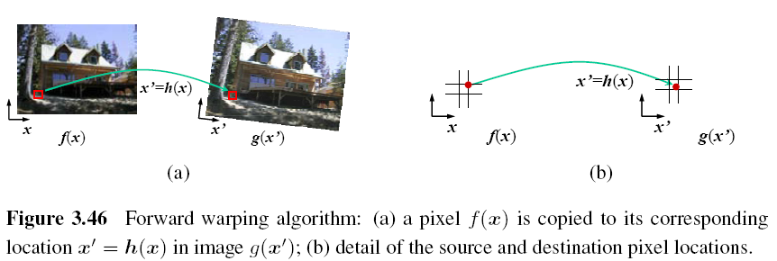

Slide 90
Inverse Warping
is (presumably) defined for all pixels in , we no longer have holes.
can simply be computed as the inverse of
In fact, all of the parametric transforms listed in Table 3.5 have closed form solutions for the inverse transform: simply take the inverse of the 3×3 matrix specifying the transform.

Slide 91
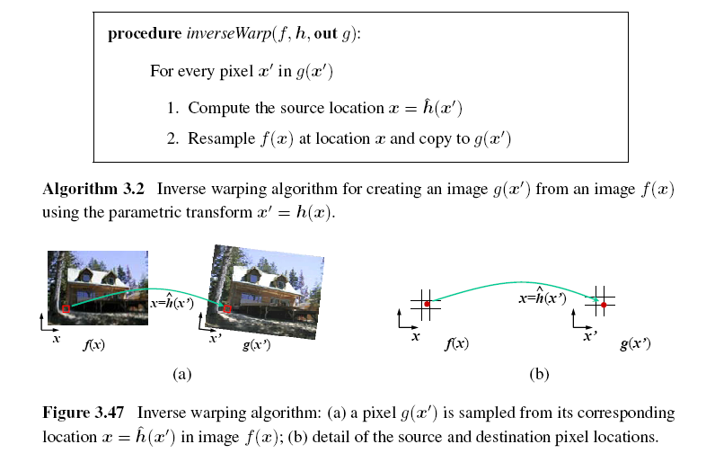

Slide 92
MIP-Mapping (1/3)
MIP-mapping was first proposed by Williams (1983) as a means to rapidly pre-filter images being used for texture mapping in computer graphics.
A MIP-map is a standard image pyramid, where each level is pre-filtered with a high-quality filter rather than a poorer quality approximation, such as five-tap binomial.

Slide 93
MIP-Mapping (2/3)
To resample an image from a MIP-map, a scalar estimate of the resampling rate r is first computed.
For example, r can be the maximum of the absolute values in A (which suppresses aliasing) or it can be the minimum (which reduces blurring).
Once a resampling rate has been specified, a fractional pyramid level is computed using the base 2 logarithm,

Slide 94
MIP-Mapping (3/3)
One simple solution is to resample the texture from the next higher or lower pyramid level, depending on whether it is preferable to reduce aliasing or blur.
A better solution is to resample both images and blend them linearly using the fractional component of l.
Since most MIP-map implementations use bilinear resampling within each level, this approach is usually called trilinear MIP-mapping.

Slide 95
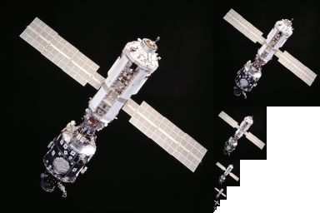
An example of MIP-mapping image storage: the principal image on the left is accompanied by filtered copies of reduced size.

Slide 96
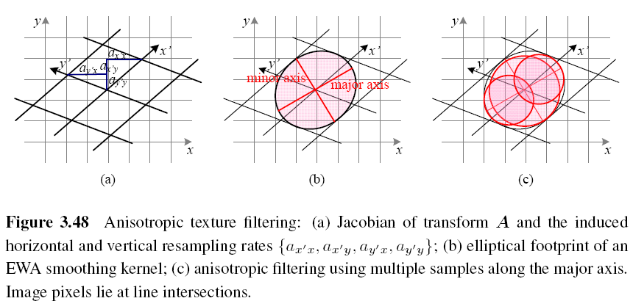

Slide 97
Elliptical Weighted Average (EWA)
The Elliptical Weighted Average filter is based on the observation that the affine mapping defines a skewed two-dimensional coordinate system in the vicinity of each source pixel x.
For every destination pixel , the ellipsoidal projection of a small pixel grid in onto x is computed.
This is used to filter the source image g(x) with a Gaussian whose inverse covariance matrix is ellipsoid.

Slide 98
Anisotropic Filtering
In this approach, several samples at different resolutions (fractional levels in the MIP-map) are combined along the major axis of the EWA Gaussian.

Slide 99
Multi-Pass Transforms (1/3)
The optimal approach to warping images without excessive blurring or aliasing is to adaptively pre-filter the source image at each pixel using an ideal low-pass filter, i.e., an oriented skewed sinc or low-order (e.g., cubic) approximation.

Slide 100
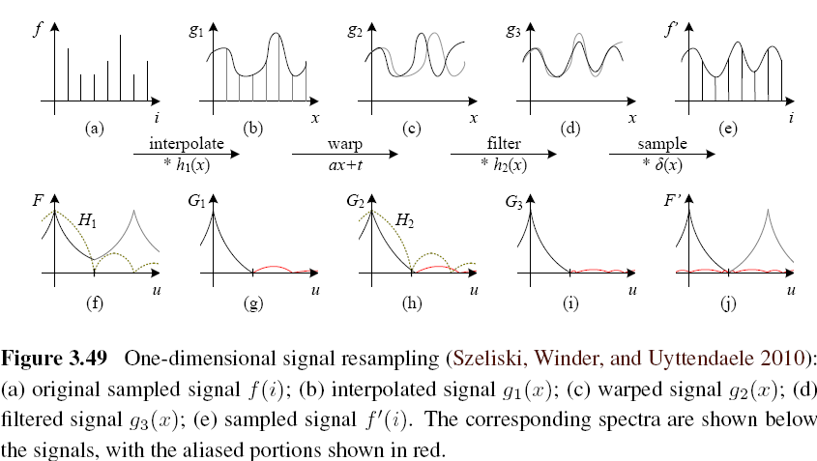
Multi-Pass Transforms (2/3)

Slide 101
Multi-Pass Transforms (3/3)
For parametric transforms, the oriented two-dimensional filtering and resampling operations can be approximated using a series of one-dimensional resampling and shearing transforms.
In order to prevent aliasing, however, it may be necessary to upsample in the opposite direction before applying a shearing transformation.

Slide 102
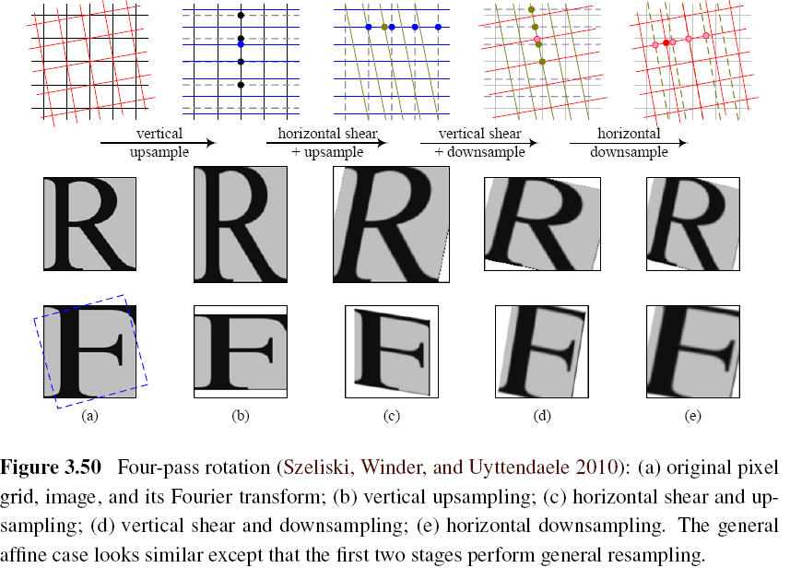

Slide 103
3.6.2 Mesh-Based Warping (1/3)
While parametric transforms specified by a small number of global parameters have many uses, local deformations with more degrees of freedom are often required.
Different amounts of motion are required in different parts of the image.

Slide 104
3.6.2 Mesh-Based Warping (2/3)
The first approach, is to specify a sparse set of corresponding points. The displacement of these points can then be interpolated to a dense displacement field.
A second approach to specifying displacements for local deformations is to use corresponding oriented line segments.

Slide 105
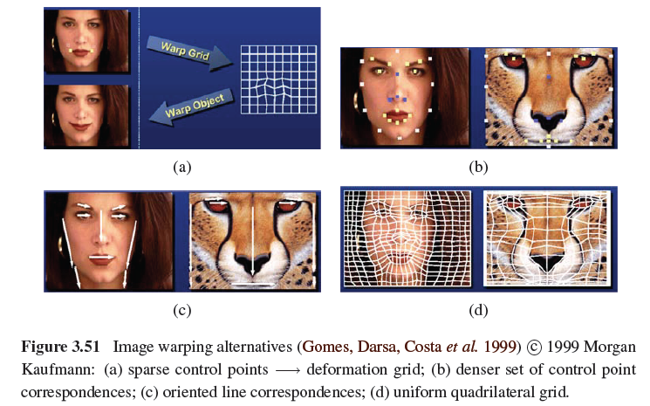
3.6.2 Mesh-Based Warping (3/3)

Slide 106
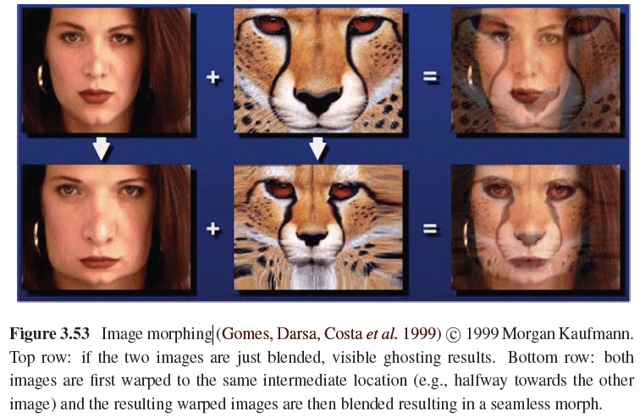

Slide 107
Image Processing
3.1 Point Operators
3.2 Linear Filtering
3.3 More Neighborhood Operators
3.4 Fourier Transforms
3.5 Pyramids and Wavelets
3.6 Geometric Transformations
3.7 Global Optimization

Slide 108
3.7 Global Optimization
Regularization (variational methods)
Constructs a continuous global energy function that describes the desired characteristics of the solution and then finds a minimum energy solution using sparse linear systems or related iterative techniques.
Markov random field
Using Bayesian statistics, modeling both the noisy measurement process that produced the input images as well as prior assumptions about the solution space.

Slide 109
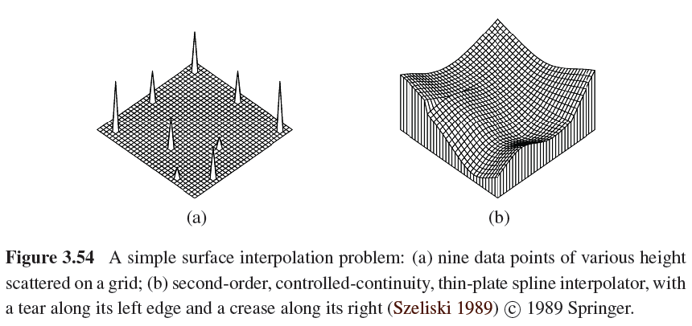
3.7.1 Regularization (1/6)

Slide 110
3.7.1 Regularization (2/6)
Finding a smooth surface that passes through (or near) a set of measured data points.
Such a problem is described as ill-posed because many possible surfaces can fit this data.
Since small changes in the input can sometimes lead to large changes in the fit, such problems are also often ill-conditioned.

Slide 111
3.7.1 Regularization (3/6)
Since we are trying to recover the unknown function f(x, y) from which the data point
d(x_{i}, y_{i}) were sampled, such problems are also often called inverse problems.
Many computer vision tasks can be viewed as inverse problems, since we are trying to recover a full description of the 3D world from a limited set of images.

Slide 112
3.7.1 Regularization (4/6)
In order to quantify what it means to find a smooth solution, we can define a norm on the solution space.
For one-dimensional functions f(x), we can integrate the squared first derivative of the function,
or perhaps integrate the squared second derivative,

Slide 113
3.7.1 Regularization (5/6)
In two dimensions, the corresponding smoothness functionals are
The first derivative norm is often called the membrane, since interpolating a set of data points using this measure results in a tent-like structure.
The second-order norm is called the thin-plate spline, since it approximates the behavior of thin plates (e.g., flexible steel) under small deformations.

Slide 114
3.7.1 Regularization (6/6)
For scattered data interpolation, the data term measures the distance between the function f(x, y) and a set of data points d_{i} =d(x_{i} , y_{i})
To obtain a global energy that can be minimized, the two energy terms are usually added together,

Slide 115
3.7.2 Markov Random Fields (1/3)
The posterior distribution for a given set of measurements y, combined with a prior p(x) over the unknowns x, is given by
Negative posterior log likelihood.

Slide 116
3.7.2 Markov Random Fields (2/3)
To find the most likely (maximum a posteriori or MAP) solution x given some measurements y, we simply minimize this negative log likelihood, which can also be thought of as an energy,
E_{d}(x, y) is the data energy or data penalty
E_{p}(x) is the prior energy

Slide 117
3.7.2 Markov Random Fields (3/3)
For image processing applications, the unknowns x are the set of output pixels
The data are (in the simplest case) the input pixels

Slide 118
Binary MRFs
The simplest possible example of a Markov random field is a binary field.
Examples of such fields include 1-bit (black and white) scanned document images as well as images segmented into foreground and background regions.

Slide 119
Ordinal-Valued MRFs
In addition to binary images, Markov random fields can be applied to ordinal-valued labels such as grayscale images or depth maps.
The term “ordinal” indicates that the labels have an implied ordering, e.g., that higher values are lighter pixels.

Slide 122
Unordered Labels

Slide 124
Term Project
Tentative term project problems: Exercises in textbook, (30%) total grade:
Submit one page in English explaining method, steps, expected results
Submit report in a month: April 12
Report progress every other week
All right to be the same problem with Master’s thesis

Slide 125
Objective: a working prototype with new, original, novel ideas
Objective: not just literature survey
Objective: not just straightforward implementation of existing algorithms
Objective: all right to modify existing algorithms

