Slide 1
Advanced Computer Vision
Chapter 3
Image Processing (2)
Presented by: 林政安
0932837981
r99944038@ntu.edu.tw

Slide 2
Image Processing
3.1 Point Operators
3.2 Linear Filtering
3.3 More Neighborhood Operators
3.4 Fourier Transforms
3.5 Pyramids and Wavelets
3.6 Geometric Transformations
3.7 Global Optimization

Slide 3
3.5 Pyramids and Wavelets
Image pyramids are extremely useful for performing multi-scale editing operations such as blending images while maintaining details.
For example, the task of finding a face in an image. Since we do not know the scale at which the face will appear, we need to generate a whole pyramid of differently sized images and scan each one for possible faces.

Slide 4
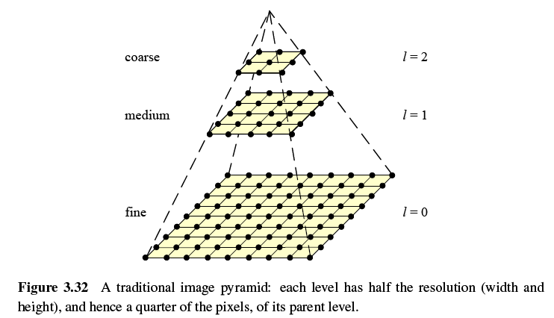

Slide 5
3.5.1 Interpolation (Upsampling)
Interpolation can be used to increase the resolution of an image.
To select some interpolation kernel with which to convolve the image
r: upsampling rate.

Slide 6
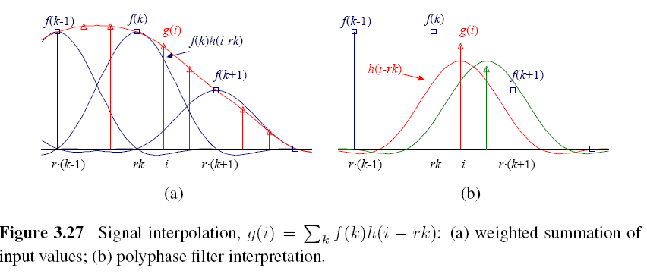

Slide 7
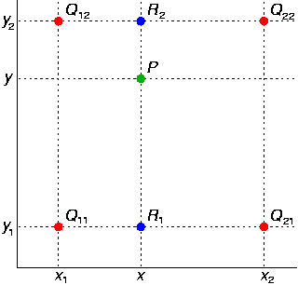
Bilinear Interpolation

Slide 8
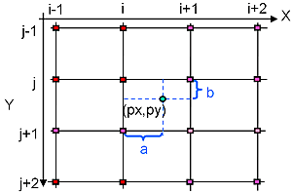
Bicubic Interpolation
Bicubic interpolation
Is an extension of cubic interpolation for interpolating data points on a two dimensional regular grid.
The interpolated surface is smoother than corresponding surfaces obtained by bilinear interpolation.

Slide 9
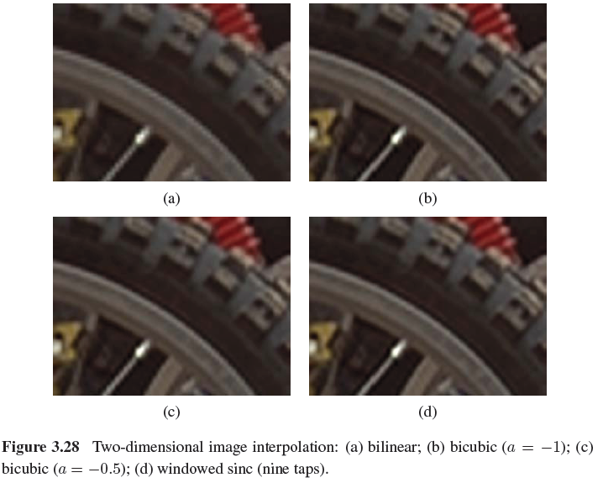

Slide 10
3.5.2 Decimation (Downsampling)
Decimation is required to reduce the resolution.
To perform decimation, we first convolve the image with a low-pass filter (to avoid aliasing) and then keep every rth sample.
h(k,l): smoothing kernel
Notes:
aliasing
aliasing: 圖形的鋸齒邊緣

Slide 12
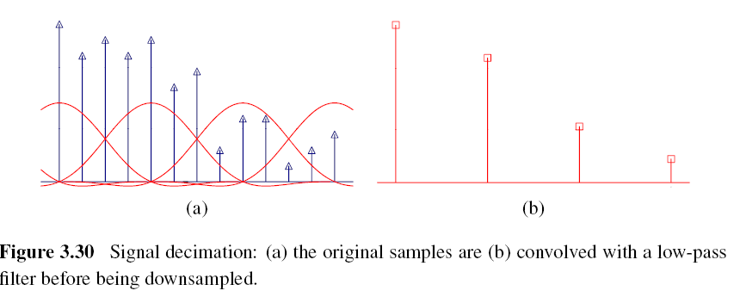

Slide 13
3.5.3 Multi-Resolution Representations
Pyramids can be used to accelerate coarse-to-fine search algorithms, to look for objects or patterns at different scales, and to perform multi-resolution blending operations.
To construct the pyramid, we first blur and subsample the original image by a factor of two and store this in the next level of the pyramid.

Slide 14
Gaussian Pyramid (1/2)
The technique involves creating a series of images which are weighted down using a Gaussian average and scaled down.
Five-tap kernel:

Slide 15
Gaussian Pyramid (2/2)
The reason they call their resulting pyramid a Gaussian pyramid is that repeated convolutions of the binomial kernel converge to a Gaussian
Notes:
converge to: 收斂

Slide 16
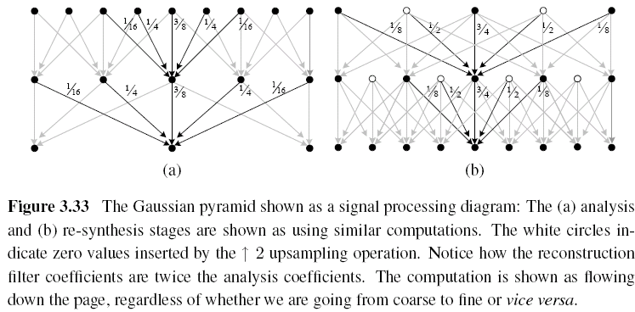

Slide 17
Laplacian Pyramid
First, interpolate a lower resolution image to obtain a reconstructed low-pass version of the original image.
They then subtract this low-pass version from the original to yield the band-pass “Laplacian” image, which can be stored away for further processing.

Slide 18
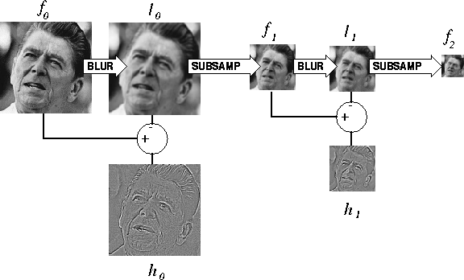

Slide 19
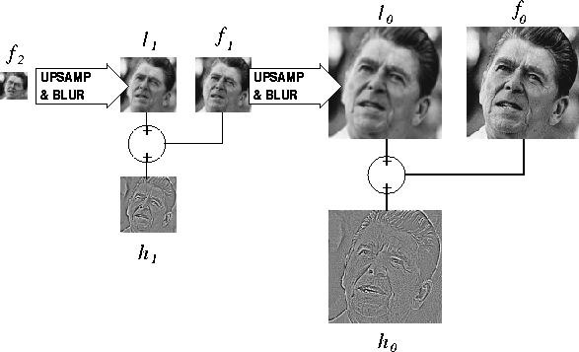

Slide 20
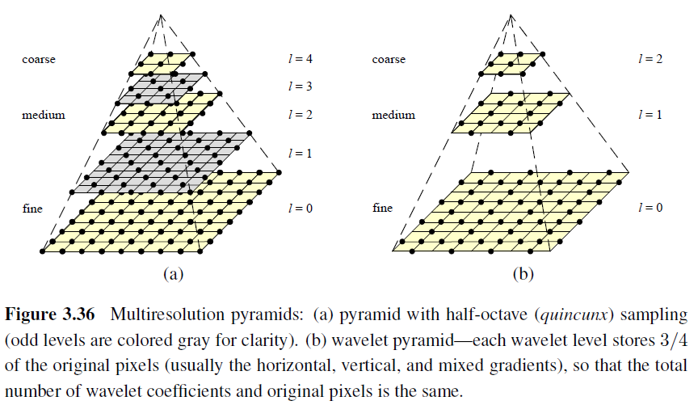
Pyramids

Slide 21
3.5.4 Wavelets
Two-dimensional wavelets
The high-pass filter followed by decimation keeps 3/4 of the original pixels, while 1/4 of the low-frequency coefficients are passed on to the next stage for further analysis.
The resulting three wavelet images are called the high–high (HH), high–low (HL), and low–high (LH) images.
The HL and LH images accentuate the horizontal and vertical edges and gradients, while the HH image contains the less frequently occurring mixed derivatives.

Slide 22
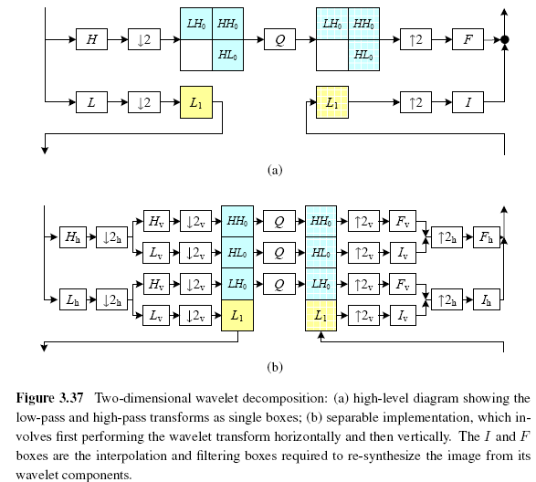

Slide 23
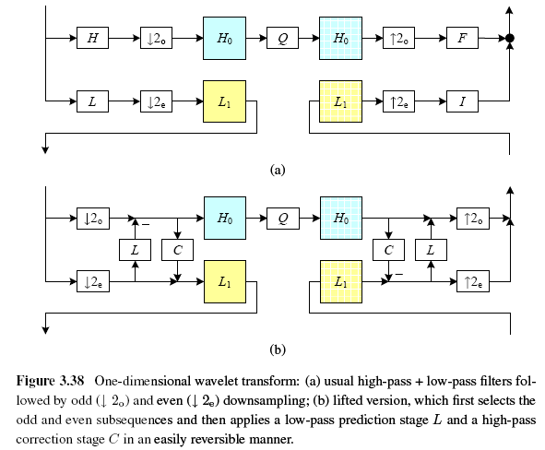
One-Dimensional Wavelets

Slide 24
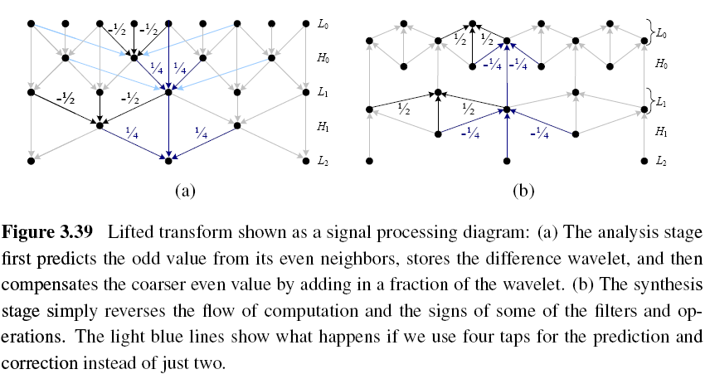
Lifted Transform

Slide 25
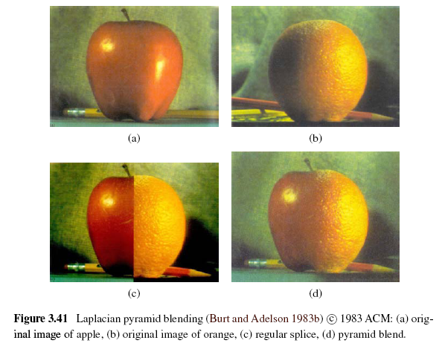
Image Blending

Slide 26
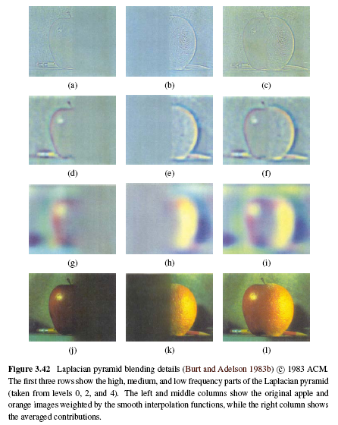

Slide 27
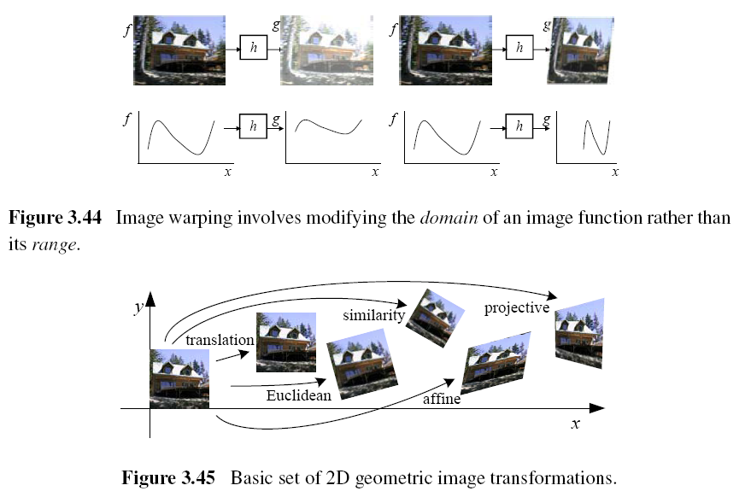
3.6 Geometric Transformations
Notes:
rotations, translations, reflections

Slide 28
3.6.1 Parametric Transformations
Parametric transformations apply a global deformation to an image, where the behavior of the transformation is controlled by a small number of parameters.

Slide 29
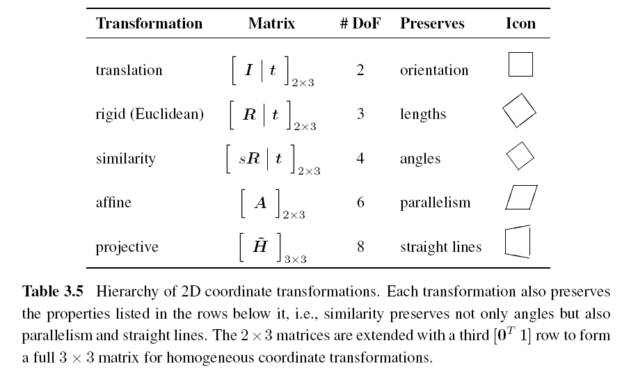
3.6.1 Parametric Transformations
Notes:
straight line 之後 保留 直線
#degree of freedom translation = (tx,ty) euclidean(tx,ty,theta) similarity(tx,ty,theta,s) affine: 六個變數

Slide 30
Forward Warping
The process of copying a pixel f(x) to a location in g is not well defined when has a non-integer value.
You can round the value of to the nearest integer coordinate and copy the pixel there, but the resulting image has severe aliasing.
The second major problem with forward warping is the appearance of cracks and holes, especially when magnifying an image.
Notes:
Crack: 裂縫

Slide 31
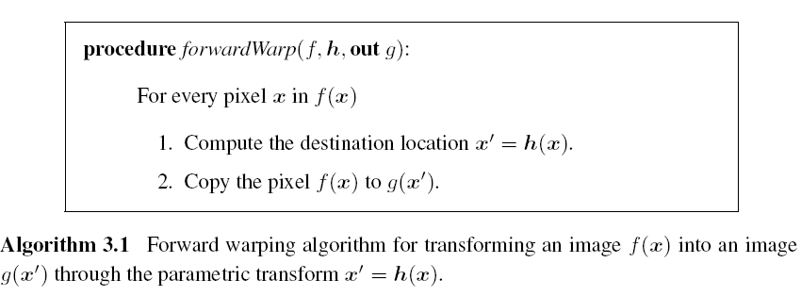
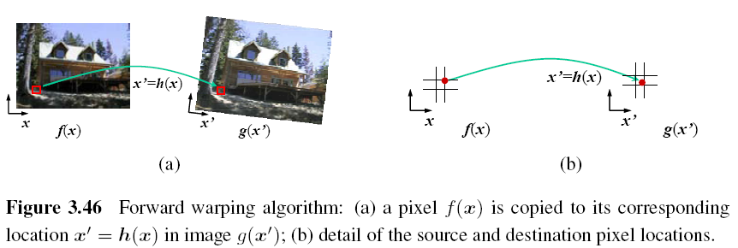

Slide 32
Inverse Warping
is (presumably) defined for all pixels in , we no longer have holes.
it can simply be computed as the inverse of
In fact, all of the parametric transforms listed in Table 3.5 have closed form solutions for the inverse transform: simply take the inverse of the 3×3 matrix specifying the transform.

Slide 33
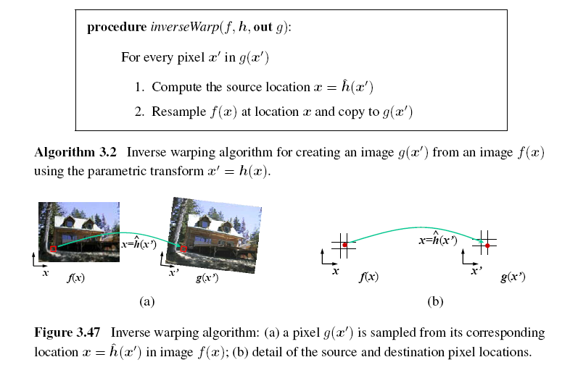

Slide 34
MIP-Mapping (1/3)
MIP-mapping was first proposed by Williams (1983) as a means to rapidly pre-filter images being used for texture mapping in computer graphics.
A MIP-map is a standard image pyramid, where each level is pre-filtered with a high-quality filter rather than a poorer quality approximation, such as five-tap binomial.
Notes:
many things in a small place

Slide 35
MIP-Mapping (2/3)
To resample an image from a MIP-map, a scalar estimate of the resampling rate r is first computed.
Once a resampling rate has been specified, a fractional pyramid level is computed using the base 2 logarithm,

Slide 36
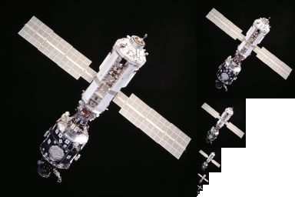
MIP-Mapping (3/3)
One simple solution is to resample the texture from the next higher or lower pyramid level, depending on whether it is preferable to reduce aliasing or blur.
Since most MIP-map implementations use bilinear resampling within each level, this approach is usually called trilinear MIP-mapping.

Slide 37
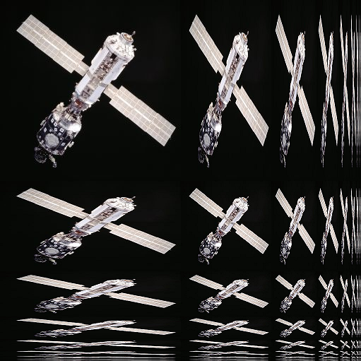
Anisotropic Filtering
An improvement on isotropic MIP mapping
Reducing blur and preserving detail at extreme viewing angles

Slide 38
Multi-Pass Transforms (1/3)
The optimal approach to warping images without excessive blurring or aliasing is to adaptively pre-filter the source image at each pixel using an ideal low-pass filter, i.e., an oriented skewed sinc or low-order (e.g., cubic) approximation.
Notes:
i.e. that is

Slide 39
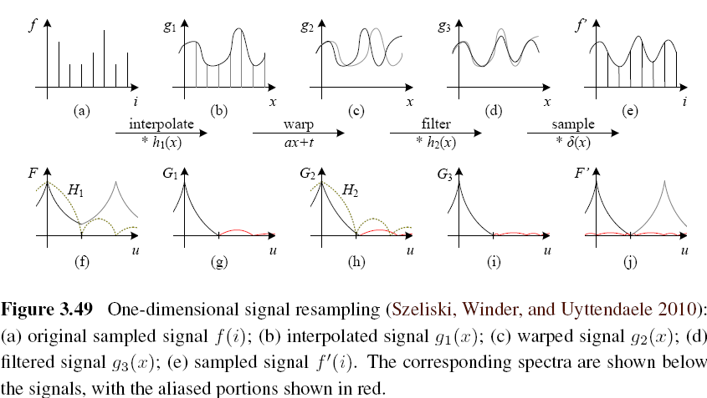
Multi-Pass Transforms (2/3)

Slide 40
Multi-Pass Transforms (3/3)
For parametric transforms, the oriented two-dimensional filtering and resampling operations can be approximated using a series of one-dimensional resampling and shearing transforms.
In order to prevent aliasing, however, it may be necessary to upsample in the opposite direction before applying a shearing transformation.

Slide 41
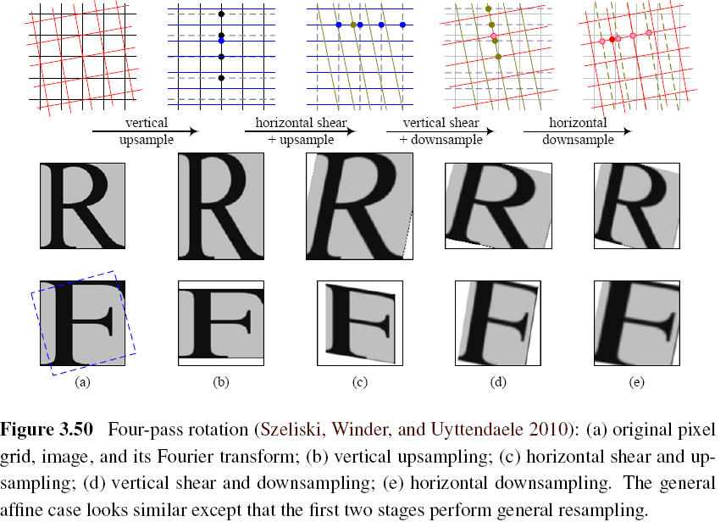

Slide 42
3.6.2 Mesh-Based Warping (1/3)
While parametric transforms specified by a small number of global parameters have many uses, local deformations with more degrees of freedom are often required.
Different amounts of motion are required in different parts of the image.

Slide 43
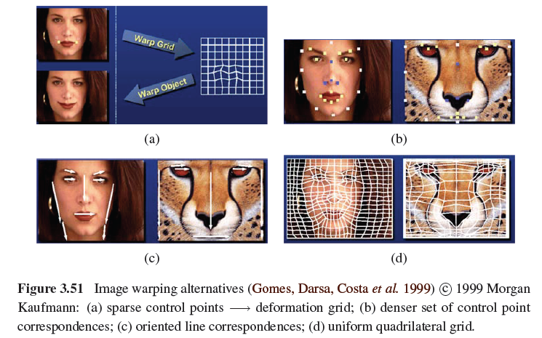
3.6.2 Mesh-Based Warping (2/3)
Notes:
deformation grid: 變形網格

Slide 44
3.6.2 Mesh-Based Warping (3/3)
The first approach, is to specify a sparse set of corresponding points. The displacement of these points can then be interpolated to a dense displacement field.
A second approach to specifying displacements for local deformations is to use corresponding oriented line segments.

Slide 45
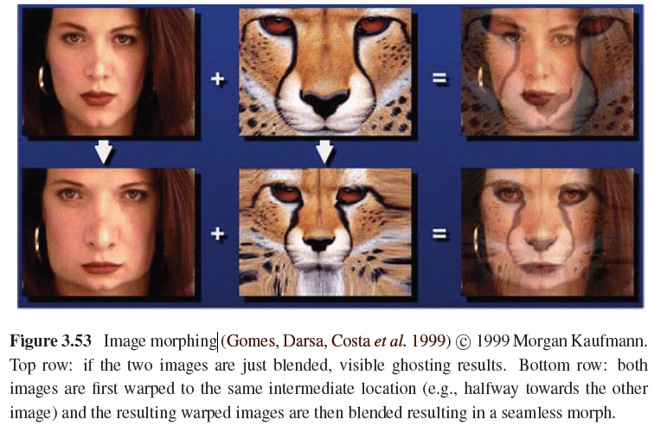

Slide 46
3.7 Global Optimization
Regularization (variational methods)
Constructs a continuous global energy function that describes the desired characteristics of the solution and then finds a minimum energy solution using sparse linear systems or related iterative techniques.
Markov random field
Using Bayesian statistics, modeling both the noisy measurement process that produced the input images as well as prior assumptions about the solution space.

Slide 47
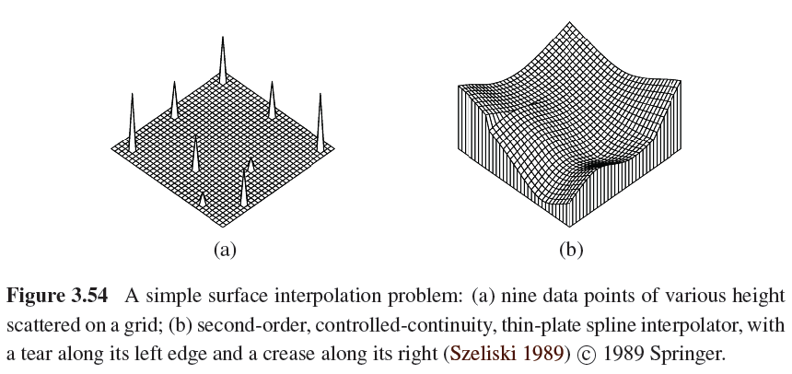
3.7.1 Regularization (1/6)

Slide 48
3.7.1 Regularization (2/6)
Finding a smooth surface that passes through (or near) a set of measured data points.
Such a problem is described as because ill-posed many possible surfaces can fit this data.
Since small changes in the input can sometimes lead to large changes in the fit, such problems are also often ill-conditioned.
Notes:
電腦視覺的初始擷取資料（raw data）在取像過程中受到許多環境因素的影響，基本上是數學上稱為「有病」的問題

Slide 49
3.7.1 Regularization (3/6)
Since we are trying to recover the unknown function f(x, y) from which the data point
d(x_{i}, y_{i}) were sampled, such problems are also often called inverse problems.
Many computer vision tasks can be viewed as inverse problems, since we are trying to recover a full description of the 3D world from a limited set of images.

Slide 50
3.7.1 Regularization (4/6)
In order to quantify what it means to find a smooth solution, we can define a norm on the solution space.
For one-dimensional functions f(x), we can integrate the squared first derivative of the function,
or perhaps integrate the squared second derivative,

Slide 51
3.7.1 Regularization (5/6)
In two dimensions, the corresponding smoothness functionals are
The first derivative norm is often called the membrane, since interpolating a set of data points using this measure results in a tent-like structure.
The second-order norm is called the thin-plate spline, since it approximates the behavior of thin plates (e.g., flexible steel) under small deformations.
Notes:
Membrane: 薄膜 Tent: 帳篷 thin-plate:薄板

Slide 52
3.7.1 Regularization (6/6)
For scattered data interpolation, the data term measures the distance between the function f(x, y) and a set of data points d_{i} =d(x_{i} , y_{i})
To obtain a global energy that can be minimized, the two energy terms are usually added together,

Slide 53
3.7.2 Markov Random Fields (1/3)
The posterior distribution for a given set of measurements y, combined with a prior p(x) over the unknowns x, is given by
Negative posterior log likelihood.

Slide 54
3.7.2 Markov Random Fields (2/3)
To find the most likely (maximum a posteriori or MAP) solution x given some measurements y, we simply minimize this negative log likelihood, which can also be thought of as an energy,
E_{d}(x, y) is the data energy or data penalty
E_{p}(x) is the prior energy

Slide 55
3.7.2 Markov Random Fields (3/3)
For image processing applications, the unknowns x are the set of output pixels
The data are (in the simplest case) the input pixels

Slide 56
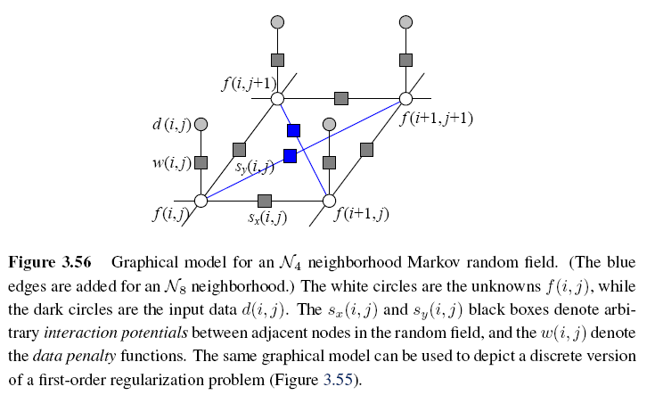

Slide 57
Binary MRFs
The simplest possible example of a Markov random field is a binary field.
Examples of such fields include 1-bit (black and white) scanned document images as well as images segmented into foreground and background regions.

Slide 58
Ordinal-Valued MRFs
In addition to binary images, Markov random fields can be applied to ordinal-valued labels such as grayscale images or depth maps.
The term “ordinal” indicates that the labels have an implied ordering, e.g., that higher values are lighter pixels.

Slide 59
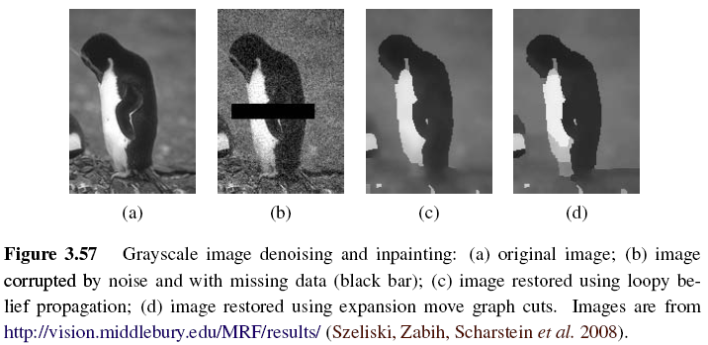
Notes:
Inpainting: 圖像修補
信念傳遞演算法 (LBP)

Slide 60
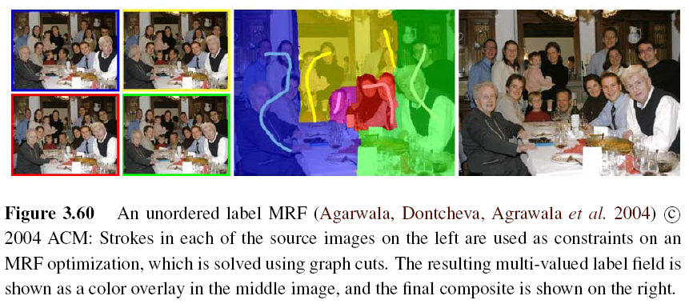
Unordered Labels

Slide 61
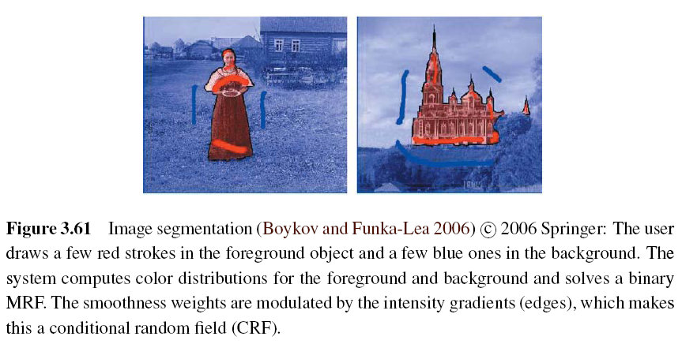
Notes:
影像復原(image restoration)、影像分割(image segmentation)、表面重建(surface reconstruction)、紋理分析(texture analysis)、光流(optical flow)、視覺合成(visual integration)以及邊緣偵測(edge detection)。

Slide 62
Term Project
Tentative term project problems: Exercises in textbook, (30%) total grade:
Submit one page in English explaining method, steps, expected results
Submit report in a month: April 16
Report progress every other week
All right to be the same problem with Master’s thesis

Slide 63
Objective: a working prototype with new, original, novel ideas
Objective: not just literature survey
Objective: not just straightforward implementation of existing algorithms
Objective: all right to modify existing algorithms

