Slide 1
Advanced Computer Vision
Chapter 3
Image Processing (1)
Presented by: 林政安
0932837981
r99944038@ntu.edu.tw

Slide 2
Image Processing
3.1 Point Operators
3.2 Linear Filtering
3.3 More Neighborhood Operators
3.4 Fourier Transforms
3.5 Pyramids and Wavelets
3.6 Geometric Transformations
3.7 Global Optimization

Slide 3
Joke

Slide 4
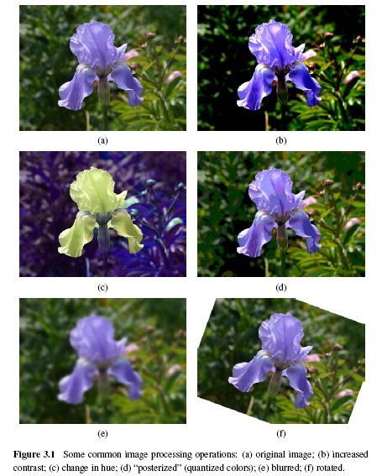

Slide 5
3.1.1 Pixel Transforms (1/3)
x is in the D-dimensional domain of the functions (usually D = 2 for images) and the functions f and g operate over some range, which can either be scalar or vector-valued, e.g., for color images or 2D motion.
For discrete images, the domain consists of a finite number of pixel locations, x = (i, j), and we can write

Slide 6
3.1.1 Pixel Transforms (2/3)
Multiplication and addition with a constant
The parameters a > 0 and b are often called the gain and bias parameters.
The bias and gain parameters can also be spatially varying.

Slide 7
3.1.1 Pixel Transforms (3/3)
Multiplicative gain is a linear operation
Dyadic (two-input) operator is the linear blend operator
Non-linear transform: gamma correction

Slide 8
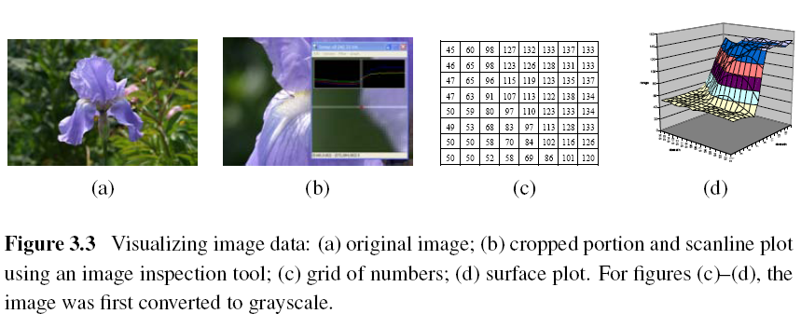
Notes:
Figure 3.3 shows how an image can be represented either by its color (appearance), as a grid
of numbers, or as a two-dimensional function

Slide 9
3.1.2 Color Transforms
In fact, adding the same value to each color channel not only increases the apparent intensity of each pixel, it can also affect the pixel’s hue and saturation.

Slide 10
3.1.3 Compositing and Matting (1/4)
In many photo editing and visual effects applications, it is often desirable to cut a foreground object out of one scene and put it on top of a different background.
The process of extracting the object from the original image is often called matting, while the process of inserting it into another image (without visible artifacts) is called compositing.

Slide 11
3.1.3 Compositing and Matting (2/4)
Alpha-matted color image
In addition to the three color RGB channels, an alpha-matted image contains a fourth alpha channel α (or A) that describes the relative amount of opacity or fractional coverage at each pixel.
Pixels within the object are fully opaque (α= 1), while pixels fully outside the object are transparent (α= 0).
Notes:
Opaque: 不透明

Slide 12
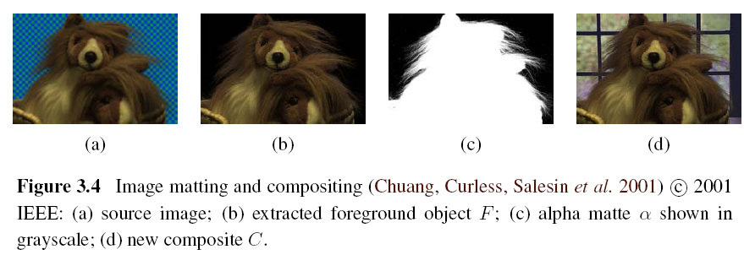
3.1.3 Compositing and Matting (3/4)

Slide 13
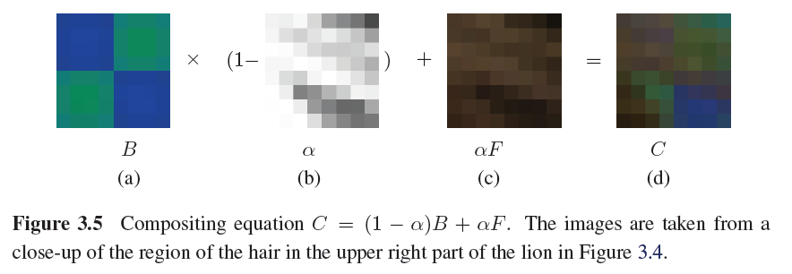
3.1.3 Compositing and Matting (4/4)

Slide 14
Joke

Slide 15
3.1.4 Histogram Equalization
To find an intensity mapping function f(I) such that the resulting histogram is flat
h(I): original histogram
c(I): cumulative distribution
N: the number of pixels in the image
A linear blend between the cumulative distribution function and the identity transform
Notes:
直方圖平坦

Slide 16
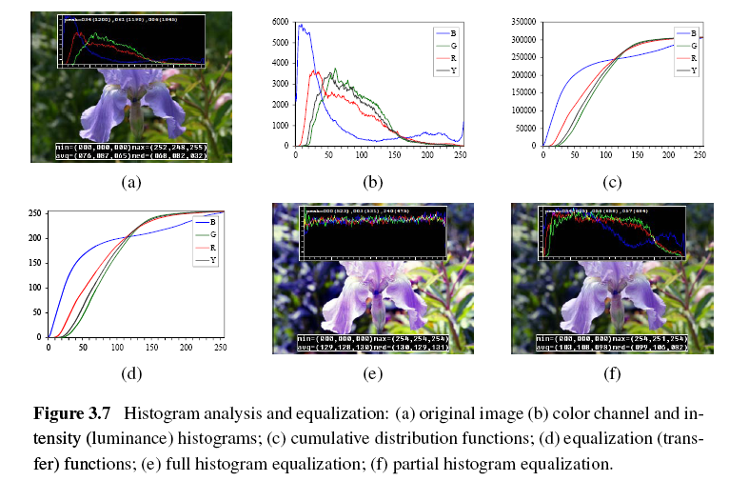

Slide 17
Locally Adaptive Histogram Equalization (1/4)
Subdivide the image into M×M pixel blocks and perform separate histogram equalization in each sub-block.
But the resulting image exhibits a lot of blocking artifacts, i.e., intensity discontinuities at block boundaries.

Slide 18
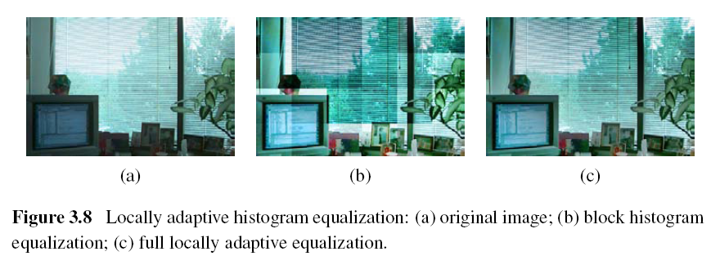

Slide 19
Locally Adaptive Histogram Equalization (2/4)
One way to eliminate blocking artifacts is to use a moving window, i.e., to recompute the histogram for every M×M block centered at each pixel.
A more efficient approach is to compute non-overlapped block-based equalization functions as before, but to then smoothly interpolate the transfer functions as we move between blocks. This technique is known as adaptive histogram equalization (AHE).

Slide 20
Locally Adaptive Histogram Equalization (3/4)
Adaptive Histogram Equalization (AHE)
The weighting function for a given pixel (i, j) can be computed as a function of its horizontal and vertical position (s, t) within a block.
To blend the four lookup {f₀₀,…,f₁₁}, a bilinear blending function

Slide 21
Locally Adaptive Histogram Equalization (4/4)
A variant on this algorithm is to place the lookup tables at the corners of each M×M block.
In addition to blending four lookups to compute the final value, we can also distribute each input pixel into four adjacent lookup tables during the histogram accumulation phase.
Notes:
soft histogramming.

Slide 22
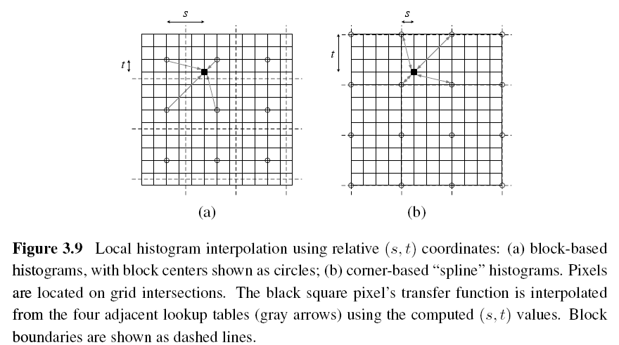

Slide 23
Joke

Slide 24
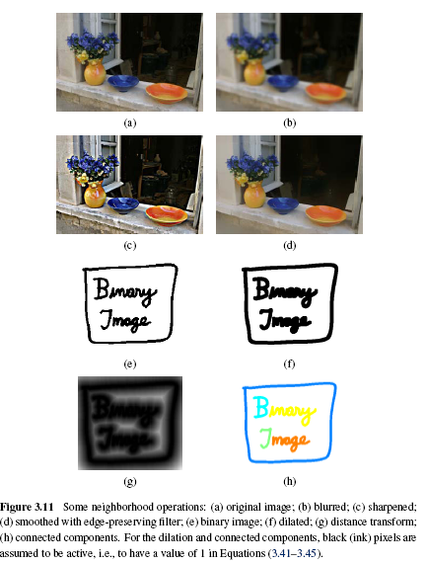
Notes:
Sharpened = 銳化
接著利用鄰居的資訊去對影像做處理。
Locally adaptive histogram equalization is an example of a neighborhood operator or local
operator, which uses a collection of pixel values in the vicinity of a given pixel to determine
its final output value (Figure 3.10). In addition to performing local tone adjustment,
neighborhood operators can be used to filter images in order to add soft blur, sharpen details,
accentuate edges, or remove noise (Figure 3.11b–d).

Slide 25
3.2 Linear Filtering
An output pixel’s value is determined as a weighted sum of input pixel values.

Slide 26
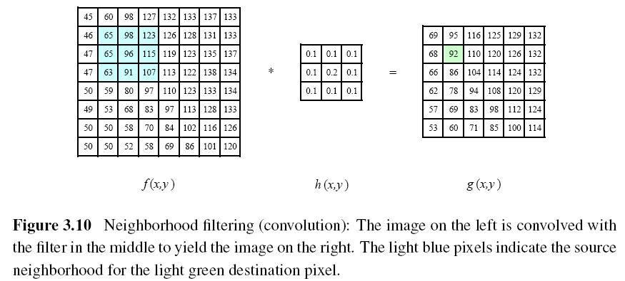

Slide 27
A one-dimensional convolution can be represented in matrix-vector form.
The results of filtering the image in this form will lead to a darkening of the corner pixels.

Slide 28
Padding (Border Effects)
zero: set all pixels outside the source image to 0.
constant (border color): set all pixels outside the source image to a specified border value.
clamp (replicate or clamp to edge): repeat edge pixels indefinitely
(cyclic) wrap (repeat or tile): loop “around” the image in a toroidal configuration
mirror: reflect pixels across the image edge
extend: extend the signal by subtracting the mirrored version of the signal from the edge pixel value
Notes:
Padding = 填充
Clamp = 堆
wrap (repeat or tile): 包 (重複或平鋪)
toroidal configuration :環形配置

Slide 29
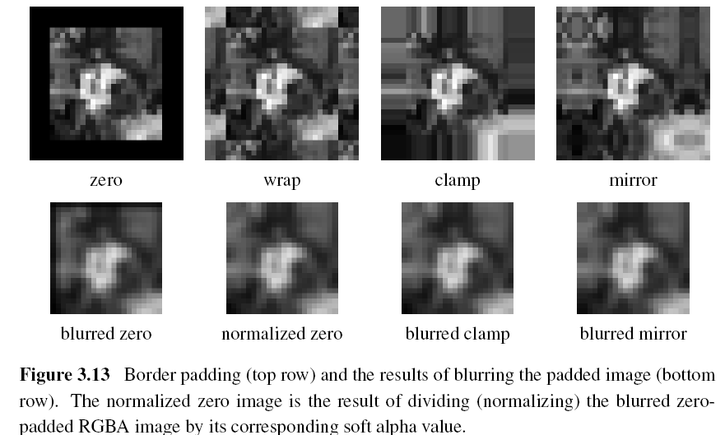
Notes:
Soft alpha value ??

Slide 30
3.2.1 Separable Filtering (1/2)
The process of performing a convolution requires K² operations per pixel, where K is the size (width or height) of the convolution kernel.
This operation can be significantly speed up by first performing a one-dimensional horizontal convolution followed by a one-dimensional vertical convolution (which requires a total of 2K operations per pixel).

Slide 31
3.2.1 Separable Filtering (2/2)
It is easy to show that the two-dimensional kernel K corresponding to successive convolution with a horizontal kernel h and a vertical kernel v is the outer product of the two kernels,

Slide 32
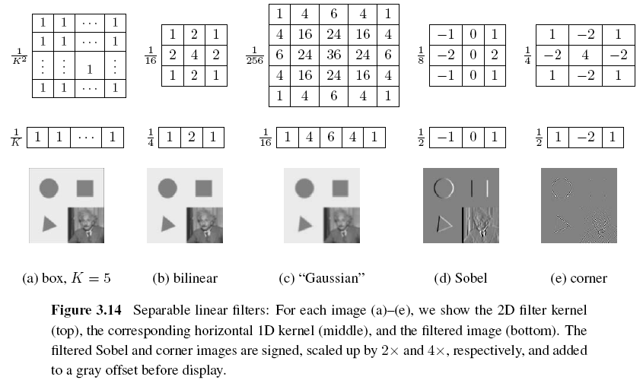

Slide 33
Joke

Slide 34
3.2.2 Examples of Linear Filtering
The simplest filter to implement is the moving average or box filter, which simply averages the pixel values in a K×K window.
Gaussian kernel

Slide 35
3.2.3 Band-Pass and Steerable Filters (1/4)
The Sobel and corner operators are simple examples of band-pass and oriented filters.
More sophisticated kernels can be created by first smoothing the image with a Gaussian filter, and then taking the first or second derivatives.
Such filters are known collectively as band-pass filters, since they filter out both low and high frequencies.
Notes:
帶通濾波器之用途是只使特定頻帶之訊號通過的電

Slide 36
3.2.3 Band-Pass and Steerable Filters (2/4)
The (undirected) second derivative of a two-dimensional image is known as the Laplacian operator.
Blurring an image with a Gaussian and then taking its Laplacian is equivalent to convolving directly with the Laplacian of Gaussian (LoG) filter.

Slide 37
3.2.3 Band-Pass and Steerable Filters (3/4)
The Sobel operator is a simple approximation to a directional or oriented filter, which can be obtained by smoothing with a Gaussian (or some other filter) and then taking a directional derivative , which is obtained by taking the dot product between the gradient field and a unit direction

Slide 38
3.2.3 Band-Pass and Steerable Filters (4/4)
The smoothed directional derivative filter,
is an example of a steerable filter, since the value of an image convolved with can be computed by first convolving with the pair of filters (G_{x}, G_{y}) and then steering the filter by multiplying this gradient field with a unit vector
Notes:
可導引濾 波器(steerable filter)的特性為"任意方向的濾波器,可用有限個固定方 向的濾波器當基底(basis filter)來線性合成" (linear combination).

Slide 39
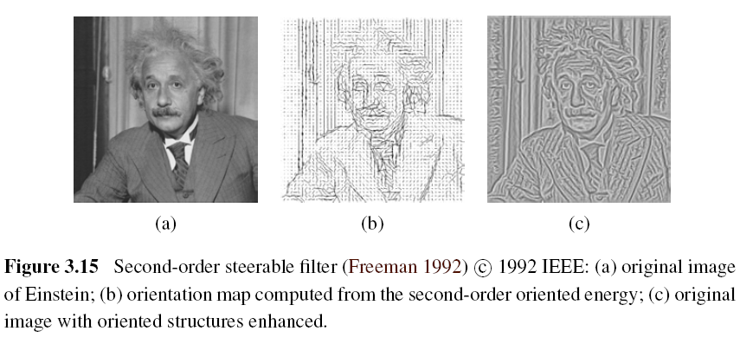

Slide 40
Joke

Slide 41
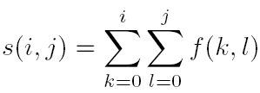
Summed Area Table (Integral Image)
To find the summed area (integral) inside a rectangle[i₀, i₁] ×[j₀, j₁], we simply combine four samples from the summed area table,

Slide 42
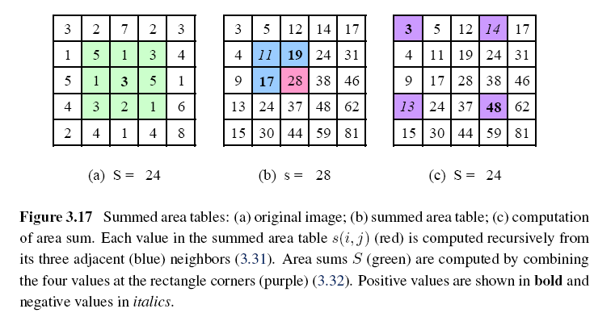
Notes:
Italics = 斜體

Slide 43
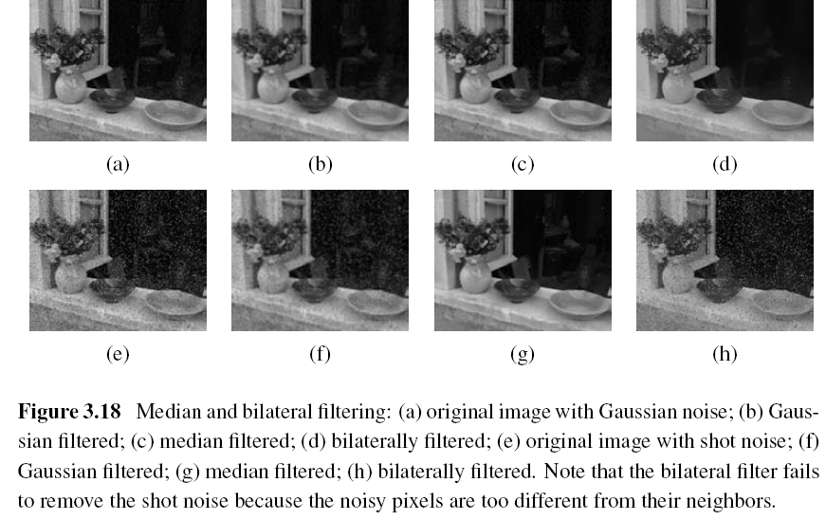
3.3 More Neighborhood Operators
Notes:
Shot noise = 散粒雜訊

Slide 44
3.3.1 Non-Linear Filtering
Median filtering: selects the median value from each pixel’s neighborhood.
α-trimmed mean: averages together all of the pixels except for the α fraction that are the smallest and the largest.
Weighted median: each pixel is used a number of times depending on its distance from the center.
Notes:
找一個g(I,J) minimize the result

Slide 45
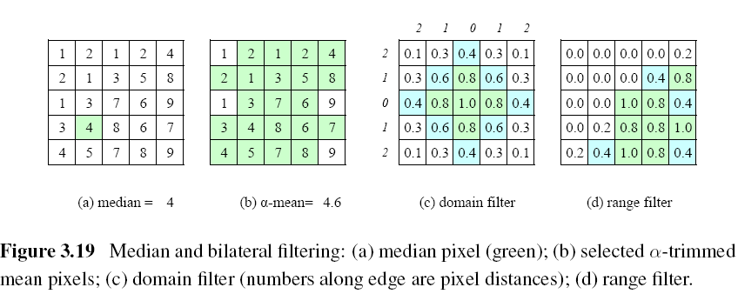

Slide 46
Bilateral Filtering
The output pixel value depends on a weighted combination of neighboring pixel values
w(i, j, k, l): bilateral weight function, which is depends on the product of a domain kernel and a data-dependent range kernel.

Slide 47
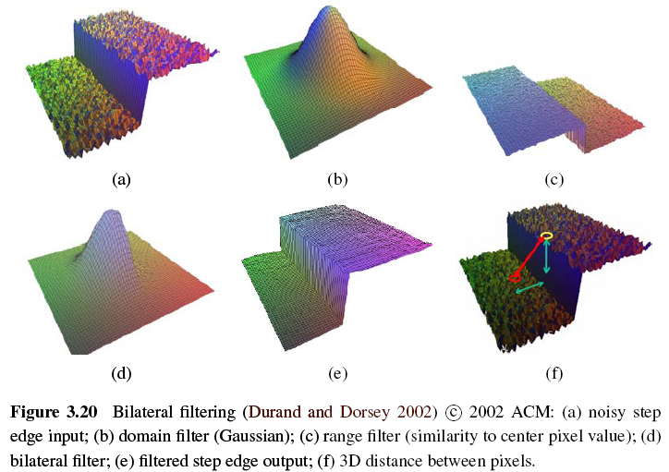
Notes:
http://cg2010studio.wordpress.com/2012/10/14/%E9%9B%99%E9%82%8A%E6%BF%BE%E6%B3%A2%E5%99%A8-bilateral-filter/
補充

Slide 48
Joke

Slide 49
3.3.2 Morphology (1/3)
The most common binary image operations are called morphological operations, since they change the shape of the underlying binary objects.
We first convolve the binary image with a binary structuring element and then select a binary output value depending on the thresholded result of the convolution.
Notes:
Such images 指經過filter處理過的gray or color image;

Slide 50
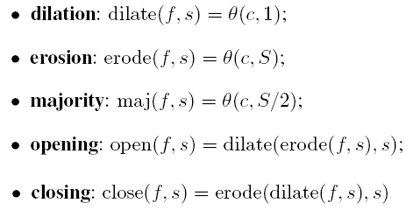
3.3.2 Morphology (2/3)
c: count of the number of 1s inside each structuring element as it is scanned over the image
s: structuring element
S: the size of the structuring element

Slide 51
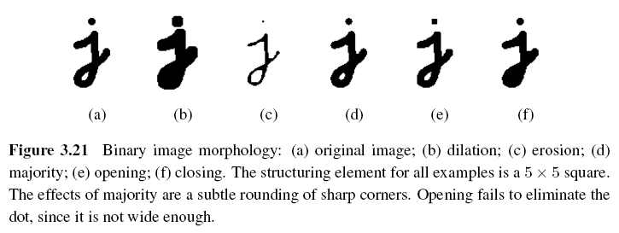
3.3.2 Morphology (3/3)

Slide 52
3.3.3 Distance Transforms
City block or Manhattan distance
Euclidean distance
The distance transform is then defined as

Slide 53
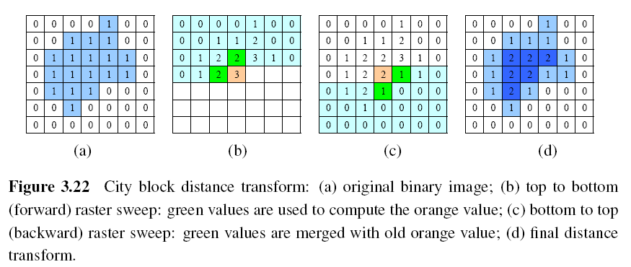
During the forward pass, each non-zero pixel is replaced by the minimum of 1 + the distance of its north or west neighbor.
During the backward pass, the same occurs.

Slide 54
3.3.4 Connected Components (1/3)
To compute the connected components of an image, we first split the image into horizontal runs of adjacent pixels, and then color the runs with unique labels, re-using the labels of vertically adjacent runs whenever possible. In a second phase, adjacent runs of different colors are then merged.

Slide 55
3.3.4 Connected Components (2/3)

Slide 56
3.3.4 Connected Components (3/3)
The area (number of pixels)
The perimeter (number of boundary pixels)
The centroid (average x and y values)

Slide 57
Joke

Slide 58
3.4 Fourier Transforms (1/6)
How can we analyze what a given filter does to high, medium, and low frequencies?
The answer is to simply pass a sinusoid of known frequency through the filter and to observe by how much it is attenuated.
Notes:
Attenuated: 衰減

Slide 59
3.4 Fourier Transforms (2/6)
f: frequency
: angular frequency
: phase
A: the gain or magnitude

Slide 60
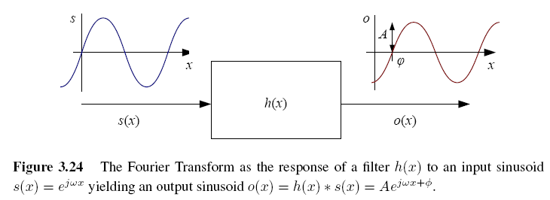
3.4 Fourier Transforms (3/6)

Slide 61
3.4 Fourier Transforms (4/6)
The Fourier transform is simply a tabulation of the magnitude and phase response at each frequency
Fourier transform pair:
Continuous domain:
Discrete domain:

Slide 62
3.4 Fourier Transforms (5/6)
Discrete Fourier Transform: O(N²)
Fast Fourier Transform: O(N logN)

Slide 63
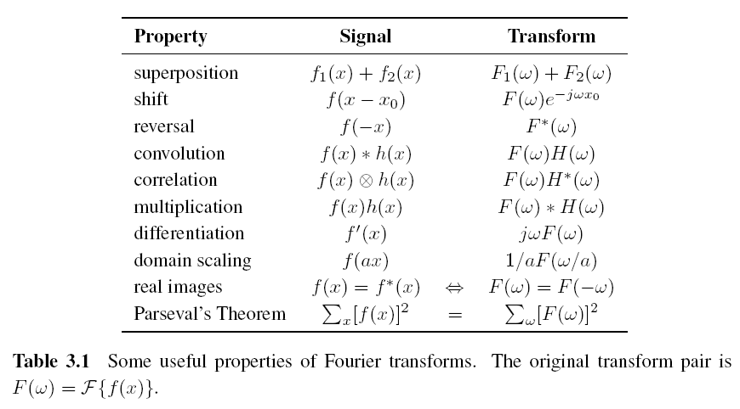
3.4 Fourier Transforms (6/6)

Slide 64
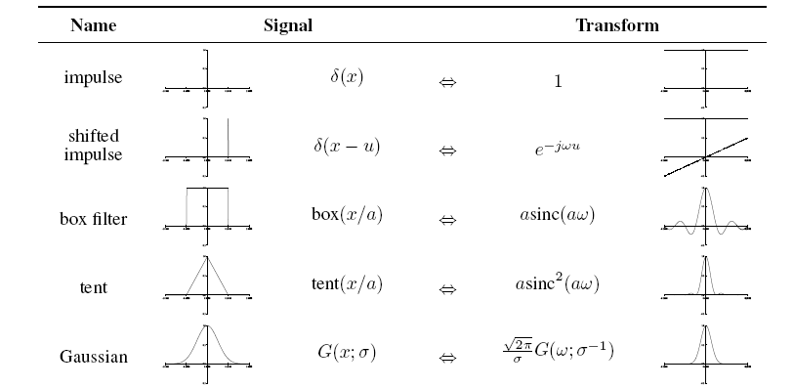
3.4.1 Fourier Transform Pairs

Slide 65
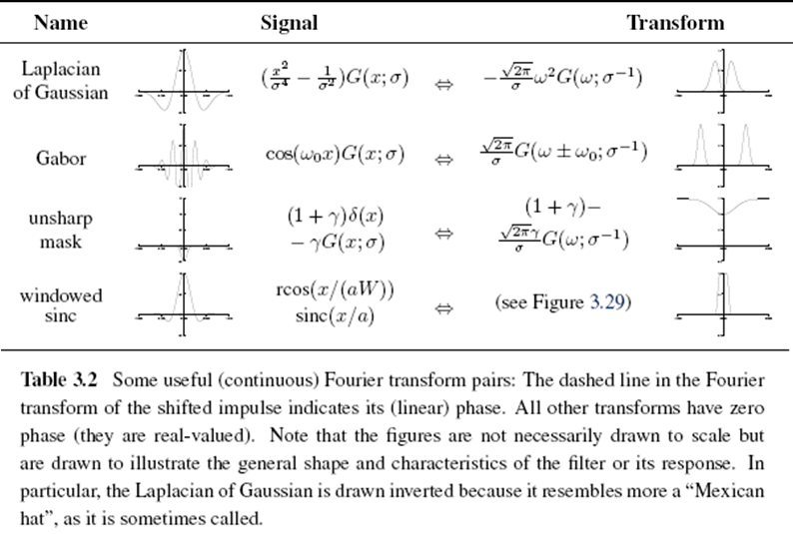

Slide 66
3.4.2 Two-Dimensional Fourier Transforms
Continuous domain:
Discrete domain:

Slide 67
Discrete Cosine Transform
The one-dimensional DCT is computed by taking the dot product of each N-wide block of pixels with a set of cosines of different frequencies,
The two-dimensional version of the DCT is
Like the FFT, each of the DCTs can also be computed in O(N logN) time.

Slide 68
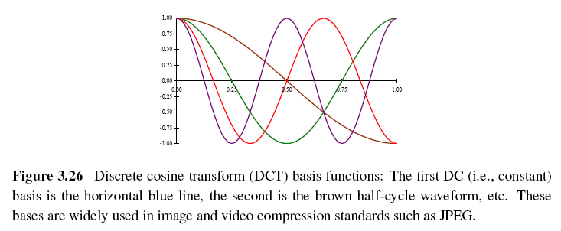
The first basis function (the straight blue line) encodes the average DC value in the block of pixels, while the second encodes a slightly curvy version of the slope.

Slide 70
Gradient Edge Detectors
Sobel edge detector: 2X2 smoothing followed by 2X2 gradient
Notes:
兩mask做convolution即可得到

Slide 71
Gradient Edge Detectors

Slide 73
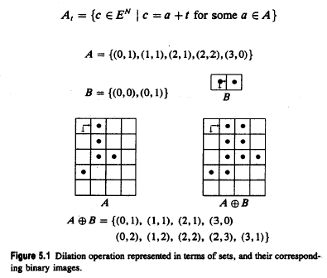
5.2.1 Binary Dilation (cont’)

Slide 74
5.2.2 Binary Erosion
erosion: morphological dual of dilation
erosion of A by B: set of all x s.t.
erosion: shrink: reduce:

Slide 75
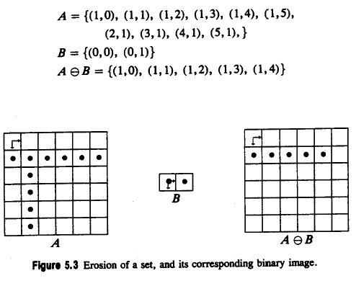
5.2.2 Binary Erosion (cont’)

