Slide 1
Advanced Computer Vision
Chapter 2
Image Formation
Presented by: 傅楸善教授 & 鄭詠鏹
0958307580
qaz30239@gmail.com

Slide 2
Image Formation
2.1 Geometric primitives and transformations
2.2 Photometric image formation
2.3 The digital camera
Notes:
Photometric 光度學

Slide 3
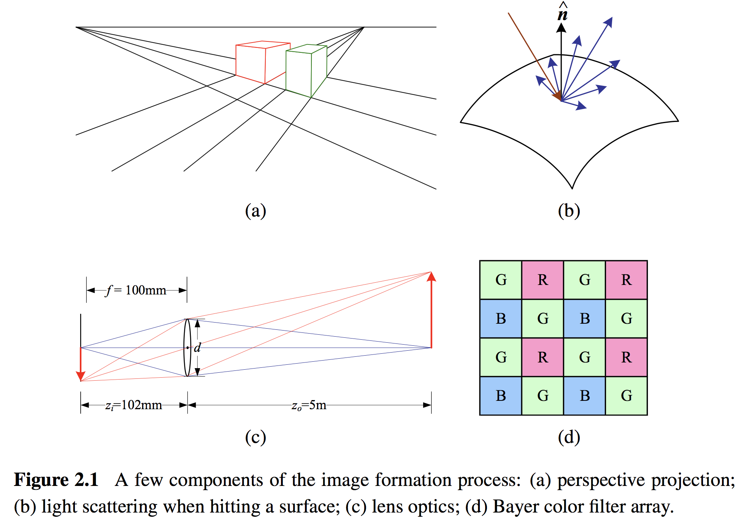
Image Formation
Notes:
Perspective projection 透視投影 <-> Orthography projection 平行投影

Slide 4
2.1 Geometric Primitives and Transformations
2.1.1 Geometric Primitives
2.1.2 2D Transformations
2.1.3 3D Transformations
2.1.4 3D Rotations
2.1.5 3D to 2D Projections
2.1.6 Lens Distortions
Notes:
Distortions 失真

Slide 5
2.1.1 Geometric Primitives
Simplest geometric objects used to describe 2D and 3D shapes.
Points, Lines and Planes.
Notes:
Distortions 失真

Slide 6
2.1.1 Geometric Primitives
2D points (pixel coordinates in an image)
$x=\left(x,y\right)=\left[\begin{matrix}x \\ y\end{matrix}\right]∈ℛ^{2}$.
Homogeneous coordinates: $\tilde{x}=\left(\tilde{x}, \tilde{y}, \tilde{w}\right)∈𝒫^{2}$
A system of coordinates used in projective geometry.
$𝒫^{2}$: 2D projective space, $𝒫^{2}=ℛ^{3}−\left(0,0,0\right)$.
(tx, ty, t) = (x, y, 1) in homogeneous coordinate.
Augmented vector $\overline{x}=\left(x, y, 1\right)$.
Notes:
Homogeneous coordinates 齊次座標
如果最後一個值為0 則代表 ideal points(理想點) or points at infinity(無窮遠點)
原點是 (0, 0, 1)

Slide 7
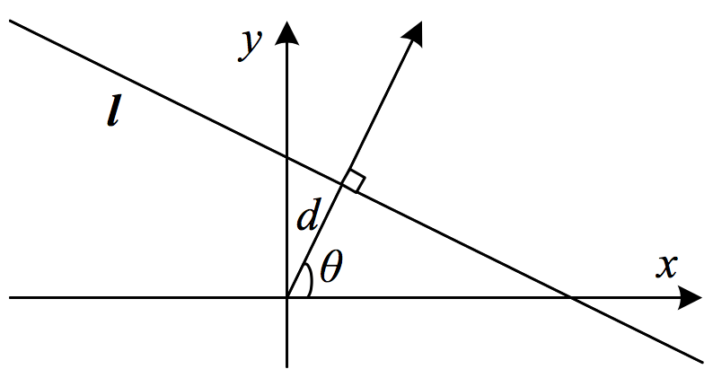
2.1.1 Geometric Primitives
2D lines
$\overline{x}∙\tilde{l}=ax+by+c=0$, where $\tilde{l}=(a,b,c)$.
Normalize the line equation vector:
$l=\left({\hat{n}}_{x},{\hat{n}}_{y},d\right)=\left(\hat{n},d\right)$ with $\left\|\hat{n}\right\|=1$.
$\hat{n}$ is the normal vector.
|$d|$ is the distance to the origin.
$$\hat{n}=\left({\hat{n}}_{x},{\hat{n}}_{y}\right)=(cosθ,sinθ)$$
$$(dcosθ,dsinθ)$$
Notes:
$\overline{x}∙\tilde{l}$是內積
$\hat{n}$ 法向量

Slide 8
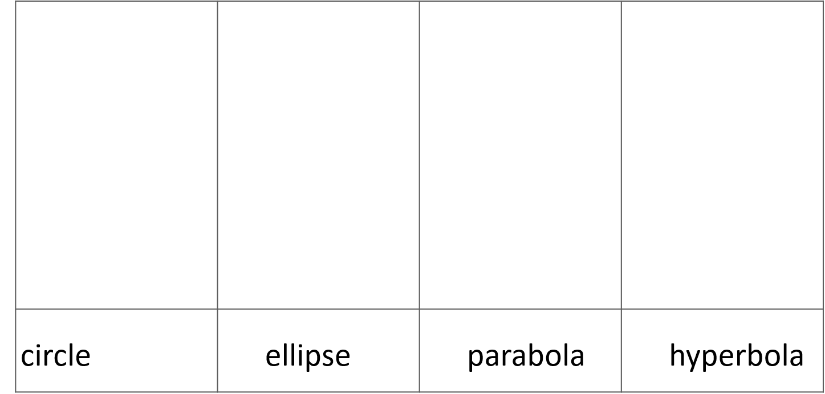
2.1.1 Geometric Primitives
2D conics: circle, ellipse, parabola, hyperbola
Q
Quadric equation: ${\tilde{x}}^{T}Q\tilde{x}=0$.
Notes:
Conics 圓錐曲線
Ellipse 橢圓
Parabola 拋物線
Hyperbola 雙曲線

Slide 9
2.1.1 Geometric Primitives
3D points:
$x=\left(x,y,z\right)∈ℛ^{3}$
Homogeneous coordinates: $\tilde{x}=\left(\tilde{x},\tilde{y},\tilde{z},\tilde{w}\right)∈𝒫^{3}$
Augmented vector: $\overline{x}=\left(x,y,z,1\right)$

Slide 10
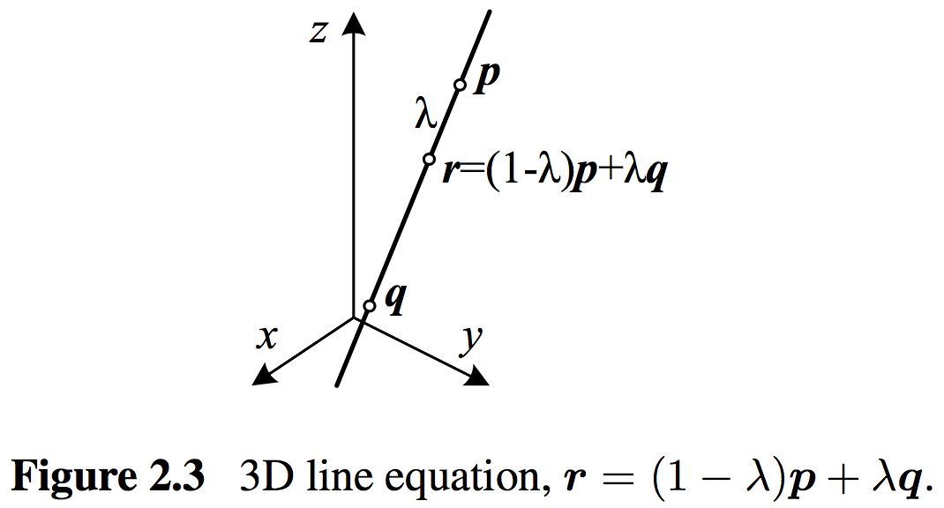
2.1.1 Geometric Primitives
3D lines:
Two points on the line, $\left(p, q\right)$.
Any other point on the line can be expressed as a linear combination of these two points.
$$r=\left(1−λ\right)p+λq$$
$$(λ=0)$$
midpoint $(λ=0.5)$
$$(λ=1)$$

Slide 11
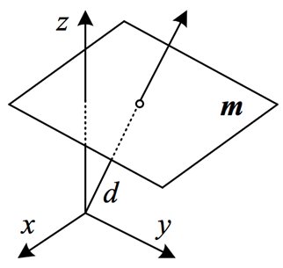
2.1.1 Geometric Primitives
3D planes:
$\overline{x}∙\tilde{m}=ax+by+cz+d=0$ where $\tilde{m}=(a,b,c,d)$.
Normalize the plane equation: $m=\left({\hat{n}}_{x},{\hat{n}}_{y},{\hat{n}}_{z},d\right)=\left(\hat{n},d\right)$ with $\left\|\hat{n}\right\|=1$.
$\hat{n}$ is the normal vector.
|$d|$ is the distance to the origin.
$$\hat{n}=(cosθsinφ,sinθsinφ,cosφ)$$

Slide 12
2.1.1 Geometric Primitives
3D quadrics:
${\tilde{x}}^{T}Q\tilde{x}=0$
Spheres, Ellipsoids, Cylinders
Sphere
Circular cylinder
Parabolic cylinder
Ellipsoid
Elliptic cylinder
Hyperbolic cylinder
Notes:
Quadrics 二次曲面
Cylinder 圓柱體
Elliptic 橢圓的
Parabolic 拋物線

Slide 13
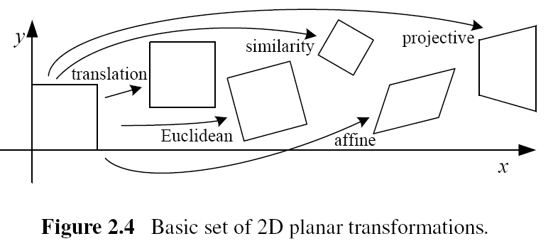
2.1.2 2D Transformations
Preserves | Translation | Euclidean | Similarity | Affine | Projective
Lengths | O | O | X | X | X
Angles | O | O | O | X | X
Parallelism | O | O | O | O | X
Notes:
轉換(位移)、歐基里德(旋轉+位移)、相似、仿射、投影

Slide 14
2.1.2 2D Transformations
Translation
2D translations can be written as $x^{′}=x+t$ or $x^{′}=\left[ \begin{matrix}I & t \end{matrix}\right]\overline{x}$.
Augmented vector:

Slide 15
2.1.2 2D Transformations
Euclidean
Rotation + Translation.
Also known as 2D rigid body motion.
$x^{′}=Rx+t$ or $x^{′}=\left[\begin{matrix} R & t \end{matrix}\right]\overline{x}$
R is an orthonormal rotation matrix with $RR^{T}=I$ and $\left|R\right|=1$.
orthonormal matrix: $Q^{T}=Q^{−1}⟺Q^{T}Q=QQ^{T}=I$.
$$R=\left[\begin{matrix}cosθ & −sinθ \\ sinθ & cosθ\end{matrix}\right]$$
Notes:
鋼體運動
逆時針選轉 $θ$ 度

Slide 16
2.1.2 2D Transformations
Similarity
Scaled Rotation.
$x^{′}=sRx+t$
s: an arbitrary scale factor
$$x^{′}=\left[s\begin{matrix}R & t\end{matrix}\right]\overline{x}=\left[\begin{matrix}a & −b & t_{x} \\ b & a & t_{y}\end{matrix}\right]\overline{x}$$

Slide 17
2.1.2 2D Transformations
Affine
$x^{′}=A\overline{x}$, where $A$ is an arbitrary 2 × 3 matrix.
Preserves parallelism:
Square → Parallelogram
Parallelogram → Parallelogram
$$x^{′}=\left[\begin{matrix}a_{00} & a_{01} & a_{02} \\ a_{10} & a_{11} & a_{12}\end{matrix}\right]\overline{x}$$

Slide 18
2.1.2 2D Transformations
Projective
2D Projective operates on homogeneous coordinates ${\tilde{x}}^{′}=\tilde{H}\tilde{x}$,
Also known as perspective transform or homography.
Preserves straight lines:
Square → arbitrary quadrilateral
Straight lines → straight lines
$$\tilde{H}=\left[\begin{matrix}h1 & h2 & h3 \\ h4 & h5 & h6 \\ h7 & h8 & h9\end{matrix}\right]$$
$$x^{′}=\frac{h1x+h2y+ h3}{h7x+h8y +h9}$$
$$y^{′}=\frac{h4x+h5y+ h6}{h7x+h8y +h9}$$
Notes:
perspective transform 透視轉換
Homography 單應性
arbitrary quadrilateral 多變的四邊形

Slide 19
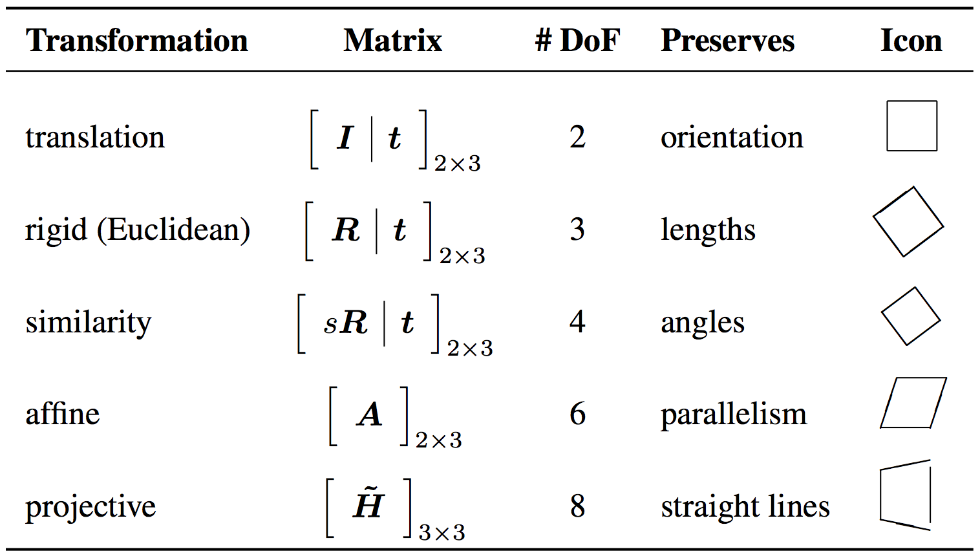
2.1.2 2D Transformations
Hierarchy of 2D coordinate transformations. Each transformation also preserves the properties listed in the rows below. The 2 X 3 matrices are extended with a third [0 0 1] row to form a full 3 X 3 matrix.

Slide 20
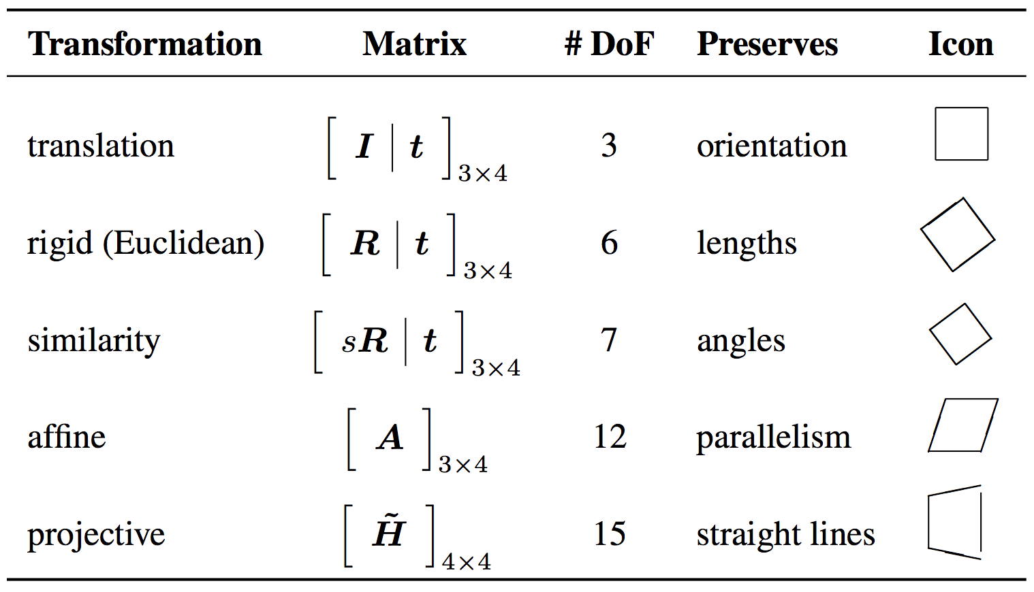
2.1.3 3D Transformations
The 3D transformations are similar to the 2D transformations.

Slide 21
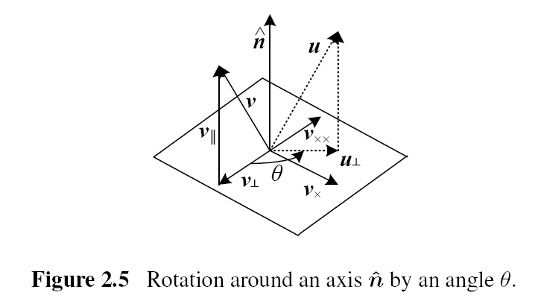
2.1.4 3D Rotations
Axis/Angle
A rotation can be represented by a rotation axis $\hat{n}$ and an angle $θ$.
Or equivalently by a 3D vector $ω=θ\hat{n}$.

Slide 22
2.1.4 3D Rotations
Project the vector$v$ onto the axis $\hat{n}$:
$v_{∥}=\hat{n}\left(\hat{n}∙v\right)=\left(\hat{n}{\hat{n}}^{T}\right)v$
Compute the perpendicular residual of $v$ from $\hat{n}$:
$v_{⊥}=v−v_{∥}=\left(I−\hat{n}{\hat{n}}^{T}\right)v$
Rotate this vector by 90◦ using the cross product:
$v_{×}=\hat{n}×v={\left[\hat{n}\right]}_{×}v$
Where ${\left[\hat{n}\right]}_{×}$ is the matrix form of cross product operator with the vector $\hat{n}=({\hat{n}}_{x},{\hat{n}}_{y},{\hat{n}}_{z})$.
$${\left[\hat{n}\right]}_{×}=\left[\begin{matrix}0 & −{\hat{n}}_{z} & {\hat{n}}_{y} \\ {\hat{n}}_{z} & 0 & −{\hat{n}}_{x} \\ −{\hat{n}}_{y} & {\hat{n}}_{x} & 0\end{matrix}\right]$$
Notes:
Perpendicular 垂直的
Residual 分量

Slide 23
2.1.4 3D Rotations
Rotate this vector by another 90◦:
$v_{××}=\hat{n}×v_{×}={\left[\hat{n}\right]}_{×}^{2}v=−v_{⊥}$
$v_{∥}=v−v_{⊥}=v+v_{××}=\left(I+{\left[\hat{n}\right]}_{×}^{2}\right)v$
Compute the in-plane component of the rotated vector $u:$
$u_{⊥}=cosθv_{⊥}+sinθv_{×}=\left(sinθ{\left[\hat{n}\right]}_{×}−cosθ{\left[\hat{n}\right]}_{×}^{2}\right)v$
Obtain the final rotated vector:
$u=u_{⊥}+v_{∥}=\left(I+sinθ{\left[\hat{n}\right]}_{×}+\left(1−cosθ\right){\left[\hat{n}\right]}_{×}^{2}\right)v$
Rodriguez’s formula: $R\left(\hat{n},θ\right)=I+sinθ{\left[\hat{n}\right]}_{×}+\left(1−cosθ\right){\left[\hat{n}\right]}_{×}^{2}$
Notes:
Perpendicular 垂直的
Residual 分量

Slide 24
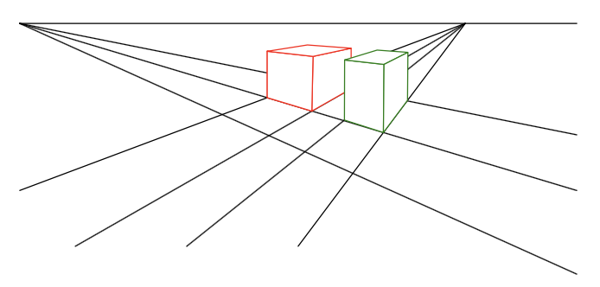
2.1.5 3D to 2D Projections
We need to specify how 3D primitives are projected onto the image plane.
The simplest model is orthography, and the more commonly used model is perspective.
vanishing point

Slide 25
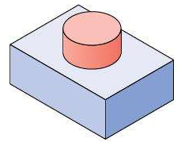
2.1.5 3D to 2D Projections
Orthography
An orthographic projection simply drops the z component of the 3D coordinate 𝒑 to obtain the 2D point 𝒙. $x=\left[I_{2×2} | 0\right]p$
Homogeneous (projective) coordinates:
In practice, world coordinates need to be scaled to fit onto an image sensor. For this reason, scaled orthography is actually more commonly used.
$x=\left[sI_{2×2} | 0\right]p$
$$\tilde{x}=\left[\begin{matrix}\begin{matrix}1 & 0 \\ 0 & 1 \\ 0 & 0\end{matrix} & \begin{matrix}0 & 0 \\ 0 & 0 \\ 0 & 1\end{matrix}\end{matrix}\right]\tilde{p}$$

Slide 26
2.1.5 3D to 2D Projections
Perspective
The most commonly used projection in computer graphics and computer vision is true 3D perspective.
Points are projected onto the image plane by dividing them by their z component.
$\overline{x}=𝒫_{z}\left(p\right)=\left[\begin{matrix}x/z \\ y/z \\ 1\end{matrix}\right]$

Slide 27
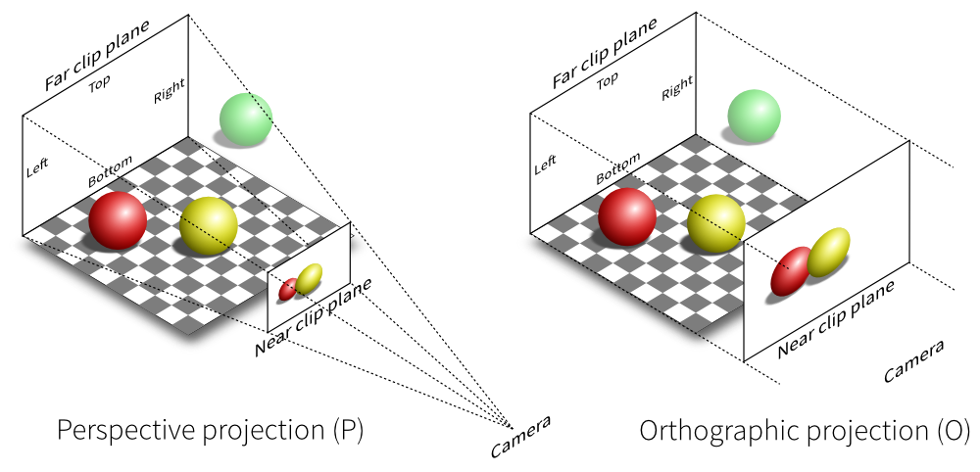
2.1.5 3D to 2D Projections
Perspective vs. Orthography

Slide 28
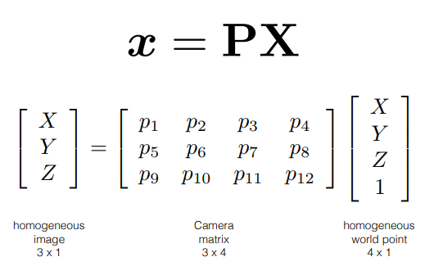
Camera Intrinsics
A camera is a mapping between the 3D world and a 2D image
Notes:
Intrinsics 內部
Nodal point 節點

Slide 29
Camera Intrinsics
The pinhole camera
y
image plane
X
camera center
principal axis
principal point
Notes:
Intrinsics 內部
principal point 主點
Pinhole camera 針孔相機

Slide 30
Camera Intrinsics
Image plane
X
fY
Y
Z
f
Z
[X Y Z]^{T} → [f X/Z fY /Z]^{T}

Slide 31
Camera Intrinsics

Slide 32
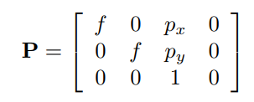
Camera Intrinsics
Camera origin and image origin might be different
CCD array
p
camera coordinate system
Accounts for different origins
image coordinate system

Slide 33
Camera Intrinsics
Can be decomposed into two matrices

Slide 34
Camera Intrinsics
Rotate
R
X_{c}
y_{c}
X_{w}
x_{c}
y_{w}
Camera coordinate
system
x_{w}
z_{c}
C
z_{w}
World coordinate system
(X_{w} — C)

Slide 35
Camera Intrinsics

Slide 36
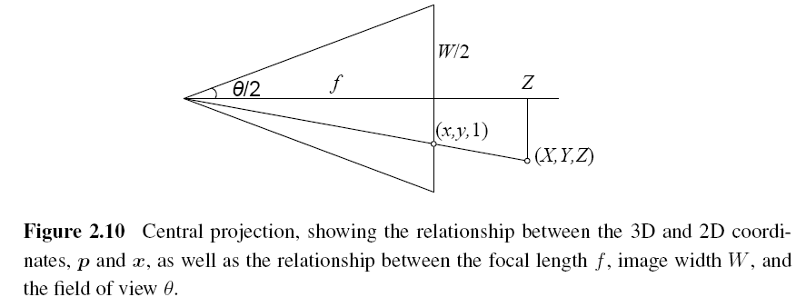
A note on Focal Lengths
Notes:
Focal length 焦距

Slide 37
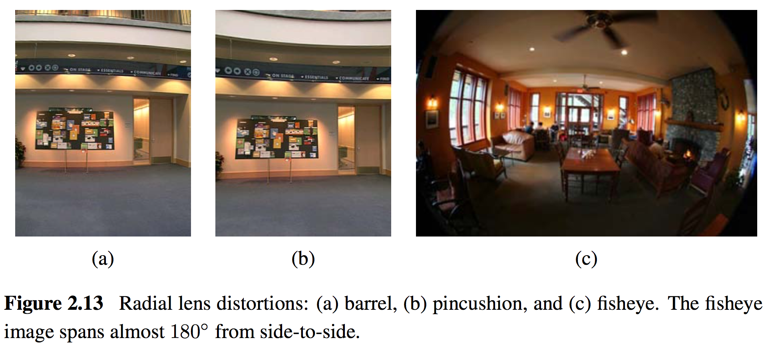
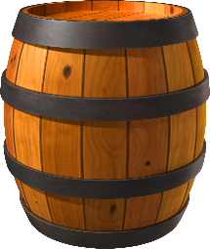
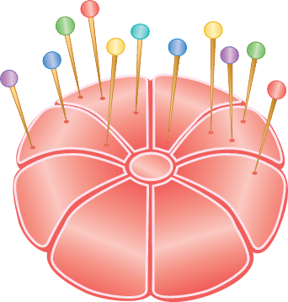
2.1.6 Lens Distortions
Imaging models all assume that cameras obey a linear projection model where straight lines in the world result in straight lines in the image.
Many wide-angles lenses have noticeable radial distortion

Slide 38
2.2 Photometric Image Formation
2.2.1 Lighting
2.2.2 Reflectance and shading
2.2.3 Optics

Slide 39
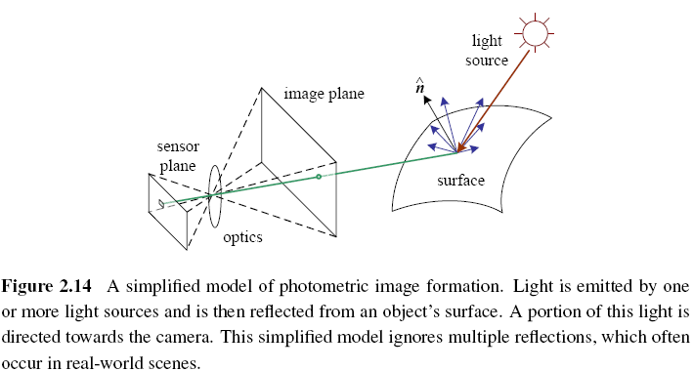
2.2.1 Lighting
To produce an image, the scene must be illuminated with one or more light sources.
A point light source has an intensity and a color spectrum, i.e., a distribution over wavelengths $L(λ)$.

Slide 40
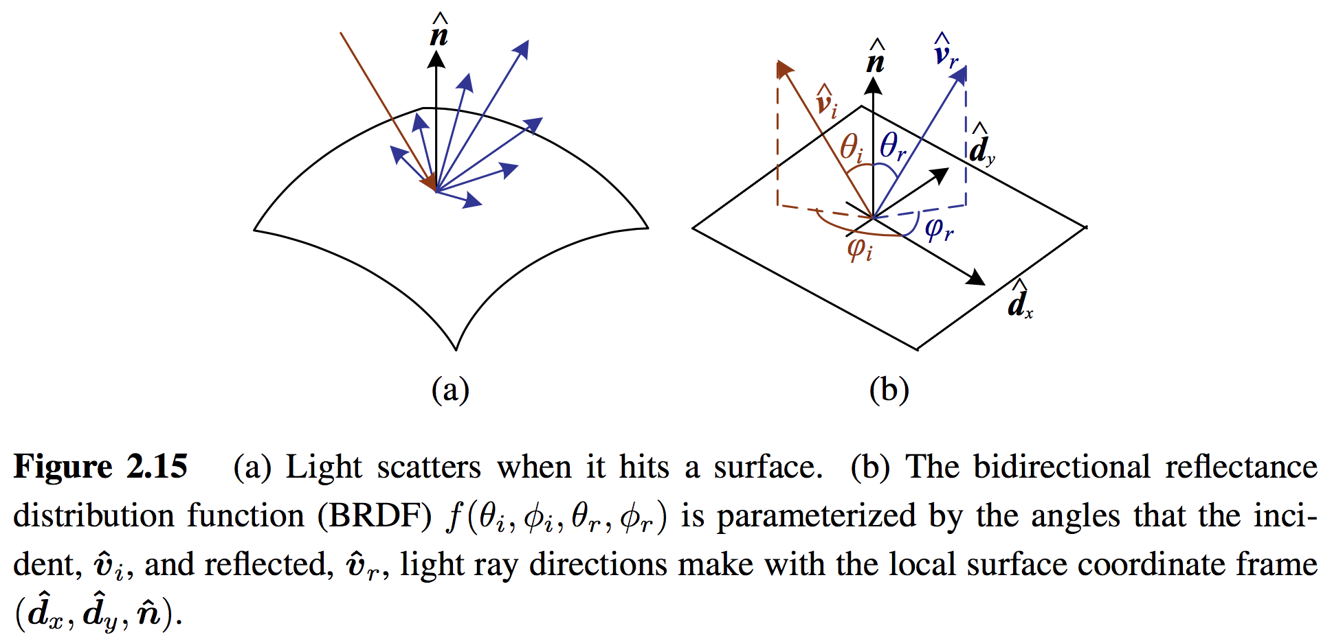
2.2.2 Reflectance and Shading
Bidirectional Reflectance Distribution Function (BRDF)
BRDF describes how much of each wavelength arriving at an incident direction ${\hat{v}}_{i}$ is emitted in a reflected direction ${\hat{v}}_{r}$.
The angles of the incident and reflected directions relative to the surface frames as $f_{r}(θ_{i},φ_{i},θ_{r},φ_{r};λ)$.

Slide 41
2.2.2 Reflectance and Shading
Diffuse Reflection and Specular Reflection
Diffuse Reflection: The diffuse component scatters light uniformly in all directions.
Specular Reflection: Incident light rays are reflected in a direction that is rotated by 180◦ around the surface normal $\hat{n}$.
Specular Reflection
(smooth surfaces)
Diffuse Reflection
(rough surfaces)
Notes:
Diffuse 漫射
Specular 鏡射

Slide 42
2.2.2 Reflectance and Shading
Phong combined the diffuse and specular components of reflection with ambient illumination.
Objects are generally illuminated not only by point light sources but also by a diffuse illumination corresponding to inter-reflection (e.g., the walls in a room) or distant sources, such as the blue sky.
Notes:
Phong shading Phong 著色法
Ambient illumination 周圍照明

Slide 43
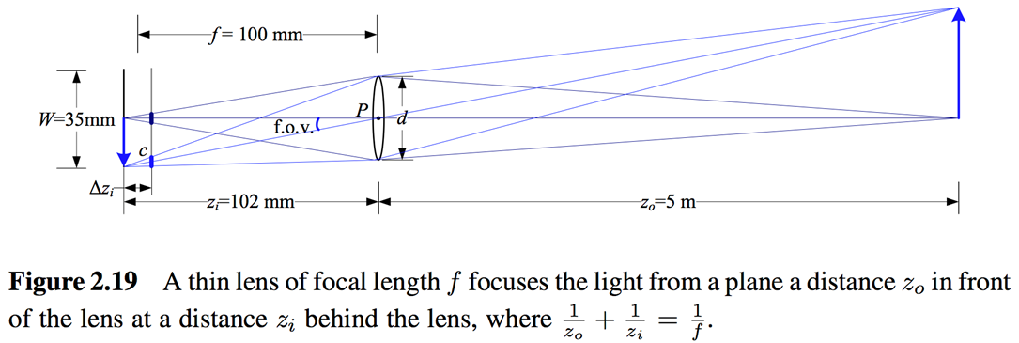
2.2.3 Optics
The light from a scene reaches the camera, it must pass through the lens before reaching the sensor.
The thin lens composed of a single piece of glass with very low, equal curvature on both sides.
Notes:
Phong shading Phong 著色法
Ambient illumination 周圍照明

Slide 44
2.2.3 Optics
Vignetting
The tendency for the brightness of the image to fall off towards the edge of the image.
Notes:
Vignetting 暈影

Slide 45
2.3 The Digital Camera
2.3.1 Sampling and aliasing
2.3.2 Color
2.3.3 Compression

Slide 46
2.3 The Digital Camera
CCD: Charge-Coupled Device
CMOS: Complementary Metal-Oxide-Semiconductor
A/D: Analog-to-Digital Converter
DSP: Digital Signal Processor
JPEG: Joint Photographic Experts Group
ISO: International Standards Organization
Notes:
Optics 光學
Aperture 光圈

Slide 47
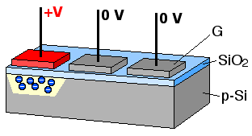
2.3 The Digital Camera
CCD (Charge-Coupled Device)
Photons are accumulated in each active well during the exposure time.
In a transfer phase, the charges are transferred from well to well in a kind of “bucket brigade” until they are deposited at the sense amplifiers.
Notes:
Charge-Coupled device 電荷耦合元件
Photon 光子
Well 井
Brigade 旅

Slide 48
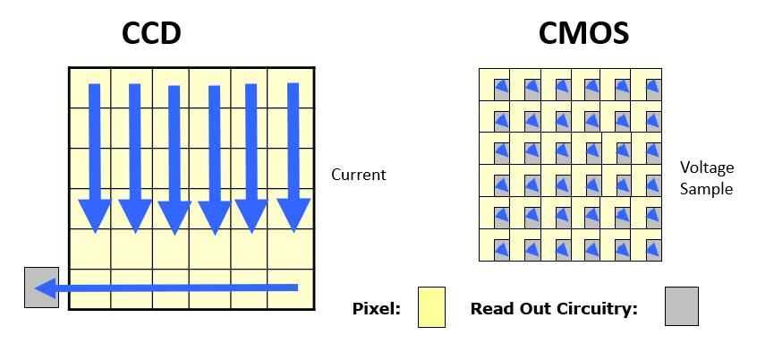
2.3 The Digital Camera
CMOS (Complementary Metal-Oxide-Semiconductor)
The photons hitting the sensor directly affect the conductivity of a photodetector, which can be selectively gated to control exposure duration, and locally amplified before being read out using a multiplexing scheme.
Notes:
Complementary 互補的
Oxide 氧化物
Photodetector 光感測器

Slide 49
2.3 The Digital Camera
Shutter speed
The shutter speed (exposure time) directly controls the amount of light reaching the sensor and determines if images are under- or over-exposed.
Sampling pitch
The sampling pitch is the physical spacing between adjacent sensor cells on the imaging chip.
Fill factor
The fill factor is the active sensing area size as a fraction of the theoretically available sensing area (the product of the horizontal and vertical sampling pitches).
Notes:
Fill factor 填充因子

Slide 50
2.3 The Digital Camera
Chip size
Video and point-and-shoot cameras have traditionally used small chip areas(1/4-inch to 1/2-inch sensors).
Analog gain
Before analog-to-digital conversion, the sensed signal is usually boosted by a sense amplifier.
Sensor noise
Throughout the whole sensing process, noise is added from various sources, which may include fixed pattern noise, dark current noise, shot noise, amplifier noise and quantization noise.
Notes:
Point-and-shoot cameras 傻瓜相機
Pattern 圖形
dark current noise 暗電流，沒有光子通過sensor時還會有的微小電流
Shot noise 散粒雜訊
quantization noise 量化雜訊

Slide 51
2.3 The Digital Camera
ADC resolution
Resolution: how many bits it yields
Noise level: how many of these bits are useful in practice
Digital post-processing
To enhance the image before compressing and storing the pixel values.
Notes:
Yields 產生

Slide 52
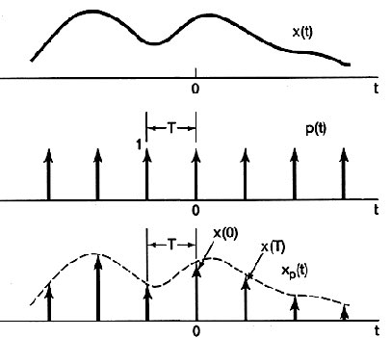
2.3.1 Sampling and Aliasing
Sampling

Slide 53
2.3.1 Sampling and Aliasing
Nyquist Frequency
The minimum sampling rate required to reconstruct a signal from its samples must be at least twice the highest frequency.
The inverse of the minimum sampling frequency is known as the Nyquist rate.
$$f_{s}≥2f_{max}$$
$$r_{s}=1/f_{s}$$

Slide 54
2.3.1 Sampling and Aliasing
Aliasing

Slide 55
2.3.2 Color
Additive Colors:
R + G = Yellow
B + R = Magenta
G + B = Cyan
R + G + B = White
R
C
Subtractive Colors:
M + C = Blue
C + Y = Green
Y + M = Red
Y + M + C = black
K
G
B
M
Y
(a) Additive colors: RGB
(a) Subtractive colors: CMYK

Slide 56
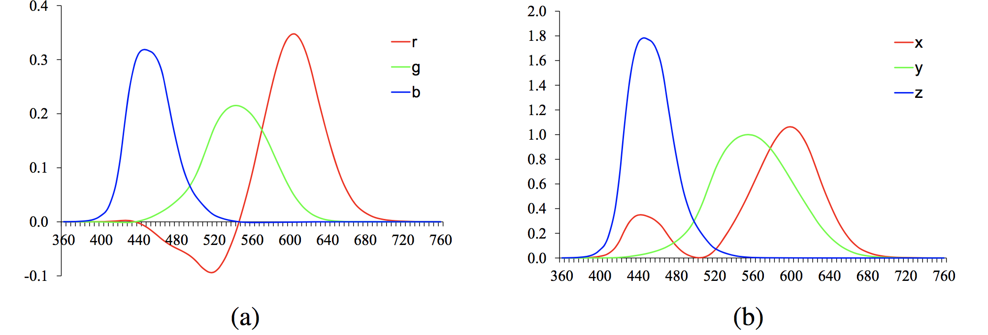
2.3.2 Color
CIE: International Commission on Illumination
CIE RGB and XYZ
In the 1930s, Commission Internationale de L'Eclairage (CIE) standardized the RGB representation by performing such color matching experiments using the primary colors of red (700.0nm wavelength), green (546.1nm), and blue (435.8nm).
Figure 2.28 Standard CIE color matching functions: (a) $\overline{r}(λ),\overline{g}(λ),\overline{b}(λ)$ color spectra obtained from matching pure colors to the R=700.0nm, G=546.1nm, and B=435.8nm primaries; (b) $\overline{x}(λ),\overline{y}(λ),\overline{z}(λ)$ color matching functions, which are linear combinations of the $(\overline{r}(λ),\overline{g}(λ),\overline{b}(λ))$ spectra.

Slide 57
2.3.2 Color
CIE RGB and XYZ
Because of the problem associated with mixing negative light, the CIE also developed a new color space called XYZ.
The transformation from RGB to XYZ is given by:
Chromaticity coordinates

Slide 58
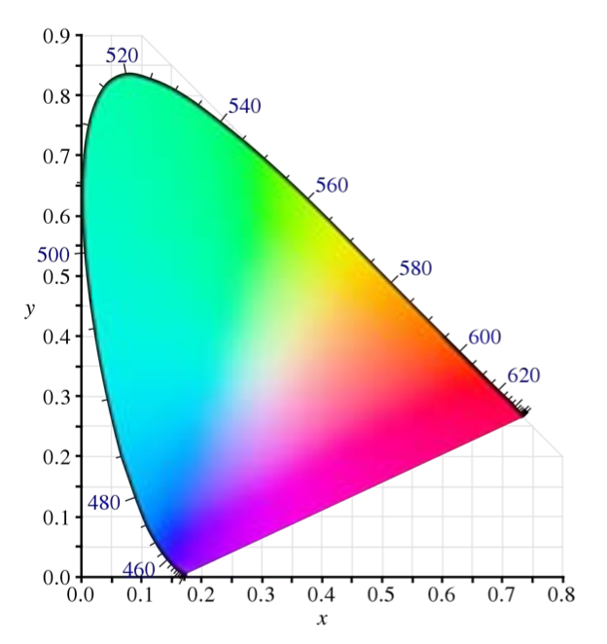
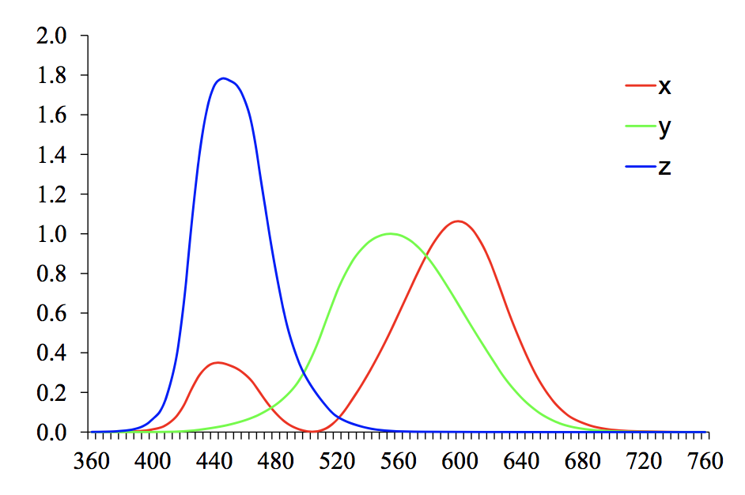
2.3.2 Color
λ = 380 nm ~
λ = 800 nm
Figure 2.29 CIE chromaticity diagram, showing colors and their corresponding (x, y) values. Pure spectral colors are arranged around the outside of the curve.

Slide 59
2.3.2 Color
L*a*b* Color Space
CIE defined a non-linear re-mapping of the XYZ space called L*a*b* (also sometimes called CIELAB).

Slide 60
2.3.2 Color
L*a*b* Color Space
The three coordinates of L*a*b* space represent the lightness of the color.
L*: L* = 0 yields black and L* = 100 indicates white.
a*: The position between red/magenta (positive values) and green (negative values).
b*: The position between yellow (positive values) and blue (negative values).

Slide 61
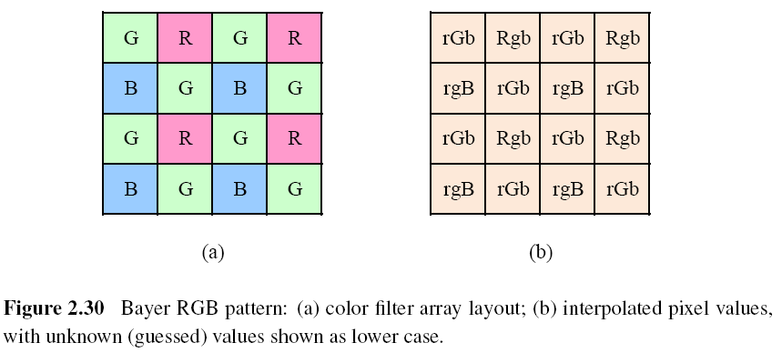
2.3.2 Color
Color Filter Arrays (CFA)
Most of today’s digital still cameras and video cameras use a color filter array (CFA), where alternating sensors are covered by different colored filters.

Slide 62
2.3.2 Color
Color Filter Arrays (CFA) – Bayer Pattern
Green filters are placed over half of the sensors (in a checkerboard pattern), and red and blue filters are placed over the remaining ones.
The reason that there are twice as many green filters as red and blue is:
The luminance signal is mostly determined by green values.
The visual system is much more sensitive to high frequency detail in luminance than in chrominance.
Incoming light
Filter layer
Sensor array
Resulting pattern

Slide 63
2.3.2 Color
Color Filter Arrays (CFA) – Bayer Pattern
The process of interpolating the missing color values so that we have valid RGB values for all the pixels is known as demosaicing (color interpolation).

Slide 64
2.3.2 Color
Color Balance (Auto White Balance)
Before encoding the sensed RGB values, most cameras perform some kind of color balancing operation in an attempt to move the white point of a given image closer to pure white.
If the illuminant is strongly colored, such as incandescent indoor lighting (which generally results in a yellow or orange hue), the compensation can be quite significant.
Notes:
Incandescent 熾熱的
Compensation 補償

Slide 65
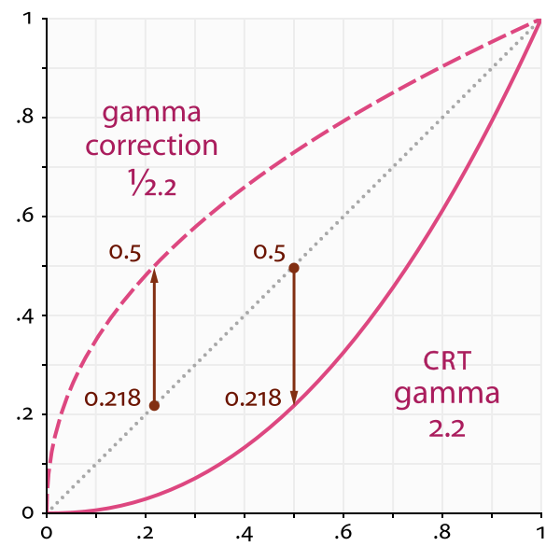
2.3.2 Color
Gamma
For CRT (Cathode Ray Tube), the relationship between the voltage (V) and the brightness (B) was characterized by gamma (γ), γ=2.2.
To compensate for this effect, the electronics in the TV camera would pre-map the luminance Y through an inverse gamma, 1/γ = 0.45.
Camera
LCD
Notes:
CRT 陰極射線管
Compensate 補償

Slide 66
2.3.2 Color
Other Color Spaces
YUV
Y: luminance (Y’: luma)
U, V: chrominance
YCbCr
Cb, Cr: the blue-difference and red-difference chroma components.
R’G’B’ values are the eight-bit gamma-compressed color components.

Slide 67
2.3.2 Color
Other Color Spaces
HSV: hue, saturation, value
A projection of the RGB color cube onto a non-linear chroma angle, a radial saturation percentage, and a luminance-inspired value.
RGB
HSV

Slide 68
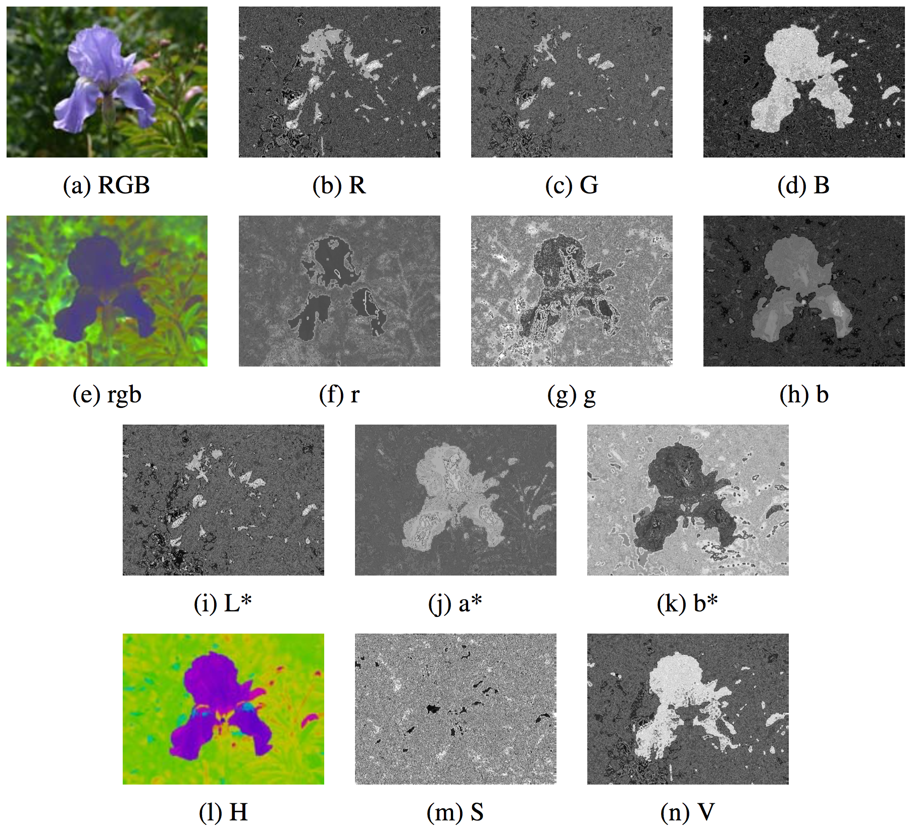
2.3.2 Color
Figure 2.32 Color space transformations: (a–d) RGB; (e–h) rgb; (i–k) L*a*b*; (l–n) HSV. Note that the rgb, L*a*b*, and HSV values are all re-scaled to fit the dynamic range of the printed page.

Slide 69
2.3.3 Compression
All color video and image compression algorithms start by converting the signal into YCbCr (or some closely related variant), so that they can compress the luminance signal with higher fidelity than the chrominance signal.
In video, it is common to subsample Cb and Cr by a factor of two horizontally; with still images (JPEG), the subsampling (averaging) occurs both horizontally and vertically.
Notes:
Fidelity 保真度
Chrominance 色度

Slide 70
2.3.3 Compression
Once the luminance and chrominance images have been appropriately subsampled and separated into individual images, they are then passed to a block transform stage.
The most common technique used here is the Discrete Cosine Transform (DCT), which is a real-valued variant of the Discrete Fourier Transform (DFT).
After transform coding, the coefficient values are quantized into a set of small integer values that can be coded using a variable bit length scheme such as a Huffman code or an arithmetic code.
Notes:
Chrominance 色度

Slide 71
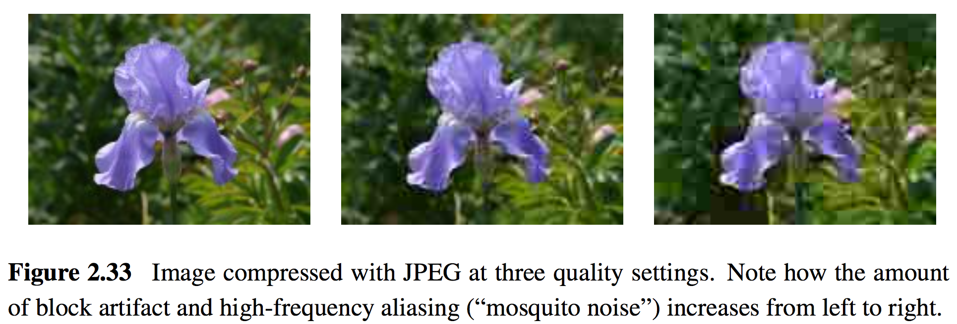
2.3.3 Compression
The step size in the quantization is the main variable controlled by the quality setting on the JPEG file.
JPEG (Joint Photographic Experts Group)

Slide 72
Homework 2: Project due March 19
1. Camera calibration i.e. compute #mm/ pixel object displacement
2. Calculate horizontal field of view in degrees of angle.
3. Calculate theoretical values (FOV) and compare with measured values.
Using the sample images at http://goo.gl/pWBNN0
Use lens of focal length: 18mm, 53mm, 135mm
Object displacement of: 1mm, 5mm, 10mm, 20mm
Object distance of: 0.6m, 1.2m, 1.8m

Slide 73
Homework 2: Project due March 19
Pentax K-7 相機資訊 https://www.digicamdb.com/specs/pentax_k-7/
Sensor size: 23.4 x 15.6 mm

Slide 74
Homework 2: Project due March 19
FOV theoretical value (f = 135mm, sensor width = 23.4mm):
FOV $=2×arctan⁡(\frac{sensor width}{2×f})×\frac{180}{π}$
FOV measured value:
FOV $=2×arctan⁡(\frac{Image width(in pixel)× \text{mm} \text{per} \text{pixel}}{2×object distance})×\frac{180}{π}$

