Slide 1
Advanced Computer Vision
Chapter 2 Image Formation
Presented by: 傅楸善教授、曾柄元
r07922034@ntu.edu.tw

Slide 2
Outline
2.1 Geometric primitives and transformations
2.2 Photometric image formation
2.3 The digital camera

Slide 3
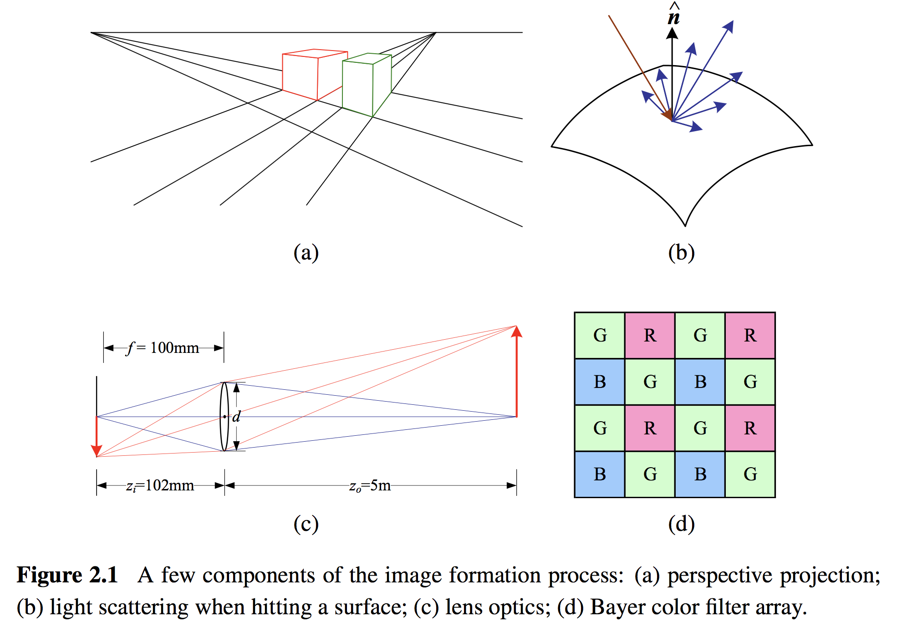
Image Formation

Slide 4
2.1 Geometric Primitives and Transformations
2.1.1 Geometric Primitives
2.1.2 2D Transformations
2.1.3 3D Transformations
2.1.4 3D Rotations
2.1.5 3D to 2D Projections
2.1.6 Lens Distortions

Slide 5
2.1.1 Geometric Primitives
Geometric primitives form the basic building blocks used to describe three-dimensional shapes.
Points, Lines and Planes.

Slide 6
2.1.1 Geometric Primitives
2D Points
2D points (pixel coordinates in an image) can be denoted using a pair of values $x=\left(x,y\right)=\left[\begin{matrix}x \\ y\end{matrix}\right]∈ℛ^{2}$.
Homogeneous Coordinates: $\tilde{x}=\left(\tilde{x}, \tilde{y}, \tilde{w}\right)∈𝒫^{2}$
2D projective space $𝒫^{2}=ℛ^{3}−\left(0,0,0\right)$
inhomogeneous vector $x$: by dividing the last element $\tilde{w}$
augmented vector $\overline{x}=\left(x, y, 1\right)$
last element $\tilde{w}=0$ are called ideal points or points at infinity.
$$\tilde{x}=\left(\tilde{x}, \tilde{y}, \tilde{w}\right)=\tilde{w}\left(x, y, 1\right)=\tilde{w}\overline{x}$$
Notes:
(tx, ty, 1) = (x, y, 1/t) in homogenous coordinate.

Slide 7
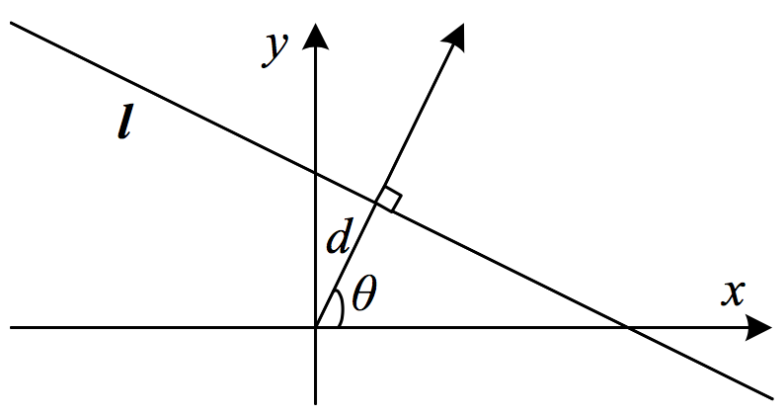
2.1.1 Geometric Primitives
2D Lines
2D lines can be represented using homogeneous coordinates $\tilde{l}=(a,b,c)$.
The corresponding line equation is $\overline{x}∙\tilde{l}=ax+by+c=0$.
Normalize the line equation vector: $l=\left({\hat{n}}_{x},{\hat{n}}_{y},−d\right)=\left(\hat{n},−d\right)$ with $\left\|\hat{n}\right\|=1$.
$\hat{n}$ is the normal vector perpendicular to the line.
|$d|$ is the distance to the origin.
The combination ($θ, d$ ) is known as polar coordinates.
$$\hat{n}=\left({\hat{n}}_{x},{\hat{n}}_{y}\right)=(cosθ,sinθ)$$
Notes:
課本上是錯的。
L : cos$θ$x + sin$θ$y – d = 0
(dcos$θ$, dsin$θ$) 會通過該條線。

Slide 8
2.1.1 Geometric Primitives
When using homogeneous coordinates, we can compute the intersection of two lines as
$\tilde{x}=\tilde{l1} ×\tilde{l2} ,$where $×$ is the cross product operator.
Similarly, the line joining two points can be written as
$\tilde{l}=\tilde{x1} ×\tilde{x2}$

Slide 9
Cross product
Conversion to matrix multiplication

Slide 10
2.1.1 Geometric Primitives
2D Conics
Conic sections: circle, ellipse, parabola and hyperbola.
Quadric equation: ${\tilde{x}}^{T}Q\tilde{x}=0$.
circle | ellipse | parabola | hyperbola
Notes:
Conic section - Wiki: https://en.wikipedia.org/wiki/Conic_section

Slide 11
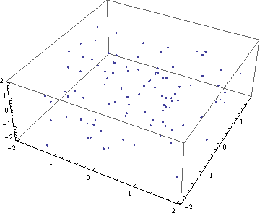
2.1.1 Geometric Primitives
3D Points (similar to 2D points)
inhomogeneous coordinates: $x=\left(x,y,z\right)∈ℛ^{3}$
homogeneous coordinates: $\tilde{x}=\left(\tilde{x},\tilde{y},\tilde{z},\tilde{w}\right)∈𝒫^{3}$
augmented vector: $\overline{x}=\left(x,y,z,1\right)$

Slide 12
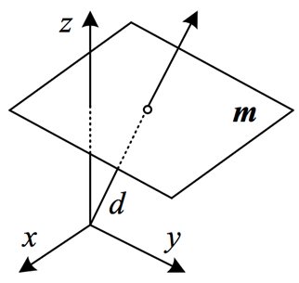
2.1.1 Geometric Primitives
3D Planes
3D planes can be represented as homogeneous coordinates $\tilde{m}=(a,b,c,d)$.
The corresponding plane equation: $\overline{x}∙\tilde{m}=ax+by+cz+d=0$.
Normalize the plane equation: $m=\left({\hat{n}}_{x},{\hat{n}}_{y},{\hat{n}}_{z},d\right)=\left(\hat{n},d\right)$ with $\left\|\hat{n}\right\|=1$.
$\hat{n}$ is the normal vector perpendicular to the plane.
$d$ is the distance to the origin.
$$\hat{n}=(cosθsinφ,sinθsinφ,cosφ)$$
spherical coordinates

Slide 13
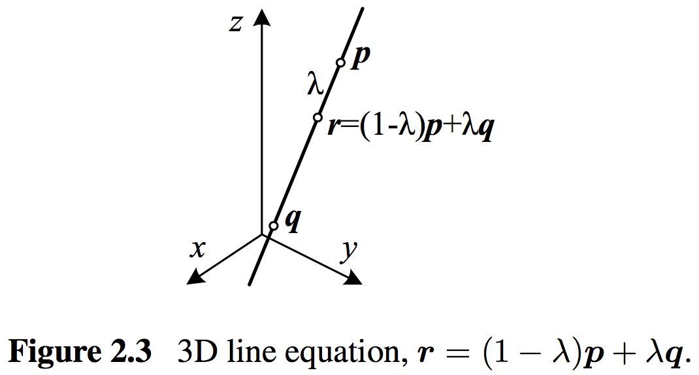
2.1.1 Geometric Primitives
3D Lines
Use two points on the line $\left(p, q\right)$, and any other point on the line can be expressed as a linear combination of these two points:
$$r=\left(1−λ\right)p+λq$$
$$(λ=0)$$
midpoint $(λ=0.5)$
$$(λ=1)$$

Slide 14
2.1.1 Geometric Primitives
3D Quadrics
The 3D analog of a conic section is a quadric surface ${\tilde{x}}^{T}Q\tilde{x}=0$.
Spheres, Ellipsoids, Cylinders
Sphere
Circular cylinder
Parabolic cylinder
Ellipsoid
Elliptic cylinder
Hyperbolic cylinder
Notes:
Quadric - Wiki: https://en.wikipedia.org/wiki/Quadric

Slide 15
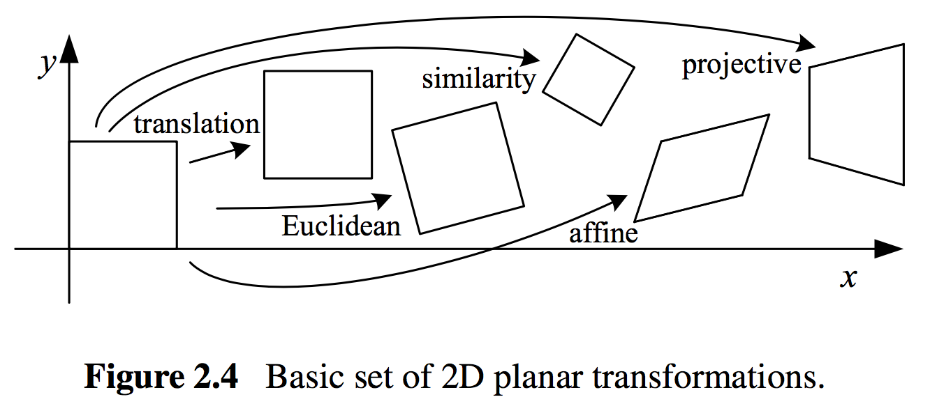
2.1.2 2D Transformations
Having defined our basic primitives, we can now turn our attention to how they can be transformed.
 | Translation | Euclidean | Similarity | Affine | Projective
保長 | O | O | ✕ | ✕ | ✕
保角 | O | O | O | ✕ | ✕
保平行 | O | O | O | O | ✕

Slide 16
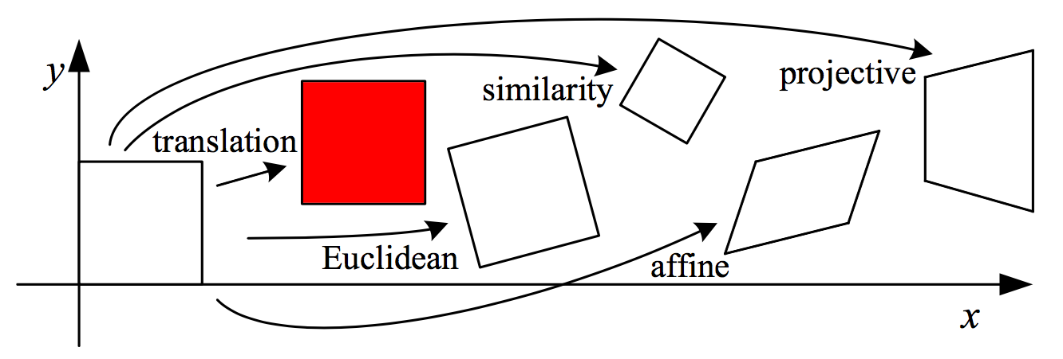
2.1.2 2D Transformations
Translation
2D translations can be written as $x^{′}=x+t$ or $x^{′}=\left[ \begin{matrix}I & t \end{matrix}\right]\overline{x}$ where $I$ is the (2×2) identity matrix.
augmented vector:

Slide 17
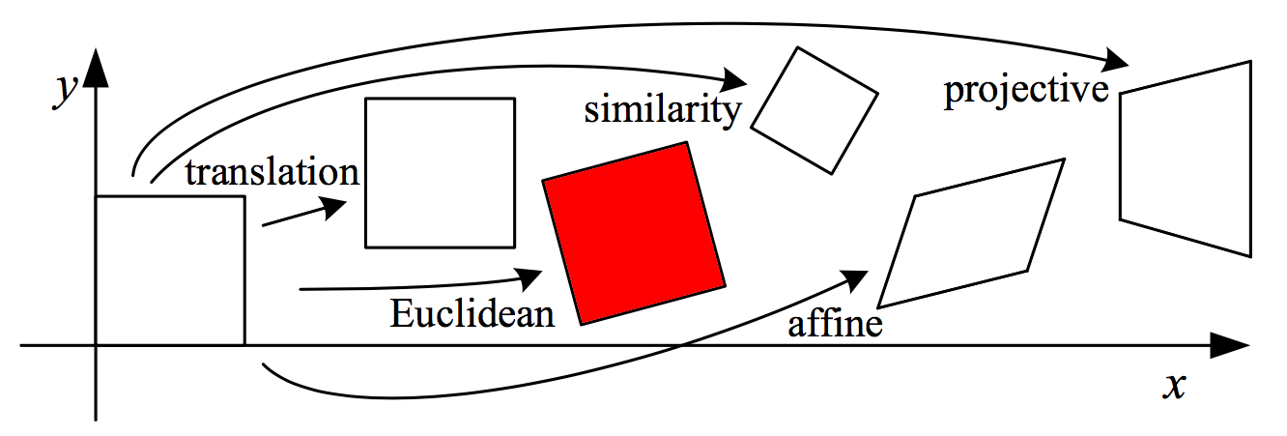
2.1.2 2D Transformations
Euclidean (Rotation + Translation)
This transformation is also known as 2D rigid body motion.
2D Euclidean can be written as $x^{′}=Rx+t$ or $x^{′}=\left[\begin{matrix} R & t \end{matrix}\right]\overline{x}$ where
R is an orthonormal rotation matrix with $RR^{T}=I$ and $\left|R\right|=1$.
orthonormal matrix: $Q^{T}=Q^{−1}⟺Q^{T}Q=QQ^{T}=I$.
$$R=\left[\begin{matrix}cosθ & −sinθ \\ sinθ & cosθ\end{matrix}\right]$$

Slide 18
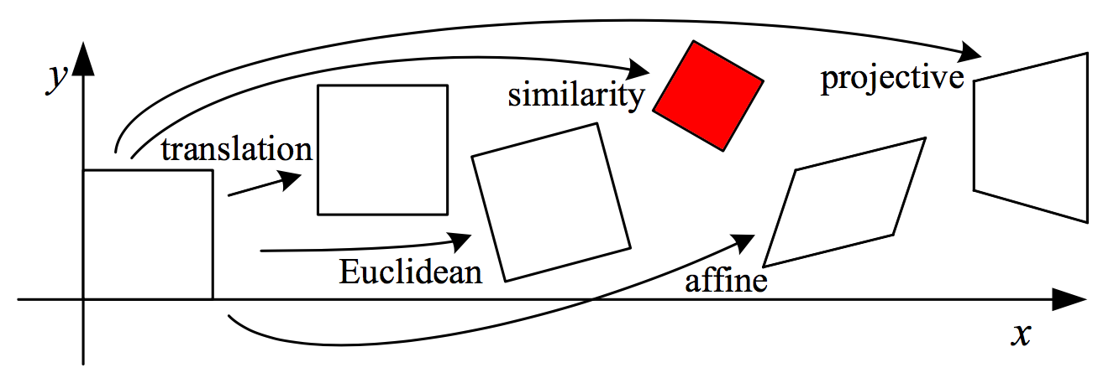
2.1.2 2D Transformations
Similarity (Scaled Rotation)
2D Similarity can be written as $x^{′}=sRx+t$ or where $s$ is an arbitrary scale factor.
Preserves: angles.
$$x^{′}=\left[s\begin{matrix}R & t\end{matrix}\right]\overline{x}=\left[\begin{matrix}a & −b & t_{x} \\ b & a & t_{y}\end{matrix}\right]\overline{x}$$
Notes:
S^2 = a^2 + b^2

Slide 19
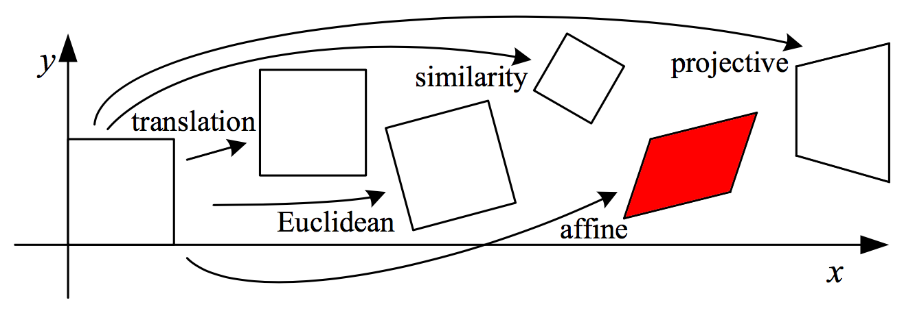
2.1.2 2D Transformations
Affine
2D Affine can be written as $x^{′}=A\overline{x}$, where $A$ is an arbitrary 2 × 3 matrix, i.e.,
Preserves: parallelism.
square → parallelogram
parallelogram → parallelogram
$$x^{′}=\left[\begin{matrix}a_{00} & a_{01} & a_{02} \\ a_{10} & a_{11} & a_{12}\end{matrix}\right]\overline{x}$$

Slide 20
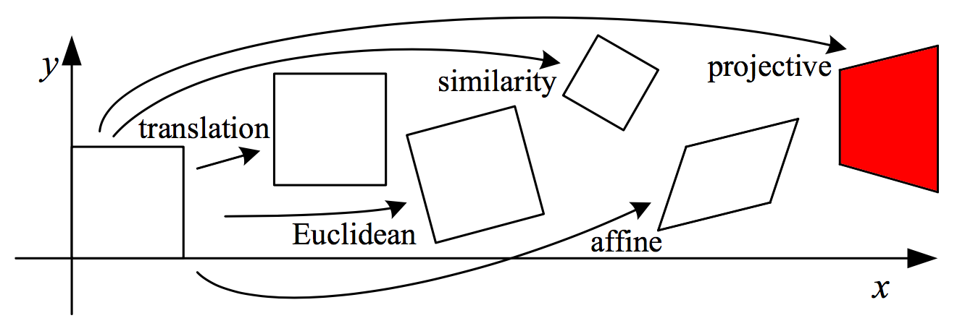
2.1.2 2D Transformations
$$x^{′}=\frac{h1x+h2y+ h3}{h7x+h8y +h9}$$
$$y^{′}=\frac{h4x+h5y+ h6}{h7x+h8y +h9}$$
Projective
This transformation is also known as perspective transform or homography.
2D Projective operates on homogeneous coordinates ${\tilde{x}}^{′}=\tilde{H}\tilde{x}$, where $\tilde{H}$ is an arbitrary 3 × 3 matrix.
Preserves: straight lines.
square → arbitrary quadrilateral
straight line → straight line
$$\tilde{H}=\left[\begin{matrix}h1 & h2 & h3 \\ h4 & h5 & h6 \\ h7 & h8 & h9\end{matrix}\right]$$
Notes:
直線轉換後還是直線
證法:
P1, P2 = P1+ aV
a為scalar, V為直線方向
P1, P2 經過H 轉換後為 P1’, P2’
發現斜率與 a 無關。

Slide 21
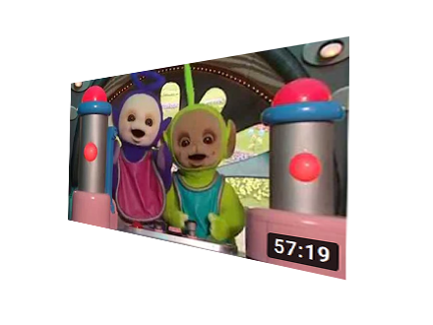
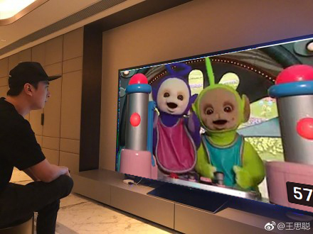
2.1.2 2D Transformations
Projective

Slide 22
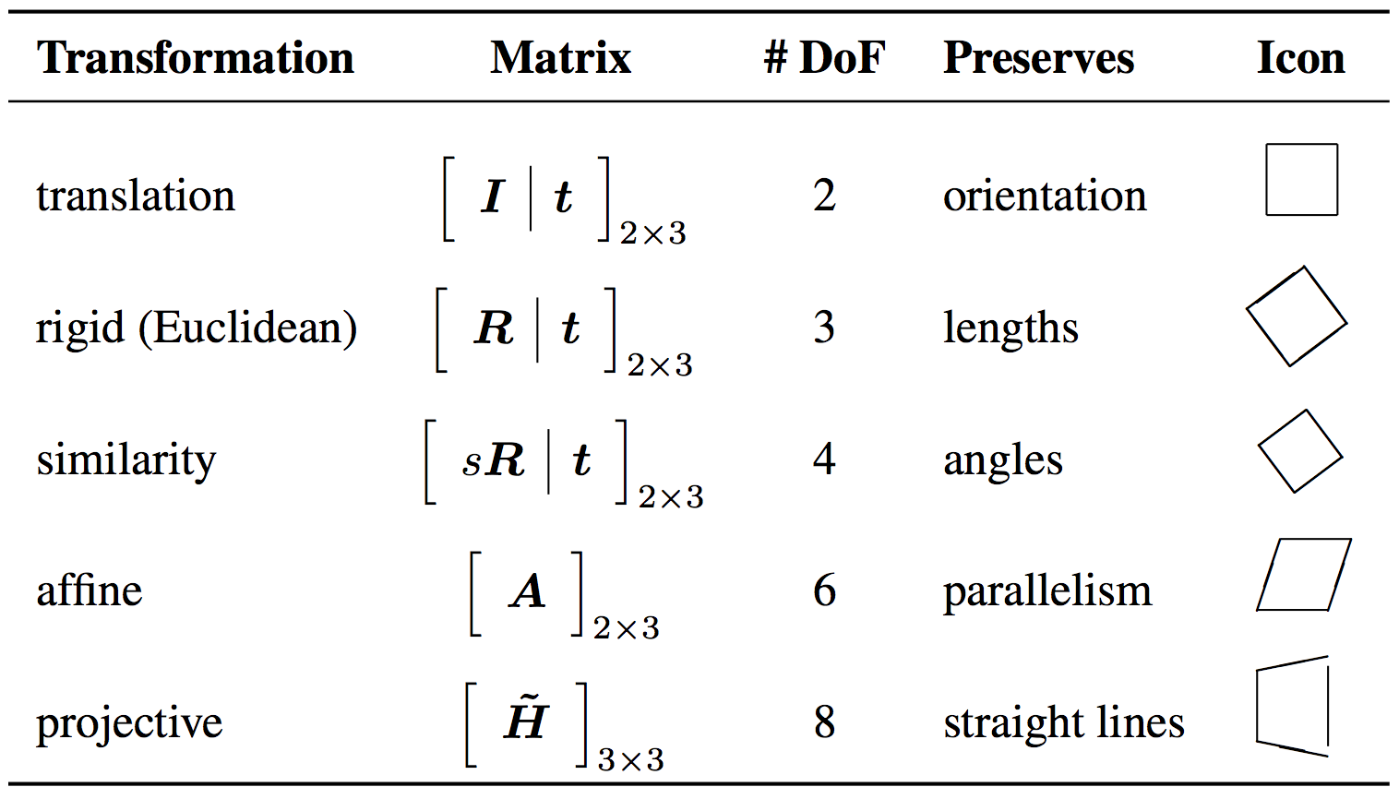
2.1.2 2D Transformations
Hierarchy of 2D coordinate transformations
#DoF: Number of Degrees of Freedom

Slide 23
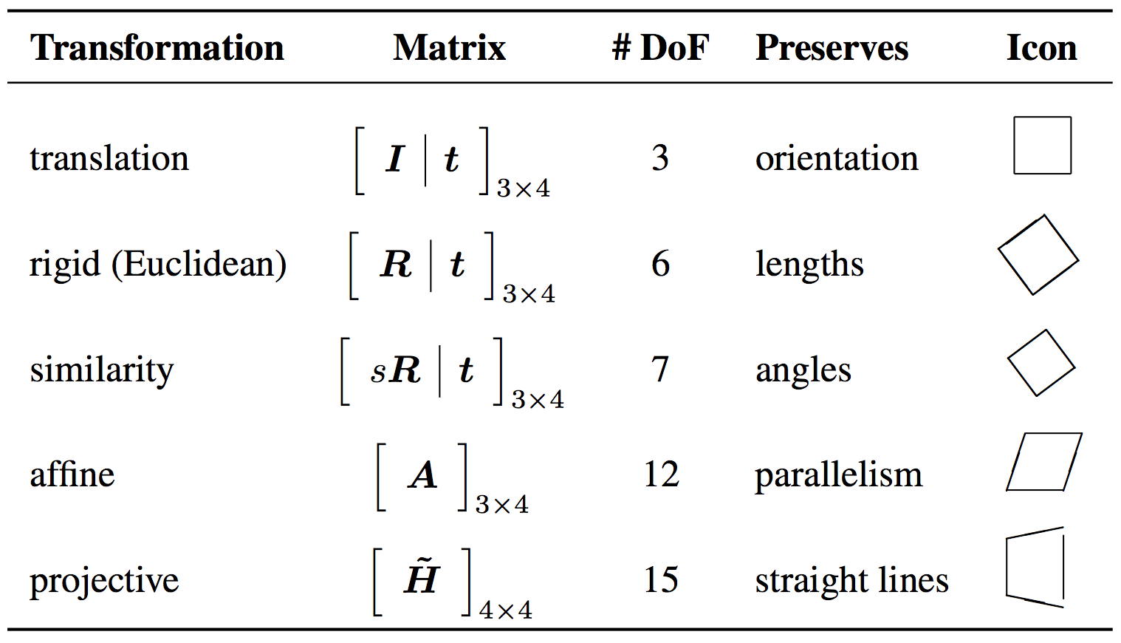
2.1.3 3D Transformations
The 3D transformations are similar to the 2D transformations.

Slide 24
2.1.4 3D Rotations
The biggest difference between 2D and 3D coordinate transformations is that the parameterization of the 3D rotation matrix R is not as straightforward.
Axis / Angle
A rotation can be represented by a rotation axis $\hat{n}$ and an angle $θ$, or equivalently by a 3D vector $ω=θ\hat{n}$.

Slide 25
2.1.4 3D Rotations
Axis / Angle
Project the vector $v$ onto the axis $\hat{n}$:
Compute the perpendicular residual of $v$ from $\hat{n}$:
Rotate this vector by 90◦ using the cross product:
where ${\left[\hat{n}\right]}_{×}$ is the matrix form of the cross product operator with the vector $\hat{n}=({\hat{n}}_{x},{\hat{n}}_{y},{\hat{n}}_{z})$.
$$v_{∥}=\hat{n}\left(\hat{n}∙v\right)=\left(\hat{n}{\hat{n}}^{T}\right)v$$
$$v_{⊥}=v−v_{∥}=\left(I−\hat{n}{\hat{n}}^{T}\right)v$$
$${\left[\hat{n}\right]}_{×}=\left[\begin{matrix}0 & −{\hat{n}}_{z} & {\hat{n}}_{y} \\ {\hat{n}}_{z} & 0 & −{\hat{n}}_{x} \\ −{\hat{n}}_{y} & {\hat{n}}_{x} & 0\end{matrix}\right]$$
$$v_{×}=\hat{n}×v={\left[\hat{n}\right]}_{×}v$$

Slide 26
2.1.4 3D Rotations
Axis / Angle
Rotate this vector by another 90◦:
Compute the in-plane component of the rotated vector $u$:
Obtain the final rotated vector:
Rodriguez’s formula:
$$v_{××}=\hat{n}×v_{×}={\left[\hat{n}\right]}_{×}^{2}v=−v_{⊥}$$
$$v_{∥}=v−v_{⊥}=v+v_{××}=\left(I+{\left[\hat{n}\right]}_{×}^{2}\right)v$$
$$u_{⊥}=cosθv_{⊥}+sinθv_{×}=\left(sinθ{\left[\hat{n}\right]}_{×}−cosθ{\left[\hat{n}\right]}_{×}^{2}\right)v$$
$$u=u_{⊥}+v_{∥}=\left(I+sinθ{\left[\hat{n}\right]}_{×}+\left(1−cosθ\right){\left[\hat{n}\right]}_{×}^{2}\right)v$$
$$R\left(\hat{n},θ\right)=I+sinθ{\left[\hat{n}\right]}_{×}+\left(1−cosθ\right){\left[\hat{n}\right]}_{×}^{2}$$

Slide 27
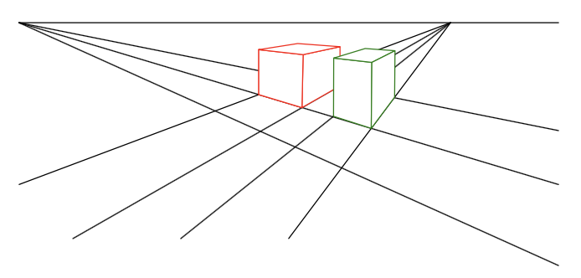
2.1.5 3D to 2D Projections
We need to specify how 3D primitives are projected onto the image plane.
The simplest model is orthography, and the more commonly used model is perspective.
vanishing point (消失點)：3D平行線在2D透視圖中交匯的點。
3D view

Slide 28
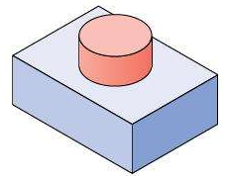
2.1.5 3D to 2D Projections
Orthography (垂直投影)
An orthographic projection simply drops the z component of the 3D coordinate $p$ to obtain the 2D point $x$.
homogeneous (projective) coordinates:
In practice, world coordinates need to be scaled to fit onto an image sensor. For this reason, scaled orthography is actually more commonly used.
$$x=\left[I_{2×2} | 0\right]p$$
$$\tilde{x}=\left[\begin{matrix}\begin{matrix}1 & 0 \\ 0 & 1 \\ 0 & 0\end{matrix} & \begin{matrix}0 & 0 \\ 0 & 0 \\ 0 & 1\end{matrix}\end{matrix}\right]\tilde{p}$$
$$x=\left[sI_{2×2} | 0\right]p$$

Slide 29
2.1.5 3D to 2D Projections
Perspective
The most commonly used projection in computer graphics and computer vision is true 3D perspective.
Points are projected onto the image plane by dividing them by their z component.
$$\overline{x}=𝒫_{z}\left(p\right)=\left[\begin{matrix}x/z \\ y/z \\ 1\end{matrix}\right]$$

Slide 30
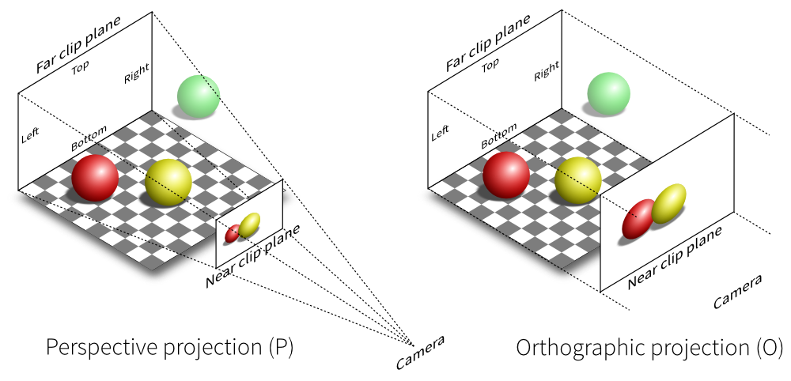
2.1.5 3D to 2D Projections
Orthography vs. Perspective

Slide 31
Camera Matrix
16-385 Computer Vision (Kris Kitani)
Carnegie Mellon University

Slide 32
2D to 2D Transform (last session)

Slide 33
3D object
3D to 2D Transform (today)
2D to 2D Transform (last session)

Slide 34
A camera is a mapping between
the 3D world
and
a 2D image

Slide 35
A camera is a mapping between the 3D world and a 2D image
x = P X
2D image point
camera matrix
3D world point
What do you think the dimensions are?

Slide 36
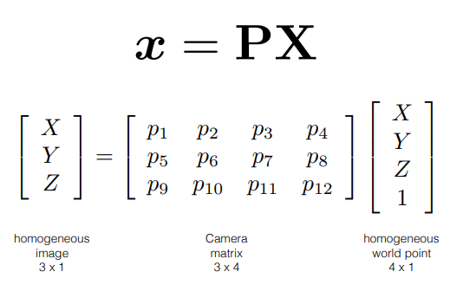

Slide 37
The pinhole camera
y
image plane
X
camera center
principal axis
z = f
principal point
What is the equation for image coordinate x (in terms of X)?

Slide 38
X
y
image plane
fY
Y
Z
f
Z
[X Y Z]^{T} → [f X/Z fY /Z]^{T}

Slide 41
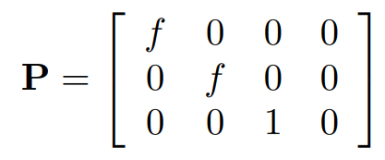
Camera origin and image origin might be different
CCD array
p
camera coordinate system
image coordinate system

Slide 42
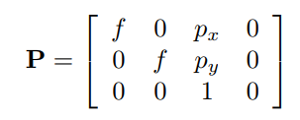
CCD array
p
camera coordinate system
image coordinate system
Accounts for different origins

Slide 43
In general, the camera and image sensor have different coordinate systems
X world point
Oimage
image point
Ocamera

Slide 44
In general, there are three different coordinate systems…
X world point
Oimage
Oworld
image point
Ocamera
so you need the know the transformations between them

Slide 48
y_{c}
X_{c}
X_{w}
x_{c}
y_{w}
Camera coordinate
system
z_{c}
x_{w}
C
z_{w}
Coordinate of the camera center in the world coordinate frame
World coordinate system
(X_{w} — C)
(X_{w} — C)
Translate

Slide 49
What happens to points after alignment?
Rotate
R
X_{c}
y_{c}
X_{w}
x_{c}
y_{w}
Camera coordinate
system
z_{c}
x_{w}
C
z_{w}
World coordinate system
R(X_{w} — C)
Rotate Translate

Slide 51
x = PX
3D points to 2D image points
Quiz
The camera matrix relates what two quantities?
The camera matrix can be decomposed into?
P = K[R|t]
intrinsic and extrinsic parameters

Slide 52
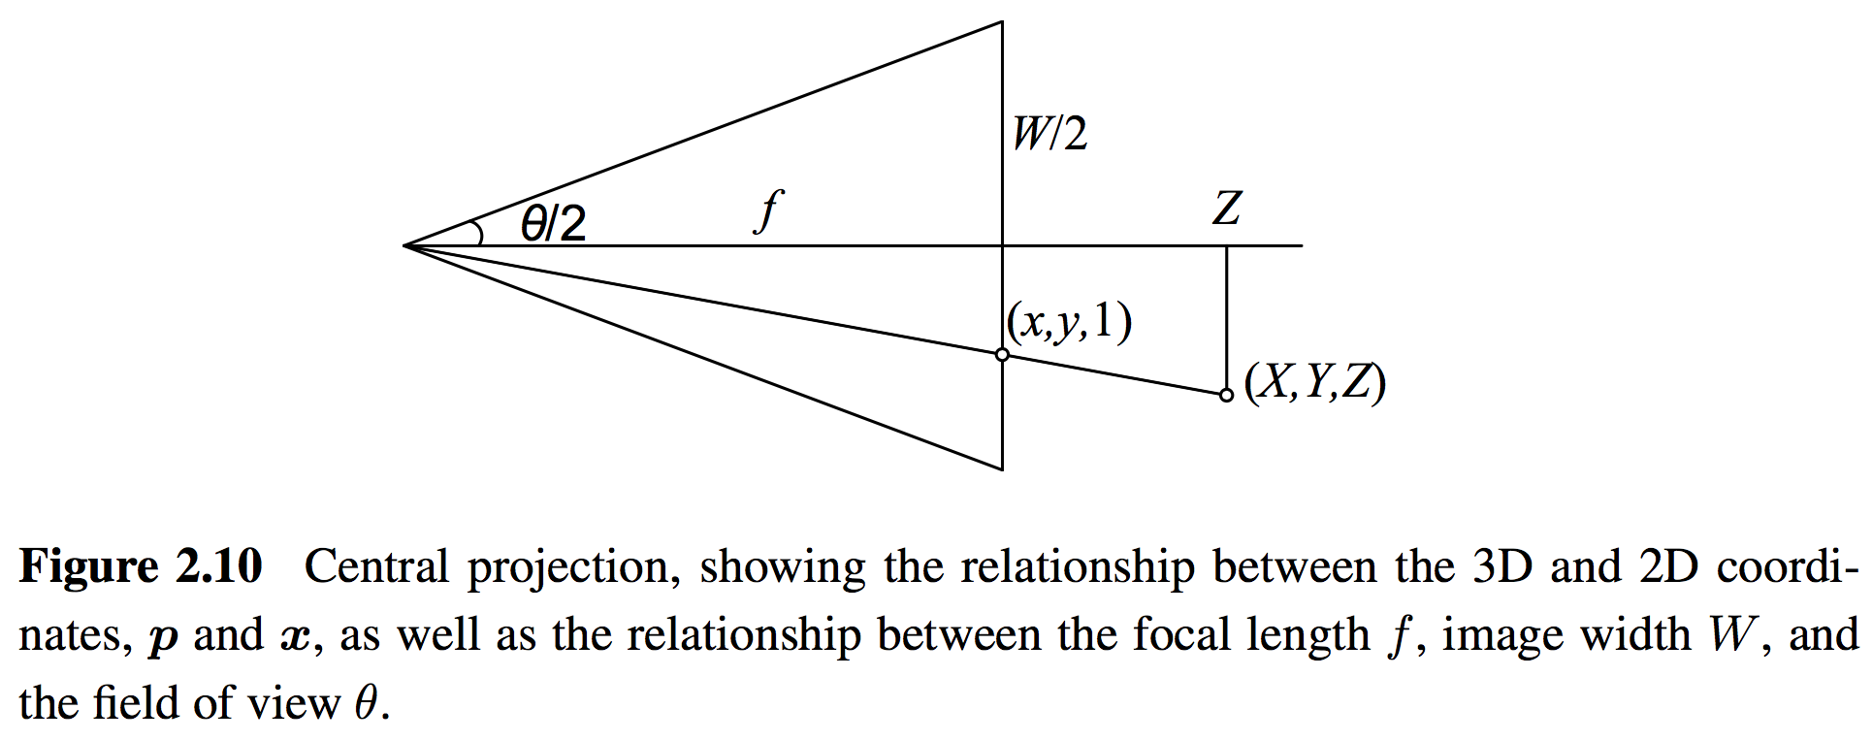
2.1.5 3D to 2D Projections
A Note on Focal Lengths
$$tan\frac{θ}{2}=\frac{W}{2f} ⟹ f=\frac{W}{2}{[tan\frac{θ}{2}]}^{−1}$$

Slide 53
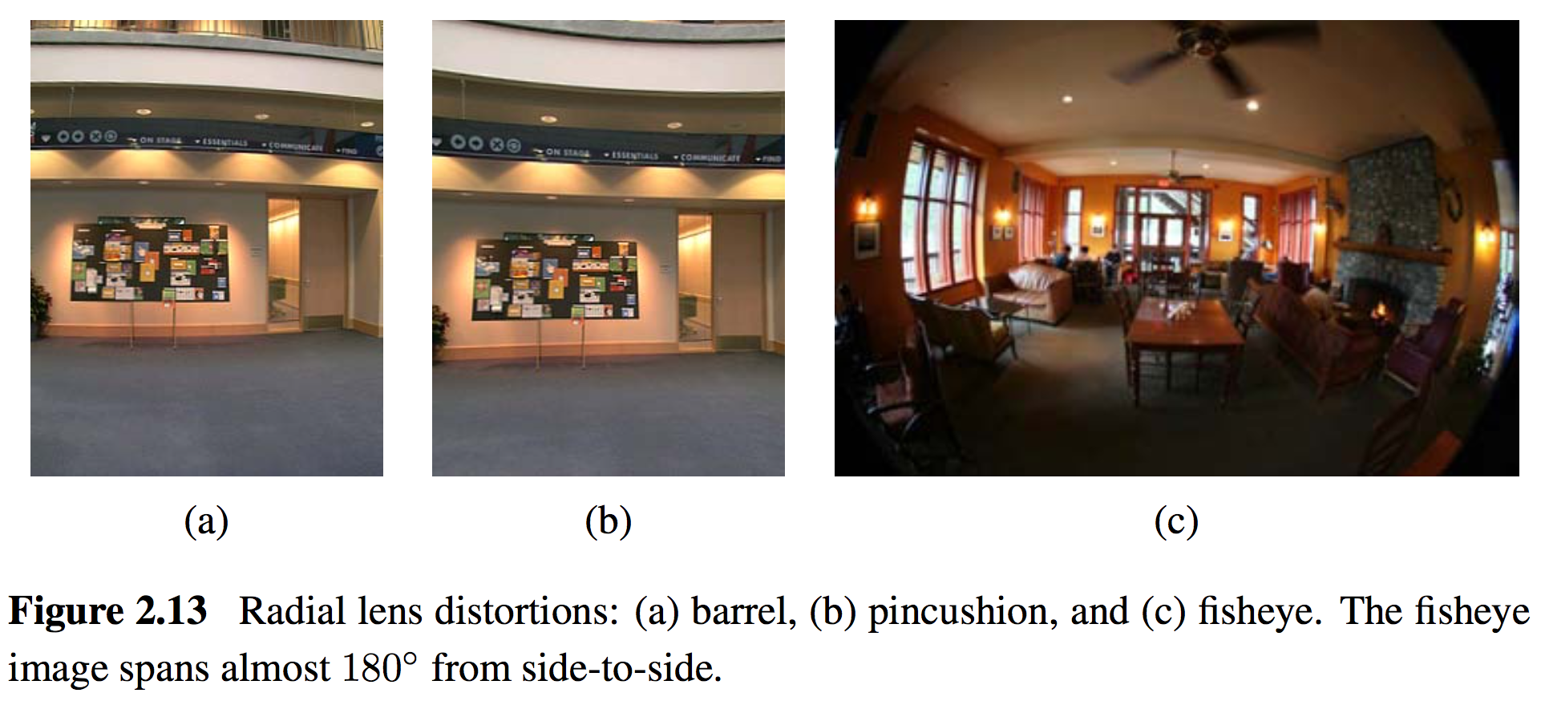
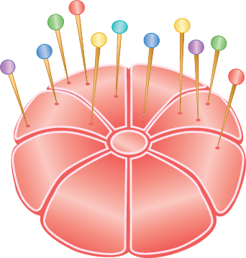
2.1.6 Lens Distortions
Imaging models all assume that cameras obey a linear projection model where straight lines in the world result in straight lines in the image.
Many wide-angle lenses have noticeable radial distortion, which manifests itself as a visible curvature in the projection of straight lines.
Notes:
魚眼校正 http://monkeycoding.com/?p=781

Slide 54
2.2 Photometric Image Formation
2.2.1 Lighting
2.2.2 Reflectance and shading
2.2.3 Optics

Slide 55
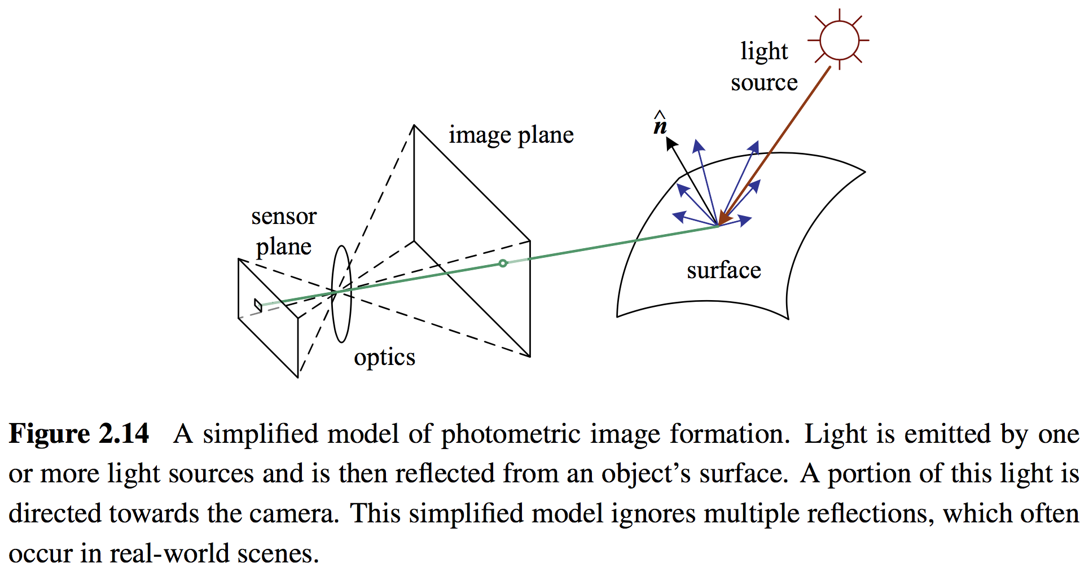
2.2 Photometric Image Formation
Images are made up of discrete color or intensity values.
How do they relate to the lighting in the environment, surface properties and geometry, camera optics, and sensor properties?

Slide 56
2.2.1 Lighting
To produce an image, the scene must be illuminated with one or more light sources.
A point light source originates at a single location in space (e.g., a small light bulb), potentially at infinity (e.g., the sun).
A point light source has an intensity and a color spectrum, i.e., a distribution over wavelengths $L(λ)$.

Slide 57
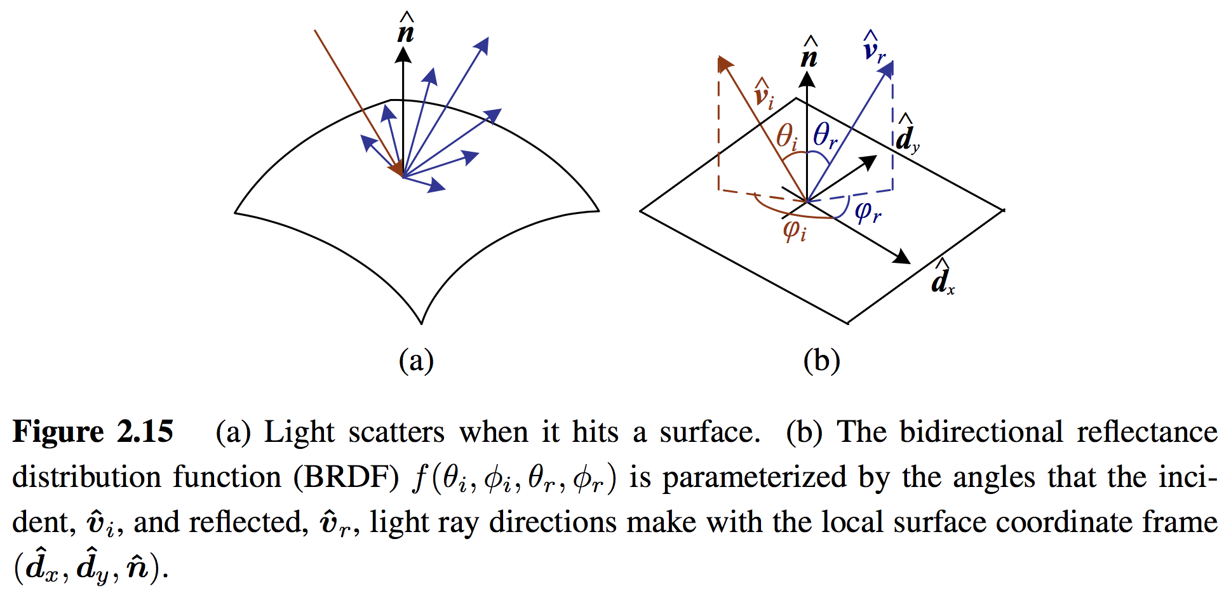
2.2.2 Reflectance and Shading
The Bidirectional Reflectance Distribution Function (BRDF)
BRDF describes how much of each wavelength arriving at an incident direction ${\hat{v}}_{i}$ is emitted in a reflected direction ${\hat{v}}_{r}$.
The angles of the incident and reflected directions relative to the surface frame as $f_{r}(θ_{i},φ_{i},θ_{r},φ_{r};λ)$.

Slide 58
2.2.2 Reflectance and Shading
Diffuse Reflection and Specular Reflection
Diffuse Reflection: The diffuse component scatters light uniformly in all directions.
Specular Reflection: Incident light rays are reflected in a direction that is rotated by 180◦ around the surface normal $\hat{n}$.
Specular Reflection
(smooth surfaces)
Diffuse Reflection
(rough surfaces)

Slide 59
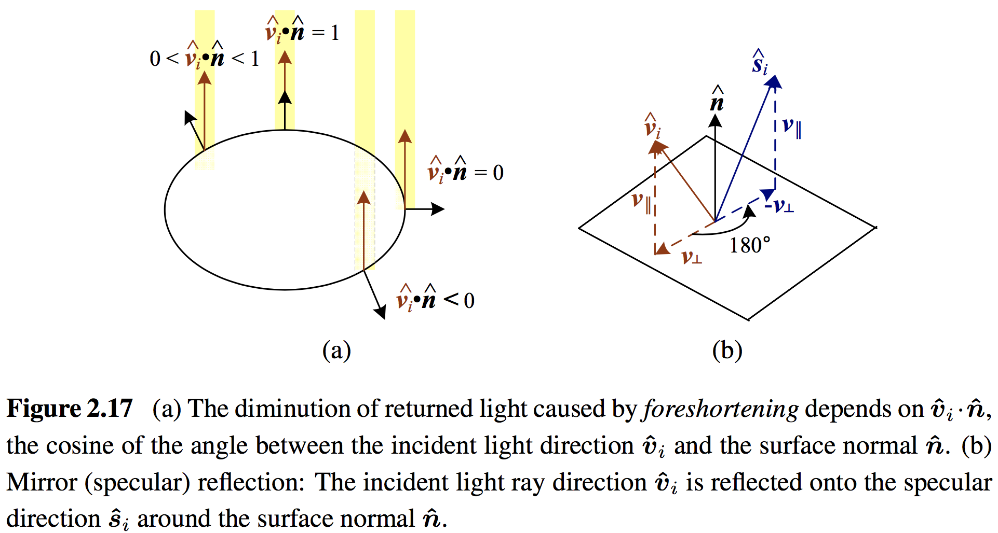
2.2.2 Reflectance and Shading
Diffuse Reflection and Specular Reflection

Slide 60
2.2.2 Reflectance and Shading
Phong Shading
Phong combined the diffuse and specular components of reflection with ambient illumination.
Objects are generally illuminated not only by point light sources but also by a diffuse illumination corresponding to inter-reflection (e.g., the walls in a room) or distant sources, such as the blue sky.
Notes:
Phong shading - Wiki: https://en.wikipedia.org/wiki/Phong_shading
Phong reflection model - Wiki: https://en.wikipedia.org/wiki/Phong_reflection_model

Slide 61
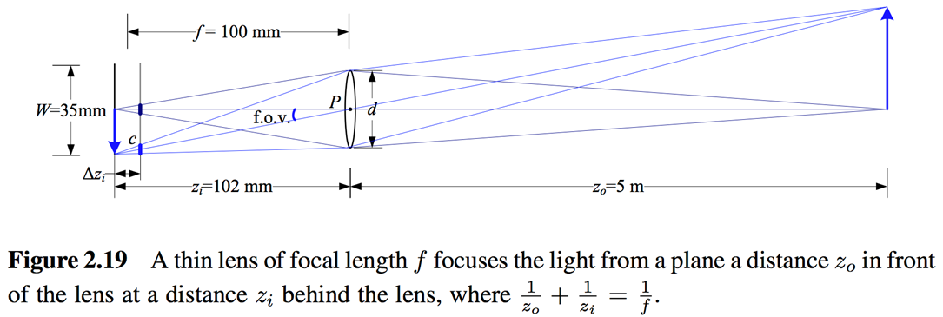
2.2.3 Optics
The light from a scene reaches the camera, it must pass through the lens before reaching the sensor.
The thin lens composed of a single piece of glass with very low, equal curvature on both sides.
Lens law: $\frac{1}{z_{0}}+\frac{1}{z_{i}}=\frac{1}{f}$

Slide 62
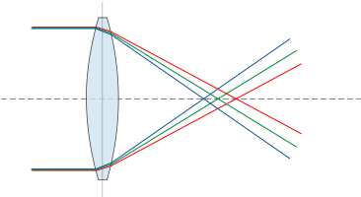
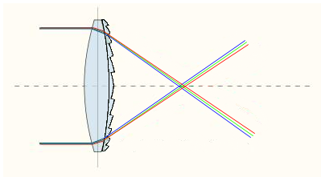
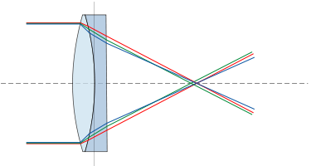
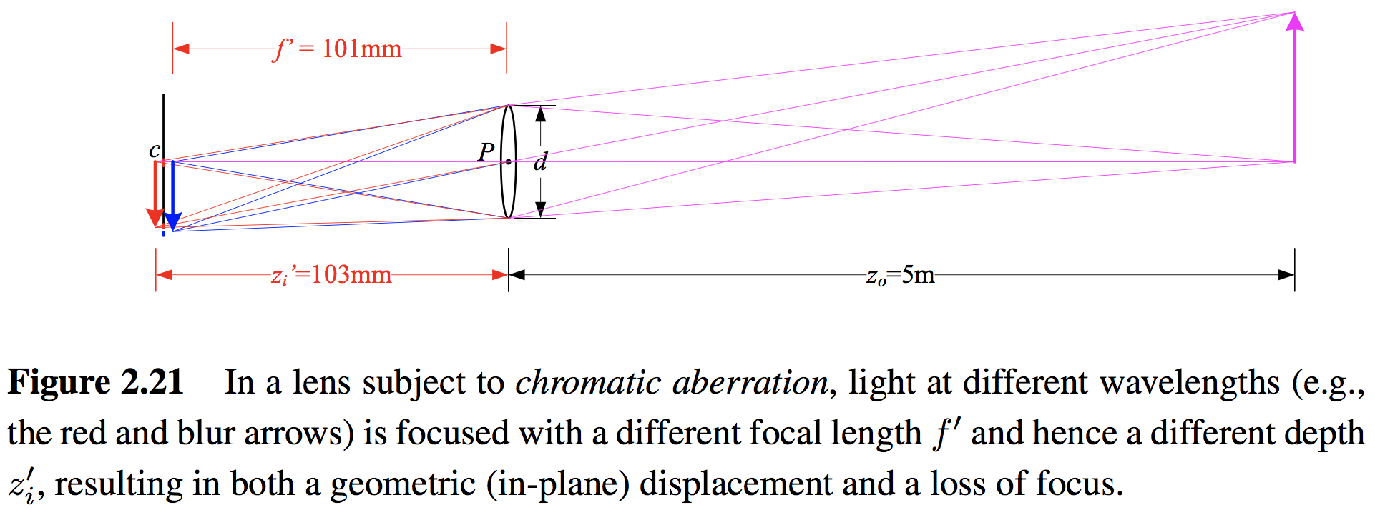
2.2.3 Optics
Chromatic Aberration
The tendency for light of different colors to focus at slightly different distances.
Chromatic Aberration
Notes:
不同波長折射率不同

Slide 63
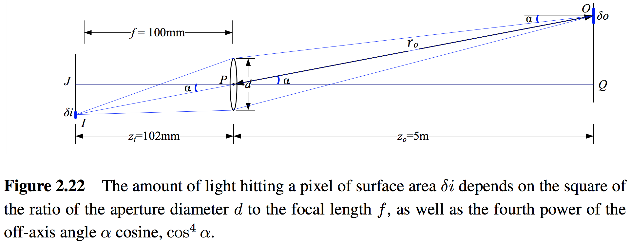
2.2.3 Optics
Vignetting
The tendency for the brightness of the image to fall off towards the edge of the image.

Slide 64
2.2.3 Optics
Vignetting
The tendency for the brightness of the image to fall off towards the edge of the image.

Slide 65
2.3 The Digital Camera
2.3.1 Sampling and aliasing
2.3.2 Color
2.3.3 Compression

Slide 66
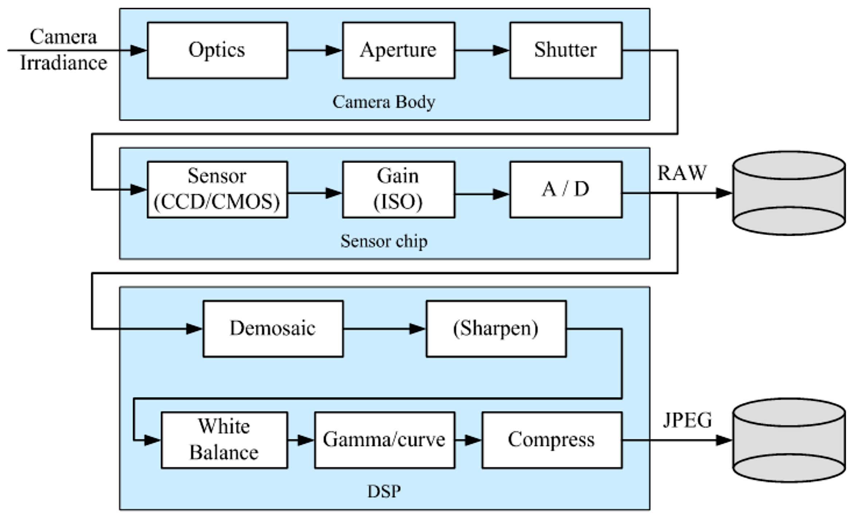
2.3 The Digital Camera
Sensor:
CCD: Charge-Coupled Device
CMOS: Complementary Metal-Oxide-Semiconductor
A/D: Analog-to-Digital Converter
DSP: Digital Signal Processor
JPEG: Joint Photographic Experts Group

Slide 67
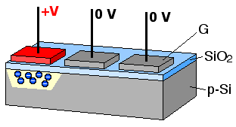
2.3 The Digital Camera
CCD (Charge-Coupled Device)
Photons are accumulated in each active well during the exposure time.
In a transfer phase, the charges are transferred from well to well in a kind of “bucket brigade” until they are deposited at the sense amplifiers.
CMOS (Complementary Metal-Oxide-Semiconductor)
The photons hitting the sensor directly affect the conductivity of a photodetector, which can be selectively gated to control exposure duration, and locally amplified before being read out using a multiplexing scheme.

Slide 68
2.3 The Digital Camera
Shutter speed
The shutter speed (exposure time) directly controls the amount of light reaching the sensor and determines if images are under- or over-exposed.
Sampling pitch
The sampling pitch is the physical spacing between adjacent sensor cells on the imaging chip.
Fill factor
The fill factor is the active sensing area size as a fraction of the theoretically available sensing area (the product of the horizontal and vertical sampling pitches).

Slide 69
2.3 The Digital Camera
Chip size
Video and point-and-shoot cameras have traditionally used small chip areas(1/4-inch to 1/2-inch sensors).
Digital SLR (Single-Lens Reflex) camera try to come closer to the traditional size of a 35mm film frame.
When overall device size is not important, having a larger chip size is preferable, since each sensor cell can be more photo-sensitive.
Analog gain
Before analog-to-digital conversion, the sensed signal is usually boosted by a sense amplifier.

Slide 70
2.3 The Digital Camera
Sensor noise
Throughout the whole sensing process, noise is added from various sources, which may include fixed pattern noise, dark current noise, shot noise, amplifier noise and quantization noise.
ADC resolution
Resolution: how many bits it yields
noise level: how many of these bits are useful in practice
Digital post-processing
To enhance the image before compressing and storing the pixel values.

Slide 71
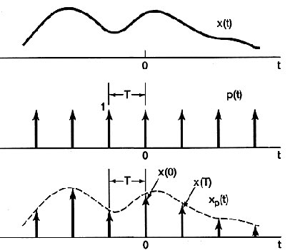
2.3.1 Sampling and Aliasing
Sampling

Slide 72
2.3.1 Sampling and Aliasing
Nyquist Frequency
The minimum sampling rate required to reconstruct a signal from its samples must be at least twice the highest frequency.
The inverse of the minimum sampling frequency is known as the Nyquist rate.
$$f_{s}≥2f_{max}$$
$$r_{s}=1/f_{s}$$

Slide 73
2.3.1 Sampling and Aliasing
Aliasing

Slide 74
2.3.1 Sampling and Aliasing

Slide 75
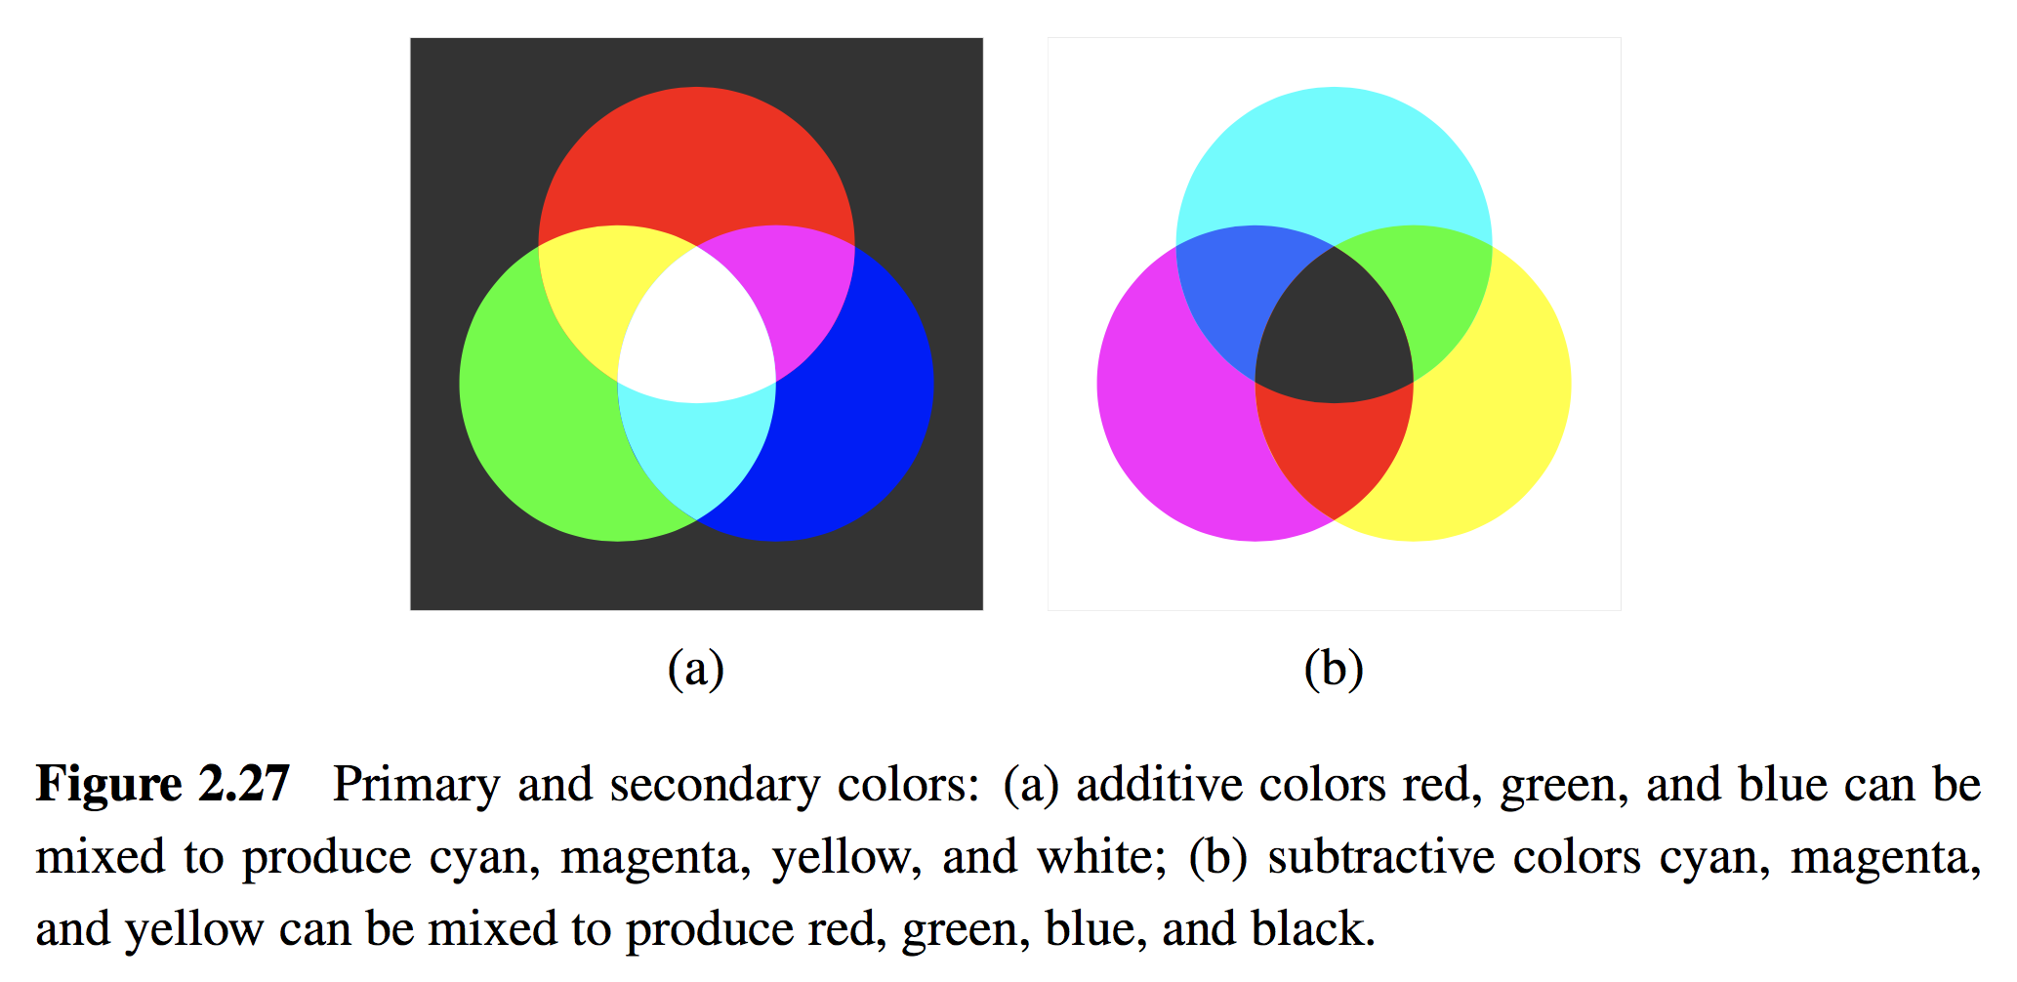
2.3.2 Color
When the incoming light hits the imaging sensor, light from different parts of the spectrum is somehow integrated into the discrete red, green, and blue (RGB) color values that we see in a digital image.
Additive Colors:
R + G = Yellow
B + R = Magenta
G + B = Cyan
R + G + B = White
R
C
Subtractive Colors:
M + C = Blue
C + Y = Green
Y + M = Red
Y + M + C = blacK
K
G
B
M
Y
(a) Additive colors: RGB
(a) Subtractive colors: CMYK

Slide 76
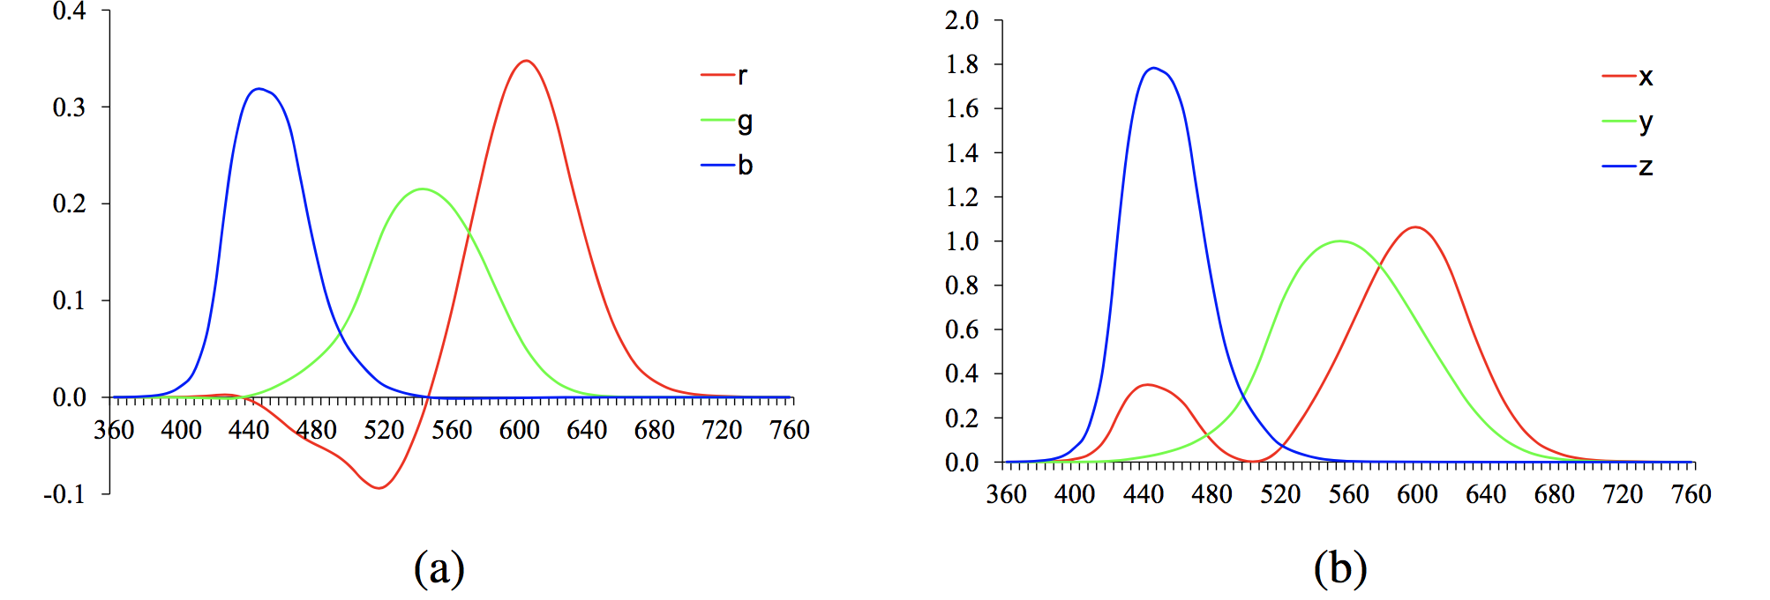
2.3.2 Color
CIE RGB and XYZ
In the 1930s, Commission Internationale de L'Eclairage (CIE) standardized the RGB representation by performing such color matching experiments using the primary colors of red (700.0nm wavelength), green (546.1nm), and blue (435.8nm).
Figure 2.28 Standard CIE color matching functions: (a) $\overline{r}(λ),\overline{g}(λ),\overline{b}(λ)$ color spectra obtained from matching pure colors to the R=700.0nm, G=546.1nm, and B=435.8nm primaries; (b) $\overline{x}(λ),\overline{y}(λ),\overline{z}(λ)$ color matching functions, which are linear combinations of the $(\overline{r}(λ),\overline{g}(λ),\overline{b}(λ))$ spectra.
Notes:
其實三原色是一種誤解，用這三種波長定義的RGB無法組成所有顏色。

Slide 77
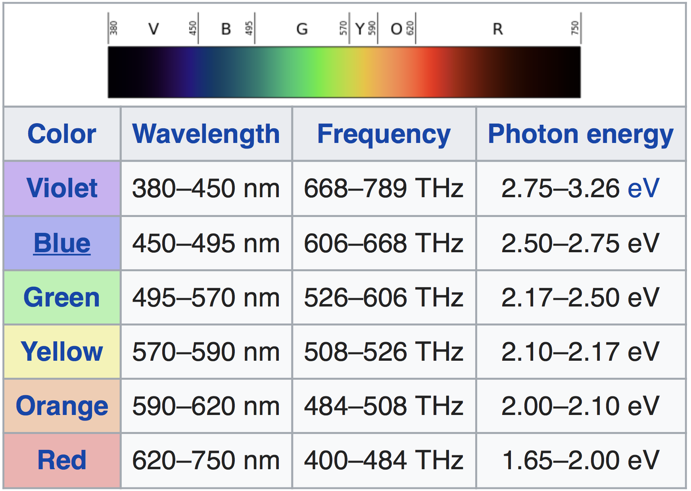
2.3.2 Color
CIE RGB and XYZ
Visible Spectrum
435.8nm
546.1nm
700.0nm

Slide 78
2.3.2 Color
CIE RGB and XYZ
Because of the problem associated with mixing negative light, the CIE also developed a new color space called XYZ.
The transformation from RGB to XYZ is given by
Chromaticity coordinates
Notes:
注意: X+Y+Z = 1

Slide 79
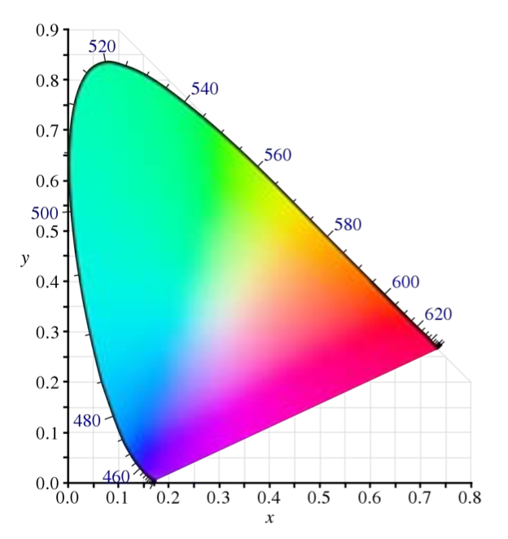
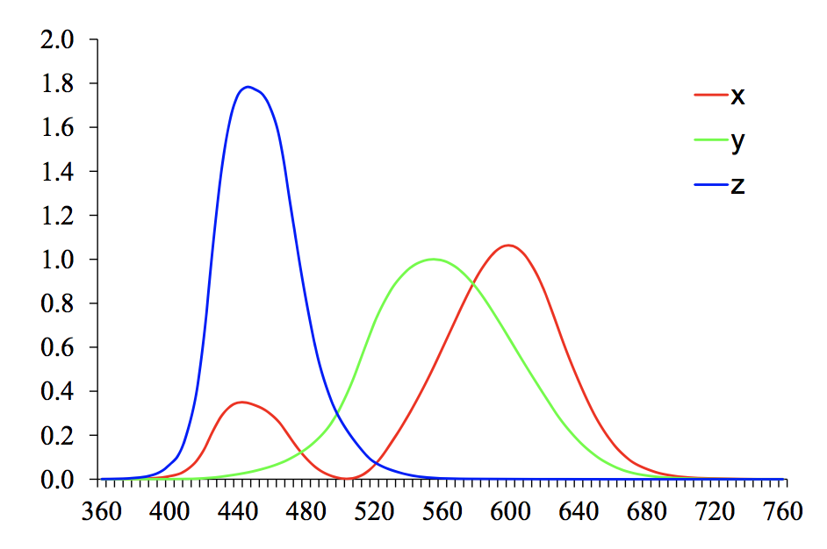
2.3.2 Color
The CIE 1931 color space chromaticity Diagram
λ = 380 nm ~
λ = 800 nm
Figure 2.29 CIE chromaticity diagram, showing colors and their corresponding (x, y) values. Pure spectral colors are arranged around the outside of the curve.
Notes:
為啥沒有Z座標: 因為 X+Y+Z = 1，知道X和Y就知道Z 自然沒必要顯示Z座標

Slide 80
2.3.2 Color
L*a*b* Color Space
CIE defined a non-linear re-mapping of the XYZ space called L*a*b* (also sometimes called CIELAB).

Slide 81
2.3.2 Color
L*a*b* Color Space
The three coordinates of L*a*b* space represent the lightness of the color.
L*: L* = 0 yields black and L* = 100 indicates white.
a*: The position between red/magenta (positive values) and green (negative values).
b*: The position between yellow (positive values) and blue (negative values).

Slide 82
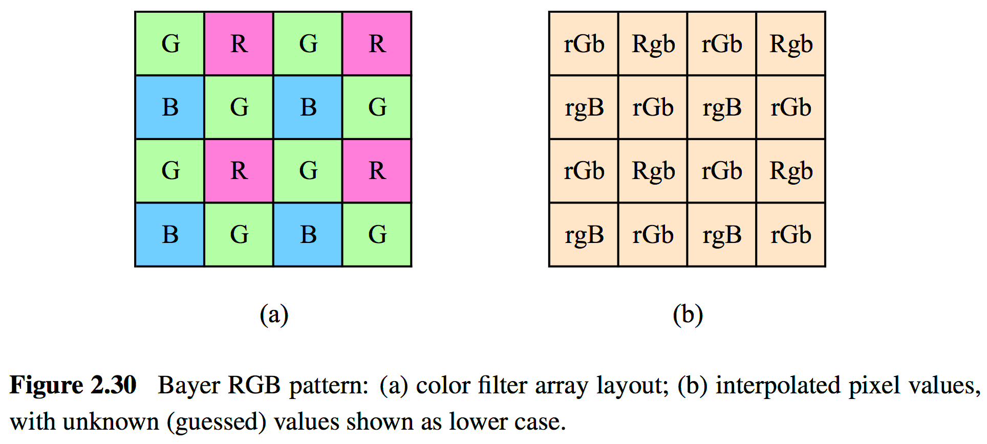
2.3.2 Color
Color Filter Arrays (CFA)
Most of today’s digital still cameras and video cameras use a color filter array (CFA), where alternating sensors are covered by different colored filters.

Slide 83
2.3.2 Color
Color Filter Arrays (CFA) - Bayer Pattern
Green filters are placed over half of the sensors (in a checkerboard pattern), and red and blue filters are placed over the remaining ones.
The reason that there are twice as many green filters as red and blue is:
The luminance signal is mostly determined by green values.
The visual system is much more sensitive to high frequency detail in luminance than in chrominance.
Incoming light
Filter layer
Sensor array
Resulting pattern

Slide 84
2.3.2 Color
Color Filter Arrays (CFA) - Bayer Pattern
The process of interpolating the missing color values so that we have valid RGB values for all the pixels is known as demosaicing (color interpolation).

Slide 85
2.3.2 Color
Color Balance (Auto White Balance)
Before encoding the sensed RGB values, most cameras perform some kind of color balancing operation in an attempt to move the white point of a given image closer to pure white.
If the illuminant is strongly colored, such as incandescent indoor lighting (which generally results in a yellow or orange hue), the compensation can be quite significant.

Slide 86
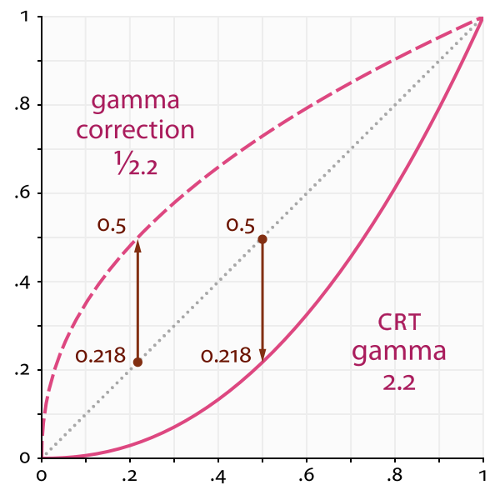
2.3.2 Color
Gamma
For CRT (Cathode Ray Tube), the relationship between the voltage (V) and the brightness (B) was characterized by gamma (γ), γ=2.2.
To compensate for this effect, the electronics in the TV camera would pre-map the luminance Y through an inverse gamma, 1/γ = 0.45.
Camera
LCD

Slide 87
2.3.2 Color
Other Color Spaces
YUV
Y: luminance (Y’: luma)
U, V: chrominance
YCbCr
Cb, Cr: the blue-difference and red-difference chroma components
R’G’B’ values are the eight-bit gamma-compressed color components.
YCbCr is closely related to YUV but uses different scale factors to fit within the eight-bit range available with digital signals.

Slide 88
2.3.2 Color
Other Color Spaces
HSV: Hue, Saturation, Value A projection of the RGB color cube onto a non-linear chroma angle, a radial saturation percentage, and a luminance-inspired value.
RGB
HSV

Slide 89
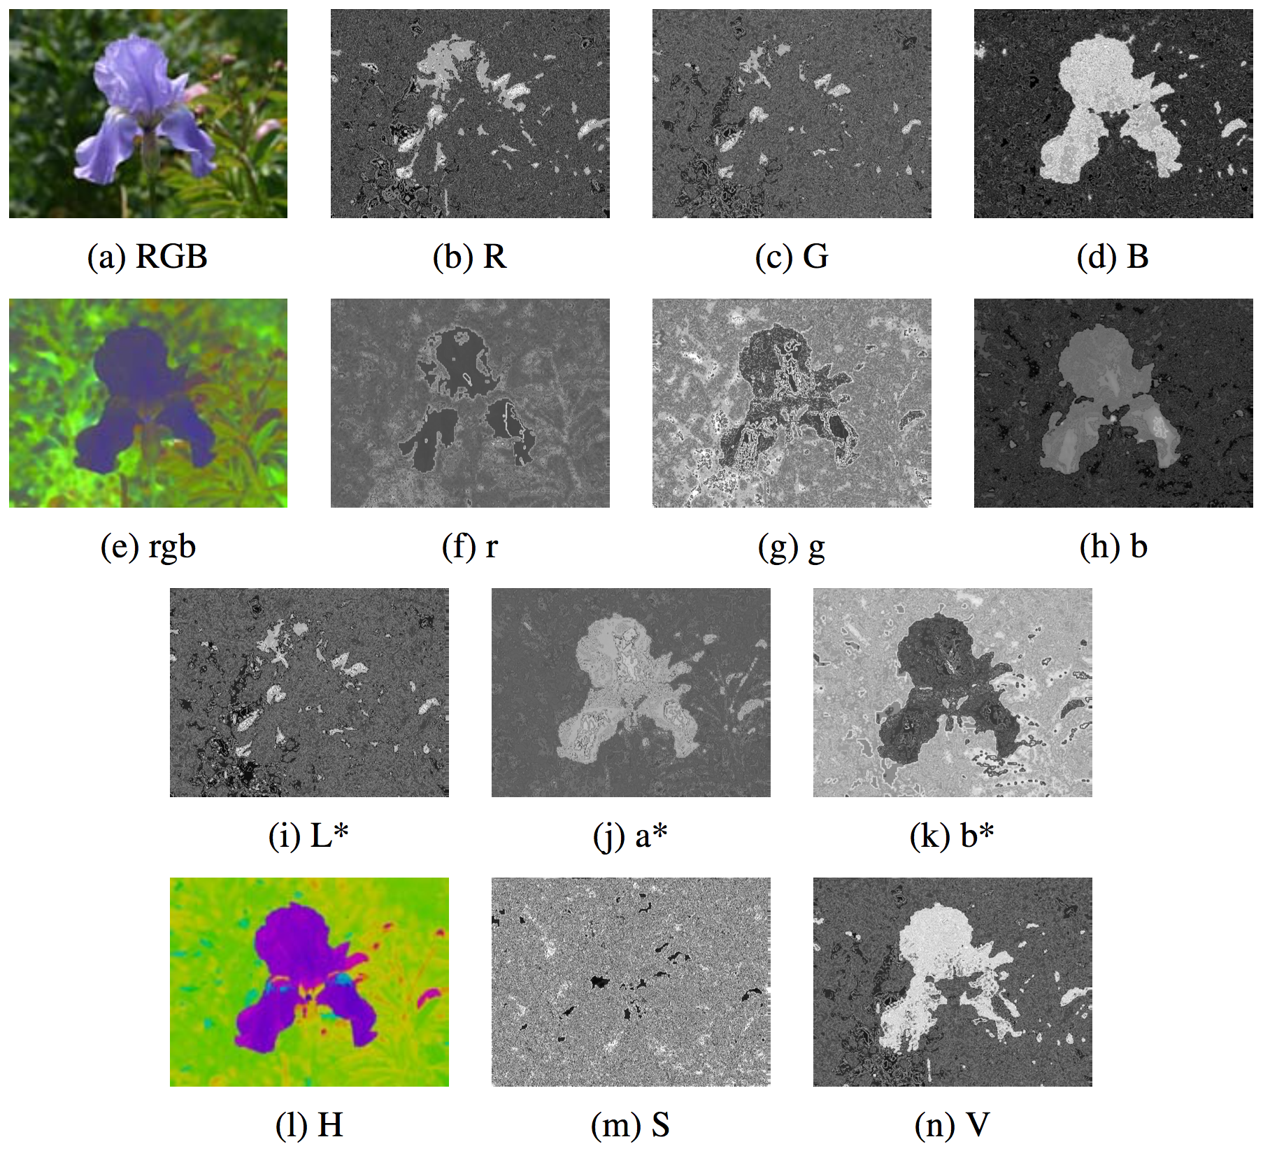
2.3.2 Color
Figure 2.32 Color space transformations: (a–d) RGB; (e–h) rgb; (i–k) L*a*b*; (l–n) HSV. Note that the rgb, L*a*b*, and HSV values are all re-scaled to fit the dynamic range of the printed page.

Slide 90
2.3.3 Compression
All color video and image compression algorithms start by converting the signal into YCbCr (or some closely related variant), so that they can compress the luminance signal with higher fidelity than the chrominance signal.
In video, it is common to subsample Cb and Cr by a factor of two horizontally; with still images (JPEG), the subsampling (averaging) occurs both horizontally and vertically.

Slide 91
2.3.3 Compression
Once the luminance and chrominance images have been appropriately subsampled and separated into individual images, they are then passed to a block transform stage.
The most common technique used here is the Discrete Cosine Transform (DCT), which is a real-valued variant of the Discrete Fourier Transform (DFT).
After transform coding, the coefficient values are quantized into a set of small integer values that can be coded using a variable bit length scheme such as a Huffman code or an arithmetic code.

Slide 92
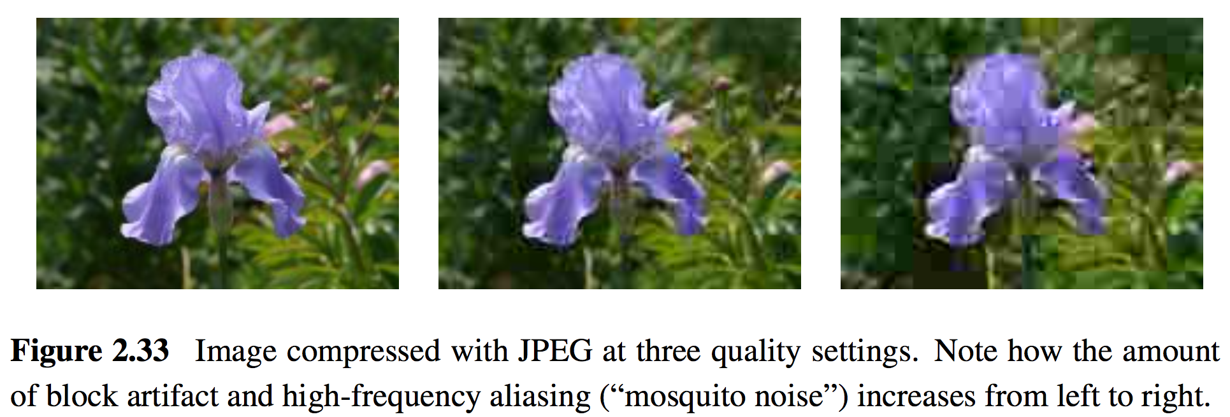
2.3.3 Compression
The step size in the quantization is the main variable controlled by the quality setting on the JPEG file.
JPEG (Joint Photographic Experts Group)

Slide 93
Homework 2: Project due March 19
1. Camera calibration i.e. compute #mm/ pixel object displacement
2. Calculate horizontal field of view in degrees of angle.
3. Calculate theoretical values (FOV) and compare with measured values.
Using the sample images at http://goo.gl/pWBNN0
Use lens of focal length: 18mm, 53mm, 135mm
Object displacement of: 1mm, 5mm, 10mm, 20mm
Object distance of: 0.6m, 1.2m, 1.8m

Slide 94
Homework 2: Project due March 19
Pentax K-7 相機資訊 https://www.digicamdb.com/specs/pentax_k-7/
Sensor size: 23.4 x 15.6 mm

Slide 95
Homework 2: Project due March 19
FOV theoretical value (f = 135mm, sensor width = 23.4mm):
FOV $=2×arctan⁡(\frac{sensor width}{2×f})×\frac{180}{π}$
FOV measured value:
FOV $=2×arctan⁡(\frac{Image width(in pixel)× \text{mm} \text{per} \text{pixel}}{2×object distance})×\frac{180}{π}$

