Slide 1
Advanced Computer Vision
Chapter 2
Image Formation
Presented by: 傅楸善 & 翁丞世
0925970510 mob5566@gmail.com

Slide 2
Image Formation
2.1 - Geometric primitives and transformations
2.2 - Photometric image formation
2.3 - The digital camera
Notes:
In Chapter 2, we break down image formation into three major components.
Geometric image formation (Section 2.1) deals with points, lines, and planes, and how these are mapped onto images using projective geometry and other models (including radial lens distortion).
Photometric image formation (Section 2.2) covers radiometry, which describes how light interacts with surfaces in the world, and optics, which projects light onto the sensor plane.
Finally, Section 2.3 covers how sensors work, including topics such as sampling and aliasing, color sensing, and in-camera compression.

Slide 3
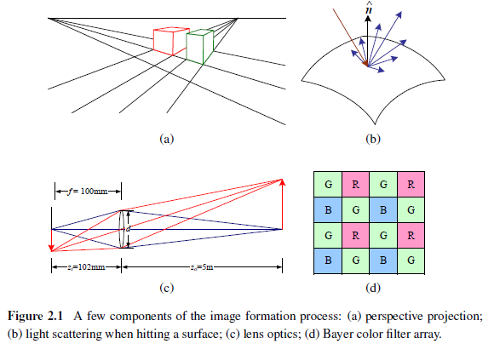
Image Formation
Notes:
Section 2.1 introduces the basic geometric primitives used throughout the book (points, lines, and planes) and the geometric transformations that project these 3D quantities into 2D image features (Figure 2.1a).
Section 2.2 describes how lighting, surface properties (Figure 2.1b), and camera optics (Figure 2.1c) interact in order to produce the color values that fall onto the image sensor.
Section 2.3 describes how continuous color images are turned into discrete digital samples inside the image sensor (Figure 2.1d) and how to avoid (or at least characterize) sampling deficiencies, such as aliasing.

Slide 4
2.1 Geometric primitives and transformation
2.1.1 - Geometric primitives
2.1.2 - 2D transformations
2.1.3 - 3D transformations
2.1.4 - 3D rotations
2.1.5 - 3D to 2D projections
2.1.6 - Lens distortions
Notes:
Before we can intelligently analyze and manipulate images, we need to establish a vocabulary for describing the geometry of a scene.
In this chapter, we present a simplified model of such an image formation process.

Slide 5
2.1.1 Geometric Primitives
Geometric primitives form the basic building blocks used to describe three-dimensional shapes.
Points, Lines, Planes

Slide 6
2.1.1 Geometric Primitives
2D points (pixel coordinates in an image)
Denoted using a pair of values
$x=\left(x,y\right)=\left[\begin{matrix}x \\ y\end{matrix}\right]∈ℛ^{2}$
Homogeneous coordinates: $\tilde{x}=\left(\tilde{x}, \tilde{y}, \tilde{w}\right)∈𝒫^{2}$
$𝒫^{2}=ℛ^{3}−\left(0,0,0\right)$ is called the 2D projective space
$\tilde{x}=\left(\tilde{x}, \tilde{y}, \tilde{w}\right)=\tilde{w}\left(x, y, 1\right)=\tilde{w}\overline{x}$
$\overline{x}=\left(x, y, 1\right)$ is the augmented vector

Slide 7
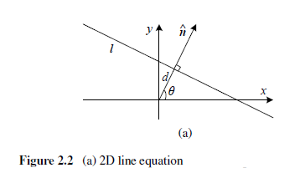
2.1.1 Geometric Primitives
2D lines
2D lines can be represented using homogeneous coordinates $\tilde{l}=(a,b,c)$
$\overline{x}∙\tilde{l}=ax+by+c=0$
Normalize the line equation vector
$l=\left({\hat{n}}_{x},{\hat{n}}_{y},d\right)=\left(\hat{n},d\right), \left\|\hat{n}\right\|=1$
$\hat{n}=\left({\hat{n}}_{x},{\hat{n}}_{y}\right)=(cosθ,sinθ)$

Slide 8
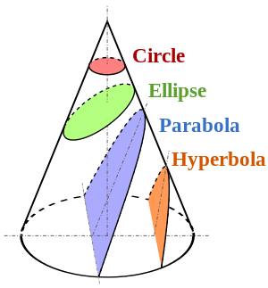
2.1.1 Geometric Primitives
2D conics: circle, ellipse, parabola, hyperbola
There are other algebraic curves that can be expressed with simple polynomial homogeneous equations
Quadric equation: ${\tilde{x}}^{T}Q\tilde{x}=0$

Slide 9
2.1.1 Geometric Primitives
3D points, similar to 2D points
$x=\left(x,y,z\right)∈ℛ^{3}$
$\tilde{x}=\left(\tilde{x},\tilde{y},\tilde{z},\tilde{w}\right)∈𝒫^{3}$
$\overline{x}=\left(x,y,z,1\right)$

Slide 10
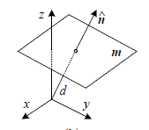
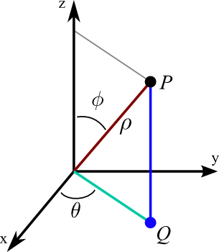
2.1.1 Geometric Primitives
3D planes
$\tilde{m}=(a,b,c,d)$
$\overline{x}∙\tilde{m}=ax+by+cz+d=0$
Normalize the plane equation vector
$m=\left({\hat{n}}_{x},{\hat{n}}_{y},{\hat{n}}_{z},d\right)=\left(\hat{n},d\right), \left\|\hat{n}\right\|=1$
$\hat{n}=(cosθsinφ,sinθsinφ,cosφ)$

Slide 11
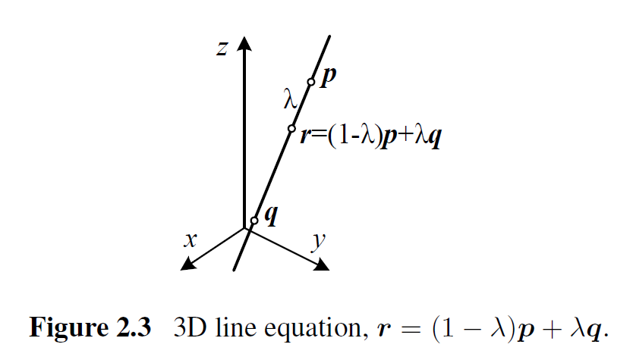
2.1.1 Geometric Primitives
3D lines
use two points on the line, $\left(p, q\right)$
Any other point on the line can be expressed as a linear combination of these two points
$r=\left(1−λ\right)p+λq$

Slide 12
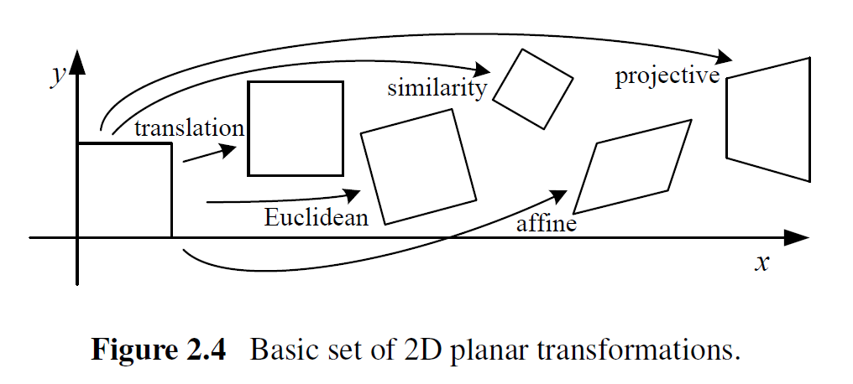
2.1.2 2D Transformation
Having defined our basic primitives, we can now turn our attention to how they can be transformed.

Slide 13
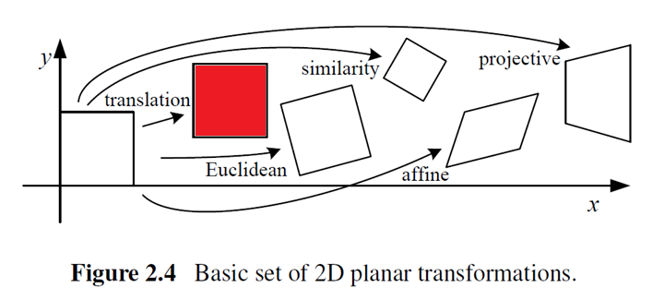
2.1.2 2D Transformation
Translation
$x^{′}=x+t$
$x^{′}=\left[\begin{matrix}I & t\end{matrix}\right]\overline{x}, I is the 2x2 identity matrix$
$x^{′}=\left[\begin{matrix}I & t \\ 0^{T} & 1\end{matrix}\right]\overline{x}$, makes it possible to chain transformations using matrix multiplication

Slide 14
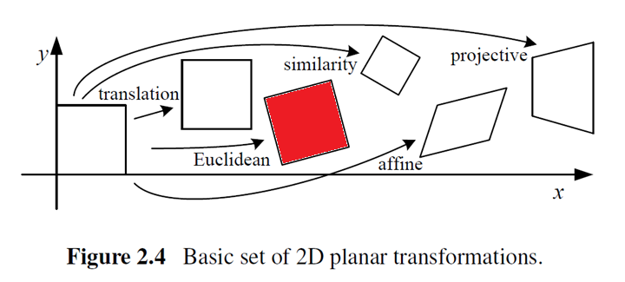
2.1.2 2D Transformation
Rotation + Translation
$x^{′}=Rx+t$
$x^{′}=\left[\begin{matrix}R & t\end{matrix}\right]\overline{x}, R=\left[\begin{matrix}cosθ & −sinθ \\ sinθ & cosθ\end{matrix}\right], RR^{T}=I and \left|R\right|=1$

Slide 15
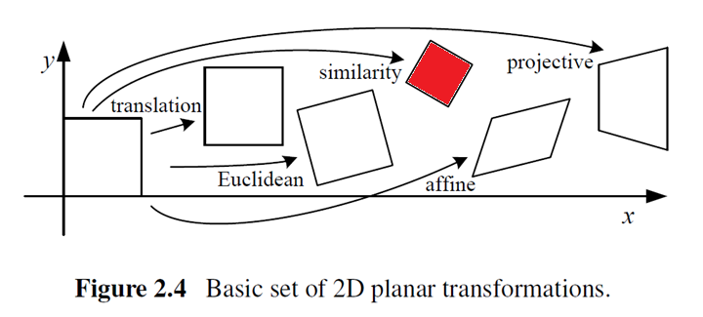
2.1.2 2D Transformation
Scaled rotation
Also known as similarity transform
$x^{′}=sRx+t$
$x^{′}=\left[s\begin{matrix}R & t\end{matrix}\right]\overline{x}=\left[\begin{matrix}a & −b & t_{x} \\ b & a & t_{y}\end{matrix}\right]\overline{x}$
The similarity transform preserve angles between lines

Slide 16
2.1.2 2D Transformation
Affine
Written as $x^{′}=A\overline{x}, where A is an arbitrary 2x3 matrix$
$x^{′}=\left[\begin{matrix}a_{00} & a_{01} & a_{02} \\ a_{10} & a_{11} & a_{12}\end{matrix}\right]\overline{x}$
Parallel lines remain parallel under affine transformation

Slide 17
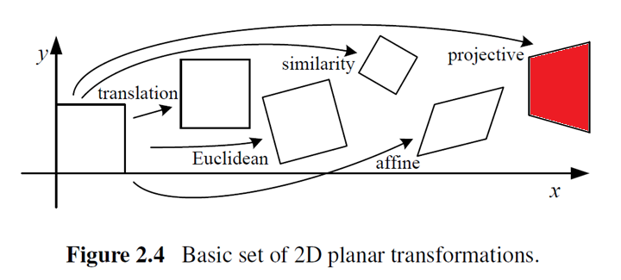
2.1.2 2D Transformation
Projective
Also known as a perspective transform
${\tilde{x}}^{′}=\tilde{H}\tilde{x}, where \tilde{H} is an arbitrary 3x3 matrix$
$x^{′}=\frac{h_{00}x+h_{01}y+h_{02}}{h_{20}x+h_{21}y+h_{22}}, y^{′}=\frac{h_{10}x+h_{11}y+h_{12}}{h_{20}x+h_{21}y+h_{22}}$
Perspective transformations preserve straight lines

Slide 18
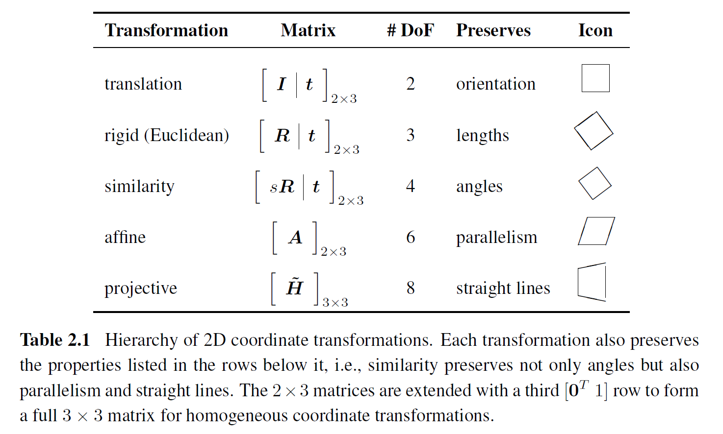
2.1.2 2D Transformation

Slide 19
2.1.3 3D Transformation
The set of three-dimensional coordinate transformation is very similar to that available for 2D transformations.

Slide 20
2.1.3 3D Transformation
Translation
$x^{′}=x+t$
$x^{′}=\left[\begin{matrix}I & t\end{matrix}\right]\overline{x}, I is the 3x3 identity matrix$

Slide 21
2.1.3 3D Transformation
Rotation + Translation
$x^{′}=Rx+t$
$x^{′}=\left[\begin{matrix}R & t\end{matrix}\right]\overline{x}, RR^{T}=I and \left|R\right|=1$

Slide 22
2.1.3 3D Transformation
Scaled rotation
$x^{′}=sRx+t$
$x^{′}=\left[s\begin{matrix}R & t\end{matrix}\right]\overline{x}$
The similarity transform preserves angles between lines and planes

Slide 23
2.1.3 3D Transformation
Affine
$x^{′}=A\overline{x}, where A is an arbitrary 3x4 matrix$
$x^{′}=\left[\begin{aligned}\begin{matrix}a_{00} & a_{01} & a_{02} \\ a_{10} & a_{11} & a_{12}\end{matrix} \\ \begin{matrix}a_{20} & a_{21} & a_{22}\end{matrix}\end{aligned} \begin{matrix}a_{03} \\ a_{13} \\ a_{23}\end{matrix}\right]\overline{x}$
Parallel lines and planes remain parallel under affine transformation

Slide 24
2.1.3 3D Transformation
Projective
Also known as a perspective transform
${\tilde{x}}^{′}=\tilde{H}\tilde{x}, where \tilde{H} is an arbitrary 4x4 matrix$
Perspective transformations preserve straight lines

Slide 25
2.1.3 3D Transformation

Slide 26
2.1.4 3D Rotations
The biggest difference between 2D and 3D coordinate transformation is that the parameterization of the 3D rotation matrix R is not as straightforward.

Slide 27
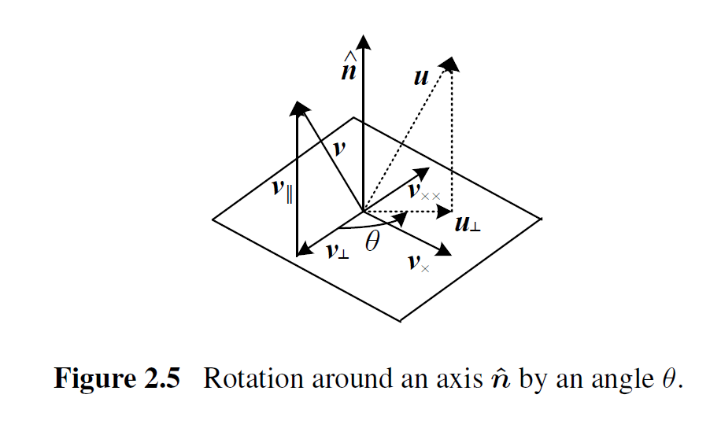
2.1.4 3D Rotations
Axis/angle
A rotation can be represented by a rotation axis $\hat{n}$ and an angle $θ$, or equivalently by a 3D vector $ω=θ\hat{n}$.

Slide 28
2.1.4 3D Rotations
Project the vector v onto the axis $\hat{n}$ $v_{∥}=\hat{n}\left(\hat{n}∙v\right)=\left(\hat{n}{\hat{n}}^{T}\right)v$
The perpendicular residual of v from $\hat{n}$ $v_{⊥}=v−v_{∥}=\left(I−\hat{n}{\hat{n}}^{T}\right)v$
Rotate this vector by 90° $v_{×}=\hat{n}×v={\left[\hat{n}\right]}_{×}v$
${\left[\hat{n}\right]}_{×}=\left[\begin{matrix}0 & −{\hat{n}}_{z} & {\hat{n}}_{y} \\ {\hat{n}}_{z} & 0 & −{\hat{n}}_{x} \\ −{\hat{n}}_{y} & {\hat{n}}_{x} & 0\end{matrix}\right]$ is the matrix form of the cross product operator

Slide 29
2.1.4 3D Rotations
Then rotating this vector by another 90° $v_{××}=\hat{n}×v_{×}={\left[\hat{n}\right]}_{×}^{2}v=−v_{⊥}$
Hence, $v_{∥}=v−v_{⊥}=v+v_{××}$ $=\left(I+{\left[\hat{n}\right]}_{×}^{2}\right)v$
The rotate vector u $u_{⊥}=cosθv_{⊥}+sinθv_{×}$ $=\left(sinθ{\left[\hat{n}\right]}_{×}−cosθ{\left[\hat{n}\right]}_{×}^{2}\right)v$
Final rotate vector u $u=u_{⊥}+v_{∥}$ $=\left(I+sinθ{\left[\hat{n}\right]}_{×}+\left(1−cosθ\right){\left[\hat{n}\right]}_{×}^{2}\right)v$

Slide 30
2.1.4 3D Rotations
We can therefore write the rotation matrix corresponding to a rotation by $θ$ around an axis $\hat{n}$ as $R\left(\hat{n},θ\right)=I+sinθ{\left[\hat{n}\right]}_{×}+\left(1−cosθ\right){\left[\hat{n}\right]}_{×}^{2}$

Slide 31
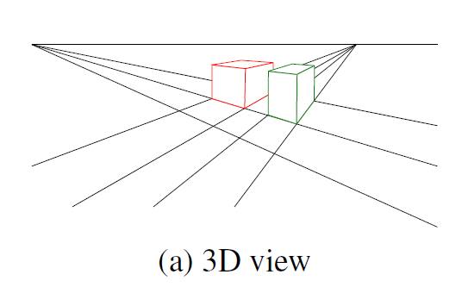
2.1.5 3D to 2D Projections
We need to specify how 3D primitives are projected onto the image planes.
The simplest model is orthography, and the more commonly used model is perspective.

Slide 32
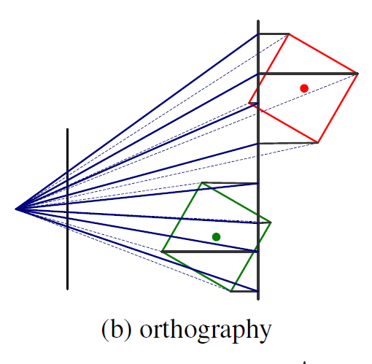
2.1.5 3D to 2D Projections
An orthography projection simply drop the z components of the three-dimensional coordinate p to obtain the 2D point x.
$x=\left[I_{2×2} | 0\right]p$
In homogeneous coordinates, $\tilde{x}=\left[\begin{matrix}\begin{matrix}1 & 0 \\ 0 & 1 \\ 0 & 0\end{matrix} & \begin{matrix}0 & 0 \\ 0 & 0 \\ 0 & 1\end{matrix}\end{matrix}\right]\tilde{p}$

Slide 33
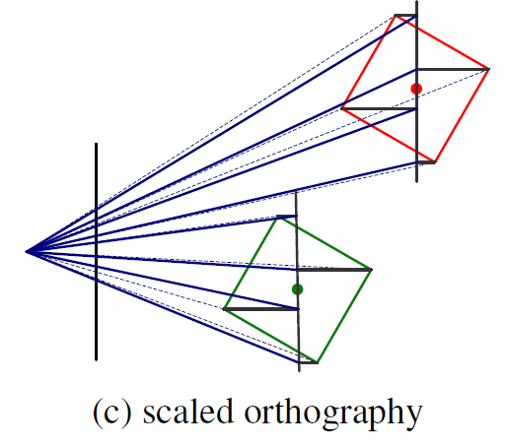
2.1.5 3D to 2D Projections
In practice, world coordinates need to be scaled to fit onto an image sensor.
Then scaled orthography is actually more commonly used, $x=\left[sI_{2×2} \right| 0]p$

Slide 34
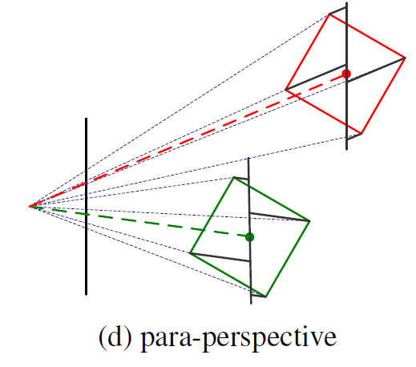
2.1.5 3D to 2D Projections
A closely related projection model is para-perspective.
In this model, object points are first projected onto a local reference parallel to the image plane.
Then they are projected parallel to the line of sight to the object center.

Slide 35
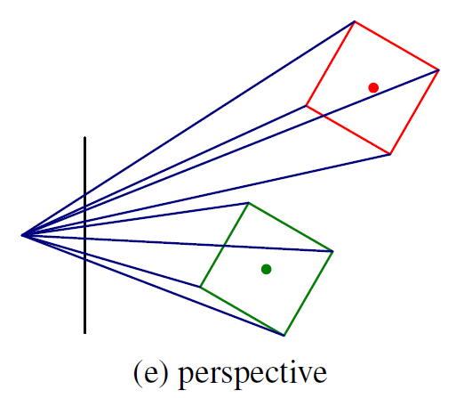
2.1.5 3D to 2D Projections
The most commonly used projection in computer graphics and computer vision is true 3D perspective.
Here, points are projected onto the image plane by dividing them by their z component.
$\overline{x}=𝒫_{z}\left(p\right)=\left[\begin{matrix}x/z \\ y/z \\ 1\end{matrix}\right]$

Slide 36
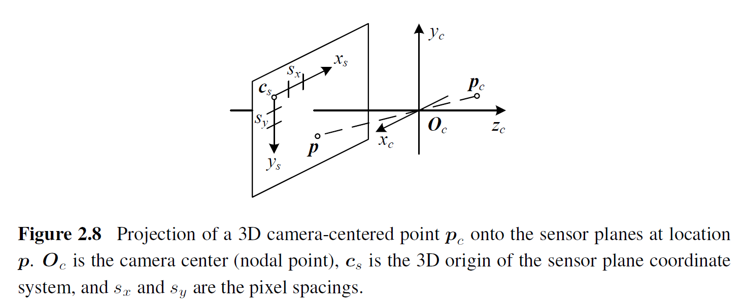
2.1.5 Camera Intrinsics
Once we have projected a 3D point through an ideal pinhole using a projection matrix, we must still transform the resulting coordinates according to the pixel sensor spacing and the relative position of the sensor plane to the origin.
Notes:
Intrinsics 本質

Slide 37
2.1.5 Camera Intrinsics
The combined 2D to 3D projection can then be written as
(x_{s}, y_{s}): pixel coordinates
(s_{x}, s_{y}): pixel spacings
c_{s}: 3D origin coordinate
R_{s}: 3D rotation matrix
M_{s}: sensor homography matrix

Slide 38
2.1.5 Camera Intrinsics
The relationship between the 3D pixel center p and the 3D camera-centered point $p_{c}$ is given by an unknown scaling s, $p=sp_{c}$.
K: calibration matrix
p_{w}: 3D world coordinates
P: camera matrix

Slide 39
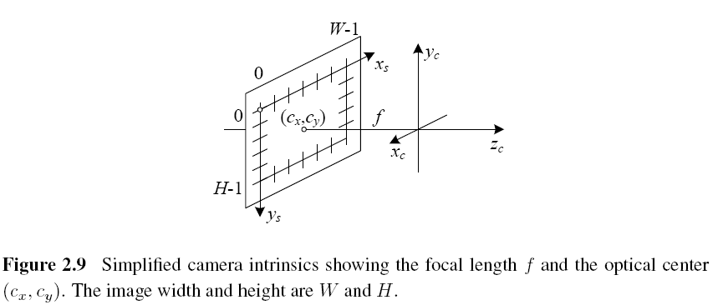
2.1.5 Camera Intrinsics

Slide 40
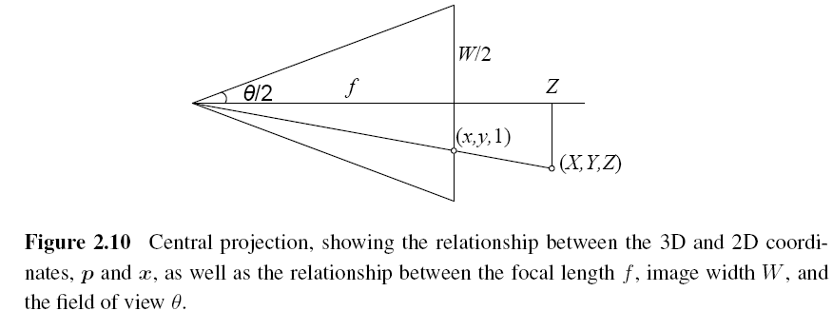
2.1.5 A Note on Focal Lengths

Slide 41
2.1.5 Camera Matrix
3×4 camera matrix
$E$ is a 3D rigid-body (Euclidean) transformation $\tilde{K}$ is the full-rank calibration matrix

Slide 42
2.1.6 Lens Distortions
Imaging models all assume that cameras obey a linear projection model where straight lines in the world result in straight lines in the image.
Many wide-angle lenses have noticeable radial distortion, which manifests itself as a visible curvature in the projection of straight lines.

Slide 43
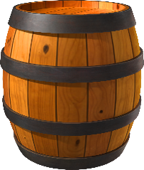
2.1.6 Lens Distortions

Slide 44
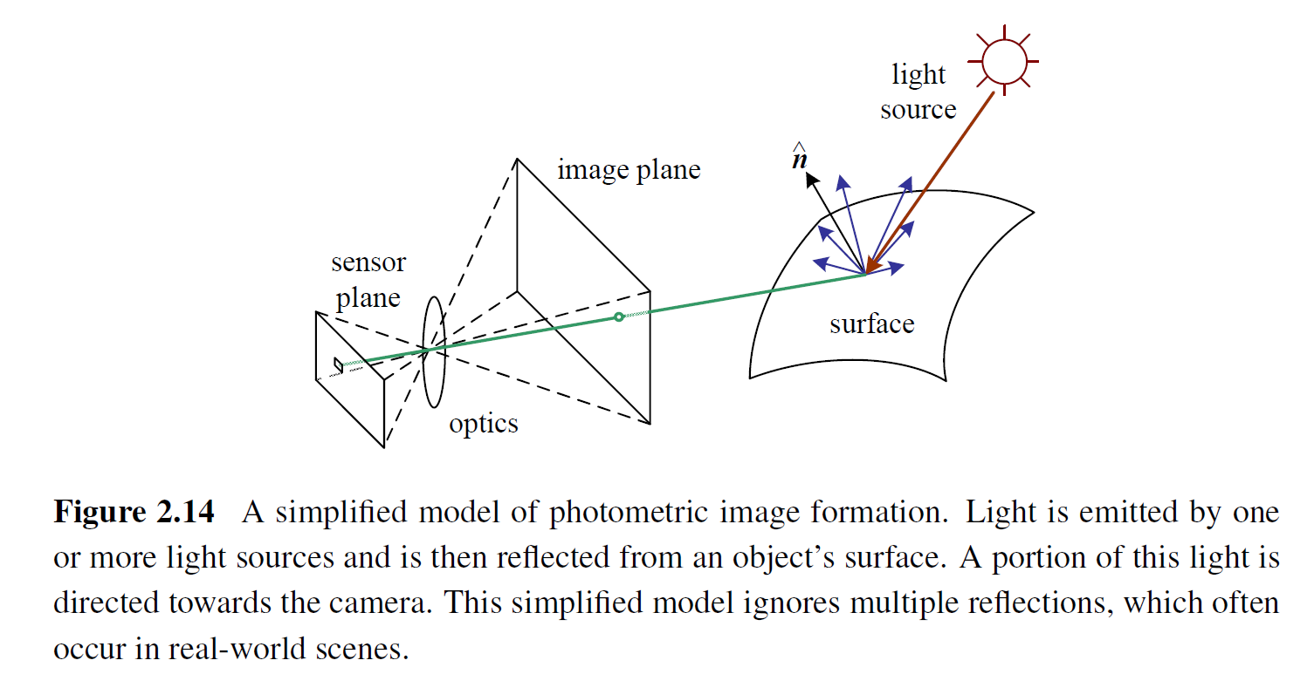
2.2 Photometric Image Formation
Images are not composed of 2D features, they are made up of discrete color or intensity values.
How do they relate to the lighting in the environment, surface properties and geometry, camera optics, and sensor properties?

Slide 45
2.2.1 Lighting
To produce an image, the scene must be illuminated with one or more light sources.
A point light source originates at a single location in space (e.g., a small light bulb), potentially at infinity (e.g., the sun).
A point light source has an intensity and a color spectrum, i.e., a distribution over wavelengths L(λ).

Slide 46
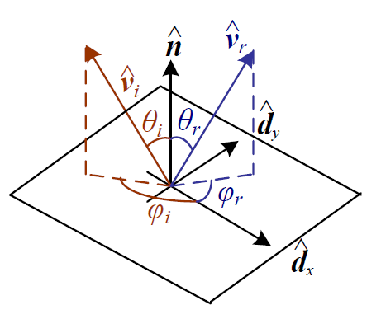
2.2.2 Reflectance and Shading
Bidirectional Reflectance Distribution Function (BRDF)
describes how much of each wavelength arriving at an incident direction ${\hat{v}}_{i}$ is emitted in a reflected direction ${\hat{v}}_{r}$.
the angles of the incident and reflected directions relative to the surface frame

Slide 47
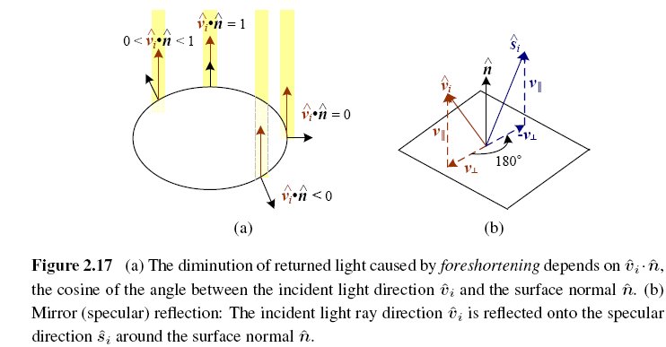
2.2.2 Diffuse reflection

Slide 48
2.2.2 Diffuse Reflection vs. Specular Reflection

Slide 49
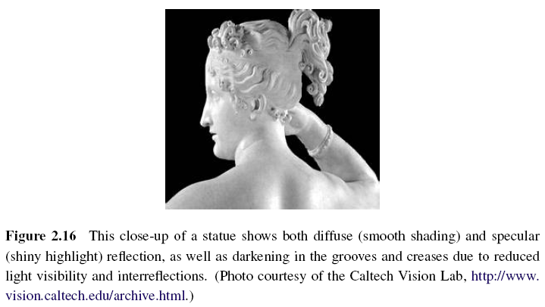
2.2.2 Diffuse Reflection vs. Specular Reflection

Slide 50
2.2.2 Phong Shading
Phong reflection is an empirical model of local illumination.
Combined the diffuse and specular components of reflection.
Objects are generally illuminated not only by point light sources but also by a diffuse illumination corresponding to inter-reflection (e.g., the walls in a room) or distant sources, such as the blue sky.
Notes:
Ambient 環境的、周圍的

Slide 51
2.2.3 Optics
Once the light from a scene reaches the camera, it must still pass through the lens before reaching the sensor.
For many applications, it suffices to treat the lens as an ideal pinhole.
Notes:
Suffice 滿足

Slide 52
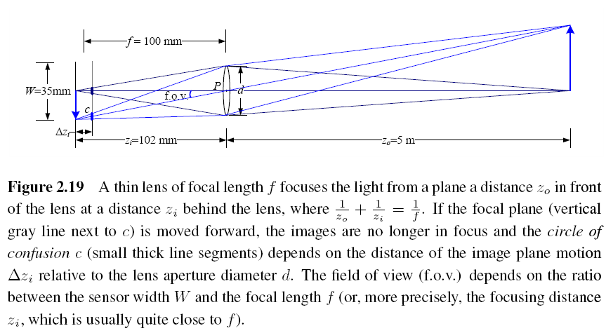
2.2.3 Optics

Slide 53
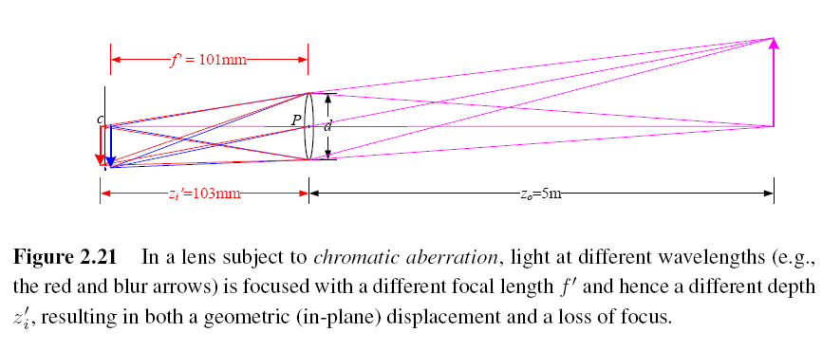
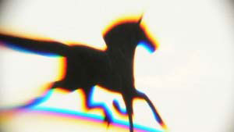
2.2.3 Chromatic Aberration
The tendency for light of different colors to focus at slightly different distances.

Slide 54
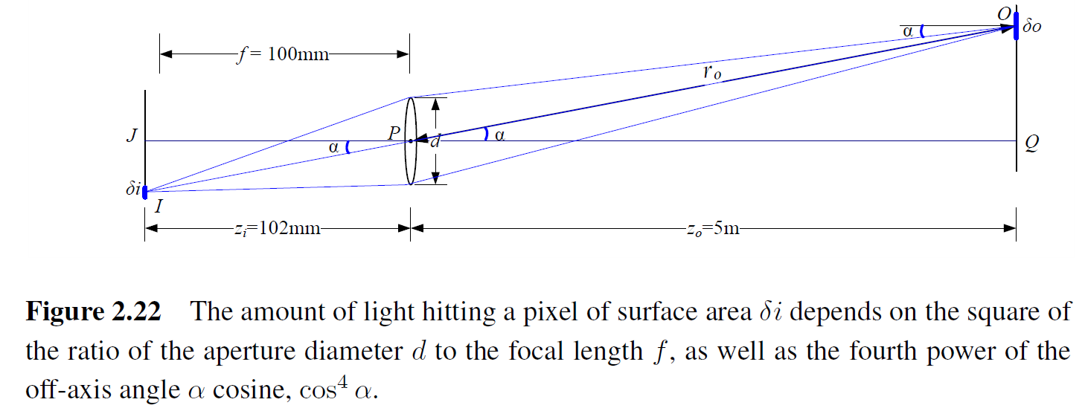
2.2.3 Vignetting
The tendency for the brightness of the image to fall off towards the edge of the image.

Slide 55
2.3 The Digital Camera
CCD: Charge-Coupled Device
CMOS: Complementary Metal-Oxide-Semiconductor
A/D: Analog-to-Digital Converter
DSP: Digital Signal Processor
JPEG: Joint Photographic Experts Group

Slide 56
2.3 Image Sensor
CCD: Charge-Coupled Device
Photons are accumulated in each active well during the exposure time.
In a transfer phase, the charges are transferred from well to well in a kind of “bucket brigade” until they are deposited at the sense amplifiers, which amplify the signal and pass it to an Analog-to-Digital Converter (ADC).

Slide 57
2.3 Image Sensor
CMOS: Complementary Metal-Oxide-Semiconductor
The photons hitting the sensor directly affect the conductivity of a photodetector, which can be selectively gated to control exposure duration, and locally amplified before being read out using a multiplexing scheme.

Slide 58
2.3 Image Sensor
Shutter speed
The shutter speed (exposure time) directly controls the amount of light reaching the sensor and, hence, determines if images are under- or over-exposed.
Sampling pitch
The sampling pitch is the physical spacing between adjacent sensor cells on the imaging chip.

Slide 59
2.3 Image Sensor
Fill factor
The fill factor is the active sensing area size as a fraction of the theoretically available sensing area (the product of the horizontal and vertical sampling pitches).
Chip size
Video and point-and-shoot cameras have traditionally used small chip areas(1/4-inch to 1/2-inch sensors).
Digital SLR (Single-Lens Reflex) camera try to come closer to the traditional size of a 35mm film frame.
When overall device size is not important, having a larger chip size is preferable, since each sensor cell can be more photo-sensitive.
Notes:
Point-and-shoot 傻瓜相機、全自動相機
SLR camera (single-lens reflex camera) 單眼反光相機

Slide 60
2.3 Image Sensor
Analog gain
Before analog-to-digital conversion, the sensed signal is usually boosted by a sense amplifier.
Sensor noise
Throughout the whole sensing process, noise is added from various sources, which may include fixed pattern noise, dark current noise, shot noise, amplifier noise and quantization noise.

Slide 61
2.3 Image Sensor
ADC resolution
Resolution: how many bits it yields
noise level: how many of these bits are useful in practice
Digital post-processing
To enhance the image before compressing and storing the pixel values.

Slide 62
2.3.1 Sampling and Aliasing

Slide 63
2.3.1 Nyquist Frequency
$f_{s}≥2f_{max}$
The maximum frequency in a signal is known as the Nyquist frequency and the inverse of the minimum sampling frequency $r_{s}=1/f_{s}$ known as the Nyquist rate.

Slide 64
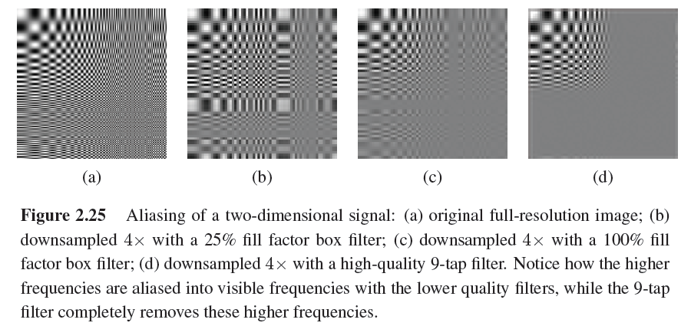
2.3.1 Nyquist Frequency

Slide 65
2.3.2 Color

Slide 66
2.3.2 CIE RGB
In the 1930s, the Commission Internationale d’Eclairage (CIE) standardized the RGB representation by performing such color matching experiments using the primary colors of red (700.0nm wavelength), green (546.1nm), and blue (435.8nm).
For certain pure spectra in the blue–green range, a negative amount of red light has to be added.

Slide 67
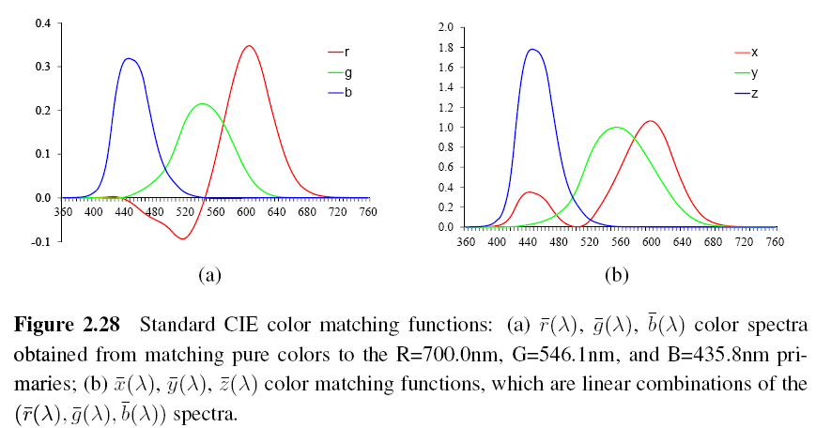
2.3.2 CIE RGB

Slide 68
2.3.2 XYZ
The transformation from RGB to XYZ is given by
Chromaticity coordinates

Slide 69
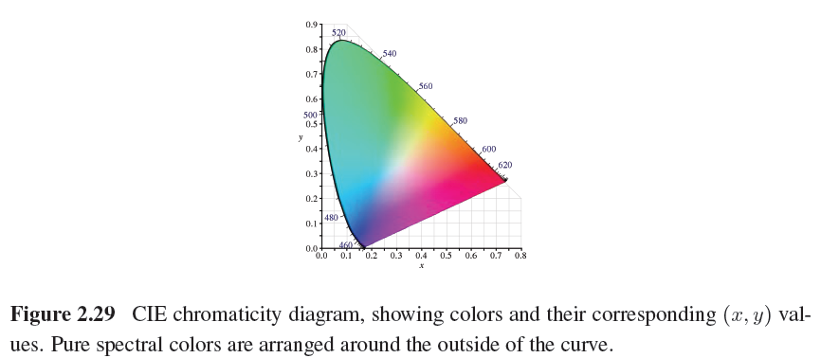
2.3.2 XYZ

Slide 70
2.3.2 L*a*b* Color Space
CIE defined a non-linear re-mapping of the XYZ space called L*a*b* (also sometimes called CIELAB)
L*: lightness

Slide 71
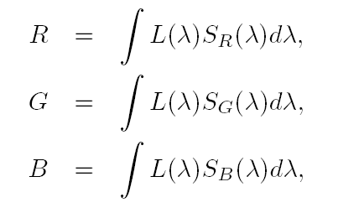
2.3.2 Color Cameras
Each color camera integrates light according to the spectral response function of its red, green, and blue sensors
L(λ): incoming spectrum of light at a given pixel
S_{R}(λ), S_{B} (λ), S_{G} (λ): the red, green, and blue spectral sensitivities of the corresponding sensors

Slide 72
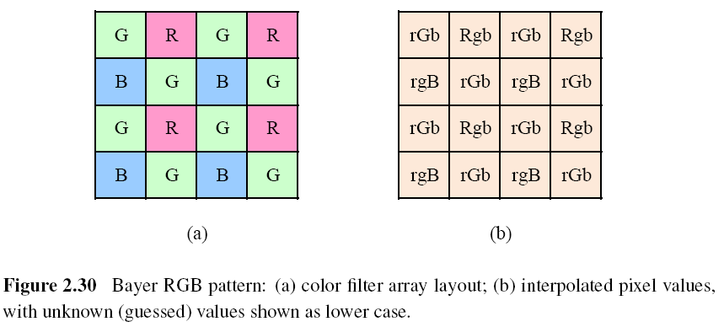
2.3.2 Color Filter Arrays

Slide 73
2.3.2 Bayer Pattern
Green filters over half of the sensors (in a checkerboard pattern), and red and blue filters over the remaining ones.
The reason that there are twice as many green filters as red and blue is because the luminance signal is mostly determined by green values and the visual system is much more sensitive to high frequency detail in luminance than in chrominance.
The process of interpolating the missing color values so that we have valid RGB values for all the pixels is known as demosaicing.

Slide 74
2.3.2 Color Balance (Auto White Balance)
Move the white point of a given image closer to pure white.
If the illuminant is strongly colored, such as incandescent indoor lighting (which generally results in a yellow or orange hue), the compensation can be quite significant.
Notes:
Incandescent 發白光的、發光的

Slide 75
2.3.2 Gamma
The relationship between the voltage and the resulting brightness was characterized by a number called gamma (γ), since the formula was roughly $B=V^{γ}$.
$γ=2.2$

Slide 76
2.3.2 Gamma
To compensate for this effect, the electronics in the TV camera would pre-map the sensed luminance Y through an inverse gamma $Y^{′}=Y^{\frac{1}{γ}}$
$\frac{1}{γ}=0.45$

Slide 77
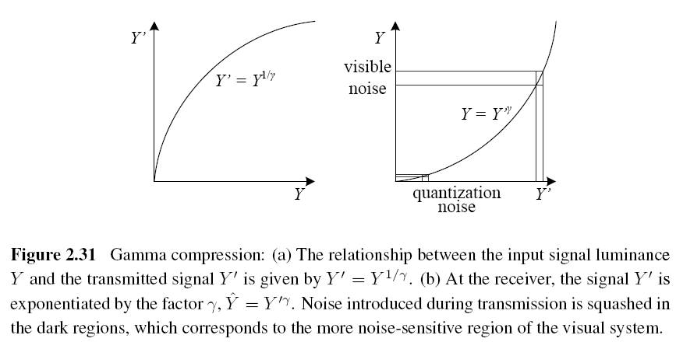
2.3.2 Gamma

Slide 78
2.3.2 Other Color Spaces
YUV
$R^{′}G^{′}B′$: the triplet of gamma-compressed color components
Notes:
Mnemonics [ni-mon-iks] 記憶術

Slide 79
2.3.2 Other Color Spaces
JPEG standard uses the full eight-bit range with no reserved values
$R^{′}G^{′}B′$: the eight-bit gamma-compressed color components
The Cb and Cr signals carry the blue and red color difference signals and have more useful mnemonics than UV.

Slide 80
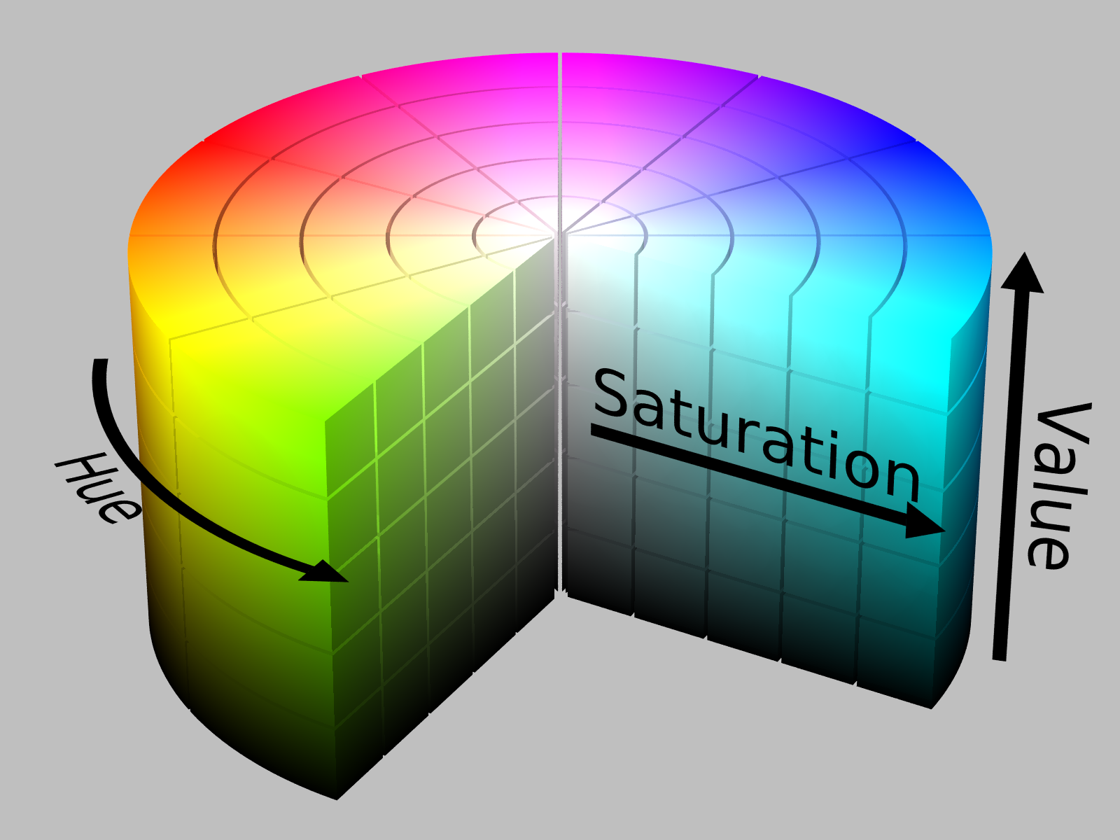
2.3.2 Other Color Spaces
HSV: hue, saturation, value
A projection of the RGB color cube onto a non-linear chroma angle, a radial saturation percentage, and a luminance-inspired value.

Slide 81
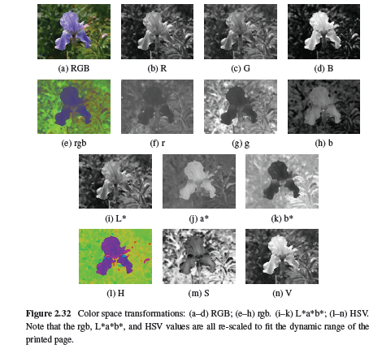
2.3.2 Other Color Spaces

Slide 82
2.3.3 Compression
All color video and image compression algorithms start by converting the signal into YCbCr (or some closely related variant), so that they can compress the luminance signal with higher fidelity than the chrominance signal.
In video, it is common to subsample Cb and Cr by a factor of two horizontally; with still images (JPEG), the subsampling (averaging) occurs both horizontally and vertically.
Notes:
Fidelity 準確性

Slide 83
2.3.3 Compression
Once the luminance and chrominance images have been appropriately subsampled and separated into individual images, they are then passed to a block transform stage.
The most common technique used here is the Discrete Cosine Transform (DCT), which is a real-valued variant of the Discrete Fourier Transform (DFT).

Slide 84
2.3.3 Compression
After transform coding, the coefficient values are quantized into a set of small integer values that can be coded using a variable bit length scheme such as a Huffman code or an arithmetic code.

Slide 85
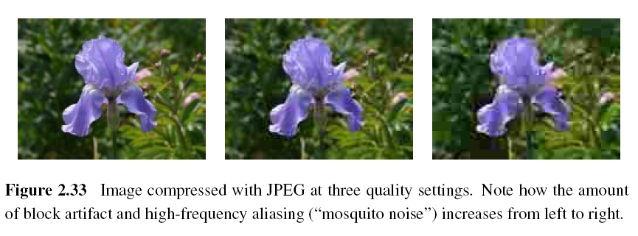
2.3.3 Compression
JPEG (Joint Photographic Experts Group)

Slide 86
2.3.3 PSNR (Peak Signal-to-Noise Ratio)
The quality of a compression algorithm MSE (Mean Square Error) = $\frac{1}{n}\sum_{x}{{\left[I\left(x\right)−\hat{I}\left(x\right)\right]}^{2}}$
$I(x)$: the original uncompressed image
$\hat{I}\left(x\right):$ its compressed counterpart
$RMS \left(Root Mean Square Error\right)=\sqrt{MSR}$
$PSNR=10\log_{10}\left(\frac{I_{max}^{2}}{MSE}\right)=20\log_{10}{\frac{I_{max}}{RMS}}$

Slide 87
Project due March 22
Camera calibration i.e. compute #pixels/mm object displacement
Use lens of focal length: 16mm, 25mm, 55mm
Object displacement of: 1mm, 5mm, 10mm, 20mm
Object distance of: 0.5m, 1m, 2m
Camera parameters: 8.8mm * 6.6mm ==> 512*485 pixels
Are pixels square or rectangular?

Slide 88
Calculate theoretical values and compare with measured values.
Calculate field of view in degrees of angle.

