Slide 1
Advanced Computer Vision
Chapter 2
Image Formation
Presented by 楊應甲 2012/3/6, 13, 20
0953968086
b96902026@ntu.edu.tw

Slide 2
Image Formation
2.1 Geometric primitives and transformations
2.2 Photometric image formation
2.3 The digital camera
Notes:
Before we can intelligently analyze and manipulate images, we need to establish a vocabulary for describing the geometry of a scene. We also need to understand the image formation process that produced a particular image given a set of lighting conditions, scene geometry, surface properties, and camera optics.
Geometric Primitives – 幾何元素
Photometric – 光度
2.1 – points, lines, and planes; and geometric transformations that project these 3D quantities into 2D image features
2.2 – describes how lighting, surface properties, and camera optics interact in order to produce the color values that fall onto the image sensor
2.3 – describes how continuous color images are turned into discrete digital samples inside the image sensor and how to avoid (or at least characterize) sampling deﬁciencies, such as aliasing

Slide 3
2.1.1 Geometric Primitives (1/4)
2D points (pixel coordinates in an image)
Notes:
Homogenous coordinates – 齊次座標
圖為超連結，此圖取自連結目標網站。
Homogeneous points whose last element is ˜w = 0 are called ideal points or points at inﬁnity and do not have an equivalent inhomogeneous representation.

Slide 4
2.1.1 Geometric Primitives (2/4)
2D lines
normalize the line equation vector
Notes:
ˆn is the normal vector perpendicular to the line and d is its distance to the origin.
The angle representation is commonly used in the Hough transform line-ﬁnding algorithm, which is discussed in Section 4.3.2. The combination (θ, d) is also known as polar coordinates.

Slide 5
2.1.1 Geometric Primitives (3/4)
2D conics: circle, ellipse, parabola, hyperbola
There are other algebraic curves that can be expressed with simple polynomial homogeneous equations.
Notes:
R^{n}上的每一個二次型q都可以唯一寫成q(x) = x^{T}Ax的形式，其中A是對稱的n × n矩陣

Slide 6
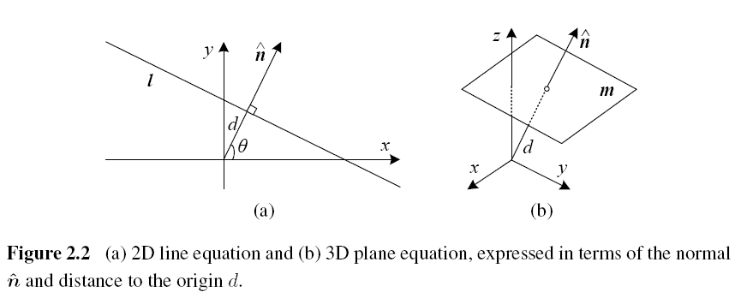
2.1.1 Geometric Primitives (4/4)

Slide 7
3D (1/3)
3D points
3D planes
normalize the plane equation vector
Notes:
We can express ˆn as a function of two angles (θ, φ), ˆn = (cos θ cos φ, sin θ cos φ, sin φ)

Slide 8
3D (2/3)
3D lines
two points on the line, (p, q)
Any other point on the line can be expressed as a linear combination of these two points.
3D quadrics

Slide 9
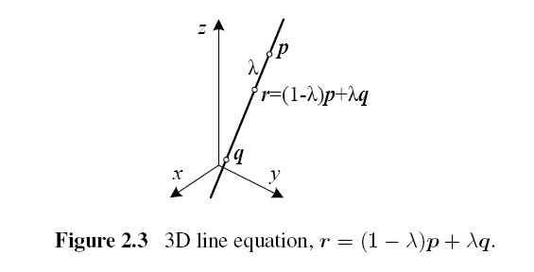
3D (3/3)

Slide 10
2.1.2 2D Transformations

Slide 11
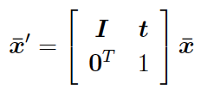
Translation
x’
y’
x
y
tx
ty
x’
y’
1 | 0 | tx
0 | 1 | ty
x
y
1
x’
y’
1
=
+
=
.
1 | 0 | tx
0 | 1 | ty
0 | 0 | 1
.
x
y
1
=

Slide 12
Rotation + Translation
2D Euclidean transformation
R: orthonormal rotation matrix
Notes:
Orthonormal matrix is aka orthogonal matrix, a matrix Q is orthogonal if its transpose is equal to its inverse.
An orthogonal matrix Q is necessarily square, invertible (with inverse Q⁻¹ = Q^{T}), unitary (Q⁻¹ = Q*), and normal (Q*Q = QQ*).

Slide 13
Scaled Rotation
Similarity transform

Slide 14
Affine
Parallel lines remain parallel under affine transformations.

Slide 15
Projective
Aka a perspective transform or homography
Perspective transformations preserve straight lines.

Slide 16
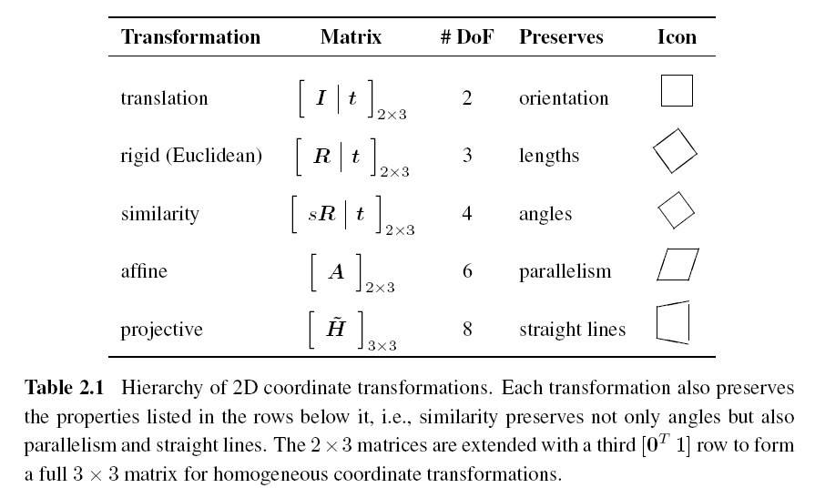

Slide 17
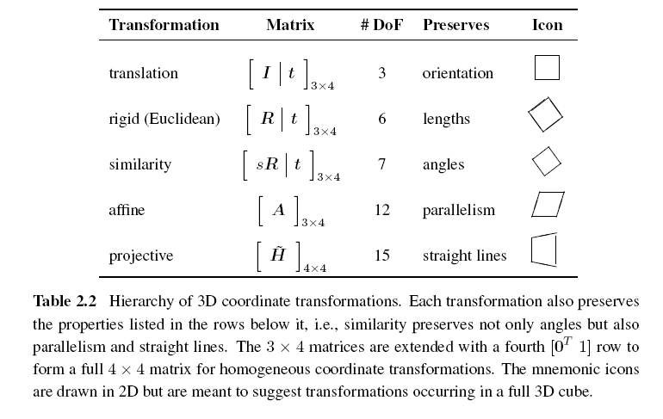
2.1.3 3D Transformations

Slide 18
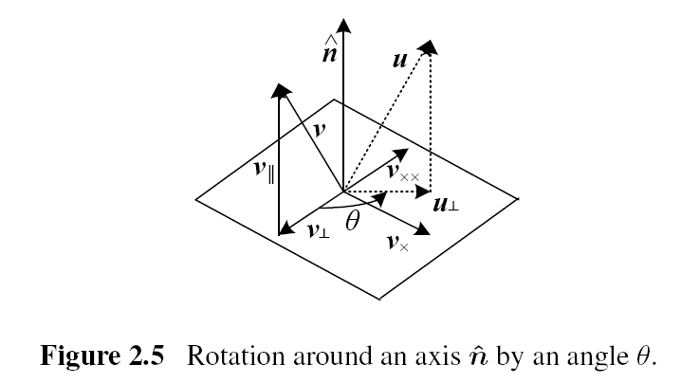
2.1.4 3D Rotations (1/4)
Axis/angle

Slide 19
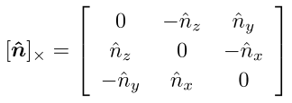
2.1.4 3D Rotations (2/4)
Project the vector v onto the axis
Compute the perpendicular residual of v from

Slide 20
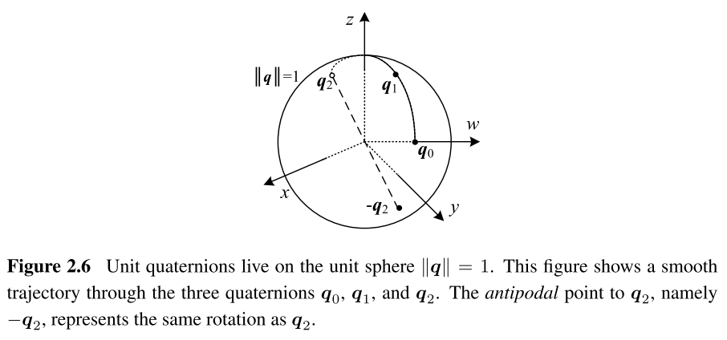
2.1.4 3D Rotations (3/4)

Slide 21
2.1.4 3D Rotations (4/4)
Which rotation representation is better?
Axis/angle
Representation is minimal.
Quaternions
Better if you want to keep track of a smoothly moving camera.
Notes:
Axis/angle does not require any additional constraints on the parameters (no need to re-normalize after each update).
Quaternions is also easier to interpolate between rotations and to chain rigid transformations.

Slide 22
2.1.5 3D to 2D Projections
Drops the z component of the three-dimensional coordinate p to obtain the 2D point x.
Orthography and para-perspective
Scaled orthography

Slide 23
Perspective
Points are projected onto the image plane by dividing them by their z component.

Slide 24
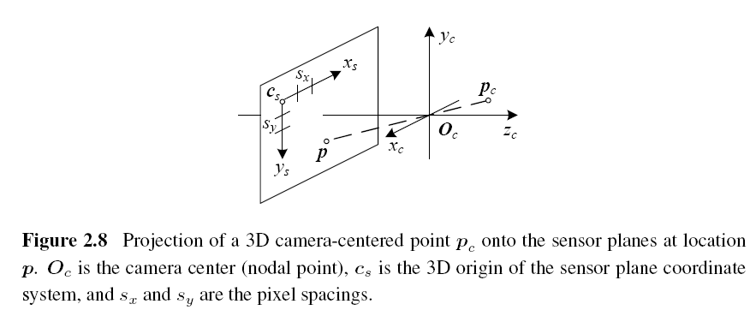
Camera Intrinsics (1/4)

Slide 25
Camera Intrinsics (2/4)
The combined 2D to 3D projection can then be written as
(x_{s}, y_{s}): pixel coordinates
(s_{x}, s_{y}): pixel spacings
c_{s}: 3D origin coordinate
R_{s}: 3D rotation matrix
M_{s}: sensor homography matrix

Slide 26
Camera Intrinsics (3/4)
K: calibration matrix
p_{w}: 3D world coordinates
P: camera matrix

Slide 27
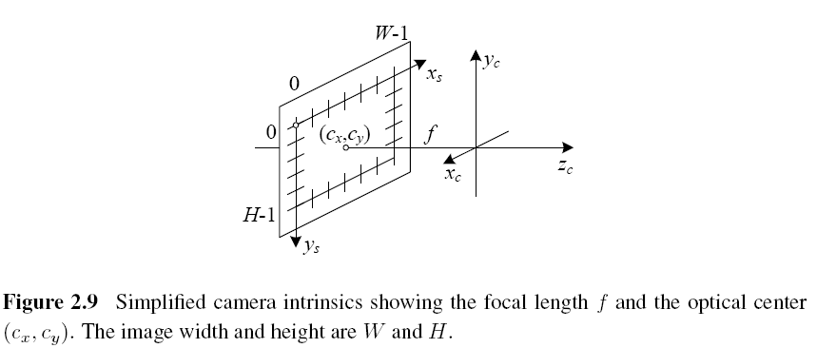
Camera Intrinsics (4/4)

Slide 28
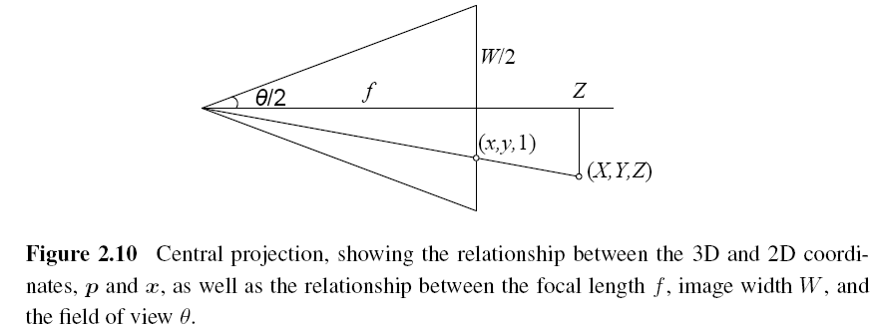
A Note on Focal Lengths

Slide 29
Camera Matrix
3×4 camera matrix

Slide 30
2.1.6 Lens Distortions (1/2)
Imaging models all assume that cameras obey a linear projection model where straight lines in the world result in straight lines in the image.
Many wide-angle lenses have noticeable radial distortion, which manifests itself as a visible curvature in the projection of straight lines.

Slide 31
2.1.6 Lens Distortions (2/2)
End of 2.1

Slide 32
2.2 Photometric Image Formation
2.2.1 Lighting
To produce an image, the scene must be illuminated with one or more light sources.
A point light source originates at a single location in space (e.g., a small light bulb), potentially at infinity (e.g., the sun).
A point light source has an intensity and a color spectrum, i.e., a distribution over wavelengths L(λ).

Slide 33
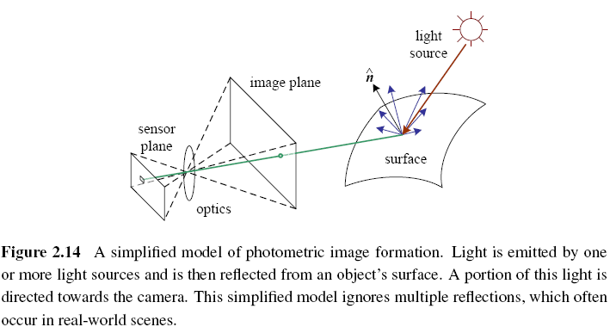

Slide 34
2.2.2 Reflectance and Shading
Bidirectional Reflectance Distribution Function (BRDF)
the angles of the incident and reflected directions relative to the surface frame

Slide 35
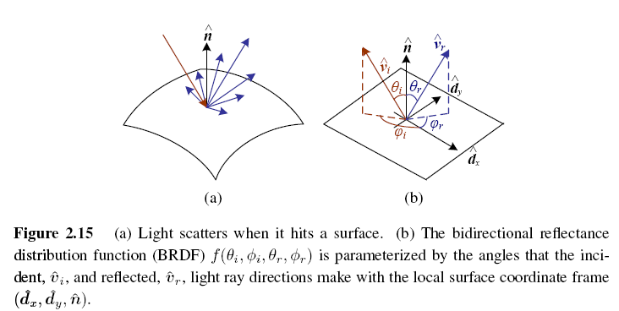

Slide 36
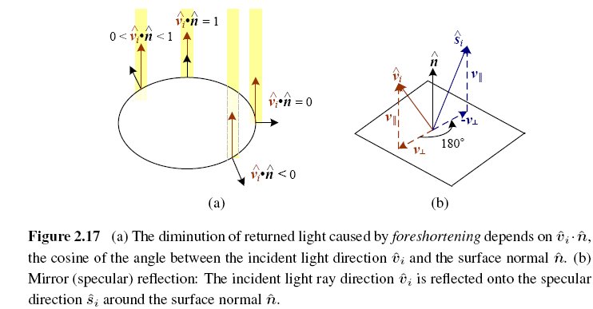
Diffuse Reflection vs. Specular Reflection (1/2)

Slide 37
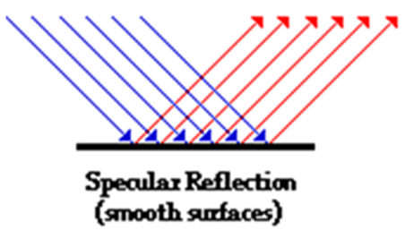
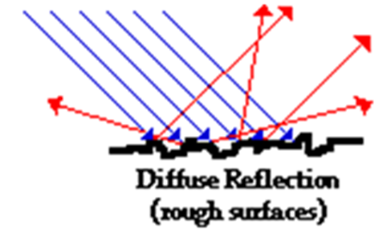
Diffuse Reflection vs. Specular Reflection (2/2)

Slide 38
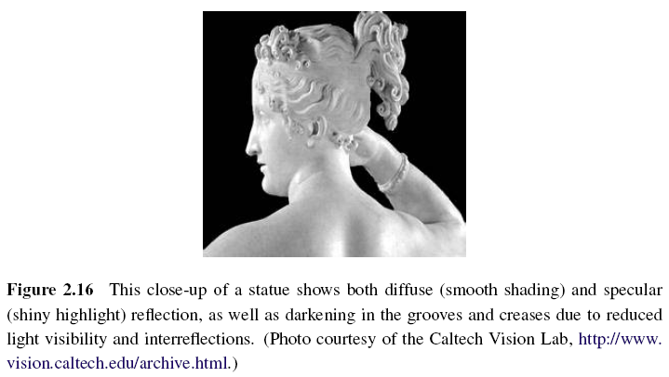

Slide 39
Phong Shading
Phong reflection is an empirical model of local illumination.
Combined the diffuse and specular components of reflection.
Objects are generally illuminated not only by point light sources but also by a diffuse illumination corresponding to inter-reflection (e.g., the walls in a room) or distant sources, such as the blue sky.

Slide 40
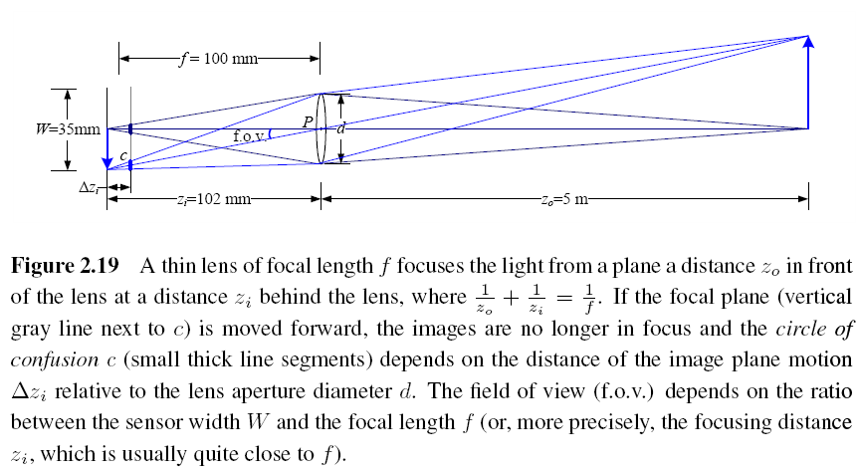
2.2.3 Optics

Slide 41
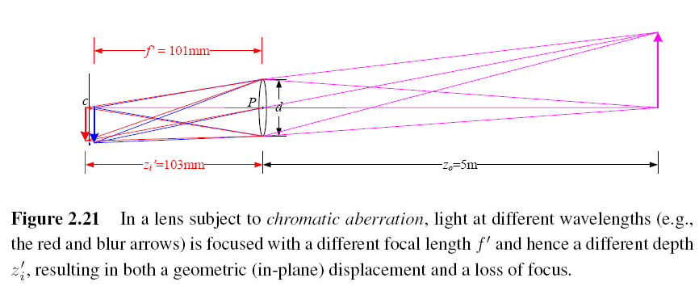
Chromatic Aberration
The tendency for light of different colors to focus at slightly different distances.

Slide 42
Vignetting
The tendency for the brightness of the image to fall off towards the edge of the image.
End of 2.2
Notes:
Two kinds of phenomena usually contribute to this effect (Ray 2002). The first is called natural vignetting and is due to the foreshortening in the object surface, projected pixel, and lens aperture.
The other major kind of vignetting, called mechanical vignetting, is caused by the internal occlusion of rays near the periphery of lens elements in a compound lens, and cannot easily be described mathematically without performing a full ray-tracing of the actual lens design. However, unlike natural vignetting, mechanical vignetting can be decreased by reducing the camera aperture (increasing the f-number). It can also be calibrated (along with natural vignetting) using special devices such as integrating spheres, uniformly illuminated targets, or camera rotation, as discussed in Section 10.1.3.

Slide 43
2.3 The Digital Camera
CCD: Charge-Coupled Device
CMOS: Complementary Metal-Oxide-Semiconductor
A/D: Analog-to-Digital Converter
DSP: Digital Signal Processor
JPEG: Joint Photographic Experts Group

Slide 44
Image Sensor (1/6)
CCD: Charge-Coupled Device
Photons are accumulated in each active well during the exposure time.
In a transfer phase, the charges are transferred from well to well in a kind of “bucket brigade” until they are deposited at the sense amplifiers, which amplify the signal and pass it to an Analog-to-Digital Converter (ADC).

Slide 45
Image Sensor (2/6)
CMOS: Complementary Metal-Oxide-Semiconductor
The photons hitting the sensor directly affect the conductivity of a photodetector, which can be selectively gated to control exposure duration, and locally amplified before being read out using a multiplexing scheme.

Slide 46
Image Sensor (3/6)
Shutter speed
The shutter speed (exposure time) directly controls the amount of light reaching the sensor and, hence, determines if images are under- or over-exposed.
Sampling pitch
The sampling pitch is the physical spacing between adjacent sensor cells on the imaging chip.

Slide 47
Image Sensor (4/6)
Fill factor
The fill factor is the active sensing area size as a fraction of the theoretically available sensing area (the product of the horizontal and vertical sampling pitches).
Chip size
Video and point-and-shoot cameras have traditionally used small chip areas(1/4-inch to 1/2-inch sensors).

Slide 48
Image Sensor (5/6)
Analog gain
Before analog-to-digital conversion, the sensed signal is usually boosted by a sense amplifier.
Sensor noise
Throughout the whole sensing process, noise is added from various sources, which may include fixed pattern noise, dark current noise, shot noise, amplifier noise and quantization noise.

Slide 49
Image Sensor (6/6)
ADC resolution
Resolution: how many bits it yields
noise level: how many of these bits are useful in practice
Digital post-processing
To enhance the image before compressing and storing the pixel values.

Slide 50
2.3.1 Sampling and Aliasing

Slide 51
Nyquist Frequency
The maximum frequency in a signal is known as the Nyquist frequency and the inverse of the minimum sampling frequency known as the Nyquist rate.

Slide 52
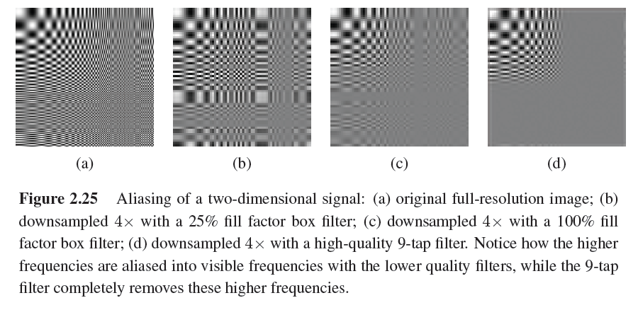

Slide 53
2.3.2 Color

Slide 54
CIE RGB
In the 1930s, the Commission Internationale d’Eclairage (CIE) standardized the RGB representation by performing such color matching experiments using the primary colors of red (700.0nm wavelength), green (546.1nm), and blue (435.8nm).
For certain pure spectra in the blue–green range, a negative amount of red light has to be added.

Slide 55
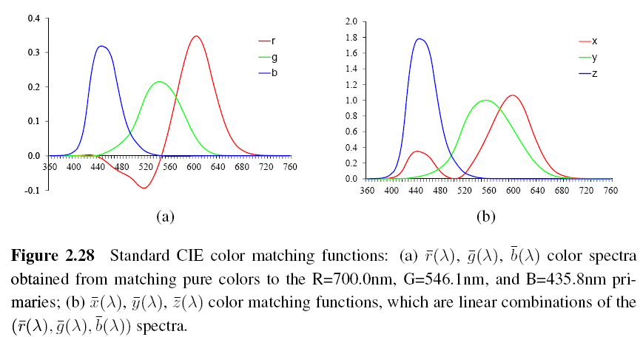

Slide 56
XYZ
The transformation from RGB to XYZ is given by
Chromaticity coordinates

Slide 57
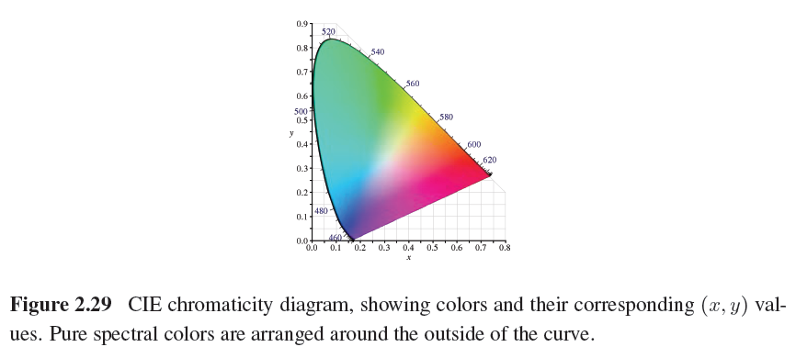

Slide 58
L*a*b* Color Space
CIE defined a non-linear re-mapping of the XYZ space called L*a*b* (also sometimes called CIELAB)
L*: lightness

Slide 59
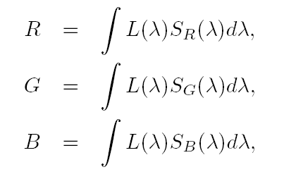
Color Cameras
Each color camera integrates light according to the spectral response function of its red, green, and blue sensors
L(λ): incoming spectrum of light at a given pixel
S_{R}(λ), S_{B} (λ), S_{G} (λ): the red, green, and blue spectral sensitivities of the corresponding sensors

Slide 60
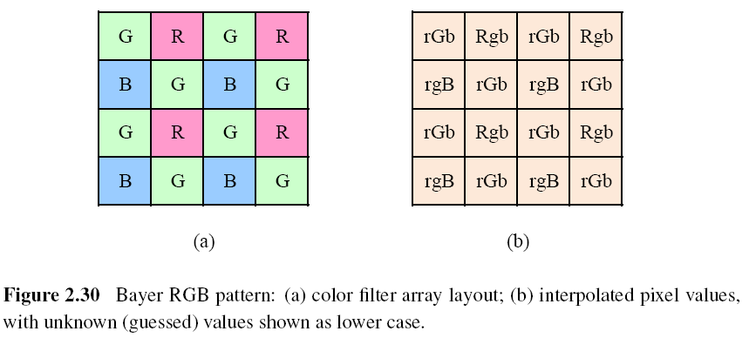
Color Filter Arrays

Slide 61
Bayer Pattern
Green filters over half of the sensors (in a checkerboard pattern), and red and blue filters over the remaining ones.
The reason that there are twice as many green filters as red and blue is because the luminance signal is mostly determined by green values and the visual system is much more sensitive to high frequency detail in luminance than in chrominance.
The process of interpolating the missing color values so that we have valid RGB values for all the pixels.

Slide 62
Color Balance (Auto White Balance)
Move the white point of a given image closer to pure white.
If the illuminant is strongly colored, such as incandescent indoor lighting (which generally results in a yellow or orange hue), the compensation can be quite significant.

Slide 63
Gamma (1/2)
The relationship between the voltage and the resulting brightness was characterized by a number called gamma (γ), since the formula was roughly
γ: 2.2

Slide 64
Gamma (2/2)
To compensate for this effect, the electronics in the TV camera would pre-map the sensed luminance Y through an inverse gamma
: 0.45

Slide 65
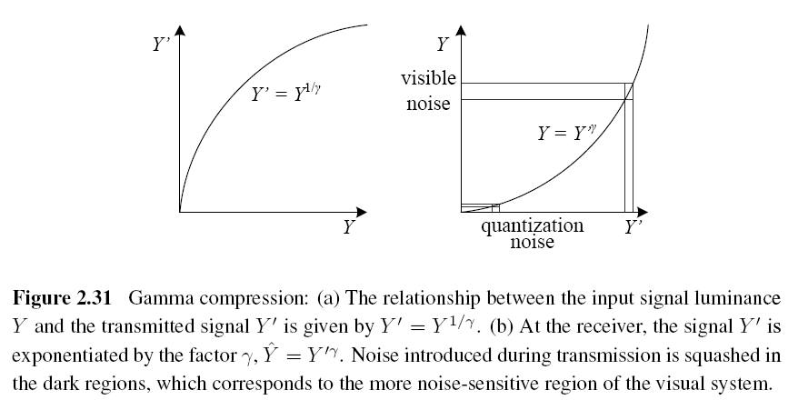

Slide 66
Other Color Spaces (1/3)
YCbCr
The Cb and Cr signals carry the blue and red color difference signals and have more useful mnemonics than UV.
: the triplet of gamma-compressed color components

Slide 67
Other Color Spaces (2/3)
JPEG standard uses the full eight-bit range with no reserved values
: the eight-bit gamma-compressed color components

Slide 68
Other Color Spaces (3/3)
HSV: hue, saturation, value
A projection of the RGB color cube onto a non-linear chroma angle, a radial saturation percentage, and a luminance-inspired value.

Slide 69
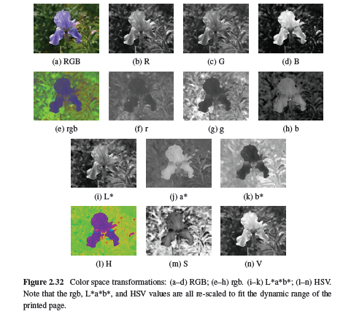

Slide 70
2.3.3 Compression (1/4)
All color video and image compression algorithms start by converting the signal into YCbCr (or some closely related variant), so that they can compress the luminance signal with higher fidelity than the chrominance signal.
In video, it is common to subsample Cb and Cr by a factor of two horizontally; with still images (JPEG), the subsampling (averaging) occurs both horizontally and vertically.

Slide 71
2.3.3 Compression (2/4)
Once the luminance and chrominance images have been appropriately subsampled and separated into individual images, they are then passed to a block transform stage.
The most common technique used here is the Discrete Cosine Transform (DCT), which is a real-valued variant of the Discrete Fourier Transform (DFT).

Slide 72
2.3.3 Compression (3/4)
After transform coding, the coefficient values are quantized into a set of small integer values that can be coded using a variable bit length scheme such as a Huffman code or an arithmetic code.

Slide 73
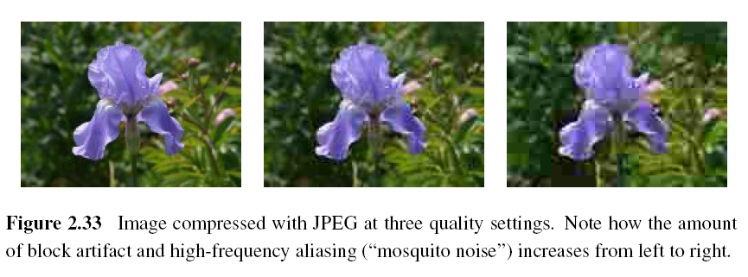
2.3.3 Compression (4/4)
JPEG (Joint Photographic Experts Group)

Slide 74
PSNR (Peak Signal-to-Noise Ratio)
The quality of a compression algorithm

Slide 75
Project due April 10
Camera calibration i.e. compute #pixels/mm object displacement
Use lens of focal length: 16mm, 25mm, 55mm
Object displacement of: 1mm, 5mm, 10mm, 20mm
Object distance of: 0.5m, 1m, 2m
Camera parameters: 8.8mm * 6.6mm ==> 512*485 pixels
Are pixels square or rectangular?

Slide 76
Calculate theoretical values and compare with measured values.
Calculate field of view in degrees of angle.

