Slide 1
Advanced Computer Vision Chapter 14 Recognition
Yu-Jhe Li
0973400693
r06942074@ntu.edu.tw
NTU GICE

Slide 2
Content
Introduction to recognition
Object detection
Face recognition
Instance recognition
Category recognition
Context and scene understanding

Slide 3
Content
Introduction to recognition
Object detection
Face recognition
Instance recognition
Category recognition
Context and scene understanding

Slide 4
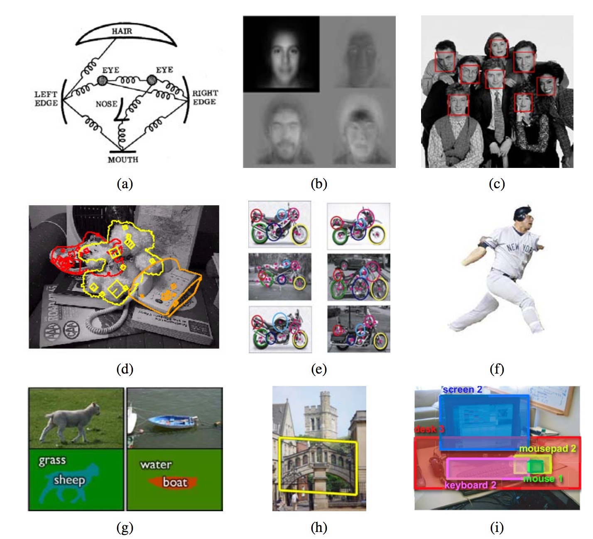
14. Introduction to Recognition
Notes:
Figure 14.1 Recognition: face recognition with (a) pictorial structures (Fischler and Elschlager 1973) ⃝c 1973 IEEE and (b) eigenfaces (Turk and Pentland 1991b); (c) real-time face detection (Viola and Jones 2004) ⃝c 2004 Springer; (d) instance (known object) recognition (Lowe 1999) ⃝c 1999 IEEE; (e) feature-based recognition (Fergus, Perona, and Zisserman 2007); (f) region-based recognition (Mori, Ren, Efros et al. 2004) ⃝c 2004 IEEE; (g) simultaneous recognition and segmentation (Shotton, Winn, Rother et al. 2009) ⃝c 2009 Springer; (h) location recognition (Philbin, Chum, Isard et al. 2007) ⃝c 2007 IEEE; (i) using context (Russell, Torralba, Liu et al. 2007).

Slide 5
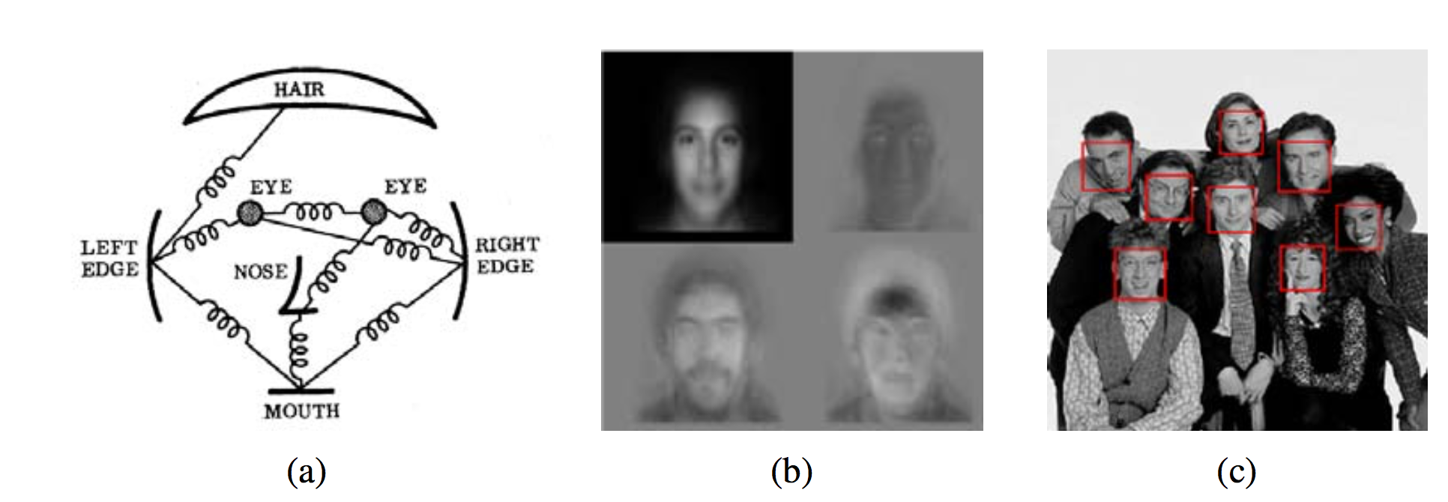
14. Introduction to Recognition
Face recognition
Pictorial structure
Eigenfaces
real-time face detection
Notes:
Figure 14.1 Recognition: face recognition with (a) pictorial structures (Fischler and Elschlager 1973) ⃝c 1973 IEEE and (b) eigenfaces (Turk and Pentland 1991b); (c) real-time face detection (Viola and Jones 2004) ⃝c 2004 Springer; (d) instance (known object) recognition (Lowe 1999) ⃝c 1999 IEEE; (e) feature-based recognition (Fergus, Perona, and Zisserman 2007); (f) region-based recognition (Mori, Ren, Efros et al. 2004) ⃝c 2004 IEEE; (g) simultaneous recognition and segmentation (Shotton, Winn, Rother et al. 2009) ⃝c 2009 Springer; (h) location recognition (Philbin, Chum, Isard et al. 2007) ⃝c 2007 IEEE; (i) using context (Russell, Torralba, Liu et al. 2007).

Slide 6
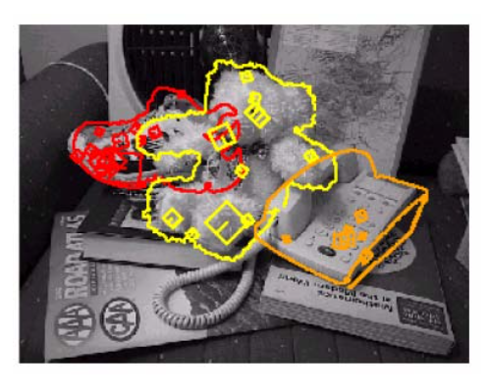
14. Introduction to Recognition
Instance recognition
Notes:
Figure 14.1 Recognition: face recognition with (a) pictorial structures (Fischler and Elschlager 1973) ⃝c 1973 IEEE and (b) eigenfaces (Turk and Pentland 1991b); (c) real-time face detection (Viola and Jones 2004) ⃝c 2004 Springer; (d) instance (known object) recognition (Lowe 1999) ⃝c 1999 IEEE; (e) feature-based recognition (Fergus, Perona, and Zisserman 2007); (f) region-based recognition (Mori, Ren, Efros et al. 2004) ⃝c 2004 IEEE; (g) simultaneous recognition and segmentation (Shotton, Winn, Rother et al. 2009) ⃝c 2009 Springer; (h) location recognition (Philbin, Chum, Isard et al. 2007) ⃝c 2007 IEEE; (i) using context (Russell, Torralba, Liu et al. 2007).

Slide 7
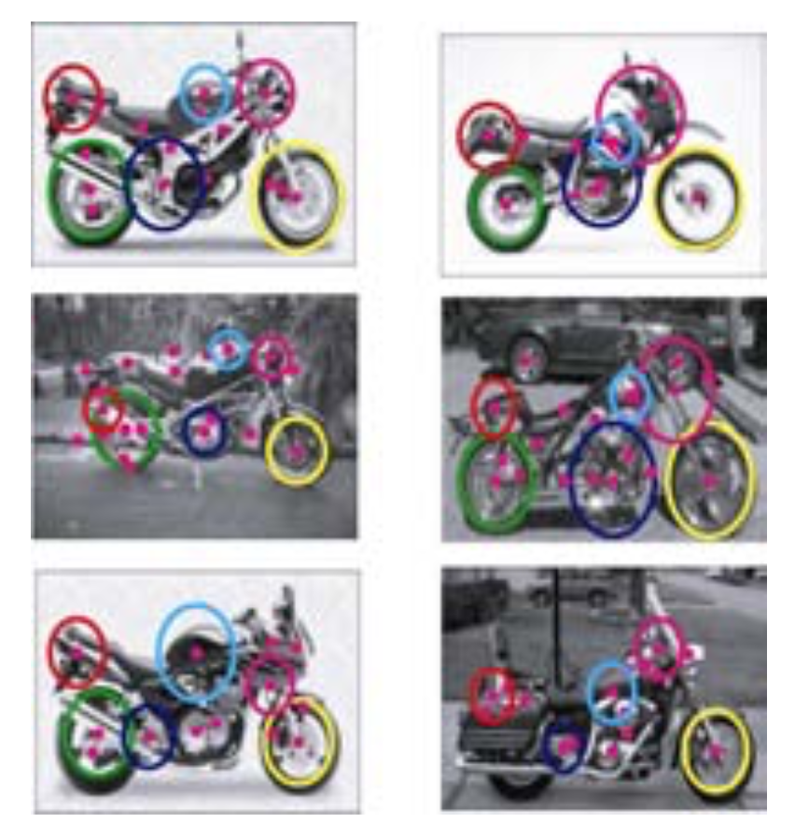
14. Introduction to Recognition
Feature based recognition
Notes:
Figure 14.1 Recognition: face recognition with (a) pictorial structures (Fischler and Elschlager 1973) ⃝c 1973 IEEE and (b) eigenfaces (Turk and Pentland 1991b); (c) real-time face detection (Viola and Jones 2004) ⃝c 2004 Springer; (d) instance (known object) recognition (Lowe 1999) ⃝c 1999 IEEE; (e) feature-based recognition (Fergus, Perona, and Zisserman 2007); (f) region-based recognition (Mori, Ren, Efros et al. 2004) ⃝c 2004 IEEE; (g) simultaneous recognition and segmentation (Shotton, Winn, Rother et al. 2009) ⃝c 2009 Springer; (h) location recognition (Philbin, Chum, Isard et al. 2007) ⃝c 2007 IEEE; (i) using context (Russell, Torralba, Liu et al. 2007).

Slide 8
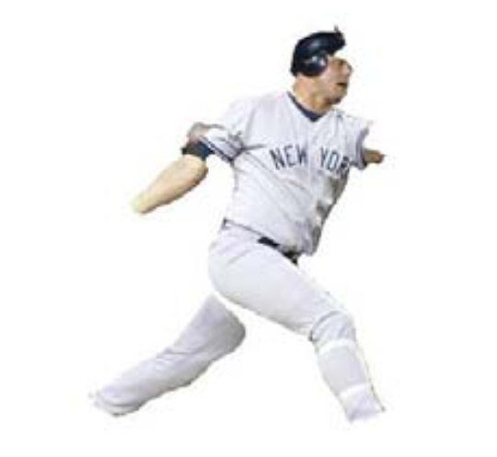
14. Introduction to Recognition
Region-based recognition
Notes:
Figure 14.1 Recognition: face recognition with (a) pictorial structures (Fischler and Elschlager 1973) ⃝c 1973 IEEE and (b) eigenfaces (Turk and Pentland 1991b); (c) real-time face detection (Viola and Jones 2004) ⃝c 2004 Springer; (d) instance (known object) recognition (Lowe 1999) ⃝c 1999 IEEE; (e) feature-based recognition (Fergus, Perona, and Zisserman 2007); (f) region-based recognition (Mori, Ren, Efros et al. 2004) ⃝c 2004 IEEE; (g) simultaneous recognition and segmentation (Shotton, Winn, Rother et al. 2009) ⃝c 2009 Springer; (h) location recognition (Philbin, Chum, Isard et al. 2007) ⃝c 2007 IEEE; (i) using context (Russell, Torralba, Liu et al. 2007).

Slide 9
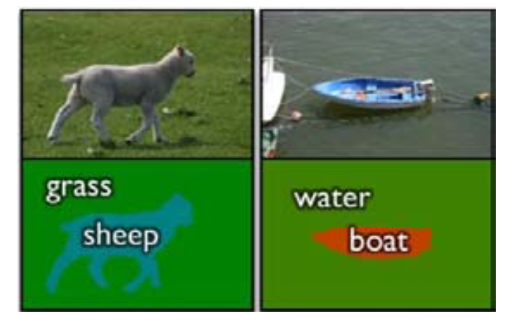
14. Introduction to Recognition
Simultaneous recognition and segmentation
Notes:
Figure 14.1 Recognition: face recognition with (a) pictorial structures (Fischler and Elschlager 1973) ⃝c 1973 IEEE and (b) eigenfaces (Turk and Pentland 1991b); (c) real-time face detection (Viola and Jones 2004) ⃝c 2004 Springer; (d) instance (known object) recognition (Lowe 1999) ⃝c 1999 IEEE; (e) feature-based recognition (Fergus, Perona, and Zisserman 2007); (f) region-based recognition (Mori, Ren, Efros et al. 2004) ⃝c 2004 IEEE; (g) simultaneous recognition and segmentation (Shotton, Winn, Rother et al. 2009) ⃝c 2009 Springer; (h) location recognition (Philbin, Chum, Isard et al. 2007) ⃝c 2007 IEEE; (i) using context (Russell, Torralba, Liu et al. 2007).

Slide 10
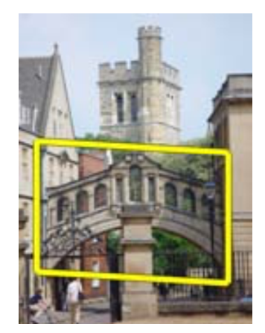
14. Introduction to Recognition
Location
recognition
Notes:
Figure 14.1 Recognition: face recognition with (a) pictorial structures (Fischler and Elschlager 1973) ⃝c 1973 IEEE and (b) eigenfaces (Turk and Pentland 1991b); (c) real-time face detection (Viola and Jones 2004) ⃝c 2004 Springer; (d) instance (known object) recognition (Lowe 1999) ⃝c 1999 IEEE; (e) feature-based recognition (Fergus, Perona, and Zisserman 2007); (f) region-based recognition (Mori, Ren, Efros et al. 2004) ⃝c 2004 IEEE; (g) simultaneous recognition and segmentation (Shotton, Winn, Rother et al. 2009) ⃝c 2009 Springer; (h) location recognition (Philbin, Chum, Isard et al. 2007) ⃝c 2007 IEEE; (i) using context (Russell, Torralba, Liu et al. 2007).

Slide 11
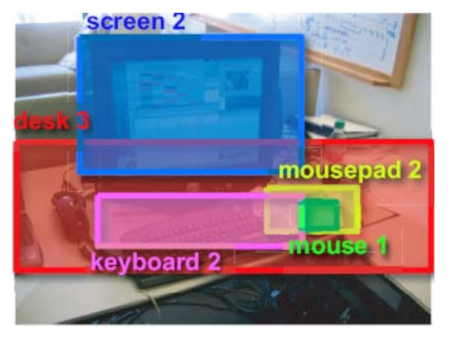
14. Introduction to Recognition
Using context
Notes:
Figure 14.1 Recognition: face recognition with (a) pictorial structures (Fischler and Elschlager 1973) ⃝c 1973 IEEE and (b) eigenfaces (Turk and Pentland 1991b); (c) real-time face detection (Viola and Jones 2004) ⃝c 2004 Springer; (d) instance (known object) recognition (Lowe 1999) ⃝c 1999 IEEE; (e) feature-based recognition (Fergus, Perona, and Zisserman 2007); (f) region-based recognition (Mori, Ren, Efros et al. 2004) ⃝c 2004 IEEE; (g) simultaneous recognition and segmentation (Shotton, Winn, Rother et al. 2009) ⃝c 2009 Springer; (h) location recognition (Philbin, Chum, Isard et al. 2007) ⃝c 2007 IEEE; (i) using context (Russell, Torralba, Liu et al. 2007).

Slide 12
Content
Introduction to recognition
Object detection
Face recognition
Instance recognition
Category recognition
Context and scene understanding

Slide 13
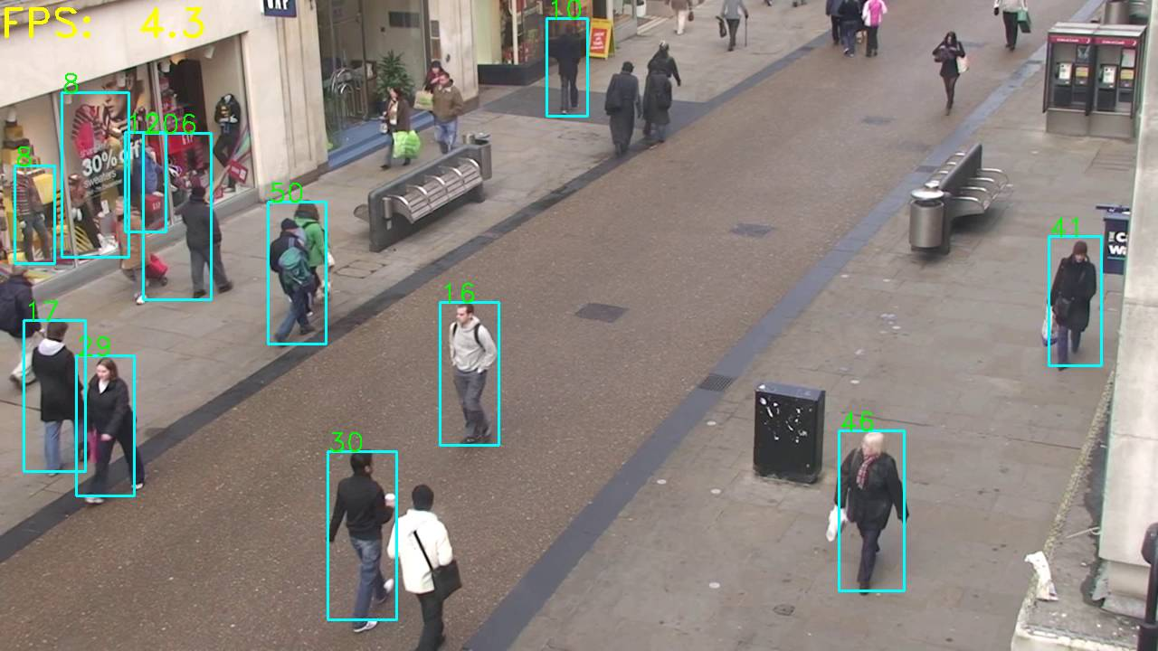
14.1 Object Detection
14.1.1 Face detection
14.1.2 Pedestrian detection

Slide 14
14.1.1 Face Detection
Feature-based
Find the locations of distinctive image features such as the eyes, nose, and mouth, and then verify whether these features are in a plausible geometrical arrangement.
Template-based
Active Appearance Models (AAMs) (Section 14.2.2) deal with a wide range of pose and expression variability.
Appearance-based
Scan over small overlapping rectangular patches of the image searching for likely face candidates
Notes:
In order to deal with scale variation, the image is usually converted into a sub-octave pyramid and a separate scan is performed on each level. Most appearance-based approaches today rely heavily on training classifiers using sets of labeled face and non-face patches.

Slide 15
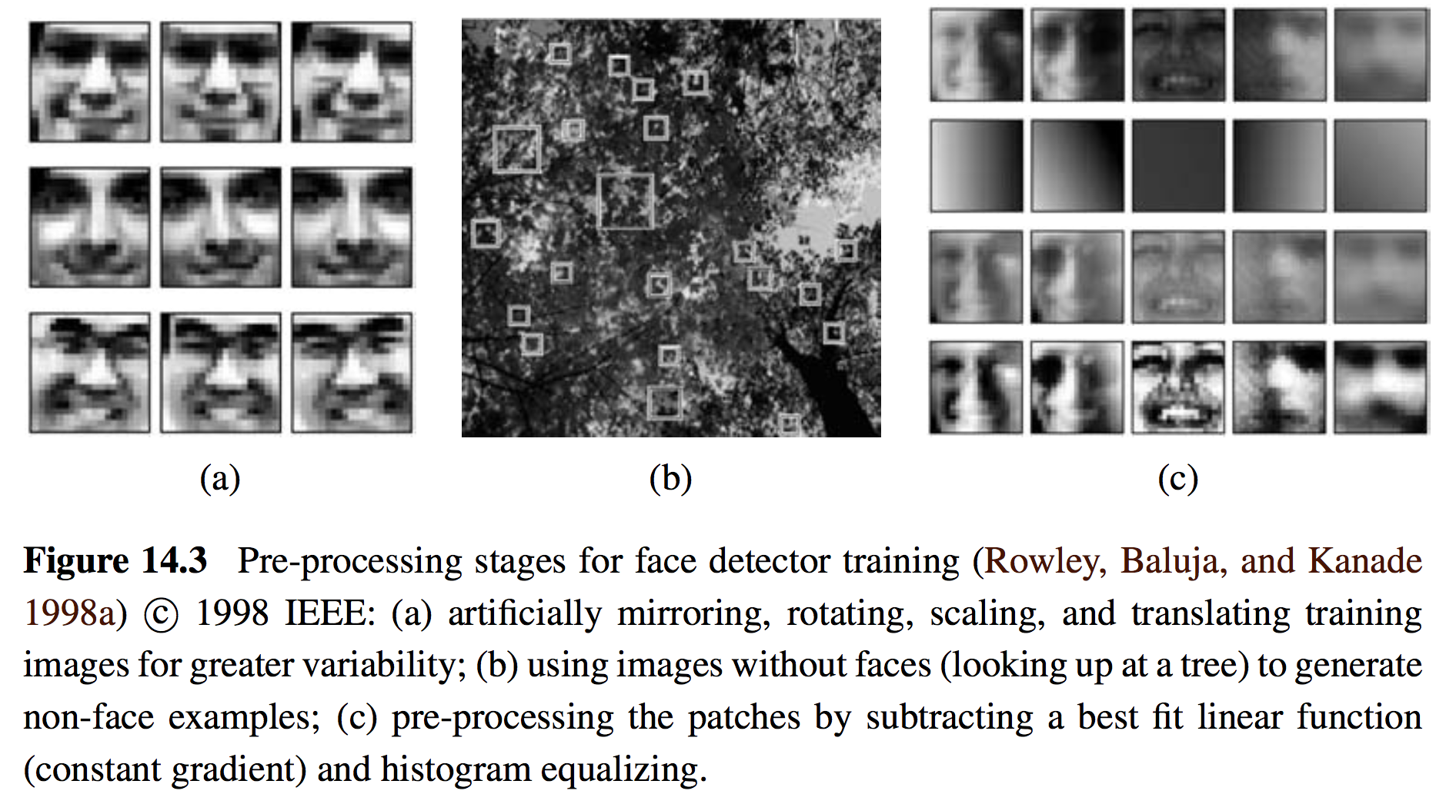

Slide 16
Model
Clustering and Principal Component Analysis (PCA)
Neural Networks
Support Vector Machine (SVM)
Adaptive Boosting (AdaBoost)

Slide 17
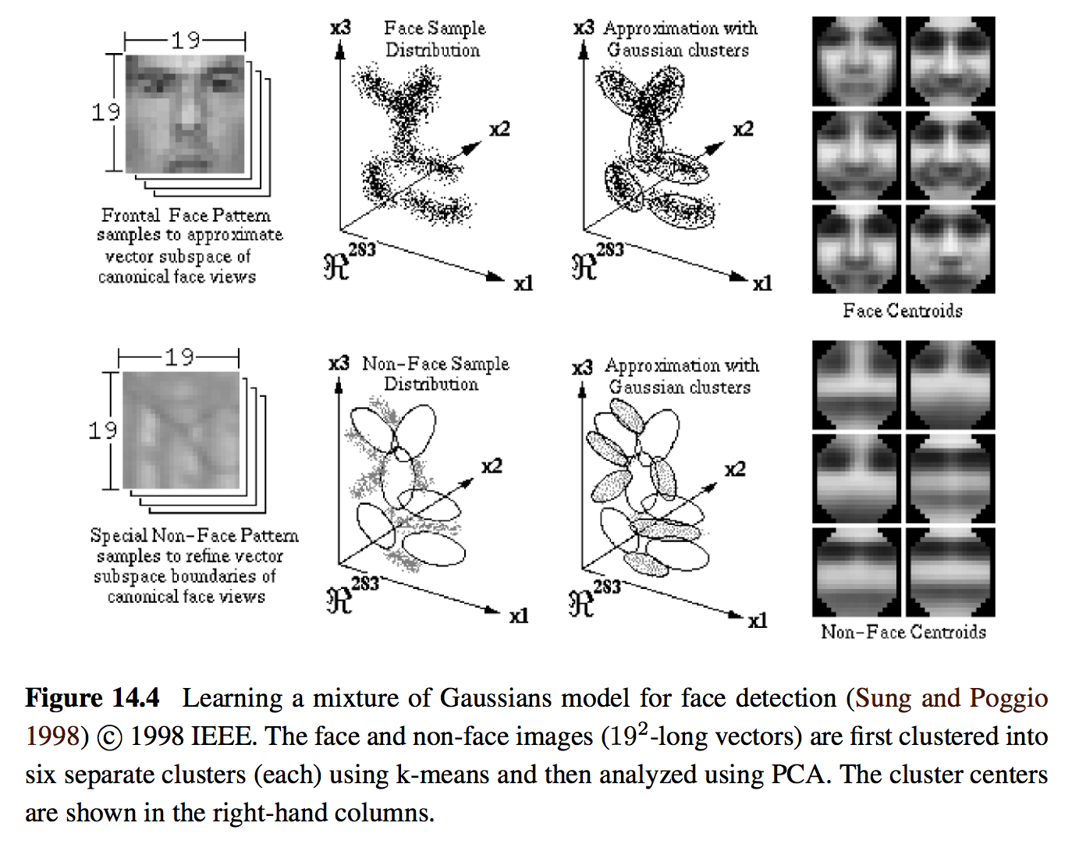
Clustering and PCA

Slide 18
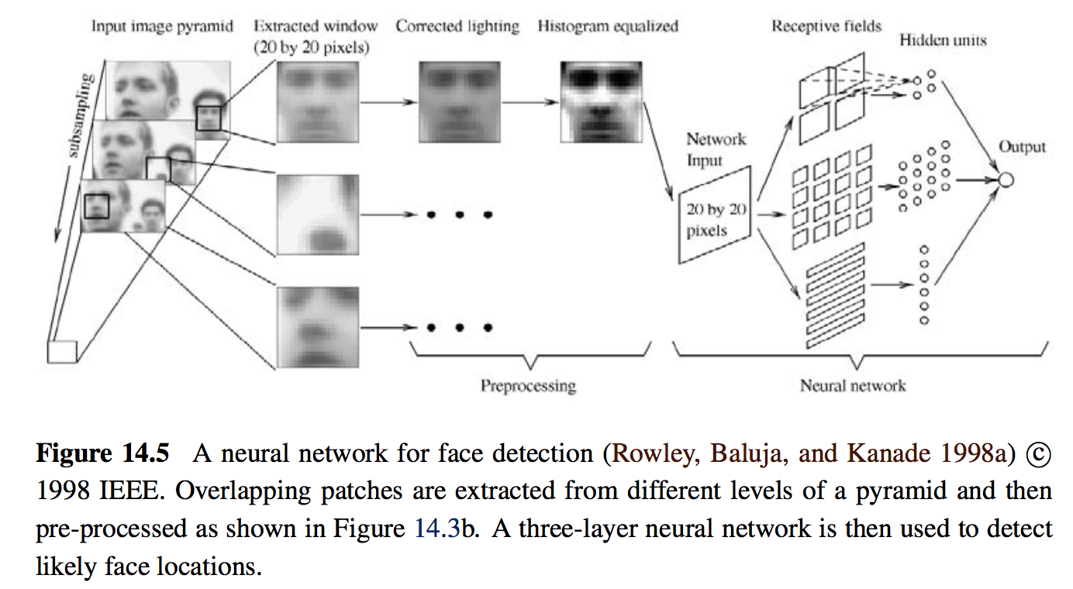
Neural Networks

Slide 19
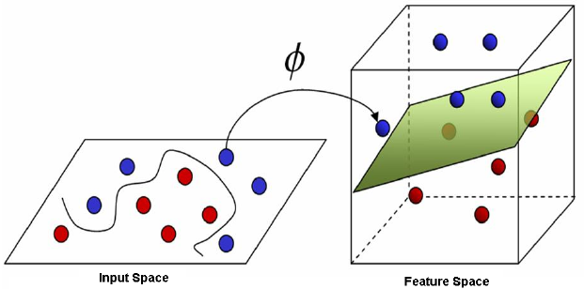
SVM
The feature space can be lifted into higher-dimensional features using kernels

Slide 20
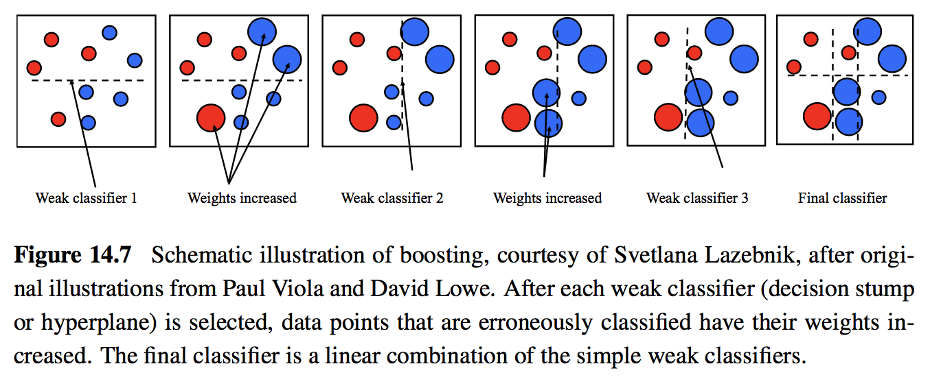
Boosting

Slide 21
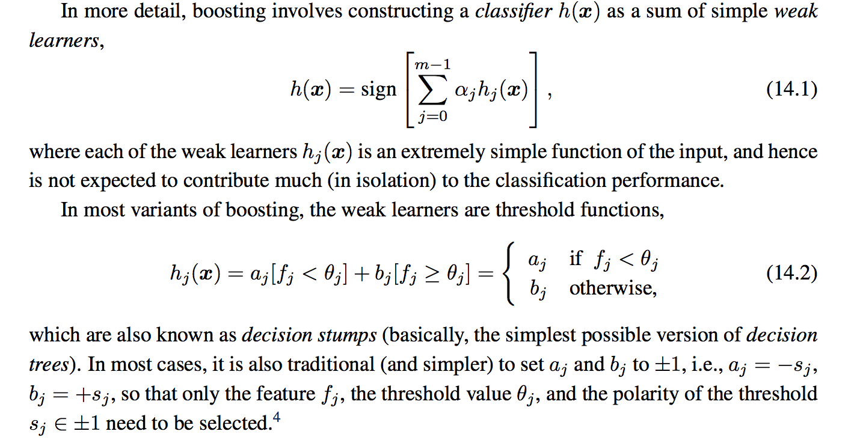
Boosting (Warning of Mathematics)

Slide 22
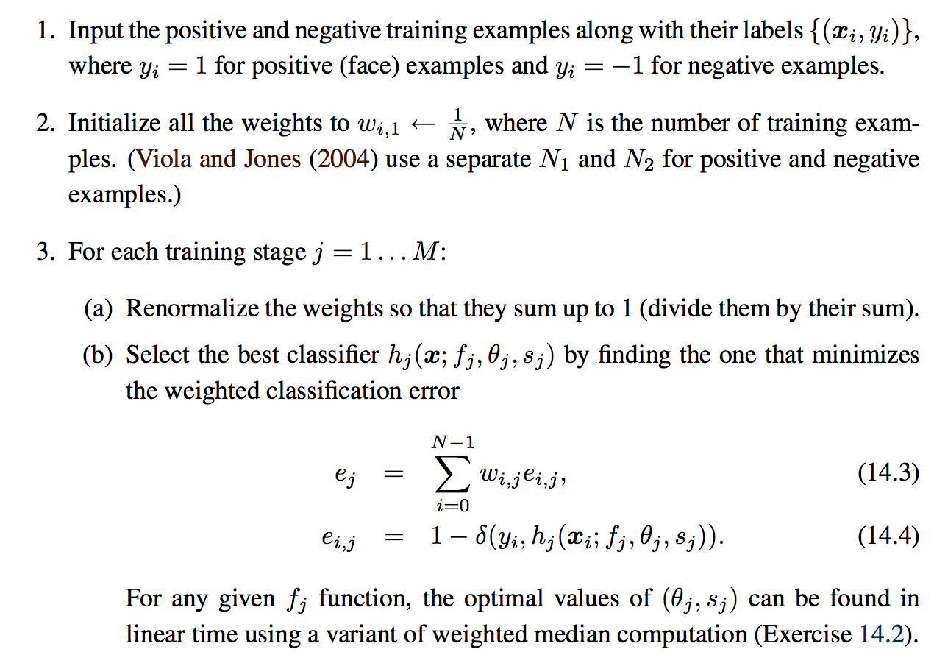
Adaptive Boosting (Warning of Mathematics)

Slide 23
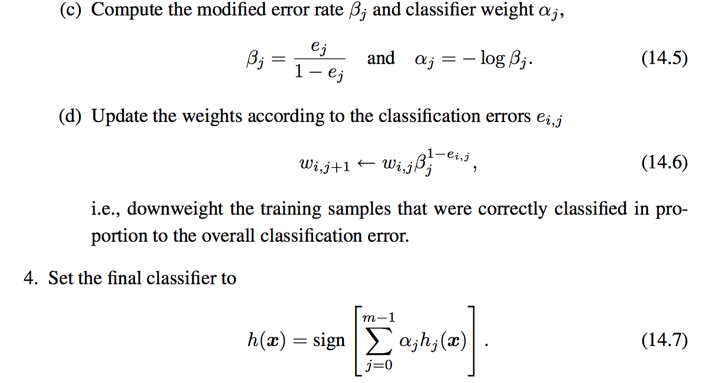
Adaptive Boosting (Cont’d)

Slide 24
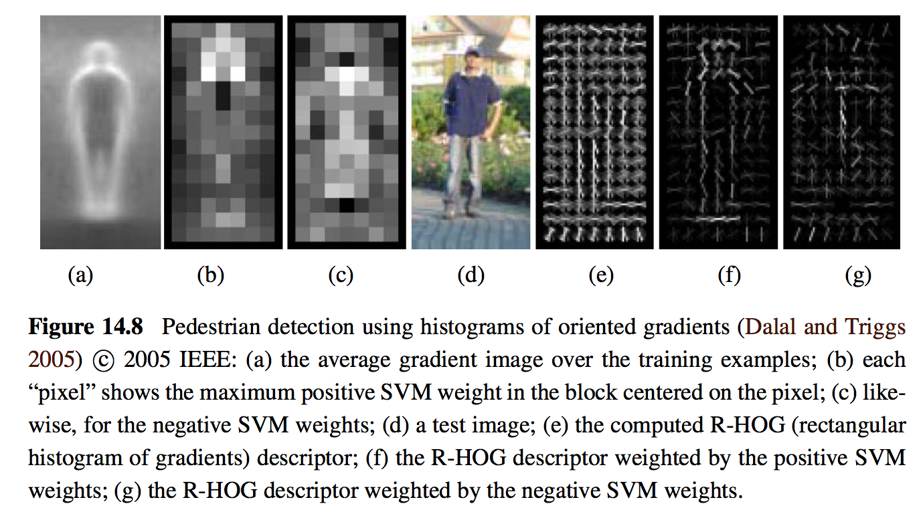
14.1.2 Pedestrian Detection
Notes:
An example of a well-known pedestrian detector is the algorithm developed by Dalal and Triggs (2005), who use a set of overlapping histogram of oriented gradients (HOG) de- scriptors fed into a support vector machine (Figure 14.8). Each HOG has cells to accumulate magnitude-weighted votes for gradients at particular orientations, just as in the scale invariant feature transform (SIFT) developed by Lowe (2004), which we discussed in Section 4.1.2 and Figure 4.18. Unlike SIFT, however, which is only evaluated at interest point locations, HOGs are evaluated on a regular overlapping grid and their descriptor magnitudes are normalized using an even coarser grid; they are only computed at a single scale and a fixed orientation. In order to capture the subtle variations in orientation around a person’s outline, a large number of orientation bins is used and no smoothing is performed in the central difference gradient computation see the work of Dalal and Triggs (2005) for more implementation details.

Slide 25
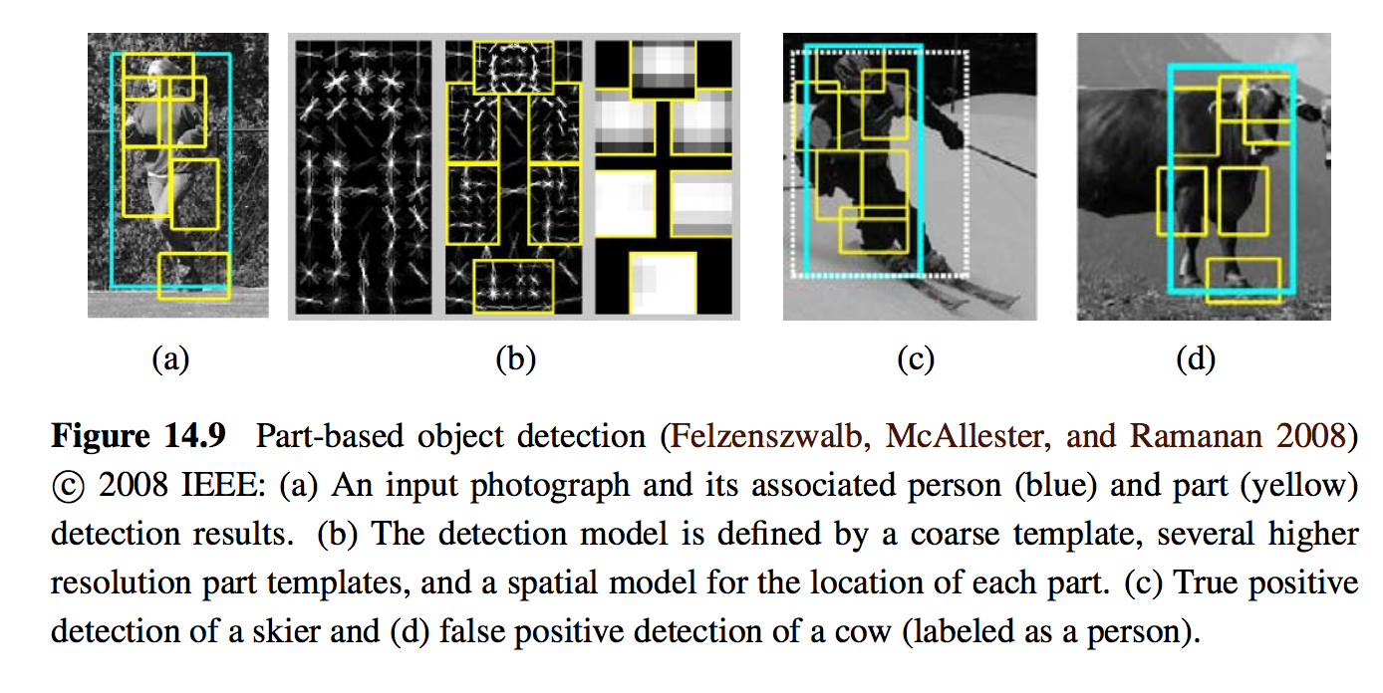
The extension of the oriented gradients person detector: Part-based object detection

Slide 26
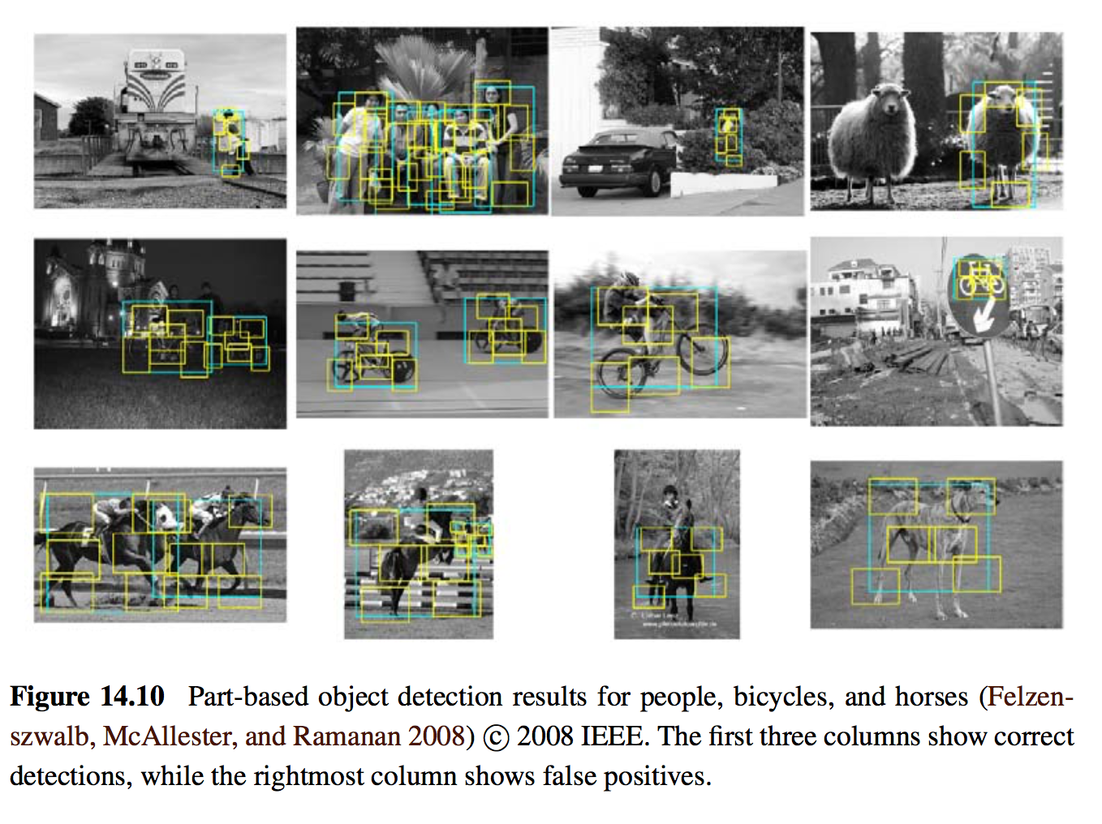

Slide 27
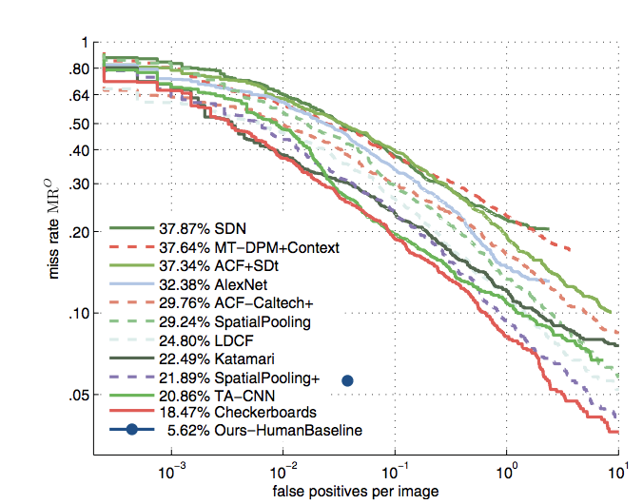
How Far Are We from Solving Pedestrian Detection? (CVPR’16)
Shanshan Zhang, Rodrigo Benenson, Mohamed Omran, Jan Hosang and Bernt Schiele. How Far are We from Solving Pedestrian Detection? CVPR 2016

Slide 28
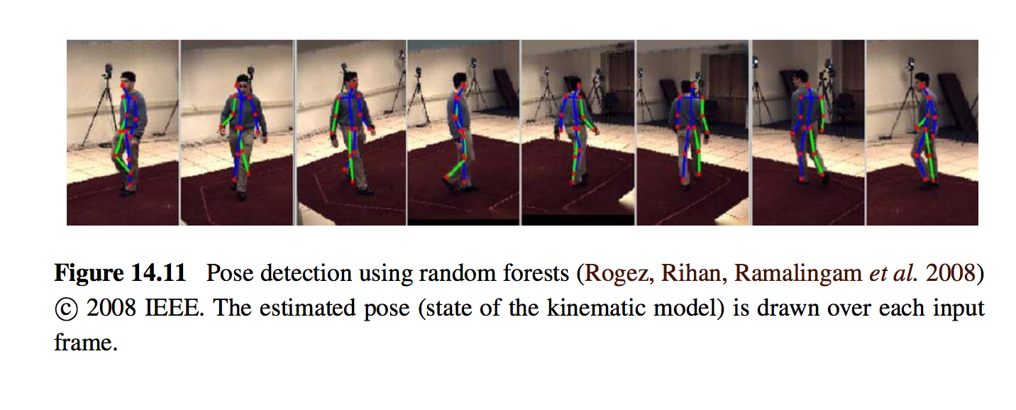
Person’s pose and location

Slide 29
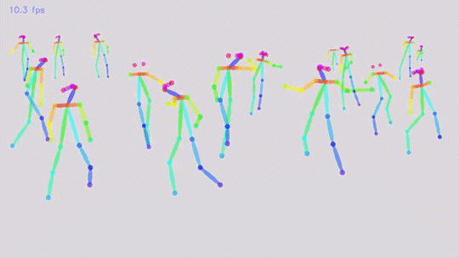
Real-time Multi-Person 2D Pose Estimation using Part Affinity Fields (CVPR’ 17)
Zhe Cao and Tomas Simon and Shih-En Wei and Yaser Sheikh. Realtime Multi-Person 2D Pose Estimation using Part Affinity Fields. CVPR 2017

Slide 30
Content
Introduction to recognition
Object detection
Face recognition
Instance recognition
Category recognition
Context and scene understanding

Slide 31
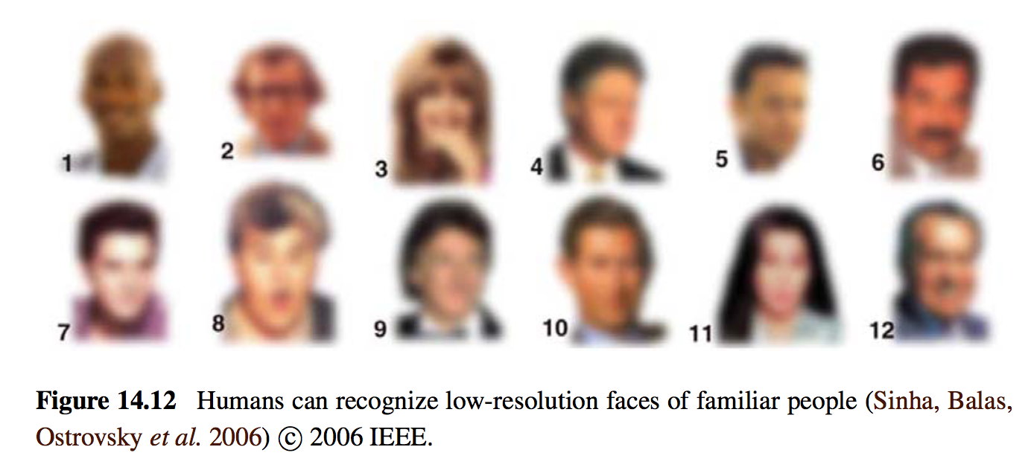
14.2 Face recognition
14.2.1 Eigenfaces
14.2.2 Active appearance and 3D shape models
14.2.3 Application: Personal photo collections

Slide 32
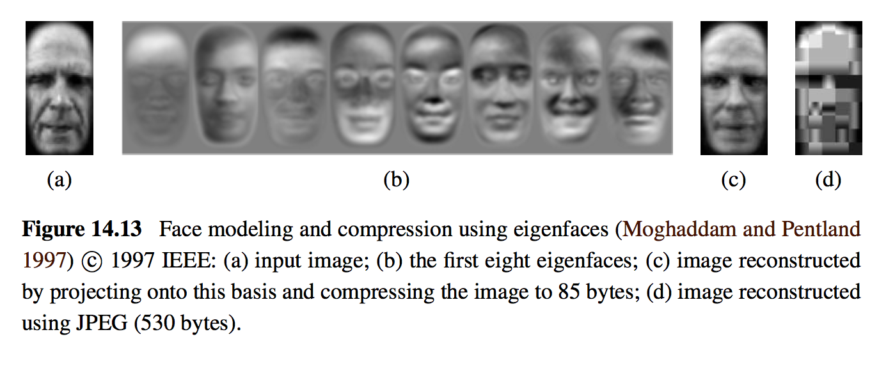
14.2.1 Eigenfaces
JPEG: Joint Photographic Experts Group
IEEE: Institute of Electrical and Electronics Engineers

Slide 33
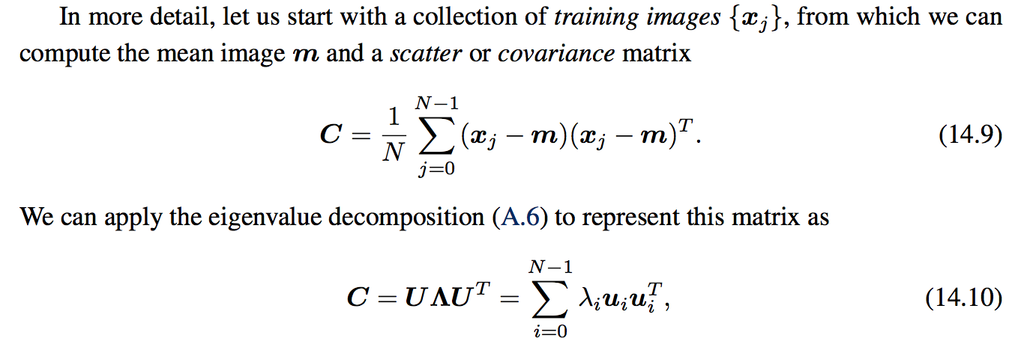
Eigenfaces
SVD: Singular Value Decomposition

Slide 34
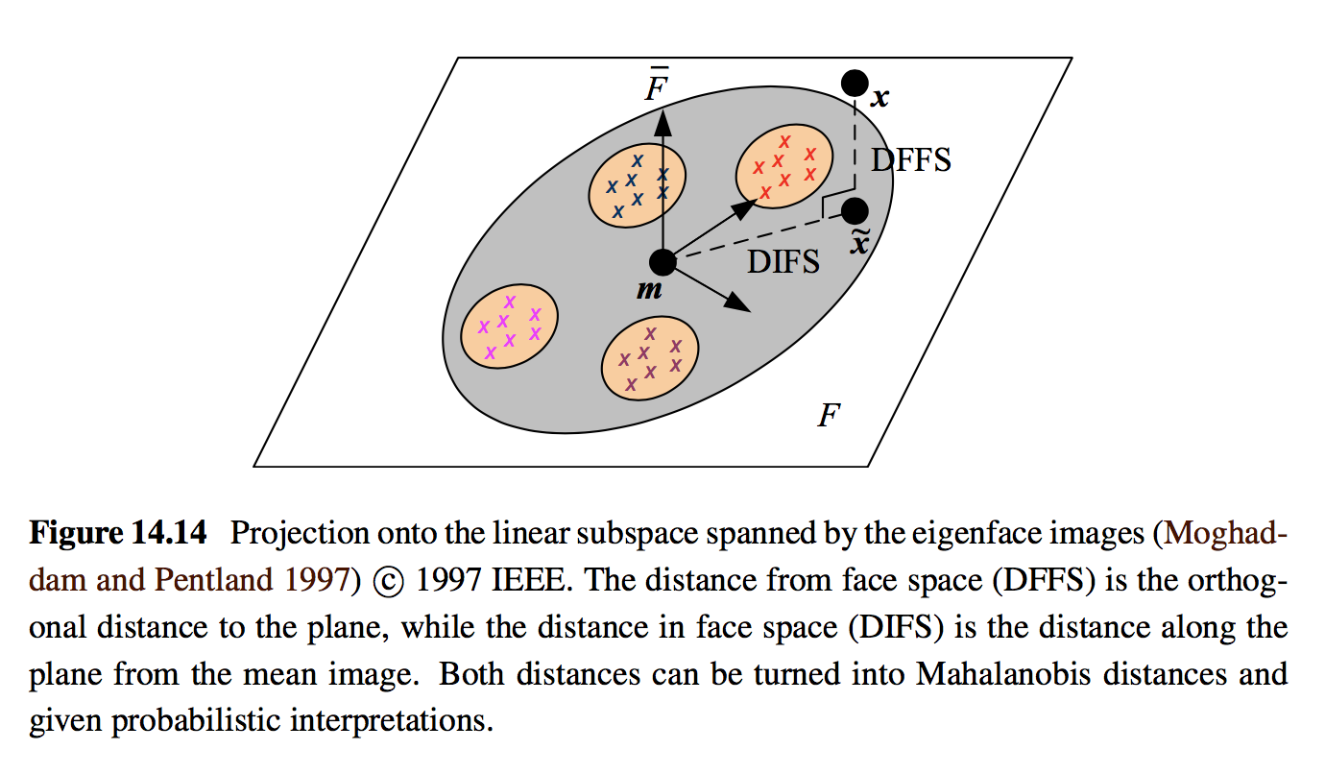

Slide 35
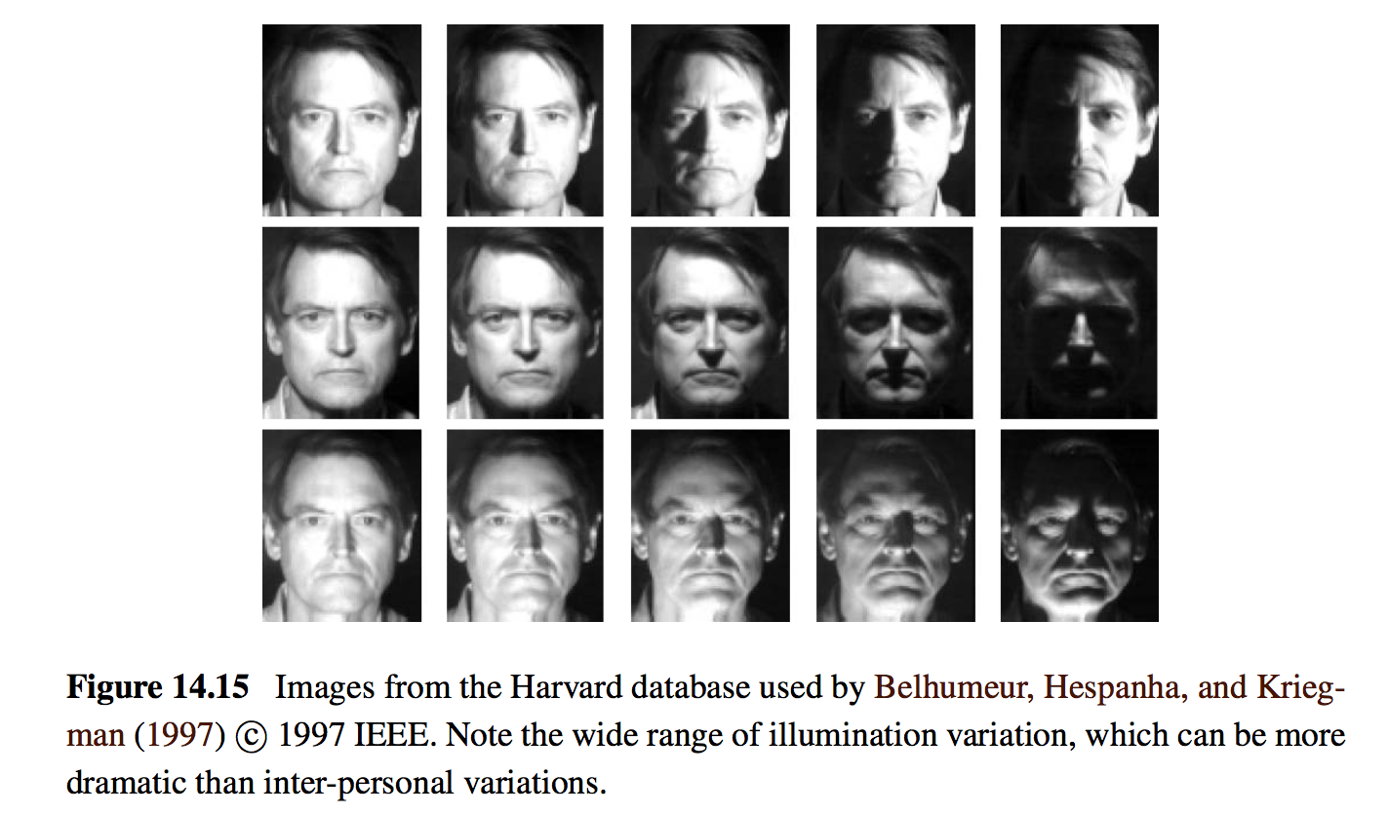
What’s problem with PCA?
Notes:
Consider the set of images of one person taken under a wide range of illuminations shown in Figure 14.15. As you can see, the intrapersonal variability within these images is much greater than the typical extrapersonal variability between any two people taken under the same illumination. Regular PCA analysis fails to distinguish between these two sources of variability and may, in fact, devote most of its principal components to modeling the intrap- ersonal variability.

Slide 36
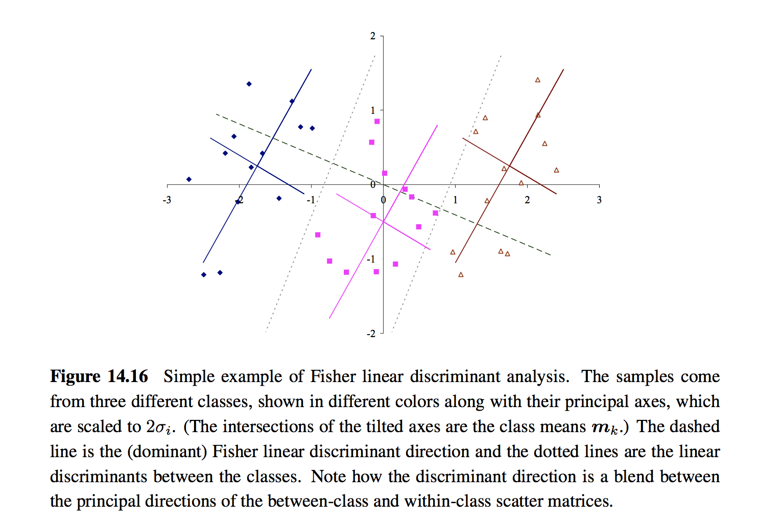

Slide 37
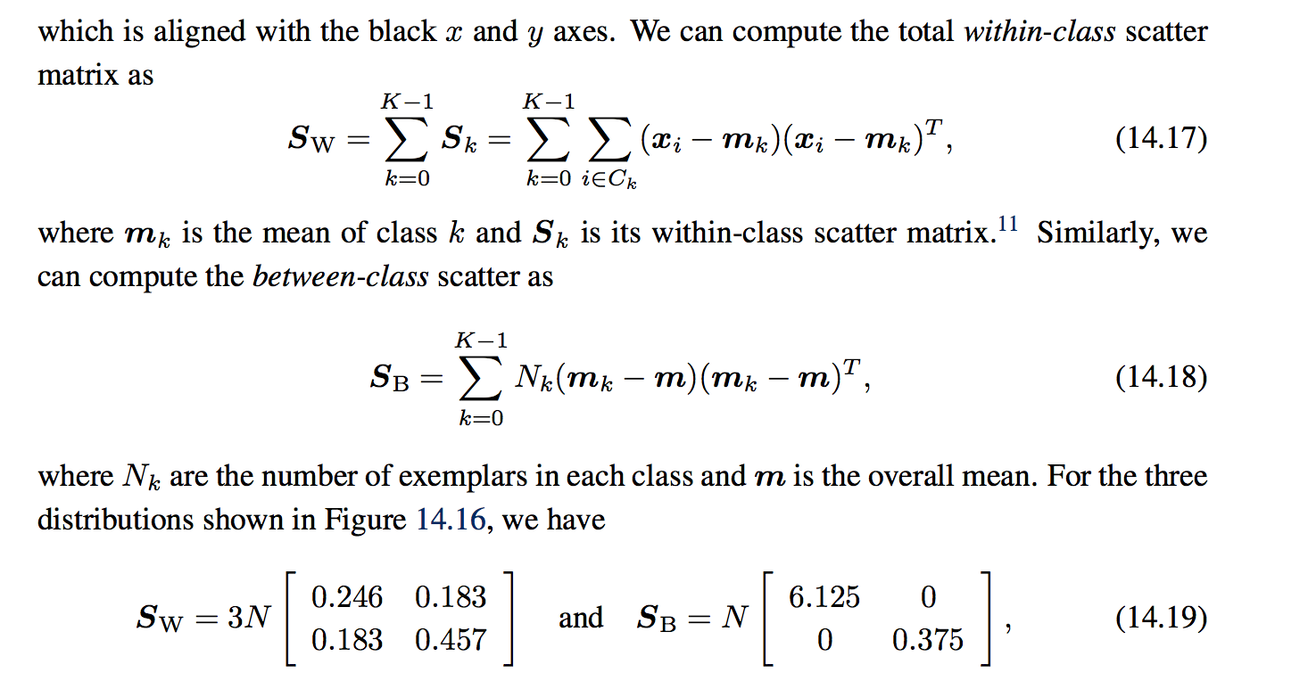
Improved PCA: Fisher’s linear discriminant (FLD)

Slide 38
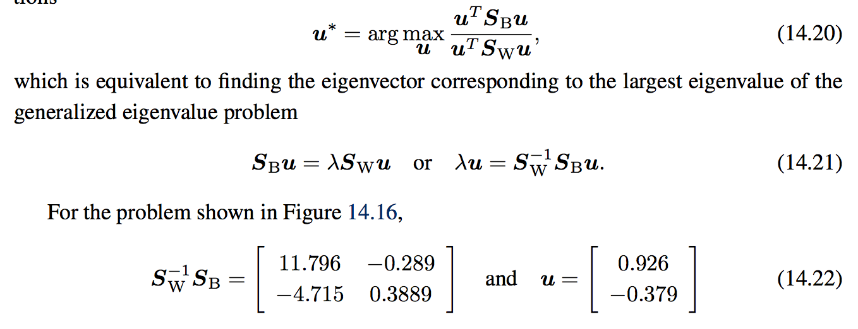

Slide 39
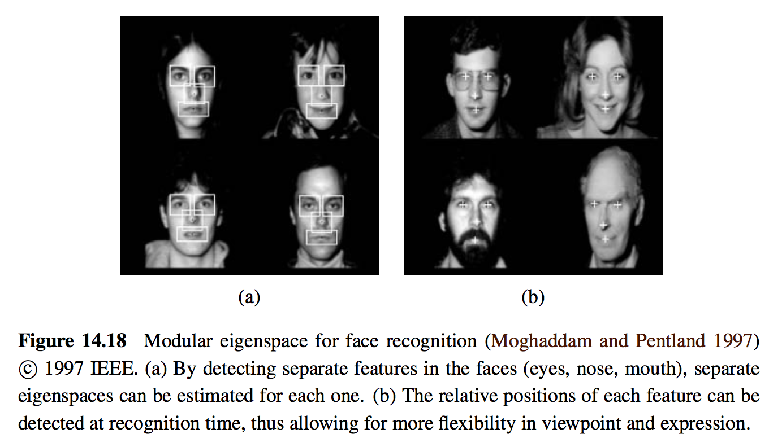

Slide 40
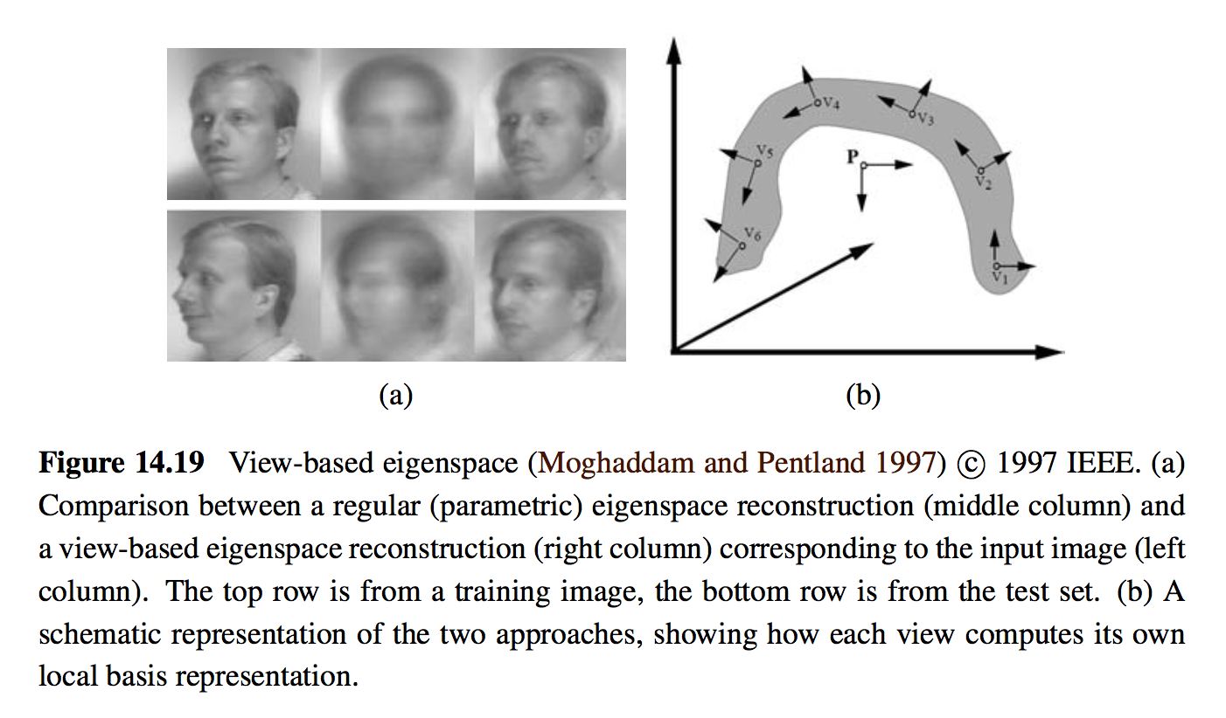
Large training data

Slide 41
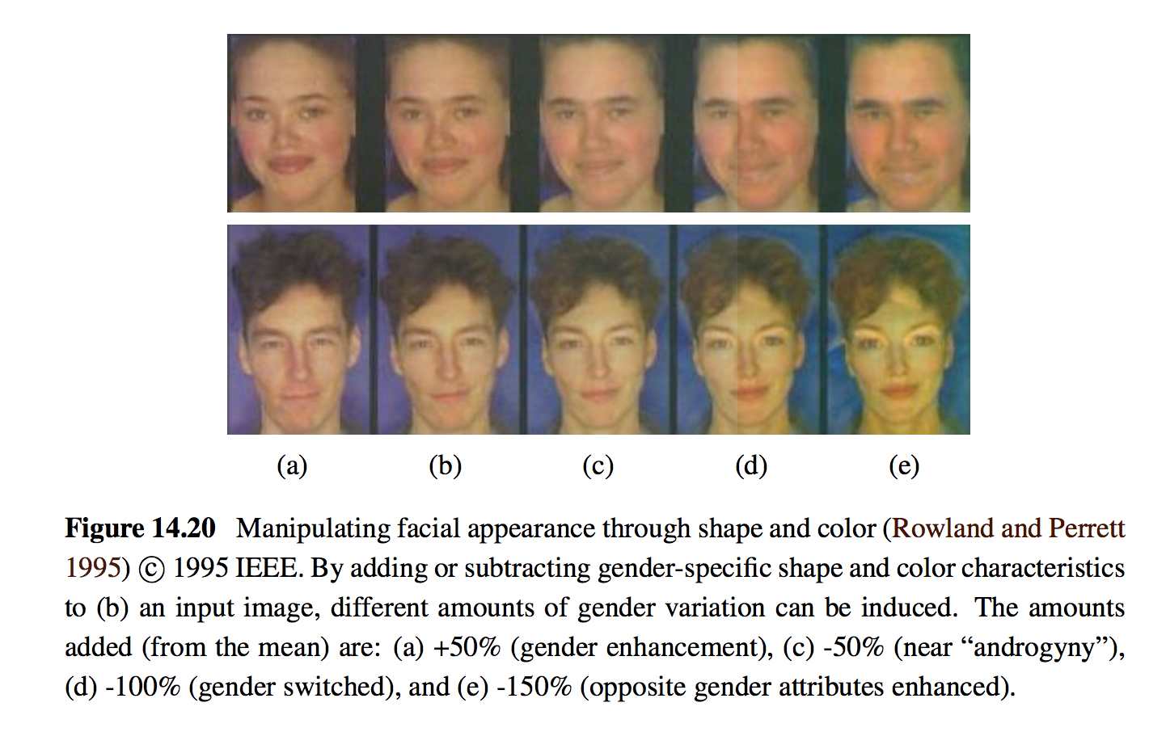
14.2.2 Active appearance and 3D shape models

Slide 42
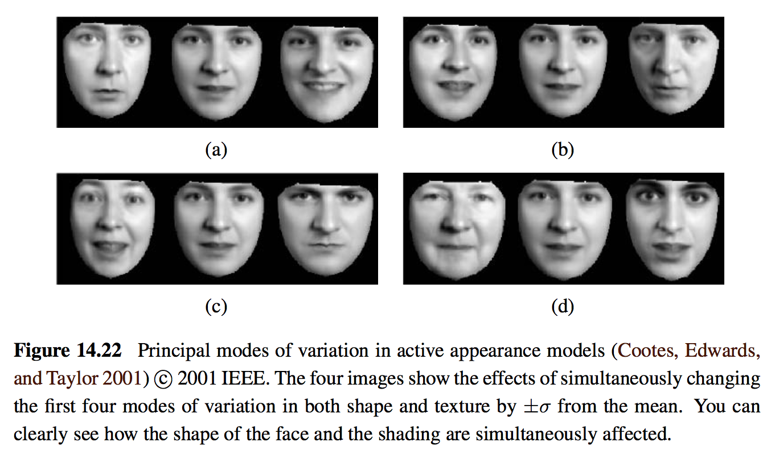

Slide 43
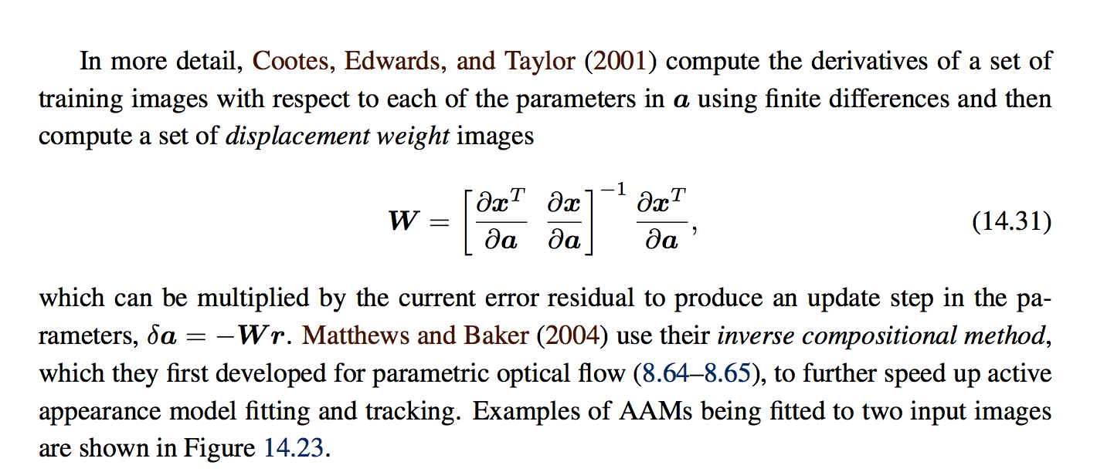
AAM: Active Appearance Model

Slide 44
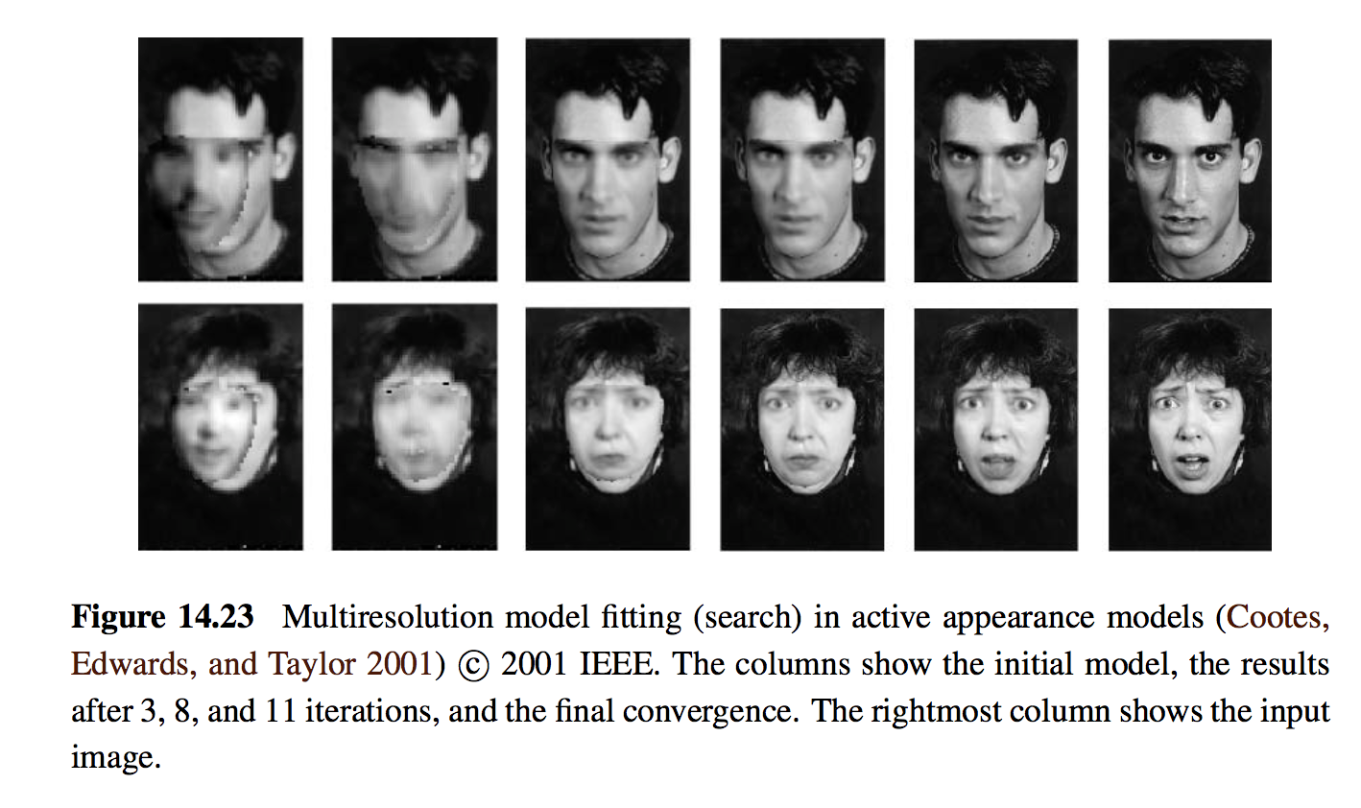

Slide 45
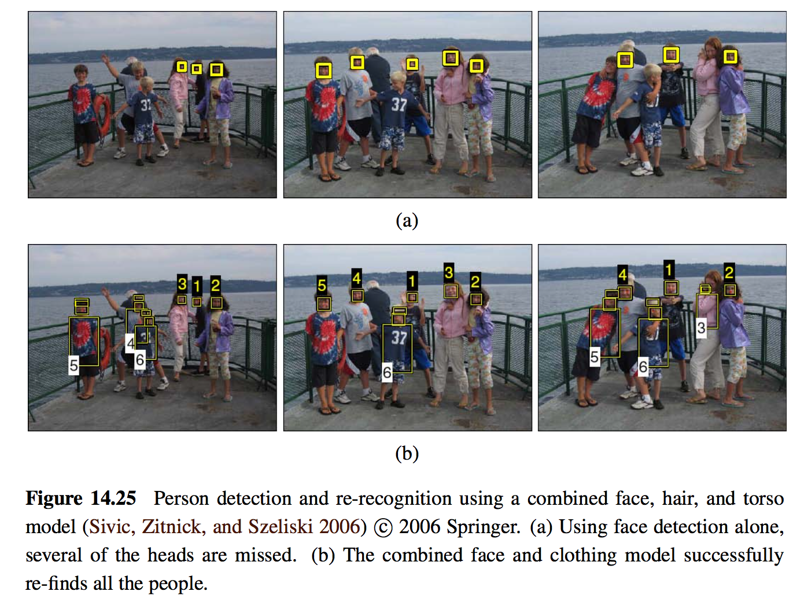
14.2.3 Application: Personal photo collections

Slide 46
Content
Introduction to recognition
Object detection
Face recognition
Instance recognition
Category recognition
Context and scene understanding

Slide 47
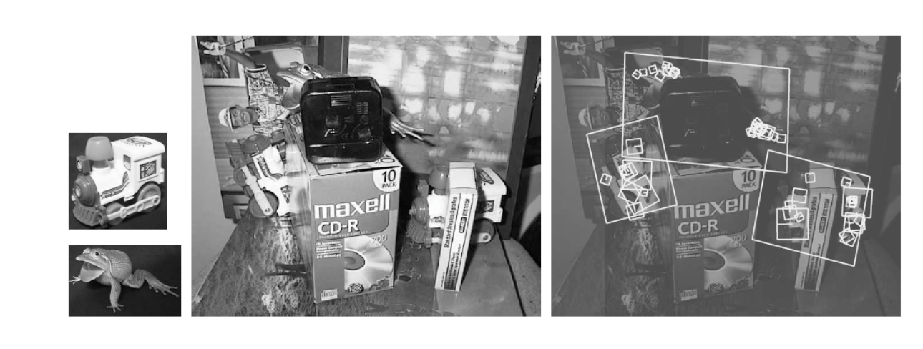
14.3 Instance recognition
14.3.1 Geometric alignment
14.3.2 Large databases
14.3.3 Application: Location recognition

Slide 48
14.3.1 Geometric alignment
Extracts a set of interest points in each database image and stores the associated descriptors (and original positions) in an indexing structure such as a search tree
At recognition time, features are extracted from the new image and compared against the stored object features.

Slide 49
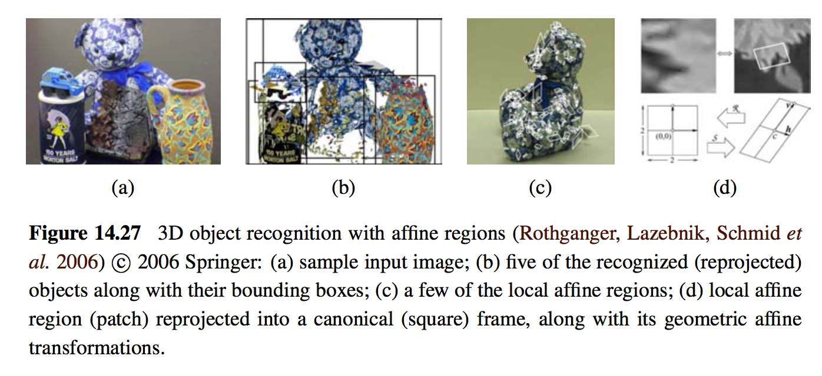

Slide 50
14.3.2 Large databases
The problem of quickly finding partial matches between documents is one of the central problems in information retrieval (IR)
The basic approach in fast document retrieval algorithms is to pre-compute an inverted index between individual words and the documents (or Web pages or news stories) where they occur.
The frequency of occurrence of particular words in a document is used to quickly find documents that match a particular query.

Slide 51
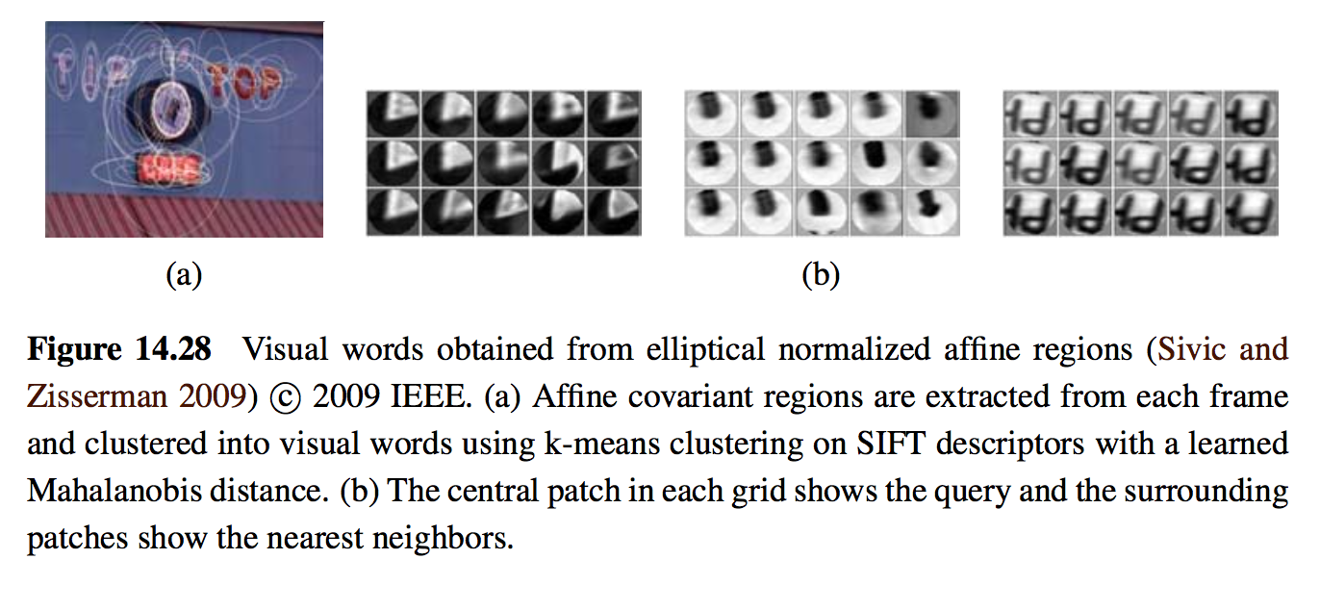
SIFT: Scale-Invariant Feature Transform

Slide 52
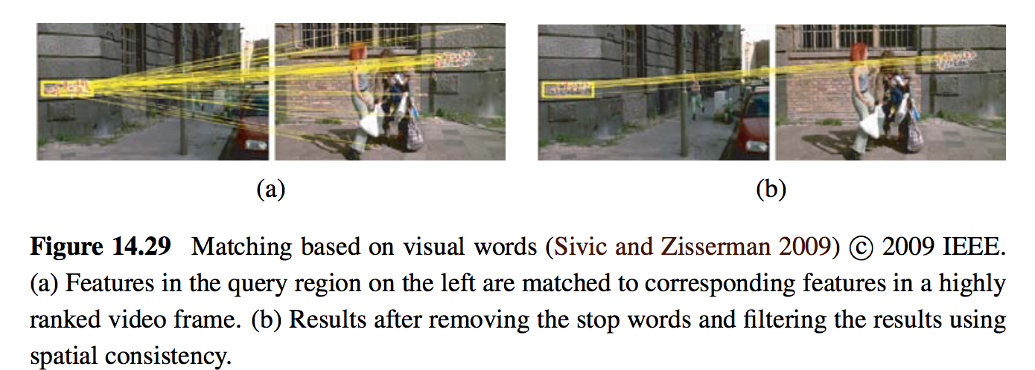

Slide 53
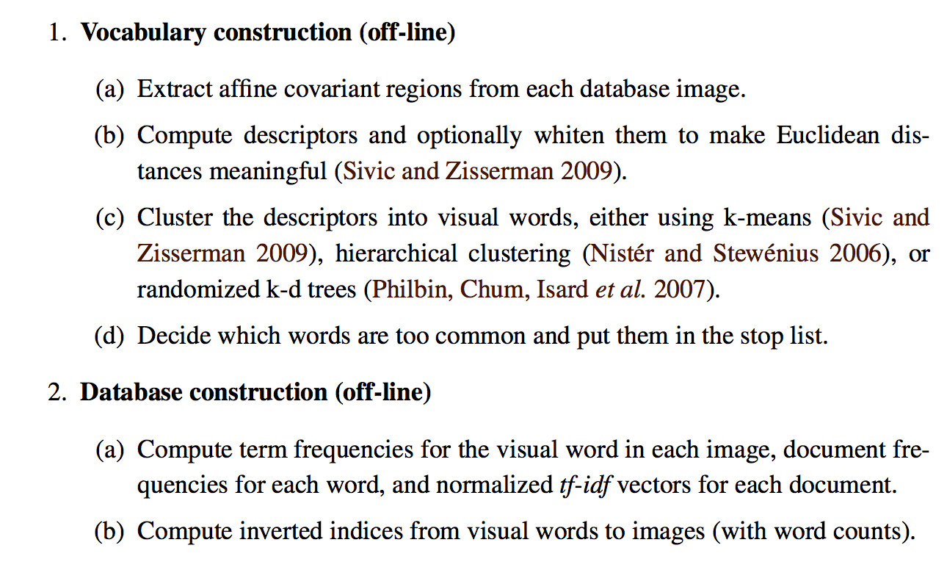
Image retrieval using visual words
TF-IDF: Term Frequency–Inverse Document Frequency

Slide 54
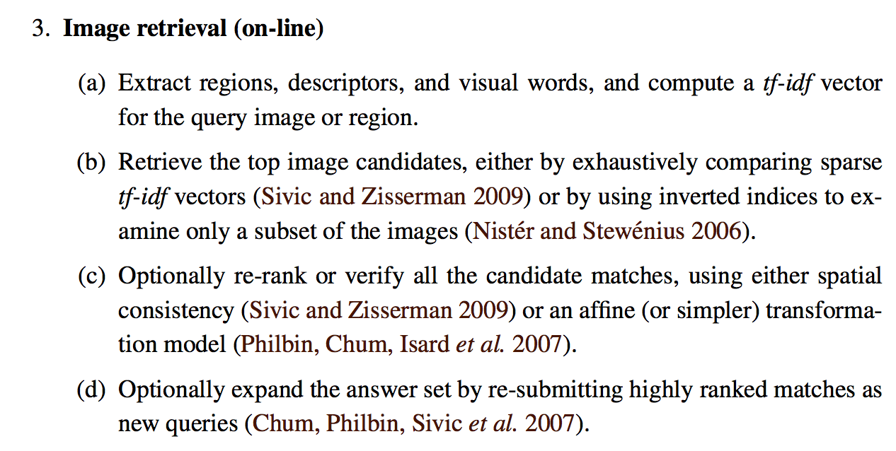

Slide 55
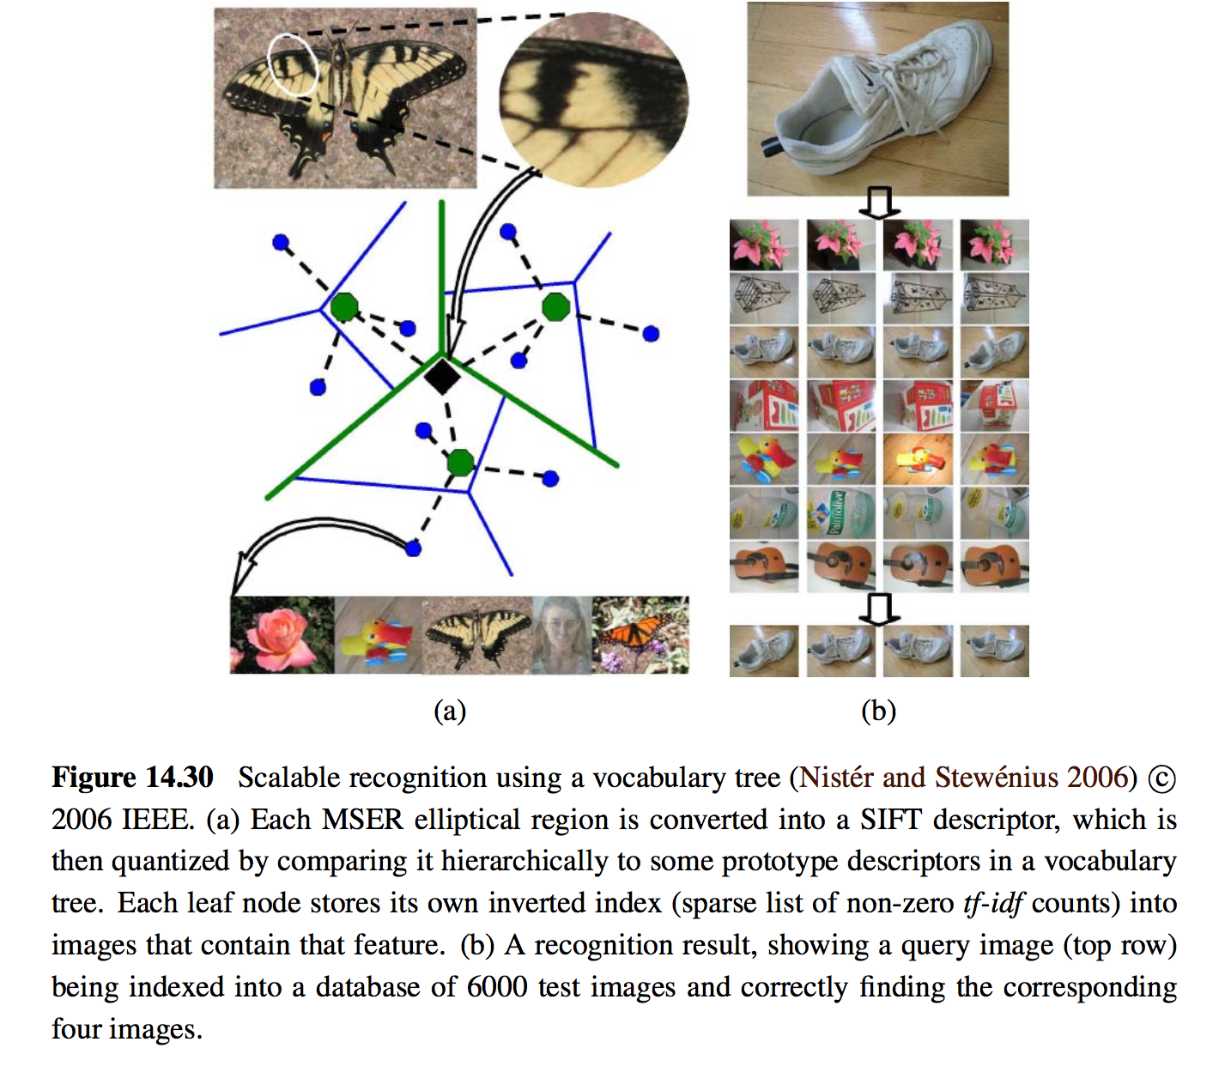
MSER: Maximally Stable Extremal Regions

Slide 56
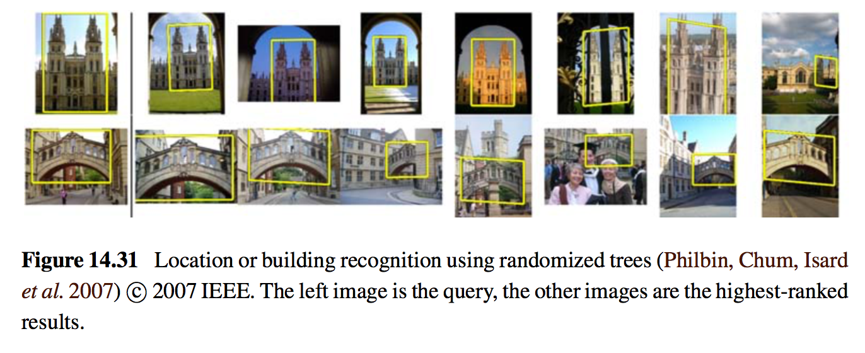
14.3.3 Application: Location recognition

Slide 57
Content
Introduction to recognition
Object detection
Face recognition
Instance recognition
Category recognition
Context and scene understanding

Slide 58
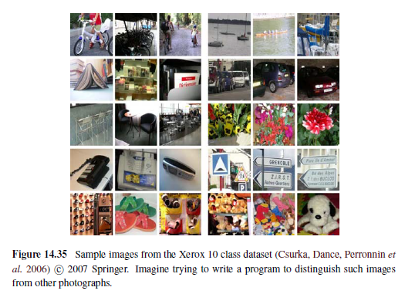
14.4 Category recognition
14.4.1 Bag of words
14.4.2 Part-based models
14.4.3 Recognition with segmentation
14.4.4 Application: Intelligent photo editing

Slide 59
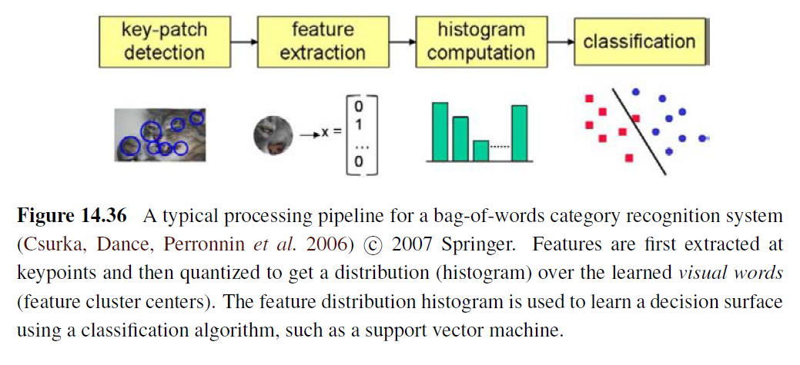
14.4.1 Bag of words

Slide 60
14.4.1 Bag of words
Simply computes the distribution (histogram) of visual words found in the query image and compares this distribution to those found in the training images.

Slide 61
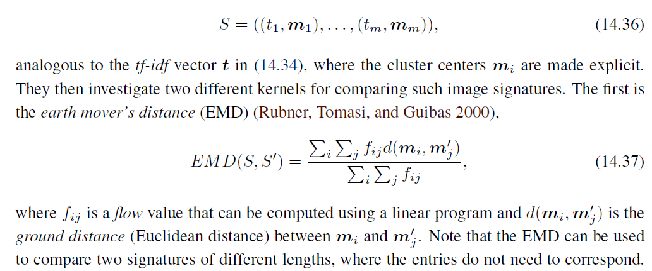
To estimate distances for the kernel function: form an image signature

Slide 62
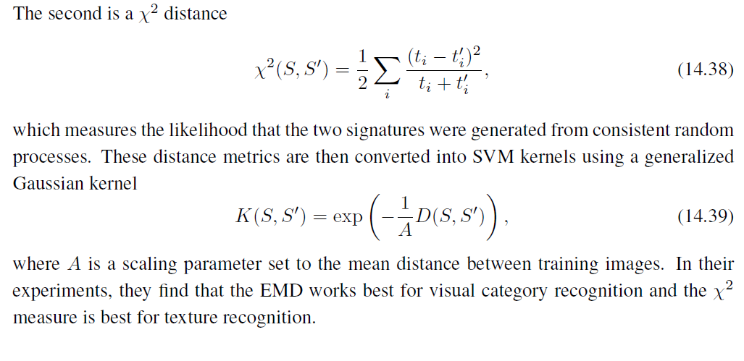

Slide 66
14.4.2 Part-based models

Slide 67
Pictorial structures

Slide 71
14.4.3 Recognition with segmentation

Slide 75
14.4.4 Application: Intelligent photo editing

Slide 76
Content
Introduction to recognition
Object detection
Face recognition
Instance recognition
Category recognition
Context and scene understanding

Slide 77
14.5 Context and scene understanding
14.5.1 Learning and large image collections
14.5.2 Application: Image search

Slide 78
14.5 Context and scene understanding

Slide 81
14.5.1 Learning and large image collections

Slide 83
14.5.2 Application: Image search
Visual features and visual similarity
Content-based image retrieval (CBIR)
Feature-based learning

Slide 84
Jokes
Substitute teacher: https://www.youtube.com/watch?v=zRpsRKuyi3Y
Friends: https://www.youtube.com/watch?v=V_eRt3Mp1_w&list=PL0B373664BB976D46
Big Bang https://www.youtube.com/watch?v=C8lMW0MODFs&list=RD8xn-Rb0jejo&index=4

