Slide 1
Advanced Computer Vision
Chapter 13
3D Reconstruction
Presented by: 傅楸善 & 方郁婷
0933 826 120
r10922196@ntu.edu.tw
指導教授: 傅楸善

Slide 2
Before Start…
123D Catch for iOS 7
Capture: 3D Scan Anything
holoportation: virtual 3D teleportation in real-time

Slide 3
13 3D reconstruction
13.1 Shape from X
13.2 3D scanning
13.3 Surface representations
13.4 Point-based representations
13.5 Volumetric representations
13.6 Model-based reconstruction
13.7 Recovering texture maps and albedos
IEEE: Institute of Electrical and Electronic Engineers
ACM: Association for Computing Machinery

Slide 4
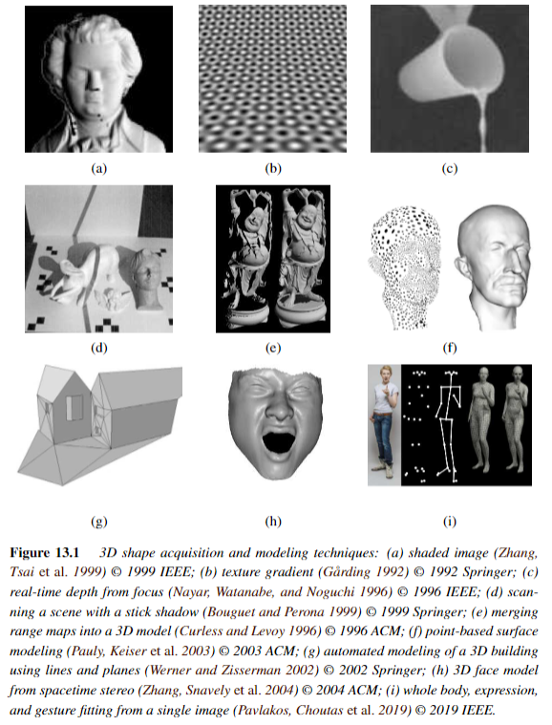

Slide 5
13.1 Shape from X
What is “Shape from X”?
- The study of how shape can be inferred from such cues like shading, texture, focus is sometimes called shape from X.
Shape from shading
Shape from texture
Shape from focus

Slide 6
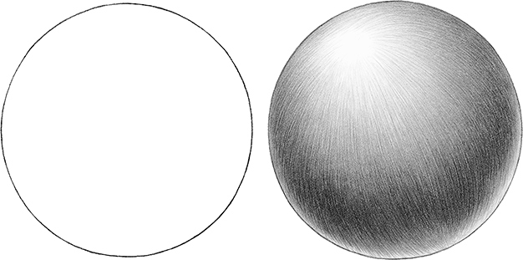
13.1.1 Shape from shading and photometric stereo
Notes:
可從陰影感受到立體

Slide 7
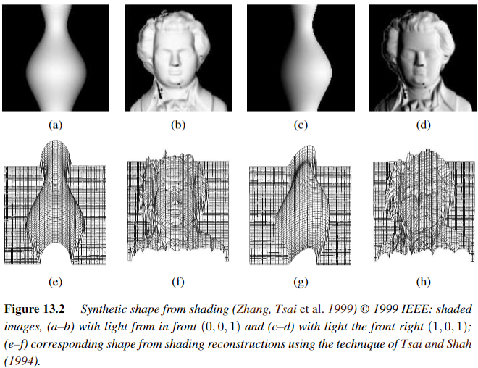
13.1.1 Shape from shading and photometric stereo

Slide 8
13.1.1 Shape from shading and photometric stereo
How is this possible?
The answer is that as the surface normal changes across the object, the apparent brightness changes as a function of the angle between the local surface orientation and the incident illumination.
Notes:
incident: 【物】入射的 ; 事件；伴隨而來的
incident illumination: 入射照明

Slide 9
13.1.1 Shape from shading and photometric stereo

Slide 10
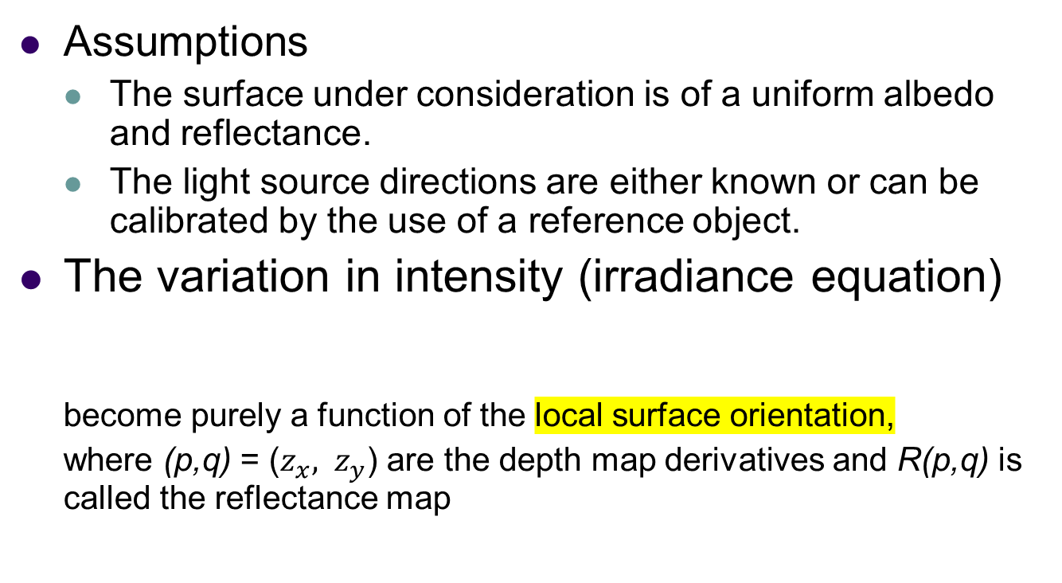
13.1.1 Shape from shading and photometric stereo
Notes:
Derivative 倒數
Irradiance 輻照度 ; 發光

Slide 11
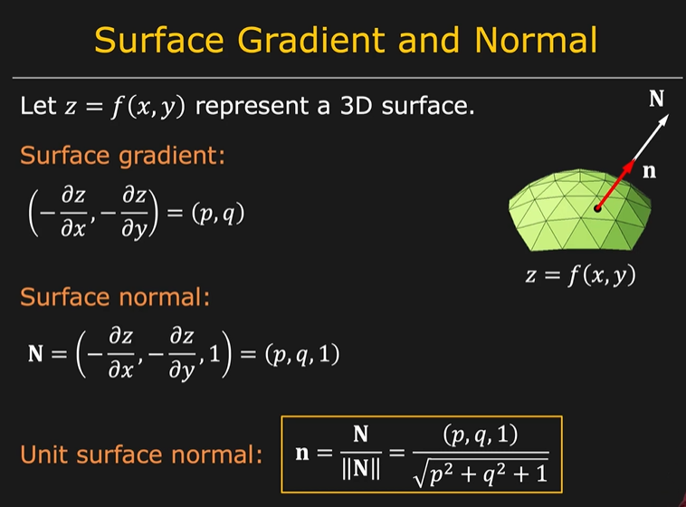
13.1.1 Shape from shading and photometric stereo
https://www.youtube.com/watch?v=6-bElBHXhOQ

Slide 12
13.1.1 Shape from shading and photometric stereo
Lambertian Surface
Light falling on it is scattered such that the apparent brightness of the surface to an observer is the same regardless of the observer's angle of view
DC & CV Lab.
CSIE NTU
Notes:
12
朗伯表面具有以下兩種性質。第一、不論表面被光如何照射，在所有的觀測方向上都是呈現相
同輝度，即輝度是與方向無關的常數。第二、如果所有入射光都被反射，無任何吸收，則又稱為完
美反射漫射體(perfect reflecting diffuser)。

Slide 13
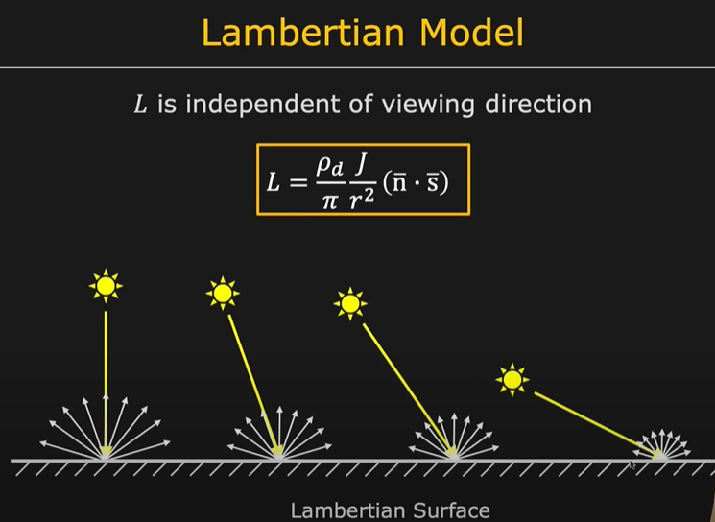
13.1.1 Shape from shading and photometric stereo
https://www.youtube.com/watch?v=6-bElBHXhOQ
DC & CV Lab.
CSIE NTU
Notes:
13
朗伯表面具有以㆘兩種性質。第㆒、不論表面被光如何照射，在所有的觀測方向㆖都是呈現相
同輝度，即輝度是與方向無關的常數。第㆓、如果所有入射光都被反射，無任何吸收，則又稱為完
美反射漫射體(perfect reflecting diffuser)。

Slide 14
13.1.1 Shape from shading and photometric stereo
For example, a diffuse (Lambertian) surface has a reflectance map that is the (non-negative) dot product (2.89) between the surface normal:
and the light source direction:
where is the surface reflectance factor (albedo).
Albedo: Reflection Coefficient
Notes:
朗伯表面具有以下兩種性質。
第一、不論表面被光如何照射，在所有的觀測方向上都是呈現相同亮度，即亮度是與方向無關的常數。
第二、如果所有入射光都被反射，無任何吸收，則又稱為完美反射漫射體(perfect reflecting diffuser)。

Slide 15
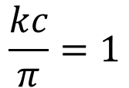

Reflectance Map - RECAP
Relates image irradiance I(x,y) to surface orientation (p,q) for given source direction and surface reflectance
Lambertian case:
: source brightness
: surface albedo (reflectance)
: constant (optical system)
Image irradiance:
Let
then

Slide 16
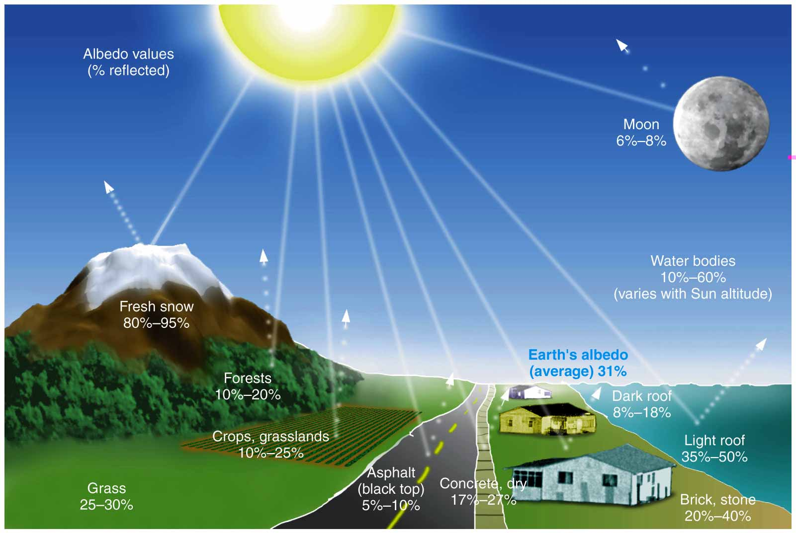
13.1.1 Shape from shading and photometric stereo

Slide 17
13.1.1 Shape from shading and photometric stereo
Photometric stereo:
Another way to make shape from shading more reliable is to use multiple light sources that can be selectively turned on and off.
For each light source, we have a different reflectance map, R1(p,q), R2(p,q), etc. Given the corresponding intensities I1, I2, etc. at a pixel, we can in principle recover both an unknown albedo ρ and a surface orientation estimate (p,q).
Notes:
立體光學法（Photometric Stereo）
為了彌補光度成形法中單張照片提供之資訊不足，立體光學法採用一個相機拍攝多張照片，這些照片的拍攝角度是相同的，其中的差別是光線的照明條件。最簡單的立體光學法使用三盞光源，從三個不同的方向照射待測物，每次僅開啟一盞光源。拍攝完成後再綜合三張照片並使用光學中的完美漫射（perfect diffusion）模型解出物體表面的梯度向量（gradients），經過向量場的積分後即可得到三維模型。此法並不適用於光滑而不近似於朗伯表面（Lambertian surface）的物體

Slide 18
Photometric Stereo
Lambertian case:
Image irradiance:
We can write this in matrix form:
Notes:
可以由多角度取光源亮度來推出albedo ρ和表面法向量(梯度向量（gradients）)

Slide 19
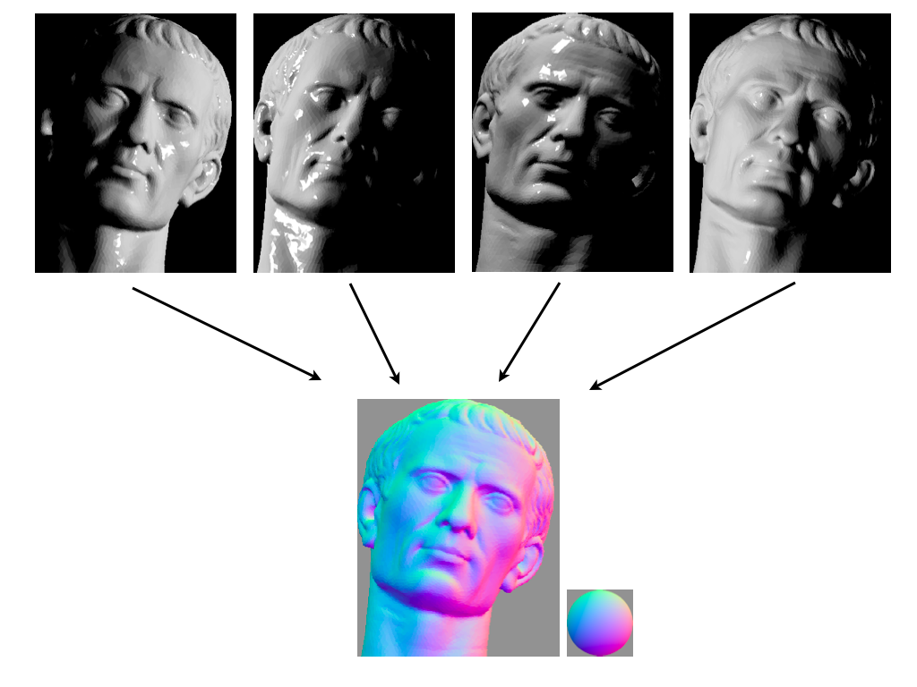

Slide 20
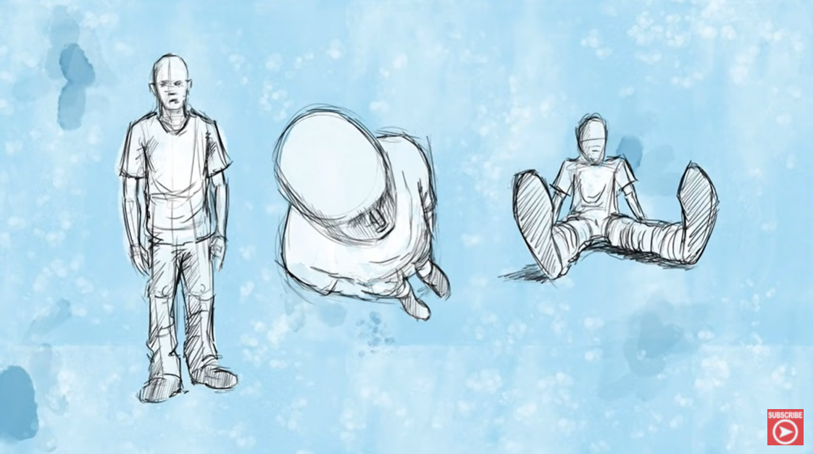
13.1.2 Shape from texture
Shape from texture
The foreshortening of regular patterns as the surface slants or bends away from the camera.
https://www.youtube.com/watch?v=XtRwwIuzqSw
Notes:
Foreshortening 正前縮距透視法

Slide 21
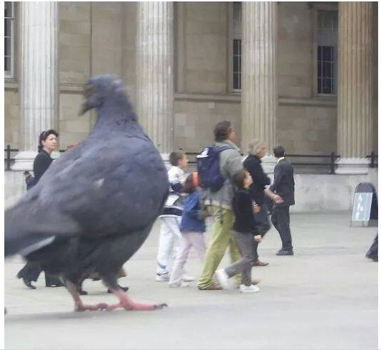
13.1.2 Shape from texture
Notes:
鴿子為啥那麼大??
https://forum.gamer.com.tw/Co.php?bsn=60084&sn=2301677

Slide 22
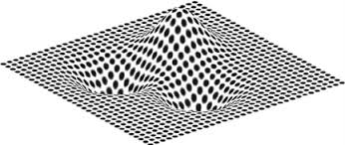
13.1.2 Shape from texture

Slide 23
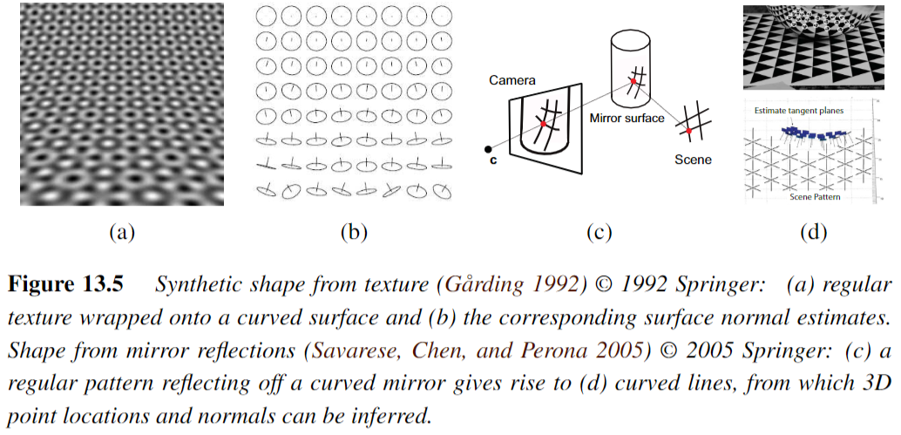
13.1.2 Shape from texture
Notes:
Texture: 紋理；材質
Pattern: 格式; 圖案; 樣子

Slide 24
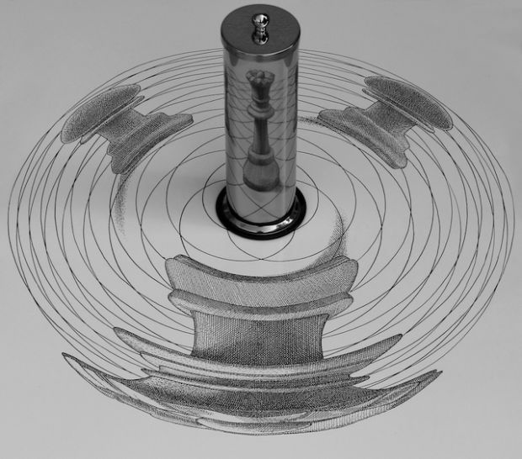
13.1.2 Shape from texture
https://www.youtube.com/watch?v=09Rqfqe9pa8
Notes:
我們可以推出反射之間的關係，運用在藝術創作上

Slide 25
13.1.3 Shape from focus
Shape from focus
- A strong cue for object depth is the amount of blur, which increases as the object’s surface moves away from the camera’s focusing distance.
DC & CV Lab.
CSIE NTU

Slide 26

13.1.3 Shape from focus
DC & CV Lab.
CSIE NTU

Slide 27
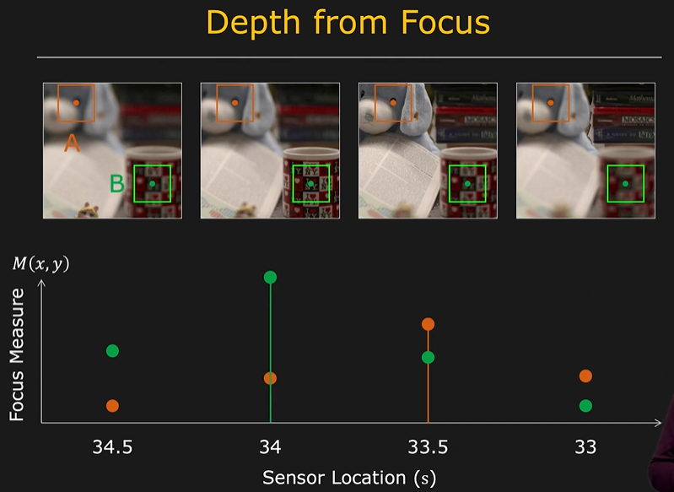
13.1.3 Shape from focus
https://www.youtube.com/watch?v=A-fgaR7vJ-w
DC & CV Lab.
CSIE NTU

Slide 28
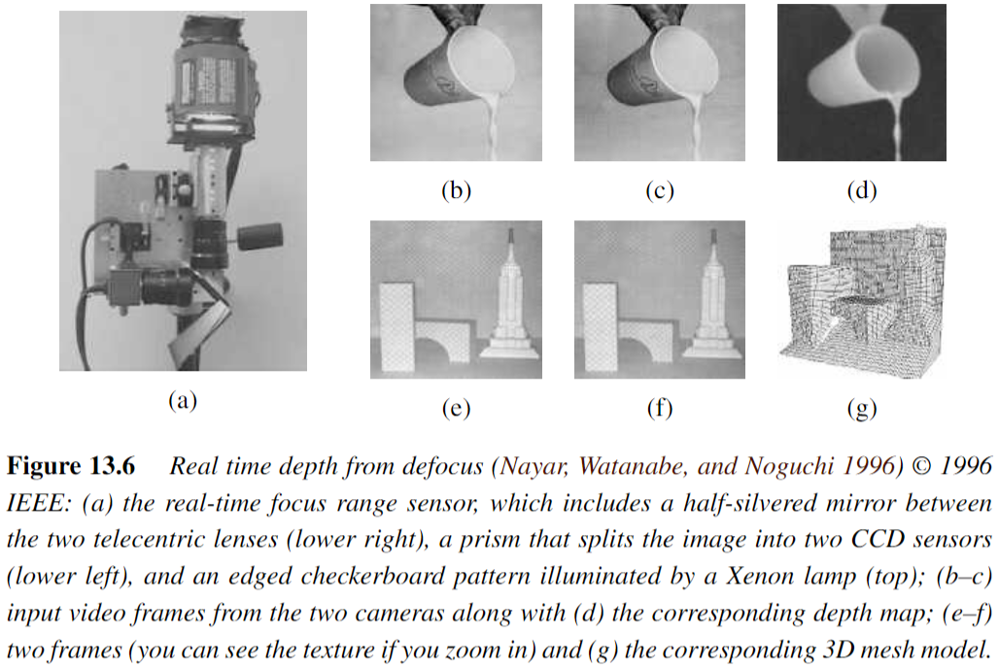
13.1.3 Shape from focus
Notes:
Defocus : 散焦

Slide 29
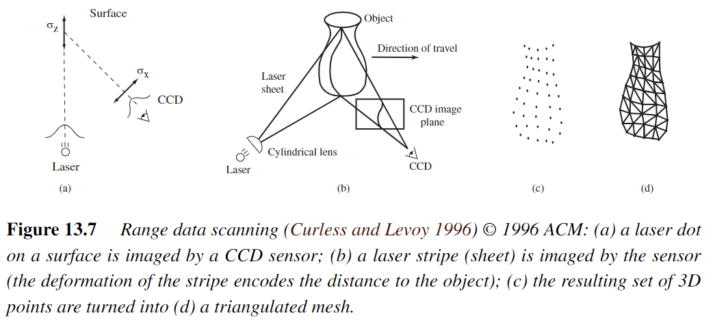
13.2 3D scanning
Structured Light
CCD: Charge-Coupled Device

Slide 30
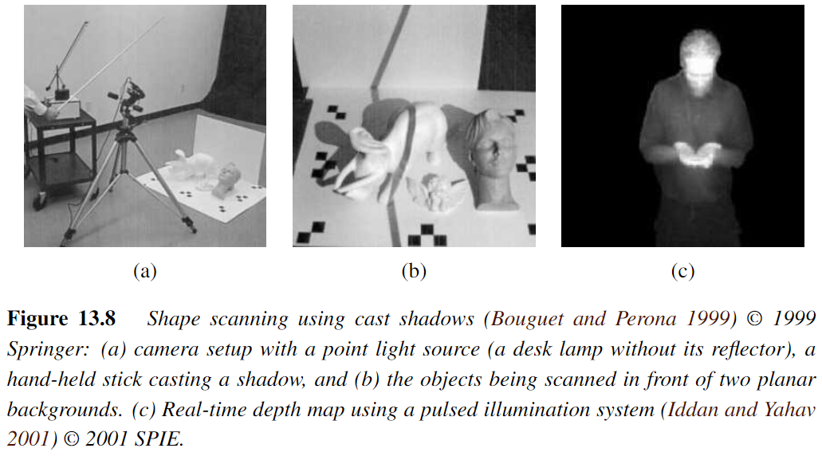
13.2 3D scanning
SPIE: Society of Photo-Optical Instrumentation Engineers
Notes:
Casting: 投擲
Illumination: 照明

Slide 31
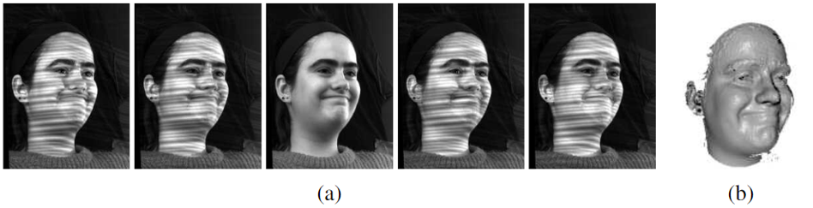
13.2 Active rangefinding
Rangefinding is an old-fashioned word for measuring distance, often using passive or active optical means.
The simplest way to do this is to just project random stripe patterns onto the scene to create synthetic texture, which helps match textureless surfaces

Slide 32
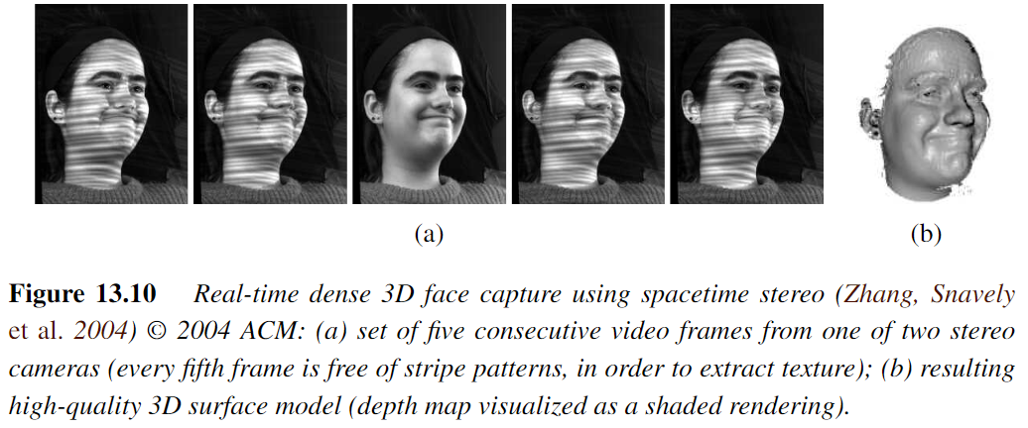
13.2 Active rangefinding
Rangefinding is an old-fashioned word for measuring distance, often using passive or active optical means.
Notes:
Active rangefinding主動測距

Slide 33
13.2.1 Range data merging
The next two steps in processing are the registration (alignment) of partial 3D surface models and their integration into coherent 3D surfaces.
The most widely used 3D registration technique is the iterated closest point (ICP) algorithm, which alternates between finding the closest point matches between the two surfaces being aligned and then solving a 3D absolute orientation problem.
Notes:
Coherent: 連通
Iterated Closest point (ICP):
該算法交替查找兩個要對齊的表面之間的最近點匹配
Registration Technique 配準技術
其目的在於比較或融合針對同一物體在不同條件下獲取的影象，例如影象會來自不同的採集裝置，取自不同的時間，不同的拍攝視角等等。
一個經典的應用是場景的重建，比如說一張茶几上擺了很多杯具，用深度攝像機進行場景的掃描，通常不可能通過一次採集就將場景中的物體全部掃描完成，只能是獲取場景不同角度的點雲，然後將這些點雲融合在一起，獲得一個完整的場景。

Slide 34
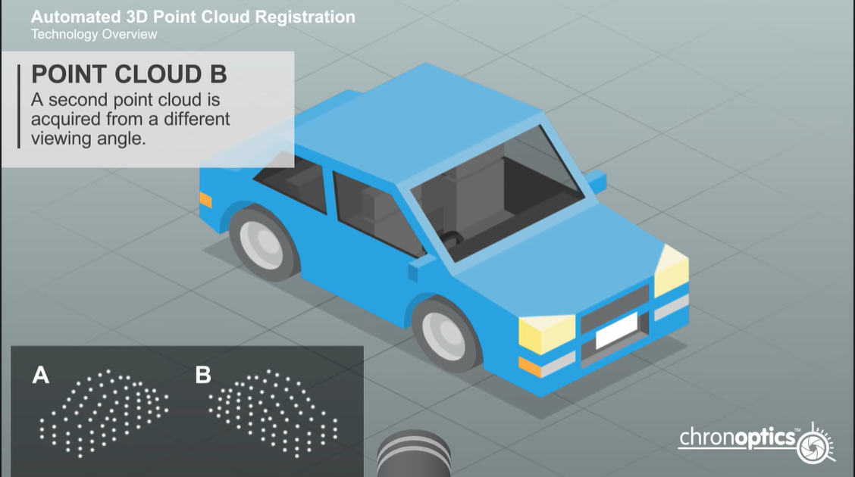
13.2.1 Range data merging
https://www.youtube.com/watch?v=Tn0JOVpFWzM
Notes:
Iterated Closest point (ICP):
Registration Technique 配準技術
其目的在於比較或融合針對同一物體在不同條件下獲取的影象，例如影象會來自不同的採集裝置，取自不同的時間，不同的拍攝視角等等。
一個經典的應用是場景的重建，比如說一張茶几上擺了很多杯具，用深度攝像機進行場景的掃描，通常不可能通過一次採集就將場景中的物體全部掃描完成，只能是獲取場景不同角度的點雲，然後將這些點雲融合在一起，獲得一個完整的場景。

Slide 35
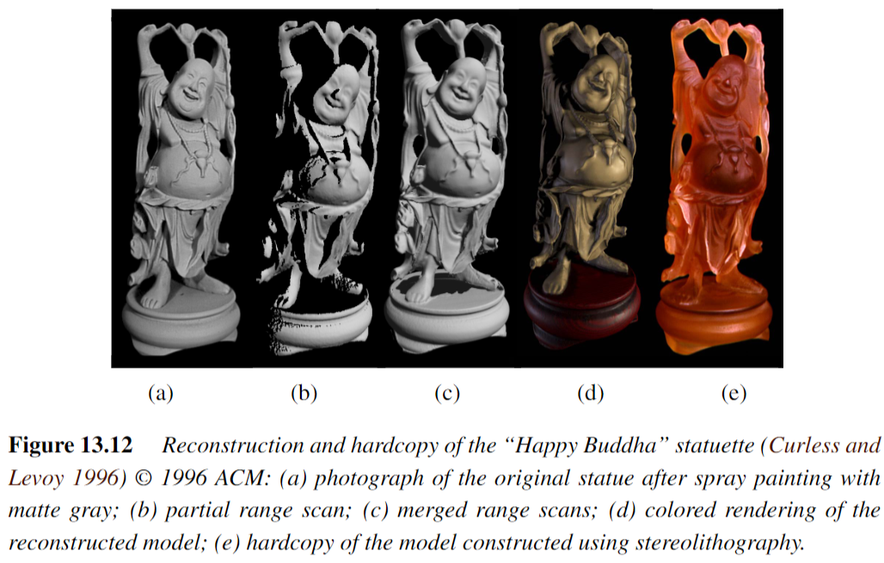
13.2.1 Range data merging
Notes:
Stereolithography:光固化

Slide 36
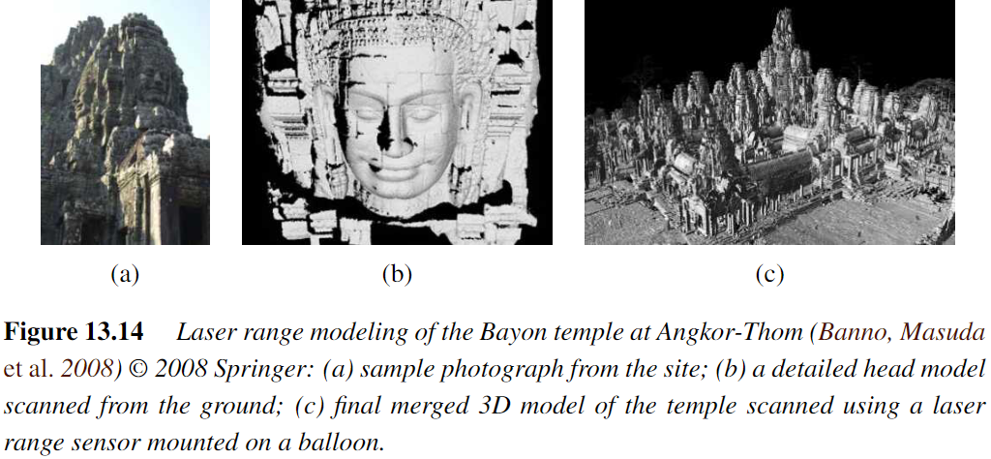
13.2.2 Application:
Digital heritage
Notes:
巴戎廟是吳哥城(Angkor Thom)中最著名最莊觀的一座廟，構造以大尊佛像頭部主，形成一群又一群的塔，遠看似聳起的山頭。原本有49座塔， 現在只剩下只37座塔，大部份塔頂都雕刻有佛像頭。

Slide 37
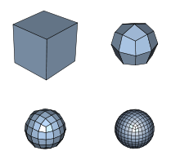
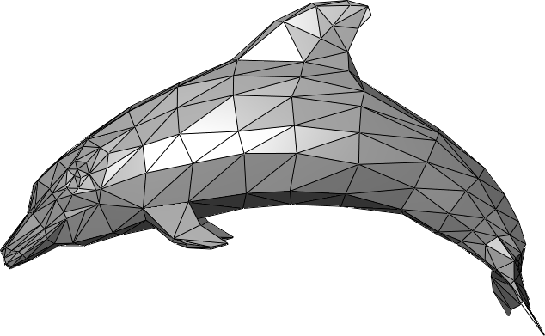
13.3 Surface representations
Surface representations:
- Triangle Meshes
- Splines
- Subdivision Surfaces
Notes:
triangle meshes 三角網格
Splines 樣條樣條函數 通常是指分段定義的多項式參數曲線
Subdivision surface 細分曲面
Introduction to subdivision surfaces https://www.khanacademy.org/computing/pixar/modeling-character/modeling-subdivision/v/cm-start
三角網格是多邊形網格的一種，多邊形網格又被稱為“Mesh”，是計算機圖形學中用於為各種不規則物體建立模型的一種資料結構

Slide 38
13.3 Surface representations
It enable not only the creation of highly detailed models but also processing operations, such as interpolation (Section 13.3.1), fairing or smoothing, and decimation and simplification (Section 13.3.2) We also examine discrete point-based representations (Section 13.4) and volumetric representations (Section 13.5)
Notes:
Decimation 抽取
fair 光順 整流
Examine 研究、檢查
這些曲面表示法，不僅可以創建高度詳細的模型，還可以進行處理數學操作，例如插值，光順或平滑以及抽取和簡化。

Slide 39
13.3.1 Surface interpolation
One of the most common operations on surfaces is their reconstruction from a set of sparse data constraints, i.e. scattered data interpolation(Section 4.1)
An alternative approach is to use radial basis (or kernel) functions (Boult and Kender 1986; Nielson 1993), which we covered in Section 4.1.1.
Notes:
Sparse data constraints 稀疏資料限制
在資料庫中，稀疏資料是指在二維表中含有大量空值的資料；即稀疏資料是指，在資料集中絕大多數數值缺失或者為零的資料。稀疏資料絕對不是無用資料，只不過是資訊不完全，通過適當的手段是可以挖掘出大量有用資訊
徑向基函數核 (Radial basis function kernel)
radial: 【數】半徑的 【海】徑向線 光線的 放射狀的

Slide 40
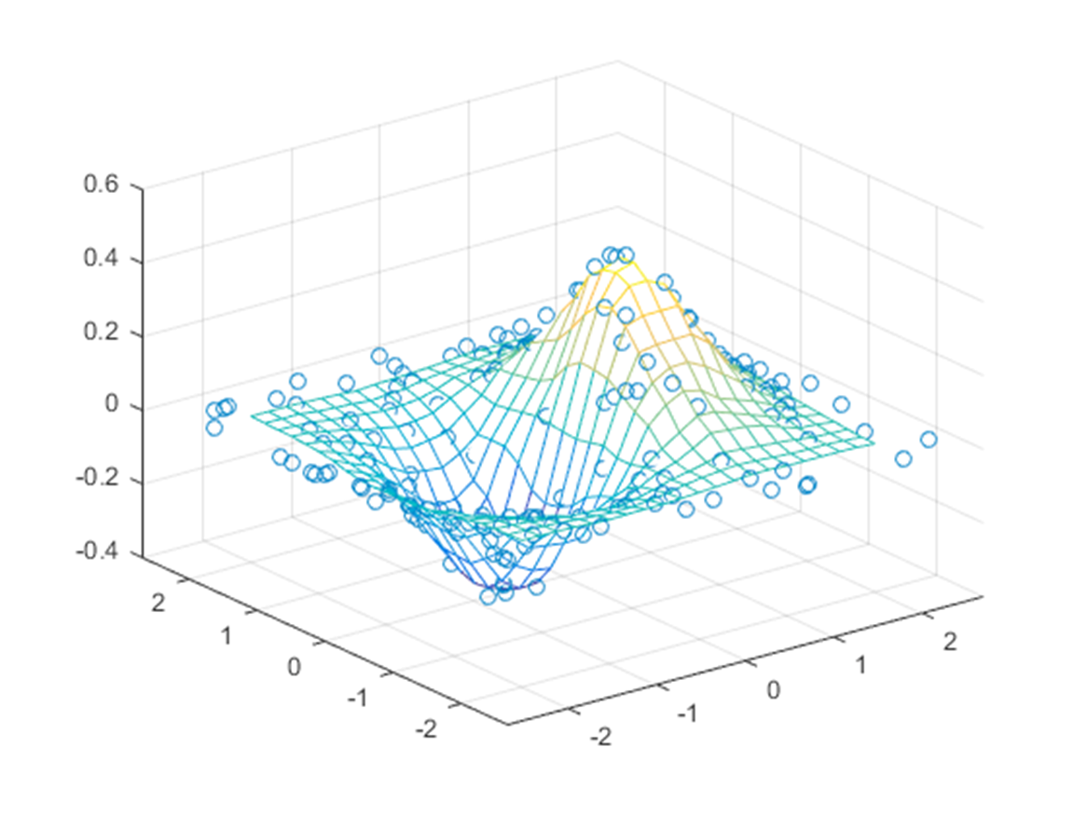
13.3.1 Surface interpolation
Notes:
利用稀疏的點來內插出曲面

Slide 41
13.3.2 Surface simplification
Once a triangle mesh has been created from 3D data, it is often desirable to create a hierarchy of mesh models, for example, to control the displayed Level Of Detail (LOD) in a computer graphics application.
Notes:
隨著物體或者模型遠離觀察者而逐步降低。由於它能夠通過減少多邊形的數目從而提升渲染效率，所以在計算機與視頻遊戲中使用了這項技術。由於物體距離很遠，所以理論上並不會察覺到模型或者物體的視覺質量會有所下降

Slide 42
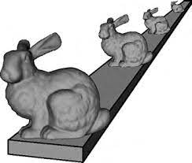
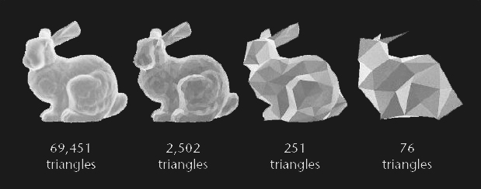
13.3.2 Surface simplification
Notes:
隨著物體或者模型遠離觀察者而逐步降低。由於它能夠通過減少多邊形的數目從而提升渲染效率，所以在計算機與視頻遊戲中使用了這項技術。由於物體距離很遠，所以理論上並不會察覺到模型或者物體的視覺質量會有所下降

Slide 43
13.3.2 Surface simplification
To approximate a given mesh with one that has subdivision connectivity, over which a set of triangular wavelet coefficients can then be computed. (Eck, DeRose,Duchamp et al. 1995).
To use sequential edge collapse operations to go from the original fine-resolution mesh to a coarse base-level mesh (Hoppe 1996).

Slide 44
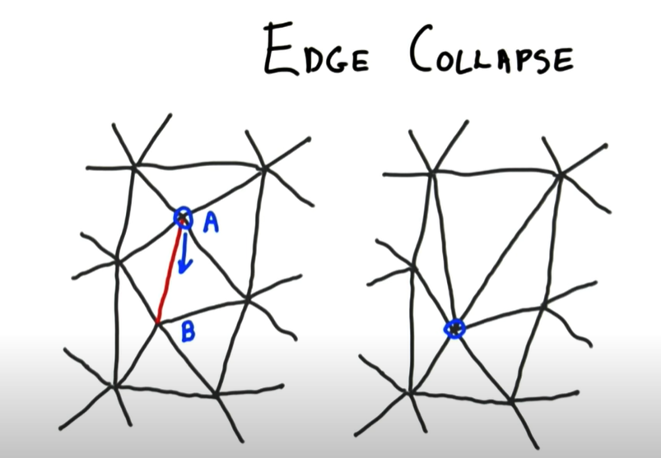
13.3.2 Surface simplification
https://www.youtube.com/watch?v=aW1zT_ib0PY
edge collapse
Notes:
edge collapse
主要是用二個在幾何模型上的運算：edge collapse、vertex split，來達到幾何模型
的簡化。每次edge collapse 會將二個頂點變成一個頂點，並將共享此邊的二個三角形
拿掉。每次簡化的過程會被記錄，而後能由最簡的模型反推回原來的模型。在簡化的
過程中，每次會挑選簡化後產生誤差最小的邊來作edge collapse。

Slide 45
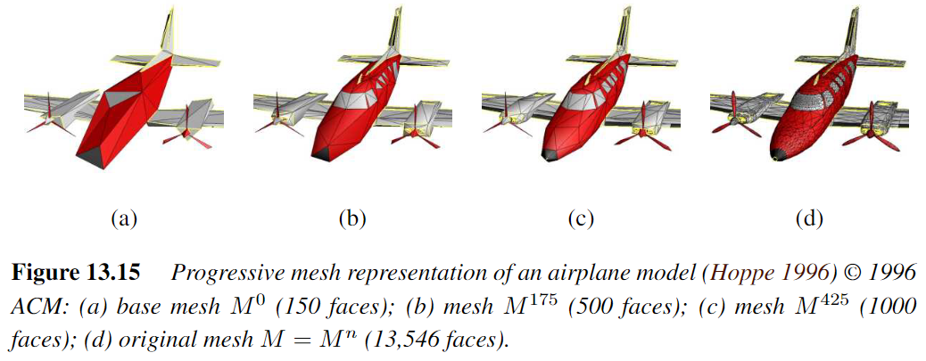
13.3.2 Surface simplification

Slide 46
13.3.3 Geometry images
To make meshs more easy to compress and store in a cache-efficient manner.
To create geometry images by cutting surface meshes along well chosen lines and “flattening” the resulting representation into a square. (Gu, Gortler, and Hoppe (2002))
Notes:
Geometry 幾何學
Cache快取記憶體
為了使網格更易於壓縮和以緩存有效的方式存儲。

Slide 47
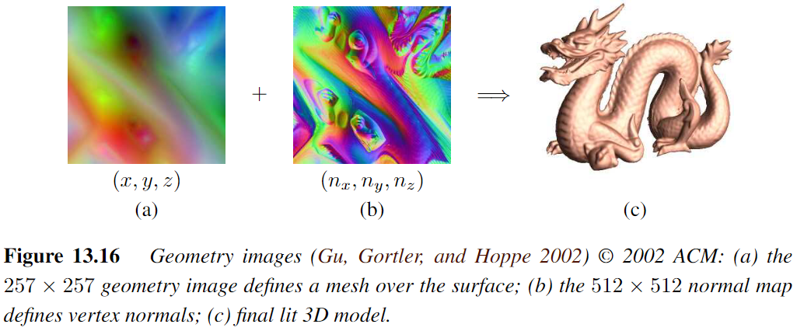
13.3.3 Geometry images
Notes:
Geometry 幾何學
Cache快取記憶體
為了使網格更易於壓縮和以緩存有效的方式存儲。

Slide 48
13.4 Point-based representations
As we mentioned previously, triangle-based surface models assume that the topology (and often the rough shape) of the 3D model is known ahead of time.
While it is possible to re-mesh a model as it is being deformed or fitted, a simpler solution is to dispense with an explicit triangle mesh altogether and to have triangle vertices behave as oriented points, or particles, or surface elements (surfels)

Slide 49
13.4 Point-based representations
How to render the particle system as a continuous surface :
- local dynamic triangulation heuristics (Szeliski and Tonnesen 1992)
- direct surface element splatting (Pfister, Zwicker, van Baar et al. 2000)
- Moving Least Squares (MLS) (Pauly, Keiser,Kobbelt et al. 2003)
Notes:
局部動態三角剖分啟發法
直接表面噴濺
移動最小二乘法

Slide 50
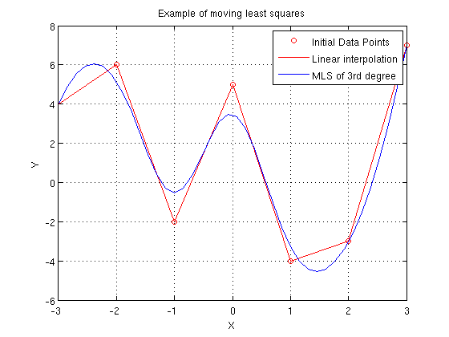
13.4 Point-based representations
Moving Least Squares (MLS)
Notes:
Here is a 2D example. The circles are the samples and the polygon is a linear interpolation. The blue curve is a smooth approximation of order 3.

Slide 51
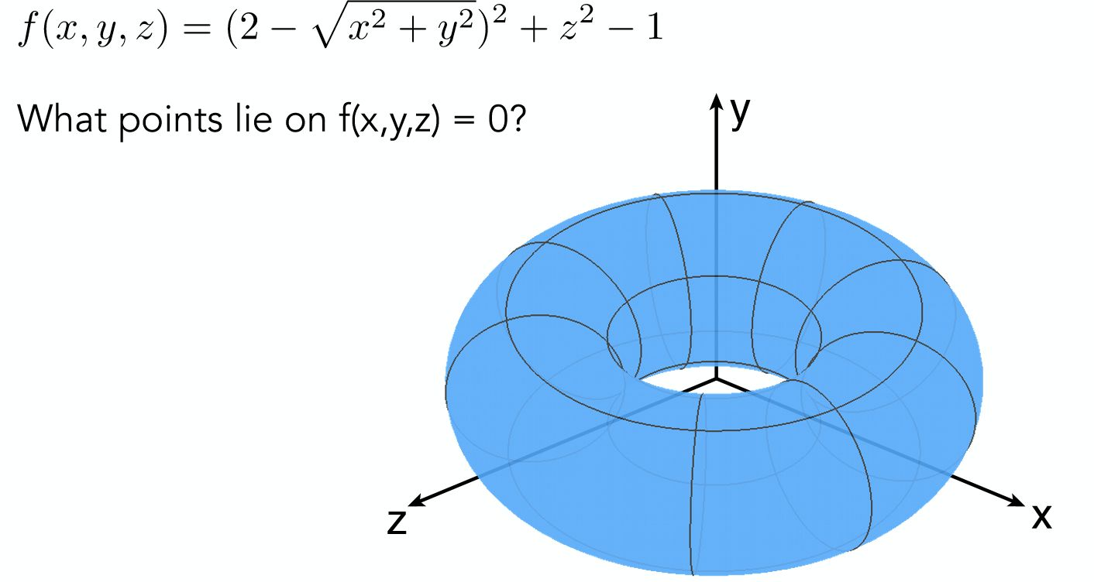
13.4 Point-based representations
https://zhuanlan.zhihu.com/p/144392820
Implicit function

Slide 52
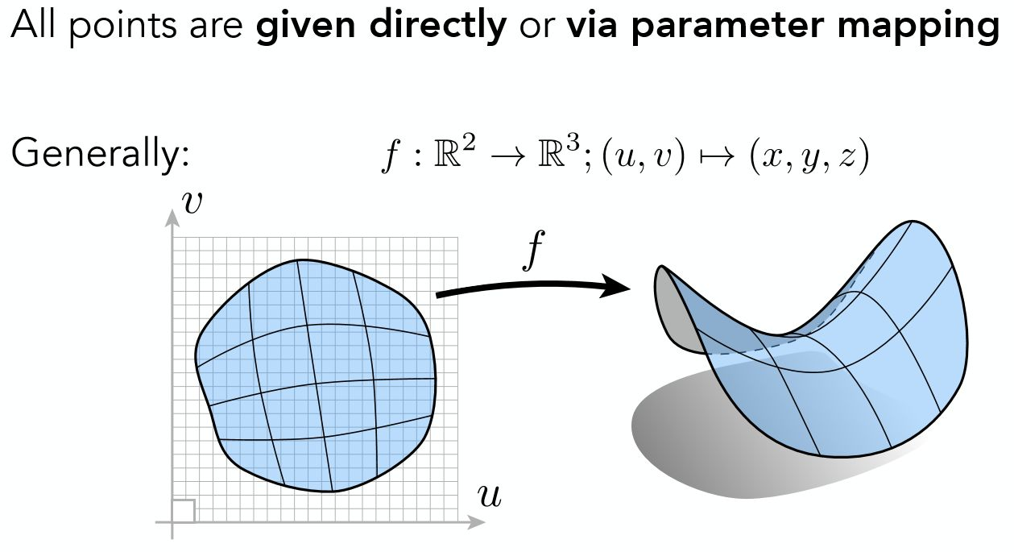
13.4 Point-based representations
https://zhuanlan.zhihu.com/p/144392820
Explicit function

Slide 53
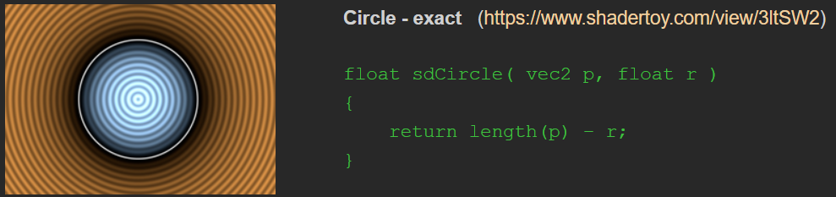
13.4 Point-based representations
Sign Distance function
https://iquilezles.org/www/articles/distfunctions2d/distfunctions2d.htm
Notes:
符號距離函數（sign distance function），簡稱SDF，又可以稱為定向距離函數（oriented distance function )
點在區域邊界外部為正，內部為負，位於邊界上時為0。
https://blog.csdn.net/qq_41368247/article/details/106194092

Slide 54
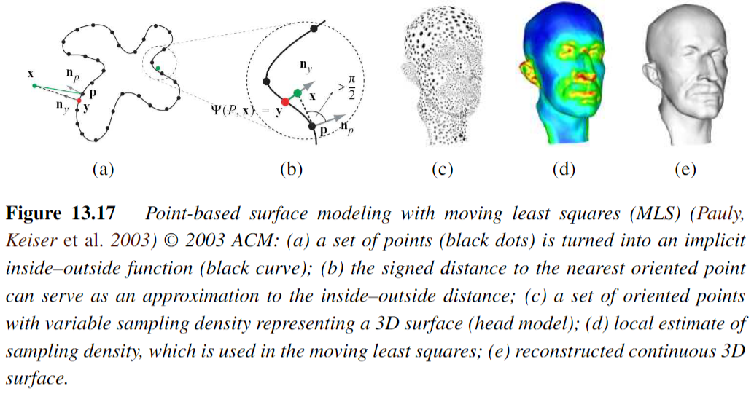
13.4 Point-based representations
Notes:
Paper: https://www.researchgate.net/publication/283845022_Shape_modeling_with_point-sampled_geometry
Moving Least Squares (MLS) obtain a very robust inside/outside classification.

Slide 55
13.5 Volumetric representations
A third alternative for modeling 3D surfaces is to construct 3D volumetric inside–outside functions (Section 12.7.2)
In this section, we look at continuous implicit (inside–outside) functions to represent 3D shape.
Notes:
體積的表示法
對3D曲面建模的第三個替代方法是構造3D體積內外函數

Slide 56
13.5.1 Implicit surfaces and level sets
implicit surfaces
- which use an indicator function (characteristic function) F(x; y; z) to indicate which 3D points are inside F(x; y; z) < 0 or outside F(x; y; z) > 0 the object.

Slide 57
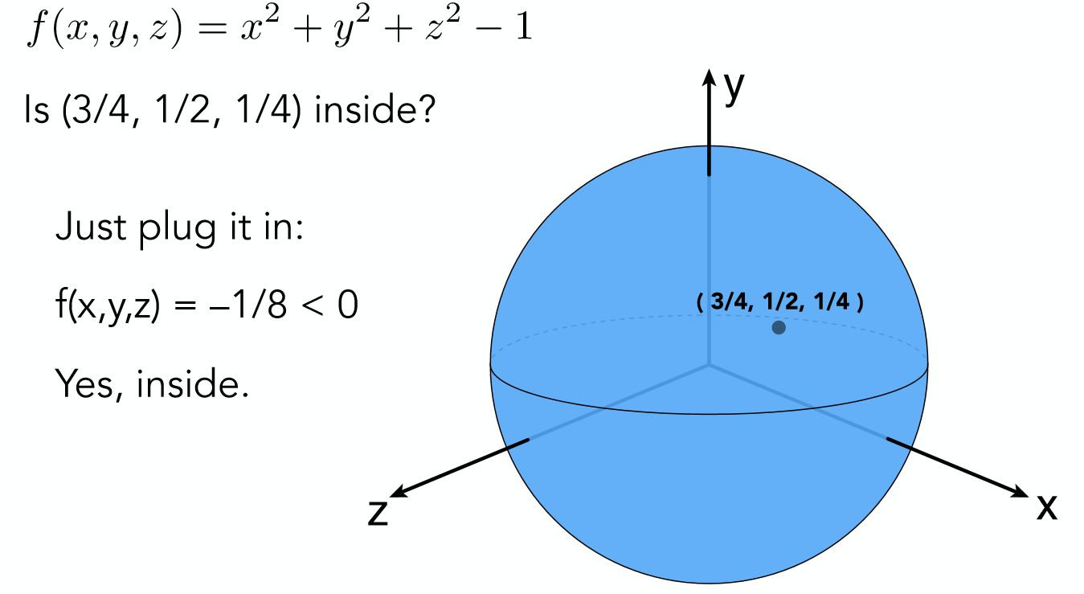
13.5.1 Implicit surfaces and level sets
https://zhuanlan.zhihu.com/p/144392820

Slide 58
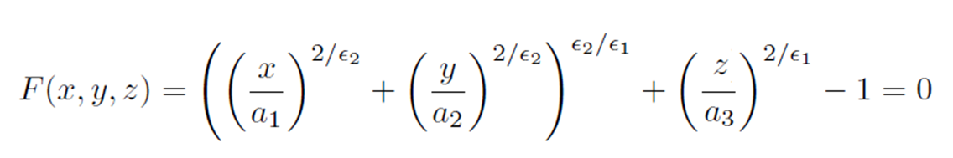

12.5.1 Implicit Surfaces and Level Sets
Implicit (inside-outside) functions of superquadrics:
The values of control the extent of model along each (x; y; z) axis, while the values of control how “square” it is.
Notes:
超二次曲面體 superquadrics
是一類幾何體，其表面方程由橢球體或其他二次曲面體方程演化而來。將橢球體表面方程中的指數由2更改為其他任意正實數，即得到超二次曲面體
可以表達圓角或近似方角的立方體、八面體、圓柱等諸多形狀，是一種很好的計算機三維圖形模型
Extent 長度

Slide 59
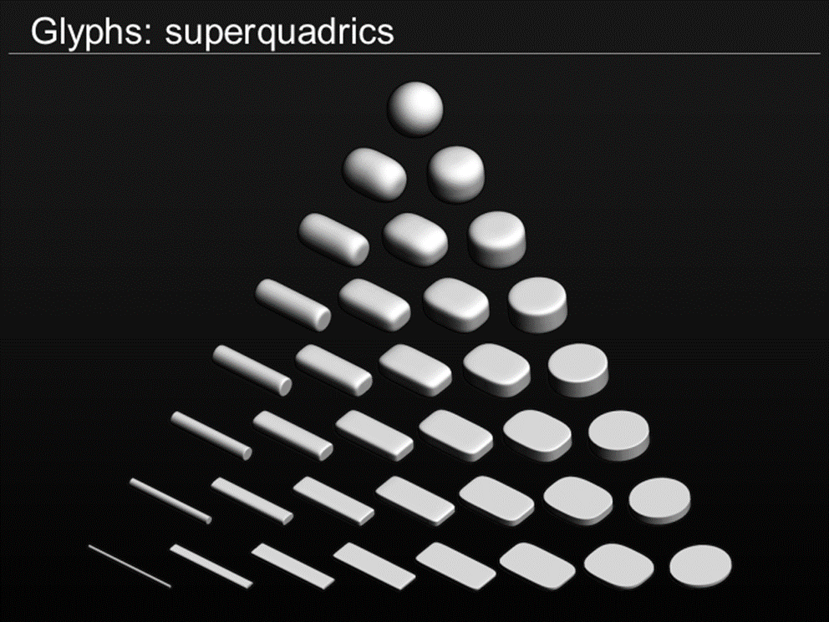
Superquadrics
Notes:
These are an extension of quadrics, where the power on the coordinate does not have to be 2
各參數不侷限2次了

Slide 60
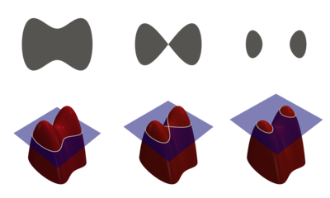
13.5.1 Implicit surfaces and level sets
Level-set
Notes:
水平集介紹:
https://zhuanlan.zhihu.com/p/140318665
https://blog.csdn.net/webzhuce/article/details/101120185
算法實作:
https://github.com/Ramesh-X/Level-Set

Slide 61
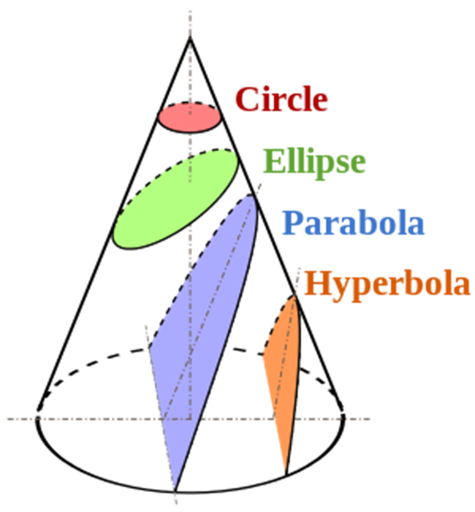
Conics (2D Curve)
Notes:
Conics 圓錐曲線 two dimensional curve
Parabola 拋物線
Hyperbola 雙曲線
不同切面會有不同圖形

Slide 62
13.5.1 Implicit surfaces and level sets
A different kind of implicit shape model can be constructed by defining a signed distance function over a regular three-dimensional grid, optionally using an octree spline to represent this function more coarsely away from its surface (zero-set) (Lavall´ee and Szeliski 1995 Szeliski and Lavall´ee 1996; Frisken, Perry, Rockwood et al. 2000; Ohtake, Belyaev, Alexaet al. 2003).
Notes:
Signed distance function 正負號距離表示法
另一種類型的隱式形狀模型可以通過在規則的三維網格上定義符號距離函數來構造，可選擇使用八元樹樣條將該函數更粗糙地表示為遠離其表面（零集）
八元樹（英語：octree）是一種樹形資料結構，每個內部節點都正好有八個子節點。八元樹常用於分割三維空間，將其遞迴細分為八個卦限。八元樹是四元樹在三維空間中的對應，在三維圖形、三維遊戲引擎等領域有很多應用。
https://www.wikiwand.com/zh-tw/%E5%85%AB%E5%8F%89%E6%A0%91
Region 資料結構 : https://web.ntnu.edu.tw/~algo/Region.html

Slide 63
13.5.1 Implicit surfaces and level sets
Examples of signed distance functions being used
- distance transforms (Section 3.3.3)
- level sets for 2D contour fitting and tracking (Section 7.3.2)
- volumetric stereo (Section 12.7.2)
- range data merging (Section 13.2.1)
- point-based modeling (Section 13.4)

Slide 64
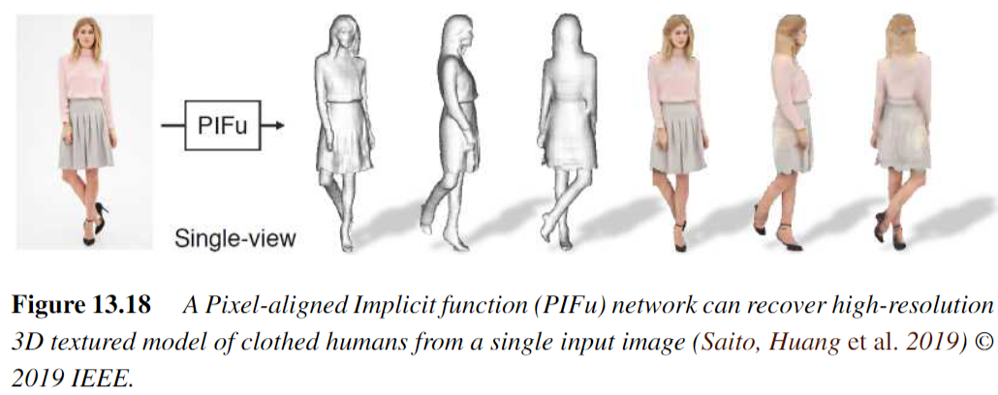
13.5.1 Implicit surfaces and level sets
Notes:
Implicit Function 是一個用來表達物體表面的函數，其形式如：F(X) = 0
PIFu方法中提出的Pixel-Aligned Implicit Function則是將2D圖像中的Pixel也引入進來，所以叫做Pixel-Aligned
https://zhuanlan.zhihu.com/p/148509062

Slide 65
13.6 Model-based reconstruction
13.6.1 Architecture
13.6.2 Heads and faces
13.6.3 Application: Facial animation
13.6.4 Whole body modeling and tracking

Slide 66
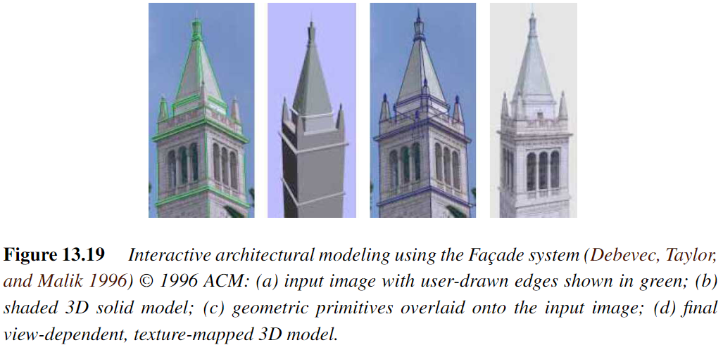
13.6.1 Architecture
Notes:
幾何圖元 (Geometric primitive)
Overlaid 覆蓋

Slide 67
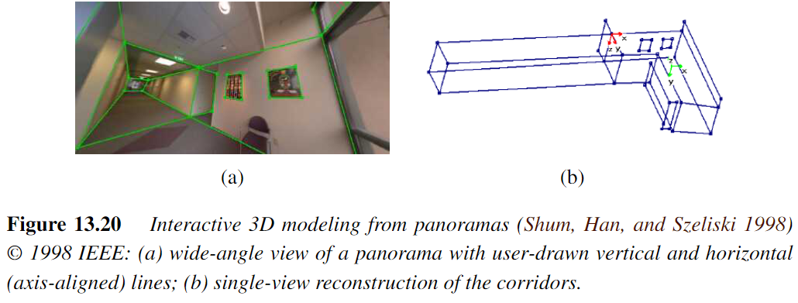
13.6.1 Architecture
Architectur interior modeling
Lumion 9
IEEE: Institute of Electrical and Electronic Engineers

Slide 68
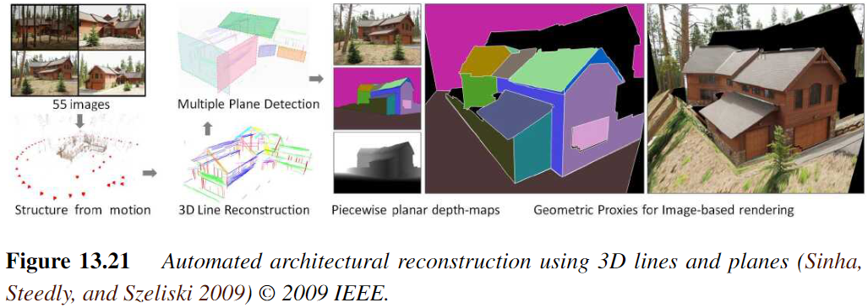
13.6.1 Architecture
3D model using drones and cameras
Automated line-based reconstruction

Slide 69
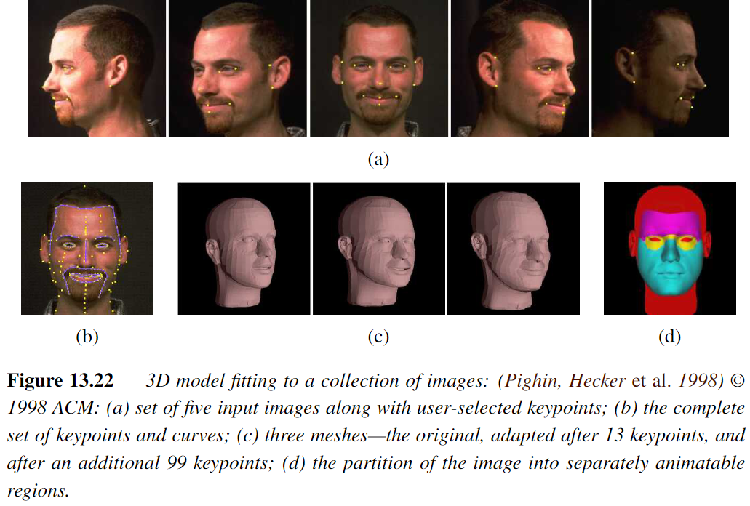
13.6.2 Heads and faces

Slide 70
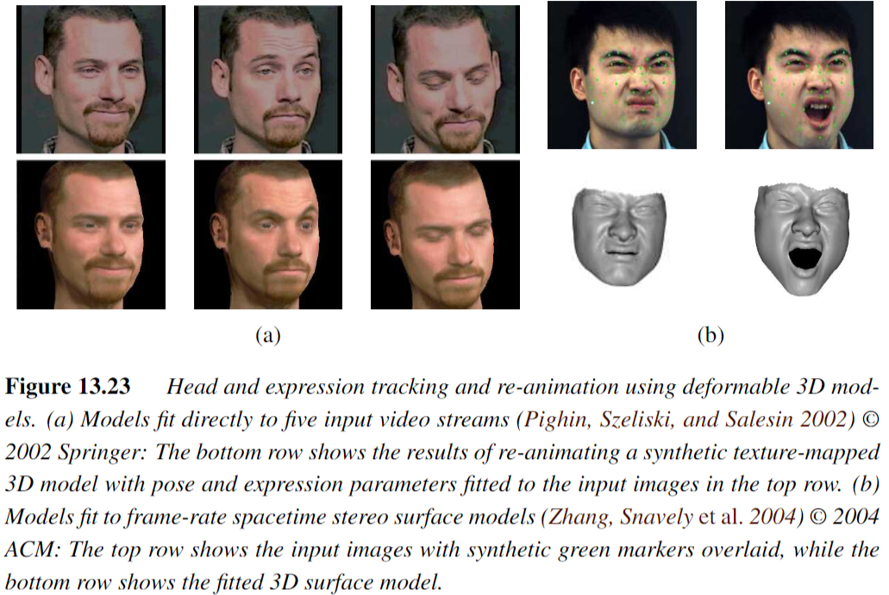
13.6.2 Heads and faces
Notes:
Deformable: 可變形

Slide 71
13.6.2 Model-based reconstruction
3D head model applications
head tracking (Toyama 1998; Lepetit, Pilet, and Fua 2004; Matthews, Xiao, and Baker
2007)
face transfer, i.e., replacing one person’s face with another in a video (Bregler, Covell, and Slaney 1997; Vlasic, Brand, Pfister et al.2005)
face beautification by warping face images toward a more attractive “standard” (Leyvand, Cohen-Or, Dror et al. 2008)

Slide 72
13.6.2 Model-based reconstruction
3D head model applications
face de-identification for privacy protection (Gross, Sweeney, De la Torre et al. 2008)
face swapping (Bitouk,Kumar, Dhillon et al. 2008).

Slide 73
13.6.3 Application: Facial animation
(a) Original 3D face model with the addition of shape and texture variations in specific directions:deviation from the mean (caricature), gender, expression, weight, and nose shape;
Notes:
原始 3D 人臉模型，增加了特定方向的形狀和紋理變化：偏離平均值（漫畫）、性別、表情、體重和鼻子形狀；
Caricature: 漫畫
Frown: 愁眉苦臉

Slide 74
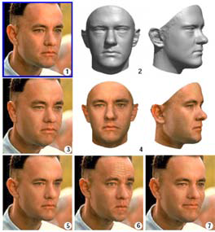
13.6.3 Application: Facial animation
(b) a 3D morphable model is fit to a single image, after which its weight or expression can be manipulated
Notes:
(b) 3D 可變形模型適合單個圖像，之後可以操縱其權重或表達

Slide 75
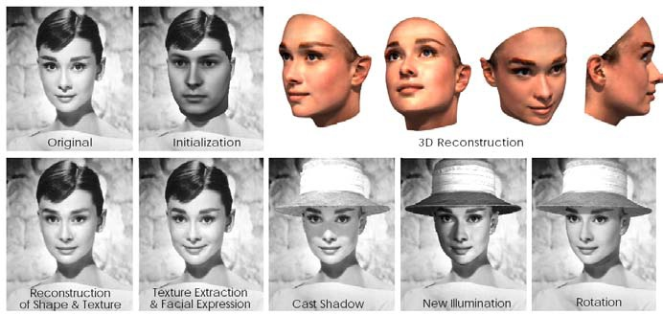
13.6.3 Application: Facial animation
(c) another example of a 3D reconstruction along with a different set of 3D manipulations such as lighting and pose change.
Notes:
(c) 另一個 3D 重建示例以及一組不同的 3D 操作，例如照明和姿勢變化。

Slide 76
13.6.3 Application: Facial animation
DC & CV Lab.
CSIE NTU
Morphable Face: Automatic 3D Reconstruction and Manipulation from Single Data-Set Reference Face
Video
https://www.youtube.com/watch?v=pSRA8GpWIrA
Notes:
Facial Animation: 面部動畫

Slide 77
13.6.3 Application: Facial animation
DC & CV Lab.
CSIE NTU
Achieving a Photoreal Digital Actor
Video
https://www.youtube.com/watch?v=piJ4Zke7EUw

Slide 78
13.6.4 Whole body modeling and tracking
Background subtraction
Initialization and detection
Tracking with flow
3D kinematic models
Probabilistic models
Adaptive shape modeling
Activity recognition

Slide 79
13.6.4 Whole body modeling and tracking
Background subtraction
- One of the first steps in many (but certainly not all) human tracking systems is to model the background in order to extract the moving foreground objects (silhouettes) corresponding to people.
- Once silhouettes have been extracted from one or more cameras, they can then be modeled using deformable templates or other contour models
Notes:
背景減法
- 許多（但肯定不是全部）人類跟踪系統的第一步是對背景進行建模，以提取與人相對應的移動前景對象（剪影）。
- 一旦從一台或多台攝像機中提取出輪廓，就可以使用可變形模板或其他輪廓模型對其進行建模
第九章的optical flow區分前、背景

Slide 80
13.6.4 Whole body modeling and tracking
Initialization and detection.
- In order to track people in a fully automated manner, it is necessary to first detect (or re-acquire) their presence in individual video frames.
- This topic is closely related to pedestrian detection, which is often considered as a kind of object recognition (Mori, Ren, Efros et al. 2004; Felzenszwalb and Huttenlocher 2005; Felzenszwalb, McAllester, and Ramanan 2008)
pedestrain detection
Notes:
初始化和檢測。
- 為了以全自動方式跟踪人員，有必要首先檢測（或重新獲取）他們在各個影片幀中的存在。
- 這個主題與行人檢測密切相關，通常被認為是一種物體識別（Mori, Ren, Efros et al. 2004; Felzenszwalb and Huttenlocher 2005; Felzenszwalb, McAllester, and Ramanan 2008）

Slide 81
13.6.4 Whole body modeling and tracking
3D kinematic models.
- which specifies the length of each limb in a skeleton as well as the 2D or 3D rotation angles between the limbs or segments
Notes:
3D 運動學模型。
- 指定骨骼中每個肢體的長度以及肢體或區域之間的 2D 或 3D 旋轉角度

Slide 82
13.6.4 Whole body modeling and tracking
Probabilistic models.
- Because tracking can be such a difficult task, sophisticated probabilistic inference techniques are often used to estimate the likely states of the person being tracked.
Notes:
Sophisticated 複雜的
概率模型。
- 由於跟踪可能是一項艱鉅的任務，因此通常使用複雜的概率推理技術來估計被跟踪人員的可能狀態。
推測連動方式

Slide 83
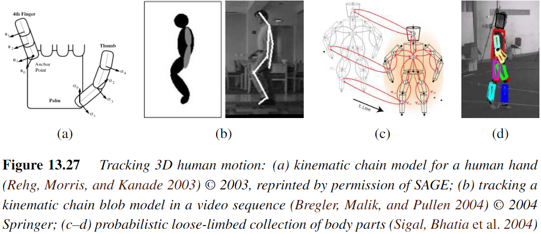
13.6.4 Whole body modeling and tracking
Realtime Multi-Person 2D Human Pose Estimation using Part Affinity Fields
Notes:
找出可以旋轉的關節點並且建模

Slide 84
13.6.4 Whole body modeling and tracking
Adaptive shape modeling.
- Another essential component of whole body modeling and tracking is the fitting of parameterized shape models to visual data.
Notes:
自適應形狀建模。
- 全身建模和跟踪的另一個重要部分是參數化的形狀模型 與 視覺數據的擬合。
視覺化數位模型建模

Slide 85

13.6.4 Whole body modeling and tracking

Slide 86

13.6.4 Whole body modeling and tracking
Notes:
https://www.youtube.com/watch?v=eUnZ2rjxGaE

Slide 87
13.6.4 Whole body modeling and tracking
Activity recognition.
- The final widely studied topic in human modeling is motion, activity, and action recognition (Bobick 1997; Hu, Tan, Wang et al. 2004; Hilton, Fua, and Ronfard 2006).
- Examples of actions that are commonly recognized include walking and running, jumping, dancing, picking up objects, sitting down and standing up, and waving.
Notes:
活動識別。
- 人體建模中最後一個廣泛研究的主題是運動、活動和動作識別（Bobick 1997；Hu、Tan、Wang 等人 2004；Hilton、Fua 和 Ronfard 2006）。
- 常見的動作示例包括走路和跑步、跳躍、跳舞、撿起物體、坐下和站起來以及揮手。
辨識出行為的意義

Slide 88
13.7 Recovering texture maps and albedos
After a 3D model of an object or person has been acquired, the final step in modeling is usually to recover a texture map to describe the object’s surface appearance.

Slide 89

13.7 Recovering texture maps and albedos
Notes:
Albedos 反照率

Slide 90

13.7 Recovering texture maps and albedos
Notes:
Specular 鏡面反射

Slide 91

13.7.1 Estimating BRDFs
BRDF: Bidirectional Reflectance Distribution Function
https://www.youtube.com/watch?v=R9iZzaXUaK4
Notes:
BRDF表示的是雙向反射分布函數（Bidirectional Reflectance Distribution Function），它描述了光線如何在物體表面進行反射，可以用來描述材質屬性。
BRDF的輸入參數是入射光的的仰角、方位角、出射光的仰角、方位角，還與入射光的波長相關。
BRDF的輸出結果是一個數值，表示在給定的入射條件下，出射方向上反射的相對能量，另外一種理解方式是用光子的概念來考慮，BRDF給出了入射光子以特定方向離開的概率。
通俗的講BRDF是渲染中物體的表面材質，是物體接受光照後表面顏色的生成算法。BRDF不僅僅用於光線追踪算法中，也用於實時渲染算法中，現在主流的遊戲引擎，例如Unreal 、Unity它們的材質系統都是基於BRDF的

Slide 92

13.7.1 Estimating BRDFs
BRDF: Bidirectional Reflectance Distribution Function
Notes:
圖 13.32
基於圖像的外觀和詳細幾何重建
(a) 使用分裂聚類重新估計外觀模型 (BRDF)。
(b) 為了模擬詳細的空間變化外觀，每個 lumitexel 都被投影到由聚集材料形成的基礎上。

Slide 93
13.7.1 Estimating BRDFs
BRDF: Bidirectional Reflectance Distribution Function
More recent approaches to recovering spatially-varying BRDFs (SVBRDFs) either start with RGB-D scanners (Park, Newcombe, and Seitz 2018; Schmitt, Donne et al. 2020)
Real-time Geometry, Albedo and Motion Reconstruction Using a Single RGBD Camera
Surface Light Field Fusion

Slide 94
13.7.2 Application: 3D model capture
3D photography

