Slide 1
Chapter 13 Image-Based Rendering
Presented by 翁丞世
0925970510
mob5566@gmail.com

Slide 2
Outline
View Interpolation
Layered Depth Images
Light Fields and Lumigraphs
Environment Mattes
Video-Based Rendering

Slide 3
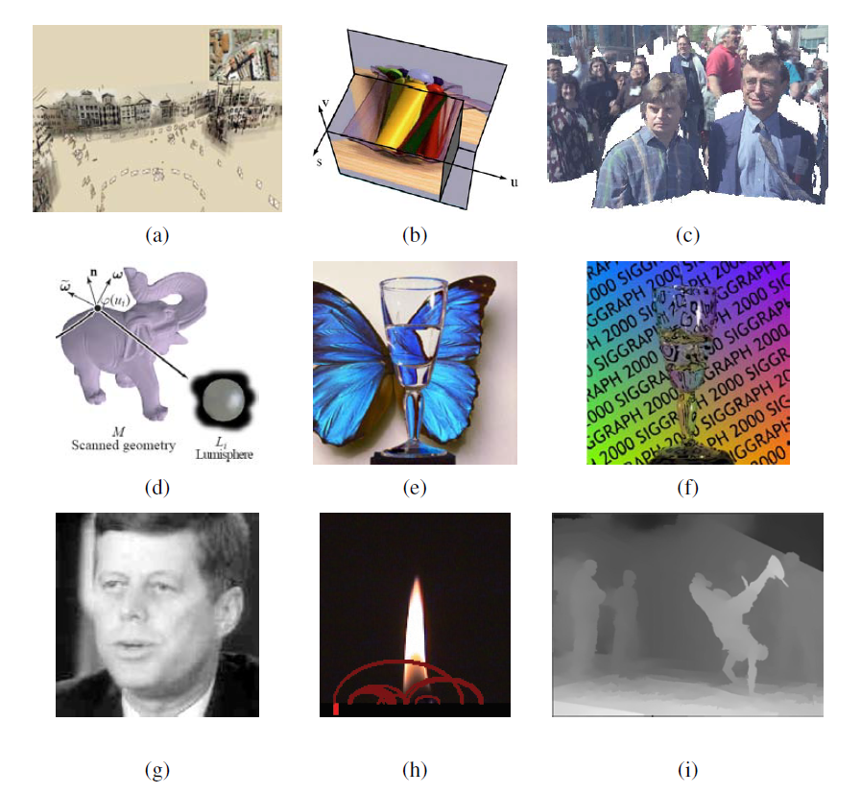
13. Image-Based Rendering
Notes:
(a) a 3D view of a Photo Tourism reconstruction
(b) a slice through a 4D light field
(c) sprites with depth
(d) surface light
(e) environment matte in front of a novel background
(f) real-time video environment
(g) Video Rewrite used to re-animate old
(h) video texture of a candle
(i) video view interpolation

Slide 4
13.1 View Interpolation
13.1.1 View-Dependent Texture Maps
13.1.2 Application: Photo Tourism

Slide 5
13.1 View Interpolation
View interpolation creates a seamless transition between a pair of reference images using one or more pre-computed depth maps.
Closely related to this idea are view-dependent texture maps, which blend multiple texture maps on a 3D model’s surface.

Slide 6
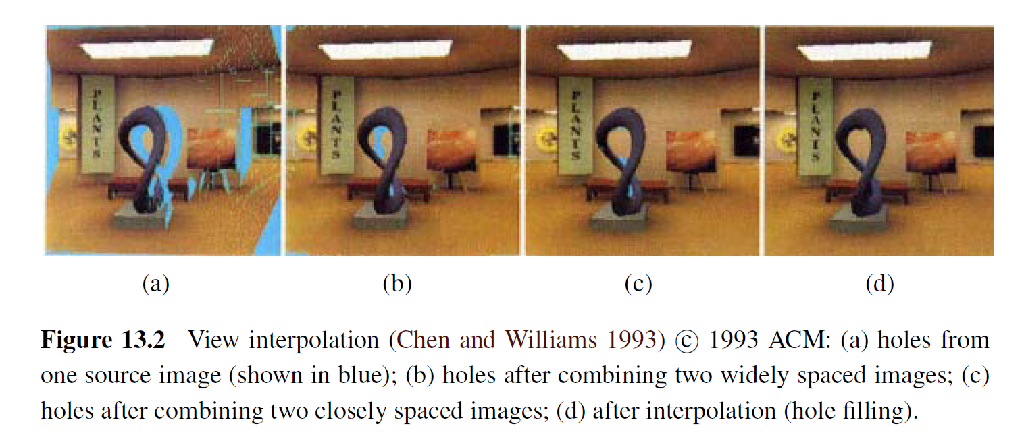
13.1 View Interpolation

Slide 7
13.1.1 View Interpolation
View-dependent texture maps are closely related to view interpolation.
Instead of associating a separate depth map with each input image, a single 3D model is created for the scene, but different images are used as texture map sources depending on the virtual camera’s current position.

Slide 8
13.1.1 View Interpolation

Slide 9
13.1.1 View Interpolation
Given a new virtual camera position, the similarity of this camera’s view of each polygon (or pixel) is compared with that of potential source images.
The images are then blended using a weighting that is inversely proportional to the angles between the virtual view and the source views (Figure 13.3a).

Slide 10
13.1.1 View Interpolation
Even though the geometric model can be fairly coarse, blending between different views gives a strong sense of more detailed geometry because of the parallax (visual motion) between corresponding pixels.
Notes:
Parallax 視差

Slide 11
13.1.2 Photo Tourism

Slide 12
13.2 Layered Depth Images
13.2.1 Imposters, Sprites, and Layers

Slide 13
13.2 Layered Depth Images
When a depth map is warped to a novel view, holes and cracks inevitably appear behind the foreground objects.
One way to alleviate this problem is to keep several depth and color values (depth pixels) at every pixel in a reference image (or, at least for pixels near foreground–background transitions) (Figure 13.5).

Slide 14
13.2 Layered Depth Images
The resulting data structure, which is called a Layered Depth Image (LDI), can be used to render new views using a back-to-front forward warping algorithm (Shade, Gortler, He et al. 1998).

Slide 15
13.2 Layered Depth Images

Slide 16
13.2.1 Impostors, Sprites, and Layers
An alternative to keeping lists of color-depth values at each pixel, as is done in the LDI, is to organize objects into different layers or sprites.
Notes:
Impostor 騙子、冒充者
Sprite 小妖精

Slide 17
13.2.1 Impostors, Sprites, and Layers

Slide 18
13.3 Light Fields and Lumigraphs
13.3.1 Unstructured Lumigraph
13.3.2 Surfaces Light Fields
13.3.3 Applications: Concentric Mosaics

Slide 19
13.3 Light Fields and Lumigraphs
Is it possible to capture and render the appearance of a scene from all possible viewpoints and, if so, what is the complexity of the resulting structure?
Let us assume that we are looking at a static scene, i.e., one where the objects and illuminants are fixed, and only the observer is moving around.
Notes:
Dispersion 色散

Slide 20
13.3 Light Fields and Lumigraphs
We can describe each image by the location and orientation of the virtual camera (6 DOF).
If we capture a two-dimensional spherical image around each possible camera location, we can re-render any view from this information.
DOF: Degree Of Freedom

Slide 21
13.3 Light Fields and Lumigraphs
To make the parameterization of this 4D function simpler, let us put two planes in the 3D scene roughly bounding the area of interest, as shown in Figure 13.7a.
Any light ray terminating at a camera that lives in front of the st plane (assuming that this space is empty) passes through the two planes at (s, t) and (u, v) and can be described by its 4D coordinate (s, t, u, v).

Slide 22
13.3 Light Fields and Lumigraphs

Slide 23
13.3 Light Fields and Lumigraphs
This diagram (and parameterization) can be interpreted as describing a family of cameras living on the st plane with their image planes being the uv plane.
The uv plane can be placed at infinity, which corresponds to all the virtual cameras looking in the same direction.

Slide 24
13.3 Light Fields and Lumigraphs
While a light field can be used to render a complex 3D scene from novel viewpoints, a much better rendering (with less ghosting) can be obtained if something is known about its 3D geometry.
The Lumigraph system of Gortler, Grzeszczuk, Szeliski et al. (1996) extends the basic light field rendering approach by taking into account the 3D location of surface points corresponding to each 3D ray.

Slide 25
13.3 Light Fields and Lumigraphs
While a light field can be used to render a complex 3D scene from novel viewpoints, a much better rendering (with less ghosting) can be obtained if something is known about its 3D geometry.
The Lumigraph system of Gortler, Grzeszczuk, Szeliski et al. (1996) extends the basic light field rendering approach by taking into account the 3D location of surface points corresponding to each 3D ray.

Slide 26
13.3 Light Fields and Lumigraphs
Consider the ray (s, u ) corresponding to the dashed line in Figure 13.8, which intersects the object’s surface at a distance z from the uv plane.
Instead of using quadri-linear interpolation of the nearest sampled (s, t, u, v ) values around a given ray to determine its color, the (u, v ) values are modified for each discrete (si, ti ) camera.

Slide 27
13.3 Light Fields and Lumigraphs

Slide 28
13.3.1 Unstructured Lumigraph
When the images in a Lumigraph are acquired in an unstructured (irregular) manner, it can be counterproductive to resample the resulting light rays into a regularly binned (s, t, u, v ) data structure.
This is both because resampling always introduces a certain amount of aliasing and because the resulting gridded light field can be populated very sparsely or irregularly.
Notes:
Counterproductive 產生不好的後果

Slide 29
13.3.1 Unstructured Lumigraph
The alternative is to render directly from the acquired images, by finding for each light ray in a virtual camera the closest pixels in the original images.
The unstructured Lumigraph rendering (ULR) system of Buehler, Bosse, McMillan et al. (2001) describes how to select such pixels by combining a number of fidelity criteria, including epipole consistency (distance of rays to a source camera’s center), angular deviation (similar incidence direction on the surface), resolution (similar sampling density along the surface), continuity (to nearby pixels), and consistency (along the ray).

Slide 30
13.3.2 Surfaces Light Fields
If we know the 3D shape of the object or scene whose light field is being modeled, we can effectively compress the field because nearby rays emanating from nearby surface elements have similar color values.

Slide 31
13.3.2 Surfaces Light Fields
These observations underlie the surface light field representation introduced by Wood, Azuma, Aldinger et al. (2000).
In their system, an accurate 3D model is built of the object being represented.

Slide 32
13.3.2 Surfaces Light Fields
The Lumisphere of all rays emanating from each surface point is estimated or captured (Figure 13.9).
Nearby Lumispheres will be highly correlated and hence amenable to both compression and manipulation.

Slide 33
13.3.2 Surfaces Light Fields

