Slide 1
Advanced Computer Vision
Chapter – 12
Depth Estimation
Presenter – Rohit Das
Advisor – Prof. Chiou-Shann Fuh
Cell Phone: 0905023713
Email – rdas.879@gmail.com
Digital Camera and Computer Vision Laboratory
Department of Computer Science and Information Engineering
National Taiwan University, Taipei, Taiwan, R.O.C.

Slide 2
Outline
Overview
12.0 Introduction
12.1 Epipolar Geometry
Rectification
Plane Sweep
12.2 Sparse Correspondence
3D curves and profiles
12.3 Dense Correspondence
Similarity Measures
12.4 Local Methods
Sub-pixel estimation and uncertainty
12.5 Global Optimization
Dynamic Programming
Segmentation-based techniques
Application: Z-keying and background replacement
12.6 Deep Neural Networks
12.7 Multi-view Stereo
Scene flow
Volumetric and 3D Surface Reconstruction
Shape from Silhouettes
Questions

Slide 3
Overview
This chapter will provide a brief analysis of different techniques of how to build a 3D model from 2D images using stereo matching.
We also look at the topic of
Multi-view Stereo algorithms that produce complete 3D volumetric or surface-based object models
Monocular depth recovery algorithms that deduce reasonable depths from single image.
Upon completion of this chapter, we will understand how to implement different depth estimation maps and extract 3D model from multiple 2D images.

Slide 4
12.0 Introduction
Stereo Matching is one of the most popular techniques to extract 3D information from digital images by comparing information about a scene from two vantage points.
3D information can be extracted by examining the relative position of objects in the two panels.

Slide 5
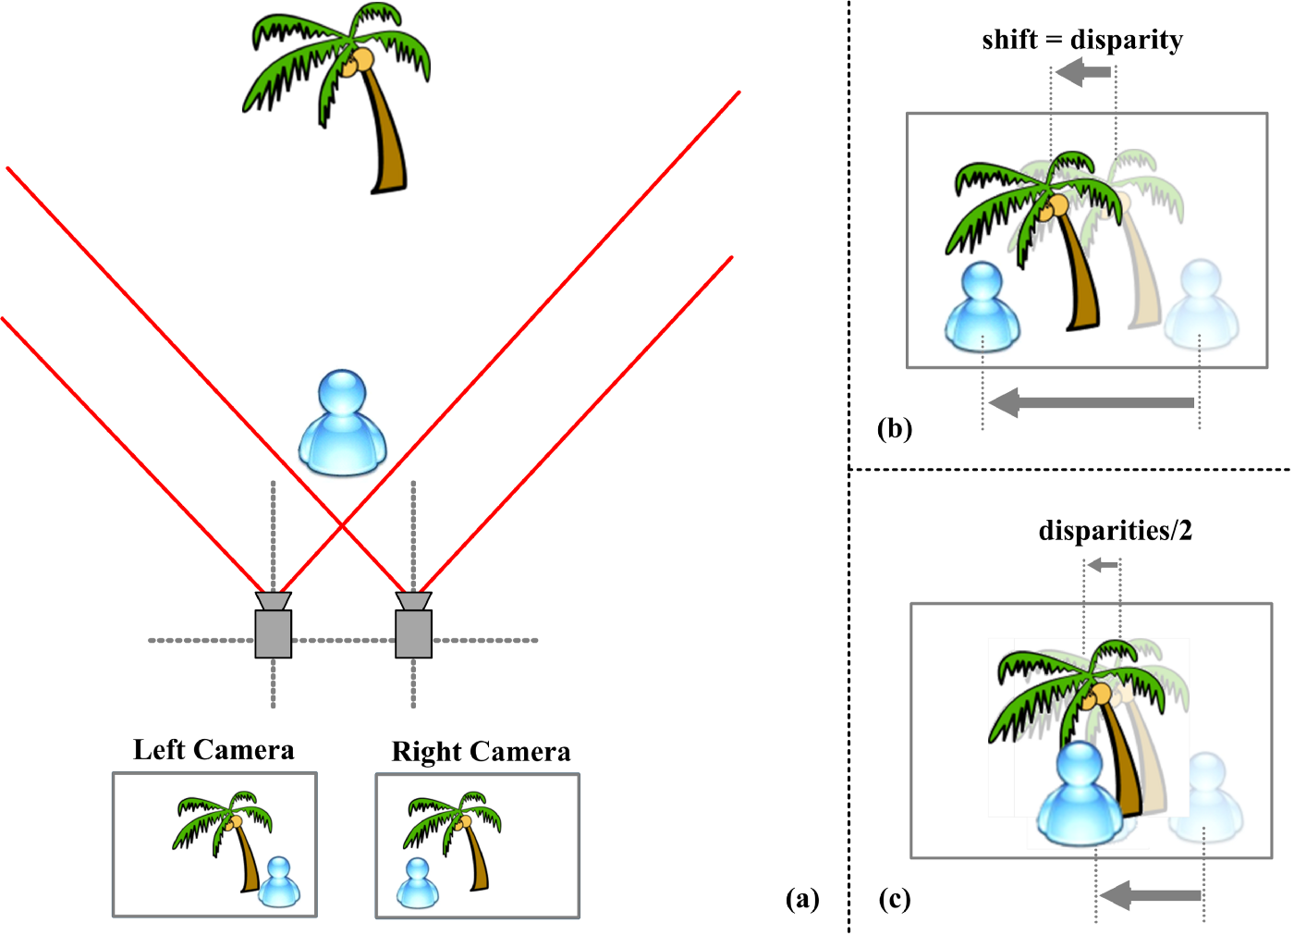
12.0 Introduction
Why are people interested in Depth Estimation and Stereo Matching?
From the earliest inquiries into visual perception, it was known that we perceive depth based on the differences in appearance between the left and right eyes.
Figure - A visualization of stereo matching.
In a, we have two cameras that capture a scene with a person and a palm tree. The images produced by the two cameras are shown at the bottom are clearly translated from each other.
In b, we see the definition of
Disparity: Difference in coordinates of similar features within two stereo images.
Notes:
Binocular disparity refers to the difference in image location of an object seen by the left and right eyes.

Slide 6
12.0 Introduction
The important observation is that the disparity of the foreground pixel is larger than that of the background pixel.
Under simple imaging configurations (both eyes or cameras looking straight ahead), the amount of horizontal motion or disparity is inversely proportional to the distance from the observer.
While the basic physics and geometry relating visual disparity to scene structure are well understood, automatically measuring this disparity by establishing dense and accurate inter-image correspondences is a challenging task.
In computational stereo, disparity information is typically stored in an intensity image(Disparity Map) where dark pixels encode low disparity values(high distances from camera) and bright intensities encode large disparities(close distance to the camera).

Slide 7
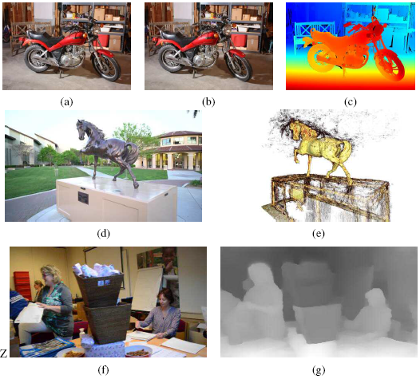
12.0 Introduction
Figure: Depth estimation algorithms can convert a pair of color images (a–b) into a depth map (c) (Scharstein, Hirschm¨uller et al. 2014) © 2014 Springer,
a sequence of images (d) into a 3D model (e) (Knapitsch, Park et al. 2017) © 2017 ACM,
or a single image (f) into a depth map (g) (Li, Dekel et al. 2019) © 2019 IEEE.

Slide 8
12.0 Introduction
Quick Quiz:
The process in visual perception that leads to depth due to the slightly different perspectives that our two eyes have of the world.
Binocular Disparity
Based on the separation of eyes by other facial features
What is the disparity of human eyes based on?

Slide 9
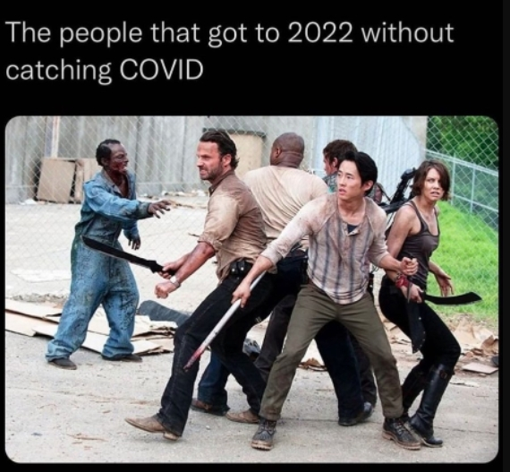
Break!

Slide 10
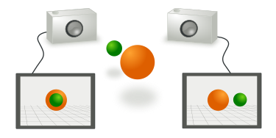
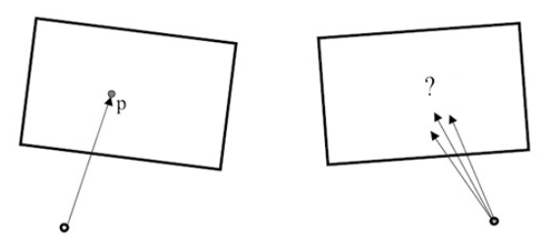
12.1 Epipolar Geometry
Given pixel in one image, how to find it’s correspondence in other image?
Figure^{[12.2]} : Two cameras take 2 pictures of the same scene from different points of view
Figure^{[12.3]} : How to find the pixel correspondence?
[12.2] : https://upload.wikimedia.org/wikipedia/commons/thumb/7/7c/Aufnahme_mit_zwei_Kameras.svg/375px-Aufnahme_mit_zwei_Kameras.svg.png
[12.3] : http://cv2.csie.ntu.edu.tw/CV2/_private/CV2_CH12_2021.pptx
Notes:
In chapter 9, we saw various techniques used to match pixels based on their local appearance as well as motion of neighbouring pixels.
In chapter 11, we discussed that in the case of stereo matching, we have some additional information available, namely the positions and calibration data for the cameras that took the pictures of the same static scene.

Slide 11
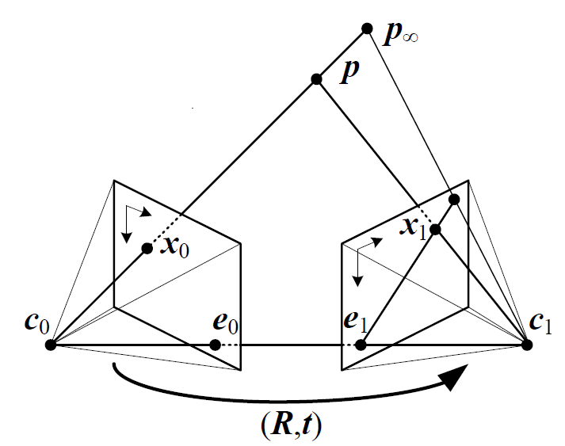
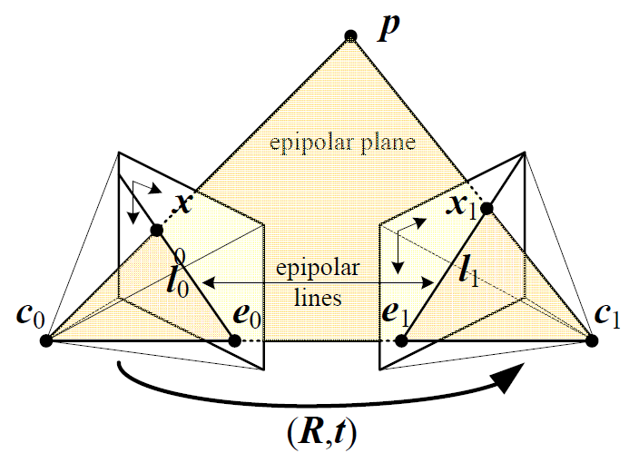
12.1 Epipolar Geometry
Since the optical centers of the cameras lenses are distinct, each center projects onto a distinct point into the other camera's image plane. These two image points, denoted by $e_{0}$ and $e_{1}$, are called Epipoles or Epipolar points.
Both epipoles $e_{0}$ and $e_{1}$ in their respective image planes and both optical centers $c_{0}$ and $c_{1}$ lie on a single 3D line.
Notes:
$x_{0}$ projects to an epipolar line segment in the other image $x_{1}$.
The segment is bounded at one end by the projection of the original viewing ray at infinity $p∞$.
At the other end by the projection of the original camera center $c_{0}$ into the second camera, which is known as the epipole $e_{1}$.
If we project the epipolar line in the second image back into the first, we get another line (segment), this time bounded by the other corresponding epipole $e_{0}$.
Extending both line segments to infinity, we get a pair of corresponding epipolar lines (Right Figure), which are the intersection of the two image planes with the epipolar plane that passes through both camera centers $c_{0}$ and $c_{1}$ as well as the point of interest $p$.

Slide 12
Important Elements
Epipolar Axis : ($c_{0}$ $c_{1}$ ) are the two projection centres.
Epipolar Plane $ε$ : ($c_{0}$ $c_{1}p$) depends on the projection centres and point.
Epipoles / Epipolar Point : $e_{0}$ and $e_{1}$ are the images of the projection centre. They are unique for a given stereo pair
Epipolar Lines : $l_{0}$ and $l_{1}$ are the images of rays $e_{0}p$ and $e_{1}p$ in the other image respectively.

Slide 13
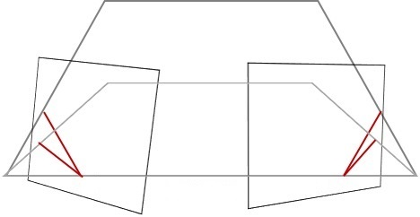
12.1 Epipolar Geometry
What does ($R,t$) stands for?
Rotation and translation of camera. These two describes the relative position between two cameras.
$$c_{0}$$
$$c_{1}$$
($R,t$)

Slide 14
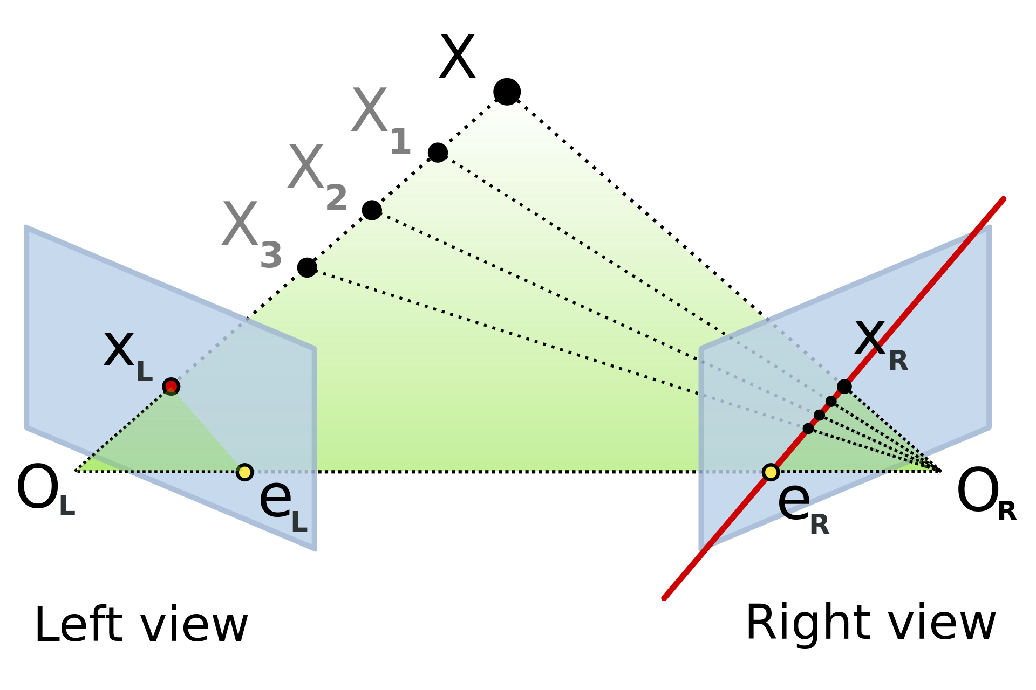
12.1 Epipolar Geometry
If the relative position ($R,t$) of the two cameras is known, this leads to two important observations:
Assume the projection point $X_{L}$ is known, and the epipolar line $e_{R}− x_{R}$ is known and the point $X$ projects into the right image, on a point $X_{R}$ which must lie on this particular epipolar line. This means that for each point observed in one image the same point must be observed in the other image on a known epipolar line. This provides an Epipolar Constraint.

Slide 15
12.1 Epipolar Geometry
If the points $X_{L}$ and $X_{R}$ are known, their projection lines are also known.
This means that $X$ can be calculated from the coordinates of two image points, a process called as Triangulation.

Slide 16
12.1 Epipolar Geometry (Epipolar Constraint)
Epipolar Constraint

Slide 17
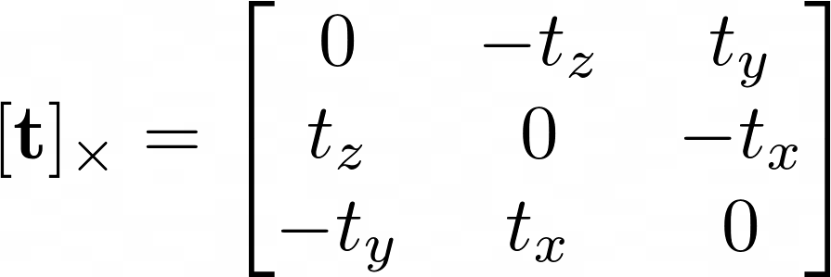
12.1 Epipolar Geometry (Epipolar Constraint)

Slide 18
12.1 Epipolar Geometry (Epipolar Constraint)
is called the essential matrix

Slide 19
12.1 Epipolar Geometry (Epipolar Constraint)
If we know intrinsic matrices of cameras, then
2D points in camera plane
is called the fundamental matrix

Slide 20
12.1 Epipolar Geometry(Epipolar Constraint)
Epipolar constraints can be described by the Essential Matrix or the Fundamental Matrix between the two cameras.
These 3*3 matrices are frequently used in stereo geometry which describe geometric relations between pairs of images.
Fundamental Matrix is essentially used for calibrated cameras and Essential matrix is used for uncalibrated cameras.
Contains all information about the relative orientation from corresponding points.
Both are homogenous matrices.
They both have a rank deficiency of 2.

Slide 21
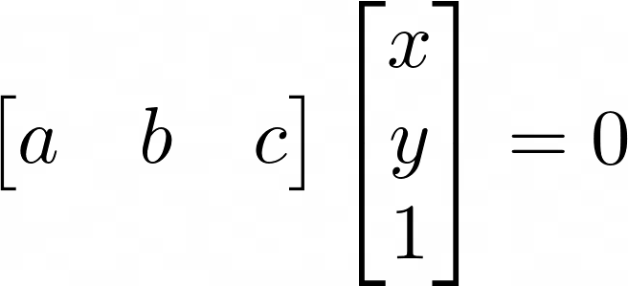
12.1 Epipolar Geometry(Epipolar Constraint)
If the fundamental matrix is known, than
The epipolar line equation
Epipolar Geometry example

Slide 22
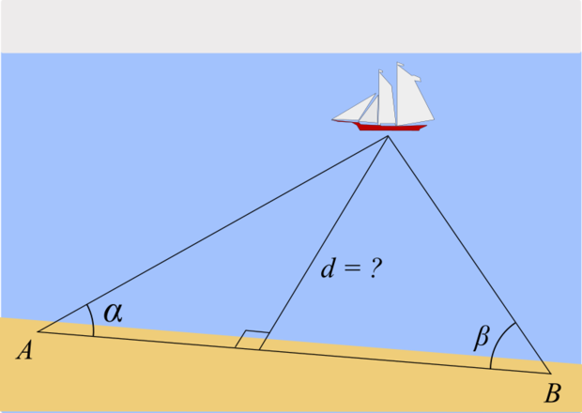
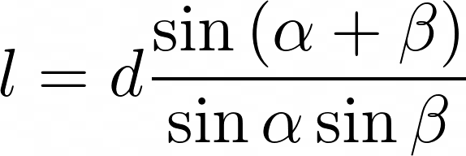
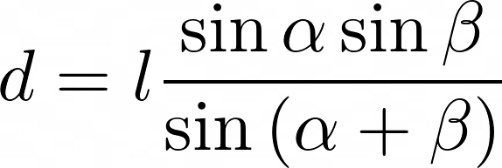
12.1 Epipolar Geometry(Triangulation)

Slide 23
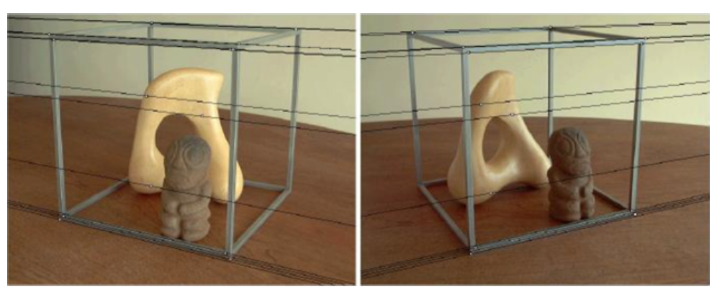
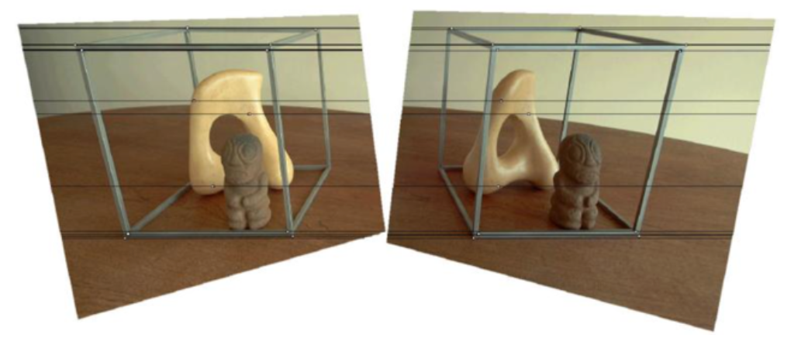
12.1.1 Rectification
The problem:

Slide 24
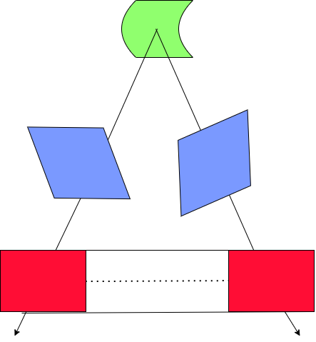
12.1.1 Rectification
What is Stereo Rectification?
Reproject image planes onto a common plane parallel to the line between camera centres
Pre-requisites for Stereo Rectification
Need two homographic matrices (Fundamental Matrices) one for each input image reprojection
Once fundamental matrix has been computed, we can use the epipolar line corresponding to a pixel in one image to constrain the search for corresponding pixels in the other image.

Slide 25
12.1.1 Rectification
Notes:
General Correspondence Algorithm such as Optical Flow (as discussed in Section 9.3 of Chapter 9) is good for rectifying but it will only consider locations along the epipolar line.

Slide 26
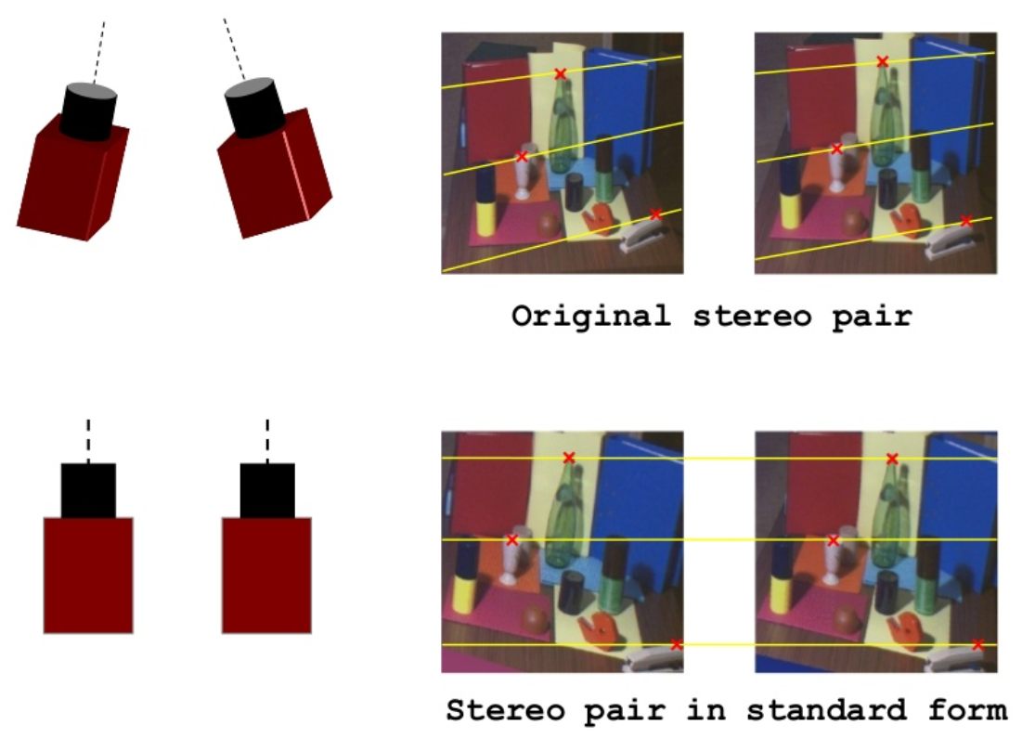
12.1.1 Rectification
A more efficient algorithm can be obtained by first rectifying the input images so that corresponding horizontal scanlines are epipolar lines.
A simple way to rectify the two images is to first rotate both cameras so that they are looking perpendicular to the line joining the camera centers $c_{0}$ and $c_{1}$.
Notes:
In general, it is not possible to rectify an arbitrary collection of images simultaneously unless their optical centers are collinear.

Slide 27
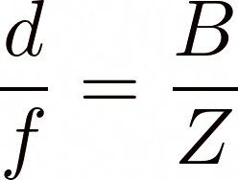
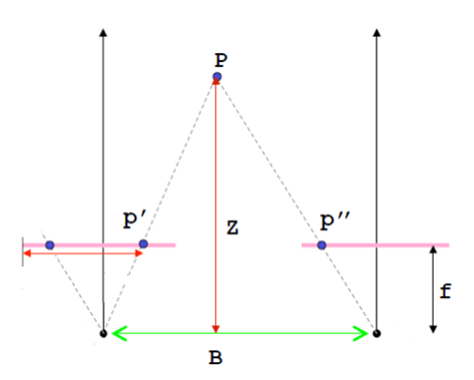
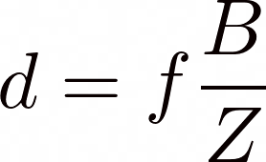
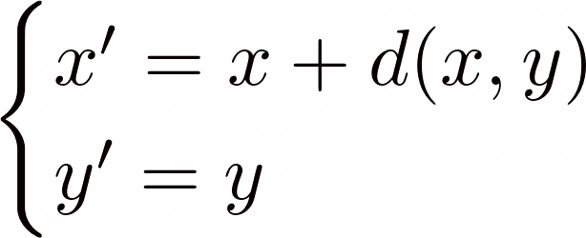
12.1.1 Rectification (Standard Rectified Geometry)
Note: Depth $Z$ and Stereo Disparity $d$ are inversely proportional
Notes:
$f$ is the focal point
$d$ is the disparity
$B$ is the baseline
The resulting standard rectified geometry is employed in a lot of stereo camera setups and stereo algorithms, and leads to a very simple inverse relationship between 3D depths $Z$ and disparities $d$,

Slide 28
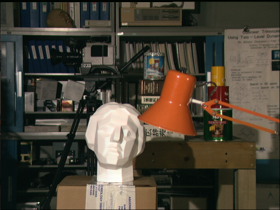
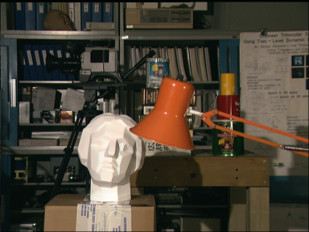
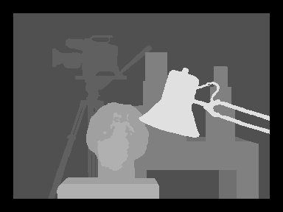
12.1.1 Rectification (Disparity Space Image)

Slide 29
12.1.1 Rectification (Disparity Space Image)
Given two input images$I_{L}(x,y)$ and $I_{R}(x,y)$, we wish to find a Disparity Space Image $d_{L}(x,y)$ such that the two images match as closely as possible.
$$I_{L}\left(x,y\right) ≈I_{R}(x−d_{L}\left(x,y\right),y)$$
The images must have been rectified to have a horizontal epipolar geometry.

Slide 30
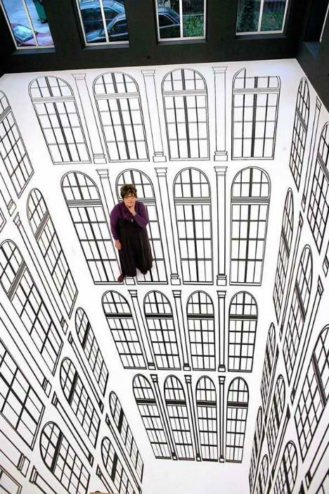
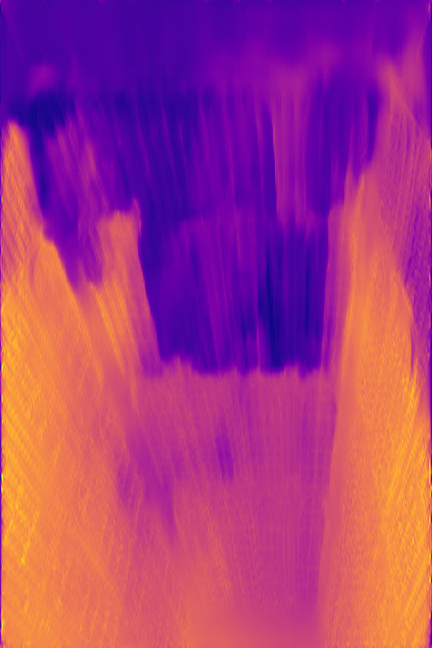
12.1.1 Rectification
Quick Quiz:
The distance from the top or surface to the bottom of an object is termed as depth.
Can you estimate this image’s depth?
Can a computer estimate this image’s depth?
What is depth according to a machine?
As researchers we have a lot of quest to finish!
Notes:
Source Left Image – https://weburbanist.com/2012/02/21/disorienting-depth-amazing-optical-illusions-in-art-galleries/
Source Right Image - https://3dphoto.io/

Slide 31
12.1.2 Plane Sweep
Plane sweep is the technique to sweep a set of planes through the scene and to measure the photo-consistency of different images as they are re-projected onto these planes

Slide 32
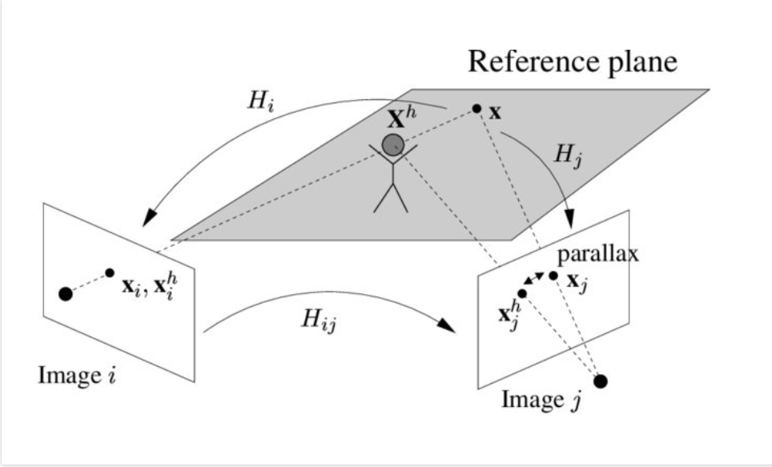
Plane Plus Parallax
https://www.researchgate.net/profile/Carsten-Rother/publication/243766669/figure/fig8/AS:648583464378370@1531645756383/Explanation-for-the-concept-of-plane-parallax_W640.jpg
Notes:
i and j are two planes
H is homograpghy of the image planes I and j
Xi and xj are the projection of x from the reference plane to the image plane
Let’s take the head as xh. Since it doesn’t lie on the reference plane , there are 2 different projection points on I and j.
So, xhj and xj is called the parallax vector. If xh is on the plane the parallax vector vanishes.
This is known as plane plus parallax

Slide 33
Plane Plus Parallax
How to solve this?
Reconsider this scenario from an “image-based” point of view. It would be convenient to superimpose the two images so that all points on the reference plane are identical and all points off the reference plane move and hence induce a parallax vector. This idea is known as stabilizing a reference plane. It can be achieved by specifying the reference plane as the plane at infinity and transforming the cameras into calibrated translating cameras.
(PDF) Multi-View Reconstruction and Camera Recovery Using a Real or Virtual Reference Plane. Available from: https://www.researchgate.net/publication/243766669_Multi-View_Reconstruction_and_Camera_Recovery_Using_a_Real_or_Virtual_Reference_Plane

Slide 34
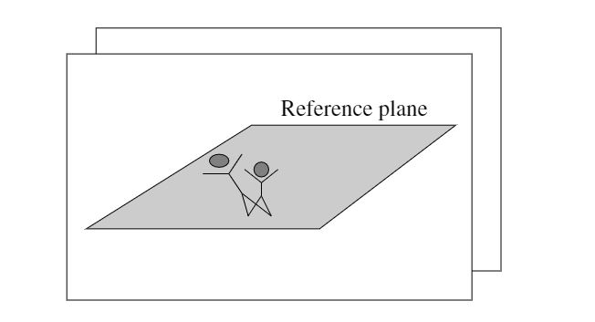
Plane Plus Parallax
https://www.researchgate.net/profile/Carsten-Rother/publication/243766669/figure/fig9/AS:648583464370179@1531645756406/Superimposed-images-after-stabilizing-the-reference-plane_W640.jpg
Notes:
The two superimposed images after stabilizing the reference plane.
The feet of the man are in both images at the same position (stabilized).
The head of the man is at different positions in the stabilized images.
In the above example we assumed that the reference plane is a real,
finite plane in the scene. In order to stabilize the reference plane,
this finite plane has been specified as the plane at infinity.

Slide 35
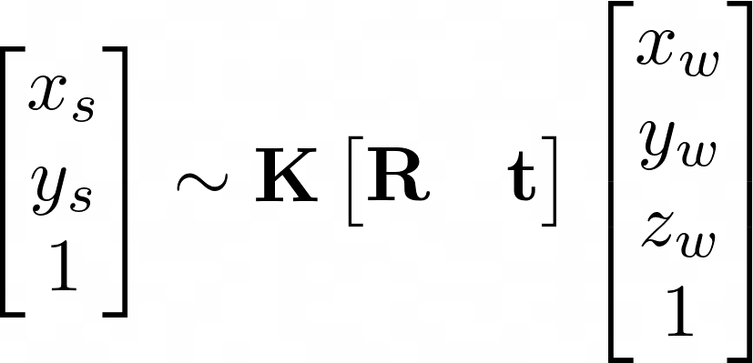
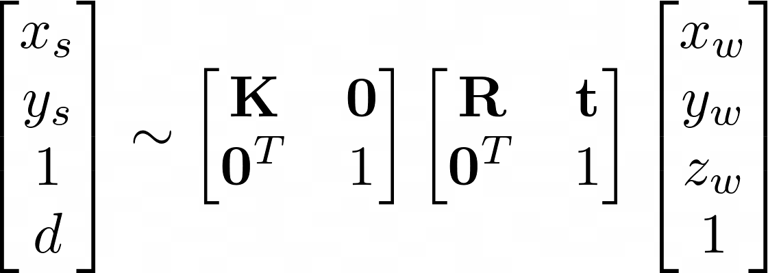
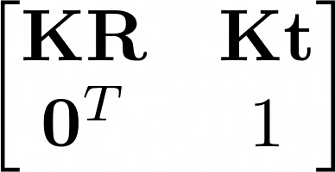
Plane Plus Parallax
Recall the camera matrix
camera plane coordinates
3D world coordinates
no disparity
$$3×3$$
$$3×3$$
$3×$1
$$4×4$$
$$4×4$$
can be changed

Slide 36
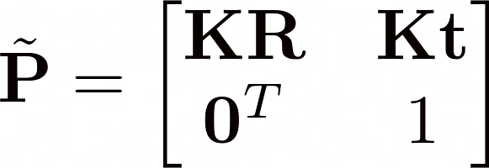
Plane Plus Parallax
Define the invertible $4×4$camera matrix by
Setting the last row of as
Where and .

Slide 37
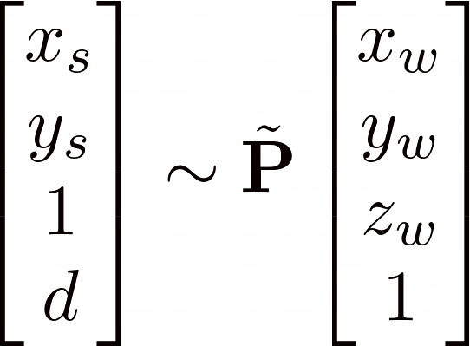
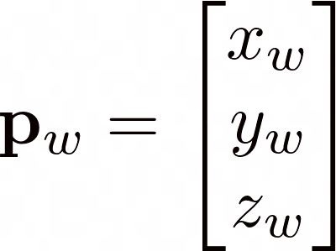
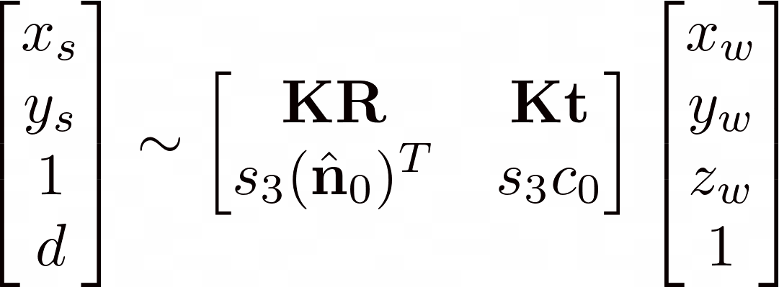
Plane Plus Parallax
Note that
camera plane coordinates with disparity
3D hyperplane

Slide 38
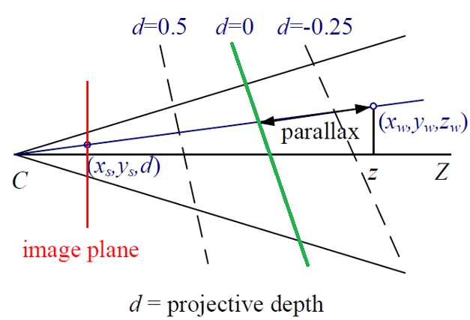
Projective Depth
We can interpret $d$ as the projective disparity or projective depth of a 3D scene point $P_{ω}$ from the reference plane $\hat{n_{0}∙}$ $P_{ω}$ + $c_{0}$
shift
reference plane

Slide 39
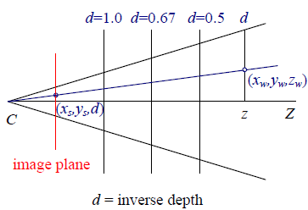
Inverse Depth
Let
The reference plane at infinity.
……
reference plane

Slide 40
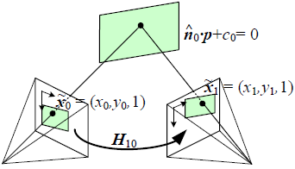
Mapping from One camera to Another
Since is full rank $4×4$ camera matrix
Project into another camera (camera matrix is )
3D world coordinates
camera plane coordinates with disparity

Slide 41
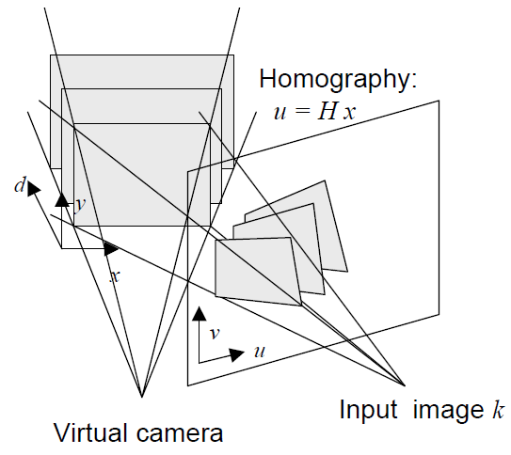
12.1.2 Plane sweep

Slide 42
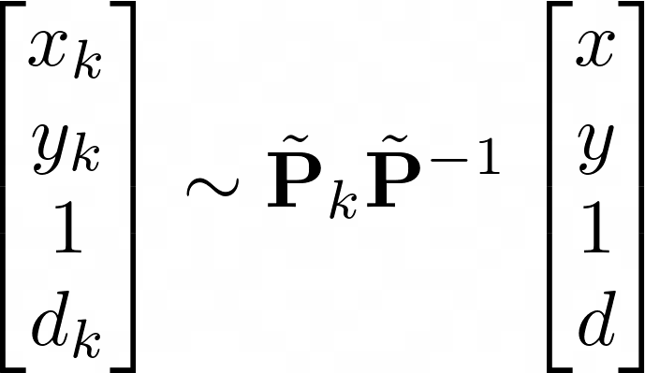
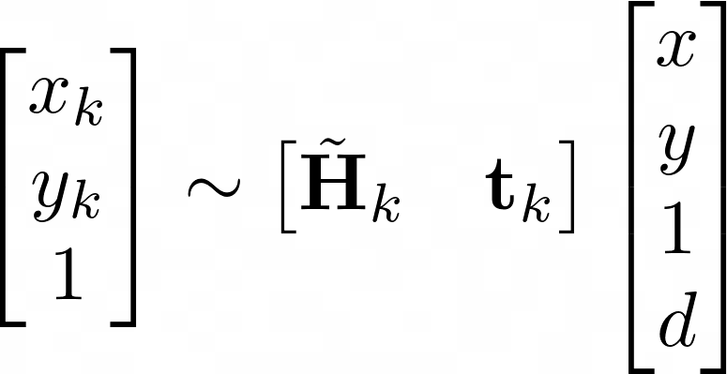
12.1.2 Plane sweep
The virtual camera defining the disparity space through a series of homographies.
k-th camera plane coordinates with disparity
virtual camera plane coordinates with disparity
want to estimate
parametererized by the addition of
a rank-1 matrix

Slide 43
12.1.2 Plane sweep
changeable
$$d=1$$
$$d=3$$
$$d=5$$
measure the photo-consistency

Slide 44
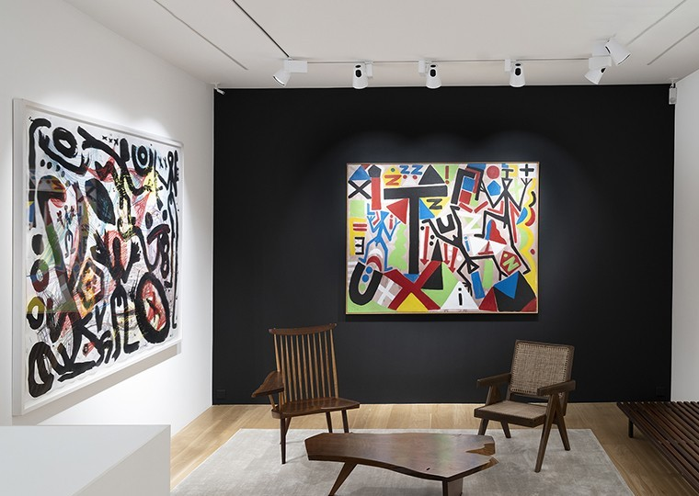
12.1.2 Plane sweep
Notes:
For further reference: https://citeseerx.ist.psu.edu/viewdoc/download?doi=10.1.1.541.2995&rep=rep1&type=pdf

Slide 45
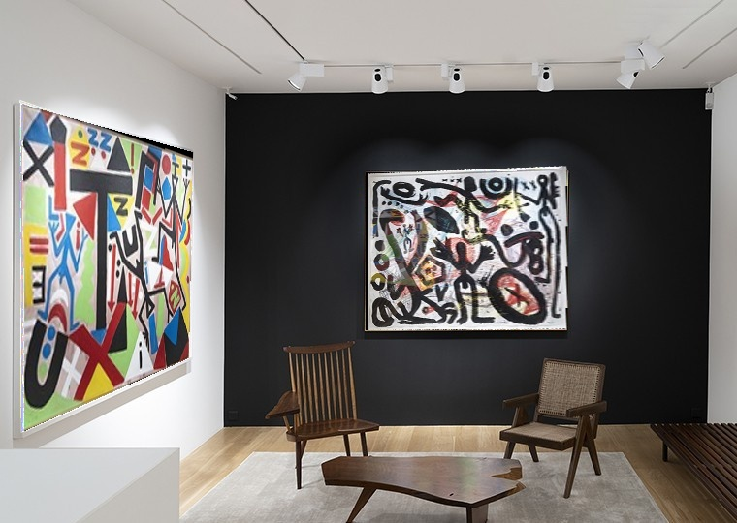
12.1.2 Plane sweep
Notes:
OpenCV: findHomography
Other algorithms: DLT,Least Square method

Slide 46
Brainstorm!
Is Stereo Rectification and Homography Same?
Stereo Rectification: Reproject image planes onto a common plane parallel to the line between camera centre.
Need two homographies for each input image projection.
Homography: A 3x3 matrix used to map a plane to another plane.
It is used in stereo rectification and many stereo algorithms
Notes:
OpenCV: findHomography
Other algorithms: DLT,Least Square method

Slide 47
Brainstorm!
Homography
Stereo Rectification

Slide 48
Break!

Slide 49
12.2 Sparse Correspondence
Feature-based matching algorithms searched for corresponding location in the other images by using either interest operators or edge detectors.
There is also a desire to match scenes with different illumination in some application.

Slide 50
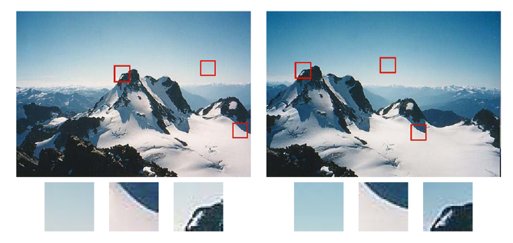
12.2 Sparse Correspondence

Slide 51
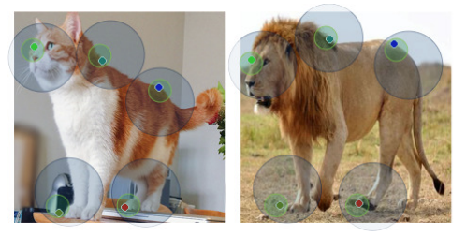
12.2 Sparse Correspondence

Slide 52
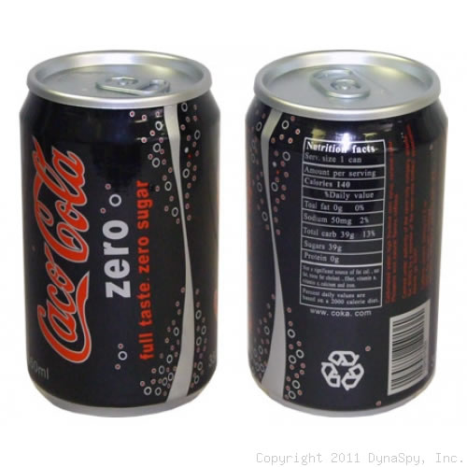
12.2.1 3D Curves and Profiles
Another example of sparse correspondence is the matching of profile curves (or occluding contours), which occur at the boundaries of objects and at interior self occlusions, where the surface curves away from the camera viewpoint.
The difficulty in matching profile curves is that in general, the locations of profile curves vary as a function of camera viewpoint. Therefore, matching curves directly in two images and then triangulating these matches can lead to erroneous shape measurements.

Slide 53
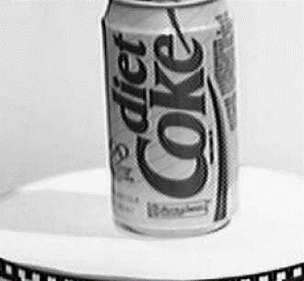
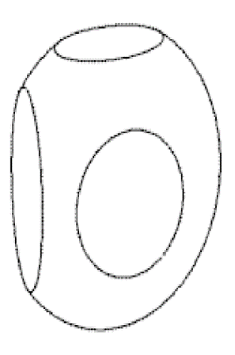
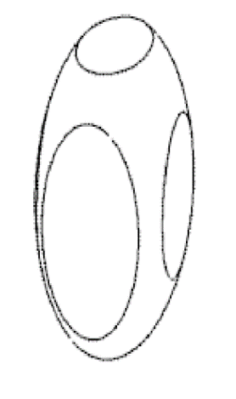
12.2.1 3D Curves and Profiles
Fortunately, if three or more closely spaced frames are available, it is possible to fit a local circular arc to the locations of corresponding edges and therefore obtain semi-dense curved surface meshes directly from the matches .

Slide 54
12.2.1 3D Curves and Profiles
$c_{i}x_{c}+s_{i}y_{c}=r−d_{i}$ where $c_{i}$, $s_{i}$ are cosθ and sinθ

Slide 55
Break!

Slide 56
12.3 Dense Correspondence
While sparse matching algorithms are still occasionally used, more challenging problems focus on dense correspondence.
This problem is more challenging than sparse correspondence, because inferring depth values in texture less regions requires a certain amount of guesswork.

Slide 57
12.3 Dense Correspondence

Slide 58
12.3 Dense Correspondence
Stereo algorithms on dense correspondence generally perform the following four steps:
Cost Computation.
Cost Aggregation.
Disparity Computation and Optimization.
Disparity Refinement.
Local Algorithm
Use a matching cost that is based on a support region.
Global Algorithm
Make explicit smoothness assumptions and then solve a global optimization problem

Slide 59
12.3 Dense Correspondence
Sum-of Squared Differences(SSD) is a type of Local Algorithm
The traditional sum-of-squared differences (SSD) algorithm can be described as:
Figure: https://academicjournals.org/article/article1380810673_Marghany%20et%20al.pdf

Slide 60
12.3 Dense Correspondence
We need to do this from left to right and right to left.
Because Depth changes some pixels visible in the left image or not in the right and vice-versa.

Slide 61
12.3.1 Similarity Measures
To assess correspondence for dense stereo matching, some similarity measure is mentioned in this section.
Entropy of the pixel values limits the influence of mismatch during aggregation.
Sign of the Laplacian leads to poor discriminability in binary matching.
Gradient-based methods are insensitive to depth discontinuities.
Census transform converts pixel into a bit vector

Slide 62
12.3.1 Similarity Measures
(a) Intensity image
(b) Mean filter
(c) LOG filter
(d) BilSub filter
(e) Rank filter
(f) SoftRank filter
LOG: Laplacian of Gaussian
BilSub: background subtraction by bilateral

Slide 63
Break!

Slide 64
12.4 Local Methods
Local and window-based methods aggregate the matching cost by summing or averaging over a support region in the DSI(Disparity Space image) $C(x,y,d).$
In local methods, the emphasis is aggregation step because of winner-takes-all strategy.

Slide 65
12.4 Local Methods
Aggregation with a fixed support region can be performed using 2D or 3D convolution.

Slide 66
12.4 Local Methods
matching 9 windows

Slide 67
Fixed Window vs Shiftable Window
Fixed window:
Shiftable window:

Slide 68
Variable Window

Slide 69
Adaptive Weight

Slide 70
Segmentation Based

Slide 71
12.4 Local Methods
Selecting correct windows is important, since windows must be large enough to contain sufficient texture and small enough to avoid straddle depth discontinuities.
Straddle Depth Discontinuities

Slide 72
12.4.1 Sub Pixel Estimation and Uncertainty
Most stereo correspondence algorithms compute a set of integer disparity estimates in discretized space, but sometimes it requires more precision in robot navigation or people tracking.

Slide 73
12.4.1 Sub Pixel Estimation and Uncertainty
To remedy this situation, many algorithms apply sub-pixel as refinement by interpolation.
Sub-pixel disparity estimates are computed by fitting curve, but regions must be the same surface.
Different object surface

Slide 74
12.4.1 Sub Pixel Estimation and Uncertainity
To work well, the intensities being matched must vary smoothly, and the regions over which these estimates are computed must be on the same (correct) surface.
Besides sub-pixel computations, there are other ways of post-processing the computed disparities.

Slide 75
12.4.1 Sub Pixel Estimation and Uncertainty
(a) input image
(b) estimated depth map
(blue is closer)
(c) estimated confidence
(red is higher).

Slide 76
Break!

Slide 77
12.5 Global Optimization
Global stereo matching are formulated in energy minimization by finding a solution $d$.
Data energy function
Total energy (cost) function
Smooth energy function

Slide 78
12.5 Global Optimization
Global method performs iterative optimization which consists of data terms and smoothness terms for replacing aggregation step.
The data term measures how well the disparity function agrees with input image pair.
Where $C$ is aggregated matching cost.
Once the energy function has been defined, a variety of algorithms are used to find minimum.
Traditional approaches are associated with Markov random fields and regularization.

Slide 79
Local Plane Sweeps
(Sinha,Scharstein and Szeliski 2014)
Instead of sweeping planes perpendicular to the viewing direction, it is also possible to model the scene using a collection of slanted planes.
(a) input image
(b) initial sparse matches
(c) matches grouped by slanted planes
(d) 3D visualization of planes and grouped features

Slide 80
12.5.1 Dynamic Programming
A different class of global optimization algorithm is based on dynamic programming.
Dynamic programming can find the global minimum for independent scanlines in polynomial time.
Left scanline
Right scanline

Slide 81
12.5.1 Dynamic Programming
Cyclopean image is a single mental image of a scene created by the brain through the process of combining two images received from both eyes.
Limited Disparity Range
Limited Disparity Range
Notes:
Lowercase letters(a-k) symbolize the intensities along each scanline.
Uppercase letters represent the selected path through the matrix.
Matches are indicated by M, while partially occluded points are indicated by L or R, corresponding to points only visible in the left or right images.

Slide 82
12.5.1 Dynamic Programming
Problems with Dynamic Programming:
Selection of the right cost for occluded pixels and the difficulty of enforcing inter-scanline consistency.
Another problems of Dynamic programming approach requires enforcing the monotonicity or ordering constraint.
This constraint requires that the relative ordering of pixels on a scanline remain the same between the two views, which may not be the case in scenes containing narrow foreground objects.

Slide 83
12.5.2 Segmentation Based Techniques
While most stereo matching algorithms perform their computations on pixels, some of the techniques segment the images into regions for trying to label with disparities.
Segment boundaries are refined during the optimization, leading to more accurate results(the thin green leaf in the bottom row)

Slide 84
12.5.2 Segmentation Based Techniques
Stereo matching with adaptive over-segmentation and matting (Taguchi, Wilburn, and Zitnick 2008) © 2008 IEEE:
Alpha Mattes are extracted at segment boundaries, which leads to visually better compositing results(middle)

Slide 85
12.5.2 Segmentation Based Techniques
Multi-frame matching using edges, planes, and superpixels (Xue, Owens et al. 2019) © 2019 Elsevier.
The algorithm starts by matching edges across a multi-frame stereo sequence and then fit overlapping square patches to obtain local plane hypotheses.
These are then refined using superpixels and a final edge-aware relaxation to get continuous depth maps.

Slide 86
12.5.3 Z-Keying and background Replacement
Z-keying systems required expensive custom-built hardware to produce the desired depth maps in real time and were, therefore, restricted to broadcast studio applications.
Background replacement using z-keying with a bi-layer segmentation algorithm (Kolmogorov, Criminisi et al. 2006) © 2006 IEEE.
Notes:
Highly accurate real-time stereo matching subsequently made it possible to perform z-keying on regular PCs,
enabling desktop video conferencing applications such as those shown in but
these have mostly been replaced with deep networks for background replacement and
real-time 3D phone-based reconstruction algorithms for augmented reality.

Slide 87
Brainstorm!
What is the difference between Segmentation Disparity and Depth?
Segmentation: Image broken down into subgroups/segments exhibiting certain characteristics.
Disparity : Measure of difference in position between correspondence points of two images.
Depth:An image or image channel that contains information relating to the distance of the surfaces of scene objects from a viewpoint. Disparity map is needed to extract depth.

Slide 88
Break!

Slide 89
12.6 Deep neural Networks
DNNs used in stereo correspondence algorithms can be classified in three categories:
Learning in the stereo pipeline
End-to-end learning with 2D architectures
End-to-end learning with 3D architectures
The first successful application of deep learning to stereo was the seminal work by Zbontar and LeCun (2016), who trained a CNN to compare image patches.
These learned matching costs are still widely used in top-performing methods on the Middlebury stereo evaluation.

Slide 90
End-to-End Learning with 2D Architectures
The availability of large synthetic datasets with ground truth disparities, in particular the SceneFlow dataset enabled the end-to-end training of stereo networks.
SceneFlow: The collection contains more than 39000 stereo frames in 960x540 pixel resolution.
Optical flow maps
Segmentations
Disparity maps

Slide 91
End-to-End Learning with 2D Architectures
The first deep learning architectures for stereo were similar to those designed for dense regression tasks such as semantic segmentation (Chen, Zhu et al. 2018).
They proposed framework of a two-stage learning method for semantic segmentation based on estimated depth information.

Slide 92
End-to-End Learning with 3D Architectures
The End-to-end learning 3D architectures explicitly encode geometry by processing features over a 3D volume.
The first examples of such architectures include GC-Net (Kendall, Martirosyan et al. 2017) and PSMNet (Chang and Chen 2018).
A recent example of domain generalization is the domain-invariant stereo matching network (DSMNet) of Zhang, Qi et al. (2020).
Input view
HD³
PSMNet
DSMNet
HD³: Hierarchical Discrete Distribution Decomposition for Match Density Estimation
GC-Net: Geometry and Context Network
PSMNet: Pyramid Stereo Matching Network
DSMNet: Domain-Invariant Stereo Matching Network

Slide 93
Break!

Slide 94
12.7 Multi-view Stereo
While matching pairs of images is a useful way of obtaining depth information, matching more images lead to better results.
Examining all the epipolar plane image can visualize the multi-frame stereo estimation.

Slide 95
12.7 Multi-view Stereo
The condition of occluded object is seen as strip of regions which explain their relationships in the epipolar plane images.

Slide 96
12.7 Multi-view Stereo
Taking advantage of these additional images is to sum up their differences from the reference image $I_{r},$
This is the basis of the well-known sum of summed-squared-difference (SSSD) approaches
$k$ different view images

Slide 97
12.7 Multi-view Stereo
(a) stable windows which center on the white pixel straddling depth discontinuities.
(b) Shiftable windows decrease the problems in partially occluded regions.

Slide 98
12.7 Multi-view Stereo
The results of applying these techniques to the multi-frame flower garden image sequence.
(a)
(b)
(c)
(d)
Window that is not spatially perturbed (centered);
Spatially perturbed window;
Using the best five of 10 neighboring frames;
Using the better half sequence.

Slide 99
12.7.1 Scene Flow
Multiple cameras are used to capture a dynamic scene.
Scene flow simultaneously recover,
Shape of the object at every instant in time.
3D motion of every surface point between frames.
(a)
3D scene flow be computed from a multi-camera dome surrounding the dancer.
3D scene flow be computed from stereo cameras mounted on a moving vehicle.

Slide 100
12.7.2 Volumetric and 3D Surface Reconstruction
The most challenging but also most useful variant of multi-view stereo reconstruction the creation of globally consistent 3D models.
Figure: Multi-view Stereo Algorithms. (a) Surface Based Stereo. (b) Voxel Coloring (c) Merging Depth Map (d) Level Set Method.

Slide 101
12.7.2 Volumetric and 3D Surface Reconstruction
Figure: Multi-view stereo algorithms. (e) Stereo Fusion (f) Multi-View Image Matching (g) Graph Cut (h) Visual Hulls.

Slide 102
12.7.2 Volumetric and 3D Surface Reconstruction
In order to compare all these techniques, there is a six point taxonomy that can help classify algorithms in this section.
The most popular representations is uniform grid of voxels in 3D scene.
Photo consistency measure is a choice that computes directly on the surface.
Single depth map is the ability to distinguish visibility and occlusions.
Most matching algorithms adopt some form of prior model for the expected shape.
Some approaches define over consistency volume to recover a complete surface by global optimization.
To refine or evolve a rough model, it usually requires an accurate initialization.
https://vision.middlebury.edu/mview/eval/.

Slide 103
12.7.3 Shape From Silhouettes
In many situations, performing a foreground–background segmentation of the object of interest is a good way to initialize or fit a 3D model.
Over the years, a number of techniques have been developed to reconstruct a 3D volumetric model from the intersection of the binary silhouettes projected into 3D.
Other approaches use voxel-based representations, usually encoded as octrees, because of the resulting space–time efficiency.
(a)
(b)
(c)
(d)

Slide 104
Visual Hull
Visual hull is based on follows observation:
The volume is maximal with respect to the visual silhouettes.
Surface elements are tangent to the viewing rays along the silhouette boundaries.
Each of these silhouettes by different camera views form in their projection a cone called visual cone and an intersection of all these cones form a description of the real object’s shape.

Slide 105
Octree
An octree is a tree data structure in which each internal node has exactly eight children. Octrees are most often used to partition a three-dimensional space by recursively subdividing it into eight octants.

Slide 106
Questions
The reason why fundamental matrix only has 7 degree of freedom.
(1, The constraint of fundamental matrix is homogenous. 2, Fundamental matrix is rank 2.)
Give three applications of stereo vision?
(1, View morphing between two images, 2, Autonomous navigation, 3, Building 3D surface models from multiple video streams in Virtualized Reality)
Describe the step of stereo rectification?
(1, Images transformed so that epipolar lines are parallel; 2, Images rectified so that epipolar lines are horizontal and in vertical correspondence; 3, Final rectification that minimizes horizontal distortions.)
Describe four steps of general stereo algorithms?
(1, Matching cost computation, 2, Cost aggregation, 3, Disparity computation and optimization, 4, Disparity refinement.)
Enumerate three transformations that can be applied to images in order to improve their similarity across illumination variations.
(1, Mean filter, 2, LOG filter, 3, BilSub filter)
Enumerate three window-based methods?
(1, Fixed windows, 2, Shiftable windows, 3, Variable windows)
What are the three categories of DNNs based stereo correspondence algorithms.?
(1, Learning in the stereo pipeline, 2, End-to-end learning with 2D architectures, 3, End-to-end learning with 3D architectures.)
List three Multi-view stereo algorithms.
(1, Surface based stereo, 2, Voxel coloring, 3, Merging depth map)
List two methods of shape from silhouettes?
(1 Visual hull. 2, Octree.)
What is the smoothness term measures differences between neighboring pixels in global optimization? Ans:

Slide 107
Thank You.
” If we knew what it was we were doing, it would not be called research, would it? ”
- Albert Einstein.

