Slide 1
Advanced Computer Vision Chapter 12
Depth Estimation
Presenter: Bo-Chen Kung 龔柏丞
Advisor: Chiou-Shann Fuh 傅楸善
Cell phone: 0978912582
E-mail: r08922a25@ntu.edu.tw
Digital Camera and Computer Vision Laboratory
Department of Computer Science and Information Engineering
National Taiwan University, Taipei, Taiwan, R.O.C.

Slide 2
Outline
12.0 Introduction
12.1 Epipolar Geometry
Rectification
Plane sweep
12.2 Sparse Correspondence
3D curves and profiles
12.3 Dense Correspondence
Similarity measures
12.4 Local Methods
Sub-pixel estimation and uncertainty

Slide 3
Outline
12.5 Global Optimization
Dynamic programming
Segmentation-based techniques
Application: Z-keying and background replacement
12.6 Deep neural networks
12.7 Multi-view Stereo
Scene flow
Volumetric and 3D surface reconstruction
Shape from silhouettes

Slide 4
12.0 Introduction
Stereo matching is the process of taking two or more images and building a 3D model of the scene by finding matching pixels in the images and converting their 2D positions into 3D depths.

Slide 5
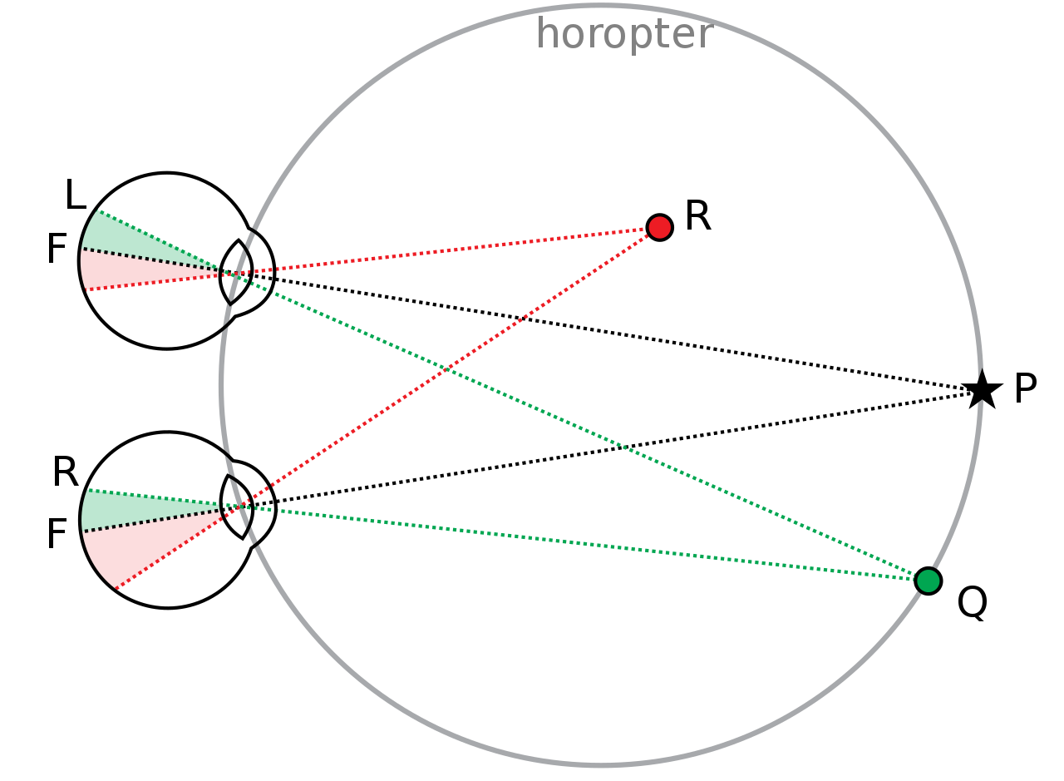
12.0 Introduction (cont’)
Binocular Vision

Slide 6
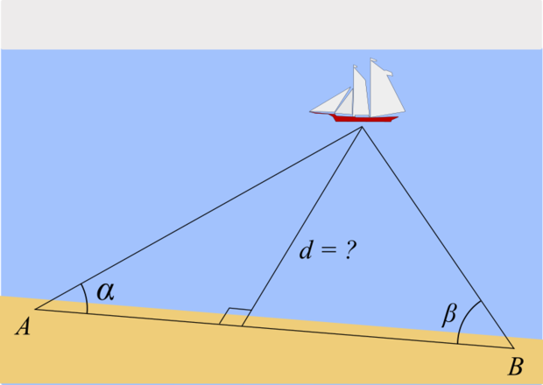
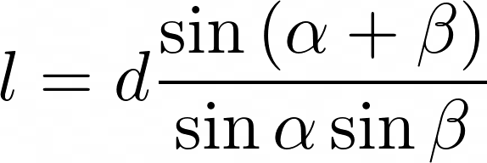
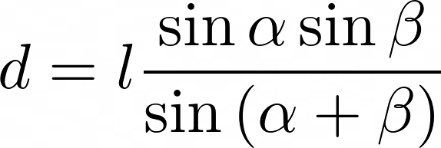
12.0 Introduction (cont’)
Triangulation

Slide 7
12.0 Introduction (cont’)
We address the question of how to build a more complete 3D model, e.g., a sparse or dense depth map that assigns relative depths to pixels in the input images.

Slide 8
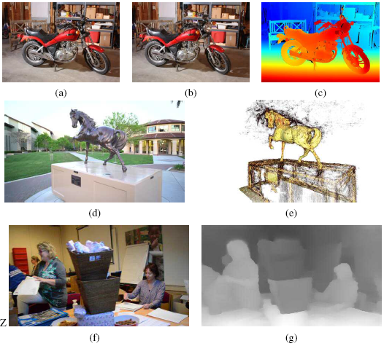
12.0 Introduction (cont’)
Figure 12.1 Depth estimation algorithms can convert a pair of color images (a–b) into a depth map (c) (Scharstein, Hirschm¨uller et al. 2014) © 2014 Springer, a sequence of images (d) into a 3D model (e) (Knapitsch, Park et al. 2017) © 2017 ACM, or a single image (f) into a depth map (g) (Li, Dekel et al. 2019) © 2019 IEEE.

Slide 9
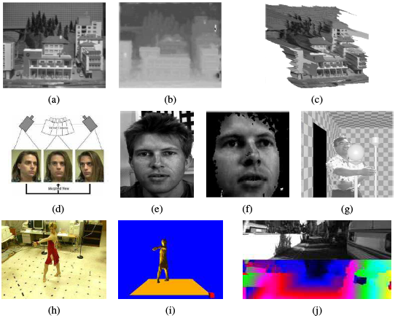
12.0 Introduction (cont’)
Figure 12.2 Applications of stereo vision: (a) input image, (b) computed depth map, and (c) new view generation from multi-view stereo (Matthies, Kanade, and Szeliski 1989) © 1989 Springer; (d) view morphing between two images (Seitz and Dyer 1996) © 1996 ACM; (e–f) 3D face modeling (images courtesy of Fr´ed´eric Devernay); (g) z-keying live and computergenerated imagery (Kanade, Yoshida et al. 1996) © 1996 IEEE; (h–i) building 3D surface
models from multiple video streams in Virtualized Reality (Kanade, Rander, and Narayanan 1997); (j) computing depth maps for autonomous navigation (Geiger, Lenz, and Urtasun 2012).

Slide 10
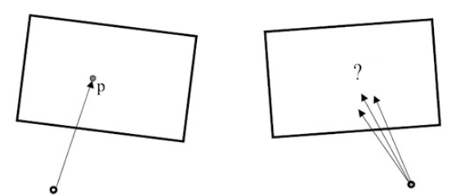
12.1 Epipolar Geometry
Question: given a pixel in one image, how to compute its correspondence in the other image?

Slide 11
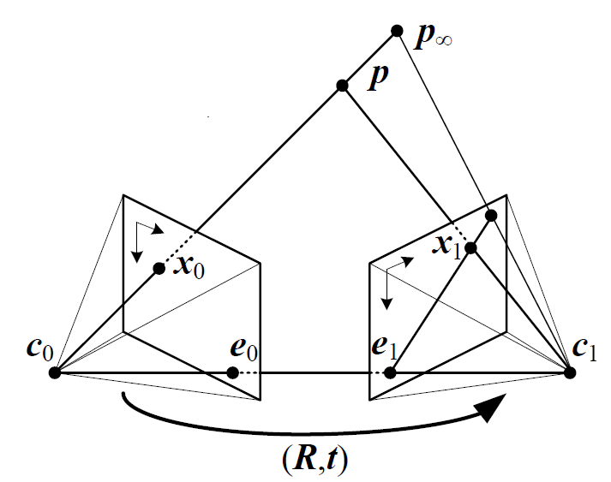
12.1 Epipolar Geometry (cont’)

Slide 12
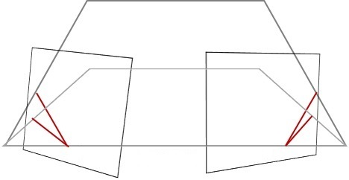
12.1 Epipolar Geometry (cont’)

Slide 13
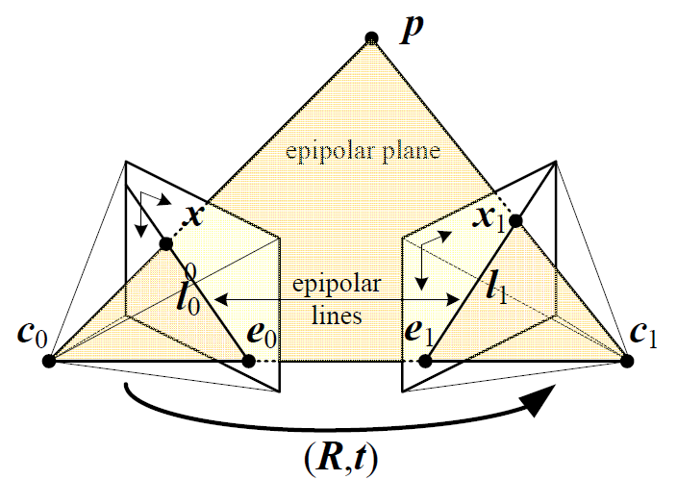
12.1 Epipolar Geometry (cont’)
epipolar constraint

Slide 14
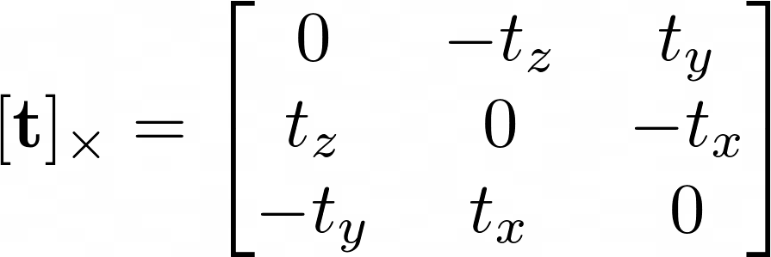
Epipolar Constraint

Slide 15
Epipolar Constraint (cont’)
is called the essential matrix

Slide 16
Epipolar Constraint (cont’)
If we know intrinsic matrices of cameras, than
2D points in camera plane
is called the fundamental matrix

Slide 17
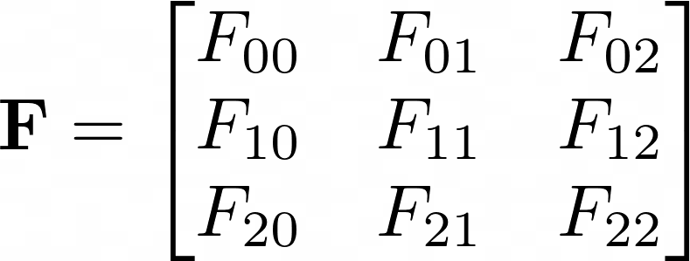
Fundamental Matrix
Fundamental matrix can be computed from seven or more point matches.
Fundamental matrix only has 7 degree of freedom.
The constraint of fundamental matrix is homogenous
Why?
Why?
for some

Slide 18
Fundamental Matrix (cont’)
Fundamental matrix is rank 2
Recall:
Therefore, the fundamental matrix only has 7 degree of freedom.
is rank 2

Slide 19
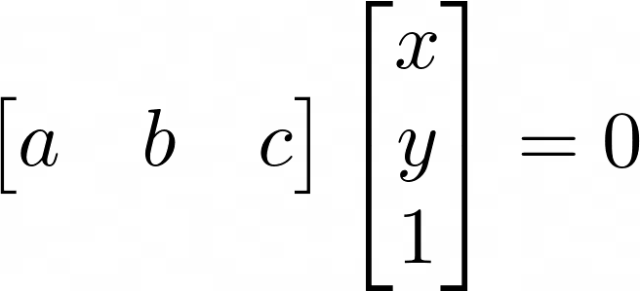
12.1 Epipolar Geometry (cont’)
If the fundamental matrix is known, than
The epipolar line equation
Epipolar Geometry example
Notes:
Fundamental matrix 的使用

Slide 20
12.1.1 Rectification
Once fundamental matrix has been computed, we can use the epipolar line corresponding to a pixel in one image to constrain the search for corresponding pixels in the other image.

Slide 21
12.1.1 Rectification (cont’)

Slide 22
12.1.1 Rectifying
A more efficient algorithm can be obtained by first rectifying the input images so that corresponding horizontal scanlines are epipolar lines.

Slide 23
12.1.1 Rectifying (cont’)
A simple way to rectify the two images is to first rotate both cameras so that they are looking perpendicular to the line joining the camera centers $c_{0}$ and $c_{1}$.

Slide 24
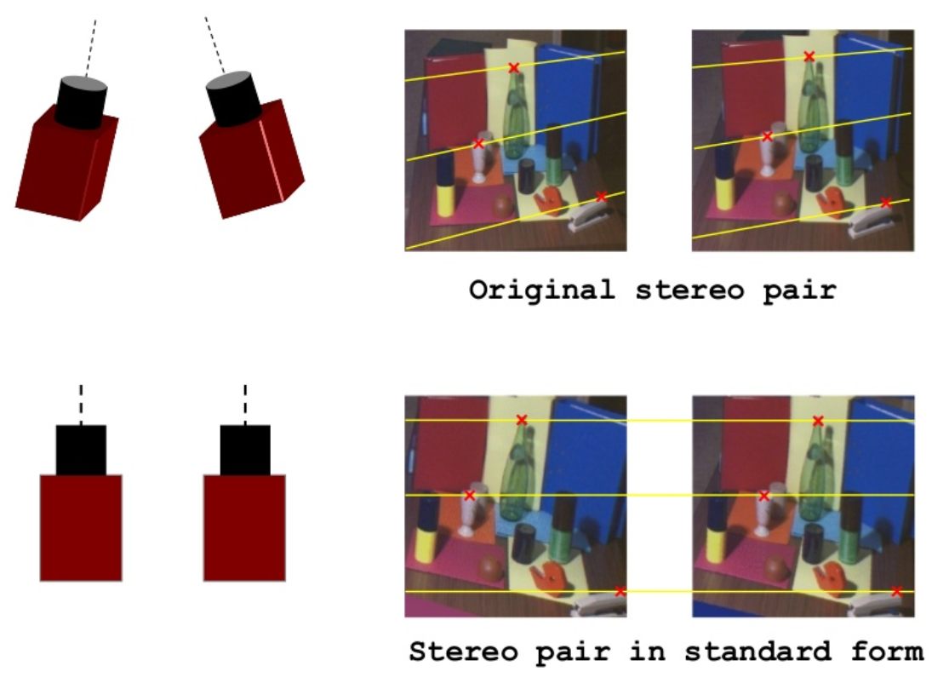
12.1.1 Rectifying (cont’)

Slide 25
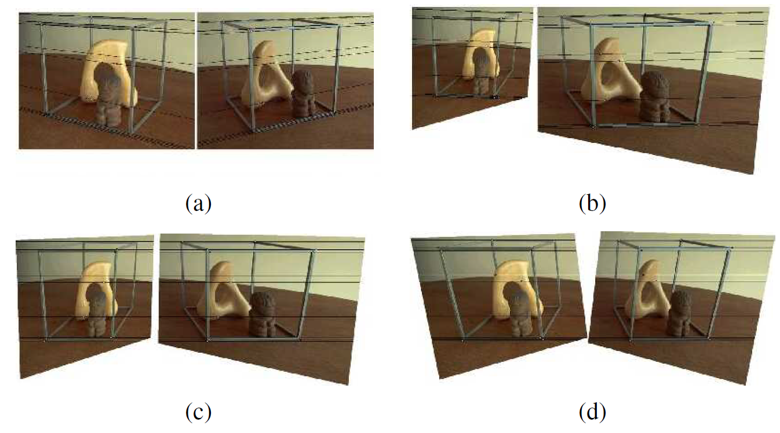
12.1.1 Rectifying (cont’)

Slide 26
12.1.1 Rectifying (cont’)
In general, it is not possible to rectify an arbitrary collection of images simultaneously unless their optical centers are collinear.

Slide 27
Stereo Disparity
Notes:
demo

Slide 28
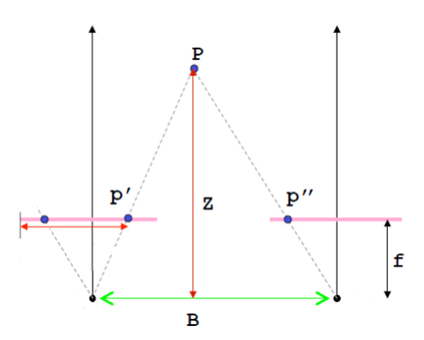
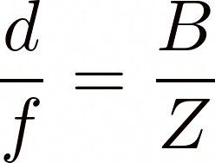
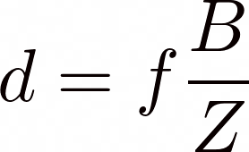
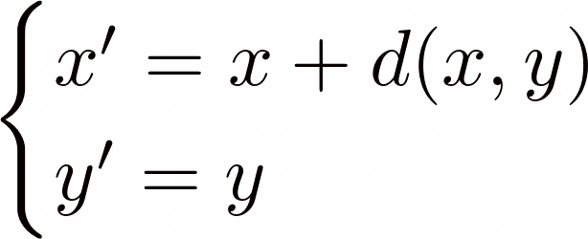
Standard Rectified Geometry

Slide 29
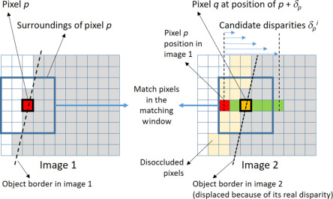
Disparity Space Image (DSI)
The disparity space image , can be obtained by stereo matching.

Slide 30
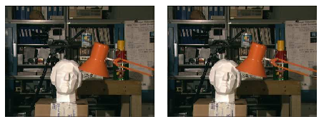
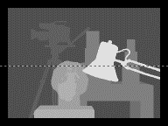
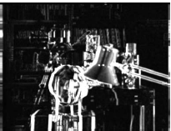
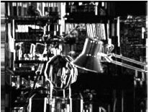
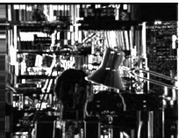
Disparity Space Image (cont’)

Slide 31
12.1.2 Plane Sweep
Plane sweep is the technique to sweep a set of planes through the scene and to measure the photo-consistency of different images as they are re-projected onto these planes.

Slide 32
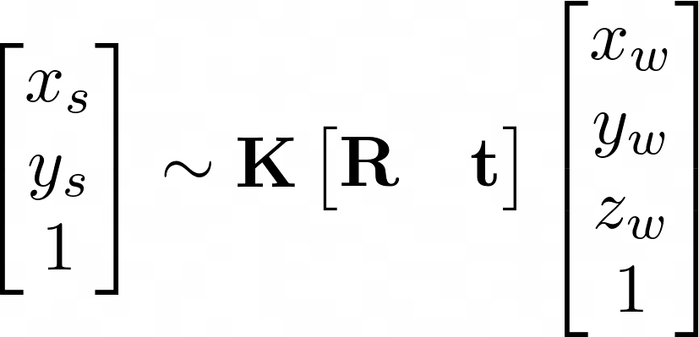
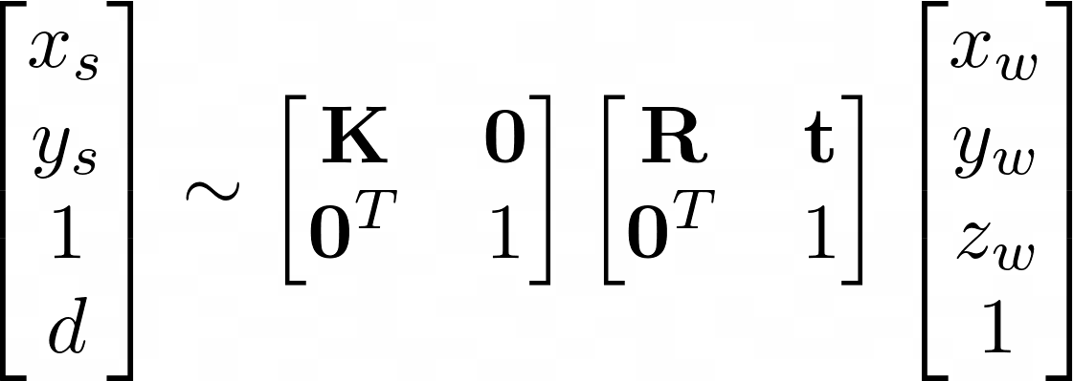
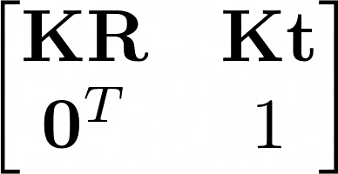
Plane Plus Parallax
Recall the camera matrix
camera plane coordinates
3D world coordinates
no disparity
$$3×3$$
$$3×3$$
$3×$1
$$4×4$$
$$4×4$$
can be changed
Notes:
Plane Plus Parallax 平面加視差

Slide 33
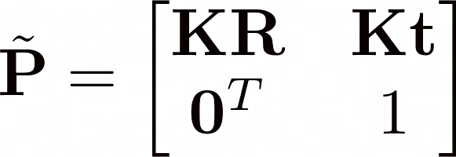
Plane Plus Parallax (cont’)
Define the invertible $4×4$camera matrix by
Setting the last row of as
where and .

Slide 34
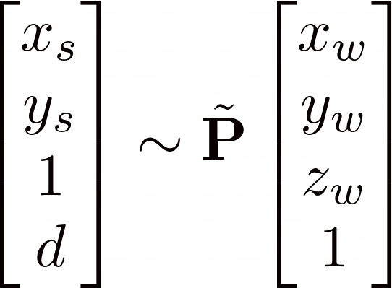
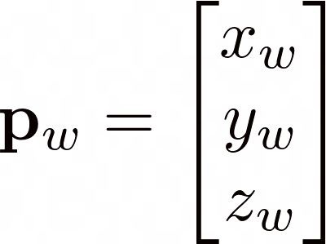
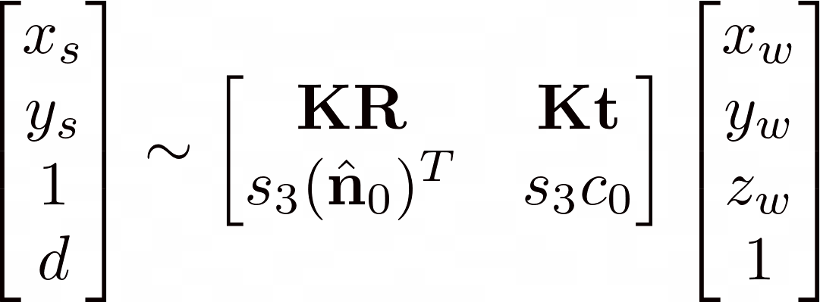
Plane Plus Parallax (cont’)
Note that
camera plane coordinates with disparity
3D hyperplane

Slide 35
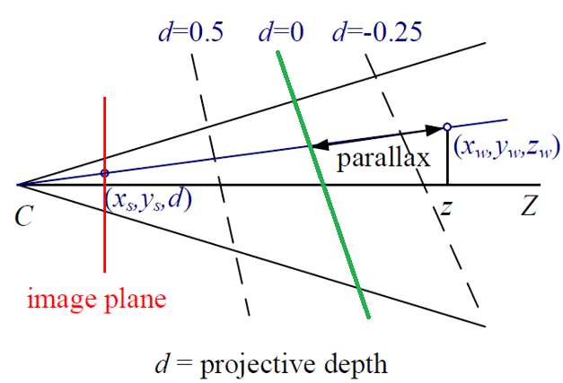
Projective Depth
We can interpret $d$ as the projective disparity or projective depth of a 3D scene point from the reference plane .
shift
reference plane

Slide 36
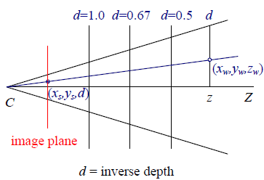
Inverse Depth
Let
The reference plane at infinity.
……
reference plane

Slide 37
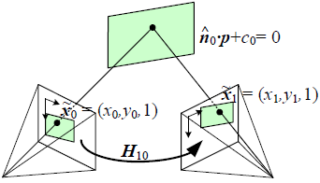
Mapping from One Camera to Another
Since is full rank $4×4$ camera matrix
Project into another camera (camera matrix is )
3D world coordinates
camera plane coordinates with disparity
Notes:
here

Slide 38
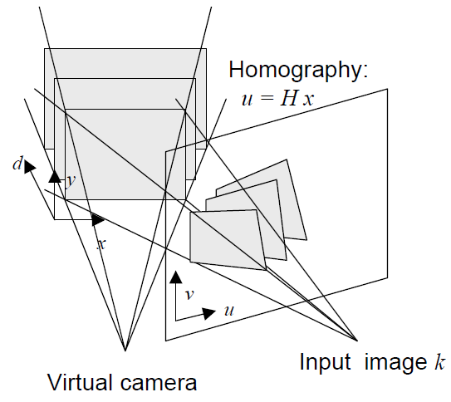
12.1.2 Plane Sweep (cont’)

Slide 39
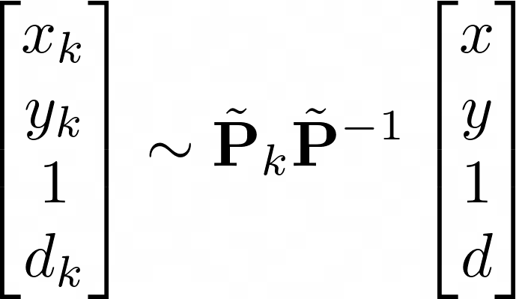
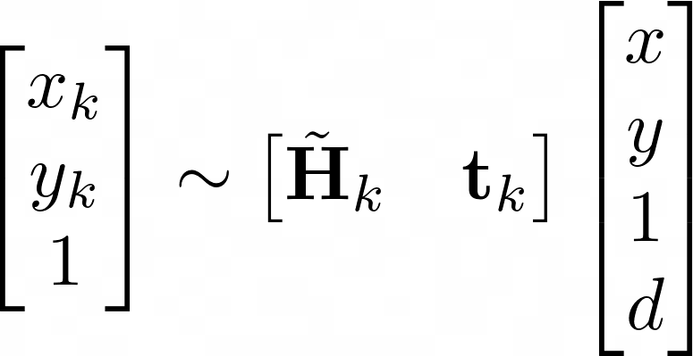
12.1.2 Plane Sweep (cont’)
The virtual camera defining the disparity space through a series of homographies.
k-th camera plane coordinates with disparity
virtual camera plane coordinates with disparity
want to estimate
parametererized by the addition of
a rank-1 matrix

Slide 40
12.1.2 Plane Sweep (cont’)
changeable
$$d=1$$
$$d=3$$
$$d=5$$
measure the photo-consistency

Slide 41
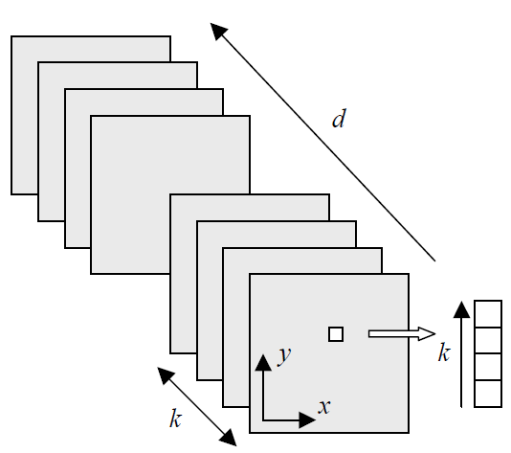
Generalized Disparity Space Volume

Slide 42
12.1.2 Plane Sweep (cont’)
The choice of virtual camera and parameterization is application dependent.

Slide 43
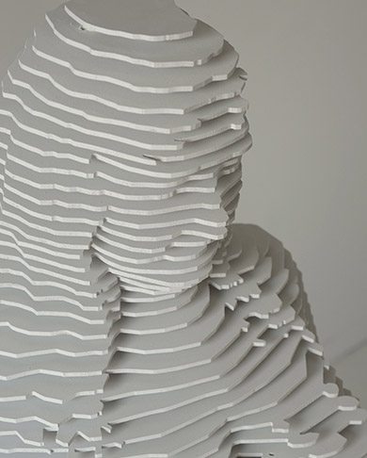
12.1.2 Plane Sweep (cont’)

Slide 44
12.2 Sparse Correspondence
Feature-based matching algorithms searched for corresponding location in the other images by using either interest operators or edge detectors.
There is also a desire to match scenes with different illumination in some application.
Notes:
here

Slide 45
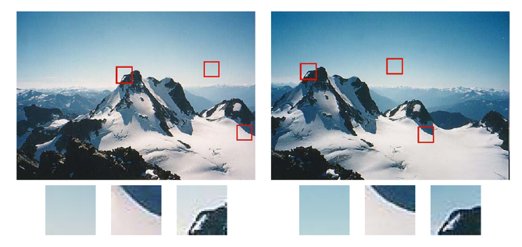
12.2 Sparse Correspondence (cont’)

Slide 46
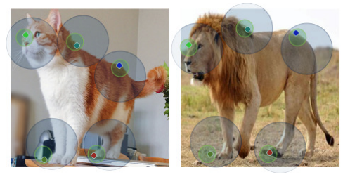
12.2 Sparse Correspondence (cont’)

Slide 47
12.2.1 3D Curves and Profiles
Another example of sparse correspondence is the matching of profile curves which occur at boundary of object.

Slide 48
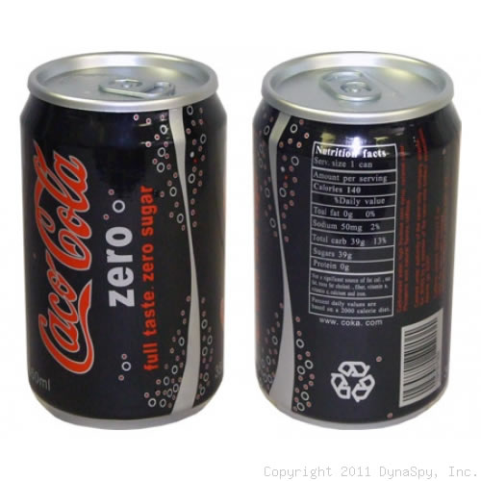
12.2.1 3D Curves and Profiles (cont’)
The difficulty in matching profile curves is that in general, the locations of profile curves vary as a function of camera viewpoint.

Slide 49
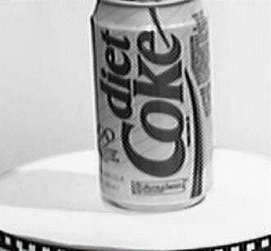
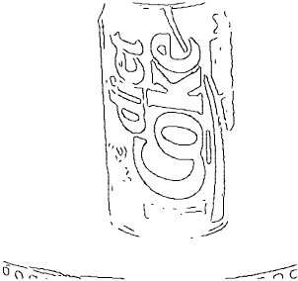
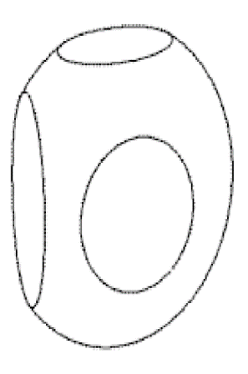
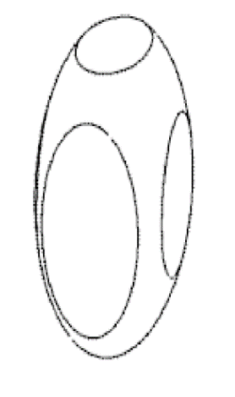
12.2.1 3D Curves and Profiles (cont’)

Slide 50
12.2.1 3D Curves and Profiles (cont’)
If closely frames are available, it is possible to fit a local circular arc for corresponding edges.

Slide 51
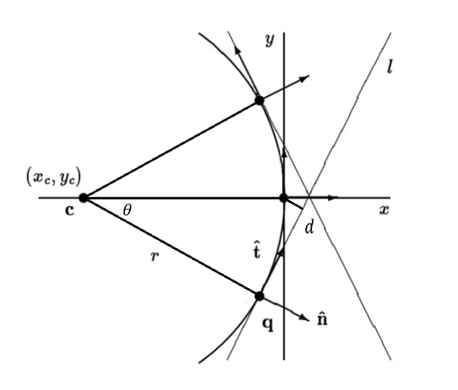
12.2.1 3D Curves and Profiles (cont’)
where $c_{i}$, $s_{i}$ are cosθ and sinθ
$$c_{i}x_{c}+s_{i}y_{c}=r−d_{i}$$

Slide 52
12.2.1 3D Curves and Profiles (cont’)
Assume that the camera moves smoothly, so the local epipolar geometry varies slowly.
Then edges are extracted and matched by pairwise epipolar geometry.

Slide 53
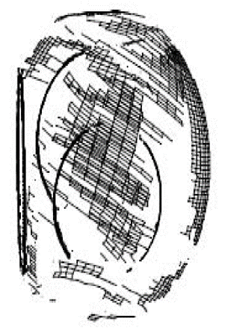
12.2.1 3D Curves and Profiles (cont’)

Slide 54
12.3 Dense Correspondence
While sparse matching algorithms are still occasionally used, more challenging problems focus on dense correspondence.

Slide 55
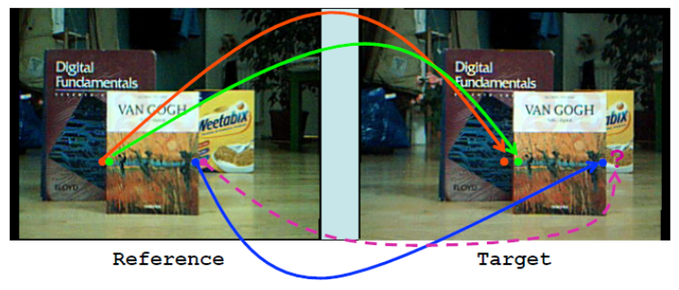
12.3 Dense Correspondence (cont’)

Slide 56
12.3 Dense Correspondence (cont’)
Stereo algorithms on dense correspondence generally perform the following four steps:
Cost computation.
Aggregation.
Optimization.
Refinement

Slide 57
12.3 Dense Correspondence (cont’)
the traditional sum-of-squared differences (SSD) algorithm can be described as:
Compute the squared difference of intensity values at given disparity.
Sum the matching cost over support regions.
Select the minimal value at each pixel.

Slide 58
12.3 Dense Correspondence (cont’)
sum-of-squared differences

Slide 59
12.3.1 Similarity measures
To assess correspondence for dense stereo matching, some similarity measure is mentioned in this subsection.

Slide 60
12.3.1 Similarity measures (cont’)
Entropy of the pixel values limits the influence of mismatch during aggregation.
Sign of the Laplacian leads to poor discriminability in binary matching.
Gradient-based methods are insensitive to depth discontinuities.
Census transform converts pixel into a bit vector.

Slide 61
12.3.1 Similarity measures (cont’)
(a) Intensity image
(b) Mean filter
(c) LOG filter
(d) BilSub filter
(e) Rank filter
(f) SoftRank filter
LOG: Laplacian of Gaussian
BilSub: background subtraction by bilateral

Slide 62
12.4 Local methods
Local and window-based methods aggregate the matching cost by summing or averaging over a support region in the DSI
In local methods, the emphasis is aggregation step because of winner-takes-all strategy.

Slide 63
12.4 Local methods (cont’)
Aggregation with a fixed support region can be performed using 2D or 3D convolution,

Slide 64
12.4 Local methods (cont’)

Slide 65
Shiftable window
matching 9 windows

Slide 66
Fixed Window vs. Shiftable Window
Fixed window:
Shiftable window:

Slide 67
Variable Window

Slide 68
Adaptive Weight

Slide 69
Segmentation-Based

Slide 70
12.4 Local methods (cont’)
Selecting correct windows is important, since windows must be large enough to contain sufficient texture and small enough to avoid straddle depth discontinuities.
Notes:
Straddle (v.) 跨越

Slide 71
Straddle Depth Discontinuities
Notes:
Straddle (v.) 跨越

Slide 72
12.4.1 Sub-pixel Estimation and Uncertainty
Most stereo correspondence algorithms compute a set of integer disparity estimates in discretized space, but sometimes it requires more precision in robot navigation or people tracking.

Slide 73
12.4.1 Sub-pixel Estimation and Uncertainty (cont’)
To remedy this situation, many algorithms apply sub-pixel as refinement by interpolation.
Sub-pixel disparity estimates are computed by fitting curve, but regions must be the same surface.
Different object surface

Slide 74
12.4.1 Sub-pixel Estimation and Uncertainty (cont’)
To work well, the intensities being matched must vary smoothly, and the regions over which these estimates are computed must be on the same (correct) surface.
Besides sub-pixel computations, there are other ways of post-processing the computed disparities.

Slide 75
Uncertainty in stereo depth estimation
(a) input image
(b) estimated depth map
(blue is closer)
(c) estimated confidence
(red is higher).

Slide 76
12.5 Global optimization
Global stereo matching are formulated in energy minimization by finding a solution $d$.
Data energy function
Total energy (cost) function
Smooth energy function

Slide 77
12.5 Global optimization (cont’)
Global method performs iterative optimization which consists of data terms and smoothness terms for replacing aggregation step.

Slide 78
12.5 Global optimization (cont’)
The data term measures how well the disparity function agrees with input image pair.
where C is aggregated matching cost.

Slide 79
12.5 Global optimization (cont’)
The smoothness term measures differences between neighboring pixels.
Where $ρ$ is some monotonically increasing function.

Slide 80
12.5 Global optimization (cont’)
Once the energy function has been defined, a variety of algorithms are used to find minimum.
Traditional approaches are associated with Markov random fields and regularization.

Slide 81
Local plane sweeps (Sinha, Scharstein, and Szeliski 2014)
Instead of sweeping planes perpendicular to the viewing direction, it is also possible to model the scene using a collection of slanted planes.
(a) input image
(b) initial sparse matches
(c) matches grouped by
slanted planes
(d) 3D visualization of planes and grouped features
Notes:
Straddle (v.) 跨越

Slide 82
12.5.1 Dynamic programming
A different class of global optimization algorithm is based on dynamic programming.
Dynamic programming can find the global minimum for independent scanlines in polynomial time.

Slide 83
12.5.1 Dynamic programming (cont’)
Left scanline
Right scanline

Slide 84
12.5.1 Dynamic programming (cont’)

Slide 85
12.5.2 Segmentation-based techniques
While most stereo matching algorithms perform their computations on pixels, some of the techniques segment the images into regions for trying to label with disparities.

Slide 86
12.5.2 Segmentation-based techniques (cont’)

Slide 87
12.5.2 Segmentation-based techniques (cont’)
Stereo matching with adaptive over-segmentation and matting (Taguchi, Wilburn, and Zitnick 2008) © 2008 IEEE:

Slide 88
12.5.2 Segmentation-based techniques (cont’)
Multiframe matching using edges, planes, and superpixels (Xue, Owens et al. 2019) © 2019 Elsevier.

Slide 89
12.5.3 Z-keying and background replacement
Z-keying systems required expensive custom-built hardware to produce the desired depth maps in real time and were, therefore, restricted to broadcast studio applications.

Slide 90
12.5.3 Z-keying and background replacement (cont’)
Background replacement using z-keying with a bi-layer segmentation algorithm (Kolmogorov, Criminisi et al. 2006) © 2006 IEEE.

Slide 91
12.6 Deep neural networks
DNNs used in stereo correspondence algorithms can be classified in three categories:
Learning in the stereo pipeline
End-to-end learning with 2D architectures
End-to-end learning with 3D architectures

Slide 92
Learning in the stereo pipeline
The first successful application of deep learning to stereo was the seminal work by Zbontar and LeCun (2016), who trained a CNN to compare image patches.
These learned matching costs are still widely used in top-performing methods on the Middlebury stereo evaluation.

Slide 93
End-to-end learning with 2D architectures
The availability of large synthetic datasets with ground truth disparities, in particular the SceneFlow dataset enabled the end-to-end training of stereo networks.
SceneFlow: The collection contains more than 39000 stereo frames in 960x540 pixel resolution.
Optical flow maps
Segmentations
Disparity maps

Slide 94
End-to-end learning with 2D architectures (cont’)
The first deep learning architectures for stereo were similar to those designed for dense regression tasks such as semantic segmentation (Chen, Zhu et al. 2018).
They proposed framework of a two-stage learning method for semantic segmentation based on estimated depth information.
Notes:
Straddle (v.) 跨越

Slide 95
End-to-end learning with 3D architectures
The End-to-end learning 3D architectures explicitly encode geometry by processing features over a 3D volume.
The first examples of such architectures include GC-Net (Kendall, Martirosyan et al. 2017) and PSMNet (Chang and Chen 2018).
GC-Net: Geometry and Context Network
PSMNet: Pyramid Stereo Matching Network

Slide 96
End-to-end learning with 3D architectures (cont’)
A recent example of domain generalization is the domain-invariant stereo matching network (DSMNet) of Zhang, Qi et al. (2020).
Input view
HD³
PSMNet
DSMNet
HD³: Hierarchical Discrete Distribution Decomposition for Match Density Estimation

Slide 97
12.7 Multi-view stereo
While matching pairs of images is a useful way of obtaining depth information, matching more images lead to better results.
Examining all the epipolar plane image can visualize the multi-frame stereo estimation.

Slide 98
12.7 Multi-view stereo (cont’)

Slide 99
12.7 Multi-view stereo (cont’)
The condition of occluded object is seen as strip of regions which explain their relationships in the epipolar plane images.

Slide 100
12.7 Multi-view stereo (cont’)

Slide 101
12.7 Multi-view stereo (cont’)
Taking advantage of these additional images is to sum up their differences from the reference image $I_{r},$
This is the basis of the well-known sum of summed-squared-difference (SSSD) approaches
$k$ different view images

Slide 102
12.7 Multi-view stereo (cont’)
(a) stable windows which center on the white pixel straddling depth discontinuities.

Slide 103
12.7 Multi-view stereo (cont’)
(b) shiftable windows decrease the problems in partially occluded regions.

Slide 104
12.7 Multi-view stereo (cont’)
The results of applying these techniques to the multi-frame flower garden image sequence.
(a)
(b)
(c)
(d)
(a) window that is not spatially perturbed (centered);
(b) Spatially perturbed window;
(c) Using the best five of 10 neighboring frames;
(d) Using the better half sequence.

Slide 105
12.7.1 Scene flow
Multiple cameras are used to capture a dynamic scene.
Scene flow simultaneously recover,
Shape of the object at every instant in time.
3D motion of every surface point between frames.

Slide 106
12.7.1 Scene flow (cont’)
(a) 3D scene flow be computed from a multi-camera dome surrounding the dancer.
(a)

Slide 107
12.7.1 Scene flow (cont’)
(b) 3D scene flow be computed from stereo cameras mounted on a moving vehicle.

Slide 108
12.7.2 Volumetric and 3D surface reconstruction
The most challenging but also most useful variant of multi-view stereo reconstruction the creation of globally consistent 3D models.

Slide 109
12.7.2 Volumetric and 3D surface reconstruction (cont’)
Figure 12.24 Multi-view stereo algorithms. (a) surface based stereo. (b) voxel coloring (c) merging depth map (d) level set method.

Slide 110
12.7.2 Volumetric and 3D surface reconstruction (cont’)
Figure 12.24 Multi-view stereo algorithms. (e) stereo fusion (f) multi-view image matching (g) graph cut (h) visual hulls.

Slide 111
12.7.2 Volumetric and 3D surface reconstruction (cont’)
In order to compare all these techniques, there is a six point taxonomy that can help classify algorithms in this section.

Slide 112
12.7.2 Volumetric and 3D surface reconstruction (cont’)
The most popular representations is uniform grid of voxels in 3D scene.
Photo consistency measure is a choice that computes directly on the surface.
Single depth map is the ability to distinguish visibility and occlusions.

Slide 113
12.7.2 Volumetric and 3D surface reconstruction (cont’)
Most matching algorithms adopt some form of prior model for the expected shape.
Some approaches define over consistency volume to recover a complete surface by global optimization.
To refine or evolve a rough model, it usually requires an accurate initialization.

Slide 114
12.7.2 Volumetric and 3D surface reconstruction (cont’)
https://vision.middlebury.edu/mview/eval/.

Slide 115
12.7.3 Shape from silhouettes
In many situations, performing a foreground–background segmentation of the object of interest is a good way to initialize or fit a 3D model.
Over the years, a number of techniques have been developed to reconstruct a 3D volumetric model from the intersection of the binary silhouettes projected into 3D.

Slide 116
visual hull
Visual hull is based on follows observation:
The volume is maximal with respect to the visual silhouettes.
Surface elements are tangent to the viewing rays along the silhouette boundaries.

Slide 117
visual hull (cont’)

Slide 118
12.7.3 Shape from silhouettes (cont’)
Other approaches use voxel-based representations, usually encoded as octrees, because of the resulting space–time efficiency.
Notes:
Straddle (v.) 跨越

Slide 119
Octree
An octree is a tree data structure in which each internal node has exactly eight children. Octrees are most often used to partition a three-dimensional space by recursively subdividing it into eight octants.
Notes:
Straddle (v.) 跨越

Slide 120
12.7.3 Shape from silhouettes (cont’)
(a)
(c)
(b)
(d)
Notes:
Straddle (v.) 跨越

Slide 121
10 Questions
The reason why fundamental matrix only has 7 degree of freedom. (1, The constraint of fundamental matrix is homogenous. 2, Fundamental matrix is rank 2.)
Give three applications of stereo vision? (1, View morphing between two images, 2, Autonomous navigation, 3, Building 3D surface models from multiple video streams in Virtualized Reality)
Describe the step of stereo rectification? (1, Images transformed so that epipolar lines are parallel; 2, Images rectified so that epipolar lines are horizontal and in vertical correspondence; 3, Final rectification that minimizes horizontal distortions.)
Describe four steps of general stereo algorithms? (1, Matching cost computation, 2, Cost aggregation, 3, Disparity computation and optimization, 4, Disparity refinement.)
Enumerate three transformations that can be applied to images in order to improve their similarity across illumination variations. (1, Mean filter, 2, LOG filter, 3, BilSub filter)
Enumerate three window-based methods? (1, Fixed windows, 2, Shiftable windows, 3, Variable windows)

Slide 122
10 Questions (cont’)
What are the three categories of DNNs based stereo correspondence algorithms.? (1, Learning in the stereo pipeline, 2, End-to-end learning with 2D architectures, 3, End-to-end learning with 3D architectures.)
List three Multi-view stereo algorithms. (1, Surface based stereo, 2, Voxel coloring, 3, Merging depth map)
List two methods of shape from silhouettes? (1 Visual hull. 2, Octree.)
What is the smoothness term measures differences between neighboring pixels in global optimization? Ans:

