Slide 1
Advanced Computer Vision
Chapter 12
3D Reconstruction
Presented: Bo-Chen Kung 龔柏丞
Advisor: Chiou-Shann Fuh 傅楸善
0978912582
r08922a25@ntu.edu.tw

Slide 2
Before Start…
123D Catch for iOS 7
Capture: 3D Scan Anything
holoportation: virtual 3D teleportation in real-time

Slide 3
Chapter 12 3D Reconstruction
12.1 Shape from X
12.2 Active Range Finding
12.3 Surface Representations
12.4 Point-Based Representations
12.5 Volumetric Representations
12.6 Model-based Reconstruction
12.7 Recovering Texture Maps and Albedos

Slide 4
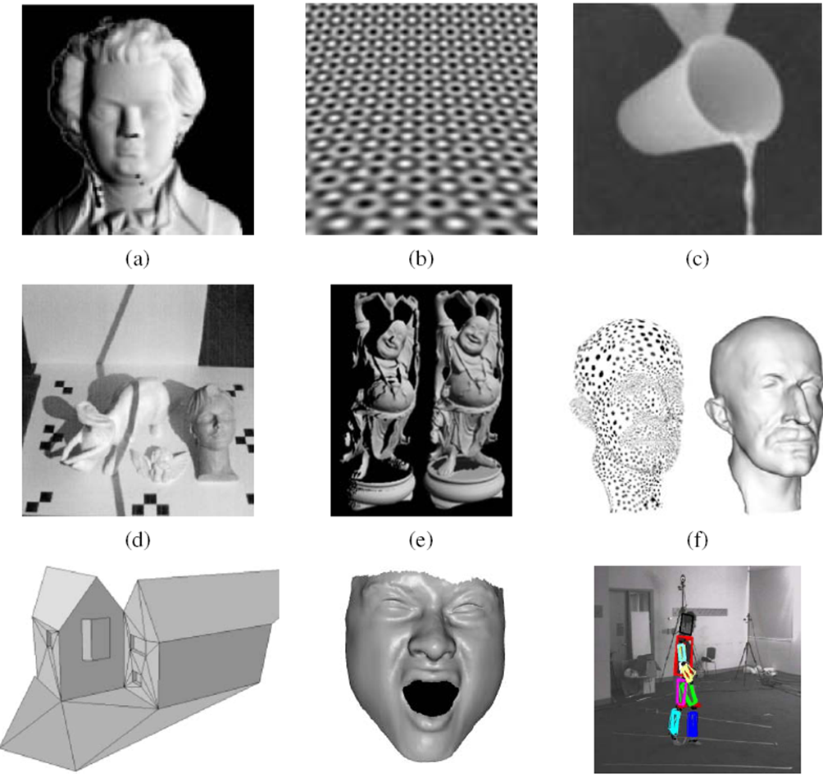
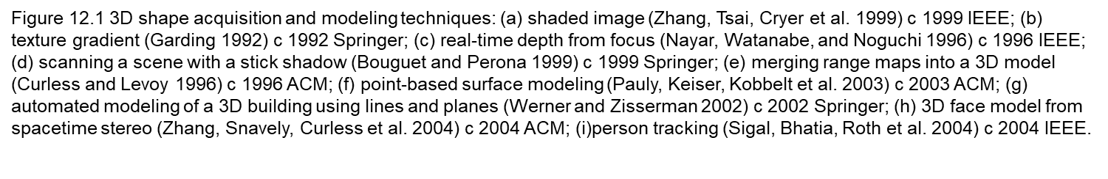

Slide 5
12.1 Shape from X
The study of how shape can be inferred from such cues like shading, texture, focus is sometimes called shape from X
  Shape from shading
  Shape from texture
  Shape from focus

Slide 6
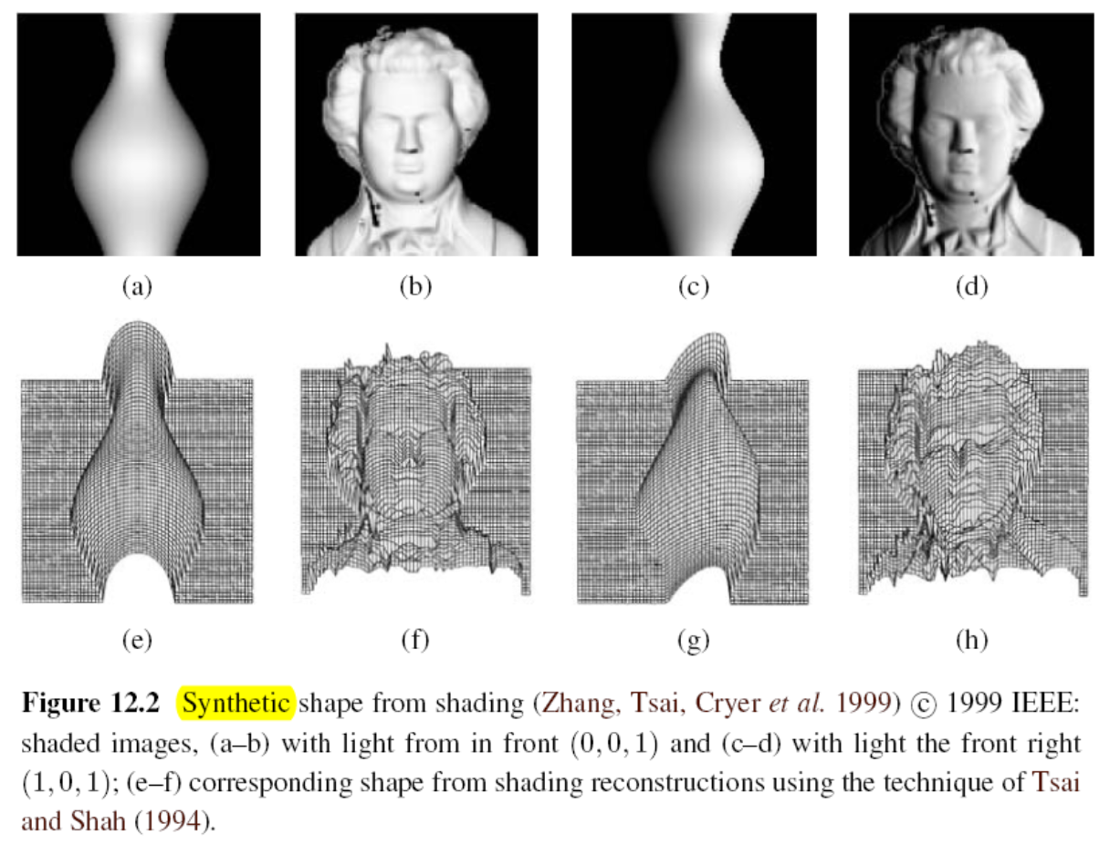
12.1.1 Shape from Shading and Photometric Stereo
Notes:
Photometric Stereo: 光度立體

Slide 7
12.1.1 Shape from Shading and Photometric Stereo
How is this possible?
  The answer is that as the surface normal changes across the object, the apparent brightness changes as a function of the angle between the local surface orientation and the incident illumination.
shape from shading
  The problem of recovering the shape of a surface from this intensity variation is known as shape from shading.
Notes:
陰影 跟 立體光學法
Surface 曲面法向量
Incident 入射光

Slide 8
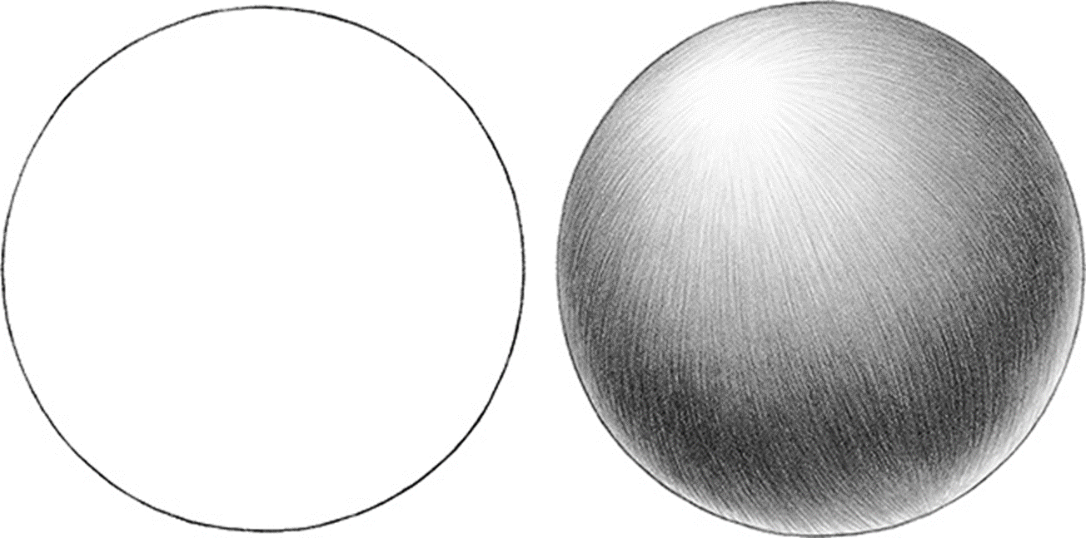

Slide 9
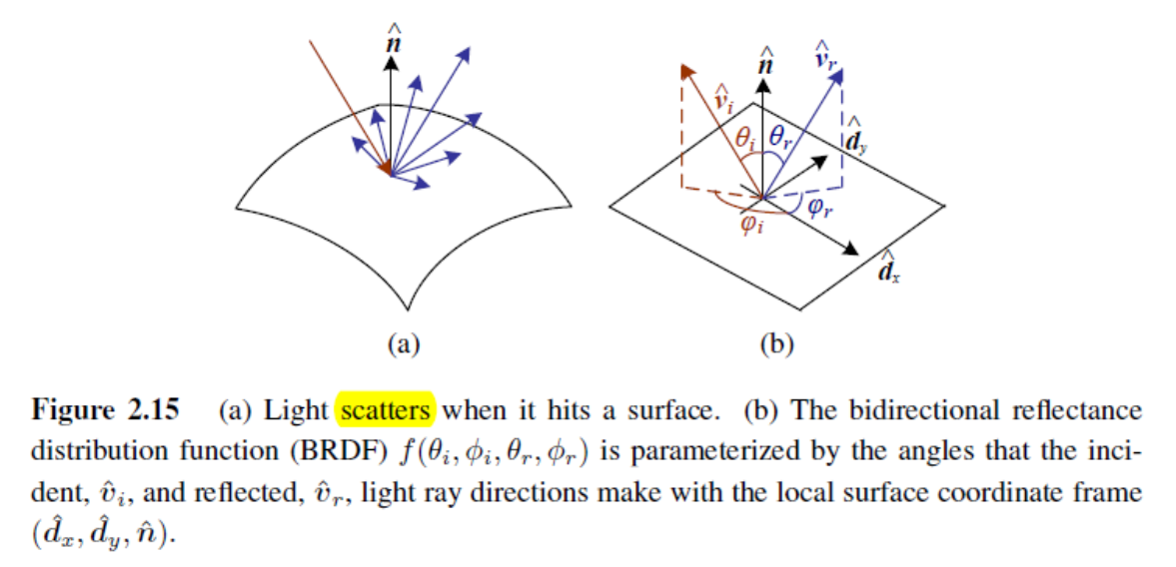
12.1.1 Shape from Shading and Photometric Stereo
Notes:
雙向反射分布函數是一個定義光線在不透明表反射的四次元函數
這裡 是指光線反射的方向 跟 光線的反方向
可透過 方向角跟天頂角參數化

Slide 10
12.1.1 Shape from Shading and Photometric Stereo
Most shape from shading algorithms assume that the surface under consideration is of a uniform albedo and reflectance, and that the light source directions are either known or can be calibrated by the use of a reference object.
Notes:
大部分的 shape form shading 演算法， 假設物體表面的 Albedos (反照率) 與
Reflectance (反射率) 都為固定的常數。
而且也需要假設光源來自的方向已知，或是相機已經被校正過(透過參考的一些物件)

Slide 11
12.1.1 Shape from Shading and Photometric Stereo
Lambertian Surface
Light falling on it is scattered such that the apparent brightness of the surface to an observer is the same regardless of the observer's angle of view.
Perfect Reflecting Diffuser
A Perfect (Reflecting) Diffuser (PRD) is a theoretical perfectly white surface with Lambertian Distance (its brightness appears the same from any angle of view). It does not absorb light, giving back 100% of the light it receives.

Slide 12


12.1.1 Shape from Shading and Photometric Stereo
The variation in intensity (irradiance equation) become purely a function of the local surface orientation,
where are the depth map derivatives and is called the reflectance map.
Notes:
對於一張影像中第 (x, y) pixel 的強度值 (intensity)，可以透過 照度方程(irradiance equation
)得到
Albedos 反照率 漫反射或是表面反射的能力
calibrate 測量
irradiance equation 輻照度 落光
「直接輻照度」與「漫輻照度」的代數和
傾斜平面，還必需添加「反射輻照度」，即從地面反射出的輻照
(p, q) 也可以說是 depth map 的法向量的方向

Slide 15
12.1.1 Shape from Shading and Photometric Stereo
For example, a diffuse (Lambertian) surface has a reflectance map that is the (non-negative) dot product between the surface normal:
and the light source direction:
reflectance map:
where is the surface reflectance factor (albedo)
Albedo: Reflection Coefficient

Slide 17
12.1.1 Shape from shading and photometric stereo
smoothness constraint:
integrability constraint
Notes:
可整合性限制，加入(12.4)這個項，可以測量 rotationally invariant

Slide 18
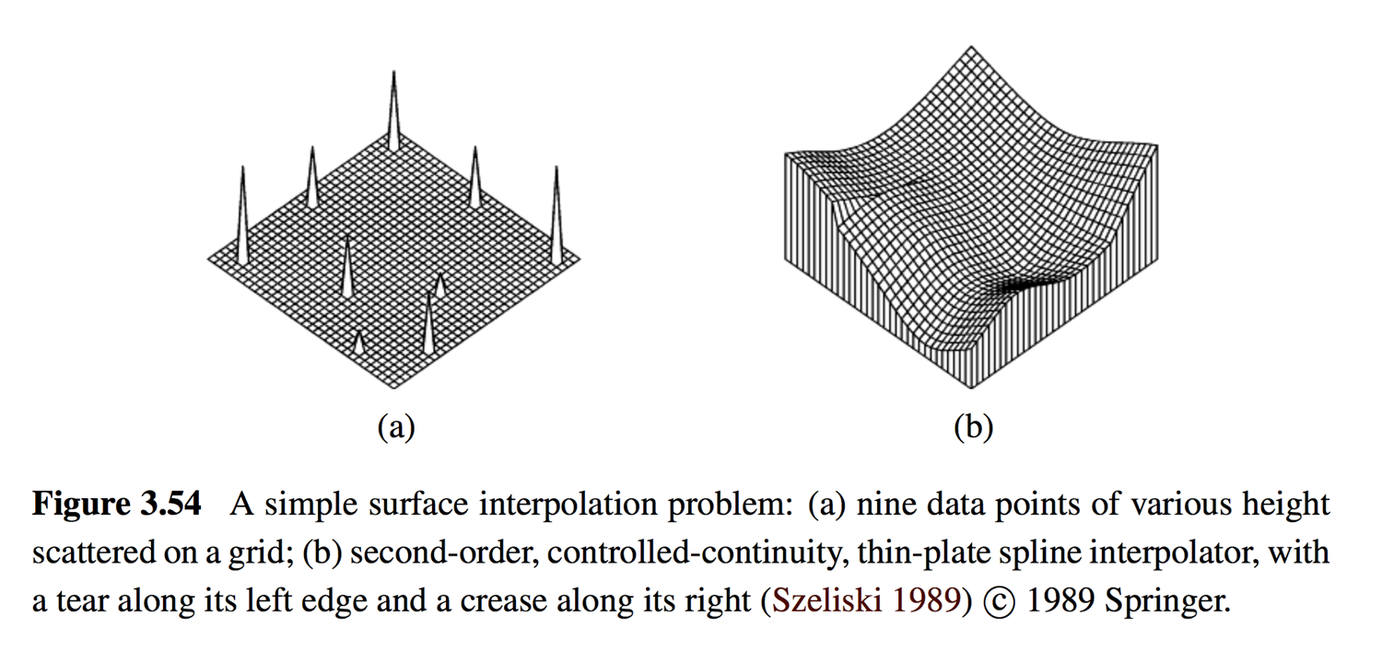
Smoothness Constraint

Slide 19
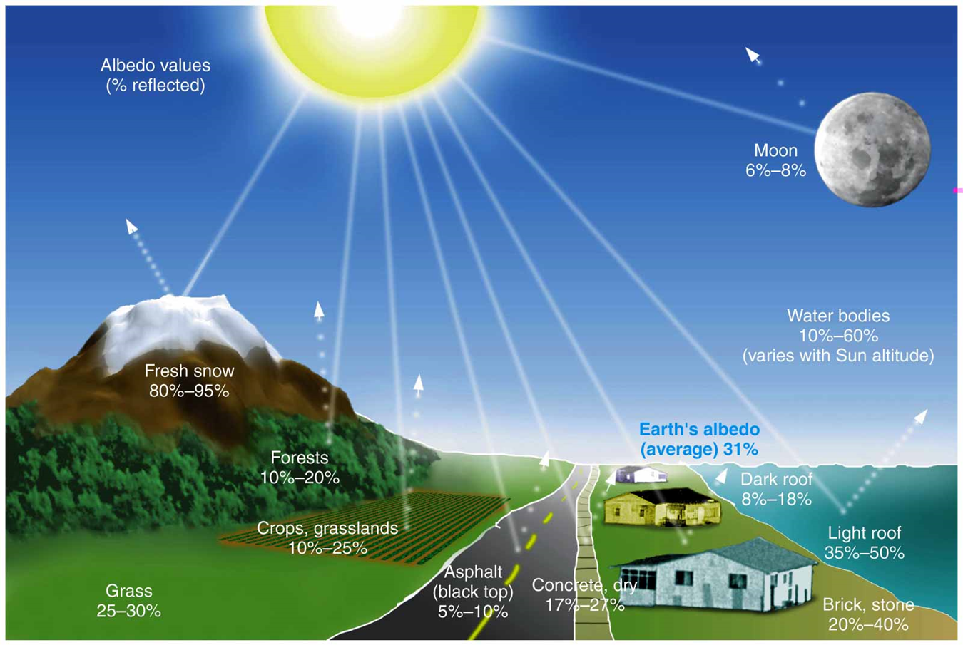

Slide 20
12.1.1 Shape from Shading and Photometric Stereo
Photometric stereo
Another way to make shape from shading more reliable is to use multiple light sources that can be selectively turned on and off.

Slide 21
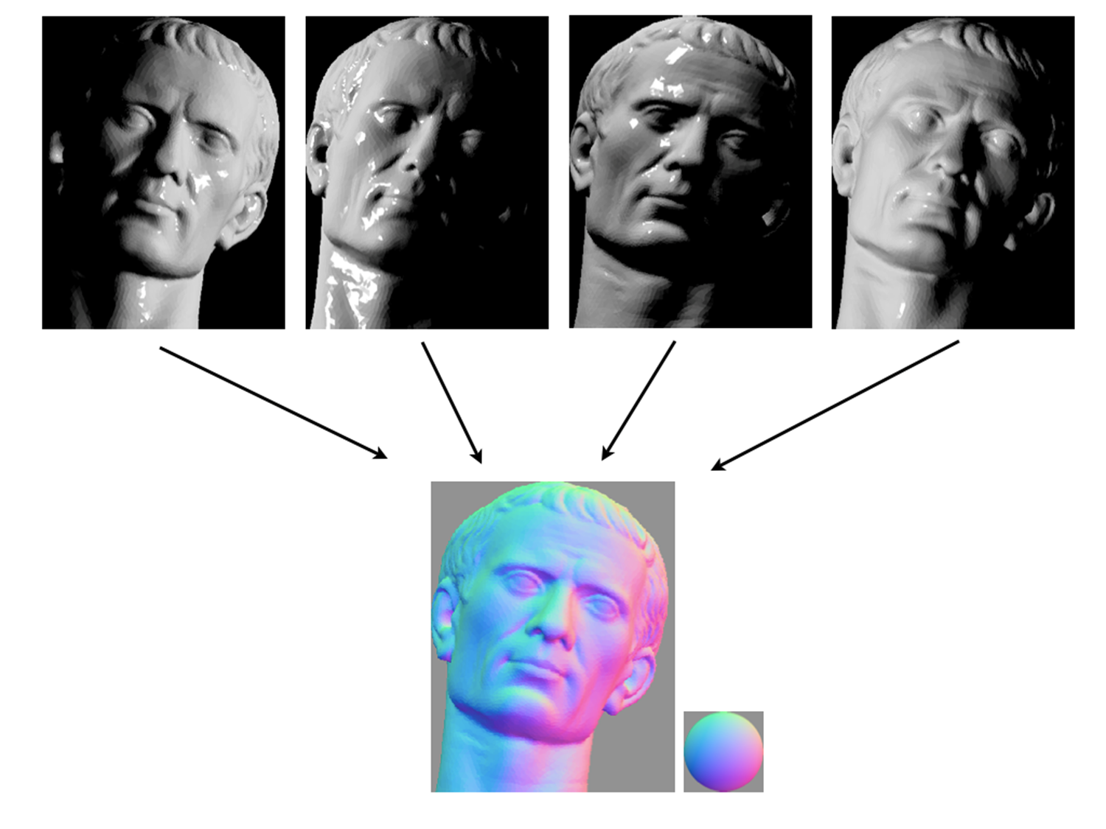
Link

Slide 22
12.1.2 Shape from Texture
Shape from texture
The foreshortening of regular patterns as the surface slants or bends away from the camera.
Notes:
透視法縮短 拿筆來示範 傾斜彎曲

Slide 23
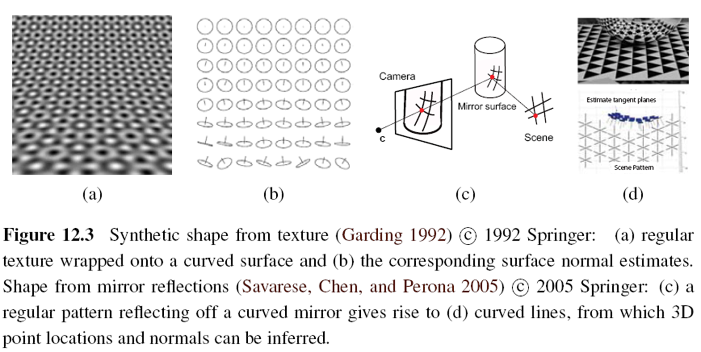
12.1.2 Shape from Texture

Slide 24
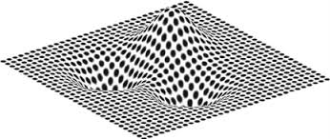
12.1.2 Shape from Texture
Shape from Texture

Slide 25
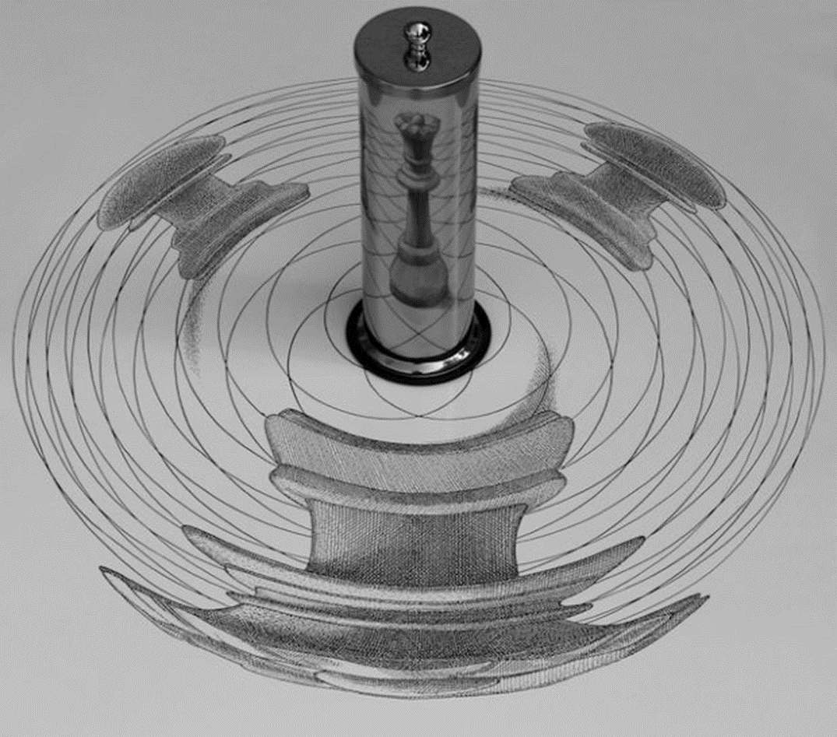
Notes:
Shape from Texture 反著做，為了讓圓柱反射得到想要的圖案，故意將圖片畫成圓柱反射後會產生想要的圖案的樣子。

Slide 26
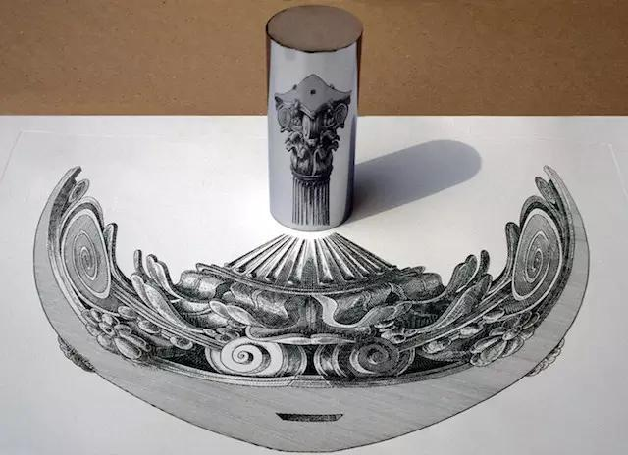

Slide 27
12.1.3 Shape from Focus
Shape from focus
A strong cue for object depth is the amount of blur, which increases as the object’s surface moves away from the camera’s focusing distance.
The amount of blur increases in both directions as you move away from the focus plane. Therefore, it is necessary to
  use two or more images captured with different focus distance settings
  or to translate the object in depth and look for the point of maximum sharpness.
Notes:
物體深度的一個重要提示是模糊量，隨著物體表面遠離相機的對焦距離而增加。

Slide 28


Slide 29
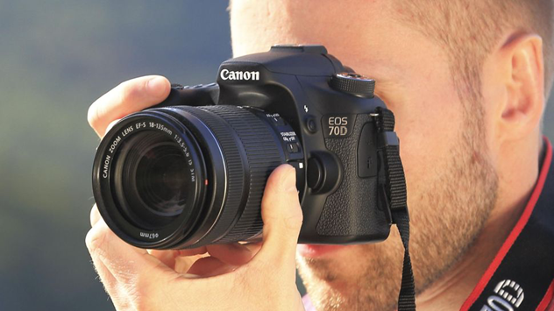
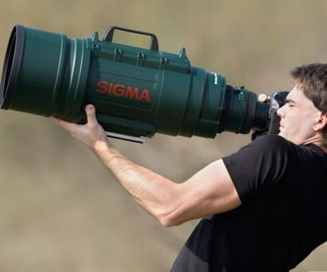
12.1.3 Shape from Focus
The magnification of the object can vary as the focus distance is changed or the object is moved. This can be modeled either explicitly (making correspondence more difficult) or using telecentric optics, which approximate an orthographic camera and require an aperture in front of the lens.
Notes:
Telecentric 遠心鏡頭
Orthographic 直角的
Aperture 光圈

Slide 30
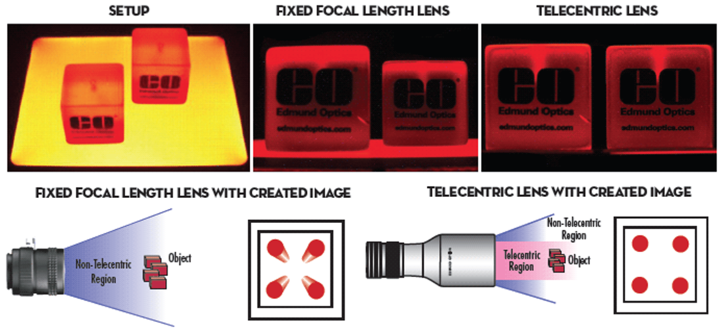

Slide 31
12.1.3 Shape from Focus
The amount of defocus must be reliably estimated. A simple approach is to average the squared gradient in a region but this suffers from several problems, including the image magnification problem mentioned above. A better solution is to use carefully designed rational filters.
Notes:
Rational 合理的

Slide 32
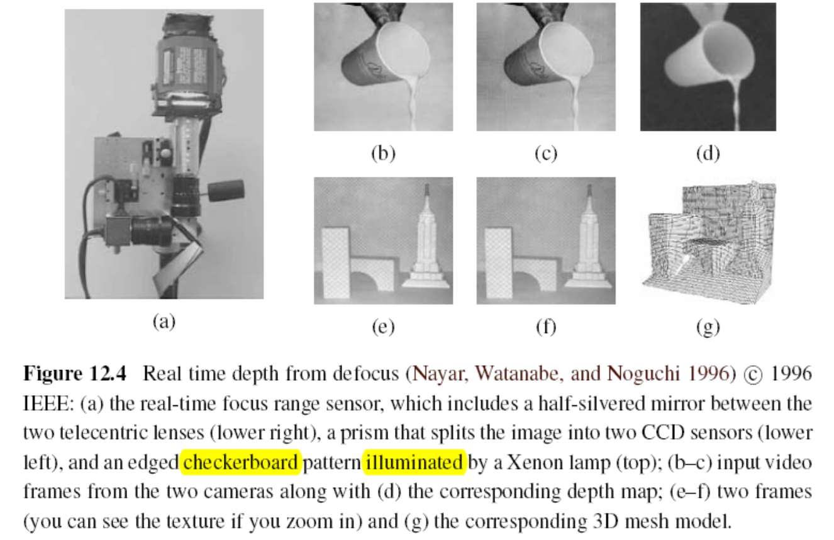
Notes:
Defocus : 散焦
Silvered: 鍍銀的
Lenses: 鏡片
Prism 稜鏡
Checkerboard 格子板
Xenon 氙氣
CCD (Charge-coupled Device) 電耦合

Slide 33
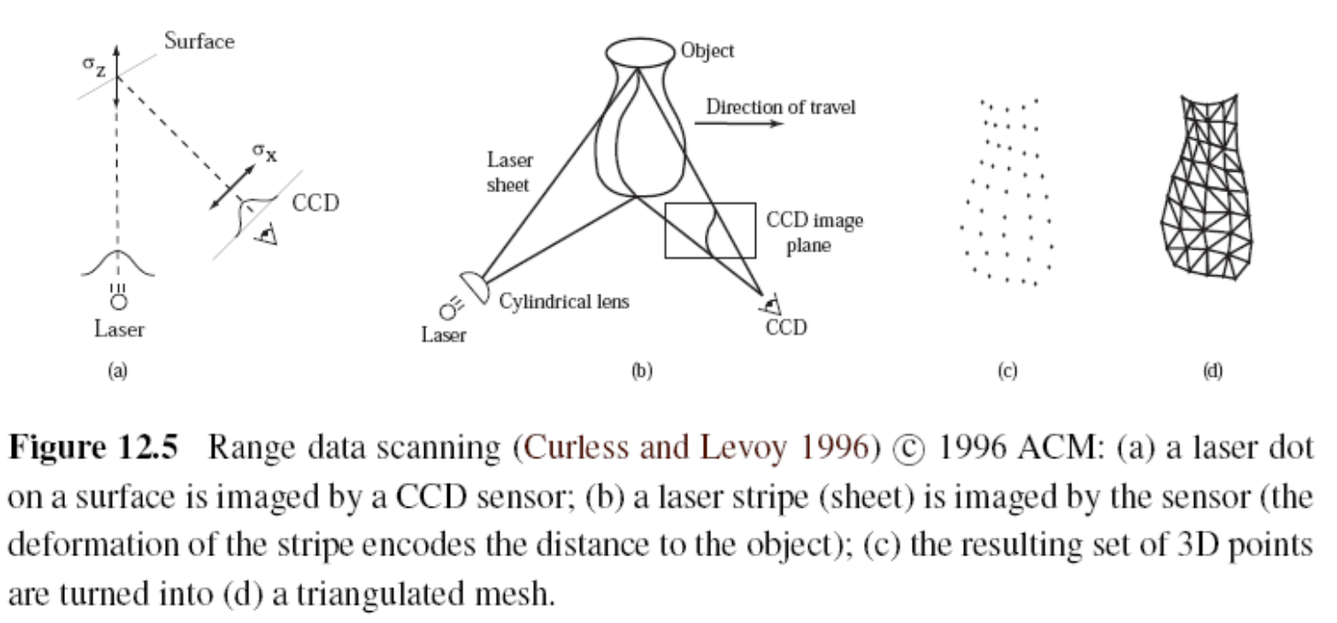
12.2 Active Range Finding
Notes:
Stripe 長條
Deformation 變形
Triangulated mesh 三角測量網線

Slide 34
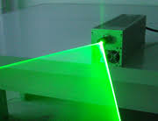
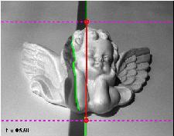
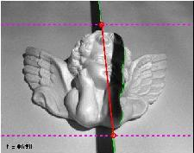
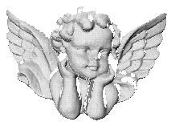
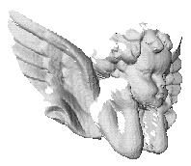
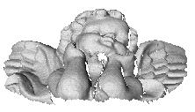
12.2 Active Range Finding

Slide 35
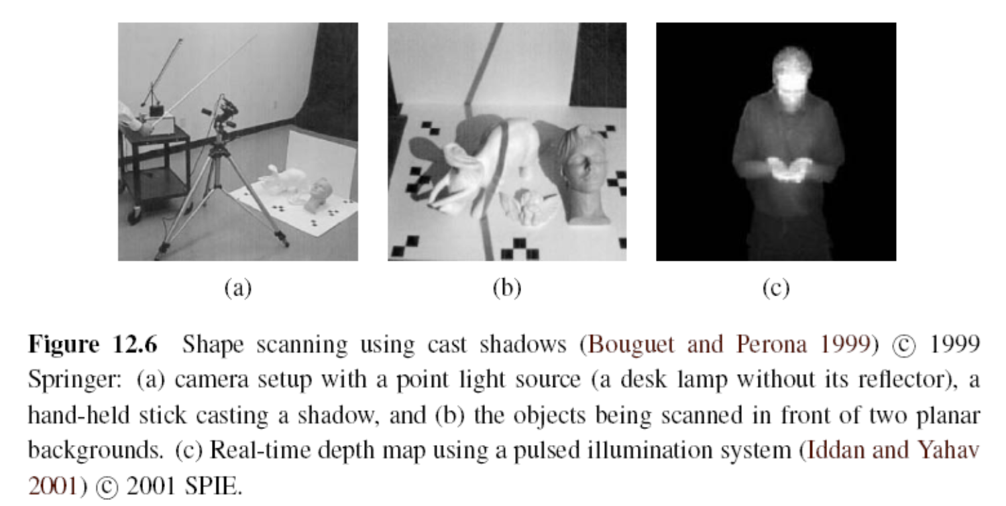
12.2 Active Range Finding
SPIE: Society of Photo-Optical Instrumentation Engineers
Notes:
點光源，與細棒子投射的陰影
©即時的深度估計，透過脈衝照明系統
Cast 投射

Slide 36
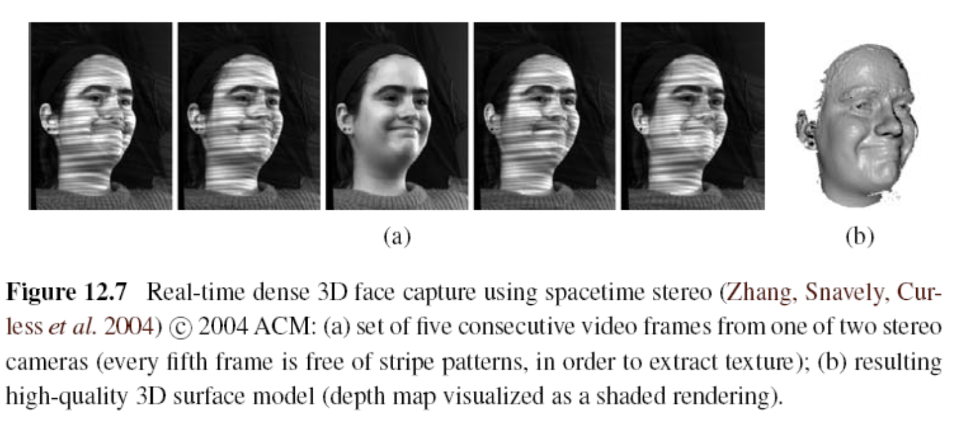
12.2 Active Range Finding

Slide 37
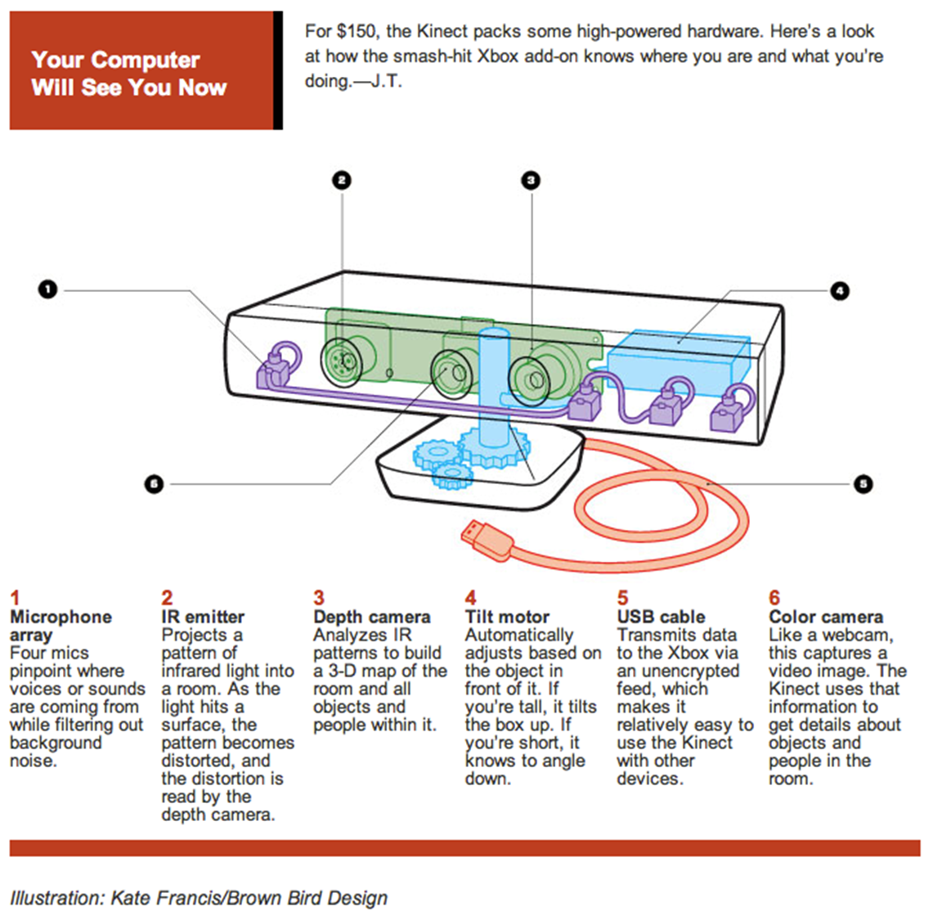
12.2 Active Range Finding
Kinect
Azure Kinect DK

Slide 38
12.2 Active Range Finding
Tango
ARCore

Slide 39
12.2 Active Range Finding
NBA 2K15
Bad face scan
NBA 2K20 face scan

Slide 40
12.2.1 Range Data Merging
Range data merging
The registration (alignment) of partial 3D surface models and their integration into coherent 3D surfaces.
Iterated Closest Point (ICP)
Which alternates between finding the closest point matches between the two surfaces being aligned and then solving a 3D absolute orientation problem

Slide 41
12.2.1 Range Data Merging
Sparse Iterative Closest Point(video)
Sparse Iterative Closest Point (introduction)

Slide 42
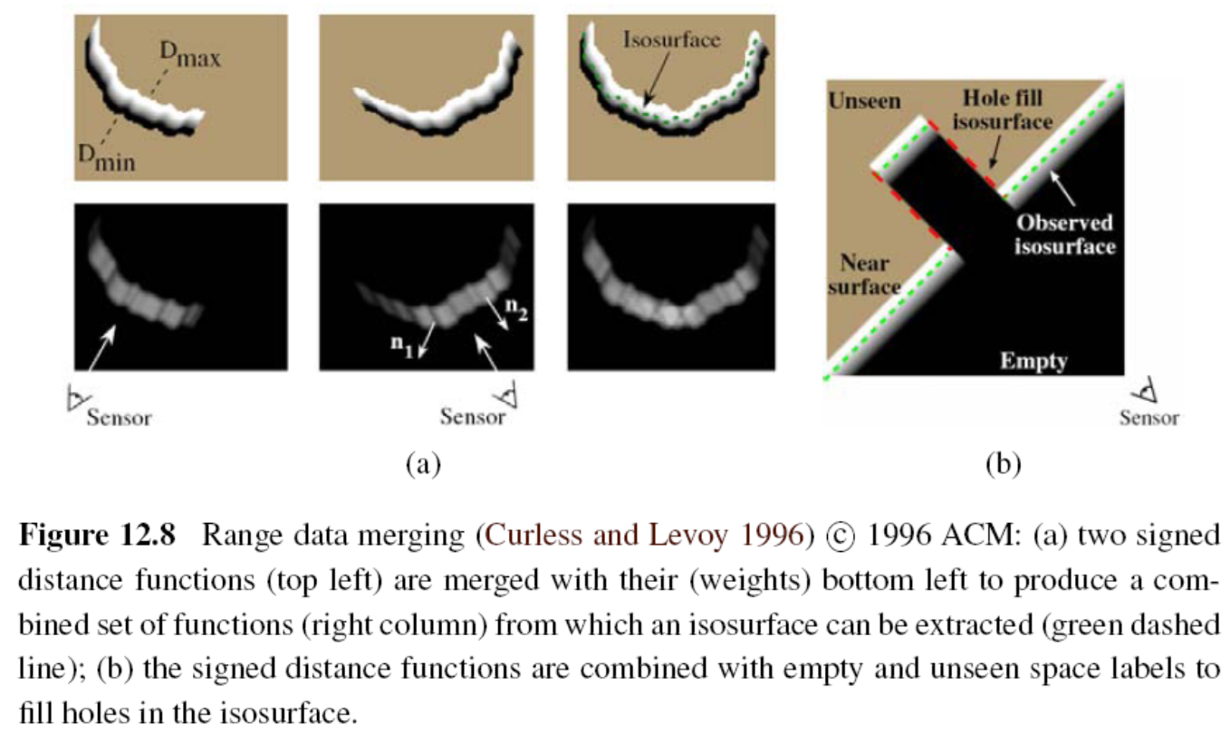
12.2.1 Range Data Merging
Notes:
Isosurface: 等值曲面
合併範圍數據（Curless和Levoy，1996年）
（a）帶正負號的距離函數（左上）與它們的（權重）合併到第三個column下以產生一個組合
可以從中提取等值面的一組函數（右列）（綠色虛線線）;
（b）帶符號的距離函數與空的(看不見的部分)用連接等值面來連接

Slide 43
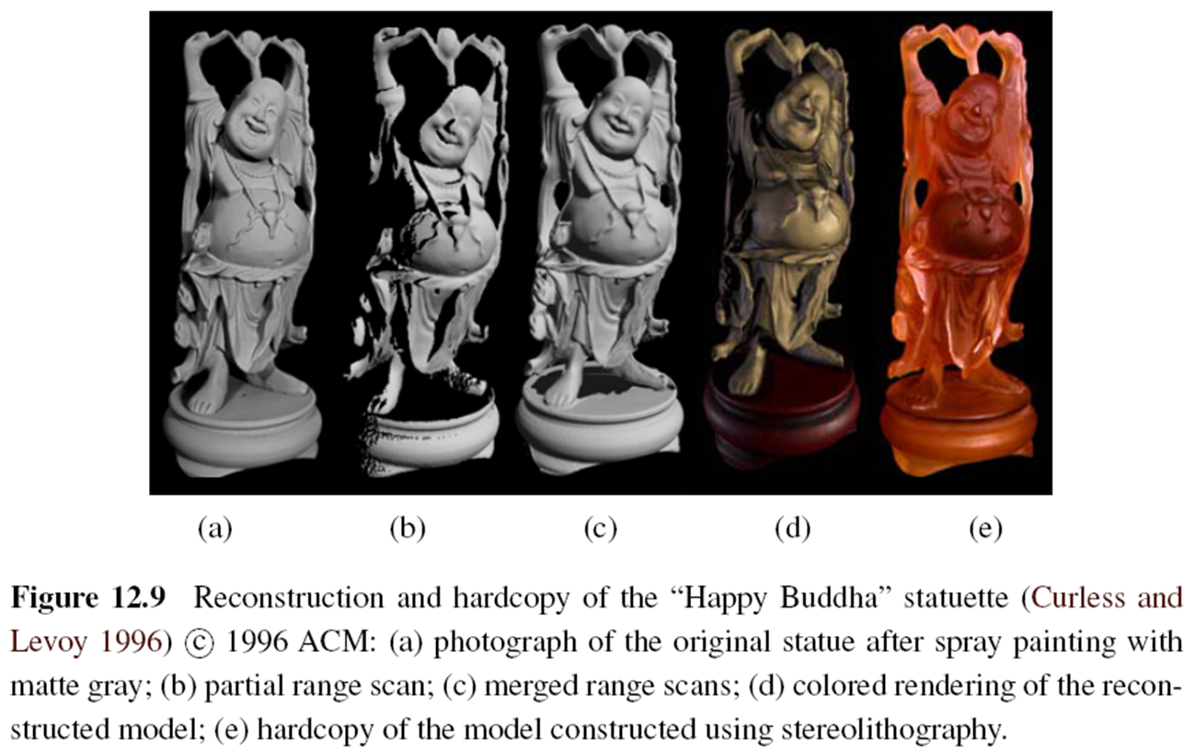
12.2.1 Range Data Merging
Notes:
Stereolithography:光固化

Slide 44
Stereolithography (SLA) Technology
Stereolithography
Notes:
Stereolithography: 光固化

Slide 45
12.2.2 Application: Digital Heritage
Active range finding technologies, combined with surface modeling and appearance modeling techniques (Section 12.7), are widely used in the fields of archeological and historical preservation, which often also goes under the name digital heritage (MacDonald 2006).
In such applications, detailed 3D models of cultural objects are acquired and later used for applications such as analysis, preservation, restoration, and the production of duplicate artwork

Slide 46
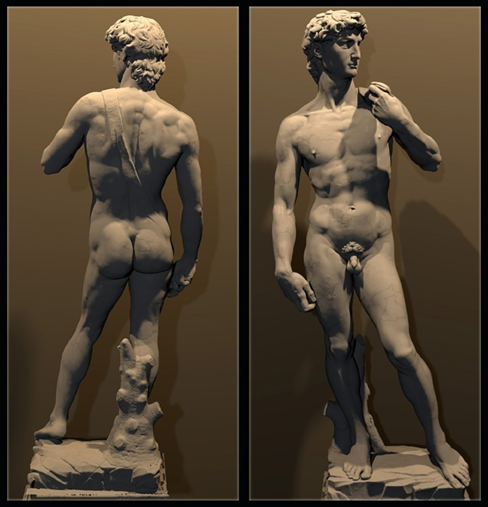
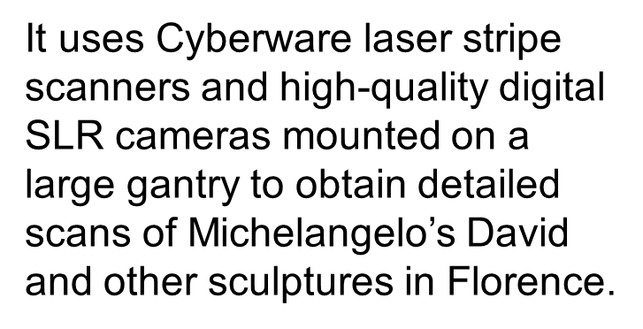
12.2.2 Application: Digital Heritage
The Digital Michelangelo project
laser scan of the David
Notes:
Gantry 起重機
Mounted 架設好的
SLR(Single Lens Reflex) camera單眼相機
透過微波雷射條文掃描機，與架設在龍門架上的高解析度單眼相機掃描得到。

Slide 47
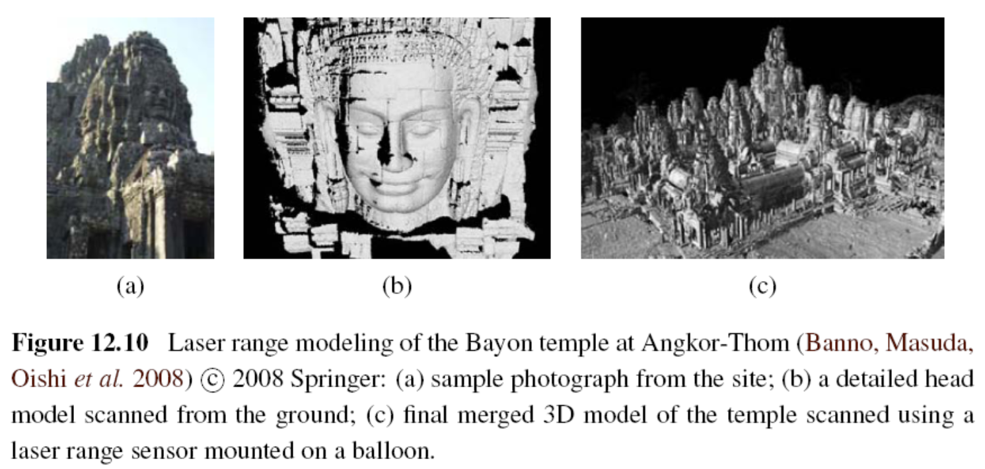
12.2.2 Application: Digital Heritage
Notes:
巴戎廟是吳哥城(Angkor Thom)中最著名最莊觀的一座廟，構造以大尊佛像頭部主，形成一群又一群的塔，遠看似聳起的山頭。原本有49座塔， 現在只剩下只37座塔，大部份塔頂都雕刻有佛像頭。

Slide 48
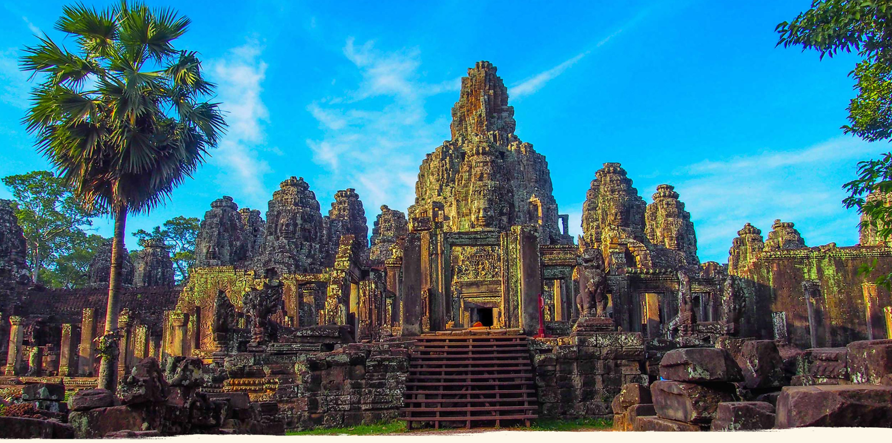

Slide 49
12.2.2 Application: Digital Heritage
https://www.youtube.com/watch?v=VbnPT3jeWL4
https://www.nationalgeographic.com/news/2015/06/150622-andrew-tallon-notre-dame-cathedral-laser-scan-art-history-medieval-gothic/
https://www.youtube.com/watch?v=nMGIU798UuE
https://www.youtube.com/watch?v=JKnZmue656k

Slide 50
12.3 Surface Representations
Surface representations
- Triangle Meshes
- Splines (Farin 1992, 1996)
- Subdivision Surfaces (Stollnitz, DeRose, and Salesin 1996; Zorin, Schr¨oder, and Sweldens 1996; Warren and Weimer 2001; Peters and Reif 2008)
Notes:
三角網格是多邊形網格的一種，多邊形網格又被稱為“Mesh”，是計算機圖形學中用於為各種不規則物體建立模型的一種資料結構
Subdivision surfaces細分曲面
Splines樣條函數
樣條通常是指分段定義的多項式參數曲線

Slide 51
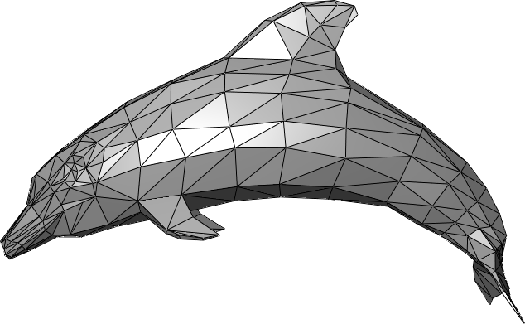
Triangle Meshes

Slide 52
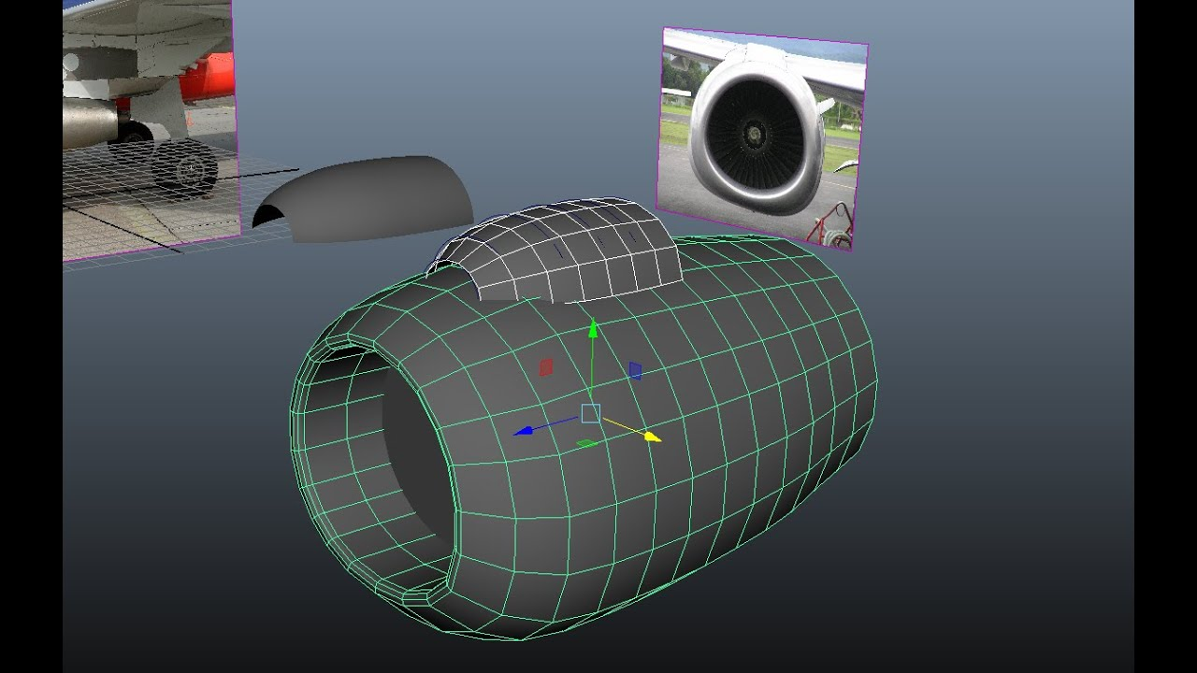
Splines Meshes
Notes:
樣條網格

Slide 53
12.3 Surface Representations
Introduction to subdivision surfaces

Slide 54
12.3 Surface Representations
It enables not only the creation of highly detailed models but also processing operations, such as interpolation (Section 12.3.1), fairing or smoothing, and decimation and simplification (Section 12.3.2).
Notes:
Decimation 抽取
fair 光順 整流
這些曲面表示法，不僅可以創建高度詳細的模型，還可以進行處理數學操作，例如插值，光順或平滑以及抽取和簡化。

Slide 55
12.3.1 Surface Representations
One of the most common operations on surfaces is their reconstruction from a set of sparse data constraints, i.e. scattered data interpolation
Notes:
Sparse data constraints 稀疏資料限制
在資料庫中，稀疏資料是指在二維表中含有大量空值的資料；即稀疏資料是指，在資料集中絕大多數數值缺失或者為零的資料。稀疏資料絕對不是無用資料，只不過是資訊不完全，通過適當的手段是可以挖掘出大量有用資訊

Slide 56
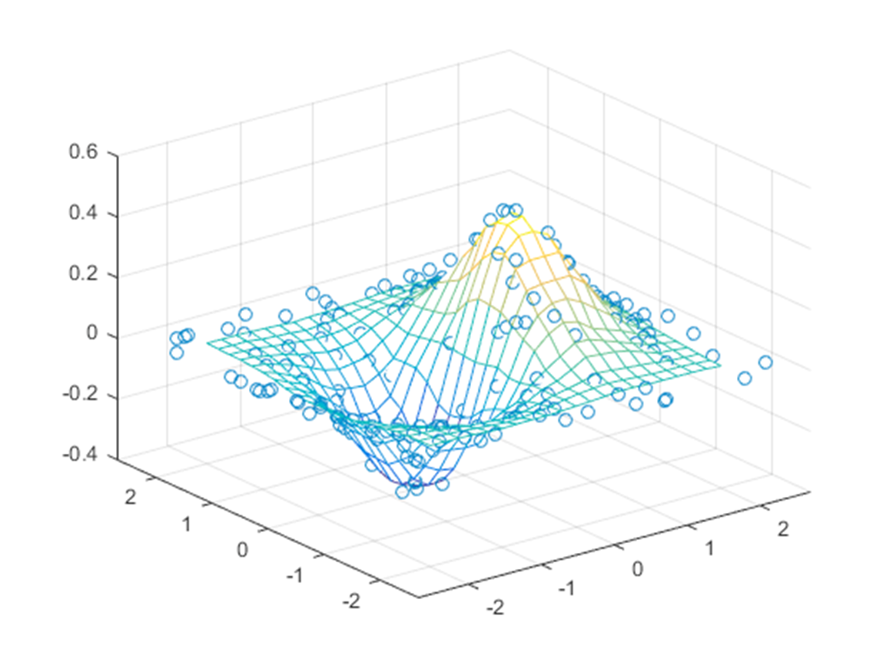
12.3.1 Surface Representations

Slide 57
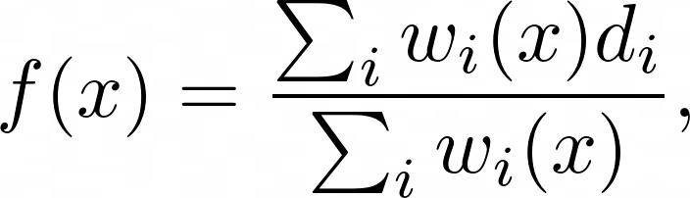
12.3.1 Surface Representations
Radial basis (or kernel) functions (Boult and Kender 1986; Nielson 1993)
To interpolate a field f(x) through (or near) a number of data values d_{i} located at x_{i}, the radial basis function approach uses
where the weights,
are computed using a radial basis (spherically symmetrical) function K(r).
Notes:
徑向基函數核
K 兩個特徵向量之間的平方歐幾里得距離

Slide 58
12.3.2 Surface Simplification
Once a triangle mesh has been created from 3D data, it is often desirable to create a hierarchy of mesh models, for example, to control the displayed Level Of Detail (LOD) in a computer graphics application
LOD
Notes:
Hierarchy 階層
Lod細節層次
隨著物體或者模型遠離觀察者而逐步降低。由於它能夠通過減少多邊形的數目從而提升渲染效率，所以在計算機與視頻遊戲中使用了這項技術。由於物體距離很遠，所以理論上並不會察覺到模型或者物體的視覺質量會有所下降

Slide 59
12.3.2 Surface Simplification
To approximate a given mesh with one that has subdivision connectivity, over which a set of triangular wavelet coefficients can then be computed. (Eck, DeRose, Duchamp et al. 1995)
To use sequential edge collapse operations to go from the original fine-resolution mesh to a coarse base-level mesh (Hoppe 1996)
Notes:
Coarse 粗糙的
edge collapse

Slide 60
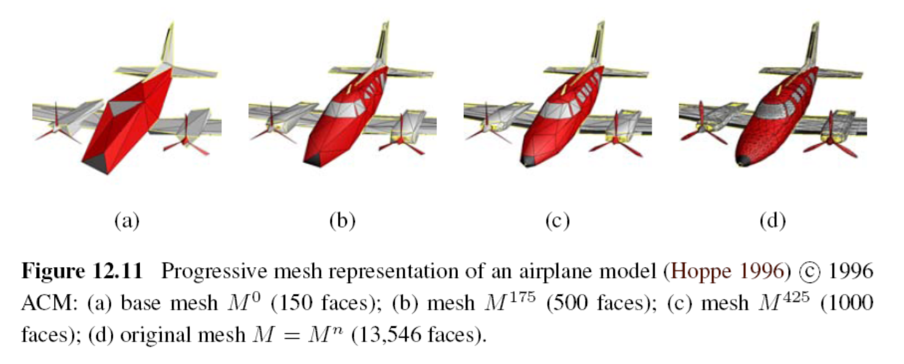
12.3.2 Surface Simplification

Slide 61
12.3.3 Geometry Images
To make meshes more easy to compress and store in a cache-efficient manner.
To create geometry images by cutting surface meshes along well chosen lines and “flattening” the resulting representation into a square.(Gu, Gortler, and Hoppe (2002))
Notes:
Geometry 幾何學
Cache快取記憶體
為了使網格更易於壓縮和以緩存有效的方式存儲。

Slide 62
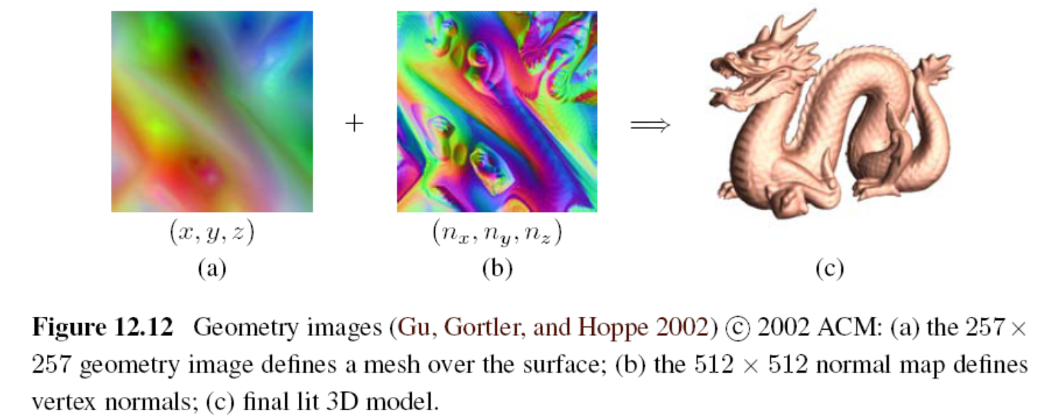
12.3.3 Geometry Images
Link

Slide 63
12.4 Point-based Representations
To dispense with an explicit triangle mesh altogether and to have triangle vertices behave as oriented points, or particles, or surface elements (surfels) (Szeliski and Tonnesen 1992)
Notes:
Dispense 免除
不用網格 用頂點

Slide 64
12.4 Point-based Representations
How to render the particle system as a continuous surface :
- local dynamic triangulation heuristics
(Szeliski and Tonnesen 1992)
- direct surface element splatting
(Pfister, Zwicker, van Baar et al. 2000)
- Moving Least Squares (MLS)
(Pauly, Keiser,Kobbelt et al. 2003)
Notes:
Render 呈現 (渲染)
Heuristics 策略法
Splat 點
局部動態三角剖分啟發法
直接表面噴濺
移動最小二乘法

Slide 65
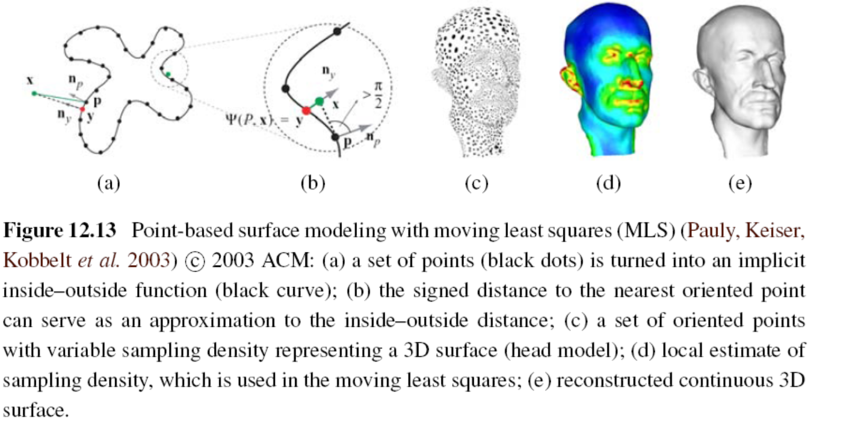
12.4 Point-based Representations

Slide 66
12.5 Volumetric Representations
A third alternative for modeling 3D surfaces is to construct 3D volumetric inside–outside functions
Implicit (inside–outside) functions to represent 3D shape
Notes:
體積的表示法
對3D曲面建模的第三個替代方法是構造3D體積內外函數
Implicit 絕對的

Slide 67
12.5.1 Implicit Surfaces and Level Sets
implicit surfaces
which use an indicator function (characteristic function) F(x; y; z) to indicate which 3D points are inside F(x; y; z) < 0 or outside F(x; y; z) > 0 the object
Notes:
隱式曲面

Slide 68
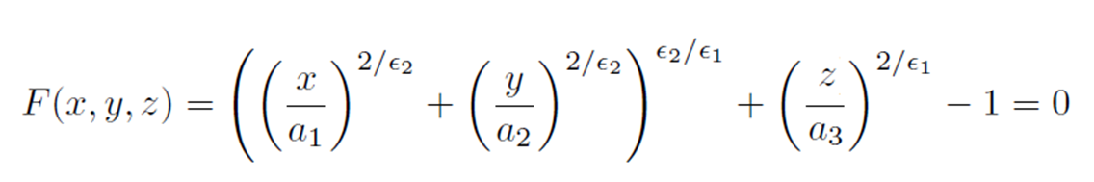

12.5.1 Implicit Surfaces and Level Sets
Implicit (inside-outside) functions of superquadrics:
The values of control the extent of model along each (x; y; z) axis, while the values of control how “square” it is.
Notes:
超二次曲面體 superquadrics
是一類幾何體，其表面方程由橢球體或其他二次曲面體方程演化而來。將橢球體表面方程中的指數由2更改為其他任意正實數，即得到超二次曲面體
可以表達圓角或近似方角的立方體、八面體、圓柱等諸多形狀，是一種很好的計算機三維圖形模型
Extent 長度

Slide 69
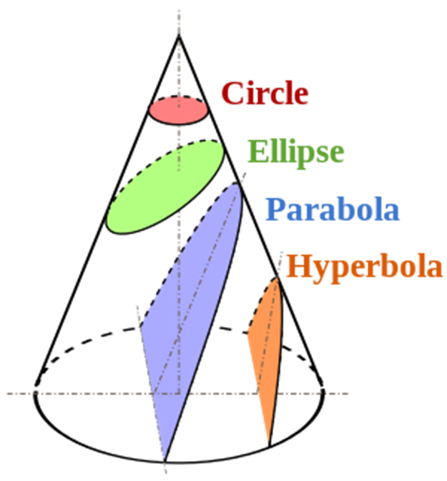
Conics (2D Curve)
Notes:
Conics 圓錐曲線 two dimensional curve
Parabola 拋物線
Hyperbola 雙曲線
不同切面會有不同圖形

Slide 70
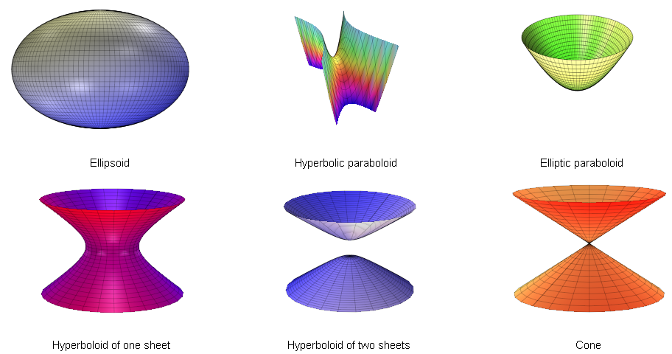
Quadric
Notes:
Quadric二次曲面
the three dimensional analogue(類似) of the conics

Slide 71
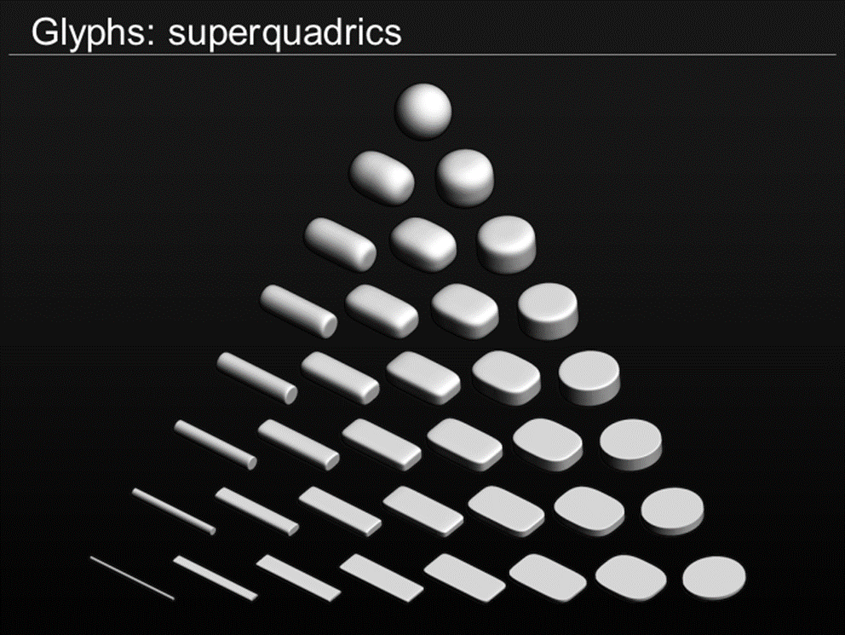
Superquadrics
Notes:
These are an extension of quadrics, where the power on the coordinate does not have to be 2
各參數不侷限2次了

Slide 72
12.5.1 Implicit Surfaces and Level Sets
A different kind of implicit shape model can be constructed by defining a signed distance function over a regular three-dimensional grid, optionally using an octree spline to represent this function more coarsely away from its surface (zero-set) (Lavall´ee and Szeliski 1995 Szeliski and Lavall´ee 1996; Frisken, Perry, Rockwood et al. 2000; Ohtake, Belyaev, Alexaet al. 2003)
Notes:
Signed distance function 正負號距離表示法
可以通過在規則的三維網格上定義帶符號的距離函數來構造另一種類型的隱式形狀模型，可以選擇使用八叉樹樣條曲線將該函數更粗糙地表示為遠離其表面（零集）

Slide 73
12.5.1 Implicit Surfaces and Level Sets
Examples of signed distance functions being used
- distance transforms (Section 3.3.3)
- level sets for 2D contour fitting and tracking (Section 5.1.4)
- volumetric stereo (Section 11.6.1)
- range data merging (Section 12.2.1)
- point-based modeling (Section 12.4)

Slide 74
12.6 Model-based Reconstruction
12.6.1 Architecture
12.6.2 Heads and faces
12.6.3 Application: Facial animation
12.6.4 Whole body modeling and tracking

Slide 75
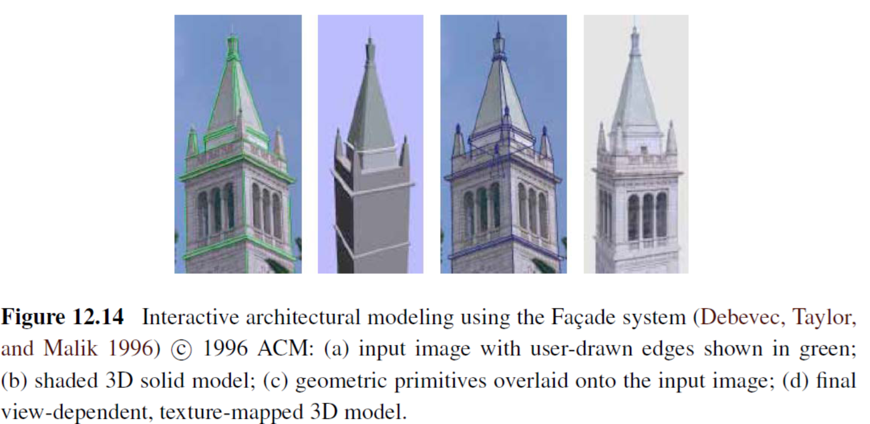
12.6.1 Architecture
Notes:
Primitive 原始
Overlaid 覆蓋

Slide 76
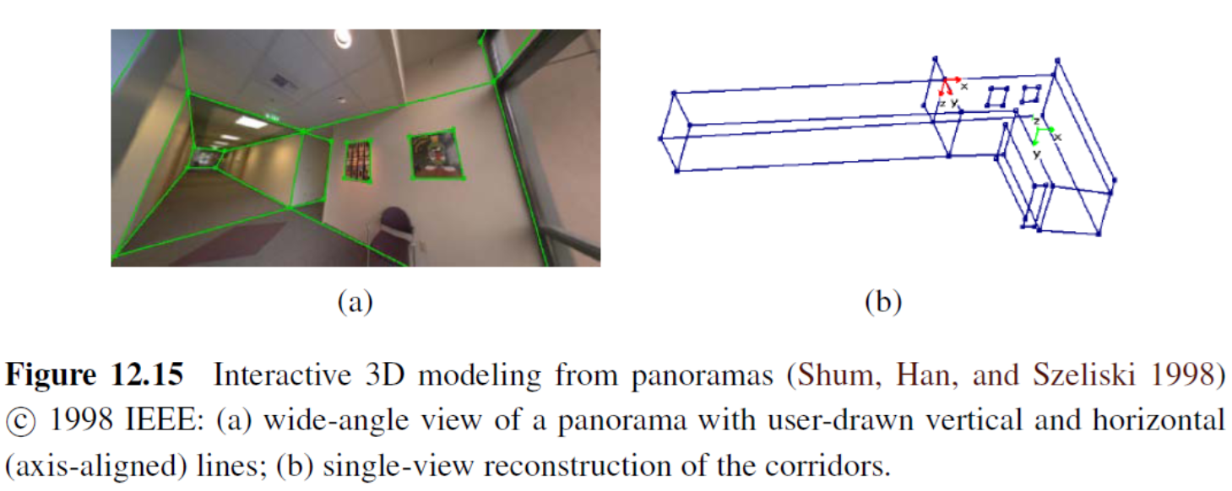
12.6.1 Architecture
Architectural interior modeling
Lumion 9
Notes:
Interior 室內
Lumion 9

Slide 77
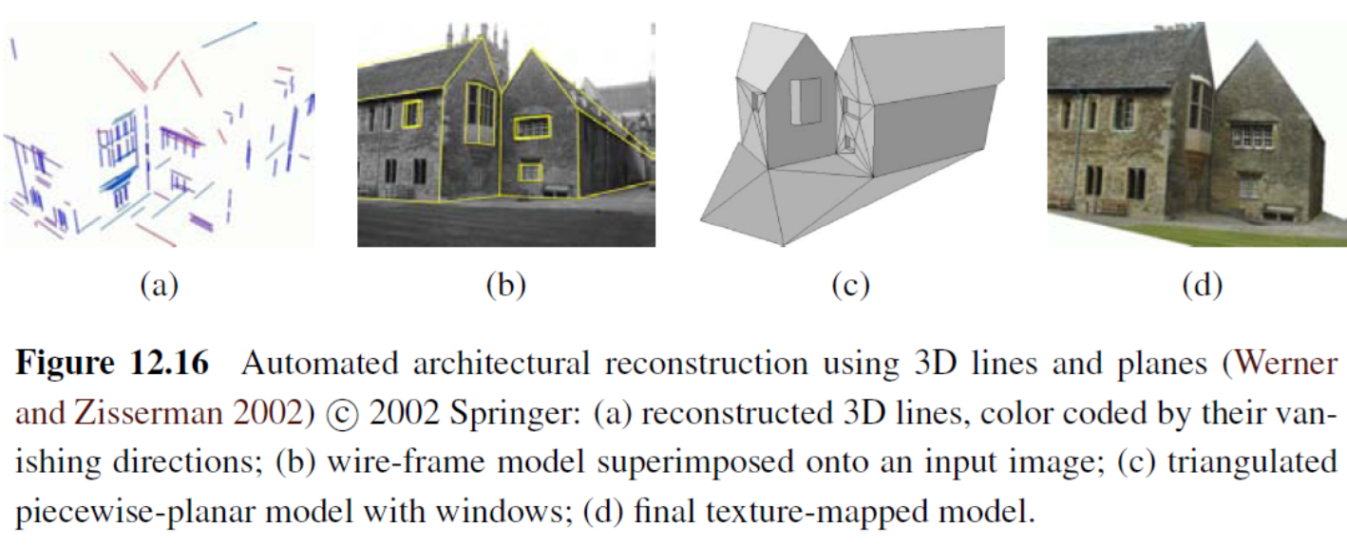
12.6.1 Architecture
Automated line-based reconstruction
Notes:
Wire-frame 線框
Superimposed 疊加

Slide 78
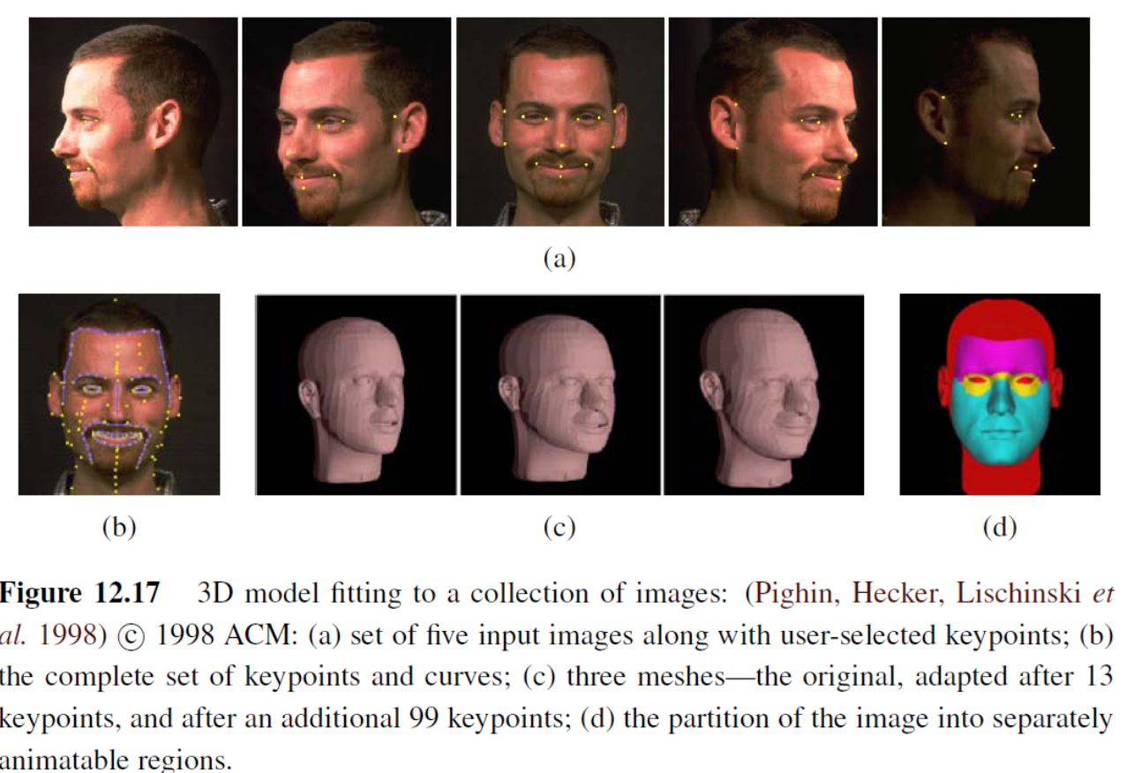
12.6.2 Heads and Faces

Slide 79
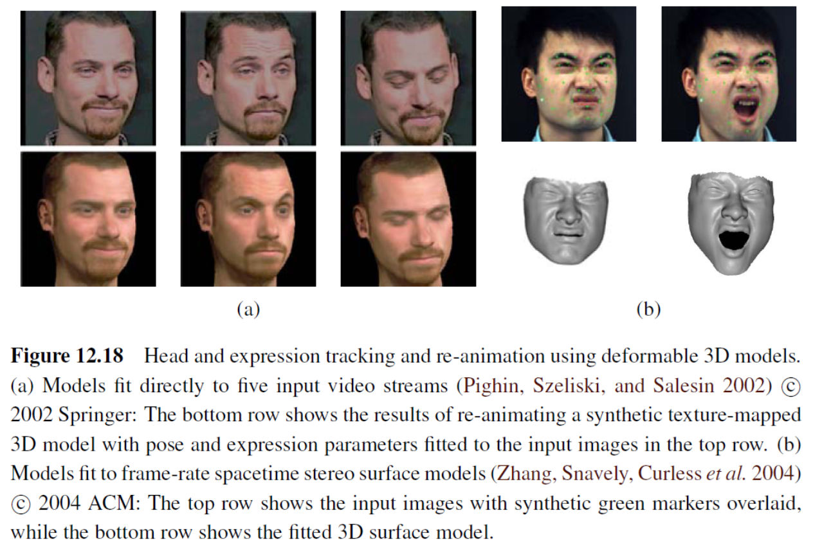
12.6.2 Heads and Faces

Slide 80
12.6.2 Model-based Reconstruction
3D head model applications
head tracking
face transfer, i.e., replacing one person’s face with another in a video
face beautification by warping face images toward a more attractive “standard”
face de-identification for privacy protection
face swapping
Notes:
(Toyama 1998; Lepetit, Pilet, and Fua 2004; Matthews, Xiao, and Baker
2007), as shown in Figures 4.29 and 14.24
(Bregler, Covell, and Slaney 1997; Vlasic, Brand, Pfister et al.2005)
(Leyvand, Cohen-Or, Dror et al. 2008)
(Gross, Sweeney, De la Torre et al. 2008) 去識別化
(Bitouk,Kumar, Dhillon et al. 2008)

Slide 81
3D Head Model Applications
face swap from Microsoft
deepfake damage
Mrdeepfakes
Fake videos of real people -- and how to spot them

Slide 82
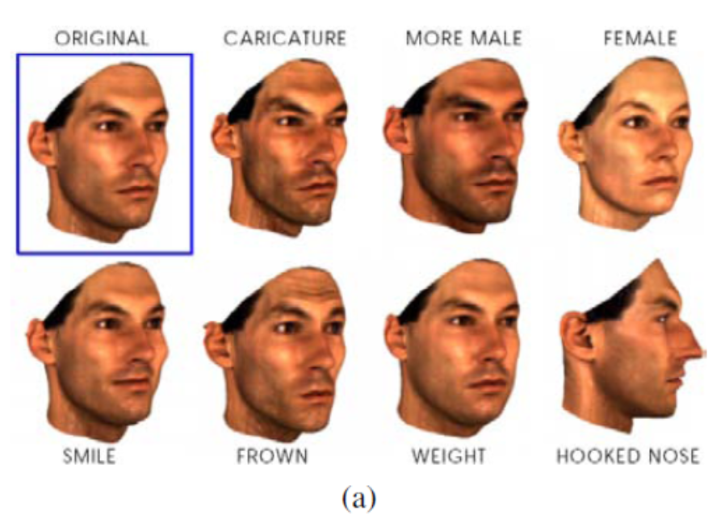
12.6.3 Application: Facial Animation
(a) Original 3D face model with the addition of shape and texture variations in specific direction: deviation from the mean (caricature), gender, expression, weight, and nose shape
Notes:
Caricature 諷刺

Slide 83
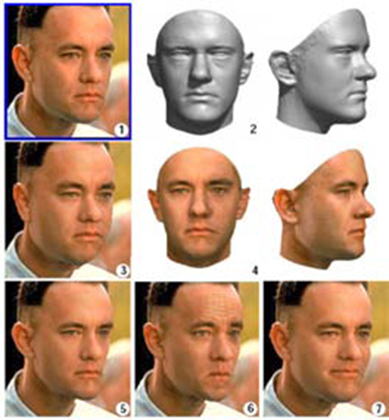
12.6.3 Application: Facial Animation
Notes:
Morphable 型變

Slide 84

12.6.3 Application: Facial Animation
(c) another example of a 3D reconstruction along with a different set of 3D manipulations such as lighting and pose change.

Slide 85
12.6.3 Application: Facial Animation
Morphable Face: Automatic 3D Reconstruction and Manipulation from Single Data-Set Reference Face
https://www.youtube.com/watch?v=fu7bTemvEKk

Slide 86
12.6.3 Application: Facial Animation
Photoreal Digital Actor
https://www.youtube.com/watch?v=piJ4Zke7EUw
Tomb Raider
Notes:
Facial Animation: 面部動畫

Slide 87
12.6.4 Whole Body Modeling and Tracking
Background subtraction
Initialization and detection
Tracking with flow
3D kinematic models
Probabilistic models
Adaptive shape modeling
Activity recognition

Slide 88
12.6.4 Whole Body Modeling and Tracking
Background Subtraction
- One of the first steps in many (but certainly not all) human tracking systems is to model the background in order to extract the moving foreground objects (silhouettes) corresponding to people.
- Once silhouettes have been extracted from one or more cameras, they can then be modeled using deformable templates or other contour models
Notes:
Silhouettes 剪影

Slide 89
12.6.4 Whole Body Modeling and Tracking
Initialization and Detection
- In order to track people in a fully automated manner, it is necessary to first detect (or re-acquire) their presence in individual video frames.
- This topic is closely related to pedestrian detection, which is often considered as a kind of object recognition (Mori, Ren, Efros et al. 2004; Felzenszwalb and Huttenlocher 2005; Felzenszwalb, McAllester, and Ramanan 2008
pedestrain detection
Notes:
行人偵測。早期做法是 image feature description 。近期做法是 neural network
treated in more depth in Section 14.1.2.

Slide 90
12.6.4 Whole Body Modeling and Tracking
3D Kinematic Models
- which specifies the length of each limb in a skeleton as well as the 2D or 3D rotation angles between the limbs or segments
Notes:
Limb 肢

Slide 91

12.6.4 Whole Body Modeling and Tracking
Realtime Multi-Person 2D Human Pose Estimation using Part Affinity Fields

Slide 92
12.6.4 Whole Body Modeling and Tracking
Probabilistic Models
- Because tracking can be such a difficult task, sophisticated probabilistic inference techniques are often used to estimate the likely states of the person being tracked
Notes:
Sophisticated 老練的

Slide 93
12.6.4 Whole Body Modeling and Tracking
Adaptive Shape Modeling
- Another essential component of whole body modeling and tracking is the fitting of parameterized shape models to visual data

Slide 94

12.6.4 Whole Body Modeling and Tracking

Slide 95
12.6.4 Whole Body Modeling and Tracking
Estimating Human Shape and Pose From a Single Image
Original
3D Human Pose and Shape from a Single Image

Slide 96
12.6.4 Whole Body Modeling and Tracking
Activity Recognition
- The final widely studied topic in human modeling is motion, activity, and action recognition (Bobick 1997; Hu, Tan, Wang et al. 2004; Hilton, Fua, and Ronfard 2006)
- Examples of actions that are commonly recognized include walking and running, jumping, dancing, picking up objects, sitting down and standing up, and waving

Slide 97

12.7 Recovering Texture Maps and Albedos
After a 3D model of an object or person has been acquired, the final step in modeling is usually to recover a texture map to describe the object’s surface appearance

Slide 98

12.7 Recovering Texture Maps and Albedos

Slide 99

12.7 Recovering Texture Maps and Albedos

Slide 100

12.7.1 Estimating BRDFs

