Slide 1
Advanced Computer Vision Chapter 11 Stereo Correspondence
Presented by: 傅楸善 & 王柏川
0929621000
d08922016@csie.ntu.edu.tw
指導教授: 傅楸善 博士

Slide 2
Introduction
Stereo matching is the process of taking two or more images to estimate a 3D model and converting their 2D positions into depth.

Slide 3
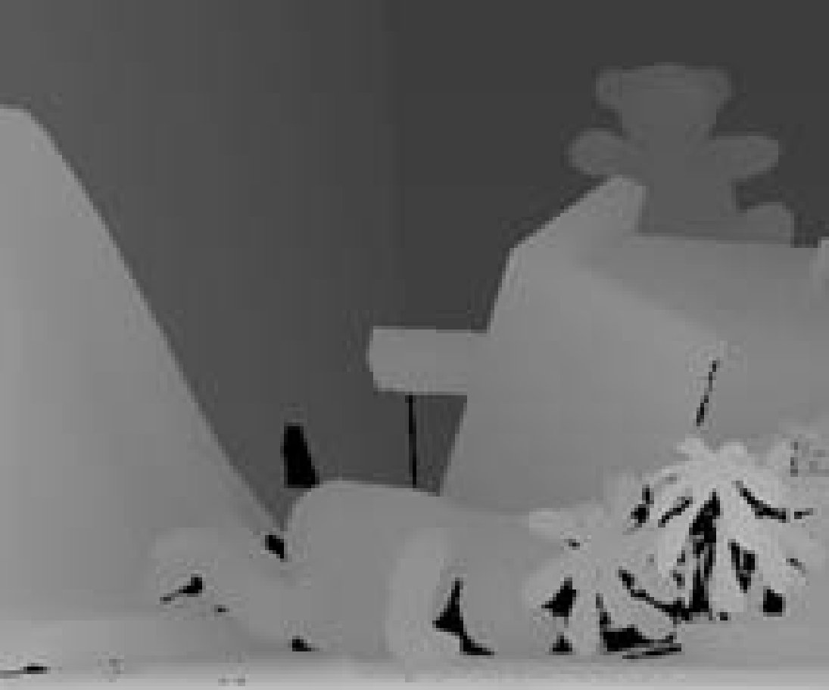
(a) (b) (c)
Figure 11.1 Stereo reconstruction (a-b) pair of images (c) depth map.

Slide 4
Introduction (cont’)
The way of building more complete model is discussed in this chapter.

Slide 5
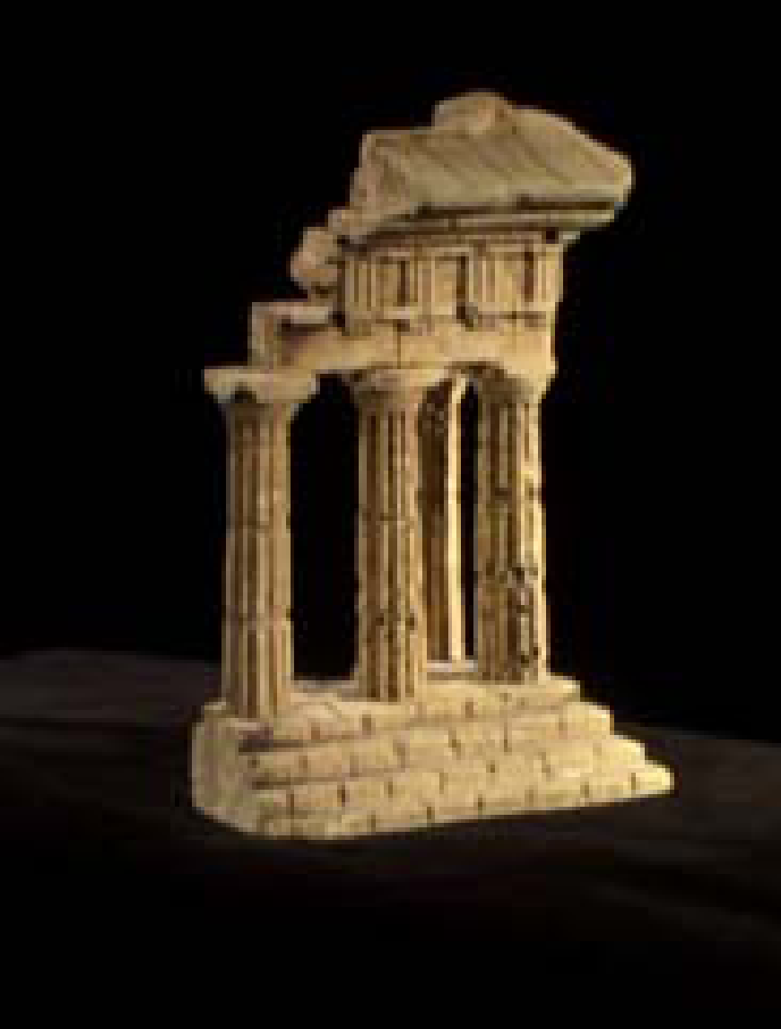
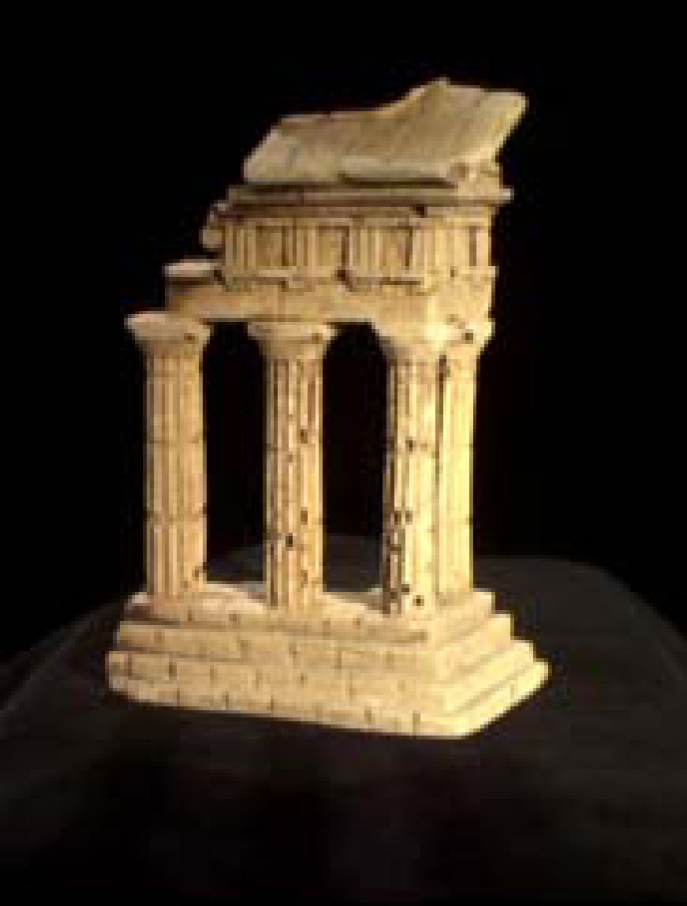
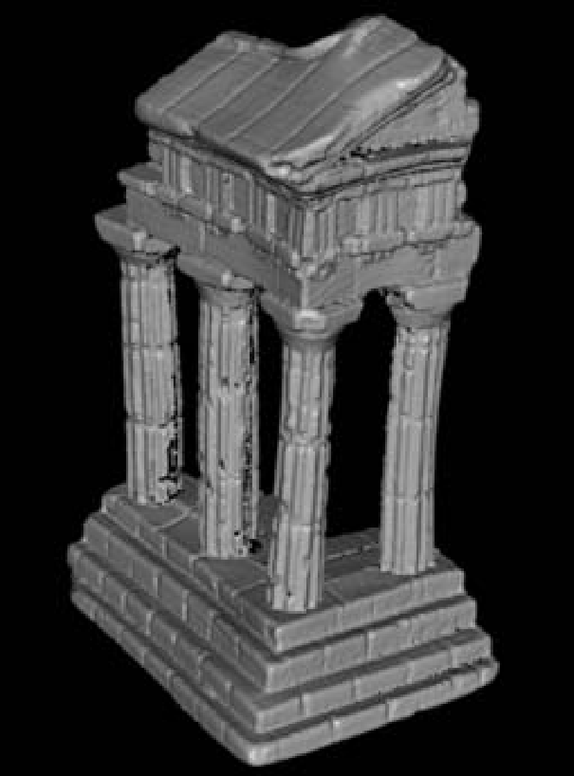
(d) (e) (f)
Figure 11.1 Stereo reconstruction (d-e) sequence of images (f) 3D model.

Slide 6
Outline
11.1 Epipolar Geometry
11.2 Sparse correspondence
11.3 Dense correspondence
11.4 Local methods
11.5 Global optimization
11.6 Multi-view stereo

Slide 7
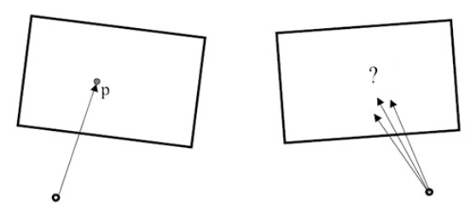

Slide 8
11.1 Epipolar Geometry
Given a pixel in one image, how to compute its correspondence in the other image?

Slide 9
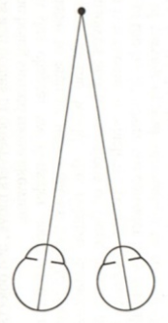
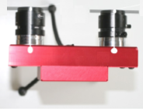

Slide 10
11.1 Epipolar Geometry (cont’)
To speed up matching, exploiting calibration data of cameras with static scene is necessary.

Slide 11
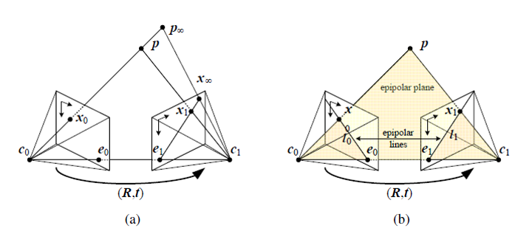
baseline
Figure 11.3 Epipolar geometry (a) epipolar line segment corresponding to one ray (b) corresponding set of epipolar lines and their epipolar plane.

Slide 12
11.1 Epipolar Geometry (cont’)
The epipolar constraint is defined as ${{\hat{x}}_{r}}^{T}E{\hat{x}}_{l}=0$.
$${\left[\begin{matrix}x \\ y \\ 1\end{matrix}\right]}^{T}\left[\begin{matrix}a \\ b \\ c\end{matrix}\right]=0$$
$$ax+by+c=0$$
where E is essential matrix.

Slide 13
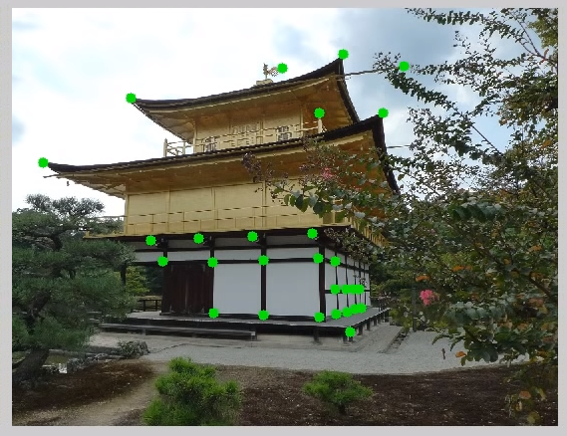
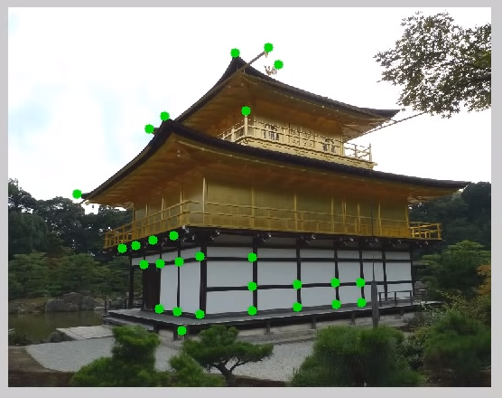
11.1 Epipolar Geometry (cont’)
https://youtu.be/QzYn0OPO0Yw?t=1417

Slide 14
11.1 Epipolar Geometry (cont’)
Epipolar line is used to search for corresponding pixels between two images.

Slide 16
11.1.1 Rectification
The algorithm can be more efficient than optical flow by first rectifying.

Slide 17
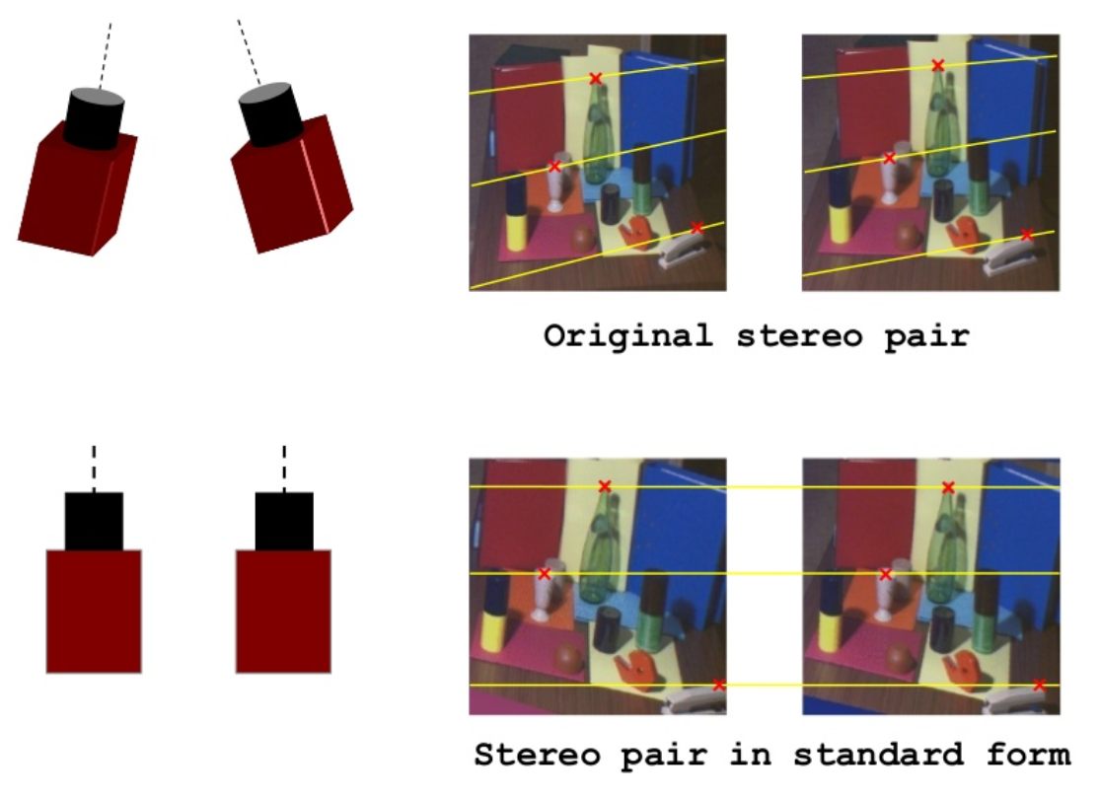

Slide 18
11.1.1 Rectification (cont’)
The standard rectified geometry is employed in a lot of camera setups and algorithms.

Slide 19
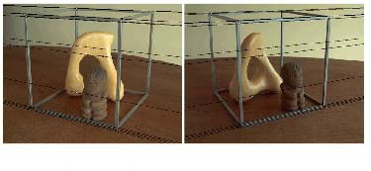
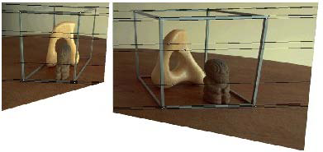
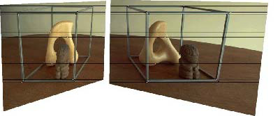
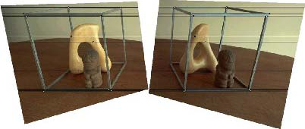
(a) (b)
(c) (d)
Figure 11.4 Rectification algorithm (a) original image pair overlaid with several epipolar lines (b) images transformed so that epipolar lines are parallel (c) images rectified so that epipolar lines are vertical correspondence (d) minimize horizontal distortions.

Slide 20
11.1.1 Rectification (cont’)
A relationship between 3D depths Z and disparities d.
where f is the focal length, B is the baseline.

Slide 21
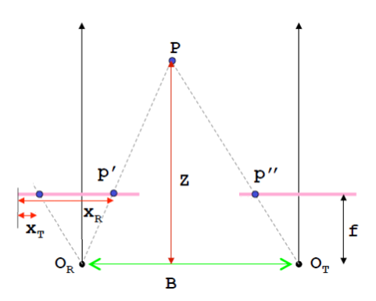
d = x_{R} - x_{T}

Slide 22
11.1.1 Rectification (cont’)
Coordinate corresponding between $p^{′}$and $p$.

Slide 23
11.1.1 Rectification (cont’)
The similar pixels at corresponding location are stored in a disparity space image.

Slide 24
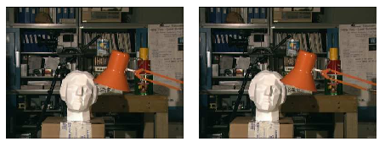
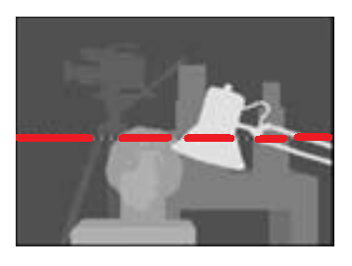
The bookshelves, table, and head statue are seen as horizontal lines. The Dark band represents successful matching in disparity space images.

Slide 25
11.1.1 Rectification (cont’)
The task of extracting depth from a set of images becomes one of estimating the disparity maps.

Slide 26
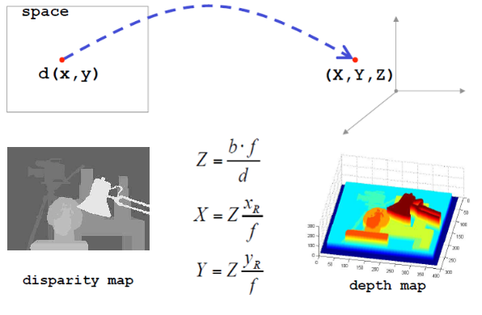

Slide 27
11.1.2 Plane Sweep
In scenes that are rich in planar structure, it is possible to directly estimate homography between different planes.

Slide 28
11.1.2 Plane Sweep (cont’)
Sweep a set of planes and measure photo consistency of different images is another alternative method.

Slide 29
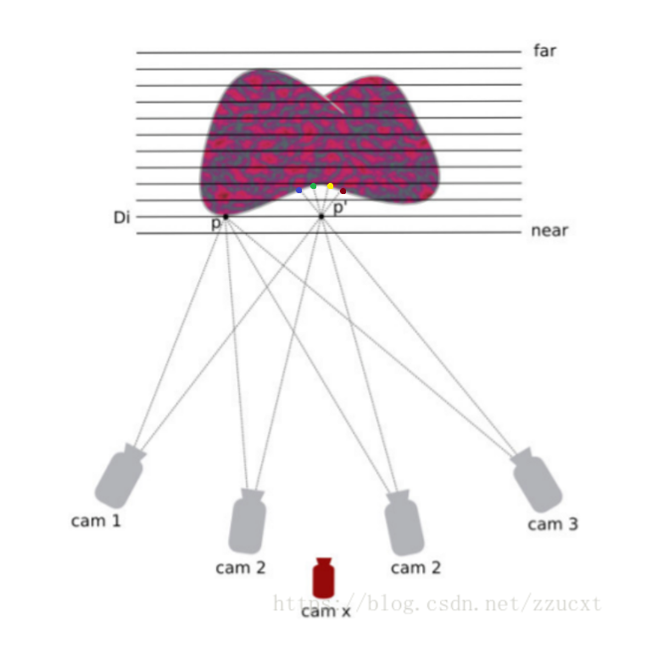

Slide 30
11.2 Sparse Correspondence
Feature-based matching algorithms searched for corresponding location in the other images by using edge detector.
There is also a desire to match scenes with different illumination in some application.

Slide 31
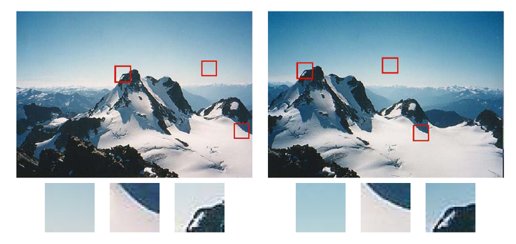

Slide 32
11.2 Sparse Correspondence (cont’)
This limitation to sparse correspondences is due to computational resource, but also driven by expectation to get the high certainty answers.

Slide 33
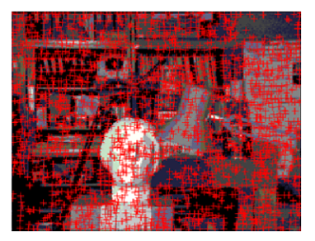

Slide 34
11.2.1 3D Curves and Profiles
Another example of sparse correspondence is the matching of profile curves which occur at boundary of object.

Slide 35
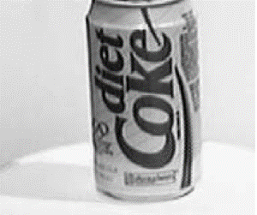
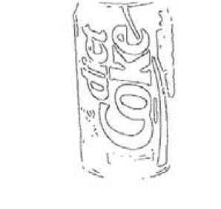

Slide 36
11.2.1 3D Curves and Profiles (cont’)
The difficulty is the locations of profile curves vary as a function of camera viewpoint.

Slide 37
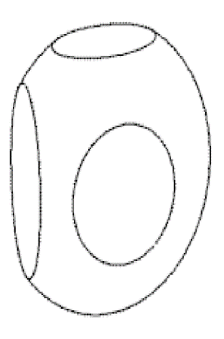
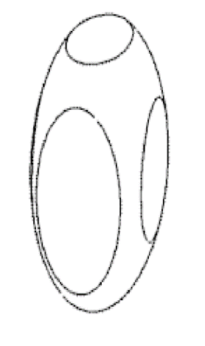

Slide 38
11.2.1 3D Curves and Profiles (cont’)
If closely frames are available, it is possible to fit a local circular arc for corresponding edges.
$$c_{i}x_{c}+s_{i}y_{c}=r−d_{i}$$
where $c_{i}$, $s_{i}$ are cosθ and sinθ

Slide 39
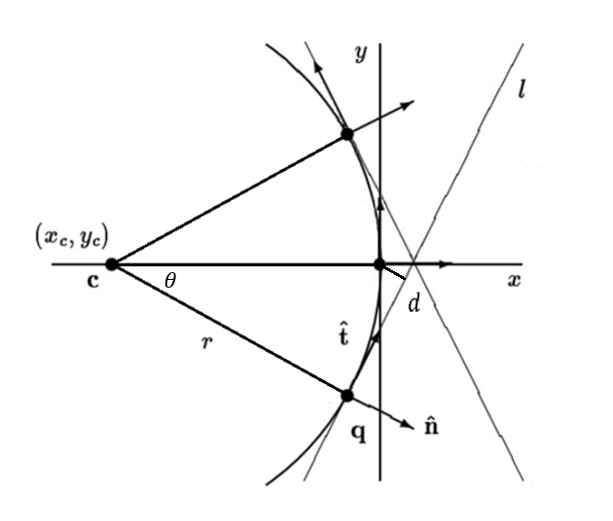

Slide 40
11.2.1 3D Curves and Profiles (cont’)
Assume that the camera moves smoothly, so the local epipolar geometry varies slowly.
Then edges are extracted and matched by pairwise epipolar geometry.

Slide 41
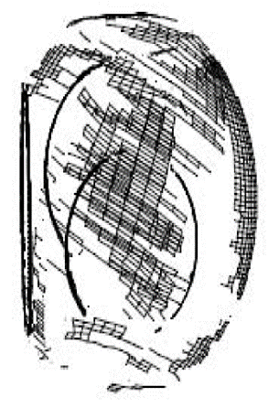

Slide 42
11.3 Dense Correspondence
While sparse matching algorithms are still occasionally used, more challenging problems focus on dense correspondence.

Slide 43
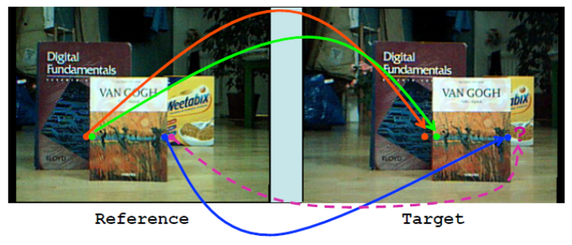

Slide 44
11.3 Dense Correspondence (cont’)
Stereo algorithms on dense correspondence generally perform the following four steps:
1. Cost computation.
2. Aggregation.
3. Optimization.
4. Refinement.

Slide 45
11.3 Dense Correspondence (cont’)
Sum of squared differences matching algorithm is described as:
Compute the squared difference of intensity values at given disparity.
Sum the matching cost over support regions.
Select the minimal value at each pixel.

Slide 46
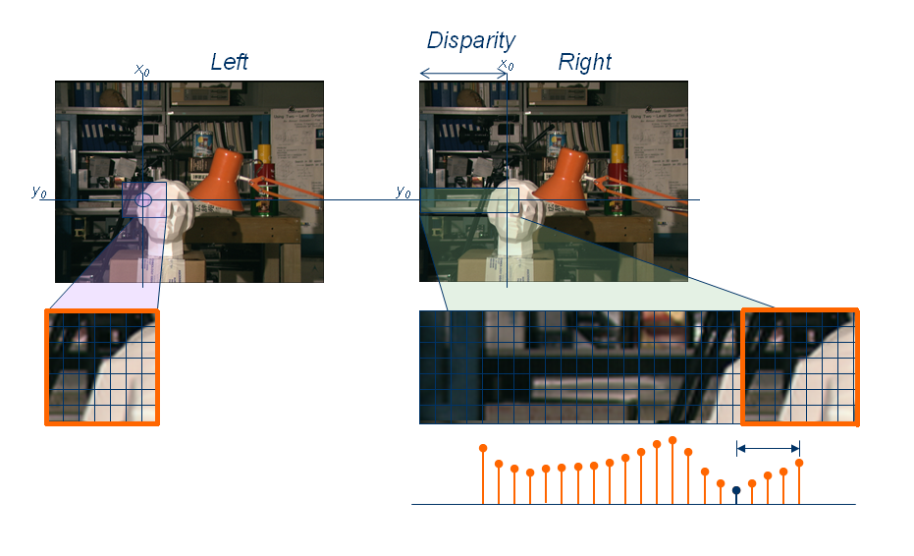

Slide 47
11.3.1 Similarity Measures
To assess correspondence for dense stereo matching, some similarity measure is mentioned in this subsection.

Slide 48
11.3.1 Similarity Measures (cont’)
Entropy of the pixel values limits the influence of mismatch during aggregation.
Sign of the Laplacian leads to poor discriminability in binary matching.
Gradient-based methods are insensitive to depth discontinuities.
Census transform converts pixel into a bit vector.

Slide 49
11.4 Local Methods
In local methods, the emphasis is aggregation step because of winner-takes-all strategy.
Square windows are implemented to sum the result of finite region.

Slide 50
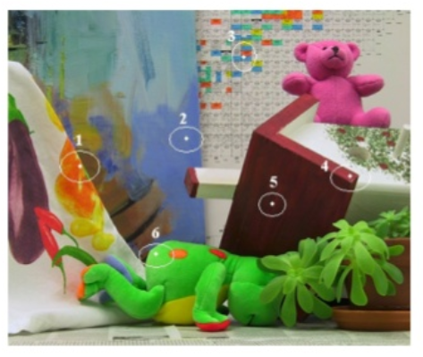

Slide 51
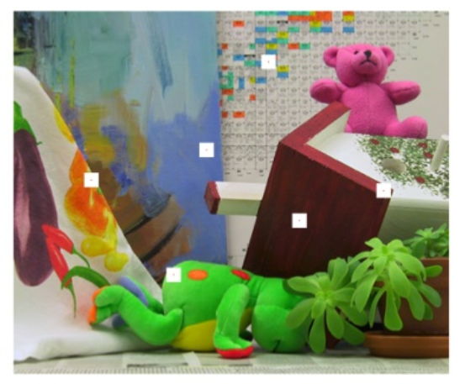
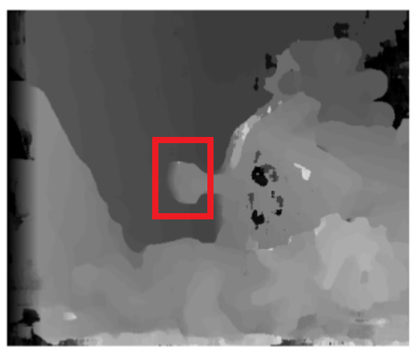
Fixed Window

Slide 52
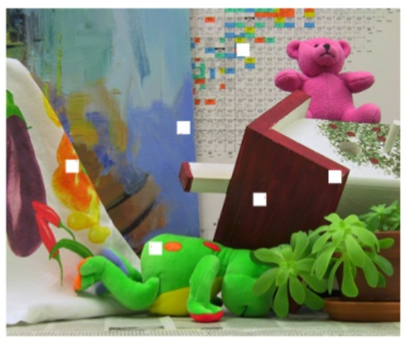
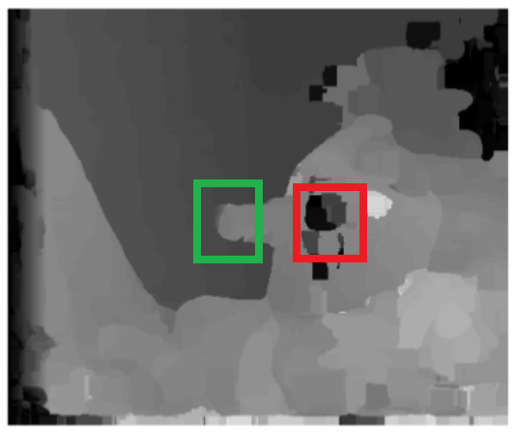
Shiftable Window

Slide 53
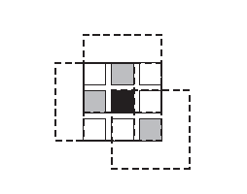

Slide 54
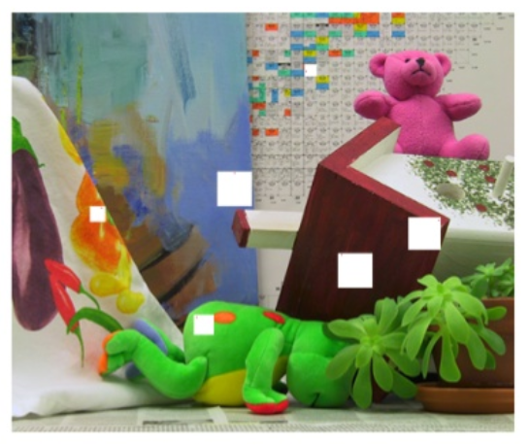
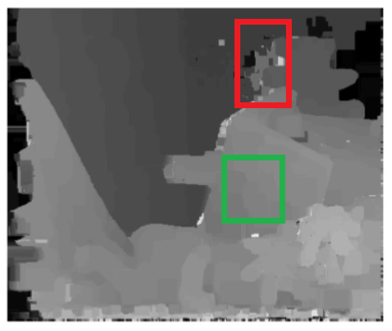
Variable Window

Slide 55
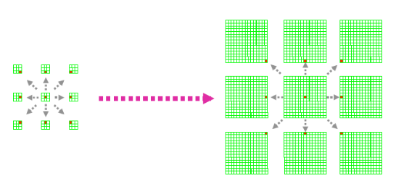

Slide 56
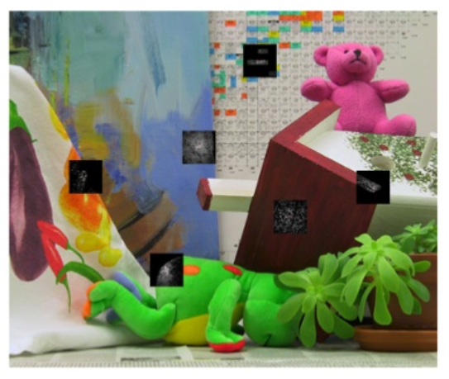
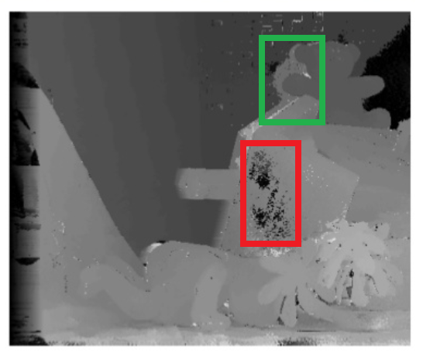
Adaptive Weight

Slide 57
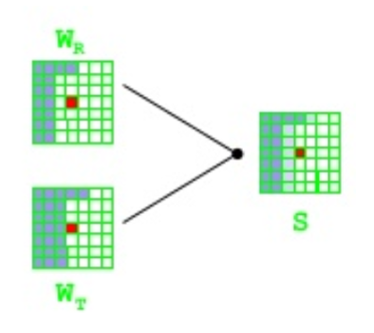

Slide 58
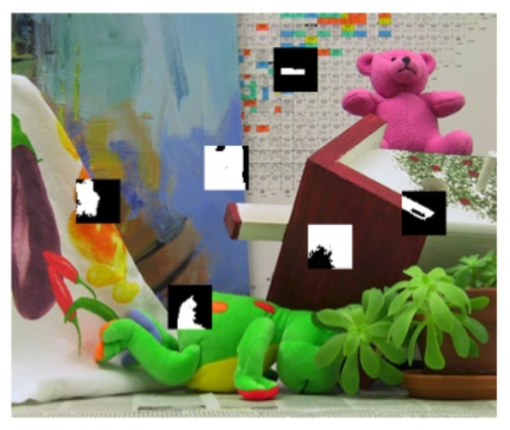
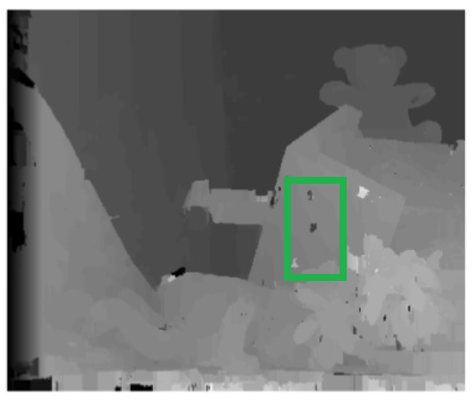
Segmentation-Based

Slide 59
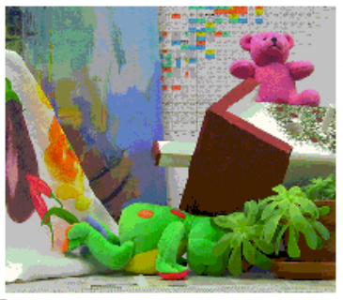
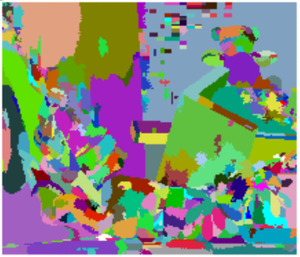

Slide 60
11.4 Local Methods (cont’)
Selecting correct windows is important, since windows must be large enough to contain sufficient texture and small enough to avoid straddle depth discontinuities.

Slide 61
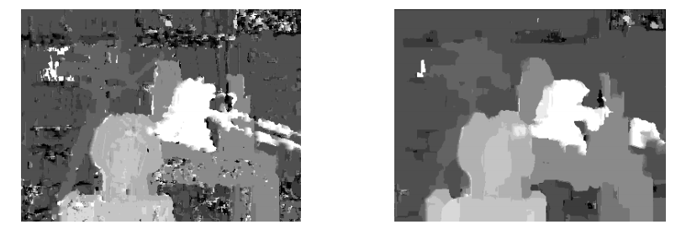

Slide 62
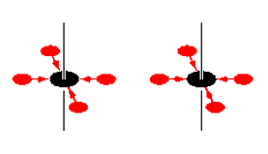
11.4 Local Methods (cont’)
Another method for aggregation is iterative diffusion which adds neighboring cost to each pixel repeatedly.

Slide 63
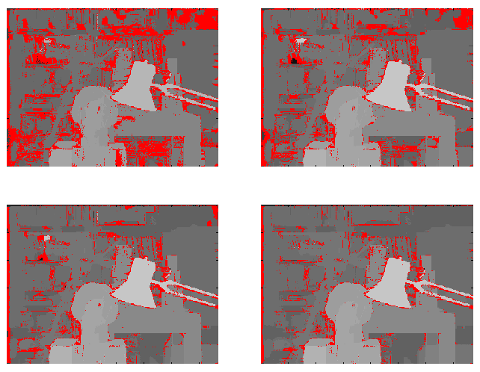

Slide 64
11.4.1 Sub-Pixel Estimation and Uncertainty
Most stereo correspondence algorithms compute a set of integer disparity estimates in discretized space, but sometimes it requires more precision in robot navigation or people tracking.
Otherwise, quantized maps lead to very unappealing view results.

Slide 65
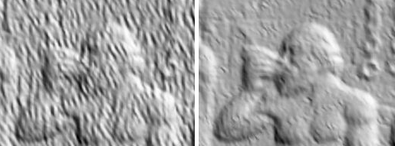

Slide 66
11.4.1 Sub-Pixel Estimation and Uncertainty (cont’)
To remedy this situation, many algorithms apply sub-pixel as refinement by interpolation.
Sub-pixel disparity estimates are computed by fitting curve, but regions must be the same surface.

Slide 68
11.4.1 Sub-Pixel Estimation and Uncertainty (cont’)
Computing certainty map from correlation is another way for post processing.

Slide 69
(a) (b) (c)
Figure 11.10 Certainty map in stereo depth estimation (a) input image (b) depth map (c) estimated confidence.

Slide 70
11.5 Global Optimization
Global stereo matching are formulated in energy minimization by finding a solution d.
E: Total energy (cost) function
E_{d}: Data energy function
E_{s}: Smooth energy function

Slide 71
11.5 Global Optimization (cont’)
Global method performs iterative optimization which consists of data terms and smoothness terms for replacing aggregation step.

Slide 72
11.5 Global Optimization (cont’)
The data term measures how well the disparity function agrees with input image pair.
where C is aggregated matching cost.

Slide 73
11.5 Global Optimization (cont’)
The smoothness term measures differences between neighboring pixels.
where is some monotonically increasing function.

Slide 74
11.5 Global Optimization (cont’)
Once the energy function has been defined, a variety of algorithms are used to find minimum.
Traditional approaches are associated with Markov random fields and regularization.

Slide 75
11.5 Global Optimization (cont’)
There are some alternative approaches worth studying.

Slide 76
11.5 Global Optimization (cont’)
Cooperative algorithms iteratively update disparity estimates using non-linear operations that cause an overall behavior.

Slide 77
11.5 Global Optimization (cont’)
In the coarse to fine method, image warping and disparity estimates are alternately performed until satisfactory registration is achieved.

Slide 79
11.5.1 Dynamic Programming
These approaches compute minimum path in the graph with all pairwise matching, and its cost is similarity of regions.

Slide 81
11.5.2 Segmentation Based Techniques
While most stereo matching algorithms perform their computations on pixels, some of the techniques segment the images into regions for trying to label with disparities.

Slide 82
11.5.2 Segmentation Based Techniques (cont’)

Slide 83
11.6 Multi-view Stereo
While matching pairs of images is a useful way of obtaining depth information, matching more images lead to better results.
Examining all the epipolar plane image can visualize the multi-frame stereo estimation.

Slide 85
11.6 Multi-view Stereo (cont’)
The condition of occluded object is seen as strip of regions which explain their relationships in the epipolar plane images.

Slide 87
11.6 Multi-view Stereo (cont’)
Figure 11.16 Shiftable windows. (a) stable windows which center on the white pixel straddling depth discontinuities.

Slide 88
11.6 Multi-view Stereo (cont’)
Figure 11.16 Shiftable windows. (b) shiftable windows decrease the problems in partially occluded regions.

Slide 89
11.6 Multi-view Stereo (cont’)
Multiple cameras are used to capture dynamic scene which is kind of scene flow.
The real-time task simultaneously recovers the 3D shape and estimates the 3D motion.

Slide 90
11.6.1 Volumetric and 3D Surface Reconstruction
The goal of multi-view stereo is reconstructing complete object model from a collection of images.
The most challenging part is creating consistent 3D models.

Slide 91
11.6.1 Volumetric and 3D Surface Reconstruction (cont’)
Figure 11.19 Multi-view stereo algorithms. (a) surface based stereo. (b) voxel coloring (c) merging depth map (d) level set method.

Slide 92
11.6.1 Volumetric and 3D Surface Reconstruction (cont’)
Figure 11.19 Multi-view stereo algorithms. (e) stereo fusion (f) multi-view image matching (g) graph cut (h) visual hulls.

Slide 93
11.6.1 Volumetric and 3D Surface Reconstruction (cont’)
In order to compare all these techniques, there is a six point taxonomy that can help classify algorithms in this section.

Slide 94
11.6.1 Volumetric and 3D Surface Reconstruction (cont’)
The most popular representations is uniform grid of voxels in 3D scene.
Photo consistency measure is a choice that computes directly on the surface.
Single depth map is the ability to distinguish visibility and occlusions.

Slide 95
11.6.1 Volumetric and 3D Surface Reconstruction (cont’)
Most matching algorithms adopt some form of prior model for the expected shape.
Some approaches define over consistency volume to recover a complete surface by global optimization.
To refine or evolve a rough model, it usually requires an accurate initialization.

Slide 96
11.6.1 Volumetric and 3D Surface Reconstruction (cont’)
http://vision.middlebury.edu/mview/eval

