Slide 1
Chapter 10 Computational Photography
講者：Alexander Yurusov (游亞力) (生醫電資所碩士班)
聯絡資訊：R10945053@ntu.edu.tw
指導教授：傅楸善

Slide 2
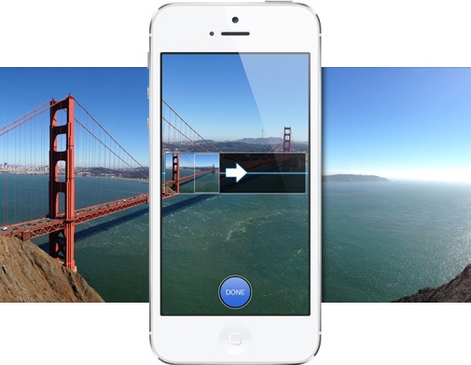
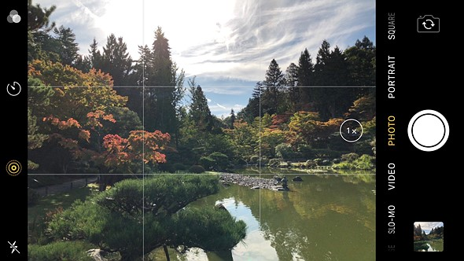
Introduction 簡介
Most widespread commercial impact.
Most smartphones has built-in computational photography functions.
Panoramic
Stitching
HDR
(High Dynamic Range)
Noise Removal

Slide 3
Definition 定義
Computational photography is a technique that uses image analysis and processing algorithms that are applied to one or more photographs to create images that go beyond the capabilities of traditional imaging systems.
Computational photography refers to digital image capture and processing techniques that use digital computation instead of optical processes. (Wikipedia)

Slide 4
Chapter Structure 章節架構
10.1 Photometric Calibration (光度學校正)
10.2 High Dynamic Range Imaging (高動態範圍成像)
10.3 Super-resolution, Denoising, and Blur Removal (超解析度、去雜訊、去模糊)
10.4 Image Matting and Compositing (影像去背與合成)
10.5 Texture Analysis and Synthesis (質地分析和生成)

Slide 5
Chapter 10-1 Photometric Calibration 光度學校正
Definition: Photometric Calibration is the process of converting instrumental magnitudes to calibrated apparent magnitudes in a standard system.

Slide 6
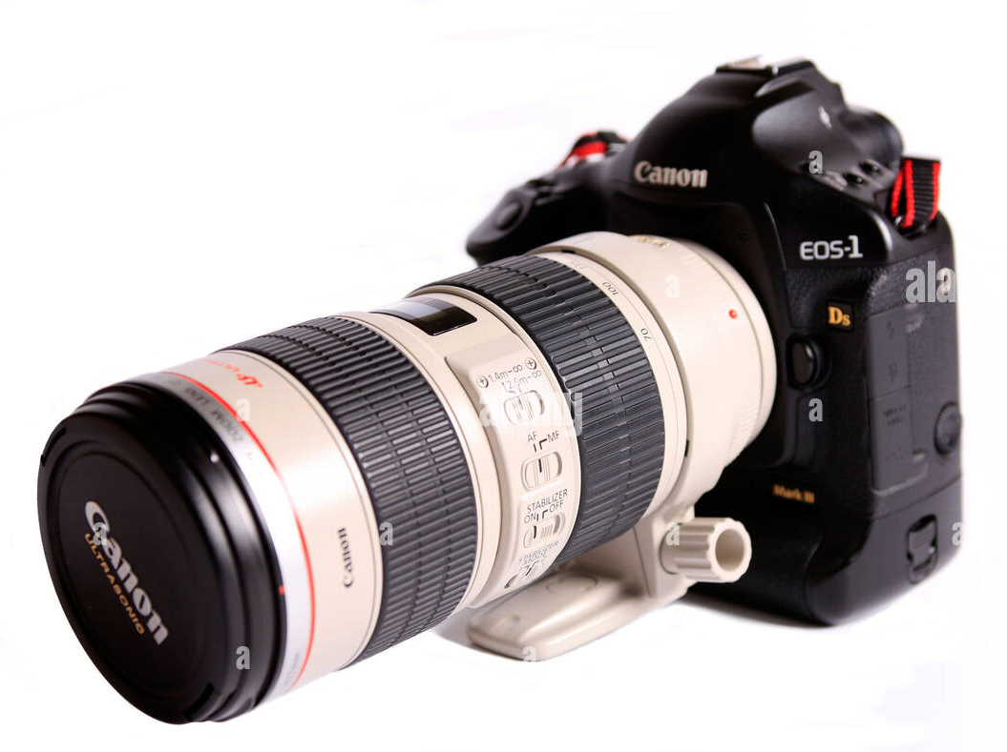
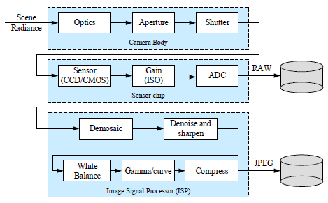
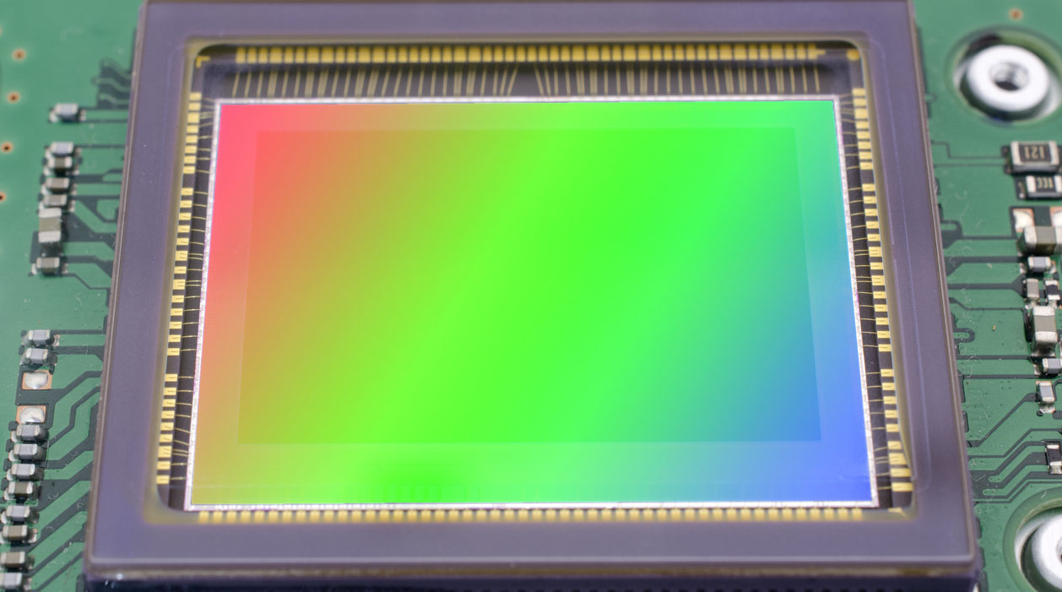
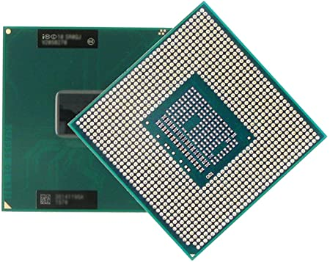
Introduction 簡介
我們想要知道 Incoming Light 🡪 Pixel Value 的對應關係
aperture: 光圈
shutter: 快門
ISO: International Organization for Standardization
ISO 12232:2019 defined speed (gain) for the digital still cameras.
Image Pipeline

Slide 7
Introduction 簡介
Three Processes in the Image Pipeline
Radiometric Response Function 輻射反應函式
Vignetting 暗角
Point Spread Function 點擴散函式

Slide 8
Introduction 簡介
As consumers or as photographers we are not exposed to these difficulties, because camera makers have performed most of the tasks for us.
Photometric Calibration is big internal process for device manufacturers and is a big business for the providers of the equipment and calibration services.

Slide 9
10.1.1 Radiometric Response Function
輻射反應函式
Definition: radiometric response is a function which maps
photons arriving at the lens into digital values stored in the image file.

Slide 10
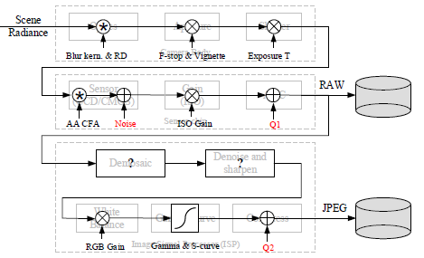
The Image Sensing Pipeline 影像感應流程
10.1.1 Radiometric Response Function
Aperture and Shutter Speed 光圈和快門速度
Global multiplier of incoming light
Sensor (Analog to Digital Converter) 感應器
Linear gain, set by ISO value

Slide 11
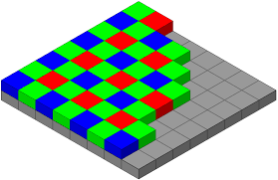
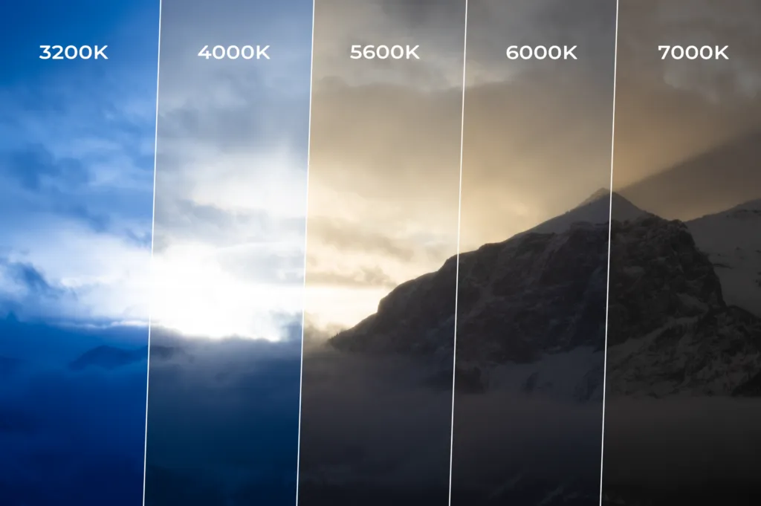
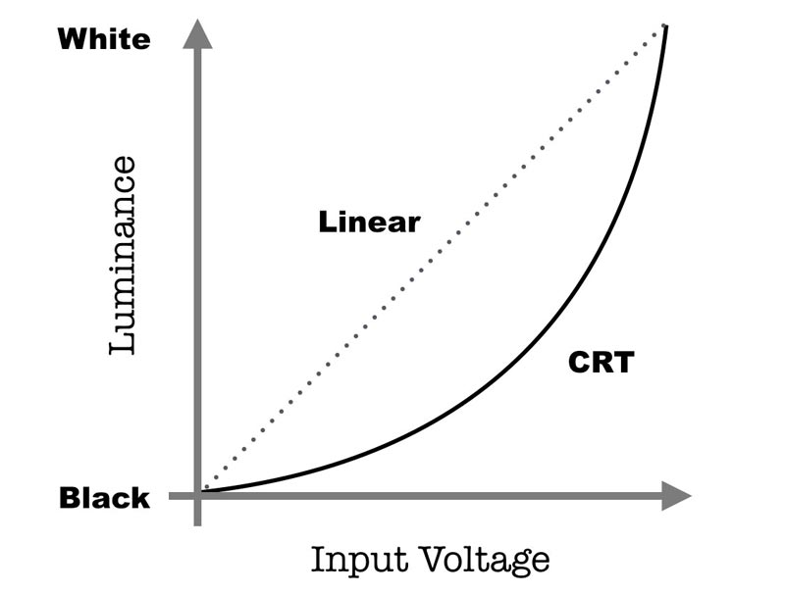
The Image Sensing Pipeline 影像感應流程
10.1.1 Radiometric Response Function
Storing into JPEG… Digital Signal Processor (DSP)
Demosaicing
Sharpening
White Balance
Gamma
Compress

Slide 12
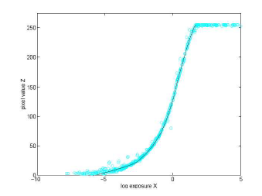
The Image Sensing Pipeline 影像感應流程
10.1.1 Radiometric Response Function
Complete Radiometric Response Function may be very complicated and not practical.
Calibrate the camera by measuring correspondences between incoming light and final values.

Slide 13
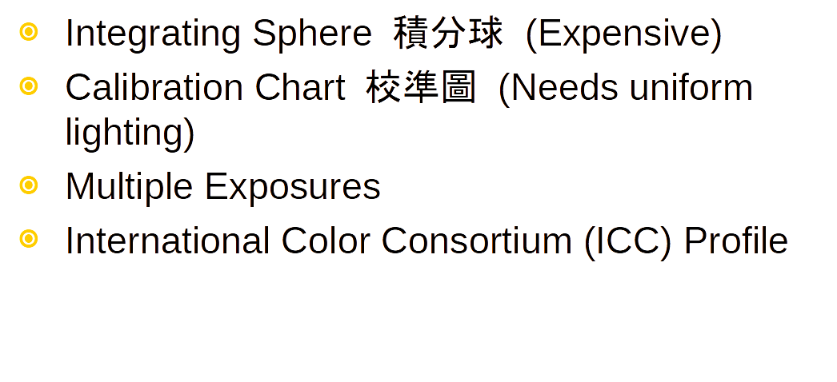
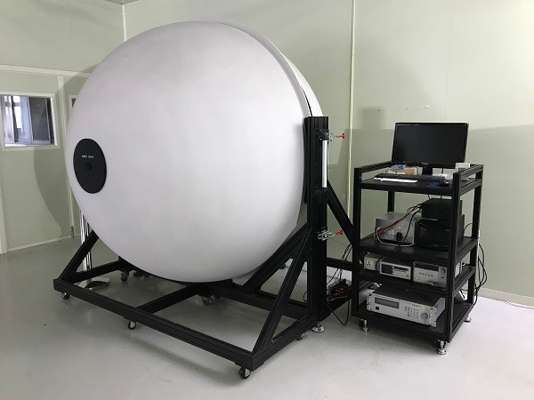
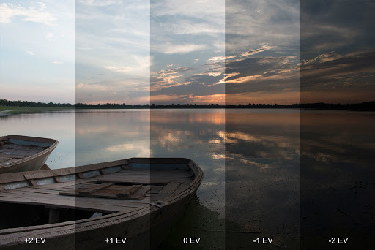
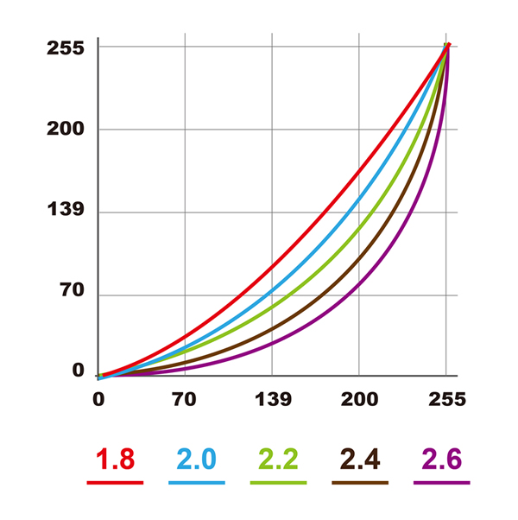
Measuring the Radiometric Response Function
測量輻射反應函式
10.1.1 Radiometric Response Function

Slide 14
10.1.2 Noise Level Estimation
雜訊量級估計
Definition: noise is a random variation of the numeric value of pixels, representing brightness or color information in images.
Throughout the whole sensing process, noise is added from various sources, which may include fixed pattern noise, dark current noise, shot noise, amplifier noise, and quantization noise

Slide 15
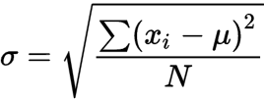
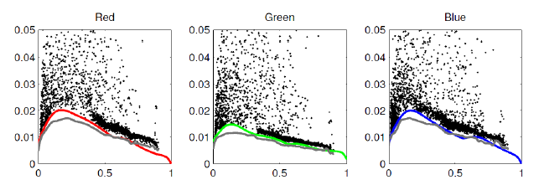
Noise Level Function 雜訊量級函式
10.1.2 Noise Level Estimation
Standard Deviation 標準差
Noise Level Function 雜訊量級函式
At independent pixels: temporal variance 時間變異
Over regions: spatial variance 空間變異

Slide 16
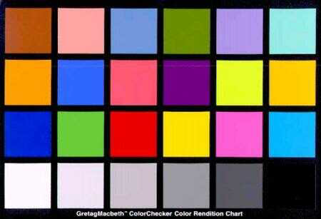
Noise Level Function 雜訊量級函式
10.1.2 Noise Level Estimation
Over Regions (Spatial Variance)
Segment the image and fit a function
Regions of constant or slow varying intensities
Measure the spatial standard deviation of the differences between input and fitted function
Fit a lower envelope to this distribution

Slide 17
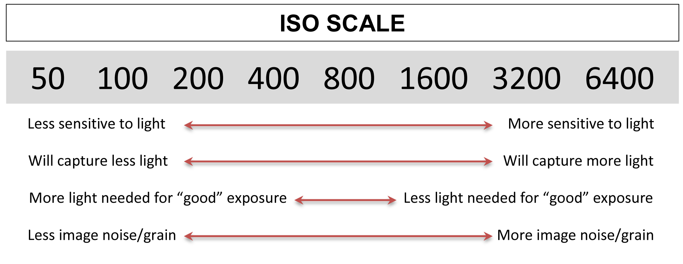
Noise Level depends on:
10.1.2 Noise Level Estimation
ISO gain (main factor)
Sensor temperature and other minor factors

Slide 18
10.1.3 Vignetting
暗角
Definition: Vignetting is the darkening of the areas at the border of the photo, especially at large apertures.

Slide 19
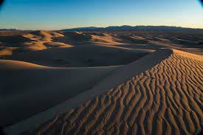
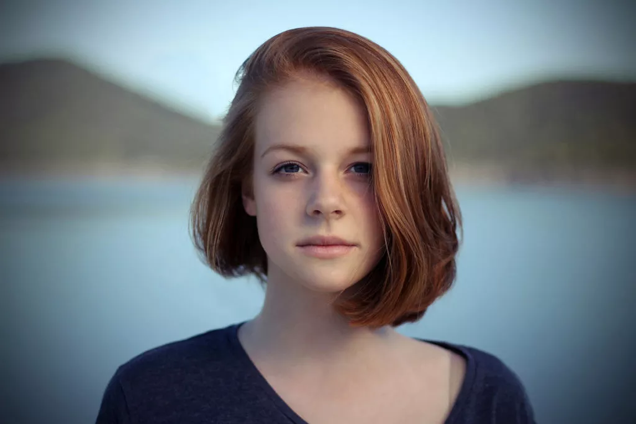
Vignetting 暗角
10.1.3 Vignetting
Common with wide angle and wide aperture lenses
Calibration: Integrating Sphere (expensive)
Alternative approaches?
Notes:
Image links:
https://www.google.com.tw/url?sa=i&url=https%3A%2F%2Fwww.terragalleria.com%2Fblog%2Fpolarizing-filters-and-vignetting-on-a-wide-angle-lens-corrections-in-processing%2F&psig=AOvVaw0DvHizkNmdwyF-fTRmiafl&ust=1622376202343000&source=images&cd=vfe&ved=0CAIQjRxqFwoTCLijwrzs7vACFQAAAAAdAAAAABAD
https://expertphotography.com/wp-content/uploads/2019/08/vignette-in-photoshop-result-1024x683.jpg

Slide 20
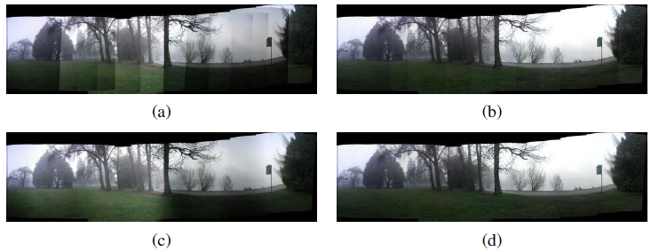
Vignetting 暗角
10.1.3 Vignetting
Stitch panoramic scene
Single image
Zhang, Lin, Kang (‘06): Segment into smoothly varying regions
Zheng, Yu et al. (‘08): Radial gradients at all the pixels

Slide 21
10.1.4 Optical Blur (Spatial Response) Estimation
光學模糊估計 (空間反應估計)

Slide 22
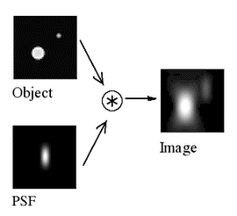
Spatial Response Function 空間反應函式
10.1.4 Optical Blur (Spatial Response) Estimation
Encodes the optical blur that gets convolved with the incoming image to produce the point-sampled image.
Point Spread Function (PSF)
a.k.a. Optical Transfer Function
The shape of the convolution kernel
Notes:
Image link:
https://www.google.com.tw/url?sa=i&url=https%3A%2F%2Fen.wikipedia.org%2Fwiki%2FPoint_spread_function&psig=AOvVaw2mY1ReeHTKqlXt6F6XQFvF&ust=1622378629225000&source=images&cd=vfe&ved=0CAIQjRxqFwoTCIDl68H17vACFQAAAAAdAAAAABAP

Slide 23
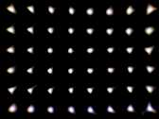
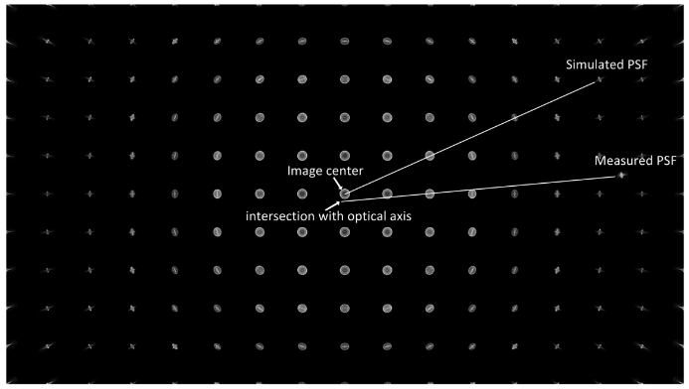
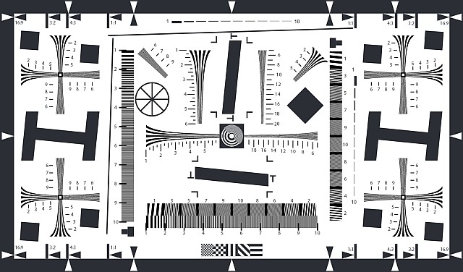
Spatial Response Function 空間反應函式
10.1.4 Optical Blur (Spatial Response) Estimation
Theory: small light source everywhere
More practical
observe image of long straight lines or bars
slightly slanted edges are preferred
Notes:
Image link:
https://www.google.com.tw/url?sa=i&url=https%3A%2F%2Fwww.mdpi.com%2F1424-8220%2F18%2F10%2F3552%2Fpdf&psig=AOvVaw3gtdcFezG4e12sCpHcHb4I&ust=1622378943688000&source=images&cd=vfe&ved=0CAIQjRxqFwoTCMCczdf27vACFQAAAAAdAAAAABAJ

Slide 24
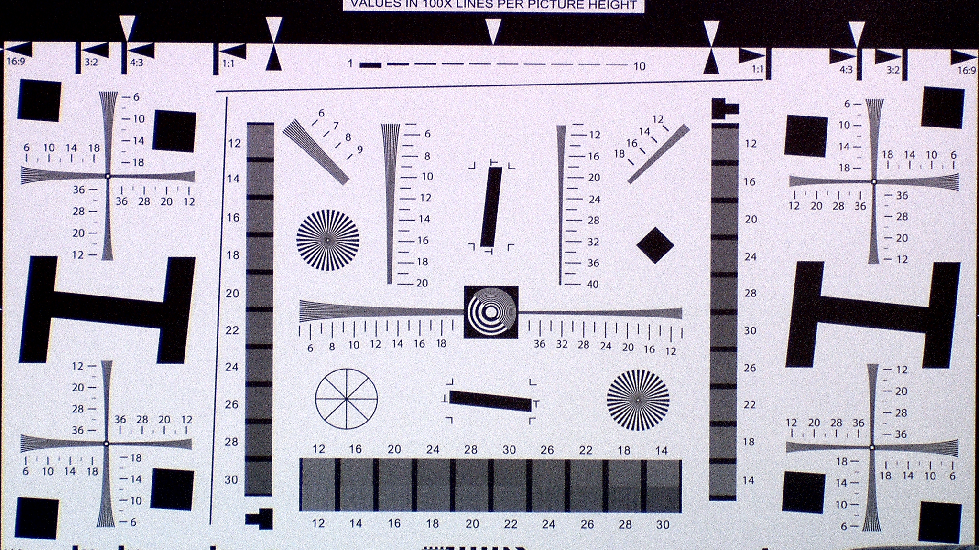

Slide 25
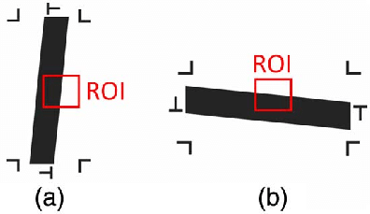
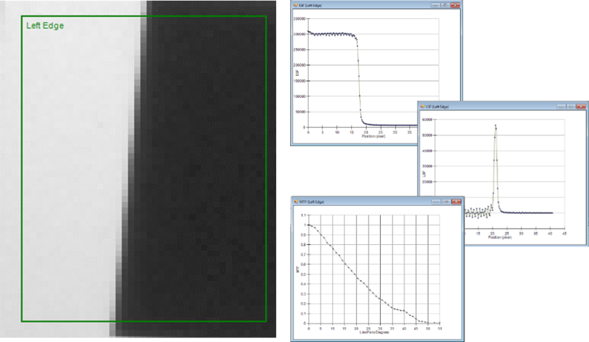
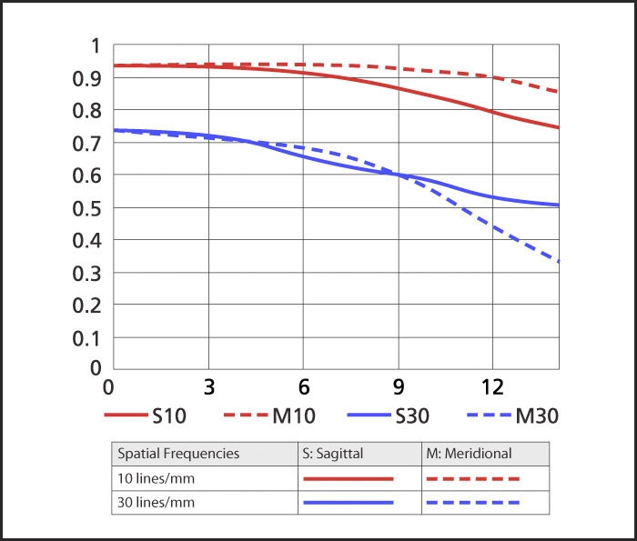
Spatial Response Function 空間反應函式
10.1.4 Optical Blur (Spatial Response) Estimation
Slanted lines gives us 1D projection of the 2D PSF
It is also called the Line Spread Function (LSF)
We can convert into Fourier domain to plot a Modulation Transfer Function (MTF) chart
Notes:
Image link:
https://cdn-7.nikon-cdn.com/Images/Learn-Explore/Camera-Technology/NIKKOR-Lenses/2012/Reading-MTF-Charts/Media/2183_MTF2.jpg

Slide 26
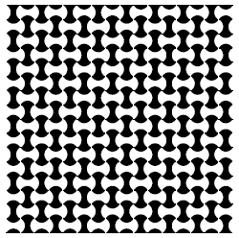
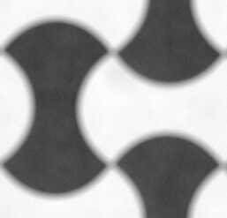
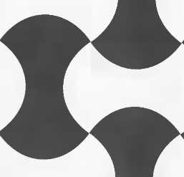
Spatial Response Function 空間反應函式
10.1.4 Optical Blur (Spatial Response) Estimation
K: PSF kernel, B: blurred image, I: ideal image, D: downsampling operator

Slide 27
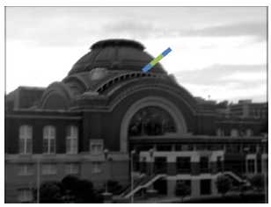
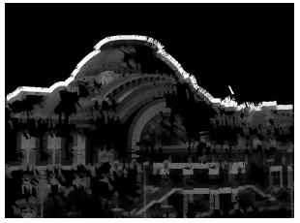
Spatial Response Function 空間反應函式
10.1.4 Optical Blur (Spatial Response) Estimation
If the process is done locally in overlapping patches, we can also estimate…
Radial distortion 放射狀變形
Chromatic aberration 色差
Vignetting 暗角
If we have an image from an uncalibrated camera…
We can detect strong elongated edges

Slide 28
Chapter 10-2 High Dynamic Range Imaging 高動態範圍成像

Slide 29
Introduction 簡介
Image taken at different exposures can help you create well-exposed photographs under challenging conditions.
10-2 High Dynamic Range Imaging
Image: ambarella.com

Slide 30
Definition 定義
High dynamic range imaging (HDR) is a technique to capture the full range of brightness in a scene through the use of multiple exposures.
Multi-exposure HDR capture is a technique allowing to capture high dynamic range images by taking and then combining several different exposures of the same subject matter. (Wikipedia)

Slide 31
Approach 方法
10-2 High Dynamic Range Imaging
Many modern cameras have a feature called Auto Exposure Bracketing (AEB) that allows to take multiple pictures at different exposures with one press of a button.
Typically 3 images are taken: normal, overexposed and underexposed.
Typical bracketing is ±2 stops (±4 times)

Slide 32
Approach 方法
10-2 High Dynamic Range Imaging
Simplest: combine pixels from different exposures
Risk of creating contrast reversals and halos.
More common approach (3 stages)
Estimate the radiometric response function
Estimate a radiance map
Tone map the image into a displayable gamut

Slide 33
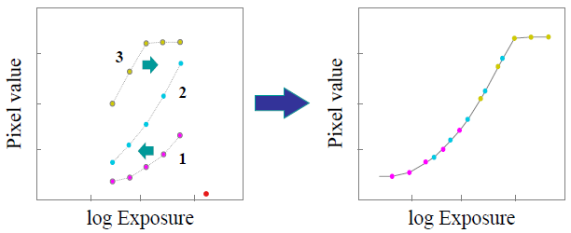
Step 1: Estimate the radiometric response function
10-2 High Dynamic Range Imaging

Slide 34
Step 1: Estimate the radiometric response function
10-2 High Dynamic Range Imaging
E_{i} - irradiance values
t_{j} - exposure time for the
j_{th} image

Slide 35
Step 1: Estimate the radiometric response function
10-2 High Dynamic Range Imaging

Slide 36
Step 1: Estimate the radiometric response function
10-2 High Dynamic Range Imaging

Slide 37
Step 1: Estimate the radiometric response function
10-2 High Dynamic Range Imaging

Slide 38
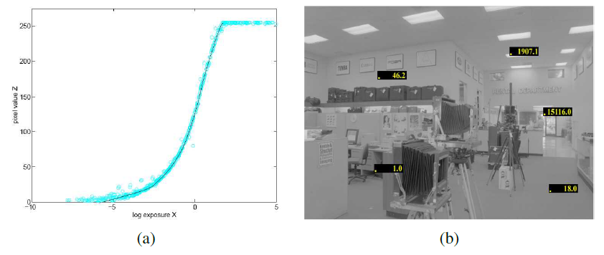
Step 1: Estimate the radiometric response function
10-2 High Dynamic Range Imaging
Result (Debevec and Malik 1997)

Slide 39
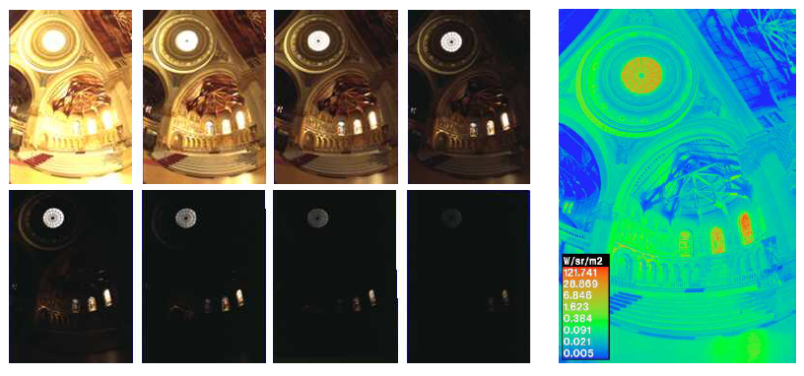
Step 2: Estimate a radiance map
10-2 High Dynamic Range Imaging

Slide 40
Step 2: Estimate a radiance map
10-2 High Dynamic Range Imaging
Problem 1: Pixels are noisy
Mitsunaga and Nayar (1996): emphasize both higher pixel and larger gradients in the transfer function.

Slide 41
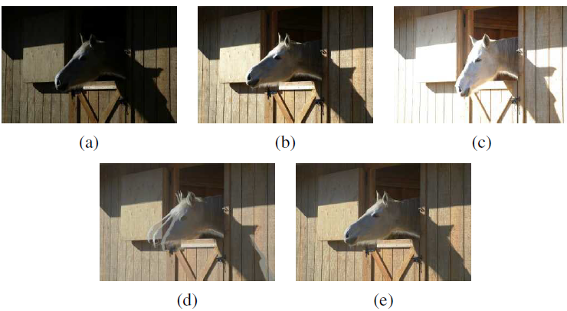
Step 2: Estimate a radiance map
10-2 High Dynamic Range Imaging
Problem 2: moving objects
Ward (2003): global transform to align
Uyttendaele (2003): combine global registration and local motion estimation (optical flow)

Slide 42
Step 2: Estimate a radiance map
10-2 High Dynamic Range Imaging
Problem 3: too many bits.
Typical bracketing is ±2 stops (±4 times) and requires extra 2 bits per bracketed image.
Example: 3 raw images, each of 14-bits of the color depth, are taken using ±2 stops bracketing. Combined color depth will require 14+2+2=18 bits.
To reduce color depth, for example, to 8-bits, tone mapping technique need to be applied.

Slide 43
HDR Image Formats
10-2 High Dynamic Range Imaging
Best solution: 32-bit IEEE float
Intermediate: 16-bit float for each channel
Practical common image format: TIFF
TIFF: Tagged Image File Format
IEEE: Institute of Electrical and Electronics Engineers

Slide 44
HDR Processing Tools
10-2 High Dynamic Range Imaging
Best HDR software 2022: Photomatix Pro, Aurora HDR
OpenCV functions:
AlignMTB() to align images
createCalibrateDebevec(), createCalibrateRobertson()
createMergeMertens()
Tutorial: https://docs.opencv.org/4.x/d2/df0/tutorial_py_hdr.html

Slide 45
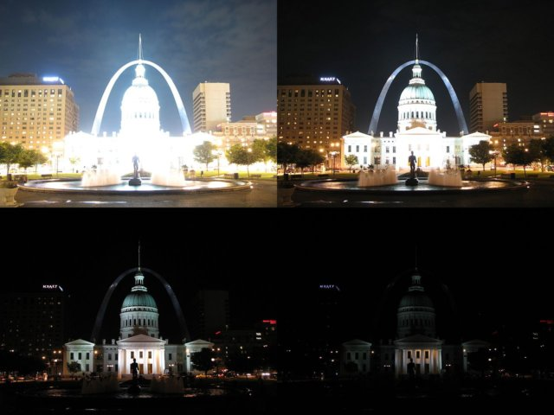
From OpenCV HDR Tutorial
10-2 High Dynamic Range Imaging
Images from Wikipedia-HDR

Slide 46
From OpenCV HDR Tutorial
10-2 High Dynamic Range Imaging
Processing steps:
Load exposure images into a list
Merge exposures into HDR image
Tonemap HDR image
or Merge exposures using Mertens fusion
Convert to 8-bit and save

Slide 47
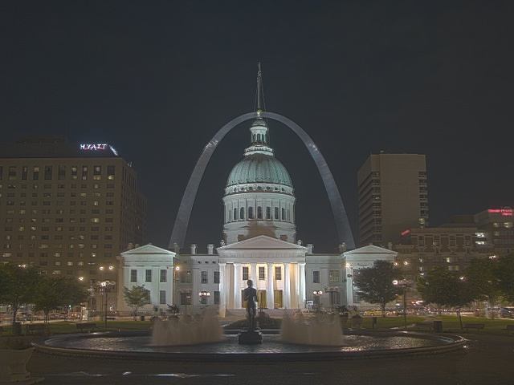
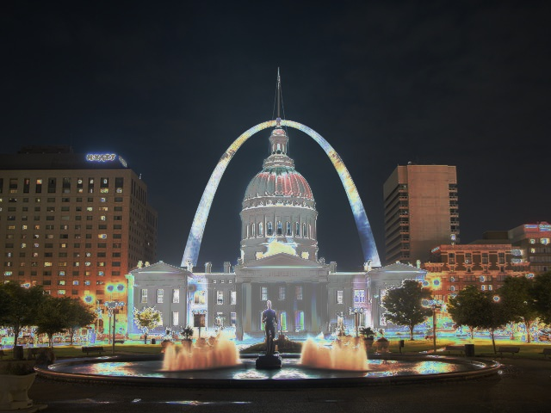
From OpenCV HDR Tutorial: Results
10-2 High Dynamic Range Imaging
Debevec
Robertson

Slide 48
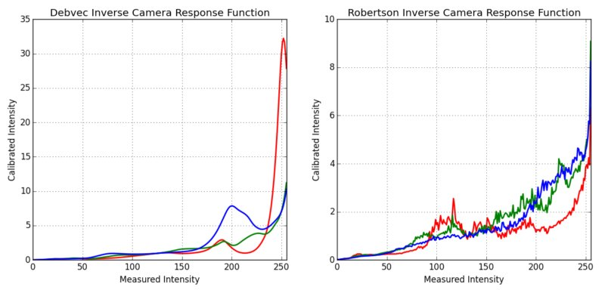
From OpenCV HDR Tutorial: Radiometric Response Function
10-2 High Dynamic Range Imaging

Slide 49
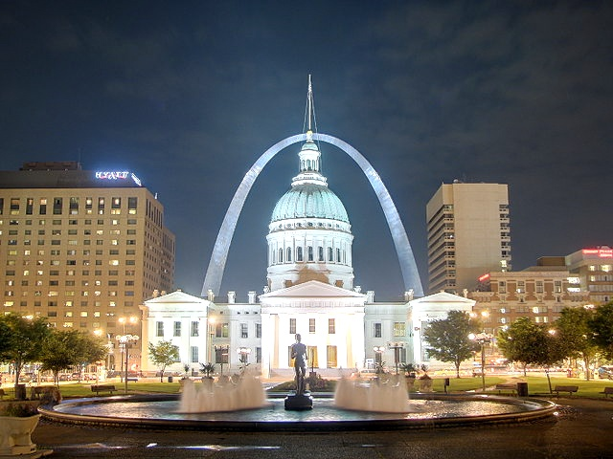
From OpenCV HDR Tutorial: Exposure Fusion result
10-2 High Dynamic Range Imaging

Slide 50
From OpenCV HDR Tutorial: Resources
10-2 High Dynamic Range Imaging
Paul E Debevec and Jitendra Malik. Recovering high dynamic range radiance maps from photographs. In ACM SIGGRAPH 2008 classes, page 31. ACM, 2008.
Mark A Robertson, Sean Borman, and Robert L Stevenson. Dynamic range improvement through multiple exposures. In Image Processing, 1999. ICIP 99. Proceedings. 1999 International Conference on, volume 3, pages 159–163. IEEE, 1999.
Tom Mertens, Jan Kautz, and Frank Van Reeth. Exposure fusion. In Computer Graphics and Applications, 2007. PG'07. 15th Pacific Conference on, pages 382–390. IEEE, 2007.

Slide 51
10.2.1 Tone Mapping
色調對應

Slide 52
Introduction 簡介
10.2.1 Tone Mapping
Many modern cameras can capture “high dynamic range” images in a single exposure, which, in fact is the Tone Mapping, especially when it is referred to the “HDR video”.
Definition: Tone Mapping is the operation to map wide-gamut images back into regular display devices such as screens and printers, as well as algorithms that merge flash and regular images to obtain better exposures.
Example: reduce image bit depth from 12 bits down to 8 bits.

Slide 53
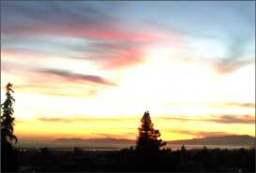
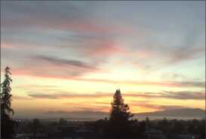
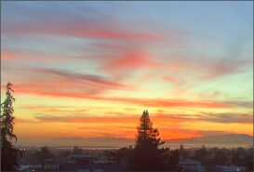
Introduction
10.2.1 Tone Mapping
Necessary to display on a lower gamut screen.
Simplest way: global transfer curve
Apply separate to each channel?
Colors become muted (higher-valued color channels contribute less)
Better approach: extract the luminance, and apply the global mapping to the luminance channel.

Slide 54
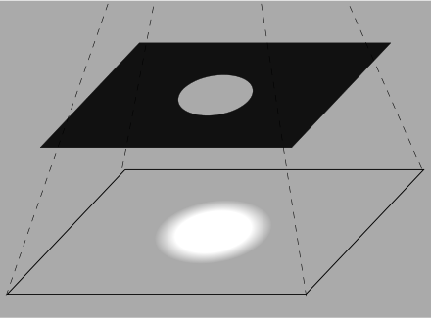
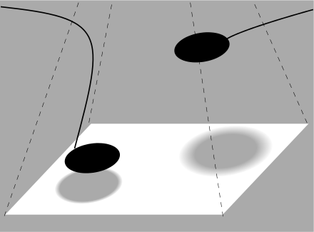
Introduction
10.2.1 Tone Mapping
Image source: Wikipedia, Dodging and burning
Fail to preserve details in regions with widely varying exposure.
Need something similar to dodging and burning
An example of dodge & burn effects
Burning: a darkroom technique
Dodging: a darkroom technique
Notes:
Image link:
https://www.google.com.tw/url?sa=i&url=https%3A%2F%2Ffstoppers.com%2Feducation%2Fhow-use-ansel-adams-zone-system-digital-world-417047&psig=AOvVaw27S3PjTN3muRfWzdPv1zXp&ust=1622461021358000&source=images&cd=vfe&ved=0CAIQjRxqFwoTCOC30bmo8fACFQAAAAAdAAAAABAY

Slide 55
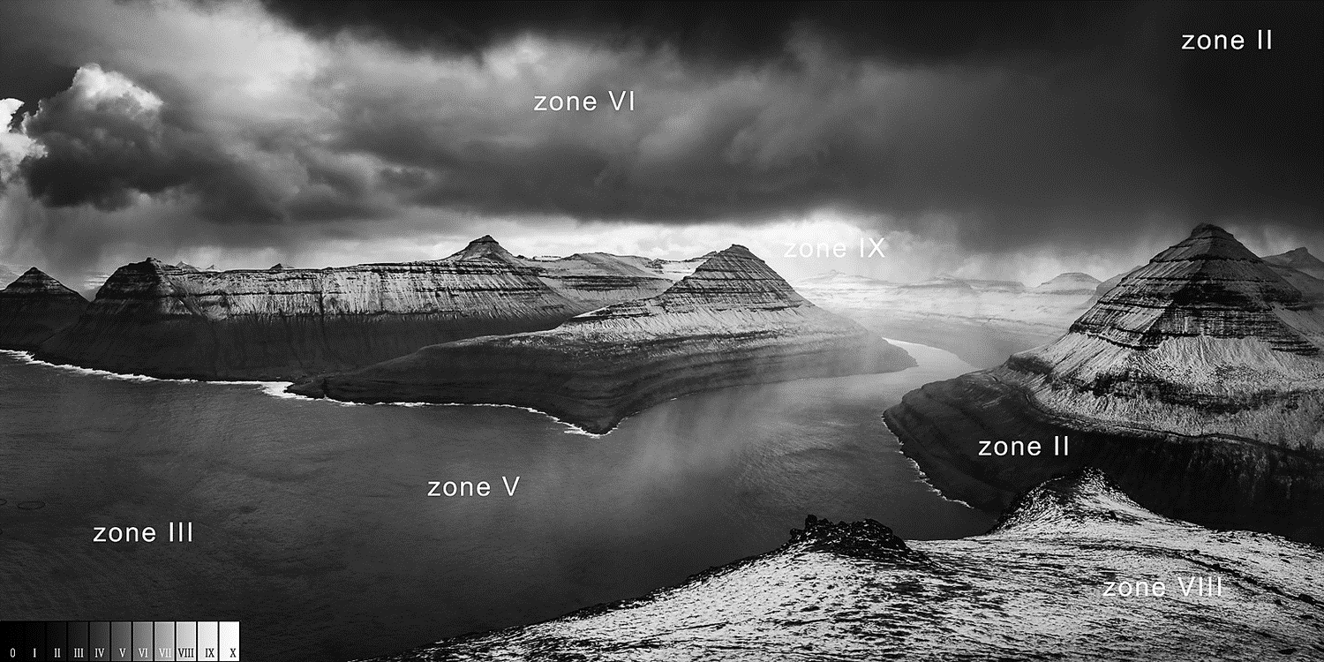
Introduction
10.2.1 Tone Mapping
Divide each pixel by the average brightness in a region around that pixel.
Notes:
Image link:
https://www.google.com.tw/url?sa=i&url=https%3A%2F%2Ffstoppers.com%2Feducation%2Fhow-use-ansel-adams-zone-system-digital-world-417047&psig=AOvVaw27S3PjTN3muRfWzdPv1zXp&ust=1622461021358000&source=images&cd=vfe&ved=0CAIQjRxqFwoTCOC30bmo8fACFQAAAAAdAAAAABAY

Slide 56
10.2.1 Tone Mapping
Mathematical Dodge and Burn

Slide 57
10.2.1 Tone Mapping
Mathematical Dodge and Burn

Slide 58
10.2.1 Tone Mapping
Mathematical Dodge and Burn
Visible halo in the detail layer around high contrast edges

Slide 59
10.2.1 Tone Mapping
Solution to Halo: edge-preserving filter
Problem: linear filtering is not edge-preserving
Solution 1: Bilateral filtering
Durand and Dorsey (2002)

Slide 60
10.2.1 Tone Mapping
Solution to Halo: edge-preserving filter
Solution 2: Derivatives

Slide 61
10.2.1 Tone Mapping
Solution to Halo: edge-preserving filter

Slide 62
10.2.1 Tone Mapping
Solution to Halo: edge-preserving filter

Slide 63
10.2.1 Tone Mapping
Other Approaches
Reinhard, Stark (2002)
Local dodging and burning using a locally scale-selective operator.
Paris, Hasinoff, and Kautz (2011)
multi-resolution decomposition, Local Laplacian Filter
Lischinski, Farbman (2006)
interactive technique

Slide 64
10.2.1 Tone Mapping
OpenCV functions
createTonemap()
cv::TonemapDrago
cv::TonemapMantiuk
cv::TonemapReinhard

Slide 65
Source images
Exposures: 2.5, 10, 30 seconds

Slide 67
Chapter 10-3 Super-resolution, denoising, and blur removal 超解析度、去雜訊、去模糊

Slide 68
Super-Resolution
超解析度
Definition: super-resolution is the process of aligning and combining several input images to produce high-resolution composites

Slide 69
Introduction
10.3 Super-resolution, denoising, and blur removal
Super-resolution goals…
Higher spatial resolution
Less noise
Notes:
Image link:
https://www.frontiersin.org/files/special%20topics/3055/thumb_400.jpg
https://blog.paperspace.com/content/images/2020/08/download.jpg

Slide 70
Multi-Image Super Resolution
10.3 Super-resolution, denoising, and blur removal
See: image deblurring in Section 3.4.1

Slide 71
Multi-Image Super Resolution
10.3 Super-resolution, denoising, and blur removal
b(x): blur kernel

Slide 72
Multi-Image Super Resolution
10.3 Super-resolution, denoising, and blur removal

Slide 73
Multi-Image Super Resolution
10.3 Super-resolution, denoising, and blur removal
How well does this work?
Depends on camera optics, motion and PSF estimates.
No image prior 🡪 lots of high-frequency noise introduced
Assume some form of image prior
TL: Original,
TR: Bicubic,
BL: Maximum Likelihood Estimate
Notes:
.com/content/images/2020/08/download.jpg

Slide 74
Assume Image Priors
10.3 Super-resolution, denoising, and blur removal
See chapters 4.29 and 4.42
Notes:
/2020/08/download.jpg

Slide 75
Hallucination
10.3 Super-resolution, denoising, and blur removal
Derivative priors can not hallucinate higher frequency texture or details.
To do this… use training set of examples
Baker and Kanade (’02): use local derivative-of-Gaussian filter response as features and then match parent structure vectors
Notes:
.jpg

Slide 76
DNNs
10.3 Super-resolution, denoising, and blur removal
Latest trend: Deep Neural Networks
Seminal work
Dong, Loy (’16) “Image Super-Resolution Using Deep Convolutional Networks”
Survey on single-image super-resolution
Anwar, Khan, and Barnes (‘20) “A Deep Journey into Super-resolution: A survey”
Dataset: RealSR, zoom lens on digital camera
Notes:
.jpg

Slide 77
Smartphone
10.3 Super-resolution, denoising, and blur removal
Building a multi-frame super-resolution algorithm directly into a smartphone camera
The processing can be done jointly with the image demosaicing
It is also possible to upsample videos using temporal frame interpolation
NTIRE 2020 Challenge on Real Image Denoising, based on a smartphone image denoising dataset (SIDD) (Abdelhamed, Lin, and Brown 2018)
Notes:
.jpg

Slide 78
OpenCV tools and methods
10.3 Super-resolution, denoising, and blur removal
createSuperResolution_BTVL1() - Create Bilateral TV-L1 Super Resolution. TV-L1: Total Variation optical flow estimation method
Using various DNN:
from cv2 import dnn_superres
sr = dnn_superres.DnnSuperResImpl_create()
sr.readModel("EDSR_x4.pb") # use different DNN here
sr.setModel("edsr", 4)
result = sr.upsample(image)
Notes:
.jpg

Slide 79
10.3.1 Color Image Demosaicing
去馬賽克
Definition: demosaicing (also de-mosaicing, demosaicking or debayering) algorithm is a digital image process used to reconstruct a full color image from the incomplete color samples output from an image sensor overlaid with a Color Filter Array (CFA). (Wikipedia)

Slide 80
Demosaicing
10.3.1 Color Image Demosaicing
Notes:
.jpg

Slide 81
Demosaicing
10.3.1 Color Image Demosaicing
Special case of super-resolution, used everyday…
Demosaicing from a color filter array (CFA) into full-color RGB
Artifacts are more visible to the eye
Zippering effect
Color Fringing
Bennett, Uyttendaele (’06): two color model
Notes:
.jpg

Slide 82
Demosaicing
10.3.1 Color Image Demosaicing
Burst Photography
Super Res Zoom in Google Pixel smartphones
Wronski, Garcia-Dorado et al. ('19)
Notes:
.jpg

Slide 83
Demosaicing
10.3.1 Color Image Demosaicing
openCV: cv::cuda::demosaicing()
can do 2 transformation types:
demosaicing using bilinear interpolation
demosaicing using Malvar-He-Cutler algorithm
Pascal Getreuer. Malvar-he-cutler linear image demosaicking. Image Processing on Line, 2011.
Notes:
.jpg

Slide 84
10.3.2 Lens Blur (Bokeh)
鏡頭模糊
Definition: In photography, bokeh is the aesthetic quality of the blur produced in out-of-focus parts of an image.

Slide 85
Lens Blur (Bokeh) 鏡頭模糊
10.3.2 Lens Blur (Bokeh)
Large format + large aperture 🡪 shallow depth-of-field
iPhone 7 Plus introduced Portrait Mode
Stereo matching and deep learning
Estimate the depth map.
Blur the background without including foreground colors, using fast approximation to a back-to-front blurred over compositing operator.
Bokeh in videoconferencing.
Notes:
.jpg

Slide 86
Chapter 10-4 Image Matting and Compositing 影像去背與合成

Slide 87
Introduction
10.4 Image Matting and Compositing
Process of cutting a foreground object out of one image and pasting it against a new background.
Different from segmentation techniques?
Subtle interplay of mixed pixels along the along the boundary
Pull a matte
Estimate a soft opacity channel α and the uncontaminated foreground colors F from the input composite image C.

Slide 88
Equation
10.4 Image Matting and Compositing
See: Section 3.1.3

Slide 89
10.4.1 Blue Screen Matting
藍幕去背

Slide 90
Blue Screen Matting
10.4.1 Blue Screen Matting
Filming an actor/object in front of constant colored background.
Chuang, Curless (’01): Mishima’s algorithm
Fit two polyhedral surfaces, separating the foreground and background color distributions
Measure a relative distance to measure α
Problem: blue spill

Slide 91
Two Screen Matting
10.4.1 Blue Screen Matting
Use more than one color to over-constrain the equation
Choose background not to saturate image
Use several values of the background
Notes:
Image link:
http://graphics.stanford.edu/courses/cs148-09-fall/papers/smith-blinn.pdf

Slide 92
Difference Matting
10.4.1 Blue Screen Matting
Difference matting: background is irregular but known.
Actor or object is filmed against a static background.
Difference matting in the videoconferencing.

Slide 93
10.4.2 Natural Image Matting
自然影像去背

Slide 94
Introduction
10.4.2 Natural Image Matting
Nothing known about the background, except a rough segmentation, known as trimap.

Slide 95
Knockout
10.4.2 Natural Image Matting
Simple algorithm: Knockout (2001)
Nearest known foreground and background pixels are determined to produce per-pixel foreground and background color estimate
Background color is adjusted so the measured color C lies on the line between F and B
Opacity α is estimated on per-channel basis
Problem when background consist more than one dominant color

Slide 96
Bayesian
10.4.2 Natural Image Matting
More accurate: treat F and B as distribution sampled over some region
Chuang, Curless (’01)
Use full 3x3 color covariance matrices to model mixture of correlated Gaussians
Matte extraction proceeds in strips starting from known color values growing into the unknown regions
Fully Bayesian

Slide 97
Bayesian
10.4.2 Natural Image Matting

Slide 98
Bayesian
10.4.2 Natural Image Matting
Results

Slide 99
10.4.3 Optimization-based Matting
最佳化去背

Slide 100
Optimization-based Matting
10.4.3 Optimization-based Matting
Alternative to estimating each pixel independently…
Use global optimization to compute a matte that takes into account correlations between neighboring α values
Border Matting
Poisson Matting
Color Line Model

Slide 101
Border Matting
10.4.3 Optimization-based Matting

Slide 102
Poisson Matting
10.4.3 Optimization-based Matting

Slide 103
Color Line Model
10.4.3 Optimization-based Matting

Slide 104
Results
10.4.3 Optimization-based Matting
Latest results: http://alphamatting.com
The Deep Image Matting by Xu, Price et al. (2017): 49,300 training images.

Slide 105
10.4.4 Smoke, Shadow, and Flash Matting 10.4.5 Video Matting

Slide 106
Smoke, Shadow, and Flash Matting
10.4.4 Smoke, Shadow, and Flash Matting
Smoke
linear combination of background color and a constant foreground color.
Figure 10.47 Smoke matting (Chuang, Agarwala et al. 2002) © 2002 ACM: (a) input video frame; (b) after removing the foreground object; (c) estimated alpha matte; (d) insertion of new objects into the background.

Slide 107
Smoke, Shadow, and Flash Matting
10.4.4 Smoke, Shadow, and Flash Matting
Shadow
pixel is assumed to vary between its fully lit and fully shadowed colors.
Figure 10.48 Shadow matting (Chuang, Goldman et al. 2003) © 2003 ACM. Instead of simply darkening the new scene with the shadow (c), shadow matting correctly dims the lit scene with the new shadow and drapes the shadow over 3D geometry (d).

Slide 108
Video Matting
10.4.5 Video Matting
The presence of moving objects can sometimes make the matting process easier
Chuang, Agarwala (‘02)
foreground objects are first remove
resulting background plates are aligned
yield a high quality background estimate

Slide 109
Chapter 10-5 Texture Analysis and Synthesis 質地分析和生成

Slide 110
Introduction
10.5 Texture Analysis and Synthesis
Texture analysis and synthesis are widely used to repair defects, such as small holes, in images or to create non-photorealistic painterly renderings from regular photographs.

Slide 111
Introduction
10.5 Texture Analysis and Synthesis
Texture synthesis: "Given a small sample of a texture, generate a larger similar-looking image."

Slide 112
Traditional Approach
10.5 Texture Analysis and Synthesis
Matching the frequency characteristics, which is equivalent to matching spatial correlations, is in itself not sufficient.
De Bonet (1997) uses a coarse-to-fine strategy to find locations in the source texture with a similar parent structure and then randomly chooses one matching location as the current sample value.
Gatys, Ecker, and Bethge (2015) use a pyramidal fine-to-coarse-to-fine algorithm, but using deep networks trained for object recognition. Iteratively update the random image until perceptually motivated statistics are matched.

Slide 113
Exemplar-Based
10.5 Texture Analysis and Synthesis
Generate texture pixels by looking for neighborhoods in the source texture that are similar to the currently synthesized image
Efros and Freeman (2001): image quilting
Application: Hole filling and inpainting

Slide 114
10.5.2 Application: Non-photorealistic rendering
10.5 Texture Analysis and Synthesis
Instead of programming a certain non-photorealistic rendering effect, it is sufficient to supply the system with examples of before and after images, and let the system synthesize the novel image using exemplar-based synthesis
With the advent of deep learning, image-guided exemplar-based texture synthesis has mostly been replaced with statistics matching in deep networks

Slide 115
10.5.2 Application: Non-photorealistic rendering
10.5 Texture Analysis and Synthesis

Slide 116
Conclusion

Slide 117
Conclusion
10.1 Photometric Calibration (光度學校正)
10.2 High Dynamic Range Imaging (高動態範圍成像)
10.3 Super-resolution, Denoising, and Blur Removal (超解析度、去雜訊、去模糊)
10.4 Image Matting and Compositing (影像去背與合成)
10.5 Texture Analysis and Synthesis (質地分析和生成)

Slide 118
Thank You
講者：Alexander Yurusov (游亞力) (生醫電資所碩士班)
聯絡資訊：R10945053@ntu.edu.tw
指導教授：傅楸善

