Slide 1
Ch.10 Computational Photography
呂英弘
NTU CSIE undergraduate senior
Email: b04902086@ntu.edu.tw
指導教授：傅楸善教授
Notes:
前言：
希望大家可以在上完課以後，就可以輕鬆的看懂書上的內容

Slide 2
Ch.10 Introduction
Intro video
Before the cool stuff, we have to understand how a camera works.
Notes:
大綱:
我會站在科學家的角度，也會站在攝影師的角度
影片: Why the pixel 3 has the best smartphone camera
希望今天上完課大家可以輕鬆看懂課本還有課本上的paper

Slide 3
10.1 Photometric Calibration 光度校準
From Light To File
We need to characterize the functions that map incoming irradiance (輻照度) into pixel values, and also the amounts of noise present in each image.
Three components in the image pipeline that affects this mapping:
Radiometric (輻射度) response function
Vignetting (暗角)
Point spread function (點擴散函數)
Notes:
補充 — 名詞解釋：
Photometric: https://en.wikipedia.org/wiki/Photometry_(optics)
Irradiance: https://zh.wikipedia.org/wiki/%E8%BC%BB%E7%85%A7%E5%BA%A6
Photometry is the science of the measurement of light, in terms of its perceived brightness to the human eye. It is distinct from radiometry, which is the science of measurement of radiant energy (including light) in terms of absolute power.
大綱：
Before we can successfully merge multiple photographs, we need to characterize the functions that map incoming irradiance into pixel values and also the amounts of noise present in each image.
In this section, we examine 3 components of the imaging pipeline the affect this mapping.

Slide 4
10.1.1 Radiometric Response Function 輻射反應函數 (1/4)
Notes:
補充資料：
鏡頭焦距: https://en.wikipedia.org/wiki/Focal_length#In_photography
ISO名稱來源: https://medium.com/photography-secrets/iso-bac13cdcf5cc
ㄣ
補充資料：
Radiance: 輻射
大綱&筆記：
鏡頭，焦距影響視角(FoV)
光圈大小，計算方式：直徑=focal length/aperture value
快門時間，單位：1/秒
感光元件，Color Filter，會有noise，照片：Cooling CCD
ISO，Gain，會讓noise更明顯
ADC，Quantization
這個時候已經從Analog變成Digital了，如果這時候存檔就叫做Raw檔
Raw檔無法直接看，我們的目標是Photometric的表現
Demosaic，對Color Filter做去模糊，用Interpolation的方式
銳利化的處理，不一定要做
白平衡，調整RGB的比例來達到眼睛所看見的色彩
Gamma/curve，
Compress，轉成JPEG(影像處理的範疇)，Lossy

Slide 5
10.1.1 Radiometric Response Function 輻射反應函數 (2/4)
Notes:
大綱：
給大家看一下Raw檔的處理過程 (cdraw+Matlab)

Slide 6
10.1.1 Radiometric Response Function 輻射反應函數 (3/4)
Given the complexity of all these processing, it is difficult to measure the camera response function.
A more practical approach: calibrate the camera by measuring correspondence between incoming light and final values.
Notes:
左圖：Typical camera response function, 典型相機反應函式，顯示log的irradiance(幅照度)和8bit輸出之間的mapping
右圖：Color checker chart

Slide 7
10.1.1 Radiometric Response Function 輻射反應函數 (4/4)
A practical way to calibrate: Using a color checker chart.
Notes:
Biggest problem with this method: Uniform lighting

Slide 8
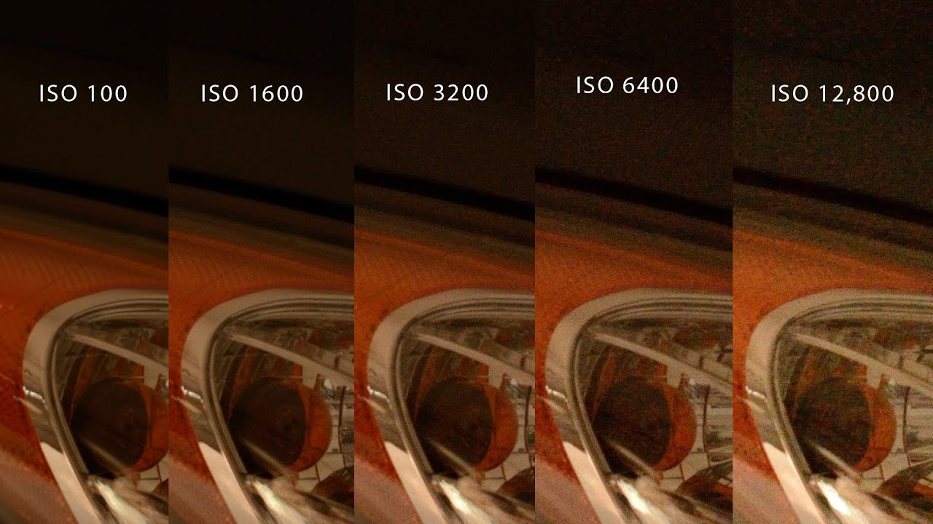
10.1.2 Noise Level Estimation 雜訊量級估計 (1/5)
It is also important to know the amount of noise being injected under a particular camera setting (e.g. ISO level).
The simplest characterization of noise is a single standard deviation, usually measured in gray levels, independent of pixel value.

Slide 9
10.1.2 Noise Level Estimation 雜訊量級估計 (2/5)
The simplest way to estimate these quantities is in the lab, using a calibration chart.
The noise can be estimated
1. either at each pixel independently, by taking repeated exposures and computing the temporal variance in the measurements
2. or over regions, by assuming that pixel values should all be the same within some region and computing a spatial variance.

Slide 10
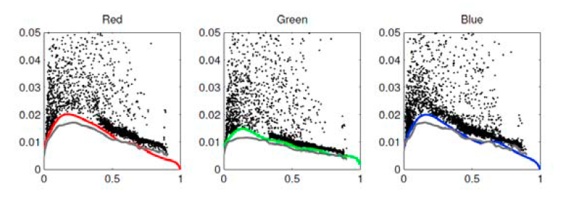
10.1.2 Noise Level Estimation 雜訊量級估計 (3/5)
First, segment the image into such regions and fit a constant or linear function inside each region.
Next, measure the standard deviation of the differences between the noisy input pixels and the smooth fitted function away from large gradients and region boundaries.
Plot these as a function of output level for each color channel:

Slide 11
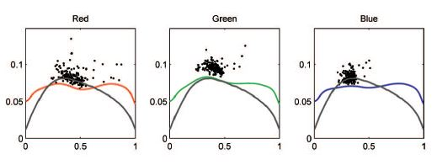
10.1.2 Noise Level Estimation 雜訊量級估計 (4/5)
降噪做得不好的話，會偏離Ground Truth(灰色的線)

Slide 12
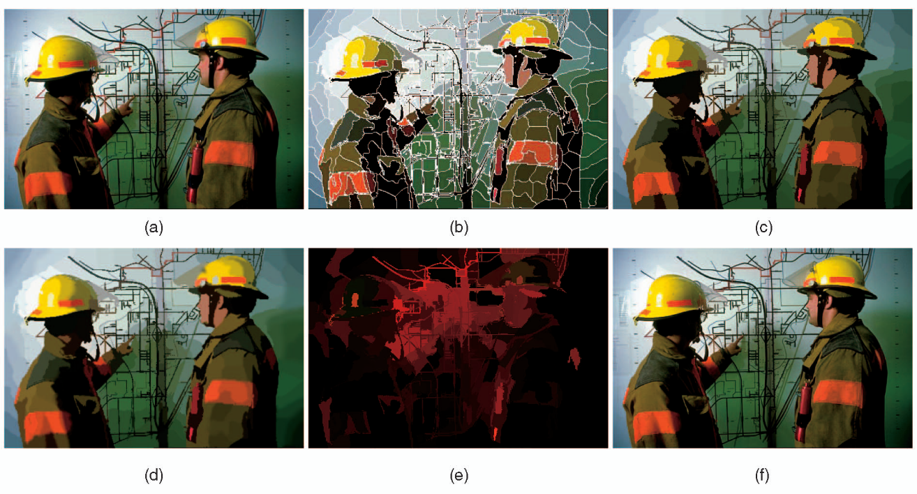
10.1.2 Noise Level Estimation 雜訊量級估計 (5/5)
(a) Original (b) Segmentation (c) Per-segment affine (仿射) reconstruction (d) Affine reconstruction plus boundary blur. (e) The sorted eigenvalues in each segment. (f) RGB values projected onto the largest eigenvector.
Notes:
補充:
Paper:
Title: Automatic Estimation and Removal of Noise from a Single Image
Link: https://ieeexplore.ieee.org/abstract/document/4359321

Slide 13
10.1.3 Vignetting 暗角 (1/5)
A common problem with using wide-angle and wide-aperture lenses is that the image tends to darken in the corners.
This problem is generally known as vignetting and comes in several different forms, including natural, optical, and mechanical vignetting.
Notes:
補充:

Slide 14
10.1.3 Vignetting 暗角 (2/5)
An approach is to stitch a panoramic scene and to assume that the true radiance at each pixel comes from the central portion of each input image.
This is easier to do if the radiometric response function is already known (e.g., by shooting in RAW mode) and if the exposure is kept constant.
Notes:
補充:

Slide 15
10.1.3 Vignetting 暗角 (3/5)
Notes:
補充:

Slide 16
10.1.3 Vignetting 暗角 (4/5)
If only a single image is available, vignetting can be estimated by looking for slow consistent intensity variations in the radial direction.
Zheng, Lin, and Kang (2006): (original)
Pre-segment the image into smoothly varying regions
Then, performed an analysis inside each region.
Zheng, Yu, Kang et al. (2008):
Compute the radial gradients at all the pixels.
Then, use the asymmetry in this to estimate the vignetting.
Notes:
補充:
2006 paper:
Title: Single-Image Vignetting Correction
Link: https://www.eecis.udel.edu/~jye/lab_research/09/JiUp.pdf
2008 paper
Title: Single-Image Vignetting Correction Using Radial Gradient Symmetry
Link: https://ieeexplore.ieee.org/document/4587413/metrics#metrics

Slide 17
10.1.3 Vignetting 暗角 (5/5)
(a) Original (b) 2006 (c) 2008
Notes:
補充:

Slide 18
10.1.4 Optical Blur Estimation 光學模糊估計 (1/7)
a.k.a. Spatial Response Estimation
Spatial response function (空間反應函式) encodes the optical blur that gets convolved with the incoming image to produce the point-sampled image.
The shape of the convolution kernel, which is also known as point spread function (點擴散函式，簡稱PSF).

Slide 19
10.1.4 Optical Blur Estimation 光學模糊估計 (2/7)
A good estimate of this function is required for applications such as multi-image super-resolution and de-blurring.
A more practical approach is to observe an image composed of long straight lines or bars, since these can be fitted to arbitrary precision.
Because the location of a horizontal or vertical edge can be aliased during acquisition, slightly slanted edges are preferred.
Notes:
補充：
Alias: edge的pixel會呈現鋸齒狀
為什麼Anti-alias反而可以讓影像更銳利: https://www.picturecorrect.com/tips/aliasing-in-digital-photography-explained/
大綱:
斜線可以讓估計到達subpixel的精細度
圖：作者提出的，適合估計PSF的圖案

Slide 20
10.1.4 Optical Blur Estimation 光學模糊估計 (3/7)
The slant-edge technique can be used to recover a 1D projection of the 2D PSF.
E.g., slightly vertical edges are used to recover the horizontal line spread function (LSF).
The LSF is then often converted into the Fourier domain and its magnitude plotted as a one-dimensional modulation transfer function (MTF), which indicates which image frequencies are lost (blurred) and aliased during the acquisition process.
Notes:
補充：
如何看MTF chart: https://photographylife.com/how-to-read-mtf-charts

Slide 21
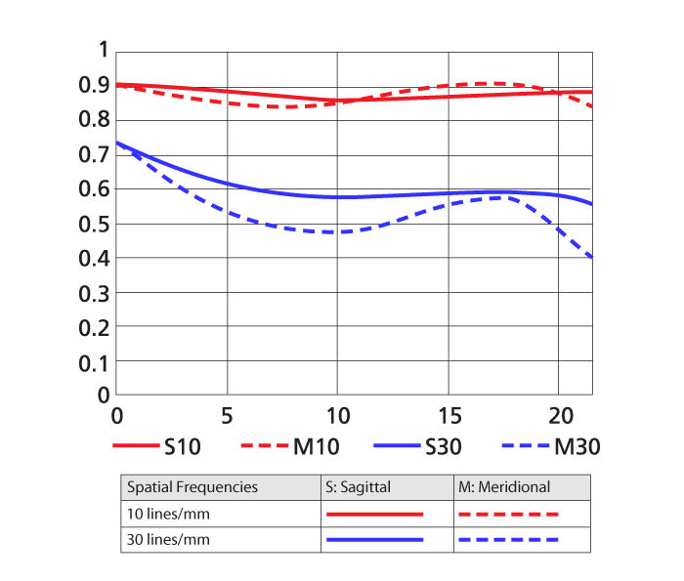
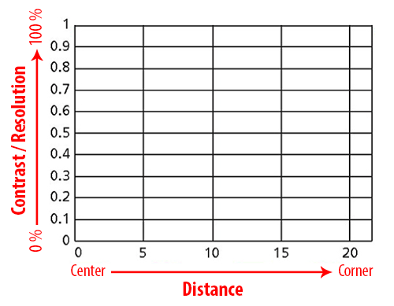
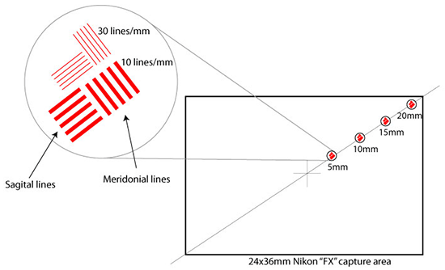
10.1.4 Optical Blur Estimation 光學模糊估計 (4/7)
(a) MTF chart for a lens (b) What the XY Axis’ show (c) Y axis
Notes:
補充：
Sagittal: 矢狀
Meridional: 子午

Slide 22
10.1.4 Optical Blur Estimation 光學模糊估計 (5/7)
Finally a large linear least squares system is solved to recover the unknown PSF kernel K.
B is the sensed (blurred) image,
I is the predicted (sharp) image,
D is an optional downsampling operator that matches the resolution of the ideal and sensed images.
Notes:
補充：
如何看MTF chart: https://photographylife.com/how-to-read-mtf-charts
大綱:
一定要來一點數學不然好像沒有學到東西
“argmin下面K” 就是讓後面這個式子達到min

Slide 23
10.1.4 Optical Blur Estimation 光學模糊估計 (6/7)
Sub-pixel PSFs at successively higher resolutions (note the interaction between the square sensing area and the circular lens blur).
Notes:
補充：
大綱:
三張圖來總結
1. Subpixel PSF

Slide 24
10.1.4 Optical Blur Estimation 光學模糊估計 (7/7)
(b) The radial distortion (輻射變形) and chromatic aberration (色差) can also be estimated and removed.
(c) PSF for a misfocused (blurred) lens showing some vignetting effects in the corners.
Notes:
補充：
Chromatic aberration: 色差，無法將所有波段的光集中在同一個點上的現象
大綱:
三張圖來總結
1. Subpixel PSF

Slide 25
10.2 High Dynamic Range Imaging
Taking images at different exposures, why?
Calibrate the radiometric response function (輻射反應函數) of a camera.
Help you create well-exposed photographs under challenging conditions.
Challenging condition:
A scene where and single exposure contains overexposed (過曝) and underexposed (曝光不足) regions.
Notes:
講稿:
請大家拿手機同時拍螢幕跟我

Slide 26
10.2 High Dynamic Range Imaging
Notes:
講稿:
開lightroom給大家看clipping的位置

Slide 27
10.2 High Dynamic Range Imaging
This is a common problem, why?
The natural world contains a range of radiance values that is far greater than can be captured with any photographic sensor (感光元件) of film (底片).
What is “dynamic range”(動態範圍):
The range of exposure from absolute white to absolute black in a photo, usually measured in stops (級).
Taking a set of bracketed exposures gives you the material from which to create a properly exposed photograph.
Notes:
講稿:
請他們看剛才用手機拍的照片，看有幾個

Slide 28
10.2 High Dynamic Range Imaging
Method 1 (bad):
It is possible to combine pixels from different exposures directly into a final composite.
However, this approach runs the risk of creating contrast reversals (對比反轉) and halos (光暈).

Slide 29
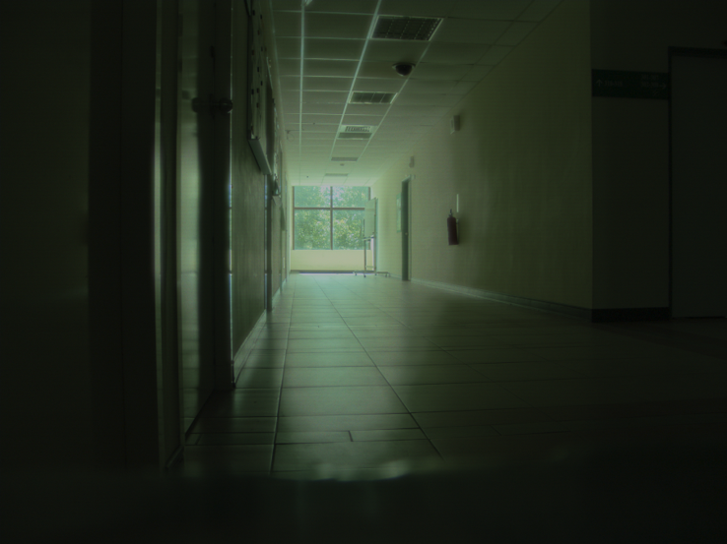
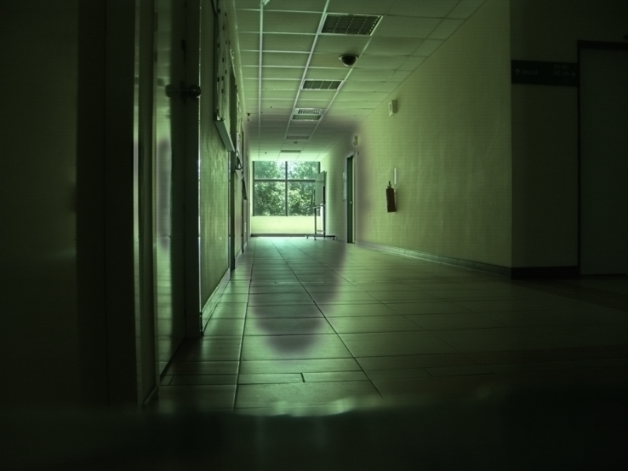
10.2 High Dynamic Range Imaging
Contrast Reversal

Slide 30
10.2 High Dynamic Range Imaging
Method 2, a more common approach, 3 stages:
Align the images and estimate their radiometric response function (輻射反應函數).
Estimate a radiance map (光度對應圖) by selecting or blending pixels from different exposures.
Tone map the resulting high dynamic range (HDR) image back into a displayable gamut.
Notes:
講稿：
3.的地方，請大家打開settings看看自己的螢幕是幾bit
JPEG 只有 8-bit

Slide 31
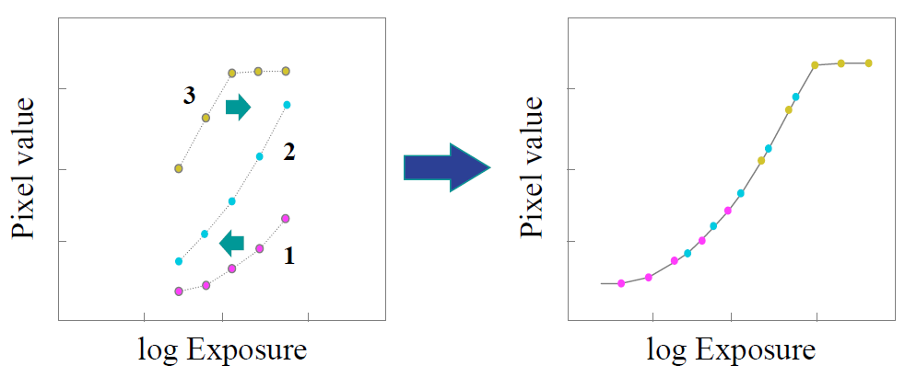
10.2 High Dynamic Range Imaging
1. Estimate Radiometric Response Function

Slide 32
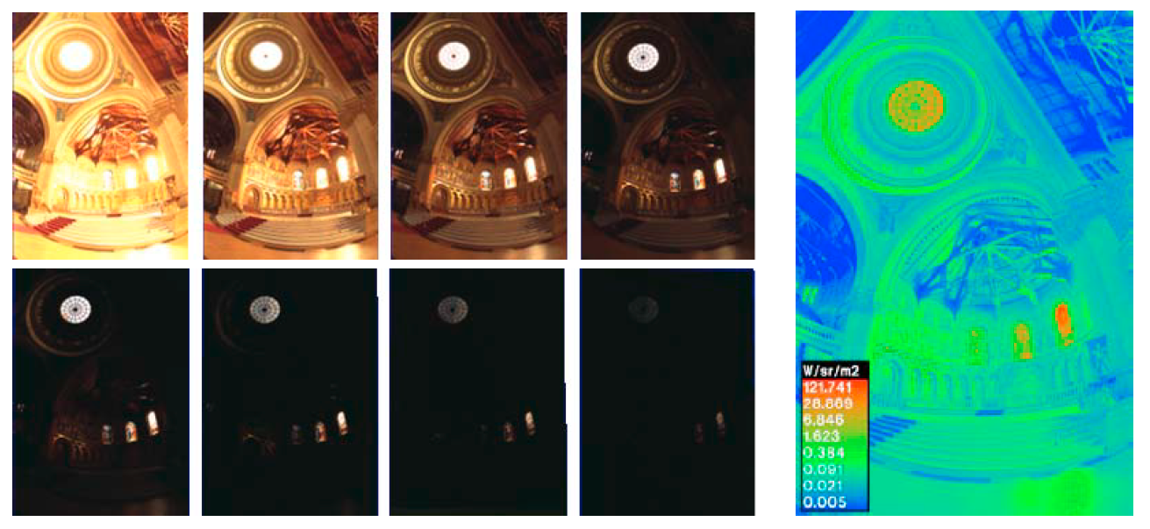
10.2 High Dynamic Range Imaging
2. Estimate a radiance map (輻射對應圖)

Slide 33
10.2 High Dynamic Range Imaging
3. Tone mapping

Slide 34
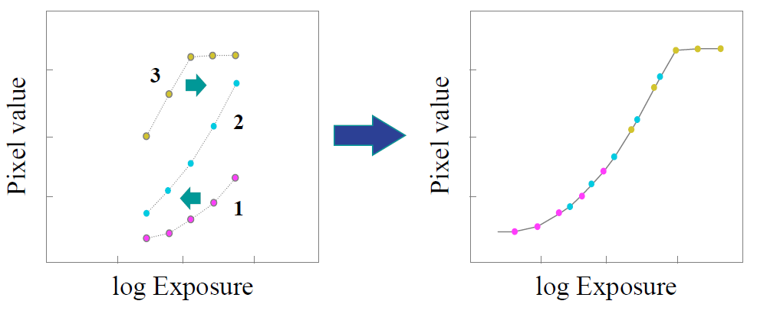
10.2.1 HDR, Estimate Radiometric Response Function
Idea:
If we were able to determine the irradiance (exposure) $E_{i}$ at each pixel, we could plot it against the measured pixel value $Z_{ij}$ for each exposure time $t_{j}$ (j-th image, i-th pixel).

Slide 35
10.2.1 HDR, Estimate Radiometric Response Function
Unfortunately, we do not know the irradiance values $E_{i}$, so these have to be estimated at the same time as the radiometric response function f.
$Z_{ij}$: measured pixel value (測量到的像素值)
$E_{i}$: irradiance (exposure) (真實世界的曝光)
$t_{j}$: exposure time (曝光時間)
$f$: radiometric response function (輻射反應函數)

Slide 36
10.2.1 HDR, Estimate Radiometric Response Function
推導過程
$Z_{ij}=f\left(E_{i}Δt_{j}\right)$
$f^{−1}\left(Z_{ij}\right)=E_{i}Δt_{j}$
Suppose $g\left(Z_{ij}\right)={log\left(f^{−1}\left(Z_{ij}\right)\right)}$
Then $g\left(Z_{ij}\right)={log\left(f^{−1}\left(Z_{ij}\right)\right)}=logE_{i}+Δt_{j}$
Notes:
RRF f is monotonic, inverse g is also monotonic

Slide 37
10.2.1 HDR, Estimate Radiometric Response Function
We assume $g$ is monotonic and smooth.
And we assume $g$ and $E_{i}$ are quadratic.
The second term is a smoothness term.

Slide 38
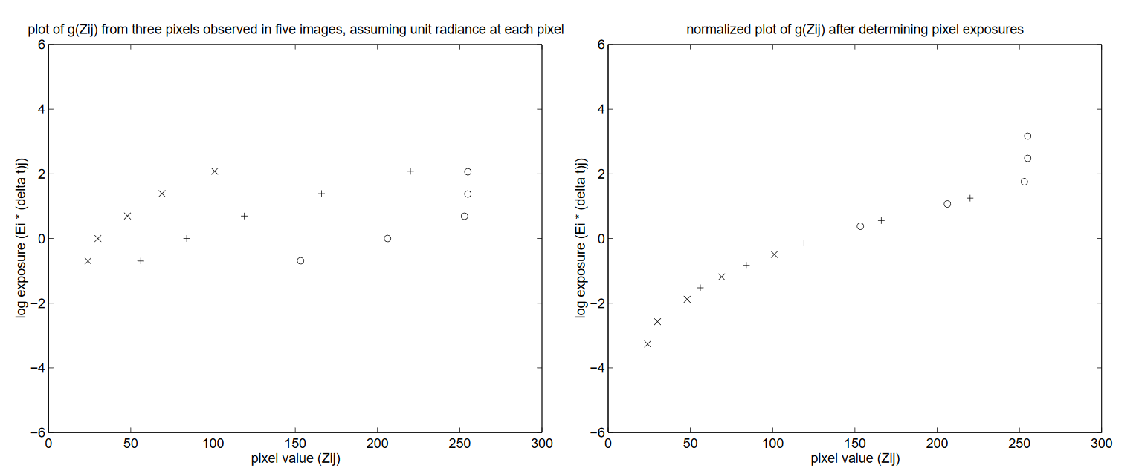
10.2.1 HDR, Estimate Radiometric Response Function
Let’s make it more practical…
Assume ${E=0}_{ }$, we slide $lnE$ up and down until they line up in a smooth monotonic curve.
Notes:
Scale is not important

Slide 39
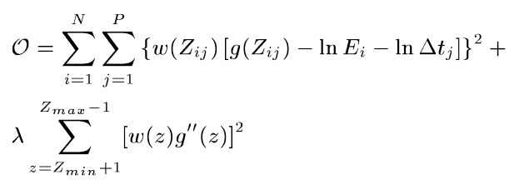
10.2.1 HDR, Estimate Radiometric Response Function
Solve: Singular Value Decomposition (SVD) (奇異質分解)
Improvement: Weights

Slide 40
10.2.1 HDR, Estimate Radiometric Response Function
Notes:
講稿：
開Matlab的Code給大家看

Slide 41
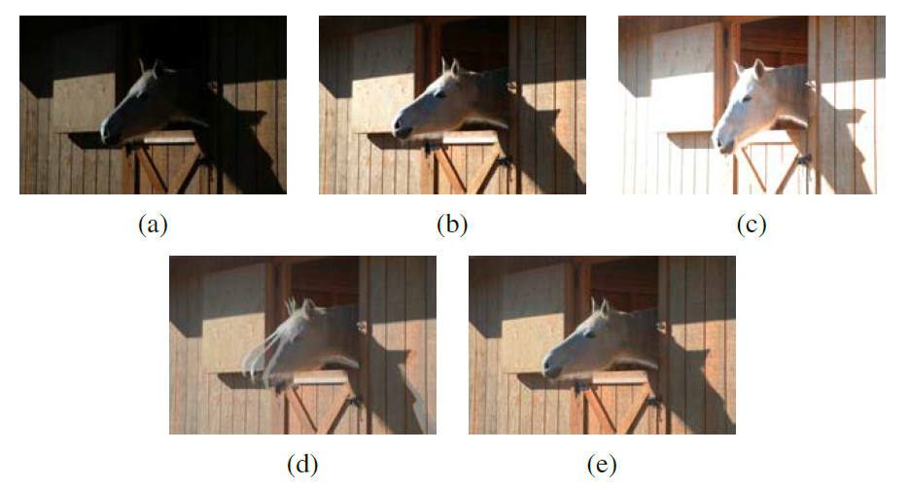
10.2.1 HDR, Estimate Radiometric Response Function
Other factors that may affect the quality:
Moving objects: use other algorithms to properly align the images first.

Slide 42
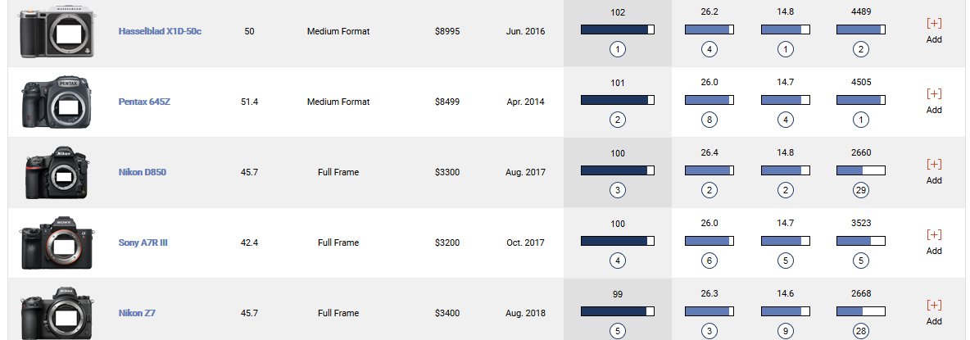
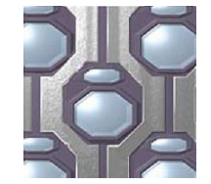
10.2.1 HDR, Estimate Radiometric Response Function
In the future, the need to compute high dynamic range images may be eliminated by advances in camera sensor technology.
However, the need to blend such images and to tone map them to lower-gamut displays is likely to remain.

Slide 43
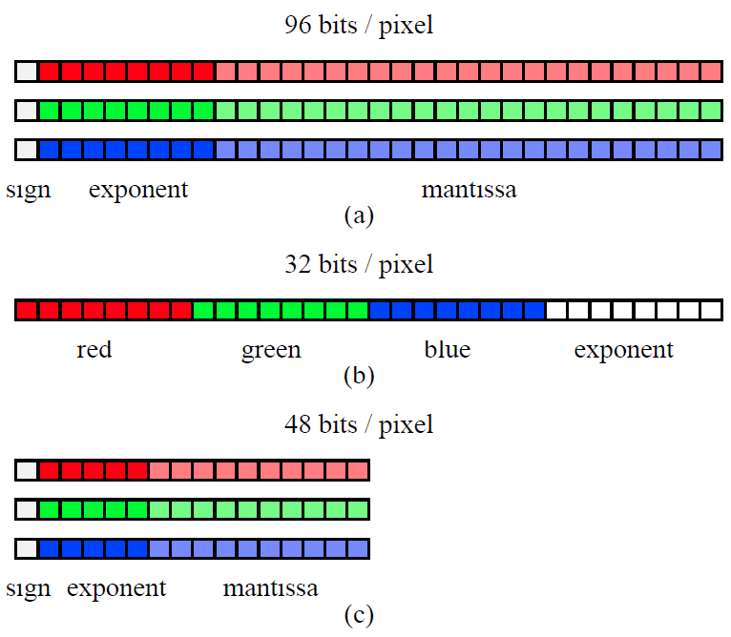
10.2.1 HDR, Estimate Radiometric Response Function
HDR formats
Exponent
(指數)
Mantissa
(尾數)
Portable PixMap (.ppm)
Radiance (.hdr/.pic)
OpenEXR (.exr)

Slide 44
10.2.2 HDR, Tone mapping
Once a radiance map has been computed, it is usually necessary to display it on a lower gamut (色域) screen or printer.
The simplest way: compress using a global transfer curve.
Notes:
給大家看電腦是幾bit的，還有螢幕色慾怎麼看

Slide 45
10.2.2 HDR, Tone mapping
https://www.youtube.com/watch?v=KZmGb0nRCfg
(0:00-3:00)
Notes:
介紹怎麼選電腦螢幕

Slide 46
10.2.2 HDR, Tone mapping
(a) linearly mapped (b) gamma applied to each color channel independently (c) gamma applied to intensity.

Slide 47
10.2.2 HDR, Tone mapping
Notes:
Gamma 的概念

Slide 48
10.2.2 HDR, Tone mapping
When the image has a wide range of exposures, this approach fails to preserve details in regions with widely varying exposures.
Dodging and Burning
Mathematically: dividing each pixel by the average brightness in a region around that pixel

Slide 49
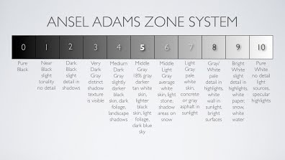
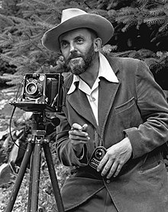
10.2.2 HDR, Tone mapping
Notes:
Dodge and burn
Ansel adams zone system

Slide 50
10.2.2 HDR, Tone mapping
Notes:
Hdr in the film era

Slide 51
10.2.2 HDR, Tone mapping
How this works:
Split image into luminance and chrominance channels
Low-pass filter to create a base layer
And a high-pass detail layer

Slide 52
10.2.2 HDR, Tone mapping
How this works, continued…
4. The base layer is contrast reduced
Add to the detail layer to produce the new log-luminance image
課本寫反了

Slide 53
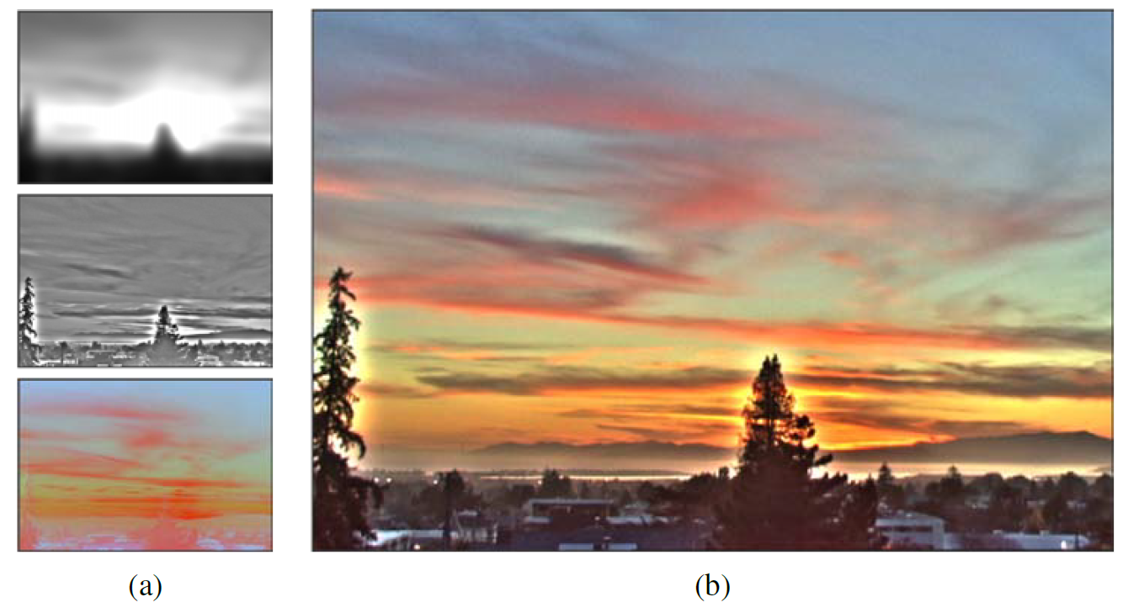
10.2.2 HDR, Tone mapping
(a) base, detail, chrominance layers
(b) resulting image

Slide 54
10.2.2 HDR, Tone mapping
HALO! 怎麼辦？
Notes:
課本3.3有詳細講解

Slide 55
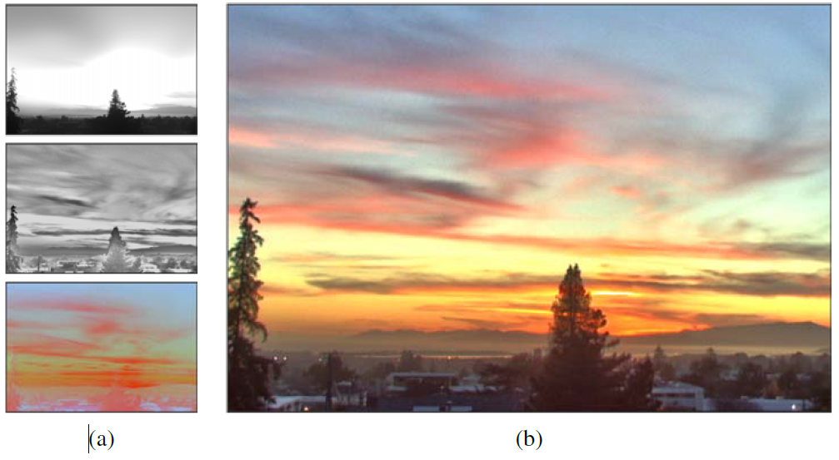
10.2.2 HDR, Tone mapping
(a) base, detail, chrominance layers with bilateral filtering
(b) resulting image

Slide 56
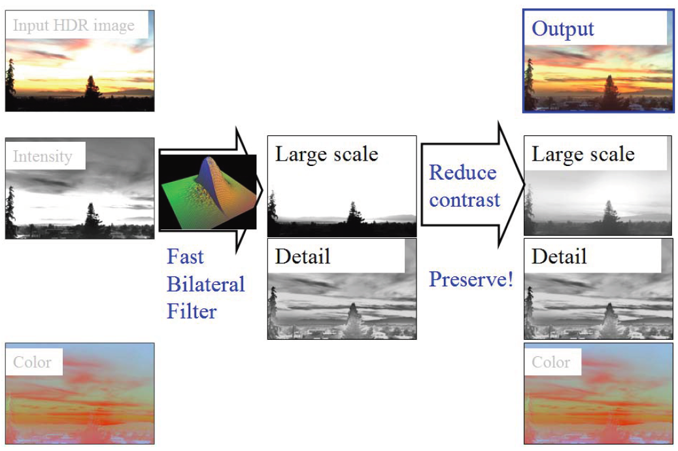
10.2.2 HDR, Tone mapping
Notes:
recap

Slide 57
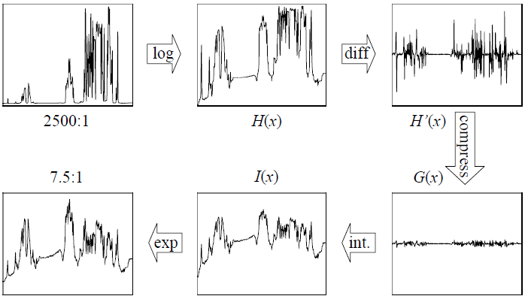
10.2.2 HDR, Tone mapping
Another method: gradient domain tone mapping

Slide 58
10.3 Super-resolution and blur removal
Super-resolution enables us with higher spatial resolution.
We can do this by generalizing the blur kernel, a.k.a. point spread function (PSF).
Remember me?
Notes:
high dynamic range imaging enables us to create images on and less noise than regular camera and obtain an image with a larger dynamic range than a single regular image

Slide 59
10.3 Super-resolution and blur removal
Instead of
We use a new function:
$o_{k}(x)$: observed images
$h_{k}(x)$: warping function to get the super-resolved image

Slide 60
10.3 Super-resolution and blur removal
Least squares problem
Problem: no image prior, so a lot of high-frequency noise can be introduced.
Notes:
ρp is quadratic

Slide 61
10.3 Super-resolution and blur removal
Simplest solution: penalty function (loss function)
Penalty on the image derivatives, still a linear least squares problem
This prior image model is Gaussian Markov random field (GMRF).
Unfortunately, GMRF tends to produce visible ripples.

Slide 62
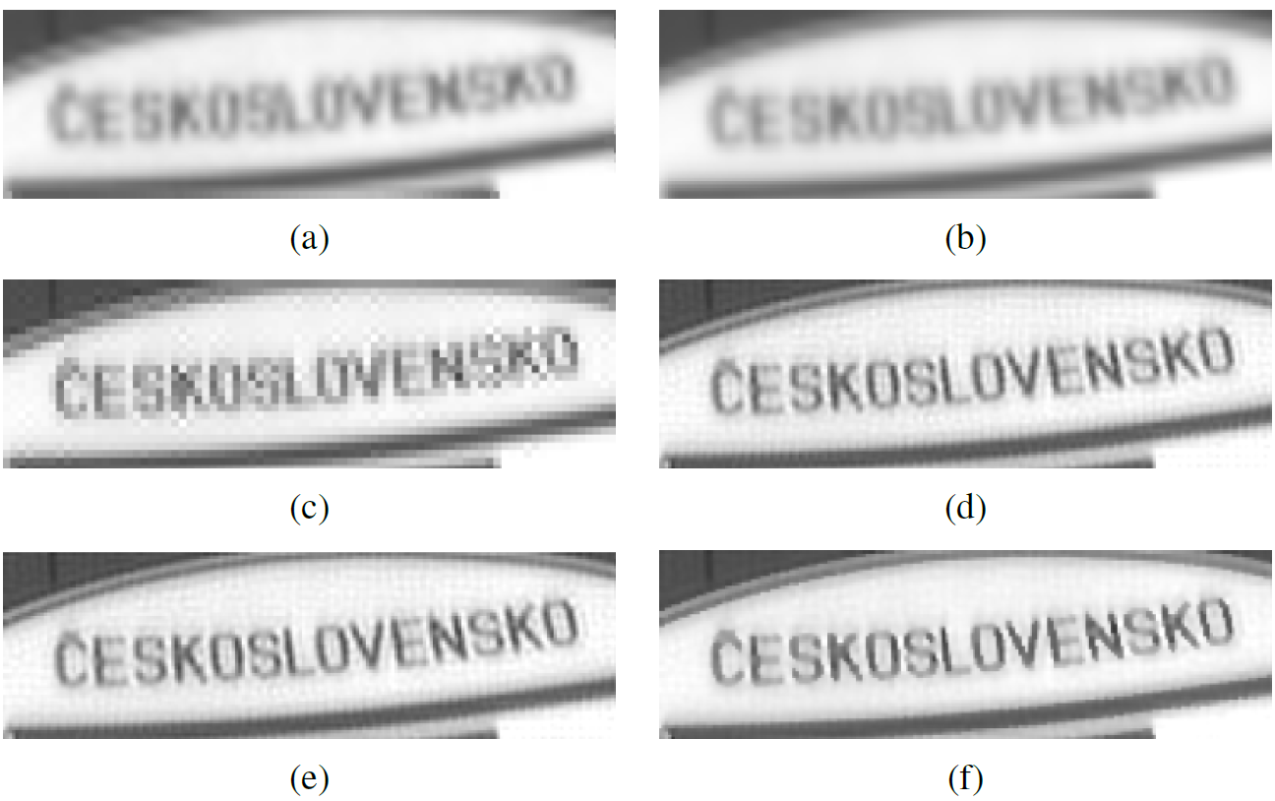
10.3 Super-resolution and blur removal
(a) low-res (b) average image (c) MLE (d) simple ${\left\|x\right\|}^{2}$prior (e) GMRF (f) HMRF
Notes:
MLE: maximum likelihood
Simple x^2 prior
HMRF: Huber Markov random field

Slide 63
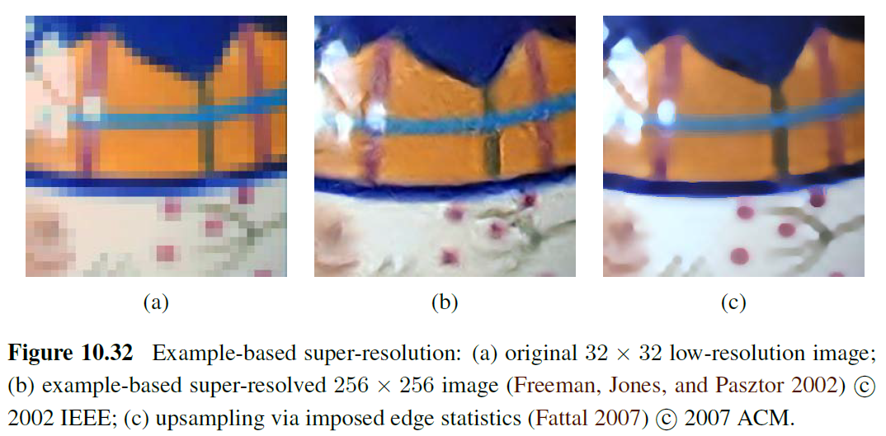
10.3 Super-resolution and blur removal
Example based super-resolution
Predict oriented gradient magnitudes, based on a pixel’s location relative to the nearest detected edge
Notes:
Other algorithms

Slide 64
10.3 Super-resolution and blur removal
https://www.youtube.com/watch?v=ppsqbOL073U
Notes:
Super resolution today with DNN

Slide 65
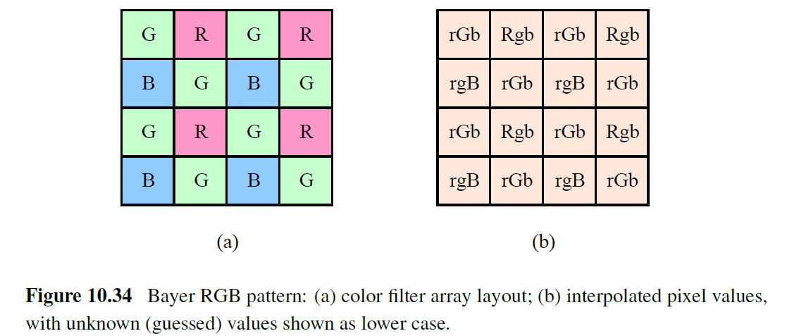
10.3.1 Color image demosaicing
A special case of super-resolution, which is used daily in most digital still cameras.
Demosaicing samples from a color filter array (CFA) into a full-color RGB image.

Slide 66
10.3.1 Color image demosaicing

Slide 67
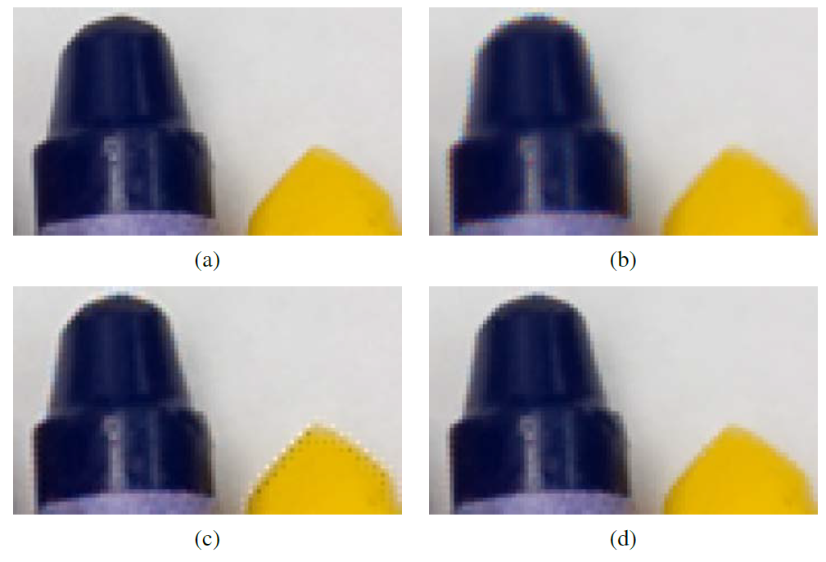
10.3.1 Color image demosaicing
(a) Original (b) bilinear (c) linear interpolation (d) local two-color prior

Slide 68
10.4 Image Matting and Compositing
Notes:
A application example

Slide 69
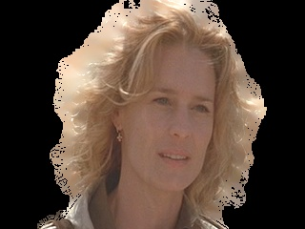
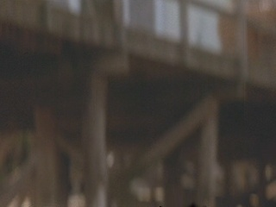
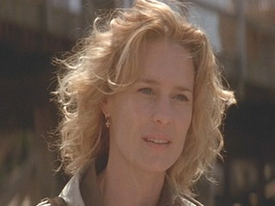
10.4 Image Matting and Compositing
alpha matte
F
α
B
foreground color
C
background plate

Slide 70
10.4.1 Blue screen matting
Mishima’s algorithm:
Fit two polyhedral (多面體) surfaces (centered at the mean background color), separating the foreground and background color distributions, and then measuring the relative distance of a novel color to these surfaces to estimate$α$ (alpha).

Slide 71
10.4.1 Blue screen matting
Two-screen matting
Smith and Blinn (1996) also introduce an algorithm called triangulation matting that uses more than one known background color to over-constrain the equations required to estimate the opacity$α$and foreground color F.

Slide 72
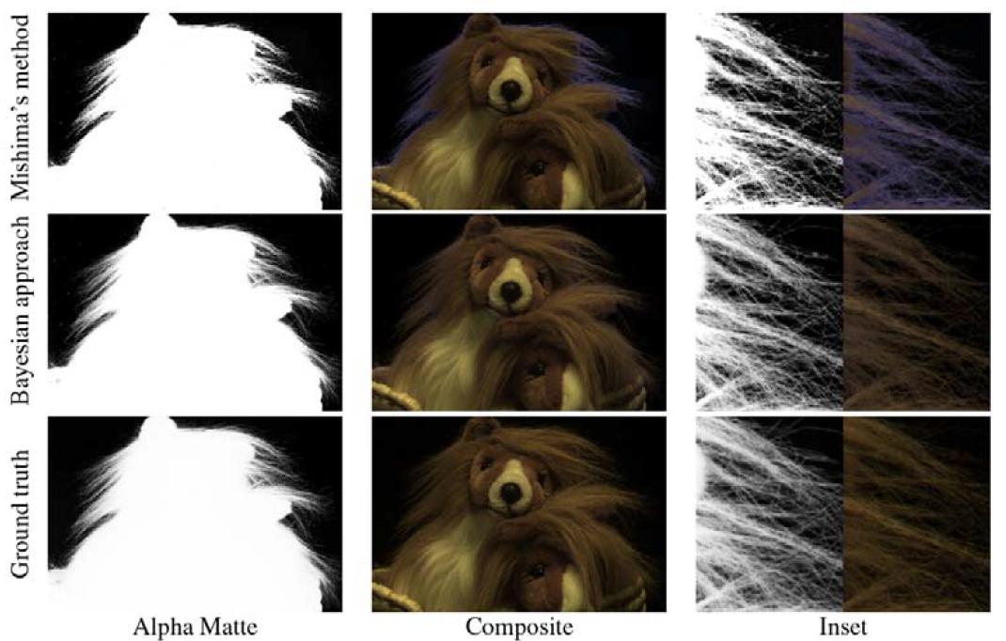
10.4.1 Blue screen matting

Slide 73
10.4.1 Blue screen matting
Difference matting
Background is irregular but known.
Most commonly used when subject is filmed against a static background.

Slide 74
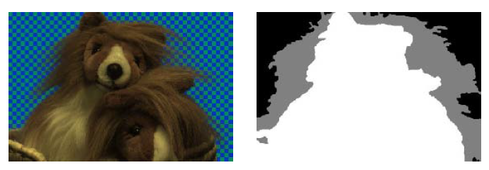
10.4.2 Natural image matting
Most general version: little or nothing is known about the background.
Trimap: a rough segmentation of the scene into foreground, background, and unknown regions.

Slide 75
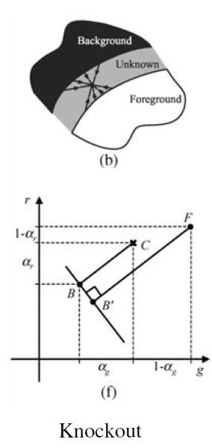
10.4.2 Natural image matting
A simple algorithm: Knockout
The nearest known foreground and background pixels are determined
The are blended with neighboring known pixels to produce a per-pixel foreground F and background B color estimate.
The background color is then adjusted so that the measured color C lies on the line between F and B.
Opacity is estimated on a per-channel basis, and the three estimates based on per-channel color differences.

Slide 76
10.4.2 Natural image matting

Slide 78
10.4.2 Natural image matting
Stroke-based segmentation result

Slide 79
10.4.3 Smoke, shadow and flash matting
It is also possible to matte out translucent media such as smoke.

Slide 80
10.4.3 Smoke, shadow and flash matting
Video sequence: each pixel is modeled as a linear combination of its (unknown) background color and a constant foreground (smoke) color that is common to all pixels.
Voting in color space is used to estimate this foreground color and the distance along each color line is used to estimate the per-pixel temporally varying alpha

Slide 81
10.5 Texture analysis and synthesis
The problem of texture synthesis (材質合成) can be formulated as follows:
Given a small sample of a “texture”, generate a larger similar-looking image.
As you can imagine, for certain sample textures, this problem can be quite challenging.

Slide 82
10.5 Texture analysis and synthesis

Slide 83
10.5 Texture analysis and synthesis
Traditional approaches to texture analysis and synthesis try to match the spectrum (頻譜) of the source image.
Matching the frequency characteristics, which is equivalent to matching spatial correlations, is in itself not sufficient.
The distributions of the responses at different frequencies must also match.
Heeger and Bergen: alternates between matching the histograms of multi-scale (steerable pyramid) responses and matching the final image histogram.

Slide 84
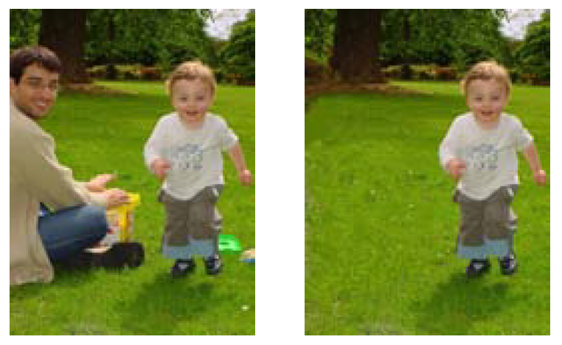
10.5 Texture analysis and synthesis
Application: Hole filling and inpainting (修補)
Exemplar-based (以範本為基準的) inpainting with confidence
Notes:
the order of synthesis is determined by the strength of the gradient along the region boundary
開PS給大家看?

Slide 85
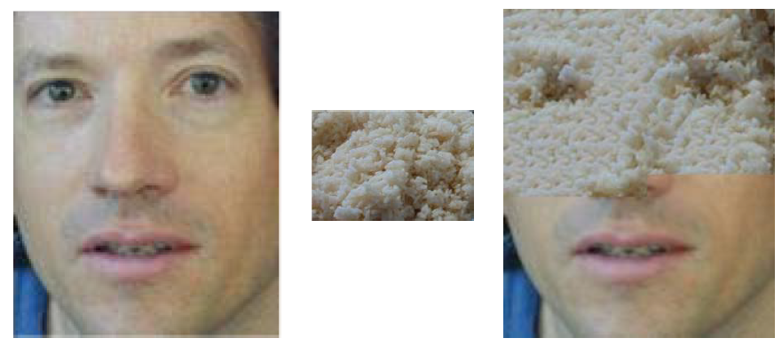
10.5 Texture analysis and synthesis
Application: Texture transfer

Slide 86
謝謝大家！
(希望我可以畢業 lol)

