Slide 1
Advanced Computer Vision
Chapter 9
Image Stitching
Presented by 鄭義錡 and 傅楸善教授
Cell phone: 0955310208
E-mail: r98922143@ntu.edu.tw

Slide 2
Outline
9.1 Motion Models
9.2 Global Alignment
9.3 Compositing
9.4 Additional Reading
9.5 Exercises

Slide 3
Image Mosaics
+ + … + =
Goal: Stitch together several images into a seamless composite

Slide 4
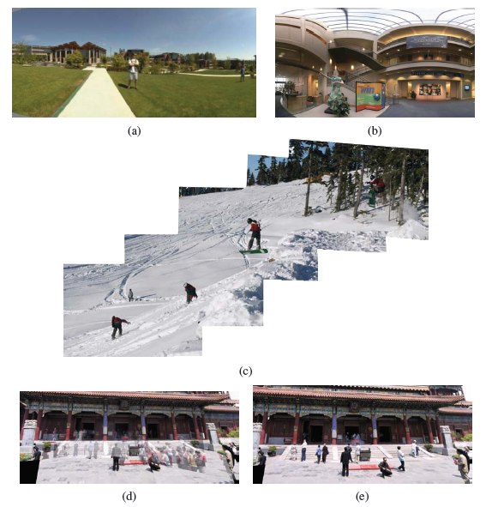
Figure 9.1 Image stitching: (a) portion of a cylindrical panorama and (b) a spherical panorama constructed from 54 photographs (Szeliski and Shum 1997) c 1997 ACM; (c) a multi-image panorama automatically assembled from an unordered photo collection; a multi-image stitch (d) without and (e) with moving object removal (Uyttendaele, Eden, and Szeliski 2001) c 2001 IEEE.

Slide 5
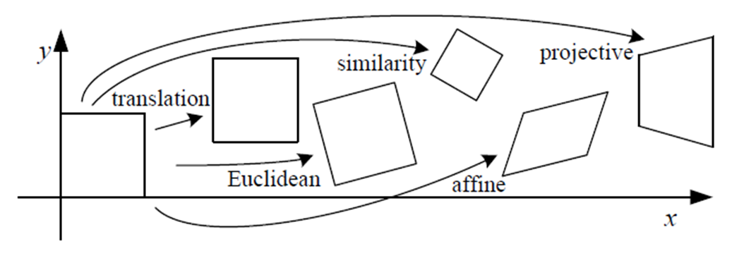



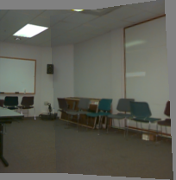
9.1.1 Planar Perspective Motion
Translation
Affine
Perspective
3D rotation

Slide 6



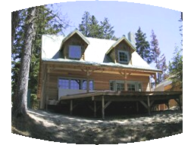

Parametric (Global) Warping
Examples of parametric warps:
translation
rotation
aspect
perspective
affine
cylindrical

Slide 7

9.1.1 Planar Perspective Motion
In Section 6.1.3, we saw how the mapping between two cameras viewing a common plane can be described using a 3*3 homography.
The resulting homography matrix (the upper left 3*3 sub-matrix of ) describes the mapping between pixels in the two images,

Slide 8

9.1.1 Planar Perspective Motion
More recent stitching algorithms first extract features and then match them up, often using robust techniques such as RANSAC (Section 6.1.4) to compute a good set of inliers.
The final computation of the homography (9.2), i.e., the solution of the least squares fitting problem given pairs of corresponding features,
RANSAC: RANdom SAmple Consensus

Slide 9
9.1.2 Application: Whiteboard and Document Scanning
The simplest image-stitching application is to stitch together a number of image scans taken on a flatbed scanner.
One complication is that a 2D rigid transformation is non-linear in the rotation angle.
A bigger problem lies in the pairwise alignment process. As you align more and more pairs, the solution may drift so that it is no longer globally consistent.
Problem: drift

Slide 10
Problem: Drift
copy of first image
Solution
  add another copy of first image at the end
  this gives a constraint: y_{n} = y₁
  there are a bunch of ways to solve this problem
    add displacement of (y₁ – y_{n})/(n -1) to each image after the first
    compute a global warp: y’ = y + ax
    run a big optimization problem, incorporating this constraint

Slide 11
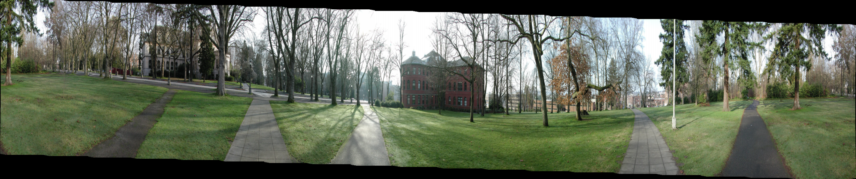
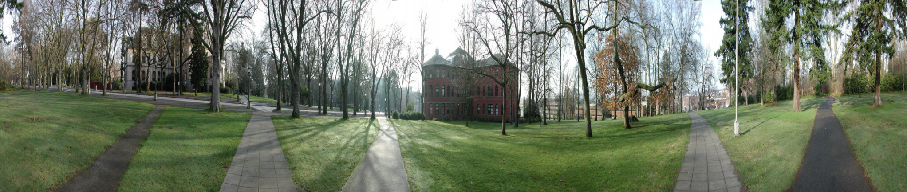

Slide 12
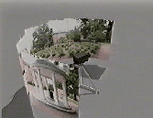
9.1.3 Rotational Panoramas
The most typical case for panoramic image stitching is when the camera undergoes a pure rotation.
http://crchaffee.com/panorama3.html

Slide 13
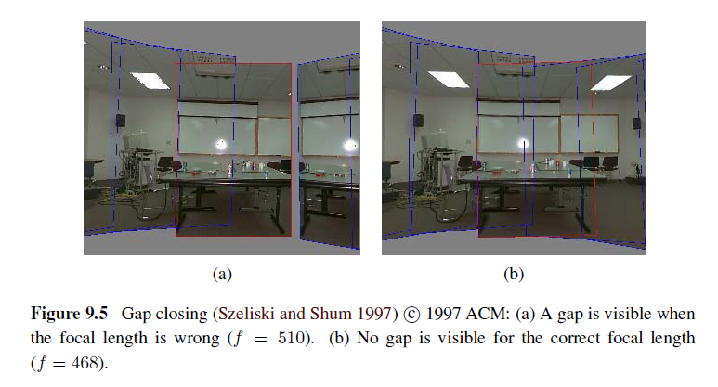
9.1.4 Gap Closing

Slide 14
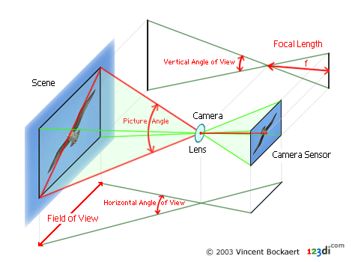
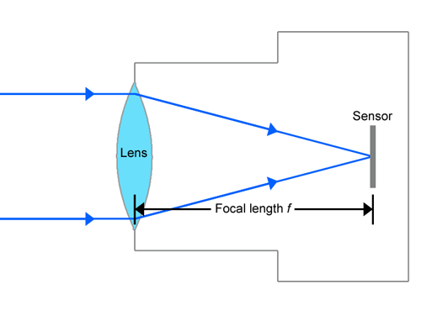
Focal Length
The focal length of a lens is the distance from the image plane to the lens.

Slide 15
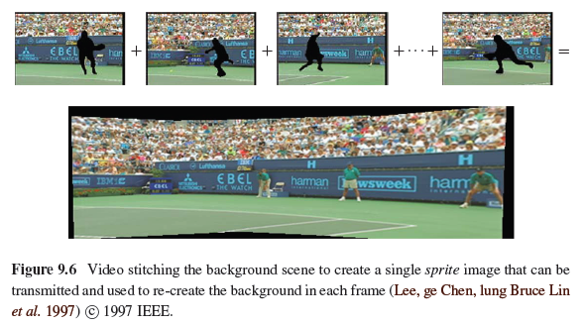
9.1.5 Application: Video Compression

Slide 16
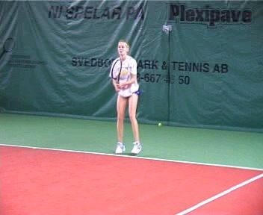
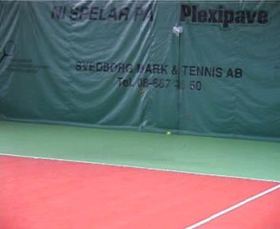
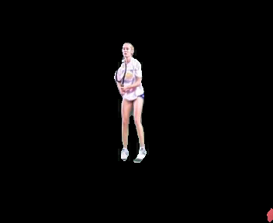
9.1.5 Application: Video Compression
=
+
Input
Segmentation result
Result by: L.Zelnik-Manor, M.Irani
“Multi-frame estimation of planar motion”, PAMI 2000

Slide 17
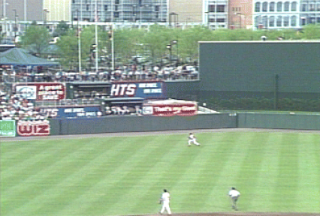
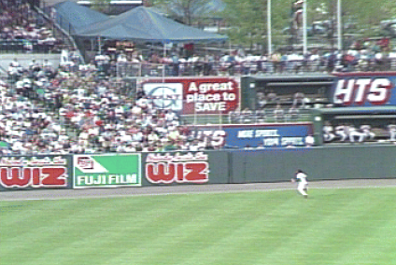
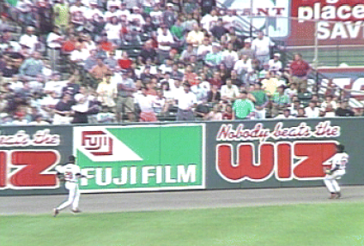
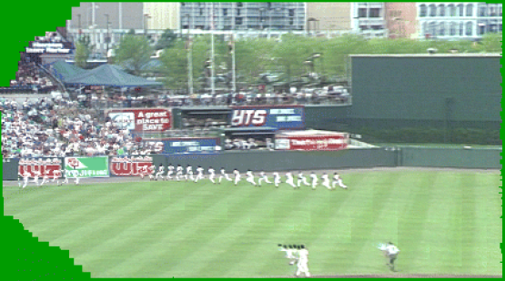
Video summarization
9.1.5 Application: Video Summarization

Slide 18
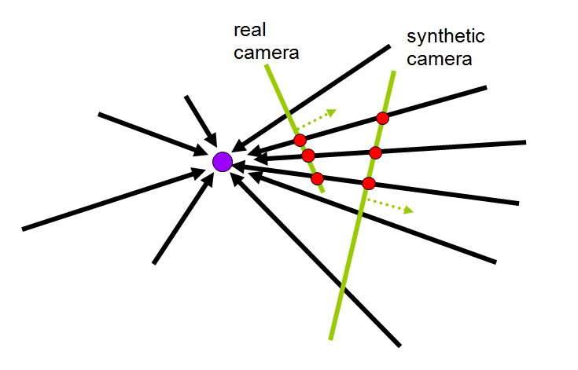
9.1.6 Cylindrical and Spherical Coordinates
An alternative to using homographies or 3D motions to align images is to first warp the images into cylindrical coordinates and then use a pure translational model to align them.

Slide 19
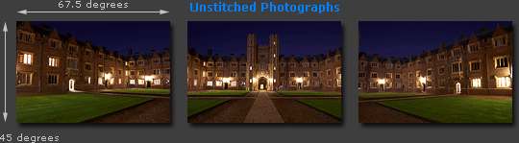
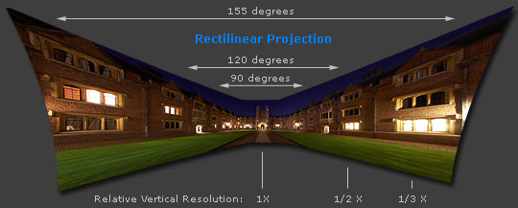
Cylindrical projection
Adopted from http://www.cambridgeincolour.com/tutorials/image-projections.htm
Notes:
http://www.cambridgeincolour.com/tutorials/image-projections.htm

Slide 20
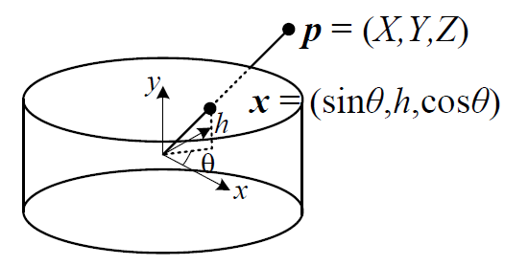

9.1.6 Cylindrical and Spherical Coordinates
We wish to project this image onto a cylindrical surface of unit radius.
Points on this surface are parameterized by an angle and a height h, with the 3D cylindrical coordinates corresponding to (θ,h) given by:
f: focal length

Slide 21
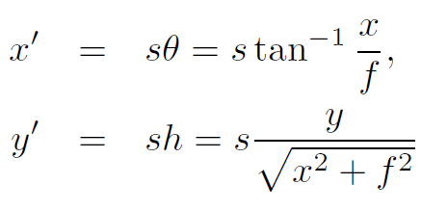
9.1.6 Cylindrical and Spherical Coordinates
s is an arbitrary scaling factor (sometimes called the radius of the cylinder)
We can set s = f to minimize the distortion (scaling) near the center of the image.

Slide 22
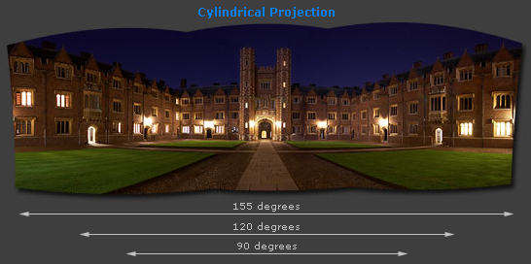
Cylindrical projection
Adopted from http://www.cambridgeincolour.com/tutorials/image-projections.htm
Notes:
http://www.cambridgeincolour.com/tutorials/image-projections.htm

Slide 23

9.1.6 Cylindrical and Spherical Coordinates
Images can also be projected onto a spherical surface, which is useful if the final panorama includes a full sphere or hemisphere of views, instead of just a cylindrical strip.
In this case, the sphere is parameterized by two angles (θ,ϕ), with 3D spherical coordinates given by:

Slide 24
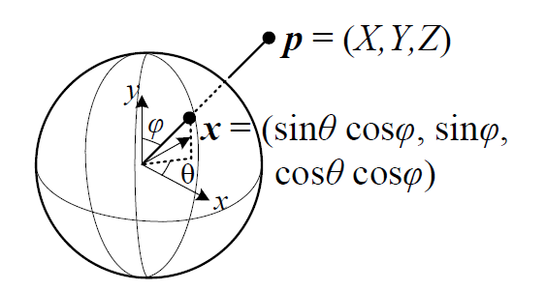
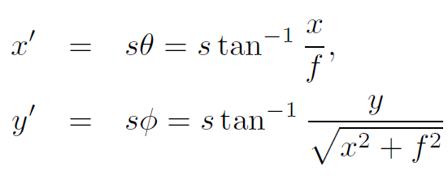
9.1.6 Cylindrical and Spherical Coordinates
The correspondence between coordinates is now given by:

Slide 25
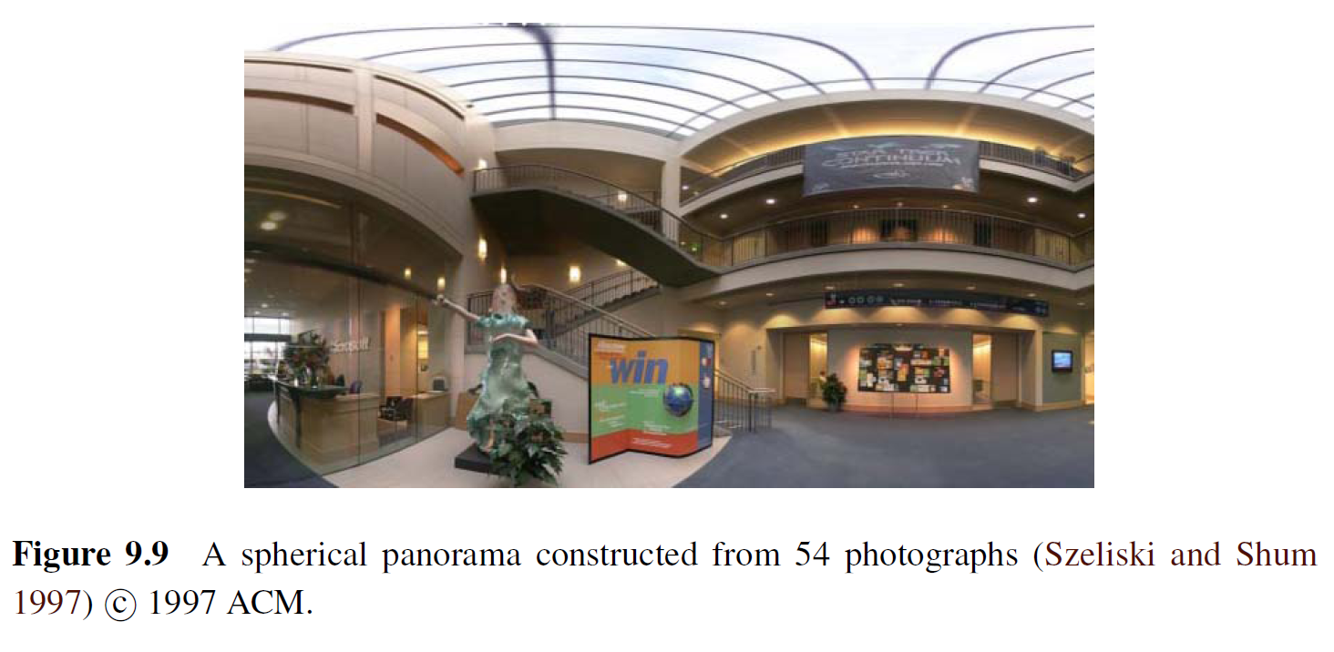
9.1.6 Cylindrical and Spherical Coordinates

Slide 26
9.2 Global Alignment
In this section, we extend the pair wise matching criteria to a global energy function that involves all of the per-image pose parameters.
Once we have computed the global alignment, we often need to perform local adjustments, such as parallax removal, to reduce double images and blurring due to local mis-registrations.

Slide 27
9.2.1 Bundle Adjustment
The process of simultaneously adjusting pose parameters for a large collection of overlapping images is called bundle adjustment in the photogrammetry community.
In this section, we formulate the problem of global alignment using a feature-based approach, since this results in a simpler system.

Slide 28
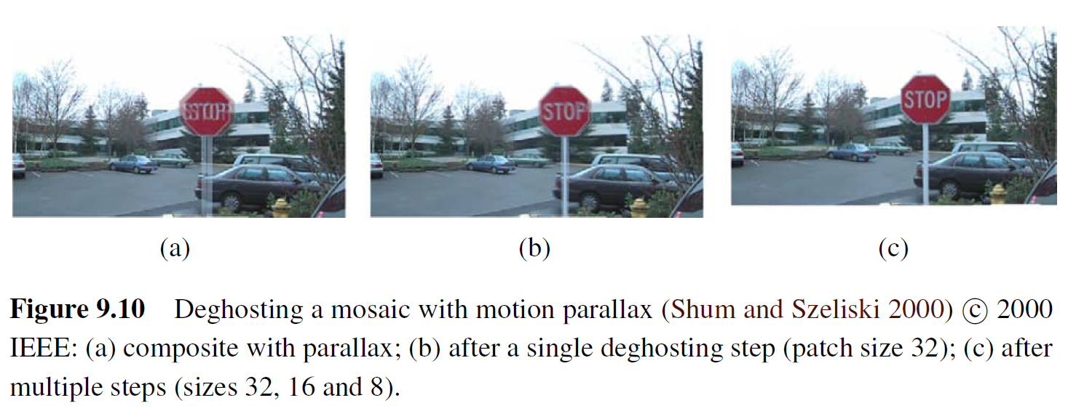
9.2.2 Parallax Removal

Slide 29
9.2.2 Parallax Removal
The resulting stitched image sometimes looks blurry or ghosted in some places.
This can be caused by:
  A unmodeled radial distortion
  3D parallax (failure to rotate the camera around its optical center)
  Small scene motions such as waving tree branches
  Large-scale scene motions such as people moving in and out of pictures

Slide 30
9.2.2 Parallax Removal
Radial distortion
  Plumb-line method
3D parallax
  A full 3D bundle adjustment
Small scene motions
  optical flow can be used to perform an appropriate correction before blending using a process called local alignment
Large-scale scene motions
  simply select pixels from only one image at a time

Slide 31
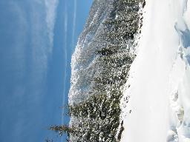
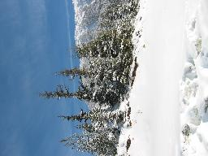
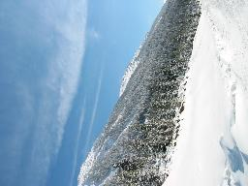
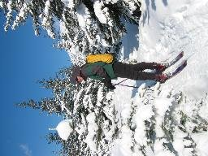
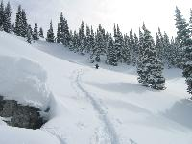
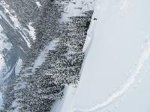
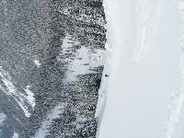
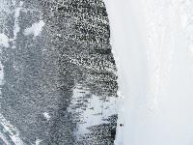
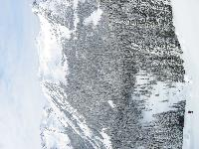
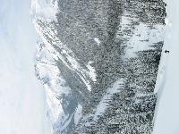
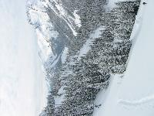
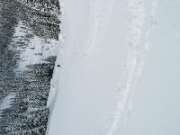
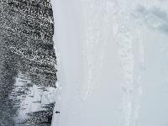
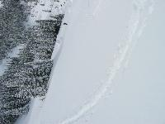
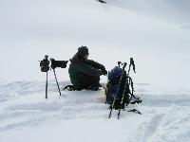
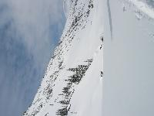
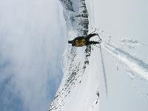
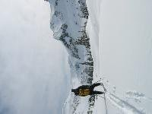
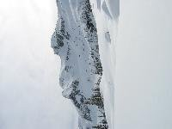
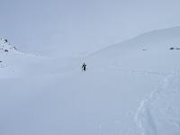
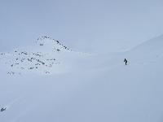
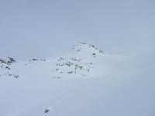






9.2.3 Recognizing panoramas

Slide 32
9.2.3 Recognizing panoramas

Slide 33
9.2.3 Recognizing panoramas

Slide 34
9.2.3 Recognizing panoramas

Slide 35
9.2.3 Recognizing panoramas

Slide 36
9.2.3 Recognizing panoramas
Feature detection and description (SIFT)
Fast matching (hash table)
RANSAC filtering of matches
Intensity-based verification
Incremental bundle adjustment
[M. Brown, R. Szeliski, and S. Winder. Multi-image matching using multi-scale oriented patches, CVPR'2005]
SIFT: scale invariant feature transform

Slide 37
9.2.4 Direct vs. feature-based alignment
Early feature-based methods
  The features get confused in regions that were either too textured or not textured enough
  The features be distributed unevenly over the images, thereby failing to match image pairs that should have been aligned.
  The features did not work well when the images were rotated or had foreshortening due to homographies.

Slide 38

Harris corner detector

Slide 39
9.2.4 Direct vs. feature-based alignment
Today, feature detection and matching schemes are remarkably robust and can even be used for known object recognition from widely separated views.
Furthermore, because they operate in scale-space and use a dominant orientation (or orientation invariant descriptors), they can match images that differ in scale, orientation, and even foreshortening.

Slide 40





SIFT

Slide 41
9.3 Compositing
namely compositing surface parameterization
pixel and seam selection
Blending
exposure compensation

Slide 42
9.3.1 Choosing a compositing surface
Flat panorama
  If only a few images are stitched together, a natural approach is to select one of the images as the reference and to then warp all of the other images into its reference coordinate system.

Slide 43

9.3.1 Choosing a compositing surface
For larger fields of view, however, we cannot maintain a flat representation without excessively stretching pixels near the border of the image.
  The usual choice for compositing larger panoramas is to use a cylindrical or spherical projection

Slide 44
9.3.1 Choosing a compositing surface
View selection
  As mentioned above, for a flat composite, we can choose one of the images as a reference.
  A reasonable choice is the one that is geometrically most central.

Slide 45
9.3.1 Choosing a compositing surface
Coordinate transformations
  The final compositing surface is flat.
  The final composite surface has some other analytic form (e.g., cylindrical or spherical).
    lookup tables by the partial trigonometric functions
    computing exact pixel mappings on a coarser grid and then interpolating these values

Slide 46
9.3.1 Choosing a compositing surface
Sampling issues
  If the final panorama has a lower resolution than the input images, pre-filtering the input images is necessary to avoid aliasing.
  Under certain conditions, it may also be possible to produce images with a higher resolution than the input images using the process of super-resolution.

Slide 47
9.3.2 Pixel selection and weighting
(de-ghosting)
Once the source pixels have been mapped onto the final composite surface, we must still decide how to blend them in order to create an attractive-looking panorama.
  visible seams (due to exposure differences)
  blurring (due to mis-registration)
  ghosting (due to moving objects)

Slide 48

9.3.2 Pixel selection and weighting
(de-ghosting)
The simplest way to create a final composite is to simply take an average value at each pixel:
Visible drawback by:
  exposure differences
  misregistrations
  scene movement

Slide 49

Final composites computed by a variety of algorithms (Szeliski 2006a):
(a)average, (b) median, (c) feathered average, (d) p-norm p = 10,

Slide 50

(e) Voronoi, (f) weighted ROD vertex cover with feathering, (g) graph cut seams with Poisson blending and (h) with pyramid blending.

Slide 51
9.3.3 Application: Photomontage
While image stitching is normally used to composite partially overlapping photographs, it can also be used to composite repeated shots of a scene taken with the aim of obtaining the best possible composition and appearance of each element.

Slide 52



Slide 53

9.3.4 Blending

Slide 54



9.3.4 Blending
+
1
=
1
0
0

Slide 55
Image Feathering
Weight each image proportional to its distance from the edge (distance map [Danielsson, CVGIP 1980]
  Generate weight map for each image
  Sum up all of the weights and divide by sum: weights sum up to 1:
    w_{i}’ = w_{i} / ( ∑_{i} w_{i})

Slide 56
Image feathering
Weight each image proportional to its distance from the edge (distance map [Danielsson, CVGIP 1980]
1. Generate weight map for each image
2. Sum up all of the weights and divide by sum:
weights sum up to 1: w_{i}’ = w_{i} / ( ∑_{i} w_{i})

Slide 57



Image Feathering

Slide 58


Effect of window size
1
left
1
right
0
0

Slide 59


Effect of window size
1
1
0
0

Slide 60

Good window size
1
0
“Optimal” window: smooth but not ghosted
  Doesn’t always work...

Slide 61



Pyramid Blending
Burt, P. J. and Adelson, E. H., A multiresolution spline with applications to image mosaics, ACM Transactions on Graphics, 42(4), October 1983, 217-236.

Slide 62
9.4 Additional reading

