Slide 1
Advanced Computer Vision
Chapter 11 Stereo Correspondence
Presented by: 傅楸善 & 李知駿
0987162671
r99922115@ntu.edu.tw
指導教授: 傅楸善 博士

Slide 2
Introduction
Stereo matching is the process of taking two or more images and estimating a 3D model of the scene by finding matching pixels in the images and converting their 2D positions into 3D depths.
In this chapter, we address the question of how to build a more complete 3D model.

Slide 3
(a) (b) (c)
(d) (e) (f)

Slide 4
11.1 Epipolar Geometry
Given a pixel in one image, how can we compute its correspondence in the other image?
We exploit this information to reduce the number of potential correspondences, and hence both speed up the matching and increase its reliability.

Slide 5
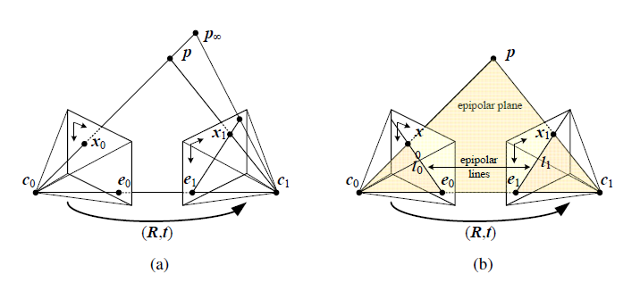
(Faugeras and Luong 2001; Hartley and Zisserman 2004).

Slide 6
11.1.1 Rectification
We can use the epipolar line corresponding to a pixel in one image to constrain the search for corresponding pixels in the other image.
One way to do this is to use a general correspondence algorithm, such as optical flow.
A more efficient algorithm can be obtained by first rectifying (i.e, warping).

Slide 7
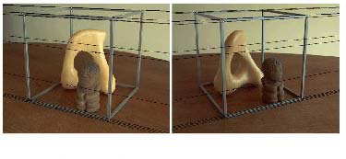
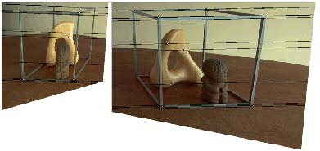
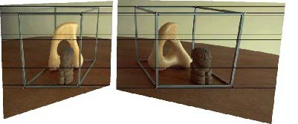
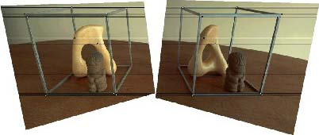
(a) (b)
(c) (d)
(a) Original image pair overlaid with several epipolar lines; (b) images transformed
so that epipolar lines are parallel; (c) images rectified so that epipolar lines are horizontal and in vertial correspondence; (d) final rectification that minimizes horizontal distortions.
(Loop and Zhang 1999; Faugeras and Luong 2001; Hartley and Zisserman 2004).

Slide 8


11.1.1 Rectification (cont’)
The resulting standard rectified geometry is employed in a lot of stereo camera setups and stereo algorithms, and leads to a very simple inverse relationship between 3D depths Z and disparities d,
where f is the focal length (measured in pixels), B is the baseline, and
(Bolles, Baker, and Marimont 1987; Okutomi and Kanade 1993; Scharstein and Szeliski 2002).

Slide 9
11.1.1 Rectification (cont’)
The task of extracting depth from a set of images then becomes one of estimating the disparity map d(x, y).
After rectification, we can easily compare the similarity of pixels at corresponding locations (x, y) and (x₀, y₀) = (x + d, y) and store them in a disparity space image C(x, y, d) for further processing

Slide 10
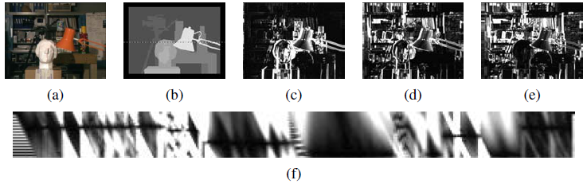
(a) original color image; (b) ground truth disparities; (c–e) three
(x; y) slices for d = 10; 16; 21; (f) an (x; d) slice for y = 151 (the dashed line in (b)).
Bobick and Intille (1999).

Slide 11
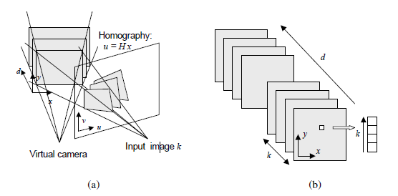
11.1.2 Plane sweep
(Collins 1996; Szeliski and Golland 1999; Saito and Kanade 1999).

Slide 12
11.2 Sparse correspondence
Early stereo matching algorithms were feature-based, i.e., they first extracted a set of potentially matchable image locations, using either interest operators or edge detectors, and then searched for corresponding locations in other images using a patch-based metric.
(Hannah 1974; Marr and Poggio 1979; Mayhew and Frisby 1980; Baker and Binford 1981; Arnold
1983; Grimson 1985; Ohta and Kanade 1985; Bolles, Baker, and Marimont 1987; Matthies,
Kanade, and Szeliski 1989; Hsieh, McKeown, and Perlant 1992; Bolles, Baker, and Hannah
1993).

Slide 13
11.2 Sparse correspondence (cont’)
This limitation to sparse correspondences was partially due to computational resource limitations.
Also driven by a desire to limit the answers produced by stereo algorithms to matches with high certainty.
In some applications, there was also a desire to match scenes with potentially very different illuminations.
(Collins 1996).

Slide 14
11.2.1 3D curves and profiles
Another example of sparse correspondence is the matching of profile curves.
Let us assume that the camera is moving smoothly enough that the local epipolar geometry varies slowly.

Slide 15
(a) (b) (c)
(d) (e) (f) (g)
(a) circular arc fitting in the epipolar plane; (b) synthetic example of an ellipsoid
with a truncated side and elliptic surface markings; (c) partially reconstructed surface
mesh seen from an oblique and top-down view; (d) real-world image sequence of a soda can
on a turntable; (e) extracted edges; (f) partially reconstructed profile curves; (g) partially
reconstructed surface mesh.

Slide 16
11.2.1 3D curves and profiles (cont’)
The first step in the processing pipeline is to extract and link edges in each of the input images.
Next, edgels in successive images are matched using pairwise epipolar geometry.
(Szeliski and Weiss 1998)

Slide 17
11.3 Dense correspondence
While sparse matching algorithms are still occasionally used, most stereo matching algorithms today focus on dense correspondence, since this is required for applications such as image-based rendering or modeling.
This problem is more challenging than sparse correspondence.

Slide 18
11.3 Dense correspondence (cont’)
It is based on the observation that stereo algorithms generally perform some subset of the following four steps:
  1. matching cost computation;
  2. cost (support) aggregation;
  3. disparity computation and optimization; and
  4. disparity refinement.

Slide 19
11.3 Dense correspondence (cont’)
For example, the traditional sum-of-squared differences (SSD) algorithm can be described as:
  1. The matching cost is the squared difference of intensity values at a given disparity.
  2. Aggregation is done by summing the matching cost over square windows with constant disparity.
  3. Disparities are computed by selecting the minimal (winning) aggregated value at each pixel.

Slide 20
11.3 Dense correspondence (cont’)
Local (window-based) algorithms (Section 11.4), where the disparity computation at a given point depends only on intensity values within a finite window.
Usually make implicit smoothness assumptions by aggregating support.

Slide 21
11.3 Dense correspondence (cont’)
Global algorithms, on the other hand, make explicit smoothness assumptions and then solve a global optimization problem (Section 11.5).
Such algorithms typically do not perform an aggregation step, but rather seek a disparity assignment (step 3) that minimizes a global cost function that consists of data (step 1) terms and smoothness terms.

Slide 22
11.3.1 Similarity measures
The first component of any dense stereo matching algorithm is a similarity measure that compares pixel values in order to determine how likely they are to be in correspondence.
We briefly review the similarity measures.

Slide 23
11.3.1 Similarity measures (cont’)
The most common pixel-based matching costs include sums of squared intensity differences (SSD) (Hannah 1974)
Based on the entropy of the pixel values at a particular disparity hypothesis (Zitnick, Kang, Uyttendaele et al. 2004)

Slide 24
11.3.1 Similarity measures (cont’)
Based on binary features such as edges (Baker and Binford 1981; Grimson 1985).
Gradient based measures (Seitz 1989; Scharstein 1994).
The census transform was found by (Hirschm¨uller and Scharstein 2009) .

Slide 25
11.4 Local methods
Local and window-based methods aggregate the matching cost by summing or averaging over a support region in the DSI C(x, y, d).
DSI: Disparity Space Image
Aggregation has been implemented using square windows or Gaussian convolution (traditional).
Shiftable windows (Arnold 1983; Fusiello, Roberto, and Trucco 1997; Bobick and Intille 1999)

Slide 26
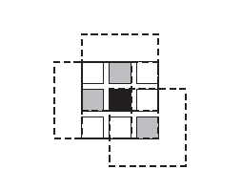
11.4 Local methods (cont’)
Figure 11.8 Shiftable window (Scharstein and Szeliski 2002) c 2002 Springer. The effect
of trying all 3x3 shifted windows around the black pixel is the same as taking the minimum
matching score across all centered (non-shifted) windows in the same neighborhood. (For
clarity, only three of the neighboring shifted windows are shown here.)

Slide 27
11.4 Local methods (cont’)
Windows with adaptive sizes (Okutomi and Kanade 1992; Kanadeand Okutomi 1994; Kang, Szeliski, and Chai 2001; Veksler 2001, 2003).
Results of color-based segmentation (Yoon and Kweon 2006; Tombari, Mattoccia, Di Stefano et al. 2008).

Slide 28
11.4 Local methods (cont’)
(a) (b) (c) (d)
Figure 11.9 Aggregation window sizes and weights adapted to image content (Tombari,
Mattoccia, Di Stefano et al. 2008) c 2008 IEEE: (a) original image with selected evaluation
points; (b) variable windows (Veksler 2003); (c) adaptive weights (Yoon and Kweon 2006);
(d) segmentation-based (Tombari, Mattoccia, and Di Stefano 2007). Notice how the adaptive
weights and segmentation-based techniques adapt their support to similarly colored pixels.

Slide 29
11.4 Local methods (cont’)
Selecting the right window is important, since windows must be large enough to contain sufficient texture and yet small enough so that they do not straddle depth discontinuities.
An alternative method for aggregation is iterative diffusion, i.e., repeatedly adding to each pixel’s cost the weighted values of its neighboring pixels’ costs (Szeliski and Hinton 1985; Shah 1993; Scharstein and Szeliski 1998).

Slide 30
11.4 Local methods (cont’)
In local methods, the emphasis is on the matching cost computation and cost aggregation steps.
Computing the final disparities is trivial: simply choose at each pixel the disparity associated with the minimum cost value.

Slide 31
11.4.1 Sub-pixel estimation and uncertainty
Most stereo correspondence algorithms compute a set of disparity estimates in some discretized space, e.g., for integer disparities.
For applications such as robot navigation or people tracking, these may be perfectly adequate.

Slide 32
11.4.1 Sub-pixel estimation and uncertainty (cont’)
However for image-based rendering, such quantized maps lead to very unappealing view synthesis results.
To remedy this situation, many algorithms apply a sub-pixel refinement stage after the initial discrete correspondence stage.

Slide 33
11.4.1 Sub-pixel estimation and uncertainty (cont’)
Sub-pixel disparity estimates can be computed in a variety of ways, including iterative gradient descent and fitting a curve to the matching costs at discrete disparity levels.
(Ryan, Gray, and Hunt 1980; Lucas and Kanade 1981; Tian and Huhns 1986; Matthies, Kanade, and Szeliski 1989; Kanade and Okutomi 1994).

Slide 34
11.4.1 Sub-pixel estimation and uncertainty (cont’)
Besides sub-pixel computations, there are other ways of post-processing the computed disparities.
Associate confidences with per-pixel depth estimates, i.e., how strong the minimum in the DSI image is at the winning disparity. Matthies, Kanade, and Szeliski (1989)

Slide 35
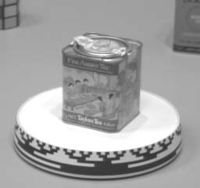
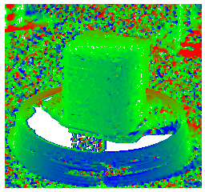
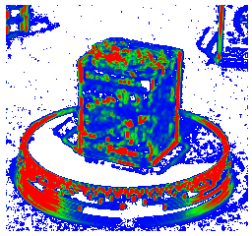
(a) (b) (c)
Figure 11.10 Uncertainty in stereo depth estimation (Szeliski 1991b): (a) input image; (b)
estimated depth map (blue is closer); (c) estimated confidence(red is higher). As you can see,
more textured areas have higher confidence.

Slide 36
11.5 Global optimization
Global stereo matching methods perform some optimization or iteration steps after the disparity computation phase and often skip the aggregation step altogether.
Many global methods are formulated in an energy-minimization framework.

Slide 37
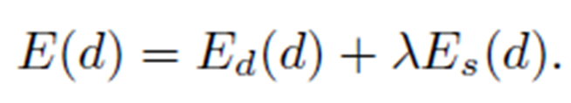

11.5 Global optimization (cont’)
The objective is to find a solution d that minimizes a global energy,
The data term, E_{d}(d), measures how well the disparity function d agrees with the input image pair.
where C is the (initial or aggregated) matching cost DSI.

Slide 38

11.5 Global optimization (cont’)
The smoothness term is often restricted to measuring only the differences between neighboring pixels’ disparities,
where ᵨ is some monotonically increasing function of disparity difference.

Slide 39
11.5 Global optimization (cont’)
Once the global energy has been defined, a variety of algorithms can be used to find a (local) minimum.
Traditional approaches associated with regularization and Markov random fields include continuation (Blake and Zisserman 1987)

Slide 40
11.5 Global optimization (cont’)
While global optimization techniques currently produce the best stereo matching results, there are some alternative approaches worth studying.
  Cooperative algorithms.
  Coarse-to-fine and incremental warping.

Slide 41
11.5 Global optimization (cont’)
Cooperative algorithms.
  Such algorithms iteratively update disparity estimates using non-linear operations that result in an overall behavior similar to global optimization algorithms.
  Coarse-to-fine and incremental warping.
  Here, images are successively warped and disparity estimates incrementally updated until a satisfactory registration is achieved.
(Dev 1974; Marr and Poggio 1976; Marroquin 1983; Szeliski and Hinton 1985; Zitnick and Kanade
2000).
(Quam 1984; Bergen, Anandan, Hanna et al. 1992; Barron, Fleet, and Beauchemin 1994; Szeliski
and Coughlan 1997).

Slide 42
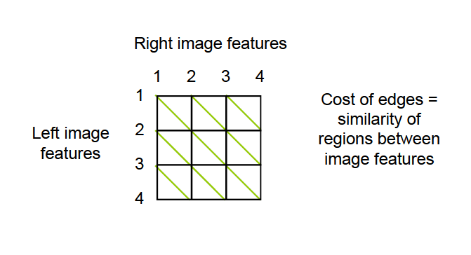
11.5.1 Dynamic programming
Treat feature correspondence as graph problem.

Slide 43
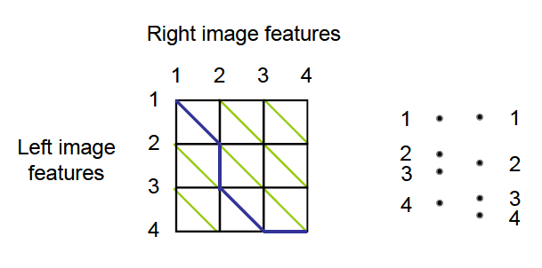
11.5.1 Dynamic programming (cont’)
Find min-cost path through graph.

Slide 44
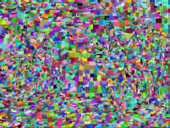
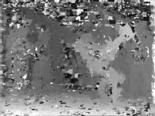
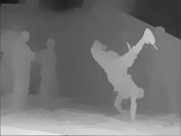
11.5.2 Segmentation-based techniques
(a) (b) (c) (d)
Figure 11.12 Segmentation-based stereo matching (Zitnick, Kang, Uyttendaele et al. 2004)
©
2004 ACM: (a) input color image; (b) color-based segmentation; (c) initial disparity estimates;
(d) final piecewise-smoothed disparities.

Slide 45
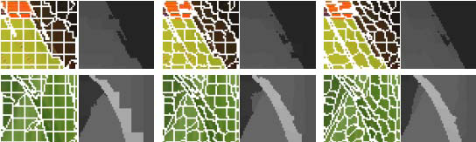
11.5.2 Segmentation-based techniques (cont’)
(a)
Figure 11.13 Stereo matching with adaptive over-segmentation and matting (Taguchi,
Wilburn, and Zitnick 2008) c 2008 IEEE: (a) segment boundaries are refined during the
optimization, leading to more accurate results (e.g., the thin green leaf in the bottom row);

Slide 46
11.6 Multi-view stereo
While matching pairs of images is a useful way of obtaining depth information, matching more images can lead to even better results.
A useful way to visualize the multi-frame stereo estimation problem is to examine the epipolar plane image (EPI) formed by stacking corresponding scanlines from all the images.

Slide 47
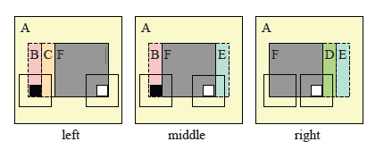
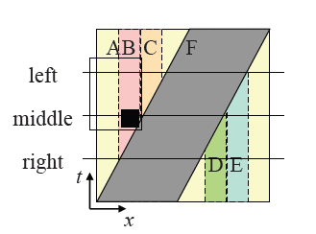
11.6 Multi-view stereo (cont’)

Slide 48
11.6 Multi-view stereo (cont’)
Foreground objects occlude background objects, which can be seen as EPI-strips (Criminisi, Kang, Swaminathan et al. 2005) occluding other strips in the EPI.
If we are given a dense enough set of images, we can find such strips and reason about their relationships in order to both reconstruct the 3D scene and make inferences about translucent objects (Tsin, Kang, and Szeliski 2006) and specular reflections (Swaminathan, Kang, Szeliski et al. 2002; Criminisi, Kang, Swaminathan et al. 2005).

Slide 49
11.6 Multi-view stereo (cont’)
A closely related topic to multi-frame stereo estimation is scene flow.
Multiple cameras are used to capture a dynamic scene.
The task is then to simultaneously recover the 3D shape of the object at every instant in time.

Slide 50
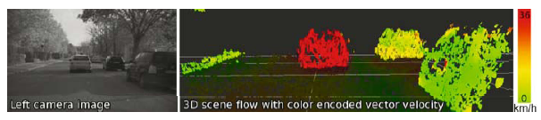
(Vedula, Baker, Rander et al. 2005) c 2005 IEEE.
(Wedel, Rabe, Vaudrey et al. 2008) c 2008 Springer.

Slide 51
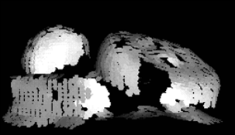
11.6.1 Volumetric and 3D surface reconstruction

Slide 52
11.6.1 Volumetric and 3D surface reconstruction (cont’)
In order to organize and compare all these techniques, Seitz, Curless, Diebel et al. (2006)developed a six-point taxonomy that can help classify algorithms according to the
  scene representation
  photoconsistency measure
  visibility model
  shape priors
  reconstruction algorithm
  initialization requirements
For more details, please consult the full survey paper (Seitz, Curless, Diebel et al. 2006) and the evaluation Web site, http://vision.middlebury.edu/mview/

Slide 53
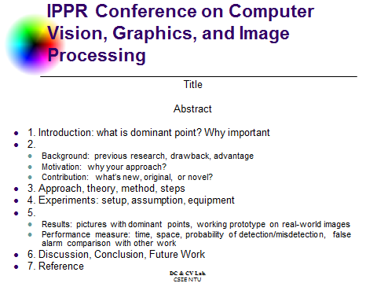
X

