Slide 1
TIOLIDA - Toric IntraOcular Lens Implant Digital Alignment
Presenter: 陳孝寧
Email: r12922162@ntu.edu.tw
Tel: 0972064212

Slide 2
Introduction

Slide 3
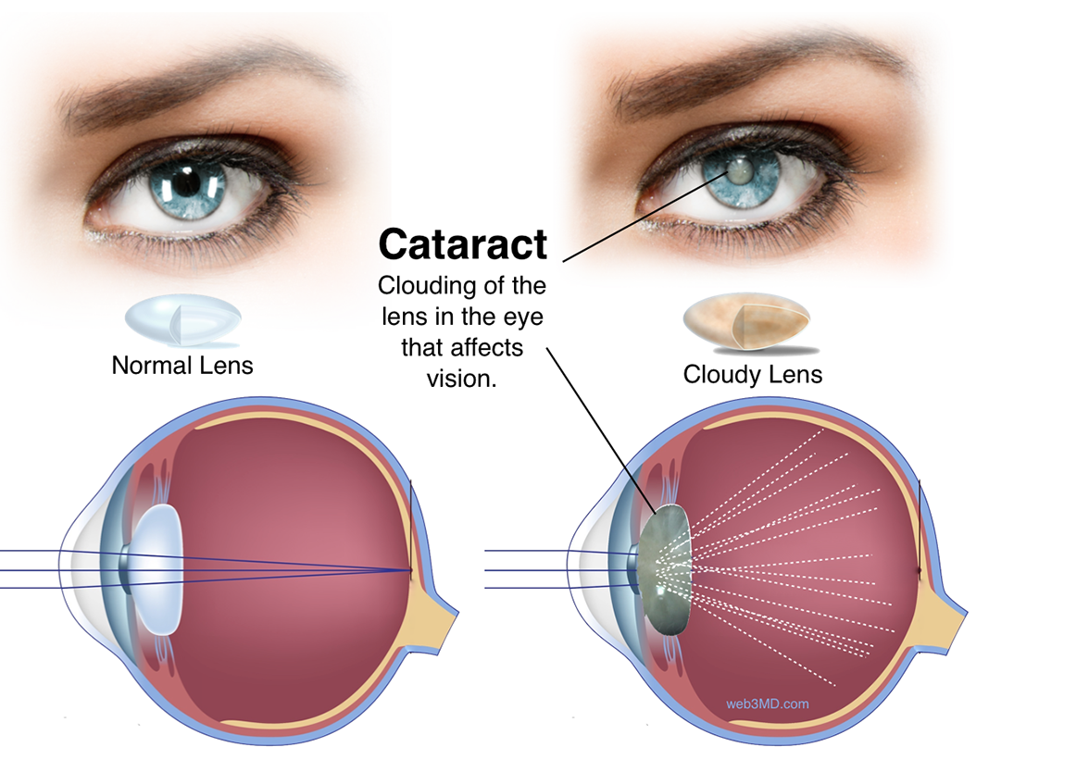
Introduction | Cataract Surgery

Slide 4
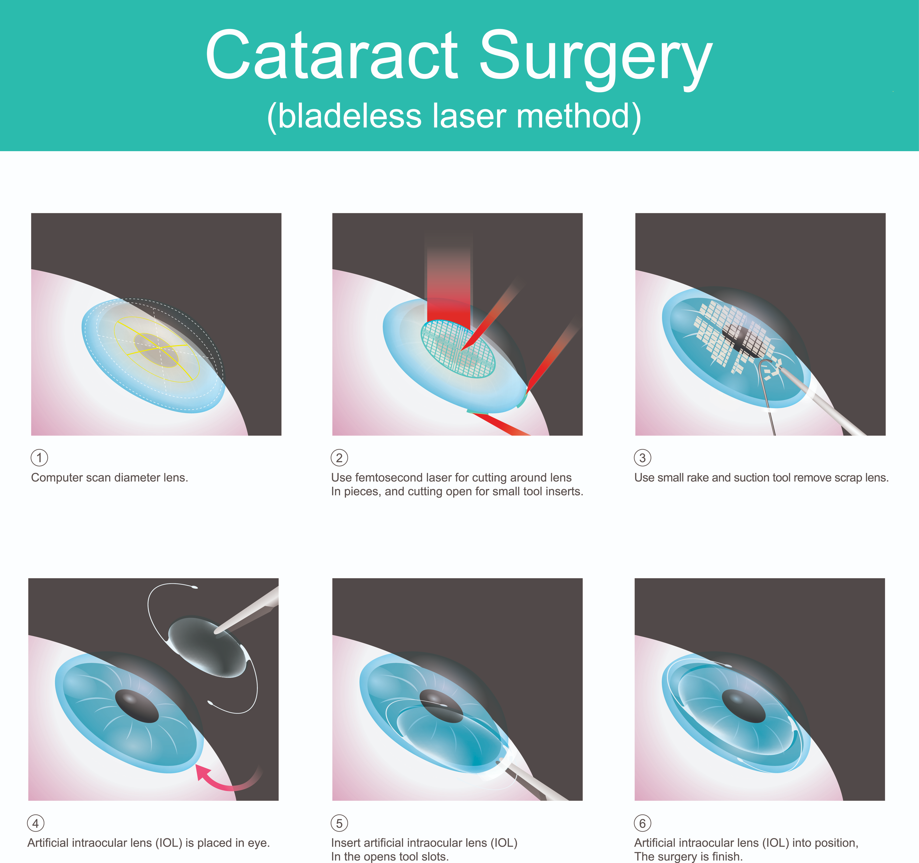
Introduction | Cataract Surgery
Surgery:
Femtosecond Laser-Assisted Cataract Surgery (FLACS): Higher operating cost, more limitations.

Slide 5
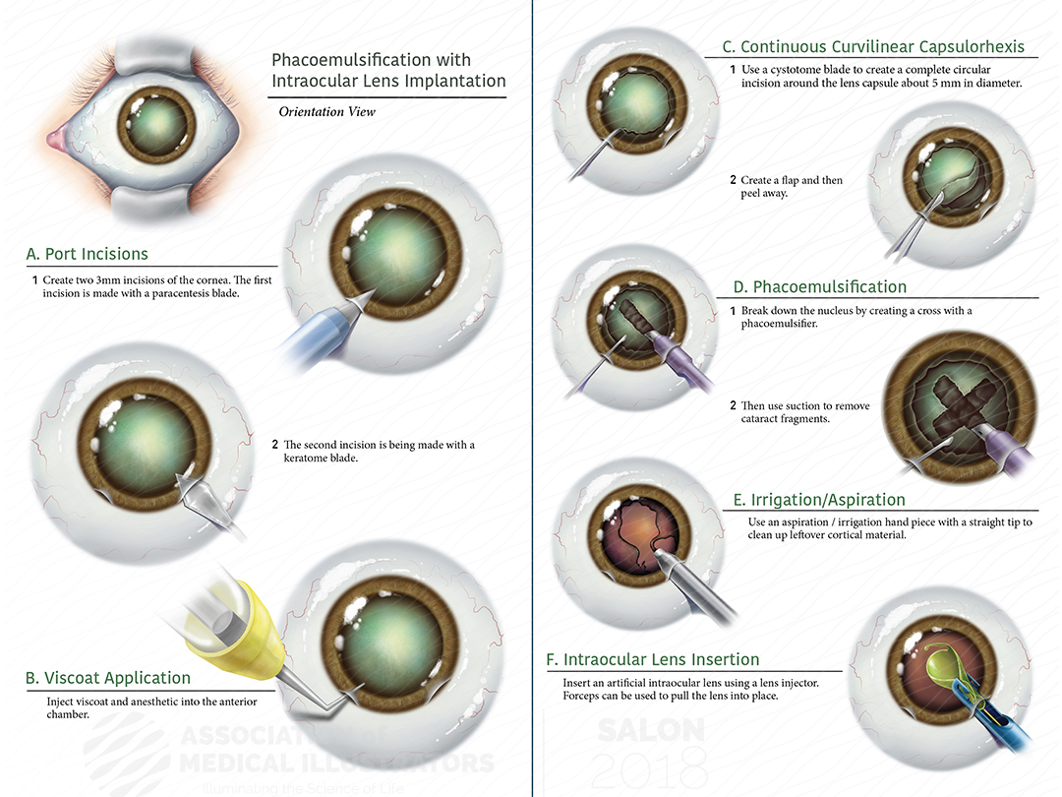
Introduction | Cataract Surgery
Surgery:
By phacoemulsification (超音波乳化晶體摘除手術): Traditional method, lower cost and fewer limitations.

Slide 6
Introduction | Cataract Surgery
Important factor:
During the operation, the size and position of the capsulorhexis (撕囊術) is important for the performance of IOL.
Small capsulorhexis can lead to anterior capsule fibrosis (水晶體前纖維化) and hyperopia shift (遠視偏移).
Large or asymmetric capsulorhexis can cause decentration, as well as subluxation (脫位) and posterior capsule opacification (水晶體後混濁) of IOL.
Accurate toric IOL alignment along the desired corneal meridian is a prerequisite for achieving optimal visual outcome. Approximately, one degree of misalignment reduces the astigmatism correction by 3.3%.

Slide 7
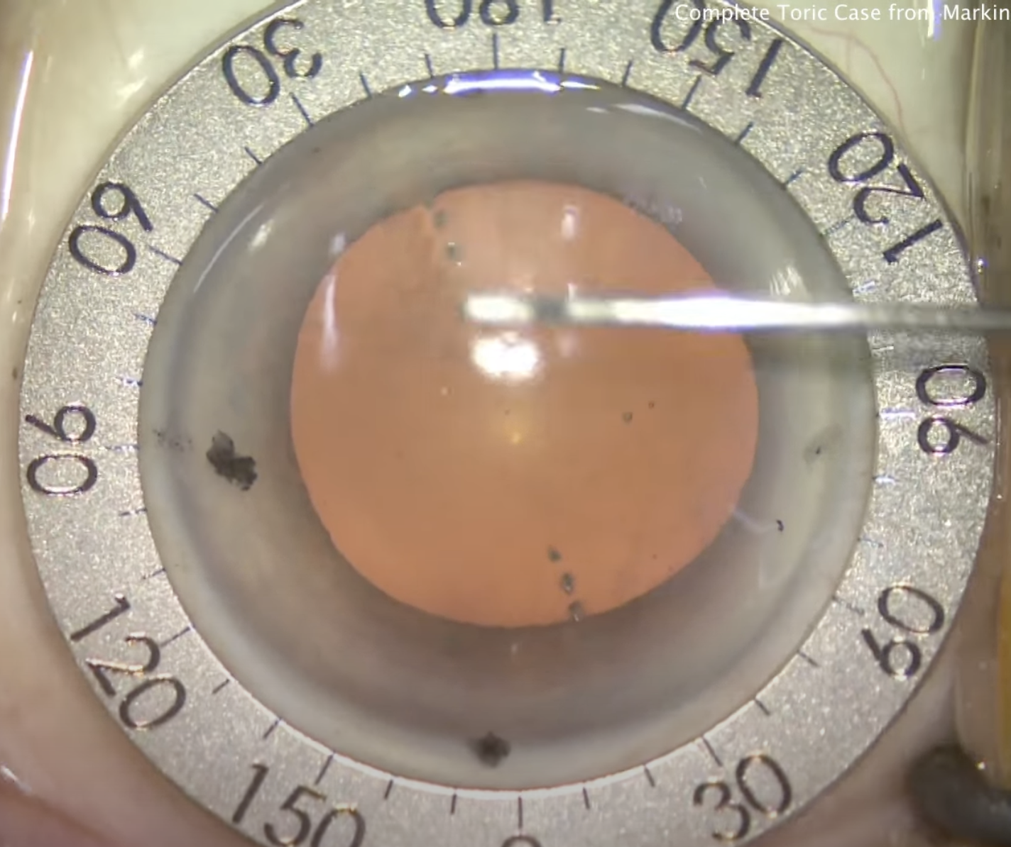
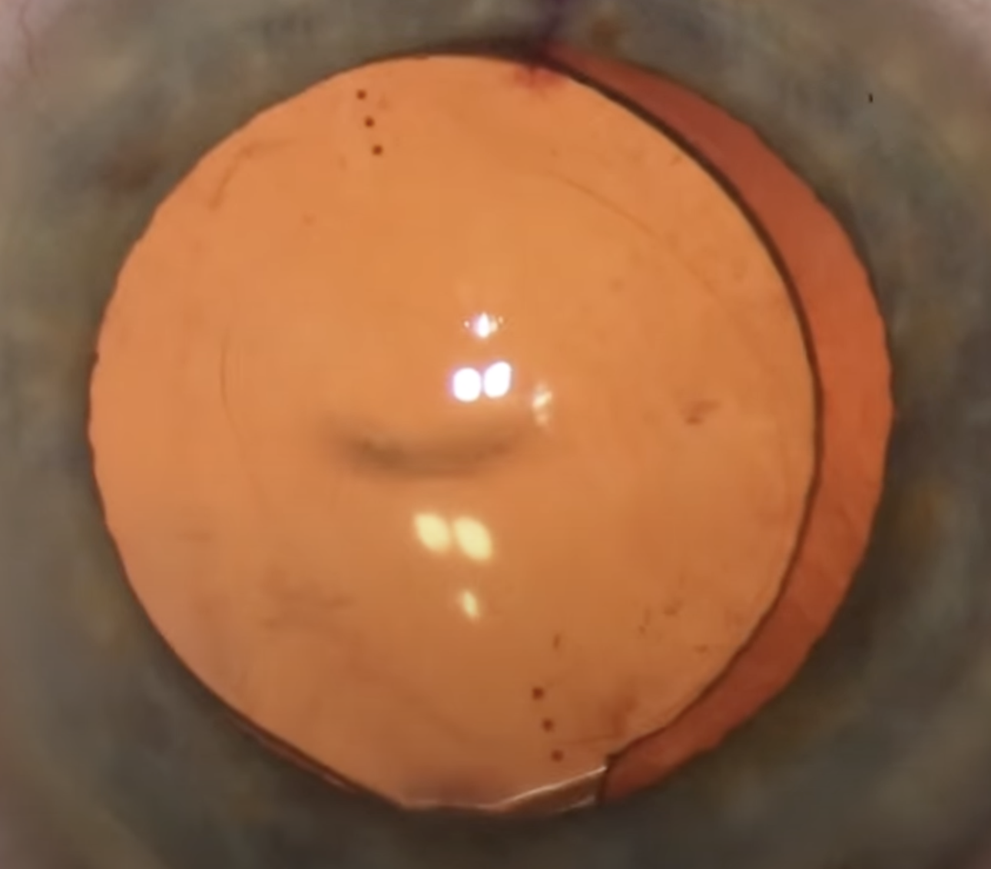
Introduction | Cataract Surgery
Traditional manual marking:
https://www.youtube.com/watch?v=dAzb-wU7mgU
Mark
Mark
Marking Tool
Mark
Mark

Slide 8
Introduction | Cataract Surgery
Drawbacks:
Color of mark may fade or disappear.
Contact marking may cause discomfort and risk of infection.
Accuracy of manual marking highly depends on surgeons.
Therefore computer-assisted IOL alignment is needed.

Slide 9
Our Approach

Slide 10
Experiment | Eye Center Detection

Slide 11
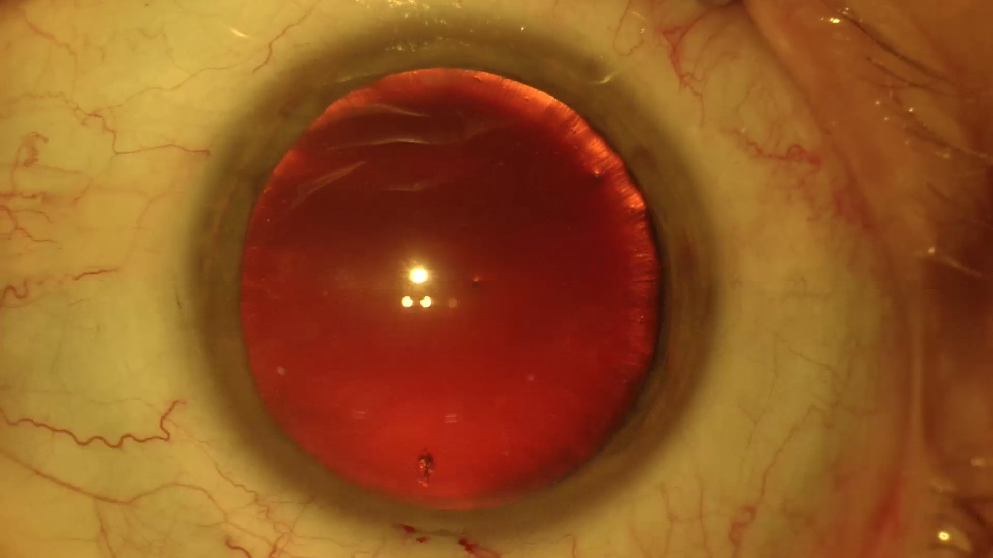
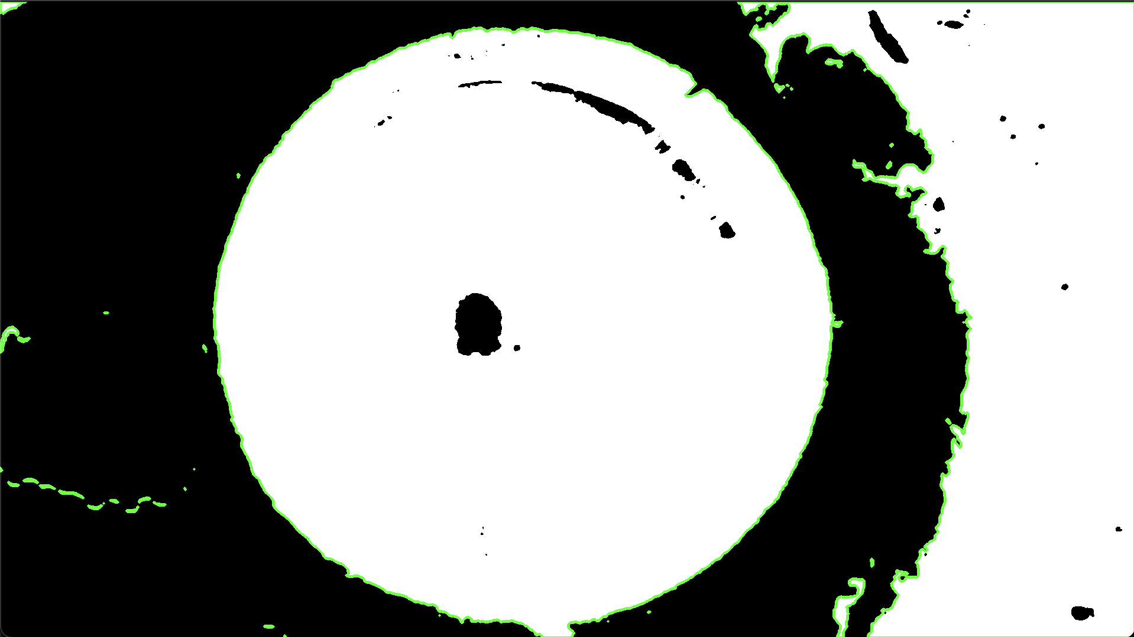
Experiment | Eye Center Detection
Read input image as grayscale image.
Binarize grayscale image by Otsu’s thresholding algorithm.
Input image
Grayscale image
Binarized image

Slide 12
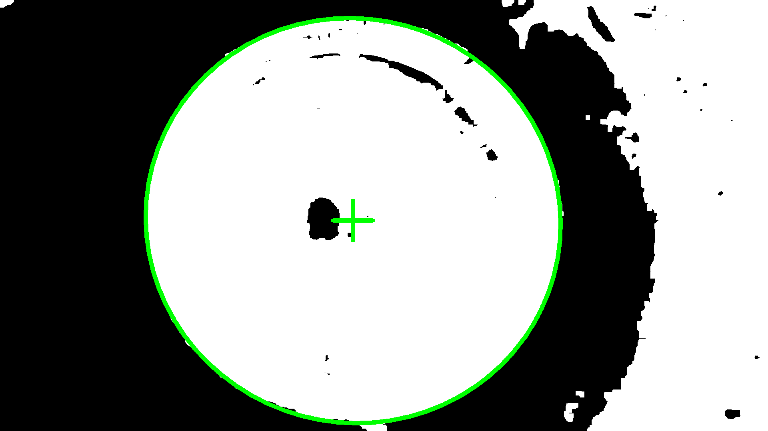
Experiment | Eye Center Detection
Fit Ellipse
Calculate best fit ellipse from filtered contour.
Result:
Works fine when the limbus boundary is complete and clear.
Issue:
When part of the limbus is out of screen, or the limbus is not clear, the calculated ellipse will deform significantly.
OK case
NG case

Slide 13
Experiment | Eye Center Detection
Primary trimming
Trim off the points on the edge of image from contour.
Result:
Effectively remove irrelevant points on contour.
Without trimming
Trimmed and filtered contour

Slide 14
LSQ: Least Square
SVD: Singular Value Decomposition
Experiment | Eye Center Detection
Secondary trimming
Take 1st fit circle as reference, keep the points within a distance range and trim off the rest.
1st trim contour
1st trim circle
1st trim circle

Slide 15
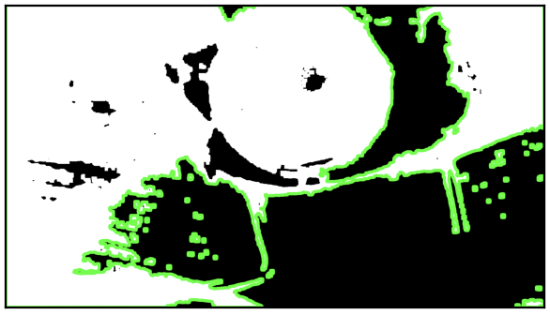
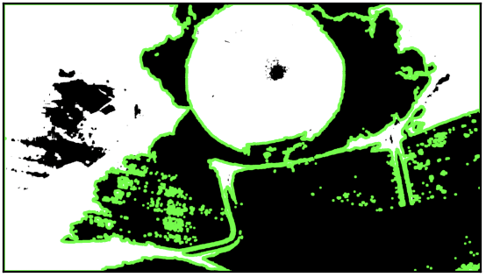
Experiment | Eye Center Detection
Histogram equalization
Apply histogram equalization as preprocessing, to handle low-contrast input image.
Result:
Successfully solved some low-contrast cases.
Without equalization
With equalization

Slide 16
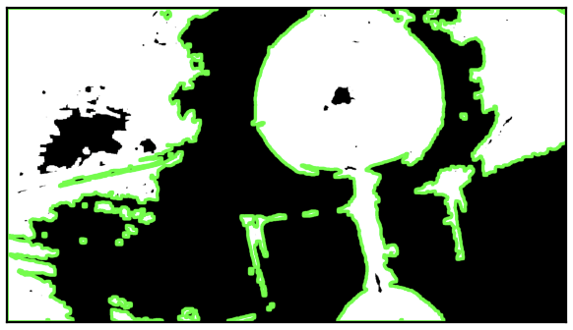
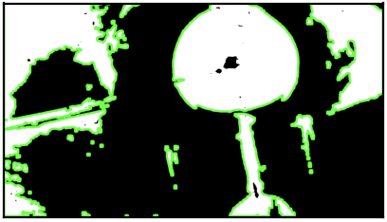
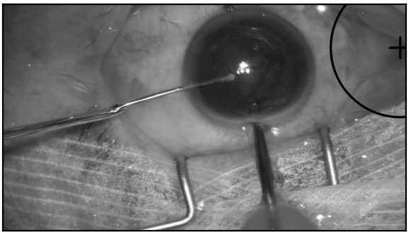
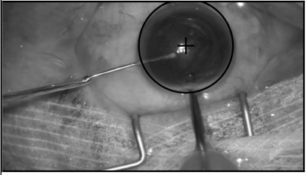
Experiment | Eye Center Detection
Truncate thresholding
Apply truncate thresholding as preprocessing, to handle overexposure input image.
Parameter: thres=135, pixel with intensity higher than threshold will be set to threshold.
Result:
Successfully solved some overexposure cases.
Without truncated thresholding
With truncated thresholding

Slide 17
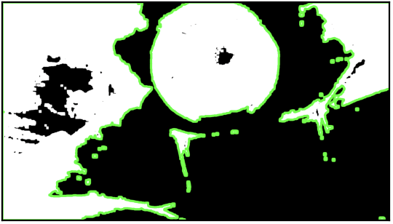
Experiment | Eye Center Detection
Morphological operation - Opening
Apply opening operation on binarized image (with 11x11 pixels kernel), to reduce connection between limbus and tool, vessels, etc.
Result:
Successfully increased limbus edge clarity.
Without opening
With opening

Slide 18
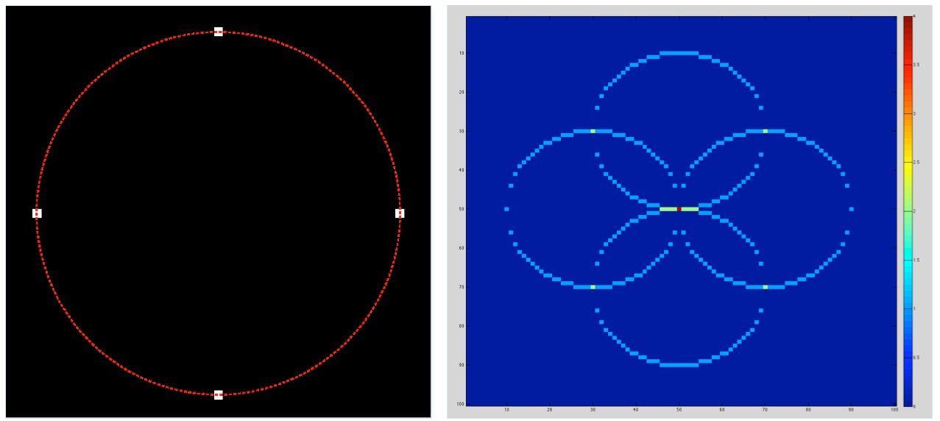
Experiment | Eye Center Detection
Method: Hough circle transform
Select possible circle by voting and selecting local maximum in the Hough parameter space.
Concept illustration of Hough circle transform

Slide 19
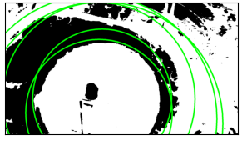
Experiment | Eye Center Detection
Method: Hough circle transform
Select possible circle by voting and selecting local maximum in the Hough parameter space.
Result:
It seems not suitable for this application.
Hough circle transform result

Slide 20
IoU: Intersection over Union
Experiment | Eye Center Detection
Model: U-Net++ with ResNet-101 backbone
Input: RGB images with size 3 channels x128 pixels x128 pixels
Classes:
0: Background
1: Limbus
Dataset:
Training Set: 5,362 video frames
Validation Set: 1,193 video frames
Number of epochs: 32
Loss function: Pixel-wise cross entropy loss.
Augmentation Strategies:
Random horizontal flip, Random vertical flip, Random shift-scale-rotation, Random brightness contrast, Random resized crop, Random Gaussian noise, Random color jitter.
Performance evaluation: IoU score of limbus area.

Slide 21
Experiment | Eye Center Detection
Input size comparison

Slide 22
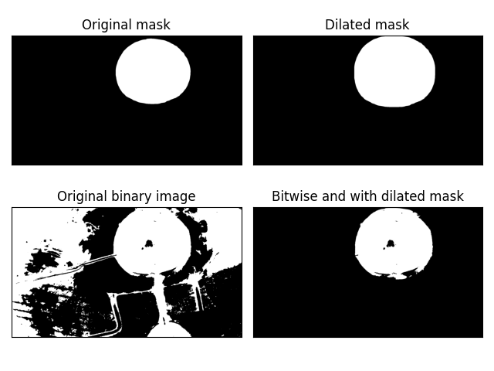
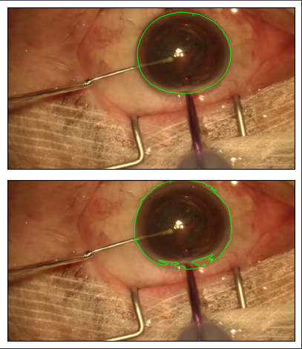
RANSAC: RANdom SAmple Consensus
Experiment | Eye Center Detection
Method 1: Use segmentation result directly to find contours.
Method 2: Use segmentation result as mask, then apply previous method.
Method 3: Use segmentation result as reference, apply distance thresholding on contour points.
Method 4: Use segmentation result as mask, apply previous method + RANSAC circle fit.

Slide 23
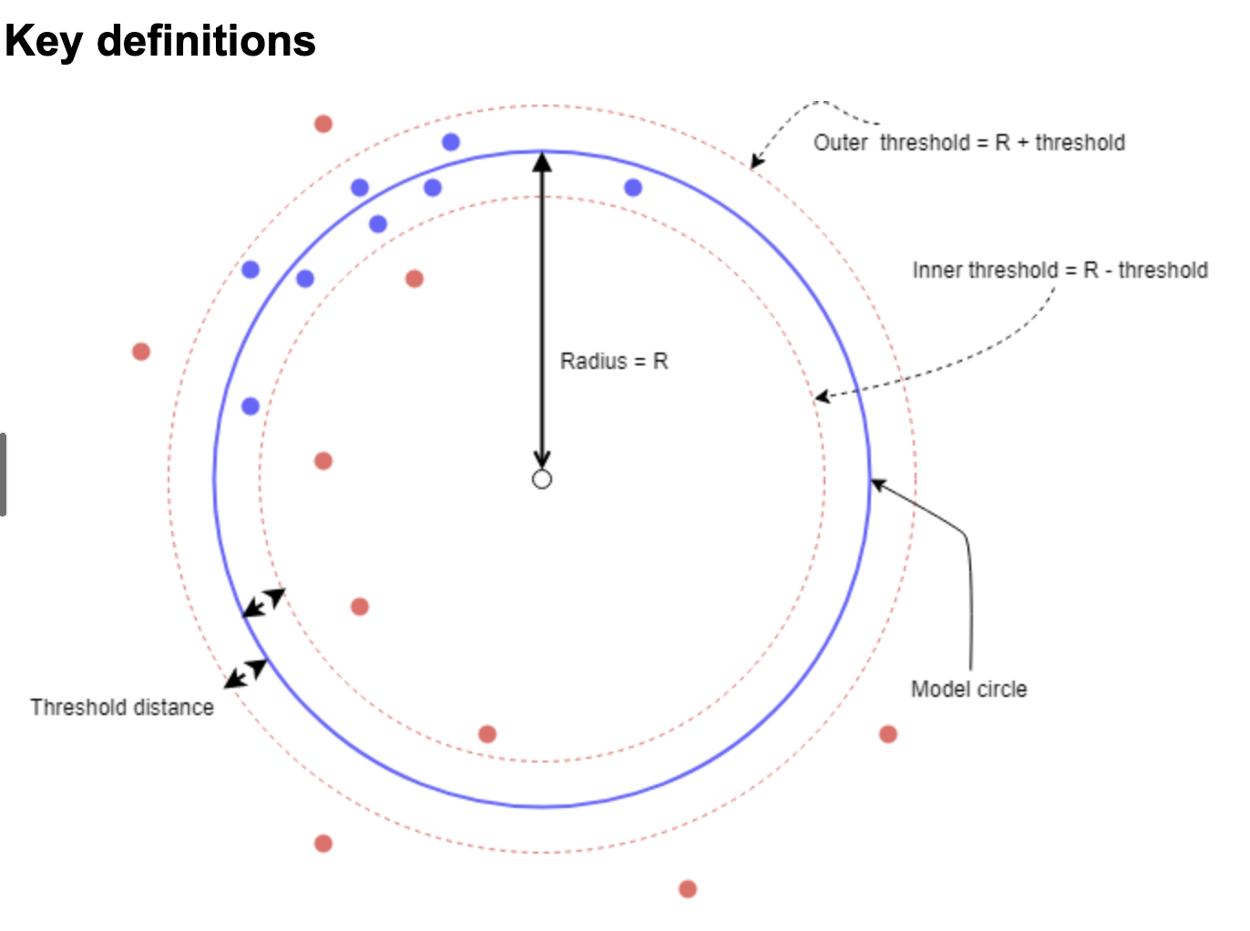
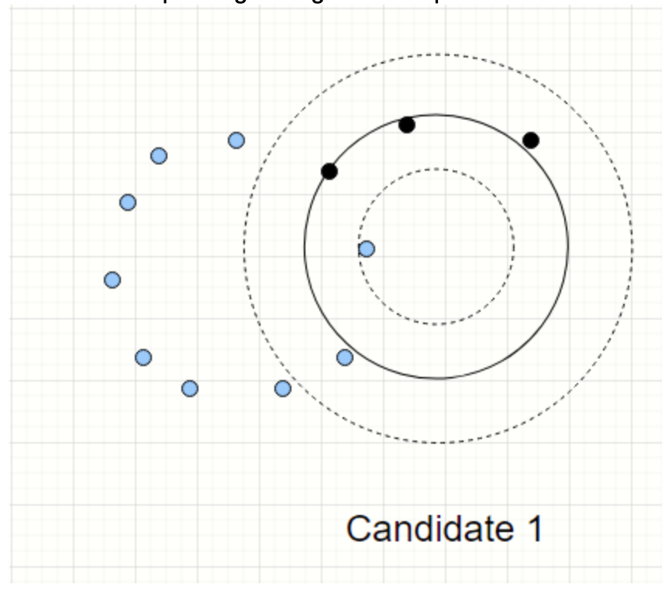
Experiment | Eye Center Detection
RANSAC circle fit:
1. Randomly choose 3 points from contour to form a circle, then count the points within threshold area.
2. Iterate several times and return the best circle.

Slide 24
Experiment | Eye Center Detection
Previous result:
Hough circle

Slide 25
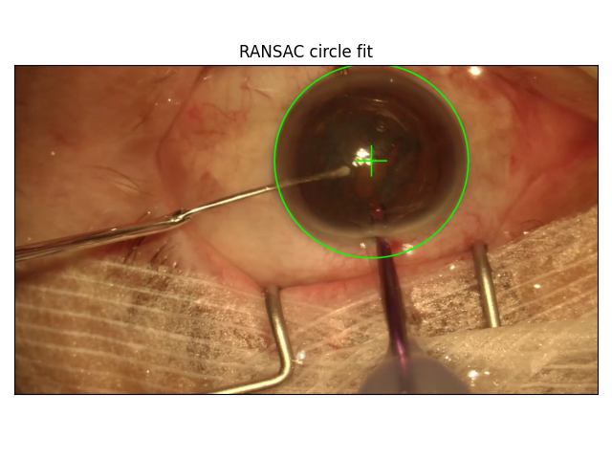
Experiment | Eye Center Detection
Improved result:
Method 1
Method 2
Method 3
Method 4

Slide 26
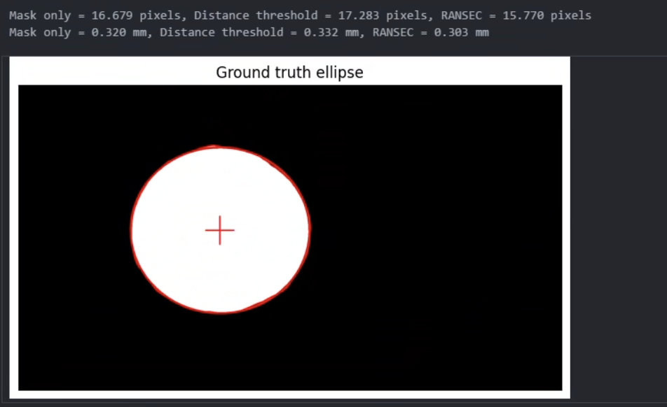
Experiment | Eye Center Detection
Evaluation:
Find contour and fitting ellipse from ground truth image.
Calculate cartesian distance between ellipse center of ground truth and detected circle center of each method.
Convert into mm by average limbus diameter (13.64 mm).

Slide 27
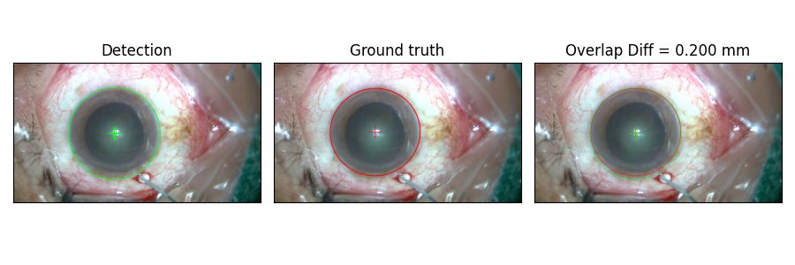
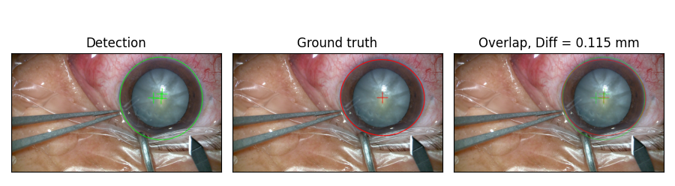
Experiment | Eye Center Detection

Slide 28
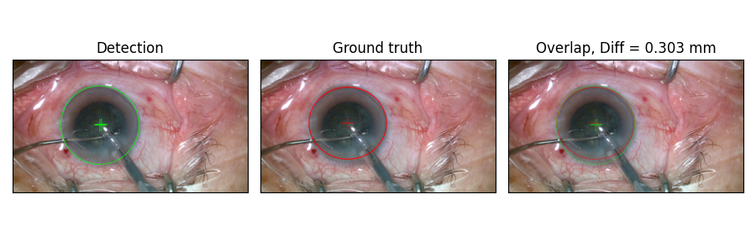
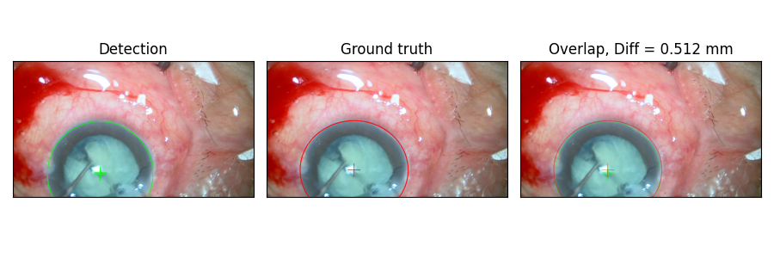
Experiment | Eye Center Detection

Slide 29
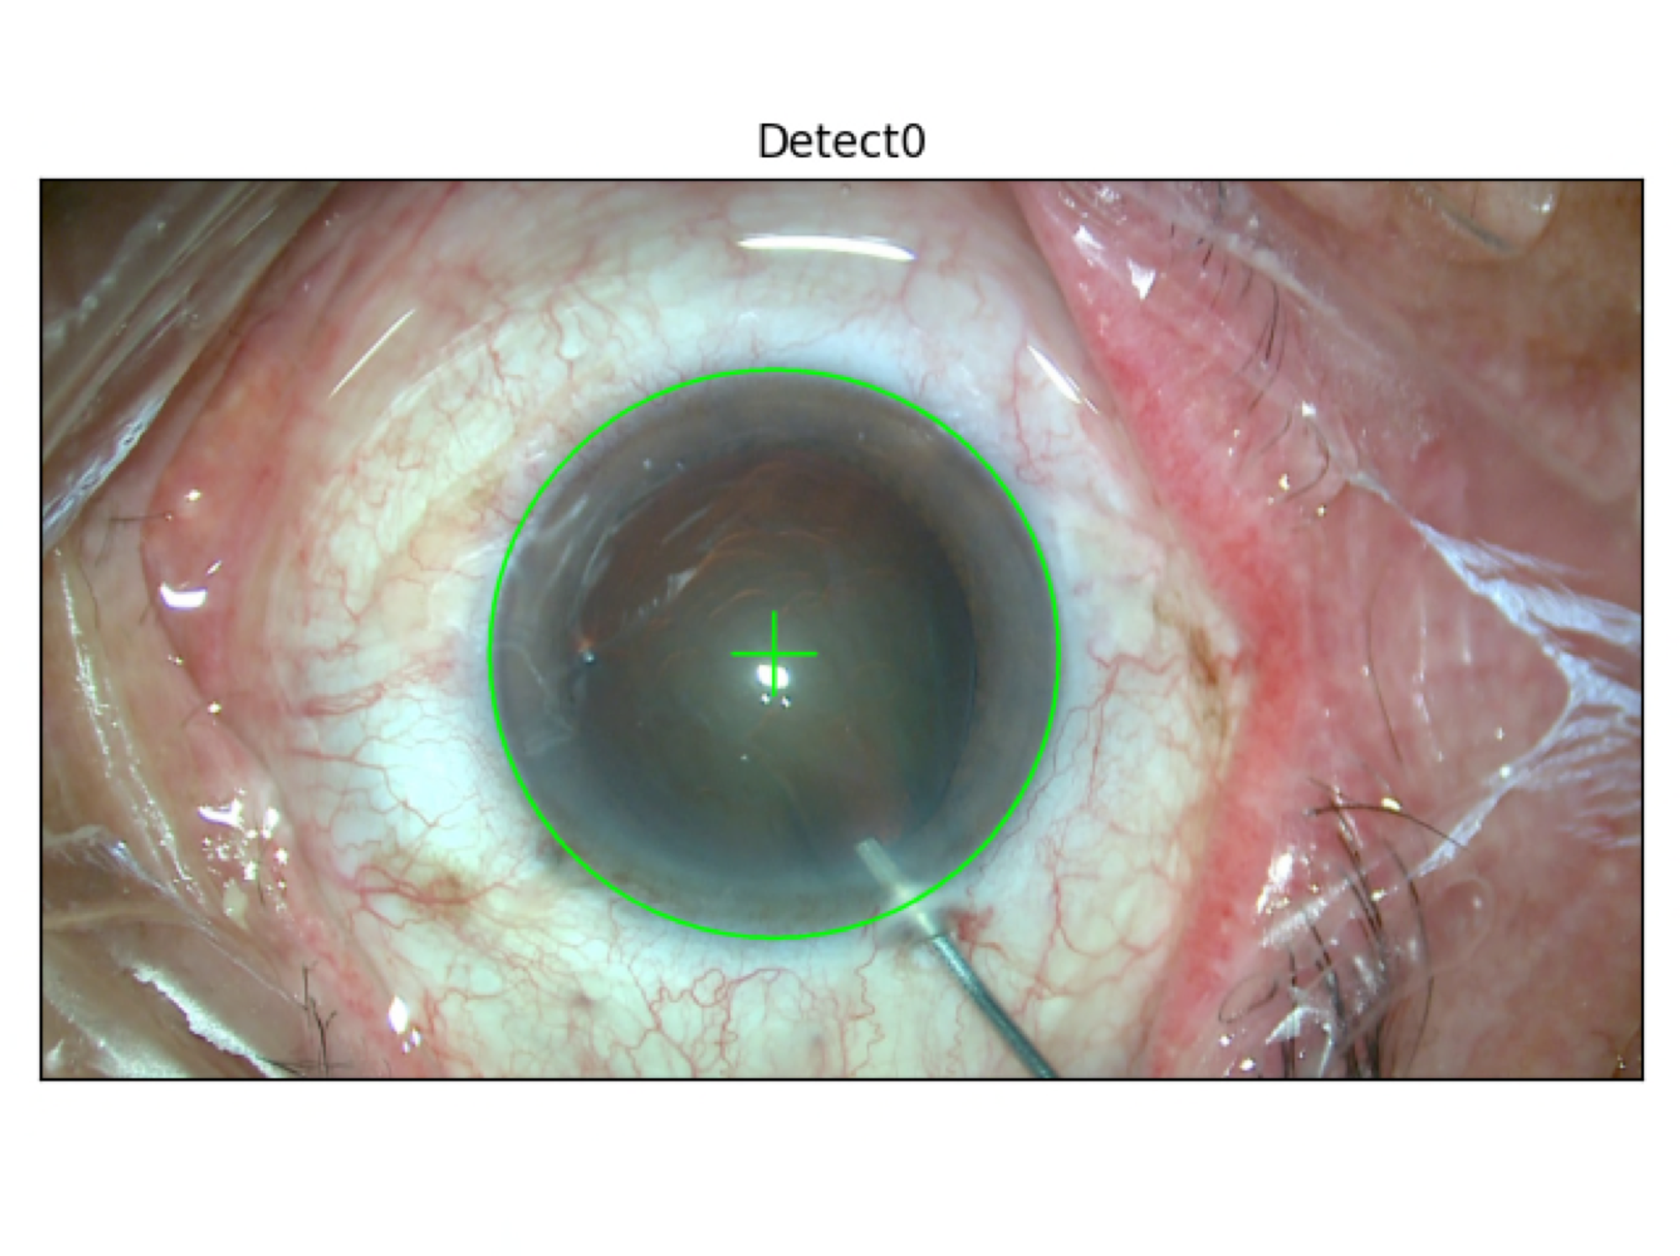
ROI: Region Of Interest
LoFTR: Local Feature TRansformer
Experiment | Rotation Tracking
Method: Apply LoFTR model to find matching pairs on ROI only instead of whole image.
Step: Extract polar area near limbus boundary.
ROI
Extracted ROI (Polar to Cartesian)

Slide 30
ROI: Region Of Interest
LoFTR: Local Feature TRansformer
Experiment | Rotation Tracking
Method: Apply LoFTR model to find matching pairs on ROI only instead of whole image.
Step: Resize width to 1,080 pixels, find all matching pairs by LoFTR model.
This approach excludes irrelevant area and hence improves performance and accuracy.

Slide 31
ROI: Region Of Interest
LoFTR: Local Feature TRansformer
RANSAC: RANdom SAmple Consensus
Experiment | Rotation Tracking
Method: Apply LoFTR model to find matching pairs on ROI only instead of whole image.
Step: Estimate angle difference using RANSAC.
Set average confidence as threshold.
For each pair, if its confidence is above threshold, store its x-axis difference (pixels) into a list.
Apply RANSAC for 200 iterations (tentative), each iteration will pick 10% values from the list, calculate the mean value, then count the number of inlier values.
The mean value with maximum inlier value count is assigned to mean_pixel_diff.
Calculate angle difference by mean_pixel_diff/1,080, the error is expected to be less than 0.33°, 1,080 pixels: image width.

Slide 32
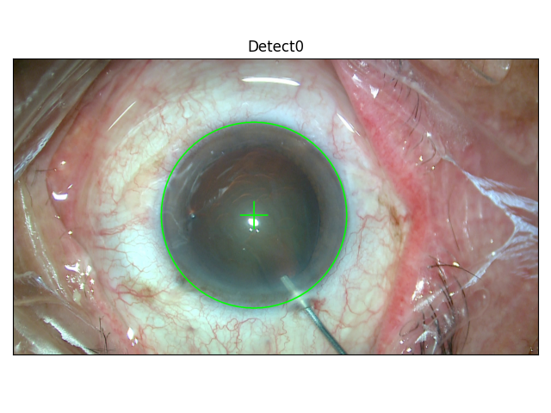
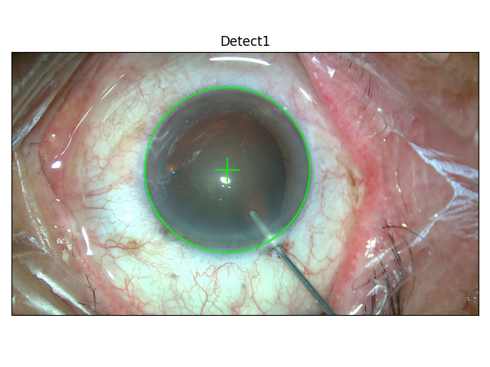
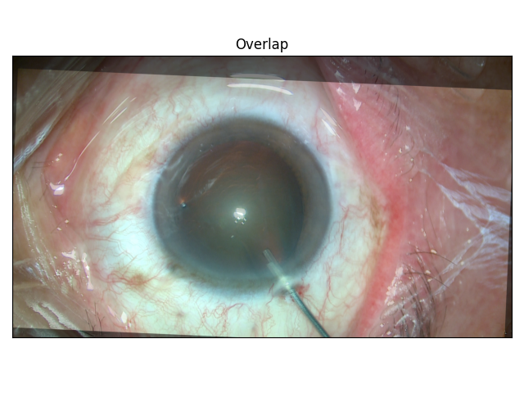
ROI: Region Of Interest
LoFTR: Local Feature TRansformer
Experiment | Rotation Tracking
Method: Apply LoFTR model to find matching pairs on ROI only instead of whole image.
Step: Draw the results and overlapped image.
Difficulty: the rotation of eyeball is not rigid, the deformation in each area is not constant, making it difficult to correctly evaluate the true accuracy of results.

Slide 33
Experiment | Rotation Tracking
Final result image

Slide 34
Summary
Method: Toric intra-ocular lens implant digital alignment.
Steps: Detect limbus center -> Extract ROI around limbus edge -> Calculate rotational displacement -> Display alignment axis in current frame.
Results: Generate accurate alignment axis in surgery image to replace the locating dots in traditional method.

Slide 35
Thanks for listening!

Slide 36
Reference
Y. Zhai et al., "Computer-Aided Intraoperative Toric Intraocular Lens Positioning and Alignment During Cataract Surgery," in IEEE Journal of Biomedical and Health Informatics, vol. 25, no. 10, pp. 3921-3932, Oct. 2021.
S. Chaudhuri, S. Chatterjee, N. Katz, M. Nelson and M. Goldbaum, "Detection of blood vessels in retinal images using two-dimensional matched filters," in IEEE Transactions on Medical Imaging, vol. 8, no. 3, pp. 263-269, Sept. 1989, doi: 10.1109/42.34715.
https://ieee-dataport.org/open-access/cataracts
https://ieee-dataport.org/documents/cataract-surgery-dataset-eye-positioning-and-alignment#files
https://en.wikipedia.org/wiki/Otsu%27s_method
https://docs.opencv.org/4.x/d7/d4d/tutorial_py_thresholding.html
https://blog.csdn.net/hjxu2016/article/details/77833336
https://en.wikipedia.org/wiki/Roundness
https://shengyu7697.github.io/python-opencv-gray-to-rgb/

Slide 37
Reference
https://docs.opencv.org/4.x/d7/d1b/group__imgproc__misc.html#ggaa9e58d2860d4afa658ef70a9b1115576a147222a96556ebc1d948b372bcd7ac59
https://en.wikipedia.org/wiki/Circle_Hough_Transform
https://docs.opencv.org/3.4/d4/d70/tutorial_hough_circle.html
https://pypi.org/project/circle-fit/

