Slide 1
ECG ARTIFACT REMOVAL FROM SINGLE-CHANNEL SURFACE EMG USING FULLY CONVOLUTIONAL NETWORKS
Presenter: Cheng-Lun Hsieh
E-mail: p12922006@ntu.edu.tw
Phone: 0933280509

Slide 2
Outline
Background and motivation
The proposed method
Materials
Results and discussion
Conclusion

Slide 3
Background and Motivation
What is surface electromyography(sEMG)?
  sEMG is a type of biomedical signal which measures the activation potentials of human muscles by attaching electrodes to the skin. It is widely used in many applications such as human-computer interface or clinical usage.
How does electrocardiography(ECG) contamination occur? Why is ECG removal necessary?
  ECG contamination occurs if the measured muscles are closed to the heart. ECG artifacts would cause distortion to sEMG signals and worsen the effectiveness of sEMG applications.
2
Notes:
Trunk muscles: diaphragm and pectoralis (chest)
表面肌電圖（sEMG）是什麼？
sEMG 是一種生物醫學信號，通過將電極附著於皮膚上來測量人類肌肉的活化電位。它廣泛用於許多應用，如人機介面或臨床使用。
心電圖（ECG）污染是如何發生的？為什麼需要移除ECG？
如果測量的肌肉靠近心臟，就會發生心電圖（ECG）污染。心電圖的雜訊會對表面肌電圖（sEMG）信號造成扭曲，並降低sEMG應用的有效性。

Slide 4
Background and Motivation
Many methods have been developed to handle this problem, but they have certain limitations.
    High-pass filters (HP) would eliminate the low-frequency part of sEMG.
    Template subtraction (TS) works effectively when its assumptions are satisfied (ECG is quasi-periodic and sEMG is a zero-mean Gaussian distribution), which is hard in an actual environment.
    Adaptive filter and independent component analysis (ICA) require additional signals for denoising.
Notes:
許多方法已經被開發出來處理這個問題，但它們都有一定的限制。
高通濾波器（HP）會消除表面肌電圖（sEMG）中的低頻部分。
模板減法（TS）只能在條件滿足時才能夠有效地工作，在心電圖中是指近似週期性且 sEMG 是零均值高斯分布，但在實際環境中很難實現。
自適應濾波器和獨立成分分析（ICA）需要額外的信號來降噪。

Slide 5
Background and Motivation
Why neural-network-based method?
  Neural-network-based denoising methods have achieved extraordinary results in many signal types, such as speech and other types of biomedical signals.
  Few studies have explored the feasibility of neural network for ECG artifacts removal in sEMG.
Thus, we propose a novel denoising method to eliminate ECG artifacts from single-channel sEMG by fully convolutional networks (FCN).
Notes:
為什麼選擇基於神經網絡的方法？
基於神經網絡的降噪方法在許多類型的信號中取得了卓越的成果，比如語音和其他類型的生物醫學信號。
只有少數研究探討了使用神經網絡去除表面肌電圖（sEMG）中心電圖（ECG）雜訊的可行性。

Slide 6
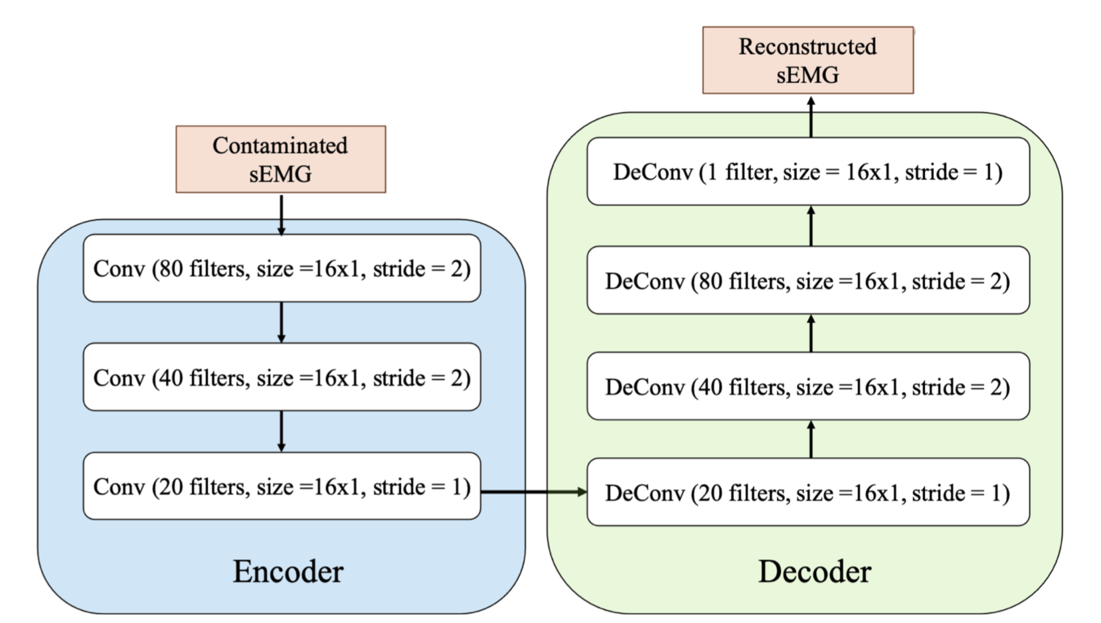
The Proposed Method
d × 1
d × 1
(d/4) × 20
Each layers includes an Exponential Linear Unit (ELU) as the activation function and a batch normalization layer.
No activation function is adopted for the output layer.
Notes:
Denoise autoencoder
All layers are convolutional and deconvolutional layers.
每一層都包括一個指數線性單元（Exponential Linear Unit, ELU）作為激活函數，以及一個批次正規化層。
輸出層則不採用任何激活函數。

Slide 7
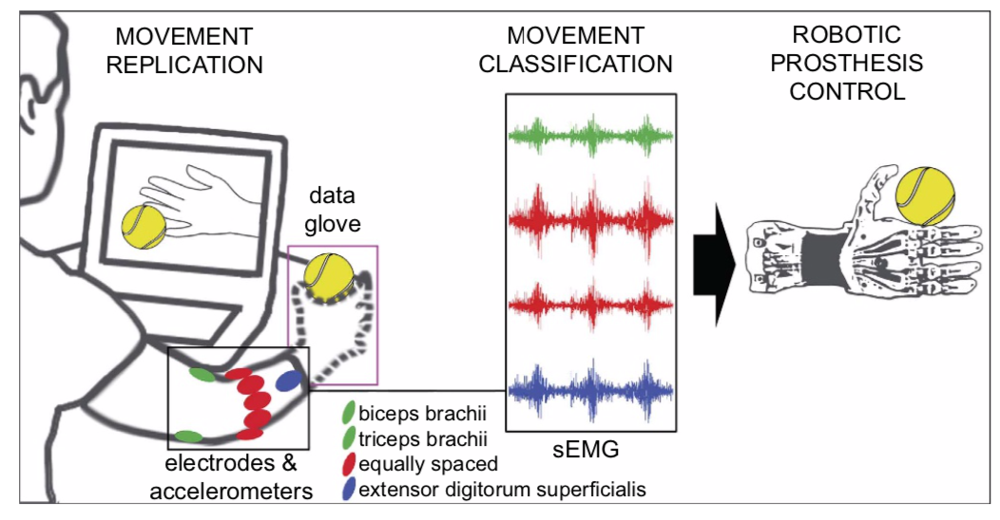
Materials
For clean sEMG data, this study employs the NINAPro database [1]. 12 channels of sEMG were measured by electrodes on the upper arm. This work uses data in DB2, including sEMG from 40 subjects.
For ECG artifacts, this study employs the MIT-BIH NSRD from the Physionet data bank [2]. There are 2 ECG channels collected from 18 healthy individuals.
Fig . Setting of sEMG measurement in NINPro database [1]
Notes:
我們的研究使用了 NINAPro 數據庫裡的乾淨 sEMG 數據。通過在大手臂上的電極測量了12導程的 sEMG。本研究使用的是 DB2 中的數據，包括來自40名受試者的 sEMG 數據。
對於心電圖雜訊，本研究使用了 Physionet 數據庫中的 MIT-BIH NSRD[2]。從18名健康人士收集了2個心電圖通道的數據。

Slide 8
Materials
After preprocessing stage, we add ECG to clean sEMG segments to create clean-noisy data pairs for denoising.
Mismatch conditions were applied between training and testing set.
Notes:
在預處理階段之後，我們將心電圖加入到乾淨的sEMG片段中，以創建用於降噪的乾淨 - 噪聲數據對。
在訓練集和測試集之間應用了不匹配條件。

Slide 9
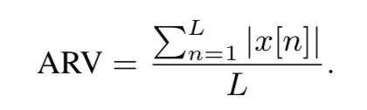
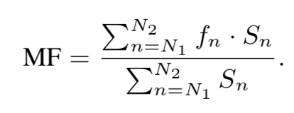
Results
Evaluation criteria
Methods
Signal reconstruction quality
Signal-to-noise-ratio improvement (SNR_{imp})
Root mean square error (RMSE)
FCN
The proposed method
Feature extraction error
RMSE of average rectified value (ARV).
RMSE of mean frequency (MF)
High pass filter (HP)
4th order Butterworth IIR filter with f_{c} = 40
Template subtraction (TS)
Template subtraction + HP
Since we focus on single-channel sEMG, only HP and TS are implemented for comparison.
Notes:
ECG detection
Template extraction
Template subtraction
High pass filter (same as HP)
評價標準

Slide 10
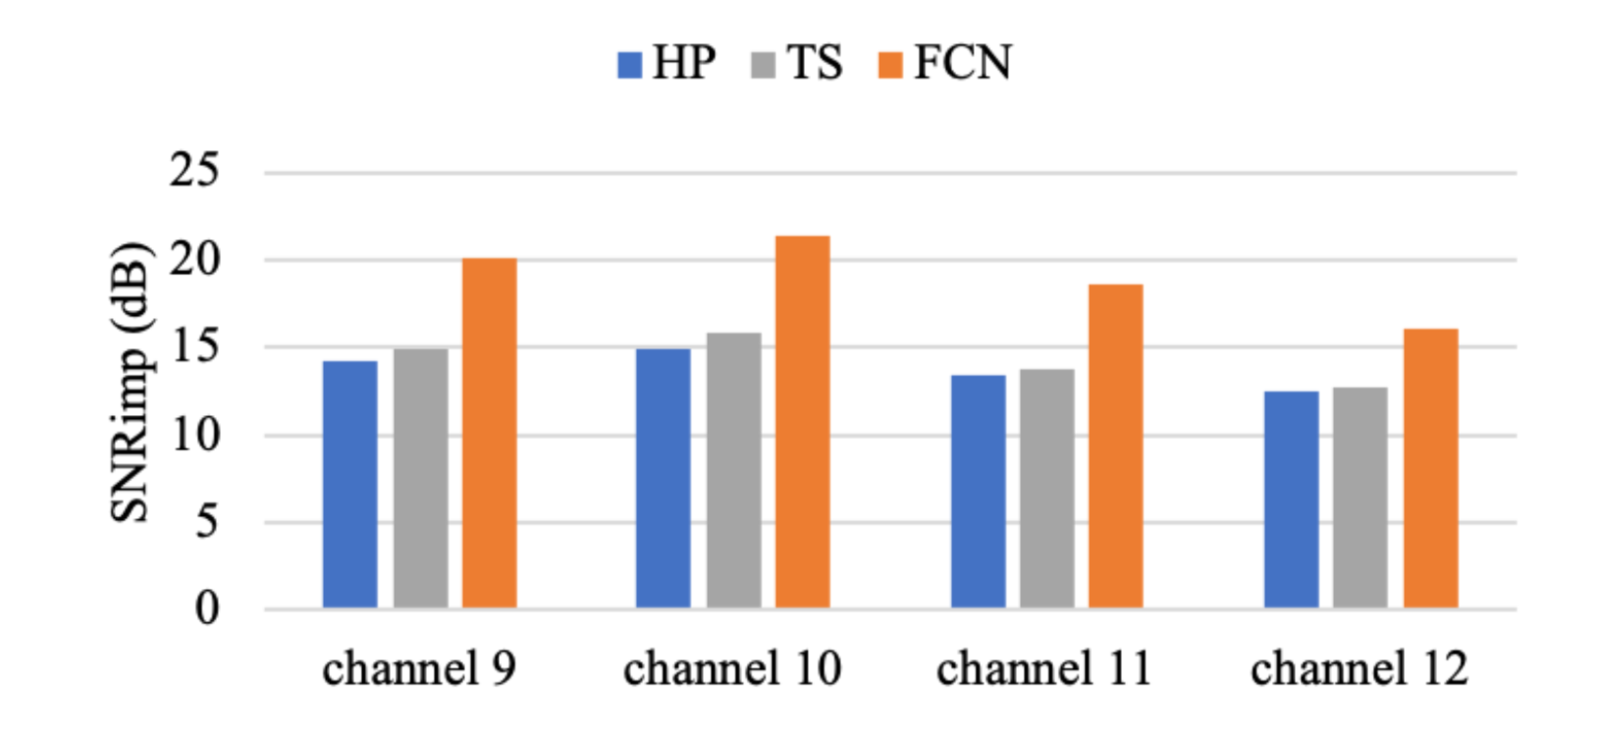
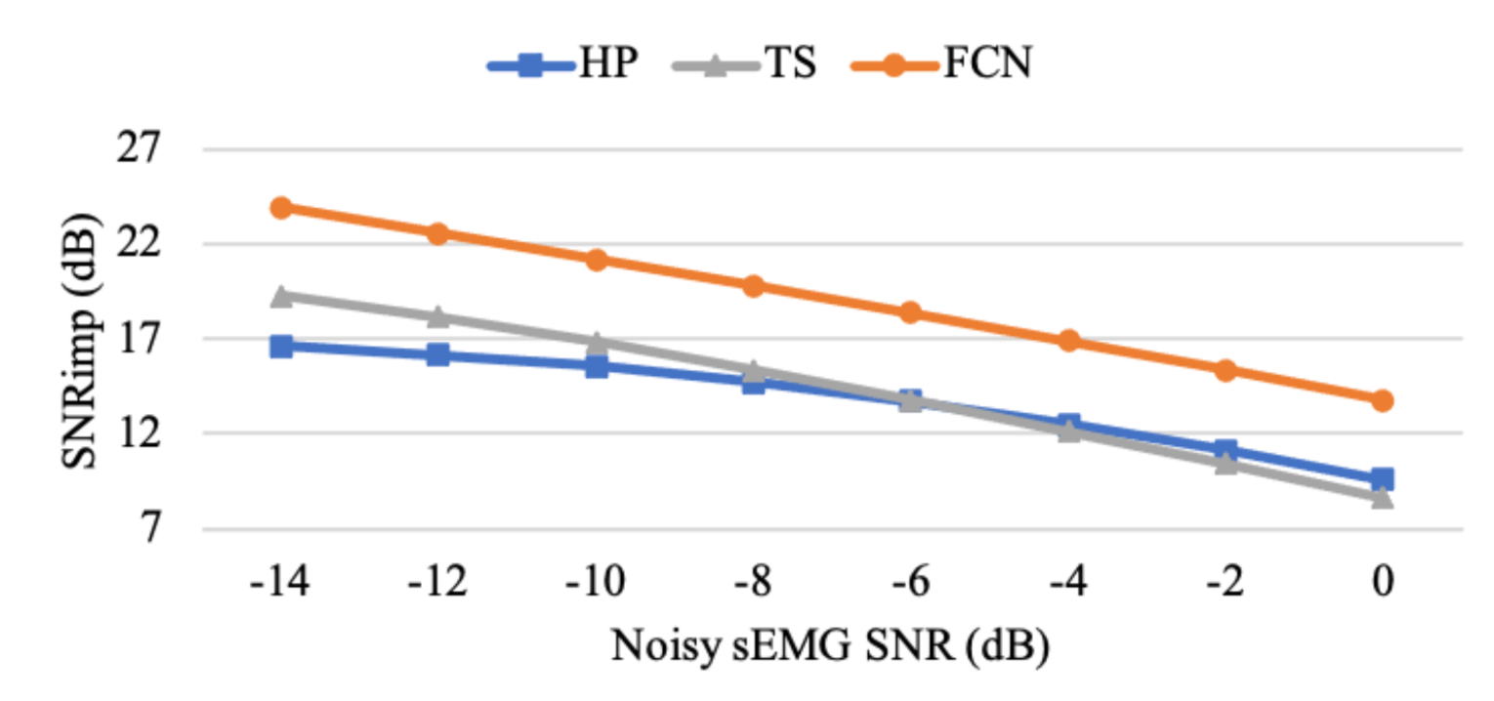
Results
The overall performance of the FCN is better than HP and TS.
FCN outperforms HP and TS under a wide range of SNR input.

Slide 11
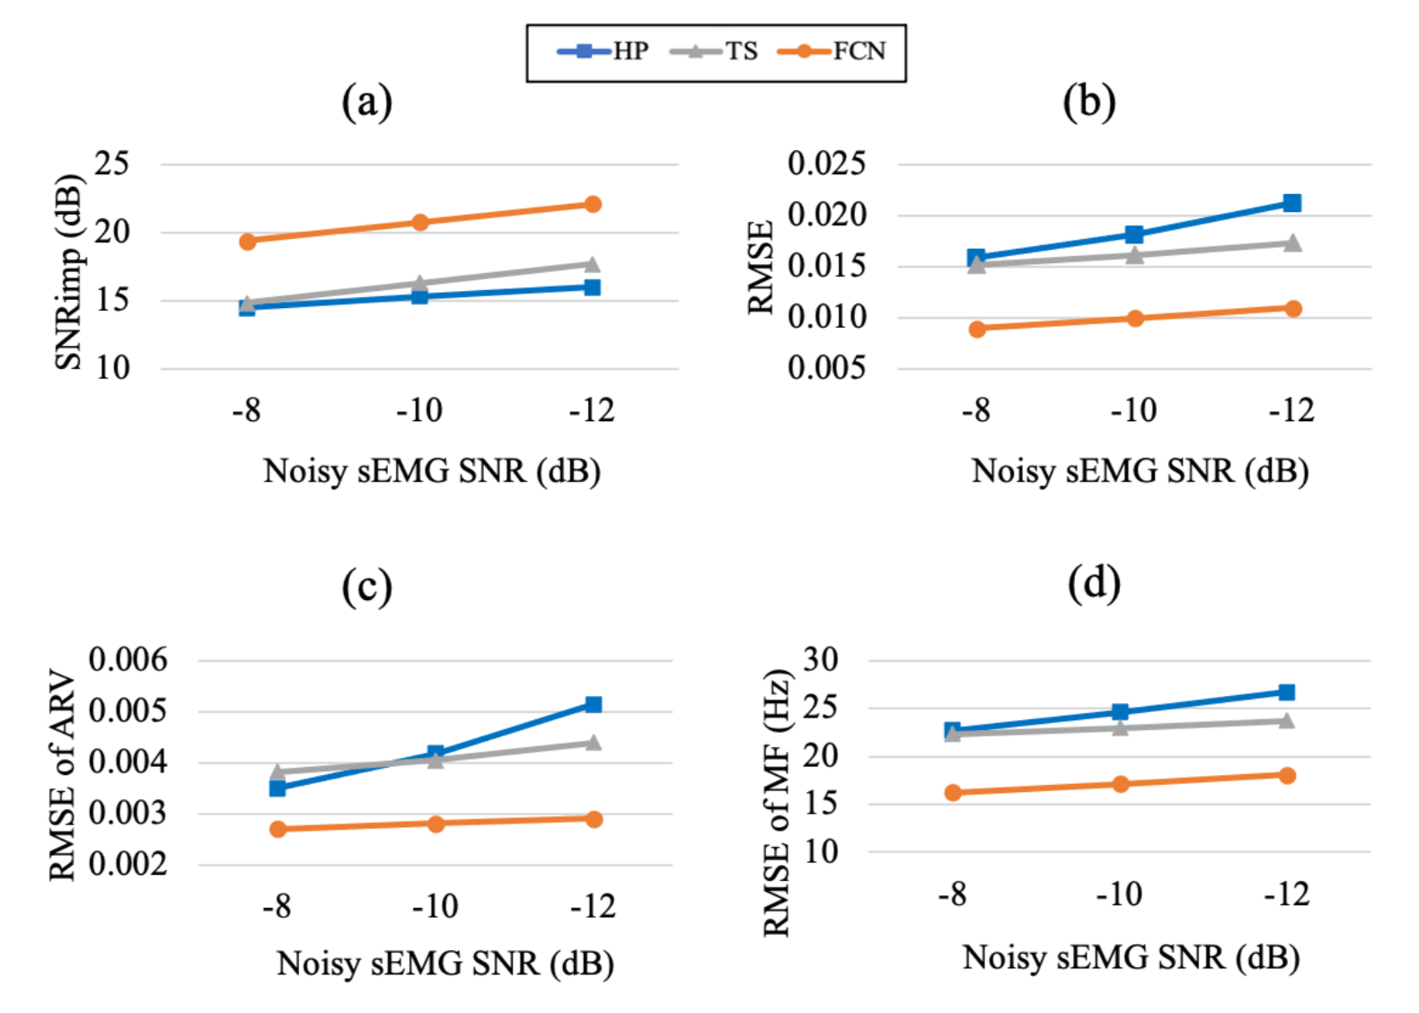
Results
FCN remains the preferred method under the specific condition simulating trunk sEMG with ECG contamination (i.e. SNR_{in} = -10 dB with biceps brachii sEMG from channel 11.)
Notes:
在模擬 sEMG 測量身體軀幹時受到 ECG 污染的特定條件下，FCN 仍然是首選方法

Slide 12
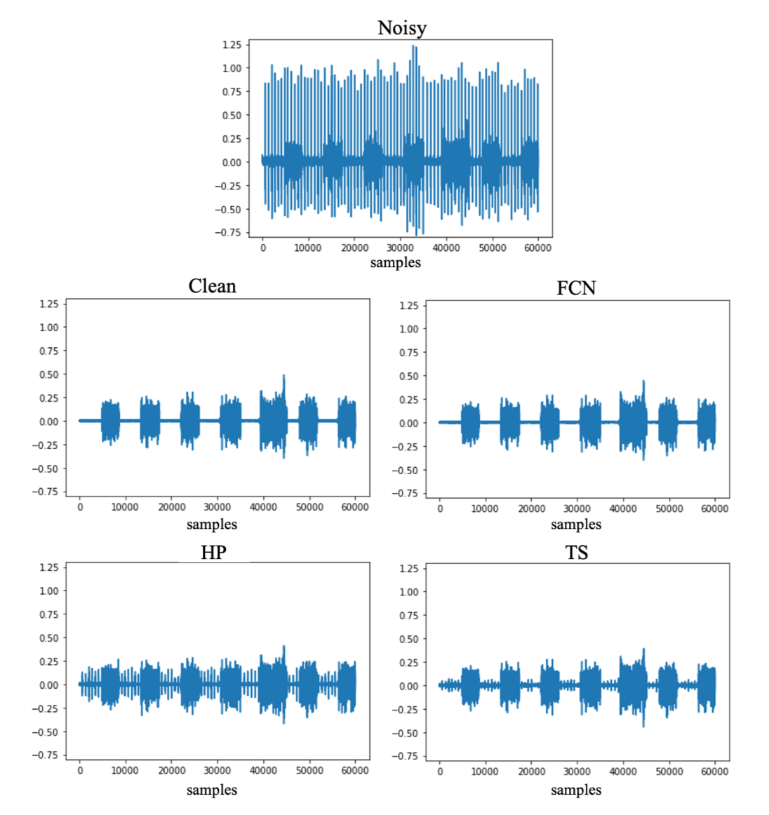
Results
HP: High Pass
TS: Template Subtraction
The noisy, clean and enhanced sEMG waveforms obtained via different ECG removal methods. (sEMG from channel 11, SNR_{in}=-10 dB)

Slide 13
Conclusion
This study proposed an FCN-based denoising method for ECG artifacts removal from single-channel sEMG. To the best of our knowledge, this is the first study applies deep learning to this research topic.
The sEMG denoised by FCN could exhibit a higher average SNR_{imp} than conventional methods (HP and TS), and its optimal performance maintained under a broad range of SNR inputs and a specific scenario which can be used to simulate trunk sEMG with ECG contamination.
Notes:
本研究提出了一種基於 FCN 的降噪方法，用於從單通道 sEMG 中移除心電圖 ECG 雜訊。據我們所知，這是首次將深度學習應用於這一研究主題。
由 FCN 降噪處理過的 sEMG 相較於傳統方法（高通濾波器 HP 和模板減法 TS）能夠展示出更高的平均信噪比改善，並且在廣泛的信噪比輸入範圍以及特定情境下保持最佳性能，這種情境可用於模擬帶有心電圖 ECG 污染的軀幹 sEMG。

Slide 14
Test
Method: Remove ECG artifacts from single-channel sEMG based on FCN denoising method.
Steps: Input Contaminated sEMG signal => FCN => Output reconstructed sEMG.
Results: Make the reconstructed sEMG to have very low ECG artifacts.

Slide 15
Reference
Manfredo Atzori, et al., “Electromyography data for non-invasive naturally-controlled robotic hand prostheses,” Scientific data, vol. 1, no. 1, pp. 1–13, 2014.
Ary L Goldberger, et al., “Physiobank, physiotoolkit, and physionet: components of a new research resource for complex physiologic signals,” circulation, vol. 101, no. 23, pp. e215–e220, 2000.

