Slide 1
Chapter 4
Model fitting and optimization
Advanced Computer Vision
Computer Vision:
Algorithms and Applications
Presented by: 傅楸善 & 陳孝寧
E-mail: r12922162@ntu.edu.tw
手機: 0972064212
授課教授：傅楸善 博士

Slide 2
Outline
  4.1 Scattered data interpolation
  4.2 Variational methods and regularization
  4.3 Markov random fields

Slide 3
  4.1 Scattered data interpolation
  4.1.1 Radial basis functions
  4.1.2 Overfitting and underfitting
  4.1.3 Robust data fitting

Slide 4
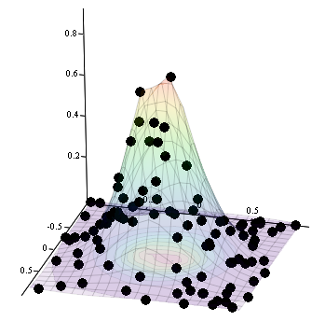
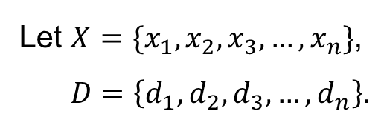

  4.1.0 Scattered data interpolation
Let $X=\{x_{1},x_{2},x_{3},…,x_{n}\}$,
$D=\left\{d_{1},d_{2},d_{3},…,d_{n}\right\}.$
Produce a function $f$, such that$f(x_{k})=d_{k}$
Example of scattered data interpolation

Slide 5
  4.1.0 Scattered data interpolation
It requires the function to pass through data point.
The data points are irregularly placed throughout the domain.
Example of scattered data interpolation

Slide 6
  4.1.0 Scattered data interpolation
Common methods:
Triangulation & interpolation
Pull-push algorithms

Slide 7
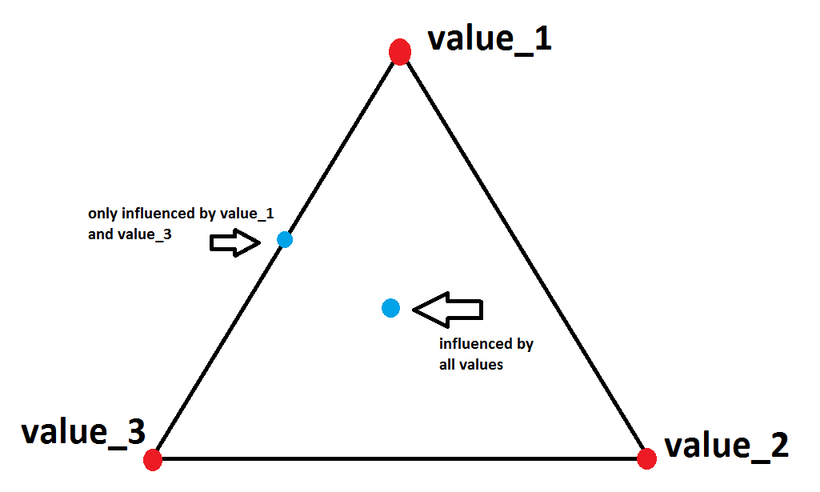
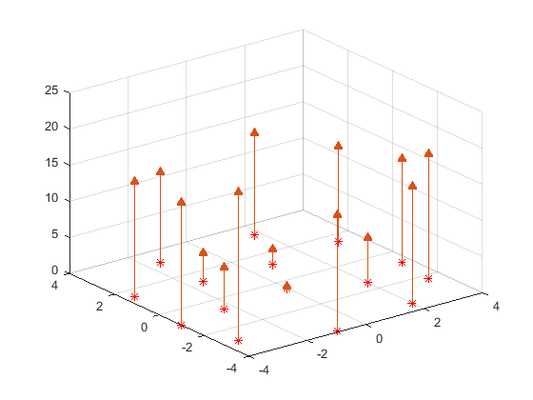
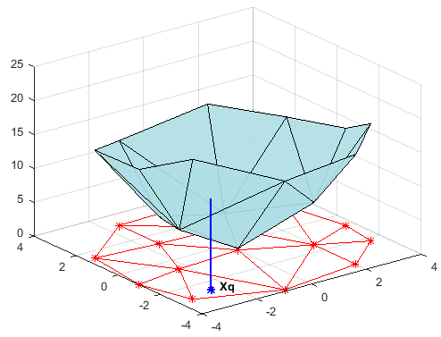
  4.1.0 Scattered data interpolation
Triangulation & interpolation
Scattered data
Triangulation
Interpolation

Slide 8
  4.1.0 Scattered data interpolation
Triangulation & interpolation
Triangulation: Division into triangles.
A good triangulation should avoid producing long skew triangles.
Scattered data
Triangulation
Notes:
Delaunay Triangulation: https://www.youtube.com/watch?v=GctAunEuHt4

Slide 9
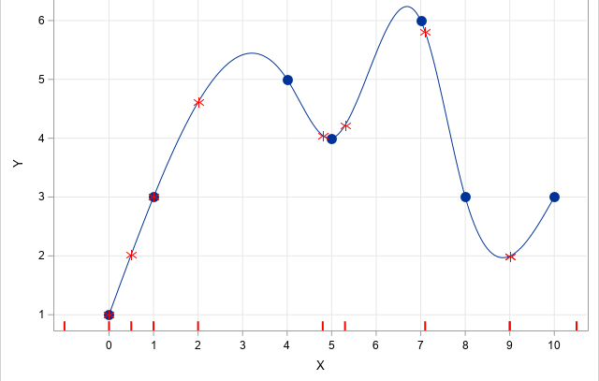
  4.1.0 Scattered data interpolation
Triangulation & interpolation
Barycentric coordinates are usually used to do interpolation.
If a smoother surface is desired, we can use higher-order splines.
Interpolation
Cubic splines interpolation
Notes:
https://davidhsu666.com/archives/barycentric-coordinates/

Slide 10
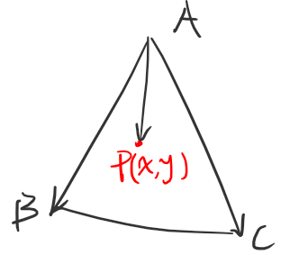


  4.1.0 Scattered data interpolation
Triangulation & interpolation
$$\vec{AP}=u\vec{AB}+v\vec{AC}$$
$$⇒P−A=u\left(B−A\right)+v(C−A)$$
$$⇒P\left(x, y\right)=\left(1−u−v\right)A+uB+vC, 0≤u,v≤1$$
$$⇒P\left(x, y\right)=αA+βB+γC, α+β+γ=1$$
Notes:
Barycentric https://davidhsu666.com/archives/barycentric-coordinates/

Slide 11
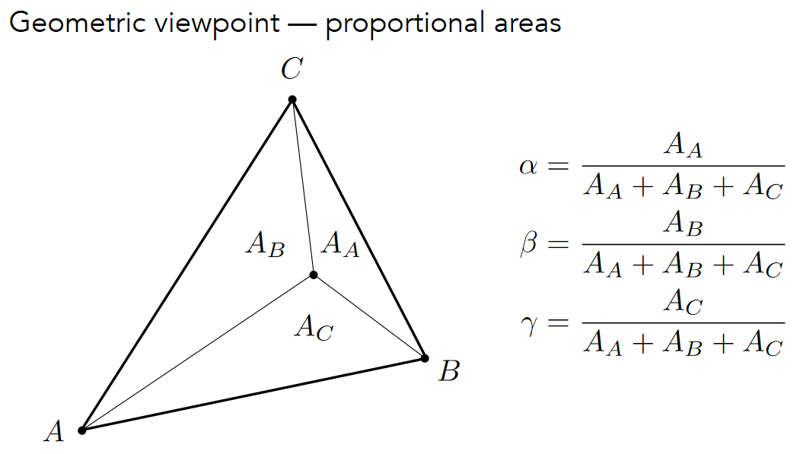
  4.1.0 Scattered data interpolation
Triangulation & interpolation
Notes:
Barycentric https://davidhsu666.com/archives/barycentric-coordinates/

Slide 12
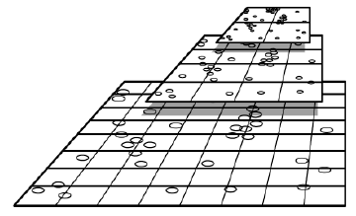
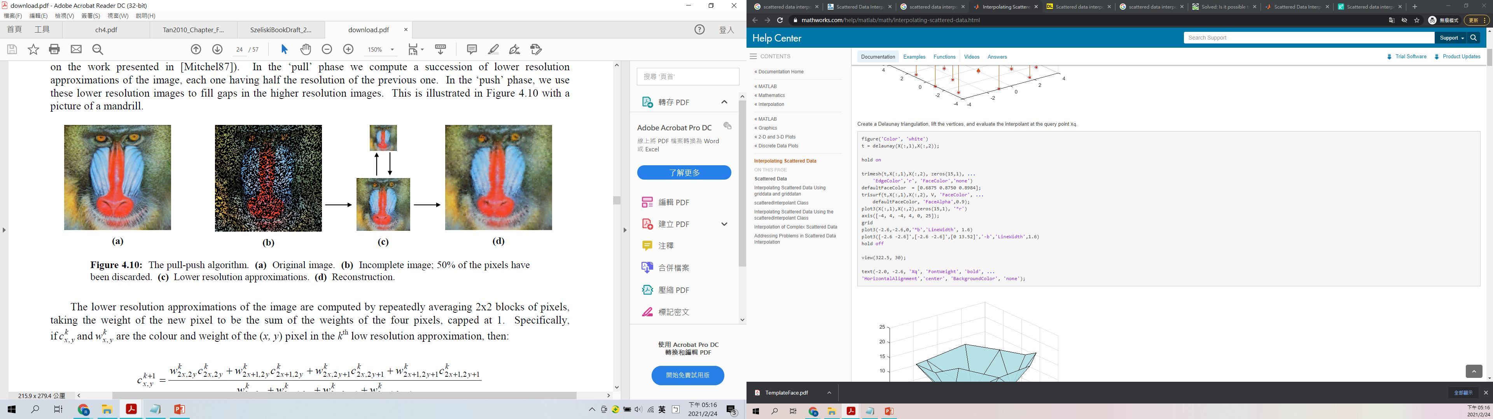
  4.1.0 Scattered data interpolation
Pull-push algorithms
The algorithm is very fast but less accurate.
Original image
Scattered data
Pull-push
Interpolation result
Gortler, S. J., Grzeszczuk, R., Szeliski, R., and Cohen, M. F. (1996). The Lumigraph. In ACM
SIGGRAPH Conference Proceedings, pp. 43–54.
Notes:
先對 high resolution image 的 pixels 進行權重估計

Slide 13
  4.1 Scattered data interpolation
  4.1.1 Radial basis functions
  4.1.2 Overfitting and underfitting
  4.1.3 Robust data fitting

Slide 14
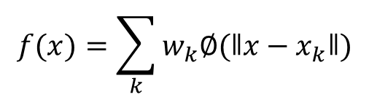
  4.1.1 Radial basis functions
Mesh-based approaches are limited to low-dimensional domain.
We here introduce radial basis functions, a mesh-free approach, which can be easily extended to higher dimension.
$$f(x)=\sum_{k}{w_{k}∅(ǁx−x_{k}ǁ)}$$
Interpolated function using radial basis functions

Slide 15
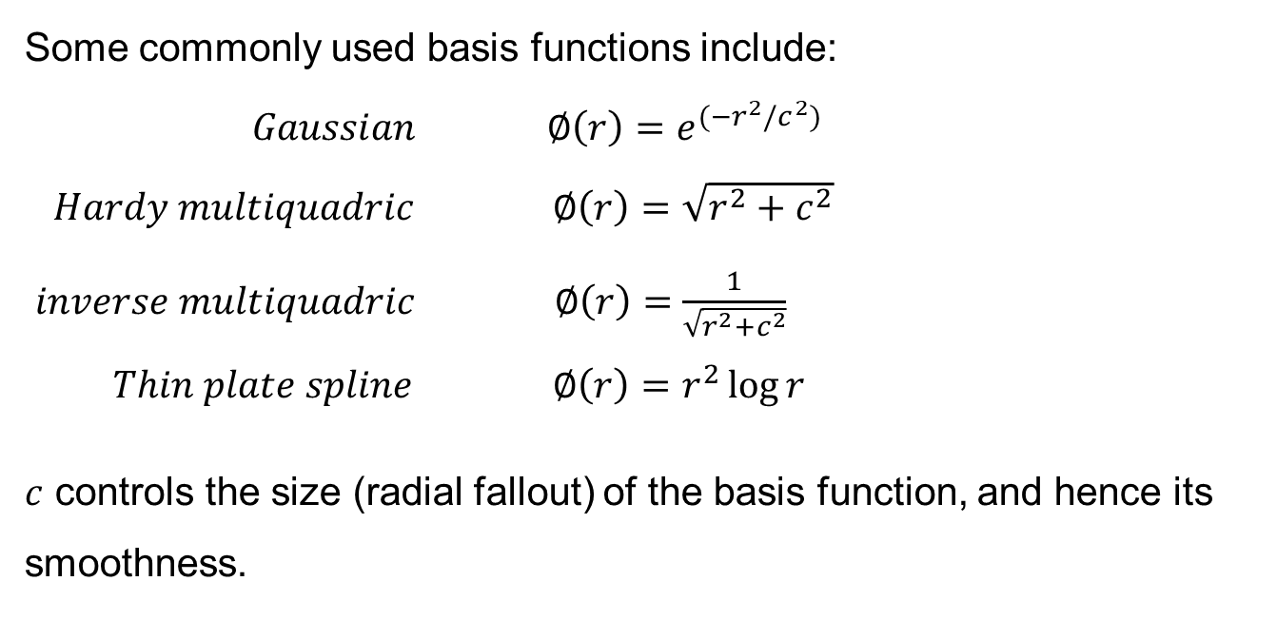
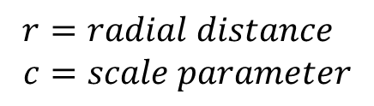
  4.1.1 Radial basis functions
Some commonly used basis functions include:
$Gaussian ∅\left(r\right)=e^{⁡(−r^{2}/c^{2}) }$
$Hardy multiquadric ∅\left(r\right)=\sqrt{r^{2}+c^{2}}$
$inverse multiquadric ∅\left(r\right)=\frac{1}{\sqrt{r^{2}+c^{2}}}$
$Thin plate spline ∅\left(r\right)=r^{2}\log{r}$
$c$ controls the size (radial fallout) of the basis function, and hence its smoothness.
$r=radial distance$
$$c=scale parameter$$
Notes:
這裡的 c 雖然可以控制 radial basis function 但它不是可以優化的參數 我們決定了 radial basis function 就會決定這個 c

Slide 16
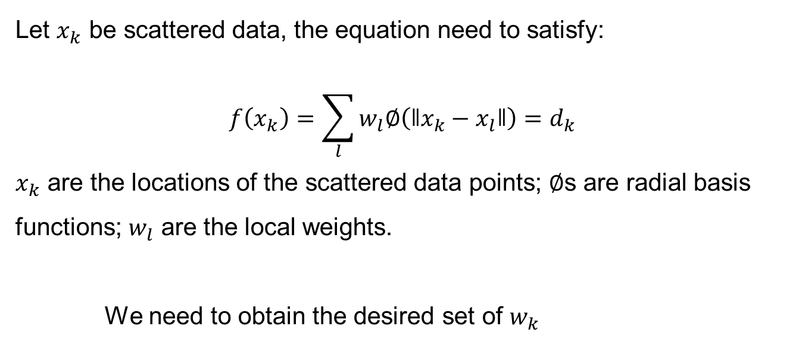
  4.1.1 Radial basis functions
Let $x_{k}$ be scattered data, the equation need to satisfy:
$$f\left(x_{k}\right)=\sum_{l}{w_{l}∅\left(ǁx_{k}−x_{l}ǁ\right)}=d_{k}$$
$x_{k}$ are the locations of the scattered data points; $∅$s are radial basis functions; $w_{l}$ are the local weights.
We need to obtain the desired set of $w_{k}$
Notes:
Inference/Testing problem

Slide 17
  4.1.1 Radial basis functions
Solution:
Minimizing the data constraint energy together with a weight penalty.
Kernel regression

Slide 18

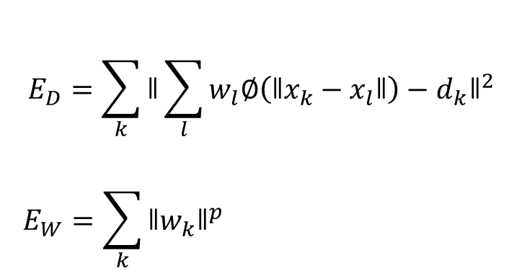
  4.1.1 Radial basis functions
Minimizing the data constraint energy together with a weight penalty:
$$E\left(\left\{w_{k}\right\}\right)=E_{D}+{λE}_{W}$$
$$E_{D}=\sum_{k}{{ǁ\sum_{l}{w_{l}∅\left(ǁx_{k}−x_{l}ǁ\right)}−d_{k}ǁ}^{2}}$$
$$E_{W}=\sum_{k}{{ǁw_{k}ǁ}^{p}}$$
Notes:
Training problem
l 代表幾個 kernel
w_l 代表各個 kernel 的權重

Slide 19
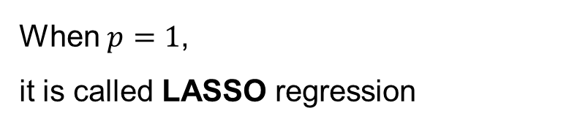
  4.1.1 Radial basis functions
Minimizing the data constraint energy together with a weight penalty:
$$E\left(\left\{w_{k}\right\}\right)=E_{D}+{λE}_{W}$$
$$E_{D}=\sum_{k}{{ǁ\sum_{l}{w_{l}∅\left(ǁx_{k}−x_{l}ǁ\right)}−d_{k}ǁ}^{2}}$$
$$E_{W}=\sum_{k}{{ǁw_{k}ǁ}^{p}}$$
When $p=1$,
it is called LASSO regression
Least Absolute Shrinkage and Selection Operator
Notes:
L1-loss
Feature selection, sparse kernel
Least Absolute Shrinkage and Selection Operator

Slide 20
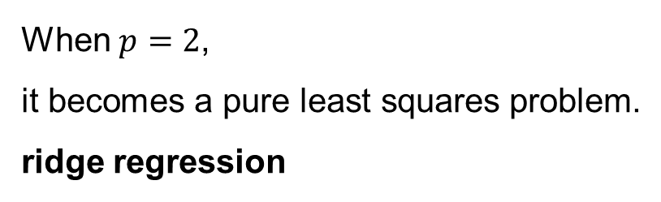
  4.1.1 Radial basis functions
Minimizing the data constraint energy together with a weight penalty:
$$E\left(\left\{w_{k}\right\}\right)=E_{D}+{λE}_{W}$$
$$E_{D}=\sum_{k}{{ǁ\sum_{l}{w_{l}∅\left(ǁx_{k}−x_{l}ǁ\right)}−d_{k}ǁ}^{2}}$$
$$E_{W}=\sum_{k}{{ǁw_{k}ǁ}^{p}}$$
When $p=2$,
it becomes a pure least squares problem.
ridge regression
Notes:
L2-weight decay

Slide 21

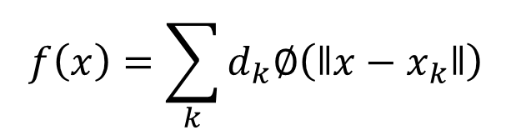
  4.1.1 Radial basis functions
An alternative to solving a set of equation
We simply set $w_{k}$ to $d_{k}$:
$$f\left(x\right)=\sum_{k}{d_{k}∅\left(ǁx−x_{k}ǁ\right)}$$
However, this fails to interpolate the data.
Notes:
Problem:
Will never converge.

Slide 22
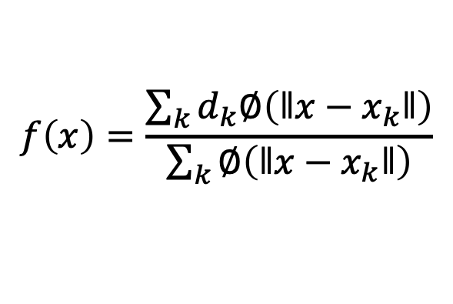
  4.1.1 Radial basis functions
Kernel regression
So, we divide the data-weighted summed basis functions by the sum of all the basis functions:
$$f\left(x\right)=\frac{\sum_{k}{d_{k}∅\left(ǁx−x_{k}ǁ\right)}}{\sum_{k}{∅\left(ǁx−x_{k}ǁ\right)}}$$
While not that widely used in computer vision, kernel regression techniques have been applied to a number of low-level image processing operations.

Slide 23
  4.1 Scattered data interpolation
  4.1.1 Radial basis functions
  4.1.2 Overfitting and underfitting
  4.1.3 Robust data fitting

Slide 24
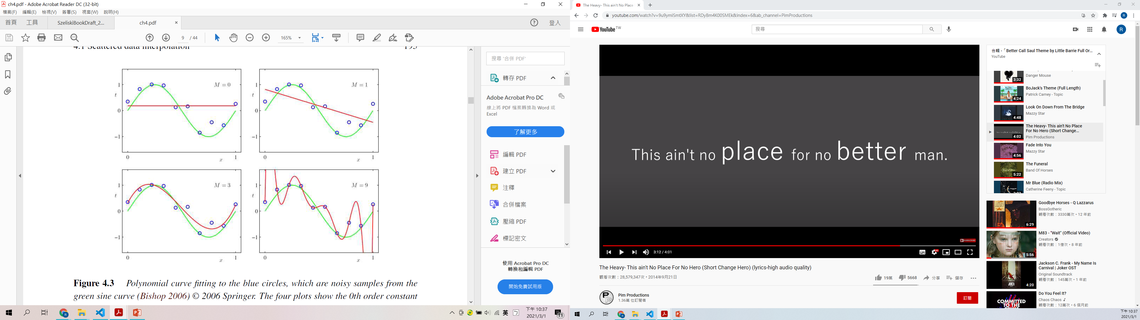
  4.1.2 Overfitting and underfitting
Some data are noisy, so fitting them makes no sense.
Doing so can produce a lot of spurious wiggles, which may cause overfitting.

Slide 25
  4.1.2 Overfitting and underfitting
underfitting
underfitting
M=0
M=1
plausible
overfitting
M=3
M=9

Slide 26
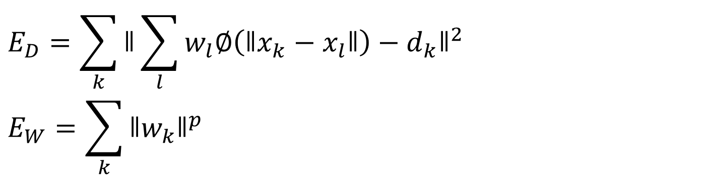
  4.1.2 Overfitting and underfitting
How can we quantify the amount of underfitting and overfitting?
How can we get just the right amount?
$E\left(\left\{w_{k}\right\}\right)=E_{D}+{λE}_{W}$Adjust $λ$ to get different results.
$$E_{D}=\sum_{k}{{ǁ\sum_{l}{w_{l}∅\left(ǁx_{k}−x_{l}ǁ\right)}−d_{k}ǁ}^{2}}$$
$$E_{W}=\sum_{k}{{ǁw_{k}ǁ}^{p}}$$

Slide 27
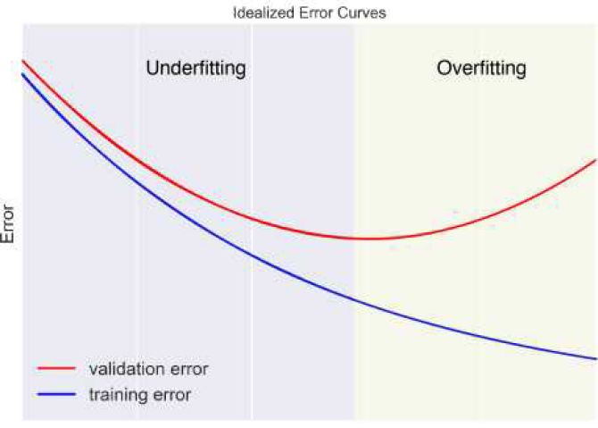

  4.1.2 Overfitting and underfitting
Now we vary $λ$, we can typically obtain a curve as below:
$$λ$$
lesser

Slide 28
  4.1.2 Overfitting and underfitting
Validation Set:
We save some data in a validation set in order to see if the function we compute is overfitting or underfitting.
data
Training set
Validation set

Slide 29
  4.1.2 Overfitting and underfitting
Cross validation:
Split the data into K folds.
We train for K runs, with different folds to be validation set.
Estimate the best result by averaging over all K training runs’ result.
…
(K=5 is often used.)
1
2
K-1
K

Slide 30
  4.1 Scattered data interpolation
  4.1.1 Radial basis functions
  4.1.2 Overfitting and underfitting
  4.1.3 Robust data fitting

Slide 31
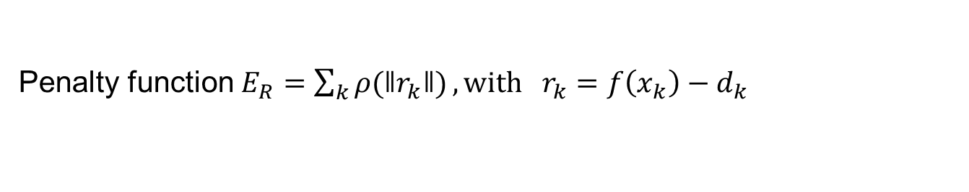

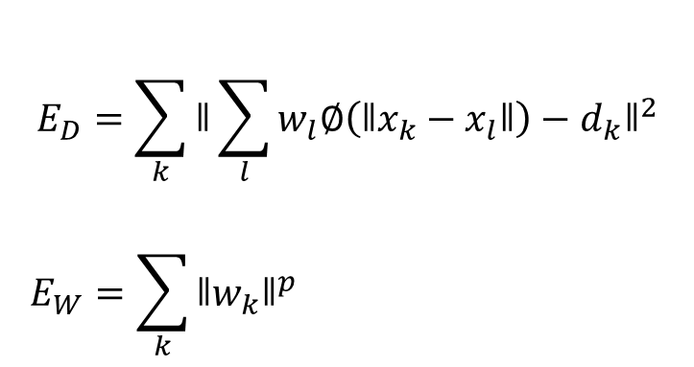

  4.1.3 Robust data fitting
$$E\left(\left\{w_{k}\right\}\right)=E_{D}+{λE}_{W}$$
$$E_{D}=\sum_{k}{{ǁ\sum_{l}{w_{l}∅\left(ǁx_{k}−x_{l}ǁ\right)}−d_{k}ǁ}^{2}}$$
$$E_{W}=\sum_{k}{{ǁw_{k}ǁ}^{p}}$$
Residual Error
Penalty function$E_{R}=\sum_{k}{ρ(ǁr_{k}ǁ)}, with r_{k}=f\left(x_{k}\right)−d_{k}$
$$E\left(\left\{w_{k}\right\}\right)=E_{R}+{λE}_{W}$$

Slide 32
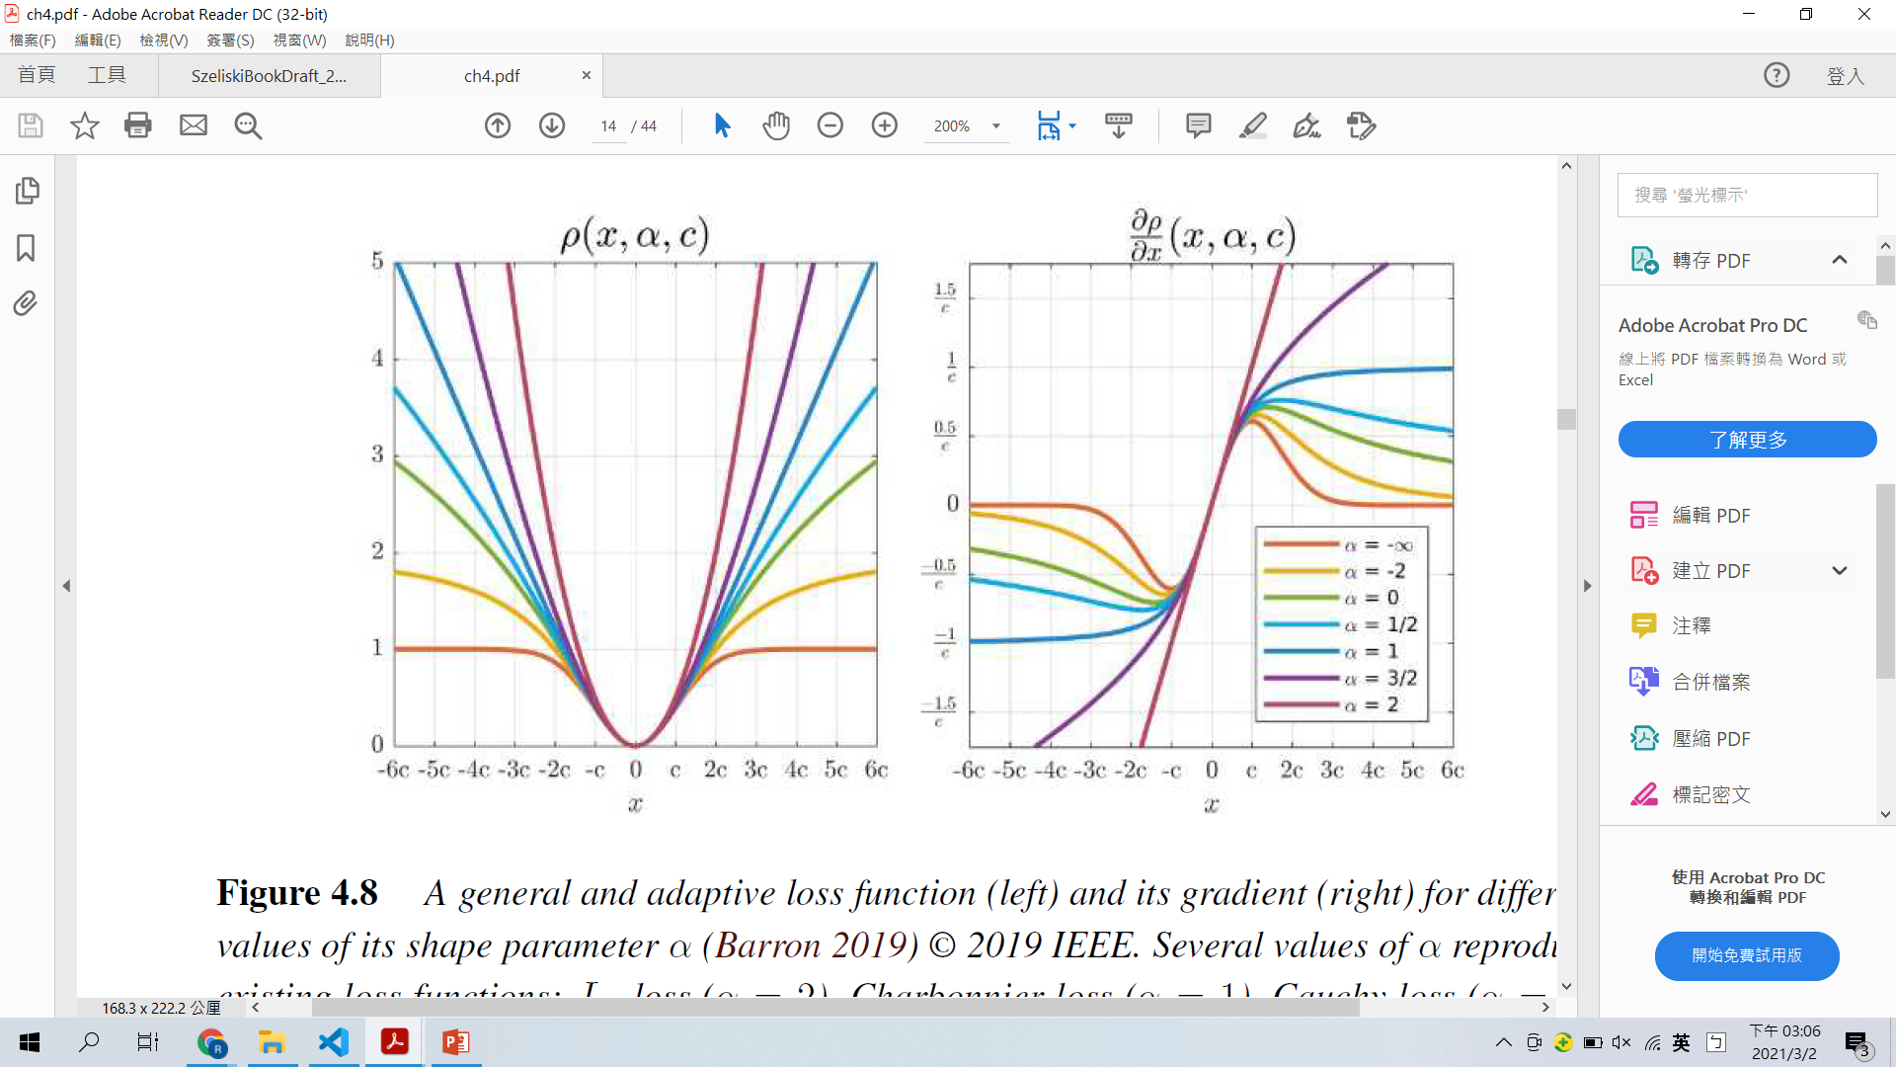
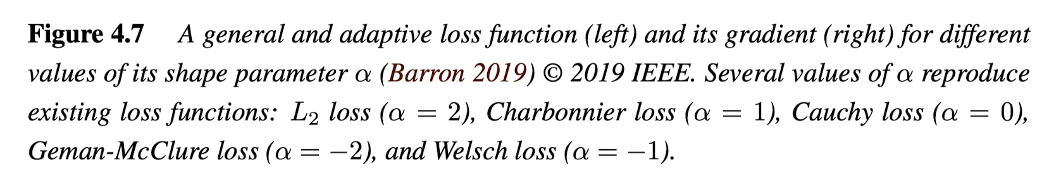
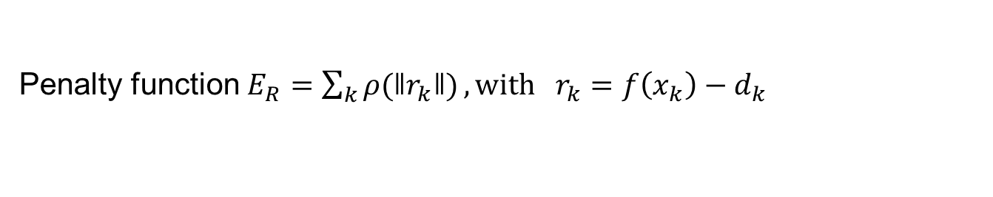
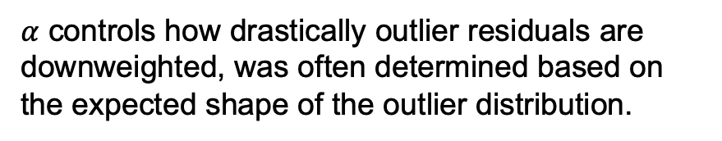
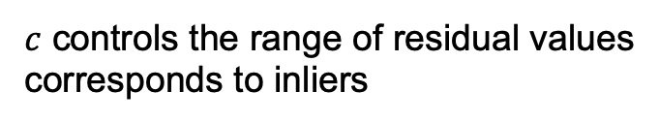
  4.1.3 Robust data fitting
Penalty function$E_{R}=\sum_{k}{ρ(ǁr_{k}ǁ)}, with r_{k}=f\left(x_{k}\right)−d_{k}$
$c$ controls the range of residual values
corresponds to inliers
$α$ controls how drastically outlier residuals are downweighted, was often determined based on the expected shape of the outlier distribution.
Notes:
Textbook P.203

Slide 33
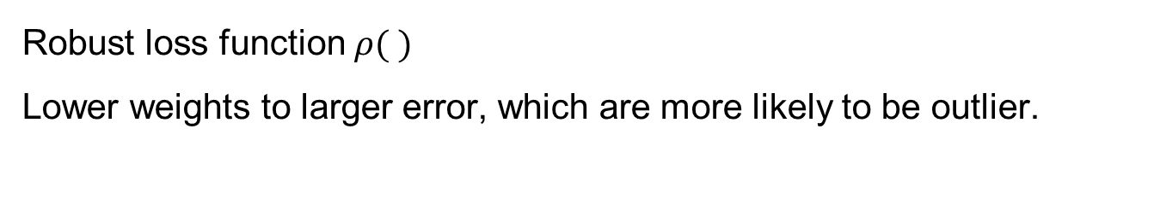
  4.1.3 Robust data fitting
Robust loss function $ρ( )$
Lower weights to larger error, which are more likely to be outlier.

Slide 34
  4.2 Variational methods and regularization
  4.2.1 Discrete energy minimization
  4.2.2 Total variation
  4.2.3 Bilateral solver
  4.2.4 Application: Interactive colorization
Notes:
3/14

Slide 35
  4.2.0 Variational methods and regularization
The methods in the previous section provide reasonable solutions, but:
Cannot directly quantify and hence optimize the amount of smoothness in the solution.
No local control over where the solution should be discontinuous.
Notes:
In most computer vision applications,
however, the fields we are trying to model or recover are only piecewise continuous, e.g., depth maps and optical flow fields jump at object discontinuities
Color images are even more discontinuous, since they also change appearance at albedo (surface color) and shading discontinuities.

Slide 36

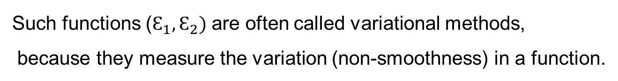
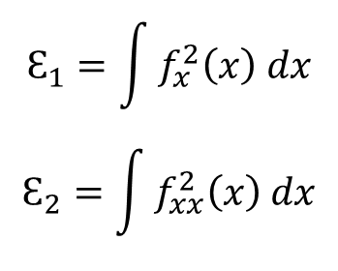
  4.2.0 Variational methods and regularization
Variational methods:
$$Ɛ_{1}=\int{f_{x}^{2}\left(x\right) dx}$$
$$Ɛ_{2}=\int{f_{xx}^{2}\left(x\right) dx}$$
1-dimensional functions $f\left(x\right)$
Such functions ($Ɛ_{1},Ɛ_{2})$ are often called variational methods,
because they measure the variation (non-smoothness) in a function.

Slide 37
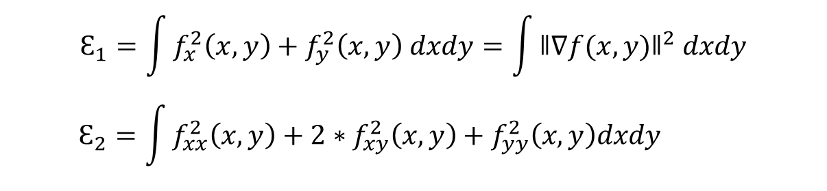
  4.2.0 Variational methods and regularization
Variational methods in 2-dimensions:
$$Ɛ_{1}=\int{f_{x}^{2}\left(x, y\right)+f_{y}^{2}\left(x, y\right) dxdy}=\int{{ǁ∇f(x, y)ǁ}^{2} dxdy}$$
$$Ɛ_{2}=\int{f_{xx}^{2}\left(x, y\right)+2∗f_{xy}^{2}\left(x, y\right)+f_{yy}^{2}\left(x, y\right)dxdy}$$
However, these smoothness functions cannot provide discontinuities.

Slide 38
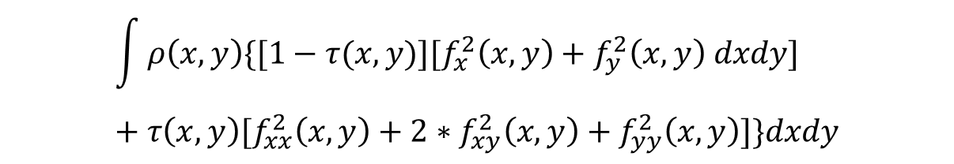
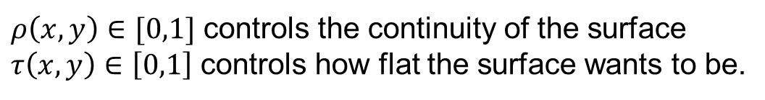

  4.2.0 Variational methods and regularization
Variational methods in 2-dimensions:
$$Ɛ_{cc}=$$
$$\int{ρ\left(x,y\right)\{[1−τ(x,y)][f_{x}^{2}\left(x, y\right)+f_{y}^{2}\left(x, y\right) dxdy]}+τ\left(x,y\right)[f_{xx}^{2}\left(x, y\right)+2∗f_{xy}^{2}\left(x, y\right)+f_{yy}^{2}\left(x, y\right)]\}dxdy$$
$ρ\left(x,y\right)∈[0,1]$ controls the continuity of the surface
$τ\left(x,y\right)∈\left[0,1\right]$ controls how flat the surface wants to be.
Notes:
controlled-continuity

Slide 39
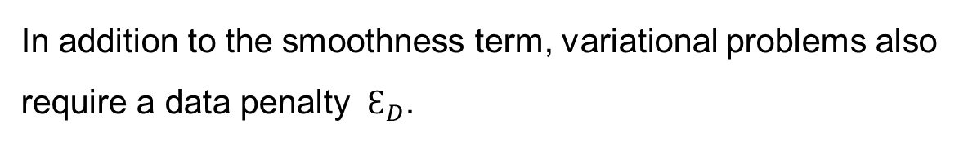
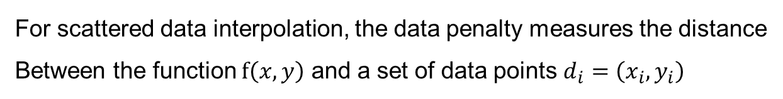

  4.2.0 Variational methods and regularization
In addition to the smoothness term, variational problems also require a data penalty $Ɛ_{D}$.
For scattered data interpolation, the data penalty measures the distance
Between the function $f\left(x, y\right)$ and a set of data points $d_{i}=\left(x_{i}, y_{i}\right)$
$$Ɛ_{D}=\sum_{i}{{[f\left(x_{i}, y_{i}\right)−d_{i}]}^{2}}$$

Slide 40

  4.2.0 Variational methods and regularization
In addition to the smoothness term, variational problems also require a data penalty $Ɛ_{D}$.
For a problem like noise removal,
a continuous version of this measure can be used,
$$Ɛ_{D}=\int{{[f\left(x, y\right)−d\left(x, y\right) ]}^{2}dxdy}$$

Slide 41
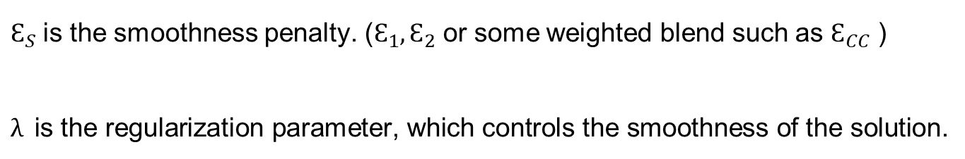

  4.2.0 Variational methods and regularization
Finally, we get a global energy that can be minimized, the two energy penalties are usually added together,
$$Ɛ=Ɛ_{D}+λƐ_{S}$$
$Ɛ_{S}$ is the smoothness penalty. ($Ɛ_{1},Ɛ_{2}$ or some weighted blend such as $Ɛ_{CC}$ )
$λ$ is the regularization parameter, which controls the smoothness of the solution.

Slide 42
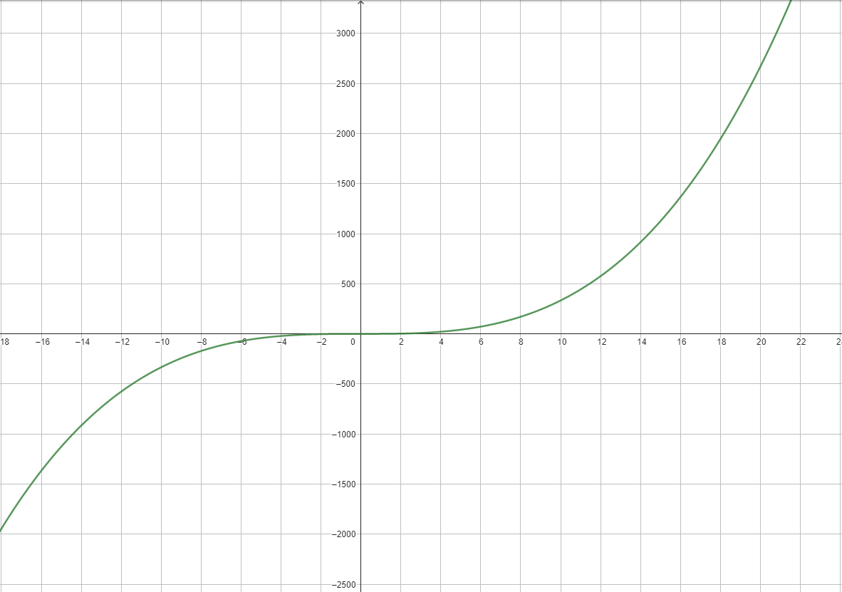
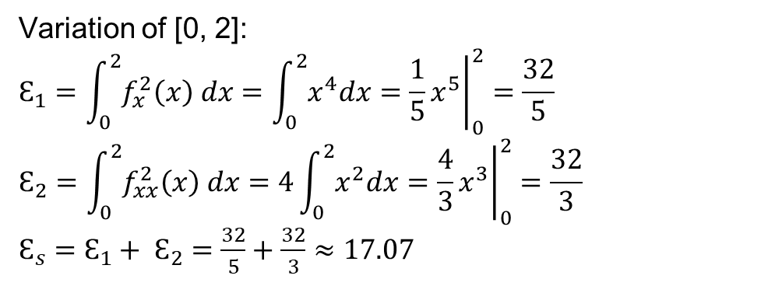
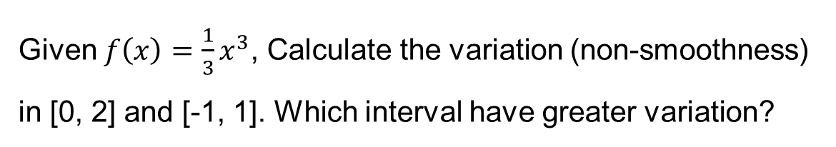
Exercise
Given $f\left(x\right)=\frac{1}{3}x^{3}$, Calculate the variation (non-smoothness) in [0, 2] and [-1, 1]. Which interval have greater variation?
Variation of [0, 2]:
$$Ɛ_{1}=\int_{0}^{2}{f_{x}^{2}\left(x\right) dx}=\int_{0}^{2}{x^{4}dx}={\left.\frac{1}{5}x^{5}\right|}_{0}^{2}=\frac{32}{5}$$
$$Ɛ_{2}=\int_{0}^{2}{f_{xx}^{2}\left(x\right) dx}=4\int_{0}^{2}{x^{2}dx}={\left.\frac{4}{3}x^{3}\right|}_{0}^{2}=\frac{32}{3}$$
$Ɛ_{s}=$ $Ɛ_{1}+ Ɛ_{2}=\frac{32}{5}+\frac{32}{3}≈17.07$

Slide 43
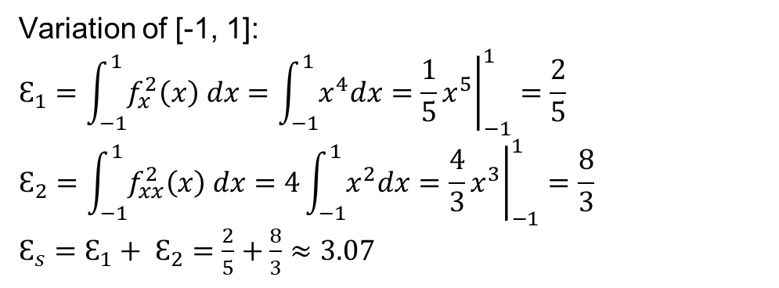
Exercise
Given $f\left(x\right)=\frac{1}{3}x^{3}$, Calculate the variation (non-smoothness) in [0, 2] and [-1, 1]. Which interval have greater variation?
Variation of [-1, 1]:
$$Ɛ_{1}=\int_{−1}^{1}{f_{x}^{2}\left(x\right) dx}=\int_{−1}^{1}{x^{4}dx}={\left.\frac{1}{5}x^{5}\right|}_{−1}^{1}=\frac{2}{5}$$
$$Ɛ_{2}=\int_{−1}^{1}{f_{xx}^{2}\left(x\right) dx}=4\int_{−1}^{1}{x^{2}dx}={\left.\frac{4}{3}x^{3}\right|}_{−1}^{1}=\frac{8}{3}$$
$Ɛ_{s}=$ $Ɛ_{1}+ Ɛ_{2}=\frac{2}{5}+\frac{8}{3}≈3.07$
[0, 2] has greater variation ➔ greater non-smoothness

Slide 44
  4.2 Variational methods and regularization
  4.2.1 Discrete energy minimization
  4.2.2 Total variation
  4.2.3 Bilateral solver
  4.2.4 Application: Interactive colorization

Slide 45


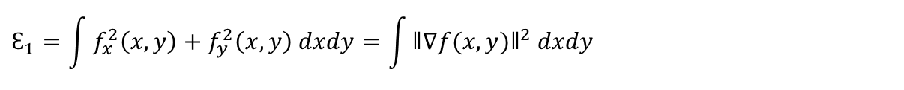
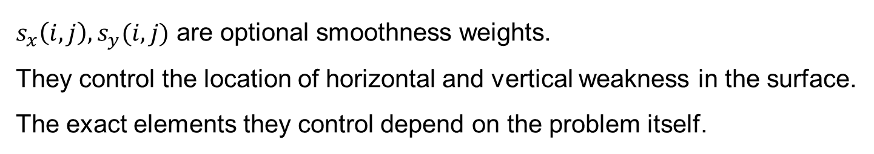
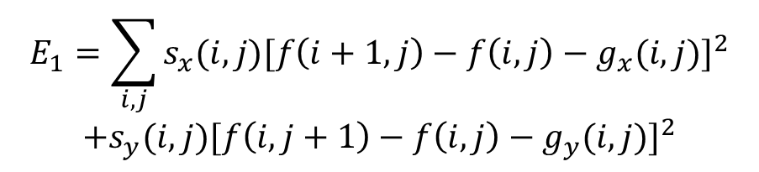
  4.2.1 Discrete energy minimization
$$Ɛ_{1}=\int{f_{x}^{2}\left(x, y\right)+f_{y}^{2}\left(x, y\right) dxdy}=\int{{ǁ∇f(x, y)ǁ}^{2} dxdy}$$
$E_{1}:$
$$f_{x}$$
$$E_{1}=\sum_{i,j}{s_{x}(i,j){[f\left(i+1,j\right)−f\left(i,j\right)−g_{x}(i,j)]}^{2}}$$
$$+s_{y}(i,j){[f\left(i,j+1\right)−f\left(i,j\right)−g_{y}(i,j)]}^{2}$$
$$f_{y}$$
$s_{x}\left(i,j\right),s_{y}(i,j)$ are optional smoothness weights.
They control the location of horizontal and vertical weakness in the surface.
The exact elements they control depend on the problem itself.
Notes:
Colorization (Levin, Lischinski, and Weiss 2004)
Interactive tone mapping (Lischinski, Farbman et al. 2006)
they control the smoothness in the interpolated chroma or exposure field
set inversely proportional to the local luminance gradient strength.

Slide 46
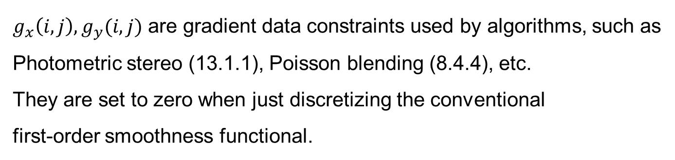
  4.2.1 Discrete energy minimization
$E_{1}:$
$$E_{1}=\sum_{i,j}{s_{x}(i,j){[f\left(i+1,j\right)−f\left(i,j\right)−g_{x}(i,j)]}^{2}}$$
$$+s_{y}(i,j){[f\left(i,j+1\right)−f\left(i,j\right)−g_{y}(i,j)]}^{2}$$
$g_{x}\left(i,j\right),g_{y}(i,j)$ are gradient data constraints used by algorithms, such as
Photometric stereo (13.1.1), Poisson blending (8.4.4), etc.
They are set to zero when just discretizing the conventional
first-order smoothness functional.
Notes:
Photometric stereo: normal vector就是gradient
Poisson blending: 計算source/destination images 的 gradient

Slide 47
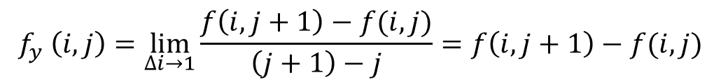
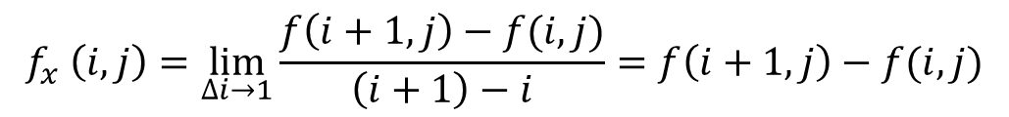
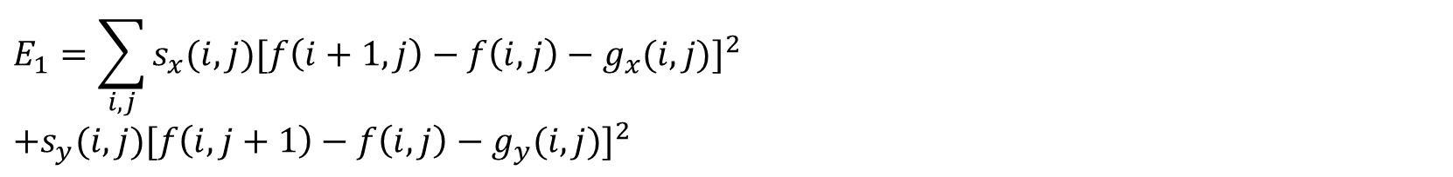
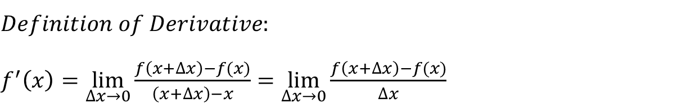
  4.2.1 Discrete energy minimization
$$E_{1}=\sum_{i,j}{s_{x}(i,j) {[f_{x} (i,j)−g_{x}(i,j)]}^{2}}+s_{y}(i,j){[f_{y} \left(i,j\right)−g_{y}(i,j)]}^{2}$$
$$Definition of Derivative:$$
$f^{′}\left(x\right)=\lim_{∆x→0}{\frac{f\left(x+∆x\right)−f(x)}{\left(x+∆x\right)−x}}=$ $\lim_{∆x→0}\frac{f\left(x+∆x\right)−f(x)}{∆x}$
$$f_{x} \left(i,j\right)=\lim_{∆i→1}{\frac{f\left(i+1, j\right)−f(i,j)}{\left(i+1\right)−i}}=f\left(i+1,j\right)−f(i,j)$$
$$f_{y} \left(i,j\right)=\lim_{∆i→1}{\frac{f\left(i, j+1\right)−f(i, j)}{\left(j+1\right)−j}}=f\left(i,j+1\right)−f(i,j)$$
$$E_{1}=\sum_{i,j}{s_{x}(i,j){[f\left(i+1,j\right)−f\left(i,j\right)−g_{x}(i,j)]}^{2}}$$
$$+s_{y}(i,j){[f\left(i,j+1\right)−f\left(i,j\right)−g_{y}(i,j)]}^{2}$$

Slide 48






  4.2.1 Discrete energy minimization
$$Ɛ_{2}=\int{f_{xx}^{2}\left(x, y\right)+2∗f_{xy}^{2}\left(x, y\right)+f_{yy}^{2}\left(x, y\right)dxdy}$$
$E_{2}:$
$E_{2}=$
$$h^{−2}\sum_{i,j}{c_{x}(i,j){[f\left(i+1,j\right)−2f\left(i,j\right)+f(i−1,j)]}^{2}}$$
$$+{2c}_{m}(i,j){[f\left(i+1,j+1\right)−f\left(i+1,j\right)−f\left(i,j+1\right)+f(i,j)]}^{2}$$
$$+c_{y}(i,j){[f\left(i,j+1\right)−2f\left(i,j\right)+f(i,j−1)]}^{2}$$
$$f_{xx}$$
$$f_{xy}$$
$$f_{yy}$$
$h$ is the size of the finite element grid. It is only important
if the energy is being discretized at a variety of resolutions.

Slide 49

  4.2.1 Discrete energy minimization
$E_{2}:$
$E_{2}=$
$$h^{−2}\sum_{i,j}{c_{x}(i,j){[f\left(i+1,j\right)−2f\left(i,j\right)+f(i−1,j)]}^{2}}$$
$$+2c_{m}(i,j){[f\left(i+1,j+1\right)−f\left(i+1,j\right)−f\left(i,j+1\right)+f(i,j)]}^{2}$$
$$+c_{y}(i,j){[f\left(i,j+1\right)−2f\left(i,j\right)+f(i,j−1)]}^{2}$$
$c_{x}\left(i,j\right), c_{m}\left(i,j\right), c_{y}(i,j)$ are crease variables.
They control the locations of creases in the surface.

Slide 50




  4.2.1 Discrete energy minimization
$$E_{2}=h^{−2}\sum_{i,j}{c_{x}(i,j){[f_{xx} (i,j)]}^{2}}+2c_{m}\left(i,j\right){\left[f_{xy} \left(i,j\right)\right]}^{2}+c_{y}(i,j){[f_{yy} (i,j)]}^{2}$$
$$Definition of Derivative:$$
$f^{′}\left(x\right)=\lim_{∆x→0}{\frac{f\left(x+∆x\right)−f(x)}{\left(x+∆x\right)−x}}=$ $\lim_{∆x→0}\frac{f\left(x+∆x\right)−f(x)}{∆x}$
$$f_{x} \left(i,j\right)=\lim_{∆i→1}{\frac{f\left(i+1, j\right)−f(i,j)}{\left(i+1\right)−i}}=f\left(i+1,j\right)−f(i,j)$$
$$f_{xx} \left(i,j\right)=f_{x}\left(i+1,j\right)−f_{x}\left(i,j\right)=\left[f\left(i+2,j\right)−f\left(i+1,j\right)\right]−\left[f\left(i+1,j\right)−f\left(i,j\right)\right]$$
$$=f\left(i+2,j\right)−2f\left(i+1,j\right)+f(i,j)$$
$$=f\left(i+1,j\right)−2f\left(i,j\right)+f(i−1,j)$$

Slide 51




  4.2.1 Discrete energy minimization
$$E_{2}=h^{−2}\sum_{i,j}{c_{x}(i,j){[f_{xx} (i,j)]}^{2}}+2c_{m}\left(i,j\right){\left[f_{xy} \left(i,j\right)\right]}^{2}+c_{y}(i,j){[f_{yy} (i,j)]}^{2}$$
$$Definition of Derivative:$$
$f^{′}\left(x\right)=\lim_{∆x→0}{\frac{f\left(x+∆x\right)−f(x)}{\left(x+∆x\right)−x}}=$ $\lim_{∆x→0}\frac{f\left(x+∆x\right)−f(x)}{∆x}$
$$f_{y} \left(i,j\right)=\lim_{∆j→1}{\frac{f\left(i, j+1\right)−f(i,j)}{\left(j+1\right)−j}}=f\left(i,j+1\right)−f(i,j)$$
$$f_{yy} \left(i,j\right)=f_{y}\left(i,j+1\right)−f_{y}\left(i,j\right)=\left[f\left(i,j+2\right)−f\left(i,j+1\right)\right]−\left[f\left(i,j+1\right)−f\left(i,j\right)\right]$$
$$=f\left(i,j+2\right)−2f\left(i,j+1\right)+f(i,j)$$
$$=f\left(i,j+1\right)−2f\left(i,j\right)+f(i,j−1)$$

Slide 52


  4.2.1 Discrete energy minimization
$$E_{2}=h^{−2}\sum_{i,j}{c_{x}(i,j){[f_{xx} (i,j)]}^{2}}+2c_{m}\left(i,j\right){\left[f_{xy} \left(i,j\right)\right]}^{2}+c_{y}(i,j){[f_{yy} (i,j)]}^{2}$$
$$Definition of Derivative:$$
$f^{′}\left(x\right)=\lim_{∆x→0}{\frac{f\left(x+∆x\right)−f(x)}{\left(x+∆x\right)−x}}=$ $\lim_{∆x→0}\frac{f\left(x+∆x\right)−f(x)}{∆x}$
$$f_{x} \left(i,j\right)=\lim_{∆i→1}{\frac{f\left(i+1, j\right)−f(i,j)}{\left(i+1\right)−i}}=f\left(i+1,j\right)−f(i,j)$$
$f_{xy} \left(i,j\right)=f_{y}\left(i+1,j\right)−f_{y}\left(i,j\right)=$ $\left[f\left(i+1,j+1\right)−f\left(i+1,j\right)\right]−\left[f\left(i,j+1\right)−f\left(i,j\right)\right]$
$=f\left(i+1,j+1\right)$ $−f\left(i+1,j\right)−f\left(i,j+1\right)+f\left(i,j\right)$

Slide 53


  4.2.1 Discrete energy minimization
The 2-dimensional discrete data energy $E_{D}$ is written as:
$E_{D}=$ $\sum_{i,j}{c (i,j){[f\left(i,j\right)−d(i,j)]}^{2}}$
$c$ controls how strongly the data constraint is enforced.

Slide 54



  4.2.1 Discrete energy minimization
The total energy $E$ of the discretized problem can now be written as a quadratic form:
$$E=E_{D}+λE_{S}=x^{T}Ax−2x^{T}b+c$$
$x={[f\left(0,0\right)…f(m−1,n−1)]}^{T}$ is called state vector.
$A$ is Hessian. It encodes the second derivative of the energy function.
$b$ is the weighted data vector.

Slide 55

  4.2.1 Discrete energy minimization
$$E=E_{D}+λE_{S}=x^{T}Ax−2x^{T}b+c$$
Minimizing the quadratic form is equivalent to solving the following linear system:
$$Ax=b$$
Notes:
Least-square solution

Slide 56
  4.2 Variational methods and regularization
  4.2.1 Discrete energy minimization
  4.2.2 Total variation
  4.2.3 Bilateral solver
  4.2.4 Application: Interactive colorization

Slide 57


  4.2.2 Total variation
Today, many regularized problems are formulated using $L_{1}(p=1)$ norm, which is often called total variation.
It tends to better preserve discontinuities, but still results in a convex problem that has a globally unique solution.
$$Ɛ_{1}=\int{f_{x}^{2}\left(x, y\right)+f_{y}^{2}\left(x, y\right) dxdy}=\int{{ǁ∇f(x, y)ǁ}^{2} dxdy}$$
$$Ɛ_{2}=\int{f_{xx}^{2}\left(x, y\right)+2∗f_{xy}^{2}\left(x, y\right)+f_{yy}^{2}\left(x, y\right)dxdy}$$

Slide 58


  4.2.2 Total variation
Hyper-Laplacian norms with $p<1 (p≅0.5−0.8)$ have gained popularity. They have even stronger tendency to prefer large discontinuities over small ones.

Slide 59
  4.2 Variational methods and regularization
  4.2.1 Discrete energy minimization
  4.2.2 Total variation
  4.2.3 Bilateral solver
  4.2.4 Application: Interactive colorization

Slide 60


  4.2.3 Bilateral solver
$σ_{d}^{2}:$ domain kernel
$σ_{r}^{2}:$range kernel
As discussed in 3.3.2, we can often get better results by looking at a larger spatial neighborhood. We can extend this idea to energy minimization. Recall the bilateral weight function:
$$w\left(i,j,k,l\right)=exp⁡(−\frac{{\left(i−k\right)}^{2}+{\left(j−l\right)}^{2}}{2σ_{d}^{2}}−\frac{{ǁf\left(i,j\right)−f(k,l)ǁ}^{2}}{2σ_{r}^{2}})$$
Notes:
get better results by looking at a larger spatial neighborhood and combining pixels with similar colors or grayscale values.

Slide 61

  4.2.3 Bilateral solver
A wider-neighborhood, bilaterally weighted version of nearest-neighbor smoothness penalty:
$E_{B}=$ $\sum_{i,j}{\sum_{k,l}{\hat{w}\left(i,j,k,l\right){[f\left(k,l\right)−f(i,j)]}^{2}}}$
$$\hat{w}\left(i,j,k,l\right)=\frac{w(i,j,k,l)}{\sum_{m,n}{w(i,j,m,n)}}$$

Slide 62


  4.2.3 Bilateral solver
The bilateral solver has been used in a number of demanding video processing and 3D reconstruction application, including the stitching of binocular omnidirectional panoramic videos, and smartphone AR (Augmented Reality) system.
Notes:
binocular omnidirectional panoramic videos
Panoramic stitching全景圖拼接

Slide 63
  4.2 Variational methods and regularization
  4.2.1 Discrete energy minimization
  4.2.2 Total variation
  4.2.3 Bilateral solver
  4.2.4 Application: Interactive colorization

Slide 64
  4.2.4 Application: Interactive colorization
A good use of edge-aware interpolation techniques is in colorization which manually adding colors to grayscale image.
grayscale + color scribbles
resulting image
original image

Slide 65

  4.2.4 Application: Interactive colorization
The user draws some scribbles, and the system interpolates the specified chrominance$\left(u,v\right)$ values.
Then, re-combined chrominance values with the luminance channel to produce a final colorized image.

Slide 66

  4.2.4 Application: Interactive colorization
The interpolation is performed using locally weighted regularization introduced in 4.2.1. This approach has inspired many later algorithms.
$$E_{1}=\sum_{i,j}{s_{x}(i,j){[f\left(i+1,j\right)−f\left(i,j\right)−g_{x}(i,j)]}^{2}}$$
$$+s_{y}(i,j){[f\left(i,j+1\right)−f\left(i,j\right)−g_{y}(i,j)]}^{2}$$

Slide 67
  4.3 Markov random fields
  4.3.1 Conditional random fields
  4.3.2 Application: Interactive segmentation

Slide 68



  4.3.0 Markov random fields
$E_{D}\left(x,y\right):$data energy or data penalty
$E_{P}(x)$: prior energy
An alternative technique is to use probabilistic model.
$$p\left(x | y\right)=\frac{p\left(y | x\right)p(x)}{p(y)}$$
$$−log{p\left(x | y\right)}=−log{p\left(y | x\right)}−log{p(x)}+C$$
$$E\left(x,y\right)=E_{D}\left(x,y\right)+E_{P}(x)$$
(We drop the constant $C$ because its value does not matter during energy minimization.)
Notes:
The first term E_{D}(x; y) is the data energy or data penalty; it measures the negative log likelihood that the data were observed given the unknown state x.
The second term EP(x) is the prior energy; it plays a role analogous to the smoothness energy in regularization.

Slide 69



  4.3.0 Markov random fields
An alternative technique is to use probabilistic model.
$$E\left(x,y\right)=E_{D}\left(x,y\right)+E_{P}(x)$$
Output pixels:
$$x=[f\left(0,0\right)…f(m−1,n−1)]$$
Input pixels:
$$y=[d\left(0,0\right)…d(m−1,n−1)]$$
Notes:
提醒講義有錯 (E_{P}(x))

Slide 70

  4.3.0 Markov random fields
Graphical model for $N_{4}$ ($N_{8}$) Markov random field:

Slide 71

  4.3.0 Markov random fields
Binary MRFs:
It simply segments images into foreground and background regions.
$$E_{D}\left(i,j\right)=wδ(f\left(i,j\right),d(i,j))$$
$$E_{P}\left(i,j\right)=sδ\left(f\left(i,j\right),d\left(i+1,j\right)\right)+sδ(f\left(i,j\right),d(i,j+1))$$

Slide 72
  4.3.0 Markov random fields
Ordinal-valued MRFs:
The term “ordinal” indicates that the labels have an implied ordering, e.g., that higher values are lighter pixels (grayscale image).
Notes:
grayscale images or depth maps.

Slide 73

  4.3.0 Markov random fields
Ordinal-valued MRFs:

Slide 74
  4.3.0 Markov random fields
Unordered labels:
Another case with multi-valued labels where MRFs are often applied are unordered labels, such as segmentation.

Slide 75

  4.3.0 Markov random fields
Unordered labels:

Slide 76
  4.3.1 Conditional random fields
  4.3.1 Conditional random fields
  4.3.2 Application: Interactive segmentation

Slide 77

  4.3.1 Conditional random fields
$N_{4}$ ($N_{8}$) MRF

Slide 78
  4.3.1 Conditional random fields
In addition to minimizing a data term, the MRF need to be modified so that the smoothness terms depend on the magnitude of the gradient between adjacent pixels.
$N_{4}$ ($N_{8}$) MRF

Slide 79

  4.3.1 Conditional random fields
Graphic model for a conditional random field (CRF):

Slide 80

  4.3.1 Conditional random fields
Penalty function for a conditional random field (CRF):
$$E\left(x|y\right)=E_{D}\left(x,y\right)+E_{S}\left(x,y\right)$$
$$=\sum_{p}{V_{p}(x_{p}, y)}+\sum_{(p,q)εN}{V_{p,q}(x_{p},x_{q},y)}$$

Slide 81
  4.3.1 Conditional random fields
Dense conditional random fields (CRFs):
Image often contains longer-range interactions.

Slide 82
  4.3.1 Conditional random fields
Dense conditional random fields (CRFs):
In order to model such longer-range interactions, we introduce a fully connected CRF (aka. dense CRF).

Slide 83

  4.3.1 Conditional random fields
Dense conditional random fields (CRFs):
$$E\left(x|y\right)=E_{D}\left(x,y\right)+E_{S}\left(x,y\right)$$
$$=\sum_{p}{V_{p}(x_{p}, y)}+\sum_{(p,q)}{V_{p,q}(x_{p},x_{q},y)}$$

Slide 84
  4.3.2 Application: Interactive segmentation
  4.3.1 Conditional random fields
  4.3.2 Application: Interactive segmentation

Slide 85
  4.3.2 Application: Interactive segmentation
The algorithm performs a binary segmentation, and the process is repeated with better region statistics.

