Slide 1
Advanced Computer Vision
Chapter 10
Computational Photography
Presented by: 傅楸善 & 鄒雨笙
E-mail: r12945072@ntu.edu.tw
手機: 0928592241
授課教授：傅楸善 博士

Slide 2
Definition
Image analysis and processing algorithms that are applied to one or more photographs to create images that go beyond the capabilities of traditional imaging systems
Notes:
計算攝影學的定義：
影像分析和處理的演算法，用在多個影像上來創造出新的影像，品質或能力比傳統的成像系統還要好

Slide 3
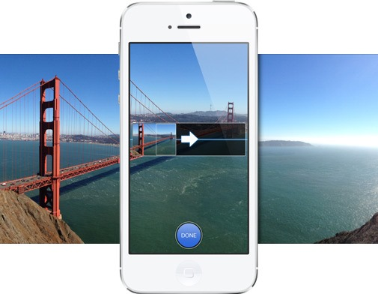
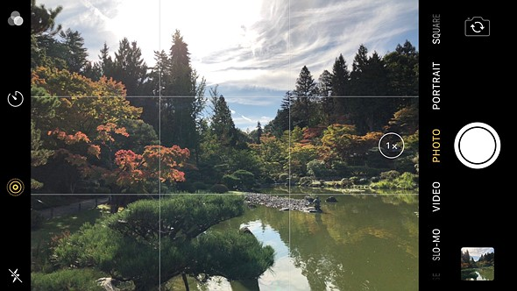
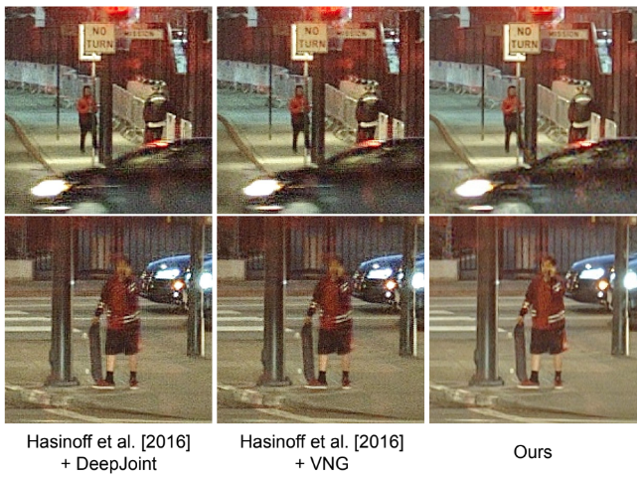
Introduction
Most widespread commercial impact
Most smartphones have built-in computational photography functions
Panoramic
Stitching
HDR
(High Dynamic Range)
Noise Removal

Slide 4
Outline
10.1 Photometric calibration
10.2 High dynamic range imaging
10.3 Super-resolution, denoising, and blur removal
10.4 Image matting and compositing
Notes:
10.1 光度標定或光度校正
10.2 高動態範圍成像
10.3 超解析度、雜訊移除和模糊移除
10.4 影像抽圖和組成

Slide 5
10.1 Photometric calibration
- Table of Contents
10.1.1 Radiometric response function
10.1.2 Noise level estimation
10.1.3 Vignetting
10.1.4 Optical blur (spatial response) estimation

Slide 6
10.1 Photometric Calibration
Before we can successfully merge multiple photographs, we need to characterize the functions that map incoming irradiance into pixel values and also the amount of noise present in each image
Notes:
光度校正
在我們可以成功合併多張照片之前，我們需要去特性化一些函數，這些函數會將入射的幅照度或照射度，映射成像素值和每張影像出現的雜訊大小。

Slide 7
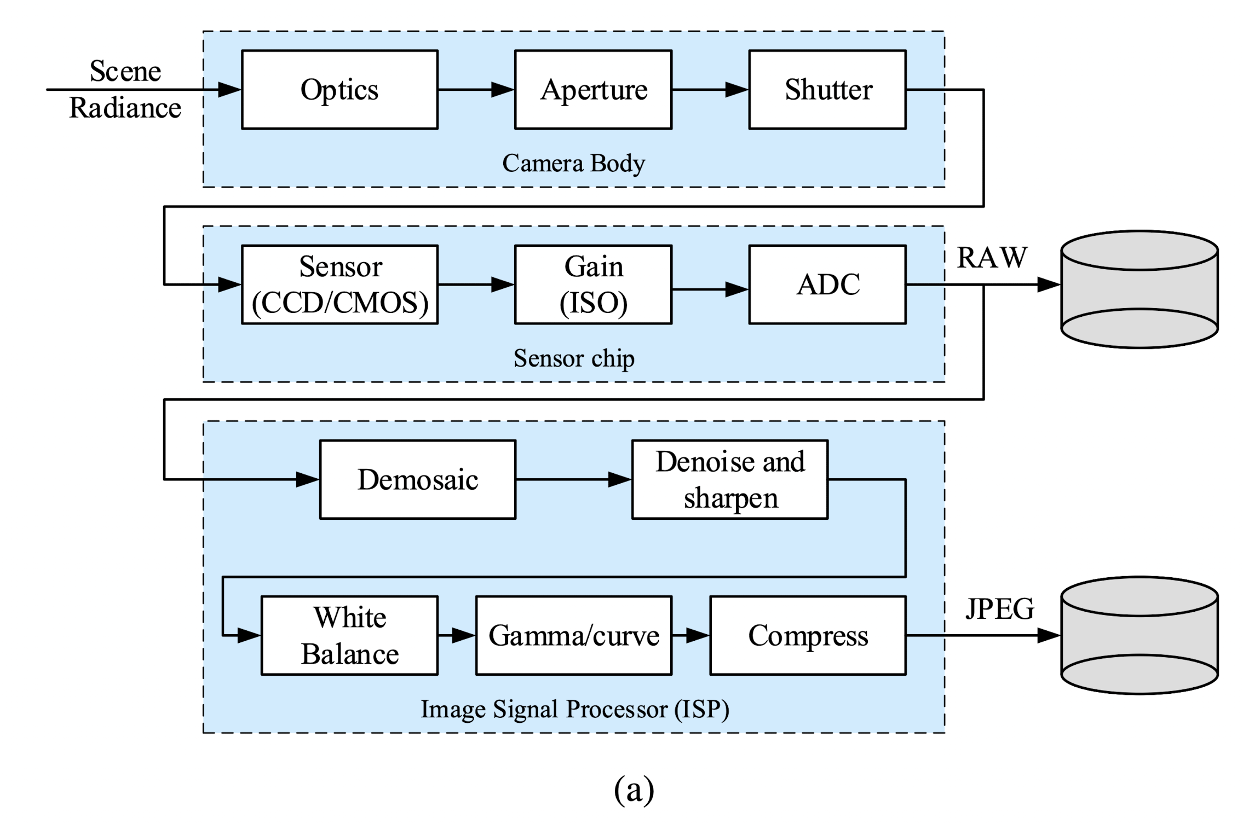
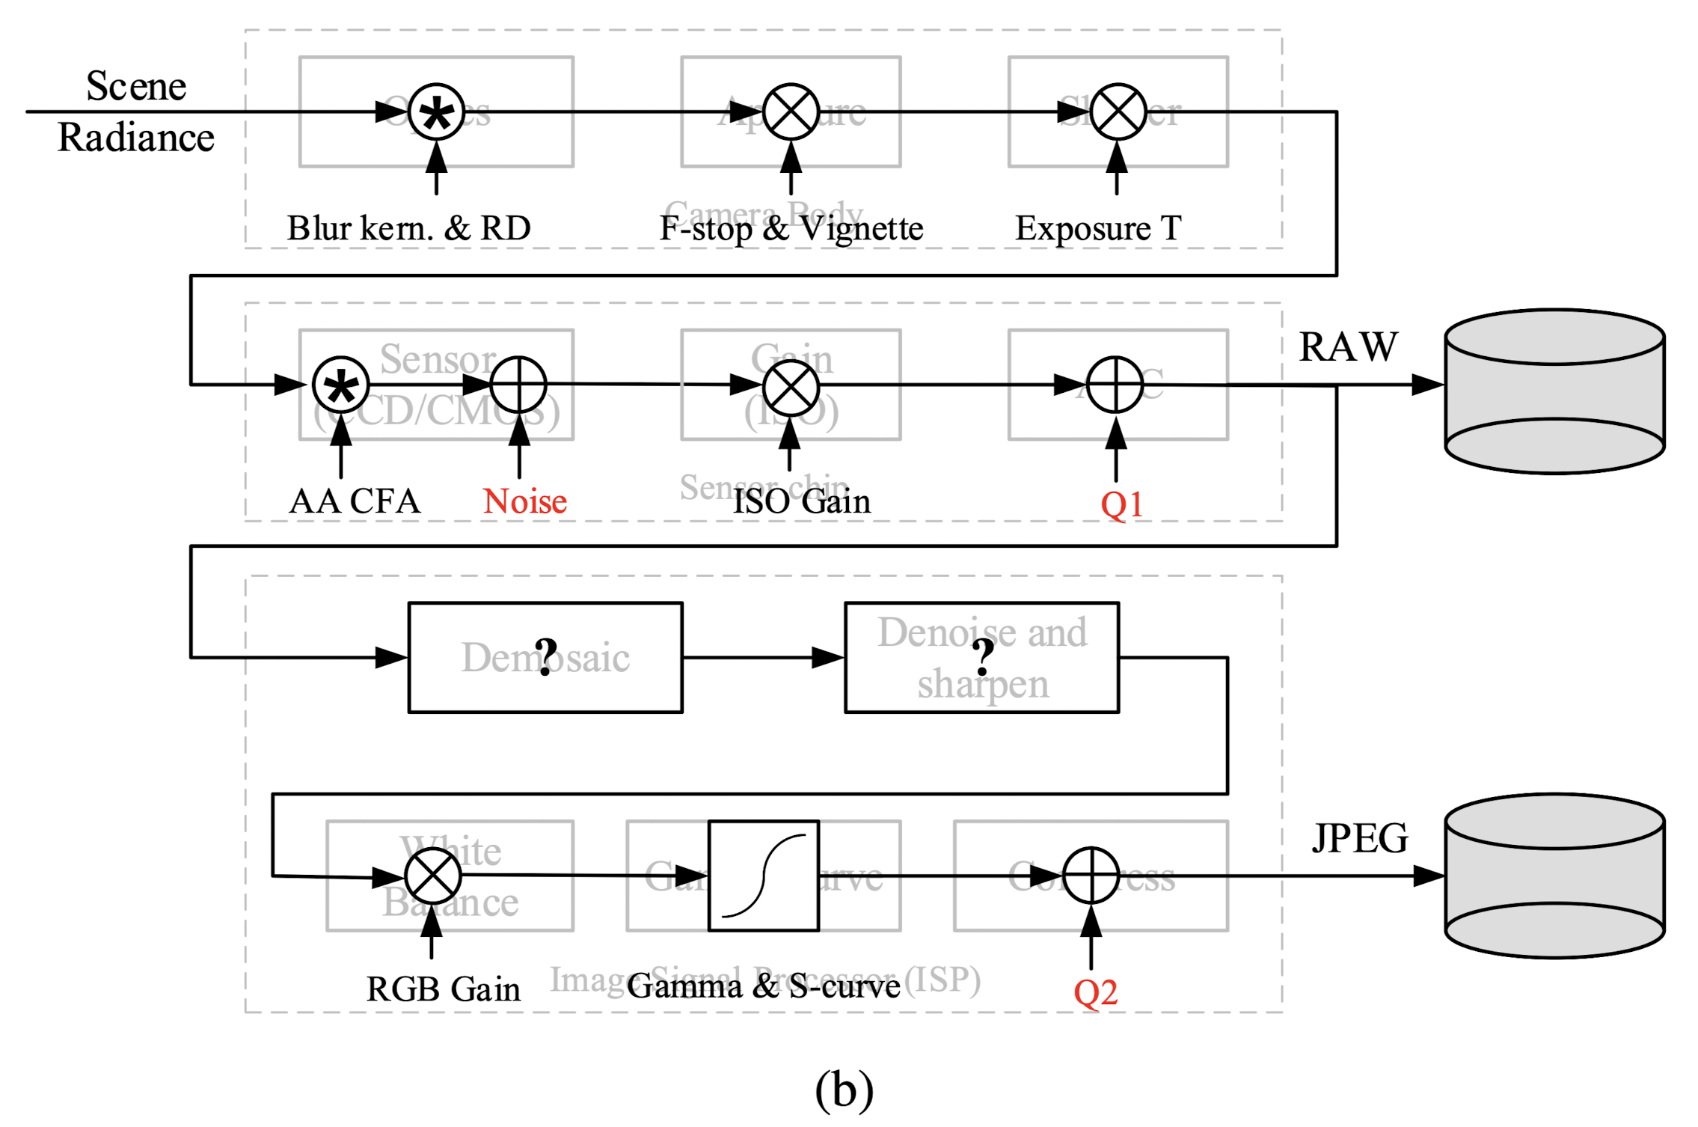
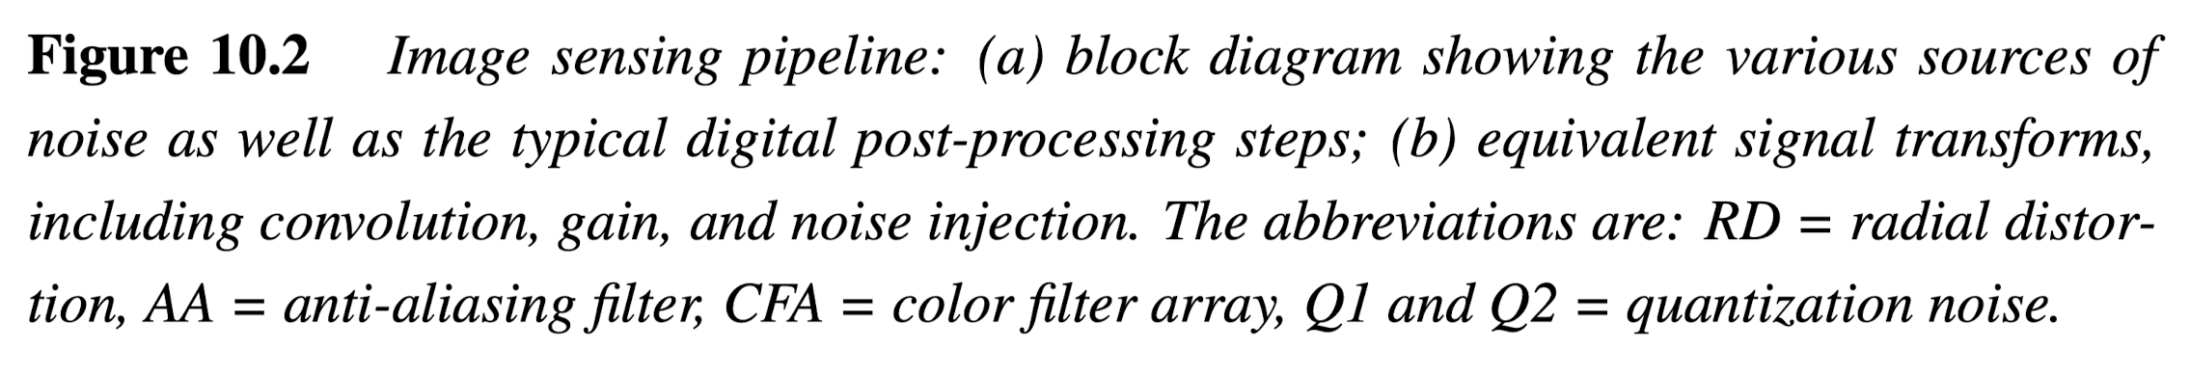
Introduction
CCD: Charge-Coupled Device
CMOS: Complementary Metal–Oxide–Semiconductor
ISO: International Standards Organization
ADC: Analog-to-Digital Converter
JPEG: Joint Photographic Experts Group
RGB: Red, Green, Blue
Notes:
在介紹有哪些因素會影響這個函數映射之前，讓我們先複習一下第二章所教的數位相機的影像感測流程圖。

Slide 8
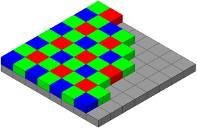
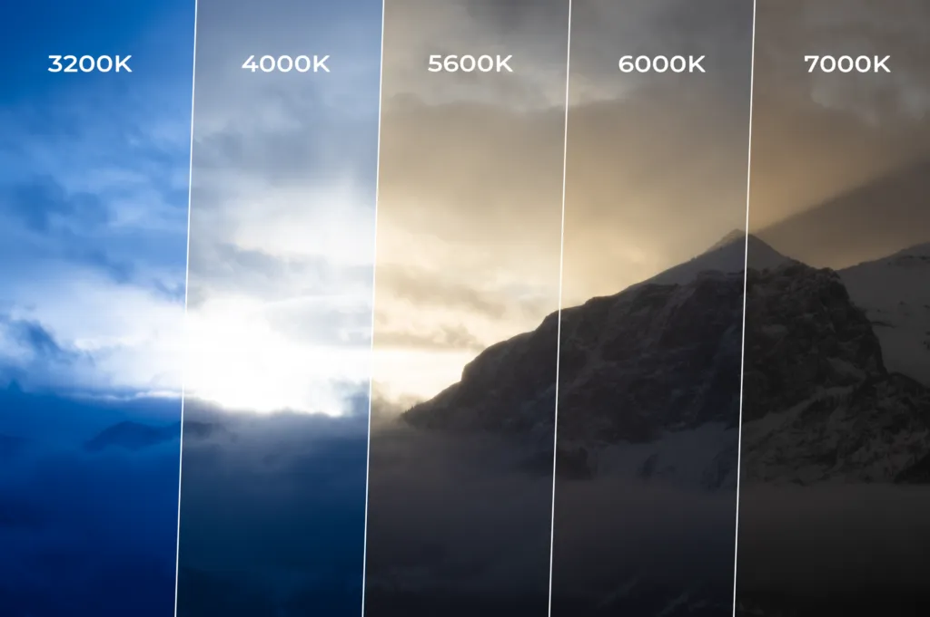
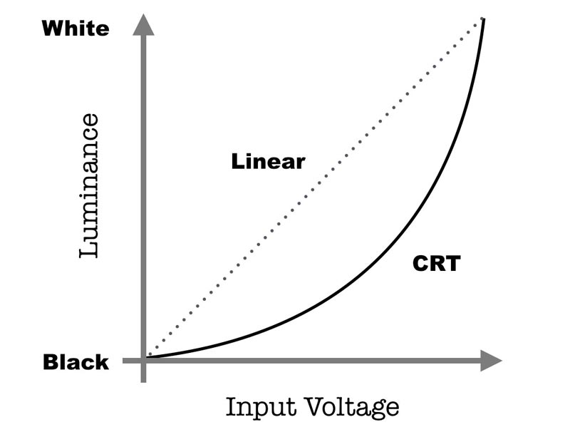
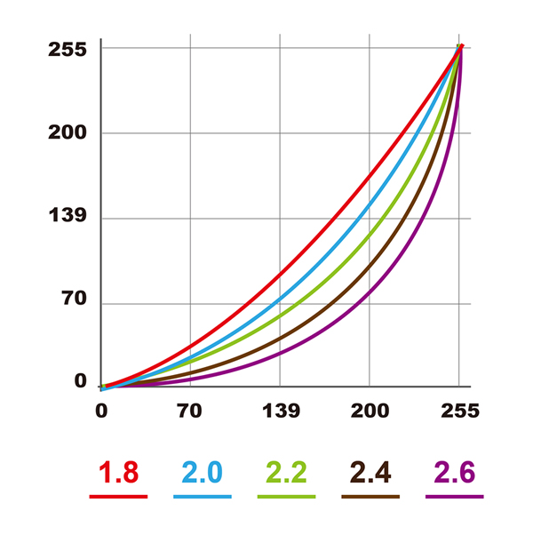

Storing into JPEG… Digital Signal Processor (DSP)
Demosaicing
Sharpening
White Balance
Gamma
Compress
Color Temperature
CRT: Cathode Ray Tube $γ=2.2$
LCD: Liquid-Crystal Display
Digital Camera $γ=0.45$

Slide 9
Introduction
Three components of the imaging pipeline that affect this mapping:
1. Radiometric Response Function
Maps photons arriving at the lens into digital values stored in the image file
2. Vignetting
Darkens pixel values near the periphery of images
3. Point Spread Function
Characterizes the blur induced by the lens, anti-aliasing filters, and finite sensor areas
Notes:
在成像流程中有三個要件會影響這個的映射，分別是：Radiometric Response Function, Vignetting, Point Spread Function
，他們的中文分別是輻射測量的響應函數、暗角、點擴散函數

Slide 10
10.1.1 Radiometric Response Function
Factors affect this mapping:
1. Aperture and Shutter Speed: Global multiplier of incoming light
2. Sensor (Analog to Digital Converter): Linear gain, set by ISO value
Notes:
如圖 10.2 所示，有一些因素會影響落在透鏡的光亮度如何映射成影像檔案所儲存的數值。
在這裡我們先忽略任何非均勻的衰減在透鏡內。
第一個影響這個映射的因素是光圈和快門速度，他們可以被模型化為入射光線的全域倍增器或乘法器，那這個入射的光線通常量化為曝光值。
第二個是

Slide 11
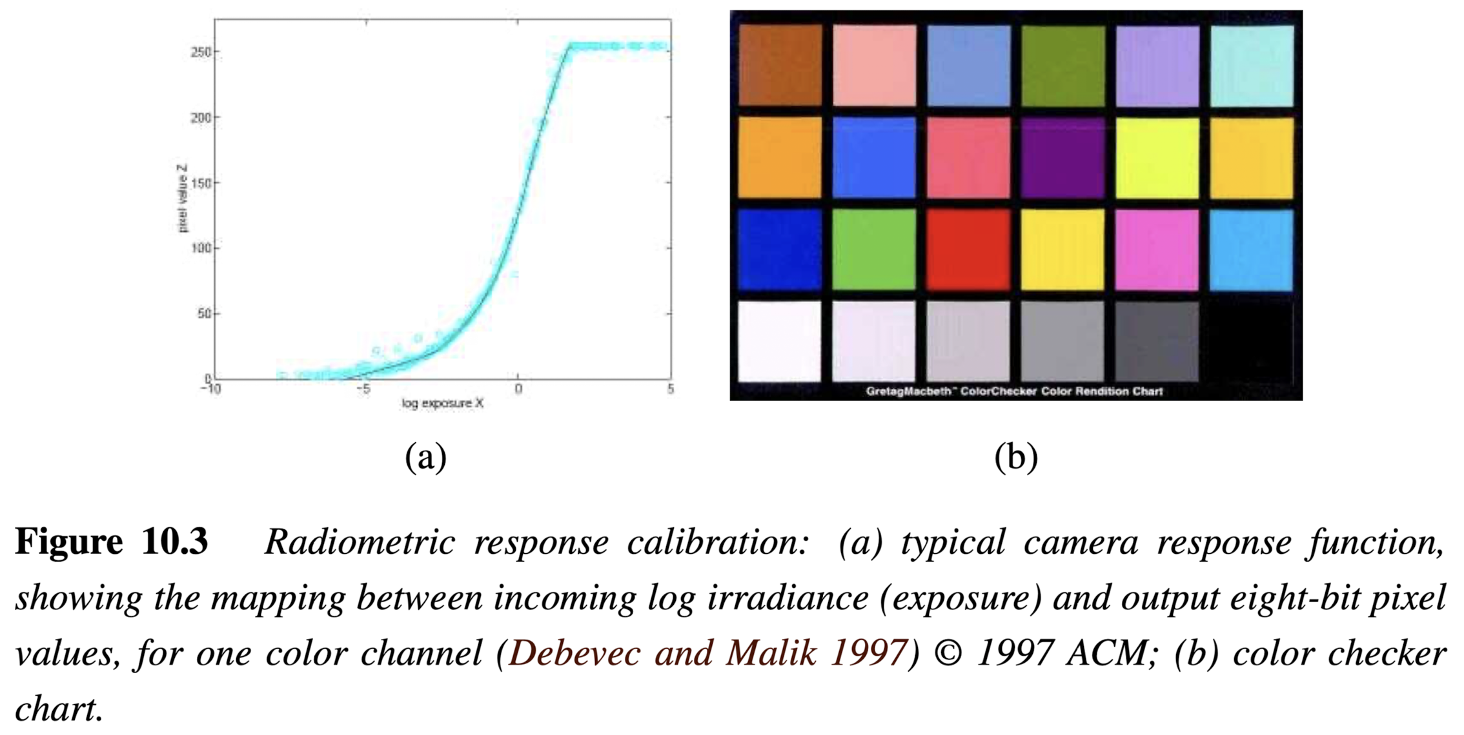
10.1.1 Radiometric Response Function
Given the complexity of all of this processing, it is difficult to model the camera response function (Figure 10.3a), mapping between incoming irradiance and digital RGB values
Notes:
如圖 10.2 所示，有一些因素會影響落在透鏡的光亮度如何映射成影像檔案所儲存的數值。
在這裡我們先忽略任何非均勻的衰減在透鏡內。
第一個影響這個映射的因素是光圈和快門速度，他們可以被模型化為入射光線的全域倍增器或乘法器，那這個入射的光線通常量化為曝光值。
第二個是

Slide 12
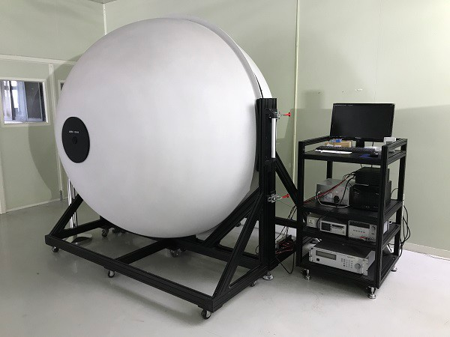

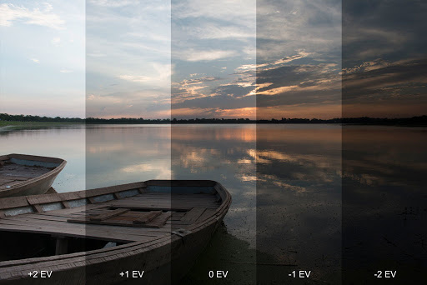

EV: Exposure Value
LV: Light Value
A more practical approach…
Calibrate the camera by measuring correspondences between incoming light and final values
1. Integrating Sphere (Expensive)
2. Calibration Chart (Needs uniform lighting)
3. Multiple Exposures
4. International Color Consortium (ICC) Profile
Notes:
use an integrating sphere, which is a large (typically 1m diameter) sphere carefully painted on the inside with white matte paint. An accurately calibrated light at the top controls the amount of radiance inside the sphere (which is constant everywhere because of the sphere’s radiometry) and a small opening at the side allows for a camera/lens combination to be mounted. By slowly varying the current going into the light, an accurate correspondence can be established between incoming radiance and measured pixel values
A more practical alternative is to use a calibration chart (Figure 10.3b) such as the Mac- bethorMunsellColorCheckerChart.10 Thebiggestproblemwiththisapproachistoensure uniform lighting. One approach is to use a large dark room with a high-quality light source far away from (and perpendicular to) the chart. Another is to place the chart outdoors away from any shadows. (The results will differ under these two conditions, because the color of the illuminant will be different.)
The easiest approach is probably to take multiple exposures of the same scene while the camera is on a tripod and to recover the response function by simultaneously estimating the incoming irradiance at each pixel and the response curve (Mann and Picard 1995; Debevec and Malik 1997; Mitsunaga and Nayar 1999). This approach is discussed in more detail in Section 10.2 on high dynamic range imaging.

Slide 13
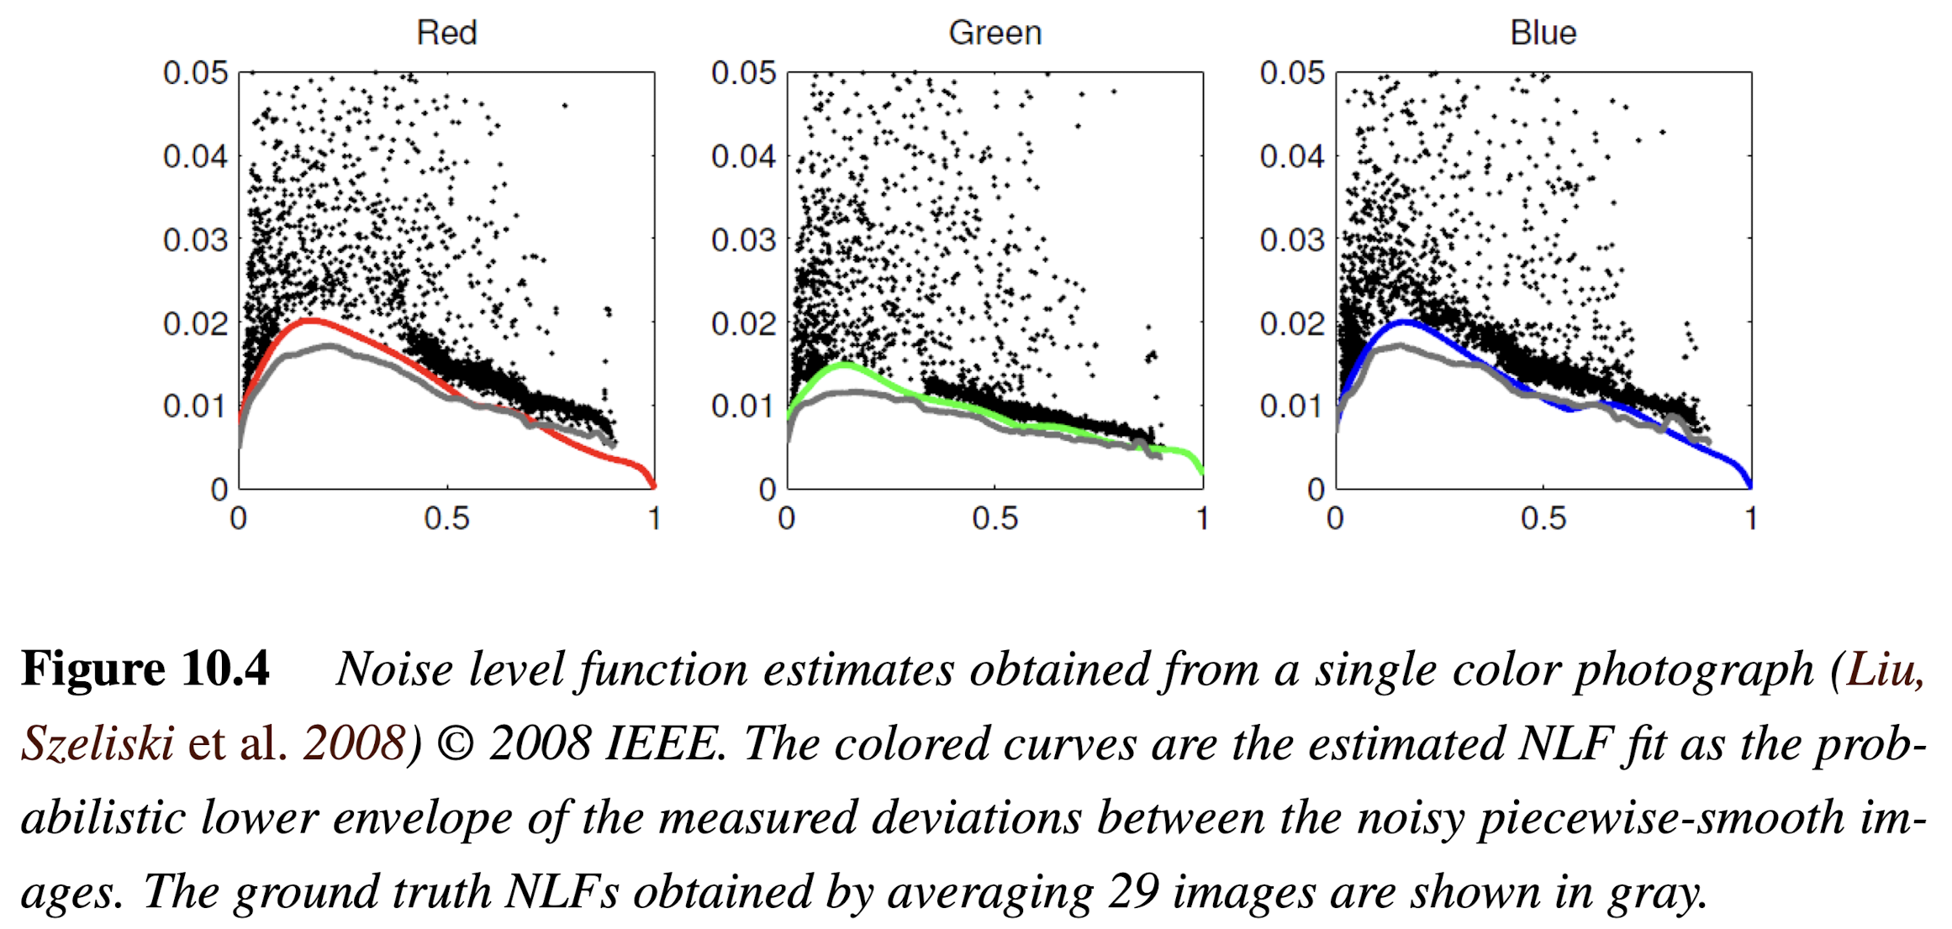
10.1.2 Noise Level Estimation
Noise Level Function:
1. Standard Deviation
2. Noise Level Function
- At independent pixels:
temporal variance
- Over regions:
spatial variance

Slide 14
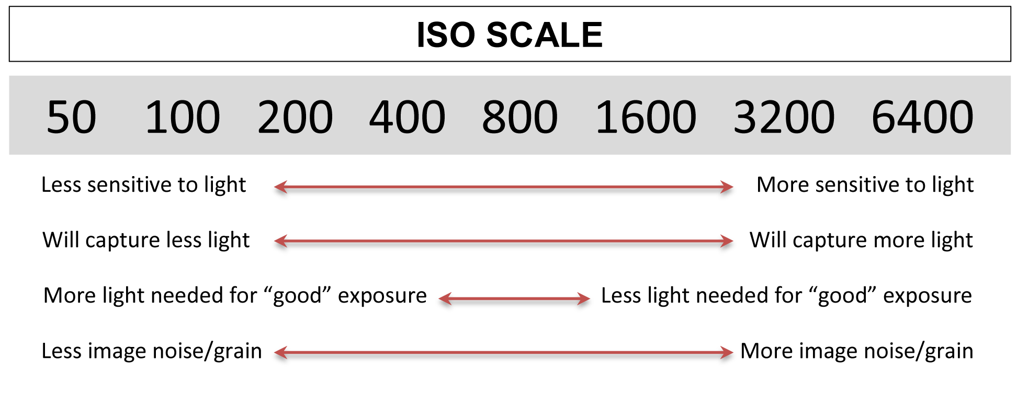
Noise Level depends on:
ISO gain (main factor)
Sensor temperature and other minor factors
Fine
Coarse

Slide 15
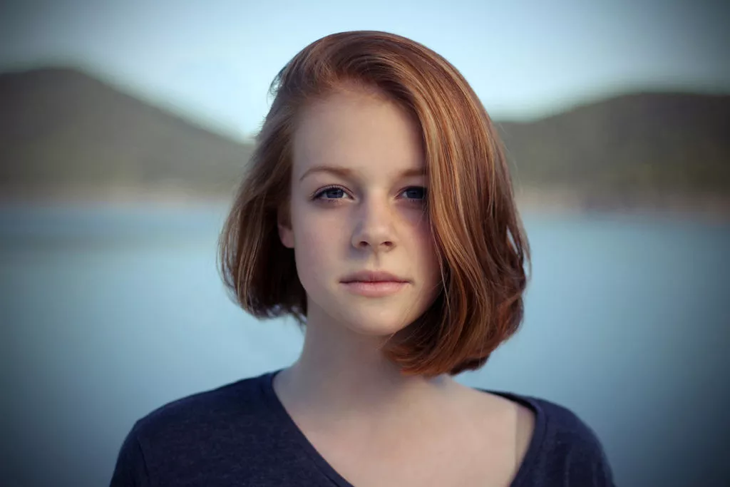
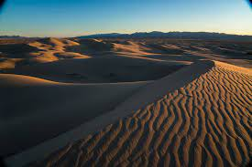
10.1.3 Vignetting
Definition: Vignetting is the darkening of the areas at the border of the photograph, especially at large apertures.
Common with wide angle and wide aperture lenses.
Calibration: Integrating Sphere (expensive)
Alternative approaches?
Image links:https://reurl.cc/KMzKa9

Slide 16
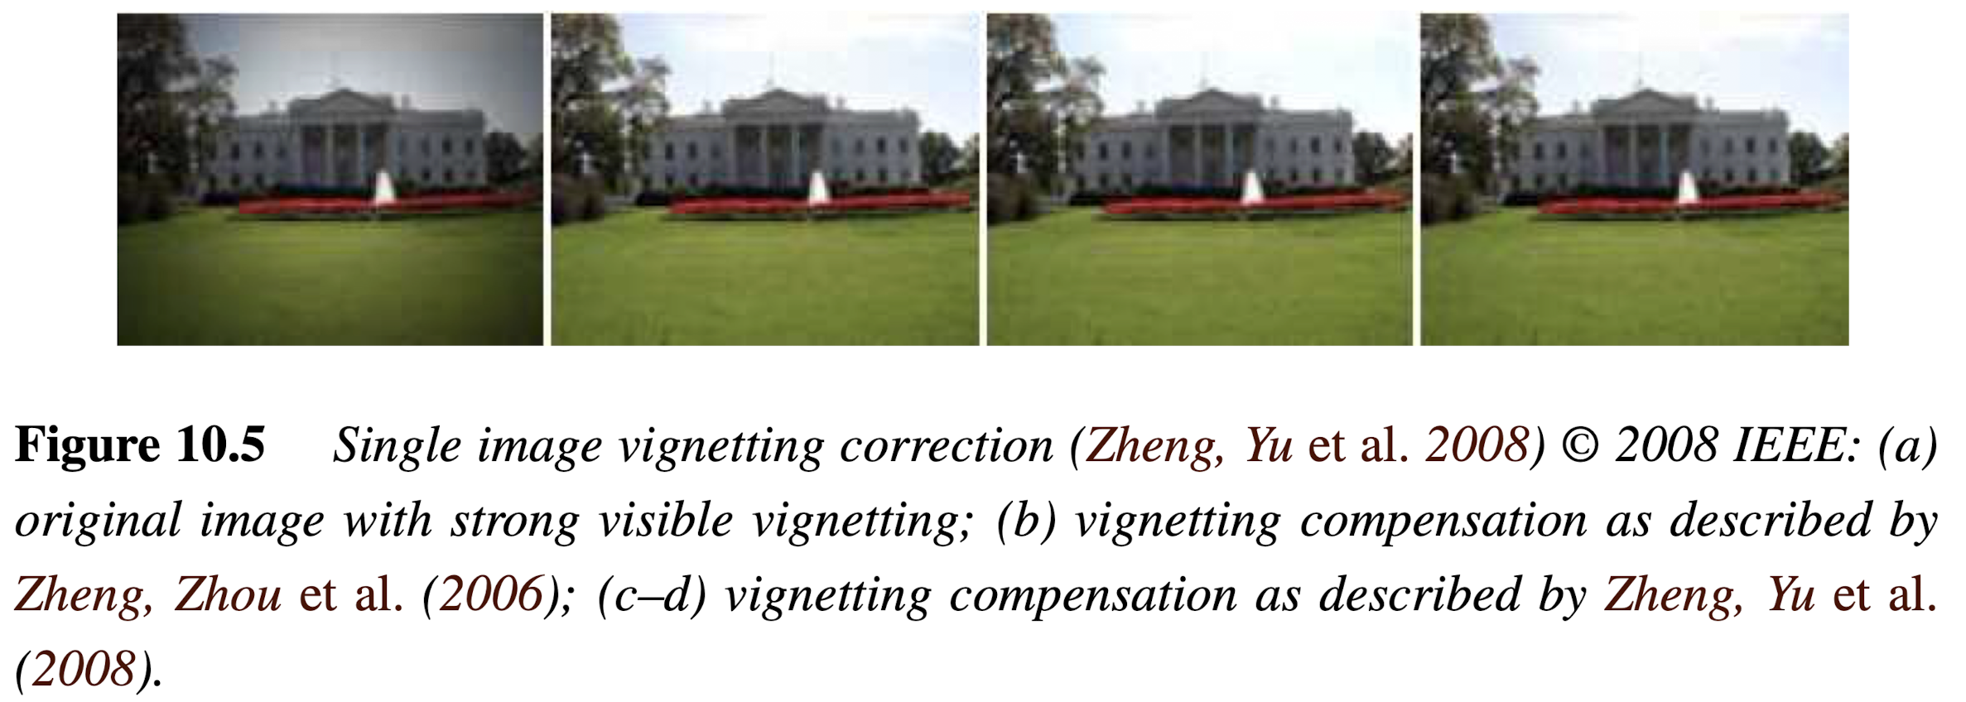
Stitch panoramic scene
Assume that the true radiance at each pixel comes from the central portion of each input image. This is easier to do if the radiometric response function is already known (e.g., by shooting in RAW mode) and if the exposure is kept constant.
Single image
  Zhang, Lin, Kang (‘06): Segment into smoothly varying regions
  Zheng, Yu et al. (‘08): Radial gradients at all the pixels

Slide 17
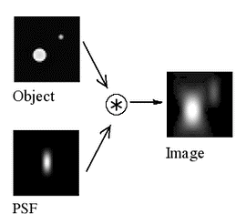
10.1.4 Optical Blur (Spatial Response) Estimation
a.k.a.: also known as
Spatial Response Function
Encodes the optical blur that gets convolved with the incoming image to produce the point-sampled image
Point Spread Function (PSF)
  a.k.a. Optical Transfer Function
  The shape of the convolution kernel

Slide 18
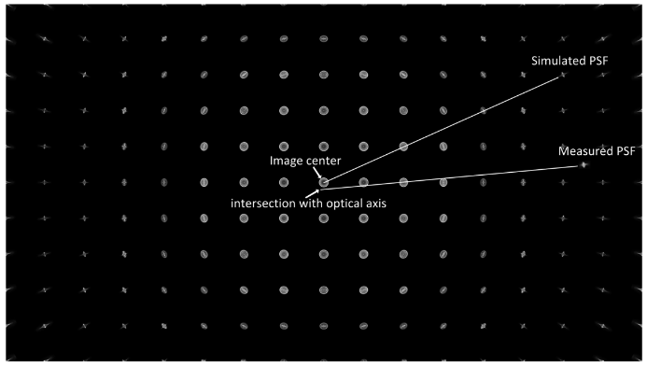
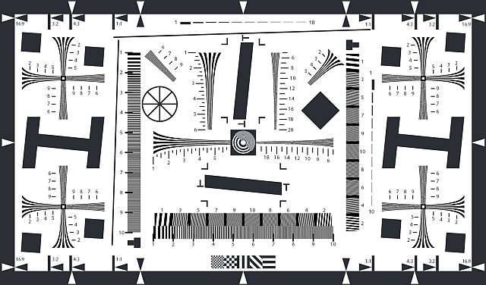
10.1.4 Optical Blur (Spatial Response) Estimation
Theory: small light source everywhere
More practical
  observe image of long straight lines or bars
  slightly slanted edges are preferred

Slide 19
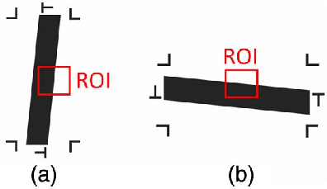
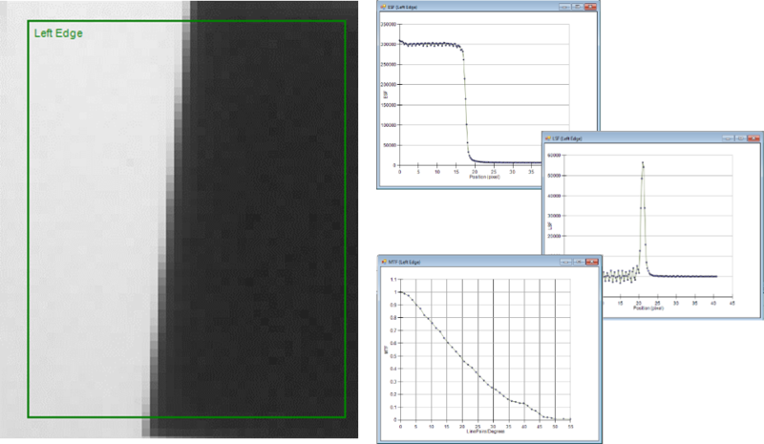
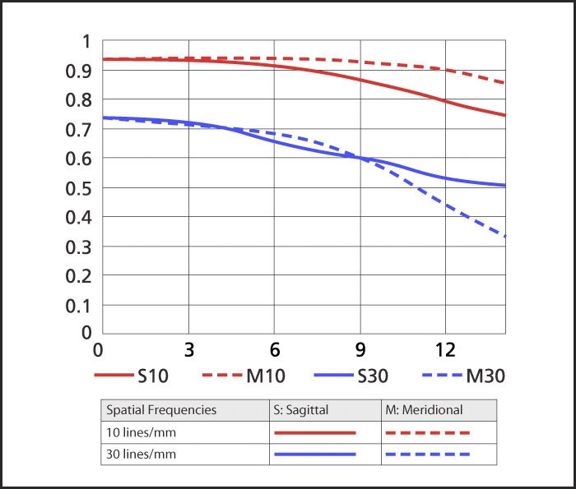
10.1.4 Optical Blur (Spatial Response) Estimation
ROI: Region Of Interest
Slanted lines gives us 1D projection of the 2D PSF
It is also called the Line Spread Function (LSF)
We can convert into Fourier domain to plot a Modulation Transfer Function (MTF) chart

Slide 20
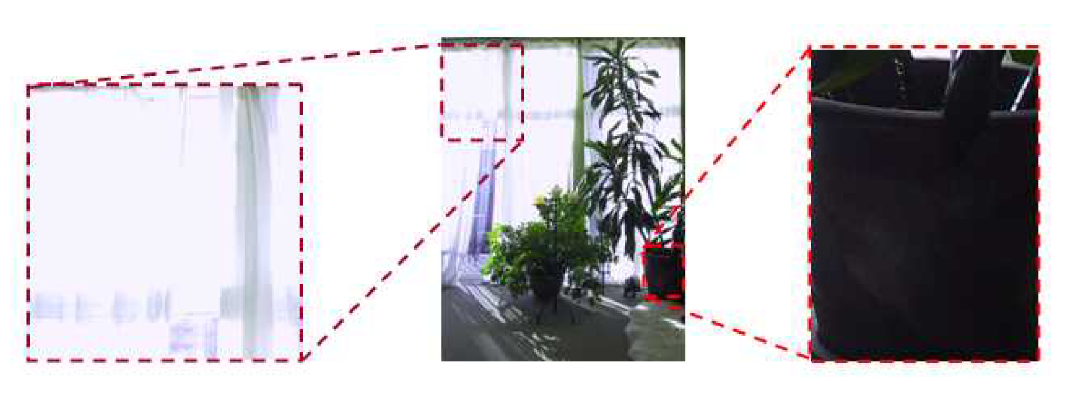
10.2 High Dynamic Range Imaging
Image taken at different exposures can help you create well-exposed photographs under challenging conditions.

Slide 21
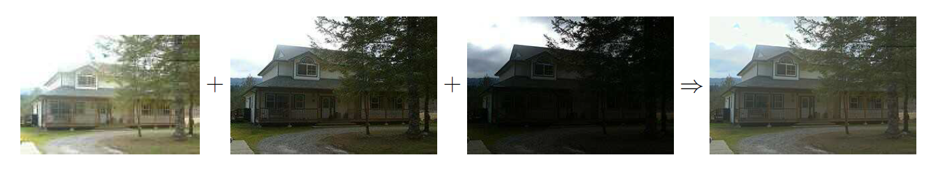
Approach
Simplest: combine pixels from different exposures
  Risk of creating contrast reversals and halos.
More common approach (3 stages)
Estimate the radiometric response function
Estimate a radiance map
Tone map the image into a displayable gamut

Slide 22
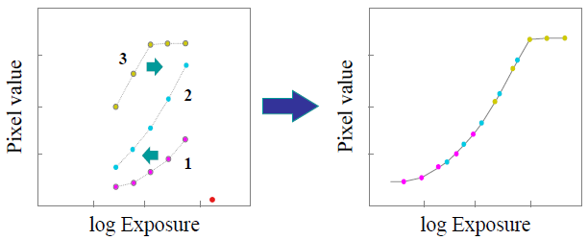

Step 1: Estimate the radiometric response function
Idea: If we can determine the irradiance (exposure) $E_{i}$ at each pixel, we could plot it against the measured pixel value $z_{ij}$ for each exposure time $t_{j}$.

Slide 23
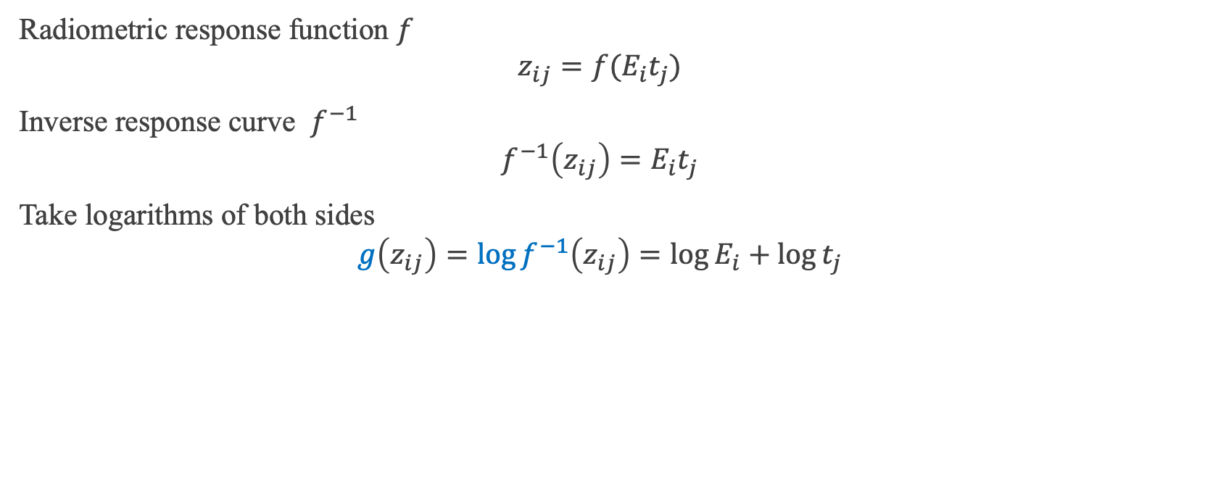
Step 1: Estimate the radiometric response function
Radiometric response function $f$
$$z_{ij}=f(E_{i}t_{j})$$
Inverse response curve $f^{−1}$
$$f^{−1}\left(z_{ij}\right)=E_{i}t_{j}$$
Take logarithms of both sides
$$g\left(z_{ij}\right)=\log{f^{−1}\left(z_{ij}\right)}=\log{E_{i}}+\log{t_{j}}$$
Notes:
Ei: 輻照度
Tj: 曝光時間
Zij: 像素值
F: 輻射響應函數

Slide 24


Step 1: Estimate the radiometric response function
$$g\left(z_{ij}\right)=\log{f^{−1}\left(z_{ij}\right)}=\log{E_{i}}+\log{t_{j}}$$
Debevec and Malik (1997)…
Assume $t_{j}$ are known
Unknowns: $E_{i}$, $g_{k}=g(k)$, $k∈\left[0,255\right]$ if 8-bit
Second-order smoothness constraint
$$λ\sum_{k}{g^{′′}{\left(k\right)}^{2}}= λ\sum{{\left[g\left(k−1\right)−2g\left(k\right)+g\left(k+1\right)\right]}^{2}}$$
Notes:
假設曝光時間已知
未知數有幅照度Ei和反應函數的反函數gk
二階導數的平滑限制，
使得最後求得的反應函數曲線更平滑

Slide 25
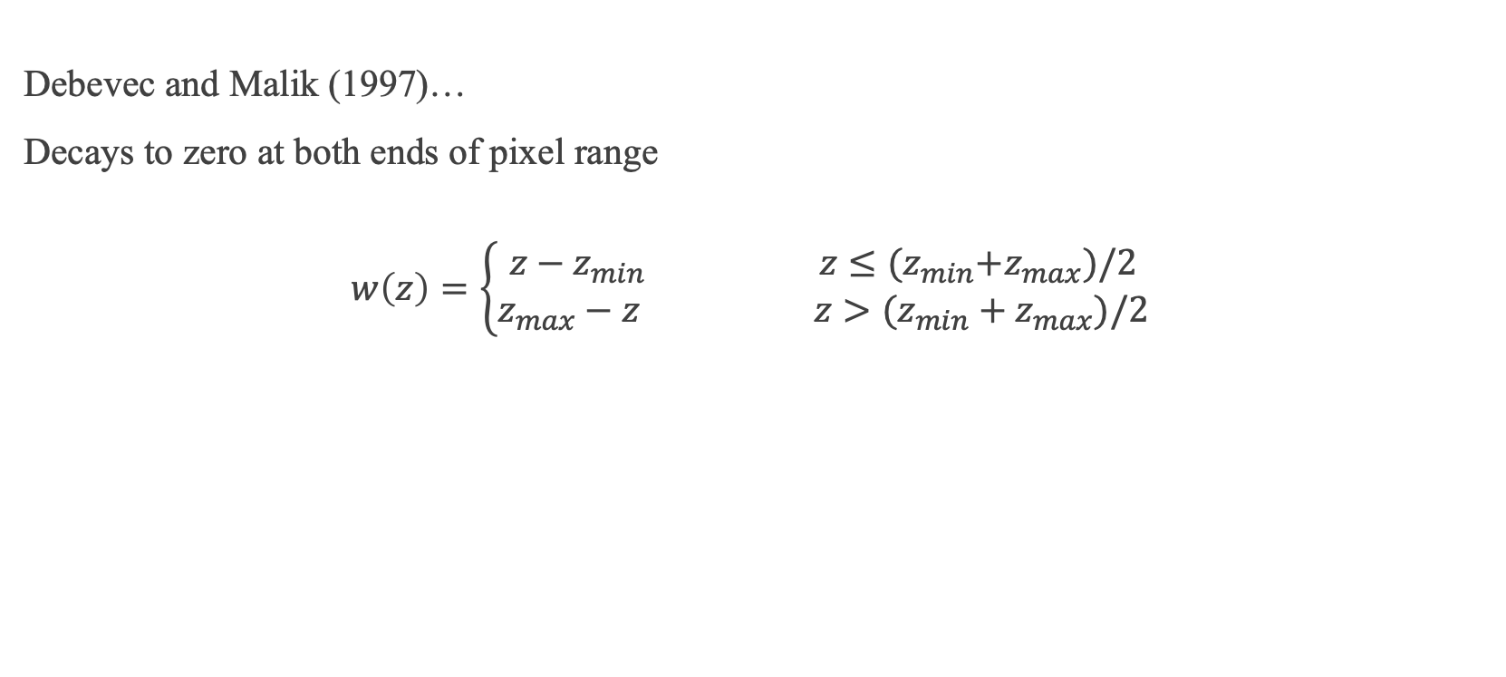
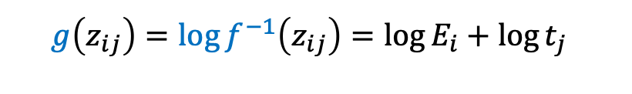
Step 1: Estimate the radiometric response function
$$g\left(z_{ij}\right)=\log{f^{−1}\left(z_{ij}\right)}=\log{E_{i}}+\log{t_{j}}$$
Debevec and Malik (1997)…
Decays to zero at both ends of pixel range
$$w\left(z\right)=\left\{\begin{aligned}z−z_{min} z≤{(z}_{min}+z_{max})/2 \\ z_{max}−z z>(z_{min}+z_{max})/2\end{aligned}\right.$$
Notes:
加入了另一項限制，因為他們發現靠近影像中心的值是較為準確
將影像兩側不準確的值作 decay

Slide 26
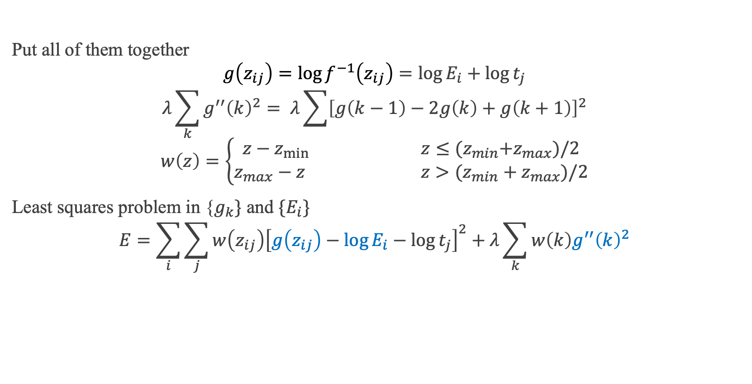
Step 1: Estimate the radiometric response function
Put all of them together
$$g\left(z_{ij}\right)=\log{f^{−1}\left(z_{ij}\right)}=\log{E_{i}}+\log{t_{j}}$$
$$λ\sum_{k}{g^{′′}{\left(k\right)}^{2}}= λ\sum{{\left[g\left(k−1\right)−2g\left(k\right)+g\left(k+1\right)\right]}^{2}}$$
$$w\left(z\right)=\left\{\begin{aligned}z−z_{min} z≤{(z}_{min}+z_{max})/2 \\ z_{max}−z z>(z_{min}+z_{max})/2\end{aligned}\right.$$
Least squares problem in {$g_{k}\}$ and $\{E_{i}\}$
$$E=\sum_{i}{\sum_{j}{w\left(z_{ij}\right){\left[g\left(z_{ij}\right)−\log{E_{i}}−\log{t_{j}}\right]}^{2}}}+λ\sum_{k}{w\left(k\right)g^{′′}{\left(k\right)}^{2}}$$
Notes:
第一式：輻射反應函數的反函數 g
第二式：
用最小平方法去求得 Ei 和 g 的值

Slide 27
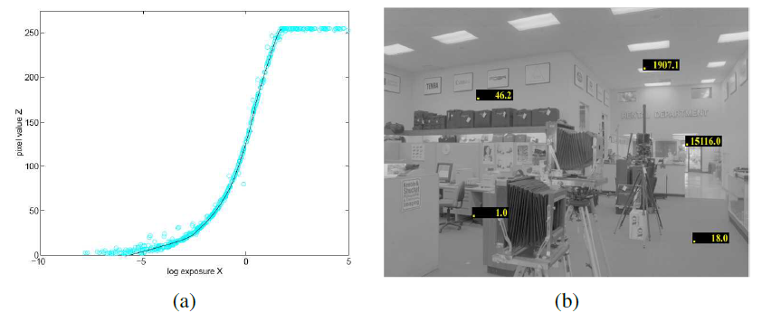
Step 1: Estimate the radiometric response function
Result (Debevec and Malik 1997)
Notes:
左邊是輻射反應函數

Slide 28
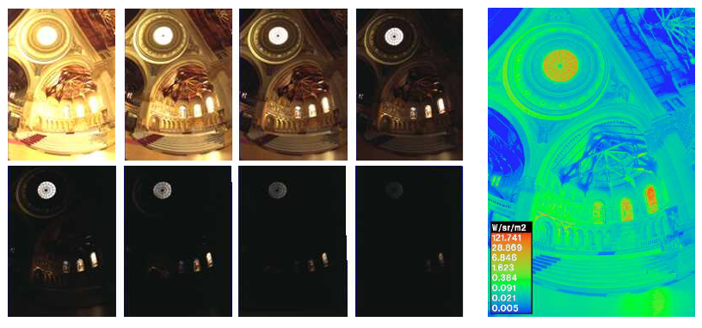
Step 2: Estimate a radiance map
Step 2: Merge the input images into a composite radiance map.
Ideal: 𝐸=𝑔(𝑧), but…
Notes:
第二步是要繪制一個輻射圖
理想上，只要有輻射反應函數和像素值z，就可以求得福照度 E

Slide 29
Step 2: Estimate a radiance map
Problem 1: Pixels are noisy
  Mitsunaga and Nayar (1996): Emphasize both higher pixel and larger gradients in the transfer function.
Notes:
但有一些像素是雜訊，所以不能用這個方法推得

Slide 30
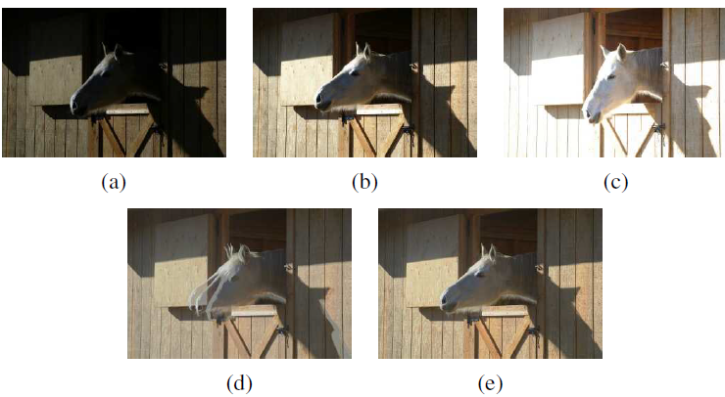
Step 2: Estimate a radiance map
Problem 2: moving objects
  Ward (2003): global transform to align
  Uyttendaele (2003): combine global registration and local motion estimation (optical flow)

Slide 31
HDR Image Formats
IEEE: Institute of Electrical and Electronics Engineers
Best solution: 32-bit IEEE float
Intermediate: 16-bit float for each channel
Notes:
第二步得到輻射圖後會轉成

Slide 32
10.2.1 Tone Mapping
Necessary to display on a lower gamut screen.
Simplest way: global transfer curve
Apply separate to each channel?
  Colors become muted (higher-valued color channels contribute less)
Better approach: extract the luminance, and apply the global mapping to the luminance channel.
Notes:
將右下角的輻射圖轉換成可顯示色域的範圍

Slide 33
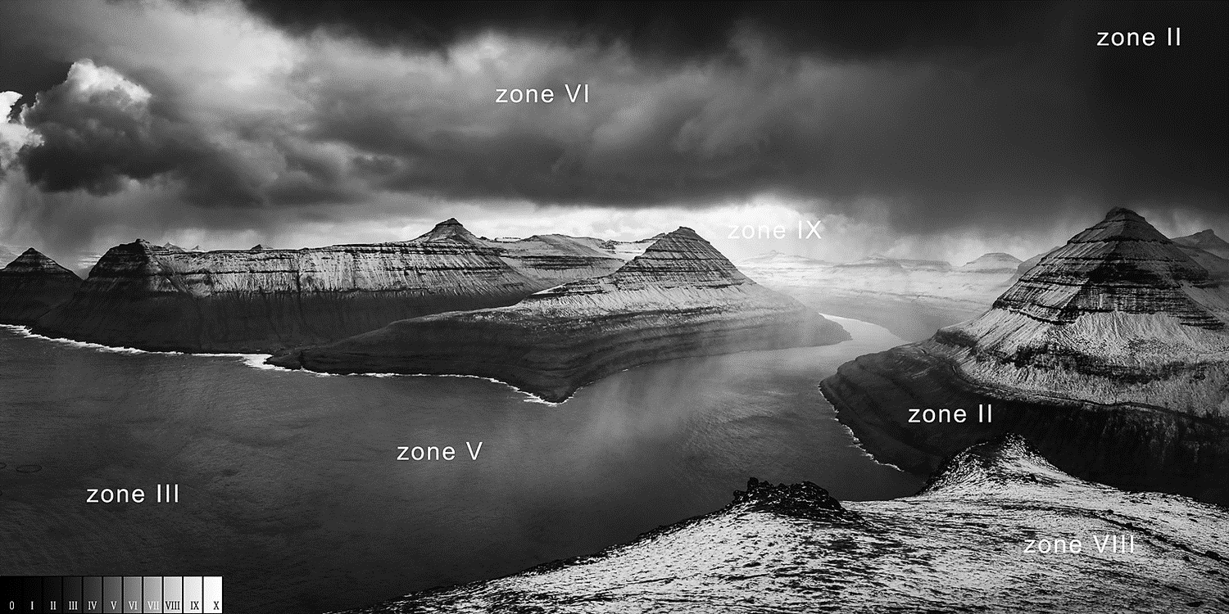
10.2.1 Tone Mapping
Fail to preserve details in regions with widely varying exposure.
Need something similar to dodging and burning
  Divide each pixel by the average brightness in a region around that pixel.
Notes:
運用亮度通道來做 Global mapping
如果附近很亮就除比較多，如果附近很暗就除的比較少

Slide 34
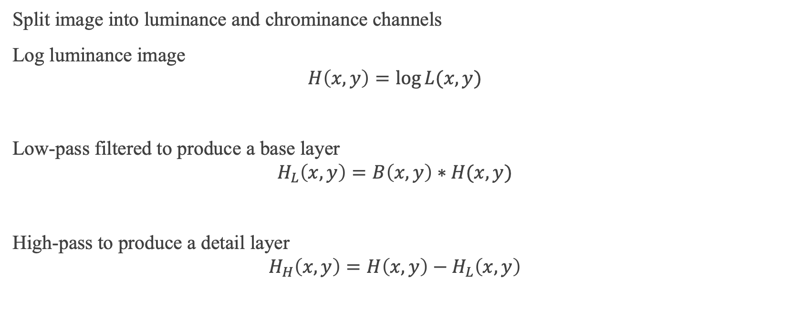
Mathematical Dodge and Burn
Split image into luminance and chrominance channels
Log luminance image
$$H\left(x,y\right)=\log{L(x,y)}$$
Low-pass filtered to produce a base layer
$$H_{L}\left(x,y\right)=B\left(x,y\right)∗H(x,y)$$
High-pass to produce a detail layer
$$H_{H}\left(x,y\right)=H\left(x,y\right)−H_{L}\left(x,y\right)$$
Notes:
將影像分成亮度和色度的通道
先對亮度取log

Slide 35

Mathematical Dodge and Burn
Contrast reduce base layer to desired luminance range
$$H_{H}^{′}\left(x,y\right)=sH_{H}(x,y)$$
Add the detail layer
$$I\left(x,y\right)=H_{H}^{′}\left(x,y\right)+H_{L}(x,y)$$
Exponentiate to produce the tone-mapped image
Notes:
壓縮到可以顯示的範圍

Slide 36
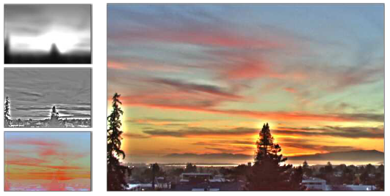
Mathematical Dodge and Burn
Visible halo in the detail layer around high contrast edges
Notes:
最左上角是 base layer
中間是 detail layer
它解決了保存細節的問題

Slide 37
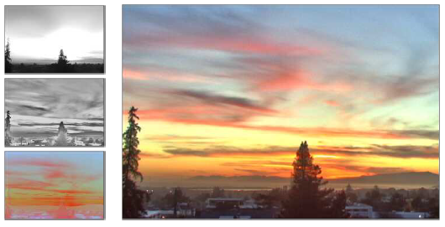
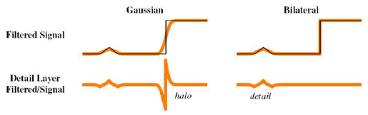
Solution to Halo: edge-preserving filter
Problem: linear filtering is not edge-preserving
Solution 1: Bilateral filtering
  Durand and Dorsey (2002)

Slide 38

Solution to Halo: edge-preserving filter
Solution 2: Derivatives
Differentiate log-luminance image
$$H^{′}\left(x,y\right)=∇H\left(x,y\right)$$
Attenuate the gradient image by a spatially varying attenuation function
$$G\left(x,y\right)=H^{′}\left(x,y\right)Φ(x,y)$$

Slide 39
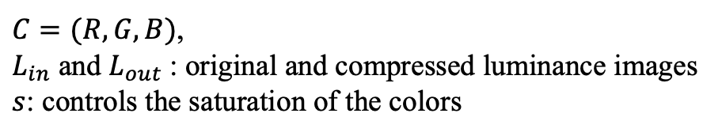
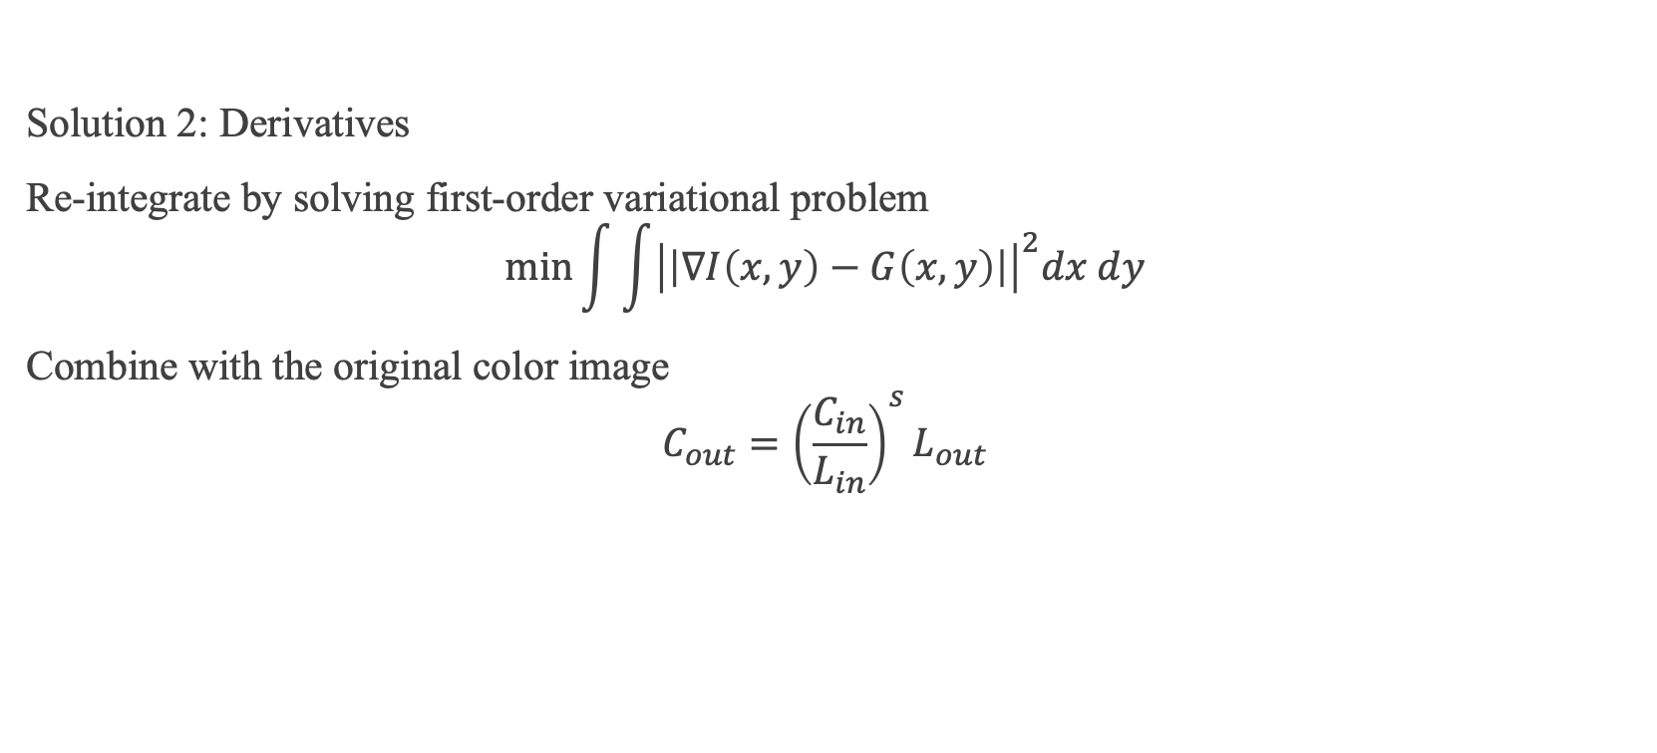
Solution to Halo: edge-preserving filter
Solution 2: Derivatives
Re-integrate by solving first-order variational problem
$$\min{\int{\int{{\left|\left|∇I\left(x,y\right)−G\left(x,y\right)\right|\right|}^{2}dx dy}}}$$
Combine with the original color image
$$C_{out}={\left(\frac{C_{in}}{L_{in}}\right)}^{s}L_{out}$$
$C=(R,G,B)$,
$L_{in}$ and $L_{out}$: original and compressed luminance images
$s$: controls the saturation of the colors

Slide 40
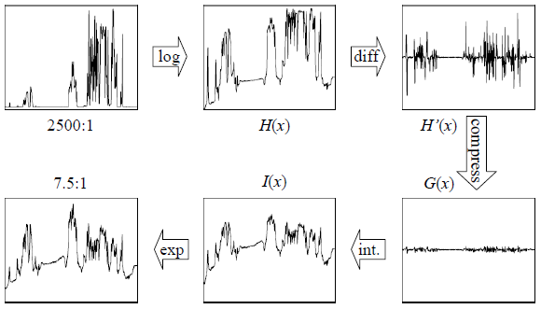
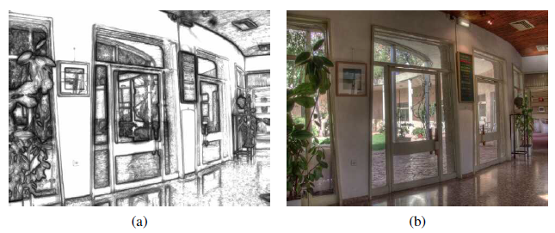
Solution to Halo: edge-preserving filter
Solution 2: Derivatives

Slide 41
10.3
Super-resolution, denoising, and blur removal

Slide 42
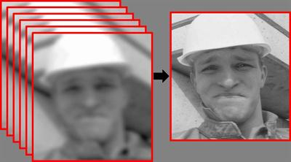
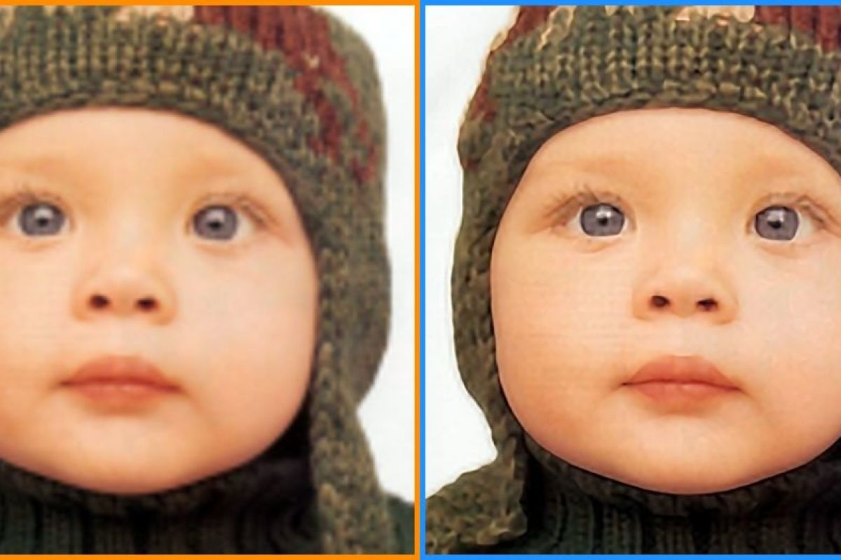
Introduction
Super-resolution goals…
Higher spatial resolution
Less noise

Slide 43
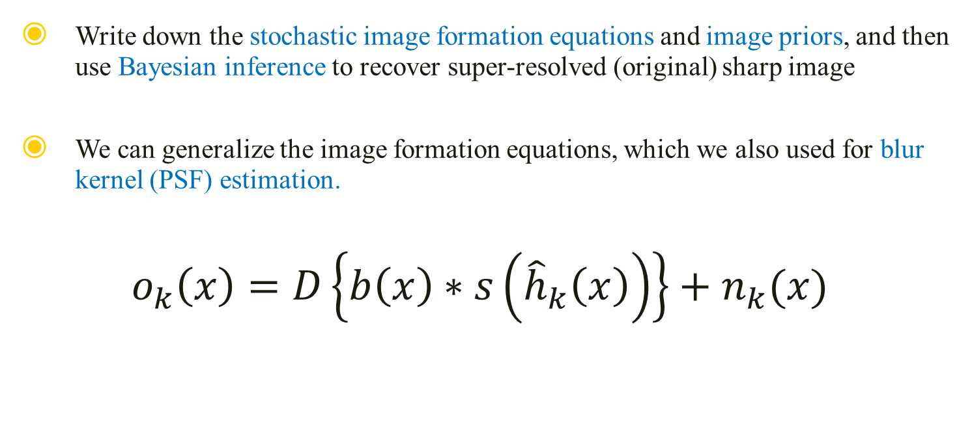
Multi-Image Super Resolution
Write down the stochastic image formation equations and image priors, and then use Bayesian inference to recover super-resolved (original) sharp image
We can generalize the image formation equations, which we also used for blur kernel (PSF) estimation.
$$o_{k}\left(x\right)=D\left\{b\left(x\right)∗s\left({\hat{h}}_{k}\left(x\right)\right)\right\}+n_{k}(x)$$

Slide 44

Multi-Image Super Resolution
$$o_{k}\left(x\right)=D\left\{b\left(x\right)∗s\left({\hat{h}}_{k}\left(x\right)\right)\right\}+n_{k}(x)$$
We have several observed images {$o_{k}\left(x\right)$}
Image warping function for each image {${\hat{h}}_{k}(x)$}
Downsampling operator $D$
Least squares problem:
$$\sum_{k}{{\left|\left|o_{k}\left(x\right)−D\left\{b_{k}\left(x\right)∗s\left({\hat{h}}_{k}\left(x\right)\right)\right\}\right|\right|}^{2}}$$

Slide 45

Multi-Image Super Resolution
$$\sum_{k}{{\left|\left|o_{k}\left(x\right)−D\left\{b_{k}\left(x\right)∗s\left({\hat{h}}_{k}\left(x\right)\right)\right\}\right|\right|}^{2}}$$
The PSF (blur kernel) $b_{k}$ is inferred or calibrated
Simultaneously inferring the blur kernel and the sharp image → blind image deconvolution
Matrix notation
$$\sum_{k}{{\left|\left|o_{k}−DB_{k}W_{k}s\right|\right|}^{2}}$$

Slide 46



Multi-Image Super Resolution
How well does this work?
  Depends on camera optics, motion and PSF estimates.
  No image prior → lots of high-frequency noise introduced
Assume some form of image prior
TL: Original,
TR: Bicubic,
BL: Maximum Likelihood Estimate

Slide 47




Assume Image Priors
Simplest: penalty on the image derivatives
$$\sum_{i,j}{ρ_{p}\left(s\left(i,j\right)−s\left(i+1,j\right)\right)+ρ_{p}(s\left(i,j\right)−s\left(i,j+1\right))}$$
  Gaussian Markov Random Field (GMRF)
  Problem: Ripples
Piecewise continuous solutions
  Blend of Gaussian and Laplacian

Slide 48

Hallucination
Derivative priors can not hallucinate higher frequency texture or details.
To do this… use training set of examples
Baker and Kanade (’02): use local derivative-of-Gaussian filter response as features and then match parent structure vectors

Slide 49
10.3.1 Color Image Demosaicing

Slide 50



Demosaicing
Special case of super-resolution, used everyday…
Demosaicing from a color filter array (CFA) into full-color RGB
Artifacts are more visible to the eye
Zippering effect
Color Fringing
  Bennett, Uyttendaele (’06): two color model
Notes:
期末考2

Slide 51


Slide 52
10.4
Image Matting and Compositing

Slide 53
Introduction
Process of cutting a foreground object out of one image and pasting it against a new background.
Different from segmentation techniques?
  Subtle interplay of mixed pixels along the along the boundary
Pull a matte
  Estimate a soft opacity channel α and the uncontaminated foreground colors F from the input composite image C.

Slide 54

Equation
The compositing equation (review)
$$C=\left(1−α\right)B+αF$$
The reverse matting operation is much more challenging.
Section structure:
Blue screen matting
Natural image matting
Variants

Slide 55



10.4.1 Blue Screen Matting
Filming an actor/object in front of constant colored background.
Chuang, Curless (’01): Mishima’s algorithm
  Fit two polyhedral surfaces, separating the foreground and background color
  distributions
  Measure a relative distance to measure α
  Problem: blue spill

Slide 56



Two Screen Matting
Use more than one color to over-constrain the equations
$$C−αF=\left(1−α\right)B$$
$B$ should be chosen so as not to saturate $C$
several values of $B$ should be used

Slide 57

10.4.2 Natural Image Matting
Nothing known about the background, except a rough segmentation, known as trimap.

Slide 58


Knockout
Simple algorithm: Knockout
  Nearest known foreground and background pixels are determined to produce per-pixel foreground and background color estimate
  Background color is adjusted so the measured color C lies on the line between F and B
  Opacity α is estimated on per-channel basis
Problem when background consist more than one dominant color

Slide 59
Bayesian
More accurate: treat F and B as distribution sampled over some region
Chuang, Curless (’01)
  Use full 3x3 color covariance matrices to model mixture of correlated Gaussians
  Matte extraction proceeds in strips starting from known color values growing into the unknown regions
  Fully Bayesian

Slide 60

Bayesian
Results

Slide 61
10.4.3 Optimization-based Matting
Alternative to estimating each pixel independently…
Use global optimization to compute a matte that takes into account correlations between neighboring α values
Border Matting
Poisson Matting

Slide 62


Border Matting
Border Matting
  Grab-cut segmentation
  Solve for boundary location $∆$ and a blur width $σ$ for every pixel along the boundary
  Dynamic programming to enforce smoothness in these parameters.
Problem: difficulty with fine details

Slide 63



Poisson Matting
Poisson Matting
  Assume known foreground and background color for each pixel
  Assumes the gradient of the alpha matte and the gradient of the color image are related by
  $$∇α=\dot{\frac{F−B}{{\left|\left|F−B\right|\right|}^{2}}}∇C$$

Slide 64

Results
Latest result: http://alphamatting.com

Slide 65

10.4.4 Smoke, Shadow, and Flash Matting
Smoke
  linear combination of background color and a constant foreground color.
Shadow
  pixel is assumed to vary between its fully lit and fully shadowed colors.

Slide 66
10.4.5 Video Matting
The presence of moving objects can sometimes make the matting process easier
Chuang, Agarwala (‘02)
  foreground objects are first remove
  resulting background plates are aligned
  yield a high quality background estimate

Slide 67
10.5
Texture Analysis and Synthesis

Slide 68


Introduction
"Given a small sample of a texture, generate a larger similar-looking image."

Slide 69
Traditional Approach
Match the spectrum of the source image while generating shaped noise. → Spatial correlations
The distributions of the responses at different frequencies must also match.

Slide 70


Exemplar-Based
Generate texture pixels by looking for neighborhoods in the source texture.
Can be repeated down or around the periphery when filling holes.

Slide 71
Thank You for Listening

