Slide 1
Chapter 11: Structure from Motion and SLAM
SLAM: Simultaneous Localization and Mapping
Speaker: Tai Peng
E-mail: d11944016@ntu.edu.tw
Phone: 0981875118
Advisor: Prof. Chiou-Shann Fuh
Graduate Institute of Networking and Multimedia
College of Electrical Engineering and Computer Science
National Taiwan University

Slide 2
Outline
11.1 Geometric intrinsic calibration
11.2 Pose estimation
11.3 Two-frame structure from motion
11.4 Multi-frame structure from motion
11.5 Simultaneous Localization And Mapping (SLAM)

Slide 3
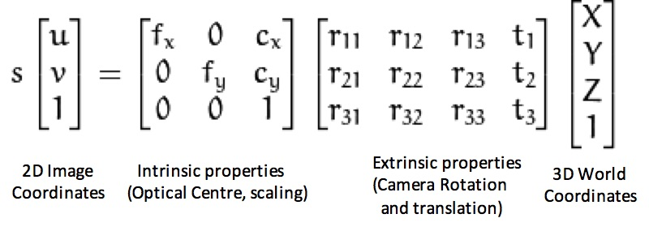
Camera matrix
camera matrix
Notes:
內參數matrix: 相機工藝決定
外參數matrix:
fx: pixel/m
fy: pixel/m
cx: 偏移
cy: 偏移
R:旋轉
T:平移
------------------
為了方便計算，假設 skew coefficient 為 0 (X, Y, Z) 為 3D 點的世界座標 (u, v) 為影像座標 A 為相機矩陣，也就是內部參數矩陣 (cx, cy) 為影像的正中心點座標 fx, fy 為以 pixel 為單位的焦距距離

Slide 4
Camera matrix

Slide 5
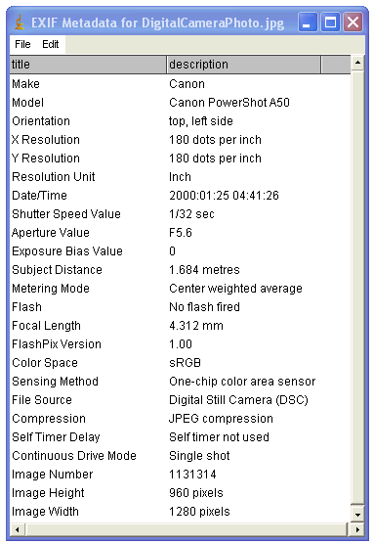
Camera matrix
EXIF: Exchangeable Image File Format
JPEG: Joint Photographic Experts Group
sRGB: standard Red, Green, Blue

Slide 6
11.1 Geometric intrinsic calibration
11.1.1 Vanishing points
11.1.2 Application: Single view metrology
11.1.3 Radial distortion

Slide 7
11.1 Geometric intrinsic calibration(1/6)
Notes:
內參數matrix: 相機工藝決定
外參數matrix:
fx: f*pixel/m
fy: f*pixel/m
cx: 偏移
cy: 偏移
R:旋轉
T:平移
S:比例常數

Slide 8
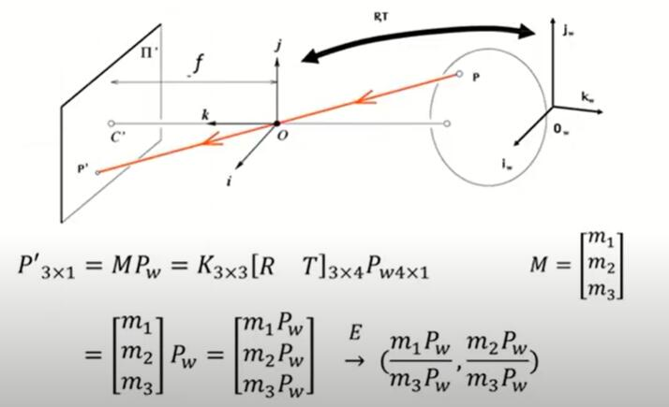
11.1 Geometric intrinsic calibration(2/6)
Perspective Projection Camera
Notes:
从3D到2D的投影更为准确，用于运动恢复结构或SLAM

Slide 9
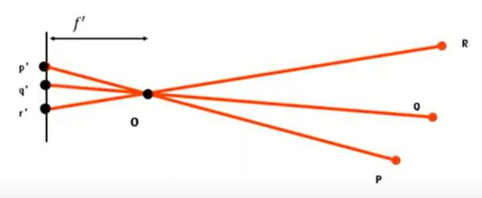
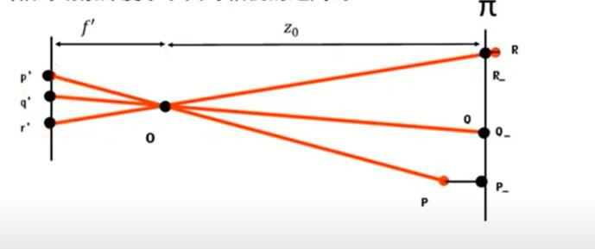
11.1 Geometric intrinsic calibration(3/6)
Simplify

Slide 10
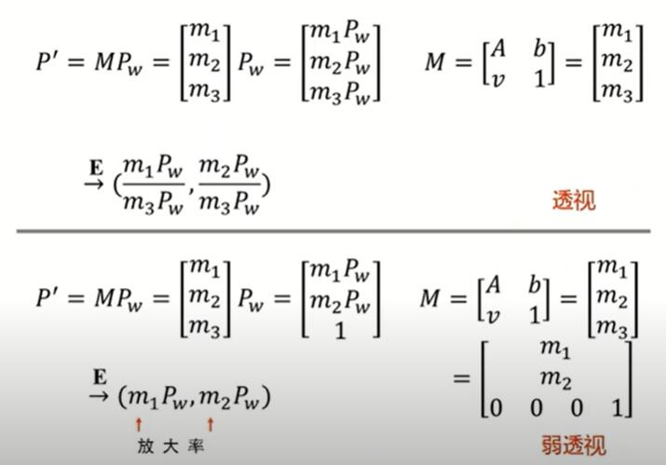
11.1 Geometric intrinsic calibration(4/6)
Objects are smaller and more accurate when they are far away, often used in image recognition tasks.
Perspective
Magnification
Weak Perspective
Notes:
物体较小，较远时较为准确，常用于图像辨识任务

Slide 11
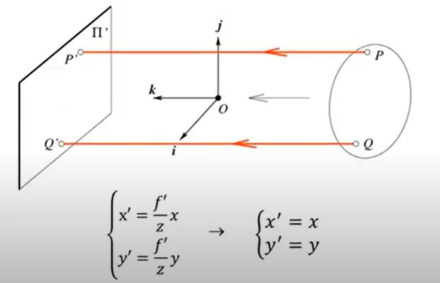
11.1 Geometric intrinsic calibration(5/6)
Orthographic Projection Camera
When the distance from the camera center to the image plane is infinite.
Multiple applications in architectural design (AUTOCAD) or industrial design
Notes:
多应用在建筑设计（AUTOCAD）或者工业设计领域

Slide 12
11.1 Geometric intrinsic calibration(6/6)
Properties of projective transformations:
Point projection as point
2. Line projection as line
3. Near objects are large and distant objects are small
4. The angle is no longer maintained
5. Parallel lines intersect
Notes:
投影变换的性质：
1.点投影为点
2.线投影为线
3.近处的物体大、远处的物体小
4.角度不再保持
5.平行线相交

Slide 13
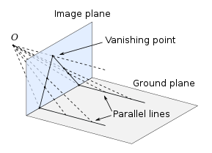
11.1.1 Vanishing points (1/6)
A common case for calibration that occurs often in practice is when the camera is looking at a man-made scene with long extended rectangular patterns such as boxes or building walls. In this case, we can intersect the 2D lines corresponding to 3D parallel lines to compute their vanishing points, as described in Section 7.4.3, and use these to determine the intrinsic and extrinsic calibration parameters.
Wikipedia: Vanishing points
Notes:
又称灭点，在两个平行的线条中，两个线条会消失在远方的一点。同一方向上的所有直线share the same vanishing point

Slide 14
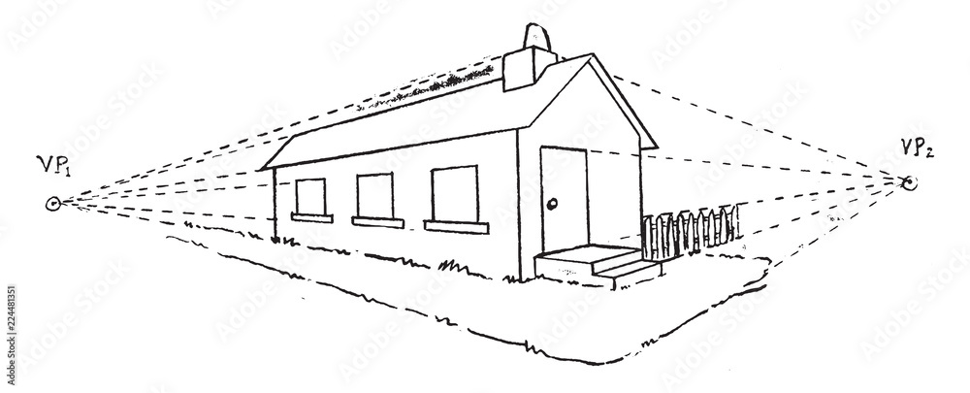
11.1.1 Vanishing points (2/6)
Vanishing point is here!
Horizon Line
Adob​​e Stock
Notes:
例如望著两条平行的铁轨，或者沿着公路线去看两边平行的树木时，两条平行的铁轨或两排树木连线相交于很远很远的某一点。
艺术家和工程师在纸上表现立体图时，常用这种透视法，这种方法源于人们的视觉经验：大小相同的物体，离你较近的看起来比离你较远的大。凡是平行的直线都消失于无穷远处的同一个点，消失于视平线上的点的直线都是水平直线。

Slide 15
11.1.1 Vanishing points (3/6)
An alternative to the 2D polar (θ, d) representation for lines is to use the full 3D m = line equation, projected onto the unit sphere.
The location of vanishing point hypothesis:
m: line equations in 3D representation
Notes:
线的 2D 极坐标 (θ, d) 表示的替代方法是使用完整的 3D m = 线方程，投影到单位球体上。

Slide 16
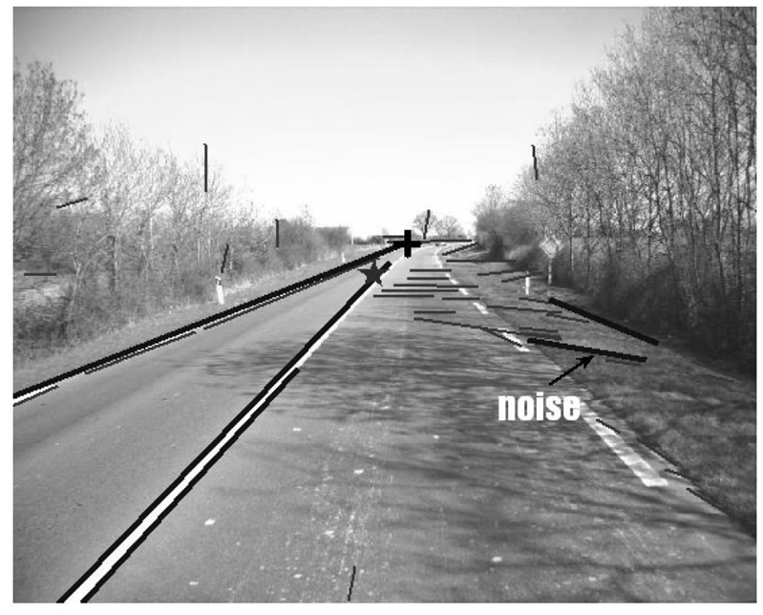
11.1.1 Vanishing points (4/6)
Corresponding weight:
l_{i}, l_{j}: corresponding line segment lengths
This has the desirable effect of down weighting (near-)collinear line segments and short line segments.

Slide 17
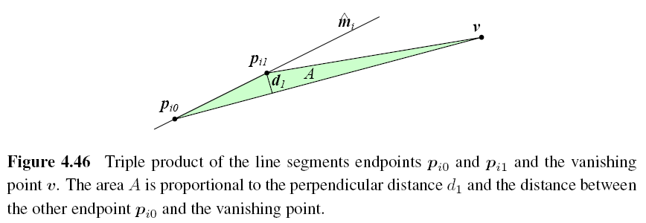
11.1.1 Vanishing points (5/6)
Notes:
兩個點P和消失點V的面積
可以應用在後面的公式

Slide 18
11.1.1 Vanishing points (6/6)
A robustified least squares estimate for the vanishing point:
Notes:
用來估計消失點正確性與否的一個估計值
W = 每個加權的測量對最終誤差的影響值

Slide 19
11.1.1 Application: camera calibration (Extra)
Equation of vanishing points and intrinsic matrix
$$d= \frac{K^{−1}v}{|\left|K^{−1}v\right||}$$
$v$ $=$𝐾𝑑
The angle between two groups of parallel lines
$\cos{θ}=\frac{d1∙d2}{\left|d1\right||d2|}$ $=\frac{{v1}^{T}ωv2}{\sqrt{{v1}^{T}ωv1}\sqrt{{v2}^{T}ωv2}} ω={{(KK}^{T})}^{−1}$
$$when θ= {90}^{°}{ v1}^{T}ωv2=0$$
Notes:
消失點等於平行線方向乘以相機內參數
空間中兩組平行線的交點可以用消失點和相機內參數表示

Slide 20
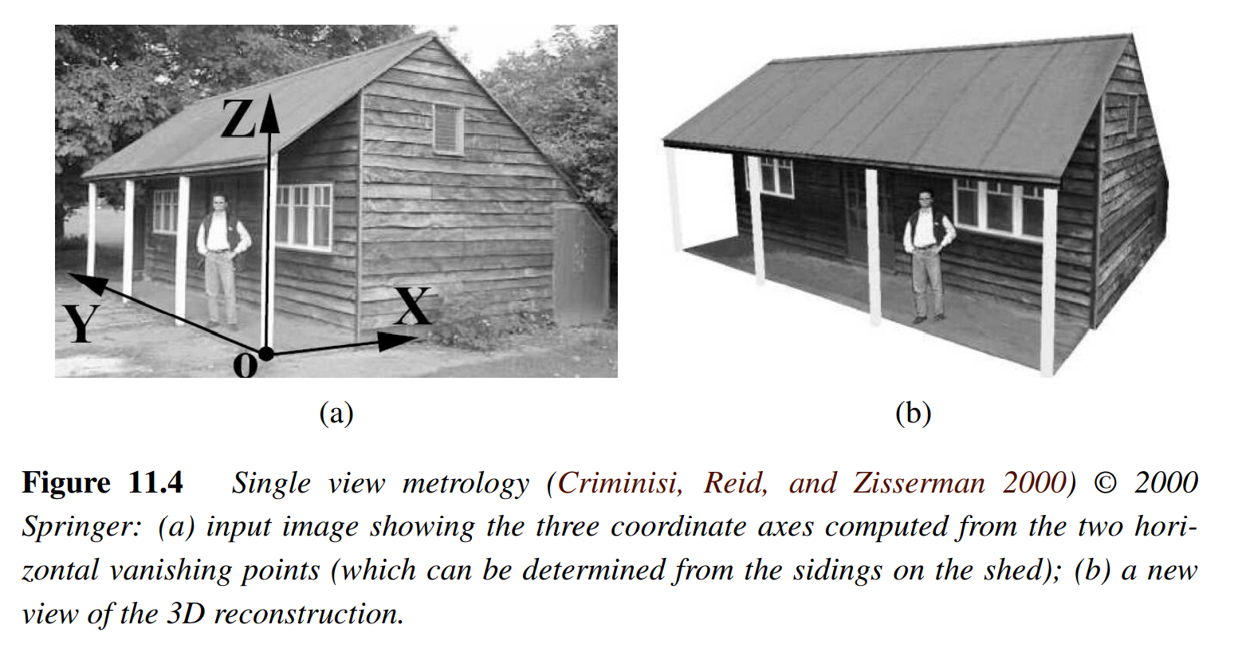
11.1.2 Application: Single view metrology
An application of vanishing point estimation and camera calibration is the single view metrology system. It allows people to interactively measure heights and other dimensions as well as to build piecewise planar 3D models.
Notes:
单视角重构
（a）輸入圖像，顯示從兩個水平帶消失點計算出的三個坐標軸（可以從棚屋的壁板上確定）；
（b）3D重建的新視野
系統允許人們交互式地測量高度和其他尺寸，
以及建立分段的平面3D模型，如圖11.4所示。
場景的實際比例無法恢復

Slide 21
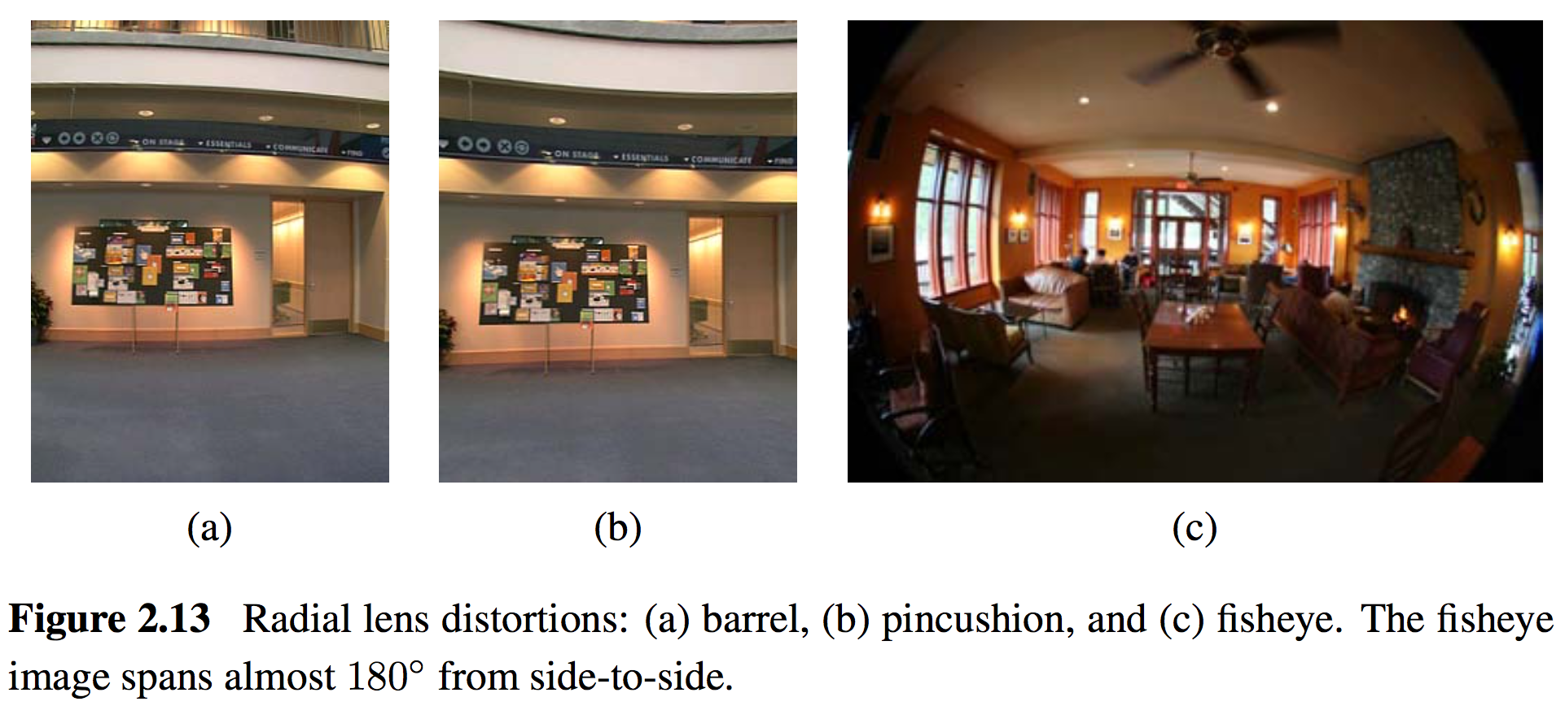
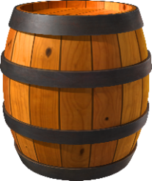
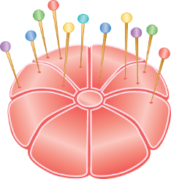
11.1.3 Radial distortion (1/5)
Imaging models all assume that cameras obey a linear projection model where straight lines in the world result in straight lines in the image.
Many wide-angles lenses have noticeable radial distortion.
Notes:
6.3.5 輻射變形 = 徑向變形
最後要說明的就是輻射變形 = 徑向變形
使用廣角鏡拍攝影像時，通常需要對鏡頭變形 (例如輻射變形 = 徑向變形) 建立模型來矯正。
如第2.1.6節所述，
Barrel distortion：在顯示畫面上的二條平行線，因失真而於二條平行線間產生像桶形的凸出 (桶狀變形= 酒桶狀變形）
Pincushion distortion：在顯示畫面上的二條平行線，因失真而於二條平行線間產生像針墊的凹 (枕狀變形 = 針墊失真）
##########
使用廣角鏡拍攝影像時，通常需要對鏡頭變形（例如輻射變形 = 徑向變形）進行建模
正徑向變形 (桶狀變形 = 酒桶狀變形)
負徑向變形 (枕形變形 = 針墊失真)
當光線進入透鏡時，由邊緣射入的光線會比從中心射入的光線有著更大的偏折，這便是造成輻射畸變的主要原因，而這樣的現象在透鏡越小時，會越加明顯。
輻射畸變又分為兩種 ： 桶狀畸變 Barrel Distortion & 枕狀畸變 Pincushion Distortion
在攝影的領域來看，通常使用廣角鏡頭容易出現桶狀畸變，而使用長焦段鏡頭則易產生枕狀畸變。這兩者其實就是一體兩面，如果我們拿廣角鏡頭來作為投放鏡頭，便會產生枕狀畸變，反之亦然。

Slide 22
11.1.3 Radial distortion (2/5)
Normal
Barrel distortion
Pincushion distortion
Notes:
原因: 光線在遠離透鏡中心的地方比靠近中心更加彎曲
图像像素点以畸变中心为中心，沿着径向产生的位置偏差，从而导致图像中所成的像发生形变。其可以分为枕形畸变和桶形畸变两种。

Slide 23
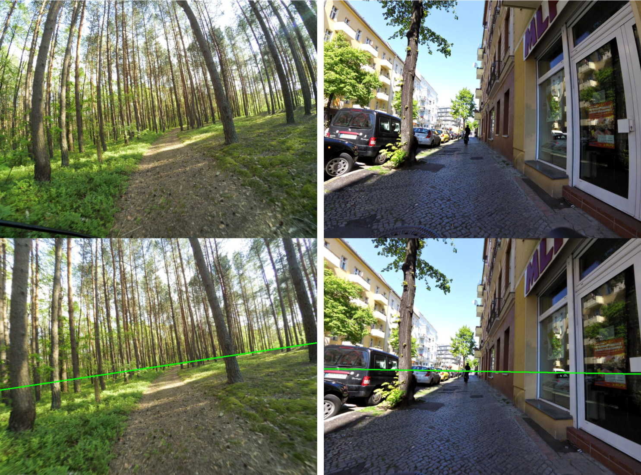
11.1.3 Radial distortion (3/5)
https://research.mapillary.com/publication/cvpr19d/

Slide 24
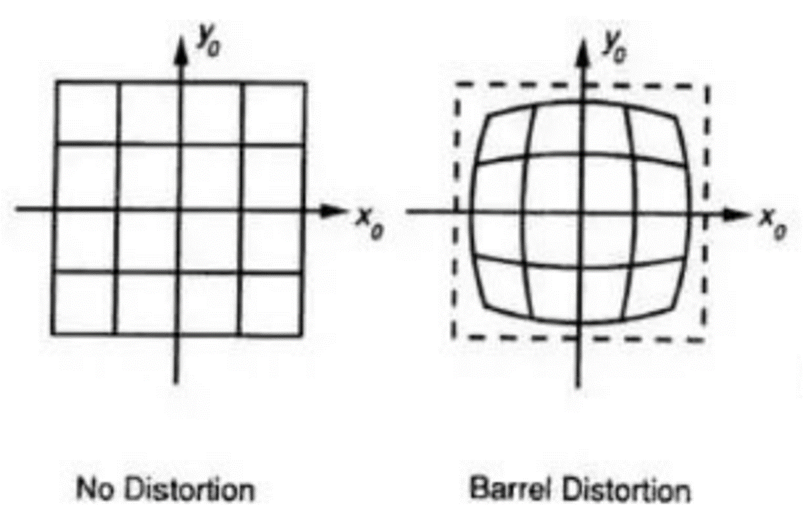
11.1.3 Radial distortion (4/5)
The simplest radial distortion models use low-order polynomials,
where $r^{2}=x^{2}+y^{2}$ and $κ_{1}$ and $κ_{2}$ are called the radial distortion parameters.
Various techniques can be used to estimate the radial distortion parameters for a given lens.
Many of today’s digital cameras now remove radial distortion using software in the camera itself.
Notes:
x,y 是實際觀測到的值x_hat, y_hat是理想的值
R = 與像素平面中心點的距離, (1+k1r2+k2r4) > 1 桶型

Slide 25
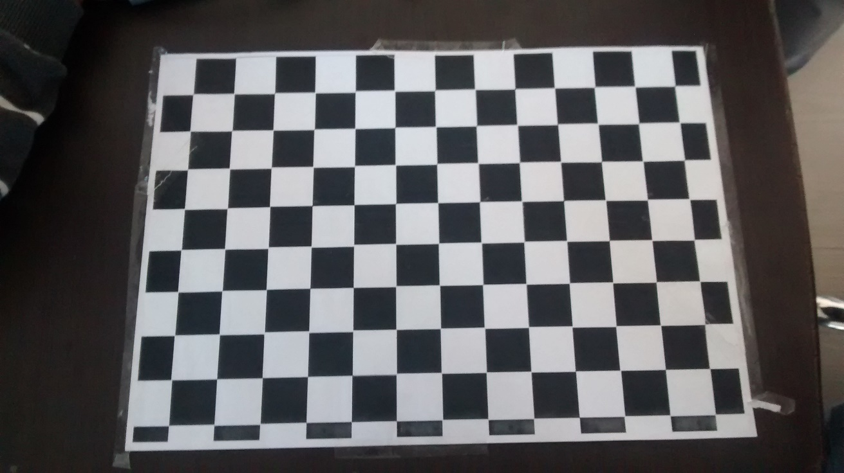
11.1.3 Radial distortion (5/5)
Barrel distortion
https://legacy.imagemagick.org/Usage/lens/correcting_lens_distortions.pdf

Slide 26
11.2 Pose estimation
11.2.1 Linear algorithms
11.2.2 Iterative algorithms
11.2.3 Application: Location recognition
11.2.4 Triangulation

Slide 28
11.2 Pose Estimation
Estimate an object’s 3D pose from a set of 2D point projections
This pose estimation problem is also known as extrinsic calibration
Linear algorithms
Iterative algorithms
Notes:
6.2 姿勢估計
基於特徵的對齊的一種情況，是根據一組2D點投影估計物體的3D姿勢(位置)，這種姿勢估計問題也稱為外部校準
外部校準與相機內部參數(例如：焦距)的內部校準相反(內部校準將在6.3節討論)
在6.2 節中，
我們將研究為解決姿勢估計問題的2種技術，
第1個：linear algorithms(線性演算法)，該技術可恢復3×4相機矩陣
第2個：Iterative algorithms (迭代演算法)
##########
根據一組2D點投影估計一個物體的的3D姿勢
1. 線性算法
2. 迭代算法

Slide 29
11.2.1 Pose Estimation - Linear Algorithms (1/9)
The simplest way to recover the pose of the camera.
Form a set of linear equations analogous to those used for 2D motion estimation from the camera matrix form of perspective projection.
Notes:
6.2.1 姿勢估計-線性演算法
線性演算法是恢復相機姿勢的最簡單方法
從透視投影的相機矩陣形成一組線性方程式，類似形式用於估計2D運動估計的線性方程式
##########
恢復相機姿勢的最簡單方法。
從透視投影的相機矩陣形式形成一組線性方程，類似於用於2D運動估計的線性方程。

Slide 30
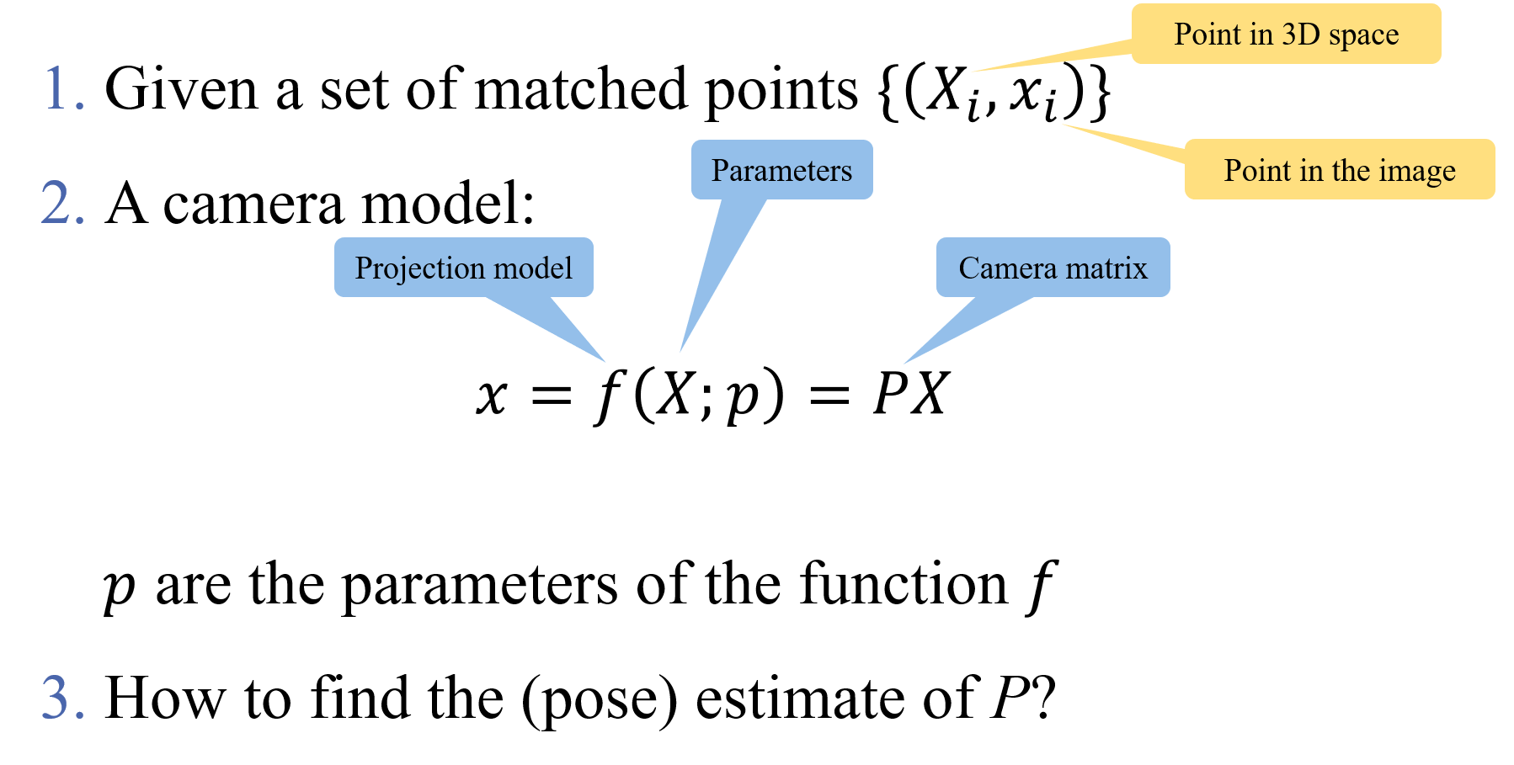
11.2.1 Pose Estimation - Linear Algorithms (2/9)
Notes:
6.2.1 姿勢估計-線性演算法
我們如何計算transformation：
第1點：先給一組匹配的特徵點{($X_{i},x_{i}$)}
第2點：給一個相機model：$x=f\left(X;p\right)$
𝑝是transformation 𝑓的參數
第3點：如何找到P的（姿勢）估計值=Camera matrix
常見的方法是使用最小平方差，即最小化殘差平方和

Slide 31
11.2.1 Pose Estimation - Linear Algorithms (3/9)
Notes:
Fx = f * pixel/m
ox,oy:偏移
R = 相機的旋轉(三維世界)
T = 平移
Mint 相機公藝決定
Mext相機的位置、旋轉方向

Slide 32
11.2.1 Pose Estimation - Linear Algorithms (4/9)
Mapping between 3D points and image points:
$$\left[\begin{matrix}x \\ y \\ 1\end{matrix}\right]= \left[\begin{matrix}p_{1} & p_{2} \\ p_{5} & p_{6} \\ p_{9} & p_{10}\end{matrix} \begin{matrix}p_{3} & p_{4} \\ p_{7} & p_{8} \\ p_{11} & p_{12}\end{matrix}\right]\left[\begin{matrix}X \\ \begin{matrix}\begin{matrix}Y \\ Z\end{matrix} \\ 1\end{matrix}\end{matrix}\right]$$
$$\left[\begin{matrix}x \\ y \\ 1\end{matrix}\right]= \left[\begin{matrix}－p_{1}^{T}－ \\ －p_{2}^{T}－ \\ －p_{3}^{T}－\end{matrix}\right]\left[\begin{matrix}︱ \\ X \\ ︱\end{matrix}\right]$$
$$x^{′}= \frac{p_{1}^{T}X}{p_{3}^{T}X} y^{′}= \frac{p_{2}^{T}X}{p_{3}^{T}X}$$
$$x=f\left(X;p\right)=PX$$
Notes:
6.2.1 姿勢估計-線性演算法
3D點和影像點之間的映射
其中(x, y)是測得的2D特徵位置，而(X_{i}, Y_{i}, Z_{i})是已知的3D特徵位置
如果要寫成非齊次座標(Inhomogeneous coordinates)，則可以寫成x’, y’

Slide 33
11.2.1 Pose Estimation - Linear Algorithms (5/9)
$$x^{′}= \frac{p_{1}^{T}X}{p_{3}^{T}X} y^{′}= \frac{p_{2}^{T}X}{p_{3}^{T}X}$$
Direct Linear Transform (DLT)
$$p_{1}^{T}X−p_{3}^{T}Xx^{′}=0$$
$$p_{1}^{T}X−p_{2}^{T}Xy^{′}=0$$
At least six correspondences are needed to compute the 12 (or 11) unknowns in $P$.
Notes:
6.2.1 姿勢估計-線性算法
直接線性變換（DLT）：
至少需要6個對應關係才能計算P中的12個（或11個）未知數
P的更準確估計可以通過非線性最小平方差用一個迭代次數少的方式獲得
##########
/ = over
一個點兩個方程，至少需要6個點

Slide 34
11.2.1 Pose Estimation - Linear Algorithms (6/9)
$$x^{′}= \frac{p_{1}^{T}X}{p_{3}^{T}X} y^{′}= \frac{p_{2}^{T}X}{p_{3}^{T}X}$$
Make them linear with algebraic manipulation:
$$p_{1}^{T}X−p_{3}^{T}Xx^{′}=0$$
$$p_{1}^{T}X−p_{2}^{T}Xy^{′}=0$$
In matrix form:
$$\left[\begin{matrix}X^{T} & 0 & −x^{′}X^{T} \\ 0 & X^{T} & −y^{′}X^{T}\end{matrix}\right]\left[\begin{matrix}p_{1} \\ p_{2} \\ p_{3}\end{matrix}\right]=0$$
For N points:
$$\left[\begin{matrix}X_{1}^{T} \\ 0 \\ \begin{matrix}⋮ \\ X_{N}^{T} \\ 0\end{matrix}\end{matrix} \begin{matrix}0 \\ X_{1}^{T} \\ \begin{matrix}⋮ \\ 0 \\ X_{N}^{T}\end{matrix}\end{matrix} \begin{matrix}−x^{′}X_{1}^{T} \\ −y^{′}X_{1}^{T} \\ \begin{matrix}⋮ \\ −x^{′}X_{N}^{T} \\ −y^{′}X_{N}^{T}\end{matrix}\end{matrix}\right]\left[\begin{matrix}p_{1} \\ p_{2} \\ p_{3}\end{matrix}\right]=0$$
Notes:
6.2.1 姿勢估計-線性算法
我們如何使這些關係線性化？
1. 通過代數運算使它們線性化：
現在可以設置一個具有多個點對應關係的線性方程組
2. 矩陣形式：
3. 如果有N個點：

Slide 35
11.2.1 Pose Estimation - Linear Algorithms (7/9)
$$P= \left[\begin{matrix}p_{1} & p_{2} \\ p_{5} & p_{6} \\ p_{9} & p_{10}\end{matrix} \begin{matrix}p_{3} & p_{4} \\ p_{7} & p_{8} \\ p_{11} & p_{12}\end{matrix}\right]$$
How do we get the intrinsic and extrinsic parameters from the projection matrix?
Decomposition of the Camera Matrix
$$P= \left[\begin{matrix}p_{1} & p_{2} & p_{3} \\ p_{5} & p_{6} & p_{7} \\ p_{9} & p_{10} & p_{10}\end{matrix}│\begin{matrix}p_{4} \\ p_{8} \\ p_{12}\end{matrix}\right]$$
Notes:
6.2.1 姿勢估計-線性算法
我們如何從投影矩陣中獲得內在和外在參數？
相機矩陣分解

Slide 36
11.2.1 Pose Estimation - Linear Algorithms (8/9)
Decomposition of the Camera Matrix
$$P= \left[\begin{matrix}p_{1} & p_{2} & p_{3} \\ p_{5} & p_{6} & p_{7} \\ p_{9} & p_{10} & p_{10}\end{matrix}│\begin{matrix}p_{4} \\ p_{8} \\ p_{12}\end{matrix}\right]$$
$$P=K\left[R│t\right]$$
Find intrinsic K and rotation R?
M = KR
Using RQ decomposition.
https://cgcooke.github.io/Blog/computer%20vision/linear%20algebra/2020/03/13/RQ-Decomposition-In-Practice.html
Notes:
6.2.1 姿勢估計-線性算法
我們如何從投影矩陣中獲得內部和外部參數？
相機矩陣分解
找到內部校準矩陣的K和旋轉R？
使用RQ分解。
RQ分解 = 上三角矩陣 + 正交矩陣

Slide 37
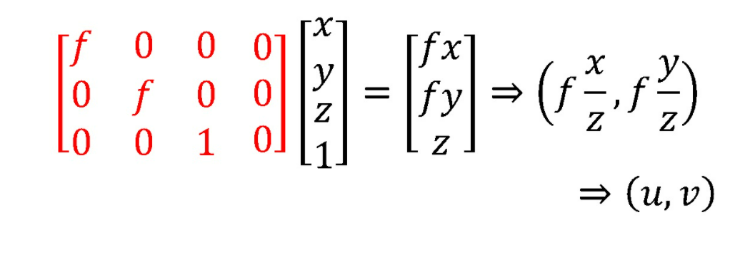
11.2.1 Pose Estimation - Linear Algorithms (9/9)
In most applications, we have some prior knowledge about the intrinsic calibration matrix $K$.
Constraints can be incorporated into a non-linear minimization of the parameters in $K$ and $(R,t)$.
Notes:
6.2.1 姿勢估計-線性算法
但是，在大多數應用中，我們對內部校準矩陣k有一些預先認知，
例如，歪斜非常小，並且光學中心位於影像中心附近(第2章2.57–2.59)
可以將這樣的認知約束的條件合併到K和(R, t)中參數的非線性最小化中。
##########
在大多數應用中，我們對內部校準矩陣K有一些預先認知。
可以將約束合併到K和(R, t)中參數的非線性最小化中。

Slide 38
11.2.2 Pose Estimation - Iterative Algorithms (1/7)
The most accurate way to estimate pose is to directly minimize the squared re-projection error.
Projection equations:
$$x_{i}=f(p_{i};R,t,K)$$
Notes:
6.2.2 姿勢估計-迭代算法
估計姿勢的最準確方式是使用非線性最小平方差，
直接最小化2D點的平方重投影誤差，
該誤差是（R，t）和K中未知函數的姿勢參數
我們可以將投影方程寫成x_{i}
##########
估計姿勢的最準確（最靈活）的方法是使用非線性最小平方差
投影方程：
----------------------------------------------------------
P = K [R| t] , P = camera matrix, K = 內參數矩陣, [R| t] = 外參數
xi = 投影預測位置
pi = 真實位置

Slide 39
11.2.2 Pose Estimation - Iterative Algorithms (2/7)
Iteratively minimize the robustiﬁed linearized reprojection errors:
$$E_{NLP }=\sum_{i}{ρ(\frac{∂f}{∂R}∆R+\frac{∂f}{∂t}∆t+\frac{∂f}{∂K}∆K−r_{i})}$$
$r_{i}=\hat{x_{i}}−\tilde{x_{i}}$
$\hat{x_{i}}$: the measured location
$\tilde{x_{i}}$: the predicted location
Notes:
6.2.2 姿勢估計-迭代算法
並迭代最小化穩健的線性重投影誤差：E_{NLP}
$r_{i}$ = current residual vector(當前殘差向量)
偏導數($∂$)與未知姿勢參數有關（旋轉R、平移t和校準K）
${{\hat{x}}^{′}}_{i}$：測量位置
${{\tilde{x}}^{′}}_{i}$：預測位置
##########
Σ = Sum i
Ρ = rho
∂ = partial
Δ = delta
$\hat{x_{i}}$ = hat
$\tilde{x_{i}}$ = tilde
----------------------------------------------------------
E = reprojection error =重投影误差：指的真实三维空间点在图像平面上的投影（也就是图像上的像素点）和重投影（其实是用我们的计算值得到的虚拟的像素点）的差值
ri = ${{\hat{x}}^{′}}_{i} −$ ${{\tilde{x}}^{′}}_{i}$, ${{\hat{x}}^{′}}_{i}$：測量位置 ${{\tilde{x}}^{′}}_{i}$：預測位置
Δx = x的增量

Slide 40
11.2.2 Pose Estimation - Iterative Algorithms (3/7)
Figure 11.7
A set of chained transforms for projecting a 3D point p_{i} to a 2D measurement x_{i} through a series of transformations f^{(k)}, each of which is controlled by its own set of parameters. The dashed lines indicate the flow of information as partial derivatives are computed during a backward pass.
Notes:
6.2.2 姿勢估計-迭代算法
一組通過一系列變換 f^{(k)} 將3D點p_{i}投影到2D測量x_{i}的鍊式變換，
每個變換都由自己的參數集控制。
虛線表示在向後傳遞期間計算偏導數時的信息流。
這是上面非線性回歸問題的更容易理解版本，可以通過重寫投影方程用更簡單的步驟來構造
這種鍊式轉換的優點在於，每個轉換就其參數和輸入而言都具有簡單的偏導數
##########
Figure 6.5 A set of chained transforms for projecting a 3D point p_{i} to a 2D measurement x_{i} through a series of transformations f^{(k)},
each of which is controlled by its own set of parameters.
The dashed lines indicate the flow of information as partial derivatives are computed during a backward pass.
圖6.5 一組通過一系列變換 f^{(k)} 將3D點p_{i}投影到2D測量x_{i}的鍊式變換，
每個變換都由自己的參數集控制。
虛線表示在向後傳遞期間計算偏導數時的信息流。
-----------------------------------------------------------
c= 相機中心
q=相機旋轉四元數(表示三空間的旋轉)
z= 齊次坐標系與歐式坐標系的轉換
k= 內參數矩陣
持續跌帶運行直到小於某個threshold

Slide 41
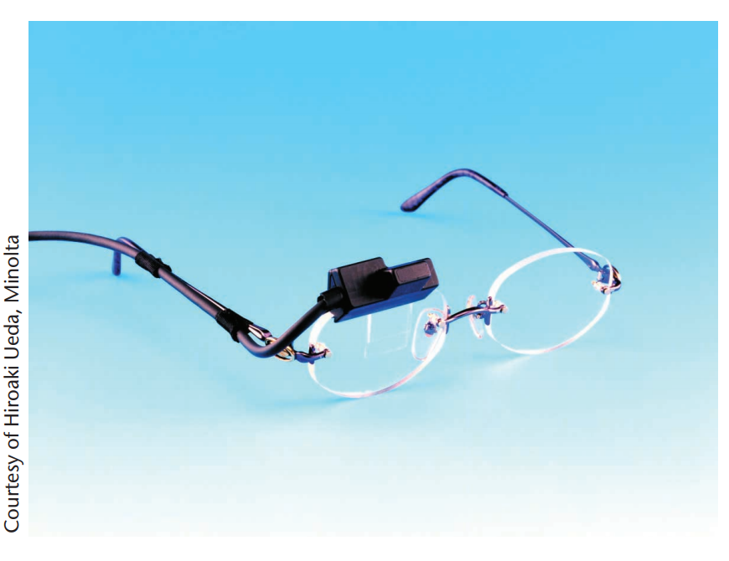
Azuma, R. T., Baillot, Y., Behringer, R., Feiner, S. K., Julier, S., and MacIntyre, B. (2001). Recent advances in augmented reality. IEEE Computer Graphics and Applications, 21(6):34–47.
HMD: Head-mounted display
11.2.2 Pose Estimation - Iterative Algorithms (4/7)
Extension: Target-based augmented reality
A widely used application of pose estimation is augmented reality, where virtual 3D images or annotations are superimposed on top of a live video feed, either through the use of see-through glasses (a Head-Mounted Display: HMD) or on a regular computer or mobile device screen.
Notes:
姿勢估計的一種廣泛使用的應用是增強現實，
其中，通過使用透明眼鏡（頭戴式顯示器）或在常規計算機或移動設備上，
將虛擬3D圖像或註釋疊加在實時視頻源的頂部設備熒幕

Slide 42
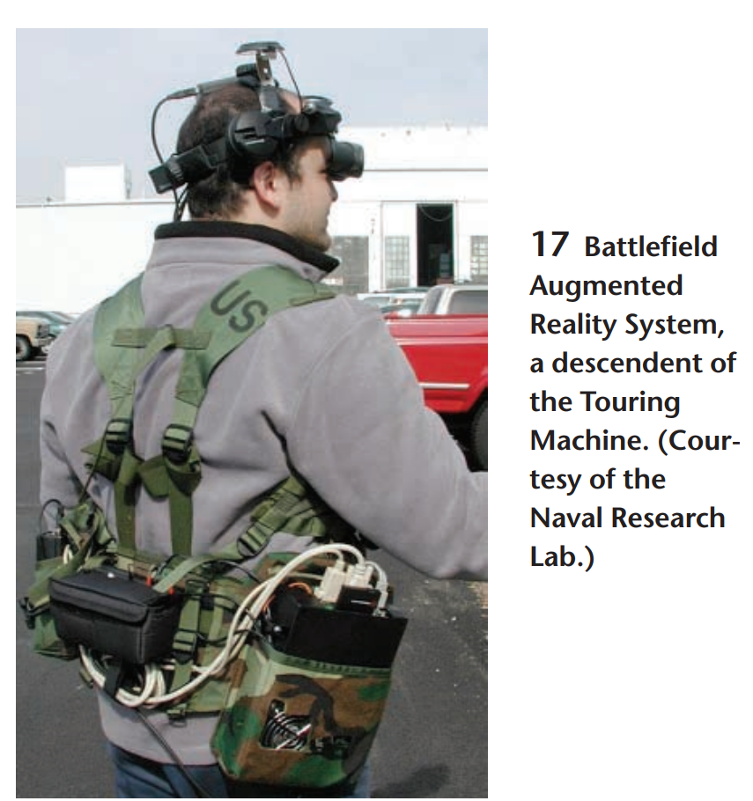
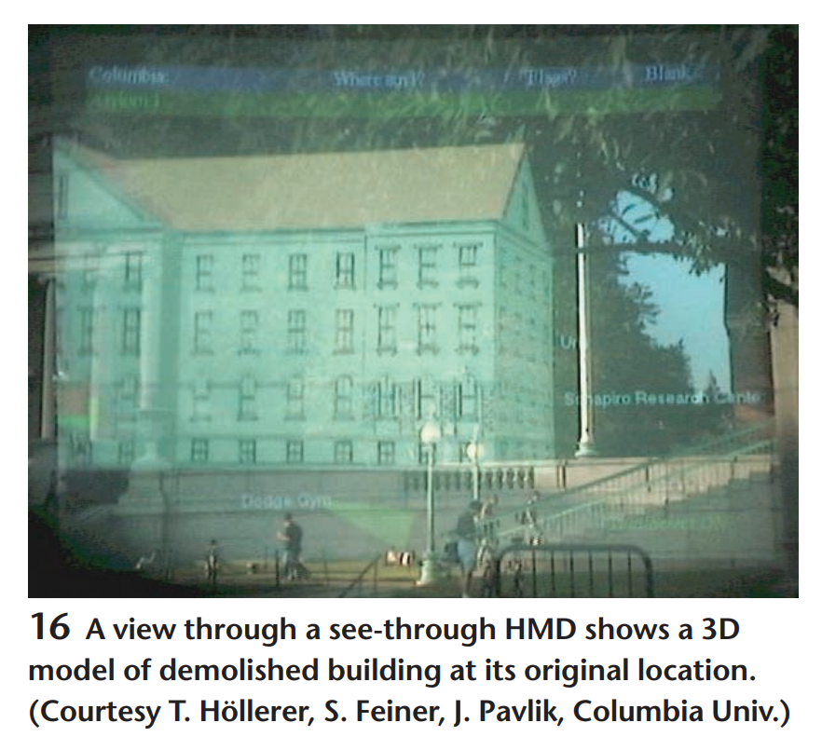
Azuma, R. T., Baillot, Y., Behringer, R., Feiner, S. K., Julier, S., and MacIntyre, B. (2001). Recent advances in augmented reality. IEEE Computer Graphics and Applications, 21(6):34–47.
HMD: Head-Mounted Display
11.2.2 Pose Estimation - Iterative Algorithms (5/7)
Extension: Target-based augmented reality
Notes:
透視HMD的視圖在其原始位置顯示了已拆除建築物的3D模型。
戰地增強現實係統，旅行機的後代。 （由海軍研究實驗室提供）

Slide 43
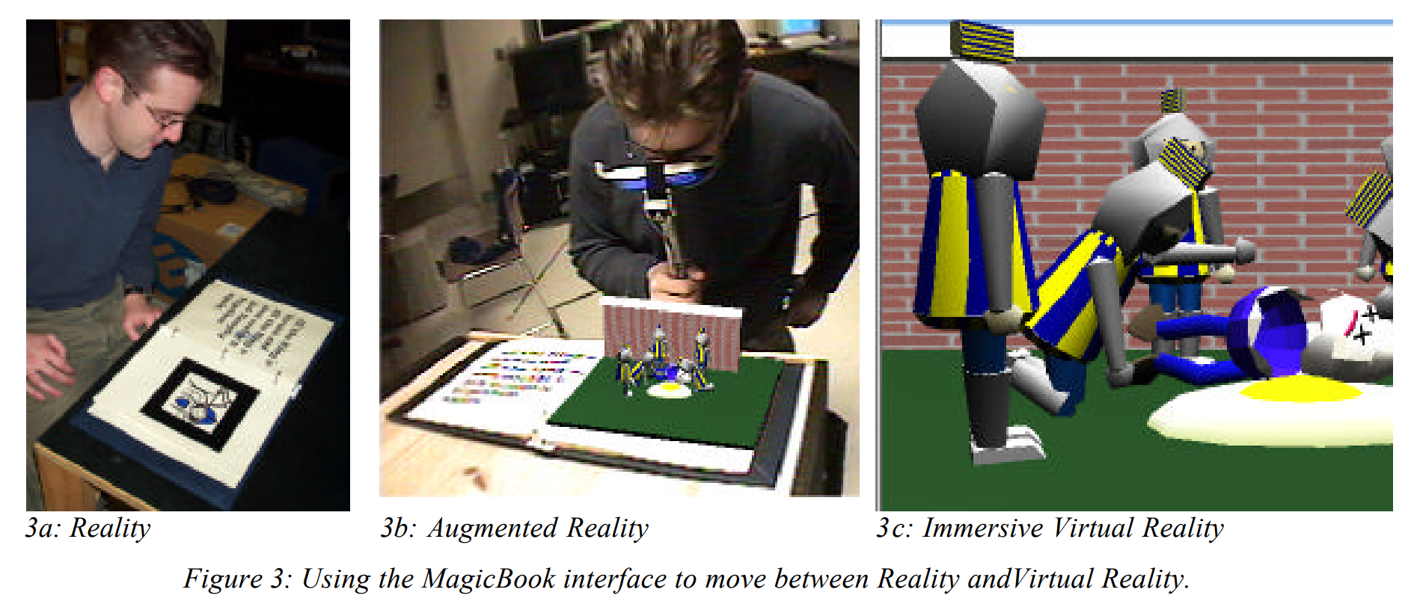
Billinghurst, M., Kato, H., and Poupyrev, I. (2001). The MagicBook: a transitional AR interface. Computers & Graphics, 25:745–753.
11.2.2 Pose Estimation - Iterative Algorithms (6/7)
Extension: Target-based augmented reality
In some applications, a special pattern printed on cards or in a book is tracked to perform the augmentation.
https://www.youtube.com/watch?v=x67wyE8EYwY

Slide 44
11.2.2 Pose Estimation - Iterative Algorithms (7/7)
Extension: Target-based Augmented Reality (AR)
Today, tracking known targets such as movie posters is used in some phone-based augmented reality systems such as Facebook’s Spark AR.
https://sparkar.facebook.com/ar-studio/
https://www.youtube.com/watch?v=kfrGL6gNVEQ

Slide 45
11.2.3 Application: Location recognition (1/5)
One of the most exciting applications of pose estimation is in the area of location recognition, which can be used both in desktop applications and in mobile smartphone applications.
The latter case includes not only finding out your current location based on a cell-phone image, but also providing you with navigation directions or annotating your images with useful information, such as building names and restaurant reviews
Notes:
姿势估计最令人兴奋的应用之一是在位置识别领域，它既可以用于桌面应用程序，也可以用于移动智能手机应用程序。
后一种情况不仅包括根据手机图像找出您的当前位置，还包括为您提供导航方向或用有用的信息注释您的图像，例如建筑物名称和餐厅评论

Slide 46
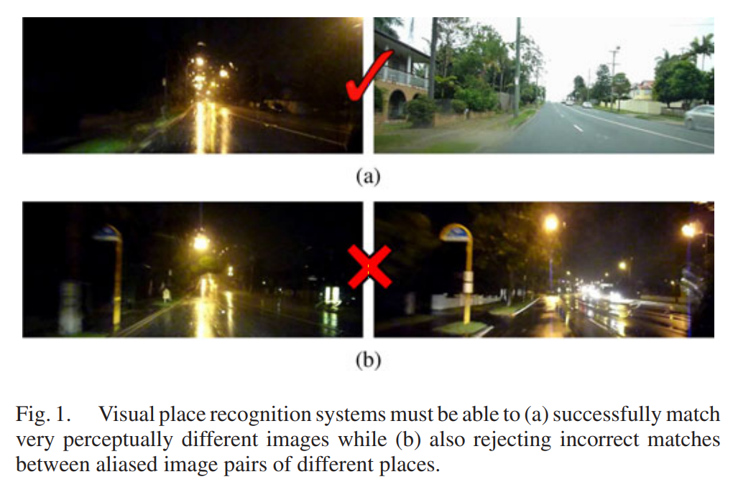
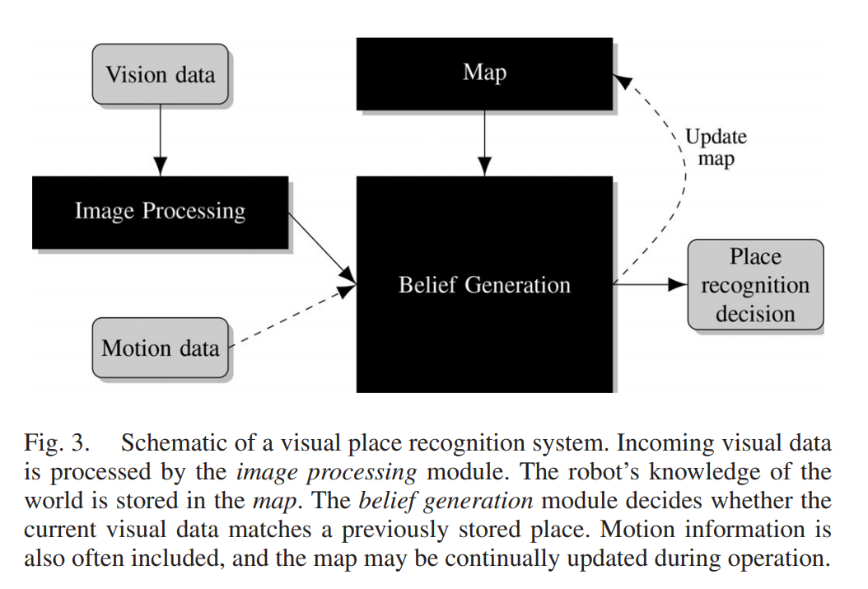
Lowry, S., Sunderhauf, ¨ N., Newman, P., Leonard, J. J., Cox, D., Corke, P., and Milford, M. J. (2015). Visual place recognition: A survey. IEEE Transactions on Robotics, 32(1):1–19.
11.2.3 Application: Location recognition (2/5)
This problem is also often called visual place recognition or visual localization.
Notes:
視覺位置識別系統必須能夠（a）成功匹配非常在視覺上不同的圖像，
而（b）還必須拒絕不同位置的別名圖像對之間的不正確匹配。
視覺位置識別系統的示意圖。 傳入的視覺數據由圖像處理模塊處理。
機器人對世界的了解存儲在地圖中。 信念生成模塊確定當前視覺數據是否與先前存儲的位置匹配。
運動信息通常也包括在內，操作過程中地圖可能會不斷更新
------------------------------------------------------------
https://blog.csdn.net/qq_40679814/article/details/103762741
视觉识别系统
一个位置识别系统需要做的是，像人或动物一样，识别出当前这个地方我曾经来过。
Belief:因此，任何地点识别系统的中心目标都是协调视觉输入和存储的地图数据，以生成一个信念分布。这种分布提供了一种可能性或置信度的度量，即当前的视觉输入与机器人的世界地图表示中的特定位置相匹配

Slide 47
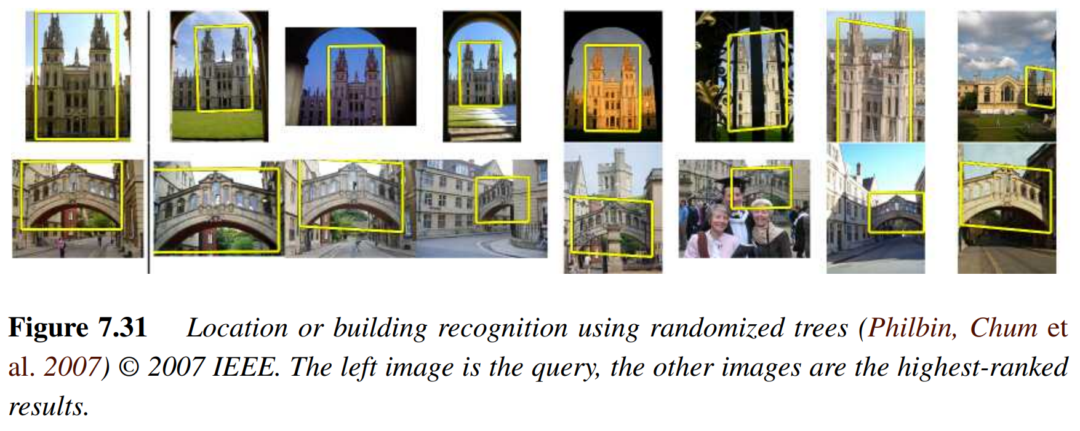
IEEE: Institute of Electrical and Electronic Engineers
11.2.3 Application: Location recognition (3/5)
The main difficulty in location recognition is in dealing with the extremely large community (user-generated) photo collections on websites such as Flickr or commercially captured databases.
Notes:
位置识别的主要困难在于处理网站（如 Flickr）或商业捕获数据库上的极其庞大的社区（用户生成的）照片集。

Slide 48
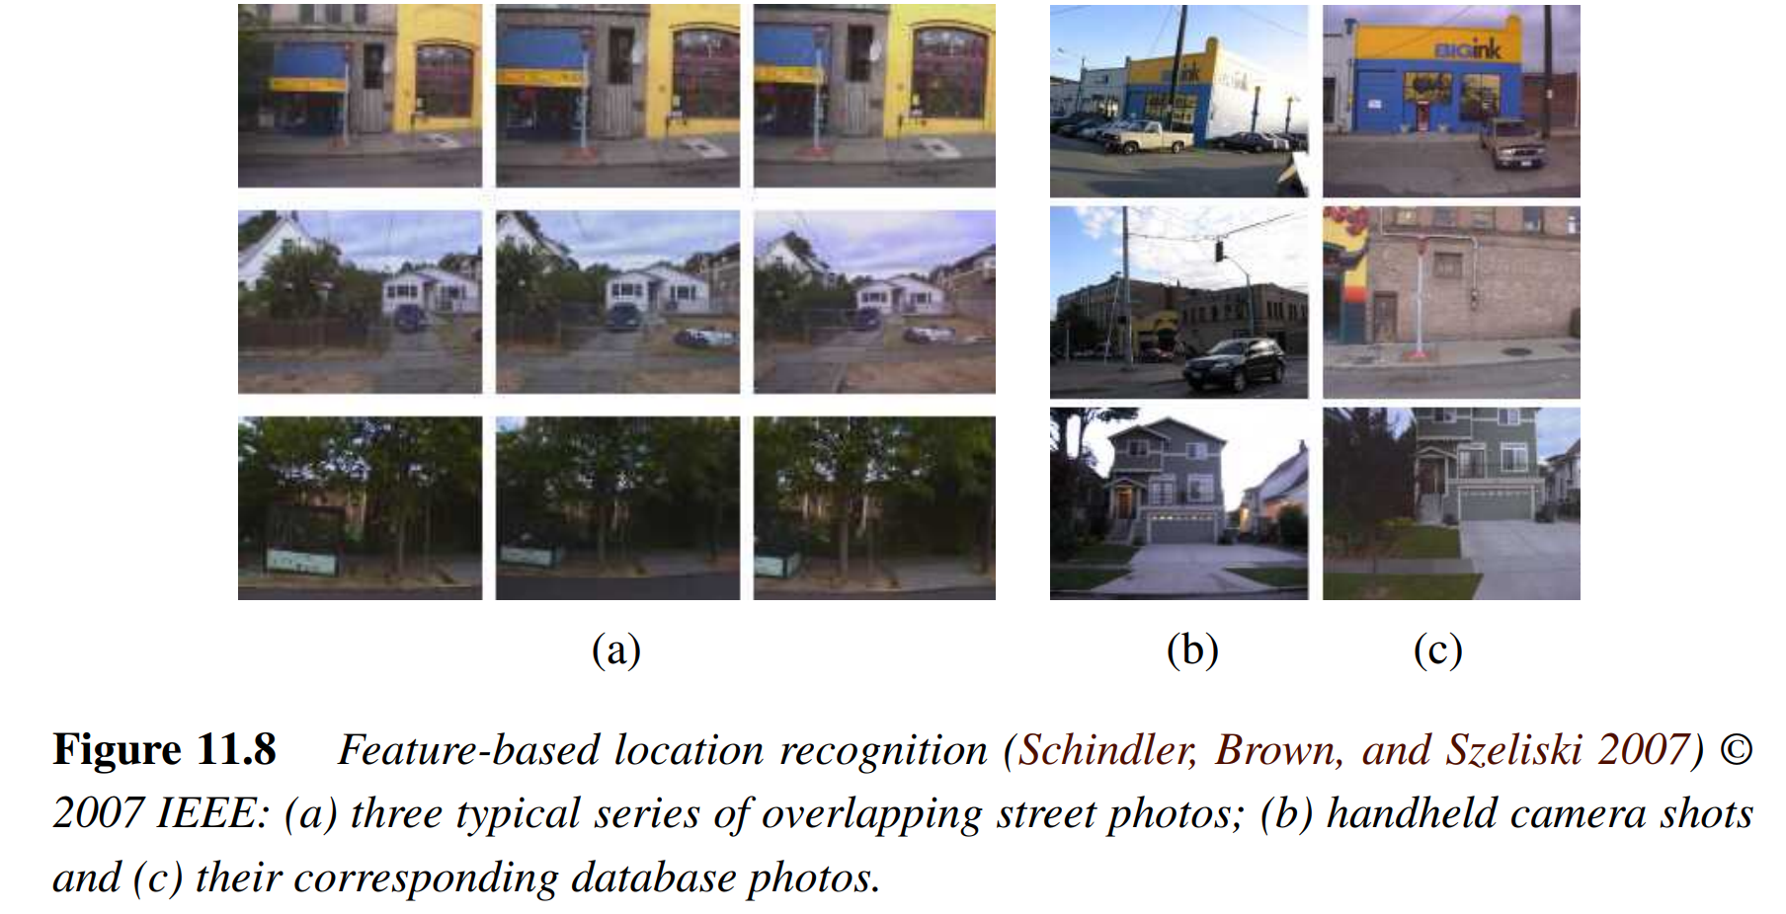
11.2.3 Application: Location recognition (4/5)
The prevalence of commonly appearing elements such as foliage, signs, and common architectural elements further complicates the task. Figure 11.8 shows sample results from denser commercially acquired datasets.
Notes:
樹葉、標誌和常見建築元素等常見元素的普遍存在使任務更加複雜。圖 11.8 顯示了來自更密集的商業獲取數據集的示例結果。

Slide 49
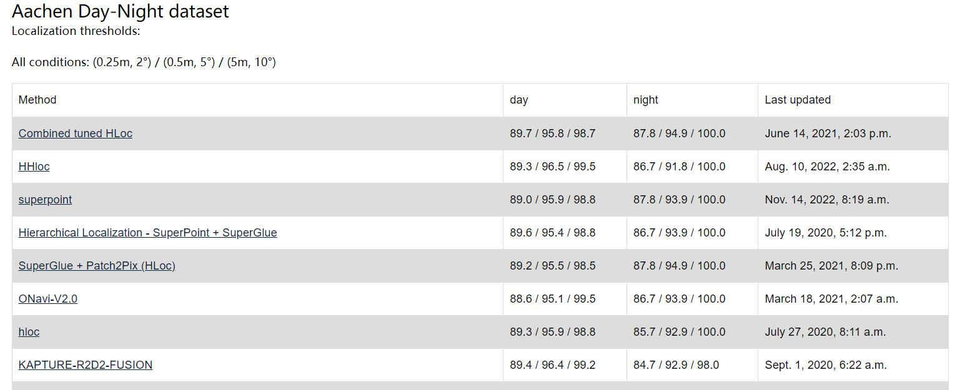
11.2.3 Application: Location recognition (5/5)
The Long-Term Visual Localization benchmark at https://www.visuallocalization.net/ has a leaderboard listing the best-performing localization systems.
https://www.visuallocalization.net/
Notes:
https://blog.csdn.net/weixin_43823854/article/details/101749899

Slide 50
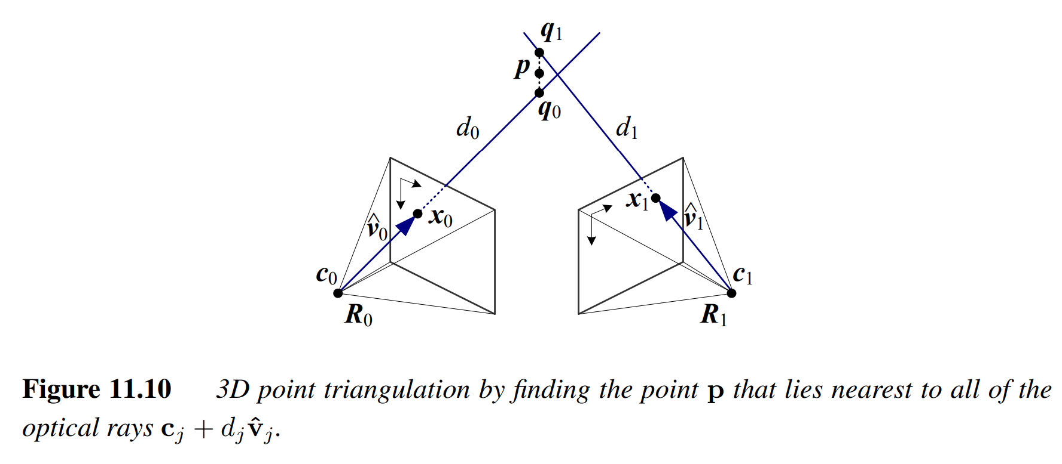
11.2.4 Triangulation (1/4)
The problem of determining a point’s 3D position from a set of corresponding image locations and known camera positions is known as triangulation.
Notes:
https://www.youtube.com/watch?v=b8A65Mp8fjk&list=PLFI1Cd4723_SNT5r-9fHsuEsKaxeDNyQ5&index=10
單一個點無法確定位置，要兩個 (人類兩隻眼)
聯合兩條線一起考慮，從兩個攝像機的視角進行測量又叫做三角化
P = l x l’, 但實際上，由於測量的精確性，這樣p點並不精準
因此用最小化方法求解

Slide 51
11.2.4 Triangulation (2/4)
Notes:
C = 相機中心
V= 方向
D = 未知
當最小值出現時，d = v。(p-c)
c+djvj =射線
p = 要找的點
求距離平方最小值
q=射線上的點

Slide 52
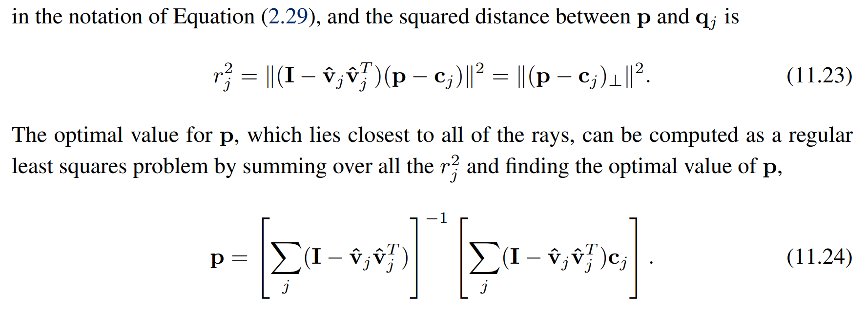
11.2.4 Triangulation (3/4)
Notes:
I = 單位向量
⊥正交補集orthogonal complement
P= 離所有射線的最接近點，固可以當成最小二乘問題來計算
Ex: r1^2+r2^2…的最小值

Slide 53
11.2.4 Triangulation (4/4)
An alternative formulation, which is more statistically optimal and which can produce significantly better estimates if some of the cameras are closer to the 3D point than others, is to minimize the residual in the measurement equations,
Notes:
另一個方法，當有些攝像機更靠近目標點時，在統計上更優的方法，P相機的參數，x,y = 2D特徵點的座標
XYZW = 欲求點的座標

Slide 54
11.3 Two-frame structure from motion
11.3.1 Application: View morphing

Slide 55
11.3 Two-frame structure from motion
In 3D reconstruction, we have always assumed that either the 3D point positions or the 3D camera poses are known in advance.
Consider Figure 11.11, which shows a 3D point p being viewed from two cameras whose relative position can be encoded by a rotation R and a translation t. Since we do not know anything about the camera positions, we can set the first camera at origin $c_{0}=0$ , and at a canonical orientation $R_{0}=I$
Figure 11.11
Notes:
Structure = P(3D point)
Motion = M(camera matrix)
P, c0, c1構成的面 = 極平面

Slide 56
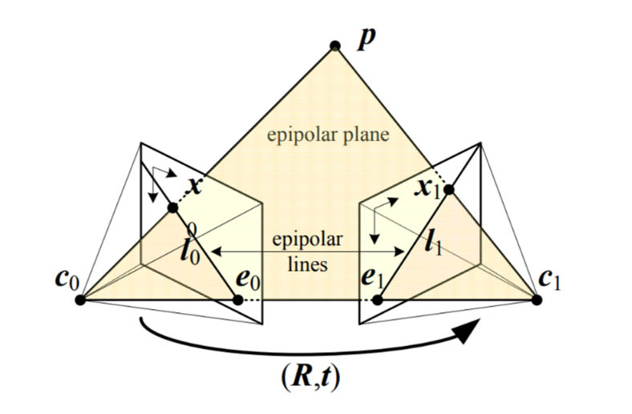
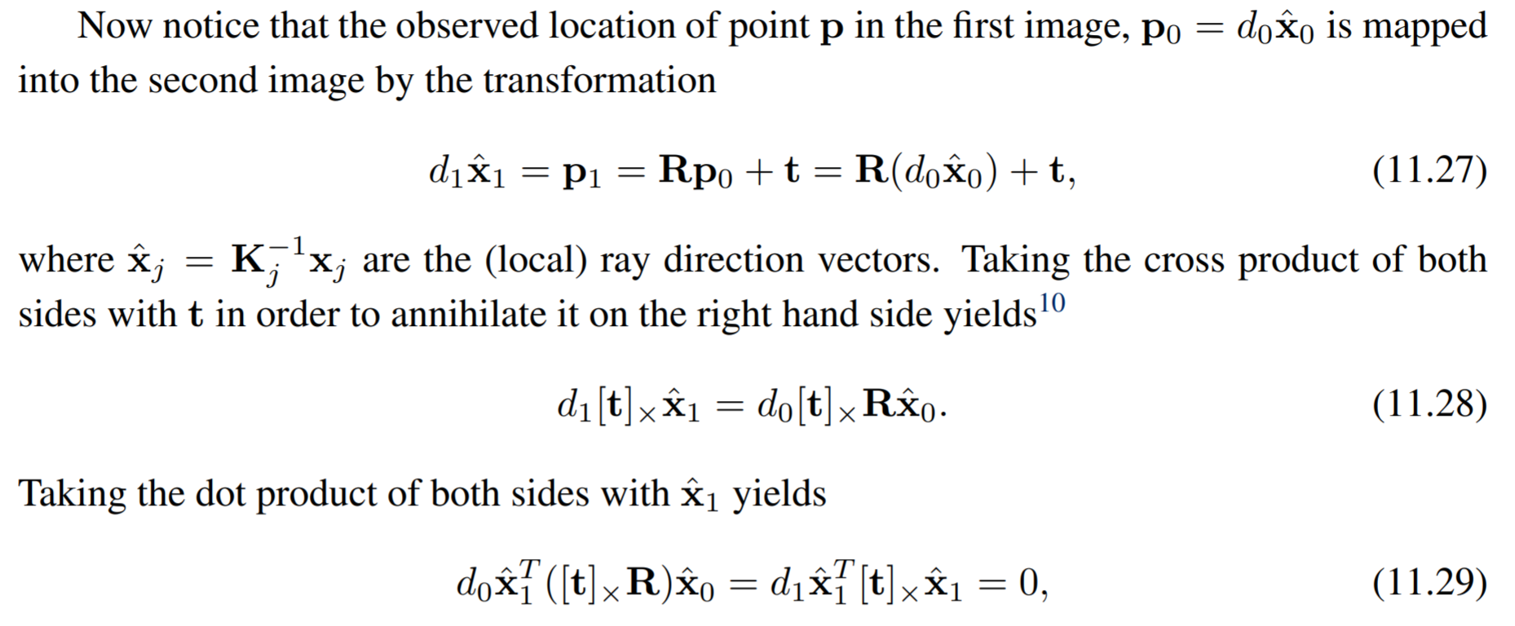
11.3 Two-frame structure from motion
Notes:
Dj = 距離
Xj = 射線方向向量
P(2D point) = K(內參數)p(3D point) = x_hat
P1 = Rp0 + t ,第一個點加上旋轉平移等於第二個點
先兩邊對同時對t做外積，去除右邊的+t
之後兩邊對x1做內積得到一個= 0的等式

Slide 57
Notes:
極幾何
極平面：過點P,O1,O2的平面
基線：O1,O2的連線
極線：極平面與成像平面的交點
極點：基線與成像平面的交點
》極平面相交于基線
》極線相較於極點
》P1的對應點在極線P2,E2上
》P2的對應點在極線P1,E1上

Slide 58
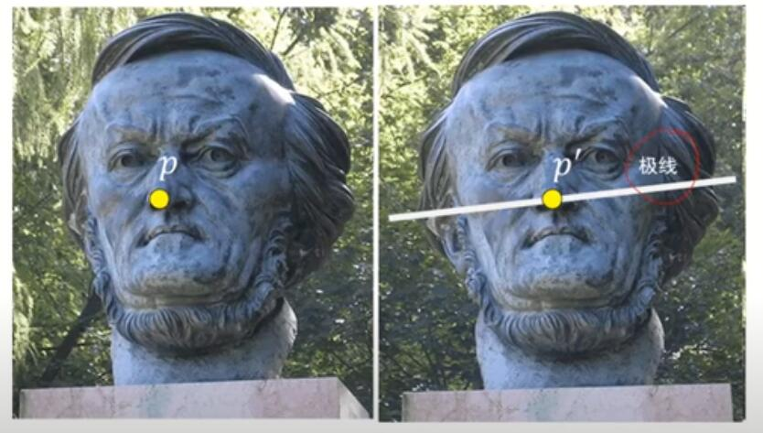
Epipolar Geometry Constraint
極線
Notes:
極幾何約束
通過級幾何約束，我們可以將對應點的搜索範圍縮小到對應的極線上

Slide 59
11.3 Two-frame structure from motion
Notes:
x1( RXt )x0 = x1 E x0
E = 本質矩陣 = R XT
規範了兩個點的對應關係
給first image的其中一點，就可以求另一點

Slide 60
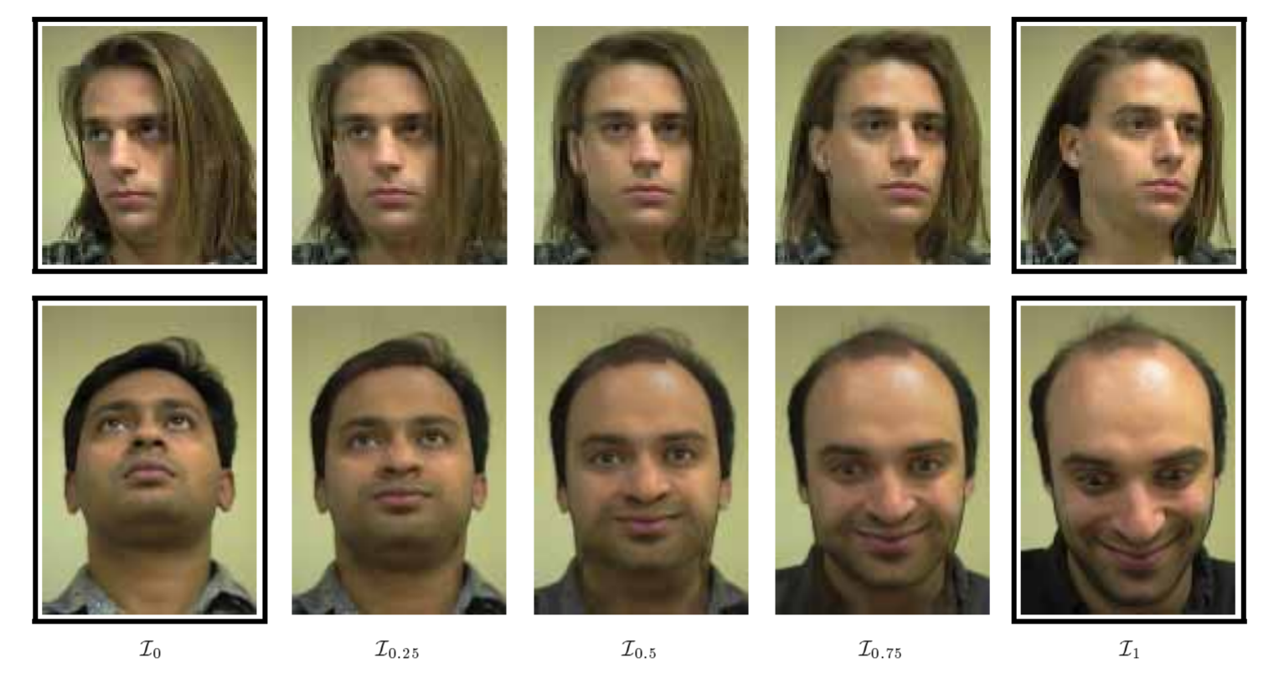
Seitz, S. M. and Dyer, C. M. (1996). View morphing. In ACM SIGGRAPH 1996 Conference Proceedings, pp. 21–30, New Orleans.
11.3.1 Application: View morphing (1/2)
An interesting application of basic two-frame structure from motion is view morphing
Notes:
面部視圖變形。 頂部：在同一個人的兩個視圖之間變形。
底部：在兩個不同人的視圖之間變形。 在每種情況下，
視圖變形都會捕捉原始圖像 I0 和 I1 之間面部姿勢的變化，傳達自然的 3D 旋轉。

Slide 61
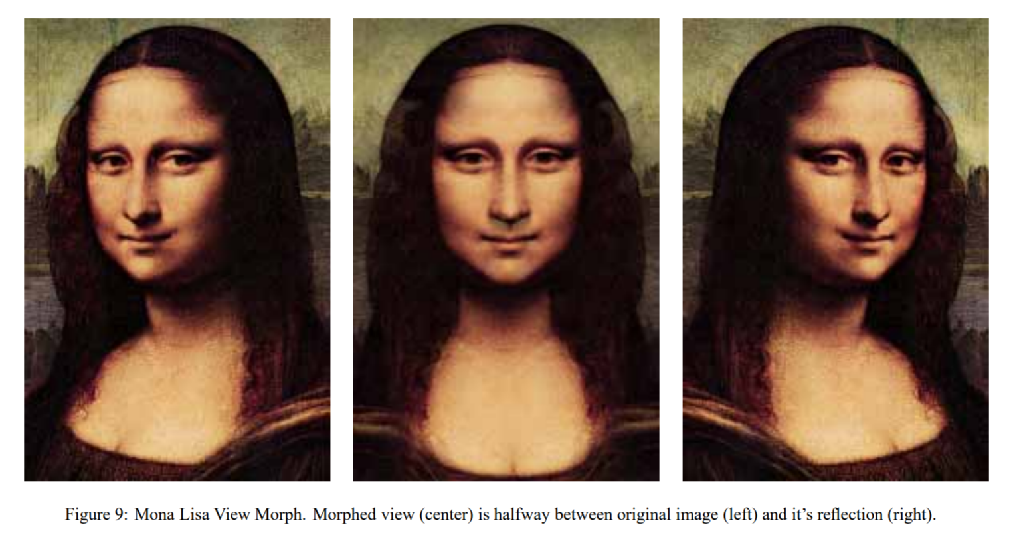
Seitz, S. M. and Dyer, C. M. (1996). View morphing. In ACM SIGGRAPH 1996 Conference Proceedings, pp. 21–30, New Orleans.
11.3.1 Application: View morphing (1/2)
Notes:
蒙娜麗莎視圖變形。 變形視圖（中）位於原始圖像（左）和它的反射（右）之間。

Slide 62
11.4 Multi-frame structure from motion
11.4.1 Application: Match move
11.4.2 Application: Reconstruction from Internet photographs
Notes:
通過多張三維圖像，恢復出該場景的三維結構和相機參數

Slide 63
11.4.1 Application: Match move (1/2)
One of the neatest applications of structure from motion is to estimate the 3D motion of a video or film camera, along with the geometry of a 3D scene, in order to superimpose 3D graphics or Computer-Generated Images (CGI) on the scene.
For very small motions, or motions involving pure camera rotations, one or two tracked points can suffice to compute the necessary visual motion. For planar surfaces moving in 3D, four points are needed to compute the homography, which can then be used to insert planar overlays.
Notes:
匹配運動
運動結構最巧妙的應用之一是估計視頻或膠片相機的 3D 運動以及 3D 場景的幾何形狀，
以便在場景上疊加 3D 圖形或計算機生成的圖像 (CGI)。
對於非常小的運動，或涉及純相機旋轉的運動，一兩個跟踪點就足以計算必要的視覺運動。
對於在 3D 中移動的平面，需要四個點來計算單應性，然後可以使用單應性插入平面覆蓋，
例如，在體育賽事期間替換廣告牌的內容。

Slide 64
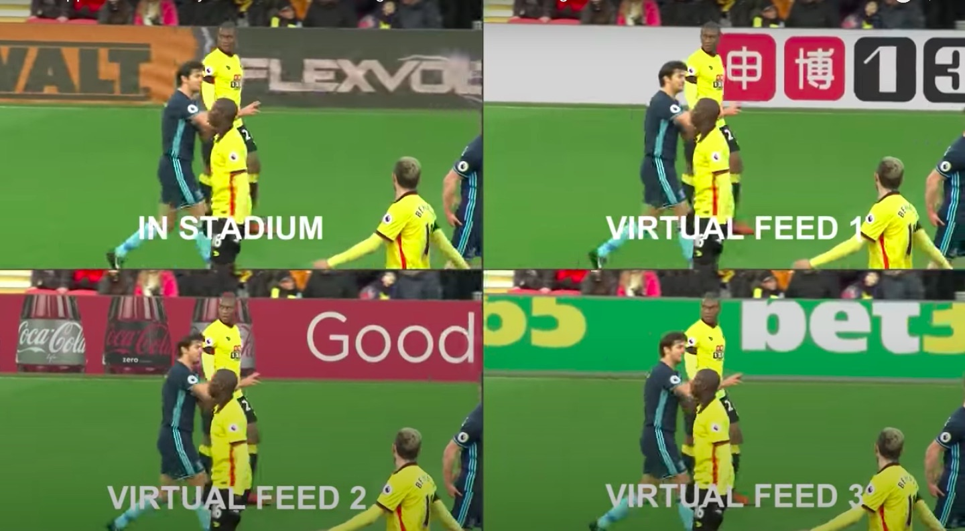
Roble, D. (1999). Vision in film and special effects. Computer Graphics, 33(4):58–60.
11.4.1 Application: Match move (2/2)
e.g, to replace the contents of advertising billboards during sporting events..
Notes:
使用2D跟踪進行數字化妝。

Slide 65
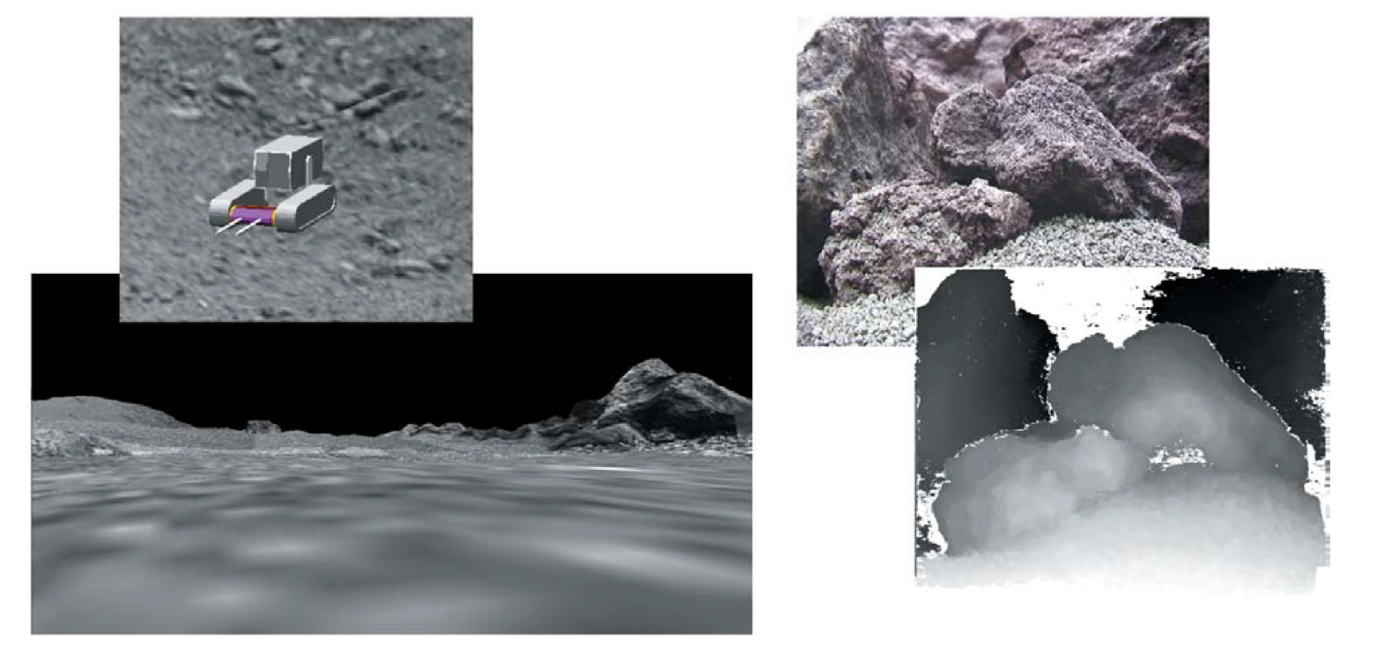
Pollefeys, M. and Van Gool, L. (2002). From images to 3D models. Communications of the ACM, 45(7):50–55.
11.4.2 Application: Reconstruction from Internet photographs (1/5)
The most widely used application of structure from motion is in the reconstruction of 3D objects and scenes from video sequences and collections of images.
Planetary rover navigation. Virtual reality simulation (left) and close-range reconstruction of rocky terrain to support rover operations (right).
Notes:
行星漫遊者導航。
虛擬現實模擬（左）和岩石地形的近距離重建以支持漫遊車操作（右）。

Slide 66
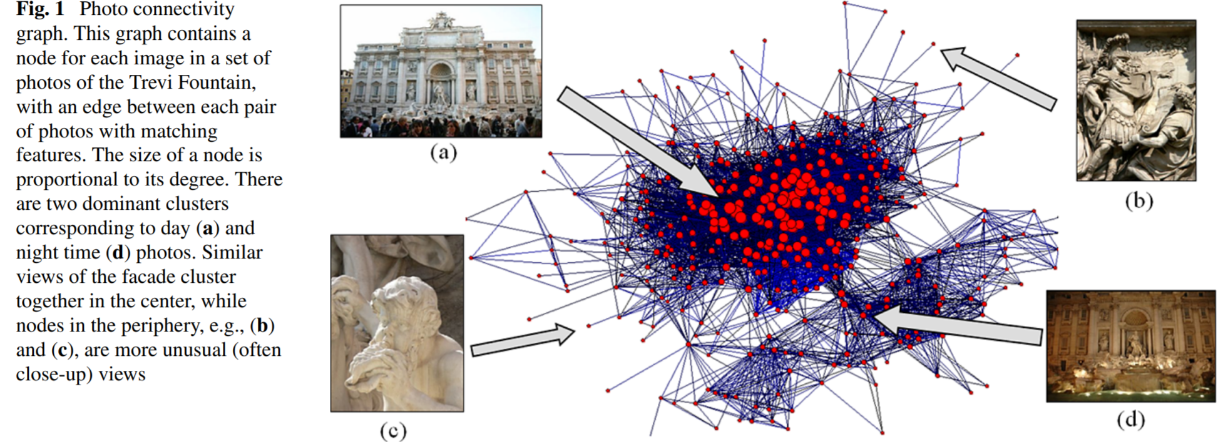
Snavely, N., Seitz, S. M., and Szeliski, R. (2008a). Modeling the world from internet photo collections. International Journal of Computer Vision, 80(2):189–210.
11.4.2 Application: Reconstruction from Internet photographs (2/5)
An exciting innovation in this space has been the application of structure from motion and multi-view stereo techniques to thousands of images taken from the internet, where very little is known about the cameras taking the photographs.
Notes:
該領域的一項令人興奮的創新是將運動和多視圖立體技術的結構應用到從互聯網拍攝的數千張圖像中，
而互聯網上對拍攝照片的相機知之甚少

Slide 67
Snavely, N., Seitz, S. M., and Szeliski, R. (2008a). Modeling the world from internet photo collections. International Journal of Computer Vision, 80(2):189–210.
11.4.2 Application: Reconstruction from Internet photographs (3/5)
Screenshots from the explorer interface. Left: when the user visits a photograph, that photograph appears at full-resolution, and information about it appears in a pane on the left. Right: a view looking down on the Prague dataset, rendered in a non-photorealistic style.
Notes:
資源管理器界面的屏幕截圖。 左：當用戶訪問照片時，
該照片以全分辨率顯示，有關它的信息顯示在左側的窗格中。
右圖：俯視布拉格數據集的視圖，以非真實感風格呈現

Slide 68
11.4.2 Application: Reconstruction from Internet photographs (4/5)
Unfortunately, as the incremental structure from motion algorithm continues to add more cameras and points, it can become extremely slow. The direct solution of a dense system of $O(N)$ equations for the camera pose updates can take ${O(N}^{3})$ time.
Notes:
不幸的是，隨著運動算法的增量結構不斷添加更多的攝像機和點，它會變得非常慢。
用於相機姿態更新的 𝑂(𝑁) 方程的密集系統的直接求解可能需要 〖𝑂(𝑁〗^3) 時間；雖然來自運動問題的結構很少密集，

Slide 69
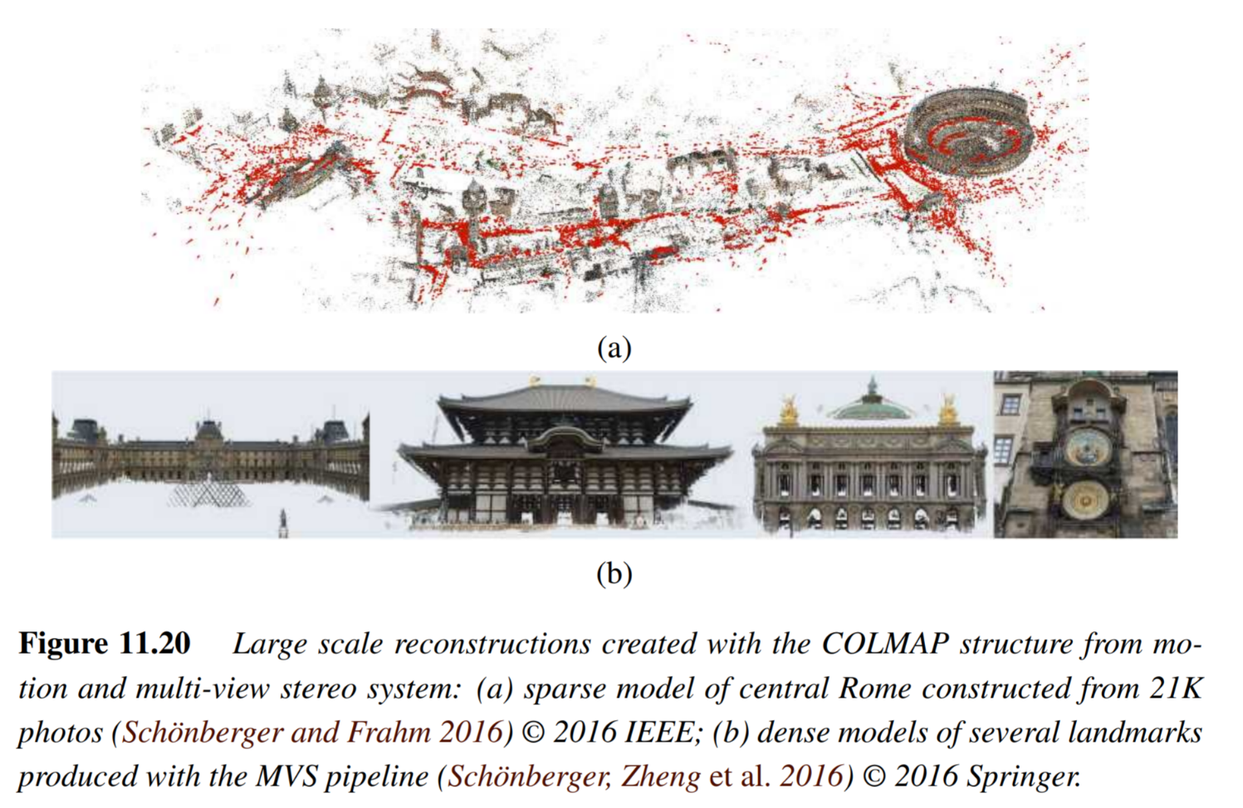
https://github.com/colmap/colmap
11.4.2 Application: Reconstruction from Internet photographs (5/5)
Among these, the COLMAP open source structure from motion and multi-view stereo system is currently one of the most widely used, since it can reconstruct extremely large scenes, such as the one shown in Figure 11.20.
MVS: Multi-View Stereo
Notes:
其中，來自運動和多視圖立體聲系統的COLMAP開源結構是目前使用最廣泛的結構之一，
因為它可以重建非常大的場景，
COLMAP是一款结合SfM(Structure-from-Motion)和MVS(Multi-View Stereo)的三维重建Pipeline

Slide 70
11.5 Simultaneous localization and mapping (SLAM)
11.5.1 Introduction
11.5.2 Overview of the Flowchart
Data Collection
Visual Odometry
Optimization
Loop Closure Detection
11.5.3 Applications: Autonomous Navigation
Notes:
同時地位和建圖
Localiztion:傳感器位置位姿
Mapping: 地圖構建
掃地機器人，第一次建圖

Slide 71
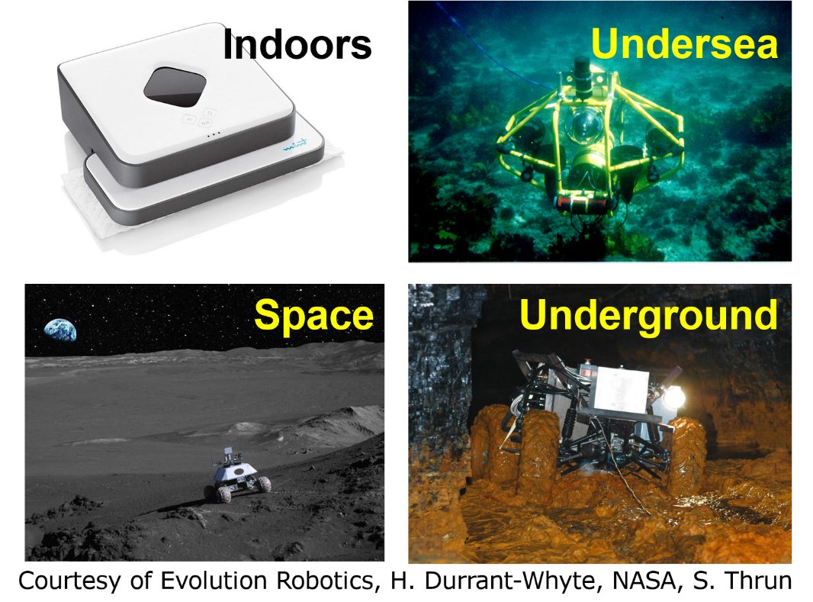
GPS: Global Positioning System
11.5.1 Introduction (1/4)
NASA: National Aeronautics and Space Administration
In some scenario, mobile robot cannot localize its position through the GPS.
However, GPS can only be used outdoors. To solve the positioning, mapping, attitude estimation, and path planning of GPS failure areas in buildings, caves, and seabeds, the most effective currently is SLAM technology.
https://www.youtube.com/watch?v=IMSozUpFFkU&t=2s
Notes:
我們知道一輛汽車在行駛中可能會使用導航或是一些路徑規劃的服務，
因此會基於GPS，根據地圖信息先標定出自己的位置。
因此地圖信息和確認自己的位置是非常重要的。
但是在一些情況，在一些無法使用GPS的場景裏面，
如一些地底，海底的探測器，一些太空的探測器，就難以實現定位的動作，
此時我們就需要用另一種方法。例如SLAM

Slide 72
11.5.1 Introduction (2/4)
What is SLAM ?
SLAM means that when a certain mobile device (such as a robot) starts from an unknown location in an unknown environment, it uses sensors to observe and locate its own position, posture, and trajectory during the movement and then builds an incremental map based on its own position, to achieve the purpose of simultaneous positioning and map construction.
The mobile robot needs to estimate the robot’s state, including the location, direction, and pose.
Mobile robot needs to build the map simultaneously.
Notes:
SLAM表示，當某個移動設備（例如機器人）從未知環境中的未知位置啟動時，
它會使用傳感器觀察並定位其在移動過程中的位置，姿勢和軌跡，
然後根據它自己的位置。 以達到同時定位和地圖構建的目的。
SLAM做三件事情，第一是定位，
第二是估計自己現在所處的狀態，當然也可以把定位當成是狀態估計的一部分。
第三件事就是對看到的環境做一個地圖建構。
同時定位與地圖構建是一種概念：希望機器人從未知環境的未知地點出發，在運動過程中通過重複觀測到的地圖特徵定位自身位置和姿態，再根據自身位置增量式的構建地圖，從而達到同時定位和地圖構建的目的。

Slide 73
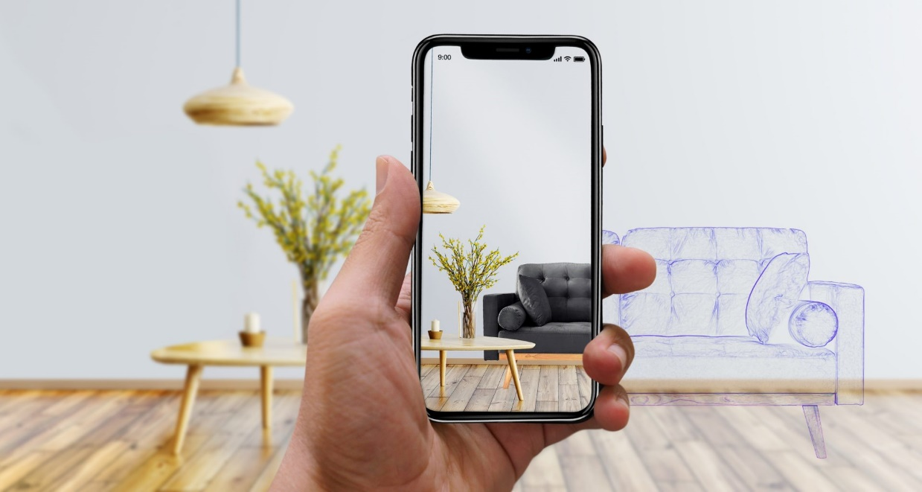
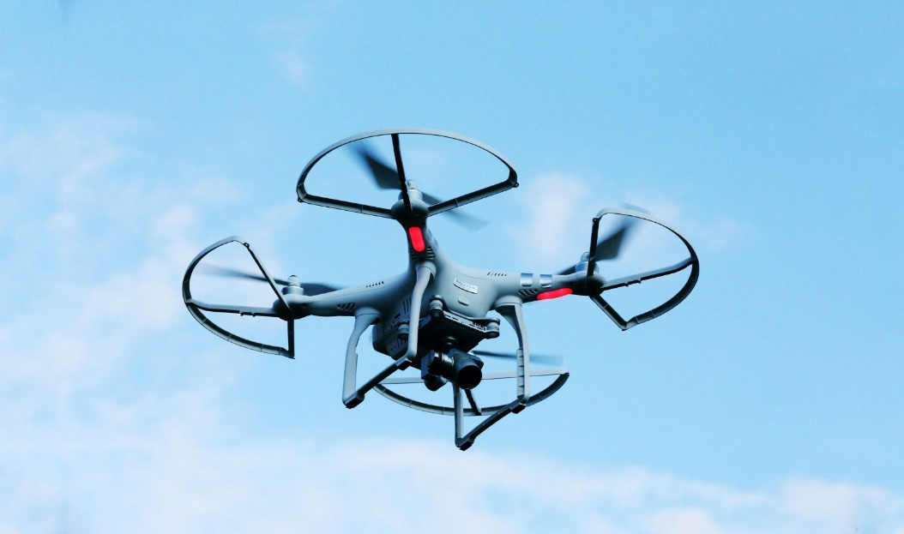
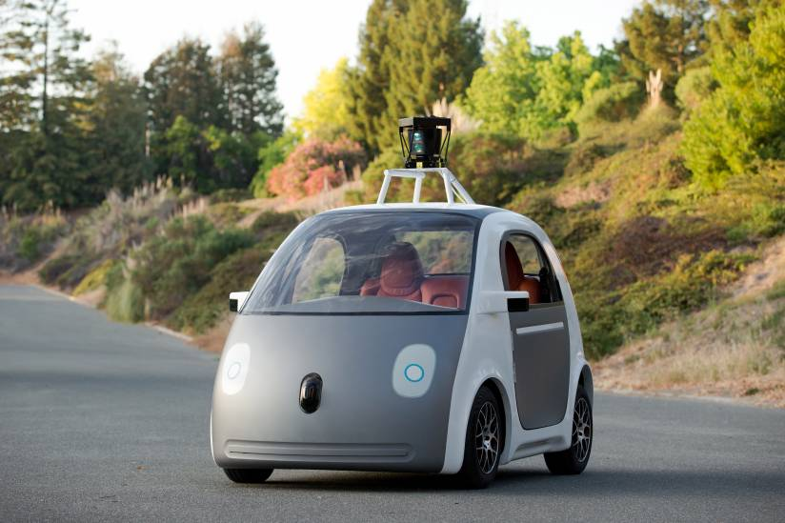
11.5.1 Introduction (3/4)
https://time.com/4129247/google-self-driving-cars-patent/
https://lvivity.com/augmented-reality-in-interior-design
https://www.wired.com/2017/05/the-physics-of-drones/
Notes:
SLAM技術用在很多地方，像是無人機的路徑規劃，
擴增實境，
一些涉及控制領域的問題，如自動駕駛。

Slide 74
11.5.1 Introduction (4/4)
For a robot vacuum
Where am I? The sweeping robot needs to know its specific location in the room during its work. The corresponding term is called: Localization.
How is the environment around me? The sweeping robot needs to know the ground structure information of the entire room. The corresponding term is called: mapping.
A Map Is Needed for Localization
State Estimation
Environment
Mapping
Notes:
用舉一個掃地機器人例子。
一個掃地機器人在室内進行清掃的動作，
他需要對整個室内環境高效率地進行清掃，已經掃過的地方不要重複清掃，
其次要在電量快耗盡的時候要找到充電位置的最佳路徑。
很明顯，對於掃地機器人來説需要知道自己在什麽地方，
需要知道自己在飯廳還是在臥室，這是定位。
其次剛才又講到，已經清掃過的地方不要重複進行清掃，
那麽就要對環境有一個認知，去判斷哪些地方是已經走過的。這是mapping。

Slide 75
11.5.2 Overview of the Flowchart
Data Collection
Visual Odometry
Optimization
Map Construction
Loop Closure
Detection
Notes:
下面來介紹SLAM的簡單的工作流程。
跟蹤路線: 確定當前位姿
跟蹤路線->優化->建構地圖
回環修正: 修正系統飄移

Slide 76
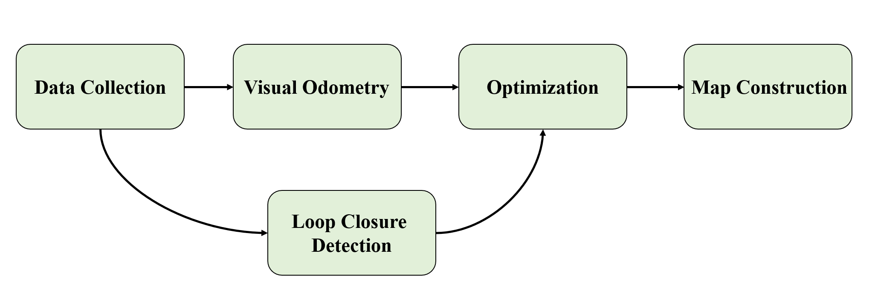
11.5.2 Overview of the Flowchart
Data Collection: Image information processing.
Visual Odometry: Estimate the pose and direction of camera movement between adjacent images and construct a local map.
Optimization: Receive looped data to make judgments more accurate.
Map Construction: Build a map based on the given data.
Loop Closure Detection: Determine whether the robot has reached the previous position, and then optimize the model based on given data.
Notes:
第一步是data collection，這部分主要是通過sensor來收集image的資料，也可以是其他種類的資料。
第二步是視覺里程計，用來估计相邻图像之间相机移动的姿势和方向，或者是走過的軌跡。并构建局部地图。
第三步分是優化，因爲收集到的資料會有噪聲，對自身狀態的估計，甚至是建構地圖會帶來誤差。因此需要通過優化來校正。
第四步分是進一步地建構地圖。
其中下面有一部步叫做回環檢測，用來判斷是否已到达先前位置，然后根据给定数据傳給模型進行优化模的動作。

Slide 77
11.5.2 Overview of the Flowchart
Data Collection
Sensors of the mobile robot are helping to measure the position and environment. Sensors represent the eyes of the mobile robot.
Interoceptive
Laser, camera…
(highly affected by noise)
Laser SLAM and Vision SLAM
Notes:
Data collection 非常簡單。
通過從外界獲得的資料才可以對外部環境進行評估。
感測裝置的話可以是laser，可以是陀螺儀，相機，
基於laser的SLAM叫做Laser SLAM，基於通過相機獲得影像資料的叫做Virtual SLAM，即視覺SLAM，
我們主要是討論Virtual SLAM的部分。
---------------------------------------
在本體上的、在環境裡的

Slide 78
11.5.2 Overview of the Flowchart
Data Collection
Laser
Camera
Precise
Low latency
Low computational complexity
High power and huge size
Expensive
High computational complexity
Environment dependency (night)
Sensitive with noise
Cheap
Light
Notes:
對比Laser和camera。
Laser會相對精準，資料收集，處理的時延會比較小，
計算複雜度較低，但是功率比較大，裝置的體積也比較大。其次是昂貴。
相機的話，計算複雜度會比較高，解析度低和解析度高的影像計算複雜度會不一樣。
受環境影響會比較大，相同的環境，白天看和在晚上，活得的影像資料完全不同。
影像資料對噪聲會比較敏感。
但是相機的優點是便宜，輕便。

Slide 79
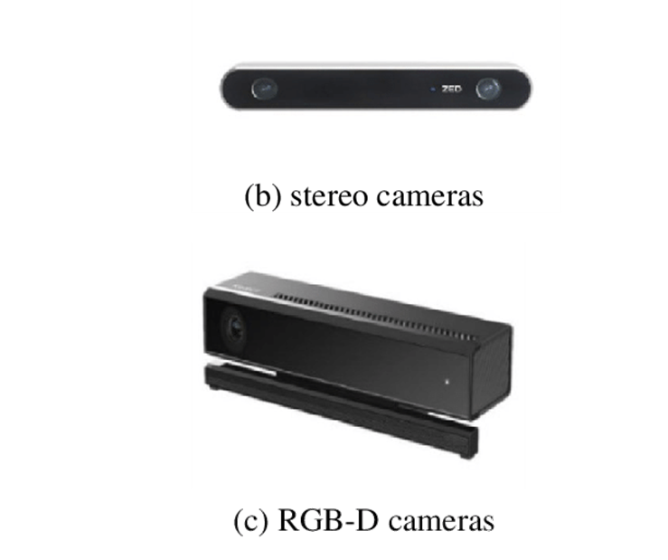
RGB-D: Red, Green, Blue - Depth
11.5.2 Overview of the Flowchart
Data Collection
Types of cameras
Monocular
Stereo
RGB-D
https://zhuanlan.zhihu.com/p/83081824
Notes:
傳感器種類
單目
雙目
RGBD(紅外光，Time of Flight)
https://www.google.com/search?q=%E5%96%AE%E7%9B%AE+%E9%9B%99%E7%9B%AE&tbm=isch&ved=2ahUKEwjWisOq2c33AhVTR_UHHYqcDccQ2-cCegQIABAA&oq=%E5%96%AE%E7%9B%AE+%E9%9B%99%E7%9B%AE&gs_lcp=CgNpbWcQAzoFCAAQgAQ6BAgAEBhQvAlYoB1g-h9oBHAAeACAATKIAd0DkgECMTCYAQCgAQGqAQtnd3Mtd2l6LWltZ8ABAQ&sclient=img&ei=YY92YpbWG9OO1e8Pirm2uAw&bih=605&biw=1396&rlz=1C1ONGR_zh-TWTW946TW946#imgrc=A5-hHVAEBXb28M

Slide 80
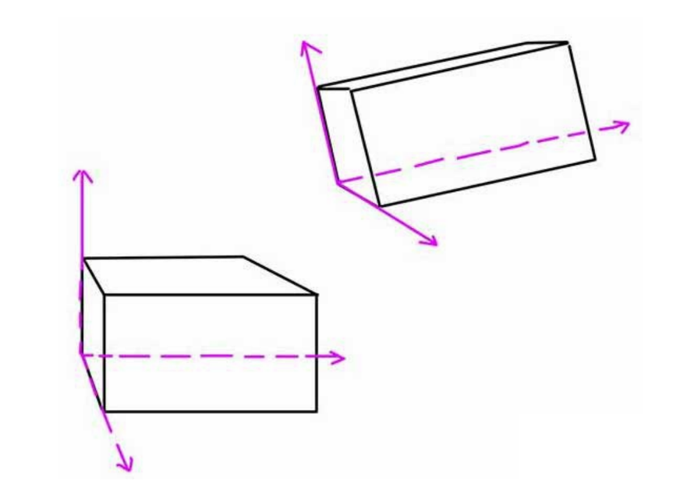
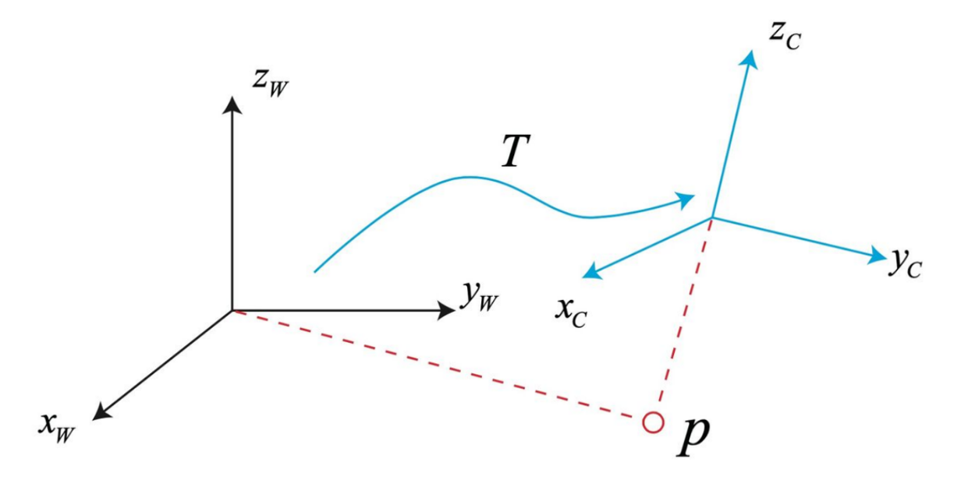
11.5.2 Overview of the Flowchart
Visual Odometry
We can use mathematics to estimate pose of the camera.
Notes:
這個視覺里程計是基於剛體運動，
坐標系進行平移和旋轉
三維世界坐標會轉換爲相機的坐標，
通過影像之間的差異來計算相機運動的軌跡。
-----------------------
根據上一偵的的向量
如果跟丟，從數據庫從重新定位

Slide 81
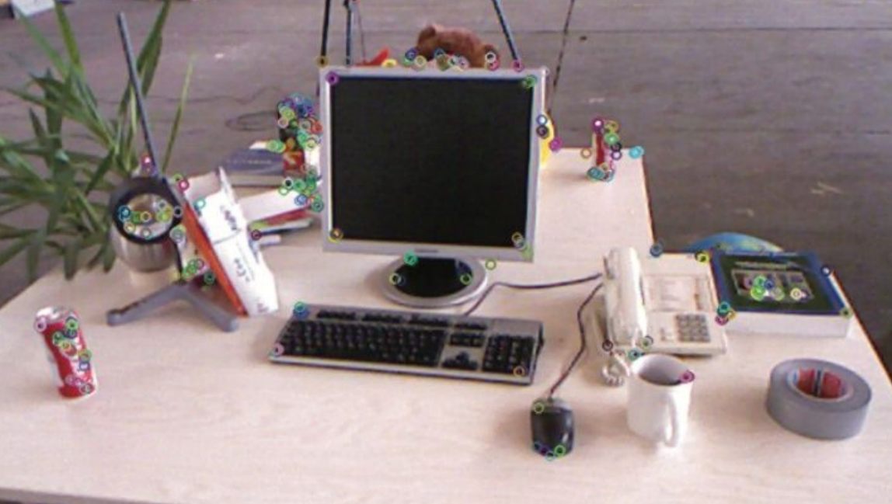
SIFT: Scale-Invariant Feature Transform
11.5.2 Overview of the Flowchart
Visual Odometry
Corner detection / Interest Point Detection
Notes:
1. 特徵提取SIFT
2.對應點的計算
d1/d2 < threshold, 而不是找最近的點
3. 軌跡 track
實際上，詞袋

Slide 82
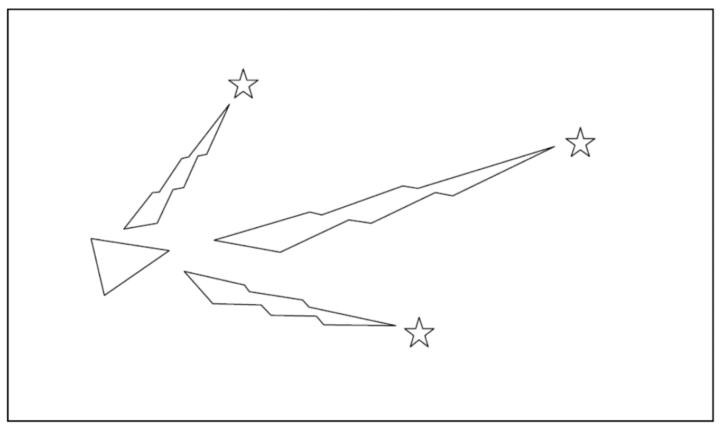
11.5.2 Overview of the Flowchart
Optimization
The robot is represented by the triangle. The stars represent landmarks. The robot initially measures using its sensors the location of the landmarks (sensor measurement illustrated with lighting)
Notes:
機器人由三角形表示。 星星代表地標。 機器人最初使用其傳感器測量地標的位置（傳感器測量以照明顯示）

Slide 83
11.5.2 Overview of the Flowchart
Optimization
The robot moves so it now thinks it is here. The distance moved is given by the robots odometry (from motion model).
Notes:
機器人移動，
因此現在認為它就在這裡。
移動的距離由機器人的測距法（根據motion model運動模型）給出。

Slide 84
11.5.2 Overview of the Flowchart
Optimization
The robot once again measures the location of the landmarks using its sensors but finds out they don’t match with where the robot thinks they should be (given the robot location). Thus the robot is not where it thinks it is.
Notes:
機器人再次使用其傳感器測量地標的位置，
但發現它們與機器人認為的位置不符（根據機器人的位置）。
因此，機器人不在它認為的位置。

Slide 85
11.5.2 Overview of the Flowchart
Optimization
As the robot believes more its sensors than its odometry it now uses the information gained about where the landmarks actually are to determine where it is (the location the robot originally thought it was at is illustrated by the dashed triangle).
Notes:
由於機器人比里程表相信更多的傳感器，
因此它現在使用獲得的有關地標實際位置的信息來確定其位置
（虛線框表示了機器人最初認為的位置）。

Slide 86
11.5.2 Overview of the Flowchart
Optimization
Notes:
針對這個場景
Observation model 就會做一些調整。
一開始motion model會給出路徑規劃 x，
同時observation model 也會估計一個路徑規劃 z’
當機器人根據x移動到下一個位置時候，用observation model 再測量一次，得到z’
對比一下 z 和 z’ 會不會一樣，如果差很多就要調整一下。
--------------------------
Motion model: 通過之前的位姿估計現在的位姿

Slide 87
11.5.2 Overview of the Flowchart
Optimization
Motion Model
A mobile robot needs pose estimation to measure its state, to take correct actions.
It is usually based on the probabilistic model.
Noise
$$x_{k}=f(x_{k−1}, u_{k}, w_{k})$$
Observation Model
A mobile robot needs to understand the environment. To estimate environment to build up a map.
It is usually based on the probabilistic model.
Noise
$$z_{k,n}=h(y_{n}, x_{k}, v_{k,n})$$

Slide 88
11.5.2 Overview of the Flowchart
Optimization
Minimize the error of the motion model and the observation model.
$$x_{k}=f(x_{k−1}, u_{k}, w_{k})$$
Motion Model
$$z_{k,n}=h(y_{n}, x_{k}, v_{k,n})$$
Observation Model
Solve by filter, non-linear optimization
Filter methods
Non-linear optimization
Extended Kalman Filter (EKF)
Bundle Adjustment
Pose Graph Optimization
https://blog.csdn.net/qq_41883714/article/details/110193979

Slide 89
11.5.2 Overview of the Flowchart
Loop Closure Detection
The visual odometer only calculates the motion of adjacent frames and performs local estimation. This will inevitably result in cumulative drift. This is because there is a certain error every time the motion between two images is estimated. The previous error will gradually accumulate in the second pass, and the drift of the track will become more and more severe.
Notes:
跟歷史紀錄匹配看看

Slide 90
11.5.2 Overview of the Flowchart
Loop Closure Detection

Slide 91
11.5.2 Overview of the Flowchart
Loop Closure Detection
Find the important features
Term Frequency–Inverse Document Frequency (TF-IDF) is widely used in Loop Closure Detection.
TF-IDF is a numerical statistic that is intended to reflect how important a word is to a document in a collection or corpus. It is often used as a weighting factor in searches of information retrieval, text mining.
Term frequency-inverse document frequency is a text vectorizer that transforms the text into a usable vector. It combines 2 concepts, Term Frequency (TF) and Document Frequency (DF).
https://towardsdatascience.com/tf-idf-simplified-aba19d5f5530
Notes:
詞頻因子
資訊檢索與文字探勘的常用加權技術
在當前的圖片某word出現的頻率
包含的文檔越多，word越不重要

Slide 93
11.5.2 Overview of the Flowchart
Loop Closure Detection
Term Frequency (TF)
The term frequency is the number of occurrences of a specific term in a document. Term frequency indicates how important a specific term in a document. Term frequency represents every text from the data as a matrix whose rows are the number of documents and columns are the number of distinct terms throughout all documents.
$tf_{(i,j)}$ represents the frequency of term $i$ in document $j$.
$$tf_{(i,j)}=\frac{total number of term i}{total number of terms in document j}$$
Notes:
詞頻因子TF:在當前的圖片某word出現的頻率

Slide 94
11.5.2 Overview of the Flowchart
Loop Closure Detection
Inverse Document Frequency (IDF):
Document frequency is the number of documents containing a specific term. Document frequency indicates how common the term is.
Inverse Document Frequency (IDF) is the weight of a term, it aims to reduce the weight of a term if the term’s occurrences are scattered throughout all the documents. IDF can be calculated as follows:
$$idf_{(i)}=log\frac{N}{df_{i}}$$
$df_{i}$ is the number of documents containing term $i.$
$N$ represents the total number of documents.
The higher the DF of a term, the lower the IDF for the term.
Notes:
逆文檔因子Idf =包含的文檔越多，word越不重要

Slide 95
11.5.2 Overview of the Flowchart
Loop Closure Detection
The TF-IDF score as the name suggests is just a multiplication of the term frequency matrix with its IDF, it can be calculated as follows:
$$w_{(i,j)}=tf_{(i,j)}⋅idf_{(i)}$$
Where $w_{(i,j)}$ is TF-IDF score for term $i$ in document $j$
Example
Sentence 1: The car is driven on the road.
Sentence 2: The truck is driven on the highway.
< car, road, highway, truck >
Sentence 1: [1, 1, 0, 0]
Sentence 2: [0, 0, 1, 1]
https://medium.com/analytics-vidhya/an-introduction-to-tf-idf-using-python-5f9d1a343f77

Slide 96
11.5.2 Overview of the Flowchart
Loop Closure Detection
Limitation of TF-IDF
It computes document similarity directly in the word-count space, which may be slow for large vocabularies.
It assumes that the counts of different words provide independent of similarity.
It makes no use of semantic similarities between words.
TF-IDF for SLAM
Terms in document → Features in image

Slide 97
11.5.2 Overview of the Flowchart
Loop Closure Detection
Summary of Loop Closure Detection
It is a procedure to find the similarity between images.
Without LCD
With LCD
https://nrottmann.github.io/publication/iros2020ws/

Slide 98
https://www.youtube.com/watch?v=H7wRrUhzyYM

Slide 99
11.5.3 Applications: Autonomous Navigation
Vision-based navigation systems of Stanford Cart, 1979
The cart was equipped with 3D vision capabilities. It was also reconfigured to pause after each meter of movement and take 10-15 minutes to reassess its surroundings and reevaluate its decided path.
In 1979, this cautious version of the cart successfully made its way 20 meters through a chair-strewn room in five hours without human intervention.
https://news.stanford.edu/2019/01/16/stanfords-robotics-legacy/

Slide 100
11.5.3 Applications: Autonomous Navigation
The Navlab, 1989
Could only advance 4m every 10 sec.
The first system to use a neural network for driving.
Pomerleau, D. A. (1989). ALVINN: An autonomous land vehicle in a neural network. In Advances in Neural Information Processing Systems (NeurIPS), pp. 305–313.
Notes:
NavLab-1与1986年建成，该车基于一辆雪佛兰厢式货车改装而成，由三台计算机通过以太网集成在一起，主要用于图像处理、图像理解、传感器信息融合、路径规划和车体控制；采用的传感器主要包括JVC BY110U云台彩色摄像机、陀螺、ERIM激光雷达测距仪、超声传感器、光电编码器和GPS等，NavLab-1系统在CMU校园非结构化道路行驶速度为12km/h，在典型结构化道路情况下运行速度为28km/h。
1989年，卡内基·梅隆大学的Dean Pomerleau用神经网络构建了一辆可以上路的自动驾驶汽车——ALVINN（Autonomous Land Vehicle In A Neural Network），ALVINN在卡耐基·梅陇大学校园实现了在没有任何人工干预的情况下自主行驶,如下图。
ALVINN 基于一套深度学习算法，通过观察人如何驾驶并“学习”人的驾驶技能。它通过车前的摄像头和激光测距仪输入数据，并根据相应的道路类型选择最为可靠的神经网络(如下图），运算出结果并从而控制车辆。那 ALVINN 是怎么学习的呢？他们向它展示人驾驶时摄像头的图像（输入数据），以及当时司机的反应（结果），从而它就会根据输入数据，调整神经网络中连接的强度，从而得出给予的结果。

Slide 101
11.5.3 Applications: Autonomous Navigation
High data throughput.
High computational complexity.
Low latency
Security
Janai, J., Gune ¨ y, F., Behl, A., and Geiger, A. (2020). Computer vision for autonomous vehicles: Problems, datasets and state of the art. Foundations and Trends® in Computer Graphics and Vision, 12(1–3):1–308.

Slide 102
CVPR: IEEE Conference on Computer Vision and Pattern Recognition
11.5.3 Applications: Autonomous Navigation
Low latency of data transmission
Cyber security

Slide 103
11.5.3 Applications: Autonomous Navigation
https://www.nytimes.com/2016/07/01/business/self-driving-tesla-fatal-crash-investigation.html

Slide 104
11.5.3 Applications: Autonomous Navigation
https://www.bbc.com/news/business-50312340

Slide 105
Thanks for Listening

