Slide 1
Chapter 10 Computational Photography
講者：游惟丞
聯絡資訊：R11922197@ntu.edu.tw
指導教授：傅楸善

Slide 2
Definition
Image analysis and processing algorithms that are applied to one or more
photographs to create images that go beyond the capabilities of traditional
imaging systems

Slide 3
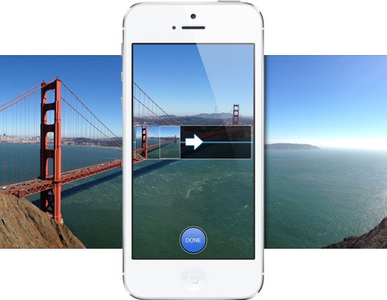
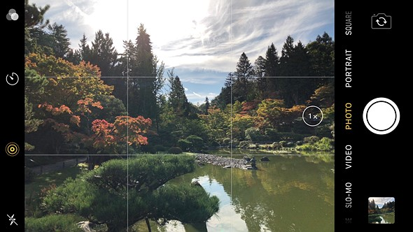
Introduction
Most widespread commercial impact.
Most smartphones has built-in computational photography functions.
Panoramic
Stitching
HDR
(High Dynamic Range)
Noise Removal

Slide 4
Chapter Structure
10.1 Photometric Calibration
10.2 High Dynamic Range Imaging
10.3 Super-resolution, Denoising, and Blur Removal
10.4 Image Matting and Compositing
10.5 Texture Analysis and Synthesis

Slide 5
Chapter 10-1 Photometric Calibration

Slide 6
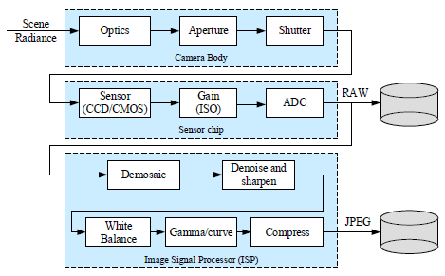
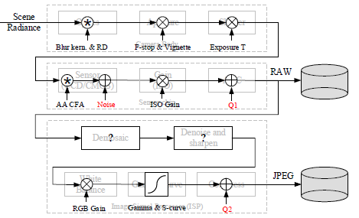
Introduction
Before we can successfully merge multiple photographs, we need to characterize the functions that map incoming irradiance into pixel values and also the amount of noise present in each image.

Slide 7
Three components of the imaging pipeline that affect this mapping:
1. Radiometric Response Function
Radiometric Response Function Maps photons arriving at the lens into digital
values stored in the image file.
2. Vignetting
Vignetting darkens pixel values near the periphery of images.
3. Point Spread Function
Point Spread Function characterizes the blur induced by the lens, anti-aliasing
filters, and finite sensor areas

Slide 8
10.1.1 Radiometric Response Function

Slide 9
10.1.1 Radiometric Response Function
ISO: International Standards Organization
Factors affect this mapping:
1. Aperture and Shutter Speed
Global multiplier of incoming light
2. Sensor (Analog to Digital Converter)
Linear gain, set by ISO value

Slide 10
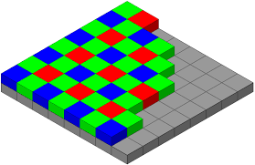
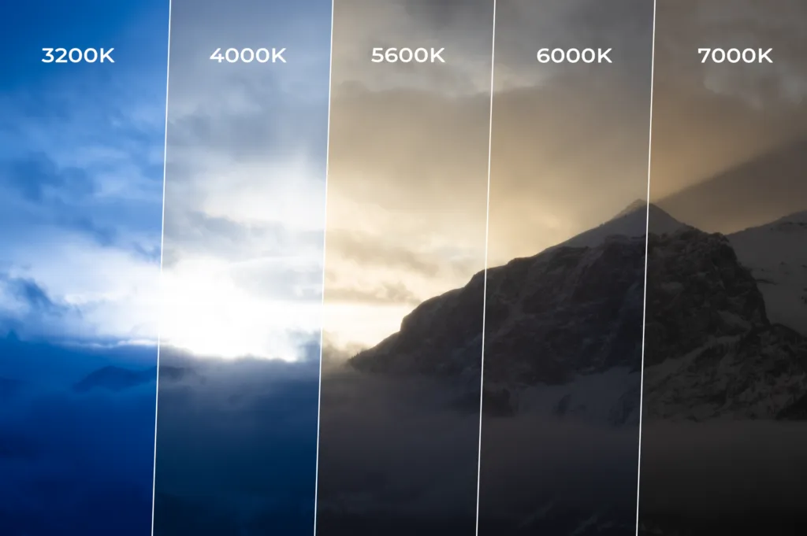
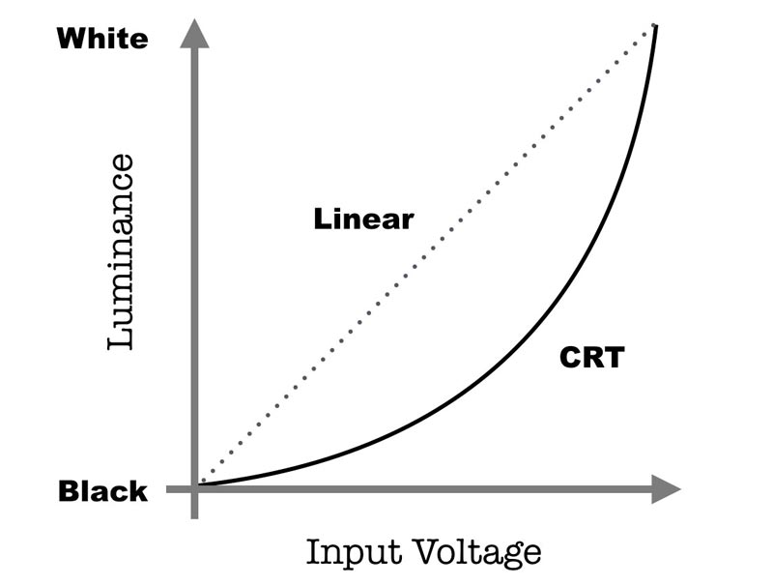
JPEG : Joint Photographic Experts Group
Storing into JPEG… Digital Signal Processor (DSP)
Demosaicing
Sharpening
White Balance
Gamma
Compress

Slide 11
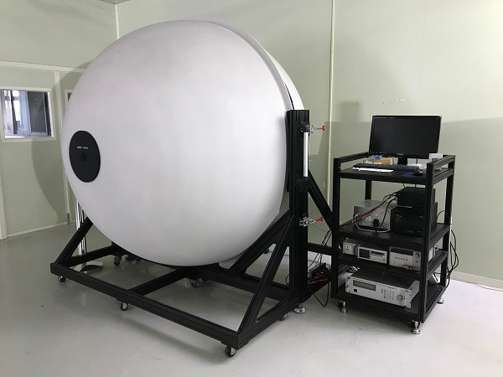
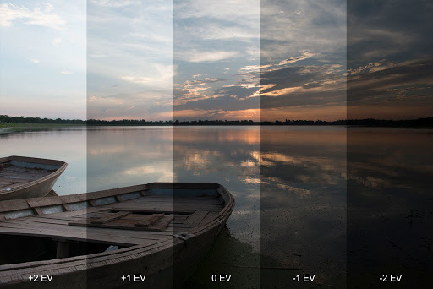
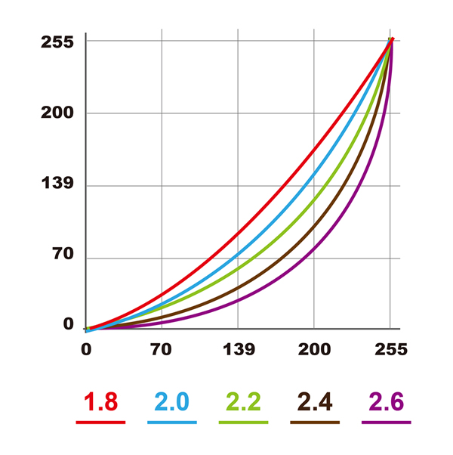
A more practical approach…
Calibrate the camera by measuring correspondences between incoming light and final values.
1. Integrating Sphere (Expensive)
2. Calibration Chart (Needs uniform lighting)
3. Multiple Exposures
4. International Color Consortium (ICC) Profile
Notes:
期末考1

Slide 12
10.1.2 Noise Level Estimation

Slide 13
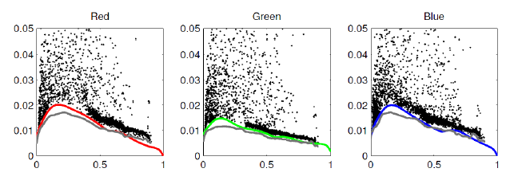
Noise Level Function
1. Standard Deviation
2. Noise Level Function
At independent pixels: temporal variance
Over regions: spatial variance

Slide 14
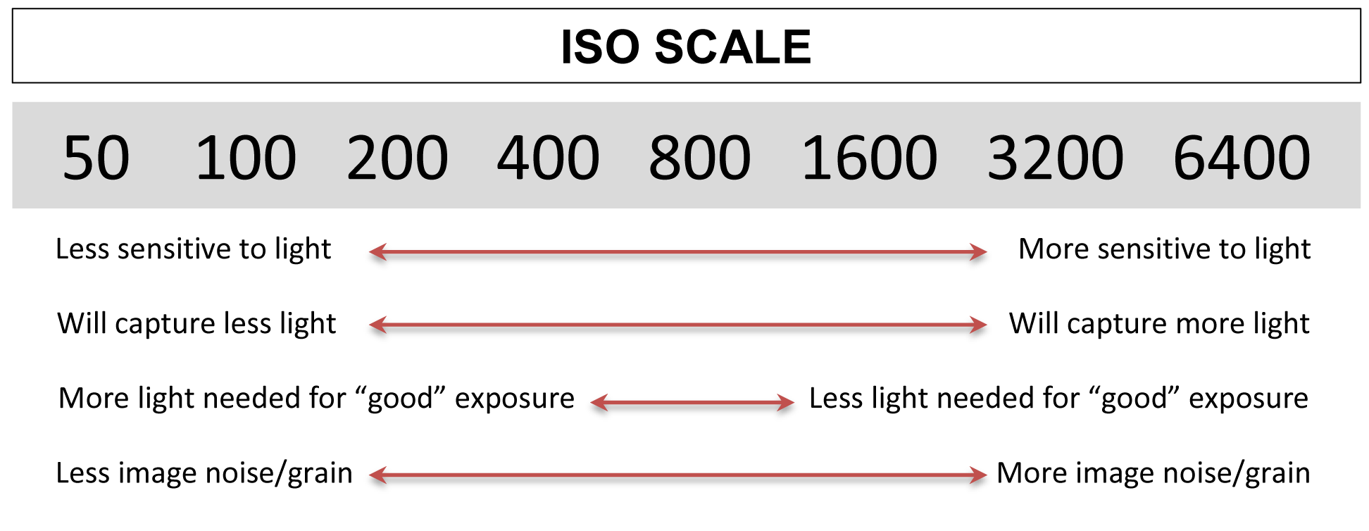
Noise Level depends on:
ISO gain (main factor)
Sensor temperature and other minor factors

Slide 15
10.1.3 Vignetting

Slide 16
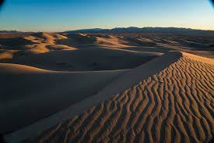
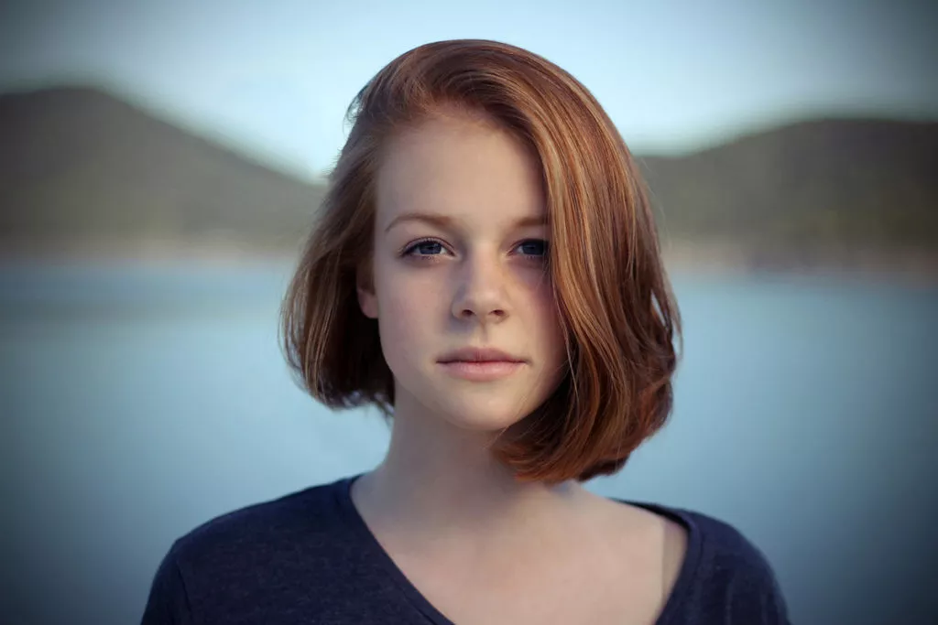
Vignetting
Definition:
Vignetting is the darkening of the areas at the border of the photo, especially at large apertures.
Common with wide angle and wide aperture lenses.
Calibration: Integrating Sphere (expensive)
Alternative approaches?
Image links:https://reurl.cc/KMzKa9

Slide 17
Stitch panoramic scene
Assume that the true radiance at each pixel comes from the central portion of each input image. This is easier to do if the radiometric response function is already known (e.g., by shooting in RAW mode) and if the exposure is kept constant.
Single image
Zhang, Lin, Kang (‘06): Segment into smoothly varying regions
Zheng, Yu et al. (‘08): Radial gradients at all the pixels

Slide 18
10.1.4 Optical Blur (Spatial Response) Estimation

Slide 19
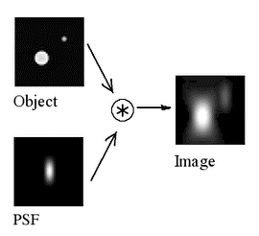
Spatial Response Function
Encodes the optical blur that gets convolved with the incoming image to produce the point-sampled image.
Point Spread Function (PSF)
a.k.a. Optical Transfer Function
The shape of the convolution kernel

Slide 20
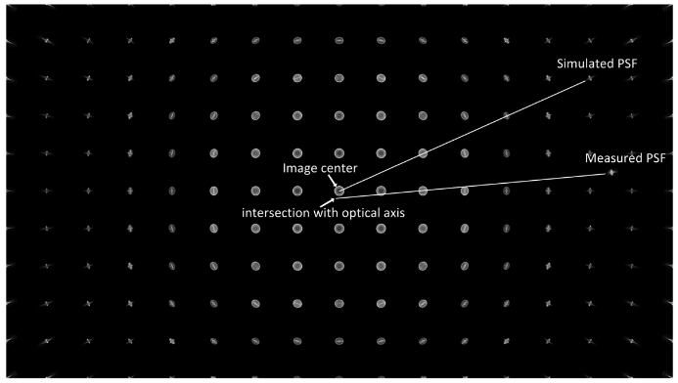
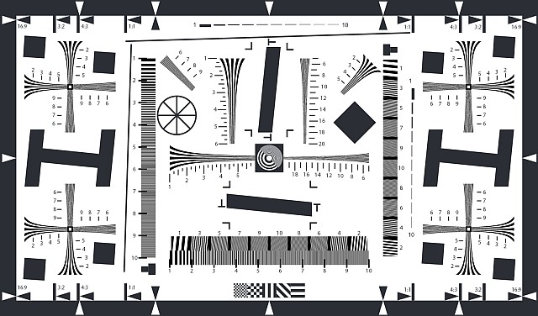
Theory: small light source everywhere
More practical
observe image of long straight lines or bars
slightly slanted edges are preferred

Slide 21
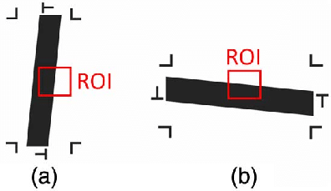
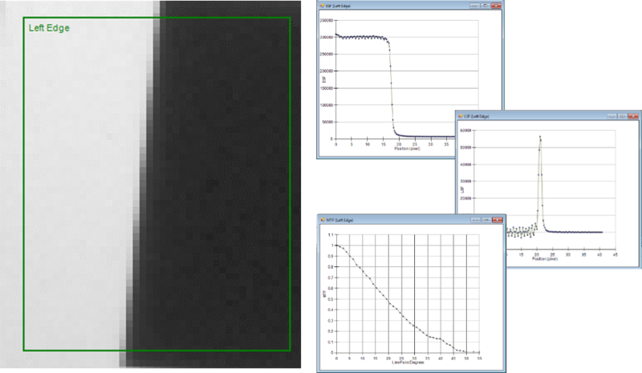
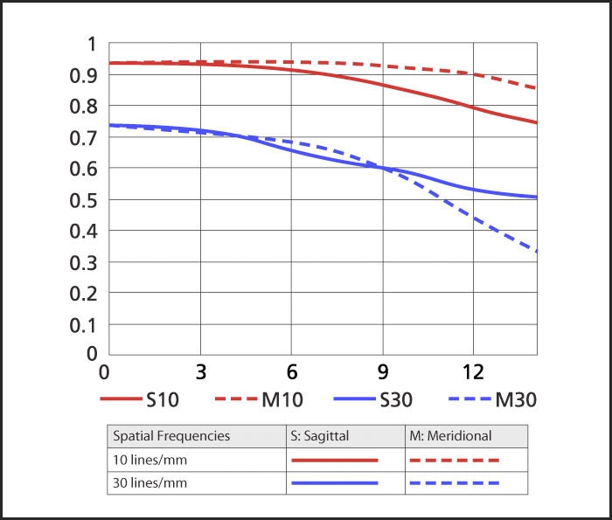
Slanted lines gives us 1D projection of the 2D PSF
It is also called the Line Spread Function (LSF)
We can convert into Fourier domain to plot a Modulation Transfer Function (MTF) chart

Slide 22
Section 10-2 High Dynamic Range Imaging

Slide 23
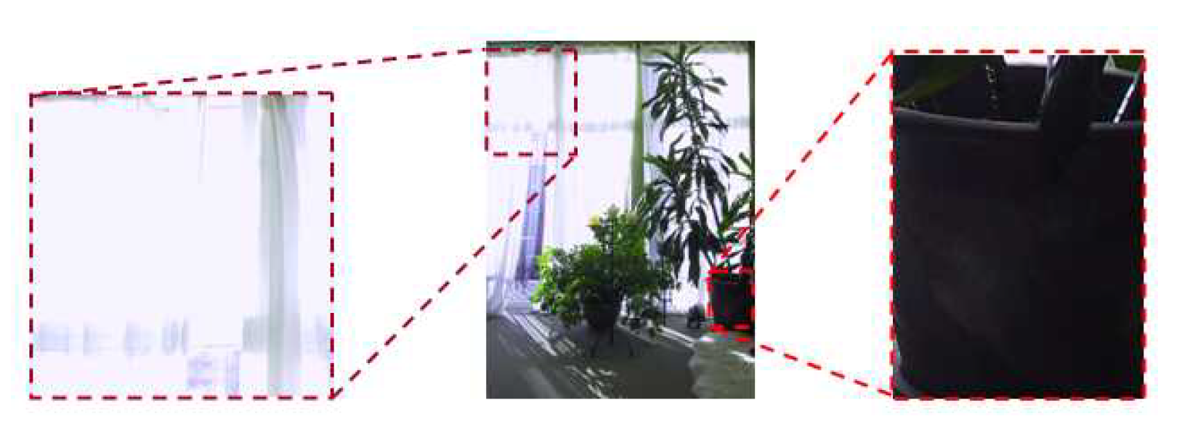
Introduction
Image taken at different exposures can help you create well-exposed photographs under challenging conditions.

Slide 24
Approach
Simplest: combine pixels from different exposures
Risk of creating contrast reversals and halos.
More common approach (3 stages)
Estimate the radiometric response function
Estimate a radiance map
Tone map the image into a displayable gamut

Slide 25
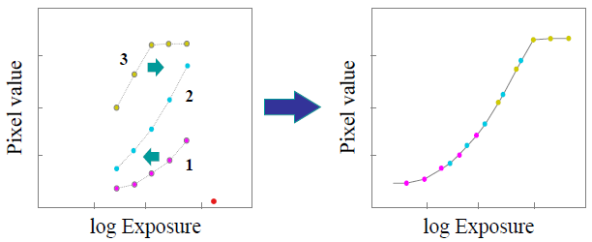
Step 1: Estimate the radiometric response function
Idea: If we can determine the irradiance (exposure) $E_{i}$ at each pixel, we could plot it against the measured pixel value $z_{ij}$ for each exposure time $t_{j}$.

Slide 26
Step 1: Estimate the radiometric response function
Radiometric response function $f$
$$z_{ij}=f(E_{i}t_{j})$$
Inverse response curve $f^{−1}$
$$f^{−1}\left(z_{ij}\right)=E_{i}t_{j}$$
Take logarithms of both sides
$$g\left(z_{ij}\right)=\log{f^{−1}\left(z_{ij}\right)}=\log{E_{i}}+\log{t_{j}}$$

Slide 27
Step 1: Estimate the radiometric response function
$$g\left(z_{ij}\right)=\log{f^{−1}\left(z_{ij}\right)}=\log{E_{i}}+\log{t_{j}}$$
Debevec and Malik (1997)…
Assume $t_{j}$ are known
Unknowns: $E_{i}$, $g_{k}=g(k)$, $k∈\left[0,255\right]$ if 8-bit
Second-order smoothness constraint
$$λ\sum_{k}{g^{′′}{\left(k\right)}^{2}}= λ\sum{{\left[g\left(k−1\right)−2g\left(k\right)+g\left(k+1\right)\right]}^{2}}$$

Slide 28
Step 1: Estimate the radiometric response function
$$g\left(z_{ij}\right)=\log{f^{−1}\left(z_{ij}\right)}=\log{E_{i}}+\log{t_{j}}$$
Debevec and Malik (1997)…
Decays to zero at both ends of pixel range
$$w\left(z\right)=\left\{\begin{aligned}z−z_{min} z≤{(z}_{min}+z_{max})/2 \\ z_{max}−z z>(z_{min}+z_{max})/2\end{aligned}\right.$$

Slide 29
Step 1: Estimate the radiometric response function
Put all of them together
$$g\left(z_{ij}\right)=\log{f^{−1}\left(z_{ij}\right)}=\log{E_{i}}+\log{t_{j}}$$
$$λ\sum_{k}{g^{′′}{\left(k\right)}^{2}}= λ\sum{{\left[g\left(k−1\right)−2g\left(k\right)+g\left(k+1\right)\right]}^{2}}$$
$$w\left(z\right)=\left\{\begin{aligned}z−z_{min} z≤{(z}_{min}+z_{max})/2 \\ z_{max}−z z>(z_{min}+z_{max})/2\end{aligned}\right.$$
Least squares problem in {$g_{k}\}$ and $\{E_{i}\}$
$$E=\sum_{i}{\sum_{j}{w\left(z_{ij}\right){\left[g\left(z_{ij}\right)−\log{E_{i}}−\log{t_{j}}\right]}^{2}}}+λ\sum_{k}{w\left(k\right)g^{′′}{\left(k\right)}^{2}}$$

Slide 30
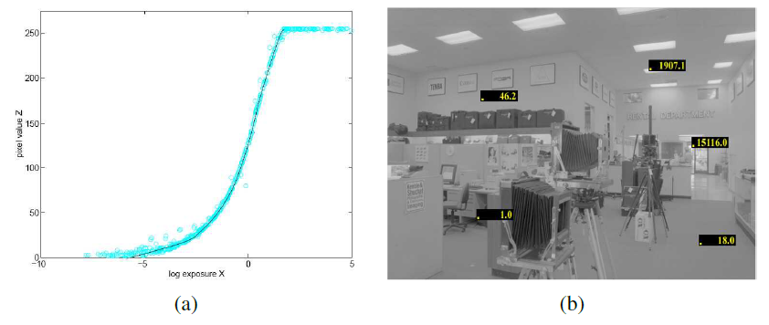
Step 1: Estimate the radiometric response function
Result (Debevec and Malik 1997)

Slide 31
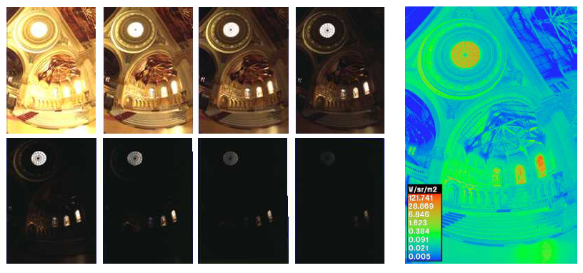
Step 2: Estimate a radiance map
Step 2: Merge the input images into a composite radiance map.
Ideal: $E=g\left(z\right)$, but…

Slide 32
Step 2: Estimate a radiance map
Problem 1: Pixels are noisy
Mitsunaga and Nayar (1996): Emphasize both higher pixel and larger gradients in the transfer function.

Slide 33
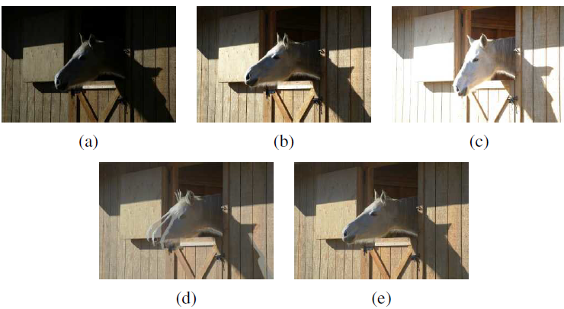
Step 2: Estimate a radiance map
Problem 2: moving objects
Ward (2003): global transform to align
Uyttendaele (2003): combine global registration and local motion estimation (optical flow)

Slide 34
HDR Image Formats
IEEE: Institute of Electrical and Electronics Engineers
Best solution: 32-bit IEEE float
Intermediate: 16-bit float for each channel

Slide 35
Introduction
10.2.1 Tone Mapping
Necessary to display on a lower gamut screen.
Simplest way: global transfer curve
Apply separate to each channel?
Colors become muted (higher-valued color channels contribute less)
Better approach: extract the luminance, and apply the global mapping to the luminance channel.

Slide 36
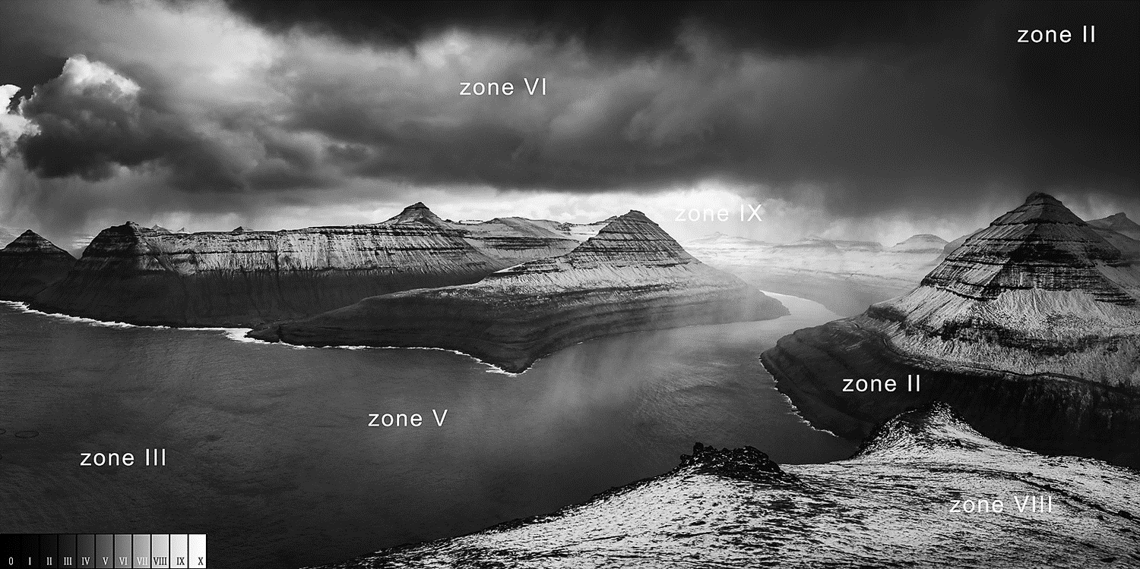
Introduction
Fail to preserve details in regions with widely varying exposure.
Need something similar to dodging and burning
Divide each pixel by the average brightness in a region around that pixel.

Slide 37
Mathematical Dodge and Burn
Split image into luminance and chrominance channels
Log luminance image
$$H\left(x,y\right)=\log{L(x,y)}$$
Low-pass filtered to produce a base layer
$$H_{L}\left(x,y\right)=B\left(x,y\right)∗H(x,y)$$
High-pass to produce a detail layer
$$H_{H}\left(x,y\right)=H\left(x,y\right)−H_{L}\left(x,y\right)$$

Slide 38
Mathematical Dodge and Burn
Contrast reduce base layer to desired luminance range
$$H_{H}^{′}\left(x,y\right)=sH_{H}(x,y)$$
Add the detail layer
$$I\left(x,y\right)=H_{H}^{′}\left(x,y\right)+H_{L}(x,y)$$
Exponentiate to produce the tone-mapped image

Slide 39
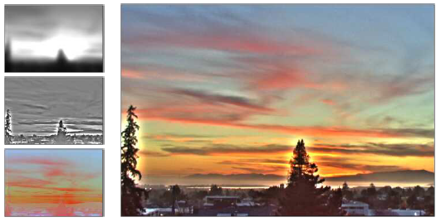
Mathematical Dodge and Burn
Visible halo in the detail layer around high contrast edges

Slide 40
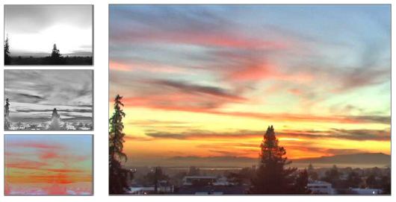
Solution to Halo: edge-preserving filter
Problem: linear filtering is not edge-preserving
Solution 1: Bilateral filtering
Durand and Dorsey (2002)

Slide 41
Solution to Halo: edge-preserving filter
Solution 2: Derivatives
Differentiate log-luminance image
$$H^{′}\left(x,y\right)=∇H\left(x,y\right)$$
Attenuate the gradient image by a spatially varying attenuation function
$$G\left(x,y\right)=H^{′}\left(x,y\right)Φ(x,y)$$

Slide 42
Solution to Halo: edge-preserving filter
Solution 2: Derivatives
Re-integrate by solving first-order variational problem
$$\min{\int{\int{{\left|\left|∇I\left(x,y\right)−G\left(x,y\right)\right|\right|}^{2}dx dy}}}$$
Combine with the original color image
$$C_{out}={\left(\frac{C_{in}}{L_{in}}\right)}^{s}L_{out}$$
$C=(R,G,B)$,
$L_{in}$ and $L_{out}$: original and compressed luminance images
$s$: controls the saturation of the colors

Slide 43
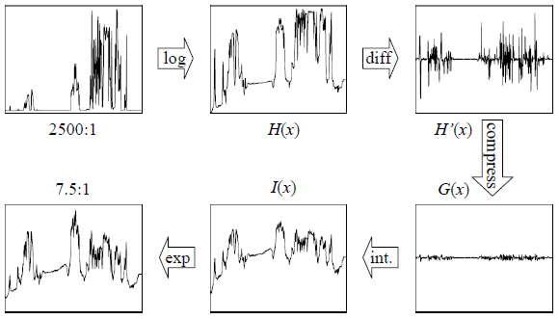
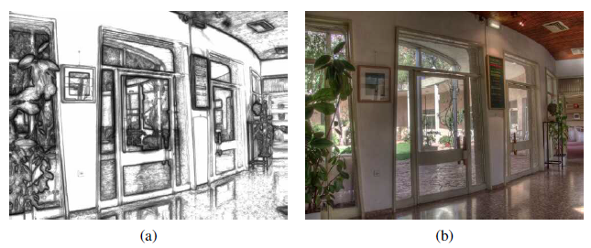
Solution to Halo: edge-preserving filter
Solution 2: Derivatives

Slide 44
Chapter 10-3 Super-resolution, denoising, and blur removal

Slide 45
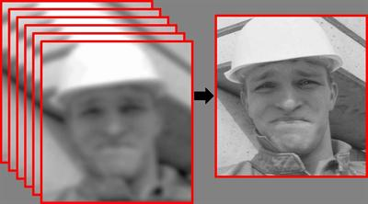
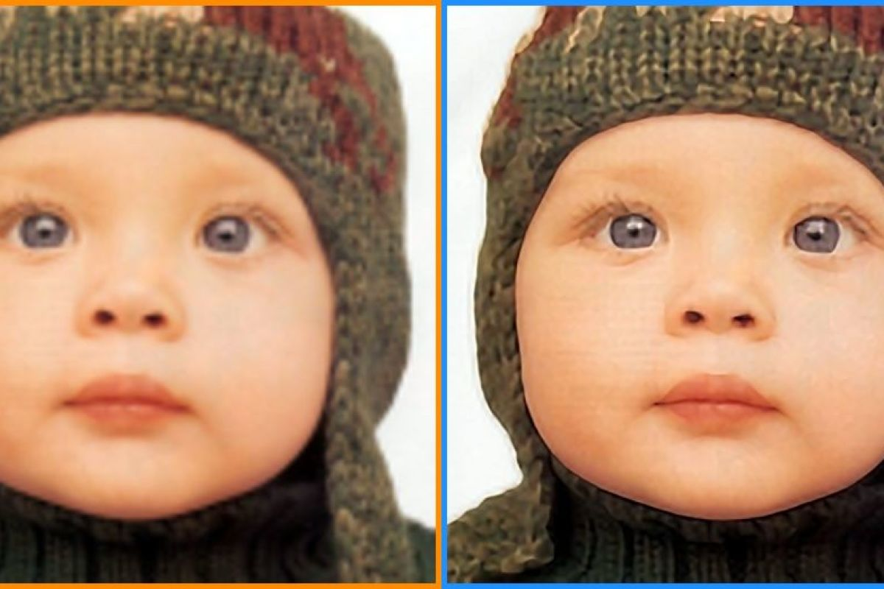
Introduction
Super-resolution goals…
Higher spatial resolution
Less noise

Slide 46
Multi-Image Super Resolution
Write down the stochastic image formation equations and image priors, and then use Bayesian inference to recover super-resolved (original) sharp image
We can generalize the image formation equations, which we also used for blur kernel (PSF) estimation.
$$o_{k}\left(x\right)=D\left\{b\left(x\right)∗s\left({\hat{h}}_{k}\left(x\right)\right)\right\}+n_{k}(x)$$

Slide 47
Multi-Image Super Resolution
$$o_{k}\left(x\right)=D\left\{b\left(x\right)∗s\left({\hat{h}}_{k}\left(x\right)\right)\right\}+n_{k}(x)$$
We have several observed images {$o_{k}\left(x\right)$}
Image warping function for each image {${\hat{h}}_{k}(x)$}
Downsampling operator $D$
Least squares problem:
$$\sum_{k}{{\left|\left|o_{k}\left(x\right)−D\left\{b_{k}\left(x\right)∗s\left({\hat{h}}_{k}\left(x\right)\right)\right\}\right|\right|}^{2}}$$

Slide 48
Multi-Image Super Resolution
$$\sum_{k}{{\left|\left|o_{k}\left(x\right)−D\left\{b_{k}\left(x\right)∗s\left({\hat{h}}_{k}\left(x\right)\right)\right\}\right|\right|}^{2}}$$
The PSF (blur kernel) $b_{k}$ is inferred or calibrated
Simultaneously inferring the blur kernel and the sharp image → blind image deconvolution
Matrix notation
$$\sum_{k}{{\left|\left|o_{k}−DB_{k}W_{k}s\right|\right|}^{2}}$$

Slide 49
Multi-Image Super Resolution
How well does this work?
Depends on camera optics, motion and PSF estimates.
No image prior → lots of high-frequency noise introduced
Assume some form of image prior
TL: Original,
TR: Bicubic,
BL: Maximum Likelihood Estimate

Slide 50
Assume Image Priors
Simplest: penalty on the image derivatives
$$\sum_{i,j}{ρ_{p}\left(s\left(i,j\right)−s\left(i+1,j\right)\right)+ρ_{p}(s\left(i,j\right)−s\left(i,j+1\right))}$$
Gaussian Markov Random Field (GMRF)
Problem: Ripples
Piecewise continuous solutions
Blend of Gaussian and Laplacian

Slide 51
Hallucination
Derivative priors can not hallucinate higher frequency texture or details.
To do this… use training set of examples
Baker and Kanade (’02): use local derivative-of-Gaussian filter response as features and then match parent structure vectors

Slide 52
10.3.1 Color Image Demosaicing

Slide 53
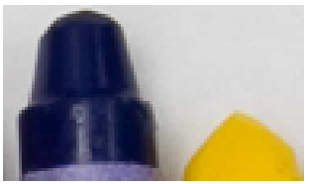
Demosaicing
Special case of super-resolution, used everyday…
Demosaicing from a color filter array (CFA) into full-color RGB
Artifacts are more visible to the eye
Zippering effect
Color Fringing
Bennett, Uyttendaele (’06): two color model
Notes:
期末考2

Slide 54
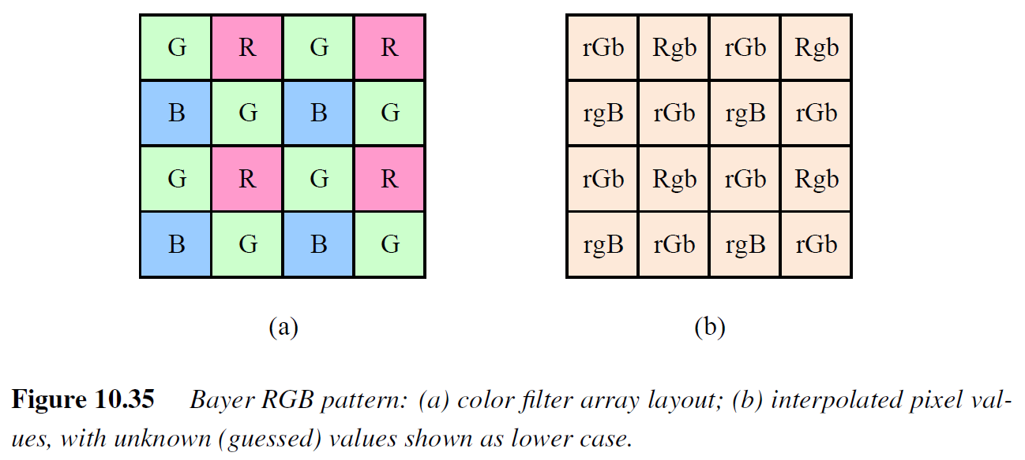

Slide 55
Chapter 10-4 Image Matting and Compositing

Slide 56
Introduction
Process of cutting a foreground object out of one image and pasting it against a new background.
Different from segmentation techniques?
Subtle interplay of mixed pixels along the along the boundary
Pull a matte
Estimate a soft opacity channel α and the uncontaminated foreground colors F from the input composite image C.

Slide 57
Equation
The compositing equation (review)
$$C=\left(1−α\right)B+αF$$
The reverse matting operation is much more challenging.
Section structure:
Blue screen matting
Natural image matting
Variants

Slide 58
10.4.1 Blue Screen Matting

Slide 59
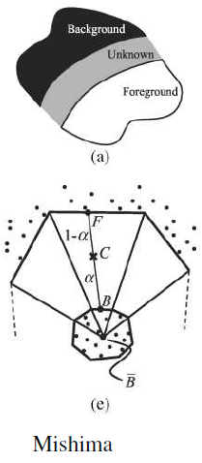
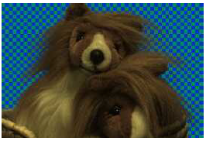
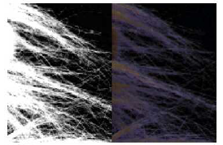
Blue Screen Matting
Filming an actor/object in front of constant colored background.
Chuang, Curless (’01): Mishima’s algorithm
Fit two polyhedral surfaces, separating the foreground and background color distributions
Measure a relative distance to measure α
Problem: blue spill

Slide 60
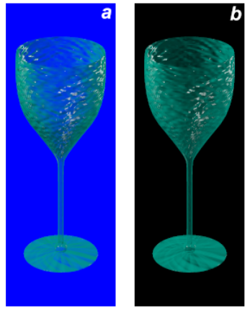
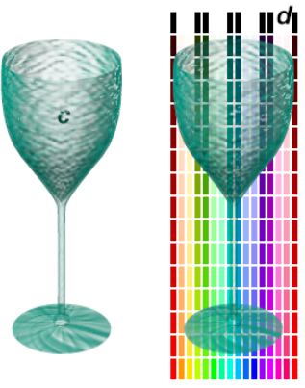
Two Screen Matting
Use more than one color to over-constrain the equations
$$C−αF=\left(1−α\right)B$$
$B$ should be chosen so as not to saturate $C$
several values of $B$ should be used

Slide 61
10.4.2 Natural Image Matting

Slide 62
Introduction
Nothing known about the background, except a rough segmentation, known as trimap.

Slide 63
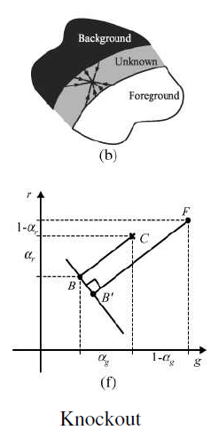
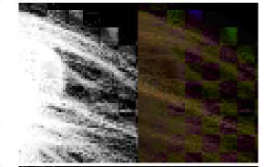
Knockout
Simple algorithm: Knockout
Nearest known foreground and background pixels are determined to produce per-pixel foreground and background color estimate
Background color is adjusted so the measured color C lies on the line between F and B
Opacity α is estimated on per-channel basis
Problem when background consist more than one dominant color

Slide 64
Bayesian
More accurate: treat F and B as distribution sampled over some region
Chuang, Curless (’01)
Use full 3x3 color covariance matrices to model mixture of correlated Gaussians
Matte extraction proceeds in strips starting from known color values growing into the unknown regions
Fully Bayesian

Slide 65
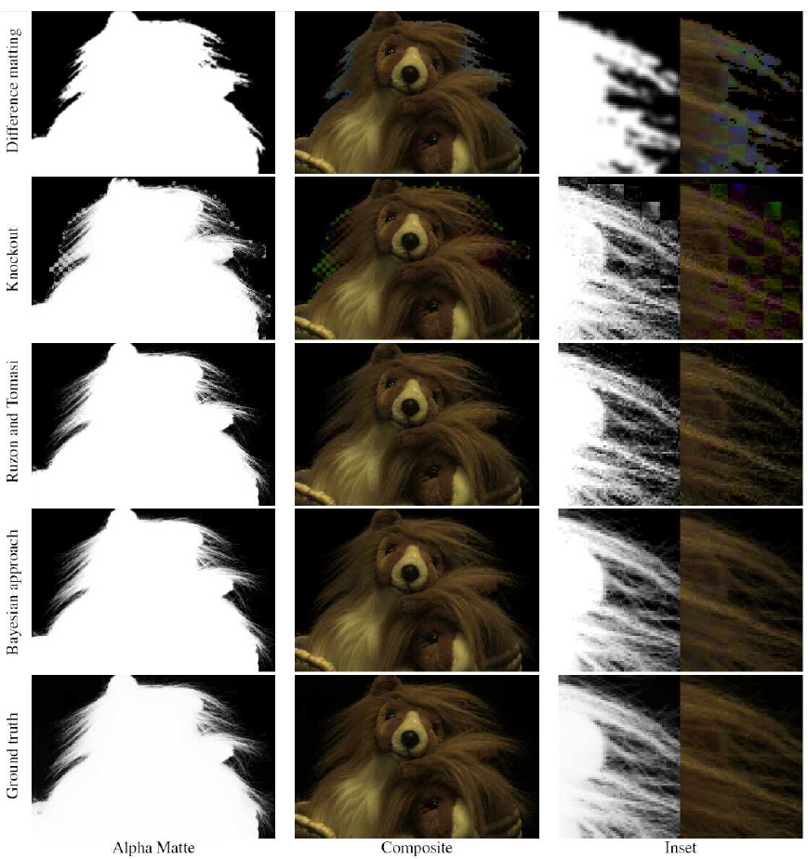
Bayesian
Results

Slide 66
10.4.3 Optimization-based Matting

Slide 67
Optimization-based Matting
Alternative to estimating each pixel independently…
Use global optimization to compute a matte that takes into account correlations between neighboring α values
Border Matting
Poisson Matting

Slide 68
Border Matting
Border Matting
Grab-cut segmentation
Solve for boundary location $∆$ and a blur width $σ$ for every pixel along the boundary
Dynamic programming to enforce smoothness in these parameters.
Problem: difficulty with fine details

Slide 69
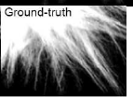
Poisson Matting
Poisson Matting
Assume known foreground and background color for each pixel
Assumes the gradient of the alpha matte and the gradient of the color image are related by
$$∇α=\dot{\frac{F−B}{{\left|\left|F−B\right|\right|}^{2}}}∇C$$

Slide 70
Results
Latest result: http://alphamatting.com

Slide 71
10.4.4 Smoke, Shadow, and Flash Matting 10.4.5 Video Matting

Slide 72
Smoke, Shadow, and Flash Matting
Smoke
linear combination of background color and a constant foreground color.
Shadow
pixel is assumed to vary between its fully lit and fully shadowed colors.

Slide 73
Video Matting
The presence of moving objects can sometimes make the matting process easier
Chuang, Agarwala (‘02)
foreground objects are first remove
resulting background plates are aligned
yield a high quality background estimate

Slide 74
Chapter 10-5 Texture Analysis and Synthesis

Slide 75
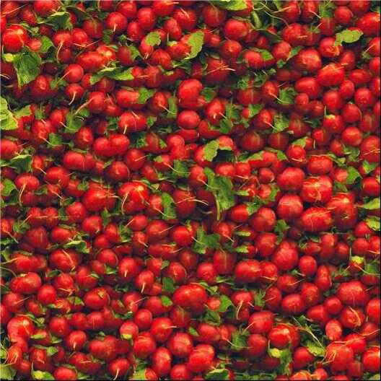
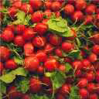
Introduction
"Given a small sample of a texture, generate a larger similar-looking image."

Slide 76
Traditional Approach
Match the spectrum of the source image while generating shaped noise. → Spatial correlations
The distributions of the responses at different frequencies must also match.

Slide 77
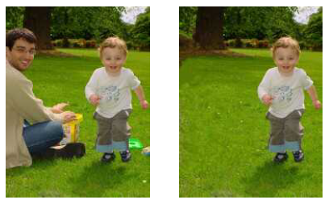
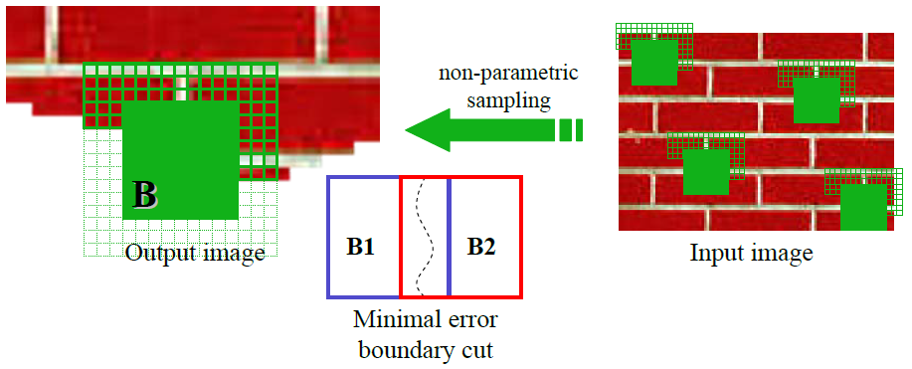
Exemplar-Based
Generate texture pixels by looking for neighborhoods in the source texture.
Can be repeated down or around the periphery when filling holes.

Slide 78
Thank You Very Much

