Slide 1
Image Watercolorization Based on Color Intensity Alteration
Chiou-Shann Fuh
Department of Computer Science and Information Engineering
National Taiwan University
Taipei, Taiwan
fuh@csie.ntu.edu.tw
Tzu-Chia Tung
Graduate Institute of Networking and Multimedia
National Taiwan University
Taipei, Taiwan
D04944016@ntu.edu.tw

Slide 2
Abstract
This paper presents a watercolor rendering technique that converts photographic images into watercolor painting. An image diffusion and mask filter algorithm is proposed. A heat transfer equation is used as the image diffusion method, and a statistic mask filter is applied to the photographic image processed by the aforementioned heat transfer equation. Experimental results show that better color effect with natural appearance is achieved.

Slide 3
Introduction
Recently the research towards computer graphics becomes more and more popular. Various graphic algorithms have been developed, and various graphics-related applications that make the application of graphics more accessible to people's lives have been realized.

Slide 4
Introduction
The functions of mobile phones have even been strengthened by cooperating with computer graphic technology, such as the photographic image can be converted into oil painting or watercolor painting effects.

Slide 5
Introduction
In this paper, we emphasize the development of image watercolorization based on color intensity alteration to obtain watercolor stylized images with natural watercolor appearance.

Slide 6
Introduction
A simple algorithm including a heat transfer diffusion method and a spatial mask filter based on statistical approach is adopted to process the photographic image for automatically converting photographic image into watercolor paintings.

Slide 7
Our Proposed Approach
The image resolution of a camera can be high such that the adjacent area in a photographic image may have significantly different intensity levels. The intensity level of color edge in a photographic image may change rapidly.

Slide 8
Our Proposed Approach
The adjacent area in a watercolor painting has roughly the same color, and the color will diffuse around. This implies that the adjacent area of a watercolor style photographic image almost has the same intensity level, and the intensity of the color edge changes slowly.

Slide 9
Our Proposed Approach
In order to have a watercolor effect for photographic images, in this paper, a heat equation is used as follows:
$$u^{n+1}=u^{n}+∆t\left[\frac{∂}{∂x}\left(Ku_{x}^{n}\right)+\frac{∂}{∂y}\left(Ku_{y}^{n}\right)\right]$$
$K=e^{{−(\frac{\left\|∇u\right\|}{a})}^{2}}$
where u denotes the temperature; the value of a is set to be 10; t denotes time step of value 0.1; and K can be expressed as $∆t$.

Slide 10
Our Proposed Approach
The intensity level of a photographic image can be regarded as the temperature, and the gray-scale distribution is regarded as the object temperature. In heat equation, the high-temperature part of the object can let heat transfer to low-temperature part. Thus the high-temperature region can be cooled, and the temperature of the adjacent region can be raised. Similarly, using the heat transfer equation, the high-intensity area of a photographic image can be decreased, and the intensity of the adjacent area can be increased.

Slide 11
Our Proposed Approach
In this paper Sobel gradient method is used to detect the boundary as follows:
$$\left\|∇u\right\|=\sqrt{u_{x}^{2}+u_{y}^{2}}$$
where u denotes the intensity value; u_{x} represents the intensity value in the x direction of the differential; and u_{y} represents the intensity value in the y direction of the differential.

Slide 12
Our Proposed Approach
Our paper has another feature: i.e. the use of a spatial mask filter based on statistical approach. The mask filter algorithm divides the pixel intensities of the image in each mask into 20 levels and computes the highest repetition level. The average value of the intensity of the Red, Green, Blue (RGB) component corresponding to the highest repetition level is calculated and will replace the original values.

Slide 13
The flowchart of our algorithm of watercolorization.
HTI: Heat Transfer Image

Slide 14
The Algorithm of Watercolorization
Details of our algorithm of watercolorization are explained as follows:
Step 1: Input an image of size M × N pixels.
Step 2: Split the image into three color channels: RGB and perform color diffusion with heat transfer equation by implementing Steps 3 to 6 for the three color channels respectively.
Step 3: Set time step and stop time for the heat transfer Equation (1).
Step 4: According to Equation (3), calculate magnitude $\left\|∇u\right\|$.

Slide 15
The Algorithm of Watercolorization
Step 5: According to Equation (2), calculate edge to stop K.
Step 6: Solve Heat Equation (1) to get the image u.
Step 7: Repeat Steps 4 to 6 until stop time is reached.
The following steps relate to spatial mask filter based on statistics.
Step 8: Set mask size W (=20, in Figure 4), and use Heat Transfer Image HTI_{(i, j)} , for W_{(i, j)} each position $(i, j)∈\left\{\left(i′, j′\right) | i−r≤i′≤i+r, j−r≤j′≤j+r\right\}$.

Slide 16
The Algorithm of Watercolorization
Step 9: Classify each pixel intensity in each mask into 20 levels by summing the intensity levels of the RGB for each pixel, normalize the result, and multiply the result by 20.
${Level}_{\left(x,y\right)}=\frac{{(R}_{\left(x,y\right)}+G_{\left(x,y\right)}+B_{\left(x,y\right)})}{\begin{aligned}3×255 \\ \end{aligned}}×20$.
Step 10: Compute the highest repetition level in each mask.
$mode({Level}_{\left(x,y\right)})$,
where the mode of a set of data values is the value that appears most often.
Step 11: Obtain the average value of the RGB intensity for the pixels corresponding to the highest repetition level respectively and replace the original RGB intensity value respectively.

Slide 17
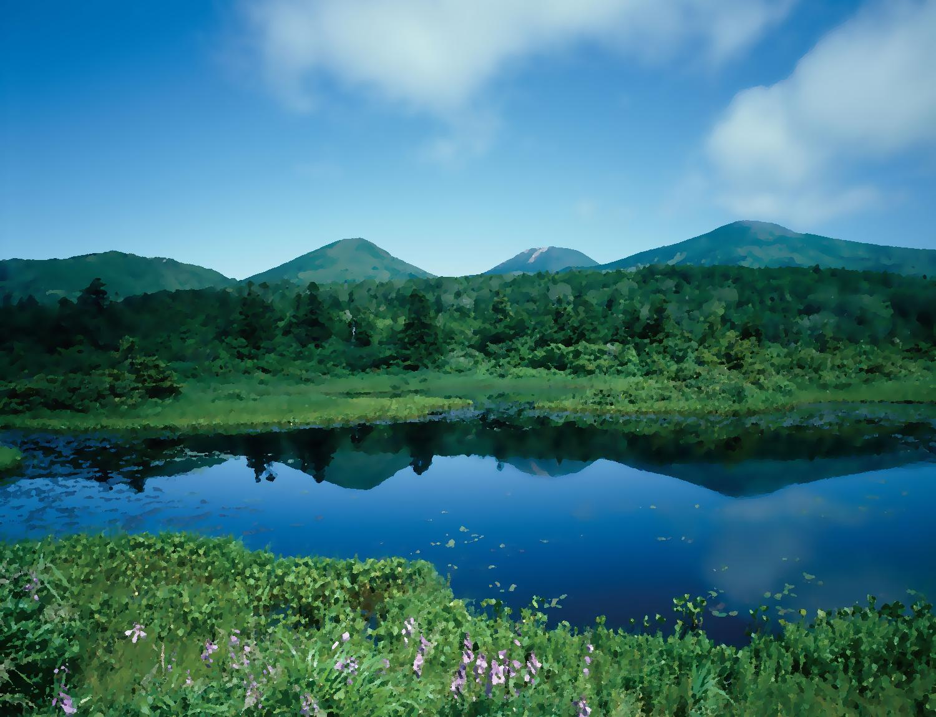
Experimental
Before
After

Slide 18
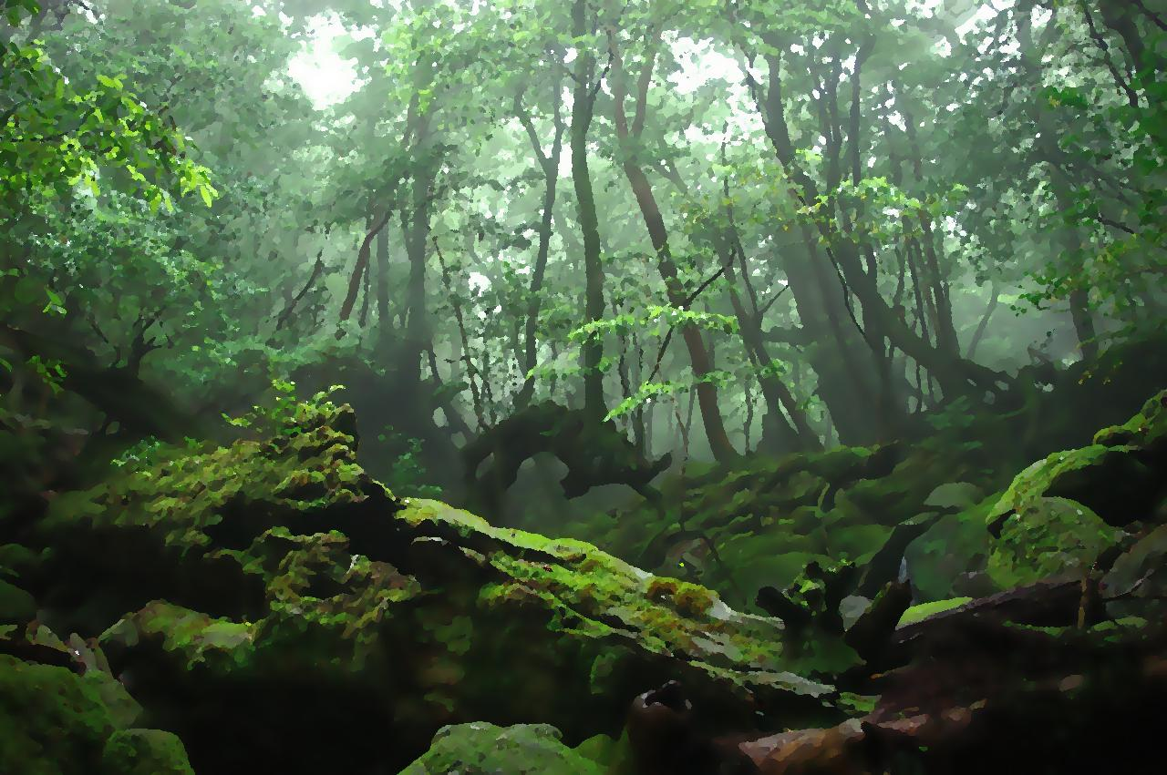
Experimental
Before
After

Slide 19
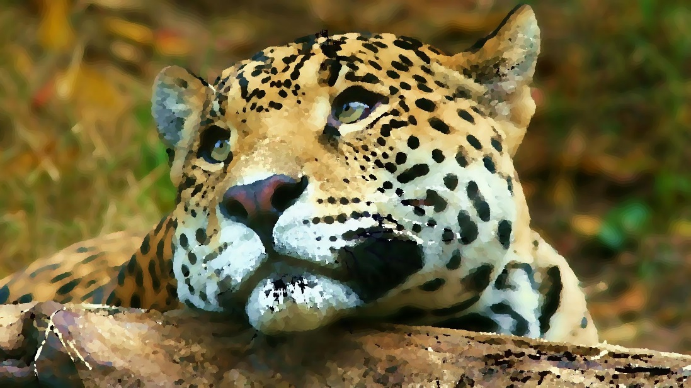
Experimental
Before
After

Slide 20
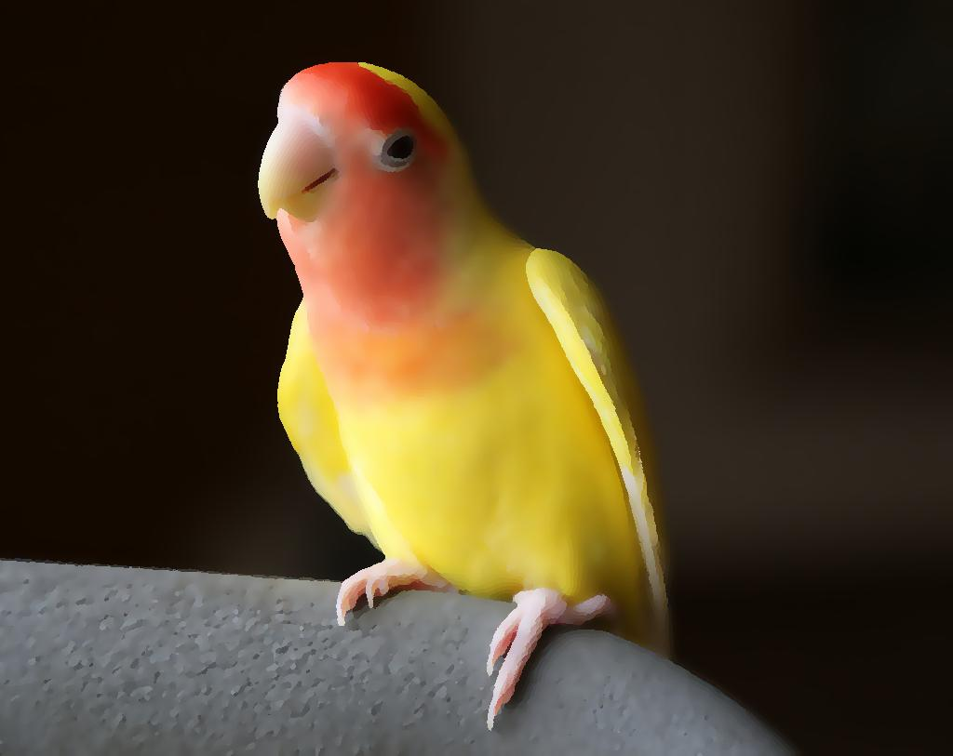
Experimental
Before
After

Slide 21
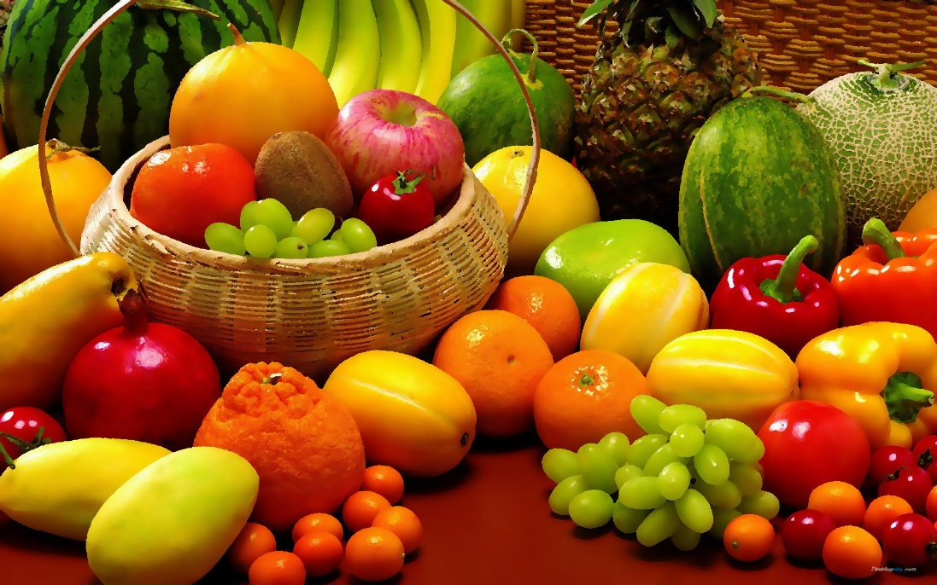
Experimental
Before
After

Slide 22
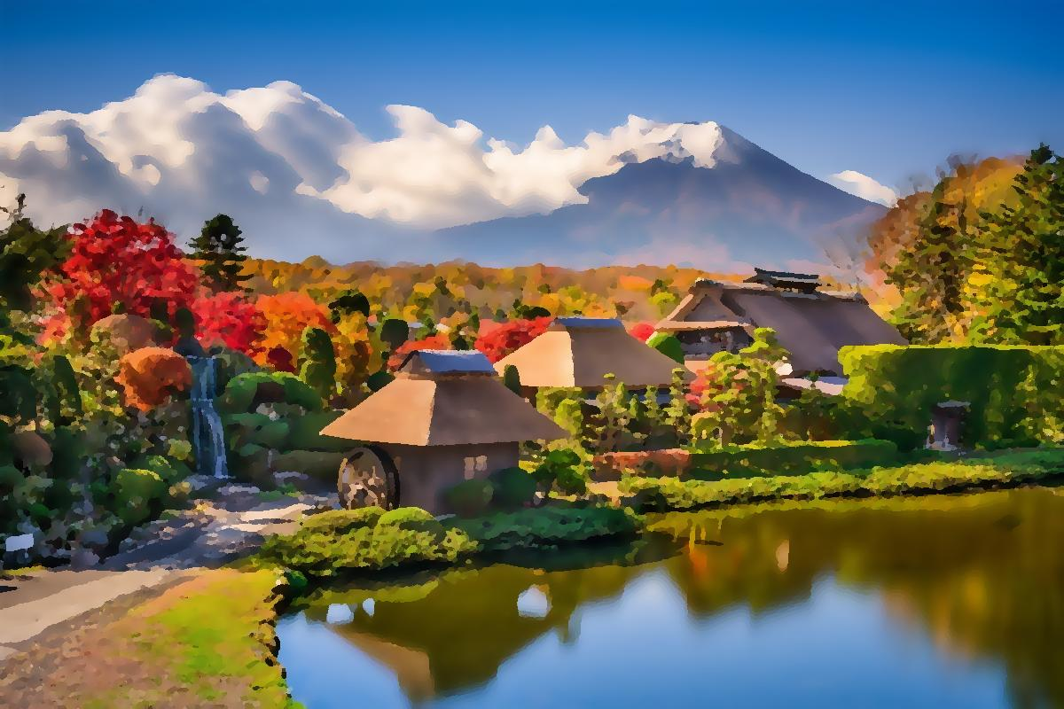
Experimental
Before
After

Slide 23
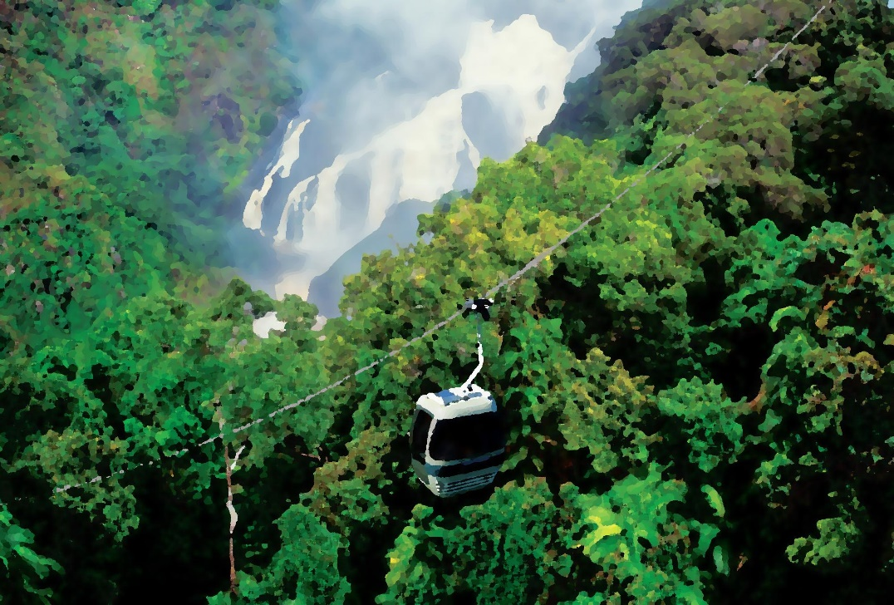
Experimental
Before
After

Slide 24
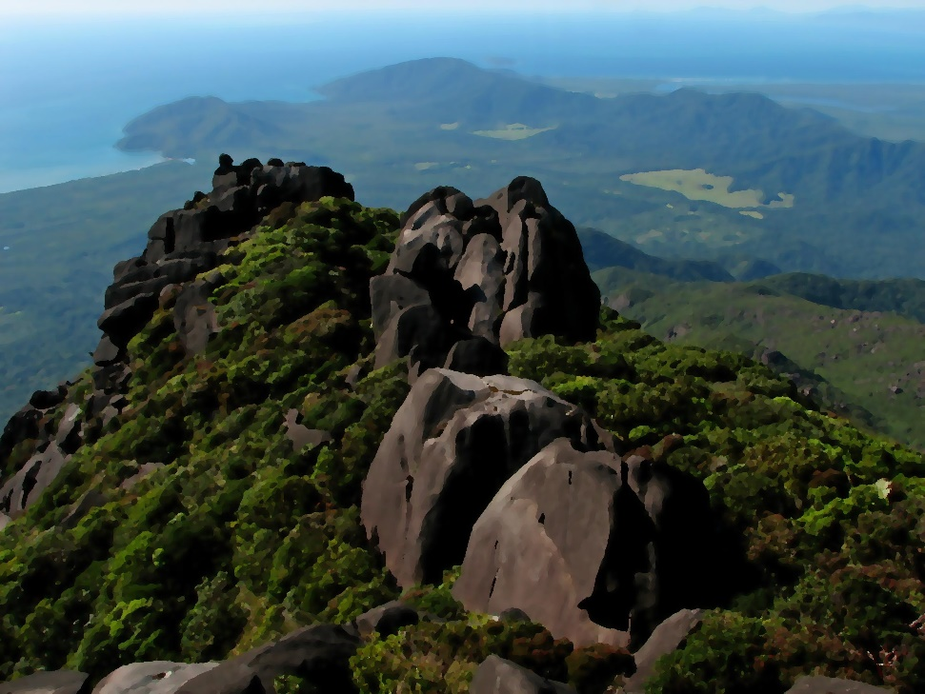
Experimental
Before
After

Slide 25
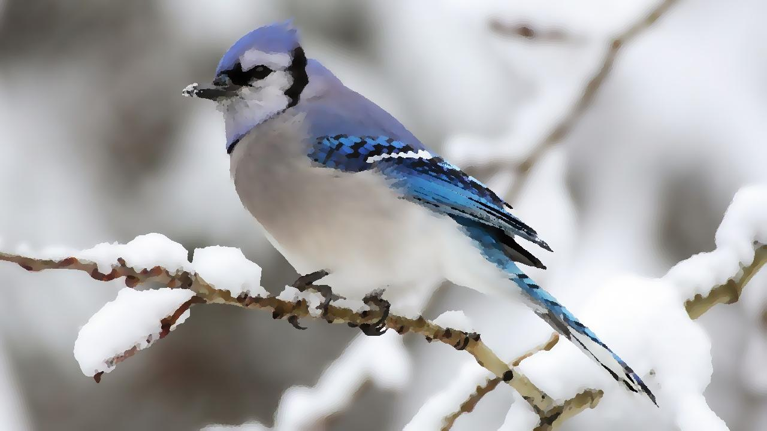
Experimental
Before
After

Slide 26
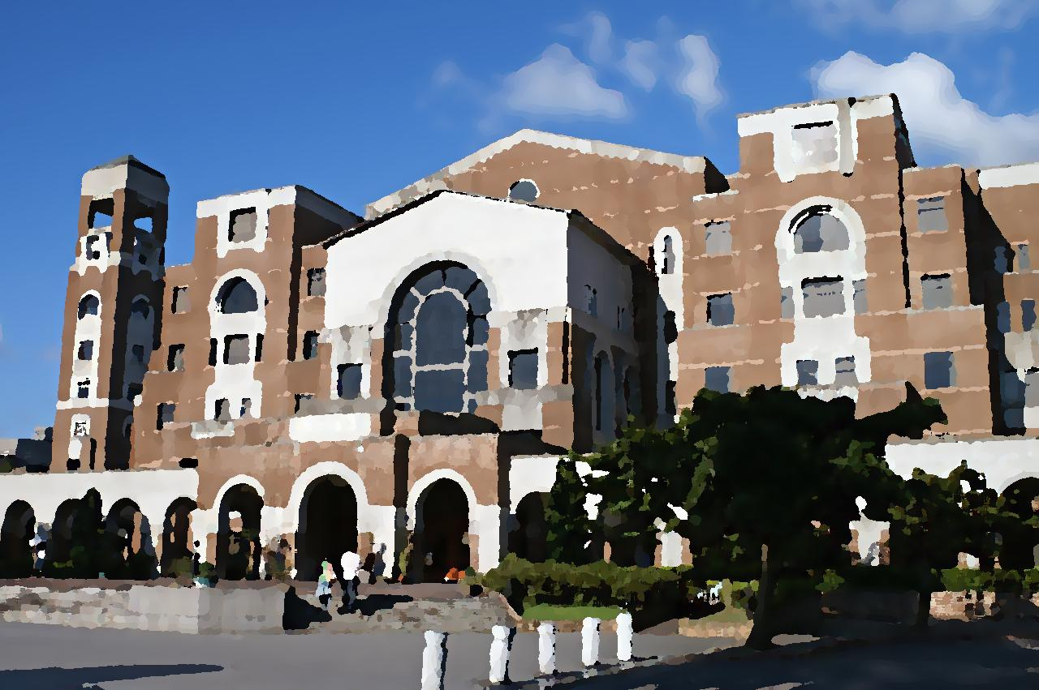
Experimental
Before
After

Slide 27
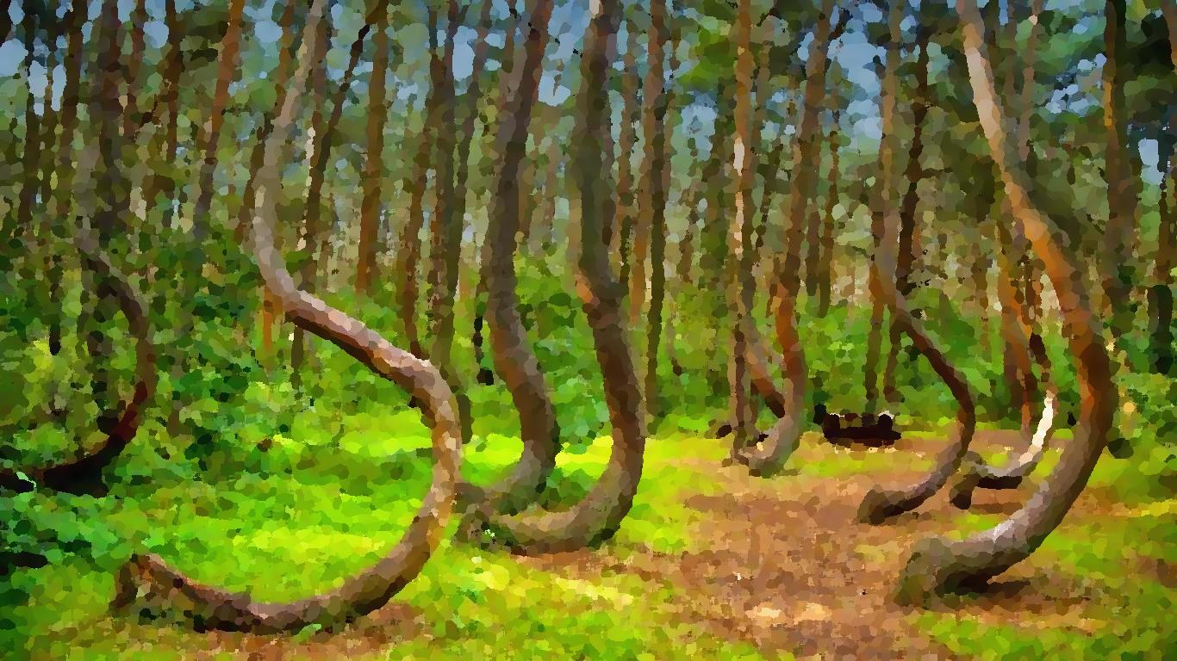
Experimental
Before
After

Slide 28
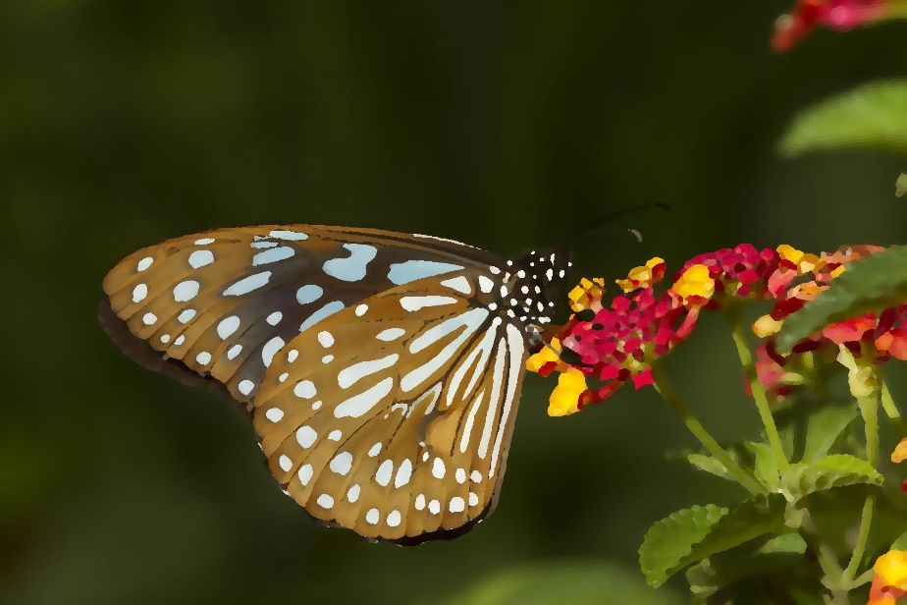
Experimental
Before
After

Slide 29
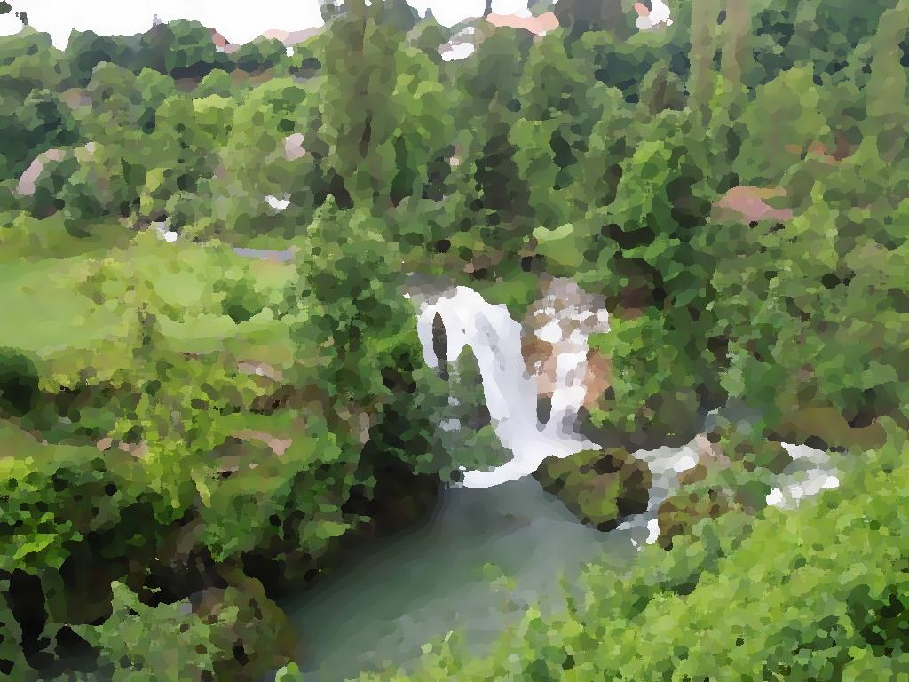
Experimental
Before
After

Slide 30
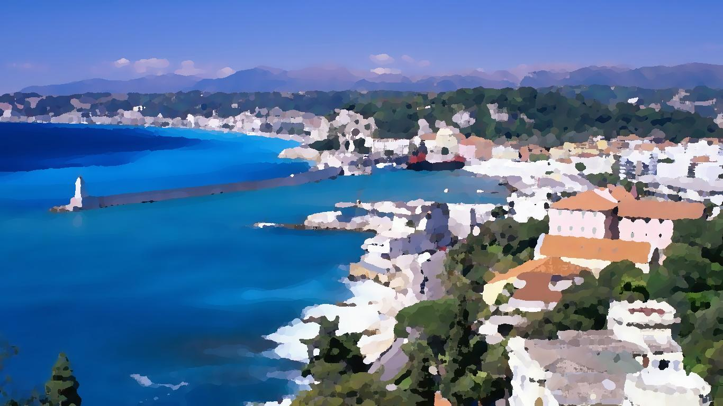
Experimental
Before
After

Slide 31
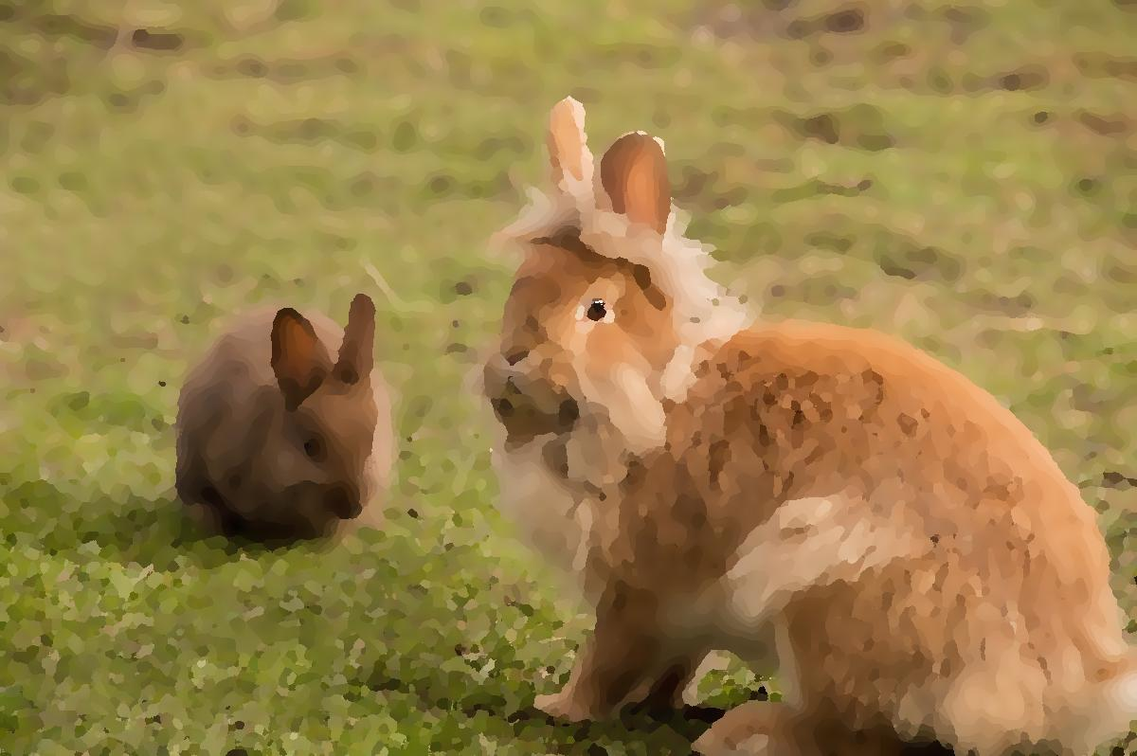
Experimental
Before
After

Slide 32
Conclusion
A heat transfer equation is used as the image diffusion method, and a statistic mask filter is applied to the photographic image afterwards. Experimental results show that better color effect with natural appearance is achieved.

Slide 33
References
A. Bousseau, M. Kaplan, J. Thollot, and F. X. Sillion, “Interactive Watercolor Rendering with Temporal Coherence and Abstraction,” Proc. Int’l Symp. Non-Photorealistic Animation and Rendering, Annecy, France, pp. 141–149, 2006.
C. J. Curtis, S. E. Anderson, J. E. Seims, K. W. Fleischer, and D. H. Salesin, “Computer-Generated Watercolor,” Proc. ACM SIGGRAPH, Los Angeles, CA, pp. 421–430, 1997.
S. DiVerdi, A. Krishnaswamy, R. Mech, and D. Ito, “A Lightweight, Procedural, Vector Watercolor Painting Engine,” Proc. ACM SIGGRAPH Symp. Interactive 3D Graphics and Games, Los Angeles, CA, pp. 63–70, 2012.
H. Johan, R. Hashimoto, and T. Nishita, “Creating Watercolor Style Images Taking into Account Painting Techniques,” J. Japan Soc. Art Science, vol. 3, no. 4, pp. 207–215, 2004.

Slide 34
References
H. W. Kang, C. K. Chui, and U. K. Chakraborty, “A Unified Scheme for Adaptive Stroke-Based Rendering,” Visual Computing, vol. 22, no. 9, pp. 814–824, 2006.
T. Van Laerhoven, J. Liesenborgs, and F. van Reeth, “Real-Time Watercolor Painting on a Distributed Paper Model,” Proc. Computer Graphics Int’l, Crete, Greece, pp. 640–643, 2004.
E. Lei and C. F. Chang, “Real-Time Rendering of Watercolor Effects for Virtual Environments,” Proc. Pacific Rim Conf. Advances in Multimedia Information Processing, Tokyo, Japan, pp. 474–481, 2004.
B. Liang, S. Cao, and M. Zhao, “A Native Android Application Development Based on Watercolor Stylized Image,” Proceedings of IEEE International Conference on Software Engineering and Service Science, Beijing, China, pp. 894–897, 2015.

Slide 35
References
C. Lu and X. Chen, “Image Watercolorization Based on Visual Weight-Map,” Proceedings of International Congress on Image and Signal Processing, Dalian, China, pp. 233–237, 2014.
T. Luft and O. Deussen, “Interactive Watercolor Animations,” Proc. Pacific Conf. Computer Graphics and Applications, Macao, China, pp. 7–9, 2005.
E. B. Lum and K. L. Ma, “Non-Photorealistic Rendering Using Watercolor Inspired Textures and Illumination,” Proc. Pacific Conf. Computer Graphics and Applications, Tokyo, Japan, pp. 322–330, 2001.
D. Small, “Modeling Watercolor by Simulating Diffusion, Pigment, and Paper Fibers,” Proc. SPIE, vol. 1460, pp. 140–146, 1991.
M. Wang, B. Wang, Y. Fei, K. Qian, W. Wang, J. Chen, and J. H. Yong, “Towards Photo Watercolorization with Artistic Verisimilitude,” IEEE Trans. Vis. Comput. Graphics, vol. 20, no. 10, pp. 1451–1460, 2014.

