Slide 1
Chapter9
Texture
Presenter: Yu-Hsiang Shao (邵育翔)
Phone: 0972326030
E-Mail: alex0967100@gmail.com
Advisor: Prof. Chiou-Shann Fuh

Slide 2
Outline
Introduction
  9.1
Statistical Texture Feature Approach
  9.2 ~ 9.10
Model-based Technique
  9.11 ~ 9.13
Application
  9.16 ~ 9.18

Slide 3
Introduction
Statistical Texture Feature Approach
Model-based Technique
Application

Slide 4
What is “texture” ?

Slide 5
Introduction
What does texture mean?
  Formal approach or precise definition of texture does not exist.
Texture discrimination techniques are for the most part ad hoc.
created for a particular purpose only
Notes:
辨認每一種texture 都是一個不一樣的model 稱為ad hoc
Formal 正規的
Approach 方法
Precise 精準的
Ad hoc.特別的 (專門)
For the most part 主要的

Slide 6
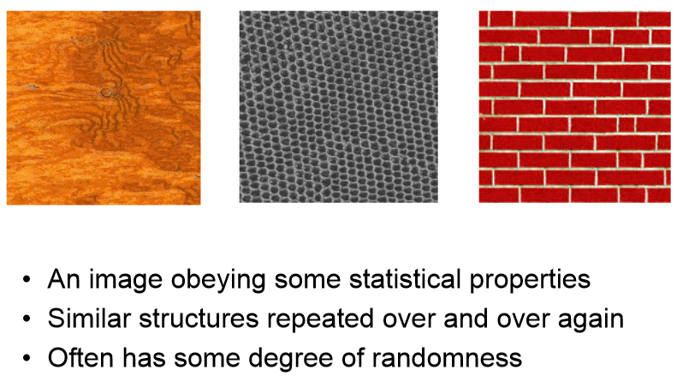
What is Texture?
An image obeying some statistical properties
Similar structure repeated over and over again
Often has some degree of randomness
Notes:
Obey 服從 一些屬性
(某些區塊一職重複)
Degree 程度 (左一)

Slide 7
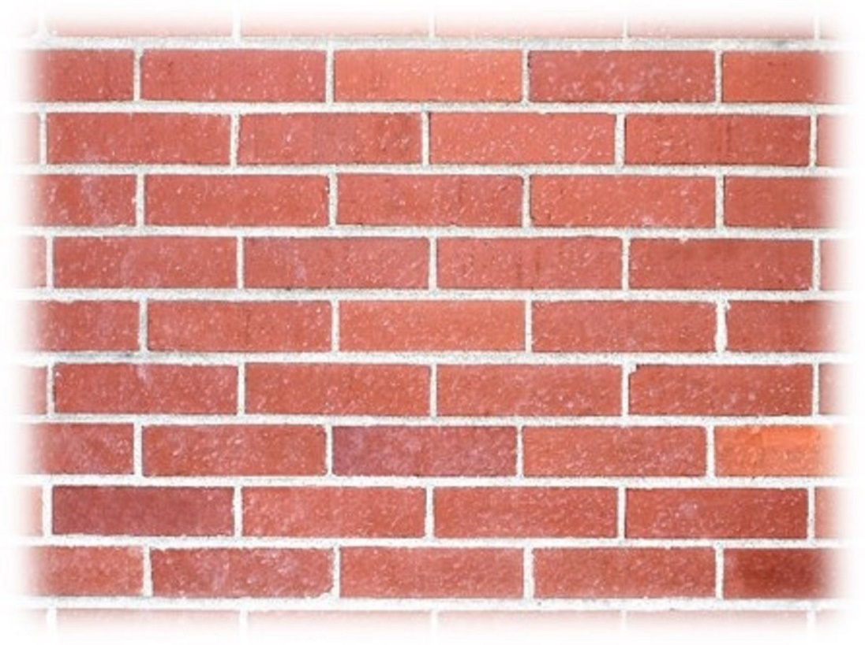
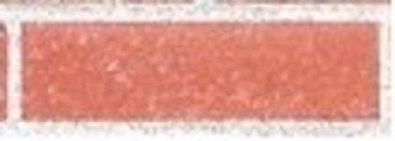

What is Texture?
Texture is a non-local property.
  Repeating patterns of local variations in image intensity which are too fine to be distinguished as separated object at the observed resolution.
Notes:
Non-local 非區域性的
只有一小塊是無法辨識的，需要看到整體
Repeat的材質應該視為相同的材質，而非不同的

Slide 8
“Texel” and “Texture Primitive”
Notes:
Texel = texture element 紋理元素
Primitive 元件
如果要了解一個texture需要了解他的基本組成

Slide 9
Texel
Texture element: basic textural unit of some defining spatial relationships.
Texture: A set texels occurring in some regular or repeated pattern.
Elements | Construct | Array
Pixels |  | Image
Texels |  | Texture

Slide 10
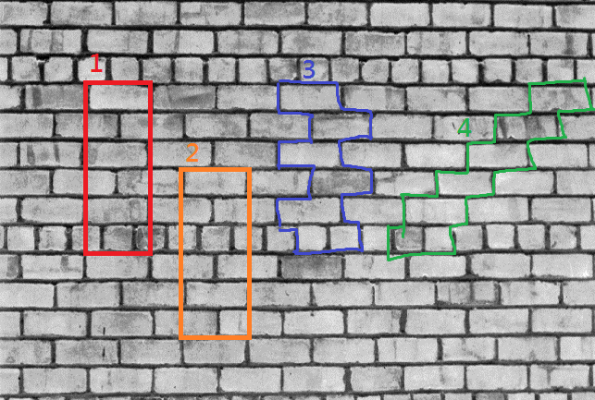
Texel
Notes:
1,2,3,4是texel
經過重新排列組合可以組成texture
紅框的不是texel

Slide 11
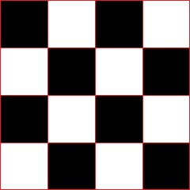
Texture Primitive
Connected set of pixels characterized by attribute set.
Simplest primitive: pixel with gray level attribute
More complicated primitive: connected set of pixels homogeneous in level, characterized by size, elongation, orientation, and average gray level
Notes:
以屬性集為特徵的連接像素集。
最簡單的圖元：具有灰度屬性的像素
更複雜的圖元：像素級別相同，相連的像素集，其特徵在於尺寸，伸長率，方向和平均灰度
Primitive 相同性質，越大塊越好
Attribute 屬性
Complicated 複雜
Elongation 拉長
Orientation 方向

Slide 12
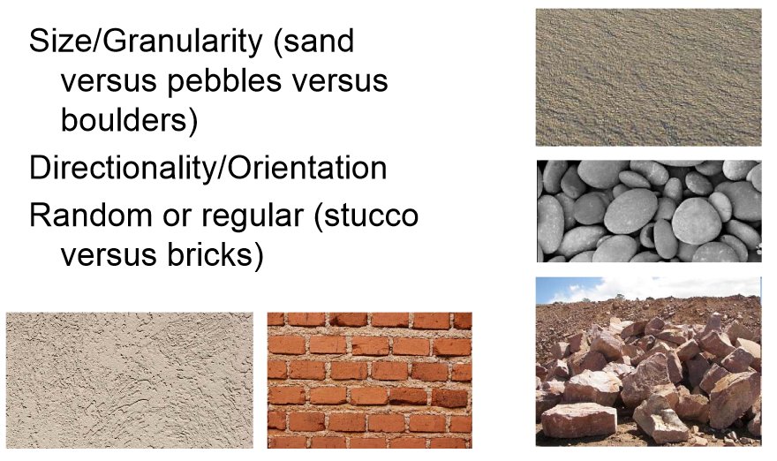
Characterizing Texture
An image texture is described by
  types of its primitives
  number of its primitives
  their spatial organization or layout.
Image texture can be qualitatively evaluated as some properties.
Notes:
沙子 石頭 岩石 都是primitive
type不一樣，數量也不一樣
Characterizing 特性化
Layout 配置
可以將圖像紋理定性為某些屬性，就像是我們平常口頭上描述的形容詞

Slide 13
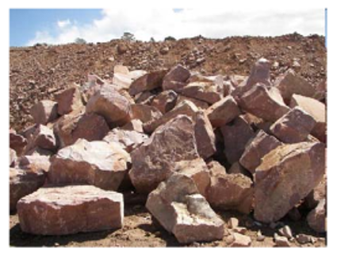
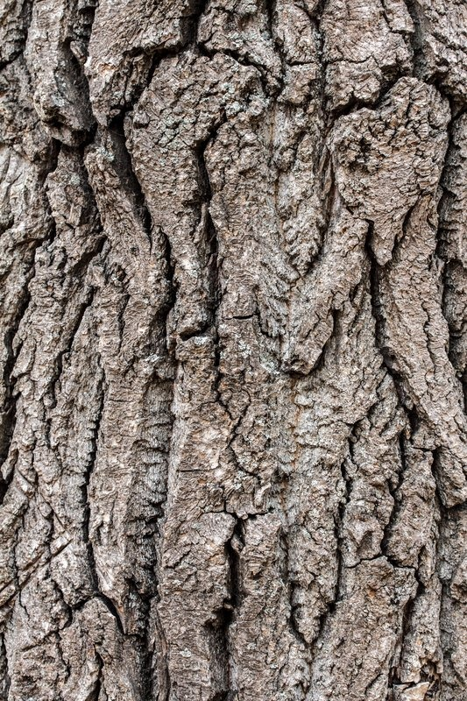
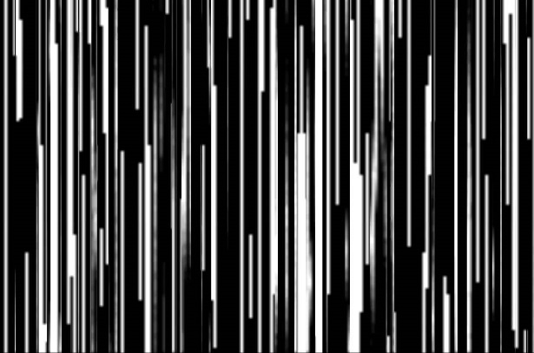
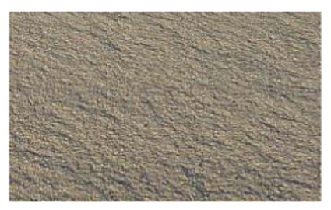
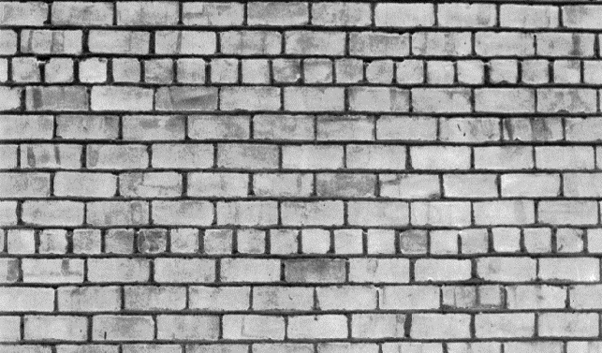
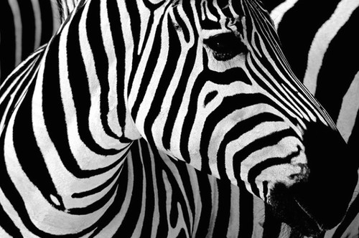
Some Texture Properties
Fineness
Coarseness
Contrast
Directionality
Roughness
Regularity
Smoothness
Notes:
細緻
粗糙
對比高
有方向性的
樹皮粗糙
排列整齊
平滑
粒度
隨機性
線型
斑駁
不規則
圓丘

Slide 14
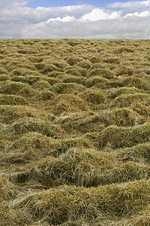
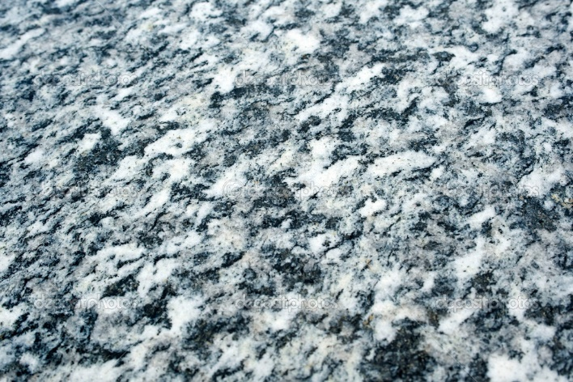
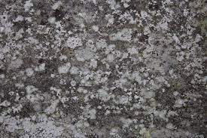
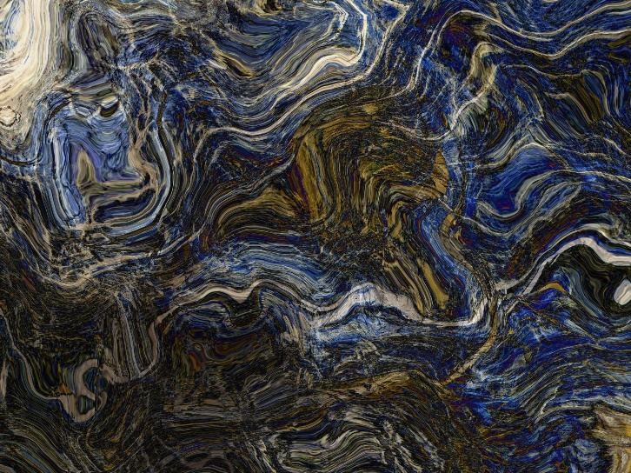
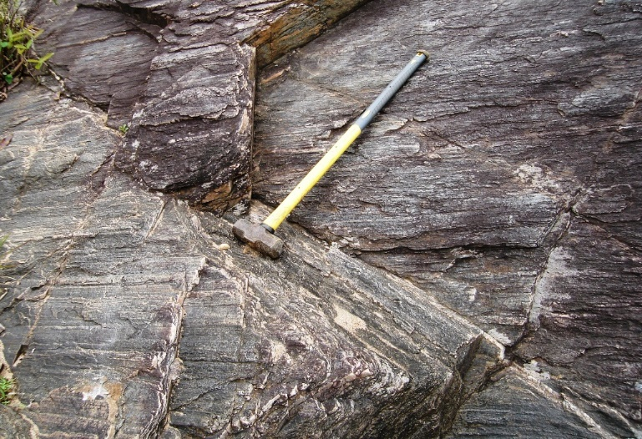
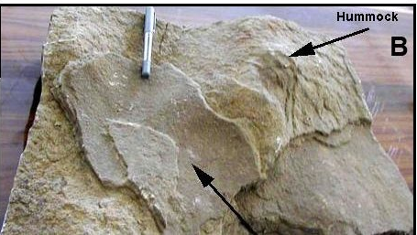
Some Texture Properties
Granularity
Randomness
Lineation
Mottled
Irregular
Hummocky
Notes:
粒度
隨機性
線型
斑駁
不規則
圓丘

Slide 15
Characterizing Texture
Each of these qualities translates into some property of the gray level primitives and the spatial interaction between them.
Open issue:
  Map semantic meaning into precise properties.
  Texture discrimination techniques are for the most part
  ad hoc.
created for a particular purpose only
Notes:
這些品質中的每一個都轉化為灰度圖元的某些屬性以及它們之間的空間交互作用。
公開問題：
將語義含義映射為精確的屬性。
Texture 是沒有formal的definition

Slide 16
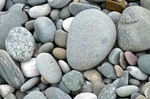
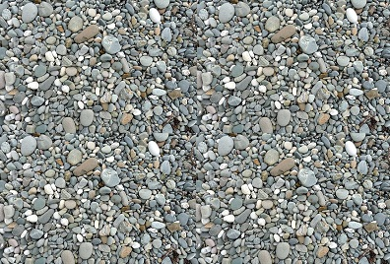
Texture and Scale
Which one is coarse/fine?

Slide 17
Texture and Scale
For any textural surface, there exists a scale at which, it appears smooth and “textureless”. (see from infinite distance)
As resolution increases, the surfaces appears as a fine texture and then a coarse one, and for multiple-scale textural surface the cycle of smooth, fine, and coarse may repeat.
https://www.youtube.com/watch?v=0vnA_KIojLg
Notes:
對於任何紋理表面，都有一個刻度，看起來很光滑且“無紋理”。 （從無限遠處看）
隨著分辨率的提高，表面表現為精細紋理，然後呈現粗糙紋理，對於多尺度紋理表面，可能會重複進行光滑，精細和粗糙的循環。

Slide 18
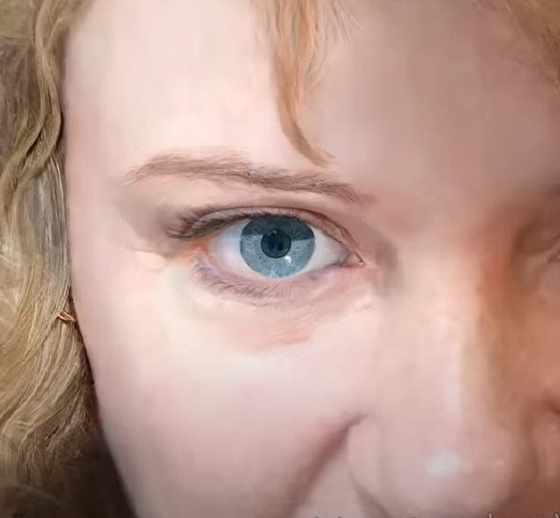
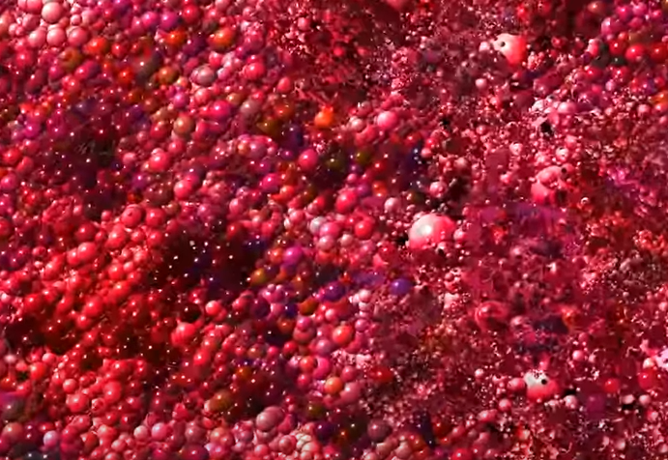
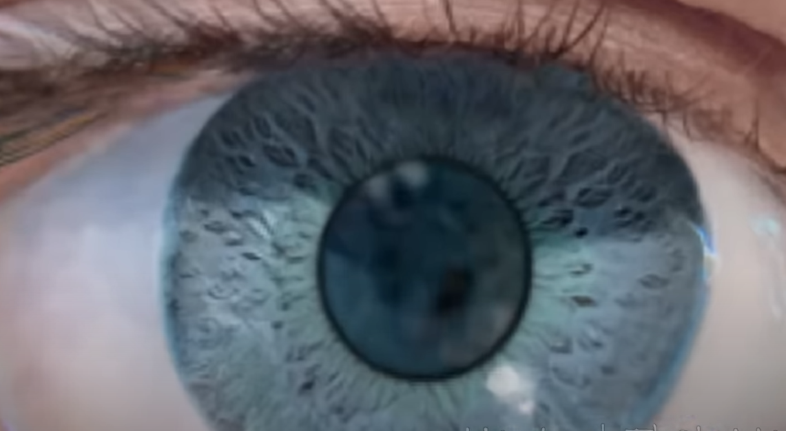
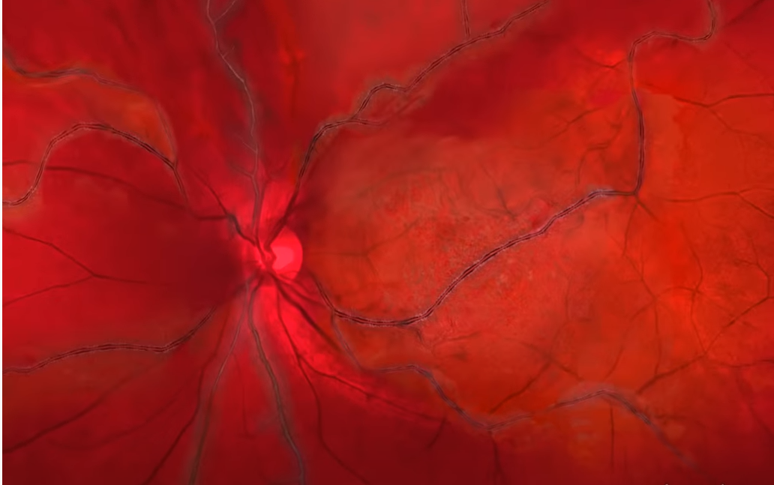
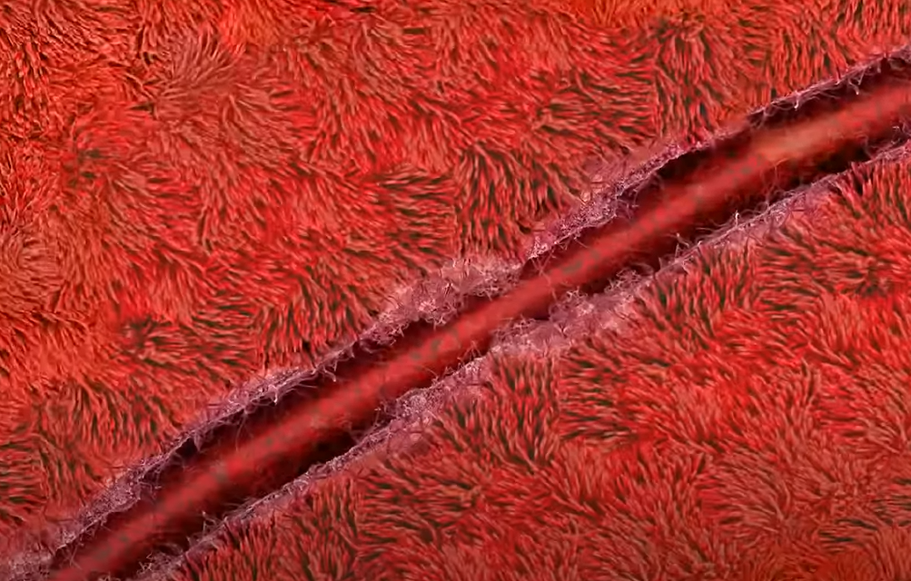
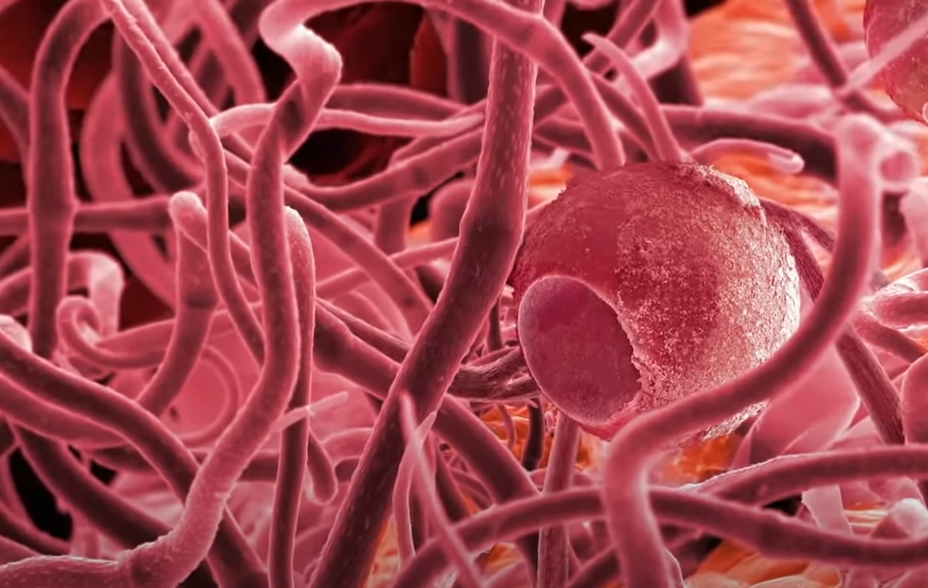
Texture and Scale
Notes:
對於任何紋理表面，都有一個刻度，看起來很光滑且“無紋理”。 （從無限遠處看）
隨著分辨率的提高，表面表現為精細紋理，然後呈現粗糙紋理，對於多尺度紋理表面，可能會重複進行光滑，精細和粗糙的循環。

Slide 19
Texture and Scale
Texture cannot be analyzed without frame of reference on scale or resolution.
Texture is a scale-dependent phenomenon.
Notes:
因此，沒有尺度或分辨率的參照係就無法分析紋理。
紋理是與比例有關的現象。

Slide 20
Fun Time

Slide 21
How to Analyze Texture ?

Slide 22
Texture Analysis Issues (Test)
Pattern recognition:
  Given textured region, determine the class the region belongs to.
Generative model:
  Given textured region, determine a description or model for it.
Texture segmentation:
  Given image having many textured areas, determine boundaries.

Slide 23
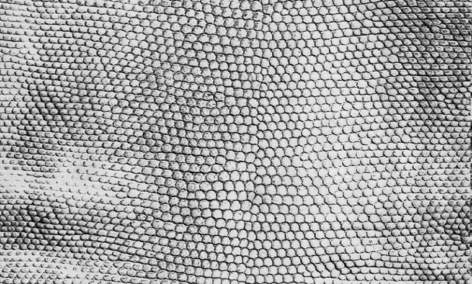
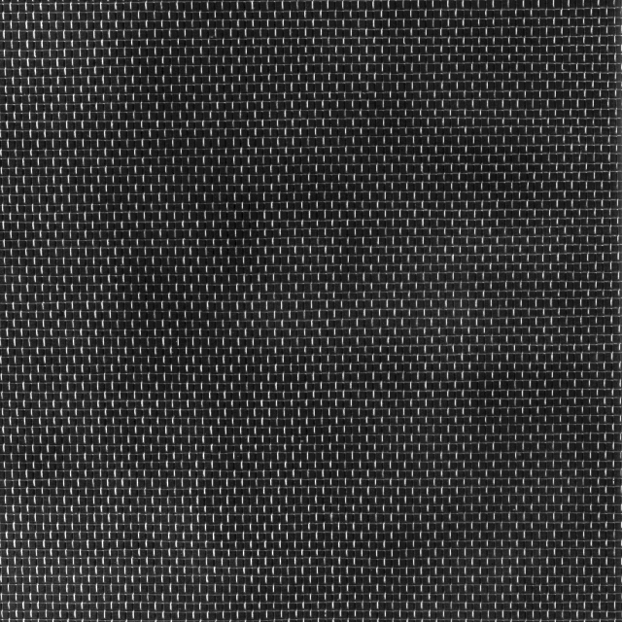

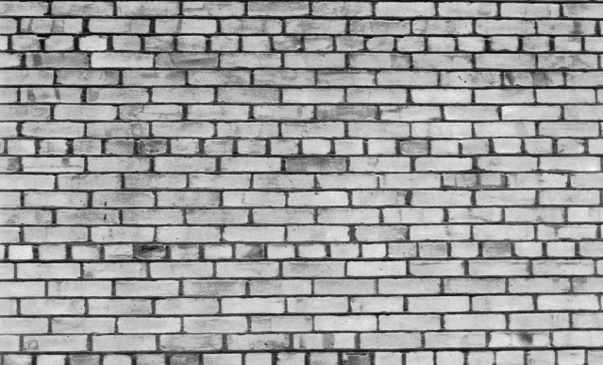
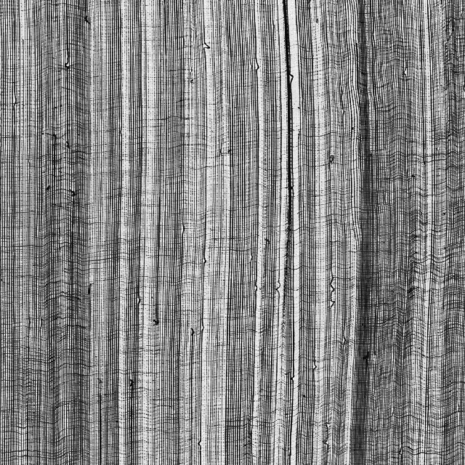
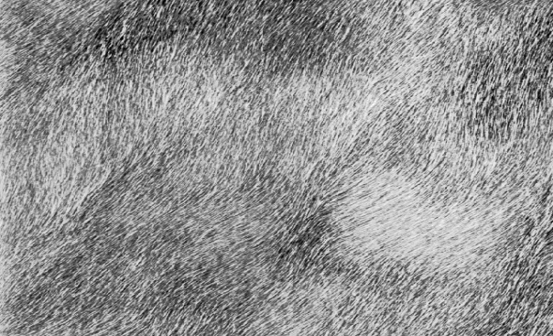
Pattern Recognition
Notes:
鱗片
麻布
尼龍布
磚牆
紗布
毛皮

Slide 24
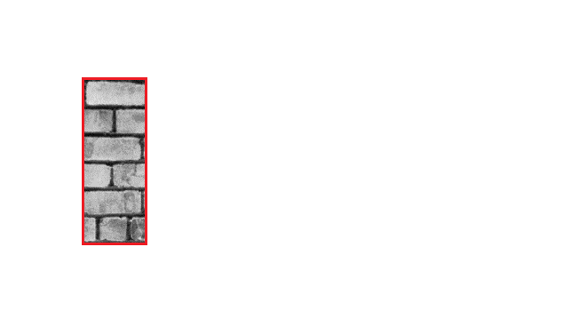
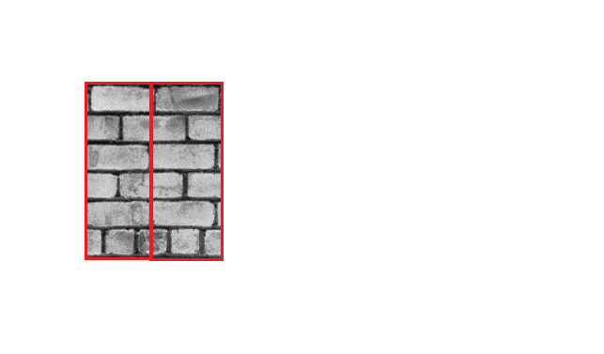
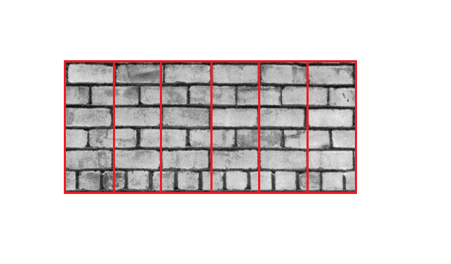
Generative Model

Slide 25
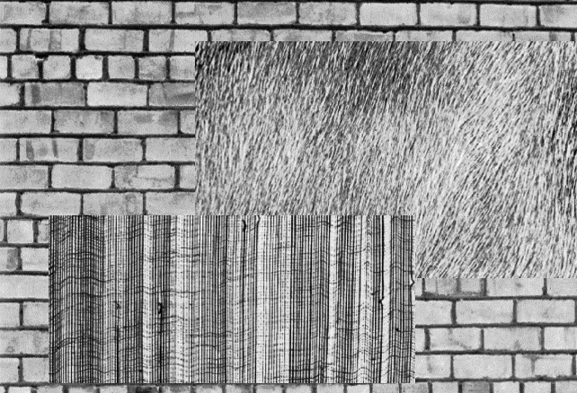
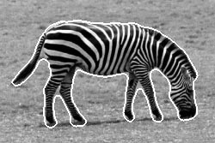
Texture Segmentation

Slide 26
Texture Analysis
Statistical Approach
Model Based Technique

Slide 27
Statistical Texture Feature Approaches
Spatial gray level co-occurrence probabilities
Autocorrelation function
Edgeness per unit area
Relative extrema distributions
Mathematical morphology
Spectral power density function
Gray-level run-length distributions
Notes:
Co-occurrence 共同發生
Probability 機率
Autocorrelation 自相關函數 f(x) time domain vs. spatial domain
Cross-correlation 交互相關函數 f(x) vs. g(x)
Extrema 極值
Distribution 分布
Morphology 形態學
Spectral power density function 頻譜功率密度函數
0001111011100000 run-length encoding 串列長度編碼

Slide 28
Model Based Technique
Auto-regression
Markov random fields
Random Mosaic models
Moving-average
Time-series models (extended to 2D)
Notes:
Auto-regression 自回歸
Fields場
Mosaic model 馬賽克模型
Extend 延伸

Slide 29
Fun Time

Slide 30
Statistical Texture Feature Approach

Slide 31
Introduction
Gray Level Statistics
Statistical Texture Feature Approach
Model-based Technique
Application

Slide 32
First-Order Gray-Level Statistics
Statistics of single pixels
E.g. Histogram, mean, median, variance
Notes:
只看單一pixel

Slide 33
Second-Order Gray-Level Statistics
The combined statistics of gray levels of pairs of pixels in which each two pixels in a pair have a fixed relative position
E.g. co-occurrence
Gray level spatial dependence: characterize texture by co-occurrence
Notes:
2個Pixel之間的相關性
灰階共生矩陣

Slide 34
Co-Occurrence Matrix
The gray level co-occurrence can be specified in a matrix of relative frequencies Pij with which two neighboring pixels separated by distance d occur on the image, one with gray level i and the other with gray level j
Symmetric matrix
Function of angle and distance between pixels
Notes:
灰階共生矩陣可以分析相鄰兩個pixel之間的關聯：
要運算灰階共生矩陣需先在影像中給定一個距離d 並給予比較的角度
先given d
2個pixel距離多遠
還要給角度

Slide 35
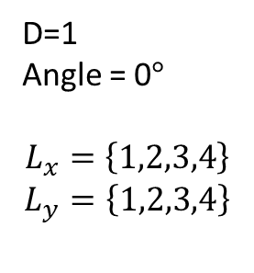
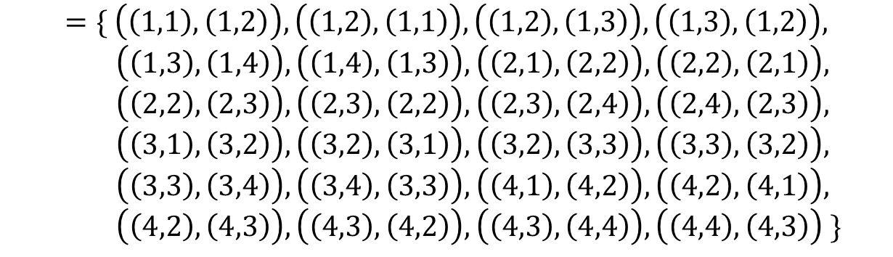
Co-Occurrence Matrix
(1,1) | (1,2) | (1,3) | (1,4)
(2,1) | (2,2) | (2,3) | (2,4)
(3,1) | (3,2) | (3,3) | (3,4)
(4,1) | (4,2) | (4,3) | (4,4)
D=1
Angle = 0$°$
$$L_{x}=\left\{1,2,3,4\right\}$$
$$L_{y}=\left\{1,2,3,4\right\}$$
$$R_{H}=\left\{\left(\left(k,l\right),\left(m,n\right)\right)∈\left(L_{y}×L_{x}\right) \right| k−m=0,\left|l−n\right|=1\}$$
$$=\{ \left(\left(1,1\right),\left(1,2\right)\right),\left(\left(1,2\right),\left(1,1\right)\right),\left(\left(1,2\right),\left(1,3\right)\right),\left(\left(1,3\right),\left(1,2\right)\right),$$
$\left(\left(1,3\right),\left(1,4\right)\right),\left(\left(1,4\right),\left(1,3\right)\right),\left(\left(2,1\right),\left(2,2\right)\right),\left(\left(2,2\right),\left(2,1\right)\right),$
$\left(\left(2,2\right),\left(2,3\right)\right),\left(\left(2,3\right),\left(2,2\right)\right),\left(\left(2,3\right),\left(2,4\right)\right),\left(\left(2,4\right),\left(2,3\right)\right),$
$\left(\left(3,1\right),\left(3,2\right)\right),\left(\left(3,2\right),\left(3,1\right)\right),\left(\left(3,2\right),\left(3,3\right)\right),\left(\left(3,3\right),\left(3,2\right)\right),$
$\left(\left(3,3\right),\left(3,4\right)\right),\left(\left(3,4\right),\left(3,3\right)\right),\left(\left(4,1\right),\left(4,2\right)\right),\left(\left(4,2\right),\left(4,1\right)\right),$
$\left(\left(4,2\right),\left(4,3\right)\right),\left(\left(4,3\right),\left(4,2\right)\right),\left(\left(4,3\right),\left(4,4\right)\right),\left(\left(4,4\right),\left(4,3\right)\right) \}$
The set of all distance-1 horizontal neighbor resolution cells on a 4x4 image.
Notes:
最簡單的例子:
空間上距離是1 然後是水平的 然後圖上的每個(k(x1) l(y1) 和 m(x2) n(y2) 就有這些關係) 。
也就是這張圖上的是x y 座標 而不是最後的矩陣，只是為了解釋一下你要統計這些pixel之間的關係
就是過去和回來都要去算。最上面的圖是我們的image，每一個格子代表著一個pixel，所以這個是一個4*4 pixel的image
Relationship horizontal
x y 各是1~4
(d=1)

Slide 36
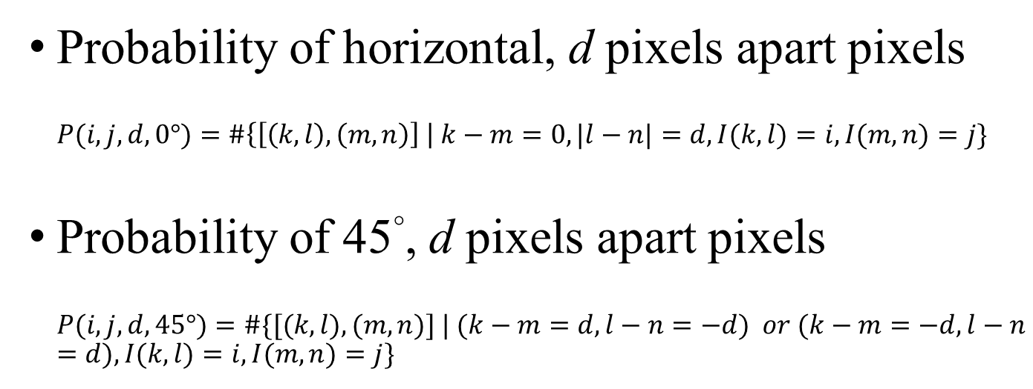


Co-Occurrence Matrix
(1,1) | (1,2) | (1,3) | (1,4)
(2,1) | (2,2) | (2,3) | (2,4)
(3,1) | (3,2) | (3,3) | (3,4)
(4,1) | (4,2) | (4,3) | (4,4)
$$L_{x}=\left\{1,2,3,4\right\}$$
$$L_{y}=\left\{1,2,3,4\right\}$$
Probability of horizontal, d pixels apart pixels
$$P(i,j,d, 0°)=\#\left\{\left[\left(k, l\right),\left(m, n\right)\right] \right| k−m=0, |l−n|=d, I(k, l)=i, I(m,n)=j\}$$
Probability of 45°, d pixels apart pixels
$$P(i, j, d, 45°)=\#\{[(k, l), (m, n)] | (k−m=d, l−n=−d) or (k−m=−d, l−n=d), I(k, l)=i, I(m,n)=j\}$$

Slide 37
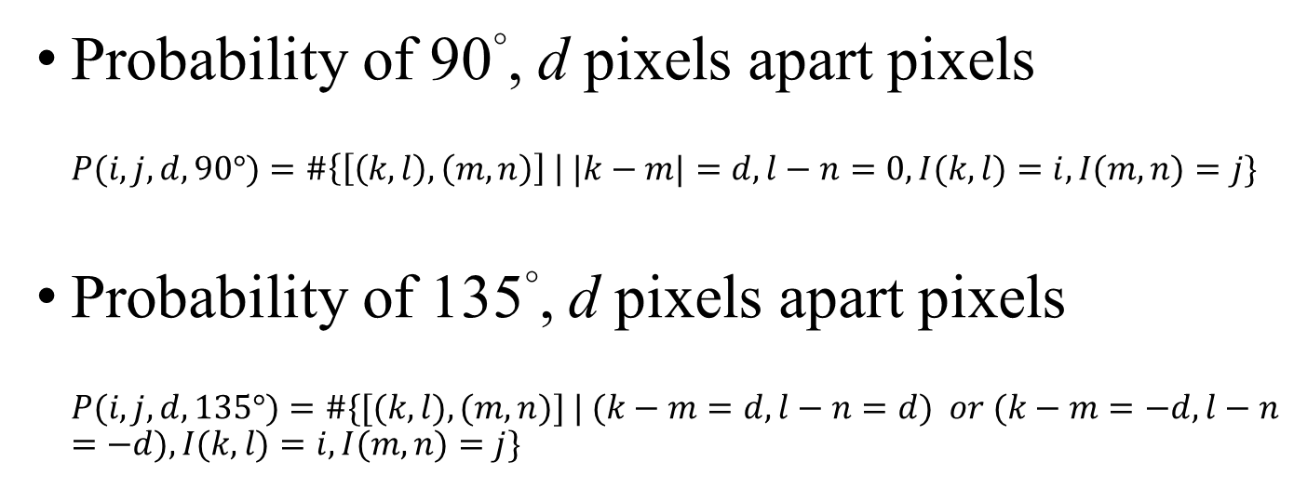
Co-Occurrence Matrix
(1,1) | (1,2) | (1,3) | (1,4)
(2,1) | (2,2) | (2,3) | (2,4)
(3,1) | (3,2) | (3,3) | (3,4)
(4,1) | (4,2) | (4,3) | (4,4)
$$L_{x}=\left\{1,2,3,4\right\}$$
$$L_{y}=\left\{1,2,3,4\right\}$$
Probability of 90°, d pixels apart pixels
$$P(i,j,d, 90°)=\#\left\{\left[\left(k, l\right),\left(m, n\right)\right] \right| |k−m|=d, l−n=0, I(k, l)=i, I(m,n)=j\}$$
Probability of 135°, d pixels apart pixels
$$P(i, j, d, 135°)=\#\{[(k, l), (m, n)] | (k−m=d, l−n=d) or (k−m=−d, l−n=−d), I(k, l)=i, I(m,n)=j\}$$

Slide 38
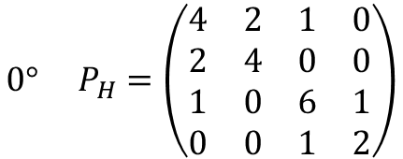
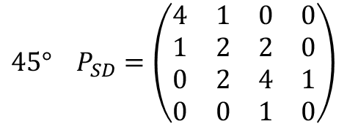
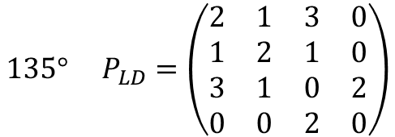
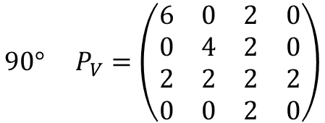
Co-Occurrence Matrix
 |  | Gray level
Gray Level |  | 0 | 1 | 2 | 3
 | 0 | #(0,0) | #(0,1) | #(0,2) | #(0,3)
 | 1 | #(1,0) | #(1,1) | #(1,2) | #(1,3)
 | 2 | #(2,0) | #(2,1) | #(2,2) | #(2,3)
 | 3 | #(3,0) | #(3,1) | #(3,2) | #(3,3)
0 | 0 | 1 | 1
0 | 0 | 1 | 1
0 | 2 | 2 | 2
2 | 2 | 3 | 3
$$0° P_{H}=\left(\begin{matrix}4 & 2 & 1 & 0 \\ 2 & 4 & 0 & 0 \\ 1 & 0 & 6 & 1 \\ 0 & 0 & 1 & 2\end{matrix}\right)$$
$$90° P_{V}=\left(\begin{matrix}6 & 0 & 2 & 0 \\ 0 & 4 & 2 & 0 \\ 2 & 2 & 2 & 2 \\ 0 & 0 & 2 & 0\end{matrix}\right)$$
$$135° P_{LD}=\left(\begin{matrix}2 & 1 & 3 & 0 \\ 1 & 2 & 1 & 0 \\ 3 & 1 & 0 & 2 \\ 0 & 0 & 2 & 0\end{matrix}\right)$$
$$45° P_{SD}=\left(\begin{matrix}4 & 1 & 0 & 0 \\ 1 & 2 & 2 & 0 \\ 0 & 2 & 4 & 1 \\ 0 & 0 & 1 & 0\end{matrix}\right)$$

Slide 39

Variant of Co-Occurrence Matrix
Gray level difference probability:
$$P\left(d\right)=\sum_{i}{\sum_{j}{P(i,j)}}$$
$$\left|i−j\right|=d$$
Notes:
Co-Occurrence Matrix的差異
灰度差異概率
一張圖上所有intensity 相差為d的這些pixel pair做co-occurrence後再累加的結果
If d=2
i=2 j=0
i=3 j=1

Slide 40
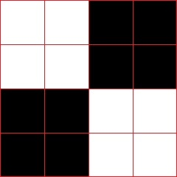







$$0° P_{H}=\left(\begin{matrix}8 & 4 \\ 4 & 8\end{matrix}\right)$$
$$0° P_{H}=\left(\begin{matrix}0 & 12 \\ 12 & 0\end{matrix}\right)$$
$$P\left(d\right)=\sum_{i}{\sum_{j}{P(i,j)}}$$
$$\left|i−j\right|=d$$
$P_{H}(0)=$ 8+8=16
$P_{H}(0)=$ 0+0=0
$P_{H}(1)=$ 4+4=8
$P_{H}(1)=$ 12+12=24
Notes:
左邊顆粒大 d小時 p(d)大
反之 相反
0是黑 1是白

Slide 41





coarse
fine
$$P\left(d\right)=\sum_{i}{\sum_{j}{P(i,j)}}$$
$$\left|i−j\right|=d$$
$P_{H}(0)=$ 8+8=16
$P_{H}(0)=$ 0+0=0
$P_{H}(1)=$ 4+4=8
$P_{H}(1)=$ 12+12=24
The probability of small contrast d for a coarse texture will be much higher than for a fine texture.
Notes:
粗糙紋理的小對比度d的可能性比精細紋理的大得多。
左邊顆粒大 d小時 p(d)大
反之 相反
0是黑 1是白

Slide 42
Summary of Gray-level Co-Occurrence
Advantages
  Use spatial interrelationship of the gray levels to characterize a texture.
  Be able to do so by gray-level transformation, which is an invariant way.
Weakness
  Not capture the shape aspects of the gray level primitives.
  Not likely to work well for textures composed of large-area primitives.
  Cannot capture the spatial relationships between primitives that are regions larger than a pixel.
Notes:
好處
是固定的，不用因為不同texture改變算法
使用灰度級的空間相互關係來表徵紋理。
弱點
無法捕獲灰度圖元的形狀方面。
對於由大面積圖元組成的紋理或是primitive不是單一pixel的類型不太可能很好地工作。

Slide 43
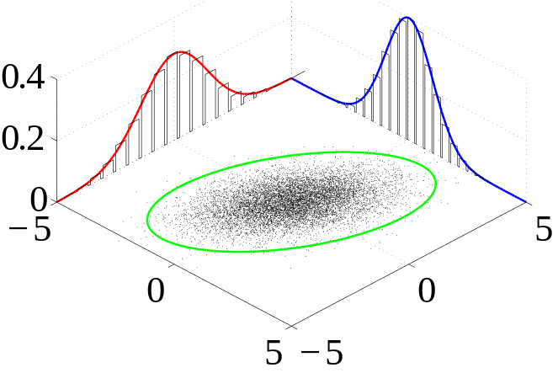
Generalized Gray Level Spatial Dependence Models for Texture
Simple generalization: consider more than two pixels at a time
Given a specific kind of spatial neighborhood and a sub-image, one can parametrically estimate the joint probability distribution of the gray levels over the neighborhoods in the sub-image.
Notes:
整體 參考多餘2個pixel以上
joint probability distribution 描述5*5的機率分布
概率分布

Slide 44
Strong Texture Measures and Generalized Co-occurrence
Gray Level Co-occurrence
Statistical Texture Feature Approach
Model-based Technique
Application

Slide 45
Strong Texture Measures and Generalized Co-occurrence
Strong texture measure takes into account the co-occurrence between texture primitives rather than pixels.
It is useful to work with primitives that are maximally connected sets of pixels having particular properties.
聯集
Notes:
前面是pixel與pixel的關係
此處分析 primitive 跟 primitive之間的關係
強大的紋理量度考慮到了紋理基元之間而不是像素之間的共現。
使用primitives是具有特定屬性的pixels最大聯集組成。
若比較primitive之間的關聯會增加分析的完整性

Slide 46
Strong Texture Measures and Generalized Co-occurrence
Other attributes include measures of shape, or with the variance of its local property.
  Connected components
  Ascending\descending components
  Saddle components
  Relative maxima\minima components
  Central Axis components
Examples of primitives property
Notes:
其他屬性包括形狀的度量，或其局部屬性的變化。
連接的組件
升序/降序組件
鞍座組件
相對最大\最小分量
中心軸組件
Step1，需要建立完善的primitive

Slide 47
Spatial Relationship
After constructing the primitives, we have
  a list of primitives
  their center coordinates
  their attributes
Notes:
Step2
得到primitive的一些性質，屬性

Slide 48
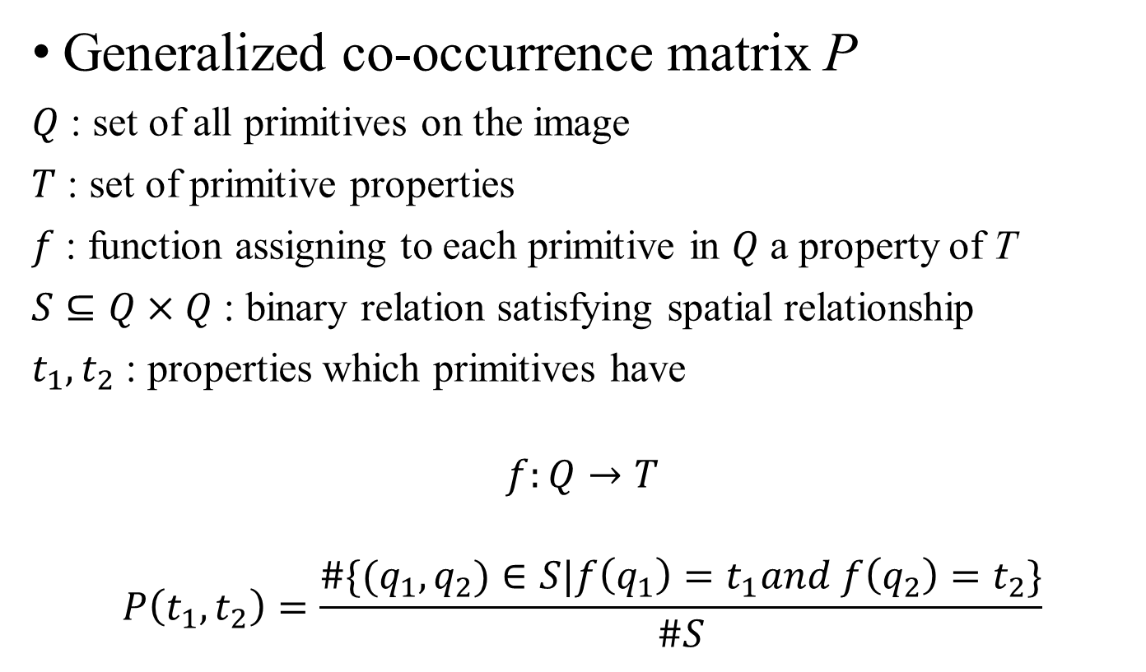
Spatial Relationship
Generalized co-occurrence matrix P
$Q$ : set of all primitives on the image
$T$ : set of primitive properties
$f$ : function assigning to each primitive in $Q$ a property of T
$S⊆Q×Q$ : binary relation satisfying spatial relationship
$t_{1},t_{2}$ : properties which primitives have
$$f:Q→T$$
$$P\left(t_{1},t_{2}\right)=\frac{\#\{(q_{1},q_{2})∈S|f\left(q_{1}\right)=t_{1}and f\left(q_{2}\right)=t_{2}\}}{\#S}$$
Notes:
Q set {primitive1, primmitive2, ….}
T set {f(Q(1))=properties, f(Q(2))properties, ….}
f(Q(1))=properties=t1
F function →針對Q做統一處理 (計算平均亮度)
S 空間中的關係 (primitive1的中心距離 與 primmitive2的中心距離差異) primitive1, primmitive2可以表示為兩種不同的石頭
# number of
比較P(t1 t2) = q1與q2屬於某空間距離後滿足f(q1)=t1且f(q2)=t2/空間中的距離
T1 t2 在S空間中，滿足條件的比率有多少

Slide 49
Fun Time

Slide 50
Strong Texture Measures and Generalized Co-occurrence
Autocorrelation Function
Statistical Texture Feature Approach
Model-based Technique
Application

Slide 51
Autocorrelation Function
Texture relates to the spatial size of the gray level primitives on an image
Gray level primitives of larger size are indicative of coarser texture
Gray level primitives of smaller size are indicative of finer texture
Autocorrelation function is a feature that describes the size of gray level primitives
Notes:
自相關 autocorrelation
先找出primitive 大小(Corse or fine)
紋理與圖像上灰度原語的空間大小有關
較大size 的gray level primitives表示較粗糙的紋理
較小size 的gray level primitives表示較精細的紋理
自相關功能是描述gray level primitives 的size

Slide 52
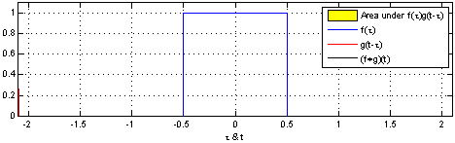




Autocorrelation Function
Area under $f(τ)⋆f(t)$
$$f(τ)$$
$$f(t)$$
($f+f)(t)$
Notes:
以1D來比較的話
自己跟自己的相關程度比較

Slide 53
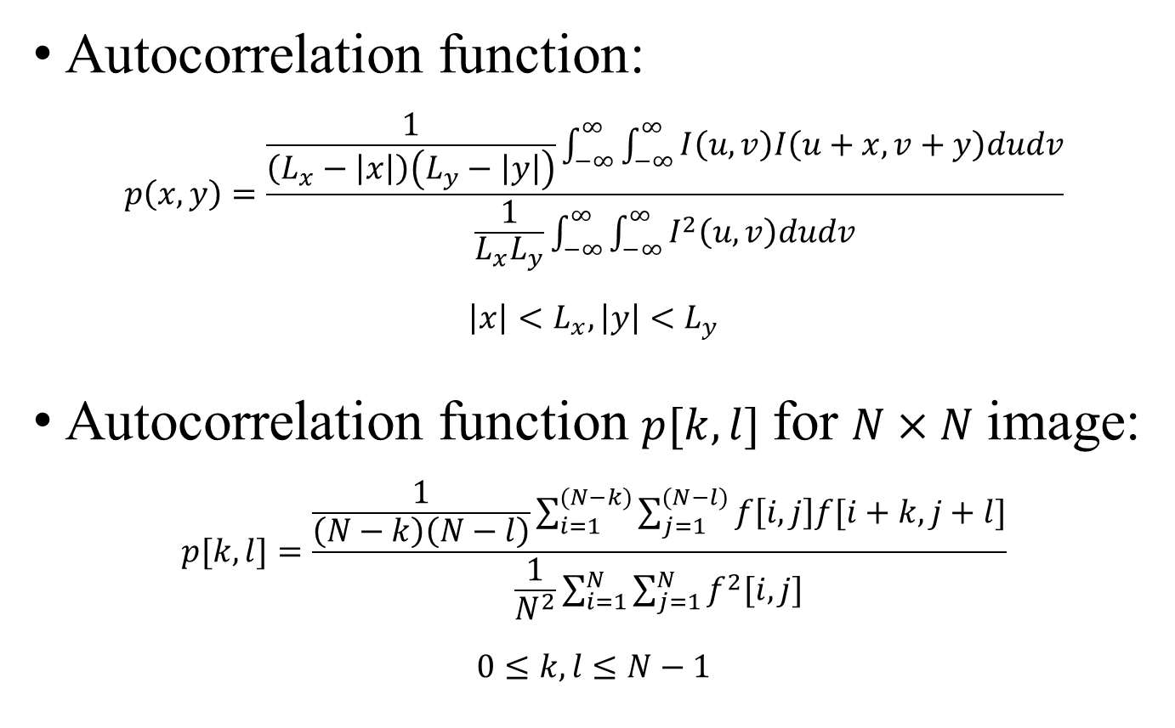
Autocorrelation Function
Autocorrelation function:
$$p\left(x,y\right)=\frac{\frac{1}{\left(L_{x}−\left|x\right|\right)\left(L_{y}−\left|y\right|\right)}\int_{−∞}^{∞}{\int_{−∞}^{∞}{I\left(u,v\right)I\left(u+x,v+y\right)dudv}}}{\frac{1}{L_{x}L_{y}}\int_{−∞}^{∞}{\int_{−∞}^{∞}{I^{2}\left(u,v\right)dudv}}}$$
$$\left|x\right|<L_{x},\left|y\right|<L_{y}$$
Autocorrelation function $p[k,l]$ for $N×N$ image:
$$p[k,l]=\frac{\frac{1}{\left(N−k\right)\left(N−l\right)}\sum_{i=1}^{(N−k)}{\sum_{j=1}^{(N−l)}{f\left[i,j\right]f[i+k,j+l]}}}{\frac{1}{N^{2}}\sum_{i=1}^{N}{\sum_{j=1}^{N}{f^{2}[i,j]}}}$$
$$0≤k,l≤N−1$$
Notes:
連續
離散

Slide 54












$$p[k]=\frac{\frac{1}{\left(N−k\right)}\sum_{i=1}^{(N−k)}{f\left[i\right]f[i+k]}}{\frac{1}{N}\sum_{i=1}^{N}{f^{2}[i]}}$$
$k=0$
$$\frac{\frac{1}{8}×4}{\frac{1}{8}×4}=1$$
$k=4$
$$\frac{\frac{1}{4}×2}{\frac{1}{8}×4}=1$$
$k=1$
$$\frac{\frac{1}{7}×2}{\frac{1}{8}×4}=\frac{4}{7}$$
$k=5$
$$\frac{\frac{1}{3}×1}{\frac{1}{8}×4}=\frac{2}{3}$$
$k=3$
$$\frac{\frac{1}{5}×1}{\frac{1}{8}×4}=\frac{2}{5}$$
$k=2$
$$\frac{\frac{1}{6}×0}{\frac{1}{8}×4}=0$$
Notes:
N 棋盤上多少塊(8塊)
K stride(位移量)
F intensity(黑0 白1)

Slide 55







$$p[k]=\frac{\frac{1}{\left(N−k\right)}\sum_{i=1}^{(N−k)}{f\left[i\right]f[i+k]}}{\frac{1}{N}\sum_{i=1}^{N}{f^{2}[i]}}$$
$k=0$
$$\frac{\frac{1}{8}×4}{\frac{1}{8}×4}=1$$
$k=2$
$$\frac{\frac{1}{6}×3}{\frac{1}{8}×4}=1$$
$k=1$
$$\frac{\frac{1}{7}×0}{\frac{1}{8}×4}=0$$
Notes:
0是黑 1是白

Slide 56

Coarse texture → function drops off slowly
Fine texture → function drops off rapidly
Notes:
上面coarse
下面 fine

Slide 57
Autocorrelation Function
Autocorrelation function:
$$p\left(x,y\right)=\frac{\frac{1}{\left(L_{x}−\left|x\right|\right)\left(L_{y}−\left|y\right|\right)}\int_{−∞}^{∞}{\int_{−∞}^{∞}{I\left(u,v\right)I\left(u+x,v+y\right)dudv}}}{\frac{1}{L_{x}L_{y}}\int_{−∞}^{∞}{\int_{−∞}^{∞}{I^{2}\left(u,v\right)dudv}}}$$
$$\left|x\right|<L_{x},\left|y\right|<L_{y}$$
Autocorrelation function $p[k,l]$ for $N×N$ image:
$$p[k,l]=\frac{\frac{1}{\left(N−k\right)\left(N−l\right)}\sum_{i=1}^{(N−k)}{\sum_{j=1}^{(N−l)}{f\left[i,j\right]f[i+k,j+l]}}}{\frac{1}{N^{2}}\sum_{i=1}^{N}{\sum_{j=1}^{N}{f^{2}[i,j]}}}$$
$$0≤k,l≤N−1$$
Notes:
2D
除了image 還可以用在訊號處理

Slide 58
Autocorrelation Function
Regular and Random:
  Regular texture → function will have peaks and valleys
  Random texture → only peak at [0,0]; breadth of peak gives the size of the texture
Coarse and Fine:
  Coarse texture → function drops off slowly
  Fine texture → function drops off rapidly
Notes:
常規和隨機：
常規紋理→將出現峰谷
隨機紋理→僅在[0,0]達到峰值；峰寬給出了紋理的大小
粗和細：
粗紋理→緩慢下降
Fine紋理 →迅速下降

Slide 59
Autocorrelation Function
Digital Transform Method
Statistical Texture Feature Approach
Model-based Technique
Application

Slide 60
Digital Transform Methods and Texture
In the digital transform method of texture analysis, the digital image is typically divided into a set of non-overlapping small square sub-images.
The vectors are re-expressed in a new coordinate system.
Fourier transform uses the complex sinusoid basic set. Hadamard transform uses the Walsh function basic set, …..
Notes:
以往在分析texture可能都會是針對x,y最標對應到的intensity
這小節講解不一樣的方式，如：傅立葉轉換 Spatial domain → frequency domain
在紋理分析的數字變換方法中，Digital Transform Methods通常將圖像劃分為不重疊的小正方形子圖像。 (達到更好的結果，每一塊都會得到不同的property)
將不同向量在新的坐標系中重新表達。
傅立葉變換使用複數正弦基本集，哈達瑪變換使用Walsh函數基本集，…..

Slide 61






Digital Transform Methods and Texture
Notes:
亮點會與原圖紋理垂直，如圖(1)
Fine texture 距離原點越遠
反之 距離越近

Slide 62






Digital Transform Methods and Texture
Notes:
亮點會與原圖紋理垂直，如圖(1)
Fine texture 距離原點越遠
反之 距離越近

Slide 63


Digital Transform Methods and Texture
Fine Texture
Coarse Texture
Notes:
亮點會與原圖紋理垂直，如圖(1)
Fine texture 距離原點越遠
反之 距離越近

Slide 64
Digital Transform Methods and Texture
Key points:
  The basis vectors of the new coordinate system have an interpretation that relates to spatial frequency or sequence.
  Since frequency is a close relative of texture, such transformations can be useful.
Notes:
關鍵點：
新坐標系的基向量具有與空間頻率或序列有關的解釋。
由於頻率與紋理密切相關，因此此類轉換非常有用。

Slide 65
Digital Transform Methods and Texture
High frequency power → fine texture
Directionality → directional texture
Notes:
透過digital transform method 可以知道
Fine or coarse
方向性

Slide 66
Digital Transform Methods and Texture
In general, features based on Fourier power spectra perform more poorly than features based on:
  second-order gray level co-occurrence statistics
  first-order statistics of spatial gray level differences
Notes:
大家可能有疑問，轉成頻率愈的處理是否比在空間愈處理來的好？
不一定，要以image 的texture 來比較 (ad hoc)
不過，課本有說到，通常，基於傅立葉功率譜的特徵會比
二階灰度共現統計 空間灰度差異的一階統計
表現更差
但也不依定，要依情況而定

Slide 67
Fun Time

Slide 68
Digital Transform Method
Textural Energy
Statistical Texture Feature Approach
Model-based Technique
Application

Slide 69

Texture Energy
The image is first convolved with a variety of kernels.
Then each convolved image is processed with a nonlinear operator to determine the total textural energy in each pixel’s neighborhood.
$$S_{n}\left(r,c\right)= \frac{1}{49}\sum_{i=−3}^{3}{\sum_{j=−3}^{3}{| J_{n}\left(r+i,c+j\right)|}}$$
$J_{n}$: Input image convolved with the n-th kernel.
Notes:
Convolve (v.)
Convolution (n.)
第一步：
首先將映像與各種內核進行卷積(convolve)。
第二步：
然後使用非線性算子(non-linear operator)對每個卷積圖像進行處理，以確定每個像素鄰域中的總紋理能量。

Slide 70
Texture Energy
The textural energy approach is very much in the spirit of the transform approach.
But it uses smaller windows or neighborhood supports.
Notes:
用一個新的kernel去分析每一個區域給予一個新的定義
紋理能量方法非常符合前面提到的Fourier transform method的精神 。
→對每一個pixel都以另一種形式去描述他們
→spatial domain to frequency domain
→先convolve再none-linear operator 計算出pixel的texture energy
但它使用較小的窗戶或鄰里支撐。

Slide 71
Texture Energy
Laws’ Technique (Laws, 1980)
  Filter the input image using texture filters.
  Compute texture energy by summing the absolute value of filtering results in local neighborhoods around each pixel.
$$S_{n}\left(r,c\right)= \frac{1}{49}\sum_{i=−3}^{3}{\sum_{j=−3}^{3}{| J_{n}\left(r+i,c+j\right)|}}$$
$J_{n}$: Input image convolved with the n-th kernel.
Notes:
先對pixel value取絕對值後針對neighborhood做相加再取平均
DL方式中，kernel的數值是針對每一次訓練，loss function跟operator進行運算得到的
此處的kernel如何運算？

Slide 72
Texture Energy — Law’s texture
L5 | (Level) | = [ -1 -4 -6 -4 -1 ]
E5 | (Edge) | = [ -1 -2 -0 -2 -1 ]
S5 | (Spot) | = [ -1 -0 -2 -0 -1 ]
R5 | (Ripple) | = [ -1 -4 -6 -4 -1 ]
L5 (Gaussian) gives a center-weighted local average
E5 (Gradient) responds to row or col step edges
S5 (LoG) detects spots
R5 (Gabor) detects ripples
Notes:
Law’s自己定義了一kernel
跟第七章學得的有點像
Gaussian → 1 4 6 4 1
Spot 點(高點)
Ripple 漣漪
這幾個kernel比較容易activate這些屬性
如果看課本，也會有L3 L7這種3或7個element的陣列

Slide 73

Texture Energy — Law’s texture
Creation of 2D Kernel
  1D kernels are “multiplied” to construct 2D kernels, for example, kernel E5L5 is the “product” of E5 and L5
$$\left[\begin{matrix}−1 \\ −2 \\ 0 \\ 2 \\ 1\end{matrix}\right]×\left[\begin{matrix}1 & 4 & 6 & 4 & 1\end{matrix}\right]=\left[\begin{matrix}−1 & −4 & −6 & −4 & −1 \\ −2 & −8 & −12 & −8 & −2 \\ 0 & 0 & 0 & 0 & 0 \\ 2 & 8 & 12 & 8 & 2 \\ 1 & 4 & 6 & 4 & 1\end{matrix}\right]$$
E5
L5
E5L5
Notes:
1D 如何到 2D？
ELSR取排列組合
第一個transpose後與第二個相乘 可以得到 2D kernel

Slide 74
Texture Energy — Law’s texture
Filter the neighborhood with 16 5x5 kernels
Compute energy at each pixel by summing absolute value of filter output across neighborhood around pixel
Define 9 features:
L5E5 / E5L5
L5R5 / R5L5
E5S5 / S5E5
S5S5
R5R5
L5S5 / S5L5
E5E5
E5R5 / R5E5
S5R5 / R5S5
Notes:
共有16個5x5內核，但有些重複，有些只有方向上的差異，不需要重複運算，最後剩下9個kenel
通過求和像素周圍附近的濾波器輸出的絕對值的總和來計算每個像素的能量
定義9個功能 kernel

Slide 75
Texture Energy — Law’s texture
Water
Fence
Small
Flower
Flag
Big
Flower
Border
Tiger
Grass
Region | E5E5 | S5S5 | R5R5 | E5L5 | S5L5 | R5L5 | S5E5 | R5E5 | R5S5
Tiger | 168.1 | 84.0 | 807.7 | 553.7 | 354.4 | 910.6 | 116.3 | 339.2 | 257.4
Water | 68.5 | 36.9 | 366.8 | 218.7 | 149.3 | 459.4 | 49.6 | 159.1 | 117.3
Flag | 258.1 | 113.0 | 787.7 | 1057.6 | 702.2 | 2056.3 | 192.4 | 611.5 | 350.8
Fence | 189.5 | 80.7 | 624.3 | 701.7 | 377.5 | 803.1 | 120.6 | 297.5 | 215.0
Grass | 206.5 | 103.6 | 1031.7 | 625.2 | 428.3 | 1153.6 | 146.0 | 427.5 | 323.6
Small flower | 114.9 | 48.6 | 289.1 | 402.6 | 241.3 | 484.3 | 73.6 | 158.2 | 109.3
Big flower | 75.7 | 28.8 | 177.1 | 301.5 | 158.4 | 270.0 | 45.6 | 89.7 | 62.9
Borders | 15.3 | 6.4 | 64.4 | 92.3 | 36.3 | 74.5 | 9.3 | 26.1 | 19.5
Notes:
Ex：tiger R5R5，S5L5數值偏大，可以以此來分類
Grass 再R5R5會有最大的數值

Slide 76
Texture Energy — Law’s texture
Water
Fence
Small
Flower
Flag
Big
Flower
Border
Tiger
Grass
Segmentation into 4 cluster
Segmentation into 4 cluster
Segmentation into 3 cluster
Notes:
可以大致將物體做區分，但我覺得比DL差很多
不過課本提到，此一方法與Co-Occurrence matrix相比效果好很多
Law’s有做一個實驗，他8種texture做比較，結果發現用這種方式的結果準確率達到94% 而co-occurrence matrix只有72%

Slide 77
Textural Energy
Textural Edgeness
Statistical Texture Feature Approach
Model-based Technique
Application

Slide 78
Texture Edgeness
Some researchers conceive of texture not in terms of spatial frequency but in terms of edgeness per unit area.
Notes:
一些研究人員不是根據空間頻率而是根據每單位面積的邊緣度來構思紋理。
也就是可以根據一個image edge的特定，來推出image的property

Slide 79
Texture Edgeness
Edge Density and Direction
  Use an edge detector as the first step in texture analysis.
  The number of edge pixels in a fixed-size region tells us how busy that region is.
  The direction of the edges also help characterize the texture.
Notes:
Edge detector 可以得到edge的size(density)或方向等
邊緣密度和方向 將邊緣檢測器用作紋理分析的第一步。
固定大小區域中邊緣像素的數量告訴我們該區域有密集。
邊緣的方向也有助於表徵紋理。

Slide 80

Texture Edgeness
Edge per unit area:
  $$F_{edgeness}=\frac{\left|\left\{p|gradient_magnitude\left(p\right)≥threshold\right\}\right|}{N}$$
  Where $N$ is the size of the image region being analyzed
Histogram of edge magnitude and direction for a region R:
  $$F_{magdir}=\left(H_{magnitude}\left(R\right), H_{direction}\left(R\right)\right)$$
  Where these are the normalized histograms of gradient magnitudes and gradient directions, respectively.
Notes:
課本舉了這兩個例子
1.給定一個有N pixel的Region，p占多少$, P屬於g radient_magnitude (計算$梯度強度，可以得到物體的骨架)，滿足某個數值的門檻
2. 對於一個Region R來說，可以直接畫出他的magnitude與direction的X,Y圖，可以此分析出region的特性

Slide 81


Texture Edgeness
Threshold Edge Image
Original Image
Different $F_{edgeness}$ for different region
Notes:
框框中密度差很多，可能就會分析說是不同的物體

Slide 82
Fun Time

Slide 83
Vector Dispersion
Textural Edgeness
Statistical Texture Feature Approach
Model-based Technique
Application

Slide 84

Vector Dispersion
Divide the texture into mutually exclusive neighborhoods
A sloped plane fit to the gray levels is performed for each neighborhood
Graphical representation of the dispersion of a group of unit surface normal vectors for a patch of gray level intensity surface.
Notes:
第八章學到的小平面方法
這部分
主要處理image是平坦還是崎嶇的
如果針對image的x,y,z軸表示的話，Z可以是intensity
將紋理劃分為互斥的鄰域 (每個平面最像，相互之間error最小的區域)
為每個鄰域執行適合灰度的傾斜平面

Slide 85

Vector Dispersion
Using relative coordinate system whose origin is the center of the neighborhood, one can model the gray level in the neighbor with:
$$I\left(r,c\right)=αr+βc+γ$$
$$\left(\begin{matrix}l_{i} \\ m_{i} \\ n_{i}\end{matrix}\right)=\frac{1}{\sqrt{{α_{i}}^{2}+{β_{i}}^{2}+1}}\left(\begin{matrix}α_{i} \\ β_{i} \\ −1\end{matrix}\right)$$
Graphical representation of the dispersion of a group of unit surface normal vectors for a patch of gray level intensity surface.
Notes:
平面方程式：
Z=alpha*X+beta*Y+gamma
移項
alpha*X+beta*Y-Z+gamma=0
Vector=(alpha, beta, -1) →法向量
此處是單位法向量：還要計算平方相加開根號
L m n就是每一個小平面的法向量 (i)指第i個

Slide 86
Vector Dispersion
For smooth texture, the coefficients are close
For rough texture, the coefficients are quite apart
Graphical representation of the dispersion of a group of unit surface normal vectors for a patch of gray level intensity surface.
Notes:
如果fine → unit surface normal vectors 相近
反之 coarse →相差比較大

Slide 87
Vector Dispersion
Relative Extrema Density
Statistical Texture Feature Approach
Model-based Technique
Application

Slide 88
Relative Extrema Density
Count the number of relative extrema per unit area for a texture measure
Relative extrema:
  Relative minimum
  Relative maximum
Notes:
計算每單位面積的相對極值以進行紋理測量
一個texture中有多少個max 跟 min
Relative extrema 可以分為局部最小跟最大

Slide 89

Relative Extrema Density
Relative minimum:
$$g\left(i\right)≤g\left(i+1\right) and g\left(i\right)≤g(i−1)$$
Relative maximum:
$$g\left(i\right)≥g\left(i+1\right) and g\left(i\right)≥g(i−1)$$
Pixels in a constant run: both minimum and maximum
Notes:
若要偵測pixel i則比較前後的數值
G是指一個function(偵測intensity)之類的
比較若較小min 若較大 max

Slide 90
Relative Extrema Density
M
M
m
M
m
m
Coarse
Fine
M
M
M
M
M
M
M
M
M
M
m
m
m
m
m
m
m
m
m
m
Notes:
Fine → Max min數量多
反之 數量少

Slide 91






Coarse texture
Fine texture
$$\frac{max}{N}=\frac{8}{56}$$
$$\frac{max}{N}≈\frac{1}{2}$$
$$\frac{min}{N}=\frac{20}{56}$$
$$\frac{min}{N}≈\frac{1}{2}$$
Notes:
0是黑 1是白
比較後可以得知
Fine → Max min數量多
反之 數量少

Slide 92
Mathematical Morphology
Relative Extrema Density
Statistical Texture Feature Approach
Model-based Technique
Application
Notes:
第五章
Dilation erosion opening closing
Morphology 形態學

Slide 93
Mathematical Morphology
Granularity
Fractal
Notes:
Granularity 顆粒度 fine coarse 顆粒度大or小
Fractal 碎形

Slide 94

Mathematical Morphology
Granularity of a binary image F:
$$G\left(d\right)=1−\frac{\#(F∘H_{d})}{\#F}$$
  $∘$ : Opening operator
  $\#$ : number of elements
  $H_{d}$: disk structuring element of diameter $d$
$G(d)$ measures the proportion of pixel participating in grains of size smaller than $d$
Notes:
一張binary image F 透過
直徑為d的structure element opening 後佔整體的比例
Image 經過直徑為d的structure element Opening 後
表示會留下顆粒度比d還要大的部分
再用1去扣掉，表示比d還小的部分
顆粒度小的(fine) →曲線比較快達到100% (畫圖)
反之 →曲線比較平緩達到100%

Slide 95

Mathematical Morphology
Use gray level erosion and dilation to determine the fractal surface of the gray level intensity surface of the texture scene:
recursive and self-similar
Notes:
Fractal 碎形
重複劃出相同的圖案
這一類recursive的動作畫出的pattern我們稱為fractal

Slide 96


Mathematical Morphology
A fractal is a natural phenomenon or a mathematical set that exhibits a repeating pattern that displays at every scale.
Notes:
放大來看會看到重複的圖形
表現出在每個尺度上都顯示的重複模式。

Slide 97

Notes:
這是針對一條線的操作
對每一個線段再做一樣的操作
會得到向第四條的樣子

Slide 98

Mathematical Morphology
Scale-$k$ volume of the blanket around a gray level intensity surface $I$:
$$V\left(k\right)=\sum_{(r,c)}{\left(I⊕_{k}H\right)\left(r,c\right)−\left(I⊖_{k}H\right)\left(r,c\right)}$$
$⊕_{k}$: k-fold dilation
$⊖_{k}$: k-fold erosion
The fractal surface area A at scale k is defined by:
$$A\left(k\right)=\frac{V\left(k\right)−V(k−1)}{2}$$
Notes:
此種分析方式可適用於各式的texture上
此處定義一個體積為k且灰階強度為I的blanket
這個式子表示針對影像做k次的dilation-k次的erosion
外包線與內包線的差異再做加總，可以得到面積的總和
A表示k與k-1增長多少

Slide 99

Mathematical Morphology
The fractal signature S at scale k is defined by:
$$S\left(k\right)=\frac{d}{d\log{k}}\log{A\left(k\right)=\frac{kA′(k)}{A(k)}}$$
Compare the similarity between textures by weighted distance D between their fractal signature:
$$D=\sum_{k}{{[S_{1}\left(k\right)−S_{2}\left(k\right)]}^{2}\log\left(\frac{k+\frac{1}{2}}{k−\frac{1}{2}}\right)}$$
Notes:
Fractal signature
兩個texture的相似度

Slide 100
Fun Time

Slide 101
Model-based Technique

Slide 102
Model Based Technique
Estimation:
  Estimate values of model parameters based on observed sample examples of model-based techniques.
Verification:
  Verify given image texture sample is consistent with or fits the model.
Notes:
類似DL中的訓練(training) 跟測試(testing)
估算：
基於觀察到的基於模型的技術的樣本示例，估計模型參數的值。
驗證：
驗證給定的圖像紋理樣本與模型一致或適合模型。

Slide 103
Mathematical Morphology
Auto-regression Model
Statistical Texture Feature Approach
Model-based Technique
Application

Slide 104
Auto-regression Models
Doing linear estimates of a pixel’s gray level with the gray levels in the neighborhood
For coarse texture, coefficient will be similar
For fine texture, coefficient will vary widely
Notes:
Auto-regression表示透過該位置前面幾個pixel的值來求得結果
Coarse → coefficient相似
反之 不相似

Slide 105

Auto-regression Models
One-dimensional auto-regression model:
  Next gray value $a_{N+1}$: linear combination of synthesized data and noise value
$$a_{N+1}=\sum_{k=0}^{K−1}{α_{k}a_{N−k}+\sum_{l=0}^{L−1}{β_{l}b_{N−l}}}$$
  $a_{k}$: given starting sequence
  $b_{k}$: randomly generated noise image
Auto-regression Terms
Moving Average Terms

Slide 106



Auto-regression Models
$$a_{1}$$ | $$a_{2}$$ | $$a_{3}$$ | $$a_{4}$$ | .. | ..
.. | .. | .. | .. | .. | ..
.. | .. | .. | .. | .. | ..
.. | .. | $$a_{n}$$
$$b_{1}$$ | $$b_{2}$$ | $$b_{3}$$ | $$b_{4}$$ | .. | ..
.. | .. | .. | .. | .. | ..
.. | .. | .. | .. | .. | ..
.. | .. | $$b_{n}$$
$$a_{N+1}=\sum_{k=0}^{K−1}{α_{k}a_{N−k}+\sum_{l=0}^{L−1}{β_{l}b_{N−l}}}$$
  $a_{k}$: given starting sequence
  $b_{k}$: randomly generated noise image
Auto-regression Terms
Moving Average Terms
Notes:
真對每一個a1 a2 a3…an都有一個屬於他的計算方式
描述pixel的方式
根據該pixel的前幾個pixel決定(有幾個需要由k決定) if 兩個位置k=2
對應到生成的noise(randomly generated ) 的數量(不一定是k個)可以是l個 if l=3 →b1 b2 b3
A4=a3*alpha3+a2*alpha2 (if k=2)

Slide 107

Auto-regression Models
Two-dimensional auto-regression model:
$$a\left(i,j\right)=\sum_{\left(k,l\right)∈N\left(i,j\right)}{α\left(i−k,j−l\right)a\left(k,l\right)}+\sum_{\left(k,l\right)∈N\left(i,j\right)}{β\left(i−k,j−l\right)b(k,l)}$$
$$N\left(i,j\right)=\left\{\left(k,l\right)\right| \left(i−D≤k<i and j−D≤l≤j+D\right)$$
$$or (k=i and j−D≤l<j)\}$$
Auto-regression Terms
Moving Average Terms
Notes:
2D的算法 (下一頁)

Slide 108



Auto-regression Models
D Pixels
D Pixels
$$a\left(i,j\right)=\sum_{\left(k,l\right)∈N\left(i,j\right)}{α\left(i−k,j−l\right)a\left(k,l\right)}+\sum_{\left(k,l\right)∈N\left(i,j\right)}{β\left(i−k,j−l\right)b(k,l)}$$
$$N\left(i,j\right)=\left\{\left(k,l\right)\right| \left(i−D≤k<i and j−D≤l≤j+D\right)$$
$$or (k=i and j−D≤l<j)\}$$
 |  | $$a\left(i,j\right)$$
 |  | $$b\left(i,j\right)$$
D Pixels
Auto-regression Terms
Moving Average Terms
Notes:
再1D的世界中，我們是根據該pixel之前位置的數值
再2D的世界中，我們會針對該位置左邊D位置以及以上D位置的左右各D的位置

Slide 109

Auto-regression Models
Estimate gray value for pixel $(i,j)$ by using the differences between the actual values and the estimated value
$$\hat{a}\left(i,j\right)=\sum_{\left(k,l\right)∈N\left(i,j\right)}{α\left(i−k,j−l\right)a\left(k,l\right)}+\sum_{\left(k,l\right)∈N\left(i,j\right)}{β\left(i−k,j−l\right)\left[a\left(k,l\right)−\hat{a}(k,l)\right]}$$
For texture category c, define the estimated gray value for pixel $(i,j)$:
$${\hat{a}}_{c}\left(i,j\right)=\sum_{\left(k,l\right)∈N\left(i,j\right)}{α_{c}\left(i−k,j−l\right)a_{c}\left(k,l\right)}+\sum_{\left(k,l\right)∈N\left(i,j\right)}{β_{c}\left(i−k,j−l\right)\left[a_{c}\left(k,l\right)−{\hat{a}}_{c}(k,l)\right]}$$
$\{α_{c}\left(m,n\right),β_{c}(m,n)\}$ are the coefficients for texture category c.
Notes:
這邊表示原本是需要random產生一個beta的數值
這邊會透過前面計算過的數值去計算
我們可以知道ground truth (a) –估計值(a haed) 就是之前的b
之前有講到，Model based 就是建立一個描述texture region
對於紋理類別c，如果要用一個model去定義Pixel(𝑖，𝑗)的估計灰度值：
就是求出一這一個model 的coefficient → alpha beta

Slide 110

Auto-regression Models
Pixel $(i,j)$ has texture category c if
  $\left|a\left(i,j\right)−{\hat{a}}_{c}(i,j)\right|≤\left|a\left(i,j\right)−{\hat{a}}_{d}(i,j)\right|$ for every texture category d, and $\left|a\left(i,j\right)−{\hat{a}}_{c}(i,j)\right|≤θ$
$θ:$ threshold
$(i,j)$ is a boundary pixel if $\left|a\left(i,j\right)−{\hat{a}}_{c}(i,j)\right|>θ$
Can be employed in texture segmentation applications as well as texture synthesis applications.
Notes:
如果要判對pixel (I,j)是不是屬於 texture c
原始數據(a(I,j))與C類別的model來分析a(I,j)的數值 (ahead c) 誤差要比較D類別的model來分析a(I,j)的數值 (ahead d)小
原始數據(a(I,j))與C類別的model來分析a(I,j)的數值 (ahead c) 誤差要小於門檻值
可以在紋理分割應用以及紋理合成應用中使用。

Slide 111
Discrete Markov Random Field
Statistical Texture Feature Approach
Model-based Technique
Application

Slide 112
Discrete Markov Random Fields
C
(r, c)
j
i
R
Notes:
與auto regression model方式很像 只不過不是只根據前面的數值
根據周圍(fields)的數值
所以，Markov Random Fields可以做到PR但無法做到pattern generation
超出界的部分會從頭開始，也就是這一張影像是一個圓柱體

Slide 113

Discrete Markov Random Fields
Each pixel’s value is a linear combination of the values in its neighborhood plus a correlated noise term:
$$I\left(r,c\right)=\sum_{\left(i,j\right)∈N}{I\left(r−i,c−j\right)h\left(i,j\right)+u\left(r,c\right)}$$
$h$: coefficients, computed from texture image with least-square method
$u$: joint set of possible correlated Gaussian random variables
Notes:
每個像素的值是其附近值與noise的線性組合：

Slide 114

Discrete Markov Random Fields
To determine the coefficients $h\left(i,j\right)$ for $\left(i,j\right)∈N$, we can proceed by least squares:
$$ε^{2}=\sum_{(r,c)}{{\left[I\left(r,c\right)−\sum_{\left(i,j\right)∈N}{I\left(r−i,c−j\right)h\left(i,j\right)}\right]}^{2}}$$
Texture classification can be done by comparing a computed set of coefficients
Notes:
如何求出coefficient
可以用最小平方法(MSE)
真實的值-估計的值再取平方
可以通過比較一組計算出的係數來完成紋理分類

Slide 115
Fun Time

Slide 116
Discrete Markov Random Field
Random Mosaic Model
Statistical Texture Feature Approach
Model-based Technique
Application

Slide 117
Random Mosaic Models
Constructing steps:
  Provide a means of tessellating a plane into cells
  Assign a property value to each cell
Notes:
構造步驟：
提供一種將平面細分為單元的方法
為每個單元分配一個屬性值
也就是要如何針對image去切割
切割完後也是透過前面所教的的方式進行分析

Slide 118
How to partition
Poisson Line Model
Occupancy Model
Delaunay Model

Slide 119

Random Mosaic Models
Poisson Line Model
  Use a Poisson process of intensity $λ/π$ determine ordered pairs $\left(θ,p\right)∈\left[0,π\right]×\left(−∞,∞\right)$.
  Each pair $\left(θ,p\right)$ is associated with a line $x\cos{θ}+y\sin{θ}=p$.
Notes:
使用Poisson distribution 產生 theta p的pair 用於定義$x\cos{θ}+y\sin{θ}=p$的線

Slide 120

Random Mosaic Models
Occupancy Model
  Tessellation is produced by a Poisson process of intensity $λ$, which plants points in the plane.
  Each point determines a cell that consists of all points in the plane closest to the given planted point. (Voronoi Diagram)
Notes:
將透過Poisson distribution 產生很多點，並以此為畫分依據。(離哪一個點是最近的即劃入那一區)
要找出實線部分，可透過每個點相連的虛線不分與之垂直的不分即可區分出不同的區塊

Slide 121
Random Mosaic Models
Delaunay Model
  A line segmentation is drawn between each pair of planted points whose corresponding cells in the occupancy model share a common border segment.
Notes:
剛剛的部分是將每一個點虛線連接，
Delaunay model則是化成實線做分割

Slide 122
Structural Approach to Texture Model
Random Mosaic Model
Statistical Texture Feature Approach
Model-based Technique
Application

Slide 123

Structural Approaches to Texture Models
Pure structural models:
  primitive in regular repetitive spatial arrangements.
To describe the texture, describe the primitive and the placement rules
Notes:
純結構模型：
在規則的重複空間排列中是原始的。
要描述紋理，請描述圖元和放置規則

Slide 124
Structural Approaches to Texture Models

Slide 125
Summary of Texture Analysis
9.2 & 9.3 co-occurrence → 顆粒大小
9.4 autocorrelation → 顆粒、隨機性
9.5 digital transform methods → 方向、顆粒
9.6 texture energy (convolution) → segmentation
9.7 texture edgeness → Edge的粗細、方向
9.8 vector dispersion → 粗糙、平坦
9.9 relative extrema density → 顆粒
9.10 mathematical morphology → 顆粒、碎形
9.11 ~ 9.13 autoregression, Markov random field, random mosaic models → 係數推測

Slide 126
Application

Slide 127
Structural Approach to Texture Model
Texture Segmentation
Statistical Texture Feature Approach
Model-based Technique
Application

Slide 128
Texture Segmentation
Each region has homogeneous texture, and each pair of adjacent region is differently textured
Notes:
每個區域具有均勻的紋理，並且每對相鄰區域具有不同的紋理
真對每一個pixel算出各自的texture energy

Slide 129
Synthetic Texture Image Generation
Texture Segmentation
Texture Feature Approach
Model-based Technique
Application

Slide 130


Synthetic Texture Image Generation
Notes:
如何將兩張影像融合再一起 (拼圖的結果)

Slide 131


Synthetic Texture Image Generation

Slide 132


Synthetic Texture Image Generation
Step0 : Input sample texture

Slide 133
Synthetic Texture Image Generation
Step1: Choose a region from the original texture sample image as the initial region.
Notes:
從原始紋理樣本圖像中選擇一個區域作為初始區域。

Slide 134
Synthetic Texture Image Generation
Step2: Find the region with the similar edges in the original image.
Notes:
在原始圖像中找到邊緣相似的區域。

Slide 135
Synthetic Texture Image Generation
Step3: Paste it on the result image.
Notes:
貼上的部分是與原來區域很相似的
除了接上去無違和以外
還需要注重原始的輪廓，才不會最後有走鐘的可能

Slide 136

Synthetic Texture Image Generation
Step4: Back to Step2 and repeat.

Slide 137

Synthetic Texture Image Generation
Boundary optimization
Notes:
有點違和的部分
可以做post processing (Blur)之類的處理

Slide 138

Synthetic Texture Image Generation
More result
Increase window size
Notes:
用越大塊來拼貼會越smooth

Slide 139

Synthetic Texture Image Generation
More result

Slide 140
Synthetic Texture Image Generation
Shape from Texture
Statistical Texture Feature Approach
Model-based Technique
Application

Slide 141
Shape from Texture
Using image texture gradients to estimate surface orientation of the observation 3D object
Assumption: the observed texture area no depth changes and no texture changes in observed texture area, and no sub-textures
Notes:
使用圖像紋理的改變來估計觀察3D對象的表面方向
假設：觀察到的紋理區域沒有深度變化，觀察到的紋理區域沒有紋理變化，並且沒有子紋理

Slide 142

Shape from Texture
Notes:
用一個2D的image怎麼去辨識3D的方向
可以分析這些圓形的長軸短軸的法向量
其垂直的平面可以得到其方向

Slide 143


Shape from Texture

Slide 144

Shape from Texture

Slide 145
Summary
Shape from Texture
Statistical Texture Feature Approach
Model-based Technique
Application

Slide 146
Fun Time

Slide 147
Summary
Texture: in terms of primitives (or texels) and their spatial relationships
We reviewed a number of different textural feature extraction techniques
Qualitatively, texture analysis works
Quantitatively, the techniques are generally not dependable
Notes:
紋理：根據圖元（或圖元）及其空間關係
我們回顧了許多不同的紋理特徵提取技術
定性地，紋理分析有效
從數量上講，這些技術通常是不可靠的

Slide 148
Reference
Computer and Robot Vision Volume I: Ch.9 Texture
NTU Computer Vision I, ch9_2006_PPT, ch9_2013_PPT, ch9_2014_PPT, ch9_2019_PPT
University of Washington
  https://courses.cs.washington.edu/courses/cse455/09wi/Lects/lect12.pdf
Wiki
  https://en.wikipedia.org/wiki/Joint_probability_distribution
  https://en.wikipedia.org/wiki/Autocorrelation
  https://en.wikipedia.org/wiki/Convolution
  https://en.wikipedia.org/wiki/Fractal
  https://en.wikipedia.org/wiki/Fractal_landscape
  https://en.wikipedia.org/wiki/Voronoi_diagram
  https://en.wikipedia.org/wiki/Delaunay_triangulation
Fractal Foundation
  http://fractalfoundation.org/resources/what-are-fractals/
Deviant Art
    http://www.deviantart.com/digitalart/fractals/rawfractal/
  London Bricks
    http://www.londonbricks-uk.co.uk/
  HIPR2
    http://homepages.inf.ed.ac.uk/rbf/HIPR2/fourier.htm

