Slide 1
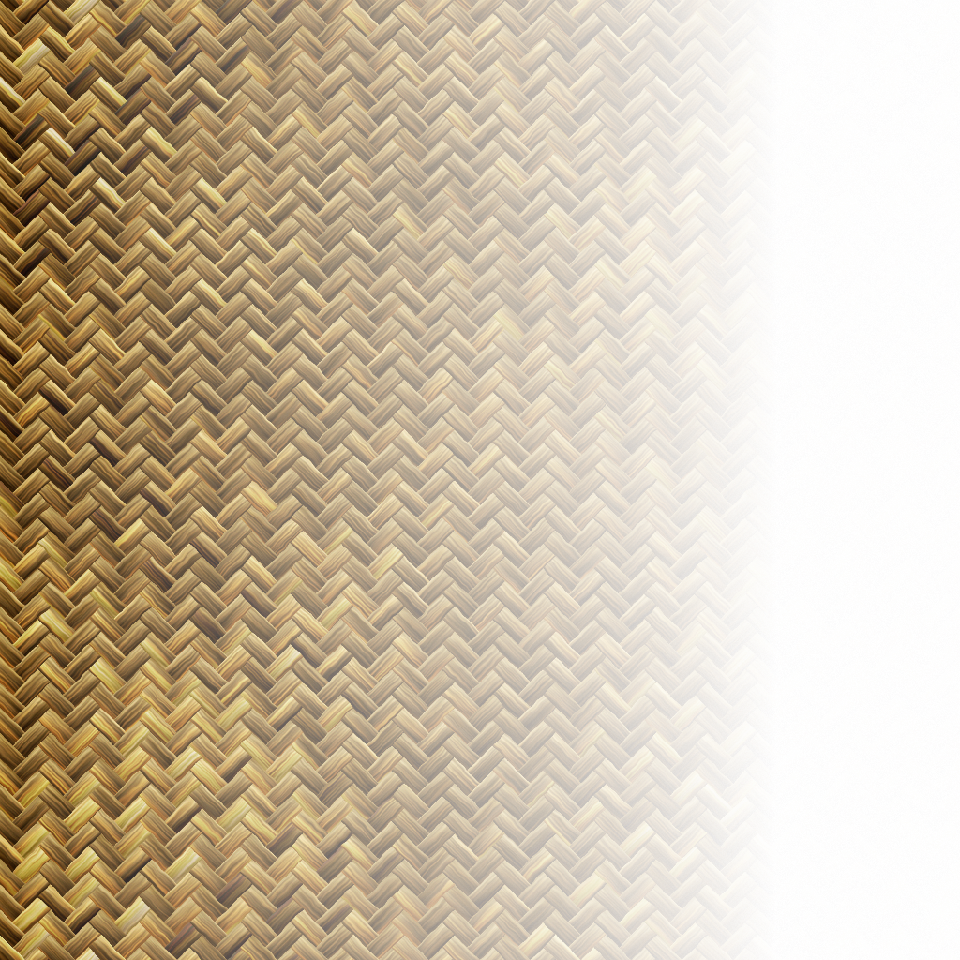
Computer Vision
Chapter 9 : Texture
Presented by 傅楸善教授 & 趙序培
Email: b01902043@ntu.edu.tw
Digital Camera and Computer Vision Laboratory
Department of Computer Science and Information Engineering
National Taiwan University, Taipei, Taiwan, R.O.C.

Slide 2
Strong Texture Measures and Generalized Co-occurrence
Discrete Markov Random Field
Synthetic Texture Image Generation
Structural Approach to Texture Model
Introduction
Gray Level Co-occurrence
Autocorrelation Function
Mathematical Morphology
Vector Dispersion
Auto-regression Model
Digital Transform Method
Random Mosaic Model
Textural Energy
Texture Segmentation
Relative Extrema Density
Textural Edgeness
Summary
Shape from Texture
Statistical Texture Feature Approach
Model-based Technique
Application
Notes:
章節介紹

Slide 3

Introduction
texture
What does texture mean?
- Formal approach or precise definition of texture does not exist.
Texture discrimination techniques are for the part ad hoc.
Notes:
眾人對”紋理”還沒有一個標準定義
分析紋理的技術經常受限於紋理類別 : ”辨識地貌紋理的方法(植被、人造建築…)”用在”辨識普通照片中的紋理(人、衣服、玩具…)”效果也許就非常差

Slide 4
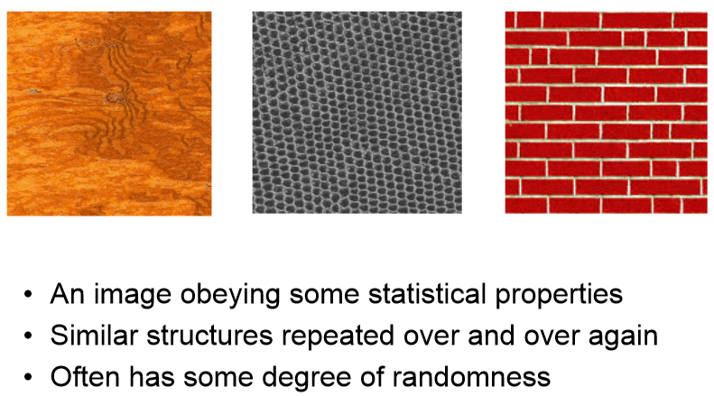
What is Texture?
An image obeying some statistical properties
Similar structure repeated over and over again
Often has some degree of randomness
Notes:
既然沒有定義，那該怎麼”描述”紋理??
影像含有統計上的數值(ex.一個黑點被其他六個黑點圍起來、兩層磚頭交錯排列，位差半個磚頭)
類似的結構不斷重複
可能含有一點隨機性(ex.木頭紋路並不是整塊都一至、磚頭大小不一)

Slide 5
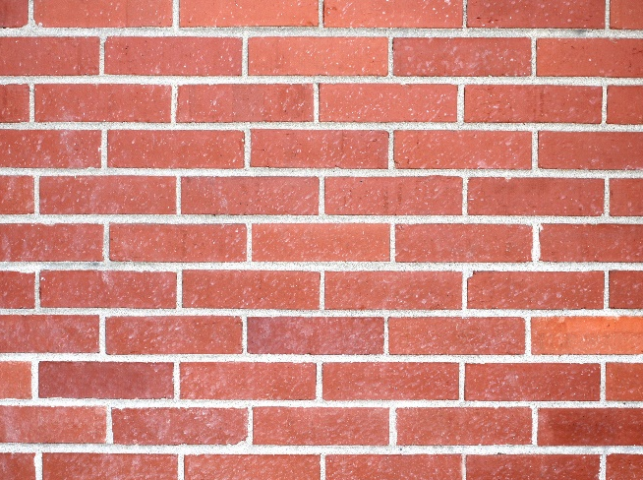
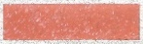
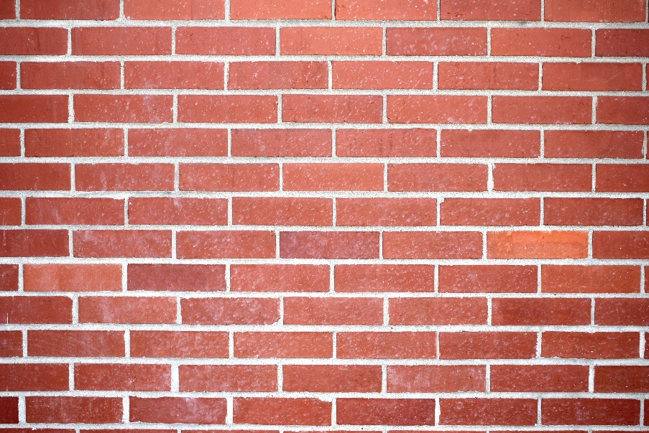
“Definition” of Texture
Non-local property, characteristic of region larger than its size.
Repeating patterns of local variations in image intensity which are too fine to be distinguished as separated object at the observed resolution.
Notes:
根據上頁三項描述，課本大致定義了一下紋理
非在地性質，紋理的特性必須觀察大範圍空間
一再重複的結構不該被視為不同的物件
Ex. 小區域pixel看不出究竟是什麼 -> 擴大區域pixel可看出是塊磚頭 -> 括智大範圍pixel是面”磚牆”，各個”磚頭”不該被視為不同物件

Slide 6
“Definition” of Texture
For humans, texture is the abstraction of certain statistical homogeneities from a portion of the visual field that contains a quantity of information grossly in excess of the observer’s perceptual capacity.
Notes:
對人類而言，”紋理”，以視覺接收，並含有大量”感官資訊”
“這面牆看起來很硬” -> 硬應是觸覺上的資訊，但是大腦在視覺接收到”牆壁上的紋理”時，便將該”物件”與牆壁作連結，並回想以前碰觸牆壁的感覺
More example – “看起來很好吃”、”看起來毛茸茸的”

Slide 7
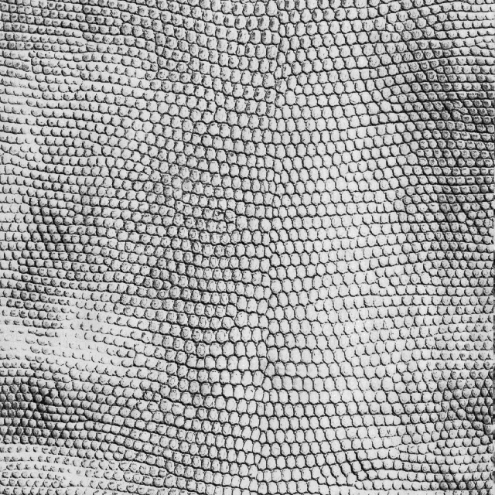
Examples of Texture

Slide 8
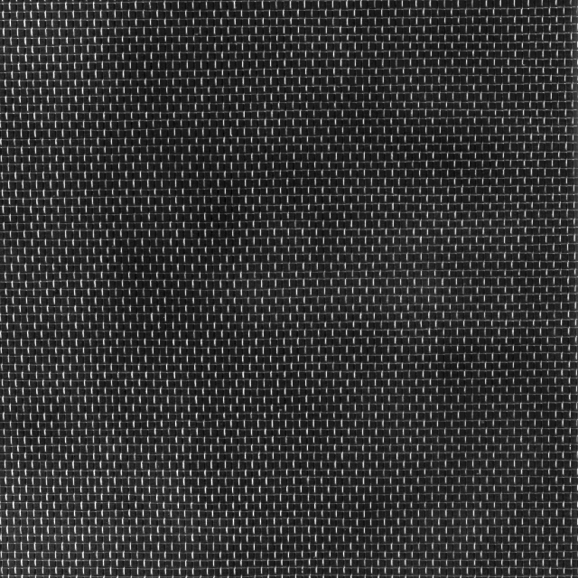
Examples of Texture

Slide 9

Examples of Texture

Slide 10
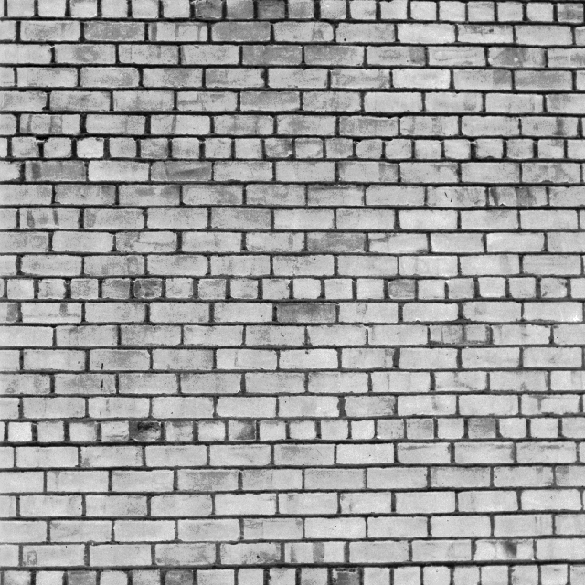
Examples of Texture

Slide 11
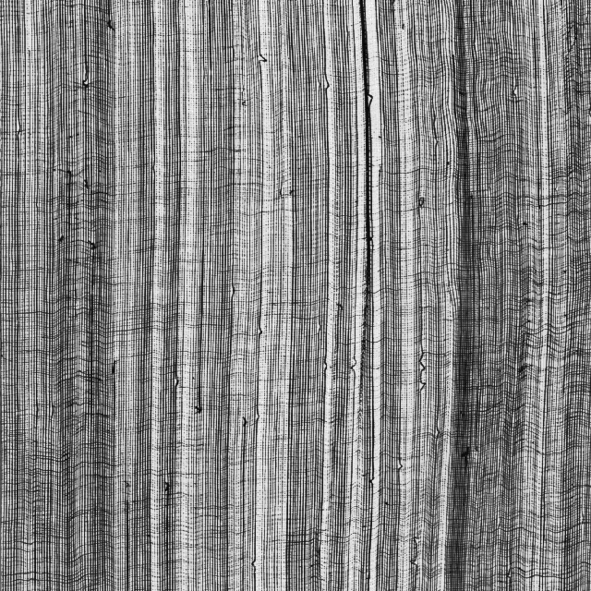
Examples of Texture

Slide 12
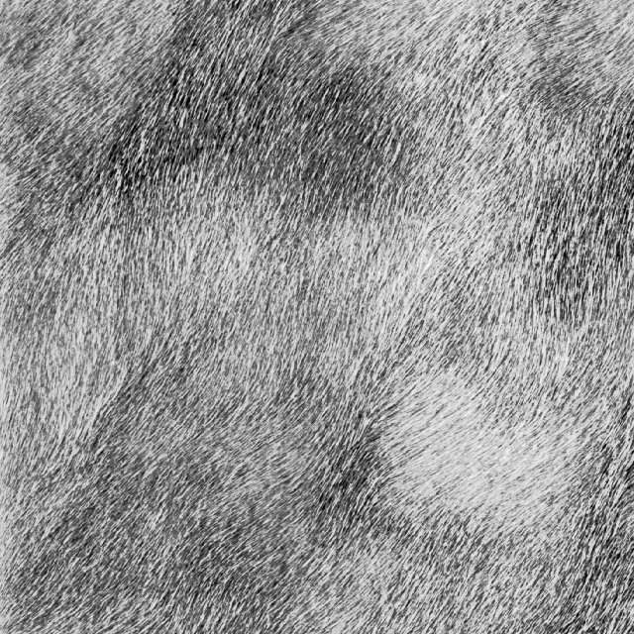
Examples of Texture

Slide 13
Texture Analysis Issues
Pattern recognition : given textured region, determine the class the region belongs to.
Generative model : given textured region, determine a description or model for it.
Texture segmentation : given image having many textured areas, determine boundaries.
Pattern recognition : given textured region, determine the class the region belongs to.
Generative model : given textured region, determine a description or model for it.
Texture segmentation : given image having many textured areas, determine boundaries.
Notes:
紋理分析上主要可分為三類
辨識模式(紋理) – 將紋理分類進有限類別之中
生成模型 – 餵進樣本來生成模型
紋理分割 – 需利用以上兩種紋理分析技巧，給定一張有著不同紋理的影像，辨別不同紋理並做切割

Slide 14
Statistical Texture Feature Approaches
Spatial gray level co-occurrence probabilities
Autocorrelation function
Edgeness per unit area
Relative extrema distributions
Mathematical morphology
Spectral power density function
Gray-level run-length distributions
Notes:
關於”以統計來描述紋理”這種方式，課本列舉了幾種
空間灰階共生機率
自相關函數
單位面積邊界密度
相對極值分布
數學型態學
光譜功率密度函數
灰階行程長度分布

Slide 15
Image Texture Analysis by Model
Give a generative model and the values of its parameters, one can synthesize homogeneous image texture samples associated with the model and the given value of its parameters.
Notes:
給訂一模型，將可以根據模型的參數合成出(該模型所描述的)紋理

Slide 16
Image Texture Analysis by Model
Estimation : estimate values of model parameters based on observed sample examples of model-based techniques
Verification : verify given image texture sample is consistent with or fits the model
Estimation : estimate values of model parameters based on observed sample examples of model-based techniques
Verification : verify given image texture sample is consistent with or fits the model
Notes:
計算 – 首先必須有樣本來建構模型
辨識 – 輸入一紋理時辨別是否與該模型一致，以此為依據來辨識不同紋理

Slide 17
Some Model-Based Techniques
Auto-regression
Markov random fields
Random Mosaic models
Moving-average
Time-series models (extended to 2D)
Notes:
關於建構模型的方式，課本列出以下幾種
– 自回歸
– 馬卡夫隨機場
– 隨機馬賽克
– 移動平均
– 時間序列

Slide 18
Texel
Texture element, basic textural unit of some textural primitives in their defining spatial relationships
A texture is a set of texture elements or texels occurring in some regular or repeated pattern
Elements | Construct | Array
Pixels |  | Image
Texels |  | Texture
Notes:
Texel(紋素)
描述紋理的基本單位，以紋理原值的空間關係來定義
紋理(texture)是紋素(texel)以某種固定或重複的方式排列所產生的

Slide 19
Texel
Notes:
框起來的部分就是這張圖的texel(不是唯一的texel)，以此texel重複排列就可以得出整張圖

Slide 20
Texture Primitive
Connected set of pixels characterized by attribute set
Simplest primitive: pixel with gray level attribute
More complicated primitive: connected set of pixels homogeneous in level, characterized by size, elongation, orientation, and average gray level
Notes:
原質 - 根據性質所聯集的pixel(s)
最簡單的原質 : 一個pixel自身的灰階
更複雜的原質… ex. “版面是黑色的一坨為一原質”即是視字母為一原質、”靠近的幾個字母為一原質”即是視單字為一原質

Slide 21
Characterizing Texture
Characterize gray level primitive properties
An image texture is described by the number and types of its primitives and their spatial organization or layout.
Image texture can be qualitatively evaluated as some properties.
Notes:
紋理特徵
根據灰階原質特性來分類、表徵
對電腦而言，紋理可以由原質數量、類型以及他們的空間關係來描述
對人而言，影像中的紋理可用一些定性的特性、特徵來描述

Slide 22
Characterizing Texture
Some Texture Features
Fineness
Coarseness
Contrast
Directionality
Roughness
Regularity
Smoothness
Granularity
Randomness
Lineation
Mottled
Irregular
Hummocky
Notes:
細粒(POI~) 顆粒
顆粒大 隨機
對比 輪廓、線理
方向 斑駁
粗糙 不規則
規律 (圓)丘狀
平滑

Slide 23
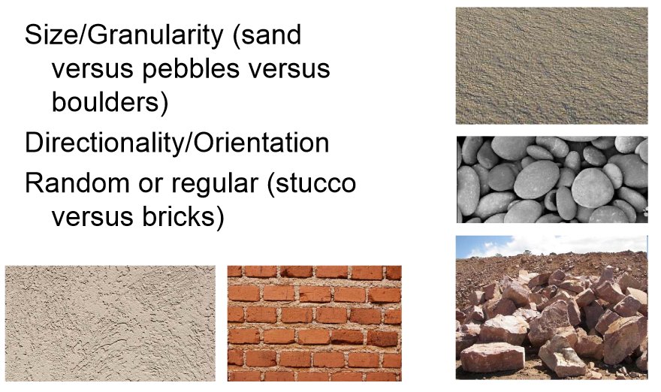
Characterizing Texture
Aspect of texture
Size
Random or Regular
Notes:
顆粒大小(中與右誰大? 拍攝距離、焦距會影響，後幾頁[Texture and Scale]會講到)
隨機、規律

Slide 24
Characterizing Texture
Each of these qualities translates into some property of the gray level primitives and the spatial interaction between them.
Open issue : few investigators have attempted to map semantic meaning into precise properties of gray level primitives and their spatial distribution.
Notes:
上述的紋理特徵可轉化為“由灰階原質以及他們的空間排列所產生特性”
Open issue: 非常少人將”精確的灰階原質特性以及他們的空間關係”與”紋理特徵”作map

Slide 25
Texture and Scale
For any textural surface, there exists a scale at which, when the surface is examined, it appears smooth and “textureless”. (see from infinite distance)
As resolution increases, the surfaces appears as a fine texture and then a coarse one, and for multiple-scale textural surface the cycle of smooth, fine, and coarse may repeat.
Notes:
若以無限遠的距離來觀測東西表面，看到的表面將會非常平順、”看起來沒紋理特性”
當相機與觀察物的距離拉近，表面就會漸漸出現紋理紋理
ex. of cycle 觀察級別
從太陽看地球 – 藍藍的球(textureless)
靠近地球 – 出現陸塊與海洋(smooth)
高空 – 人、植被、建築(fine)
拉近到人 – 皮膚(coarse)
拉近皮膚 – 膚色一大片(smooth)
拉近 – 毛孔(fine)
…
細胞
…
原子

Slide 26
Texture and Scale
Thus, texture cannot be analyzed without frame of reference on scale or resolution.
Texture is a scale-dependent phenomenon.
Notes:
因此，分析紋理時必須要有參照物、焦距、放大倍率等等
紋理可說是觀測尺度所發生的視覺現象

Slide 27
First-Order Gray-Level Statistics
Statistics of single pixels
E.g. Histogram, mean, median, variance
Notes:
進入9.2之前要稍微介紹一下灰階統計量相關的東西
首先是一階灰階統計量，也就是單個pixel的灰階拿來做統計
ex. 直方圖、平均、中位數、變異數、標準差

Slide 28
Second-Order Gray-Level Statistics
The combined statistics of gray levels of pairs of pixels in which each two pixels in a pair have a fixed relative position
E.g. co-occurrence
Gray level spatial dependence: characterize texture by co-occurrence
Notes:
二階灰階統計量
兩個固定相對位置的pixel，他們聯合的灰階所做的統計
Ex. 共生
由共生灰階空間相關性: 由pixel灰階共生所產生的紋理特征

Slide 29
Introduction
Gray Level Co-occurrence
Statistical Texture Feature Approach
Model-based Technique
Application
Notes:
9.1 introduction
↓
9.2 gray level co-occurrence

Slide 30
Co-Occurrence Matrix
The gray level co-occurrence can be specified in a matrix of relative frequencies Pij with which two neighboring pixels separated by distance d occur on the image, one with gray level i and the other with gray level j
Symmetric matrix
Function of angle and distance between pixels
Notes:
與第三章的 Co-Occurrence Matrix 相同

Slide 31


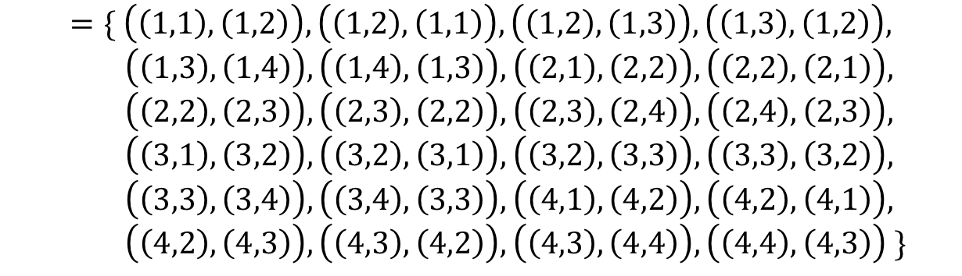
Co-Occurrence Matrix
(1,1) | (1,2) | (1,3) | (1,4)
(2,1) | (2,2) | (2,3) | (2,4)
(3,1) | (3,2) | (3,3) | (3,4)
(4,1) | (4,2) | (4,3) | (4,4)
$$L_{x}=\left\{1,2,3,4\right\}$$
$$L_{y}=\left\{1,2,3,4\right\}$$
$$R_{H}=\left\{\left(\left(k,l\right),\left(m,n\right)\right)∈\left(L_{y}×L_{x}\right) \right| k−m=0,\left|l−n\right|=1\}$$
$$=\{ \left(\left(1,1\right),\left(1,2\right)\right),\left(\left(1,2\right),\left(1,1\right)\right),\left(\left(1,2\right),\left(1,3\right)\right),\left(\left(1,3\right),\left(1,2\right)\right),$$
$\left(\left(1,3\right),\left(1,4\right)\right),\left(\left(1,4\right),\left(1,3\right)\right),\left(\left(2,1\right),\left(2,2\right)\right),\left(\left(2,2\right),\left(2,1\right)\right),$
$\left(\left(2,2\right),\left(2,3\right)\right),\left(\left(2,3\right),\left(2,2\right)\right),\left(\left(2,3\right),\left(2,4\right)\right),\left(\left(2,4\right),\left(2,3\right)\right),$
$\left(\left(3,1\right),\left(3,2\right)\right),\left(\left(3,2\right),\left(3,1\right)\right),\left(\left(3,2\right),\left(3,3\right)\right),\left(\left(3,3\right),\left(3,2\right)\right),$
$\left(\left(3,3\right),\left(3,4\right)\right),\left(\left(3,4\right),\left(3,3\right)\right),\left(\left(4,1\right),\left(4,2\right)\right),\left(\left(4,2\right),\left(4,1\right)\right),$
$\left(\left(4,2\right),\left(4,3\right)\right),\left(\left(4,3\right),\left(4,2\right)\right),\left(\left(4,3\right),\left(4,4\right)\right),\left(\left(4,4\right),\left(4,3\right)\right) \}$
The set of all distance-1 horizontal neighbor resolution cells on a 4x4 image.
Notes:
x y 各是1~4
(d=1)

Slide 32
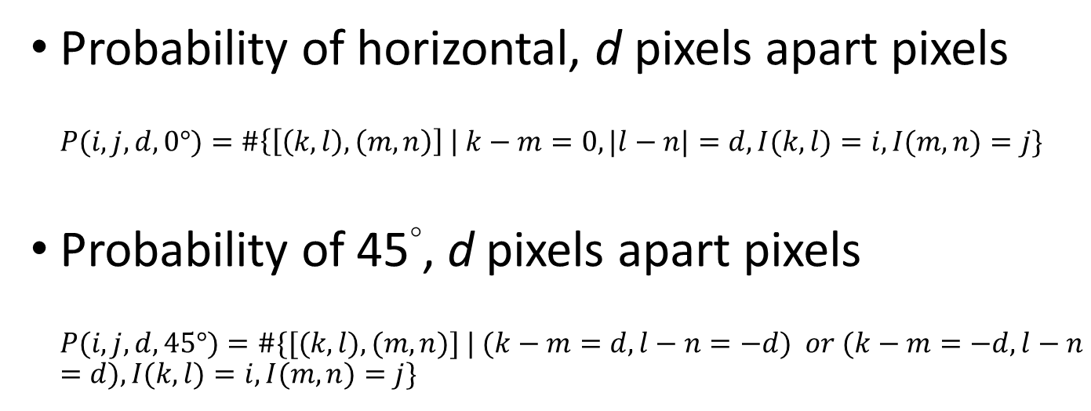
Co-Occurrence Matrix
(1,1) | (1,2) | (1,3) | (1,4)
(2,1) | (2,2) | (2,3) | (2,4)
(3,1) | (3,2) | (3,3) | (3,4)
(4,1) | (4,2) | (4,3) | (4,4)
$$L_{x}=\left\{1,2,3,4\right\}$$
$$L_{y}=\left\{1,2,3,4\right\}$$
Probability of horizontal, d pixels apart pixels
$$P(i,j,d, 0°)=\#\left\{\left[\left(k, l\right),\left(m, n\right)\right] \right| k−m=0, |l−n|=d, I(k, l)=i, I(m,n)=j\}$$
Probability of 45°, d pixels apart pixels
$$P(i, j, d, 45°)=\#\{[(k, l), (m, n)] | (k−m=d, l−n=−d) or (k−m=−d, l−n=d), I(k, l)=i, I(m,n)=j\}$$
Notes:
Function 表示 0度 & 45度

Slide 33
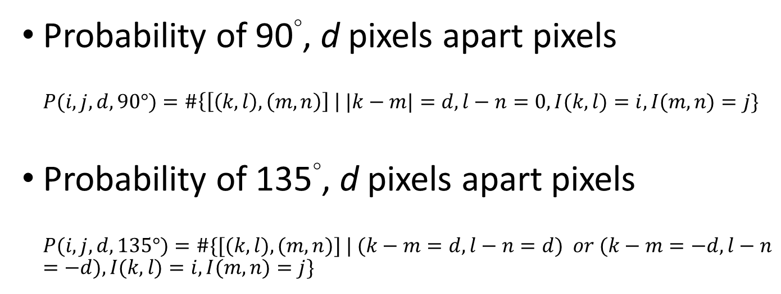
Co-Occurrence Matrix
(1,1) | (1,2) | (1,3) | (1,4)
(2,1) | (2,2) | (2,3) | (2,4)
(3,1) | (3,2) | (3,3) | (3,4)
(4,1) | (4,2) | (4,3) | (4,4)
$$L_{x}=\left\{1,2,3,4\right\}$$
$$L_{y}=\left\{1,2,3,4\right\}$$
Probability of 90°, d pixels apart pixels
$$P(i,j,d, 90°)=\#\left\{\left[\left(k, l\right),\left(m, n\right)\right] \right| |k−m|=d, l−n=0, I(k, l)=i, I(m,n)=j\}$$
Probability of 135°, d pixels apart pixels
$$P(i, j, d, 135°)=\#\{[(k, l), (m, n)] | (k−m=d, l−n=d) or (k−m=−d, l−n=−d), I(k, l)=i, I(m,n)=j\}$$
Notes:
Function 表示 90度 & 135度

Slide 34
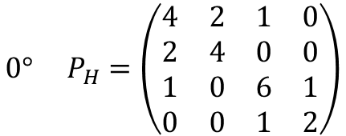
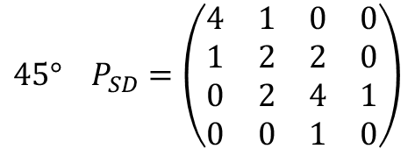
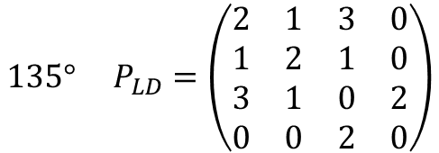
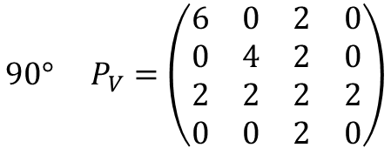
Co-Occurrence Matrix
 |  | Gray level
Gray Level |  | 0 | 1 | 2 | 3
 | 0 | #(0,0) | #(0,1) | #(0,2) | #(0,3)
 | 1 | #(1,0) | #(1,1) | #(1,2) | #(1,3)
 | 2 | #(2,0) | #(2,1) | #(2,2) | #(2,3)
 | 3 | #(3,0) | #(3,1) | #(3,2) | #(3,3)
0 | 0 | 1 | 1
0 | 0 | 1 | 1
0 | 2 | 2 | 2
2 | 2 | 3 | 3
$$0° P_{H}=\left(\begin{matrix}4 & 2 & 1 & 0 \\ 2 & 4 & 0 & 0 \\ 1 & 0 & 6 & 1 \\ 0 & 0 & 1 & 2\end{matrix}\right)$$
$$90° P_{V}=\left(\begin{matrix}6 & 0 & 2 & 0 \\ 0 & 4 & 2 & 0 \\ 2 & 2 & 2 & 2 \\ 0 & 0 & 2 & 0\end{matrix}\right)$$
$$135° P_{LD}=\left(\begin{matrix}2 & 1 & 3 & 0 \\ 1 & 2 & 1 & 0 \\ 3 & 1 & 0 & 2 \\ 0 & 0 & 2 & 0\end{matrix}\right)$$
$$45° P_{SD}=\left(\begin{matrix}4 & 1 & 0 & 0 \\ 1 & 2 & 2 & 0 \\ 0 & 2 & 4 & 1 \\ 0 & 0 & 1 & 0\end{matrix}\right)$$
Notes:
舉例建立四個角度 d=1 的 Co-Occurrence Matrix

Slide 35
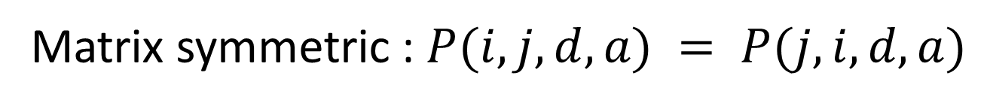
Co-Occurrence Matrix
 |  | Gray level
Gray Level |  | 0 | 1 | 2 | 3
 | 0 | #(0,0) | #(0,1) | #(0,2) | #(0,3)
 | 1 | #(1,0) | #(1,1) | #(1,2) | #(1,3)
 | 2 | #(2,0) | #(2,1) | #(2,2) | #(2,3)
 | 3 | #(3,0) | #(3,1) | #(3,2) | #(3,3)
0 | 0 | 1 | 1
0 | 0 | 1 | 1
0 | 2 | 2 | 2
2 | 2 | 3 | 3
Matrix symmetric : $P(i, j, d, a) = P(j, i, d, a)$
Notes:
Co-Occurrence Matrix 皆是對稱矩陣

Slide 36
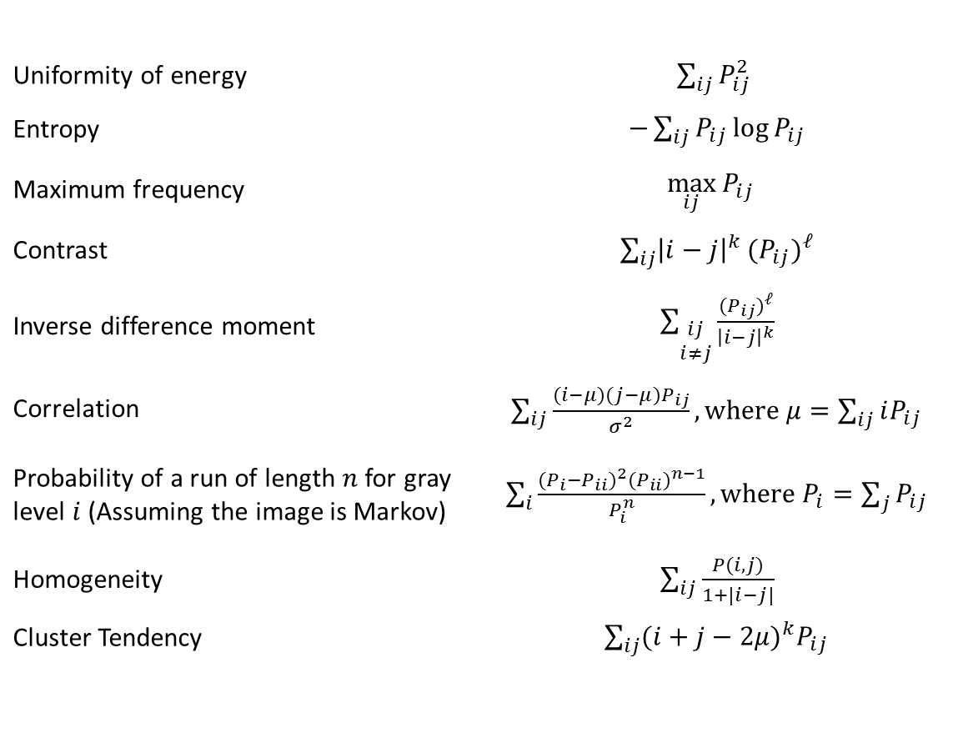
Co-Occurrence Matrix
Common features
Uniformity of energy | $\sum_{ij}{P_{ij}^{2}}$
Entropy | $−\sum_{ij}{P_{ij}}\log{P_{ij}}$
Maximum frequency | $$\max_{ij}{P_{ij}}$$
Contrast | $\sum_{ij}{{\left|i−j\right|}^{k}}{(P_{ij})}^{ℓ}$
Inverse difference moment | $\sum_{\begin{aligned}ij \\ i≠j\end{aligned}}{\frac{{(P_{ij})}^{ℓ}}{{\left|i−j\right|}^{k}}}$
Correlation | $\sum_{\begin{aligned}ij\end{aligned}}{\frac{(i−μ)(j−μ)P_{ij}}{σ^{2}}},\text{where} μ=\sum_{ij}{iP_{ij}}$
Probability of a run of length $n$ for gray level $i$ (Assuming the image is Markov) | $\sum_{i}{\frac{{(P_{i}−P_{ii})}^{2}{{(P}_{ii})}^{n−1}}{P_{i}^{n}}}, \text{where} P_{i}=\sum_{j}{P_{ij}}$
Homogeneity | $\sum_{ij}{\frac{P(i,j)}{1+|i−j|}}$
Cluster Tendency | $\sum_{ij}{{(i+j−2μ)}^{k}P_{ij}}$
Notes:
能量均勻度
亂度
最大出現頻率
對比、反差
逆差矩
相關性
灰階i，行程長度n機率
同質性
群集趨勢

Slide 37
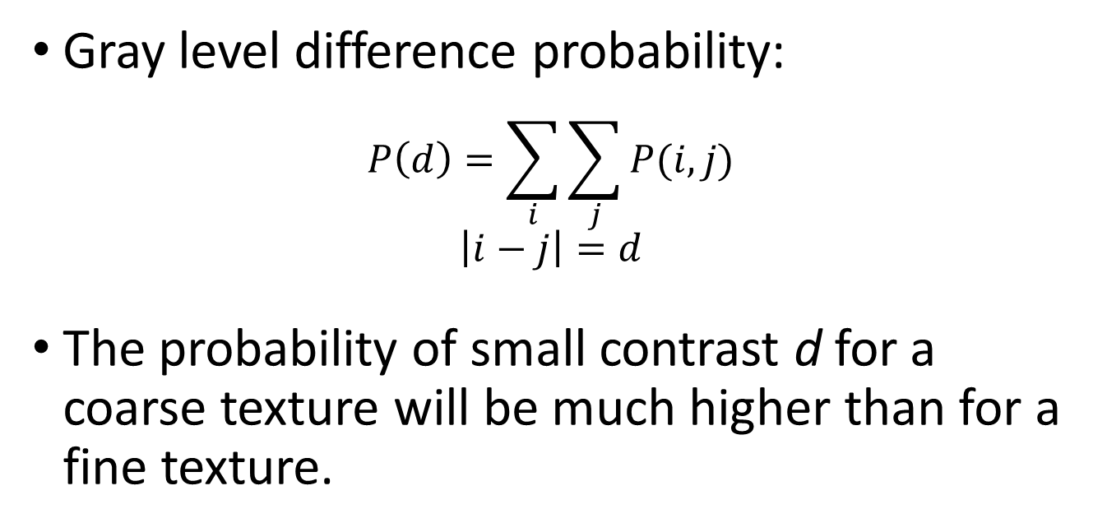
Variant of Co-Occurrence Matrix
Gray level difference probability:
$$P\left(d\right)=\sum_{i}{\sum_{j}{P(i,j)}}$$
$$\left|i−j\right|=d$$
The probability of small contrast d for a coarse texture will be much higher than for a fine texture.
Notes:
灰階差機率
在d小的時候，粒度大的紋理灰階差機率，會比粒度小的紋理來的大

Slide 38

Variant of Co-Occurrence Matrix
Gray level difference probability:
$$P\left(d\right)=\sum_{i}{\sum_{j}{P(i,j)}}$$
$$\left|i−j\right|=d$$
The probability of small contrast d for a coarse texture will be much higher than for a fine texture.
d
Coarse
Fine
one pixel
Notes:
舉例，小d的時候，同樣範圍內，粒度大的紋理出現兩個pixel灰階差為d的密度大大高於粒度小的紋理

Slide 39
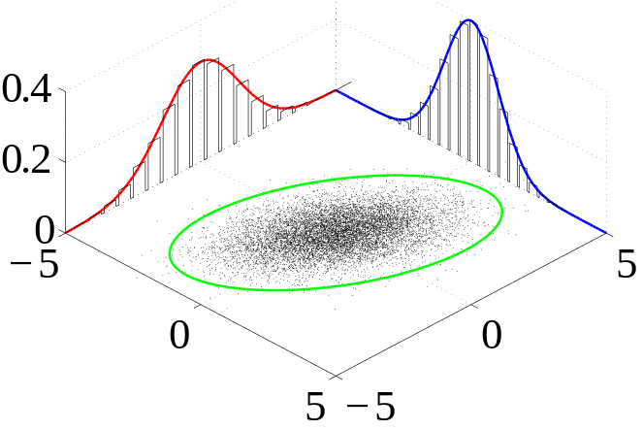
Generalized Gray Level Spatial Dependence Models for Texture
Simple generalization: consider more than two pixels at a time
Given a specific kind of spatial neighborhood and a sub-image, one can parametrically estimate the joint probability distribution of the gray levels over the neighborhoods in the sub-image.
Notes:
廣義灰階空間相關模型
前面所提的是考慮兩個pixel的關係
利用聯合機率分布納入更多pixels間的資訊

Slide 40
Summary of Gray level Co-Occurrence
The power of the gray level co-occurrence is that it characterize the spatial interrelationship of the gray levels in a texture and can do so in the way that is invariant under monotonic gray level transformation.
Its weakness is that it does not capture the shape aspects of the gray level primitives. Hence it is not likely to work well for textures composed of large-area primitives.
Notes:
共生總結
優點在於利用了pixel與pixel間的灰階空間關係來描述紋理，而且這個方式以很簡單的灰階轉換來達成。
缺點在於，它並沒有利用灰階原質方面的形態資訊。因此若一個texture必須用大面積的原質來描述，那麼共生的方法就很難應用上去。

Slide 41
Strong Texture Measures and Generalized Co-occurrence
Gray Level Co-occurrence
Statistical Texture Feature Approach
Model-based Technique
Application
Notes:
9.2 gray level co-occurrence
↓
9.3 strong texture measures and generalized co-occurrence

Slide 42
Strong Texture Measures and Generalized Co-occurrence
Strong texture measure take into account the co-occurrence between texture primitives.
It is useful to work with primitives that are maximally connected sets of pixels having a particular properties.
Notes:
較強的紋理衡量方式考慮原質間的共生關係(大於上個section的”pixel與pixel之間”)
盡可能的將性質相同的pixel聯集起來當作一個原質，ex. 相同的灰階、相同的edge角度

Slide 43
Strong Texture Measures and Generalized Co-occurrence
Other attributes include measures of shape, or with the variance of its local property.
  Connected components
  Ascending\descending components
  Saddle components
  Relative maxima\minima components
  Central Axis components
Notes:
其他像是形狀或是小區域的變異數也可以拿來當作建構原質的依據
連接
升\降
鞍型
相對極值
中心座標軸

Slide 44
Spatial Relationship
We have a list of primitives, their center coordinate, and their attributes after the primitives have been constructed.
Notes:
現在我們建立好原質了

Slide 45
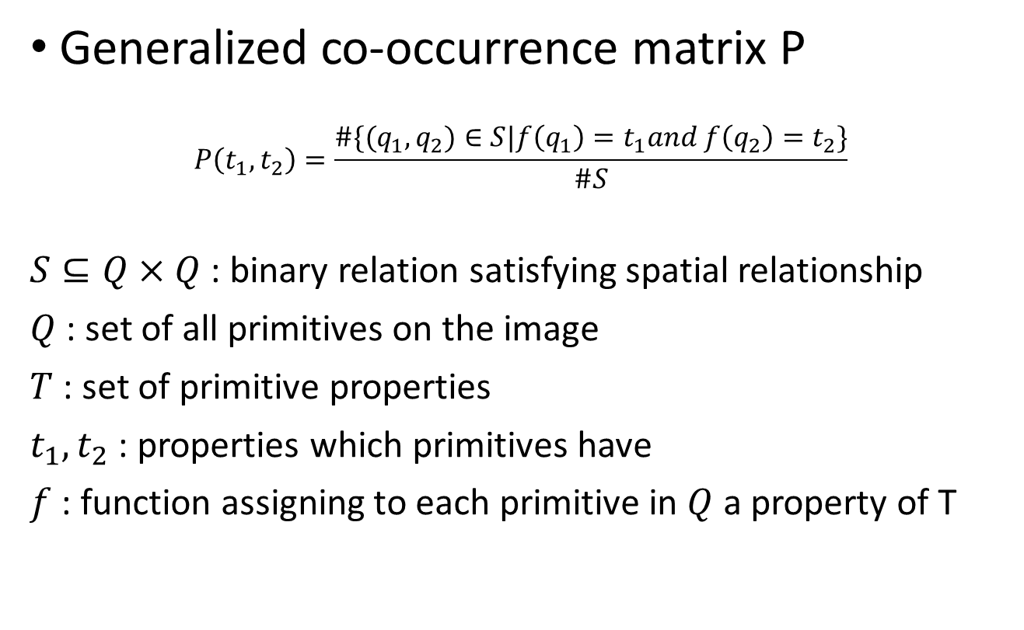
Spatial Relationship
Generalized co-occurrence matrix P
$$P\left(t_{1},t_{2}\right)=\frac{\#\{(q_{1},q_{2})∈S|f\left(q_{1}\right)=t_{1}and f\left(q_{2}\right)=t_{2}\}}{\#S}$$
$S⊆Q×Q$ : binary relation satisfying spatial relationship
$Q$ : set of all primitives on the image
$T$ : set of primitive properties
$t_{1},t_{2}$ : properties which primitives have
$f$ : function assigning to each primitive in $Q$ a property of T
Notes:
類似前面pixel co-occurrence matrix
只是“pixel”換成了”原質”

Slide 46
Strong Texture Measures and Generalized Co-occurrence
Autocorrelation Function
Statistical Texture Feature Approach
Model-based Technique
Application
Notes:
9.3 strong texture measures and generalized co-occurrence
↓
9.4 autocorrelation function and texture

Slide 47
Autocorrelation Function
Texture relates to the spatial size of the gray level primitives on an image
Gray level primitives of larger size are indicative of coarser texture
Gray level primitives of smaller size are indicative of finer texture
Autocorrelation function is a feature that describes the size of gray level primitives
Notes:
紋理與空間中原質大小有關
有著較多大塊原質的通常表示紋理粒度較大
有著較多小塊原質的通常表示紋理粒度較小
自相關函數可以拿來描述、判斷紋理的顆粒大小

Slide 48
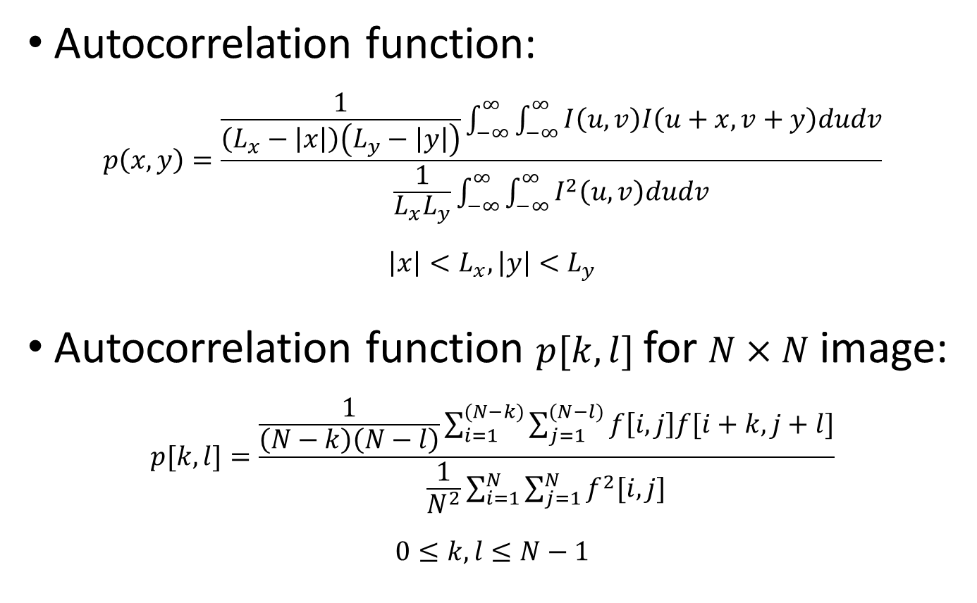
Autocorrelation Function
Autocorrelation function:
$$p\left(x,y\right)=\frac{\frac{1}{\left(L_{x}−\left|x\right|\right)\left(L_{y}−\left|y\right|\right)}\int_{−∞}^{∞}{\int_{−∞}^{∞}{I\left(u,v\right)I\left(u+x,v+y\right)dudv}}}{\frac{1}{L_{x}L_{y}}\int_{−∞}^{∞}{\int_{−∞}^{∞}{I^{2}\left(u,v\right)dudv}}}$$
$$\left|x\right|<L_{x},\left|y\right|<L_{y}$$
Autocorrelation function $p[k,l]$ for $N×N$ image:
$$p[k,l]=\frac{\frac{1}{\left(N−k\right)\left(N−l\right)}\sum_{i=1}^{(N−k)}{\sum_{j=1}^{(N−l)}{f\left[i,j\right]f[i+k,j+l]}}}{\frac{1}{N^{2}}\sum_{i=1}^{N}{\sum_{j=1}^{N}{f^{2}[i,j]}}}$$
$$0≤k,l≤N−1$$
Notes:
自相關函數…下頁看 .gif 動畫解釋

Slide 49
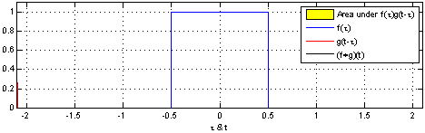




Autocorrelation Function
Area under $f(τ)⋆f(t)$
$$f(τ)$$
$$f(t)$$
($f+f)(t)$

Slide 50
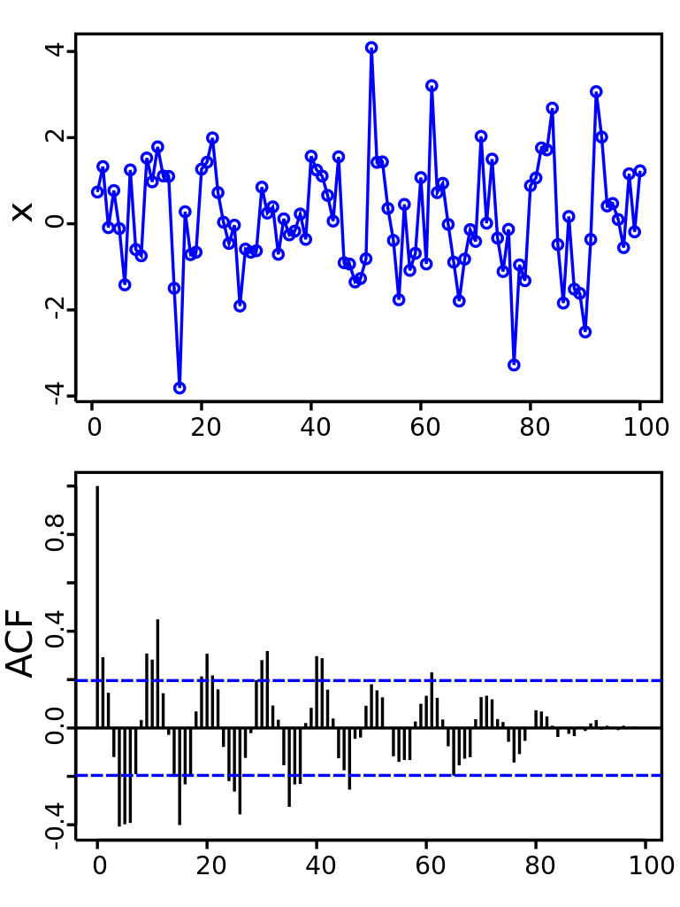
Autocorrelation Function
1D Example from Wiki
Signal = noisy sine wave
(wavelength = 10 units)
Autocorrelation function showing peaks (every 10 units starting at 0) and valleys (every 10 units starting at 5)

Slide 51
Autocorrelation Function
Interpreting autocorrelation
Regular texture → function will have peaks and valleys
Random texture → only peak at [0,0]; breadth of peak gives the size of the texture
Coarse texture → function drops off slowly
Fine texture → function drops off rapidly
Notes:
有規律的紋理 -> 有明顯且規律的高峰、低谷
顆粒大的紋理 -> 高峰變到低谷時間長
顆粒小的紋理 -> 高峰變到低谷時間短

Slide 52
Autocorrelation Function
The gray level primitive in the autocorrelation model is the gray level.
The spatial organization is characterized by the correlation coefficient that is a measure of the linear dependence one pixel has on another.
Notes:
自相關函數模型的原質就是灰階
用相關係數來描述紋理空間結構，其中相關係數又是pixel與pixel間的線性相關性

Slide 53
Autocorrelation Function
Digital Transform Method
Statistical Texture Feature Approach
Model-based Technique
Application
Notes:
9.4 autocorrelation function and texture
↓
9.5 digital transform method and texture

Slide 54
Digital Transform Methods and Texture
In the digital transform method of texture analysis, the digital image is typically divided into a set of non-overlapping small square sub-images.
The vectors is re-expressed in a new coordinate system.
Fourier transform uses the complex sinusoid basic set, Hadamard transform uses the Walsh function basic set, …..
Notes:
首先先將影像切成數個n*n大小的子區塊
每個n*n區塊的pixels可視為n*n大小的向量，且這些向量描述了一個n*n維度的座標系統
對每個vector做轉換

Slide 55
Digital Transform Methods and Texture
Key points:
  The basis vectors of the new coordinate system have an interpretation that relates to spatial frequency or sequence.
  Since frequency is a close relative of texture, such transformations can be useful.
Notes:
理念:
前述的向量有著空間頻率或序列的特性
而頻率就是紋理的特性之一，所以做這些轉換對於紋理的分析是有幫助的

Slide 56

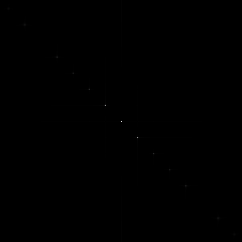

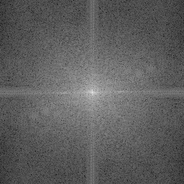
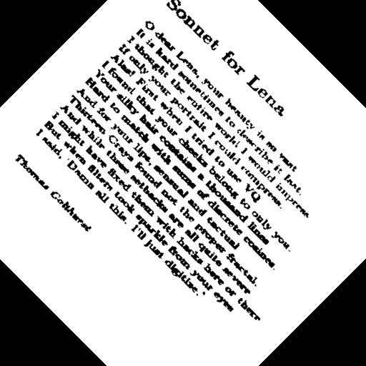
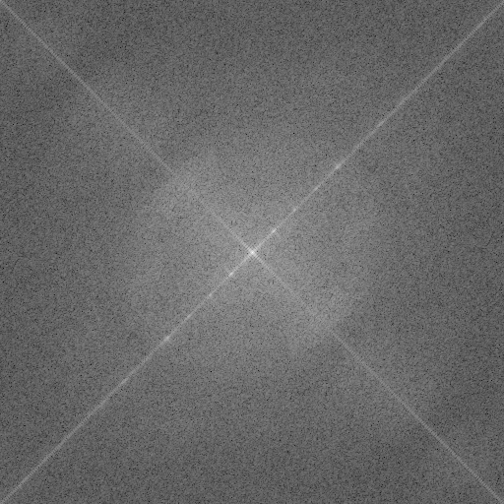
Digital Transform Methods and Texture

Slide 57
Digital Transform Methods and Texture
Concentrated power → Regularity
High frequency power → fine texture
Directionality → directional texture

Slide 58
Digital Transform Methods and Texture
In general, features based on Fourier power spectra have been shown to perform more poorly than features based on second-order gray level co-occurrence statistics or those based on first-order statistics of spatial gray level differences.
Notes:
一般來說，傅立葉光譜功率效果並沒有比 灰階共生 或 空間灰階的一階統計 來的好

Slide 59
Digital Transform Method
Textural Energy
Statistical Texture Feature Approach
Model-based Technique
Application
Notes:
9.5 digital transform method and texture
↓
9.6 textural energy

Slide 60
Texture Energy
The image is first convolved with a variety of kernels
Then each convolved image is processed with a nonlinear operator to determine the total textural energy in each pixel’s neighborhood
Notes:
先利用各種不同的kernel和影像做convolve
接下來利用非線性運算元對剛剛convolve的所有output做處理，針對每個pixel的鄰近區域計算出能量

Slide 61
Texture Energy
The textural energy approach is very much in the spirit of the transform approach.
But it uses smaller windows or neighborhood supports.
Notes:
紋理能量的方式和前章的處理方式，兩者個精神是很類似的
但是紋理能量所用的window size較小，而且還有用上鄰居

Slide 62
Texture Energy
Laws’ Technique (Laws, 1980)
  Filter the input image using texture filters.
  Compute texture energy by summing the absolute value of filtering results in local neighborhoods around each pixel.
  Combine feature to achieve rotational invariance.
Notes:
拿kernel做處理(kernel = filter)
每個pixel附近的值取絕對質相加
作旋轉等價處理(紋理旋轉過後還理論上還是同樣的紋理)

Slide 63
Texture Energy
Law’s texture
L5 | (Level) | = [ -1 -4 -6 -4 -1 ]
E5 | (Edge) | = [ -1 -2 -0 -2 -1 ]
S5 | (Spot) | = [ -1 -0 -2 -0 -1 ]
R5 | (Ripple) | = [ -1 -4 -6 -4 -1 ]
L5 (Gaussian) gives a center-weighted local average
E5 (Gradient) responds to row or col step edges
S5 (LoG) detects spots
R5 (Gabor) detects ripples
Notes:
1D kernel
Gaussian, Gradient, LoG 都與 Ch7 章的一樣
Gabor 是 Gaussian * cos

Slide 64
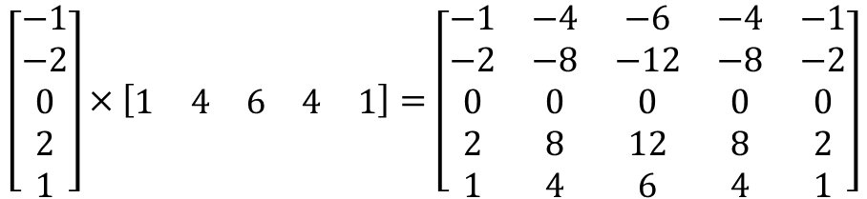
Texture Energy
Law’s texture
Creation of 2D Kernel
  1D kernels are “multiplied” to construct 2D kernels:
    kernel E5L5 is the “product” of E5 and L5
$$\left[\begin{matrix}−1 \\ −2 \\ 0 \\ 2 \\ 1\end{matrix}\right]×\left[\begin{matrix}1 & 4 & 6 & 4 & 1\end{matrix}\right]=\left[\begin{matrix}−1 & −4 & −6 & −4 & −1 \\ −2 & −8 & −12 & −8 & −2 \\ 0 & 0 & 0 & 0 & 0 \\ 2 & 8 & 12 & 8 & 2 \\ 1 & 4 & 6 & 4 & 1\end{matrix}\right]$$
E5
L5
E5L5
Notes:
利用剛剛1D的kernel建立2D kernel

Slide 65
Texture Energy
Law’s texture
Filter the neighborhood with 16 5x5 kernels
Compute energy at each pixel by summing absolute value of filter output across neighborhood around pixel
Define 9 features:
L5E5 / E5L5
L5R5 / R5L5
E5S5 / S5E5
S5S5
R5R5
L5S5 / S5L5
E5E5
E5R5 / R5E5
S5R5 / R5S5
Notes:
16 filter – L5 E5 R5 S5 交互產生的16個2D filter
拿了其中 9 個feature來作為評判紋理的依據

Slide 66
Texture Energy
Law’s texture
Water
Fence
Small
Flower
Flag
Big
Flower
Border
Tiger
Grass
Region | E5E5 | S5S5 | R5R5 | R5L5 | S5L5 | R5L5 | S5E5 | R5E5 | R5S5
Tiger | 168.1 | 84.0 | 807.7 | 553.7 | 354.4 | 910.6 | 116.3 | 339.2 | 257.4
Water | 68.5 | 36.9 | 366.8 | 218.7 | 149.3 | 459.4 | 49.6 | 159.1 | 117.3
Flag | 258.1 | 113.0 | 787.7 | 1057.6 | 702.2 | 2056.3 | 192.4 | 611.5 | 350.8
Fence | 189.5 | 80.7 | 624.3 | 701.7 | 377.5 | 803.1 | 120.6 | 297.5 | 215.0
Grass | 206.5 | 103.6 | 1031.7 | 625.2 | 428.3 | 1153.6 | 146.0 | 427.5 | 323.6
Small flower | 114.9 | 48.6 | 289.1 | 402.6 | 241.3 | 484.3 | 73.6 | 158.2 | 109.3
Big flower | 75.7 | 28.8 | 177.1 | 301.5 | 158.4 | 270.0 | 45.6 | 89.7 | 62.9
Borders | 15.3 | 6.4 | 64.4 | 92.3 | 36.3 | 74.5 | 9.3 | 26.1 | 19.5
Notes:
三張圖我們大致上可以分辨出這些物件
9 個 filter feature 的結果

Slide 67
Texture Energy
Using Texture Energy for Segmentation
Water
Fence
Small
Flower
Flag
Big
Flower
Border
Tiger
Grass
Segmentation into 4 cluster
Segmentation into 4 cluster
Segmentation into 3 cluster
Notes:
利用 9 個 filter feature 來做紋理切割

Slide 68
Textural Energy
Textural Edgeness
Statistical Texture Feature Approach
Model-based Technique
Application
Notes:
9.6 textural energy
↓
9.7 textural edgeness

Slide 69
Texture Edgeness
Some researchers conceive of texture not in terms of spatial frequency but in terms of edgeness per unit area.
Notes:
有人試著”不以頻率”的方式來判別紋理，而是以單位面積的邊緣性質來判斷(邊緣密度、邊緣方向)
(9.4 自相關函數 9.5數位轉換 皆是以頻率來判斷紋理)

Slide 70

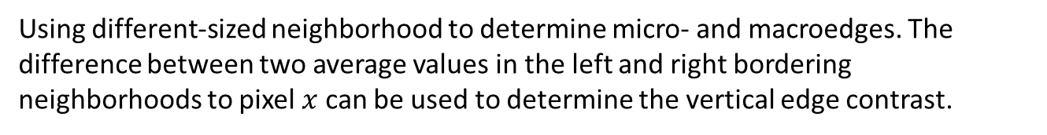

Texture Edgeness
Use small neighborhood to detect microedge
Use large neighborhood to detect macroedge
$$x$$
$$x$$
Using different-sized neighborhood to determine micro- and macroedges. The difference between two average values in the left and right bordering neighborhoods to pixel $x$ can be used to determine the vertical edge contrast.
Notes:
小邊就用小範圍的鄰居
大邊就用大範圍的鄰居

Slide 71
Texture Edgeness
Edge Density and Direction
  Use an edge detector as the first step in texture analysis.
  The number of edge pixels in a fixed-size region tells us how busy that region is
  The direction of the edges also help characterize the texture
Notes:
第七張提到的edge detector方式
邊緣密度
邊緣方向

Slide 72
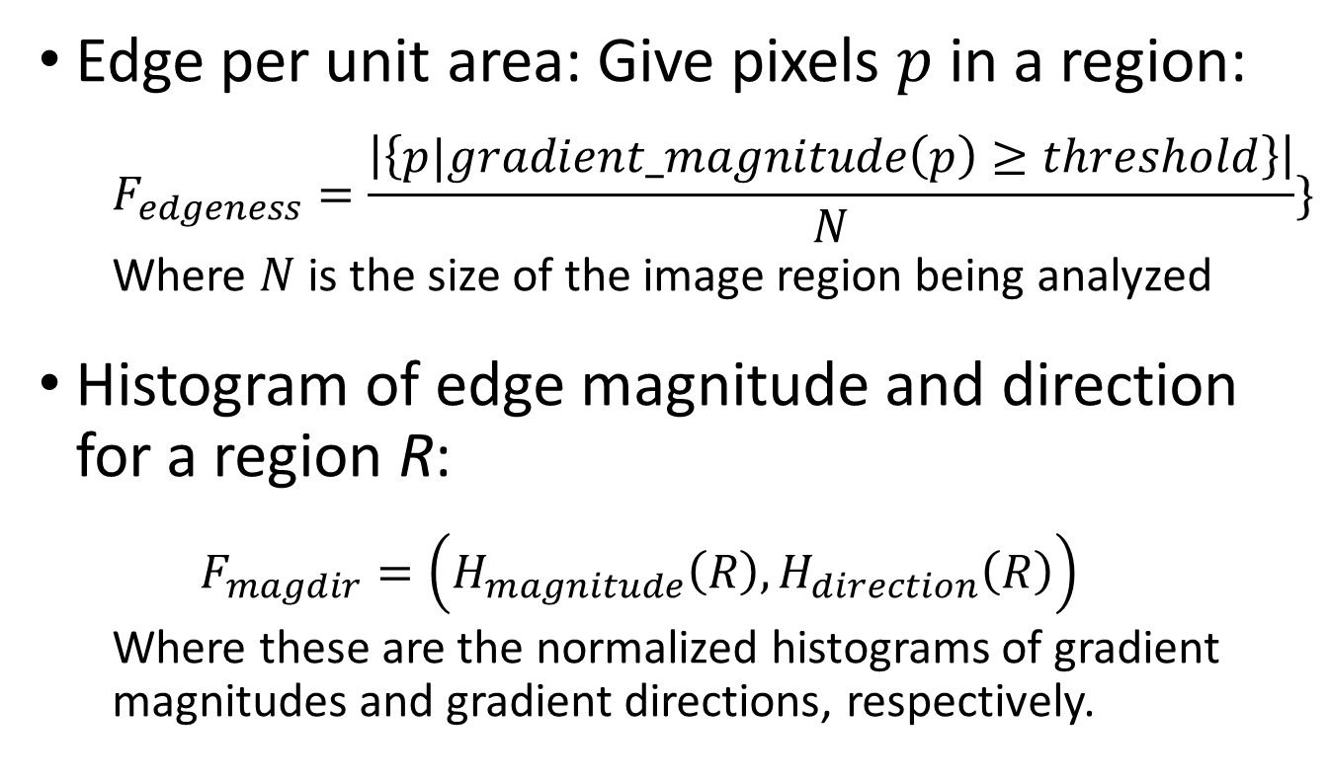
Texture Edgeness
Edge per unit area: Give pixels $p$ in a region:
  $$F_{edgeness}=\frac{\left|\left\{p|gradient_magnitude\left(p\right)≥threshold\right\}\right|}{N}\}$$
  Where $N$ is the size of the image region being analyzed
Histogram of edge magnitude and direction for a region R:
  $$F_{magdir}=\left(H_{magnitude}\left(R\right), H_{direction}\left(R\right)\right)$$
  Where these are the normalized histograms of gradient magnitudes and gradient directions, respectively.
Notes:
單位面積邊緣密度: 利用第七張提過的判斷邊緣方式，再多除一項面積 N
另外也可以去計算一個 範圍R 內的邊緣強度直方圖和邊緣方向直方圖

Slide 73
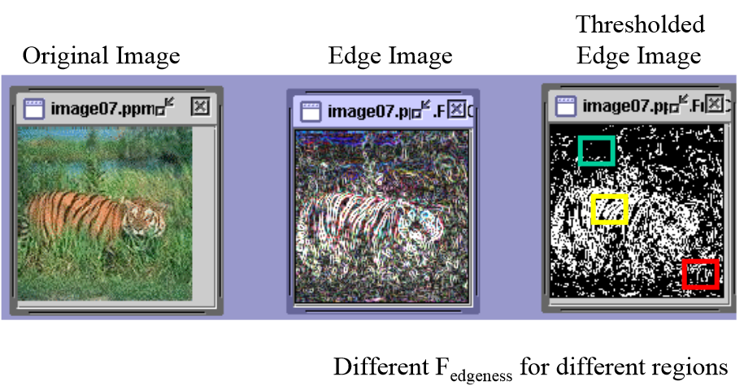
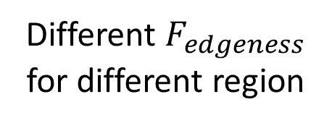
Texture Edgeness
Thresholded Edge Image
Original Image
Different $F_{edgeness}$ for different region
Notes:
三個框框內的邊緣密度明顯不同

Slide 74
Vector Dispersion
Textural Edgeness
Statistical Texture Feature Approach
Model-based Technique
Application
Notes:
9.7 textural edgeness
↓
9.8 vector dispersion

Slide 75
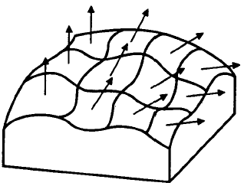
Vector Dispersion
Divide the texture into mutually exclusive neighborhoods
A sloped plane fit to the gray levels is performed for each neighborhood
Graphical representation of the dispersion of a group of unit surface normal vectors for a patch of gray level intensity surface.
Notes:
切成完全不交疊(互斥)的區塊
接下來利用第八張提到的小平面方式去fit每個剛剛切出來的小區塊

Slide 76
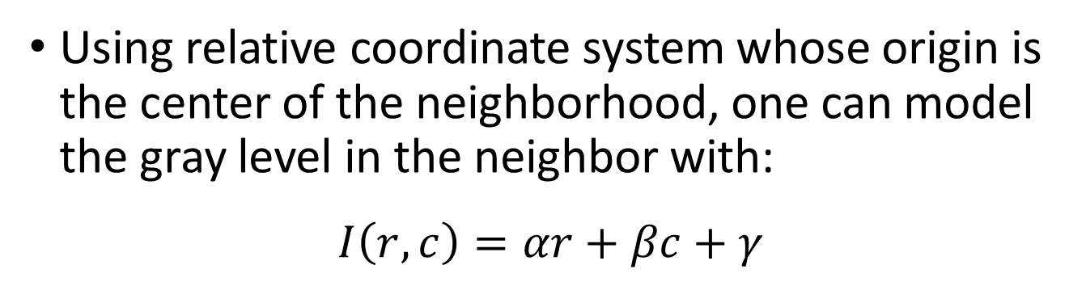
Vector Dispersion
Using relative coordinate system whose origin is the center of the neighborhood, one can model the gray level in the neighbor with:
$$I\left(r,c\right)=αr+βc+γ$$
Graphical representation of the dispersion of a group of unit surface normal vectors for a patch of gray level intensity surface.
Notes:
小平面模型的公式，求出每個小區塊的係數

Slide 77


Vector Dispersion
The unit normal vector to the plane fit for the $i$th neighborhood is given by
$$\left(\begin{matrix}l_{i} \\ m_{i} \\ n_{i}\end{matrix}\right)=\frac{1}{\sqrt{α^{2}+β^{2}+1}}\left(\begin{matrix}α_{i} \\ β_{i} \\ −1\end{matrix}\right)$$
Using relative coordinate system whose origin is the center of the neighborhood, one can model the gray level in the neighbor with:
$$I\left(r,c\right)=αr+βc+γ$$
Graphical representation of the dispersion of a group of unit surface normal vectors for a patch of gray level intensity surface.
Notes:
根據係數去建立每個小區塊的單位法向量
越是粗糙的表面，這些單位法向量方向就會越分散
越是平坦的表面，這些單位法向量方向就會越一致

Slide 78
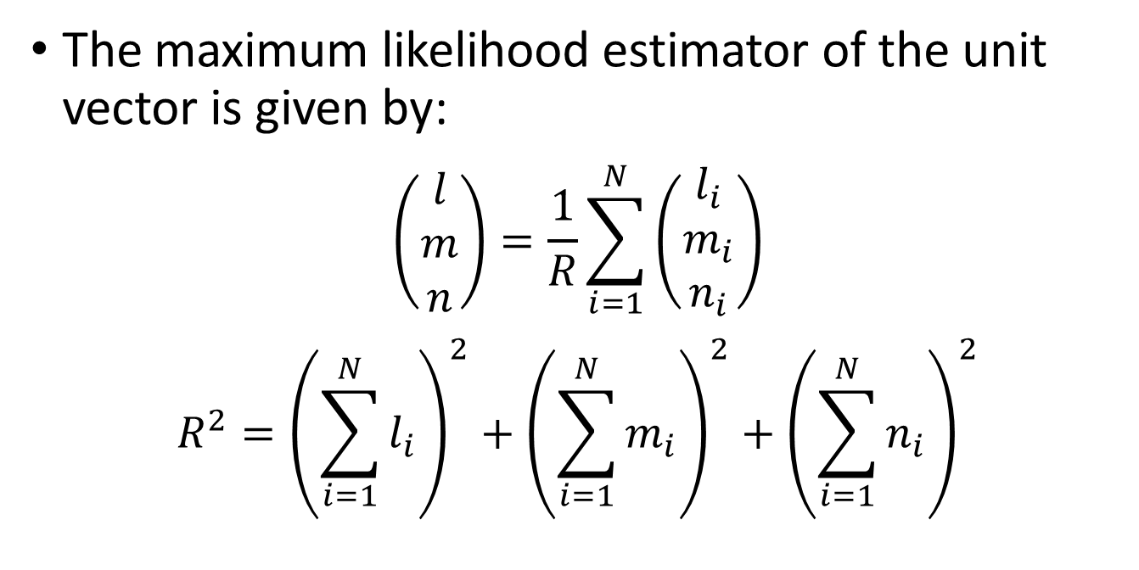
Vector Dispersion
The maximum likelihood estimator of the unit vector is given by:
$$\left(\begin{matrix}l \\ m \\ n\end{matrix}\right)=\frac{1}{R}\sum_{i=1}^{N}{\left(\begin{matrix}l_{i} \\ m_{i} \\ n_{i}\end{matrix}\right)}$$
$$R^{2}={\left(\sum_{i=1}^{N}{l_{i}}\right)}^{2}+{\left(\sum_{i=1}^{N}{m_{i}}\right)}^{2}+{\left(\sum_{i=1}^{N}{n_{i}}\right)}^{2}$$
Notes:
根據前面的每個單位法向量
可以用最大似然估計算出整個表面的單位法向量

Slide 79
Vector Dispersion
Relative Extrema Density
Statistical Texture Feature Approach
Model-based Technique
Application
Notes:
9.8 vector dispersion
↓
9.9 relative extrema density

Slide 80
Relative Extrema Density
Count the number of relative extrema per unit area for a texture measure
One dimension, along a horizontal scan
Notes:
計算單位面積內，相對極值的數量
以一維中最簡易的做法來舉例

Slide 81
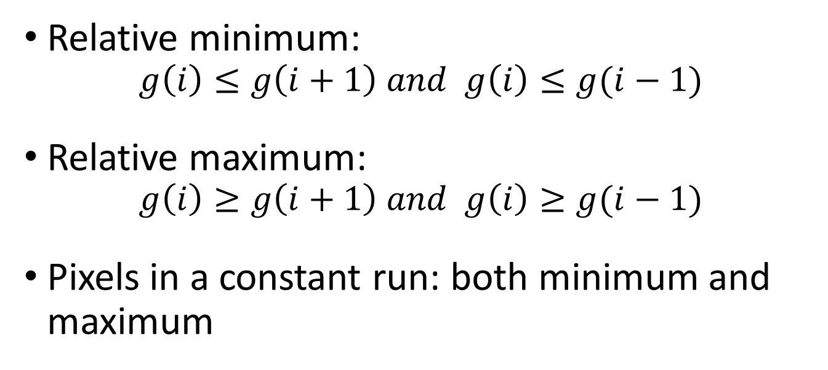
Relative Extrema Density
Relative minimum:
$$g\left(i\right)≤g\left(i+1\right) and g\left(i\right)≤g(i−1)$$
Relative maximum:
$$g\left(i\right)≥g\left(i+1\right) and g\left(i\right)≥g(i−1)$$
Pixels in a constant run: both minimum and maximum
Notes:
相對極小定義
相對極大定義
相同灰階pixel並排會同時被歸類為相對極大和相對極小

Slide 82
Relative Extrema Density
M
M
m
M
m
m
Coarse
Fine
M
M
M
M
M
M
M
M
M
M
m
m
m
m
m
m
m
m
m
m
Notes:
顆粒大的紋理，相對極值出現的頻率較低
顆粒小的紋理，相對極值出現的頻率較高

Slide 83
Mathematical Morphology
Relative Extrema Density
Statistical Texture Feature Approach
Model-based Technique
Application
Notes:
9.9 relative extrema density
↓
9.10 mathematical morphology

Slide 84
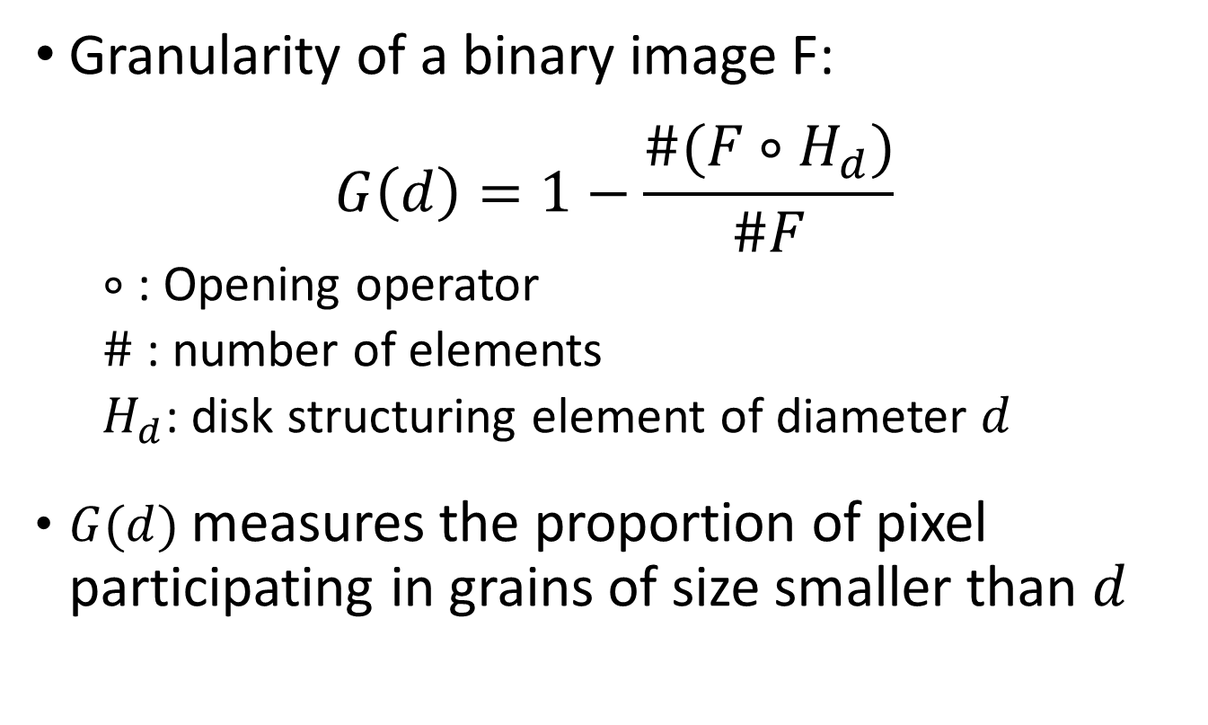
Mathematical Morphology
Granularity of a binary image F:
$$G\left(d\right)=1−\frac{\#(F∘H_{d})}{\#F}$$
  $∘$ : Opening operator
  $\#$ : number of elements
  $H_{d}$: disk structuring element of diameter $d$
$G(d)$ measures the proportion of pixel participating in grains of size smaller than $d$
Notes:
利用 opening operator 偵測、衡量紋理顆粒大小
G(d) 代表意義為: 顆粒小於直徑 d 的物件的占有比例

Slide 85
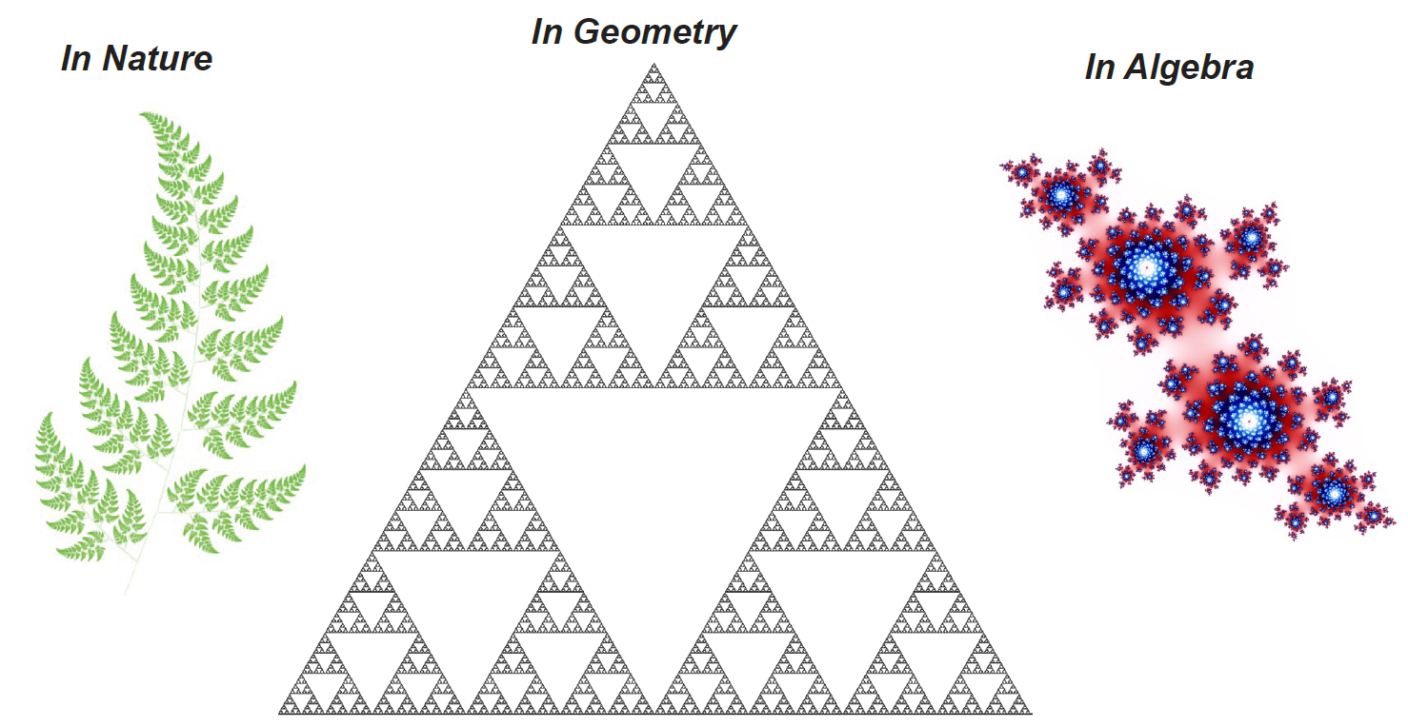
Mathematical Morphology
Use gray level erosion and dilation to determine the fractal surface of the gray level intensity surface of the texture scene.
Notes:
利用erosion和dilation去找出灰階紋理的碎形表面
什麼是碎形??

Slide 86
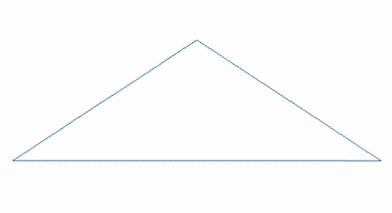
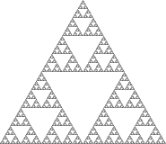
Mathematical Morphology
A fractal is a natural phenomenon or a mathematical set that exhibits a repeating pattern that displays at every scale.
Notes:
一個粗糙或零碎的幾何形狀，可以分成數個部分，且每個部分都(至少近似的)是整體縮小後的形狀

Slide 87
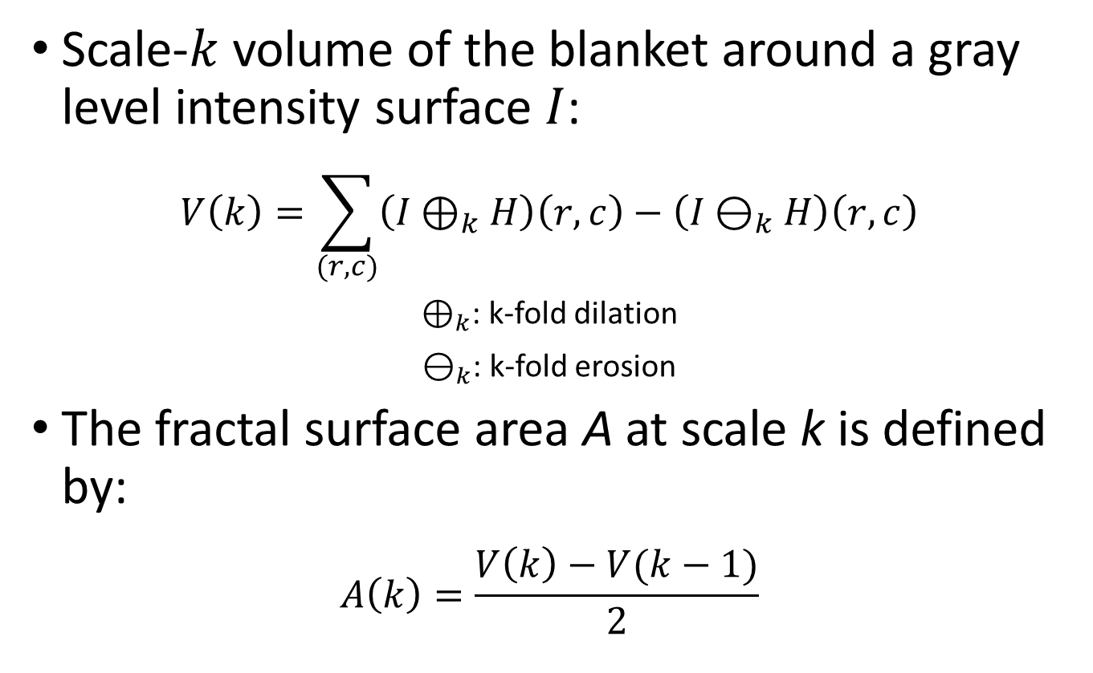
Mathematical Morphology
Scale-$k$ volume of the blanket around a gray level intensity surface $I$:
$$V\left(k\right)=\sum_{(r,c)}{\left(I⊕_{k}H\right)\left(r,c\right)−\left(I⊖_{k}H\right)\left(r,c\right)}$$
$⊕_{k}$: k-fold dilation
$⊖_{k}$: k-fold erosion
The fractal surface area A at scale k is defined by:
$$A\left(k\right)=\frac{V\left(k\right)−V(k−1)}{2}$$
Notes:
利用erosion和dilation去找出灰階紋理的碎形表面
k-fold 作 k 次操作
定義在 k scale 時的碎形表面 A

Slide 88
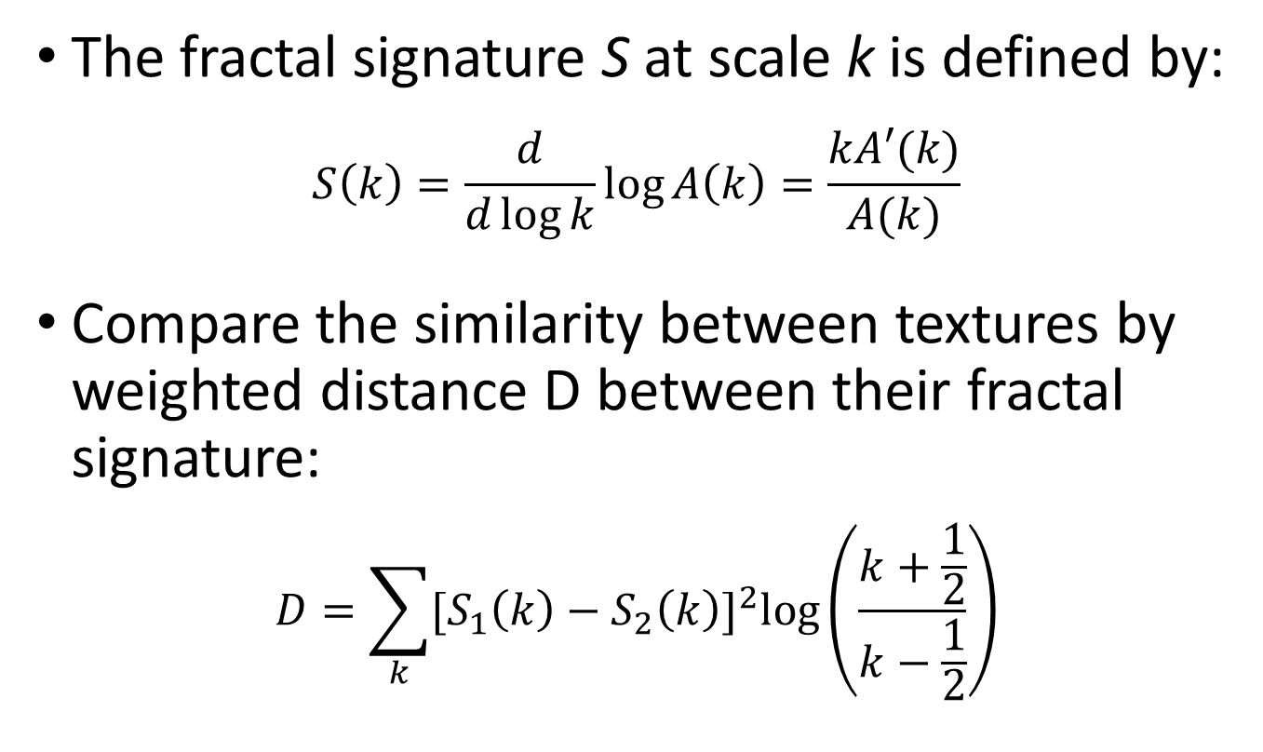
Mathematical Morphology
The fractal signature S at scale k is defined by:
$$S\left(k\right)=\frac{d}{d\log{k}}\log{A\left(k\right)=\frac{kA′(k)}{A(k)}}$$
Compare the similarity between textures by weighted distance D between their fractal signature:
$$D=\sum_{k}{{[S_{1}\left(k\right)−S_{2}\left(k\right)]}^{2}\log\left(\frac{k+\frac{1}{2}}{k−\frac{1}{2}}\right)}$$
Notes:
定義在 scale k 時的碎形特徵 S
計算碎形特徵的距離差(D)來分辨紋理是否相似

Slide 89
Mathematical Morphology
Auto-regression Model
Statistical Texture Feature Approach
Model-based Technique
Application
Notes:
9.10 mathematical morphology
↓
9.11 auto-regression models

Slide 90
Auto-regression Models
Doing linear estimates of a pixel’s gray level with the gray levels in the neighborhood
For coarse texture, coefficient will be similar
For fine texture, coefficient will vary widely
Notes:
根據一個pixel鄰居的灰階來線性計算開pixel的灰階
顆粒大的紋理，線性係數會比較相近
顆粒小的紋理，線性係數差異會較大

Slide 91
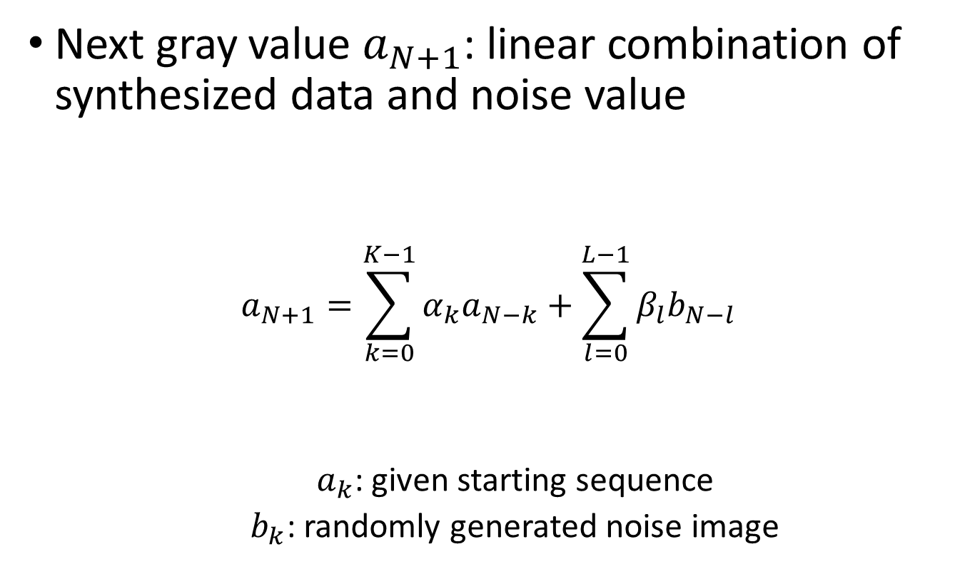
Auto-regression Models
Next gray value $a_{N+1}$: linear combination of synthesized data and noise value
$$a_{N+1}=\sum_{k=0}^{K−1}{α_{k}a_{N−k}+\sum_{l=0}^{L−1}{β_{l}b_{N−l}}}$$
  $a_{k}$: given starting sequence
  $b_{k}$: randomly generated noise image
Auto-regression Terms
Moving Average Terms
Notes:
1D範例，每一個pixel的灰階都是由前面的pixel的灰階 + noise所產生的

Slide 92

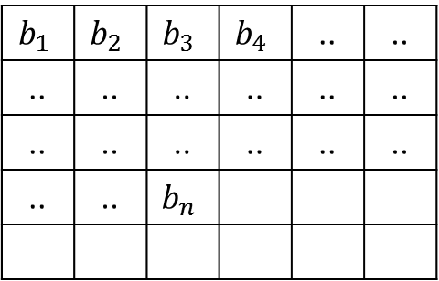

Auto-regression Models
$$a_{1}$$ | $$a_{2}$$ | $$a_{3}$$ | $$a_{4}$$ | .. | ..
.. | .. | .. | .. | .. | ..
.. | .. | .. | .. | .. | ..
.. | .. | $$a_{n}$$
$$b_{1}$$ | $$b_{2}$$ | $$b_{3}$$ | $$b_{4}$$ | .. | ..
.. | .. | .. | .. | .. | ..
.. | .. | .. | .. | .. | ..
.. | .. | $$b_{n}$$
Next gray value $a_{N+1}$: linear combination of synthesized data and noise value
$$a_{N+1}=\sum_{k=0}^{K−1}{α_{k}a_{N−k}+\sum_{l=0}^{L−1}{β_{l}b_{N−l}}}$$
  $a_{k}$: given starting sequence
  $b_{k}$: randomly generated noise image
Auto-regression Terms
Moving Average Terms
Notes:
1D 範例圖示

Slide 93

Auto-regression Models
Two-dimensional auto-regression model:
$$a\left(i,j\right)=\sum_{\left(k,l\right)∈N\left(i,j\right)}{α\left(i−k,j−l\right)a\left(k,l\right)}+\sum_{\left(k,l\right)∈N\left(i,j\right)}{β\left(i−k,l−j\right)b(k,l)}$$
$$N\left(i,j\right)=\left\{\left(k,l\right)\right| \left(i−D≤k≤i and j−D≤l≤j+D\right)$$
$$or (k=i and j−D≤l≤j)\}$$
Auto-regression Terms
Moving Average Terms
Notes:
2D 範例，也是一樣由前面的鄰居pixel們的灰階算出新pixel的灰階
其中“鄰居”定義與1D相仿

Slide 94



Auto-regression Models
Two-dimensional :
$$a\left(i,j\right)=\sum_{\left(k,l\right)∈N\left(i,j\right)}{α\left(i−k,j−l\right)a\left(k,l\right)}+\sum_{\left(k,l\right)∈N\left(i,j\right)}{β\left(i−k,j−l\right)b(k,l)}$$
$$N\left(i,j\right)=\left\{\left(k,l\right)\right| \left(i−D≤k≤i and j−D≤l≤j+D\right)$$
$$or (k=i and j−D≤l≤j)\}$$
 |  | $$a\left(i,j\right)$$
 |  | $$b\left(i,j\right)$$
D Pixels
Auto-regression Terms
Moving Average Terms
Notes:
2D 範例圖示

Slide 95

Auto-regression Models
Estimate gray value for pixel $(i,j)$ by using the differences between the actual values and the estimated value
$$\hat{a}\left(i,j\right)=\sum_{\left(k,l\right)∈N\left(i,j\right)}{α\left(i−k,j−l\right)a\left(k,l\right)}+\sum_{\left(k,l\right)∈N\left(i,j\right)}{β\left(i−k,j−l\right)\left[a\left(k,l\right)−\hat{a}(k,l)\right]}$$
For texture category c, define the estimated gray value for pixel $(i,j)$:
$${\hat{a}}_{c}\left(i,j\right)=\sum_{\left(k,l\right)∈N\left(i,j\right)}{α_{c}\left(i−k,j−l\right)a_{c}\left(k,l\right)}+\sum_{\left(k,l\right)∈N\left(i,j\right)}{β_{c}\left(i−k,j−l\right)\left[a_{c}\left(k,l\right)−{\hat{a}}_{c}(k,l)\right]}$$
$\{α_{c}\left(m,n\right),β_{c}(m,n)\}$ are the coefficients for texture category c.
Notes:
利用 估計值與實際值的差異 取代前面noise項來計算新pixel的灰階 (a hat 為估計值)
不同紋理，自回歸的參數也就不同，下面例子為利用 c紋理自回歸係數來做新pixel的灰階估算

Slide 96

Auto-regression Models
Pixel $(i,j)$ has texture category c if
  $\left|a\left(i,j\right)−{\hat{a}}_{c}(i,j)\right|≤\left|a\left(i,j\right)−{\hat{a}}_{d}(i,j)\right|$ for every texture category d, and $\left|a\left(i,j\right)−{\hat{a}}_{c}(i,j)\right|≤θ$
$θ:$ threshold
$(i,j)$ is a boundary pixel if $\left|a\left(i,j\right)−{\hat{a}}_{c}(i,j)\right|>θ$
Can be employed in texture segmentation applications as well as texture synthesis applications.
Notes:
判斷pixel i, j 是否屬於 c紋理
對於已知的所有紋理，若 c紋理自回歸係數所估算的差值最小，且這差值小於設定的門檻值，那麼就認定這個pixel屬於 c紋理
若差值最小但是卻不符合門檻值 -> 這個pixel是 c紋理的邊緣
這個方式可以來切割紋理，而自回歸去“估算新的pixel”的概念則可以用再生成紋理上

Slide 97
Discrete Markov Random Field
Auto-regression Model
Statistical Texture Feature Approach
Model-based Technique
Application
Notes:
9.11 auto-regression models
↓
9.12 discrete markov random fields

Slide 98

Discrete Markov Random Fields
C
(r, c)
j
i
R
Notes:
[音量注意!!!!音量注意!!!!]
在離散馬可夫隨機場裡，定義影像R,C座標，每個pixel (r,c) 的灰階都是用其鄰居來推估，鄰居位置皆以pixel (r,c)為(0,0)所建立的i,j座標描述
模型假設對於每個pixel皆能以相同的線性鄰居係數來推算出pixel (r,c)的灰階
對於超出影像的狀況，可以想像將影像綑在圓柱體上，超過的部分將會從到影像另一頭跑出來；因為R,C都適用，所以可以想像將影像弄成甜甜圈形狀

Slide 99

Discrete Markov Random Fields
Each pixel’s value is a linear combination of the values in its neighborhood plus a correlated noise term:
$$I\left(r,c\right)=\sum_{\left(i,j\right)∈N}{I\left(r−i,c−j\right)h\left(i,j\right)+u\left(r,c\right)}$$
$h$: coefficients, computed from texture image with least-square method
$u$: joint set of possible correlated Gaussian random variables
Notes:
根據前頁所講的想法建構出的數學式
h(i,j) 為鄰居(i,j)的係數，用最小平方法求出

Slide 100

Discrete Markov Random Fields
To determine the coefficients $h\left(i,j\right)$ for $\left(i,j\right)∈N$, we can proceed by lest squares:
$$ε^{2}=\sum_{(r,c)}{{\left[I\left(r,c\right)−\sum_{\left(i,j\right)∈N}{I\left(r−i,c−j\right)h\left(i,j\right)}\right]}^{2}}$$
Texture classification can be done by comparing a computed set of coefficients
Notes:
利用最小平方法求出鄰居們的係數h
根據係數 h 就可以將紋理進行分類

Slide 101
Discrete Markov Random Field
Random Mosaic Model
Statistical Texture Feature Approach
Model-based Technique
Application
Notes:
9.12 discrete markov random fields
↓
9.13 random mosaic models

Slide 102
Random Mosaic Models
Constructing steps:
  Provide a means of tessellating a plane into cells
  Assign a property value to each cell
Notes:
隨機馬賽克模型可以分成兩個部分
一張影像怎麼切塊(馬賽克)
切塊後怎麼去分析
第二個部分課本只有提到哪些人用了哪些方式，基本上就是把每個切出來的”塊”，當作是一個pixel，然後利用前面提過的方式用傳統統計分析；或是套用其他模型，例如自回歸。
所以這個章節會著墨的只有第一個部分，怎麼切?

Slide 103

Random Mosaic Models
Poisson Line Model
  Use a Poisson process of intensity $λ/π$ determine ordered pairs $\left(θ,p\right)∈\left[0,π\right]×\left(−∞,∞\right)$.
  Each pair $\left(θ,p\right)$ is associated with a line $x\cos{θ}+y\sin{θ}=p$.
Notes:
利用普瓦松分布產生一堆參數組($θ,p$)
再利用這些參數產生直線，用這些線來切塊

Slide 104

Random Mosaic Models
Occupancy Model
  Tessellation is produced by a Poisson process of intensity $λ$, which plants points in the plane.
  Each point determine a cell that consists of all points in the plane closest to the given planted point. (Voronoi Diagram)
Notes:
占用模型
用普瓦松在影像上灑點，每個點將離他最近的pixels都納入自己的多邊型塊裡面。(沃羅諾伊圖)

Slide 105
Random Mosaic Models
Delaunay Model
  A line segmentation is drawn between each pair of planted points whose corresponding cells in the occupancy model share a common border segment.
Notes:
德勞內模型
在占用模型中使用同邊的兩個點中間畫分出割線。
德勞內三角化 - 平面上的點集合 P三角形化，使的點P中沒有點處於三角形化後任一三角形外接圓的內部。盡量避免出現極瘦(鈍角)三角形

Slide 106
Structural Approach to Texture Model
Random Mosaic Model
Statistical Texture Feature Approach
Model-based Technique
Application
Notes:
9.13 random mosaic models
↓
9.14 structural approach to texture models

Slide 107
Structural Approaches to Texture Models
Pure structural models: primitive in regular repetitive spatial arrangements
To describe the texture, describe the primitive and the placement rules
Notes:
最單純的結構模型，原質在空間中規律的排列
如果根據上述設定，描述了原質的排列方式，也就描述了紋理

Slide 108
Structural Approach to Texture Model
Texture Segmentation
Statistical Texture Feature Approach
Model-based Technique
Application

Slide 109
Texture Segmentation
Each region has homogeneous texture, and each pair of adjacent region is differently textured
Notes:
以紋理作為切割標準，同一個區塊內的文理是相同、相似的，而鄰近的其他區塊則不是
區分方法前面section有提過很多
9.2 共生機率 - 顆粒大小
9.3 原質之間的共生關係 - 關係不同，不同紋理
9.4 自相關函數 - 顆粒大小 規律或隨機
9.6 材質能量 9.7 單位面積邊緣密度 - 有實例看到切割結果
9.8 法向量 - 粗糙平坦
9.9 相對極質密度 - 顆粒大小
9.10 數學型態學 - 顆粒大小組成、碎形特徵
9.11 自回歸模型 - 利用估算的pixel灰階分類材質
9.12 離散馬卡夫隨機場 - 利用係數區別不同材質

Slide 110
Synthetic Texture Image Generation
Texture Segmentation
Texture Feature Approach
Model-based Technique
Application
Notes:
9.15 texture segmentation
↓
9.16 synthetic texture image generation
合成紋理的部分課本僅舉例某些人用了某些方法
所以這個章節我想就由前面出現過的碎形做些延伸，看些結果
以及網路上看到的一些簡單合成過程

Slide 111
Synthetic Texture Image Generation
Fractals: shapes that exhibit recursive self-similarity
Many examples can be seen from
  http://www.deviantart.com/digitalart/fractals/rawfractal/

Slide 112

Synthetic Texture Image Generation

Slide 113

Synthetic Texture Image Generation

Slide 114


Synthetic Texture Image Generation

Slide 115


Synthetic Texture Image Generation

Slide 116
Synthetic Texture Image Generation

Slide 117
Synthetic Texture Image Generation
Find similar piece

Slide 118
Synthetic Texture Image Generation

Slide 119

Synthetic Texture Image Generation
Notice the blocky looking boundaries

Slide 120

Synthetic Texture Image Generation
Boundary optimization

Slide 121

Synthetic Texture Image Generation
More result
Increase window size

Slide 122

Synthetic Texture Image Generation
More result

Slide 123
Synthetic Texture Image Generation
Shape from Texture
Statistical Texture Feature Approach
Model-based Technique
Application
Notes:
9.16 synthetic texture image generation
↓
9.17 shape from texture

Slide 124
Shape from Texture
Using image texture gradients to estimate surface orientation of the observation 3D object
Assumption: the observed texture area no depth changes and no texture changes in observed texture area, and no sub-textures
Notes:
利用影像中紋理的梯度計算平面的旋轉角度
假設紋理出現在同一個平面上，而且沒有子紋理出現

Slide 125

Shape from Texture

Slide 126


Shape from Texture

Slide 127

Shape from Texture

Slide 128
Summary
Shape from Texture
Statistical Texture Feature Approach
Model-based Technique
Application

Slide 129
Summary
Texture: in terms of primitives and their spatial relationships
We reviewed a number of different textural feature extraction techniques
Qualitatively, texture analysis works
Quantitatively, the techniques are generally not dependable
Notes:
紋理就是原質在空間中的分部所構成的
中間大部分的章節介紹了很多的文理分析技術，前面為統計，後面為模型
定性來說，紋理分析是可行的: 分辨不同紋理可行、建立紋理模型可行、依紋理切塊可行、合成紋理可行
定量來說，目前的分析技術尚不可靠: 紋理種類不同分析容易失效、前設條件多，容易不滿足

Slide 130
Reference
Computer and Robot Vision Volume I: Ch.9 Texture
NTU Computer Vision I, ch9_2006_PPT, ch9_2013_PPT, ch9_2014_PPT
University of Washington
  https://courses.cs.washington.edu/courses/cse455/09wi/Lects/lect12.pdf
Wiki
  https://en.wikipedia.org/wiki/Joint_probability_distribution
  https://en.wikipedia.org/wiki/Autocorrelation
  https://en.wikipedia.org/wiki/Convolution
  https://en.wikipedia.org/wiki/Fractal
  https://en.wikipedia.org/wiki/Fractal_landscape
  https://en.wikipedia.org/wiki/Voronoi_diagram
  https://en.wikipedia.org/wiki/Delaunay_triangulation
Fractal Foundation
  http://fractalfoundation.org/resources/what-are-fractals/
Deviant Art
    http://www.deviantart.com/digitalart/fractals/rawfractal/
  London Bricks
    http://www.londonbricks-uk.co.uk/
  HIPR2
    http://homepages.inf.ed.ac.uk/rbf/HIPR2/fourier.htm

